Slide 1
Groupmeeting 26-10-2017
E.L. de Waardt

Slide 2
Corsika simulation data
Muon tracks
Different primary species
Primary energies between 1*10^4 – 1*10^9 GeV
Different zenith angles

Slide 3
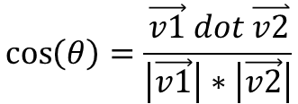
Angle:
$$\cos\left(θ\right)=\frac{\vec{v1} dot \overset{⃑}{v2}}{\left|\vec{v1}\right|∗\left|\vec{v2}\right|}$$
$$θ$$
Primary track v2(dx, dy, dz)
V1(0,0,-1)

Slide 4
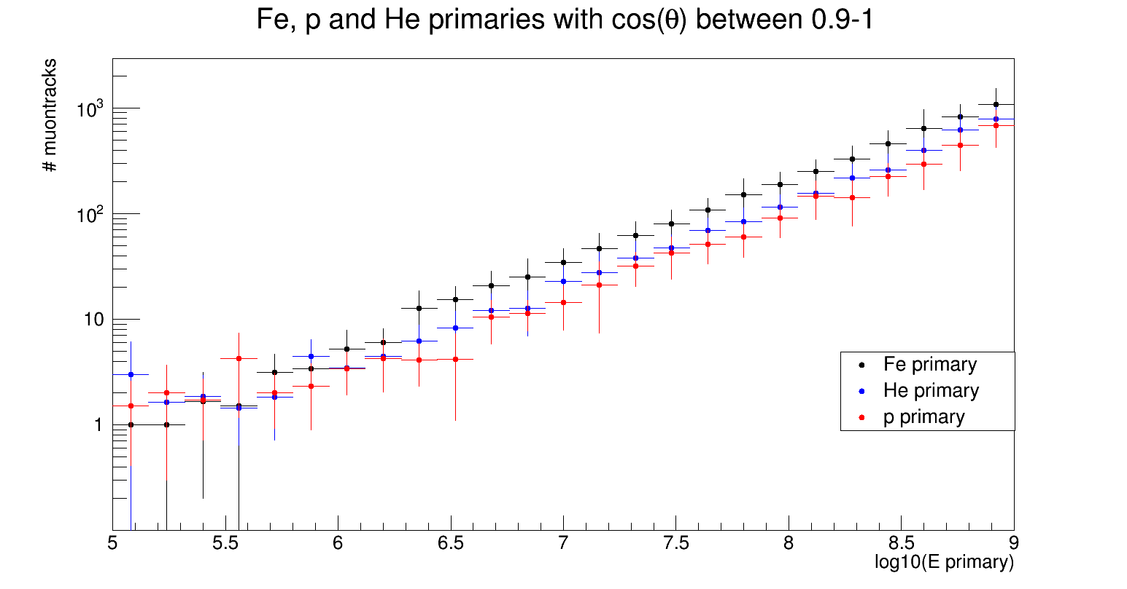

Slide 5
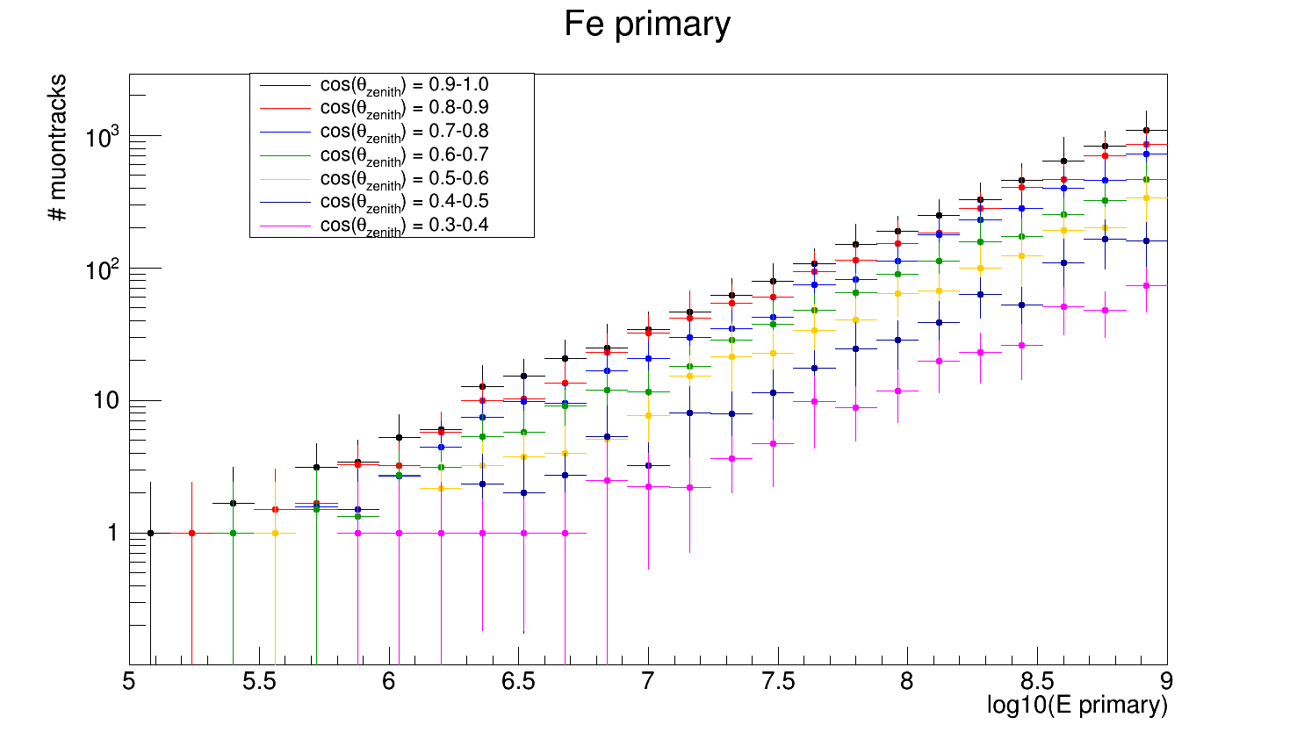

Slide 6
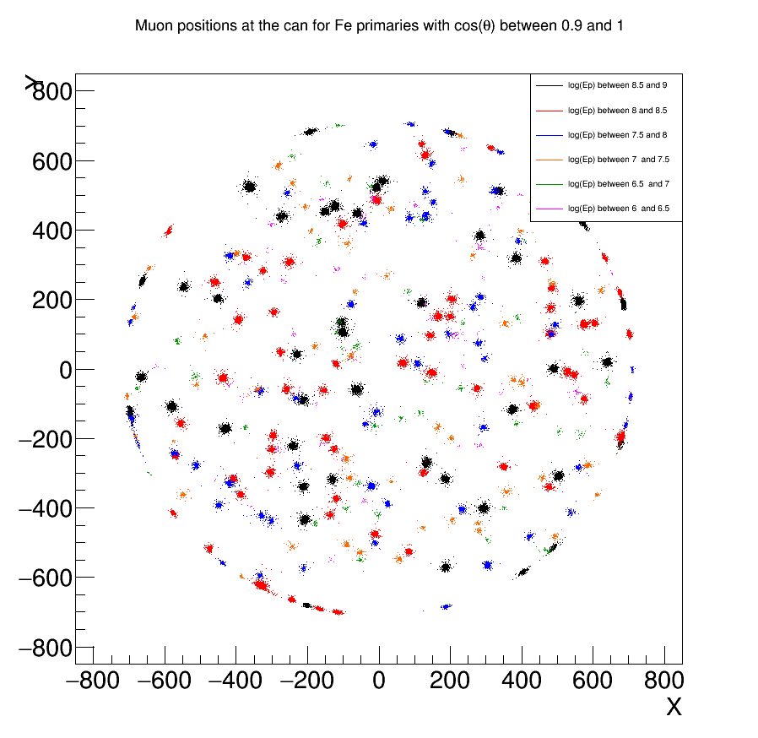

Slide 7
primary
R
secondary

Slide 8
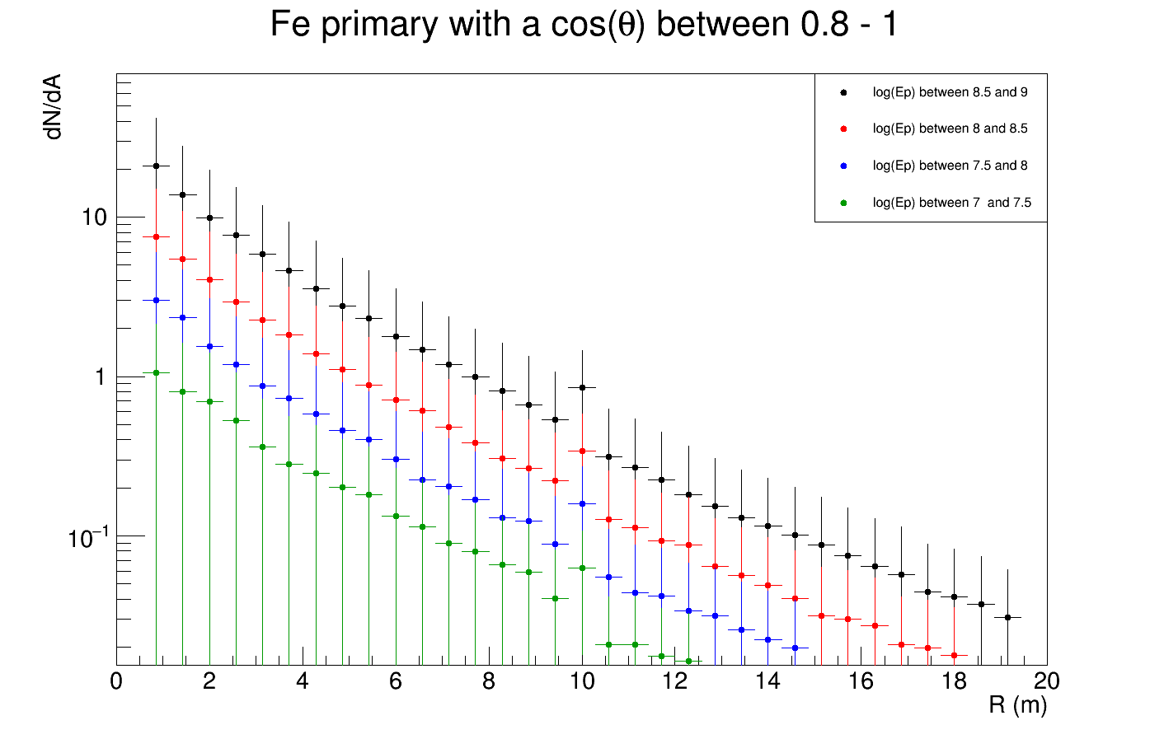

Slide 9
