Slide 1
Astroparticle school Erlangen 2017
Downward looking, too many muons
Separate out muons from above: too many!

Slide 2
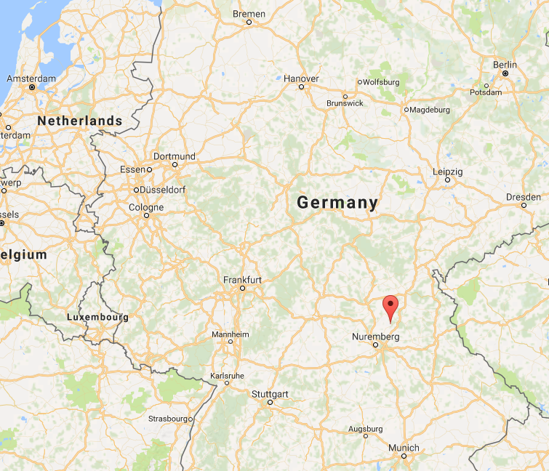
School
Morning: lecture
Dark Energy
Gravitational waves
Statistical methods
Cosmic rays
Afternoon: student presentations + exercises

Slide 3
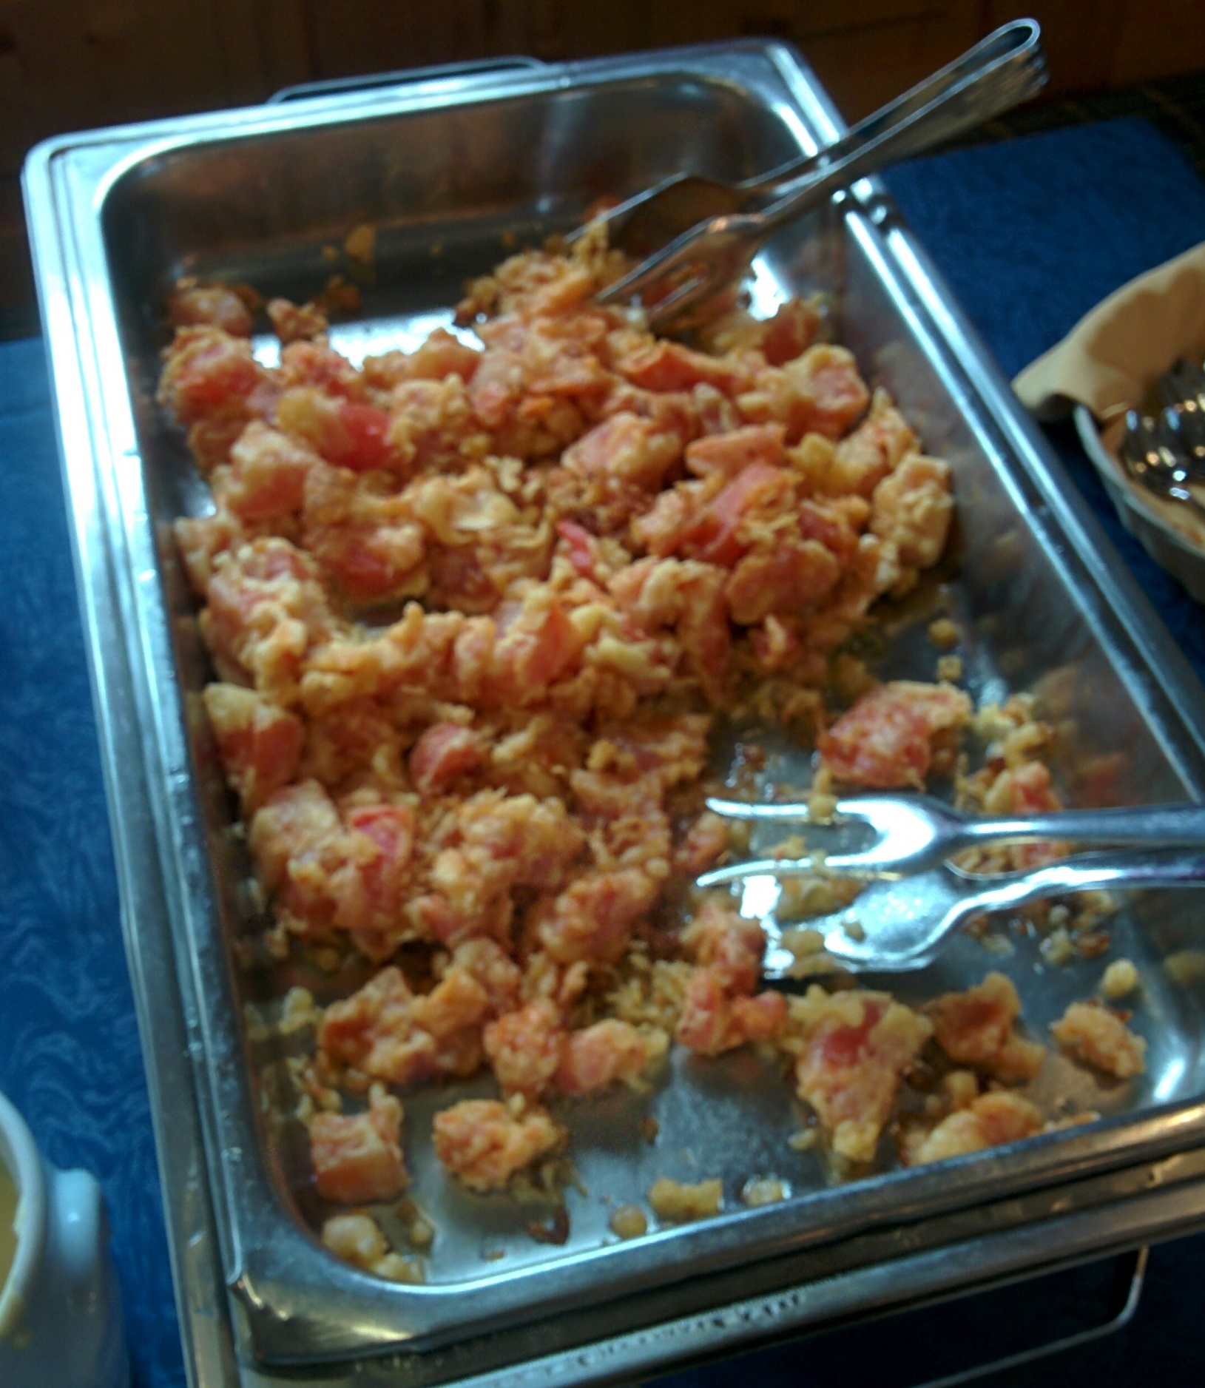
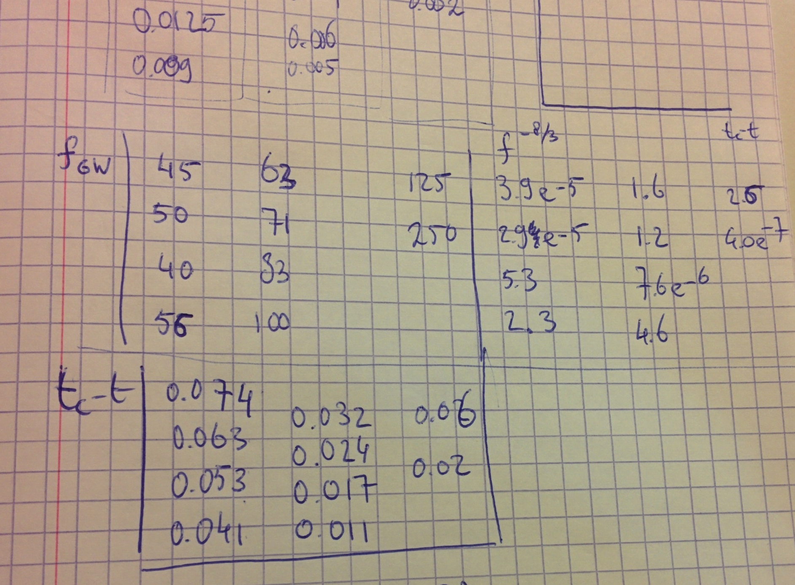
Chirp mass
20% off of real mass!

Slide 4
Student talks
Pierre Auger Observatory
IceCube
MAGIC telescope
CHEC-S
Fermi LAT
ANTARES
Xenon1T

Slide 5
Student talks
Pierre Auger Observatory
IceCube
MAGIC telescope
CHEC-S
Fermi LAT
ANTARES
Xenon1T
KATRIN

Slide 6
KATRIN

Slide 7
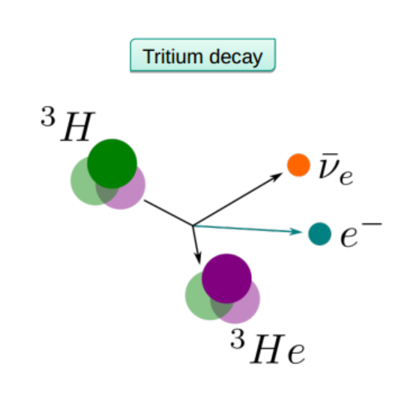
Measurement principle
Tritium half-life: 12.3 years
Do not need to open detector too often
Simple nuclear structure
Calculations uses first order electroweak theory
No nuclear corrections in beta-spectrum calculations
Low energy of the decay (18 KeV)
Bigger effect of the neutrino mass on beta-spectrum

Slide 8
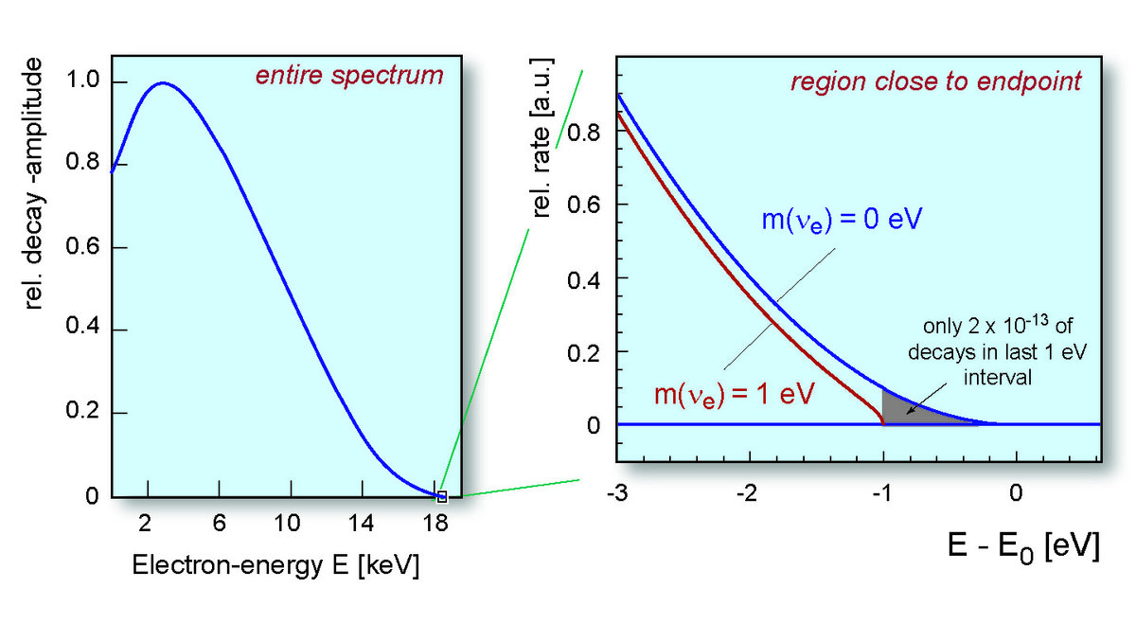
Tail of the spectrum
Tail contains information on neutrino mass
Last 30 eV measured

Slide 9
Set up
Pressure: 10⁻¹¹ bar
Detector
Spectrometer
Pre-spectrometer
Pumping system
Tritium chamber

Slide 10
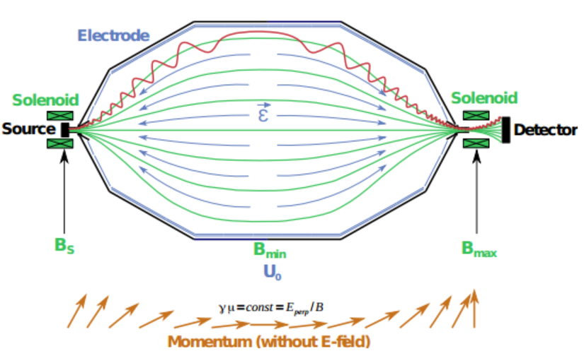
Spectrometer
MAC-E-Filter
Particles rotate around magnetic field lines
Magnetic field gradient transforms momentum forward: Adiabatic
Electric potential reflects low energy electrons
Re-accelerate energetic electrons
Detector measures energy, radial and temporal information
Scintillator vetos cosmic rays
Notes:
Magnetic adiabatic collimating Electronic filter

Slide 11
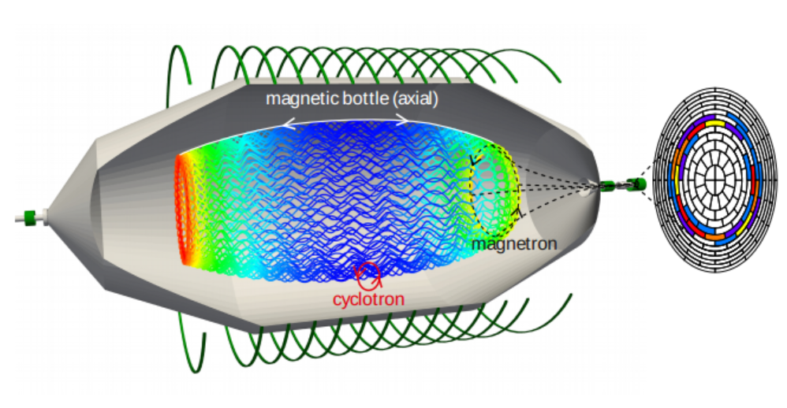
Spectrometer
www.katrin.kit.edu

Slide 12
Issues
Background particles
Cosmic
Natural radioactivity
Tritium in the chamber
Residual gas becoming ionized

Slide 13
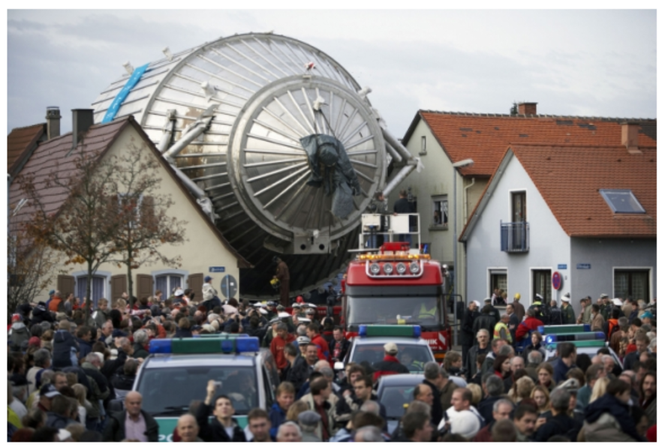
www.katrin.kit.edu

Slide 15
