Slide 1
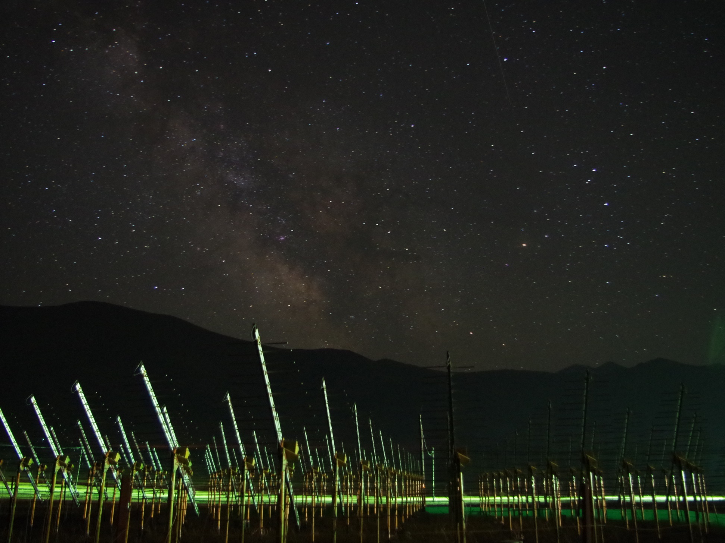

The Giant Radio Array for Neutrino Detection
Project update
Olivier Martineau
GRAND White Paper 2nd workshop
Radboud University, Feb 20, 2018
the 21CM array
site of the GRANDproto setup (picture: Gu Junhua)

Slide 2

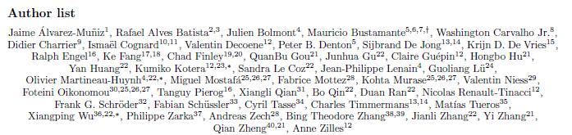
Update since 1st WP workshop
A lot has been done in all fields in the 9 last months!
  White paper: v1 released! A great achievement
  ➔ Mauricio, 2:15pm

Slide 3
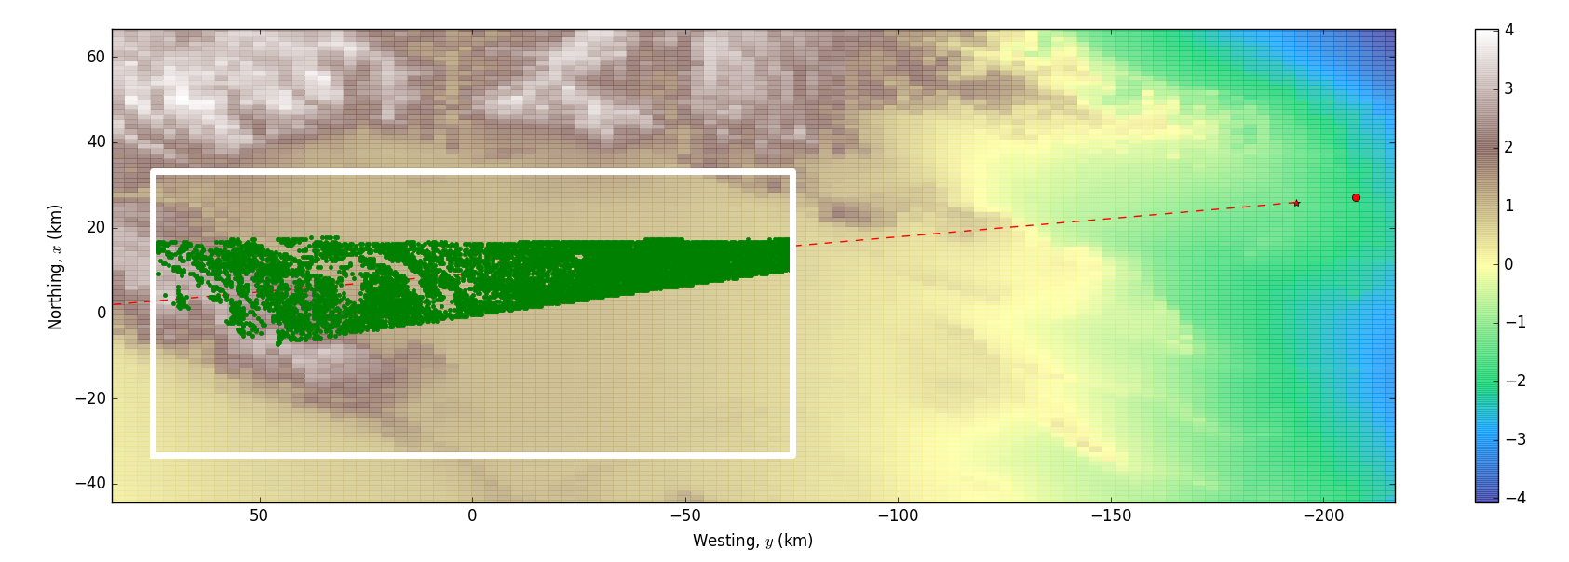
Update since 1st WP workshop
A lot has been done in all fields in the 9 last months!
  Neutrino & CR sensitivity estimate: simulation chain now complete, validated and running. First results in line with preliminary estimates. But still work ahead in view of WPv2
  ➔ simulation session (IAP gang+Sandra), 2:30pm
One simulated
GRAND event

Slide 4
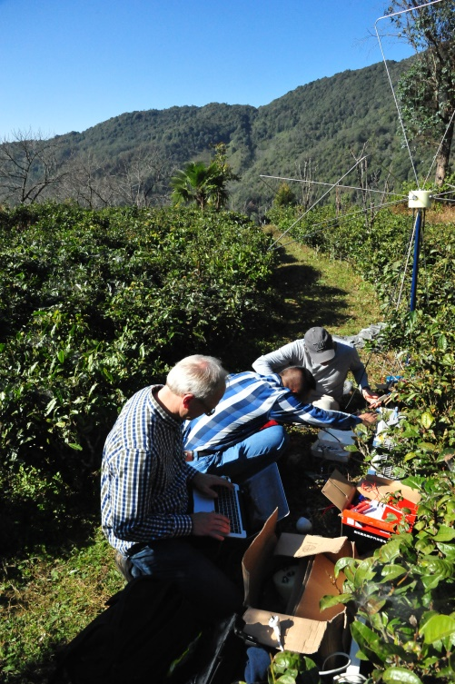
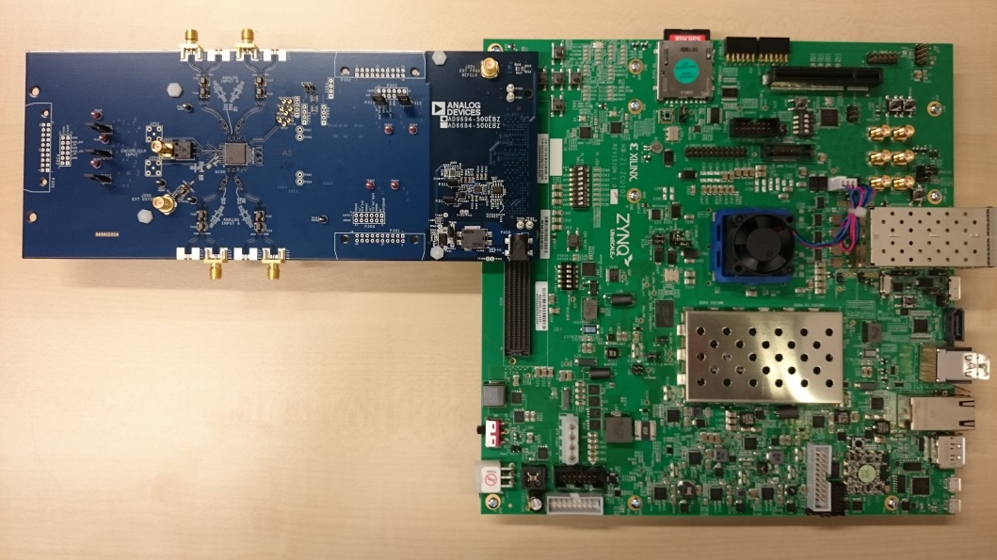
Update since 1st WP workshop
A lot has been done in all fields in the 9 last months!
  GRANDProto300:
    site survey (3 sites) & electronics developments initiated (lead: Nijmegen).
    Budget: 100-200k€ to be spent before end of the year
➔ Charles, Thursday 9:15am
AiLaoShan (Yunnan):
one very radio-quiet candidate site for GP300
GRANDProto300
DAQ development board
(René Habraken, Nijmegen)

Slide 5
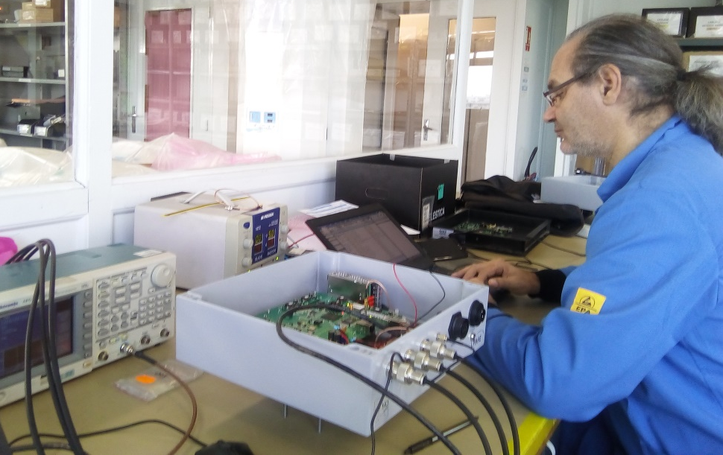
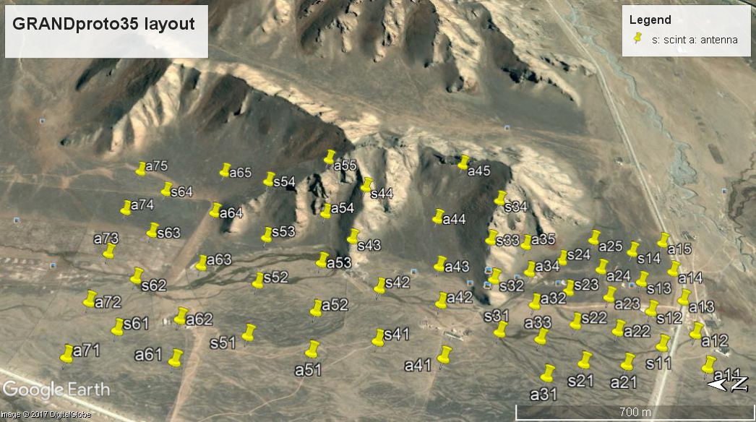
Update since 1st WP workshop
A lot has been done in all fields in the 9 last months!
  GRANDProto35:
    34 DAQ units produced & delivered (LPNHE lead, NAOC funding).
    On-site deployment on-going.
    Site access to foreigners + human ressources on project are a concern
➔ Olivier, Thursday 9am
D. Martin in GP35 DAQ tests
(STAE company, Nov 2017)

Slide 6
GRAND people
A collaboration at dawn
  Rising interest for GRAND in the community: Tanguy+Ralph @ KIT, JP Lenain+Julien Bolmont @ LPNHE, Fabian Shüssler@Irfu, Matias Tueros in Argentina...
  Key issue: how to transform this momentum into institutional support?

Slide 7
GRAND people
A collaboration at dawn
  In:
    C. Guépin & V. Decoene (IAP) as the first GRAND graduate students! ☺
    Position offered to Frank at Shanghai Jiatong. Enough support to start his group! (Important) details still to be defined & contract not signed. Would be a big boost to GRAND (GP300 ground array & GP35 data analysis)
    Qian Xiangli @ Shandong U (NSFC grant)… Involvment still to be defined (GP35 data analysis).
    Nijmegen taking lead for GP300 elec development (René Habraken + Daniel Szalas-Motesiczky), NAOC (Duan Ran) for prod (?)
  Out:
    Sandra finishing her PostDoc@NAOC next week. Great work achieved for TREND simulations & GRAND antenna simulation.
  Clear deficit of ressources for hardware development (electronics+antenna design, GP300)+ data analysis (GP35)

Slide 8
GRAND ToDo for 2018
GRAND simulations:
  Improve antenna response
  Run mass sims & define layout
  Provide recons benchmark
Input for WPv2 (timeline?)
GP300: site selection (before summer) & electronics (proto ready by sept 2018)
GP35: finishing deployment, commissioning and start of data taking by summer
Strategy/Structure:
  complete WPv2 ⬄work on our sell arguments
  Set-up structure & get institutionnal

