Slide 1
GRANDproto300
Charles Timmermans

Slide 2
GRANDProto300
Reminder
  ~300 km2 detector somewhere in China
  Validate simulations and reconstruction
  Cosmic ray physics
  Testbench for GRAND10K
Timeline
  Find a site → Summer 2018
  Antenna design → January 2019
  Electronics design → March 2019
  communications design → Summer 2019
  Installation → July 2020

Slide 3
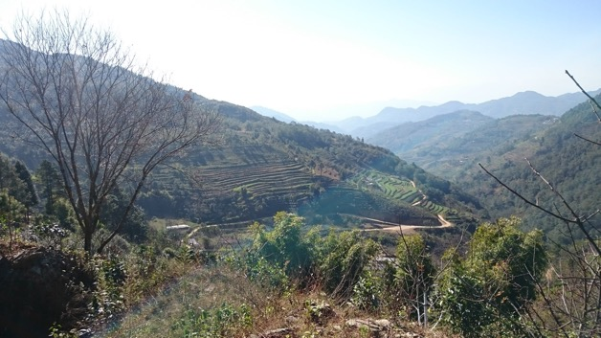
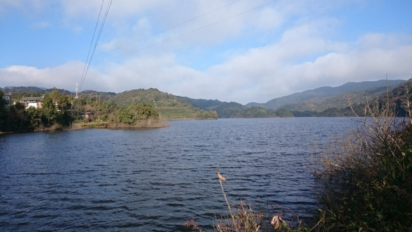
Survey Yunnan: Challenging!

Slide 4
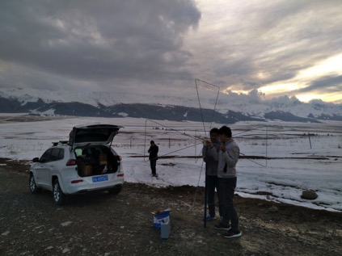
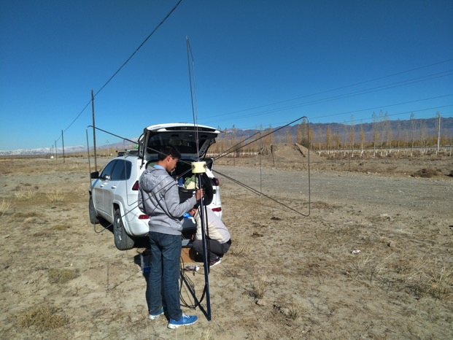
Survey Bailikun
Power Lines!

Slide 5
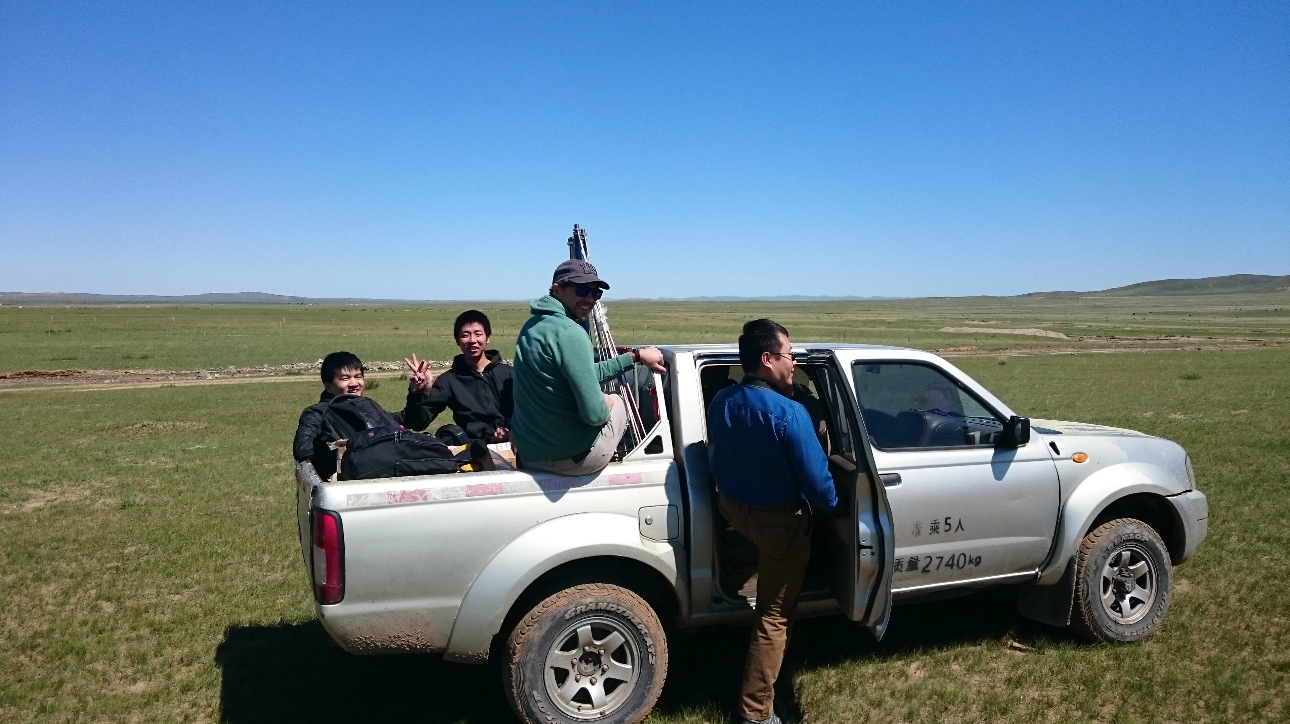
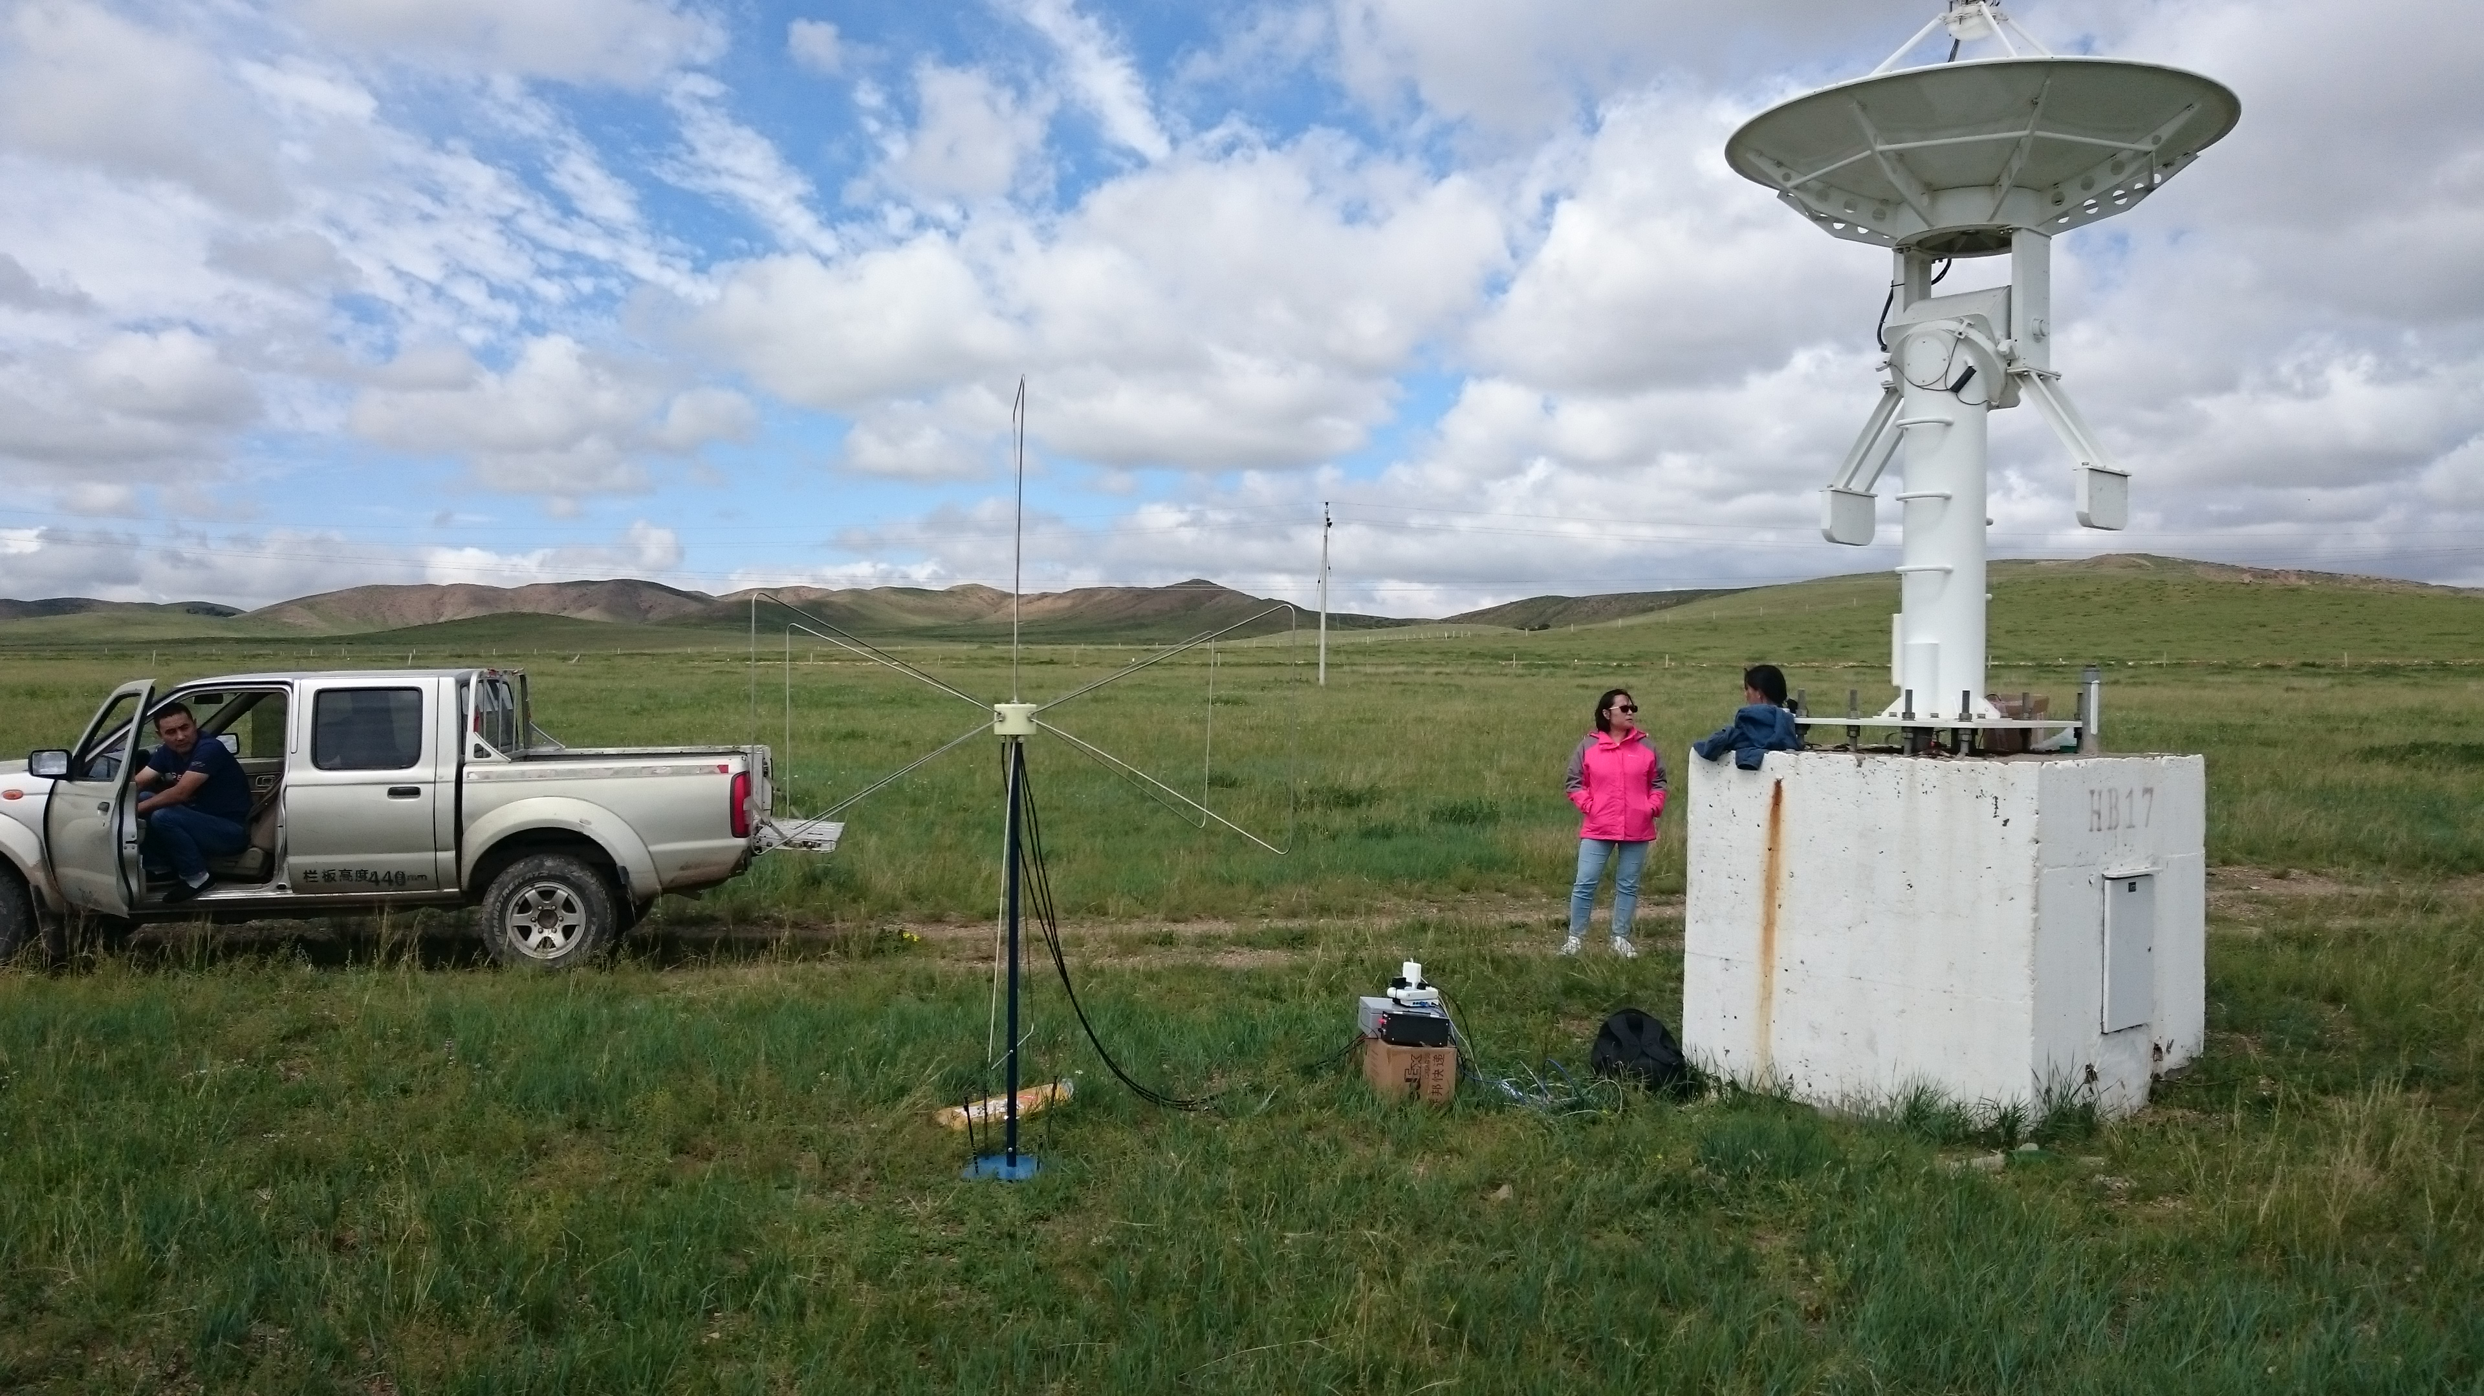
Survey Inner Mongolia

Slide 6
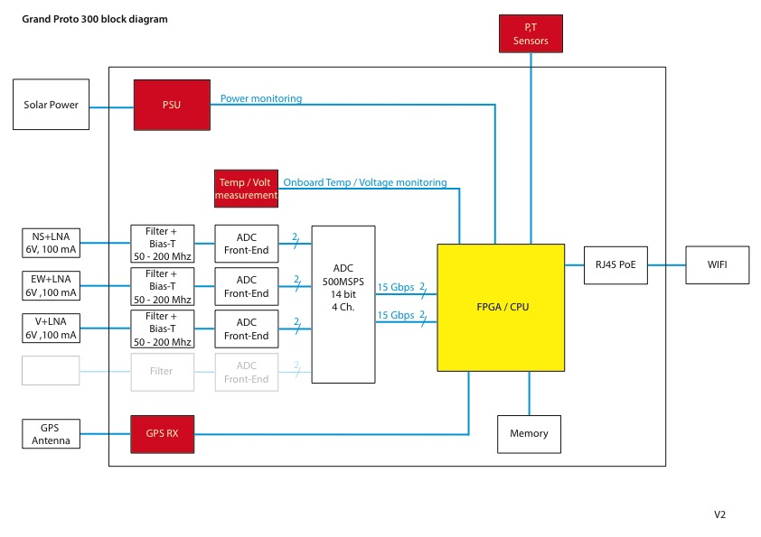
Electronics
VICTRON Solar Power 50W, 12V
Floris Hahn
Rene Habraken
Dániel Szálas-Motesiczky
Didier Charrier
Ubiquity Bullet
Xilinx Zync ZU9EG
AD9694
TRIMBLE SMT360

Slide 7
GRANDProto300: Total budget estimate 1.3 M€
2 | GRAND 300 | Responsible | Due date | Costs/unit (€) | #units | Total costs (k€)
2.1 | Antenna Stations | O. Martineau |  |  |  | 1115.391
2.1.1 | antenna mechanics |  |  |  | 330 | 59.4
2.1.1.1 | Pole |  |  | 180 | 330 | 59.4
2.1.1.2 | nut |  |  |  | 330 | 0
2.1.1.3 | Butterfly |  |  |  | 990 | 0
2.1.2 | LNA | D. Charrier |  | 60 | 990 | 59.4
2.1.3 | Cable assembly |  |  |  |  | 44.55
2.1.3.1 | Cables (10 m) |  |  | 5 | 990 | 4.95
2.1.3.2 | N-type connector |  |  | 20 | 1980 | 39.6
2.1.4 | Solar Power | C. Timmermans |  |  |  | 74.019
2.1.4.1 | Panel 50W |  |  | 84 | 330 | 27.72
2.1.4.2 | Charge Controller |  |  | 36.3 | 330 | 11.979
2.1.4.3 | Battery |  |  | 89 | 330 | 29.37
2.1.4.4 | Cables Panel-CC |  |  | 15 | 330 | 4.95
2.1.4.5 | Cables CC-Battery |  |  |  | 330 | 0
2.1.4.6 | Cables CC-digitizer |  |  |  | 330 | 0
2.1.5 | Digitizer | C. Timmermans |  | 2500 | 330 | 825
2.1.5.1 | Prototyping |  |  | 12500 | 2 | 25
2.1.5.2 | PCB |  |  |  | 330
2.1.5.3 | FPGA |  |  |  | 330
2.1.5.4 | ADC |  |  | 533 | 330
2.1.5.5 | GPS |  |  |  | 330
2.1.5.6 | GPS antenna
2.1.5.7 | Filter/amplifier |  |  |  | 990
2.1.6 | local comms | C. Timmermans |  |  |  | 51.48
2.1.6.1 | Bullet M5 |  |  | 79 | 330 | 26.07
2.1.6.2 | 5 GHz Antenna |  |  | 50 | 330 | 16.5
2.1.6.3 | Cable N-male-N-male |  |  | 27 | 330 | 8.91
2.2 | communication system |  |  |  |  | 1.542
2.2.1 | Poles |  |  |  | 6
2.2.2 | Rocket M5 |  |  | 95 | 6 | 0.57
2.2.3 | Cable N-male-N-male |  |  | 43 | 6 | 0.258
2.2.4 | Antenna |  |  | 79 | 6 | 0.474
2.2.5 | switch |  |  | 60 | 4 | 0.24
2.3 | Online computing resources |  |  |  |  | 0
2.3.1 | processing
2.3.2 | storage
2.4 | Offline computing resources |  |  |  |  | 0
2.4.1 | processing
2.5.1 | storage
2.5 | Deployment |  |  |  |  | 0

Slide 8
GRANDProto300: Total budget estimate 1.3 M€
2 | GRAND 300 | Responsible | #units | Total costs (k€)
2.1 | Antenna Stations | O. Martineau |  | 1115.391
2.1.1 | antenna mechanics |  | 330 | 59.4
2.1.3 | Cable assembly |  |  | 44.55
2.1.4 | Solar Power | C. Timmermans |  | 74.019
2.1.5 | Digitizer | C. Timmermans | 330 | 825
2.2 | communication system | C. Timmermans |  | 1.542

Slide 9
GRANDproto300
Progress is being made
A lot of work is remaining
Schedule is challenging

