Slide 1
Assessing Combined Assurance
Introducing composites of DOGWOOD and BIRCH/CEDAR in EGI and beyond
David Groep
Nikhef
co-supported by the Dutch National e-Infrastructure coordinated by SURF, and by EGI Core Services

Slide 2
EGI Combined Assurance use case
IOTA AP assurance level ‘DOGWOOD’ is different,
but remainder of the assurance can be taken up somebody else
– the user community or the registrar for the Access Platform
Only thing you get is an opaque ID
Stepping up to adequate assurance:
  Real names from pseudonyms
  Enrolling users in a community
  Keeping audit records
  Auditability and tracing
  Incident response
Identity elements
identifier management
re-binding and revocation
binding to entities
traceability of entities
emergency communications
regular communications
‘rich’ attribute assertions
correlating identifiers
access control

Slide 3
The wLCG IOTA CA by-pass
‘lcg-CA’
or explicit
configuration
For EGI-only sites nothing changed
For EGI sites also under wLCG policy and installed post-EGEE:
just install both policy packages “egi-core” and “lcg”
ca-policy-egi-core
IGTF Classic
ca-AEGIS
…
IGTF MICS
ca-TCS
…
IGTF SLCS
ca-DFN-AAI
…
ca-policy-lcg
IGTF Classic
ca-AEGIS
…
IGTF MICS
ca-TCS
…
IGTF SLCS
ca-DFN-AAI
…
ca-CERN-LCG-IOTA

Slide 4
Project MinE (ALS) use case
Access traditional global grid resources from the CLI
By users that have no PKIX experience
but are all properly vetted and registered
(in the SURFsara CUA)
Case comparable to LHC VOs (and to ELIXIR)
Give access based on DOGWOOD CUA ID – and prepopulate a VOMS server based on CUA details

Slide 5
Interlude
Thanks to Mischa Sallé

Slide 6
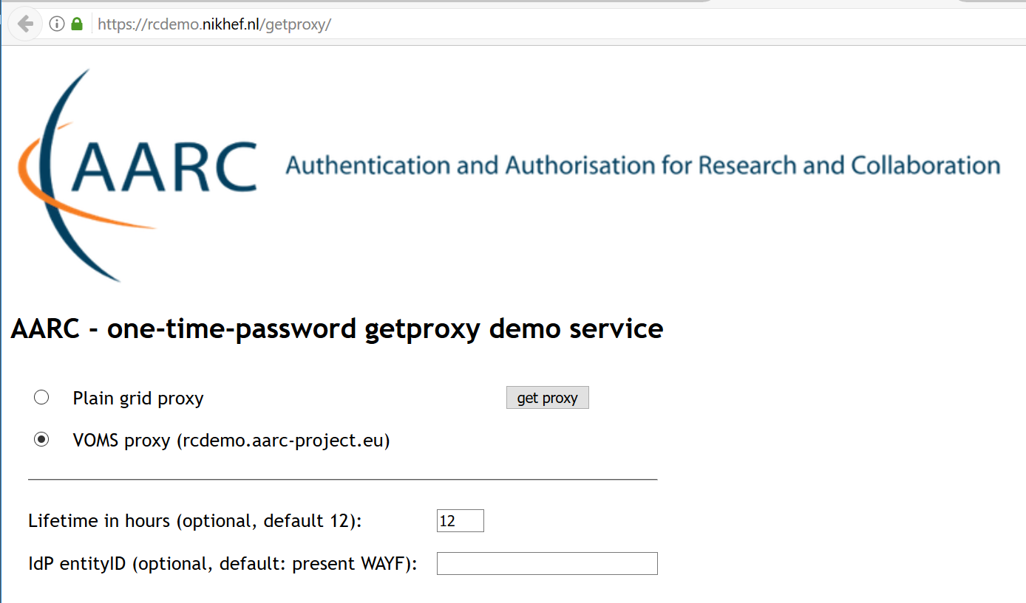
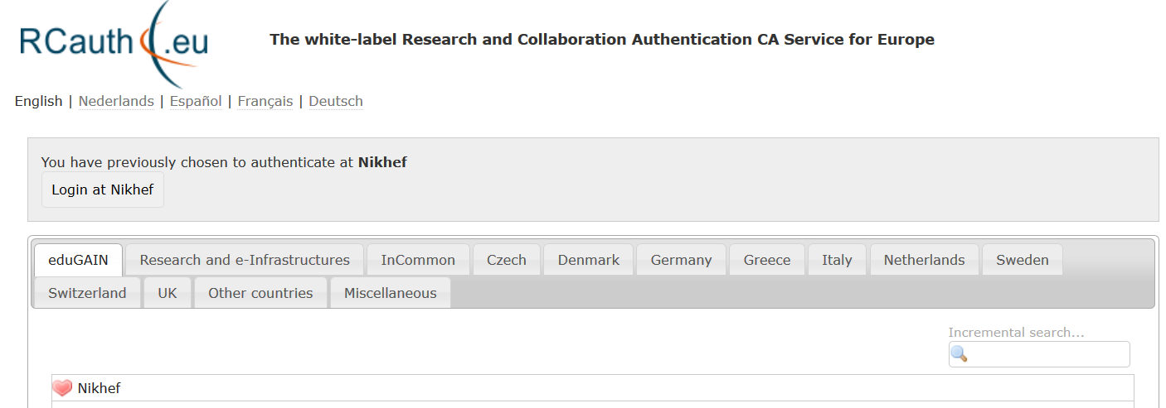
A proxy from the TTS: the ad-hoc way
additional info: Mischa Sallé, msalle@nikhef.nl

Slide 7
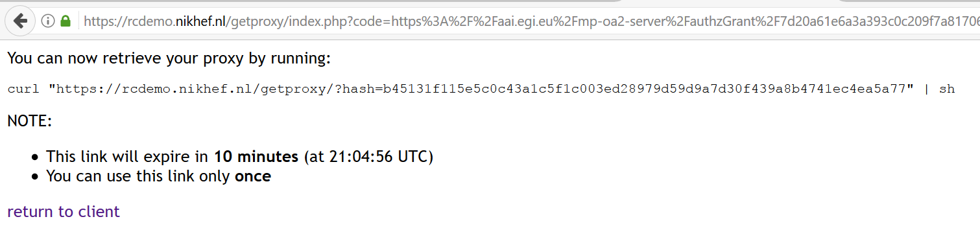
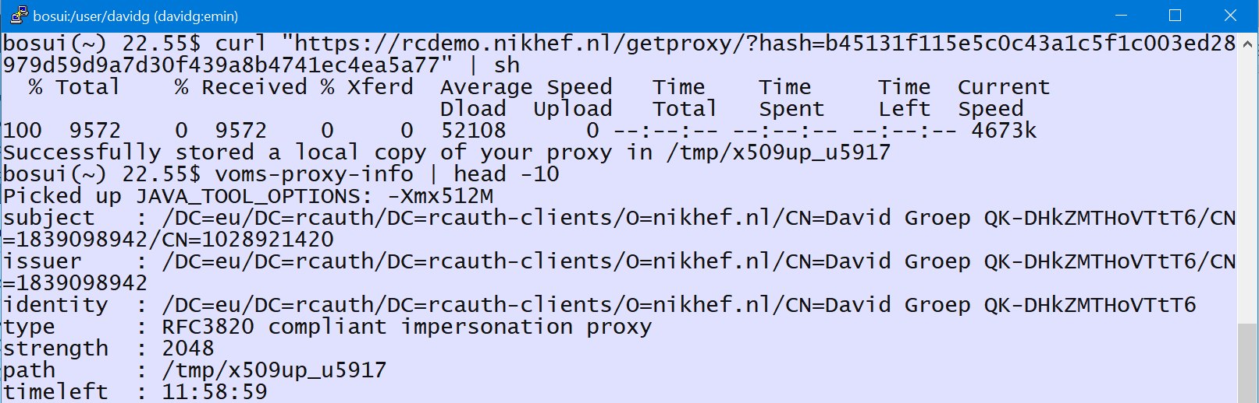
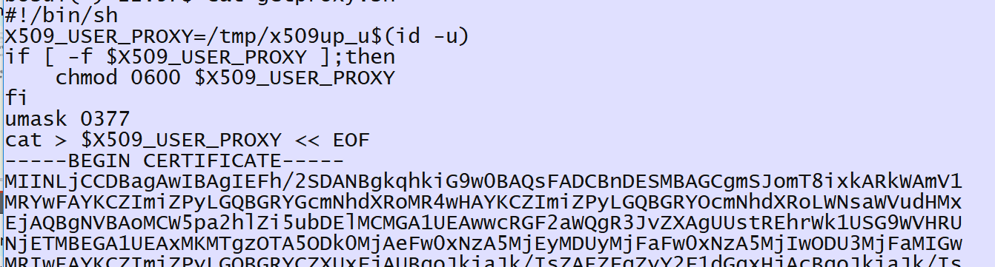
A one-time URL giving a shell script
additional info: Mischa Sallé, msalle@nikhef.nl

Slide 8
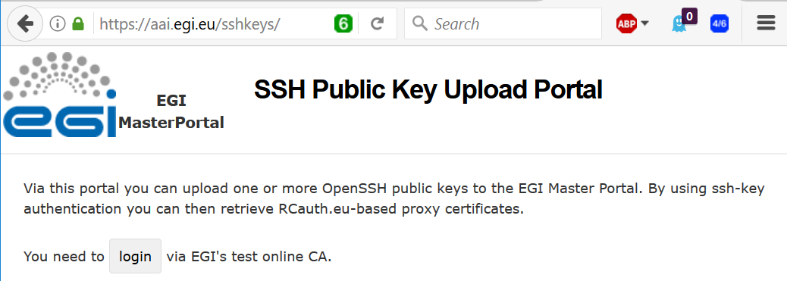
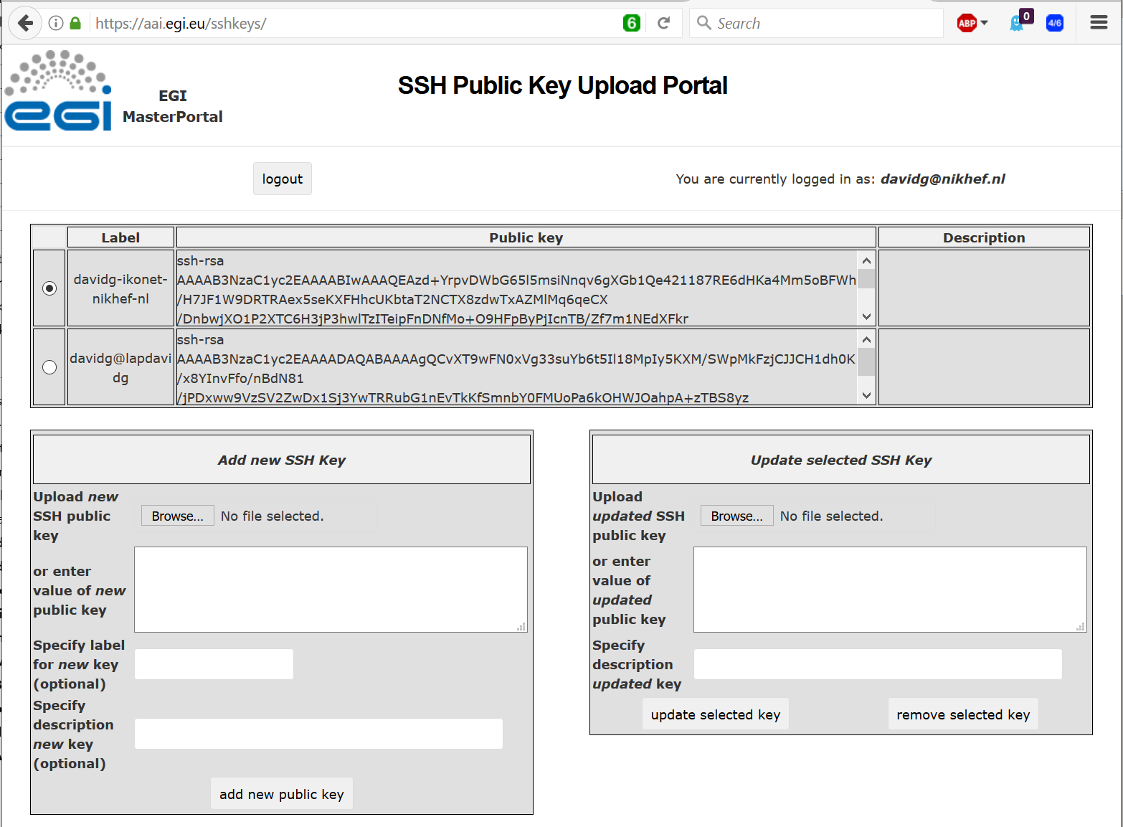
Register your ssh public key
– like in gitlab, sourceforge, &c
additional info: Mischa Sallé, msalle@nikhef.nl

Slide 9
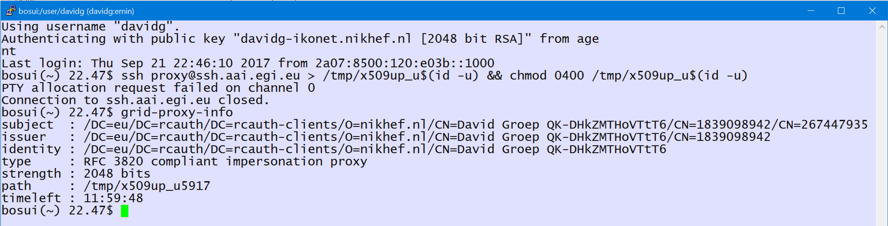
Hiding PKIX – just like KRB
Implicit retrieval of proxies using ssh-agent
Resulting proxies can decorated with VOMS without need for passphrases or other credentials
Predictable RCauth subject naming (USR) allows
pre-registering in VOMS, COmanage, &c
additional info: Mischa Sallé, msalle@nikhef.nl

Slide 10
Beyond DOGWOOD
(CERN IOTA, RCauth, CILogon Basic)
Old model: CERN STS tight VO binding model
  With the EGI and WLCG specific exception
EGI combined assurance model
  Make assurance combination part of service AuthZ
  Implemented by major AuthZ frameworks: Argus (1.7.1+), LCMAPS, dCache (3.1+)
  Configuration shipped via EGI and WLCG
But: which ‘other’ assurance providers qualify?

Slide 11
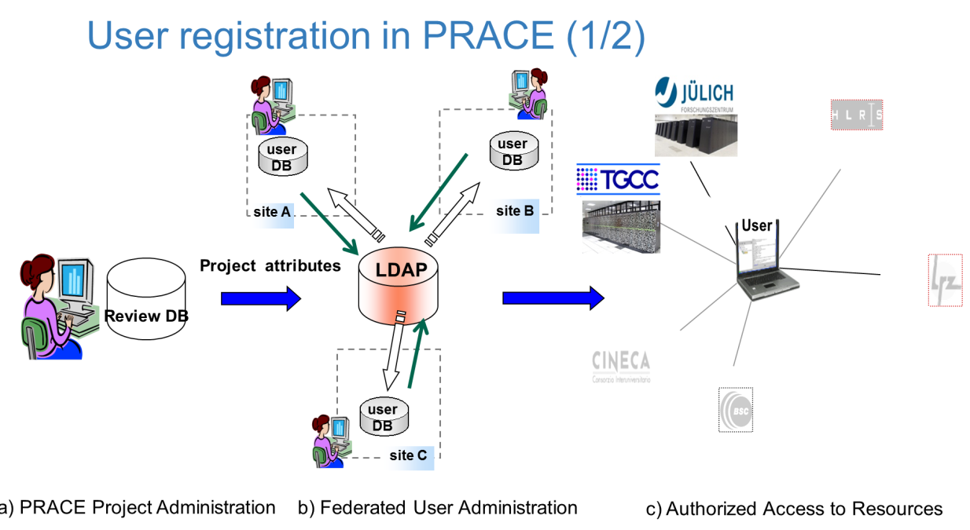
Specific Delegated Responsibilities
Need for proper traceability does not go away, so …
who holds that information need not only be a traditional CA
but can be another entity with similarly rigorous processes
Some communities have an
existing registration system
that is very robust
PRACE – in-person links
at the home sites
XSEDE – NSF grant
approval process
wLCG – CERN Users Office
and HR Database

Slide 12
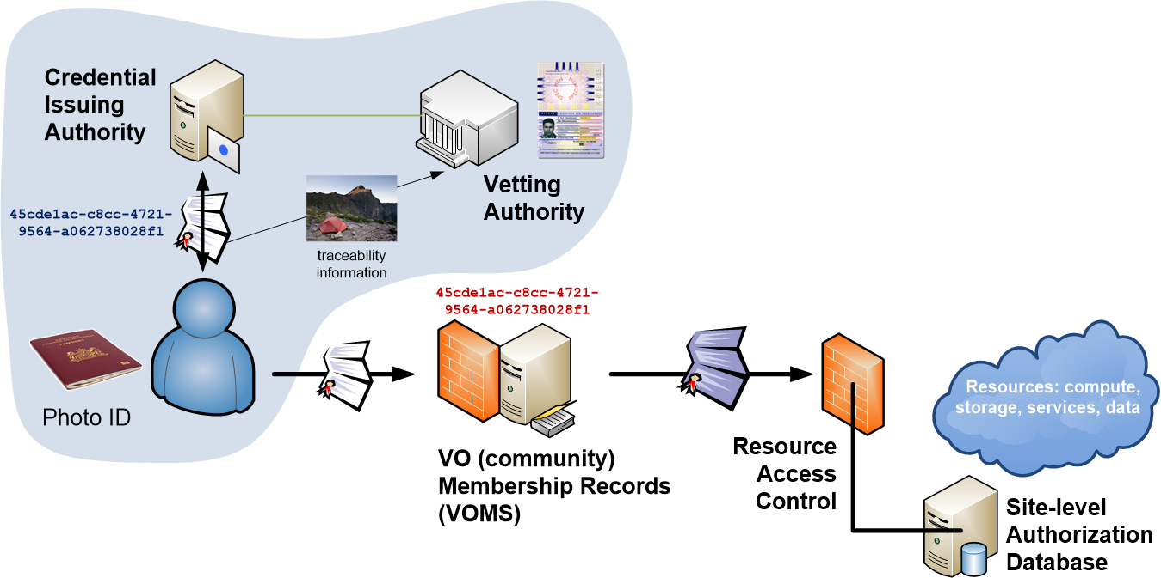
Distributed Responsibilities I:
Trusted Third Party

Slide 13
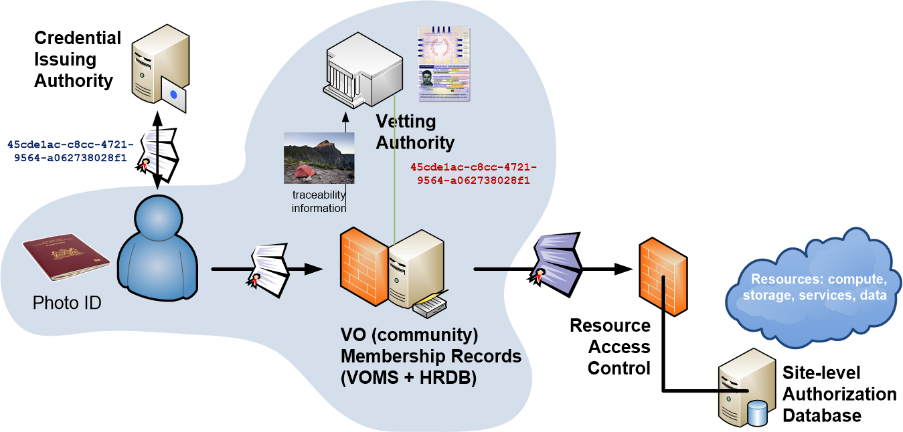
Distributed Responsibilities II:
Collaborative Assurance & Traceability

Slide 14
IOTA in the EGI context
EGI – by design - supports loose and flexible user collaboration
300+ communities
Many established ‘bottom-up’ with fairly light-weight processes
Membership management policy* is deliberately light-weight
Most VO managers rely on naming in credentials to enroll colleagues
Only a few VOs are ‘special’
LHC VOs: enrolment is based on the users’ entry in a special (CERN-managed) HR database, based on a separate face-to-face vetting process and eligibility checks, including government photo ID + institutional attestations
Only properly registered and active people can be listed in VOMS

Slide 15
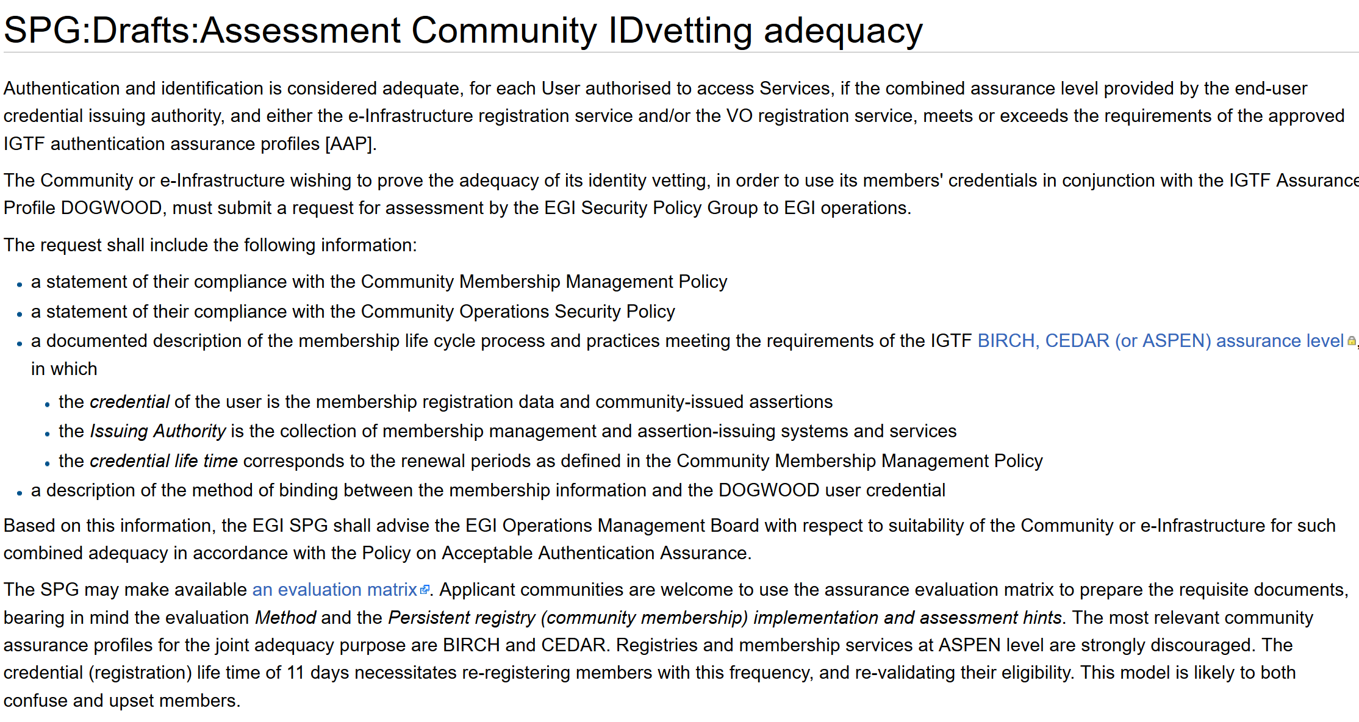
Developing an assessment framework

Slide 16
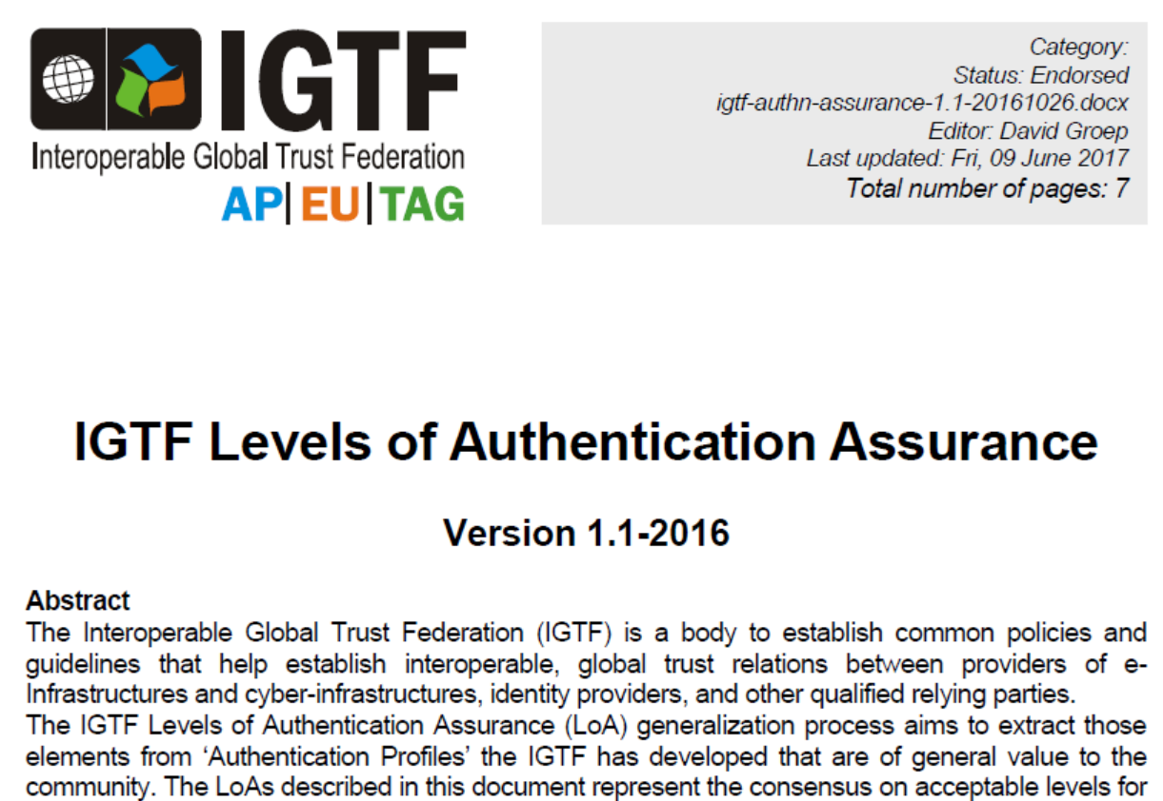
The need for guidance

Slide 17
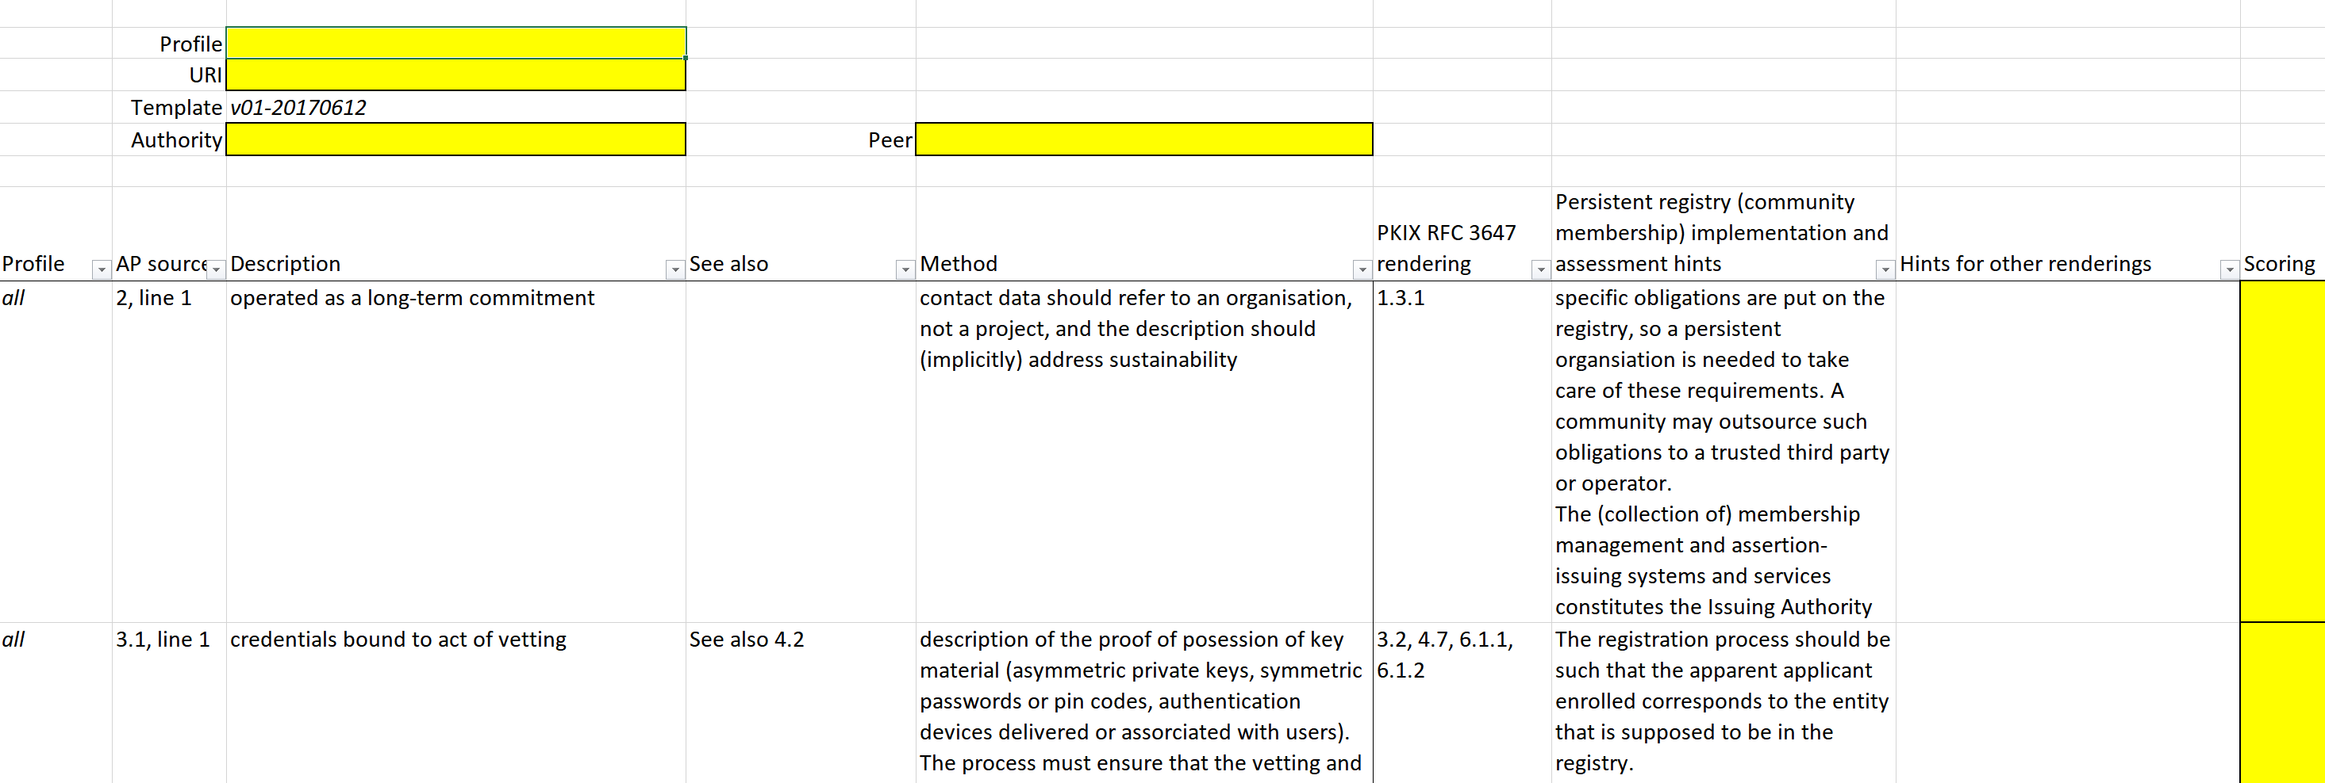
Assessment Matrix
Mapping for PKIX/RFC3647 is trivial
How to apply out BIRCH/CEDAR guidance to community registries?
Relevant for COmanage & VOMS communities,
but maybe wider?
https://wiki.eugridpma.org/Main/AssuranceAssessment

Slide 18
Building a global trust fabric
Discussion!

