Slide 1
AARC’s AEGIS: shielding research and collaboration from fragmented identity
Christos Kanellopoulos, GÉANT
41st EUGridPMA and IGTF All Hands, Manchester, UK
September 25th , 2017

Slide 2
Research Communities
The way researchers collaborate within scientific communities can vary significantly from community to community
The ability to access and share resources is crucial for the success of any collaboration
Advanced Research and Education (R&E) needs advanced IT services
Notes:
The way researchers collaborate within scientific communities can vary significantly from community to community. On the one hand, there are highly structured communities with thousands of researchers who can be virtually anywhere in the world. Typically, these communities have been working together for a long time, they want to share and have access to a wide range of resources. On the other hand, one finds a diverse number of smaller research communities working within specific or across scientific disciplines. Typically, these are either nascent communities being established around new scientific domains, or they are communities in specific domains that did not require wide spread and close collaboration among the researchers. And of course, in between these two extremes, there are many scientific communities of varying size, structure, history etc.
Regardless, if we are talking about large-scale, well-structured collaborations or about loosely coupled collaborations centred around the individual researcher, they all need to share and access resources. The ability to access and share resources is crucial for the every day research. Advanced research needs equally advanced IT services.

Slide 3
GÉANT Network – A global infrastructure enabling collaboration on a global scale
GÉANT and the NRENs connect over 50 million users at 10,000 institutions across Europe
Interconnecting with all world regions, reaching to over 100 countries.
A global infrastructure enabling European researchers to collaborate on a global scale
Notes:
Nowadays, we tend to take many things for granted, but it is important to always take a step back and try to think how research would be taking place if the GEANT network was not there. Today, GEANT and the NRENs connect 50M users and 10.000 institutions across Europe. Through the GEANT interconnections with all the major world regions, European researchers can collaborated on daily basis with fellow researchers in more than 100 countries. A global infrastructure enabling European researchers to collaborate on a truly global scale.

Slide 4
eduGAIN – A global network of academic identities
Interconnects identity federations around the world, simplifying access to content, services and resources
Researchers can use a single digital identity provided by the home organization
Notes:
At the same time, the NRENs started to experiment with federated authentication, establishing the first national academic federations, which allowed users to use their institutional accounts in order to access mainly web based services. Although the potential of federated ID was clear from the very beginning to the people involved it was not until 2010, that it could show its true potential. In 2011/2012, GÉANT brings to production the eduGAIN service, which interconnects mainly the identity federations in Europe. Very soon, other federations across the globe start connecting to eduGAIN, making eduGAIN a truly global identity network. eduGAIN has been growing and evolving ever since with the continues support from GEANT and the international community of federation operators.

Slide 5
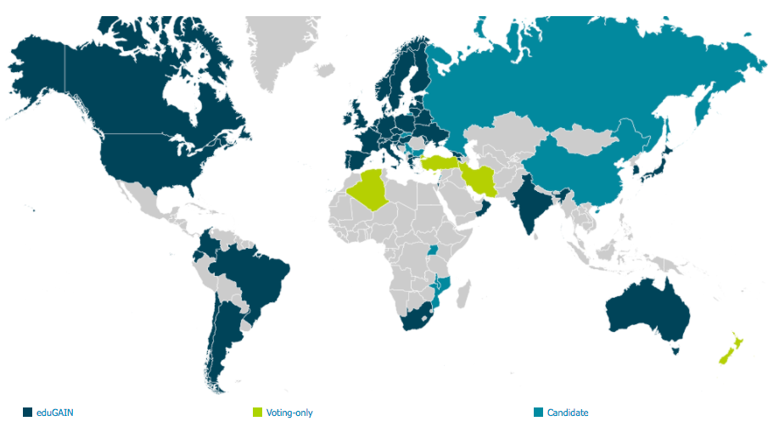
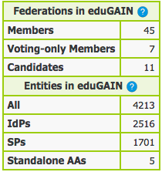
eduGAIN – A global network of academic identities

Slide 6
Federated Identity Management for Research
Access services using identities from their Home Organizations when available.
Secure integration of guest identity solutions and support for stronger authentication mechanisms when needed.
Access to the various services should be granted based on the role(s) the users have in the collaboration.
Users should have one persistent identity across all community services when needed.
Ease of use for users and service providers. The complexity of multiple IdPs/Federations/Attribute Authorities/ - technologies should be hidden.
Notes:
Of course, you can understand how compelling such a service is to the research community. Leveraging eduGAIN, researchers can rely on the institutional accounts in order to access and share services. No more need for certificates, no need to operate costly infrastructures just to offer and manage user accounts so that researchers can collaborate. But eduGAIN and the Identity Federations do not come without their own limitations.
Indeed, using eduGAIN is not just a switch that can be flipped. In most of the cases, although the identity network is there, the home institutions acting as identity providers, require that they approve the connection of each and every new service provider. Things look quite OK for local services, but what about international Service Providers? How the research community can benefit from this service?
In 2012, many scientific communities come together, forming a working group called Federated Identity Management for Research, which investigate the current state FIM and its potential within their domains. After a series of workshops, they published the FIM4R paper, which highlights the importance of eduGAIN and the identity federations and the role they can play.

Slide 7
AARC Blueprint Architecture - Enabling an ecosystem of solution on top of eduGAIN
A Blueprint Architecture for authentication and authorization
A set of architectural and policy building blocks on top of eduGAIN
eduGAIN and the Identity Federations
A solid foundation for federated access in Research and Education

Slide 8
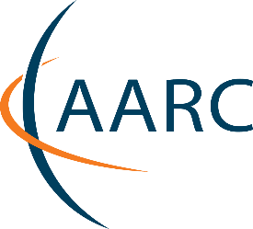
AARC Blueprint Architecture
https://aarc-project.eu/architecture/

Slide 9
AARC Blueprint Architecture
Guidelines and support documents
Best practices for managing authorisation
Expressing group membership and role information
Scalable attribute aggregation
Implementation of token TTS
Credential delegation
Non-web access
Social media IdPs
Use cases for account linking
Use cases for LoA elevation via step-up authentication
https://aarc-project.eu/architecture/

Slide 10
AARC Blueprint Architecture
Policy recommendations & frameworks
Security Incident Response Trust Framework for Federated Identity – Sirtfi
Scalable Negotiator for a Community Trust Framework in Federated Infrastructures – Snctfi
Recommendations on Minimal Assurance Level Relevant for Low-risk Research Use Cases
Differentiated LoA recommendations for policy and practices of identity and attribute providers
Recommendations and template policies for the processing of personal data by participants in the pan-European AAI
https://aarc-project.eu/policies/

Slide 11
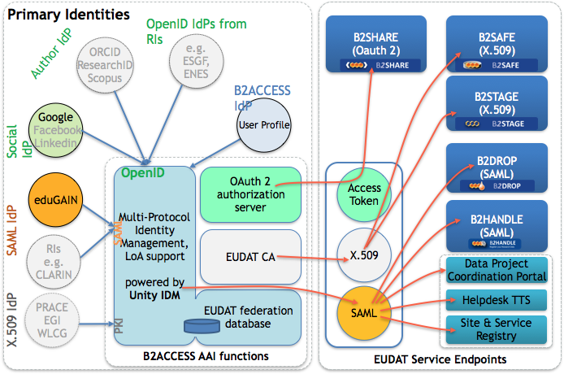
Example implementations: EUDAT B2ACCESS Service
Enables communities to use federated identities to access EUDAT services
Connects to eduGAIN to enable users use their existing accounts at their home organisations
Supports social ID logins and integration with token translations services for enable non-web access
Communities can connect their community management systems as Attribute Authorities

Slide 12
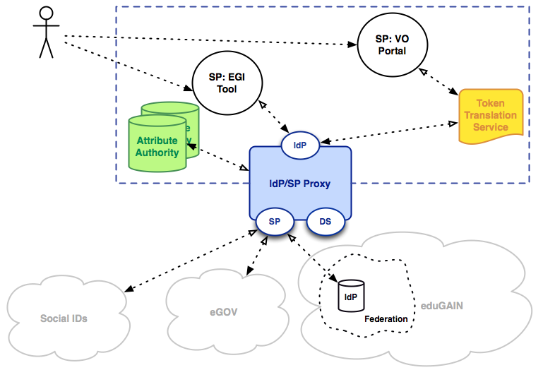
Example implementations: EGI Check-In Service
Enables communities to use federated identities to access EGI services
Connects to eduGAIN to enable users use their existing accounts at their home organisations
Supports social ID logins and integration with token translations services for enable non-web access
Communities can connect their community management systems as Attribute Authorities

Slide 13
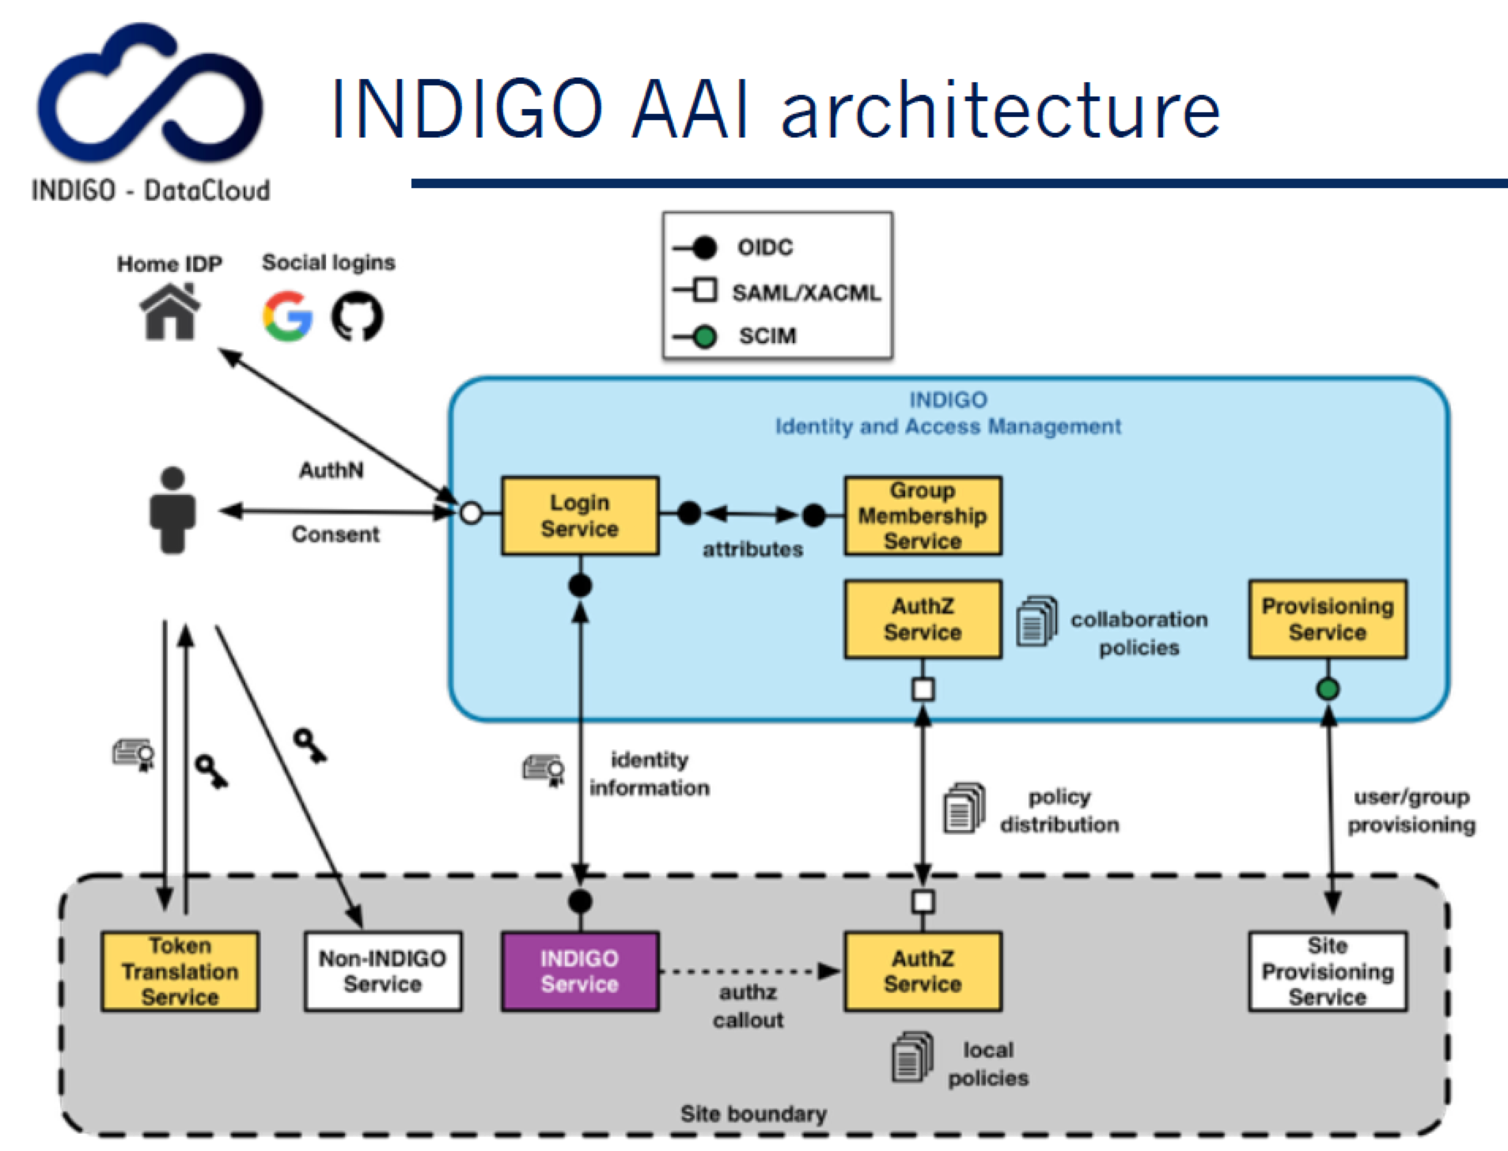
Example implementations: INDIGO AAI
Enables communities to use federated identities to access services using OIDC
Connects to eduGAIN to enable users use their existing accounts at their home organisations
Supports social ID logins and integration with token translations services for enable non-web access
Communities can connect their community management systems as Attribute Authorities

Slide 14
Example implementations: GÉANT eduTeams
A suite of services to support research collaboration
Built on top of eduGAIN, takes full advantage of federated AAI
Simplify the management of group and authorization information
Enables the integration of users from a wide range of environments
Service Providers in eduGAIN can utilize Social IDs using the identity Hub
Connects users to services

Slide 16
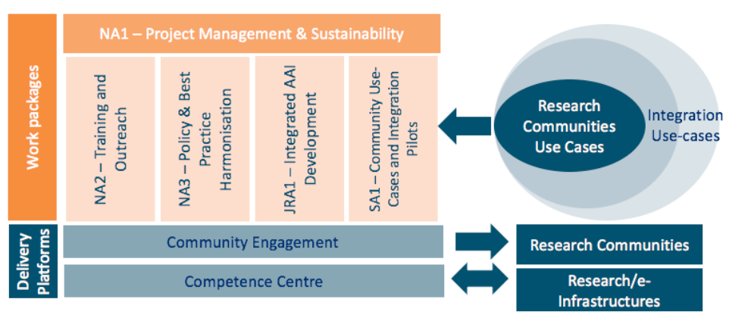
AARC 2nd edition – Working closer together

Slide 17
AARC Engagement Group for Infrastructures
Representatives from research and e-Infrastructures who operate AAI services for the communities they support
A communication channel with and across the infrastructure providers
Promote a consistent vision for federated access
Facilitate activities so that infrastructures implement harmonised solutions and avoid ’re-inventing the wheel”

Slide 18
AARC Engagement Group for Infrastructures
Implementation of AARC guidelines
AAI platform alignment activity
Levels of Assurance
How to position the LoA for social identities
LoA and eduGAIN IdPs
REFEDS assurance profiles
Infrastructure identifier syntax
Acceptable Usage Policies
Home organization affiliation
Syntax for home organization affiliation
Practices for home organization affiliation
Requested attributes from HO

Slide 19
Christos.Kanellopoulos@geant.org

