Slide 1
Leveraging the IGTF authentication fabric for research
the IGTF-to-eduGAIN Bridge and the registration authority network
David Groep
Nikhef
co-supported by the Dutch National e-Infrastructure coordinated by SURF, and by EGI Core Services

Slide 2
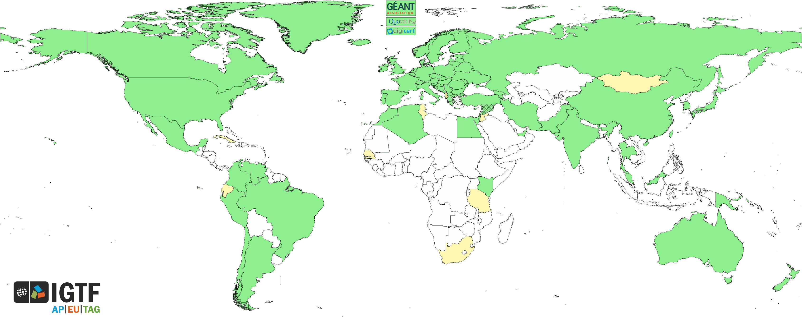
A look at the IGTF

Slide 3
IGTF capabilities
AuthN fabric and identity availability (today)
Assurance requirements and assessment for Infrastructures (tomorrow morning)
Registry operational guidelines (tomorrow morning)
Infrastructure policy harmonisation Snctfi (tomorrow)
Registry and operational capabilities (tomorrow afternoon)

Slide 4
What we do (for authN services)
User-centric authentication – across organisations
Independent of user’s home organization
Inspired by and aligned with
research communities and e-Infrastructures
Differentiated assurance derived from a both
solid and transparent assurance level
Ability to transfer registrations across authorities and countries (with the Registration Practice Statement)
… and guidance around trust and trustworthy operations for AuthN and Attributes … and …

Slide 5
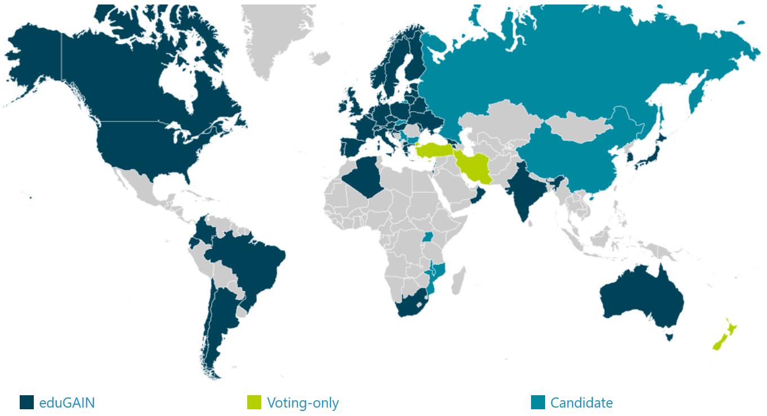
eduGAIN
40 NRENS (≈ countries)
4254 entities
(of which 2533 IdPs, i.e.,
authentication providers)
eduGAIN (status Sept 2017)
organisation-centric, and with much national autonomy in policy & practice
where it reaches the users and a ‘link’ is made, provides great ease of use
in most organisations, research is not the primary use case (yet) for the ‘IdP’

Slide 6

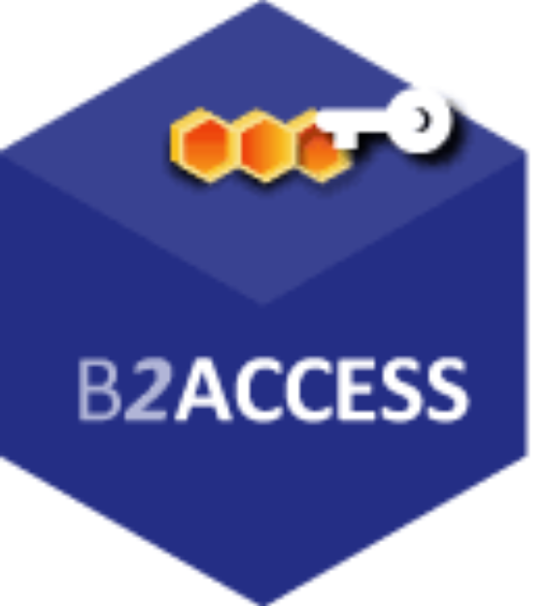


Infrastructure specific hubs
EGI CheckIn
B2ACCESS
CILogon
ORCID
…
Local log-in, mangled tokens, directory auth,
‘golden’ portals that ‘snoop’ your credentials,
‘golden’ portals assuming ownership of everything, …
Service-bespoke solutions

Slide 7
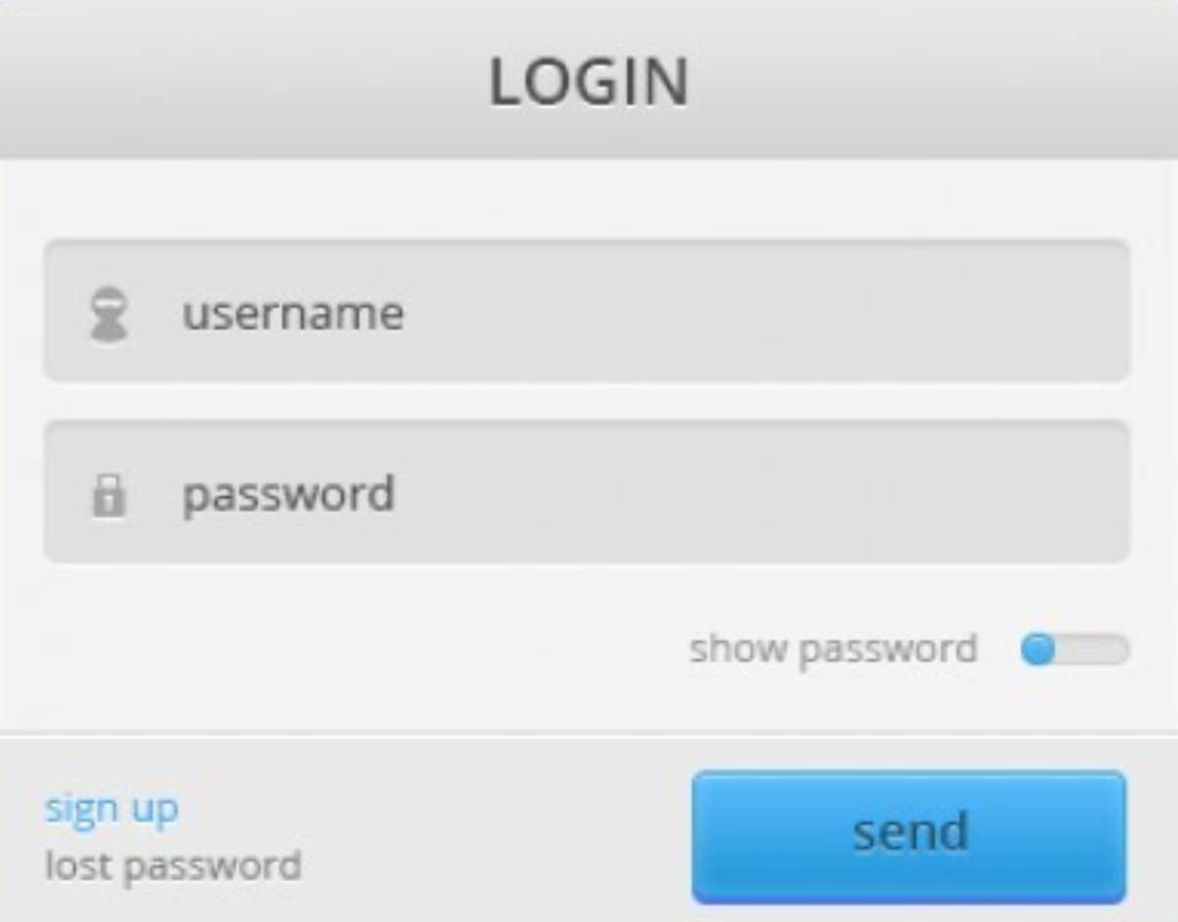



Turtles all the way down … and up!
…

Slide 8
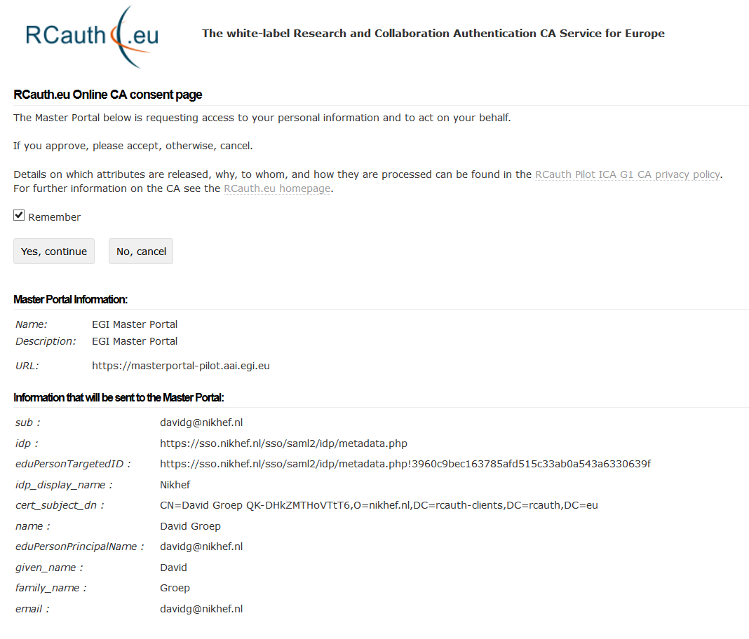
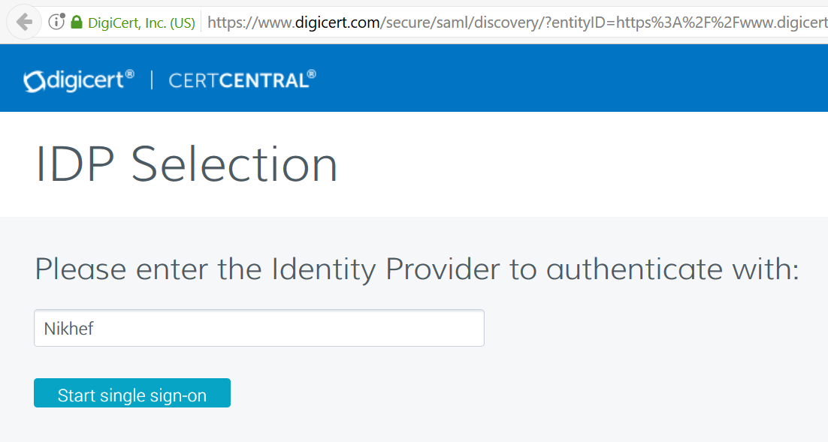
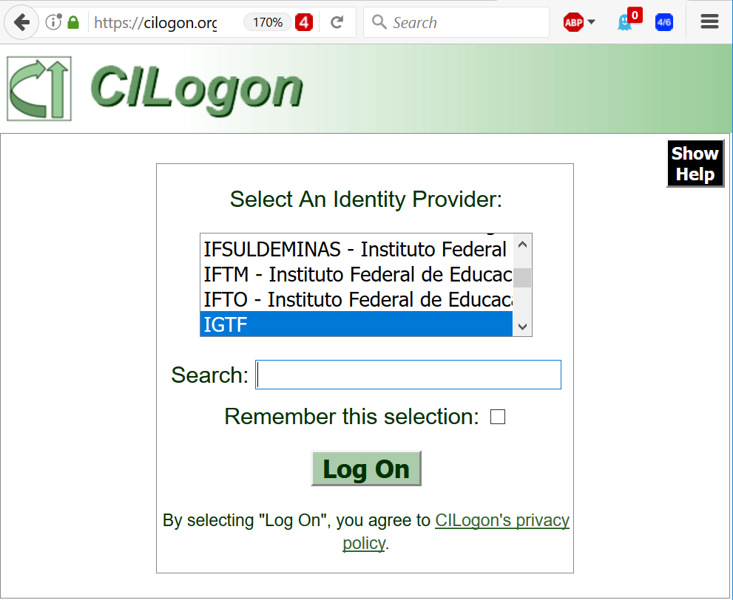
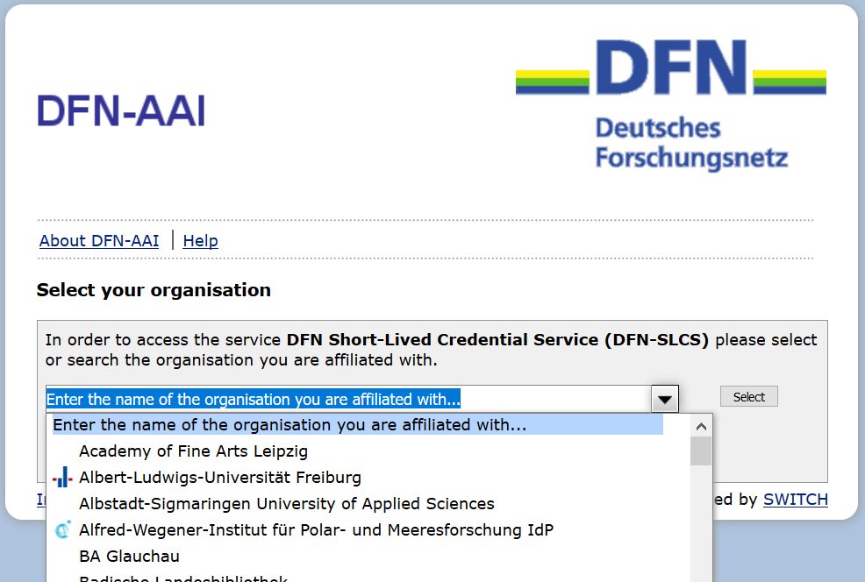
TCS – CILogon – DFN SLCS – RCauth.eu

Slide 9
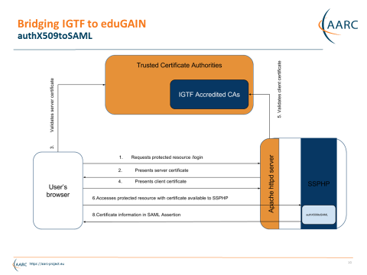
IGTF to eduGAIN bridge
Work by Ioannis Kakavas and Nicolas Liampotis (GRNET) for the AARC project

Slide 10
Guidance we have and use
Assurance Profile
https://www.igtf.net/ap/
Assessment support
http://wiki.eugridpma.org/Main/AssuranceAssessment
‘Back-office’ template practices
https://www.eugridpma.org/documentation/rps/

Slide 11
Registration Networks
Although the process is labour-intensive and relatively slow, for some user categories the prevalent ‘user-held’ credential is the only one that ‘works’:
non-academic users (SMEs, industrial R&S)
users in a place without an eduGAIN federation
users in a place that does not do unique ID
users in an organization that does not release attributes
users in an organization that does not provide assurance
…

Slide 12
A ‘high-quality IdP of last resort’?
Most useful asset is our RA network!

Slide 13
Ideas …
Promote the use of (existing) bridges
Support other credential types and/or interfaces?
In places without an existing federation
  Promote its establishment, as now eduGAIN is more open than before …
  join eduGAIN yourself – as a ‘trivial hub&spoke’ using the bridge IdP technology?
Where a federation exists
  Establish direct links – there’s an opportunity in
  ‘long-tail’ support and IdP-of-last-resort services ☺?
  Push for a federation policy aligned with global (researcher) needs?
Expose differentiated assurance model to subscribers?
User-held credentials avoid much of the privacy issues?

Slide 14
Building a global trust fabric
Discussion!

