Slide 1
Federated Identity Interest Group

Slide 2
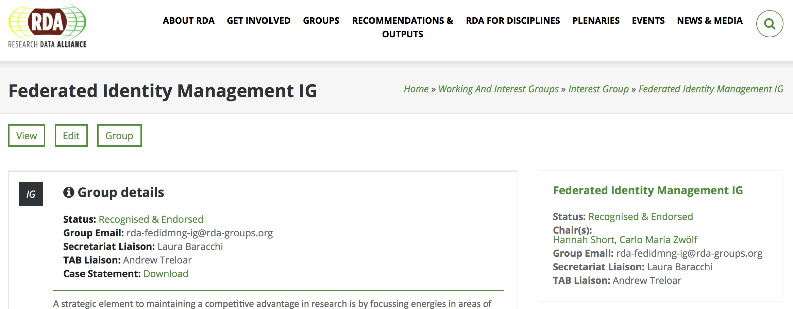
Welcome!
Long-standing Interest Group
76 members
Chairs are Carlo and Hannah

Slide 3
Agenda
Research Community Perspectives, a summary of the FIM4R Workshop
Peter Gietz, DARIAH & Hannah Short, CERN
20 minutes
The AARC Project & Policy Progress
David Groep, Nikhef
30 minutes
RDA participation in the FIM4Rv2 whitepaper
Carlo Zwölf, Paris Observatory
20 minutes
Discussion and Next Steps
20 minutes

Slide 4
Who is in the room?
Please briefly introduce yourself
Name
Institute/Organisation

Slide 5
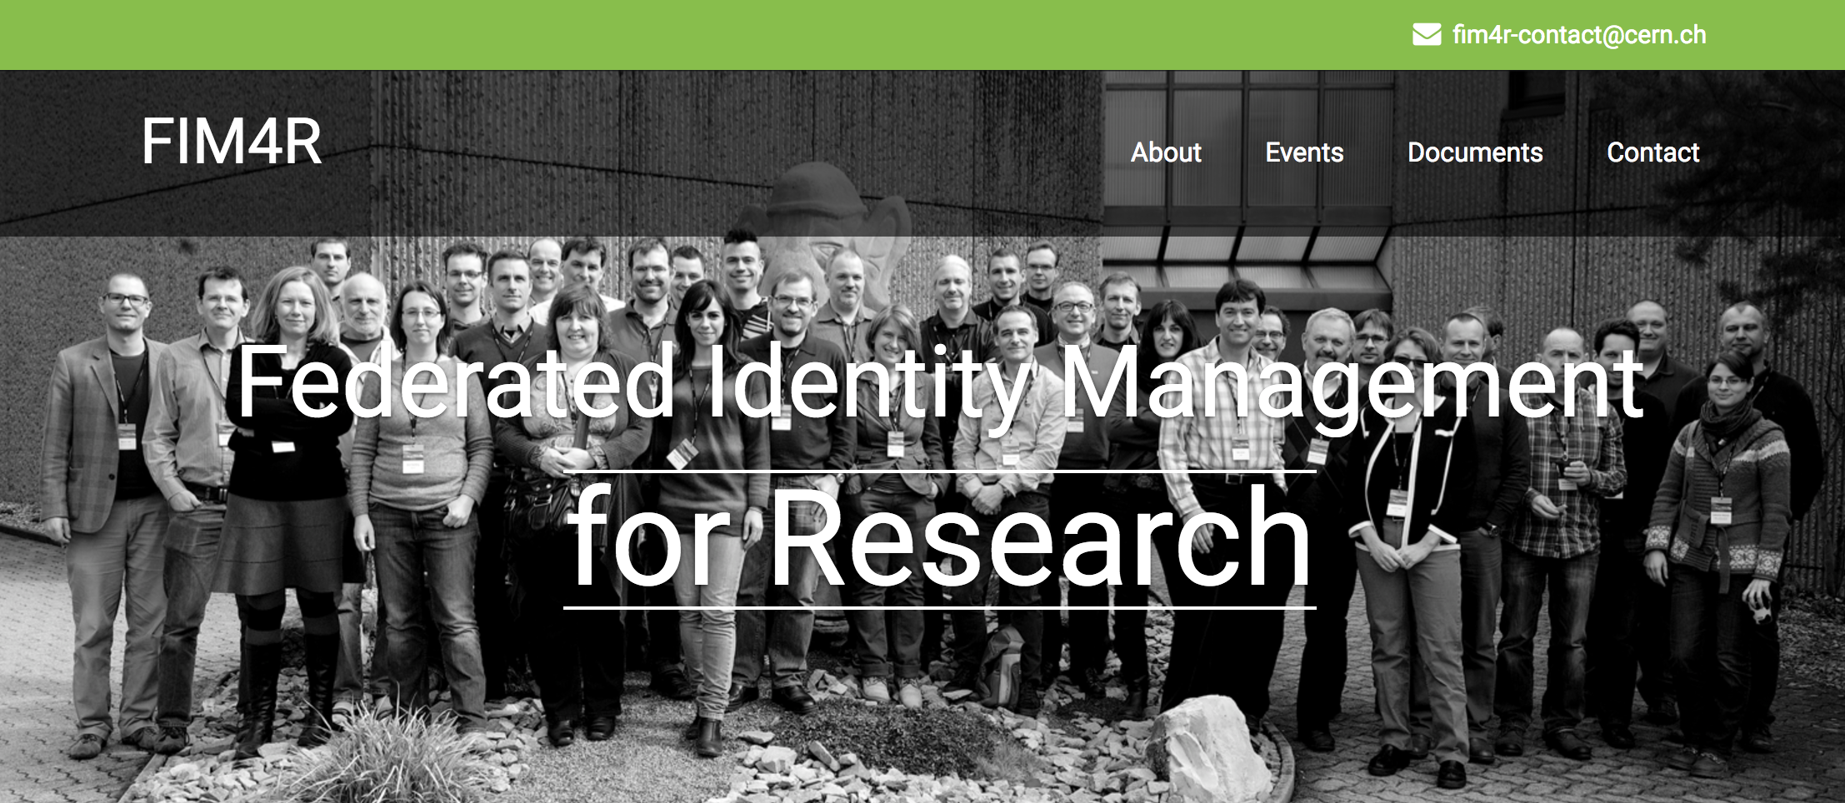
https://fim4r.org

Slide 6
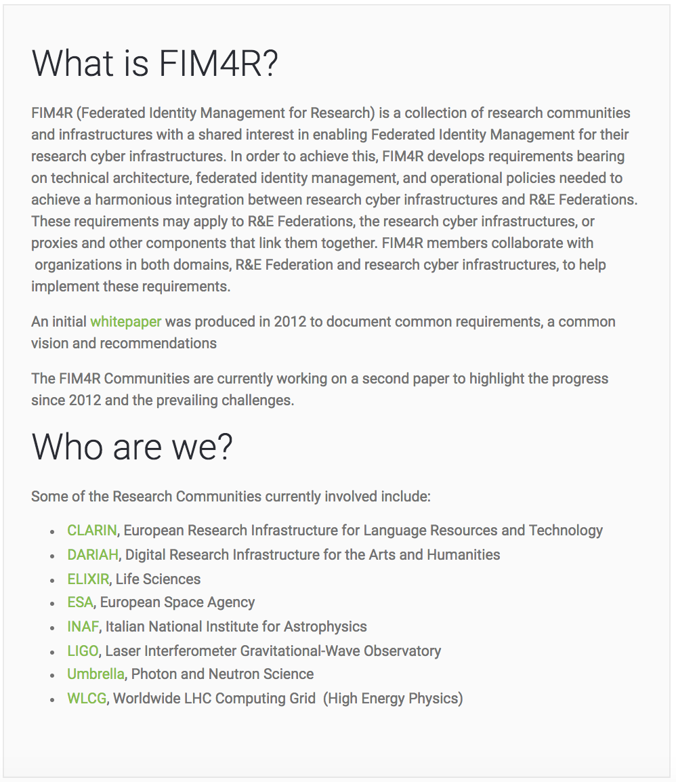
What is FIM4R?
Group of Research Communities leveraging FIM
Wrote an influential paper in 2012, now writing an update
Participation welcome!

Slide 7
FIM4R 11th Workshop Summary
28 people
Kindly hosted by McGill University Physics Department!
https://indico.cern.ch/event/647693/
Aim was to progress FIM4Rv2
Day 1 Summary – Hannah
Day 2 Summary – Peter

Slide 8
Day 1
Community Updates
Paris Observatory
LIGO (Gravitational Waves)
DARIAH (Humanities)
Umbrella (Photon & Neutron)
ELIXIR (Life Sciences)
WLCG (Particle Physics)
NIH (Infectious Diseases)

Slide 9
Day 1
Requirements Gathering
Easier Service Provider onboarding
Better testing
Better IdP discovery
Support non-legal entities
…
How to influence technology providers
Europe
North America

Slide 10
Day 2
Update on related activities
AARC (EU project on AAI for research collaboration)
Canadian projects (CANARIE)
US Projects (CI-Logon, LIGO)
UK Project Moonshot
HNSciCloud Project
EGI Check-in

Slide 11
Day 2
FIM4R All Communities Survey
Status
Which communities to target
Not yet involved ESFRIs
Communities connected to TAC
New domains,such as Chemistry, Botany, Radio Astronomy, ..
Research communities involved in RDA
How should the survey be done: just send it out, do interviews, have a short summary first?

Slide 12
Day 2
FIM4R Paper V2
A table on attributes of the single communities
Success story on what we have achieved
Requirements collection (Post-its)
A text on new recommendations to
Research infrastructures
Federation providers
Funders
First a Version 2.0, then input via surveys, final Version 2.1

Slide 13
Day 2
Deadlines
Good draft by beginning of December 2017
Final Version of Version 2.0 in March 2018
Next Meetings
February at TIIME in Vienna Feb.5.-6.?
Other possibilities
Chicago offer by Tom is still open
I2 TechEX17 San Francisco, Oct..15–18, 2017.
NSF Washington, August 2018
PERK in July in Pittsburgh?

