Slide 1
Welcome to 11th FIM4R
11th Meeting, Montréal 18-19 September 2017
Chairs: David Kelsey (STFC), Hannah Short (CERN)
https://fim4r.org

Slide 2
Welcome
To long-standing members of FIM4R
To people who have attended FIM4R before
To Newcomers!

Slide 3
FIM4R - brief history
“Federated Identity Management for Research”
Issue of IdM raised by IT leaders from the 8 EIROforum labs (Jan 2011)
CERN, EUROfusion, EMBL, ESA, ESO, ESRF, European XFEL and ILL
A collaborative effort started in June 2011 (1st workshop at CERN)
Not just EIROForum. Include many ESFRI projects and providers and infrastructures (All communities are welcome!)
Involved at start - photon & neutron facilities, social science & humanities, high energy physics, climate science, life sciences and fusion energy (more have joined since)
Workshops included participation by HTC and HPC infrastructures, TERENA(now GEANT), IGTF, Geant/eduGAIN, technology developers

Slide 4
Previous workshops
This is 1st FIM4R meeting in North America
February 2017, TIIME (https://indico.cern.ch/event/605369/)
November 2015, EWTI (https://indico.cern.ch/event/450600/)
February 2015, CERN (https://indico.cern.ch/event/358127)
April 2014, ESRIN in Frascati (https://indico.cern.ch/event/301888/)
October 2013, CSC in Helsinki (https://refeds.org/meetings/oct13/index.html)
March 2013, PSI Villigen (http://indico.psi.ch/event/2230)
June 2012, MPI Psycholinguistics Nijmegen (http://www.clarin.eu/events/3501)
February 2012, ISGC (https://indico.cern.ch/event/177418)
November 2011, RAL (https://indico.cern.ch/event/157486)
June 2011, CERN (https://indico.cern.ch/event/129364)

Slide 5
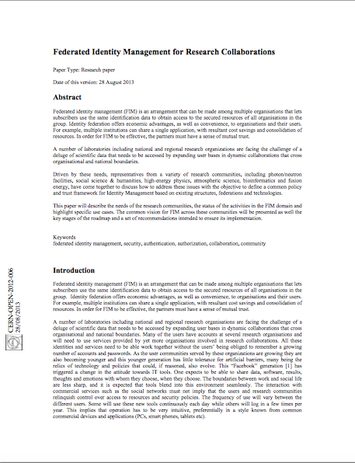
The FIM4R paper
2012: We prepared a paper that documents common requirements, a common vision and recommendations
To research communities, identity federations, funding bodies
Paper: CERN-OPEN-2012-006: https://cdsweb.cern.ch/record/1442597
The Version 1 paper was very influential
5 years on – time for Version 2

Slide 6
Agenda of 11th FIM4R
Reports from new Research Communities
Updates from existing FIM4R member communities
Talks from local identity federations and e-Infrastructures (Canada, USA)
Updates from ongoing projects (AARC, REFEDS, GEANT, eduGAIN)
Updates from e-Infrastructures
The FIM4R version 2 community survey
Progress and plans for FIM4R version 2 paper

Slide 7
Aims, outputs & principles
As usual, information exchange!
BUT, also …
The FIM4R version 2 community survey
Progress towards FIM4R version 2 paper
Date and location of 12th FIM4R?
Guiding principles:
FIM4R is all about Research Community REQUIREMENTS
Other participants and talks are always welcome
But this is not the place to make technology and deployment decisions

Slide 8
Some more details
Why are we here?
Many thanks to Dept. of Physics, McGill University
Thanks also to Tom Barton who offered to host in Chicago
Other sponsors?
Coffee breaks, lunches, dinner (Monday)
http://www.mcgill.ca/foodservices/files/foodservices/shhs_map.pdf
https://montreal.eater.com/maps/best-restaurants-cafes-mcgill-university-ghetto-milton-parc
WiFi (eduROAM)
Tuesday – clashing with start of RDA program (lunch?)
RDA session – Wednesday 20th Sep at 13:30 (Mansfield 3)
IG Federated Identity Management

Slide 9
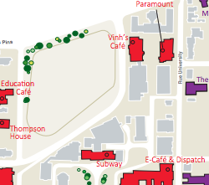
On Campus Dining http://www.mcgill.ca/foodservices/locations/retail
http://www.mcgill.ca/foodservices/files/foodservices/shhs_map.pdf
Dept of Physics

Slide 10
Dinner – Monday
Il Focolaio Pizza Restaurant
http://ilfocolaio.ca
No host – at your own expense
Sign-up sheet?
19:00

Slide 11
Agenda - Monday
Updates from FIM4R members
Requirements Analysis
Gather requirements and prioritise
Research Community Drivers
provide more, and faster, feedback to various working groups, committees and the like that are seeking to evolve federation infrastructure, policy and processes

Slide 12
Agenda - Tuesday
Updates from Projects
Updates from Infrastructures
The FIM4R version 2 community survey
Progress towards FIM4R version 2 paper

Slide 13
Any questions?

