Slide 1
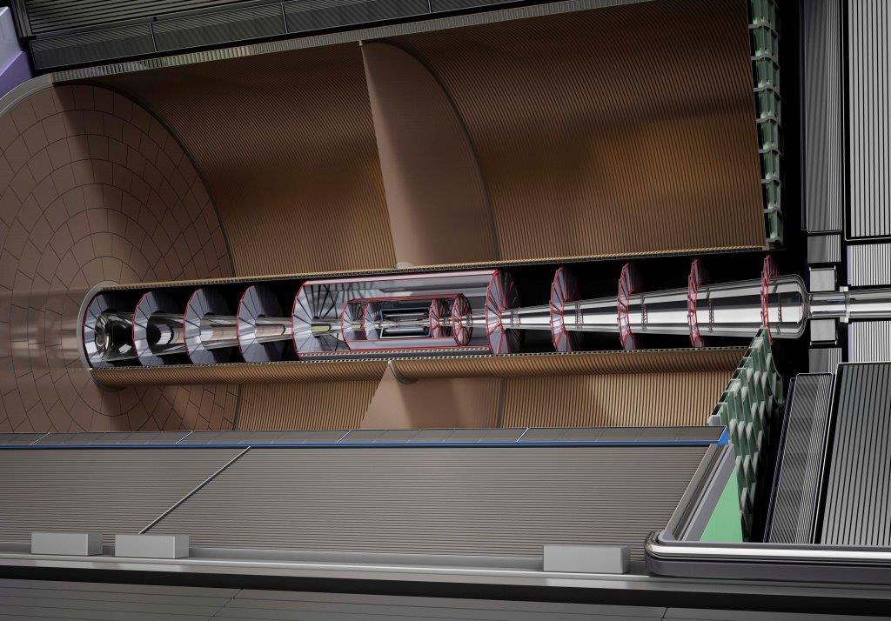
Pixel TPC tiling for ILD
Peter Kluit - Nikhef 11 september 2017

Slide 2
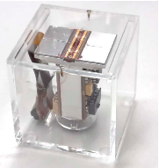
Tiling of the TPC read-out
Basic building block is the quad
- width 28.4 mm height = 39.6 mm
Sensitive area width and height 2 x 256 x 0.055 mm
New TPC dimensions Rin = 354 mm Rout = 1768.8-55 mm
Nr. Of Modules in 8 (radial) rows 14, 18, 23, 28, 32, 37, 42, 46

Slide 3
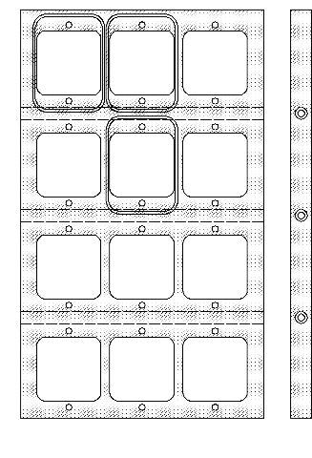
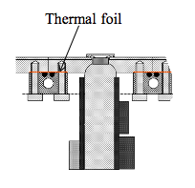
Tiling of the TPC read-out
Solving the maximum number of quads per quad row number
in the module. Putting the quads on a straight line:
Row 8 8 7 7 7 (8 large radius)
Row 5,6,7 7 7 7 7
Row 4 ,3 7 7 7 6
Row 2 7 7 6 6
Row 1 7 6 6 5
R
(row, height)
phi (width)
Most simple solution is just start tiling in the center and leave uncovered space at the module edges.
Another solution is to leave no space at the edges and allow space between quad nr 6-5 nr 5-4 nr 4-3 nr 3-2 (quadrow bottom to top). This avoids an insensitive zone at the edge of a module.

Slide 4
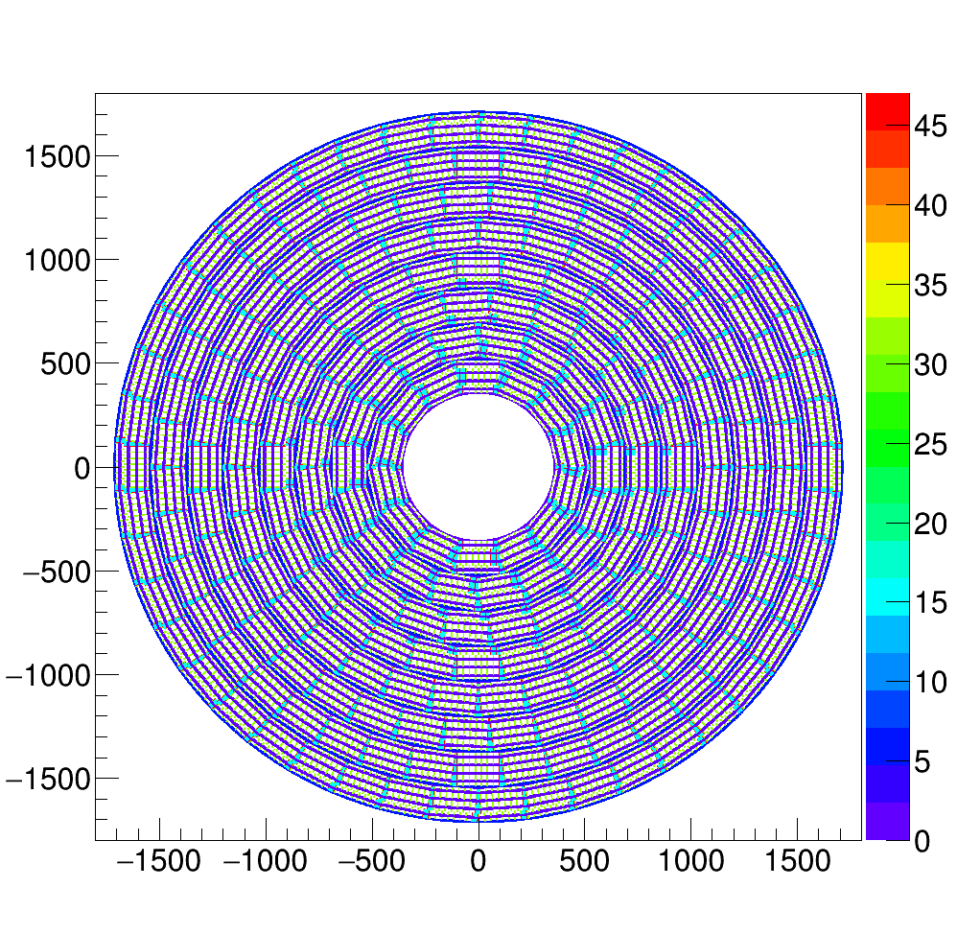
Tiling of the TPC read-out
Simple solution
Insensitive areas
In light blue
Module edge

Slide 5
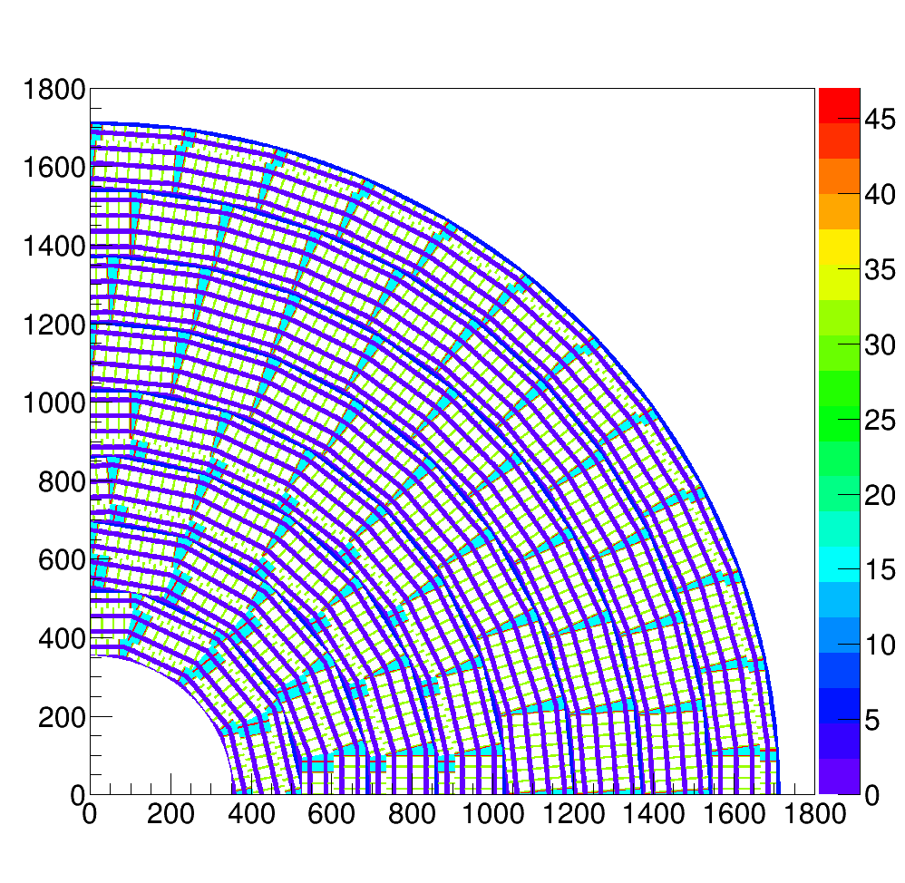
Tiling of the TPC read-out
Simple solution
Insensitive areas
In light blue
Module edge
Green between two quads
Purple inside quad (guard)

Slide 6
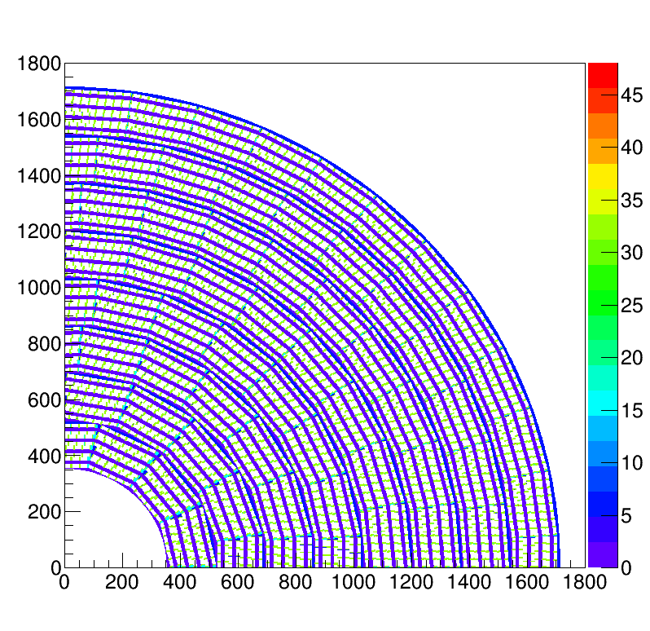
Tiling of the TPC read-out
Complex solution
Insensitive areas
In light blue
Module edge
Green between two quads
Purple inside quad (guard)

