Slide 1
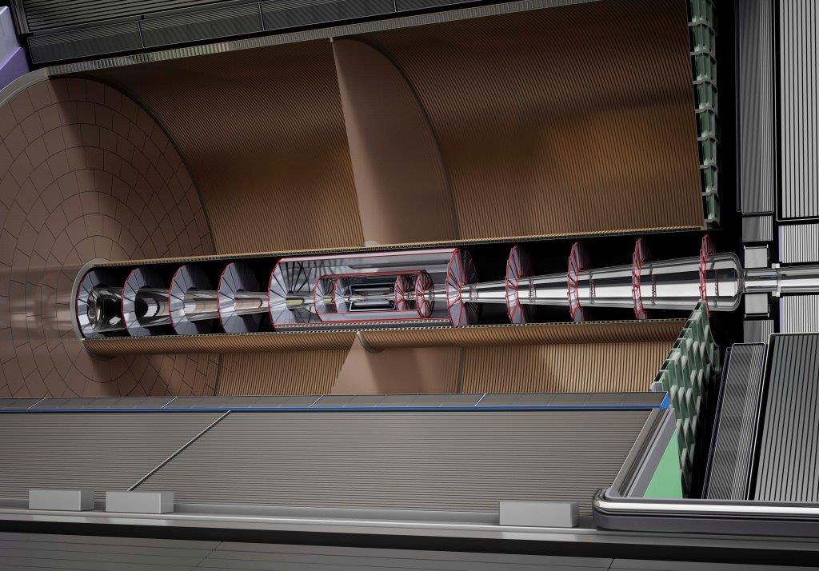
Pixel TPC tiling for ILD
Peter Kluit - Nikhef 11 september 2017

Slide 2
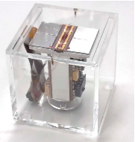
Tiling of the TPC read-out
Basic building block is the quad
- width 28.4 mm height = 39.6 mm
Sensitive area width and height 2 x 256 x 0.055 mm
New TPC dimensions Rin = 354 mm Rout = 1768.8-55 mm
Nr. Of Modules in 8 (radial) rows 14, 18, 23, 28, 32, 37, 42, 46

Slide 3
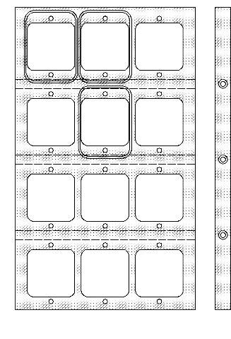
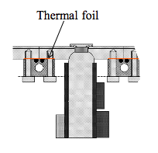
Tiling of the TPC read-out
Solving the maximum number of quads per quad row number
in the module. Putting the quads on a straight line:
Row 8 8 7 7 7 (8 large radius)
Row 5,6,7 7 7 7 7
Row 4 ,3 7 7 7 6
Row 2 7 7 6 6
Row 1 7 6 6 5
R
(row, height)
phi (width)
Most simple solution is just start tiling in the center and leave uncovered space at the module edges.
Another solution – suggested by Jan - is to leave no space at the edges and allow space between quad nr 6-5 nr 5-4 nr 4-3 nr 3-2 (quadrow bottom to top). This avoids an insensitive zone at the edge of a module.

Slide 4
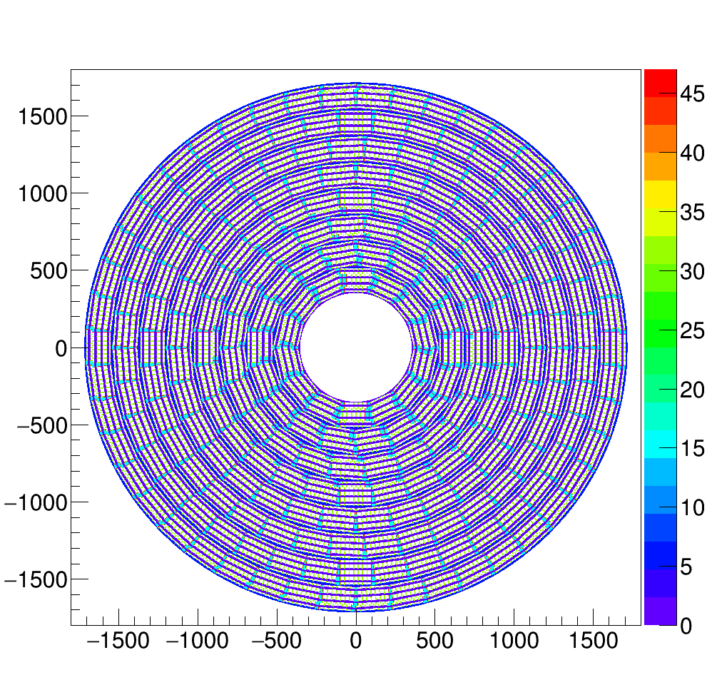
Tiling of the TPC read-out
Simple solution
Insensitive areas
In light blue
Module edge

Slide 5
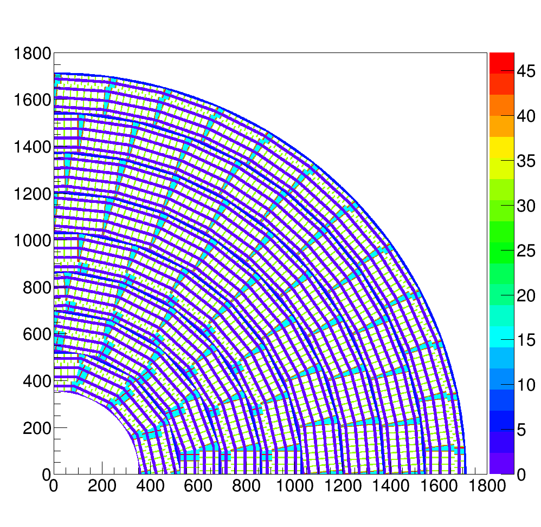
Tiling of the TPC read-out
Simple solution
Insensitive areas
In light blue
Module edge
Green between two quads
Purple inside quad (guard)

Slide 6
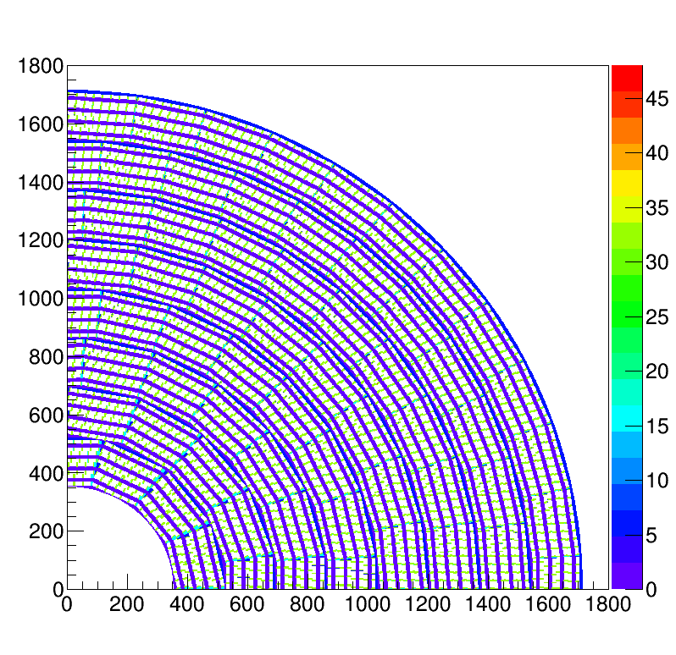
Tiling of the TPC read-out
Complex solution
Insensitive areas
In light blue
Module edge
Green between two quads
Purple inside quad (guard)

