Slide 1
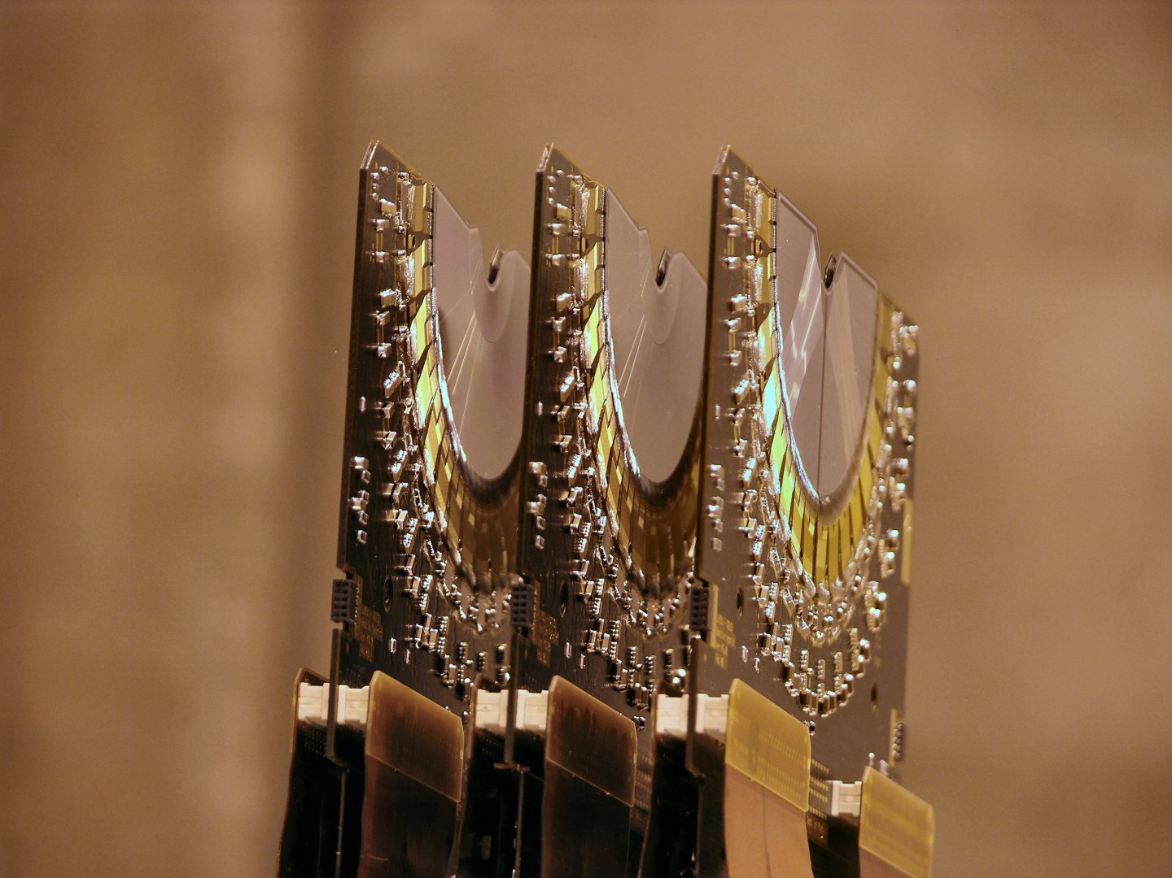
The next best vertex detector at the LHC
Kazuyoshi CARVALHO AKIBA

Slide 2
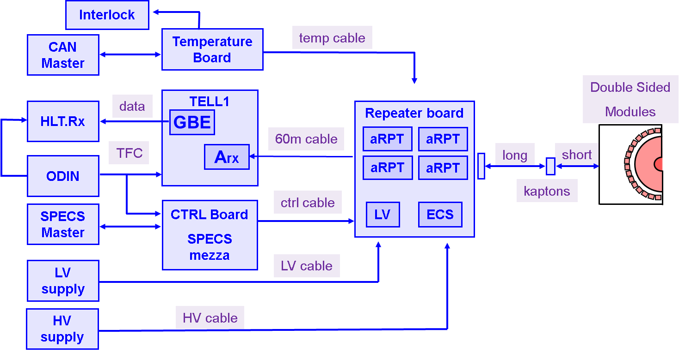


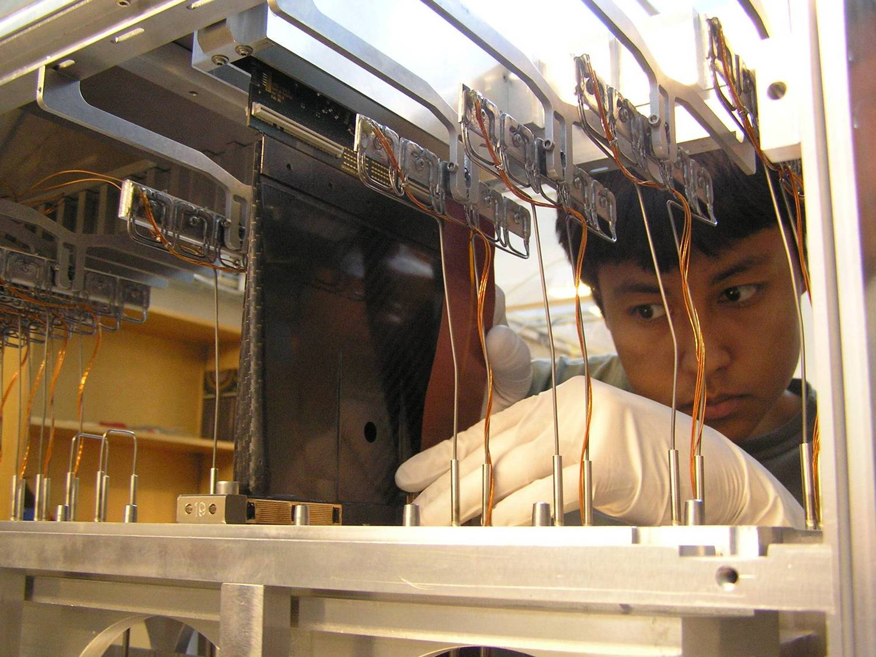
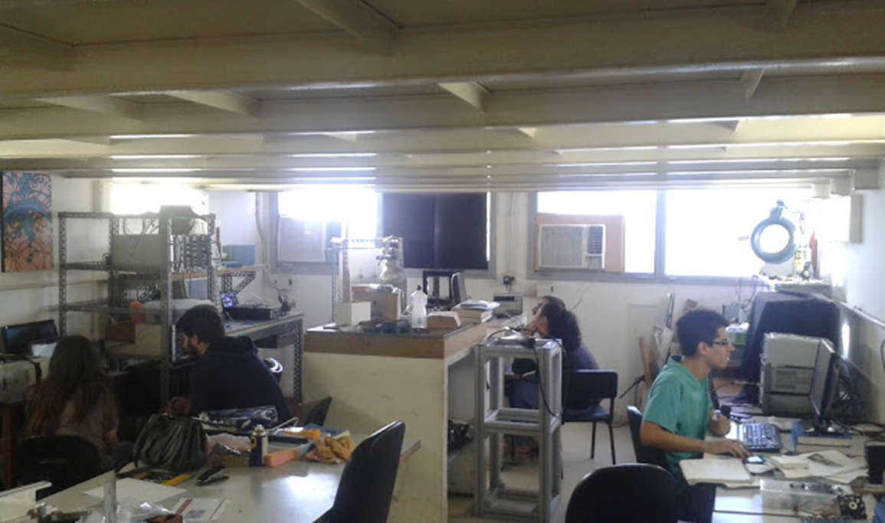
Self Introduction
2005
2007
2008
2011
2014
2016
2006
Velo Controls+DAQ
Velo Commissioning & optimization of raw data
Currently at UFRJ: Adj. Professor (2011-)
  Coordinator of the local HEP lab
  Teaching: Nucl. Phys. Lab & Instr. lab
  Deputy Project leader of the VELO (2014-)
  CERN SASS (2014-2015)
  Test beam coordinator (2015-)
  Main research – VELO upgrade
Side projects/interests:
  Co-proponent of applied physics programme in UFRJ
  Medical physics (eye tumour irradiation)
  X-rays at the Brazilian Synchrotron
  Herschel (FSC for diffractive pp interactions)
Grants:
  Local lab infrastructure: Si R&D measurements
  Construction of a Pixel Telescope
  +Personal grants
2014

Slide 3
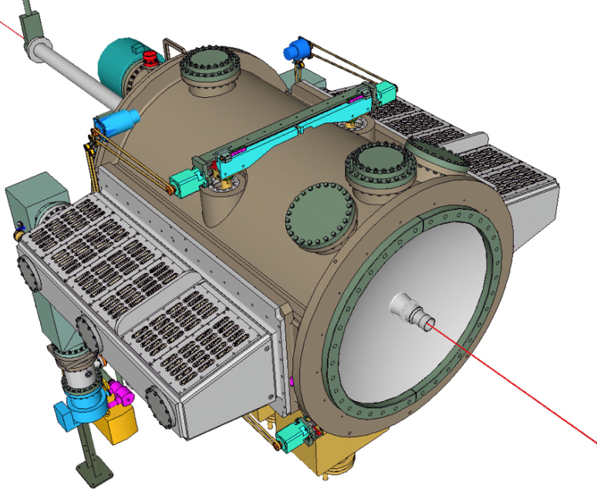
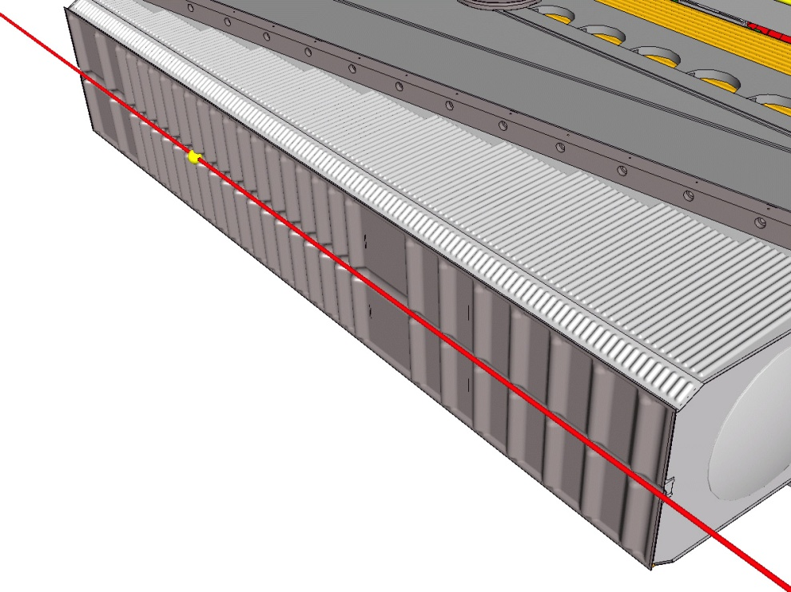
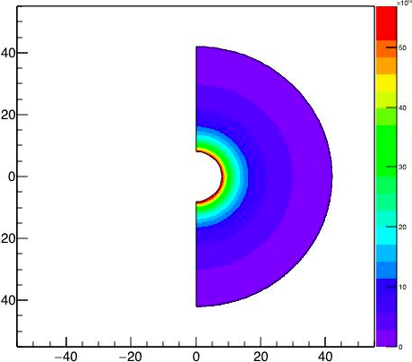
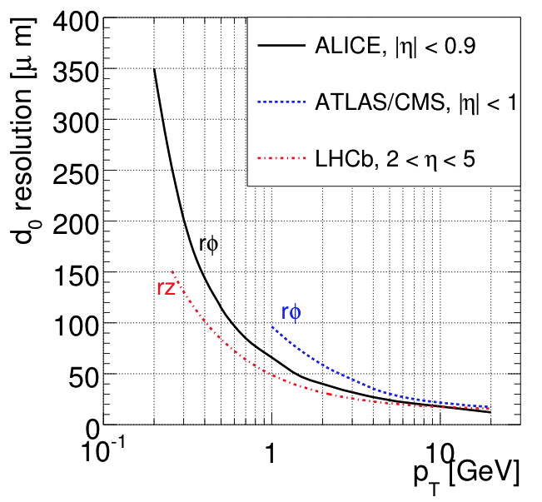
Quick Recap
42 Double sided
@1 MHz
Contains
1 Velo half
4 single sided
@ 40 MHz
Non
uniform
irradiation
profile
RF-Foil
LHC RUN I | Delivered Luminosity | Highest Fluence*
CMS pixel | ~29.5 fb⁻¹ | 9x10¹³ 1MeV n_{eq}/cm² At 39 mm
VELO | ~3.4 fb⁻¹ | 17x10¹³ MeV n_{eq}/cm² At 8 mm

Slide 4
How to improve the Vertex Locator?
Go closer to the collisions
Minimise the material
Improve hit resolution
Read more collisions at once

Slide 5
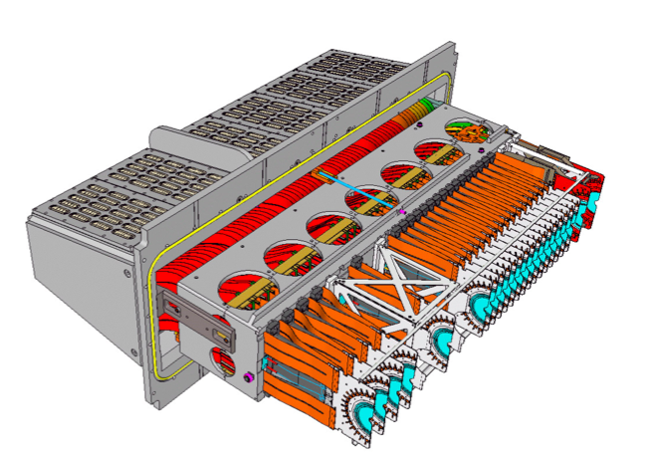
VELO Upgrade
Current detector: strip technology
Upgrade detector: hybrid pixel technology
42 shaped double sided modules (R/φ)
➔84 sensors.
52 L shaped modules
➔208 sensors.
Challenge: Read out every hit at 40 (30) MHz crossing rate
All events to computing farm: Fast pattern recognition in the trigger
Higher occupancy➔ bigger granularity.

Slide 6
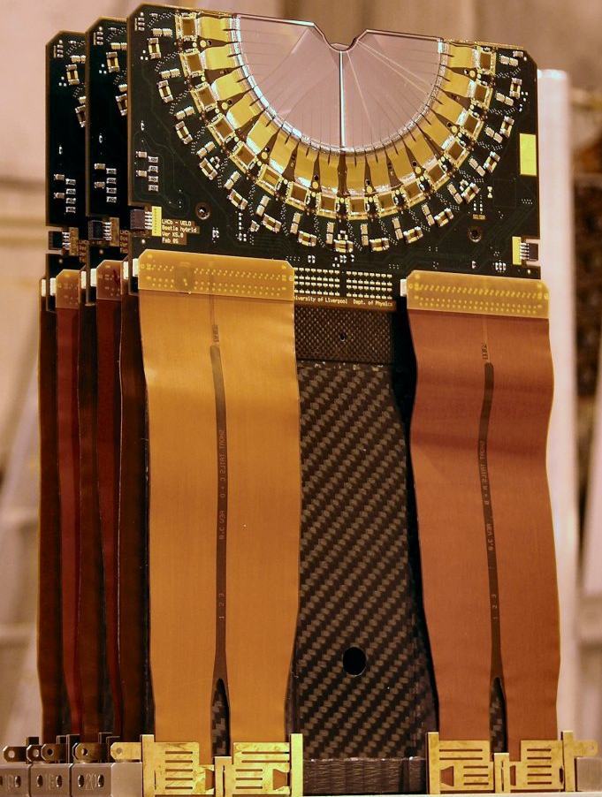
From strips to hybrid pixels

Slide 7
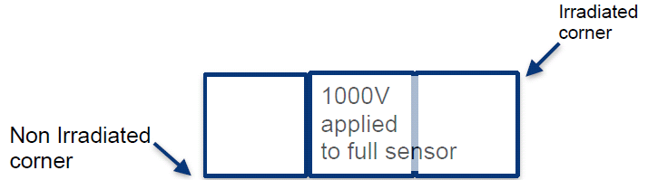
Sensors
~43mm
ASIC
ASIC
ASIC
The Velo sensors must collect:
6000e⁻/MIP – 99% eff.
at 370 MRad➔8 x 10¹⁵ 1 MeV n_{eq}/cm².
this is equivalent to 50fb⁻¹ @LHCb_up
  The ATLAS IBL – at 550 fb⁻¹ – expects
  3.3 x 10¹⁵1 MeV n_{eq}/cm² or 160 MRad.
Radiation hardness was never proved for
such small pixels: 55x55 μm .
  ATLAS ➔ 50x250 μm (FE-I4)
Irradiation tests are mandatory
Particular for the VELO: non uniform irrad.
Collection time – Could change after irradiation
sensor
Sensor tile
Longer pixels
Put together by bump bonding
100%
1%

Slide 8
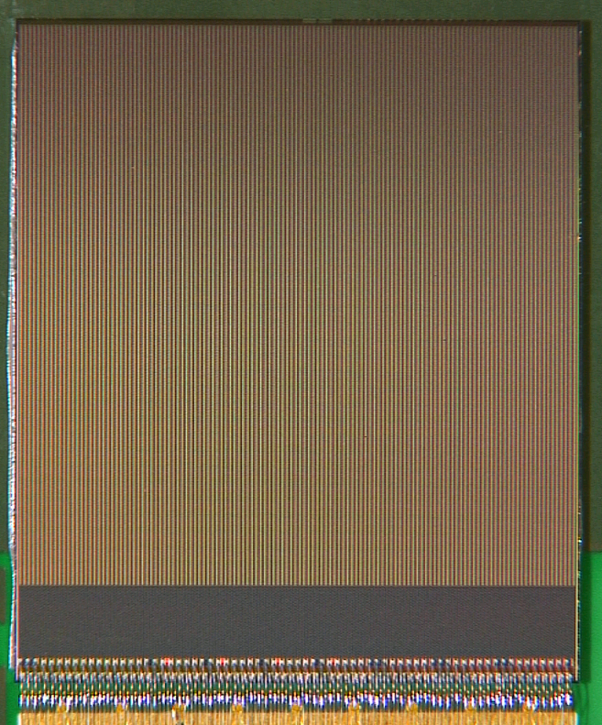
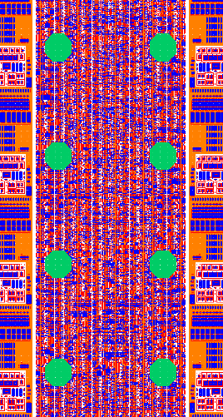
VeloPix
Binary readout
25 ns Time stamping
Extreme data rate
  800 Mhits/s
  20 Gbit/s output
  bandwidth
SEU robust
TSMC – 130 nm
The final chips
will be thinned
Analog front-end
16 x 55 um²
Pixel & Superpixel
14.14 mm

Slide 9
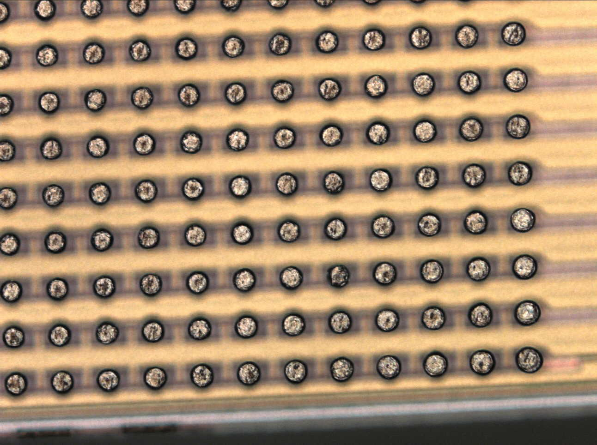
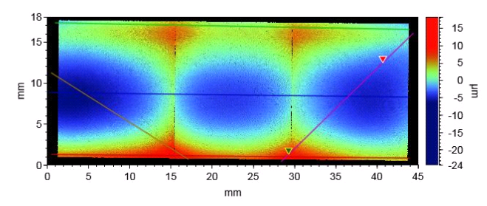
Thinning and bumping
To minimise material, ASICs will be thinned to 200 μm
ASICs and sensors must be metallised before receiving solder bumps
During reflow, this could lead to bowing due to metal layers in the chip.
2 companies trying to provide a reliable method

Slide 10
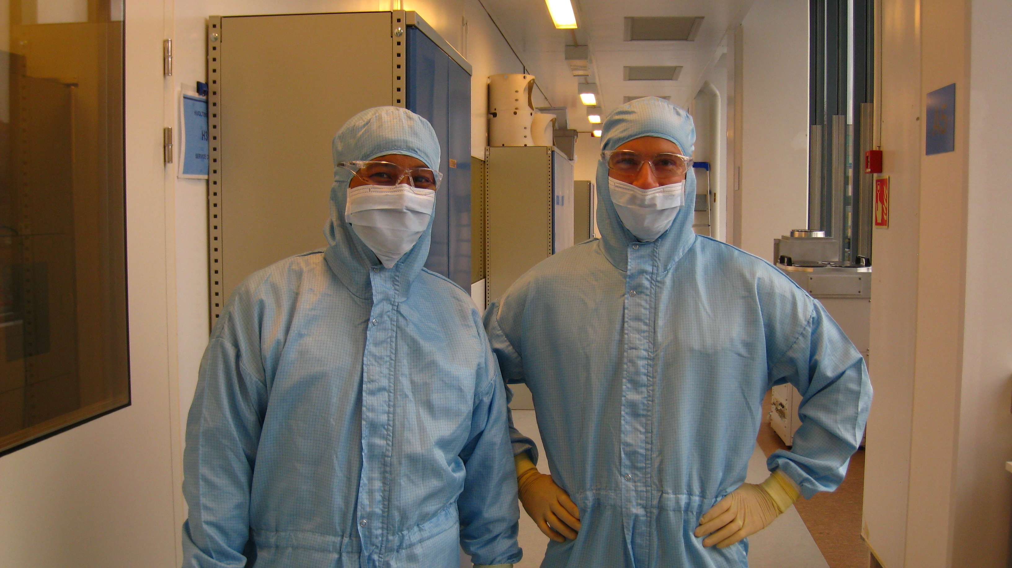
Thinning and bumping
To minimise material, ASICs will be thinned to 200 μm
ASICs and sensors must be metallised before receiving solder bumps
During reflow, this could lead to bowing due to metal layers in the chip.
2 companies trying to provide a reliable method

Slide 11
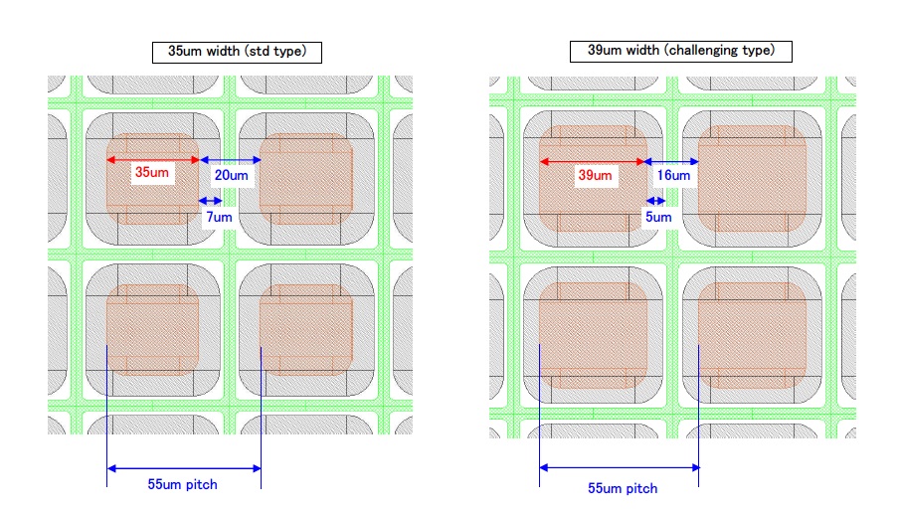
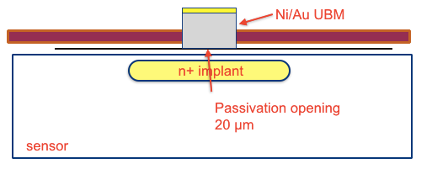
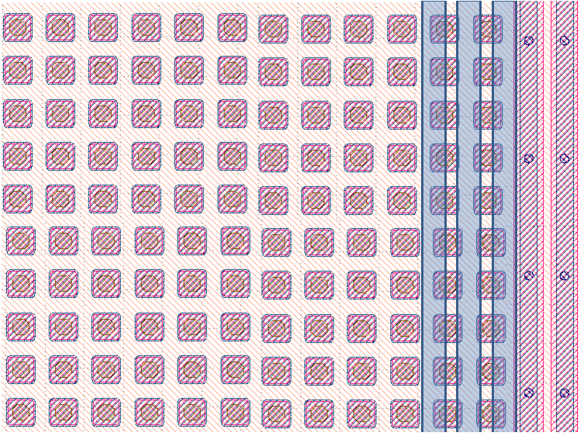
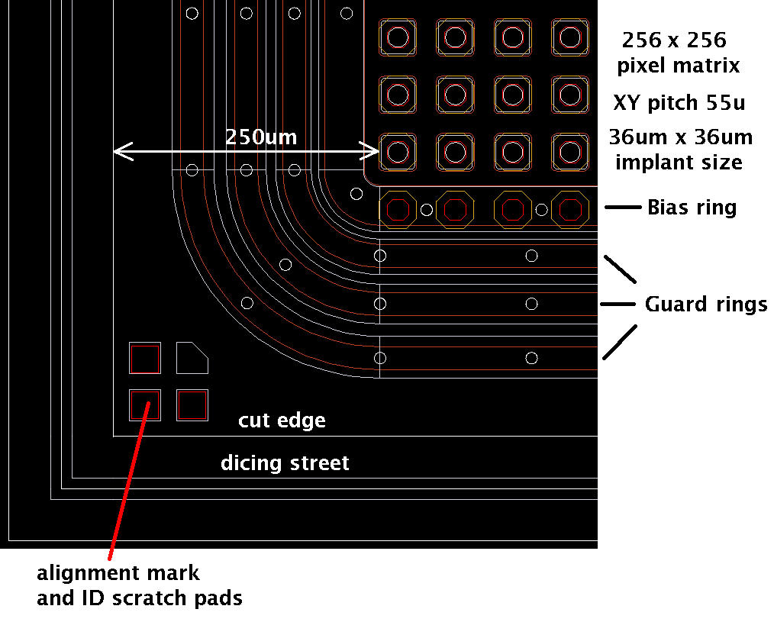
Sensor Prototypes
Round 1 HPK (CERN-Rio-USC):
  N-on-p 200 μm thick
  450 and 600 μm PTE
  35 and 39 μm implant
  UBM
Micron (L’pool):
  N-on-n and n-on-p
  36 μm implant
  150, 250 and 450 μm PTE
HPK
Micron

Slide 12
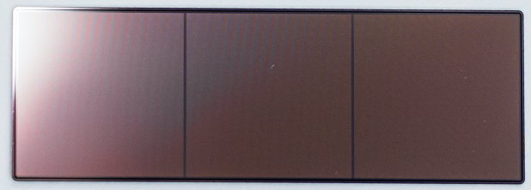
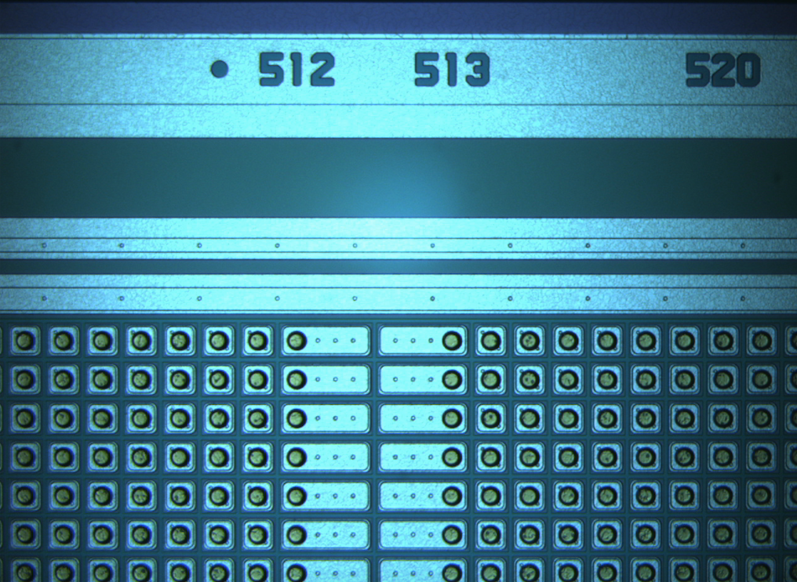
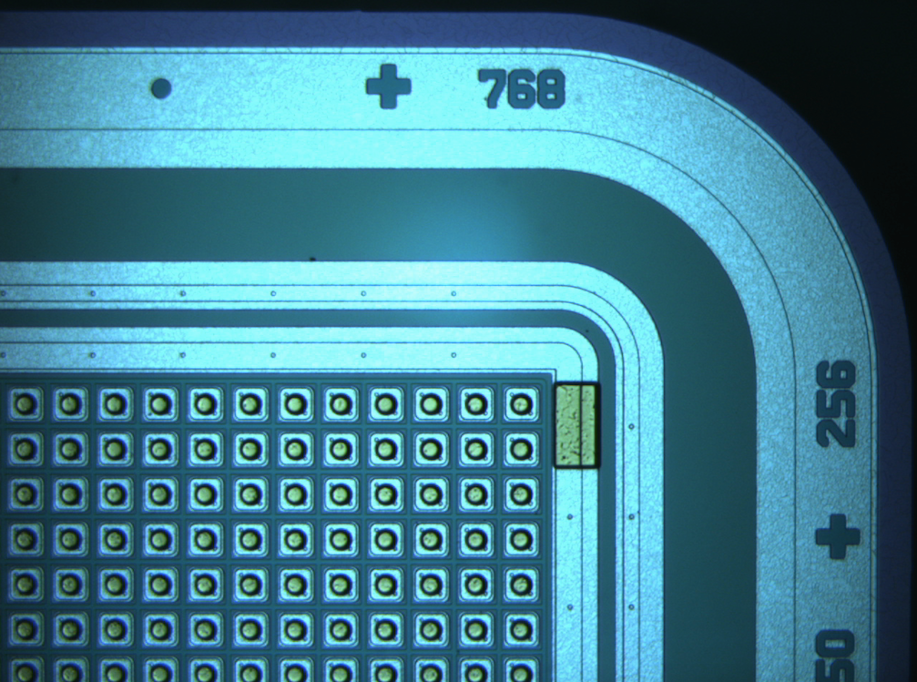
Sensor Prototypes
Round 1 HPK (CERN-Rio-USC):
  N-on-p 200 μm thick
  450 and 600 μm PTE
  35 and 39 μm implant
  UBM
Round 2 HPK (Rio):
  39 μm implant, 450
  Rounded corners
Micron (L’pool):
  N-on-n and n-on-p
  36 μm implant
  150, 250 and 450 μm PTE
HPK
Micron

Slide 13
How to decide?
Needs to fully test before and after irradiation
HV Tolerance – systematic testing of many assemblies
Charge collection – requires calibration methods
Resolution – requires track reconstruction
Drift time – requires precise track time measurement

Slide 14
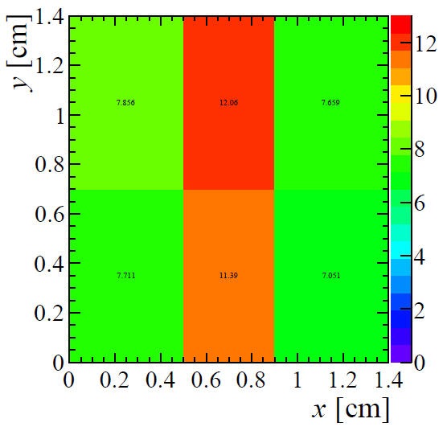
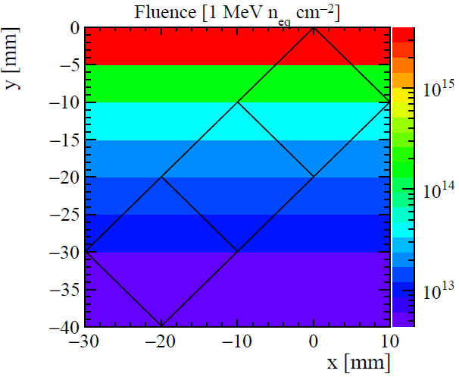
Irradiation Programme
If we have control over the collected charge we can study it as function of fluence.
Used a few different facilities:
KIT, IRRAD, JSI, IST Birmingham
Special focus on non-uniform irradiation.
IRRAD @ CERN
24 GeV p.
KIT @ Karlsruhe
24 MeV p

Slide 15
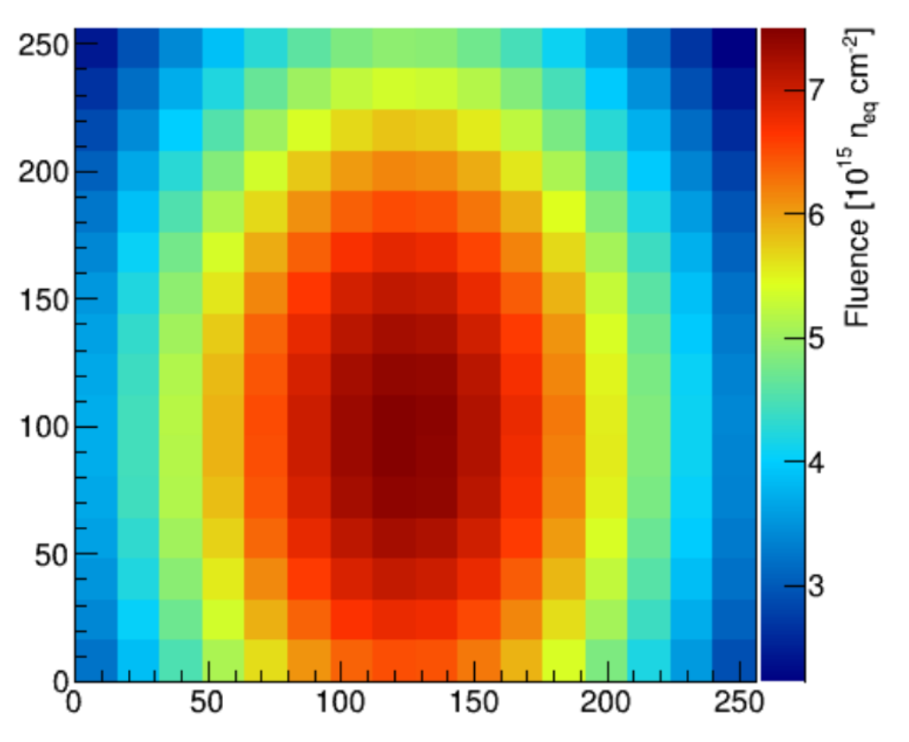
Irradiation Programme
If we have control over the collected charge we can study it as function of fluence.
Used a few different facilities:
KIT, IRRAD, JSI, IST Birmingham
Special focus on non-uniform irradiation.
IRRAD @ CERN
24 GeV p.
KIT @ Karlsruhe
24 MeV p

Slide 16
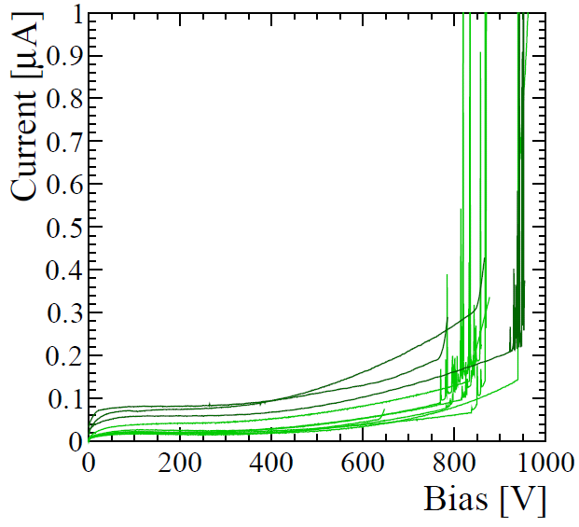
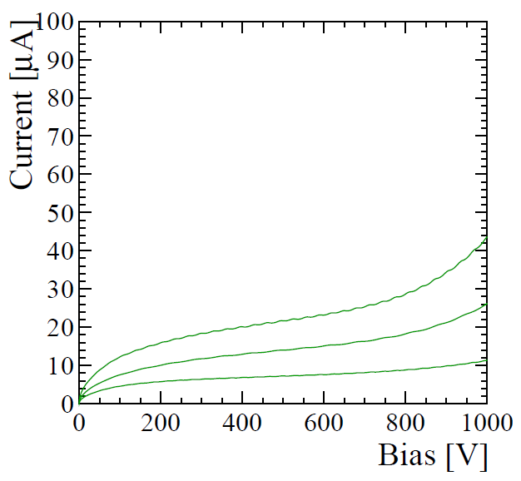
HV Tolerance
HPK KIT irrad
Non uniform
Non parylene
HPK non-irrad
Sensors tested in vacuum.

Slide 17
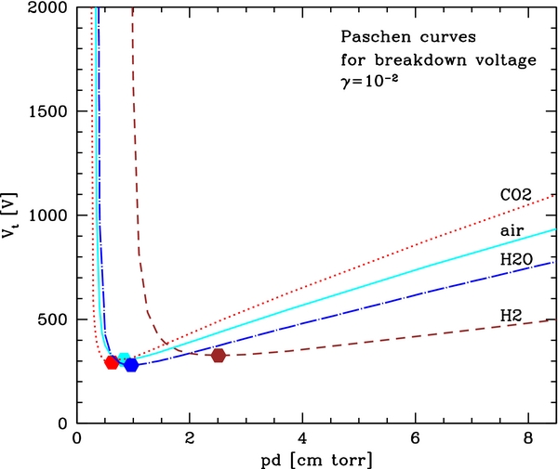
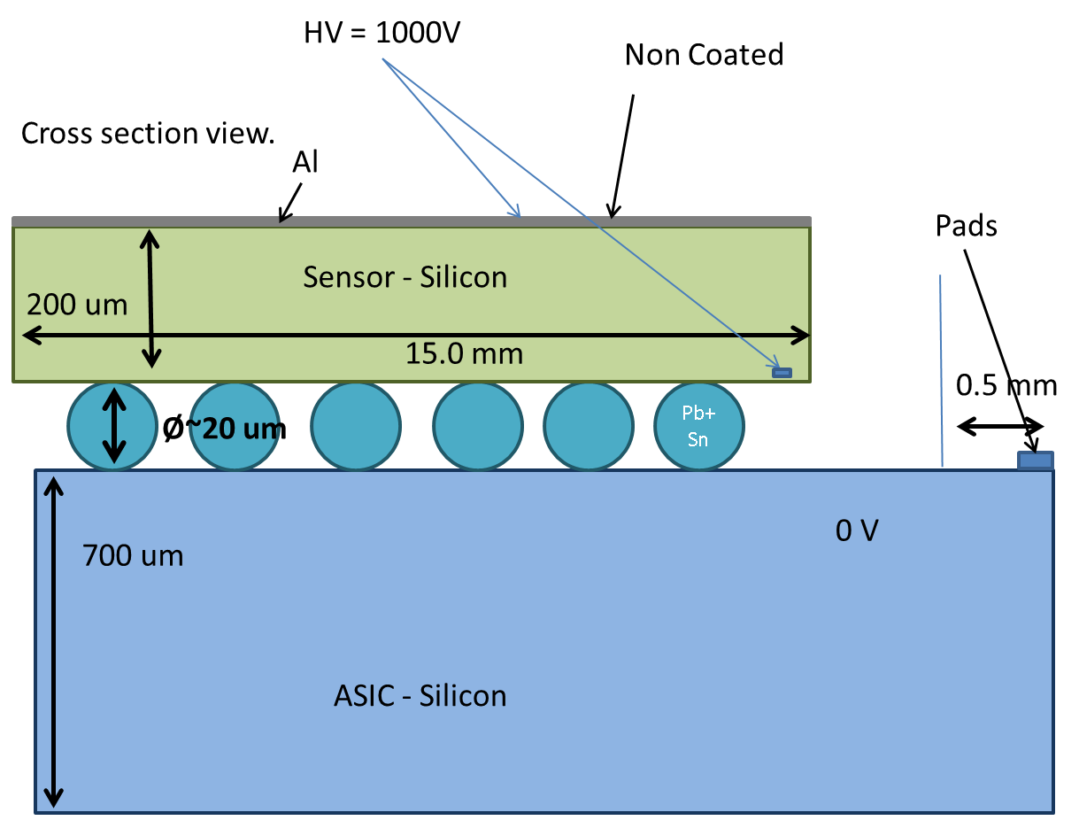
Sparking

Slide 18
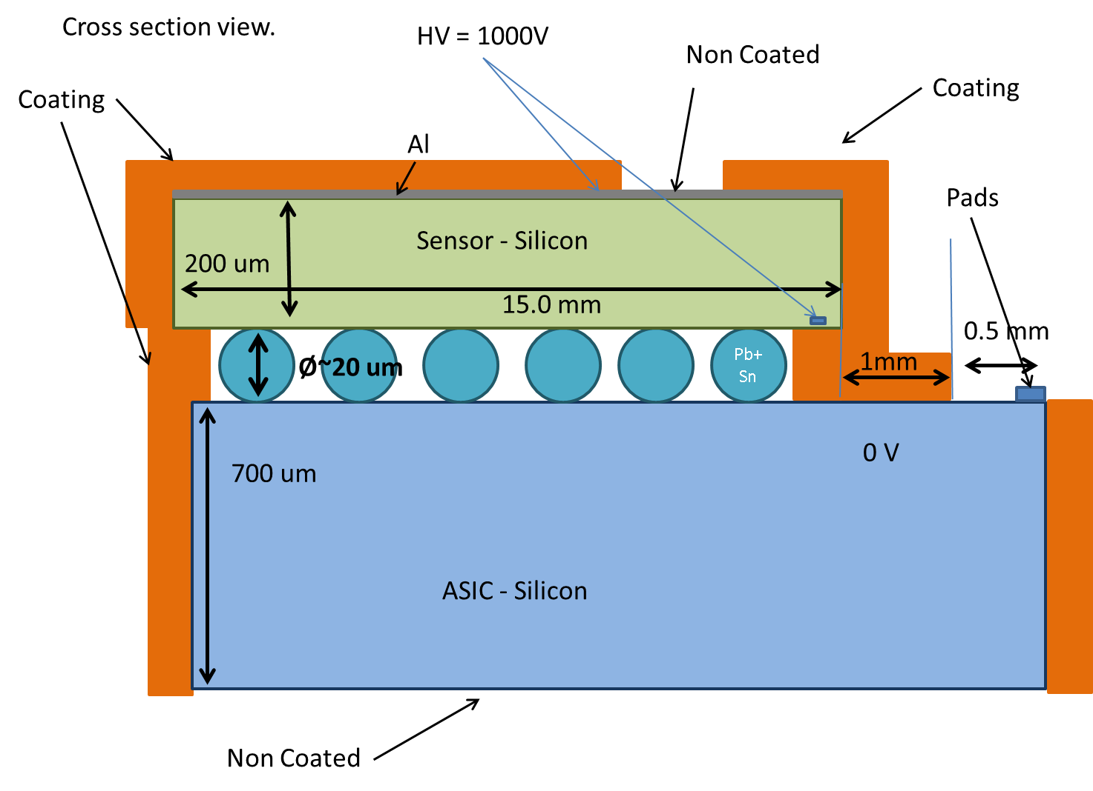
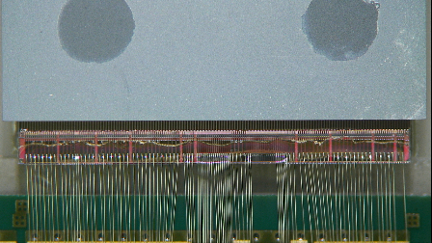
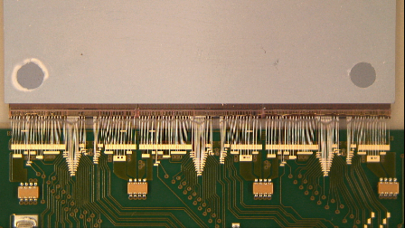
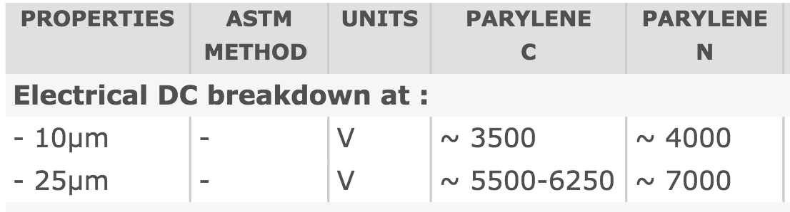
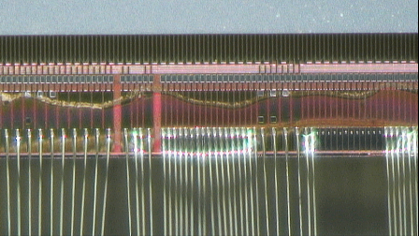
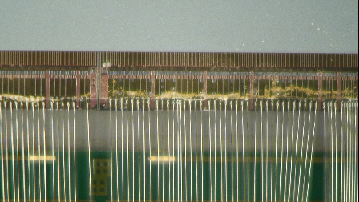
Parylene
Contacted SCS coatings (USA) and Comelec (swiss)
Parylene is deposited in all surfaces exposed.
Chips are placed in vacuum, at high temperature.
Masks are applied to the chips prior to deposition.

Slide 19
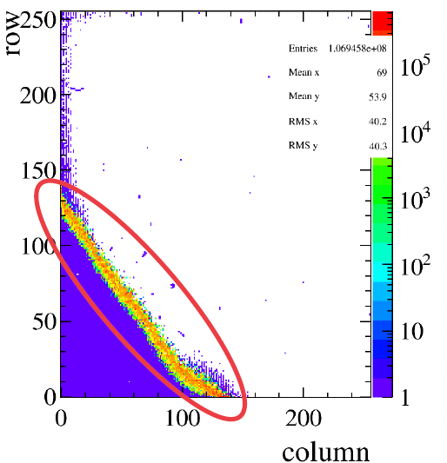
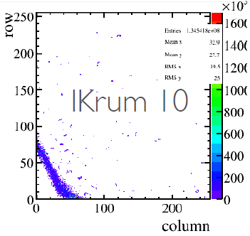
Parylene problems
Problems encountered with “low” energy high intensity proton beam (24 MeV), but only on non-uniform irradiation.
Increased noise in chip seemed to be mitigated by Ikrum.

Slide 20
Charge collection
VeloPix was not ready when the sensor R&D was performed
Used Timepix3 for the studies
Several testing methods were employed before the SPS beam was back (<2014)
  Sr90
  Am241
  Synchrotron X-rays
Extensive beam studies carried out

Slide 21
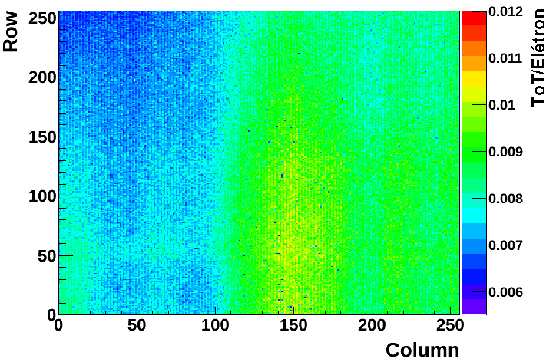
Charge calibration
Calibrated per pixel using test pulses
p1 - Slope
Test pulse
Per pixel fit

Slide 22
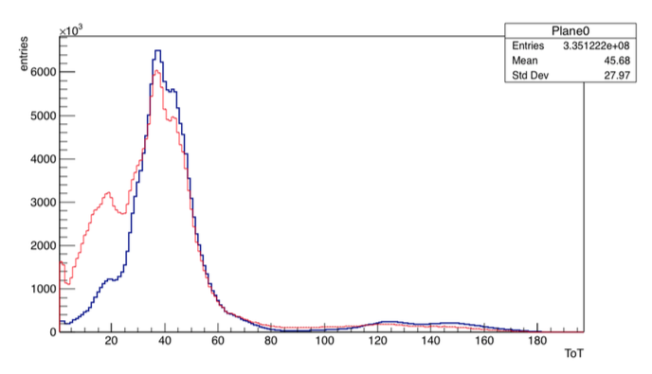
Charge calibration
Am 241
per pixel fit
Cross checked with known x-ray lines
Test pulse
Per pixel fit
Am 241
spectrum all pixels
Non-clustered
Clustered
Am241 uncalibrated

Slide 23
Charge calibration
Am 241
per pixel fit
Cross checked with known x-ray lines
Test pulse
Per pixel fit
Am 241
spectrum all pixels

Slide 24
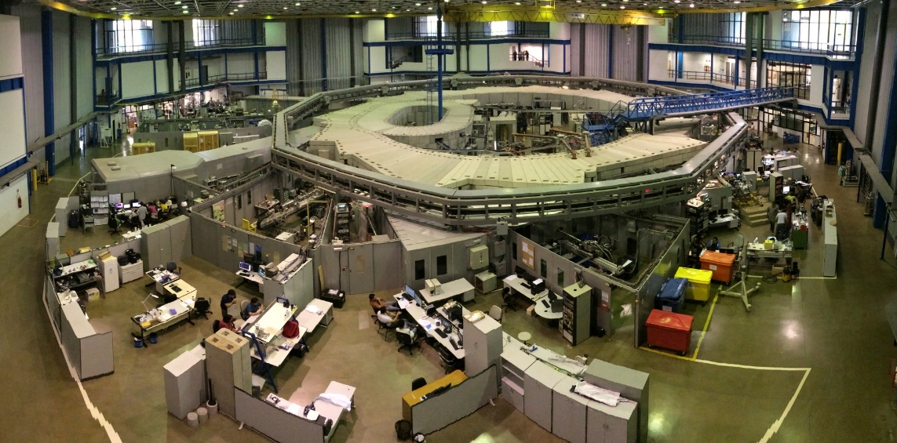
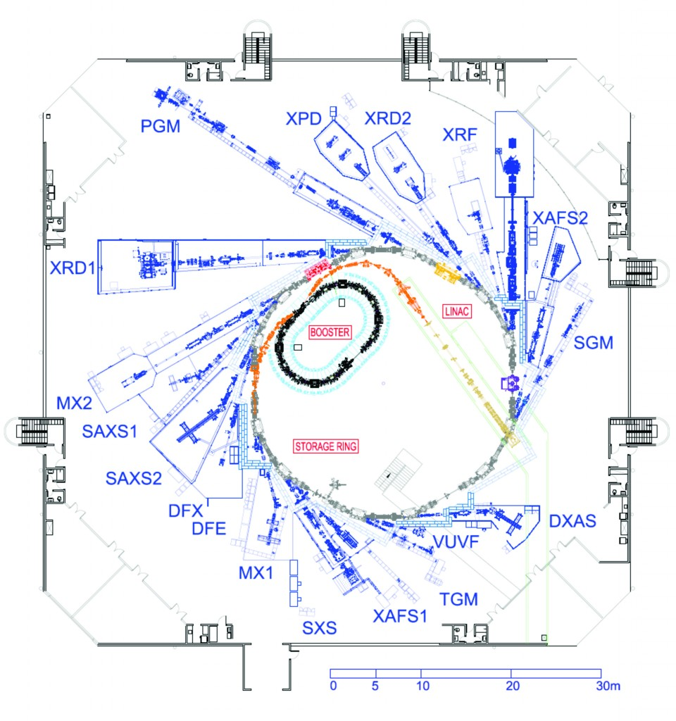
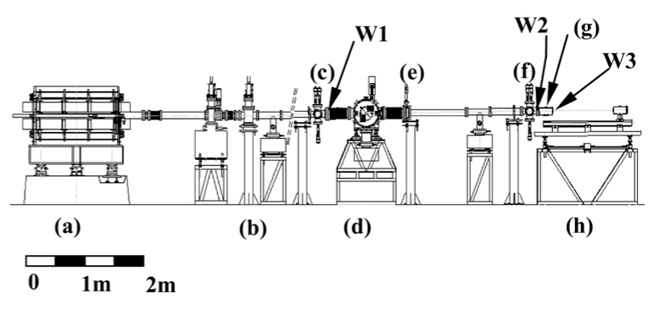
Charge calibration: LNLS*/Campinas
*National Synchrotron Light Lab
XAFS1 - X-ray Absorption and Fluorescence Spectroscopy
4 to 24 keV photons with σE/E~ 0.01%.

Slide 25
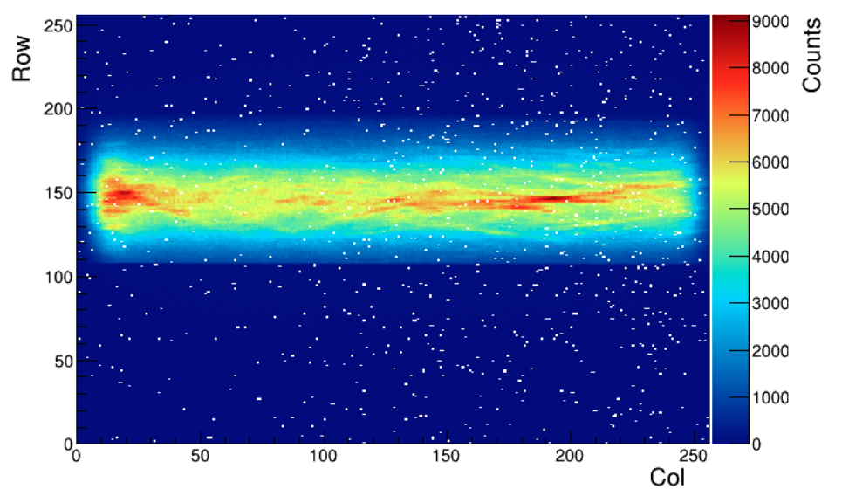
Charge calibration: LNLS*/Campinas
*National Synchrotron Light Lab

Slide 26
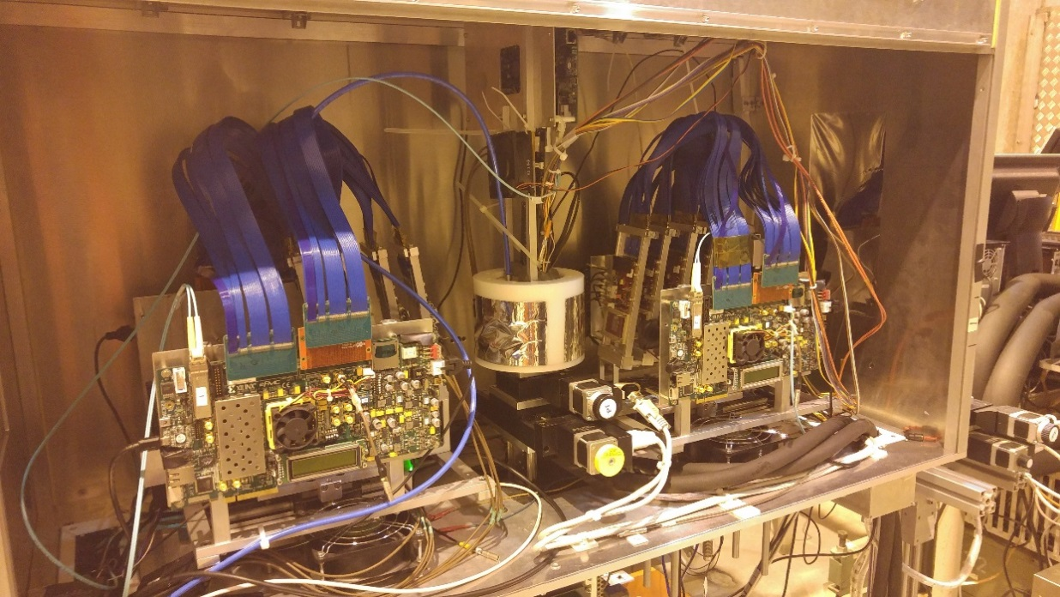
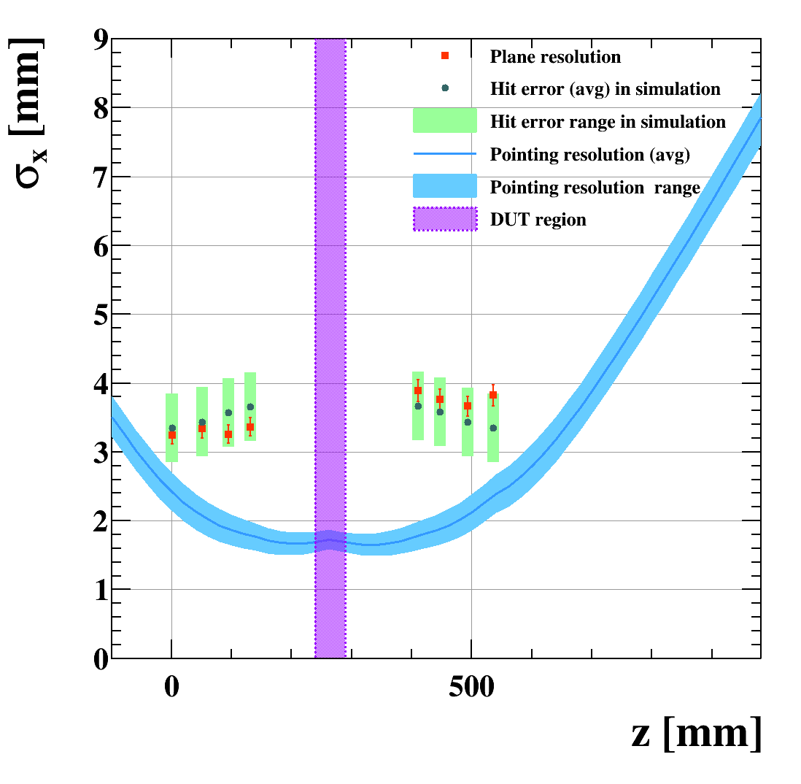
Testing prototypes with beam
Picture of the Timepix3 telescope, at CERN SPS
Using Timepix3 as VeloPix prototype
4 Timepix3 on 2 “arms”
Charge measurement and clustering yields a
2 μm pointing resolution.
Precise time stamps
(1.56 ns) make it
simple and clean
for the Pat. Rec.
We have operated
up to 5 Mtracks/s/cm².
Readout electronics
Planes
Beam
DUT
Pointing resolution

Slide 27

What if we didn’t have the beam at CERN?
In 2012 we knew that there would be no
beam at CERN till mid 2014…
What if we would like to go to Fermilab? DESY?

Slide 28

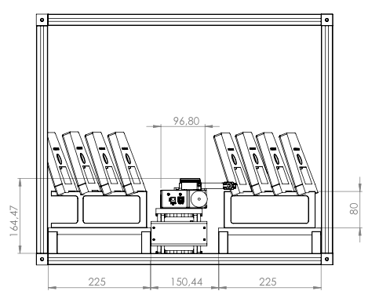
COMpact BrAzilian Telescope
Motivation
  To be portable, by airplane
  As good as the Timepix telescope, if not better.
  “Easy” to be put together
  Low cost.
stages

Slide 29
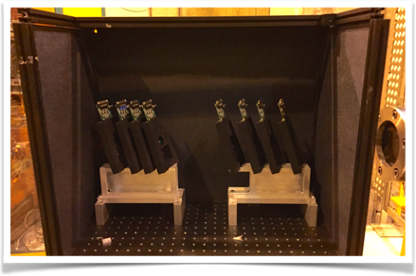
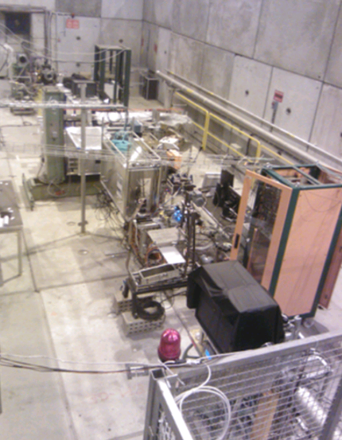
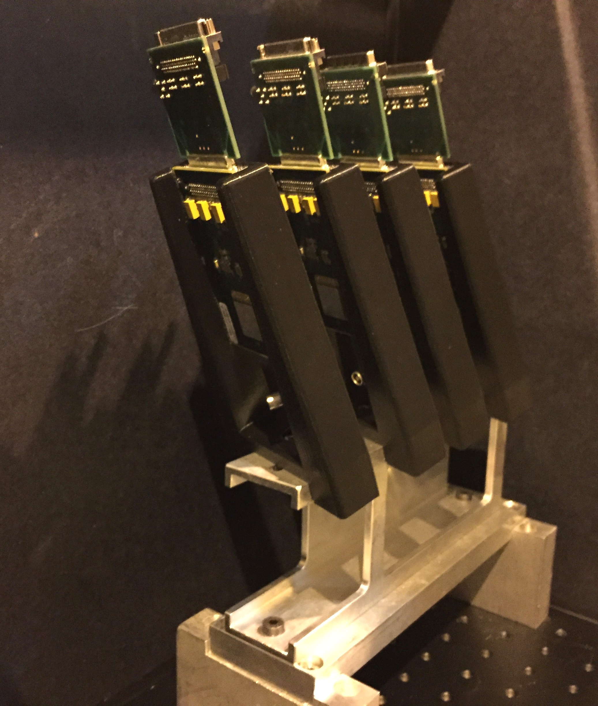

COMBAT construction
CLIC sensors. 8x150 μm thick sensors on 4x150μm and 4x700μm TPX chips.
3D printed detector holders at 20º for optimal charge sharing
PCB cut out under the sensor – less material.
Taking data at SPS – 2014
5.1 μm

Slide 30


COMBAT Readout
Dual RELAXD readout
  backup plan
Pre-commissioned
with cosmics
Created custom readout
with a PXI Flex-RIO 7952
board (Virtex5) for 9 planes
0
1
2
3
4
5
6
7
RELAXD0
RELAXD1
DAQ PC

Slide 31




COMBAT Readout
Dual RELAXD readout
  backup plan
Pre-commissioned
with cosmics
Created custom readout
with a PXI Flex-RIO 7952
board (Virtex5) for 9 planes
  Ready in 2015

Slide 32
Back to Sensor R&D results

Slide 33
Hit resolution
  HPK 200 µm n-on-p
  Micron 200 µm n-on-p
  Micron 150 µm n-on-n
Non irradiated sensors
Irradiated sensors
Best resolutions just below 5 µm.
Charge weighted – Non Binary data.

Slide 34

Charge Collection – Non Irrad

Slide 35

Collected Charge – IRRAD
  HPK 200 µm n-on-p
  39 µm
JSI irradiated sensors

Slide 36
Timing
Different amplitude and same threshold
could lead to time walk:
Th
t₀ t₁ t₂

Slide 37
Timing
Different amplitude and same threshold
could lead to time walk:
Average time of each telescope station
Combined track resolution: 350 ps.
Th
t₀ t₁ t₂

Slide 38
Timing
Different amplitude and same threshold
could lead to time walk:
For the VeloPix, all the hits should be inside 25 ns .
Average time of each telescope station
Combined track resolution: 350 ps.
Th
t₀ t₁ t₂
Time between hit and track
HPK, parylene coated
non-irrad
25 ns limit
Time to threshold
Hit time
residual: σ = 1ns
amplitude

Slide 39

Timing
Different amplitude and same threshold
could lead to time walk:
For the VeloPix, all the hits should be inside 25 ns .
Average time of each telescope station
Combined track resolution: 350 ps.
Th
t₀ t₁ t₂
Time between hit and track
HPK, parylene coated
neutrons - full fluence
HPK, parylene coated
non-irrad
25 ns limit
amplitude

Slide 40

Timing
Different amplitude and same threshold
could lead to time walk:
For the VeloPix, all the hits should be inside 25 ns .
Average time of each telescope station
Combined track resolution: 350 ps.
Th
t₀ t₁ t₂
Time between hit and track
HPK, parylene coated
neutrons - full fluence
HPK, parylene coated
non-irrad
25 ns limit
amplitude

Slide 41

Timing excursion – VELO – 2009
Peak (ns)
Amplitude
Fix values based on
known pulse shape
Width 1
Width 2
Constant
(offset)
Spillover (ns)

Slide 42


Velo Timing resolution – 2009

Slide 43




Velopix Timewalk measurements
Performing Velopix Timewalk tests with SPIDR and Test pulses

Slide 44




Velopix Timewalk measurements
Check measurements as
function of temperature:
VELO operates @ -20ºC
Tests to be made in dry air or vacuum.
Laser setup: 10 ns pulse, 12 um spot 660nm, 1060nm wavelengths

Slide 45

Summary
R&D for the VELO upgrade sensors is concluded: Moving onto production.
Constructed a rival tracking system in Brazil.
VeloPix + controls & DAQ testing will be the focus in the next test beams.
Testing of thinned chip assemblies to validate the production.
VeloPix cooled time walk to be measured in the lab.
Timing measurements are the coolest thing since

Slide 46
Bedankt

Slide 47
Backup

Slide 48


Upgrade Modules
2 sensor tiles + ASICS on
each side of the module
Micro channels etched
in silicon to bring
liquid CO2 under the chips.
→Low material active cooling.
Controls and read out
Electronic hybrids to be attached
to cooling substrate.

Slide 49
Fluorescence MPX3 Measurements

Slide 50

Intra pixel efficiency
D.Saunders
HPK
Pixel centre
Y[mm]
At 1000 V the corners are recovered.
S27
Micron
300V
36 μm
n-on-n
Pixel corner
X[mm]

Slide 51
Collected Charge – JSI
  HPK 200 µm n-on-p
  Micron 200 µm n-on-p
  Micron 150 µm n-on-n
JSI irradiated sensors

Slide 52




Hamamatsu IV tests
Check performed for each triple/single on guard ring only

Slide 53

COMpact BrAzilian Telescope

Slide 54



Time is the new Space
Simple
hits
Timed
hits
Time tags can isolate hits from the same track.
Tracks from the same PV have the same time.
An SV can be tagged to its PV by the same time!
Z → μμ in 25 Collision event. HL-LHC can go to 10x that
But the hit precision must go below 100 ps
5 cm
2mm spacing between vertices→ 200 μm

Slide 55


4D Tracking – is it really necessary?
Tracking performance (no tuning)
  VELO upgrade: 99% efficiency, 2% ghosts
  At 10x luminosity: 94% efficiency, 42% ghosts
Track association to primary vertex
  VELO upgrade: 1% mis-association
  At 10x luminosity: 13% mis-association
    Degrades decay time resolution
4D tracking: add timing information
  Improves tracking performance
  PV mis-association vs. time resolution
    200 ps hit resolution could recover current Velo Upgrade performance
LHCb
Unofficial
LHCb Unofficial
PV mismatch [%]
LHCb
Unofficial
Time resolution per hit [ps]

Slide 56





R&D on fast timing
200 mm sensor+ASIC+ μchan cooling
NA62 Gigatracker: ~150 ps resolution, TDCPix.
Timepix4 plans 200 ps TDC.
Low Gain Avalanche (LGAD) technologies theoretically to achieve 20 ps
Giga tracker TDC Pix
LGAD CNM
LGAD
simulations
N. Cartiglia, VCI 2016

Slide 57




Timeline
module
production
FW
TDR
VELO
TDR
UT
TDR
LOI
Sensor
production
Assembly
installation
year | 2010 | 2011 | 2012 | 2013 | 2014 | 2015 | 2016 | 2017 | 2018 | 2019 | 2020 | 2021 | 2022+
beam crossing | 50 ns |  |  | LS1 |  | 25 ns |  |  |  | LS2 |  | 25 ns
TeV | 0.9 | 7 | 8 |  |  | 13-14
Instant Luminosity | 10³²cm⁻²s⁻¹ | 3-4x10³²cm⁻²s⁻¹ |  |  |  | 4x10³²cm⁻²s⁻¹ |  |  |  |  |  | 2x10³³cm⁻²s⁻¹
Integrated Luminosity | 3 fb⁻¹ |  |  |  |  | 5 fb⁻¹ |  |  |  |  |  | 50 fb⁻¹
Current upgrade plan still compatible with post LS3 …

Slide 58


Cooling: micro channel substrate
Challenge:
Modules produce up to 30W, dominated by ASICs
Sensors must be kept < -20 ºC to minimize the effects of radiation damage, and to avoid thermal runaway
Must avoid material especially at tip of module
Chosen Solution:
Evaporate CO2 in micro-channels etched within silicon substrate
  High heat transfer coefficients
  No CTE difference (Si on Si)
  Excellent uniformity of material in sensitive region
  Pressure tolerance of module is important
Cross section of the
module concept
Race track design
CO2
simulations
Soldered connector

Slide 59



Microchannels under test
  Double Micro channel test setup
Tested 2
samples
Cooling performs with very low ΔT and
well beyond necessary power
Nominal
Maximum
Power

Slide 60
Irradiated resolution
  HPK 200 µm n-on-p
  Micron 200 µm n-on-p
  Micron 150 µm n-on-n
Charge weighted -- Non Binary data.
Binary like resolutions

Slide 61

Timepix3 – charge measurement
The calibration of the charge measurement has to be well understood, in order to compare different prototypes, and also at various irradiation levels.
Timepix3 is the ideal tool: very precise and easy charge collection measurement
  Timepix(1) is not radiation hard.
  Medipix3 requires slow (tedious) threshold scans
  Velopix is not out. And it’s binary.
⬅But requires tuning and calibration.
M.Williams
Am²⁴¹ spectrum
M.Vicente

Slide 62
The Telescope – our infrastructure.
The Timepix3 telescope is fast, precise, and easy to combine with Timepix3 DUTs.
The software is written in Gaudi architecture: Kepler. ~15k tracks/s.
Charge measurement and clustering give a great pointing resolution ➔down to 2 μm.
Precise time stamps make it simple and clean for the PatRec.
Tracks can be measured with 0.4 ns timing precision
We have operated up to
10 Mtracks/s/cm².
R.Dumps
No significant loss
Correlated to rate.
A.DosilSuarez

Slide 63
Collected Charge
  HPK 200 µm n-on-p
  Micron 200 µm n-on-p
  Micron 150 µm n-on-n
JSI irradiated sensors

Slide 64
Efficiencies for irradiated sensors
Uniformly
Irradiated sensors
To full fluence.
Recovered corners
At 1000V bias.

Slide 65
Efficiencies for irradiated sensors
Uniformly
Irradiated sensors
To full fluence.
Inefficient corners
At 500V bias.

Slide 66
Efficiency
DUT
The crucial part of the efficiency measurement is selecting the right tracks…
A careful clean-up removing nuclear interactions, dead pixels, noisy and vertices is performed.
Also 20 ns Δt cut..
D.Saunders

Slide 67



Edge Analysis
E.Dall’Occo
Charge and clusters accumulate in the
First (busiest) column
➔ VeloPix won’t cope (higher hit rate)
➔worse resolution

Slide 68






Edge Analysis
E.Dall’Occo
S20
HPK
200V
S23
Micron
200V
(n-on-p)
S30
Micron
200V
(n-on-n)

Slide 69

Edge Analysis
E.Dall’Occo
S20
HPK
200V
S23
Micron
200V
(n-on-p)
S30
Micron
200V
(n-on-n)
S23 n-on-p irradiated
900V

Slide 70




Edge Noise – after irradiation.
V.FrancoLima
We have observed
noise clusters at the
edge
In a irradiated n-on-n
Micron Irradiated with neutrons (JSI)
Seems to get better
increasing the pre-amp
Discharge current (Ikrum)
Under investigation!
And cross checking
If we see it in any of
HPK sensors.

Slide 71
Grazing Angle
H.Snoek, P.Tsopelas
An alternative method that provides interesting results!
dE/dx for 55 μm of silicon
Q = 3.8 ke
Irrradiated
HPK
Non-irradiated HPK

Slide 72



VELO Gain, timing, signal calibration
Proton
Kaon
Electron
Pion
Separation only below 2 GeV

Slide 73
One Picture every 25 ns
40 million events* per second at the LHC
20-50 Tracks per collision
*LHC bunch crossing frequency of ~30 MHz (2808/3654 filling),
but more than more than 1 collision is possible/likely
Notes:
Driving motivation to allow physics discoveries in human life times is given by two main factors, much higher statistical samples and precision in each measured event.

Slide 74

Decay time resolution
A data driven approach compares the decay vertex with reconstructed candidates with the same topology.
In this case B_{s}->J/ψφ.
The MC simulation compares the reconstructed position with the generated one.

Slide 75





B⁰_{s} oscillations and Δm_{s} in LHCb
Result with 1 fb⁻¹ (2013)
Decay time resolution depends on the channel, for the one used
(B_{s}→D_{s}π): 44 fs.
The main systematic error is on the length scale of the VELO: 4 fs⁻¹.
Also D⁰ oscillations:
Phys. Rev. Lett. 110, 101802 (2013)
First measurement with
36 pb⁻¹ (2010 data):
Phys.Lett. B 709 (2012) 177-184

Slide 76


Hit resolution
Use the detector as a telescope
to study unbiased resolutions
Hit Resolution as function of track angle
→ Varies from 10 to 30% of the pitch
Hit Resolution can go as low as 4 μm

Slide 77


Monolithic Active Pixel Senors
Thinner, more segmented and smart detectors.
Advantages:
  Industry friendly
  No bump bonding/flip chip
  Can be very thin O(50 μm)
  Can have on pixel amplification
  Possibility to use new inter-
  connections (e.g. CCPDs)
Disadvantages:
  Collection mostly by diffusion (slow).
  Traditional (imaging-like) technology
  is not radiation hard (~10¹³ neq)

Slide 78
HV (HR)-CMOS
-85V
Ideally one would like to achieve:
  Low capacitance – low power
  Good S/N
  Good time resolution
  High rate capability
  Radiation tolerance
  Single sided processing: low cost mass production
P substrate
depletion layer
N well
~9μm
One deep n-type well in a p-type substrate acts as a collecting electrode.
Reverse bias between n and p-types increases the depletion volume.
Low resistivity (HV) → radiation hard

Slide 79

HV (HR)-CMOS
-85V
P substrate
depletion layer
N well
~9μm
Complex CMOS electronics can be built inside the n-well.
Small pixels ~20 μm can be achieved.
Thin volumes will help keeping a low cluster size.
This is being developed for μ→3e and ATLAS ITK.
One deep n-type well in a p-type substrate acts as a collecting electrode.
Reverse bias between n and p-types increases the depletion volume.
Low resistivity (HV) → radiation hard

Slide 80



HV (HR)-CMOS, μ→3e example
  Spatial resolutions of ~20 μm were reached with pixels of 103 x 80 μm².
  Further improvement can be reached with smaller pixel sizes.
  Good time resolution could be achieved
  thanks to Biasing voltage
MuPix7 chip

Slide 81


Radiation hardness of MAPS?
Still to be achieved… but:
C.J.S. Damerell, 1995
VERTEX DETECTORS: THE STATE OF THE ART
AND FUTURE PROSPECTS

Slide 82
Motivated by physics
Some particles “live” longer than others (b and c hadrons)
The shorter they live the harder it is to separate them from the collision point.
Precise measurements of the collision and displaced vertices, allow a wide range of physics observations
  CP violation, rare decays
  Higgs→bb, bb resonances
  particle oscillations
  New particles
N_{bjet}=2 (16.7%)
N =1 (20.4%)
bjet
N_{bjet}>₋ 3 (9.3%)
N_{bjet}=0 (9.3%)
top CR (9.3%)
N/A (35.2%)(*)
(*) Of course still use some level of vertex and tracking
2 out of 3 ATLAS analyses use b jet
information, as presented in
ICHEP 2016
*S Tsuno, Pixel2016
Notes:
The purpose of a vertex detector is to measure position and angles of charged particle tracks to sufficient precision so as to be able to separate tracks originating from decay vertices from those produced at the interaction vertex.
Such measurements are interesting because they permit the detection of weakly decaying particles with lifetimes down to 10⁻¹³s, like charm and b hadrons

Slide 83
Key physical parameter
Excellent impact parameter resolution is mandatory for reconstruction of heavy flavour vertices.
Secondary vertex reconstruction depends on impact parameter (IP) resolution
d₀
SV
PV
Notes:
Many Tracks contribute to the primary vertex reconstruction. Secondary vertices are displaced from those

Slide 84

Detector Constraints
σ₂
2 point
measurement
Impact parameter resolution depends on 3 main parameters
  Intrinsic hit resolution
  Distance to the first measured point and lever arm
σ₁
d₀
r₁
r₂

Slide 85

Detector Constraints
σ₂
2 point
measurement
Impact parameter resolution depends on 3 main parameters
  Intrinsic hit resolution
  Distance to the first measured point and lever arm
  Multiple scattering in detector material, (worse at low p_{T})
σ₁
d₀
r₁
r₂
Multiple
scattering
θ
x

Slide 86

Detector Constraints
σ₂
2 point
measurement
Impact parameter resolution depends on 3 main parameters
  Intrinsic hit resolution
  Distance to the first measured point and lever arm
  Multiple scattering in detector material, (worse at low p_{T})
σ₁
d₀
r₁
r₂
Multiple
scattering
θ
x

Slide 87
High Energy Physicist wish list
Good Primary Vertex resolution – separate between collisions.
Good Impact Parameter resolution – isolate particles from primary to secondary vertices.
Good Secondary Vertex resolution – to precisely measure long lived particles.
This implies:
  Good hit resolution – small size detection elements.
  Get close to collision point – high radiation environments.
  Low material – thin sensors of low density.

Slide 88
VELO Performance

Slide 89


Primary vertex resolutions
Parametrised as A/(N_{tracks})^{B} + C

Slide 90


Impact parameter resolution
Compared to the other LHC experiments
d₀ res. as function of p
d₀ res. as function of 1/p_{T}

Slide 91



The LHCb Vertex Locator (VELO):
88 silicon
sensors
R-φ design
300 μm, n⁺n Si
2048 strips
ractive = 8.2mm
pitchmin = 40 μm
Moves away every fill and
centers around the beam
with self measured vertices

Slide 92



The LHCb Vertex Locator (VELO):
Operates in vacuum
88 silicon
sensors
R-φ design
300 μm, n⁺n Si
2048 strips
ractive = 8.2mm
pitchmin = 40 μm
Separated from primary vacuum by thin RF foil with complex shape
– Protection from beam pickup
Moves away every fill and
centers around the beam
with self measured vertices

Slide 93

The LHCb Vertex Locator (VELO):
Operates in vacuum
CO₂
88 silicon
sensors
R-φ design
300 μm, n⁺n Si
2048 strips
ractive = 8.2mm
pitchmin = 40 μm
Evaporation of CO₂ keeps the temperature stable.
Separated from primary vacuum by thin RF foil with complex shape
– Protection from beam pickup
Moves away every fill and
centers around the beam
with self measured vertices

Slide 94
The LHCb Vertex Locator (VELO):
Operates in vacuum
CO₂
88 silicon
sensors
R-φ design
300 μm, n⁺n Si
2048 strips
ractive = 8.2mm
pitchmin = 40 μm
Evaporation of CO₂ keeps the temperature stable.
Radiation exposure
Separated from primary vacuum by thin RF foil with complex shape
– Protection from beam pickup
LHC RUN I | Delivered Luminosity | Highest Fluence* per fb⁻¹
CMS pixel | ~29.5 fb⁻¹ | 3x10¹² 1MeV n_{eq}/cm² At 39 mm
VELO | ~3.4 fb⁻¹ | 5x10¹³ MeV n_{eq}/cm² At 8 mm
Moves away every fill and
centers around the beam
with self measured vertices

