Slide 1
Neutron Imaging and Tomography with MCPs
Serge Duarte Pinto
4 July 2017
iWoRiD - Krakow

Slide 2
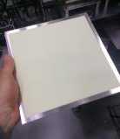
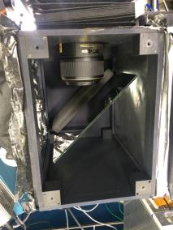
Neutron Imaging simplified setup
Bright field imaging most conventional
Tomography possible with a rotating sample stage
L/D of a beamline often limits spatial resolution to ℓ×L/D
Scintillator/mirror/camera detector trades off resolution with detection efficiency
Detector
Moderator
(thermal or cold)
Neutron source
Collimator
Sample
?
?
?
Mirror
D
L
ℓ

Slide 3
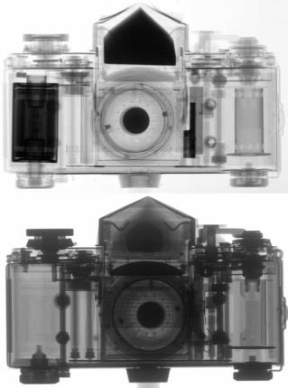
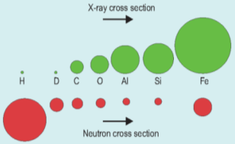
Neutron Imaging vs X-ray imaging
Difference in contrast: X-rays interact with electrons, neutrons with nuclei
X-ray cross-section increases steeply with Z, neutron cross-section less predictable, and depends on isotope
Source: PSI

Slide 4
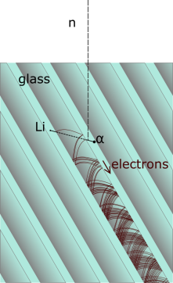
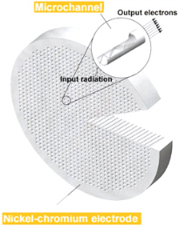
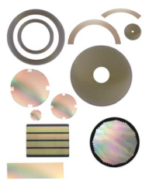
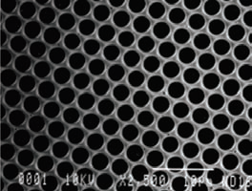
Microchannel Plates loaded with ¹⁰B and Gd
Glass capillary structures with millions of microscopic pores, each of which acts as an electron multiplier
Can be made in almost any size and shape
If the glass is doped with ¹⁰B and Gd, it becomes neutron sensitive
Detection efficiency ~50% for thermal neutrons (~70% cold)
PHOTONIS CONFIDENTIAL

Slide 5
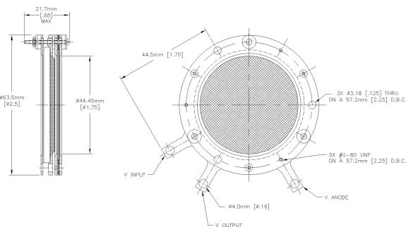
Neutron-sensitive phosphor screen imager
An assembly of one or more MCPs with a phosphor screen
Mounted in a vacuum enclosure, screen observed through a viewport by a camera
2 MCPs high gain, wider PSF
1 MCP lower gain
First tests with 40 mm round FoV
100x100 mm² unit in progress

Slide 6
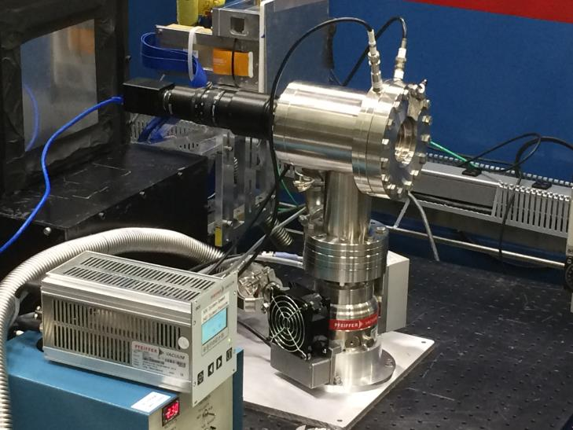
Neutron-sensitive phosphor screen imager
Tested in February at the Reactor Institute Delft (NL) with thermal neutrons, and in March at HFIR, Oak Ridge National Lab with cold neutrons.

Slide 7
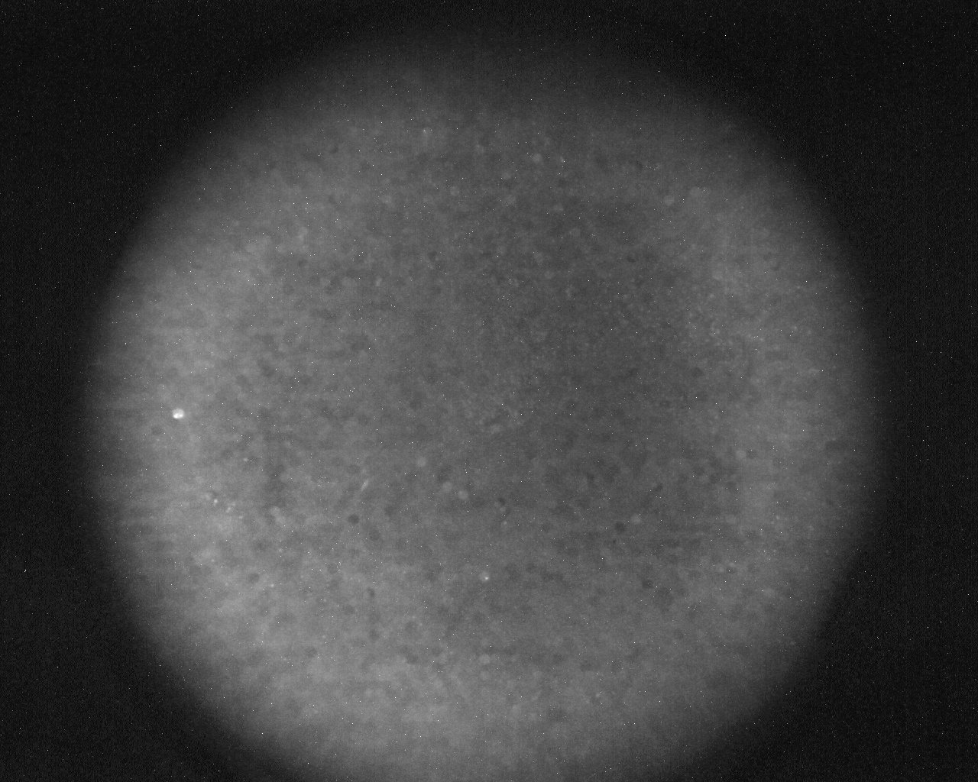
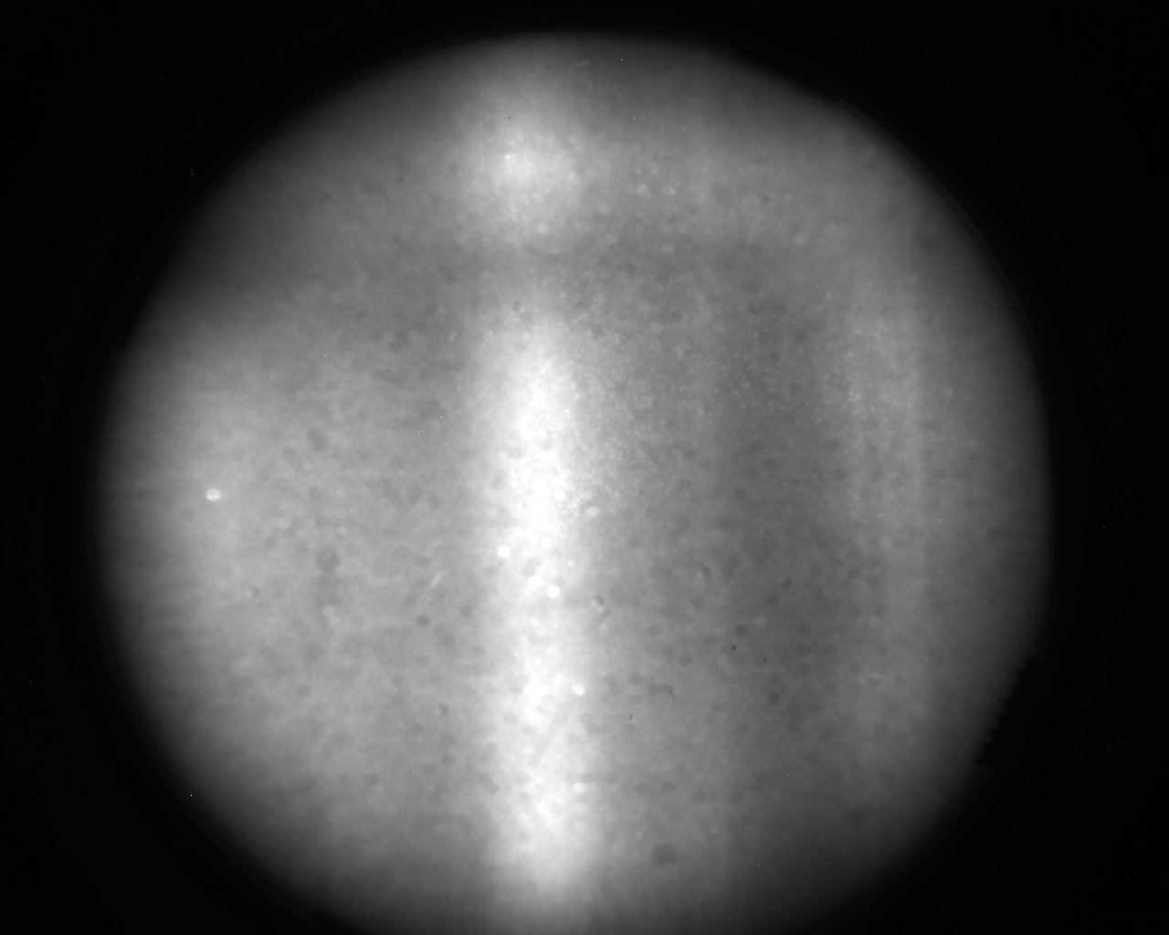
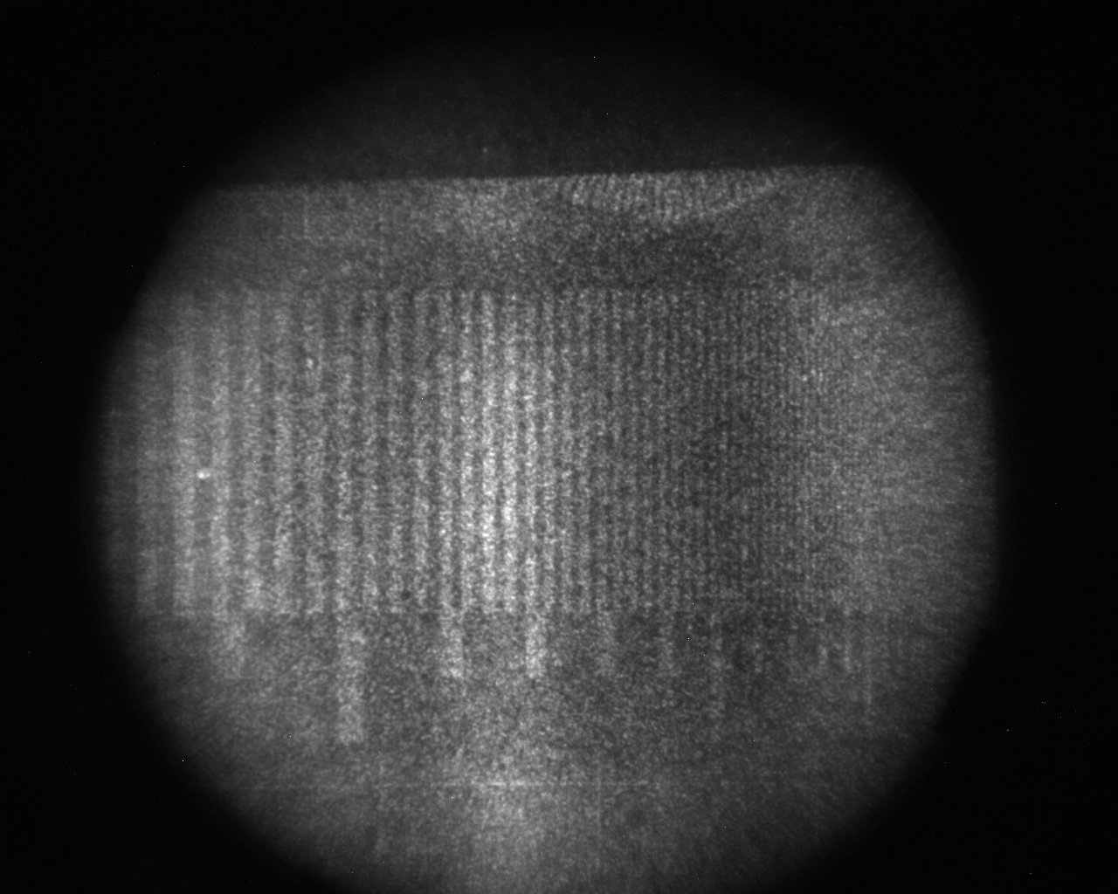
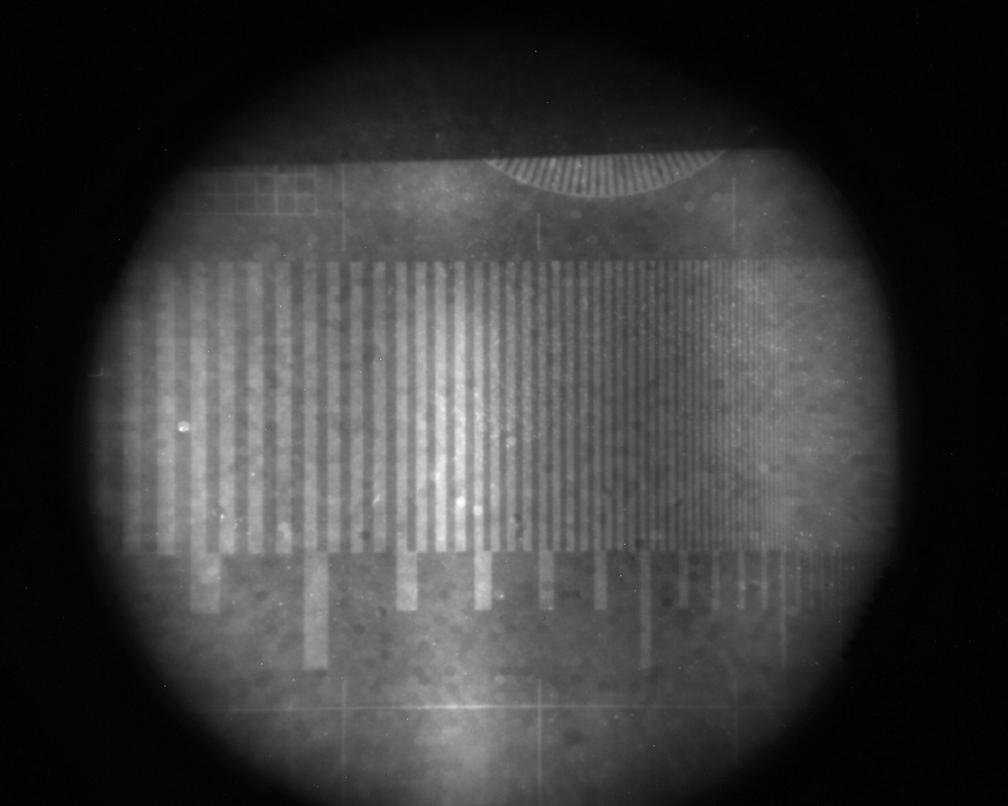
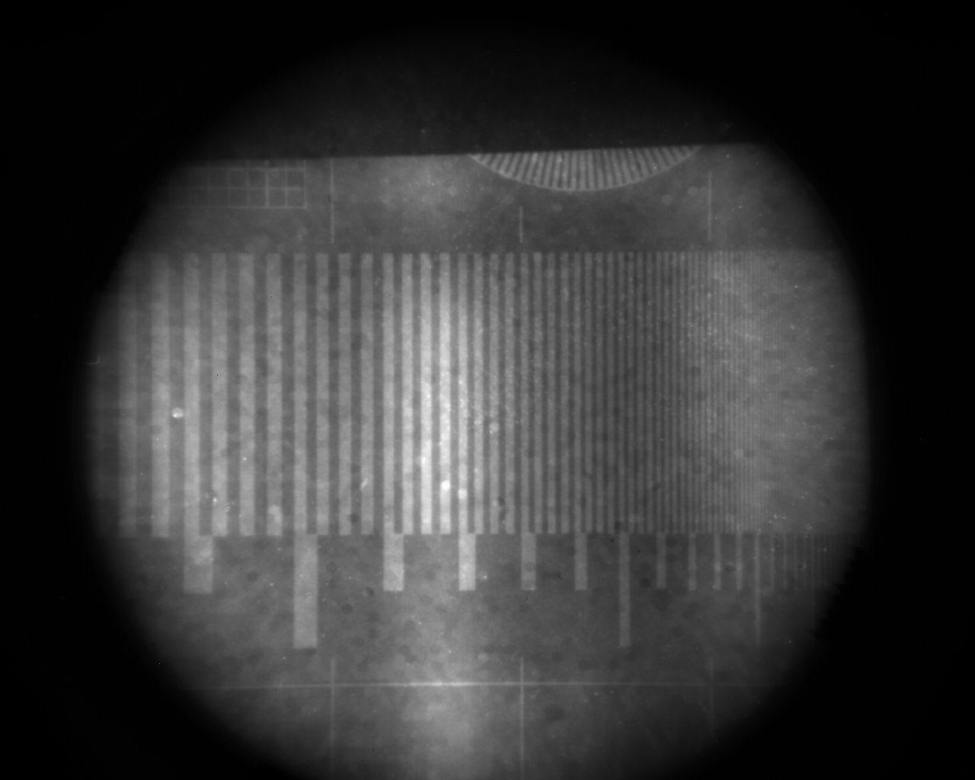
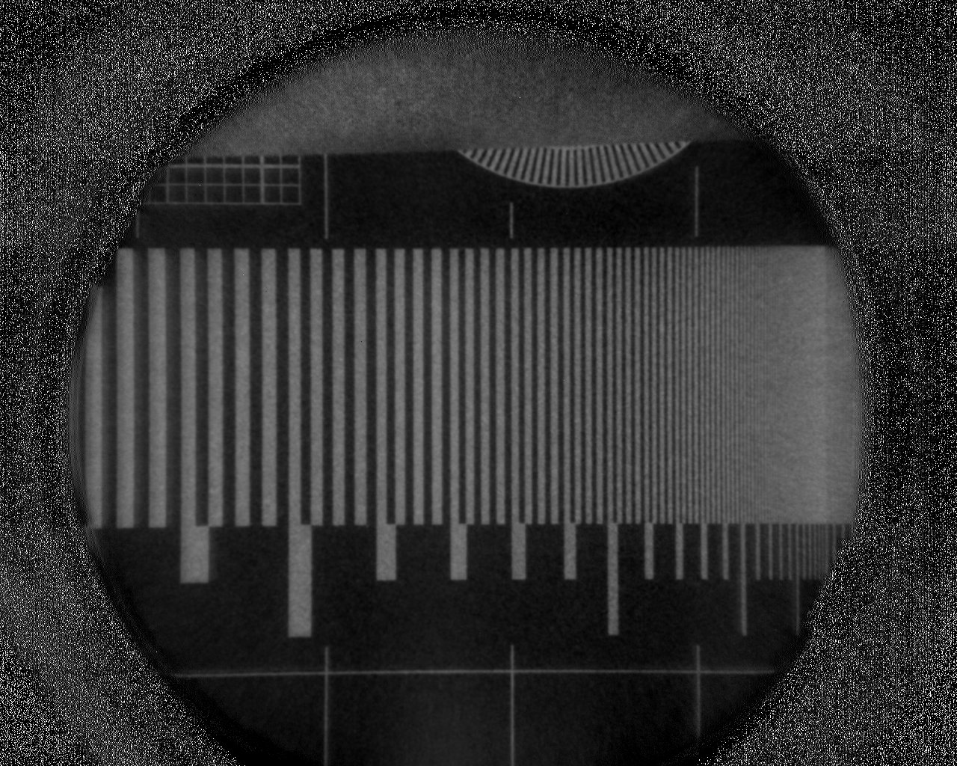
Taking Images and processing them
Raw images are taken until sufficient exposure
Background subtracted from the average raw image
Normalization with open beam image
Background
Open beam
Raw images (x200)
Average
Bkg subtracted
Normalized image

Slide 8
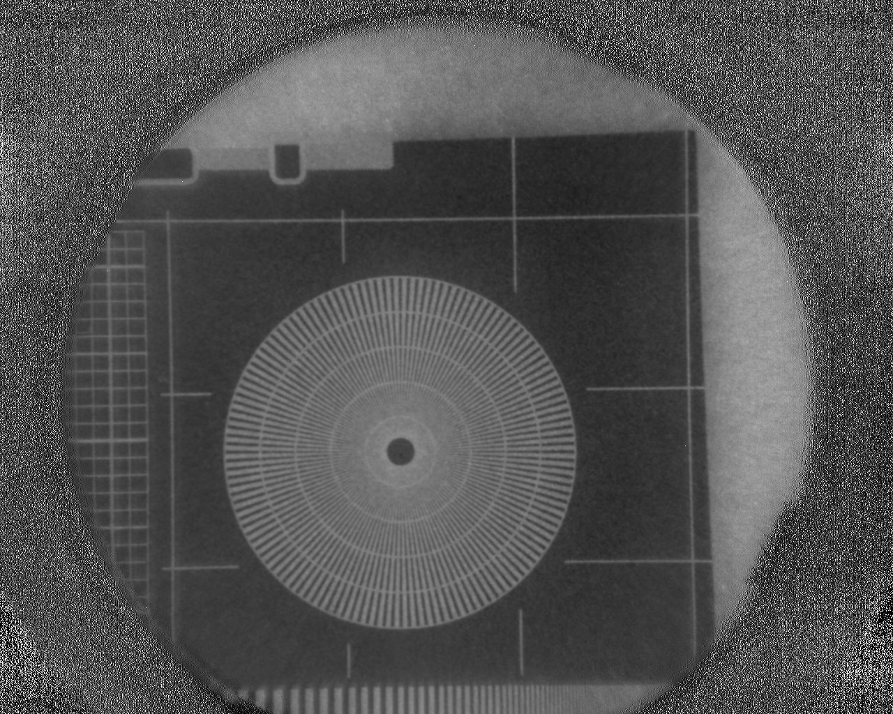
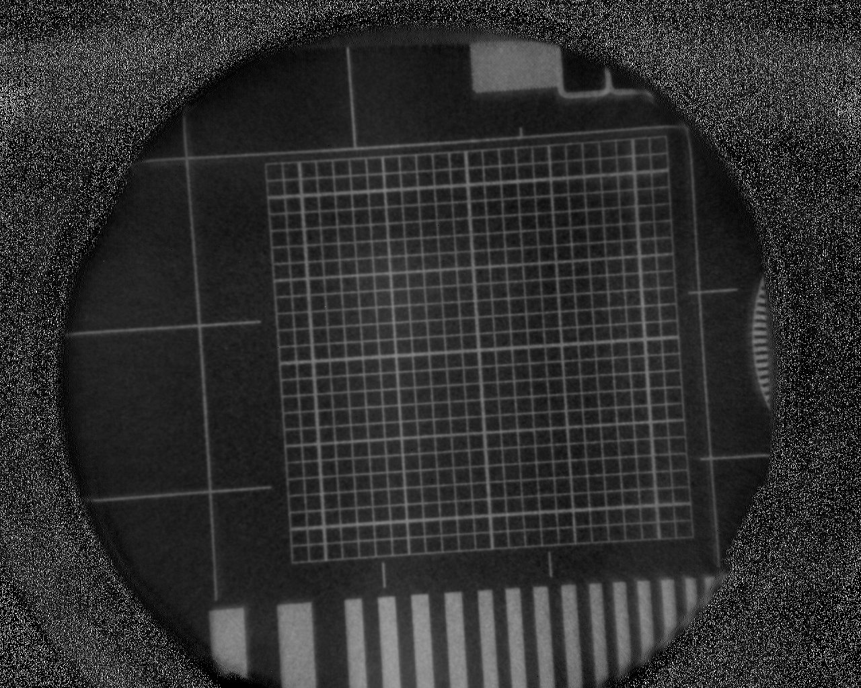
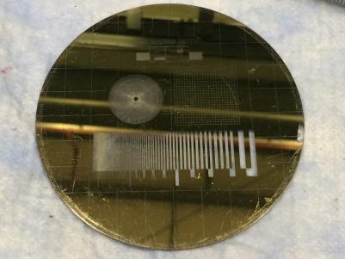
Gadolinium test mask
Made at PSI: C. Grünzweig et al., Rev. Sci. Instrum., vol. 78, no. 5, p. 53708, May 2007.

Slide 9
Gadolinium test mask
Resolution line grid can be used to calculate modulation transfer function (MTF) curve
Limiting resolution is often defined @ 10% or 5% MTF
This means 10-12 lp/mm, or 80-100 µm for our imager

Slide 10
Gadolinium test mask
The square line grid can reveal pincushion or barrel distortions. A 2D Fourier transform is particularly sensitive to such distortion.
2D FFT

Slide 11
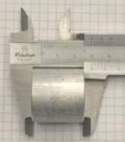
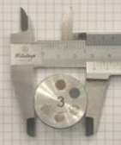
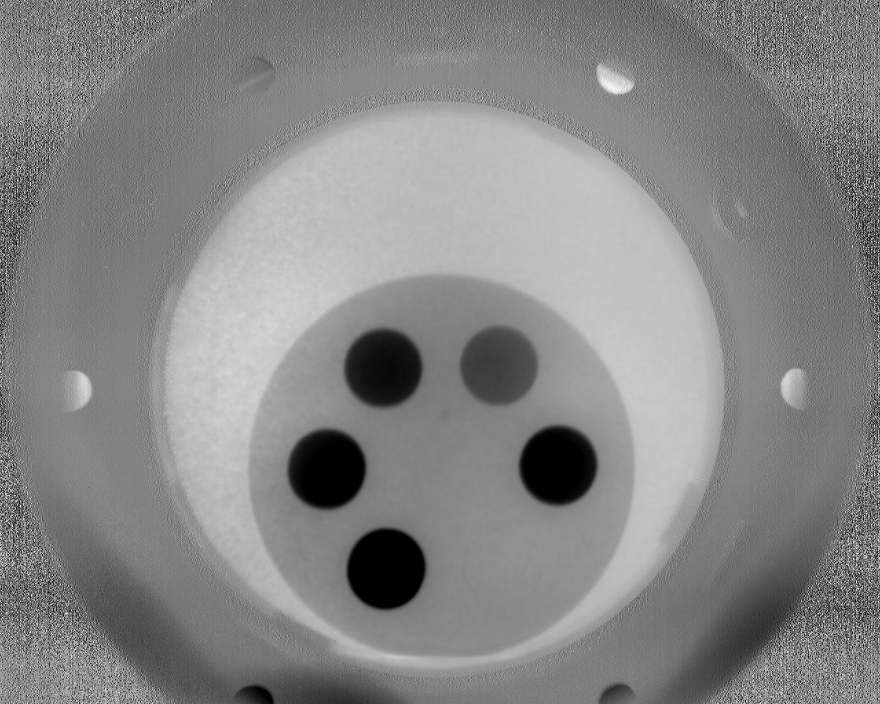
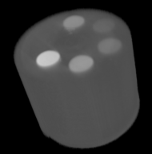
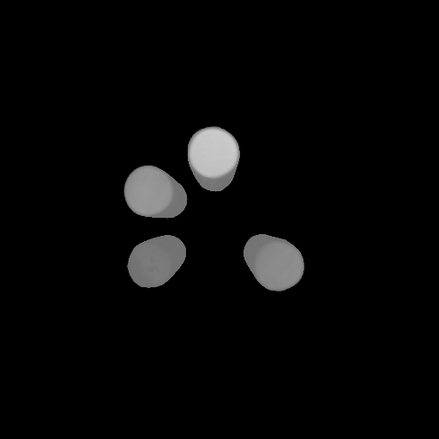
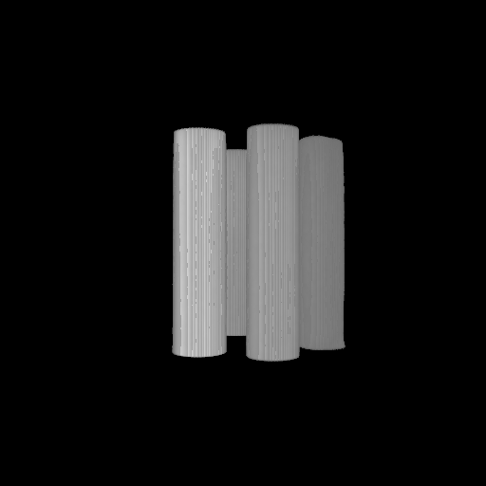
Tomography
Test sample from: A.P. Kaestner et al., Phys. Proc. 43 (2013) 128–137.
Tomography of multimetal sample
900 projections in <2 hours
Shadows due to uncorrected beam hardening →
By adjusting the attenuation coefficient threshold metals can be in- or excluded
Pb
Ti
Cu
Fe
Al
Ni
Threshold: 0.5 cm¯¹

Slide 12
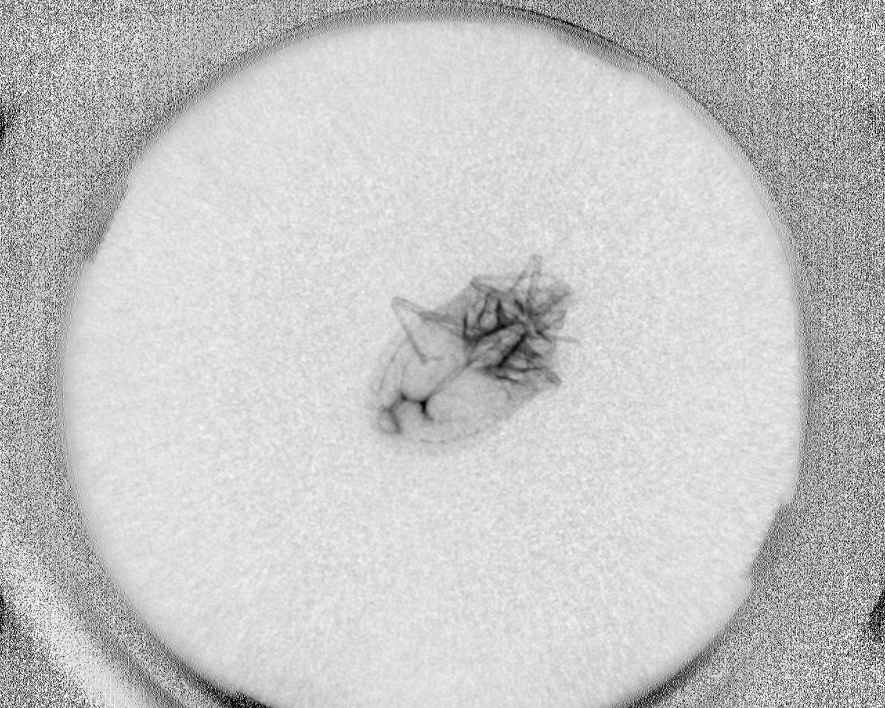
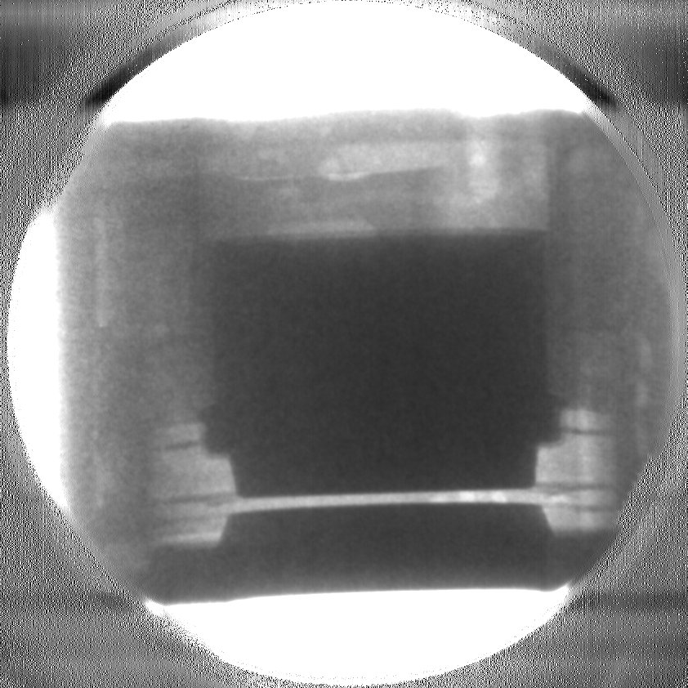
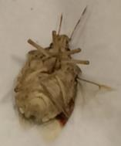
Some more images

Slide 13
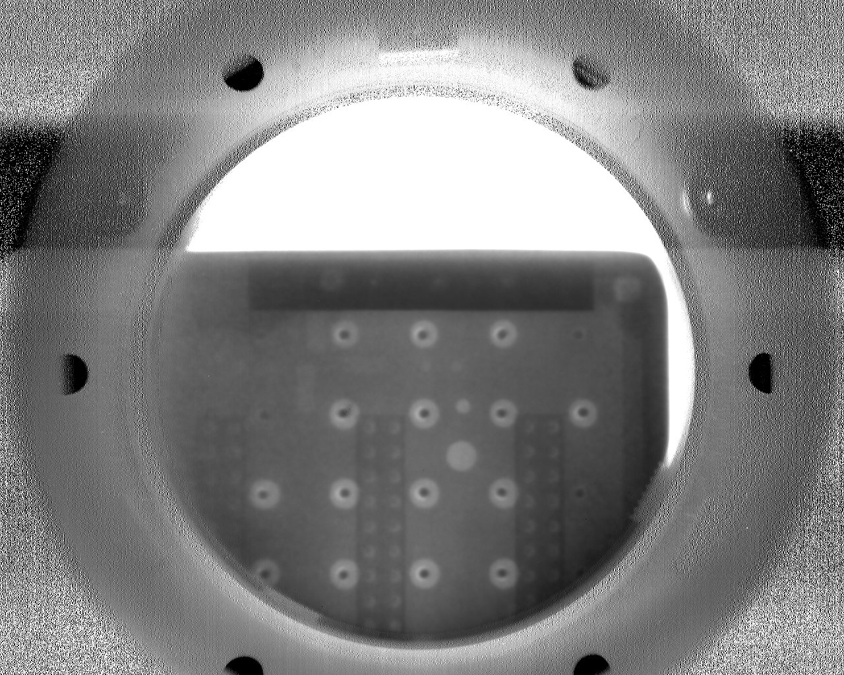
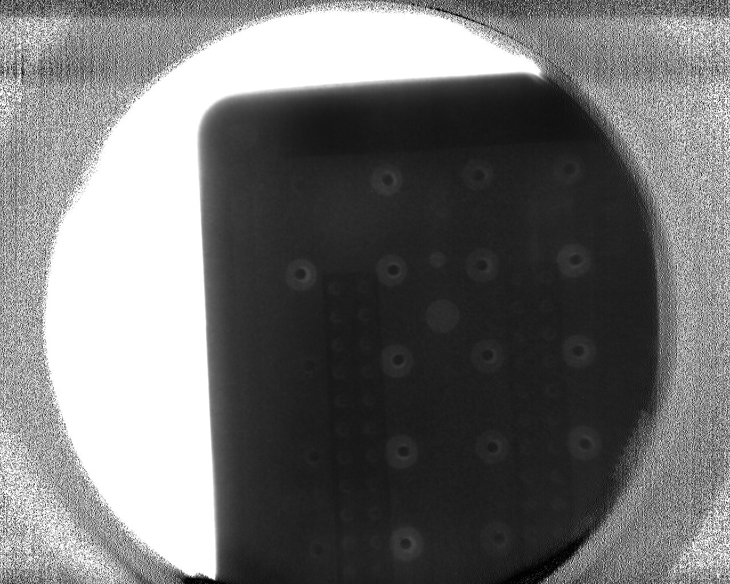
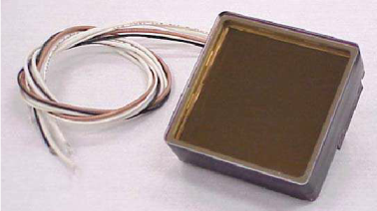
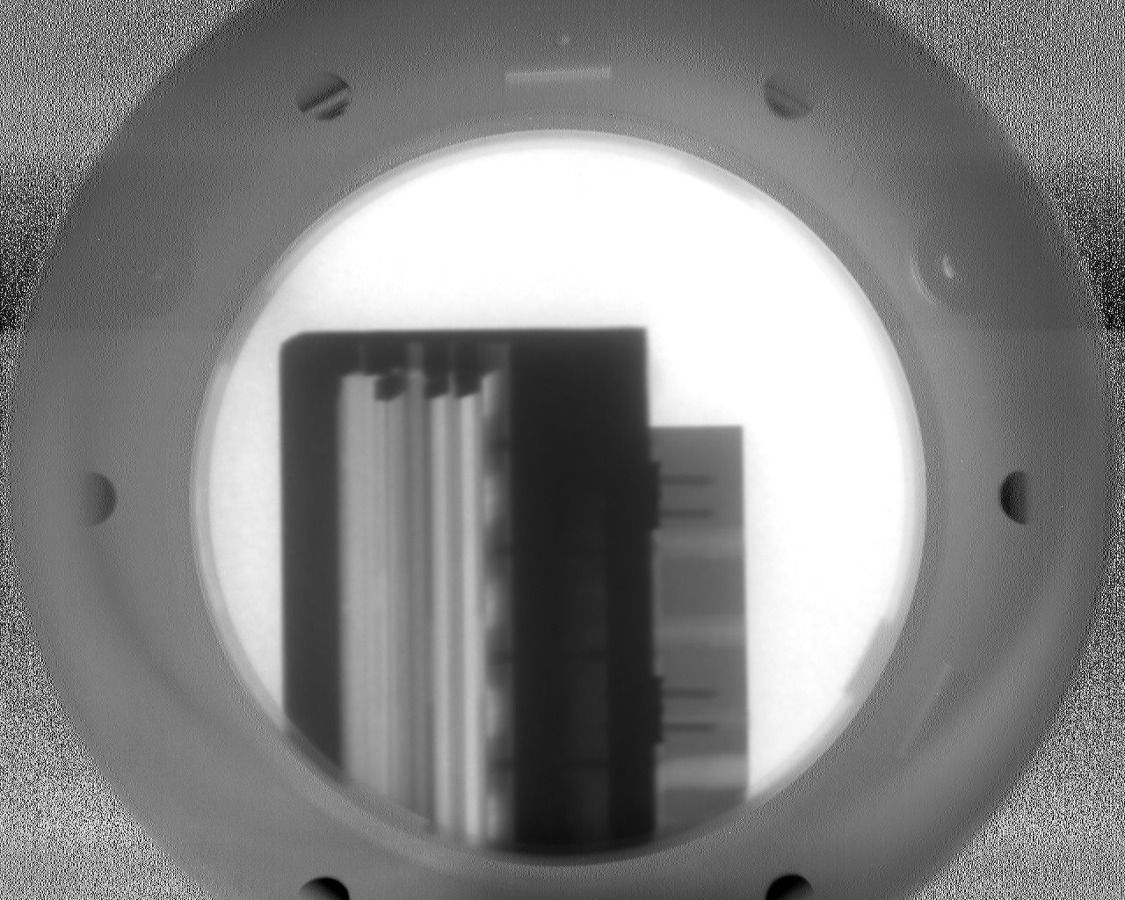
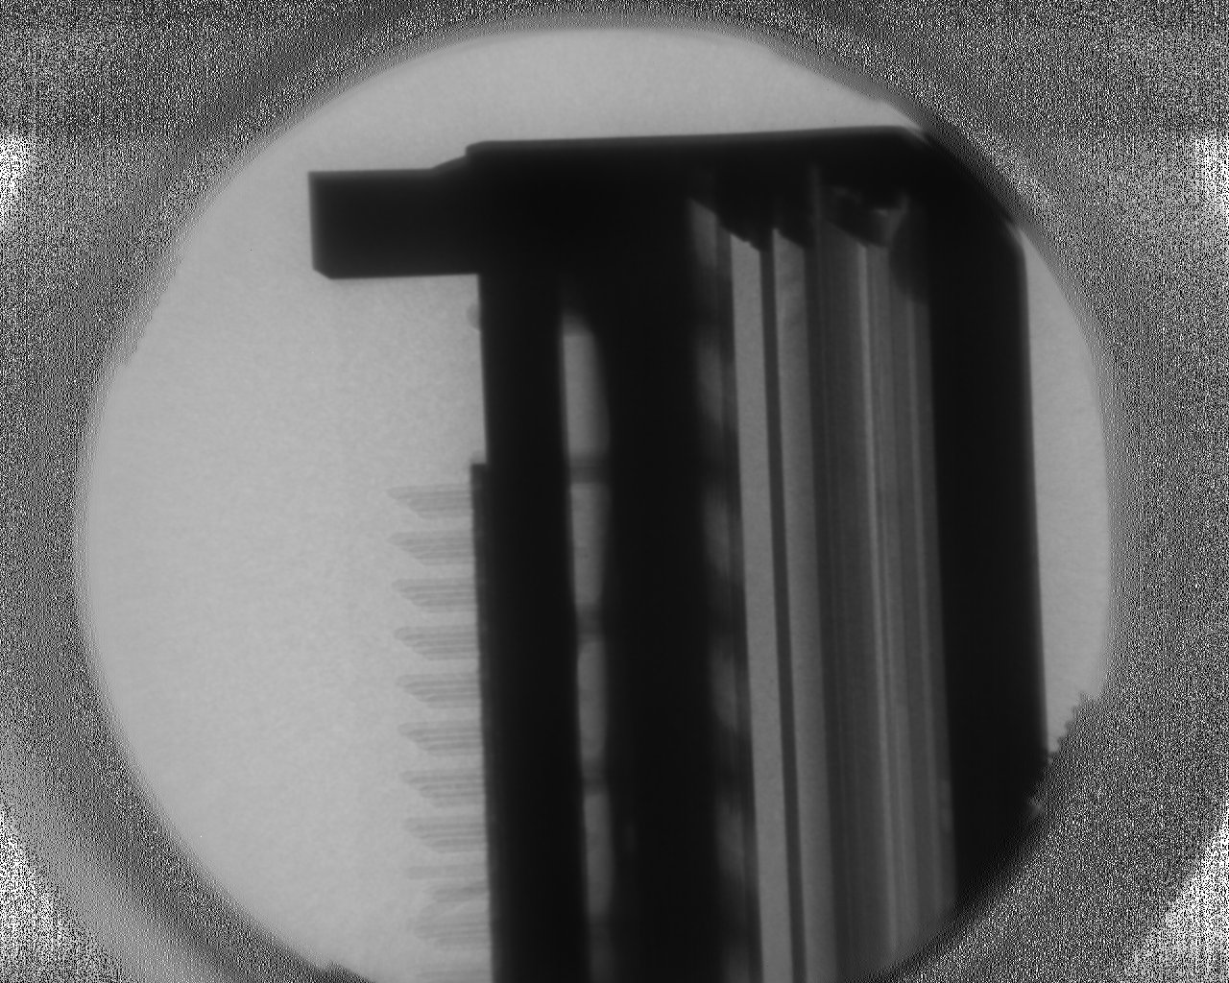
Thermal vs cold neutrons
Thermal Cold
Thermal neutrons: more penetration
Cold neutrons: more contrast
Images of a Planacon MCP-PMT made in Delft (thermal) and ORNL (cold).

Slide 14
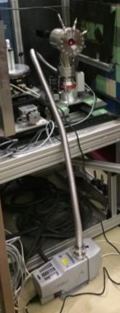
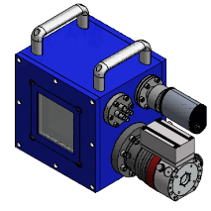
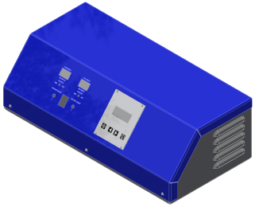
Improved design
100x100 mm$²$ active area
A single MCP for better resolution
MCP electroding and spacing to phosphor better optimized for resolution
Services (pumps, gauges, high voltage etc.) integrated in one control box
All aluminum housing (low activation)
Square active area means cylindrical FoV for tomography
Need a hi-res camera to reach a better resolution
Beam time scheduled at HFIR (ORNL) in September

Slide 15
Conclusions & outlook
A neutron imaging detector that does not trade off resolution with detection efficiency
Resolution so far: ~100 µm, we know how to improve to <50 µm
Detection efficiency ~2 orders of magnitude better than scintillators of comparable resolution
Strongly reduces exposure time for low-contrast samples, and especially for tomography
Time resolution limited by the camera
Imaging with portable sources within reach

Slide 16
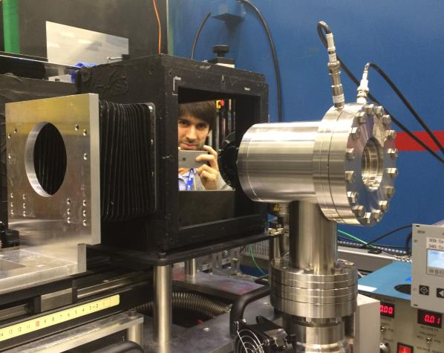
PHOTONIS Technologies S.A.S.
18 Avenue de Pythagore
CS 70019
33693 MERIGNAC Cedex
France
T +33 (0)556 16 40 50
F +33 (0)556 16 40 62
www.photonis.com

Slide 17
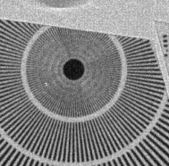
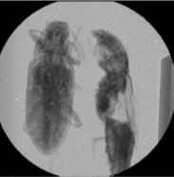
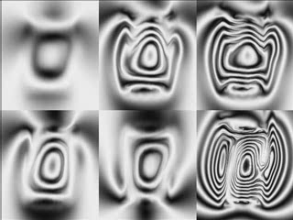
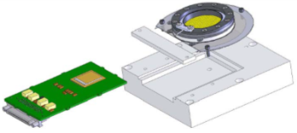
Neutron imaging & counting
Timepix chip readout instead of phosphor screen
Each neutron hit fires multiple neighboring pixels
Centroiding of these multipixel events allows a 15 µm resolution
Time resolution of ~1 ns (energy-resolved imaging)
FoV limited by chip size and shape
Rate capability limited by chip data rate
3 kHz magnetic field imaging
2.02 Å
3 Å
3.9 Å
This detector is developed by Anton Tremsin et al., and these images are from his presentations and publications.
4.87 Å
5.77 Å
6.67 Å

