Slide 1
RCauth.eu CILogon-like service in EGI and the EOSC
Deployment and Sustainability Models
for the AARC CILogon-like TTS Pilot
David Groep
AARC NA3 coordinator, EGI AAI-TCB
Nikhef PDP group
EGI TCB-AAI
May 2017
RCauth.eu is operated by Nikhef as part of the
Dutch National e-Infrastructure for Research coordinated by SURF
for the benefit of the collective European Research and e-Infrastructures

Slide 2



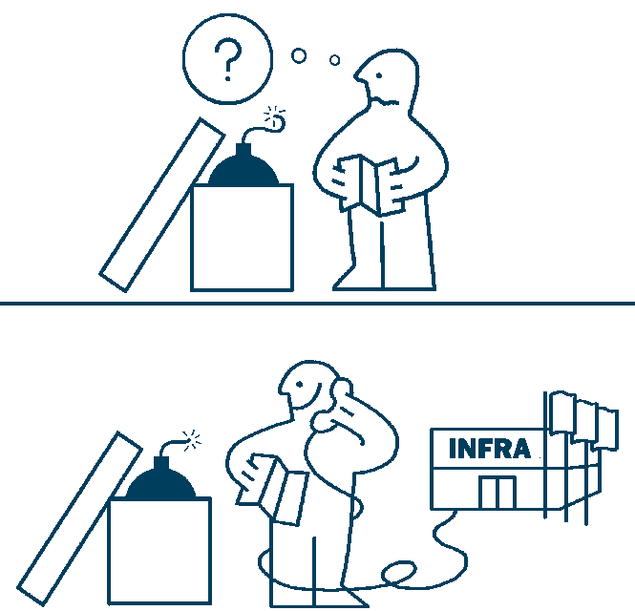
Aim: seamless access to existing services with eduGAIN for all
Pan-European Access
not country-opt-in based
standards-based assurance
No Changes to the Model
for infrastructures and
their service providers
1
:
1
Dispersed User Base
critical mass is beyond
any single institution
$ exec
$oidc->
authenticate()
echo "Hola
$name"
Command-line and VOMS
with delegation and brokering
Concentrate Sensitive Components
no long-term token needs in the VO portal
credential management by the Infrastructures
Minimal Coding
for the VO portals

Slide 3
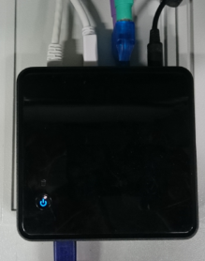

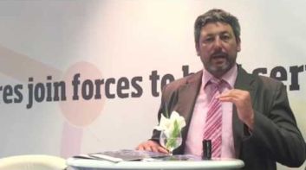










CILogon-like TTS Pilot, the User’s work flow
user login flow: VO portal → Community Infrastructure → RCauth service → federated AAI
credential flow: authentication, SAML federation, Policy Filter, OpenID Connect, PKIX+OIDC, (VOMS), proxy-on-portal
R&S
science gateways
delegation
AARC Master Portal or
Infrastructure Solution
filtering
WAYF
server

Slide 4
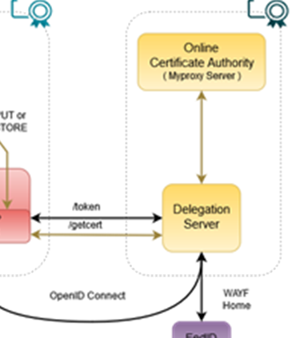
Token Translator RCauth.eu service component
Needs security and policy expertise (people) – and ability to maintain accreditation
Needs operational and technical capabilities (hardware):
hardware security modules, managed data centres, off-line and on-line secure
areas, trained personnel, designate infrastructure to security operations
Connects to – a handful of – Master Portals (MPs) with explicit agreements
to take care of user credential protection and compliance
Connects (many, we hope scalably) federations, IdPs and (few) SP-IdP-Proxies
Serves many communities, some of which we don’t yet know, and
beyond just the European e-Infrastructures
Considerations:
Trust and compliance, with IGTF accreditation
Single logical instance, with HA built in for production
Managed by a consortium: in Europe agreed by at least EGI, EUDAT, GÉANT, ELIXIR, and SURF

Slide 5
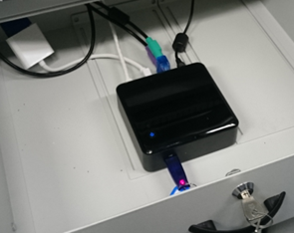
Where are we today?
In ‘pre-production’ since May 2016, now several connections deployed to EGI, ELIXIR, DNI/SURF, …
‘production demonstrator’ instance of Rcauth.eu set up in the ‘right way’ at Nikhef (only for now):
  Dedicated secure environment, FIPS 140 level 3 approved HSM, anchored in a stable way
  Policy and practices accredited under ‘unique-identifier’ profile at the IGTF
  – good enough for some infrastuctures, and within EGI in combination with vetted & managed communities
  Scalable negotiation model based on Sirtfi and REFEDS R&S section 6
  Requirements on attached credential stores defined (for key protection)
  Trust anchors in production (RCauth.eu is part of the ‘EGI-CAM’ package)
But it’s a production demonstrator, not true production,
without an SLA, and with limited capacity (~2k users)
… and it’s a bit a ‘Heath Robinson’ service, using
mostly pre-available hardware
… intended availability is high, but no on-site 24x365, nor redundancy

Slide 6








Planned RCauth.eu management model
shared governance through a
Policy Management Authority
non-discriminatory policy and practices
joint PMA authoritative
for policy and operations
Stakeholders
EGI, EUDAT, SURF,
GÉANT, ELIXIR, …
in-kind or explicit contributions
of services, kit, and operators
trust by any and all
global relying parties
Infrastructure-specific Master Portals
and Credential Repository
user contact service by
specific stakeholder

Slide 7
Service distribution and support plans
Beyond just the ‘Nikhef Best Effort’ service
what is ‘the service’ in this context: Delegation Service & WAYF
can be anywhere between a few kEur to well over 100+kEur cost per year …
Recuperation model
Master Portals (Credential Management) from other (non-RCauth) funding
Delegation Service/RCauth.eu: free at point of use
funded via in-kind contributions by the major e-Infrastructures
distributed H/A setup, leveraging existing capabilities and some additional person effort
EOSC Hub Consortium picked middle ground
contribute effort and some hardware resources to the joint pan-European pool
help steer the development through joint, independent, management body (PMA)
partners with existing security operations expertise: GRNET, STFC, FZJ + SURF/Nikhef

Slide 8
References
https://wiki.geant.org/display/AARC/Models+for+the+CILogon-like+TTS+Pilot
https://www.rcauth.eu/
DIY demo – for users from Sirtfi’ed R&S Institutions, or through the IGTF eduGAIN bridge:
https://rcdemo.nikhef.nl/

Slide 9

Parts of this work have also been performed as part of the work programme of EGI-ENGAGE
EGI-Engage is co-funded by the Horizon 2020 Framework Programme
of the European Union under grant number 654142
Thanks to all collaborators on this
joint enterprise:
EGI, EUDAT, GEANT, SURF;
Nikhef, GRNET, Christos Kanellopoulos
and to Jim Basney of
NCSA, CTSC and CILogon
davidg@nikhef.nl

