Slide 1
What we wanted to work on in Hamburg:
Characterization of the surface wavefield (direction, slowness and type of the incoming wavefield using 1- and 3-component beamforming methods)
Localization of possible noise sources (using also Matched Field Processing)
What did we look at in the end?
Temporal and spatial coherence of the surface wavefield
Coherence between borehole station TERZ and surface stations to detect possible noise sources
Ambient noise characterization following Groos and Ritter (2009)
Alignment of the horizontal components of the TERZ subarray
… and we did in fact try a time dependend characterization the surface wavefield for different frequency bands for the TERZ subarray

Slide 2
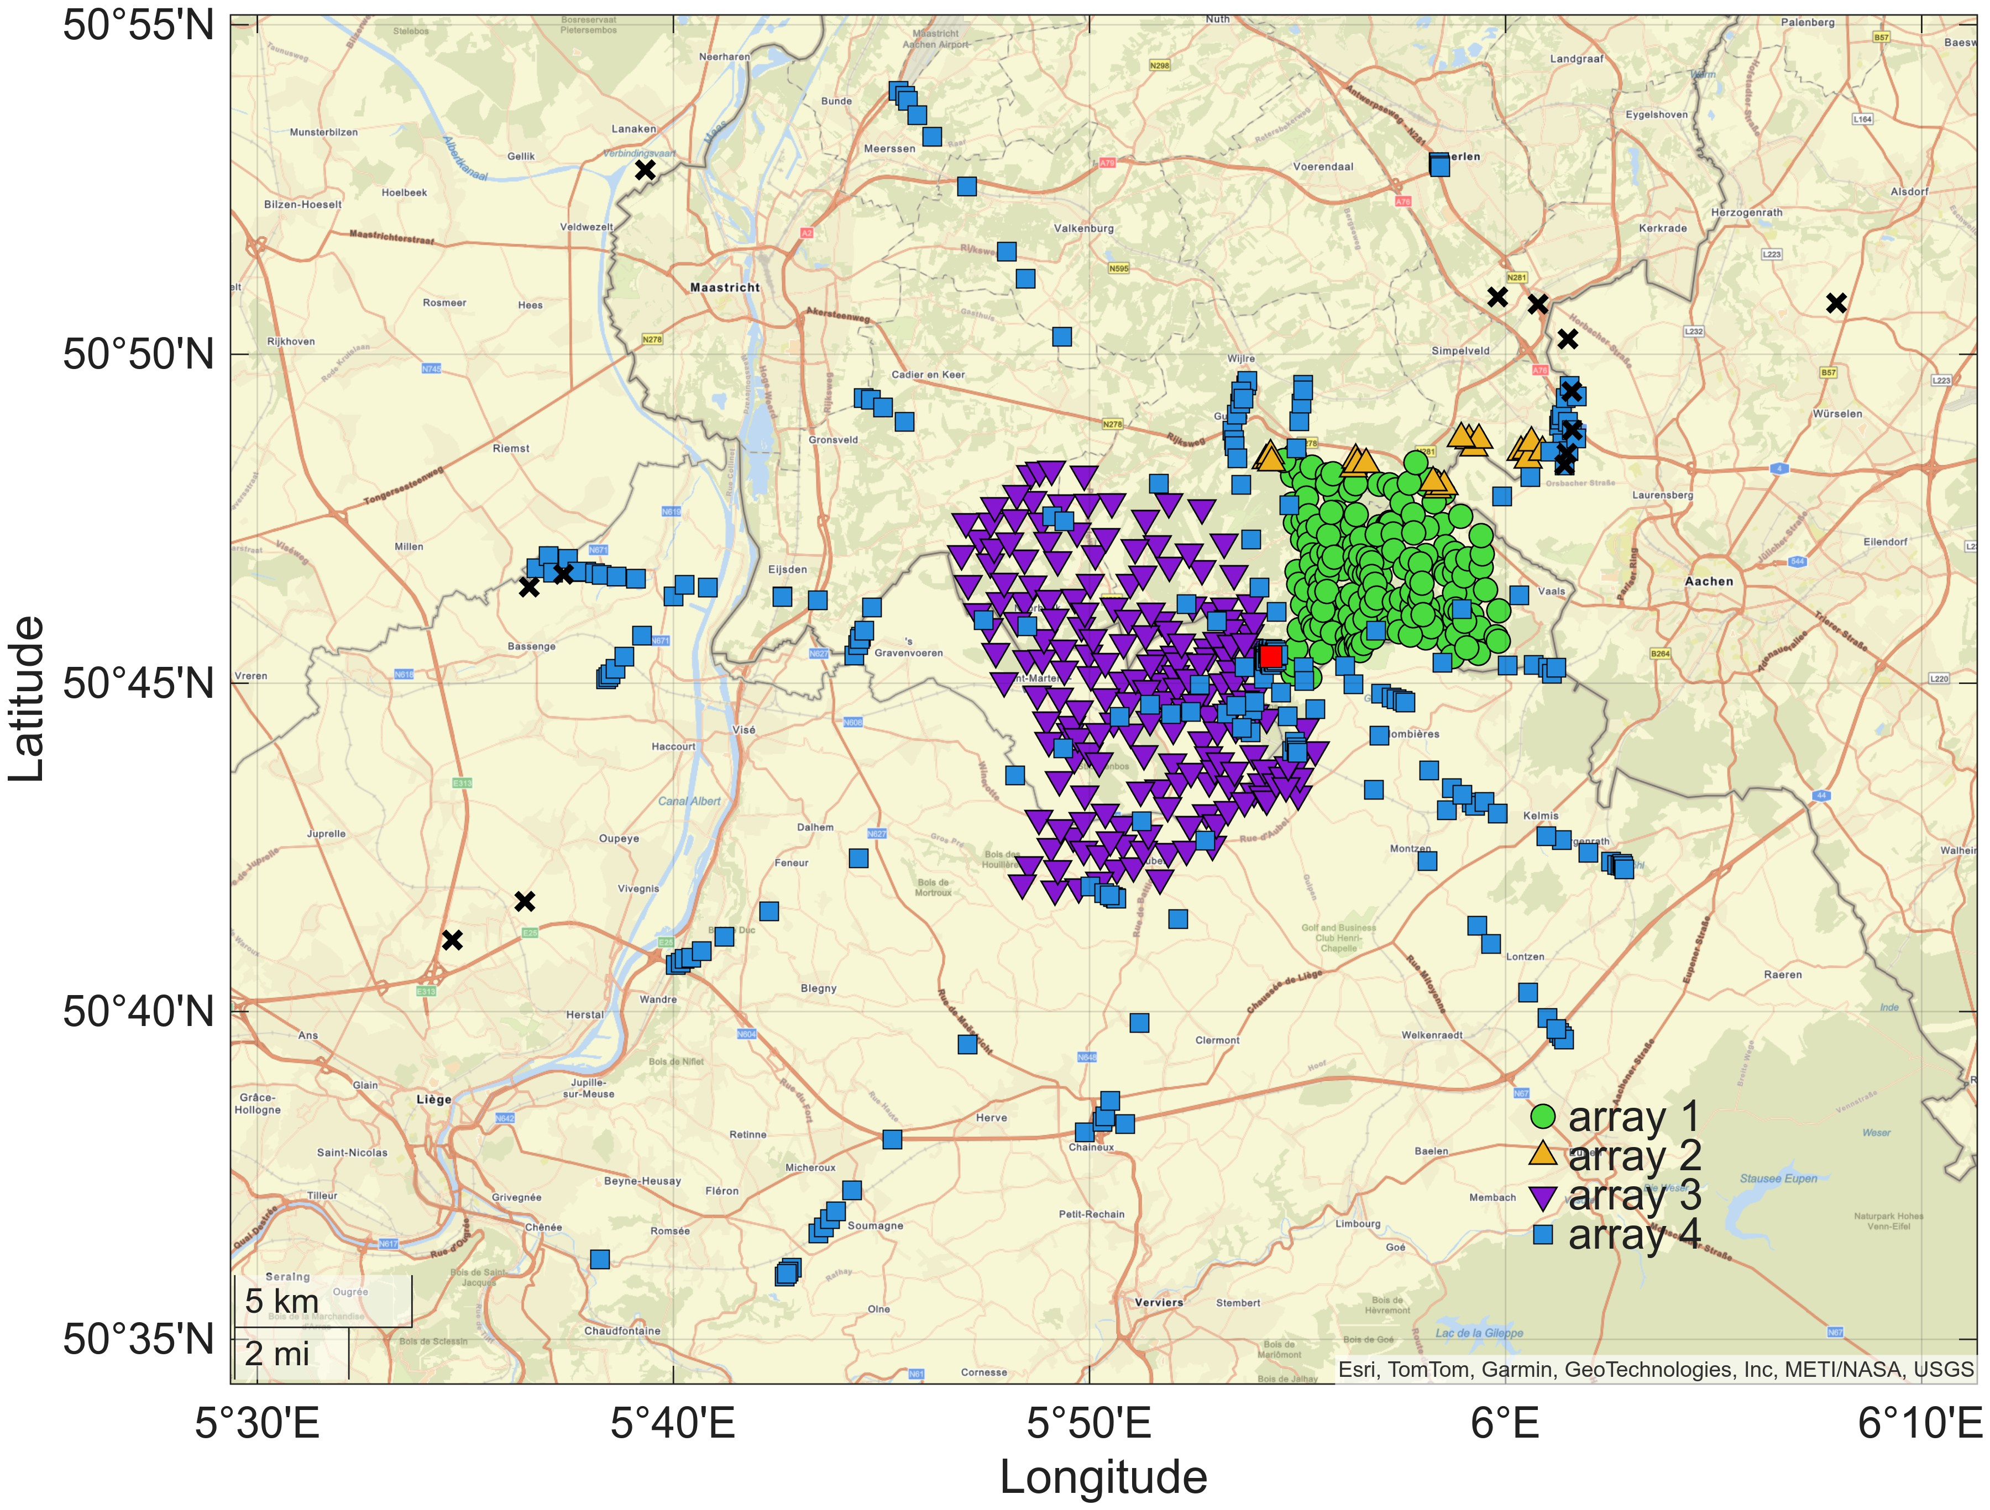
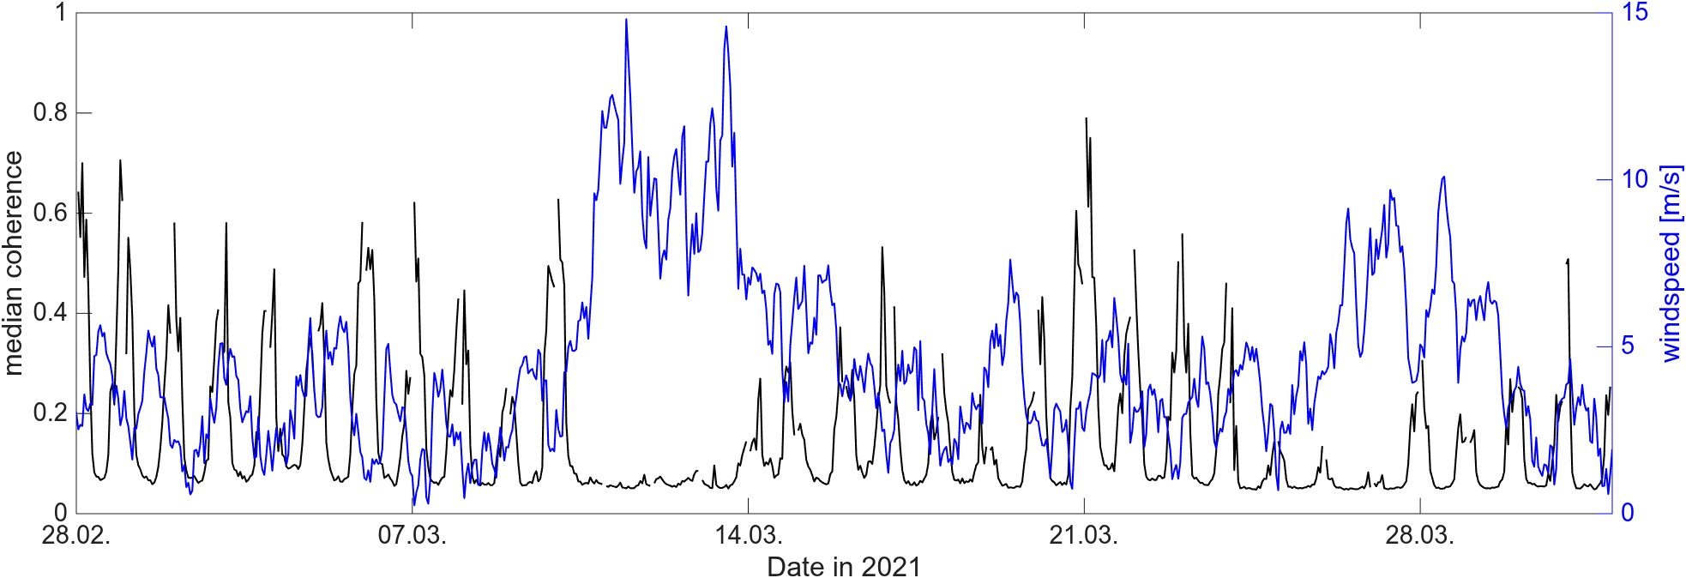
Analysis of network coherence of the surface arrays
Coherence of array 4 and TERZ subarray
TERZ
TERZ
subarray
Median of the maximum coherence in the frequency band 2.5 – 5 Hz
Coherence of array 3
Signal coherence highly sensitive to wind speed and local working activity

Slide 3
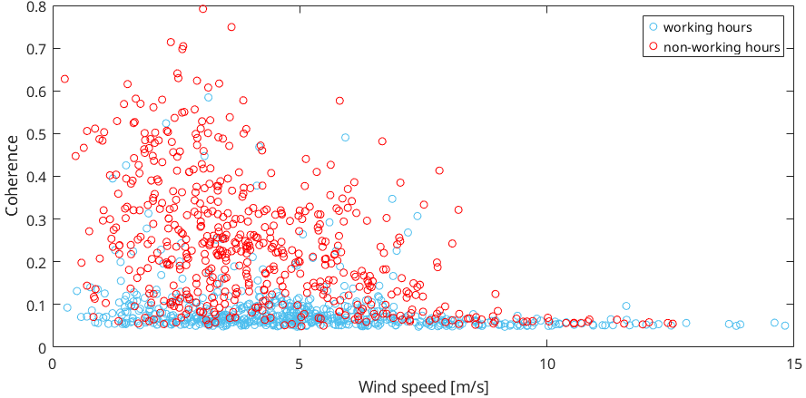
Analysis of network coherence of the surface arrays
TERZ
TERZ
subarray
Coherence over wind speed for working hours and night hours
Signal coherence highly sensitive to wind speed and local working activity

Slide 4
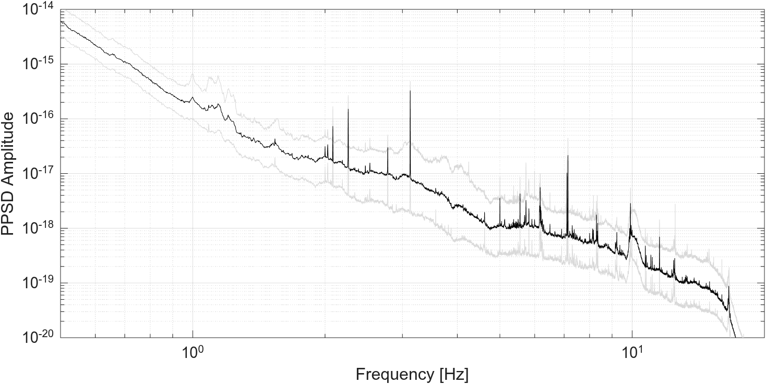
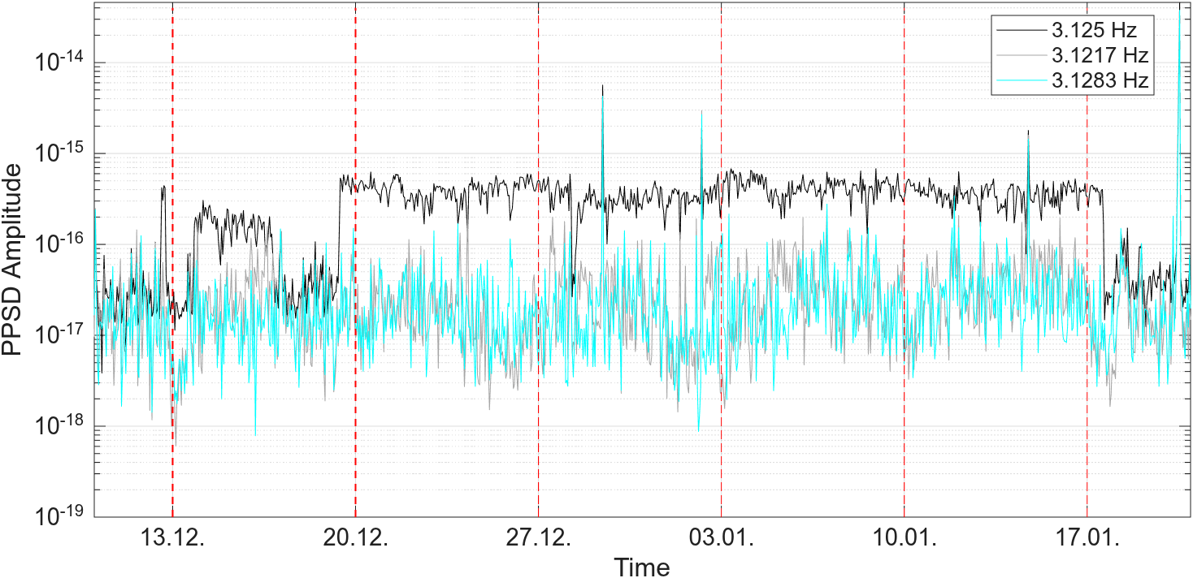
Prominent amplitude peaks at the borehole station TERZ
Median and 10th and 90th percentile for the time interval 10.12.2020-20.01.2021 for NL.TERZ.01.BHZ
There are many distinct amplitude peaks visible at depth and the question is whether a correlation with signals at the surface is possible
The well know 3.125 Hz peak
Hourly PPSD of 10 min 40 Hz data with 50% overlap
The plot of the PPSD amplitude at a frequency of 3.125 Hz over time indicates abrupt changes in the amplitude

Slide 5
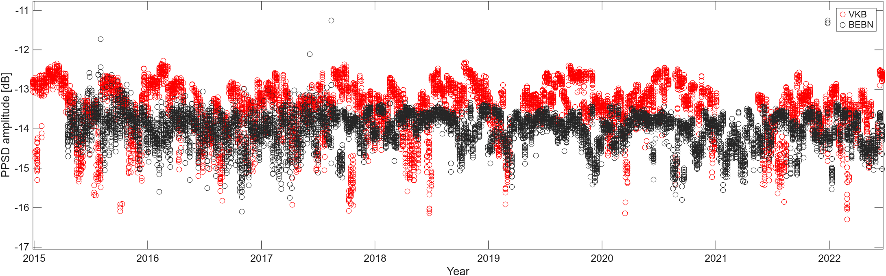
VKB
BEBN
To compare the long-term temporal behavior of the signal, we analyze it for each Sunday (with presumably lower noise floor) for about 8 years at broadband stations VKB and BEBN.
There are indications of seasonal changes in signal amplitude
Amplitude changes at the two station within a 10 km distance are not in sync

Slide 6
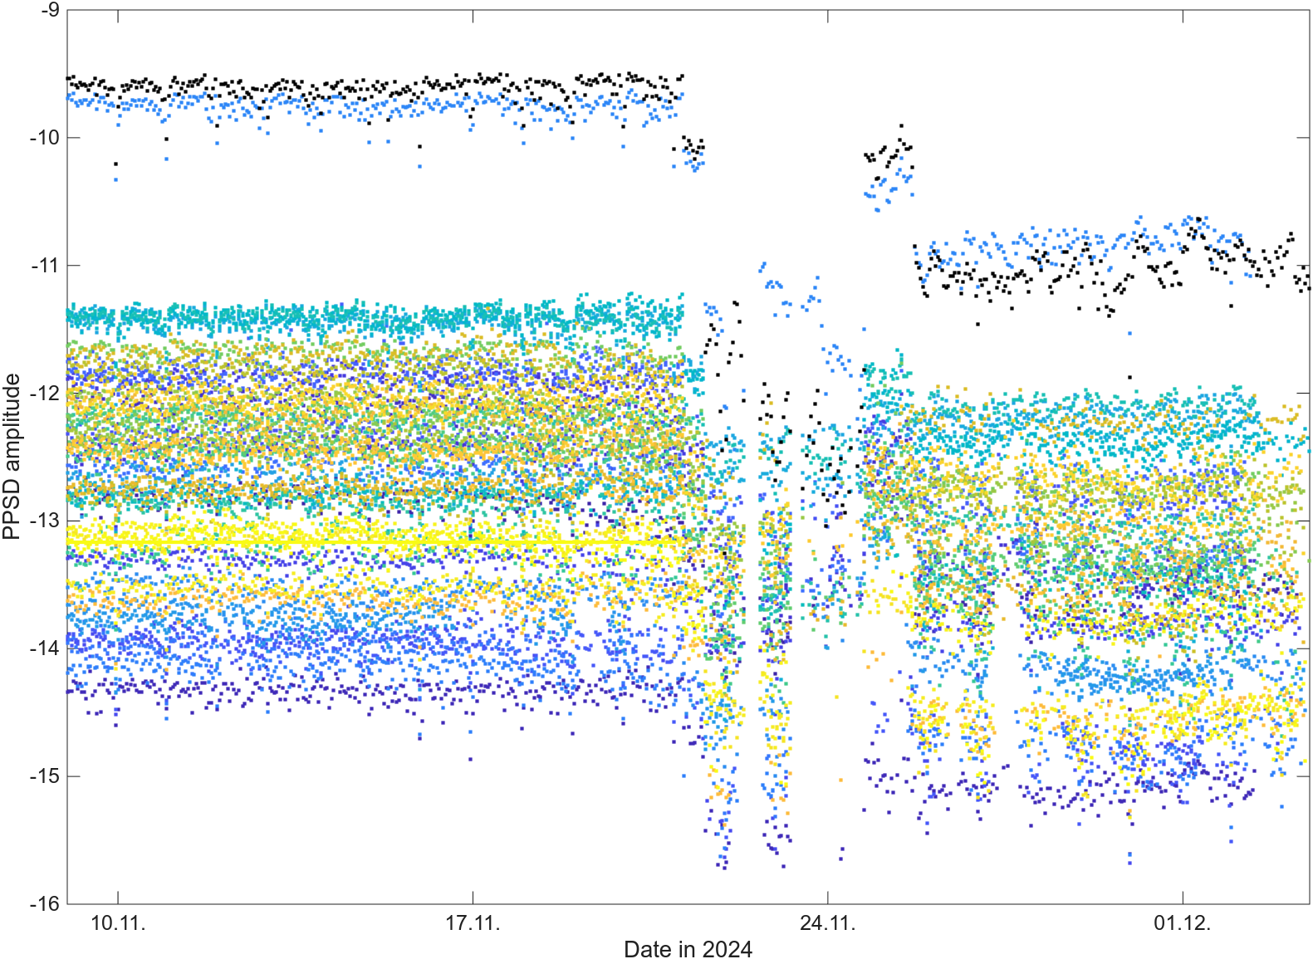
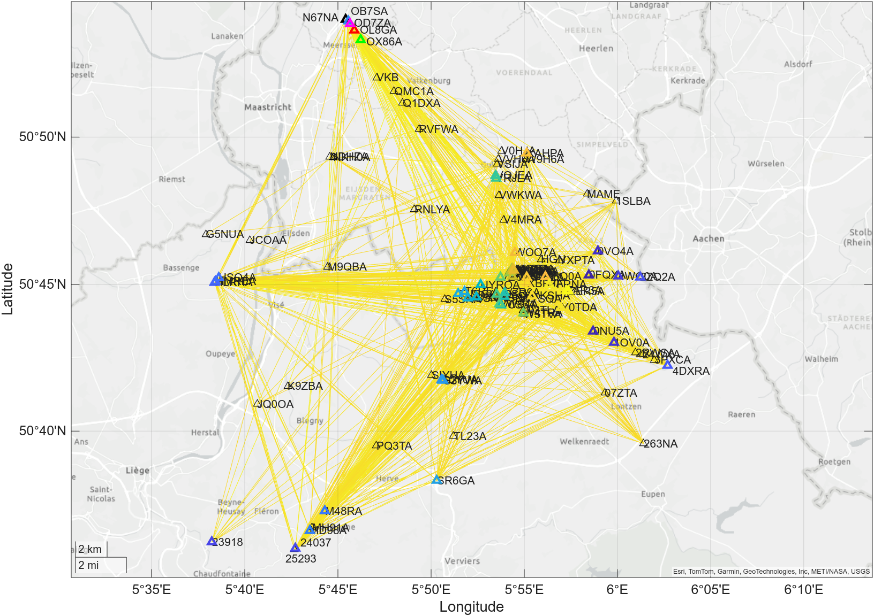
For the deployment in 2024, we try to identify all stations that show a common temporal evolution of the 3.125 Hz signal, i.e. a Pearson coefficient >0.9 for all hours with a distinct amplitude peak at 3.125 Hz
N67NA
OB7SA
Colored stations with Pearson coefficient > 0.9 wrt. to N67NA
PPSD time evolution of stations with of Pearson coefficient > 0.9 with respect to station N67NA

Slide 7
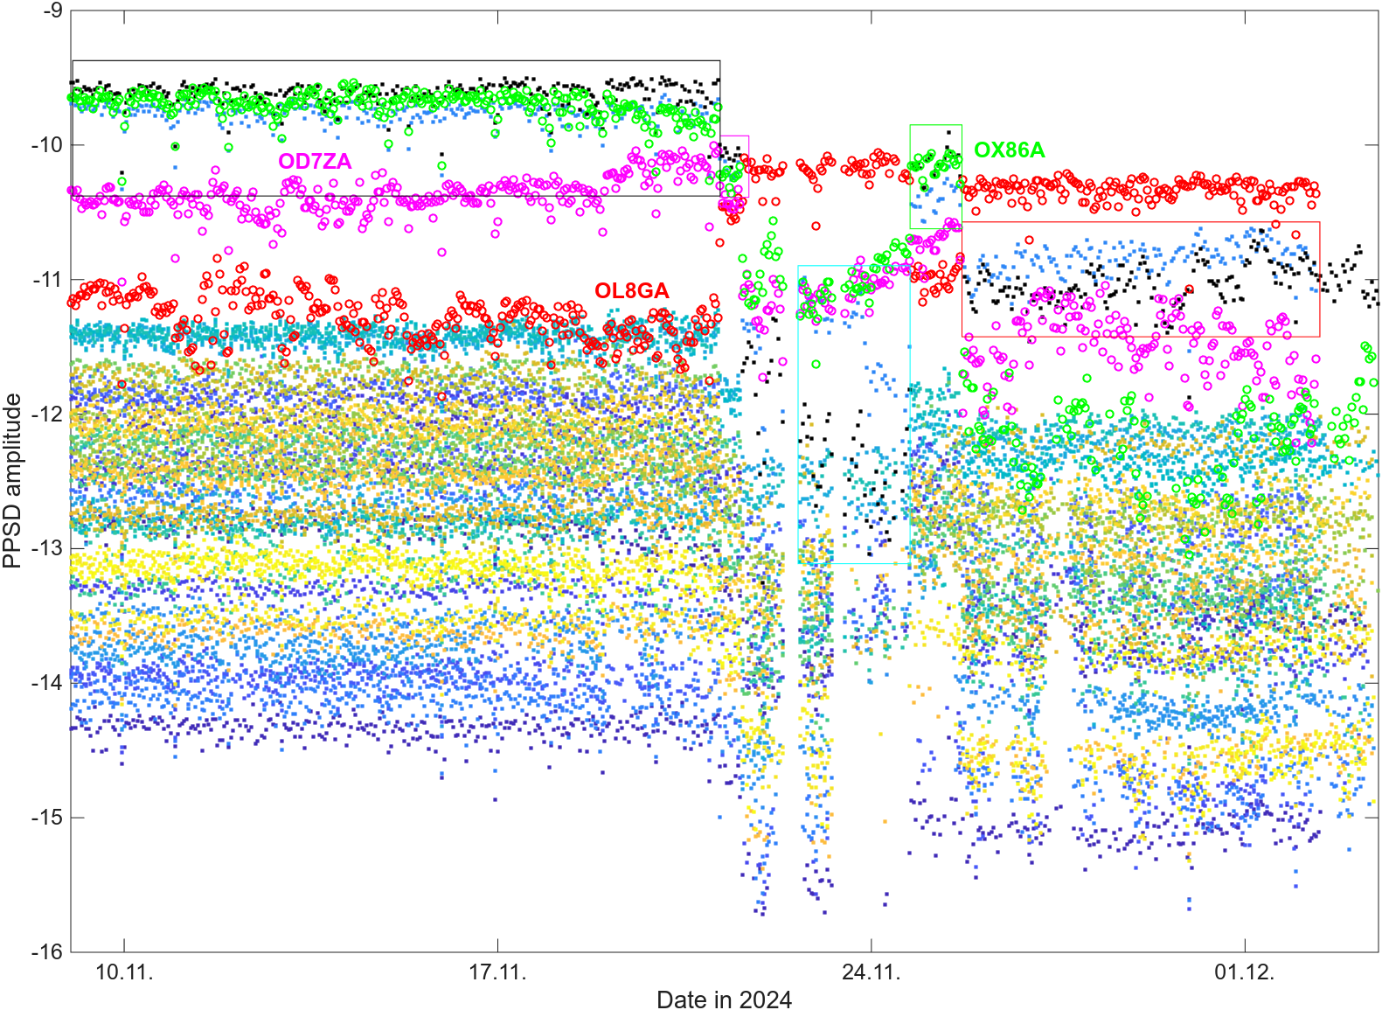
For the deployment in 2024, we try to identify all stations that show a common temporal evolution of the 3.125 Hz signal, i.e. a Pearson coefficient >0.9 for all hours with a distinct amplitude peak at 3.125 Hz
N67NA
Colored stations with Pearson coefficient > 0.9 wrt. to N67NA
However, there a stations very close to N67NA (namely OD7ZA, OL8GA and OX86A) that show a very different amplitude time evolution than N67NA
This hints at different sources for the 3.125 Hz signal that are active at different times.

Slide 8
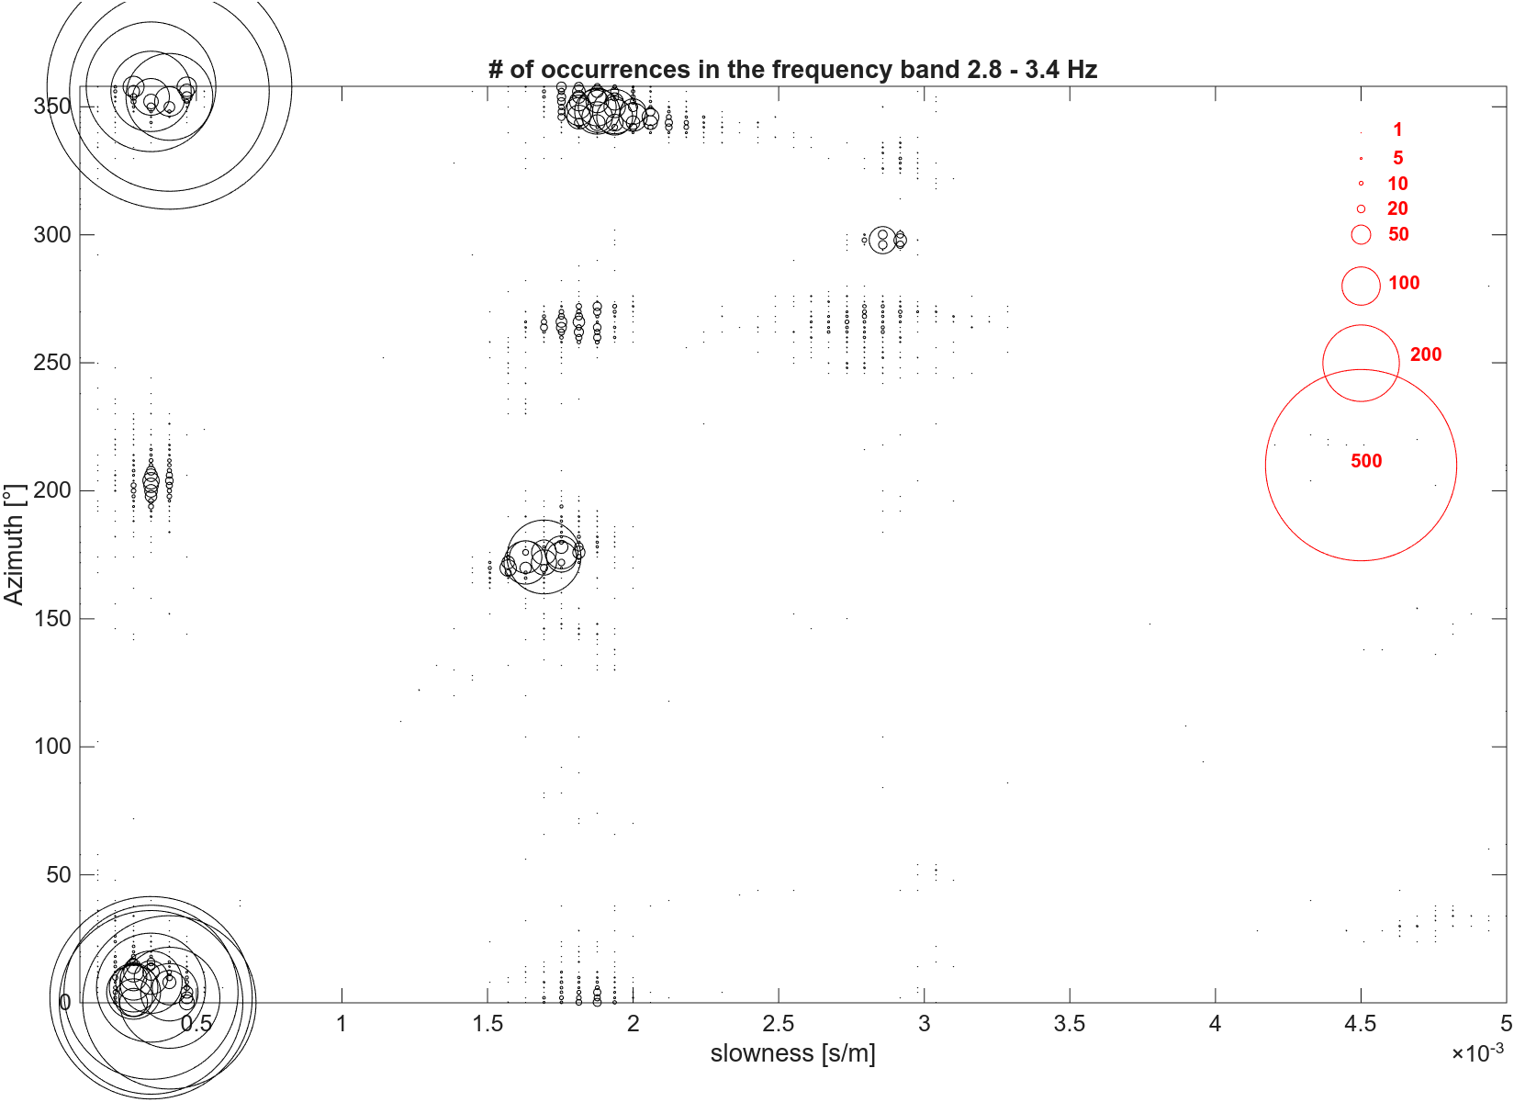
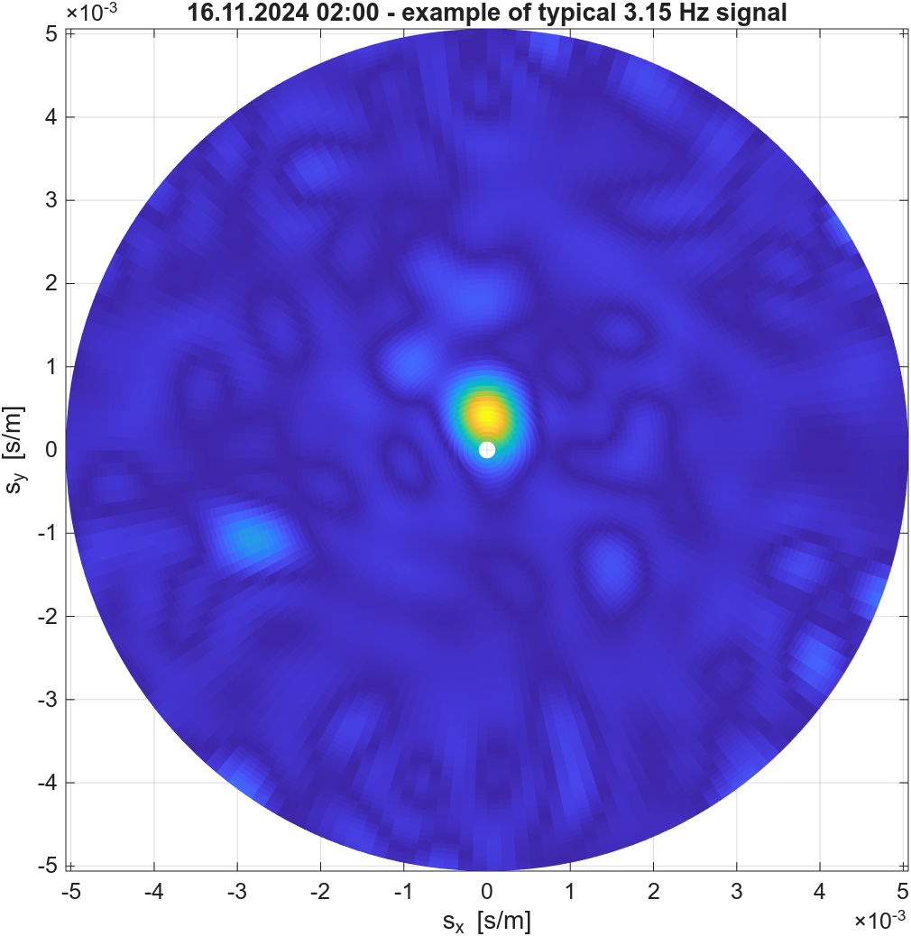
What wavefield character has the 3.125 Hz signal?
Z-component beamforming
TERZ
If we perform classical array analysis using the vertical components of the TERZ subarray in the frequency band of interest (2.8-3.4 Hz), we obtain slowness values too high for surface waves at the corresponding frequencies -> body waves constitute the signal
The signal origin is toward the north from TERZ
TERZ
subarray

Slide 9
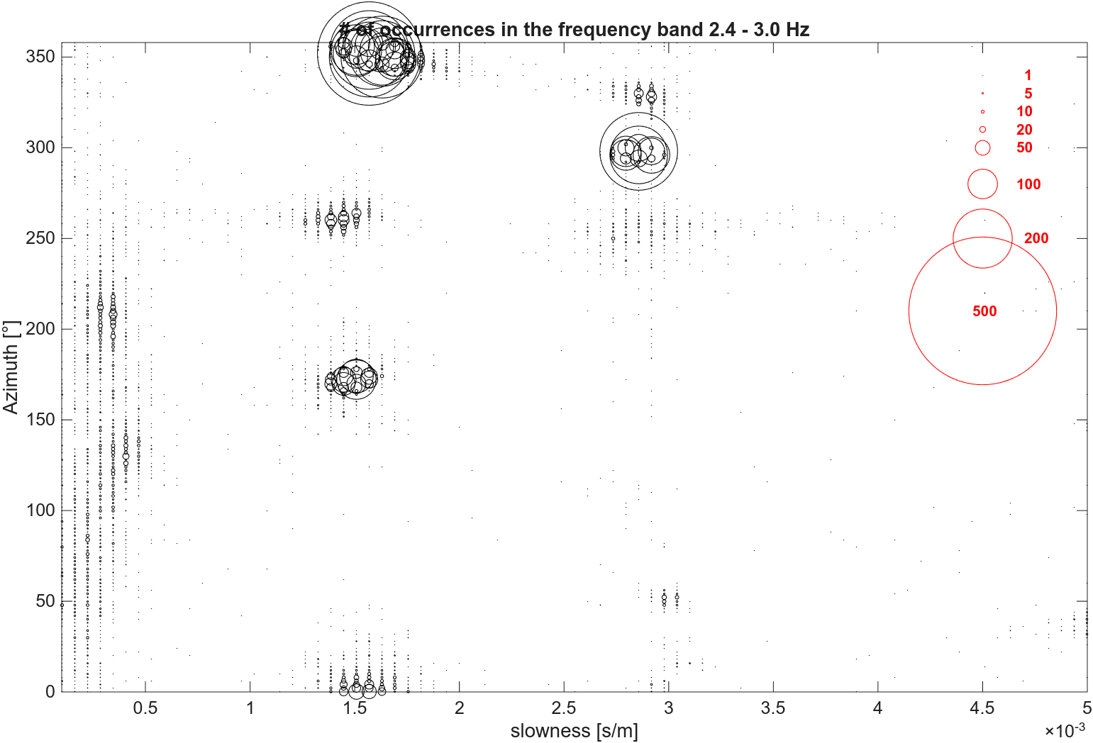
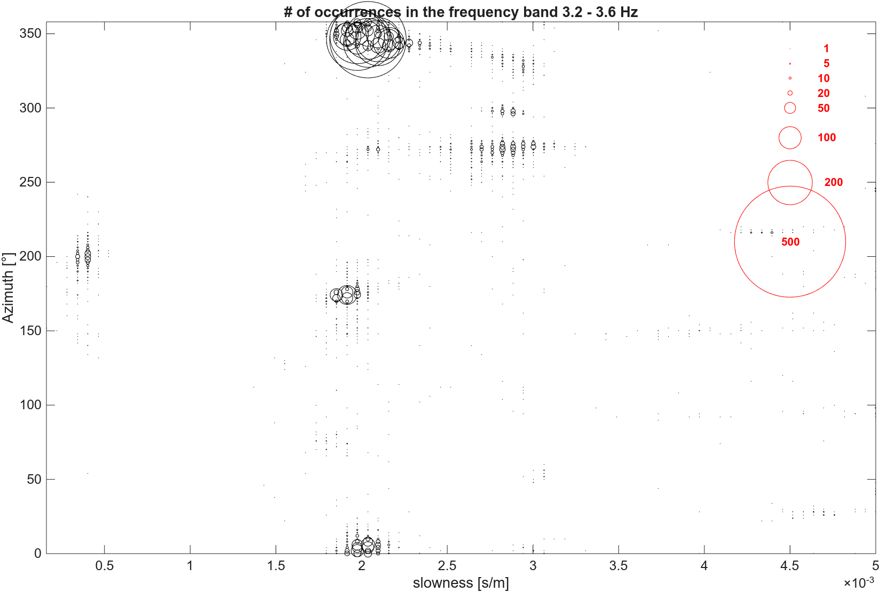
Z-component beamforming results for the adjacent frequency bands (2.4 – 3.0 Hz and 3.2. – 3.6 Hz) mainly show surface waves as dominant signals with higher velocities for the lower frequency band as expected

Slide 10
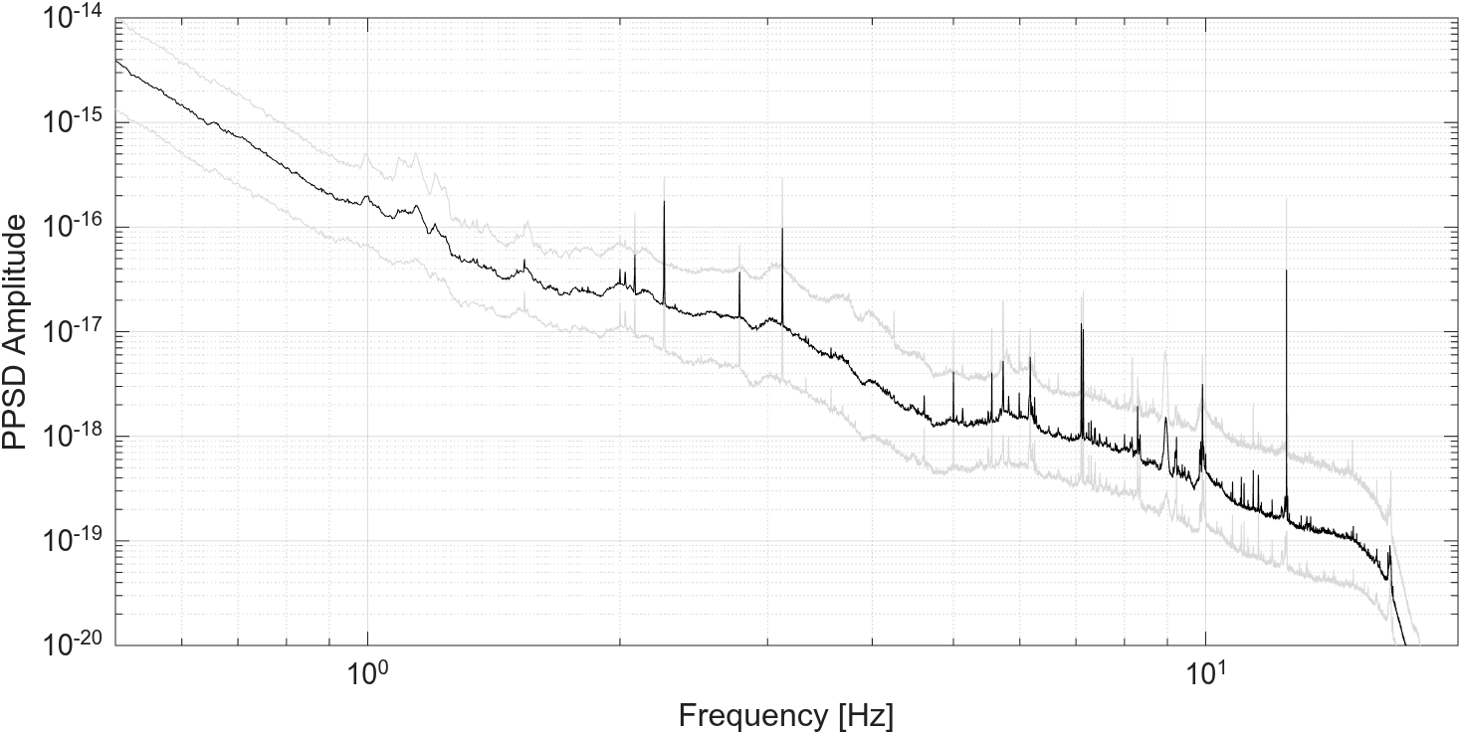
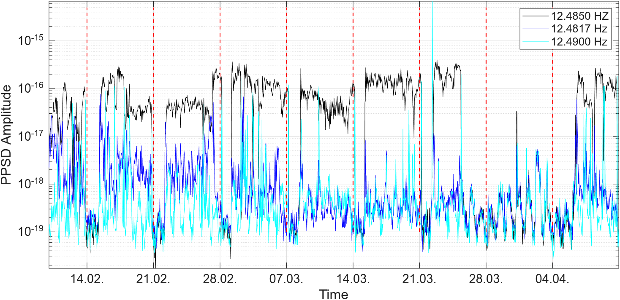
Prominent amplitude peaks at the borehole station TERZ
During the deployment of array 4 an exceptionally strong peak at a frequency of 12.485 Hz is observed.
-
The source of this peak could be identified by analyzing the coherence between the borehole station and the surface sensors.
Median and 10th and 90th percentile for the time interval 10.02.2020-10.04.2021 for NL.TERZ.01.BHZ

Slide 11
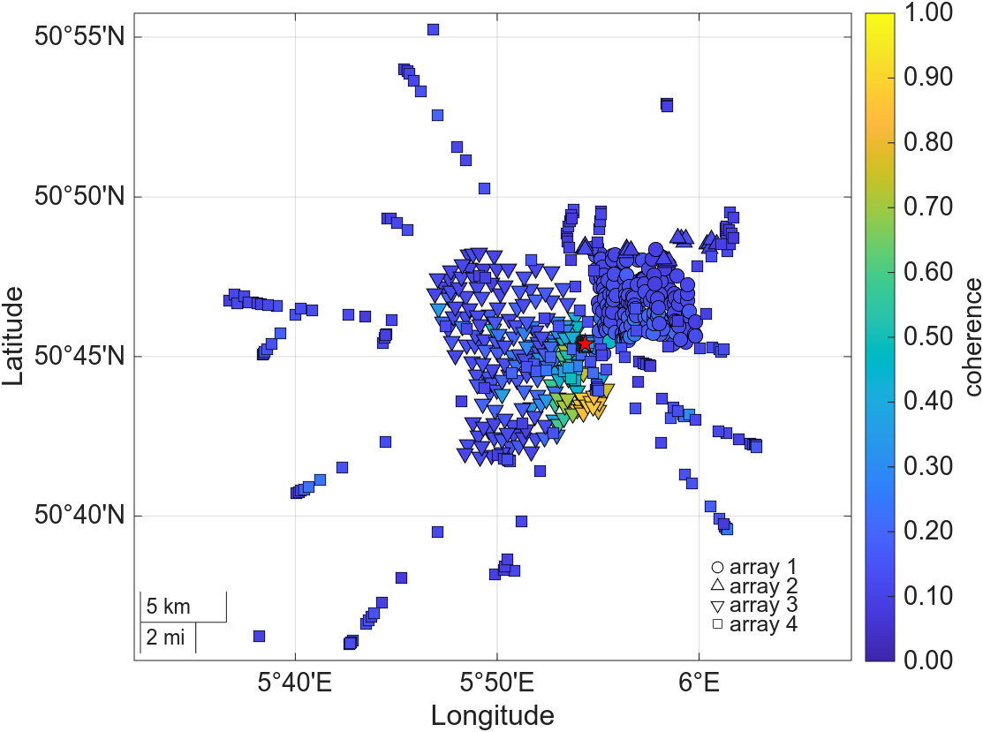
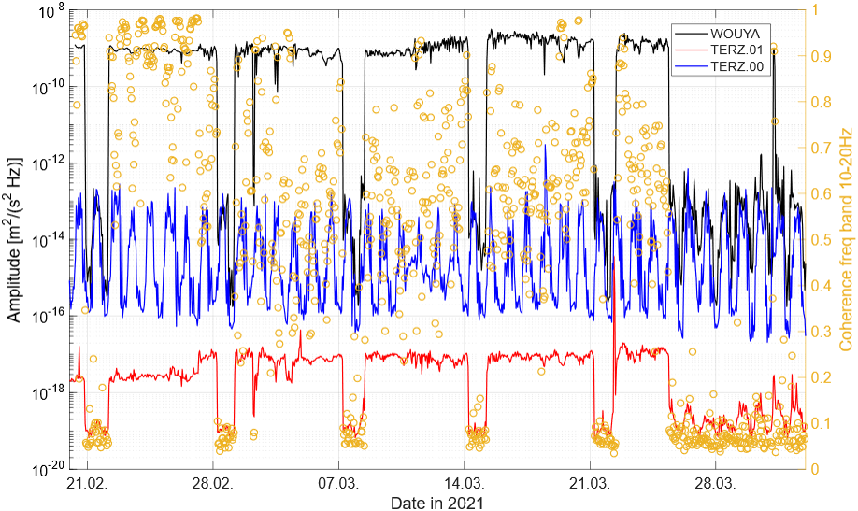
Temporal evolution of the PPSD amplitude at borehole station TERZ.01, surface station TERZ.00 and surface station WOUYA. Shown is always the vertical component PPSA amplitude in one hour resolution and the coherence in the frequency band 10-20 Hz between TERZ.01 and WOUYA.
WOUYA
90th percentile of the coherence between the z-component of station TERZ.01 and all surface stations from all deployments.

Slide 12
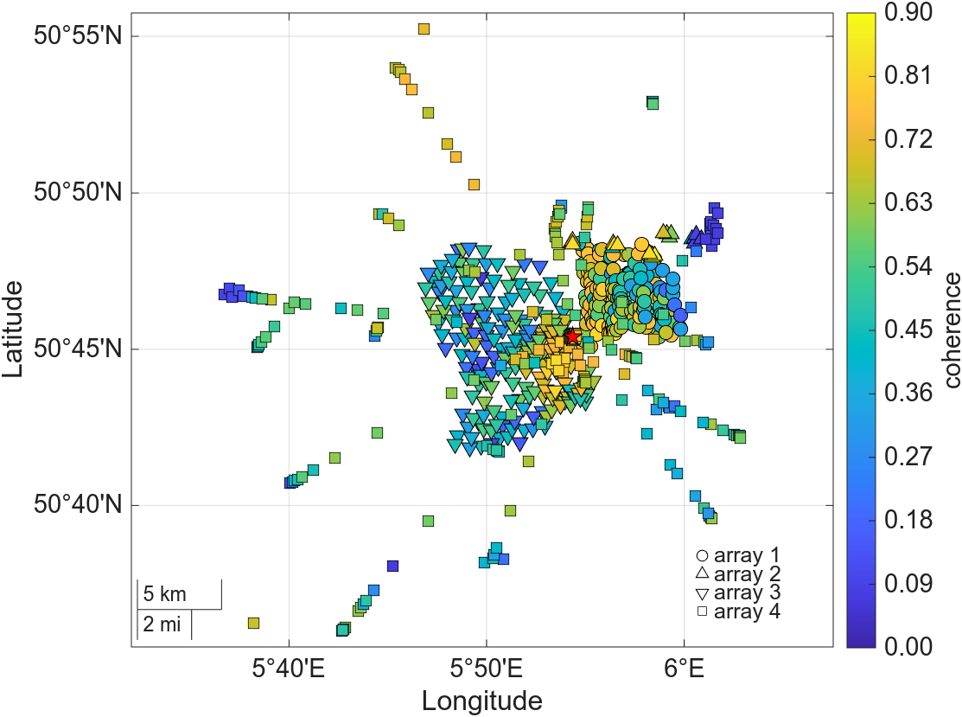
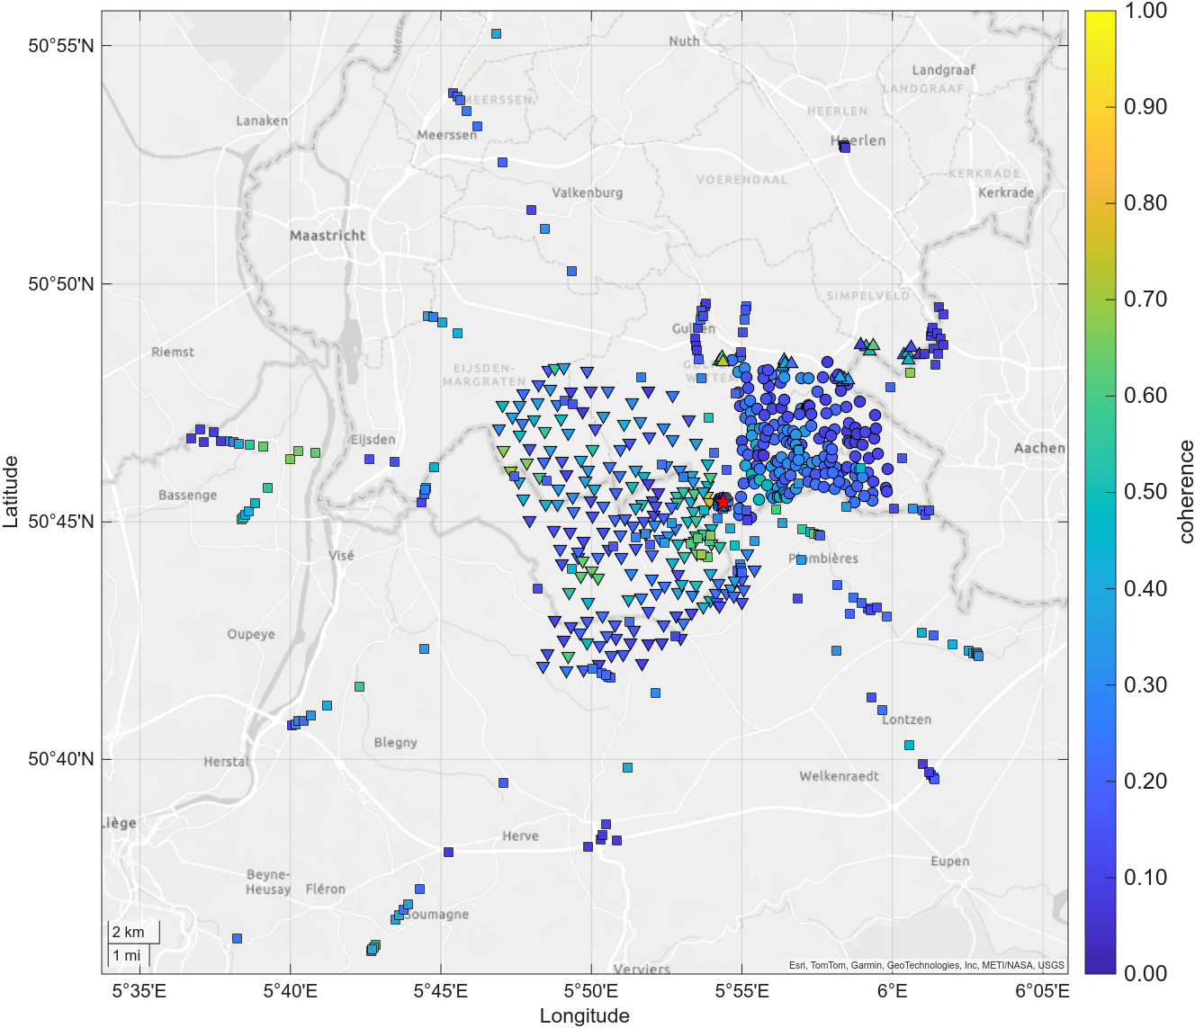
This approach can of course also be used for other frequency bands and percentile values
2.5 – 5 Hz
5 – 10 Hz
Sensors close to wind turbines always show very low coherence with borehole sensors which might be due to the near field effects

Slide 13
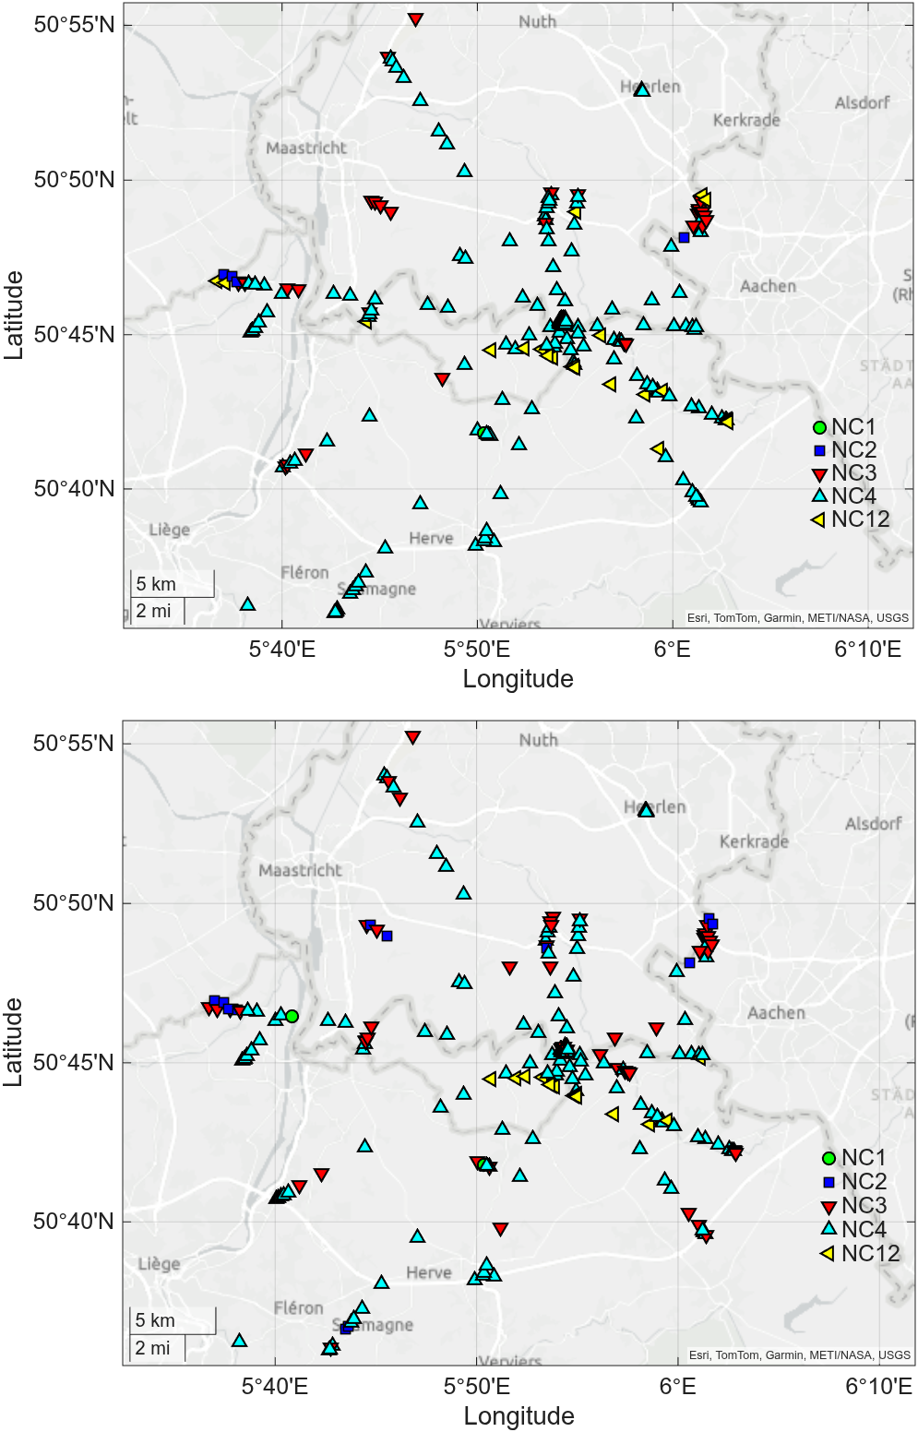
Noise analysis following Groos and Ritter (2009)
By analyzing the distrubution of the seismic amplitudes at a station you can get an idea if these amplitudes follow a normal distribution or are influenced by transient signals of different amplitudes
Daytime 2024
Nighttime 2024
Noise class 12 (NC12) e.g. in dicates an amplitude distribution that is governed by exceptionally high amplitude transients and nicely shows the train track

Slide 14
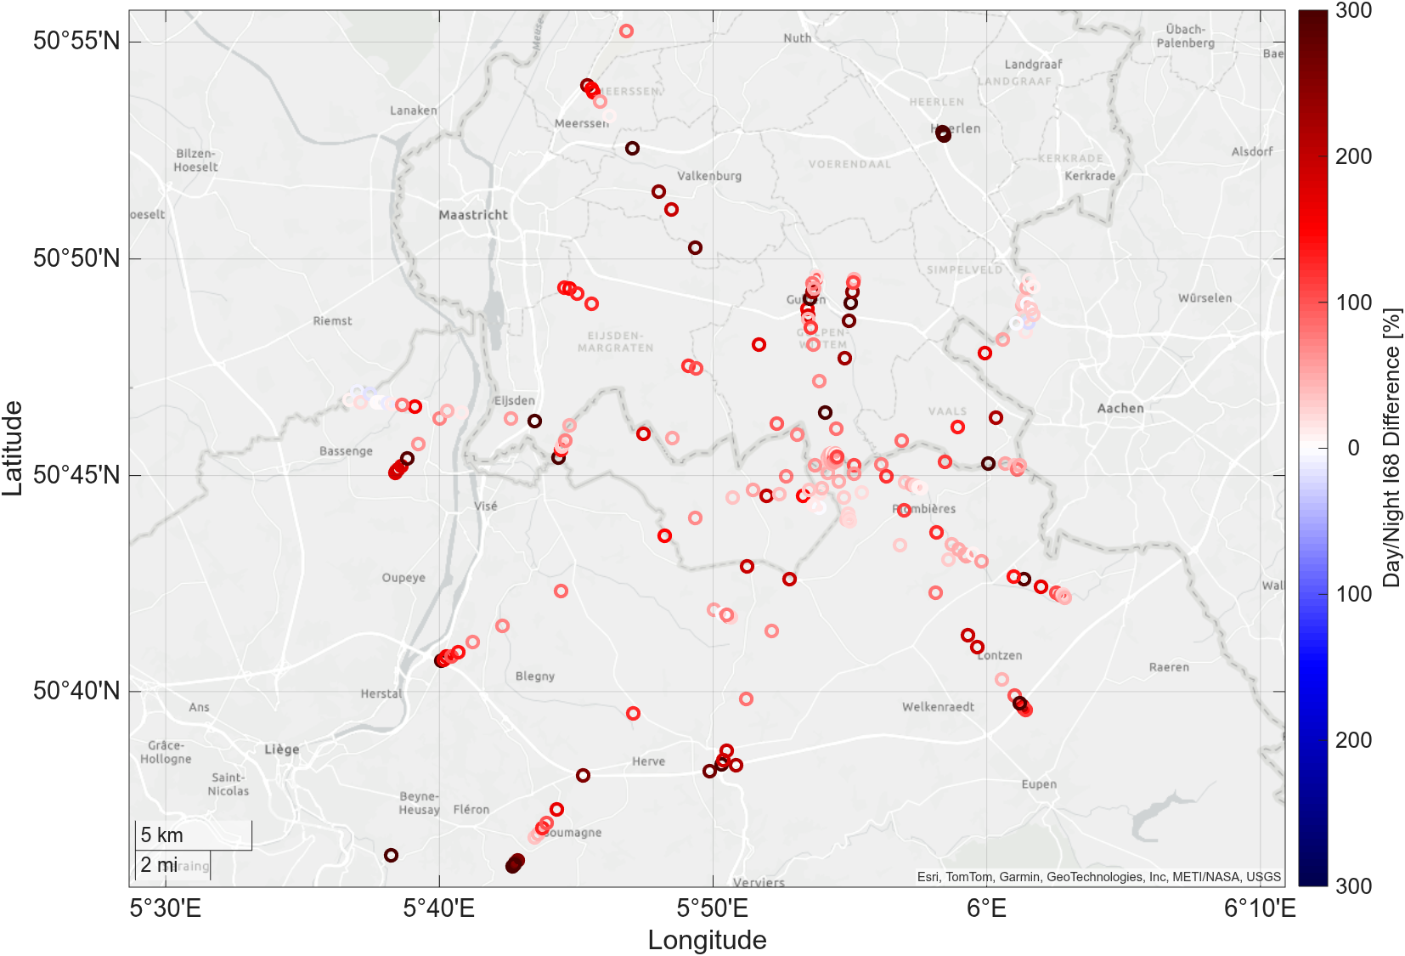
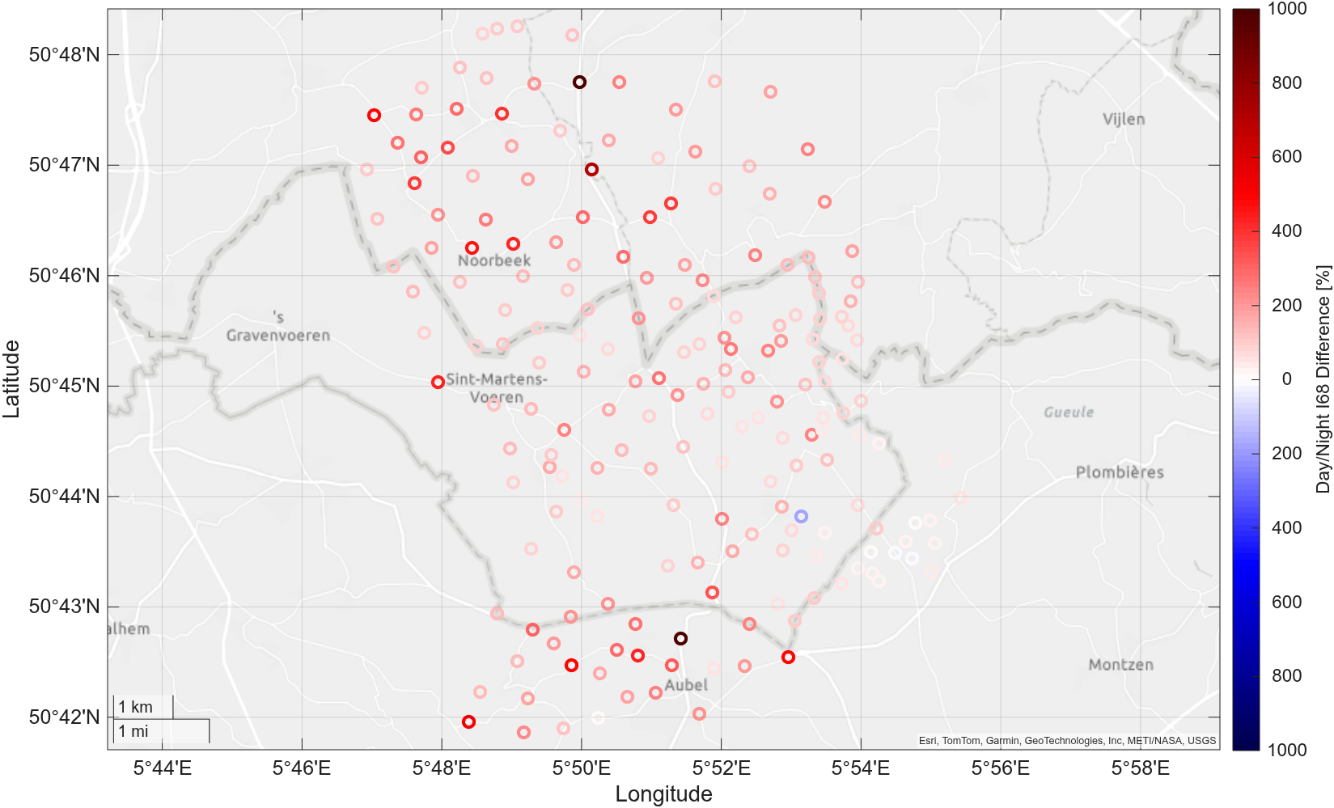
By comparing the amplitude percentiles of the analysis for day- and nighttimes you can also get an idea which stations are more influenced by human activity
Array 4 2024
Array 3 2021
Wind mills
Wind mills

Slide 15
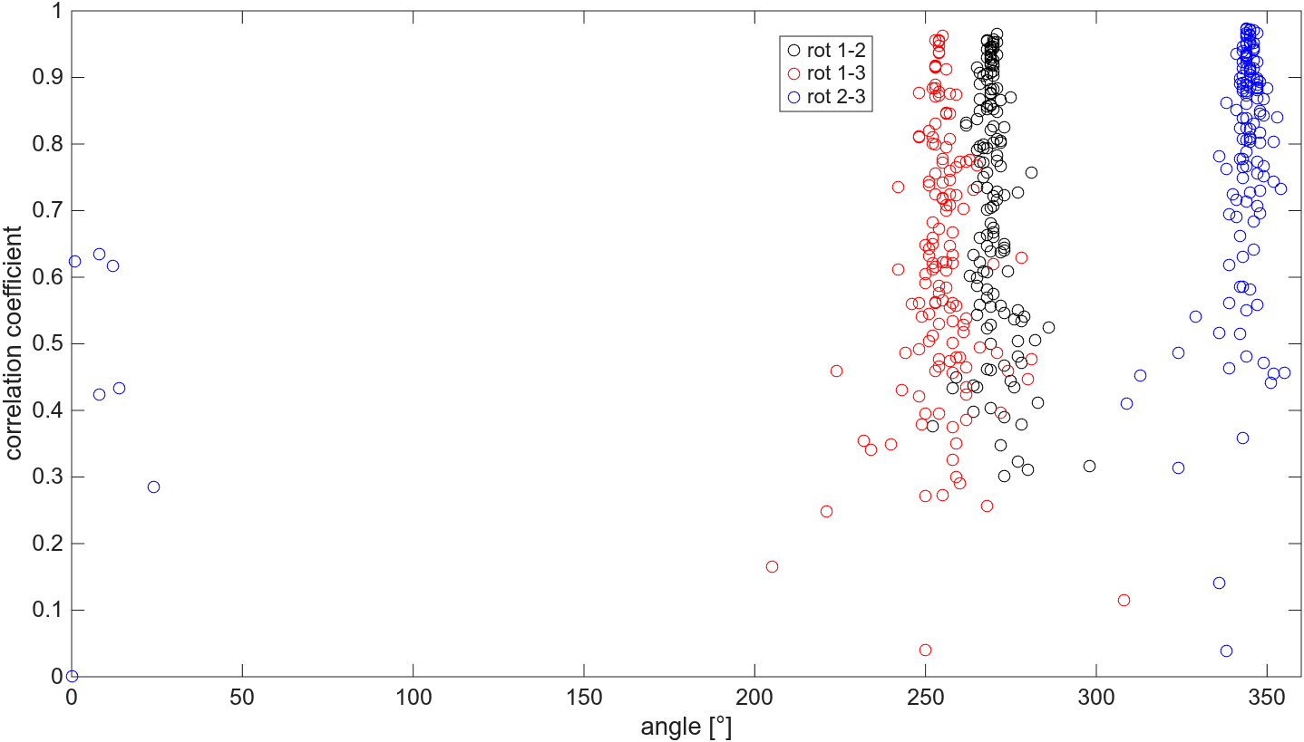
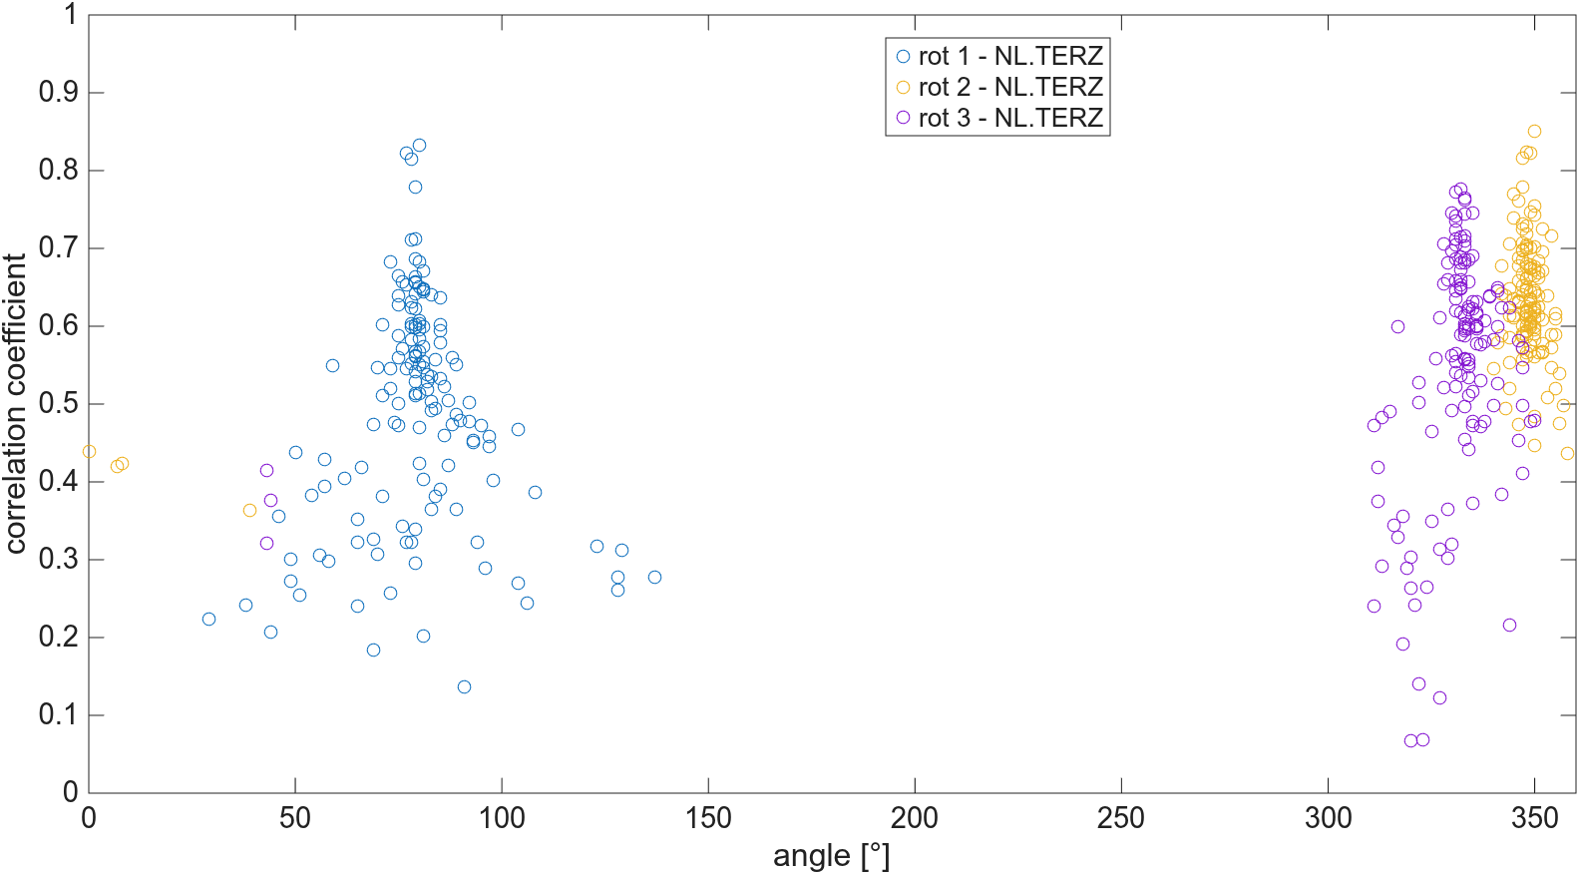
Re-alignment of the horizontal components of the TERZ subarray
Idea: Use the data of the horizontal components filtered in the ocean microseism frequency band (0.15 – 0.25 Hz) to determine the relative orientation of the horizontal sensors
Results are confirmed when we do the same analysis using the permanent broadband surface station TERZ.00 and the temporary stations
TERZ
TERZ
subarray
Angle of second station with respect to first station for maximum value of the correlation coefficient between fixed and rotated horizontal components

Slide 16
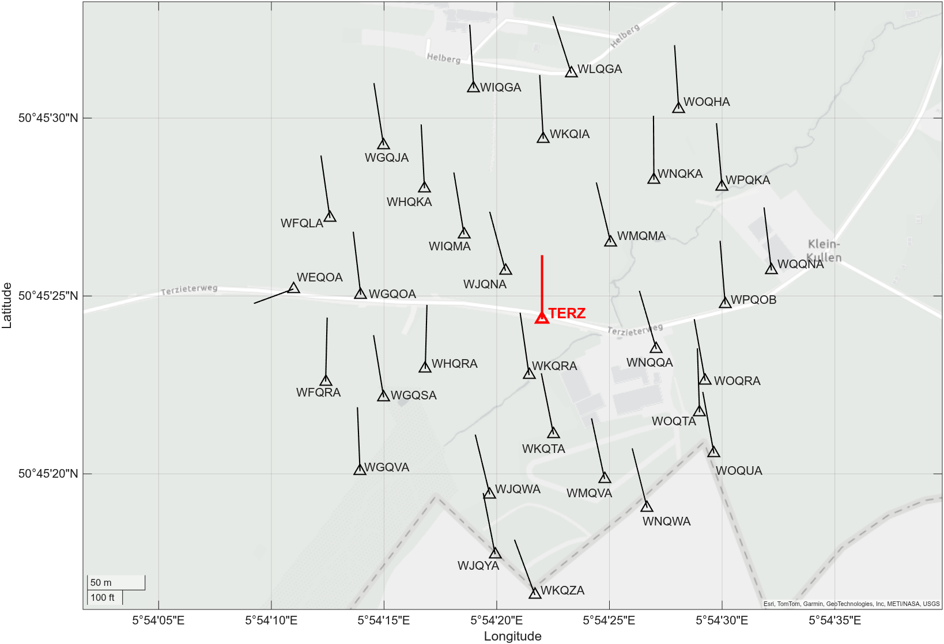
If we do the analysis for all temporary surface stations and hold broadband station TERZ.00 fixed as ‚true‘ north, we see that nearly all stations show a very consistent orientation of the N component.
Maybe it is worthwile to re-check the N orientation of the broadband station as the temporary stations show on average a slight westward shift with respect to TERZ.00

Slide 17
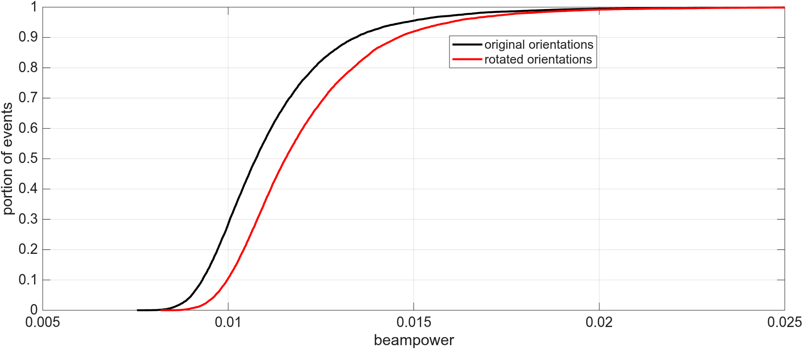
When we re-run our original beamforming analysis using the new orientations of the horizontal components of the temporary stations, we end up with a slightly higher beampower value (which is a rough measure of the waveform coherence) on average. This can be regarded as a proof that our re-alignment of the horizontal components improved the results

Slide 18
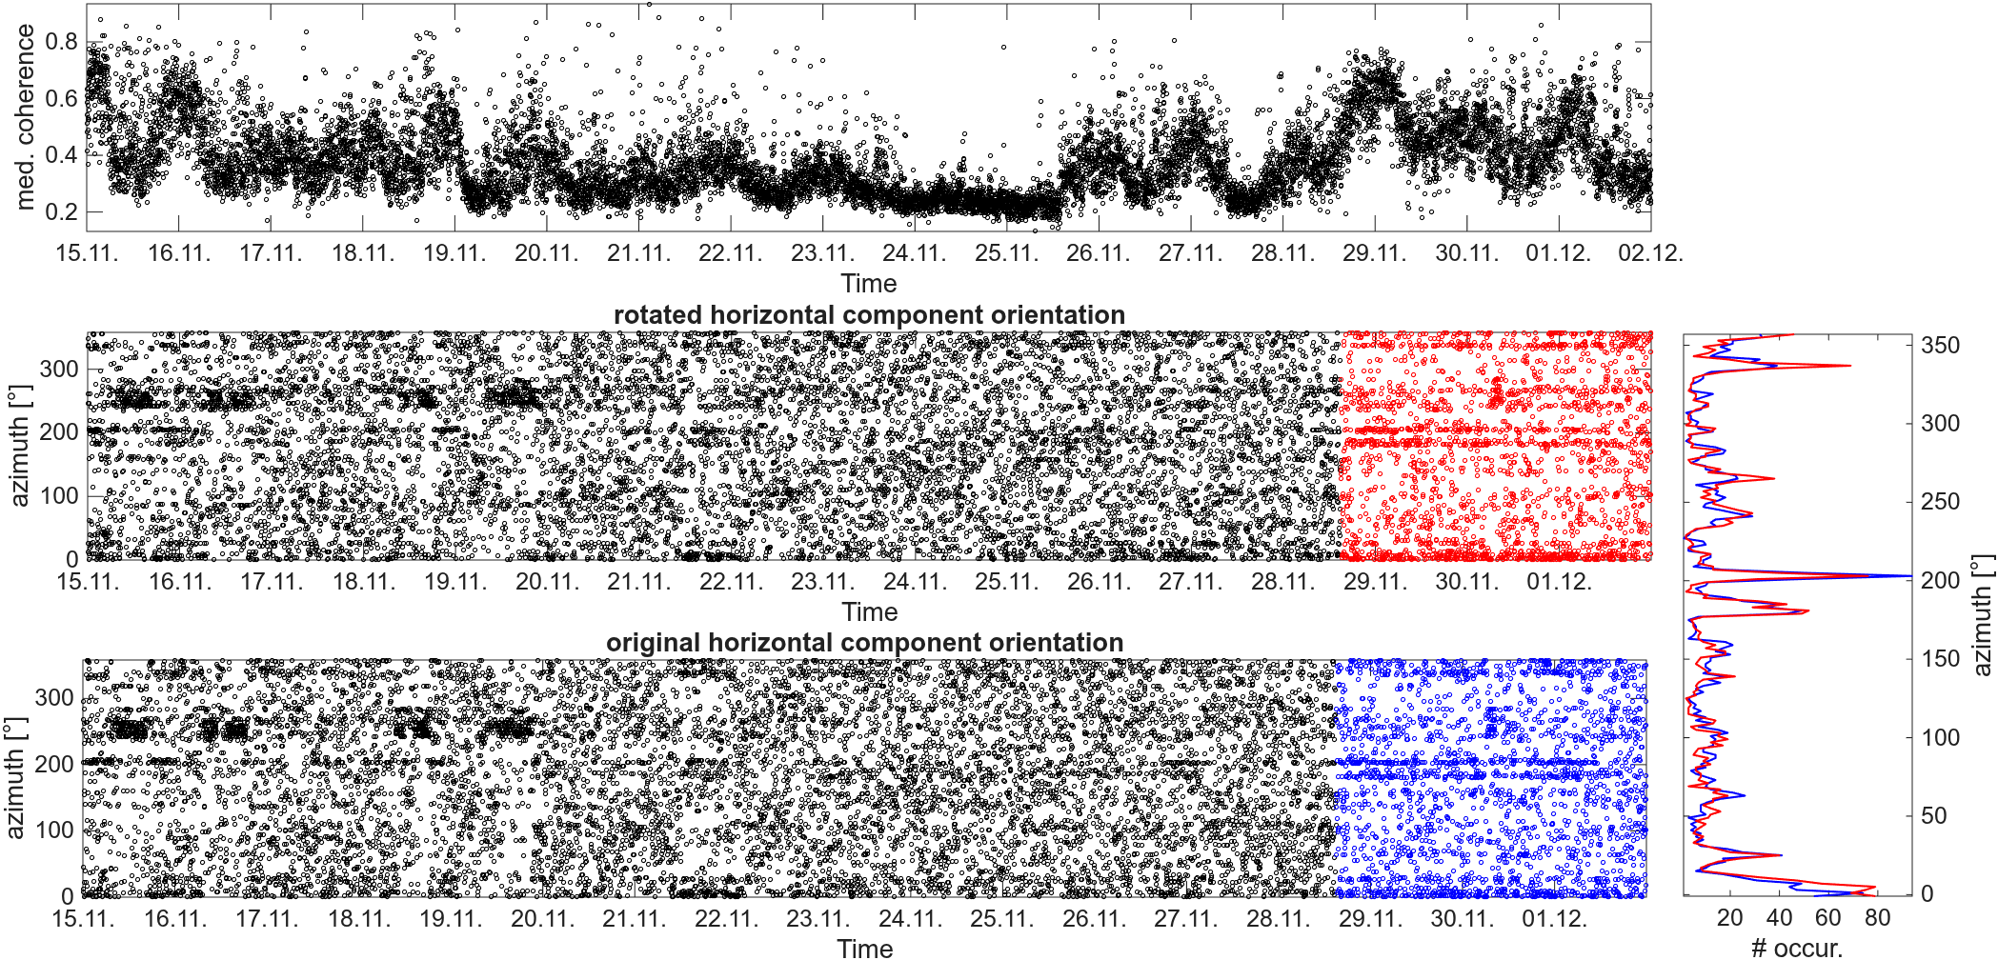
When you compare the results from the analysis with the rotated horizontal components for time intervals with the higher waveform coherence with the original results, you observe some slight changes. However, they are difficult to interpret…

Slide 19
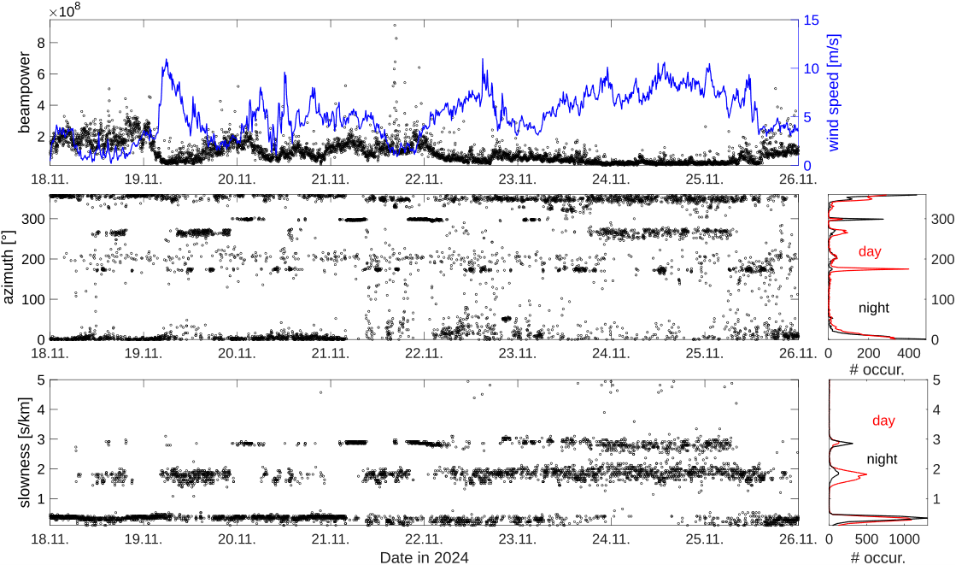
… and finally also some beamforming results
For the TERZ subarray we observe e.g. in the frequency band 2 – 3.5 Hz significant differences during night and day with respect to the azimuth (mainly N and WNE during night and also from S during the day) and slowness (higher contributions of surface waves during the day)

Slide 20
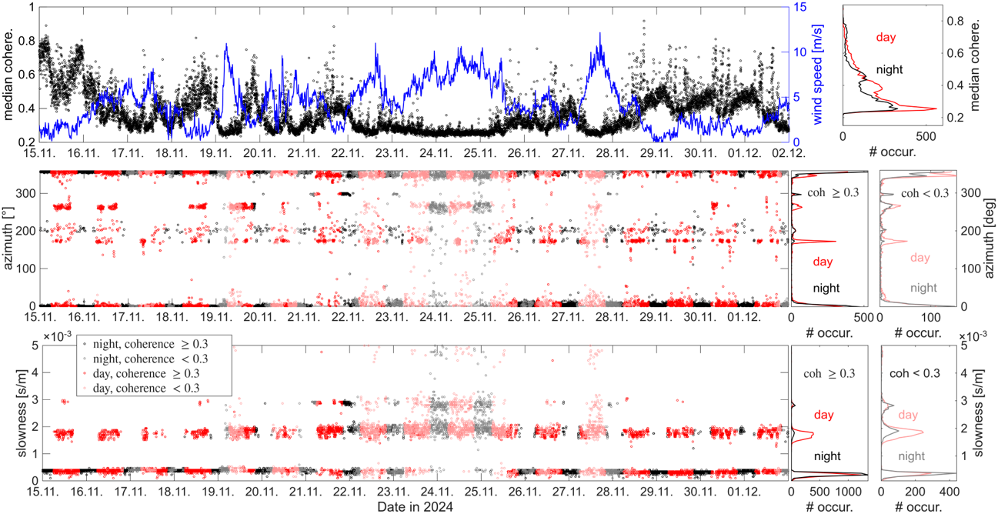
Z-component beamforming
As expected, beamforming results during time intervals with lower median coherence show a larger scatter with respect to azimuth and slowness values, while results seem to be more stable duringtime intervals with higher coherence

Slide 21
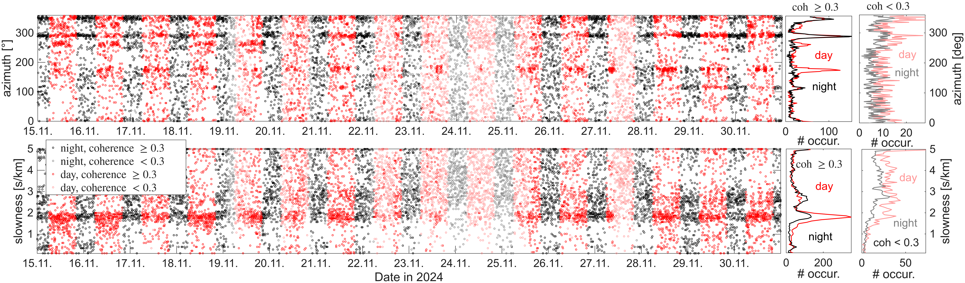
3-component beamforming for possible Rayleigh wave sources

