Slide 1
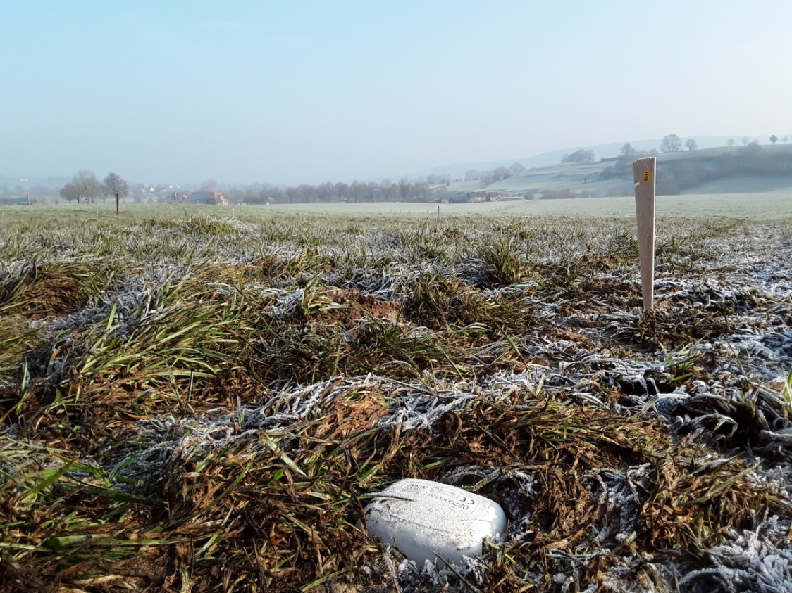








Understanding Newtonian noise in
Soumen Koley et al.
University of Liege

Slide 2
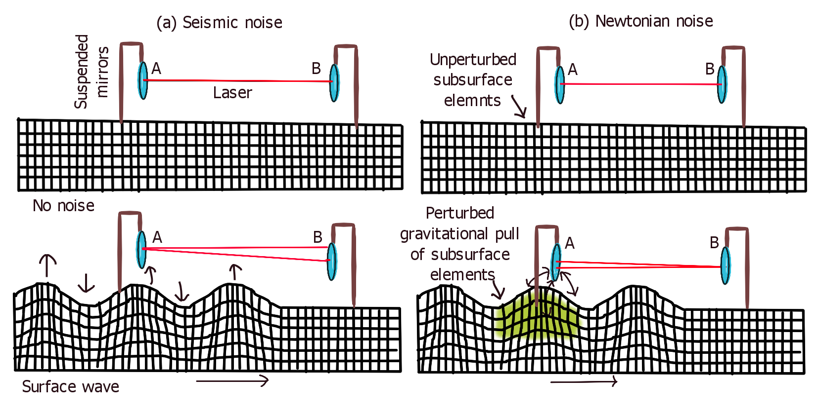
What is Newtonian noise?
Gravitational coupling of density fluctuations to the suspended optics of the detector
  Can be seismic or acoustic in origin
  Cannot be mechanically shielded from, due to the Newtonian coupling

Slide 3
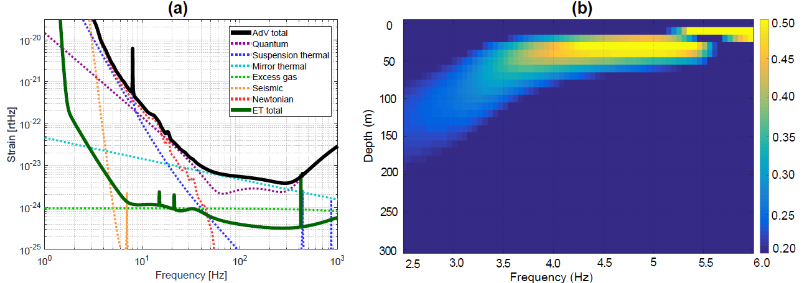

Why is Newtonian noise important for ET?
Low-frequency sensitivity of ET “is expected” be limited due to Newtonian noise
Only a reduced seismic ground motion can suppress Newtonian noise.
  Ground motion reduces by an order of magnitude as we go deeper ($≈300$ m) in the subsurface. Hence the need to build ET underground.

Slide 4
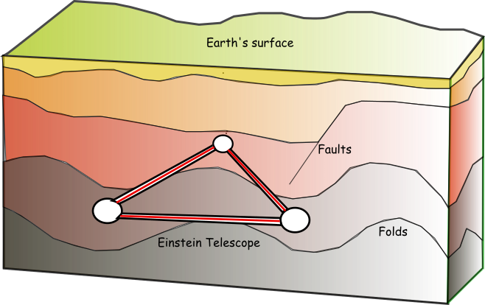

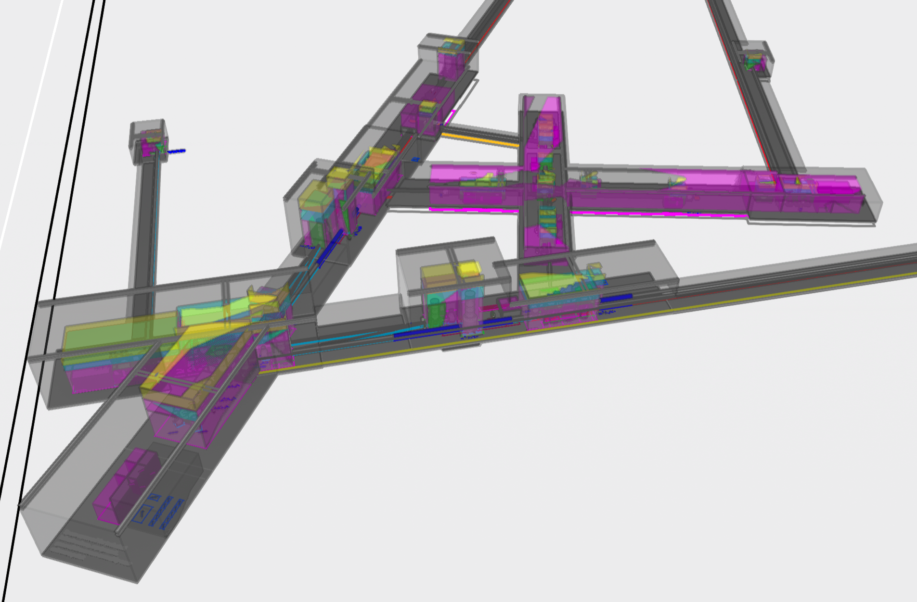
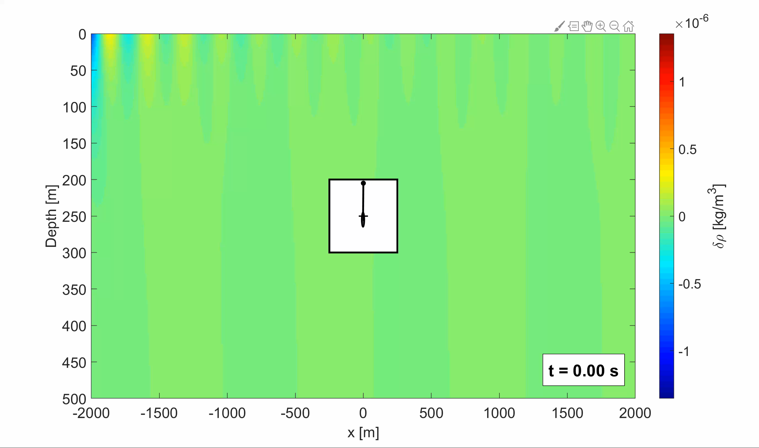
What are the factors that impact the level of Newtonian noise
Newtonian noise depends on the following factors
Subsurface geology
Infrastructure design
Types of sources
Compressive and shear strength of rocks
Density of rocks
Geological variations like faults, folds
Shape and size of caverns
Acoustic environment inside the caverns
Machines running in the infrastructure
Deterministic sources like roads, train-tracks, bridges, wind parks
Transients that cannot be modeled deterministically

Slide 5
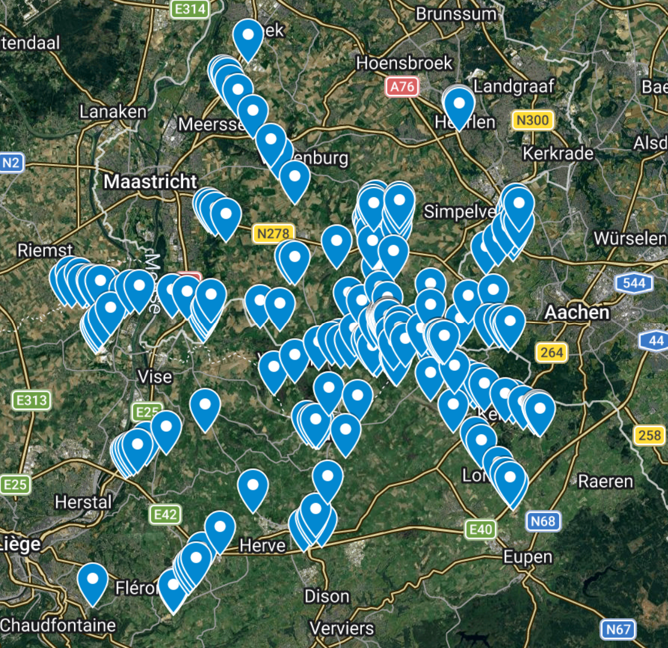
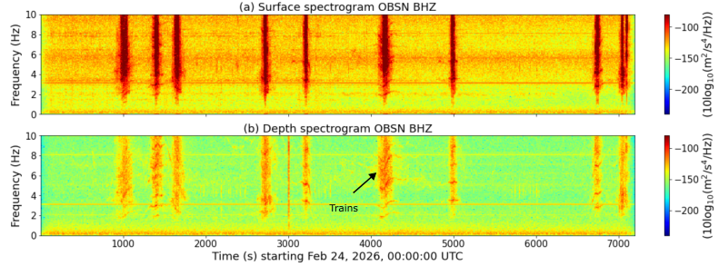
Challenge 1: Quantifying the geology and the site observables
Large seismometer arrays are deployed on the surface and underground in order to:
  Measure the seismic noise level on the surface and underground
  Simultaneously use this noise data to image the subsurface
12 km

Slide 6
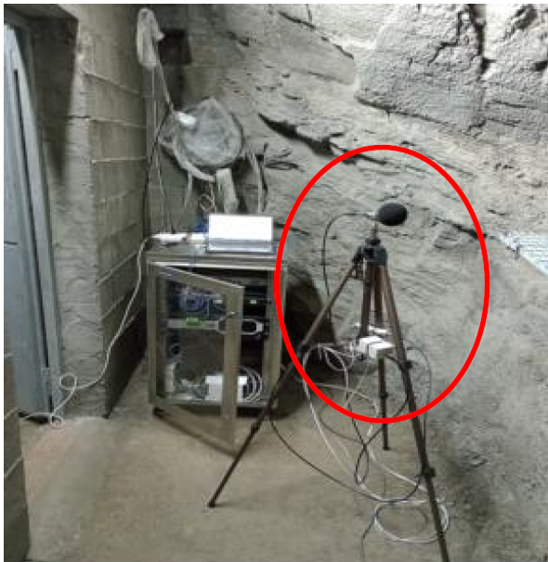
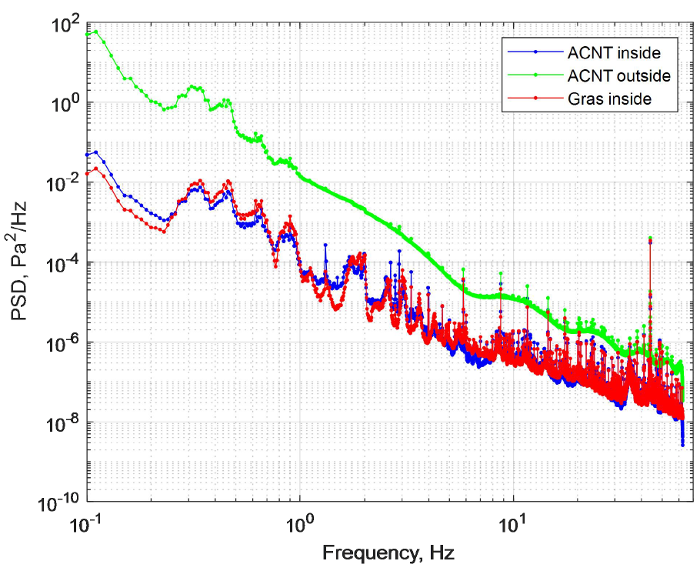
Challenge 1: Quantifying site observables with infrasound measurements
Infrasound microphone deployment on surface and in underground environments are analogous to seismometer deployments, but for acoustic monitoring
ET-TDS: ET-0420A-26

Slide 7
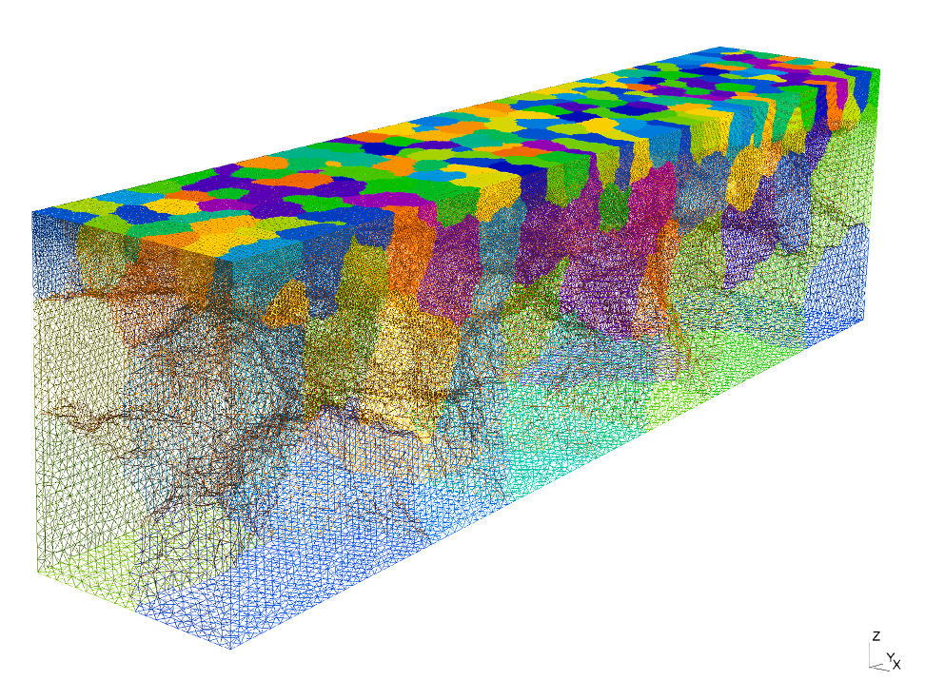
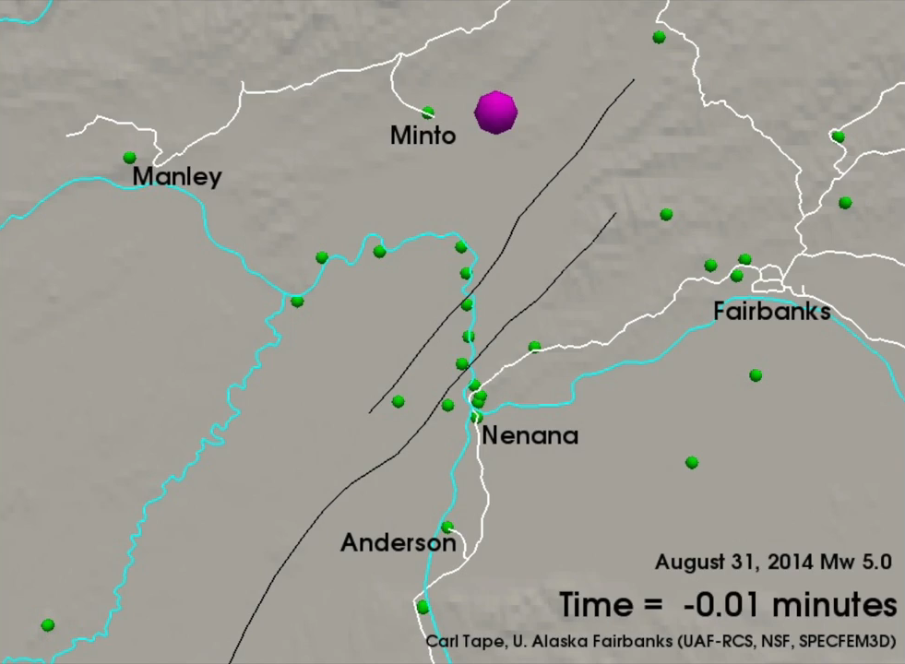
Challenge 2: Computing the seismic or acoustic wavefield for Newtonian noise modeling
Computationally the most challenging part is solving the acoustic and elastic wave-equations using finite element simulations
  Several solutions are being developed and tested
Tetrahedra based DDM solvers for both acoustic and elastic medium
SPECFEM3D class of solvers: SALVUS
https://specfem.org/
https://www.sciencedirect.com/science/article/pii/S0021999125008393

Slide 8
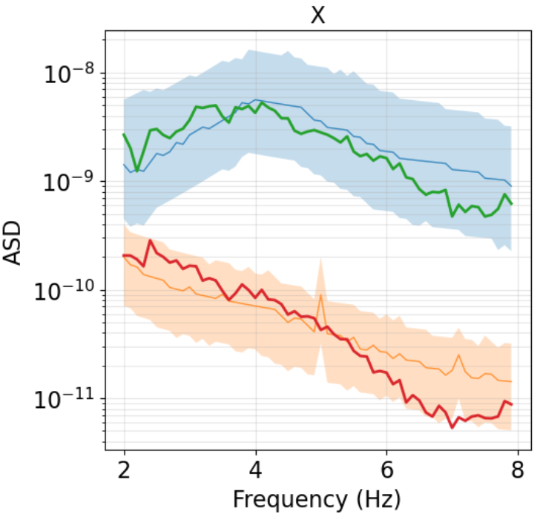
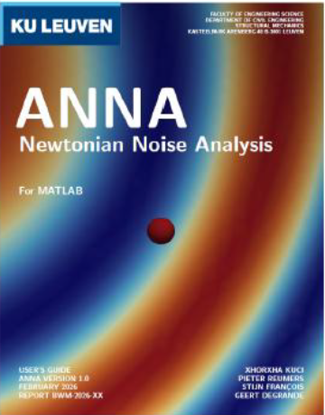
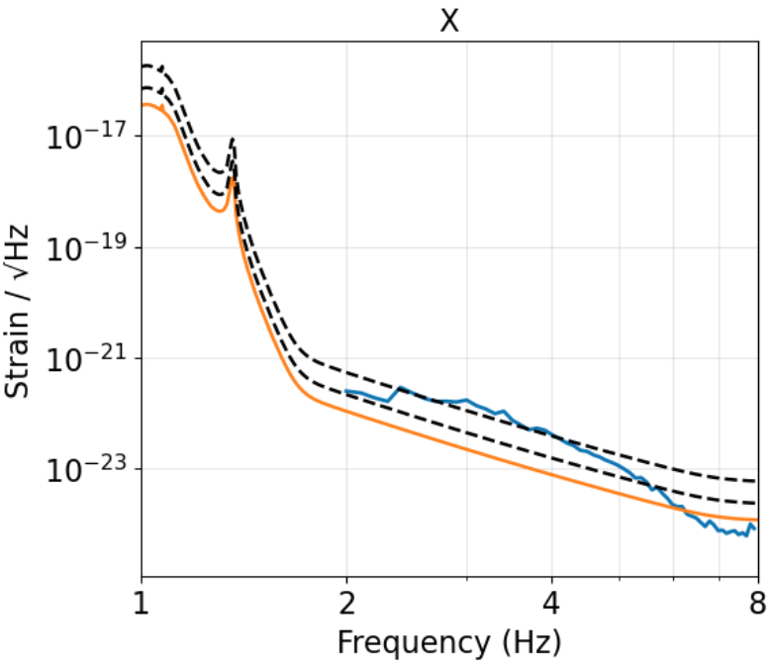
Challenge 3: Integrating the seismic displacement field to model Newtonian noise
This part remain computationally challenging (mathematically trivial) and can have huge I/O bottlenecks if not implemented on-the-fly
  Three software packages are currently being developed
    ANNA – KULeuven
    pySeisNN – Uliege
    NewtonForge-3D - GSSI
pySeisNN
Displacement simulation using specfem3D
Newtonian noise estimation on the fly – implemented within specfem3d
Supports multiple spherical and cuboid cavities
Includes scattering from cavity walls
Includes topography
ET-0360A-26, ET-0352A-26

Slide 9
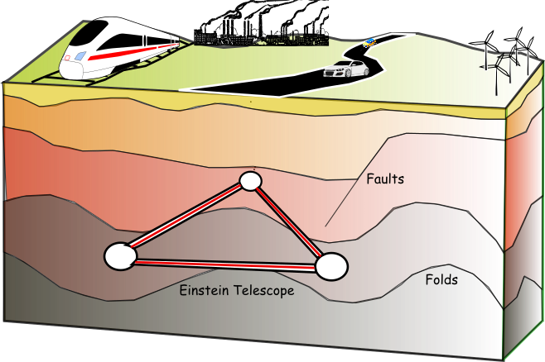
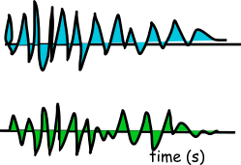


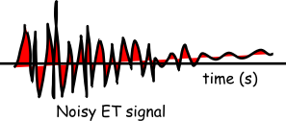
Challenge 4: Subtraction of modeled Newtonian noise using seismometers, microphones, strainmeters, tiltmeters
Once the Newtonian noise has been modeled we rely on observables like the seismic wavefield and the acoustic pressure to determine the efficiency of a cancellation system
Surface seismometers
Underground seismometers

Slide 10
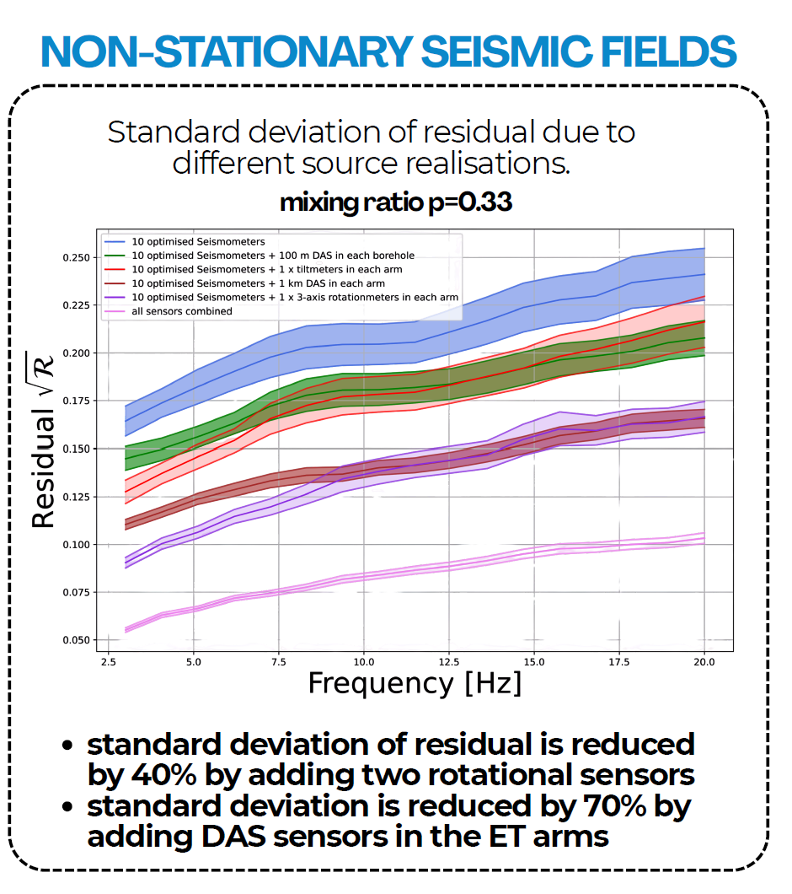
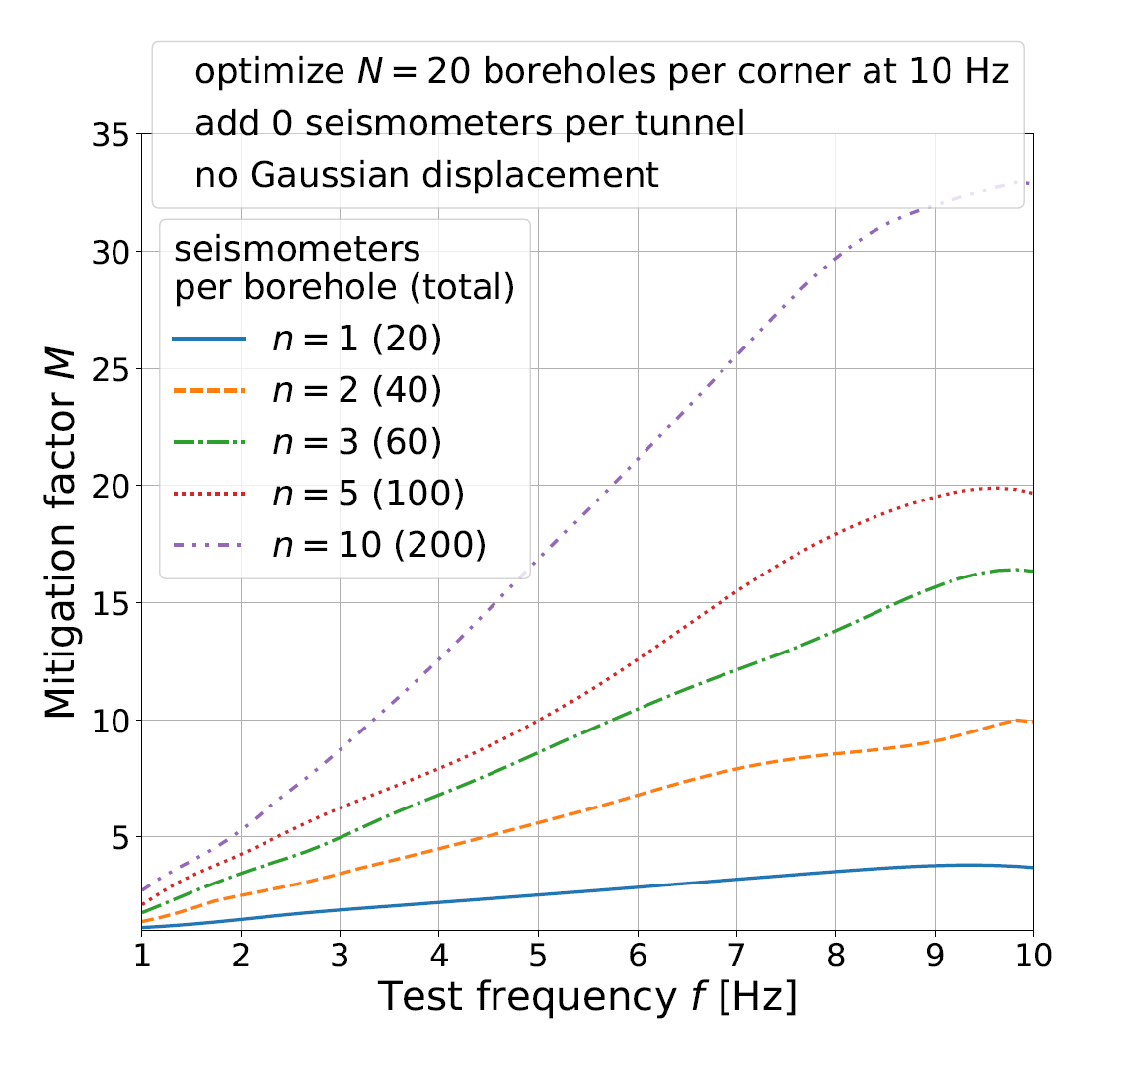
Challenge 4a: Where to position the witness channels for cancellation
A global optimization problem that maximizes the cancellation performance in the 2 – 10 Hz band for a given number of seismometers
Fusion arrays
ET-0293A-26
ET-0385A-26

Slide 11
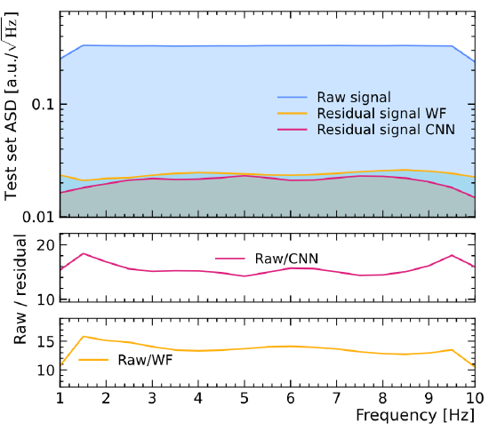
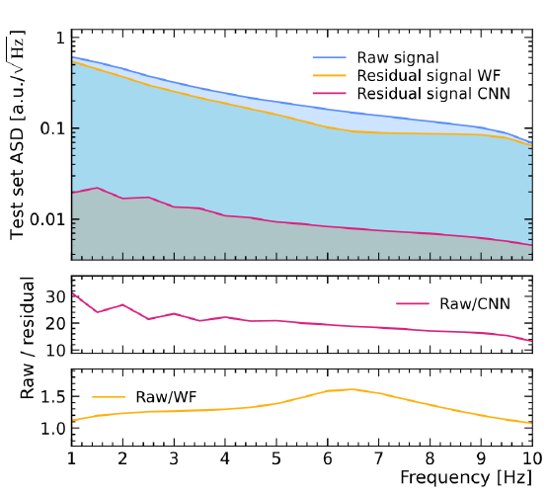
Challenge 4b: What techniques to use for cancellation – Wiener filters or ML?
Given the linear relation between the seismic/pressure field and the Newtonian noise, the easiest implementations are Wiener filters
  But usage of Neural Networks have shown tremendous improvement for canceling transient noise
  While it is comparable to Wiener filters for stationary noise
Non-stationary noise
Stationary noise
ET-TDS: ET-0420A-26

Slide 12
Newtonian noise modeling and cancellation – Where we are now!
Every stage of the modeling and cancellation pipelines are getting upgrades every week
  with an aim to understand the environment and mitigate its impact on the detector as realistically as possible
Lot of surveys completed and data analyzed
Acquiring seismic data/surveys
A much larger seismic survey in progress
Development ongoing to handle complicated caverns and layered geologies
Completed for 1D layered Earth structures
Modeling the seismic field
Currently getting integrated for complicated geologies
Autonomous validation
Modeling the Newtonian noise
Applied for homogeneous geologies/simple sources
Newtonian noise cancellation
Waiting for tests in complicated environment

Slide 13
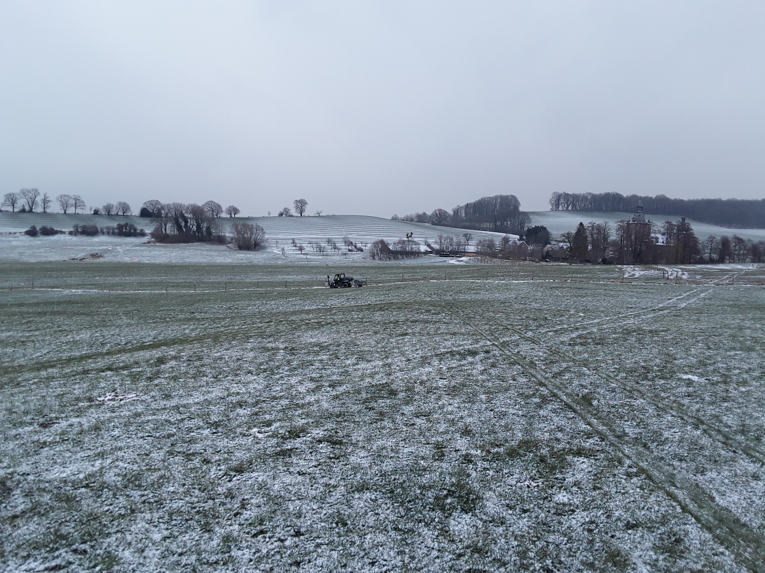
Questions?

