Slide 1

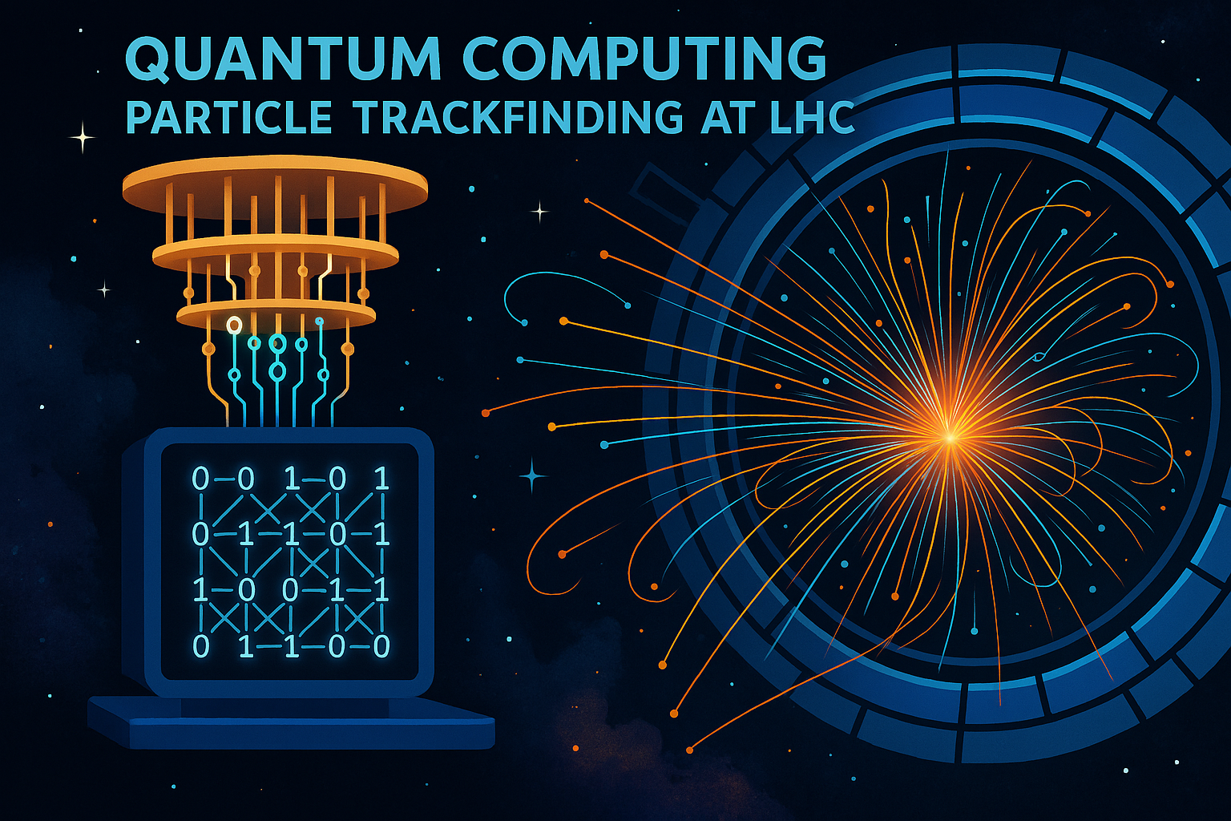
UM, June 8, 2026
WORKSHOP Particle Trackfinding with QC
Credit: chat-GPT

Slide 2


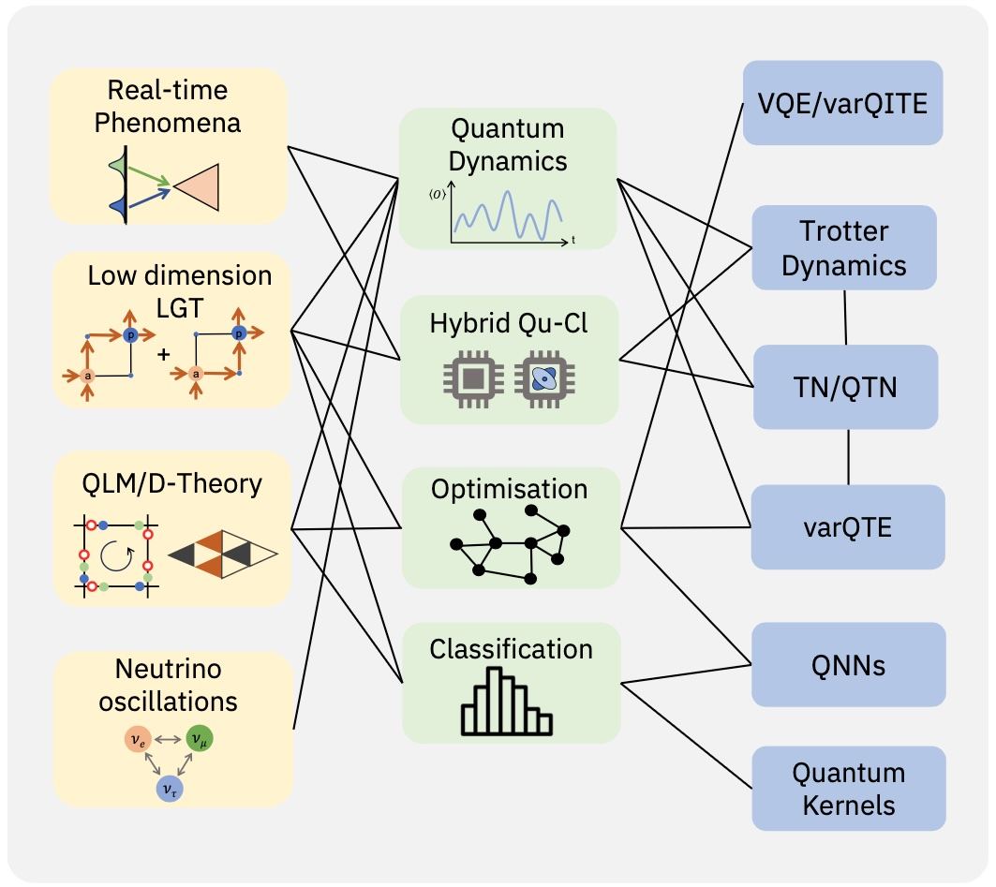
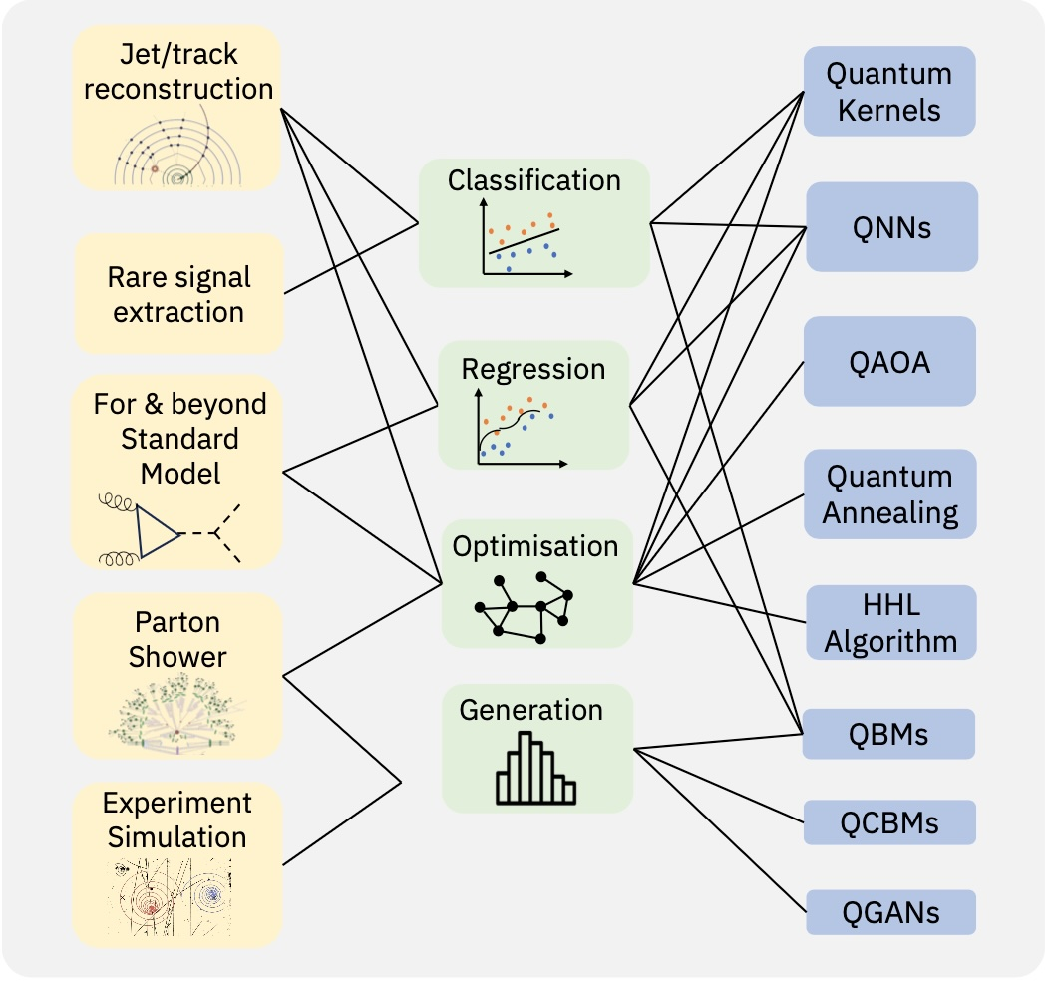
CERN QTI: QC4HEP use cases
1
“White Paper”: PRX QUANTUM 5, 037001 (2024)
Theoretical models and proposed approaches
Experimental challenges and quantum algorithms
challenges
approaches
algorithms
challenges
approaches
algorithms
Notes:
QTI: Quanum: 1) Sensing, 2) Simulation 3) Computing 4) Communication

Slide 3
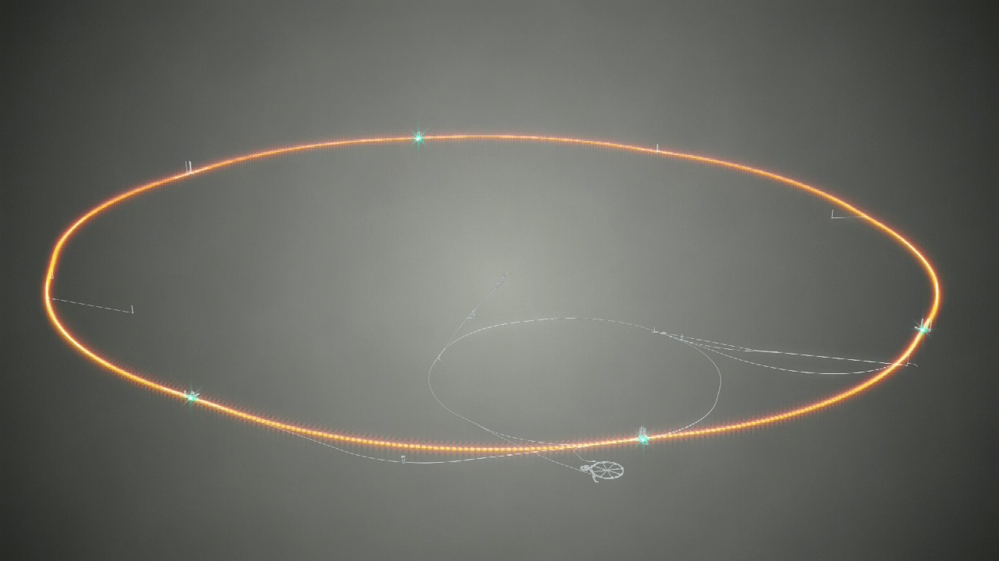
Use Case – Reconstructing Particles
2

Slide 4
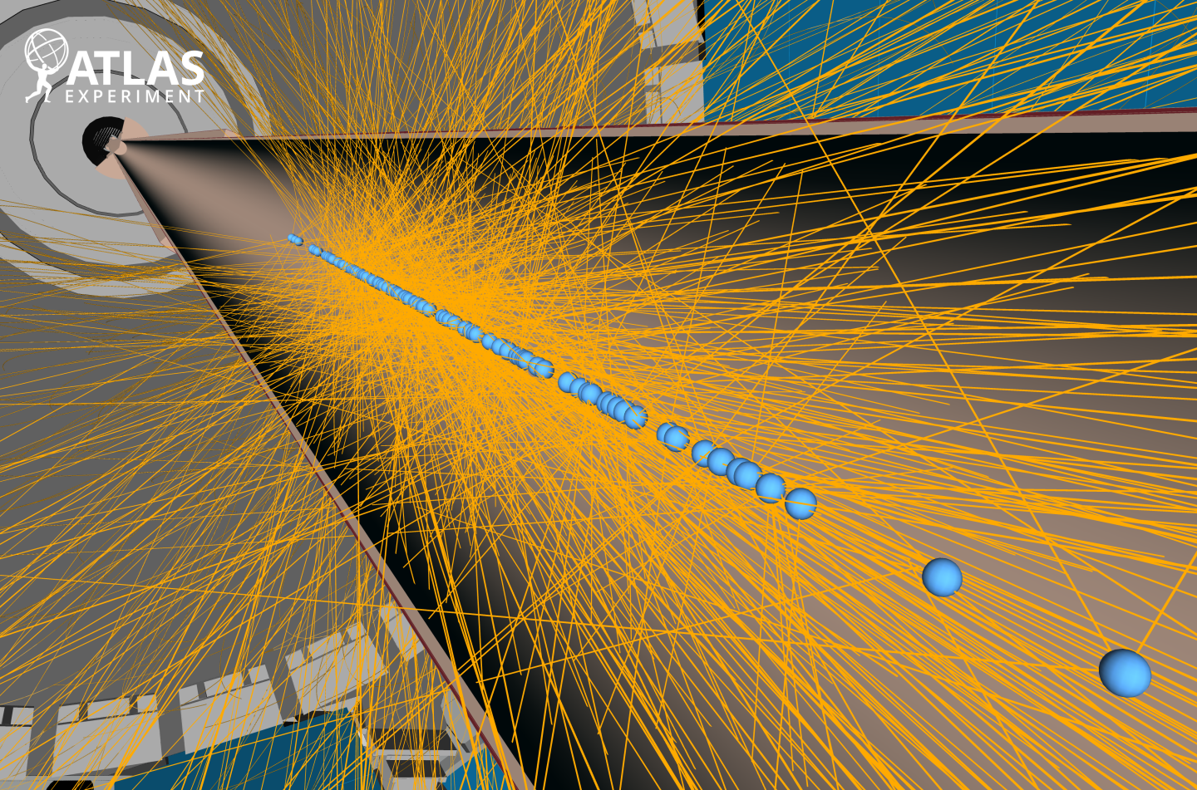
ATLAS high pile-up Event
3

Slide 5
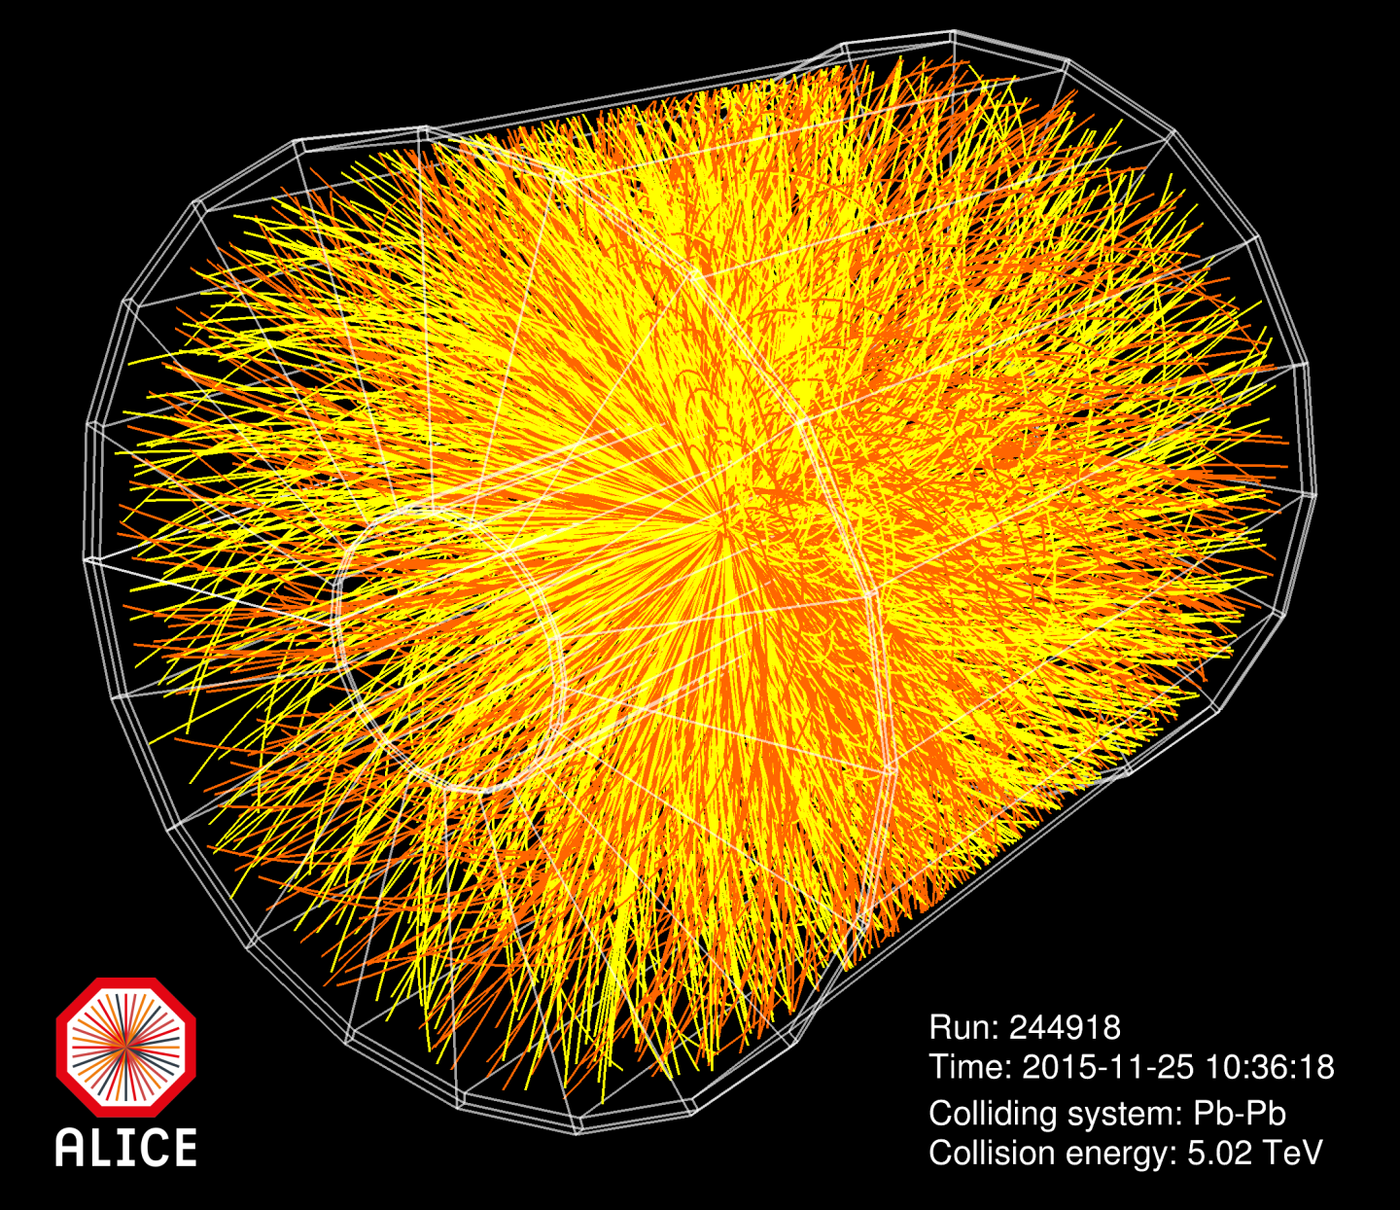
ALICE: Heavy Ion collisions
4

Slide 6
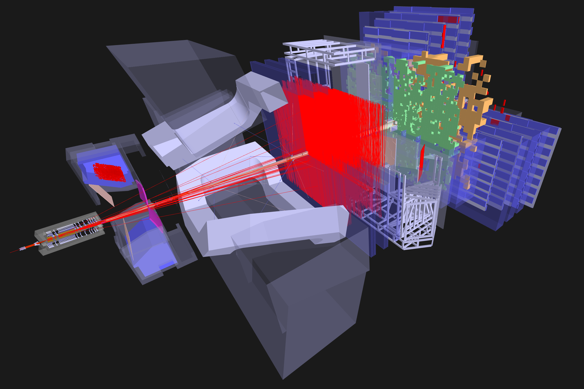
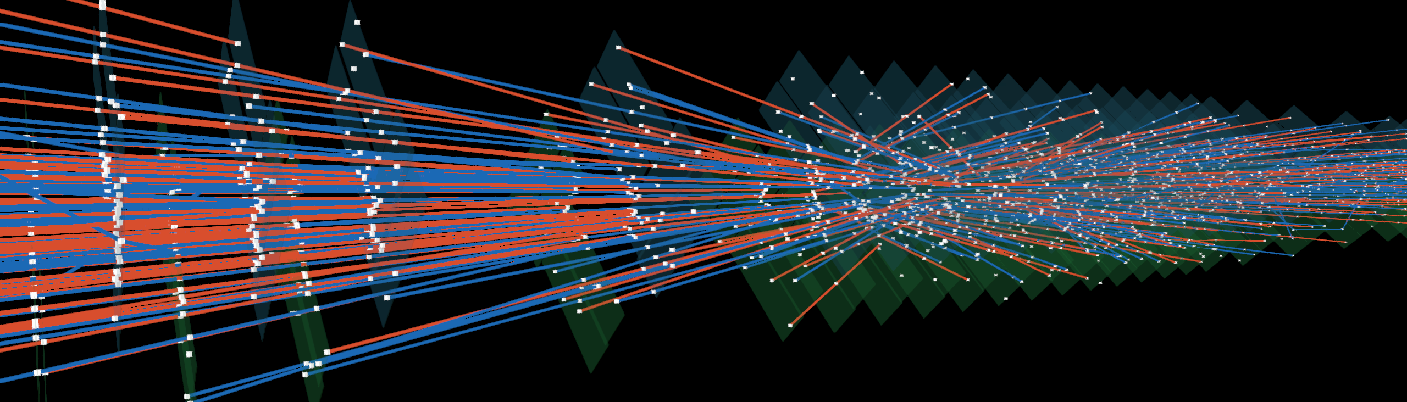
LHCb Track Reconstruction
5
”Forward” Track search in the T-stations
Particle track finding in the VELO
Track Extrapolation across the magnet

Slide 7
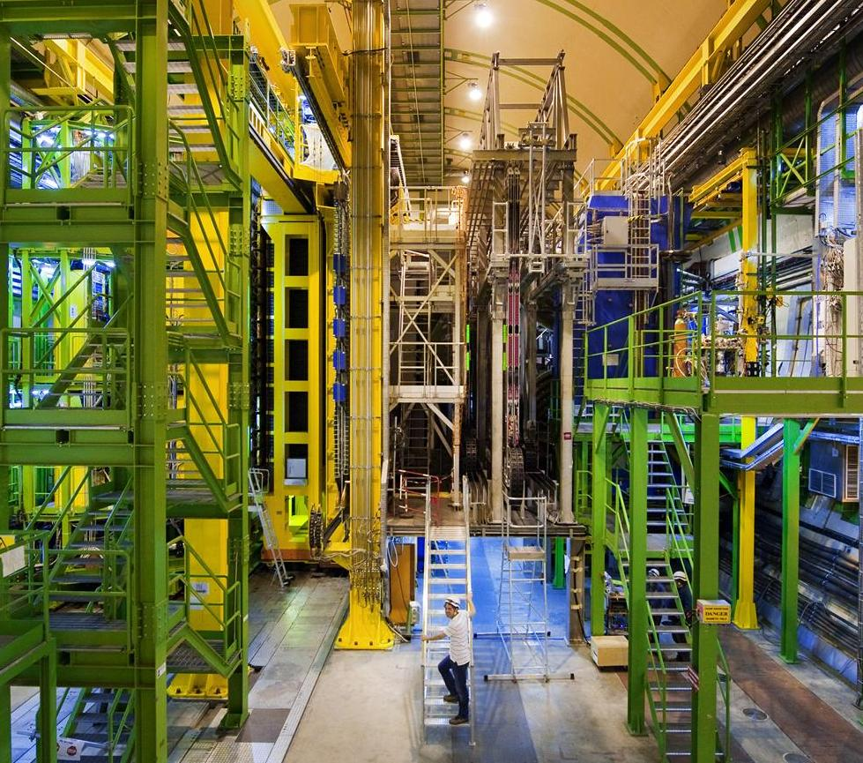
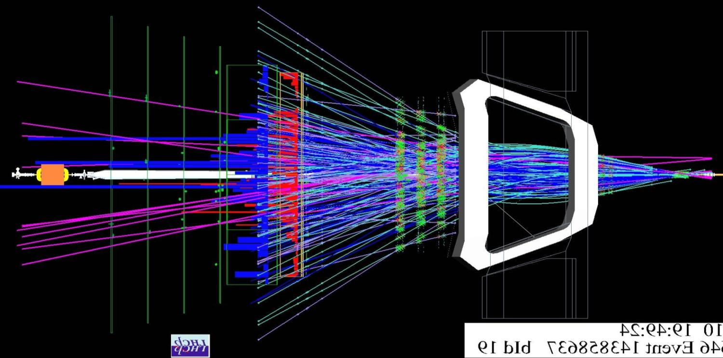
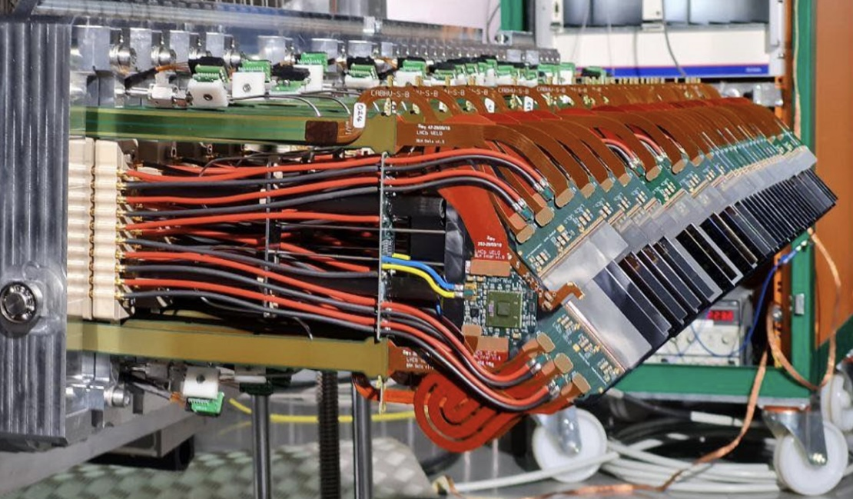
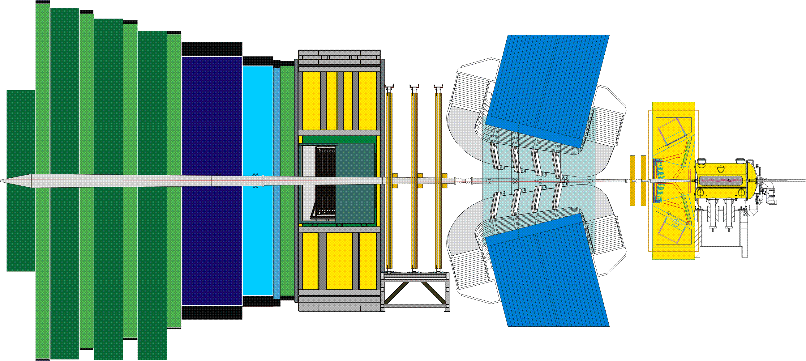
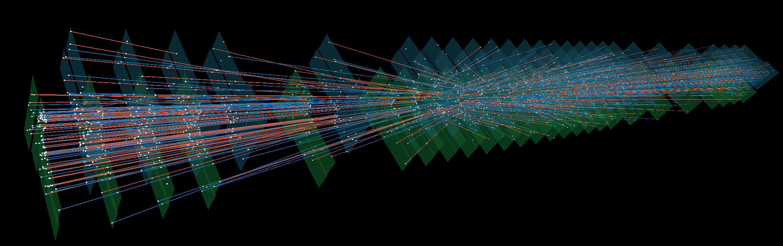
LHCb Detector and Event
6
23sep 2010 19:49:24
Run 79646 Event 143858637

Slide 8
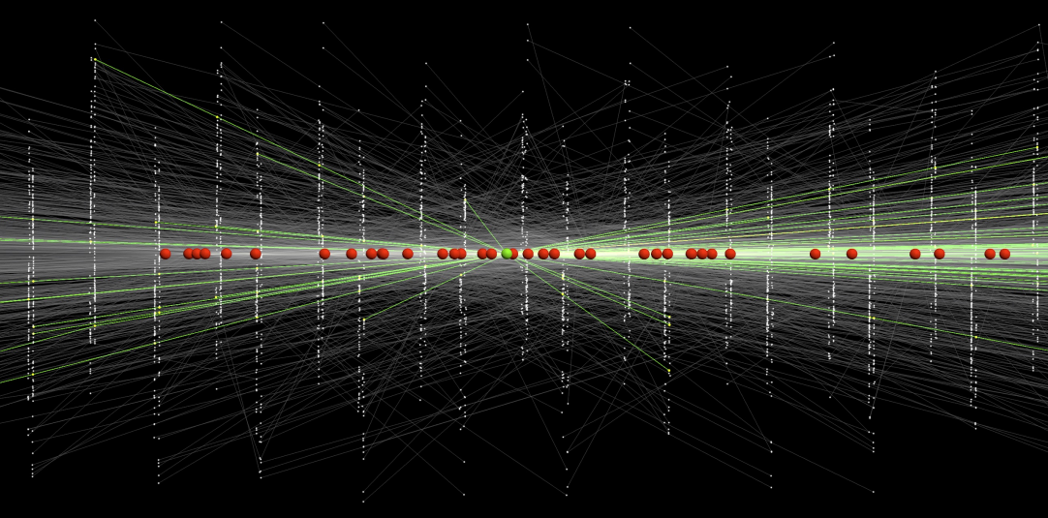
LHC: High luminosity picture
5
7
Current approach: massive parallel GPU-based combinatorics
R&D: Can a quantum algorithm help?

Slide 9
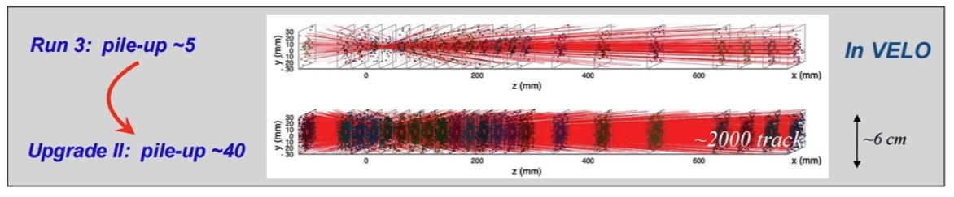
Issues for Further Investigation
8
Preprocessing: how to get detector data loaded in a hybrid data processing flow
  Unsolved.
  Efficient matrix encoding part of the problem
Quantum processing
  Currently investing a procedure to solve Hamiltonian with 1-bit HHL for many events in parallel
    ➔ Does the current Hamiltonian work in realistic events with high density?
  Other approaches can be investigated: QSVT, other,…
Postprocessing
  Currently reading out active segments seems unrealistic – requires too many shots
  Other approaches to be investigated: quantum post-processing towards vertex reconstuction?

Slide 10
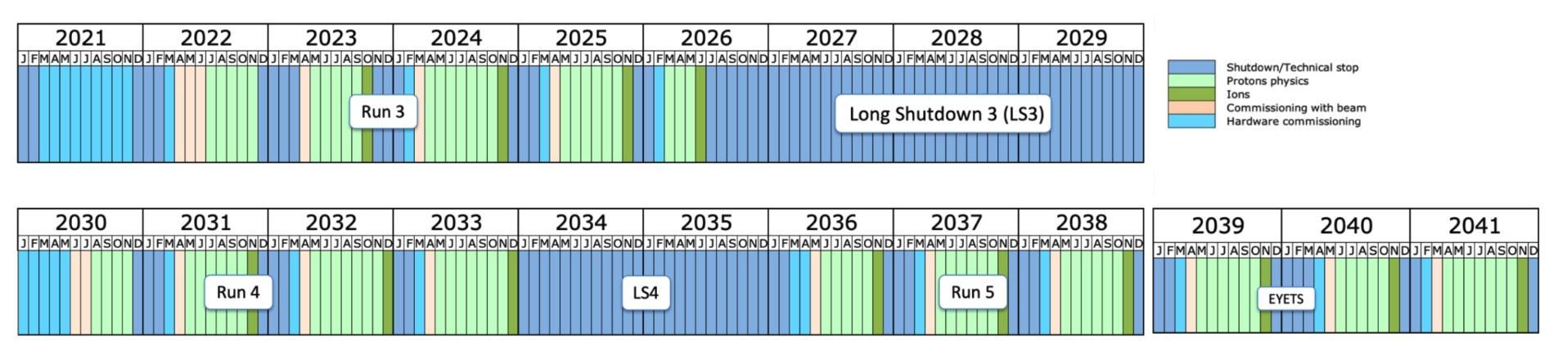
LHC Planning
9
Today
LHCb Upgrade-II
(QC target)
… 2045 – 2048: Start FCC
Timeline of the LHCb experiment:
  LHCb original detector: Run-1 + Run-2
  LHCb Upgrade 1: Run-3 + Run-4
  LHCb Upgrade 2: Run-5… (target of current QC studies)

Slide 11
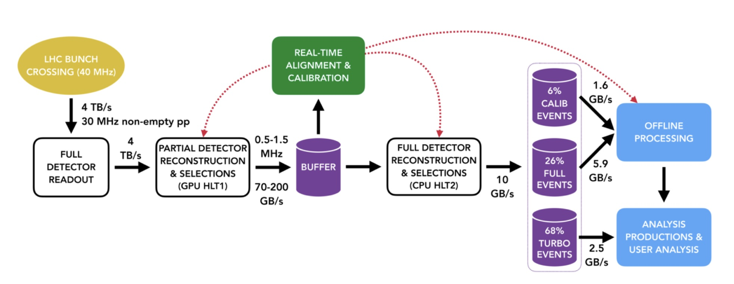
Real Time Data Processing
10

Slide 12
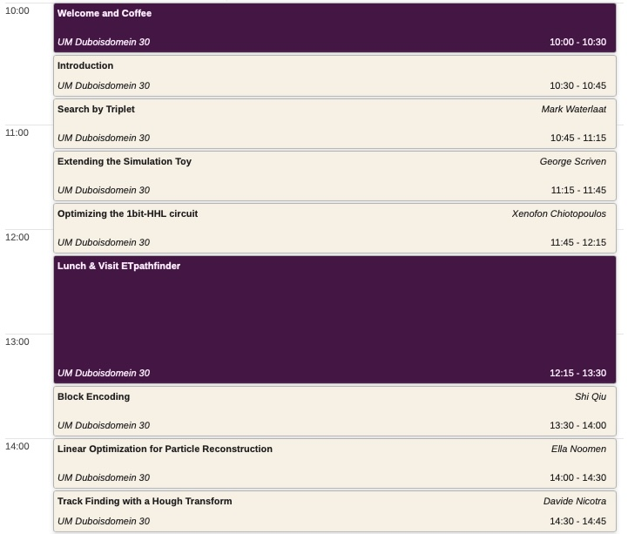
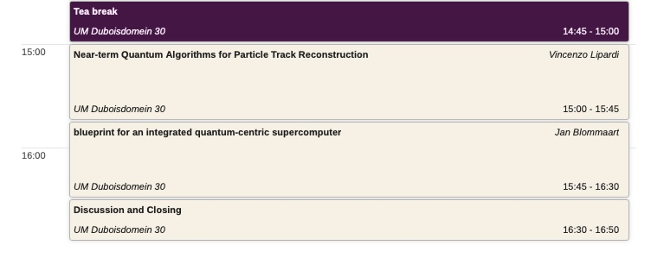
Today’s Agenda
11
Agenda
Intro to LHCb and Trackfinding at LHCb in HL-LHC
  Marcel Merk, UM+Nikhef
The current Velo track reconstruction algorithm
  Mark Waterlaat, PhD CERN & Nikhef
The simulation Toy for quantum algorithm development
  George Scriven, Hasselt+UM
The 1-bit HHL algorithm and further ideas
  Xenofon Chiotopoulos, DACS+GWFP UM
Matrix Block encoding
  Shi Qiu, DACS-UM
Linear Optimization in Paerticle Reconstruction
  Ella Noomen, PhD CERN & GWFP- UM
Track Finding with a Hough Transform
  Davide Nicotra, PhD GWFP-UM
Near-term Quantum Algorithms for Particle Track Reconstruction
  Vincenzo Lipardi, PhD DACS-UM
Blueprint for an integrated quantum-centric supercomputer
  Jan Blommaart – BioDAC, Alain Chancé, MOLKET SAS

