Slide 1
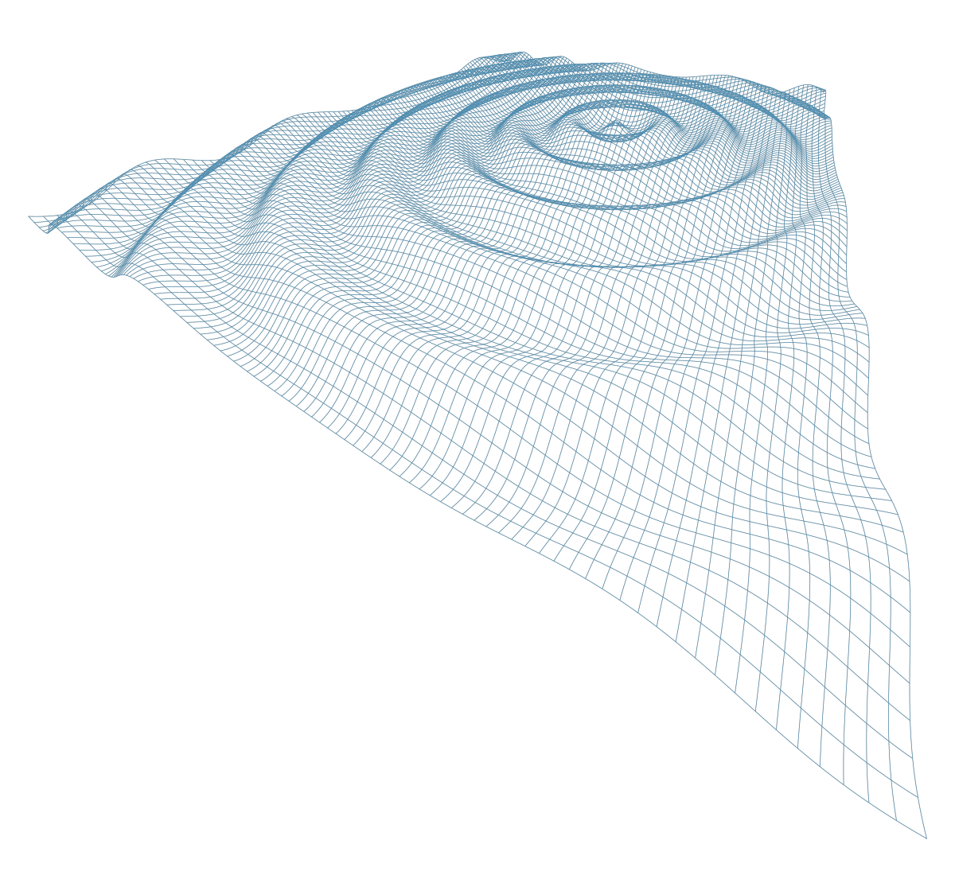

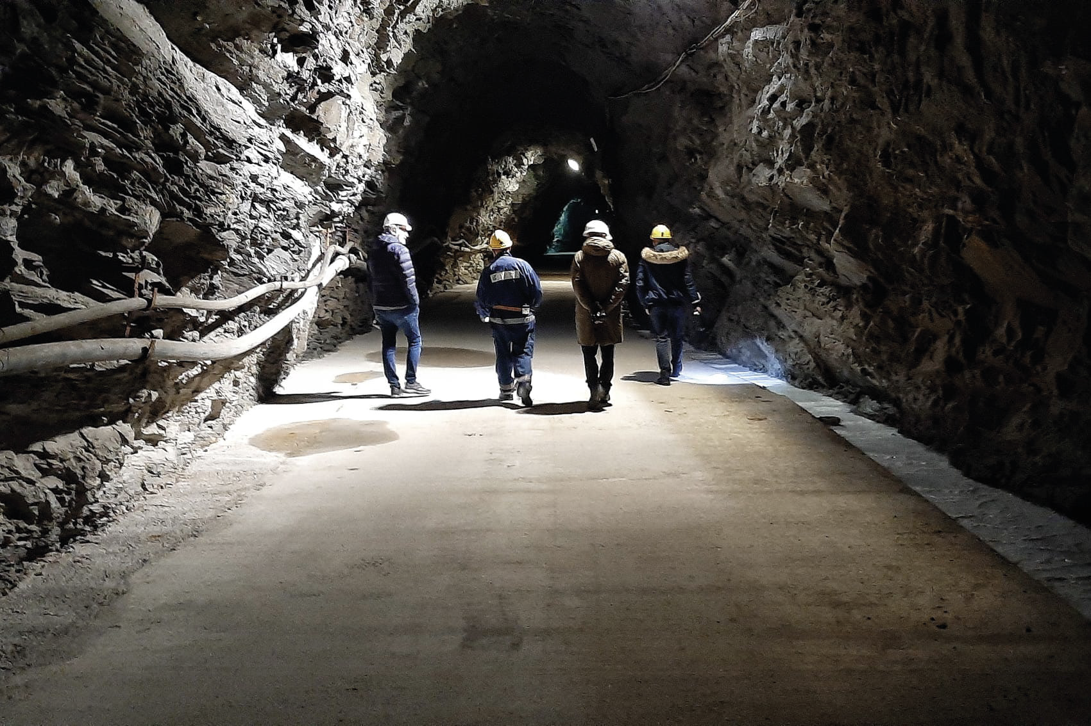
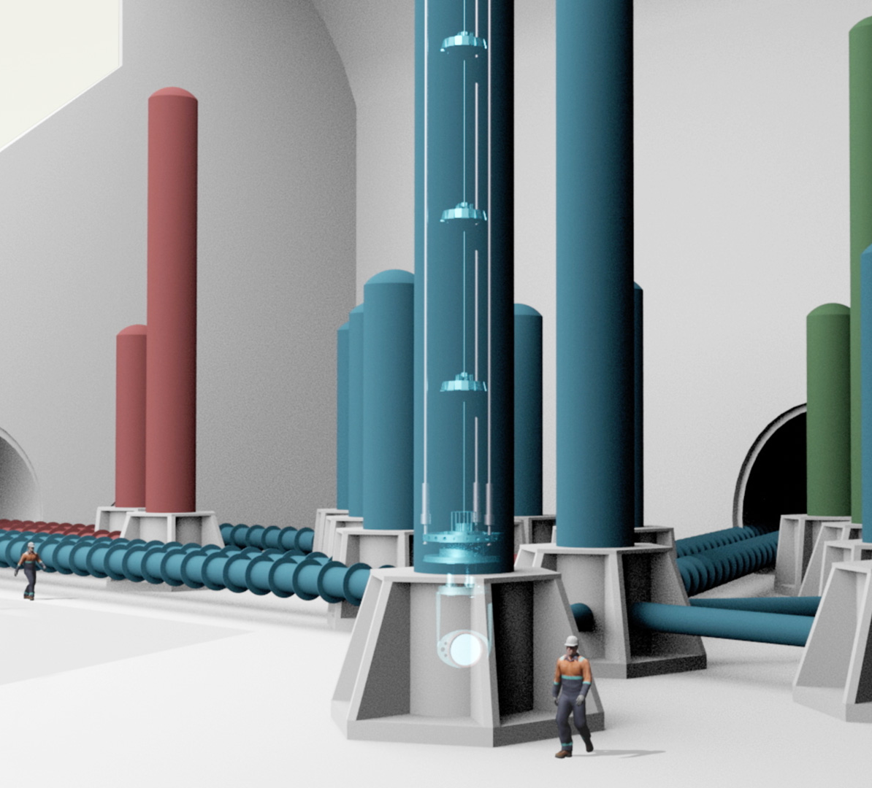

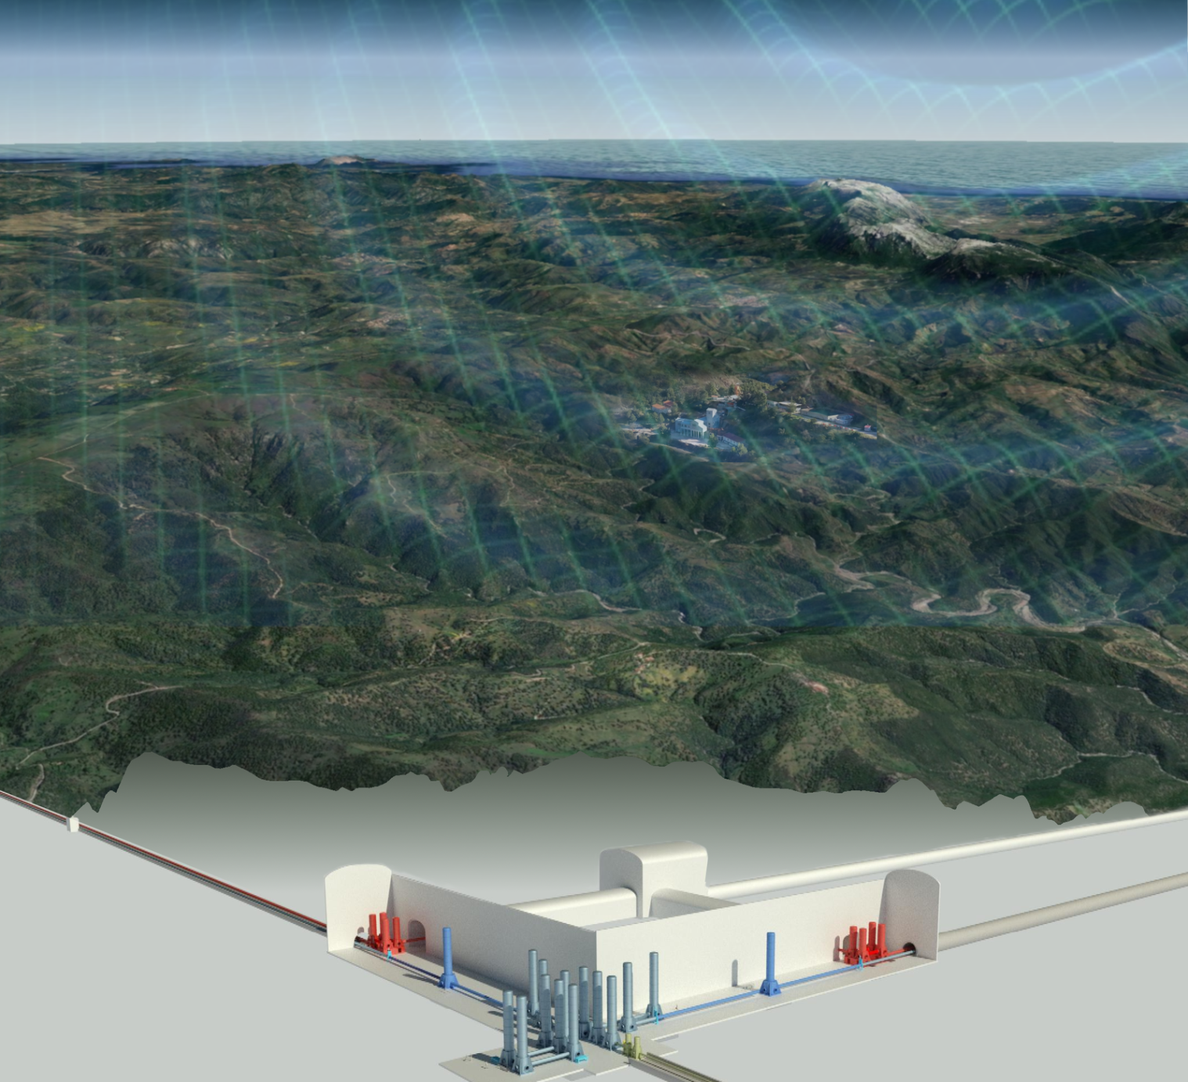
The ET Site Characterization Board
Prof. D. D’Urso
Univ. di Sassari & INFN Cagliari

Slide 2
Outline
Introduction
The SCB
The WP4 of ET-PP
Questions from SG1
Conclusions

Slide 3

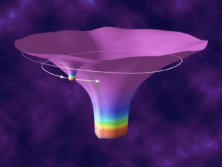
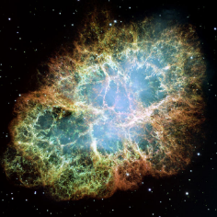

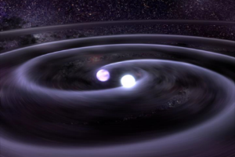
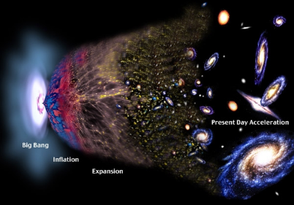
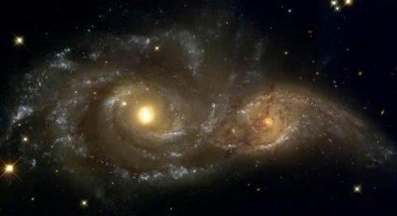
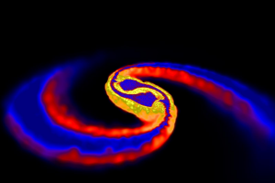
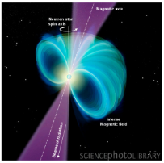
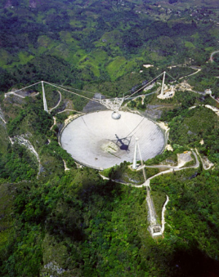

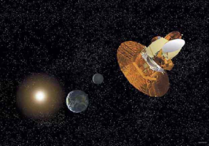
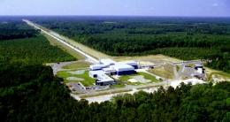
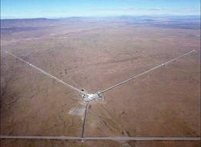
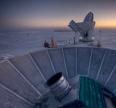
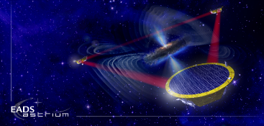
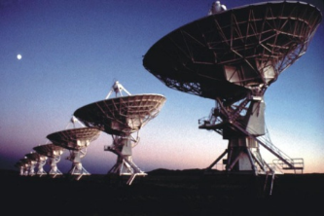
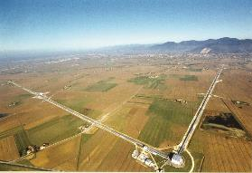
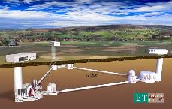
The GW spectrum
Supernovae
Cosmic Strings
BH and NS Binaries
Relic radiation
Extreme Mass Ratio
Inspirals
Supermassive BH Binaries
Binaries coalescences
Spinning NS
10⁻¹⁶ Hz
10⁻⁹ Hz
10⁻⁴ Hz
10⁰ Hz
10³ Hz
Pulsar timing
Space detectors
Ground interferometers

Slide 4

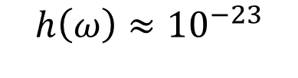
A GW detector is a noise factory
Credit: M.Punturo
Human cell 10⁻⁶-10⁻⁵m
10⁻²²
Hydrogen atom 10⁻¹⁰m
Proton 10⁻¹⁵m
Quark
(effective radius) 10⁻¹⁸m
10⁻²³
$$h\left(ω\right)≈{10}^{−23}$$
$$∆L≈{few ×10}^{−20}m$$
10⁻²²
10¹
Virgo Noise Budget
10²
10³
GW detector are measuring space-time curvature ripples as fluctuations of the differential lenghts of the arms of the interferometers: $h\left(ω\right)=\frac{∆L\left(ω\right)}{L}$

Slide 5
High Frequency: if the detector is well designed it is «relatively» simple, and the shot noise is the dominant noise. It is then mainly “detector” dependent
Medium frequency: Impact of the “environment” and of the civil infrastructure competes with the fundamental noises
Low Frequency: The importance of the infrastructure and of the site is dominant because of the impact of the seismic noises, Newtonian noise, magnetic noise, acoustic noise (also sub audible frequencies).
Relevance of seismic filtering efficiency, control noises, ….
10⁻²²
10⁻²³
10⁻²²
10¹
Virgo Noise Budget
10²
10³
Credit: M.Punturo

Slide 6
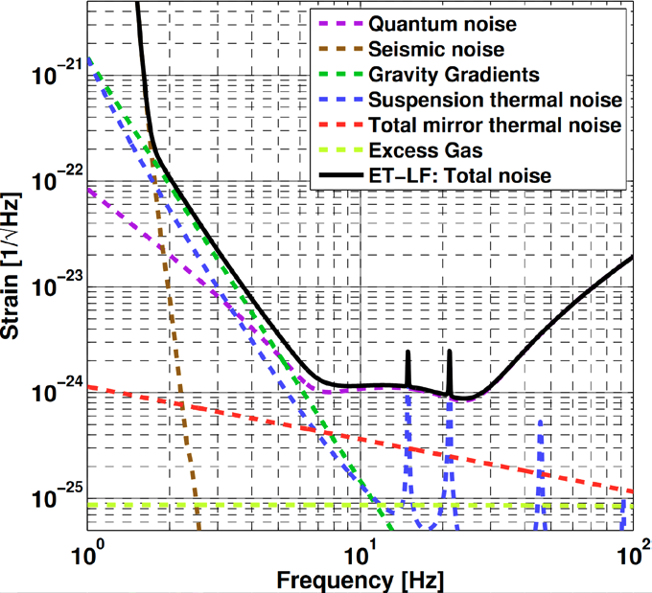
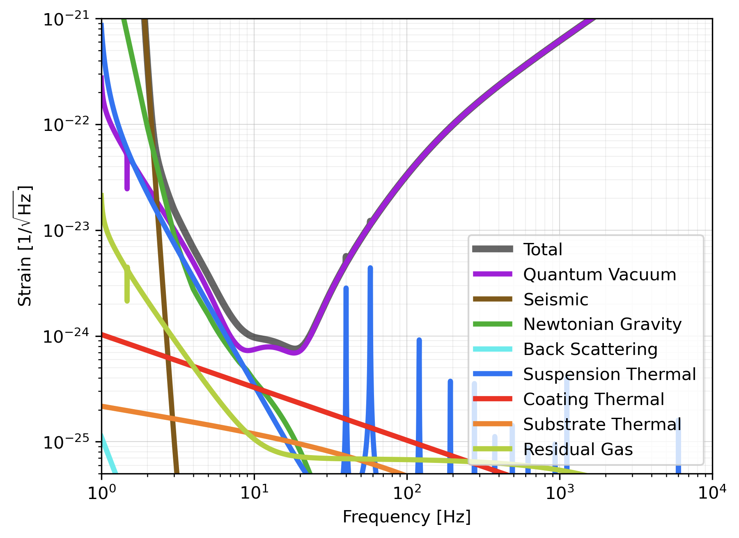
Focus at low frequencies
LF noise is given by
  Microseism motion
  Newtonian noise
  Thermal noise
  Upconversion of residual motion into the detection band
  Control noise
Newtonian noise crossing:
2 x 10⁻²² Hz^{-1/2} at 1.8 Hz (AdV: 3.2 Hz)

Slide 7
Seismic noise at Virgo at weekly basis (velocity)
GW detectors aren’t a linear device:
  Upconversions
BNS SNR is built at high frequency (>100Hz), but the BNR reach is strongly affected my (micro) seismic noise
Microseism increases also the glitchness of the detectors

Slide 8
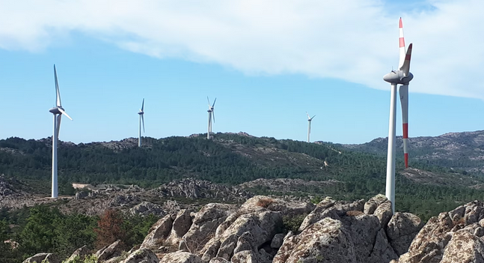
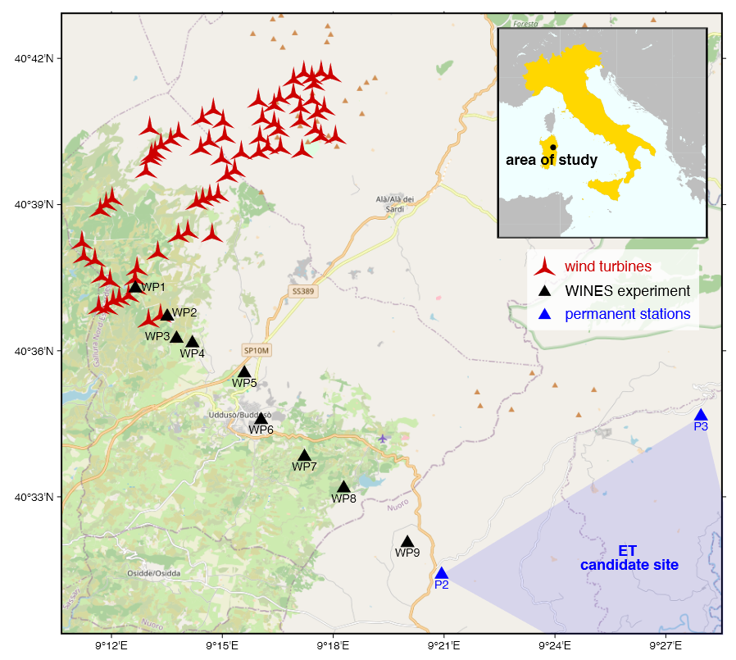
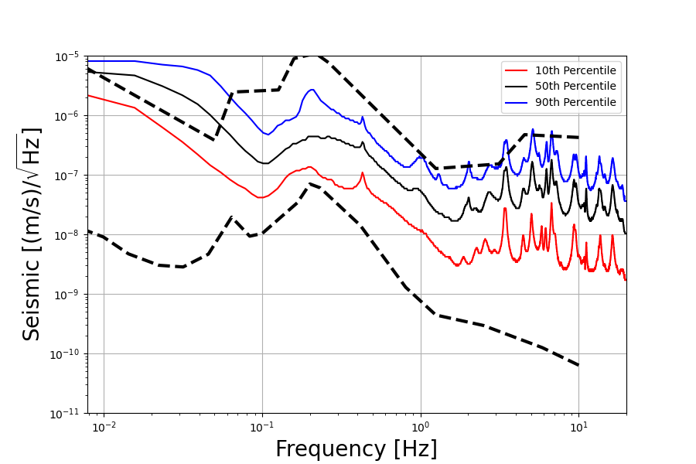
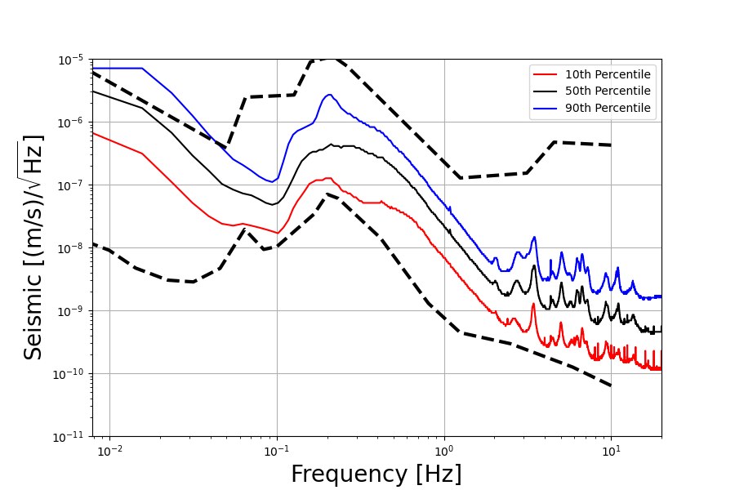
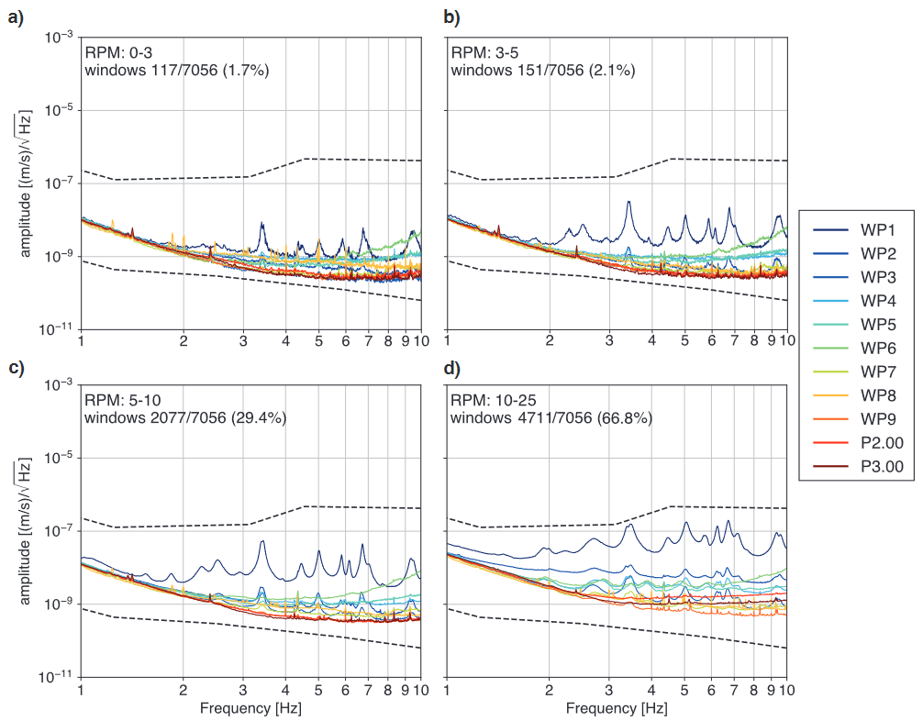
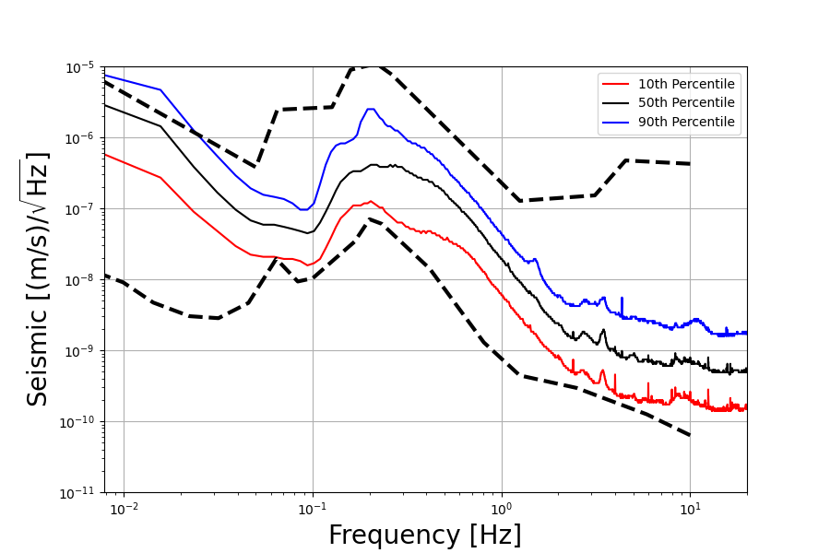
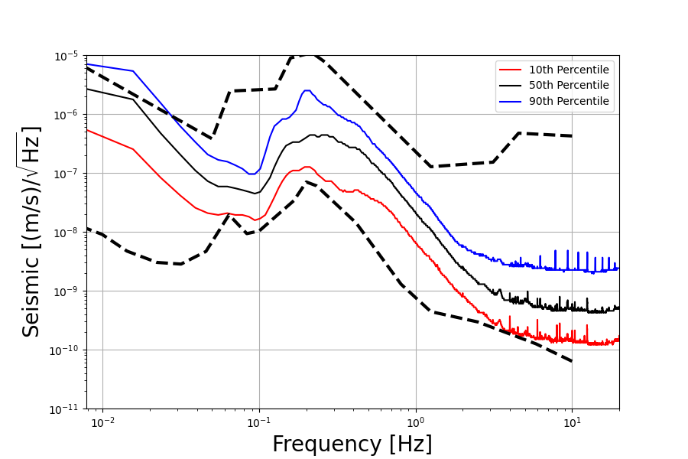
Risk from human and industrial activities:
Windfarm induced seismic noise: a case study in Sardinia for ET
Main peak at ~3Hz + harmonics close to the wind farm (WP1);
Only main peak + first few harmonics close to P2, visible wrt to the low background (NLNM);
Wind-correlated (RPM) increase of noise rms;
Propagation/attenuation/amplification of seismic waves depends on the local subsurface
WP1
WP3
~13km
WP7
WP9

Slide 9
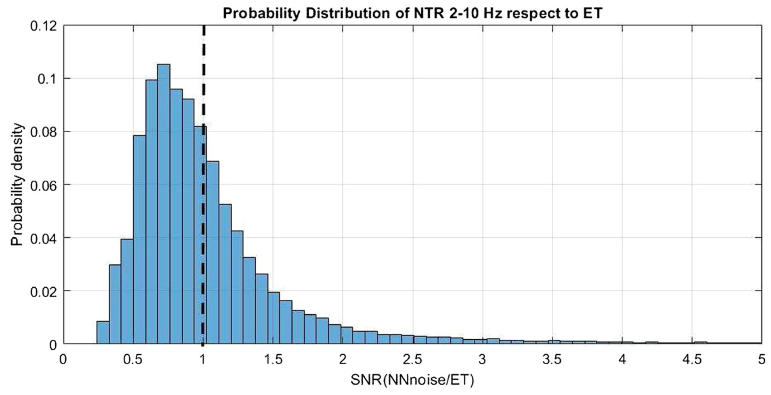
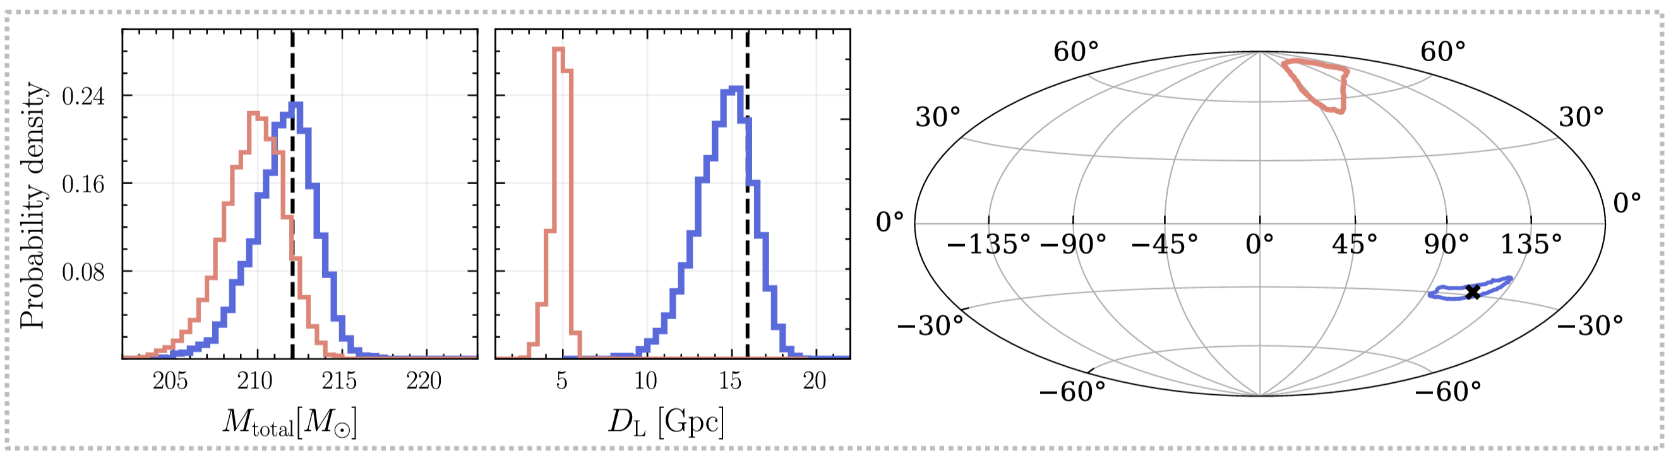
Impact of Environmental Transients on ET Science
A transient in the seismic field between 3Hz and 20Hz results in a transient in the ET-LF data (of order 1 million transients per year).
State-of-the-art glitch mitigation can be ineffective: there can be an important residual impact on GW signal analysis
Narola et al, 2025
Allocca et al, 2021

Slide 10
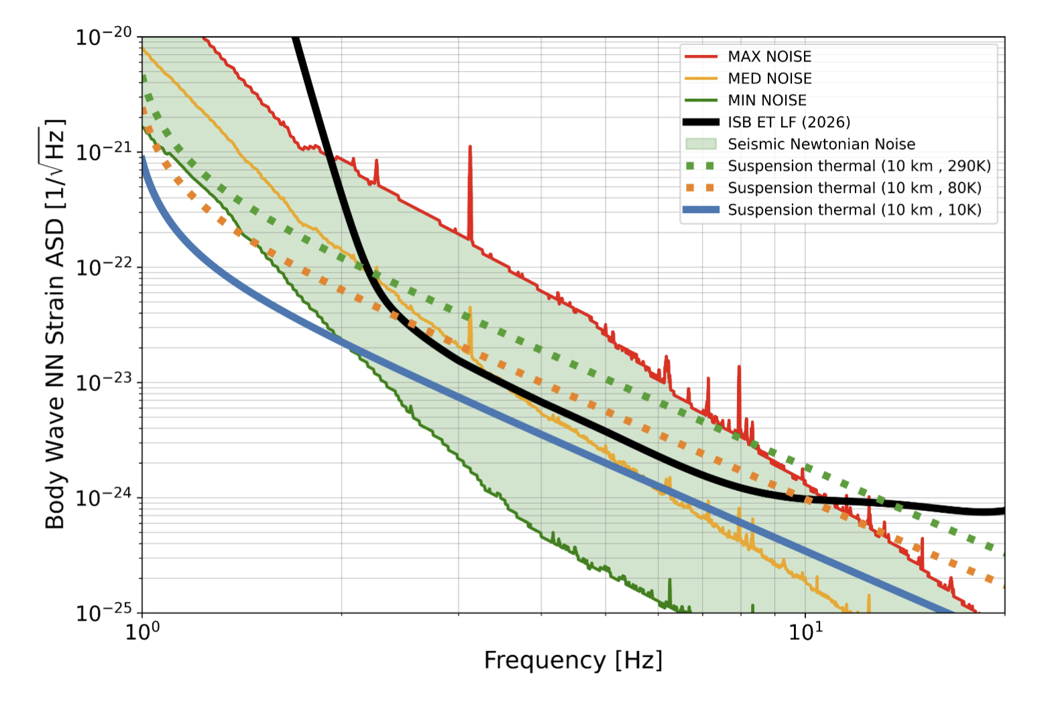
NN compared with other LF Instrument noise
From Andric et al, Impact of Site quality on ET’s detector design and innovation potential. Working document, version 260326

Slide 11
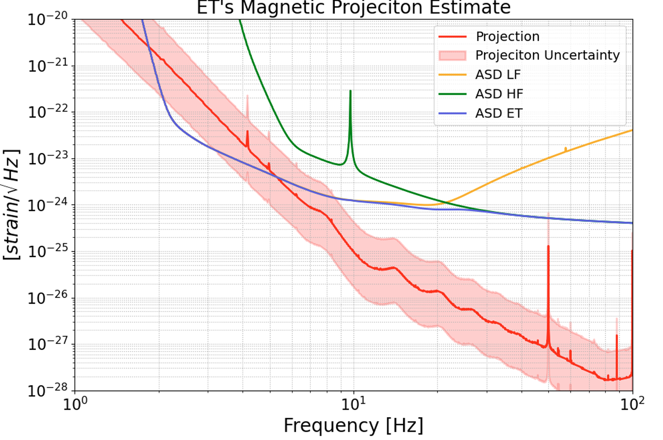
Magnetic Noise Requirements for ET
Use noise coupling estimate for ET from Virgo O4 Measurements -> Constraints to magnetic noise level for ET
Take Home Message:
Reduce detector noise
Reduce detector coupling
Site noise
Impact of magnetic glitch visible on
detector duty cycle
ET-0058A-26, R. De Rosa et al

Slide 12
The Site Selection is a crucial choice!

Slide 13
SCB: General Mission
The SCB is responsible for supplying information to be captured in a Bidbook or directly to those bodies responsible for the selection of the ET site, in the form of two tasks:
T1: Collect, organize and/or produce a complete characterization of the subsurface as well as documentation needed for a fair comparison of candidate sites.
T2: Propose a common framework and common basis for the evaluation of information to characterize the candidate sites.
T3: coordinate the estimation of site environmental conditions on ET performances in order to compare the candidate sites on a scientific basis

Slide 14
ET Site Characterization
ET Executive Board
Specific Boards
SCB
Site Characterization Board
OSB
Observation Science Board
ISB
Instrument Science Board
EIB
E-Infrastructure Board
SiteCharacterization coordinated in the framework of the ET Collaboration: Site Characterization Board (SPB).
Strong interaction with the Active Noise Mitigation division of the Instrument Science Board(ISB) and with OSB for detector performance in terms of achievable physic goals
Noise Measurement
Fundamental Physics
Suspensions
On-site Infrastructure
Cosmology
Noise Evaluation & Validation
Optics
Distributed infrastructure
Population Studies
Geological and Geotechnical Evaluation
Multimessenger Obs.
Interferometer
Software & frameworks
Synergies with GWDs
Nuclear Physics
Vacuum and Cryogenics
Transient GW Sources
Active Noise Mitigation
Waveforms
Scientific potentials …
Data Analysis Platform

Slide 15
The SCB Structure
Site Characterization Board
(SCB)
Chairs: D. D’Urso, W. Walk, A. Rietbrock
WD1: Noise Measurements
WD2: Noise Evaluation &
Validation
WD3: Geological and
Geotechnical Evaluation
WP1: Structural
Geology
WP1: Seismic Noise
WP1: Noise Impact
Evaluation
WP2: Noise Impact
Validation
WP2: Hydrogeology
WP2: Gravimetrics
WP3: Geophysics
WP3: Magnetic Noise
WP4: Other Environ-
mental Noise
WP4: Geotechnology

Slide 16
SCB Documents already produced
M1.1: List of physical variables to be measured:
ET-0012A-23, discussed and finalized at the II SPB Workshop (Jan 2023) https://apps.et-gw.eu/tds/?content=3&r=18113
M1.2: Measurements recommendations and standards:
ET-0013A-23, discussed and finalized at the II SPB Workshop (Jan 2023) https://apps.et-gw.eu/tds/?content=3&r=18114
M1.3: Data format standards and analysis tools
ET-0270A-23, https://apps.et-gw.eu/tds/?content=3&r=18398

Slide 17
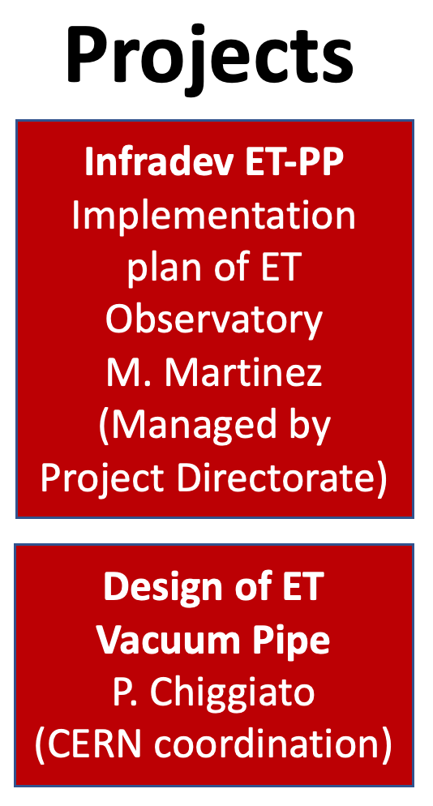


ET Preparatory Phase (ET-PP)
Main activities:
  Structuring the ET legal entity
    Defining its governance
    Defining its technical bodies
  Define the financial aspects of ET
  Manage the relationship of the ET project with the European Commission framework (ESFRI)
  collecting and processing all the required information for site qualification
  More than 120km of vacuum pipes
    Define the technical design of the vacuum pipe with a clear target in the cost reduction
    Propose innovative materials and solutions
  Joint developments with CERN involving ET and CE
Civil Engineering
(CERN advisory)
  Profit of the CERN expertise in large civil and technical underground research facilities
  Develop together, in collaboration with external companies, the design of the ET facilities

Slide 18
WP4 Objectives
WP4 is responsible for collecting and processing, from each potential site, all the required information necessary for site qualification. This includes site specific characteristics that might impact the ET scientific performance, socio-economic impacts, legal implications, and civil engineering costs. The information will be treated in a coherent and transparent manner, with the aim of facilitating a site selection process in a timescale consistent with ET anticipated schedule

Slide 19
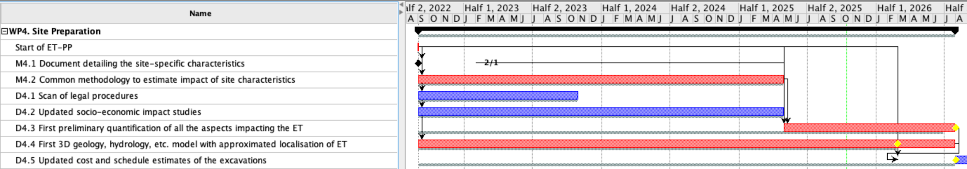
ET Preparatory Phase - WP4
Code | Name | Expected date
M2 (M4.1) | Document detailing the site-specific characteristics that impact ET sensitivity and its duty cycle | M6/Feb23 M25/Oct24
M3 (M4.2) | Common methodology to estimate impact of site characteristics | M32/March25

Slide 20
M4.1 – Milestone M2
ET-PP M04.01: “Site-specific Characteristics impacting ET sensitivity and duty cycle” (ET-0139C-25.pdf )
The document contains:
the list of quantity to be measured and how to perform the measurements
a summary of status of activities at candidate sites
the case study of anthropogenic noise in Sardinia

Slide 21
M4.2 – Milestone M3
ET-PP M04.02: “Common methodology to estimate impact of site characteristics on ET sensitivity and operation, and if required, a scheme to compensate it” (ET-0138B-25.pdf)
The document describes the process that will be followed to quantify the impact of the site on ET performance:
  methodology scheme
  milestones
  possible scientific benchmark
  definition of tools
  definition of a Validation procedure

Slide 22
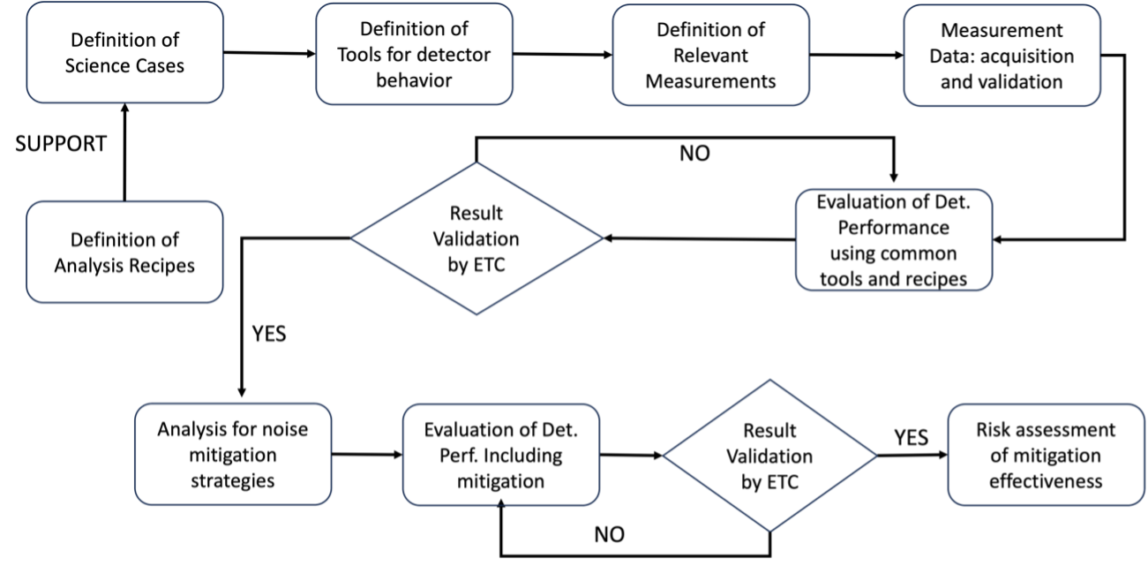
M4.2: Methodology scheme

Slide 23
M4.2: Einstein Telescope Performance Metrics
CBC & Multi-Messenger
  SNR → Detection power
  Early Warnings → Alerts before merger
  Localization → Sky maps (1–1000 deg²)
  Golden Binaries → Precision cosmology
Stochastic, CW, Bursts & Geometry
  Stochastic → Background sensitivity
  CW → Pulsars & spin-down limit
  Bursts → Unmodelled transients
  Geometry → Duty cycle, polarization, null streams

Slide 24
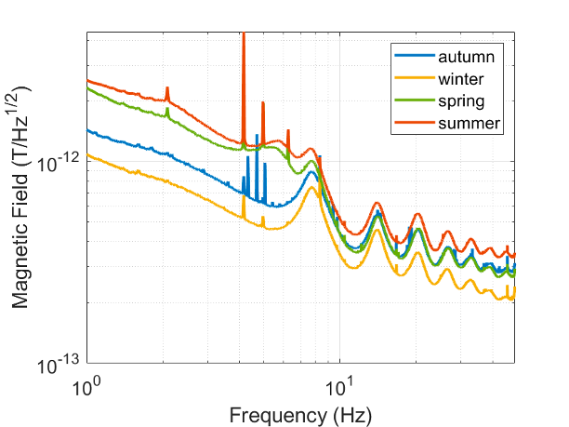
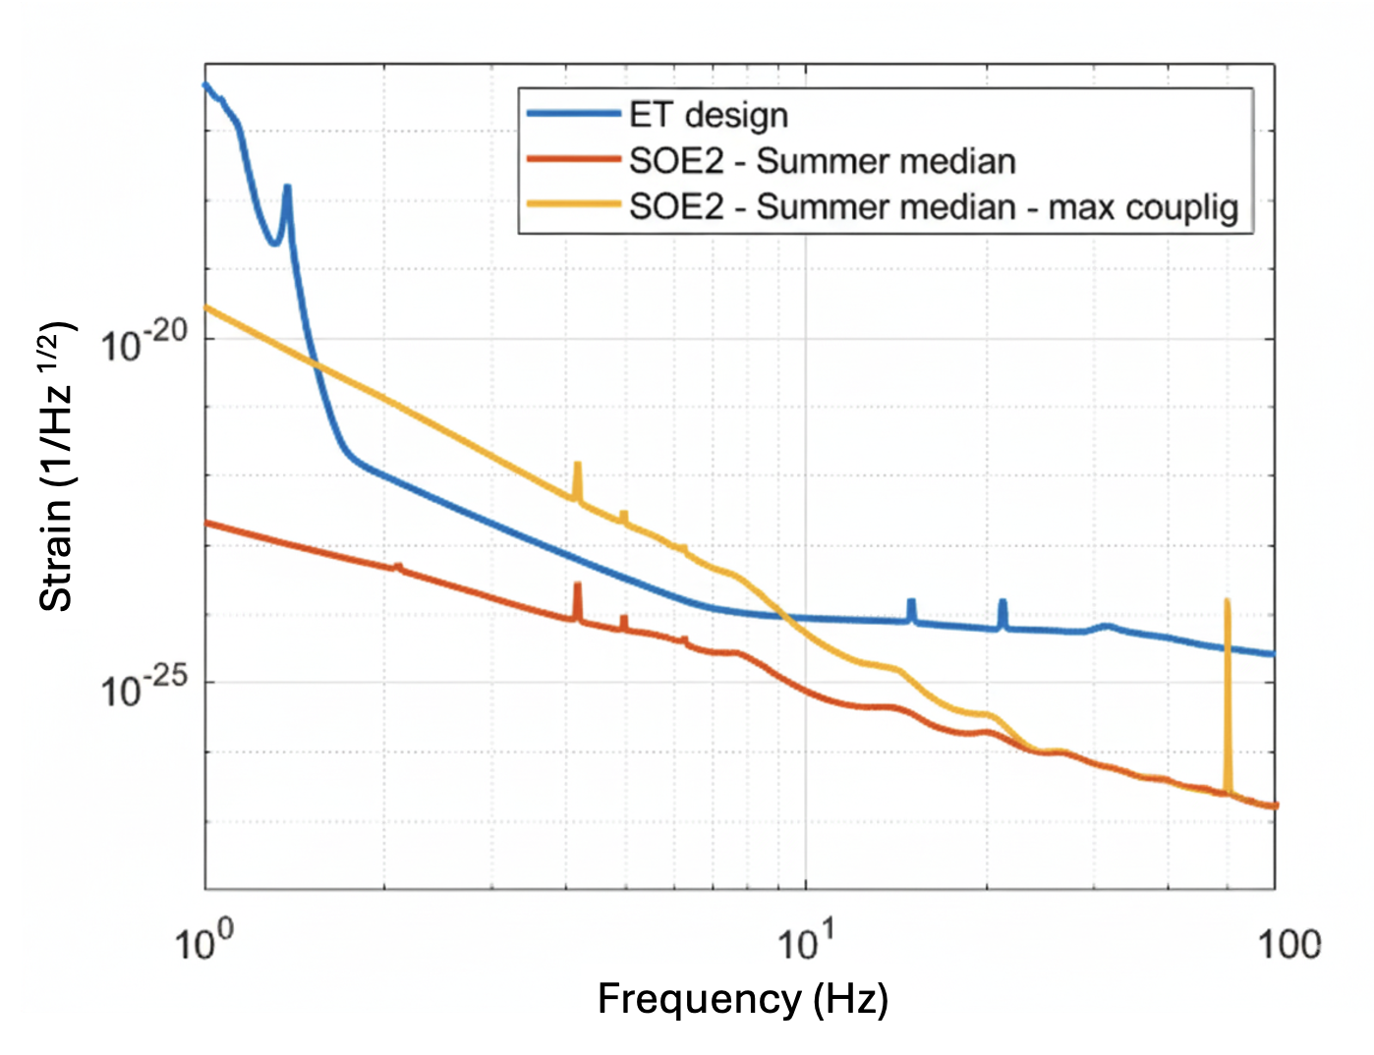
M4.2: Magnetic Noise and Mitigation in the Einstein Telescope: the Sos Enattos case
Magnetic Noise
  Sources → self-inflicted + external (railways)
  Coupling → suspensions & optics
  Mitigation → shielding + monitoring
  Site → Sos Enattos = ultra-quiet
Implications and Objectives
  Tool → MANET lab + shielding prototypes
  Impact → Protect ET low-frequency sensitivity

Slide 25
D4.4: First 3D Geological Model
1
Scope and reference frame
Area, depth, coordinate system, vertical datum, resolution, approximate ET localization
2
Evidence base
Dataset inventory: direct, indirect and contextual constraints with access status
3
Subsurface description
Geology, structures, hydrology and hydrogeology, with observations separated from interpretation
4
Model construction
Workflow, software, interpolation, faults, discontinuities, surfaces, volumes and QC
5
Usability envelope
Material parameters, uncertainty, limitations and planned updates

Slide 26
D4.4: minimum tables make the comparison auditable
Dataset inventory
Physical parameters
Geological maps, boreholes or cores, seismic profiles or arrays, gravity/magnetic data, hydrogeology, DEM/topography. Each entry: availability, coverage, resolution, constraint type, use in model and limitations.
Density, Vp, Vs, Q/attenuation, permeability and topography. Each parameter: geological association, relevance, value/range, source, uncertainty and status.
Why this matters
Reviewers can see what is measured, inferred or missing.
NN and performance studies receive traceable inputs.
Different sites can be compared without forcing identical geology.

Slide 27
D4.3: First Preliminary Site Impact Quantification
No consensus about NN estimation
  multiple tools currently available to take into account complex and realistic geological environment
  NN roadmap: a staged benchmarking process
Phase 0
Phase 1
Phase 2
Phase 3
Phase 4
Phase 5
Convergence
Jan-Apr
completed
May
flat
June
seismic
Jul-Sep
topography
Jul-Sep
subsurface
Oct
real site
Nov
consolidate
Benchmark principle
Target
Increase complexity only after baseline agreement: analytical checks, numerical robustness, geometric effects, subsurface heterogeneity, then real-site comparisons.
Consolidated comparison of NN modelling tools by November 2026, with a clear path from idealized tests to realistic site conditions.
Phase 0: inventory and ongoing activities already established.
Phases 3 and 4 proceed in parallel from a common flat homogeneous baseline.
Phase 5 is the stress test against realistic site inputs.

Slide 28
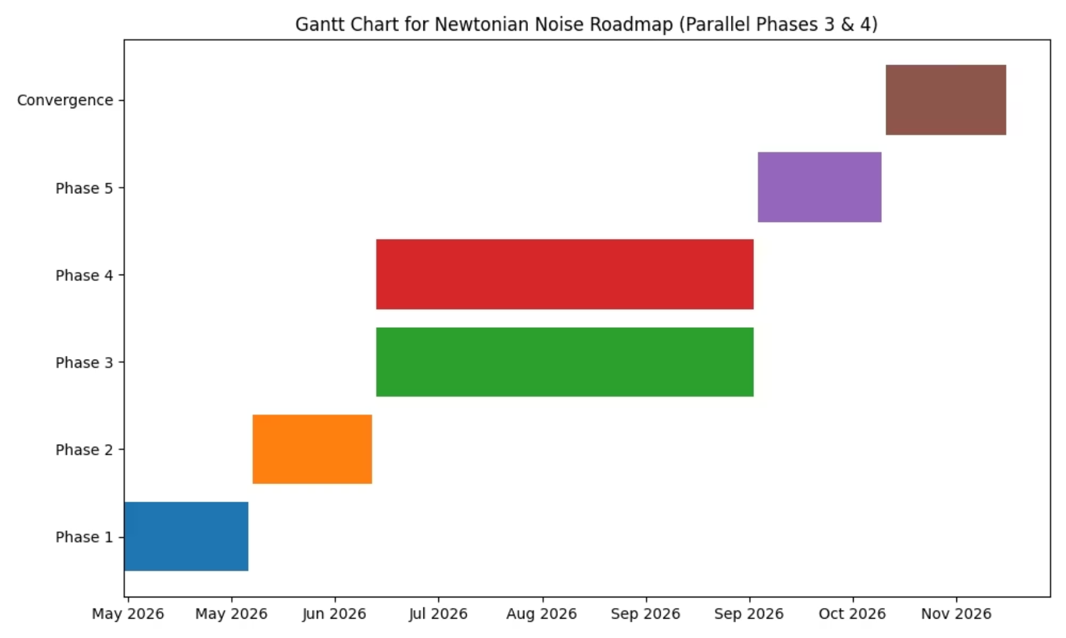
NN roadmap GANTT
Phase
Timeframe
Scope
Expected Outcome
Phase 0 (completed)
Jan–Apr 2026
Inventory and ongoing activities
Baseline established
Phase 1
May 2026
Idealized flat topography
Agreement within tight tolerances
Phase 2
June 2026
Realistic seismic fields
Numerical robustness verified
Phase 3
Jul–Sep 2026
Surface irregularities
Sensitivity to geometry
Phase 4
Jul–Sep 2026
Heterogeneous subsurface
Model-dependent effects assessed
Phase 5
October 2026
Real-site benchmarks
Full comparison across tools
Convergence
November 2026
Final comparison and interpretation
Consolidated results

Slide 29
Q1. Make all site information identifiable and available
Answer: In principle yes, through a structured living inventory
Noise Data
Models
currently available from Sardinia and Lausitz:
raw time series, logs, metadata
EMR team data not yet available
Geology & hydrology: mostly slides, a few publications, no raw data (First model for ET-PP)
NN projections: hot point of discussion

Slide 30
Q2. Harmonised observation method: formal references exist
M1.1: physical variables
M1.2: measurement procedures
M1.3: data and tools
seismic field
gravimetry and geodynamics
magnetic noise
infrasound, microbarometric and weather variables
3C broadband seismometers
borehole and surface pairs
GPS timing
PSD percentiles and transient catalogues
magnetic and infrasound standards
MiniSEED and StationXML
SDS storage structure
Python preferred; ObsPy, NumPy, SciPy
progressive FDSN availability
    Is the processing of the data fully harmonised - common and shared data analysis software and calculation parameters? If not, are there plans to do this?
    Is there a commonly agreed approach on identification of anthropogenic noise sources?
Data processing are mostly based on the same tools, but data are not yet provided from all the sites.
Formally has been asked to characterize local source of noise In reality data are not yet available from all sites.

Slide 31
Processing harmonisation: partial, with clear convergence points
Agreed seismic and data standards
Transient-sensitive cases need care
NN tools are active, not frozen
PSD percentiles: 10th, 50th, 90th
1800 s windows, 50 percent overlap
MiniSEED + StationXML + SDS
EMR train analysis: window length matters
masking train passages changes percentile estimates
source-specific treatment is required
ANNA, SeisNN, pySeisNN, NewtonForge-3D, ParaArrayOpt, FraNC
Different maturity levels
coordinated validation is on going
Data processing are mostly based on the same tools, but data are not yet provided from all the sites.
Formally has been asked to characterize local source of noise In reality data are not yet available from all sites.
Current state
Common prescriptions and shared tools
Target state
A validated end-to-end processing chain by observable and site-impact use case

Slide 32
Anthropogenic sources: common scientific approach, not yet a single protocol
1
2
3
4
5
Monitor
long-term time variability
Localize
arrays, scan-lines, beamforming
Correlate
wind, trains, roads, weather, sea state
Classify
stationary, transient, seasonal, source-specific
Propagate
impact on NN, magnetic noise, operation
Evidence examples
EMR: scan-lines toward wind turbines, railways, bridges, tunnels, airport and industrial pumps.
EMR train analysis:
Lausitz: increased noise near streets, towns and wind parks; low noise in forests, fields and thin-sediment areas.
Sardinia: study of Wind Park impact as a function of the distance
In most of the cases, data ara not available for crosscheck studies
M1.2 already requires local-source studies and transient catalogues; formalize one SCB template for source inventory, duty factor, attenuation, depth coupling and performance impact.

Slide 33
Further campaigns: driven by geometry and by harmonisation gaps
Sardinia
moving from former vertex localization to candidate geometry; new stations and magnetic probes.
EMR
two campaigns around boreholes with about 700 sensors each; borehole magnetics; active seismic at corner candidates
Lausitz
additional boreholes and temporal networks; magnetic campaigns; planned FDSN release of live and temporal data
Principle
Repeat measurements only where needed to close gaps that affect site-comparison criteria or detector-performance projections. Geometry-dependent measurements are necessary because NN estimates depend on spectra and geology at the relevant vertices, tunnels and caverns.

Slide 34
Objective criteria: use a hybrid quantitative and expert-assessment scorecard
Needed
Outcome
Examples
quantitative indicators
validated modelling
mitigation feasibility
uncertainty and risk
data traceability
multiscore-card
performance impact estimate
risk level
maturity flag
actionable gaps
seismic PSD percentiles
transient duty factor
magnetic spectra
3D model maturity
Use numbers where they are robust,
use expert judgement only in a transparent framework with explicit uncertainty and mitigation risk.

Slide 35
Conclusions
The SCB can provide SG1 with a structured, evidence-based view of site characterization. The community has defined formal references for physical variables, measurement procedures, common data formats and analysis reproducibility, and has accumulated substantial data and modelling capability. However, implementation is gradual and not yet fully homogeneous across all sites, observables and historical datasets.
Data from EMR site are still not available. Data release plan under discussion
A hybrid scorecard is preferable to either a single metric or an opaque expert judgement.
Immediate SCB action item: prepare a site-by-site inventory of measurements, validated products, model status, processing status and data-access status.

Slide 36
A wrong site may produce a project descoping
From Andric et al, Impact of Site quality on ET’s detector design and innovation potential. Working document, version 260326

Slide 37
Backup slides

Slide 38
ET primary science target: low frequency
Why low frequency focus?
One of the primary science targets of ET is to access the 1-10Hz frequency range
  Intermediate mass black holes
    Fill the gap between the stellar mass black holes (à la LIGO/Virgo) and the supermassive black holes (à la LISA)
  Cosmology
    high red-shift → low frequency
    Primordial BH and the Dark Matter quest
  Early warning in multimessenger astronomy with GW emitted by BNS

Slide 39
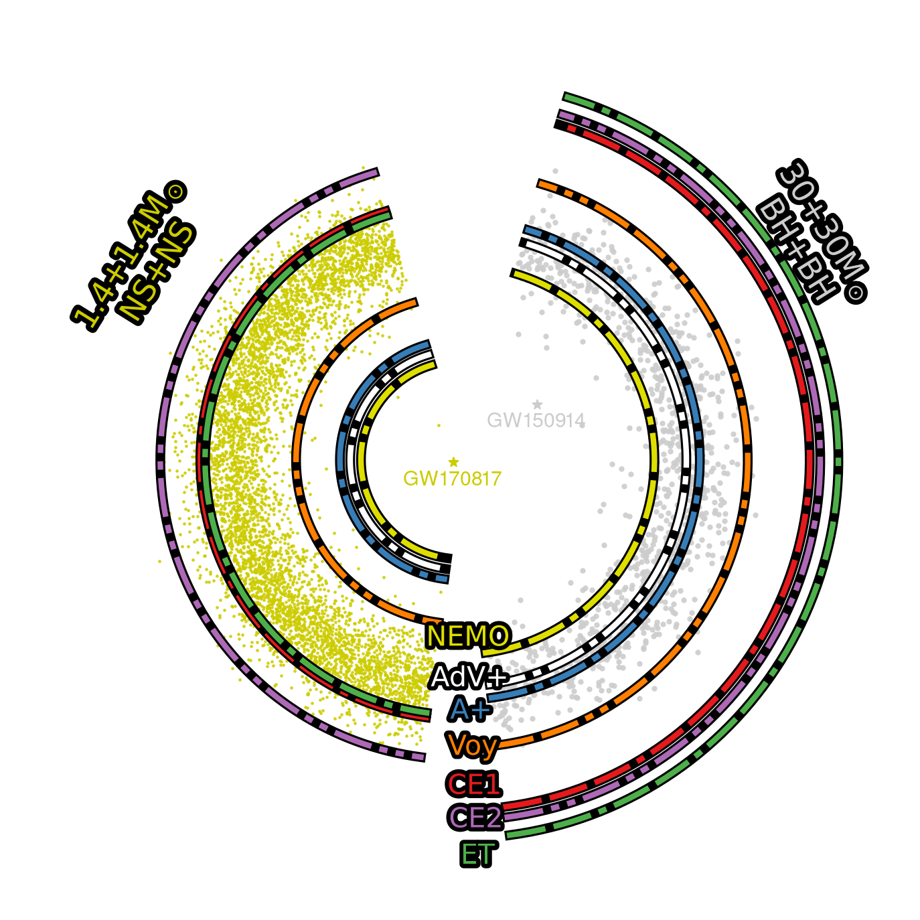
Why low frequency focus?
BBH up to z~50-100
10⁵ BBH/year
  Masses 𝑀_{𝑇}≿10³ 𝑀_{Θ}
BNS to z~2
  10⁵ BNS/year
  Possibly O(10-100)/year with e.m. counterpart
High SNR

Slide 40
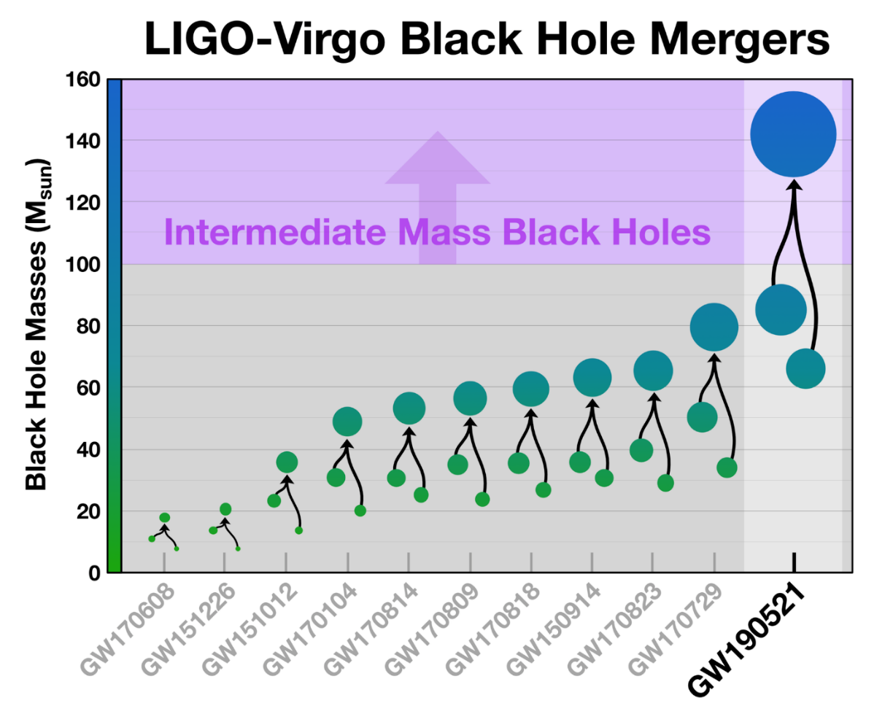
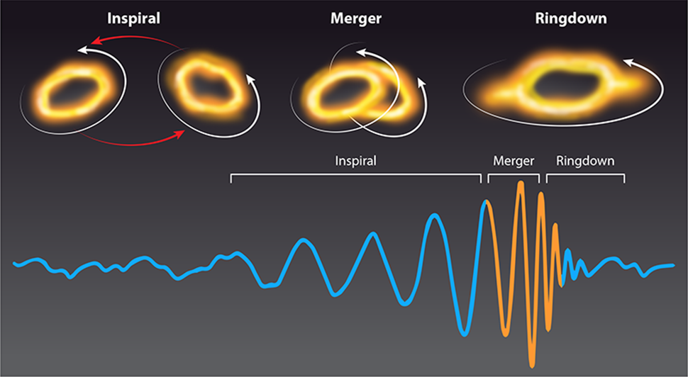
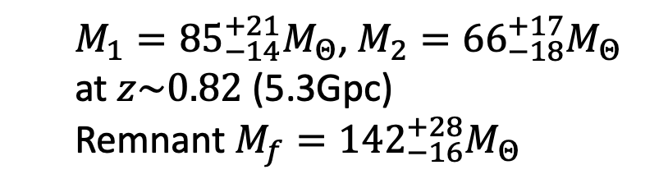
GW190521
Why low frequency focus?
  $M_{1}={85}_{−14}^{+21}M_{Θ}$, $M_{2}={66}_{−18}^{+17}M_{Θ}$
  at $z\sim 0.82$ (5.3Gpc)
  Remnant $M_{f}={142}_{−16}^{+28}M_{Θ}$
Very special event:
  M₁, a black hole that should not exist
  M_{f}, the first IMBH ever seen
Where is the chirp?
Phys. Rev. Lett. 125, 101102 (2020)
Astrophys. J. Lett. 900, L13 (2020)

Slide 41
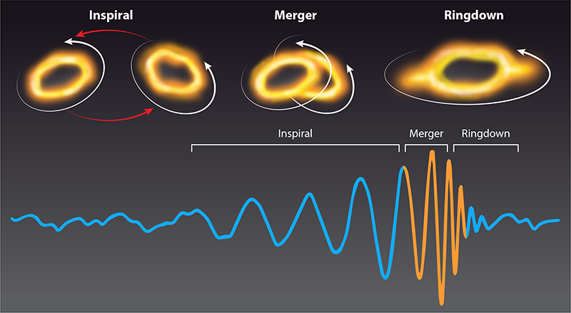
GW190521: LIGO-Virgo sensitivity to the BBH merger
Why low frequency focus?
Higher masses correspond to lower frequency GW emission
(Top) Kip Thorne; (Bottom) B. P. Abbott et al.; adapted by APS/Carin Cain

Slide 42
Primordial Black Holes
Why low frequency focus?

