Slide 1
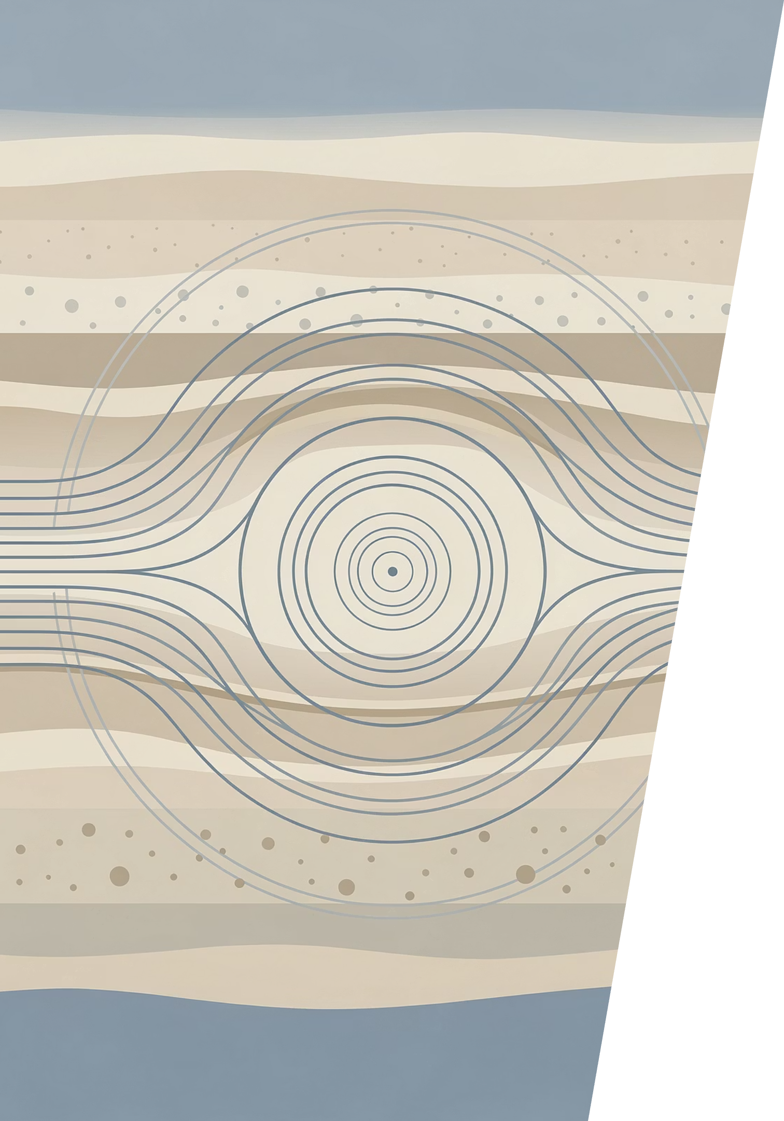
Newtonian Noise Roadmap
A structured benchmarking process for Newtonian Noise modelling tools, progressing through increasing complexity — from idealized conditions to real-site validation. Convergence targeted for November 2026.
PHASE 0 COMPLETED
6-PHASE ROADMAP

Slide 2
Roadmap Overview
The benchmarking process spans January through November 2026, advancing from baseline inventory to full convergence across all modelling tools.
Phase 0
1
Jan–Apr 2026 · Completed
2
Phase 1
May 2026
Phase 2
3
June 2026
4
Phases 3 & 4
Jul–Sep 2026
Phase 5
5
October 2026
6
Convergence
November 2026

Slide 3

PHASE 1 · MAY 2026
Idealized Flat Topography
The first active phase establishes analytical benchmarks and baseline validation using idealized flat topography. This controlled environment allows modelling tools to be compared under the simplest possible conditions, with agreement expected within tight tolerances before progressing to more complex scenarios.

Slide 4
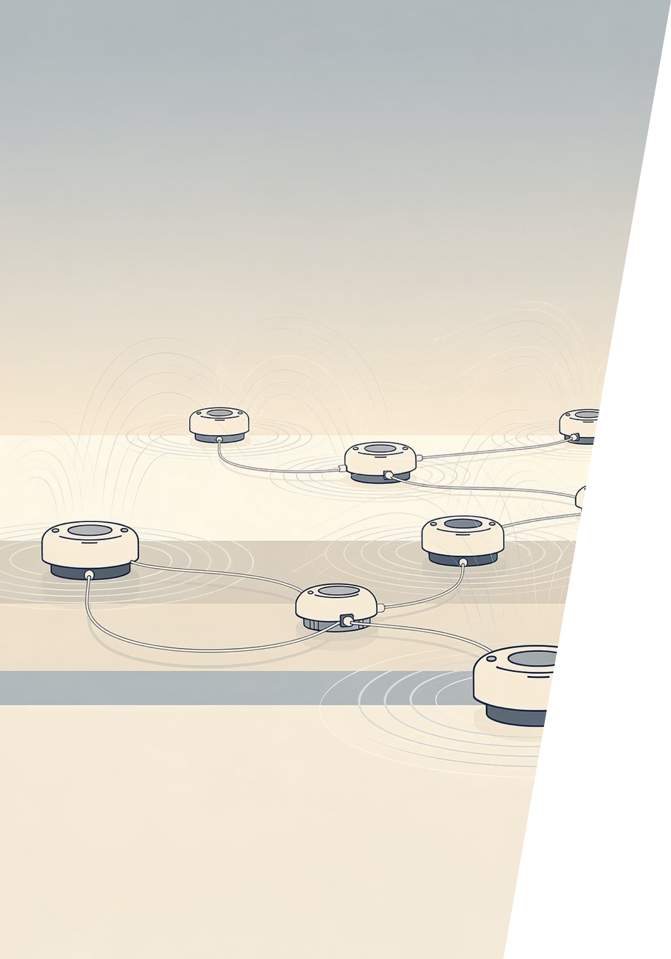
PHASE 2 · JUNE 2026
Representative Seismic Excitation Models
Objective
Expected Outcome
Introduce controlled, realistic seismic inputs to test numerical consistency across tools.
Numerical robustness verified — tools must demonstrate consistent responses to representative seismic field excitations before advancing to geometric and subsurface complexity.

Slide 5
PHASES 3 & 4 · JULY – SEPTEMBER 2026
Parallel Development
Phases 3 and 4 run concurrently, sharing a common baseline: homogeneous medium with flat topography. Each phase then diverges to explore a distinct source of complexity.
Phase 3 – Topography
Phase 4 – Subsurface
Combined Step
Progressive surface irregularities: simple → moderate → complex topography
Progressive subsurface complexity: two-layer → multi-layer → heterogeneous
Topography + heterogeneous subsurface modelled together

Slide 6



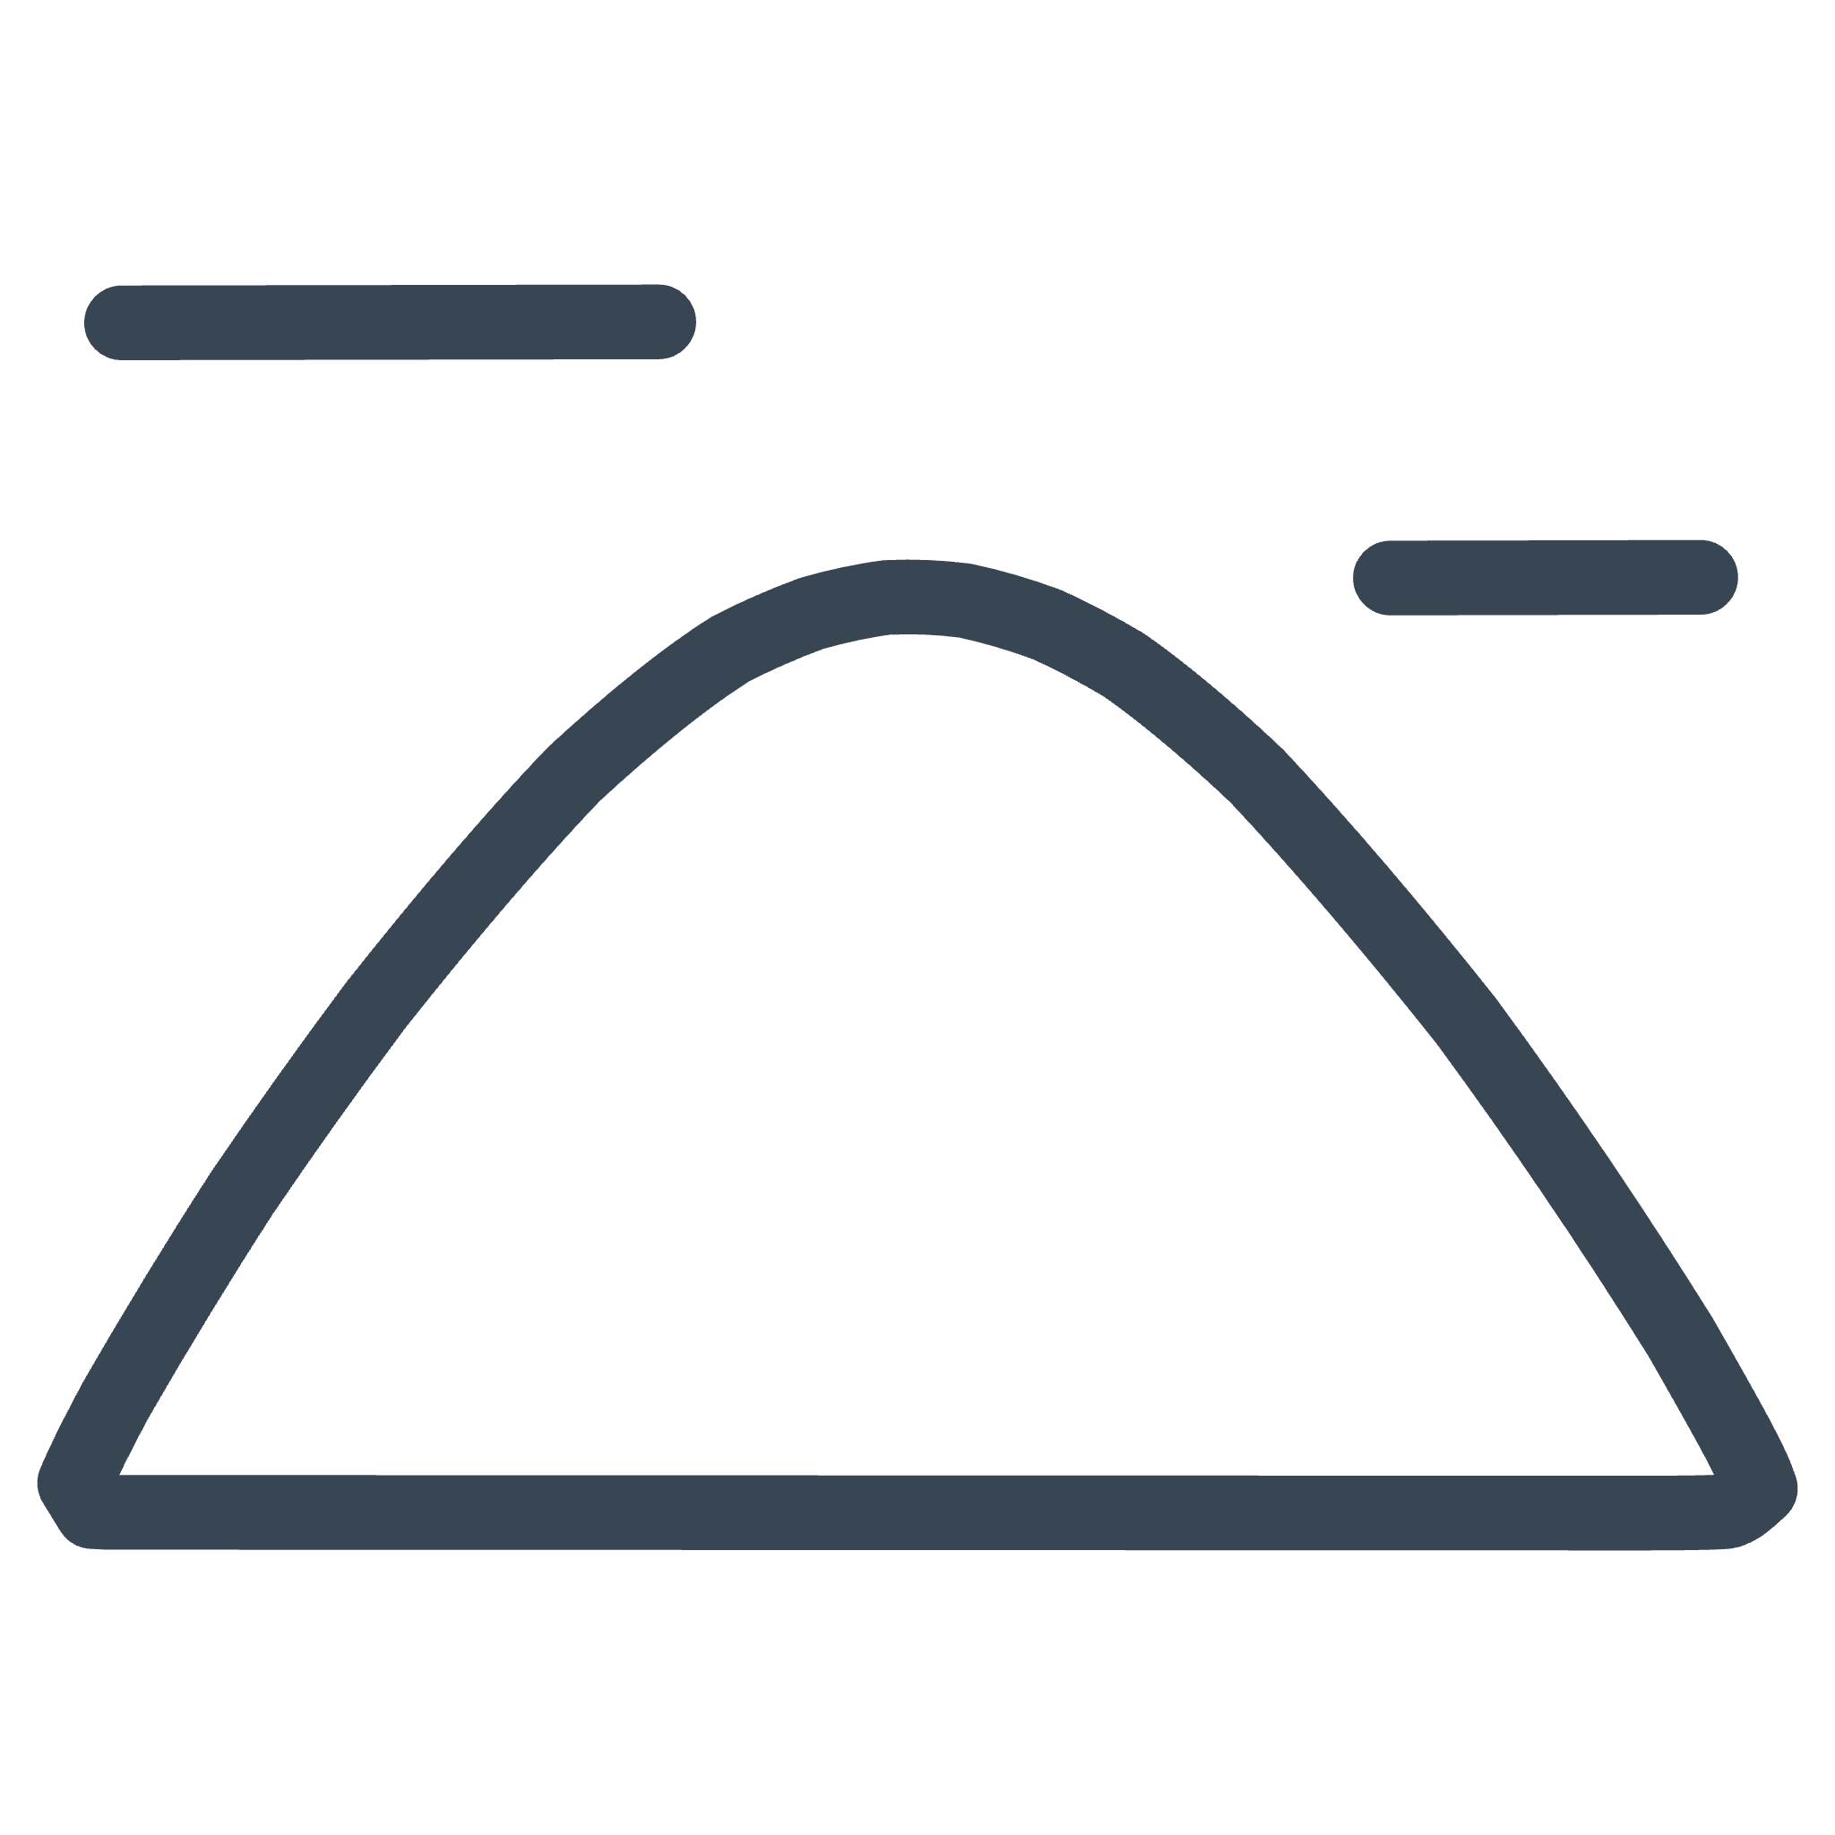

PHASE 3 · JUL–SEP 2026
Topography-Driven Complexity
Phase 3 systematically increases surface geometric complexity to assess sensitivity to topographic variation in Newtonian Noise models.
Step 1 – Flat (Baseline)
Homogeneous medium, flat topography
Step 2 – Simple Topography
Mild surface variation introduced
Step 3 – Moderate Topography
Increased surface irregularity
Step 4 – Complex Topography
Full geometric complexity

Slide 7
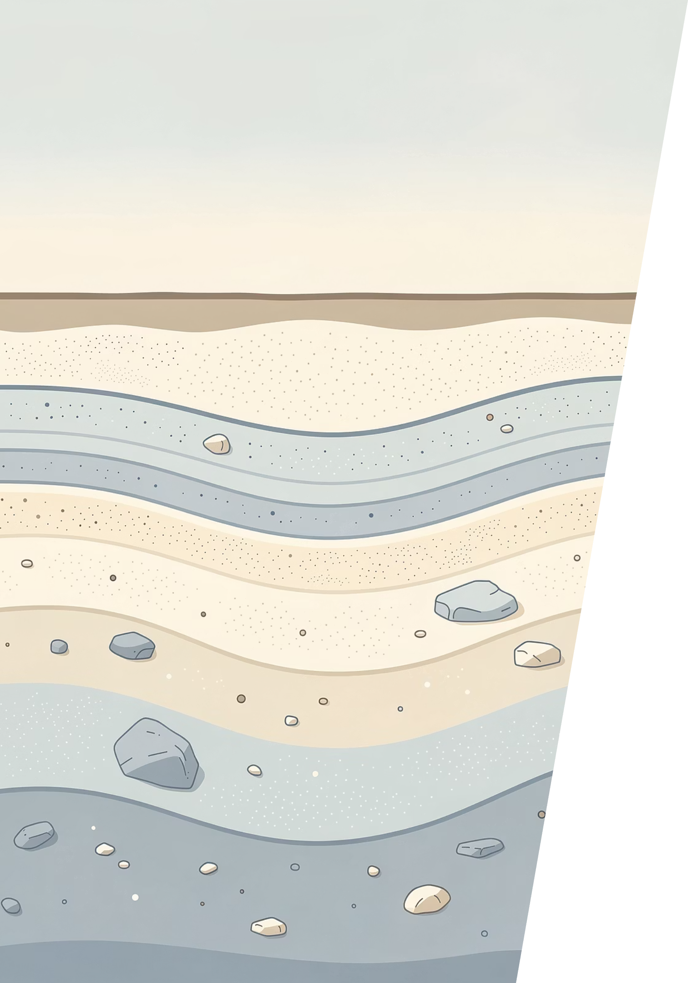




PHASE 4 · JUL–SEP 2026
Subsurface-Driven Complexity
Phase 4 progresses through increasing subsurface heterogeneity to evaluate model-dependent effects on Newtonian Noise predictions.
Flat Baseline
Homogeneous medium
Two-Layer Model
First subsurface contrast
Multi-Layer Model
Stratified complexity
Heterogeneous
Full subsurface variation

Slide 8

PHASE 5 · OCTOBER 2026
Real-Site Benchmarks
Phase 5 applies all validated modelling approaches to realistic site conditions, enabling a full cross-tool comparison under conditions representative of actual gravitational wave detector environments. This phase consolidates findings from Phases 1–4 and verifies that models perform consistently when confronted with real-world complexity.

Slide 9
CONVERGENCE · NOVEMBER 2026
Final Comparison & Consolidation
The convergence phase delivers the consolidated results of the entire benchmarking roadmap — final comparison and interpretation across all participating Newtonian Noise modelling tools.
Phase 0
Phase 1
Baseline established
Agreement within tight tolerances
Phase 2
Phase 3
Numerical robustness verified
Sensitivity to geometry
Phase 4
Phase 5
Model-dependent effects assessed
Full comparison across tools

Slide 10
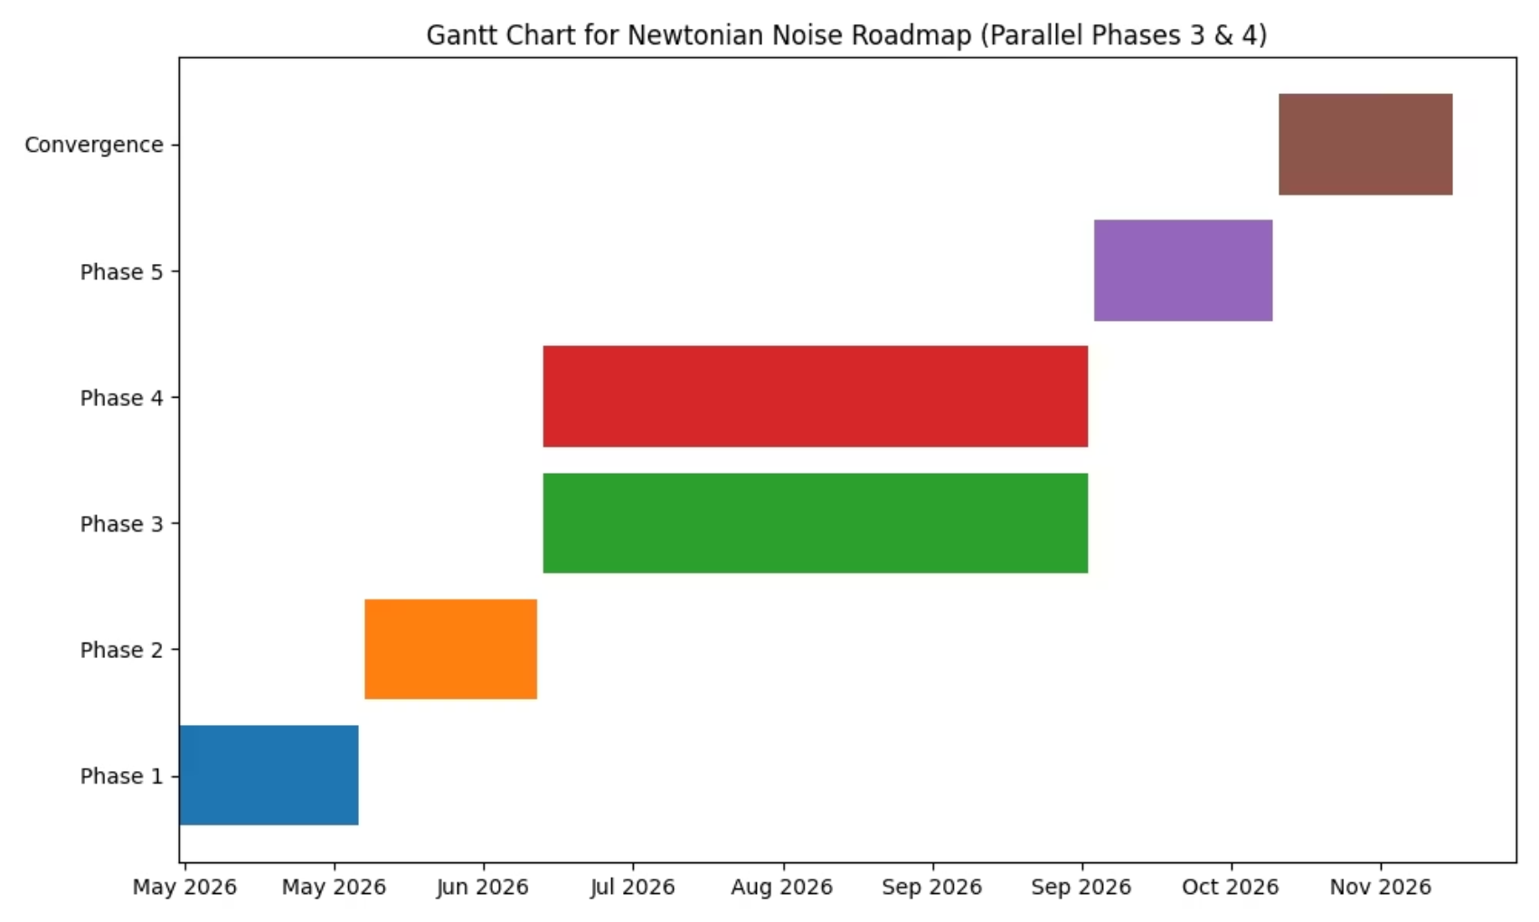
Gantt Chart
The schedule below summarizes all phases of the Newtonian Noise benchmarking roadmap from January through November 2026.
Phase
Timeframe
Scope
Expected Outcome
Phase 0 (completed)
Jan–Apr 2026
Inventory and ongoing activities
Baseline established
Phase 1
May 2026
Idealized flat topography
Agreement within tight tolerances
Phase 2
June 2026
Realistic seismic fields
Numerical robustness verified
Phase 3
Jul–Sep 2026
Surface irregularities
Sensitivity to geometry
Phase 4
Jul–Sep 2026
Heterogeneous subsurface
Model-dependent effects assessed
Phase 5
October 2026
Real-site benchmarks
Full comparison across tools
Convergence
November 2026
Final comparison and interpretation
Consolidated results

