Slide 1


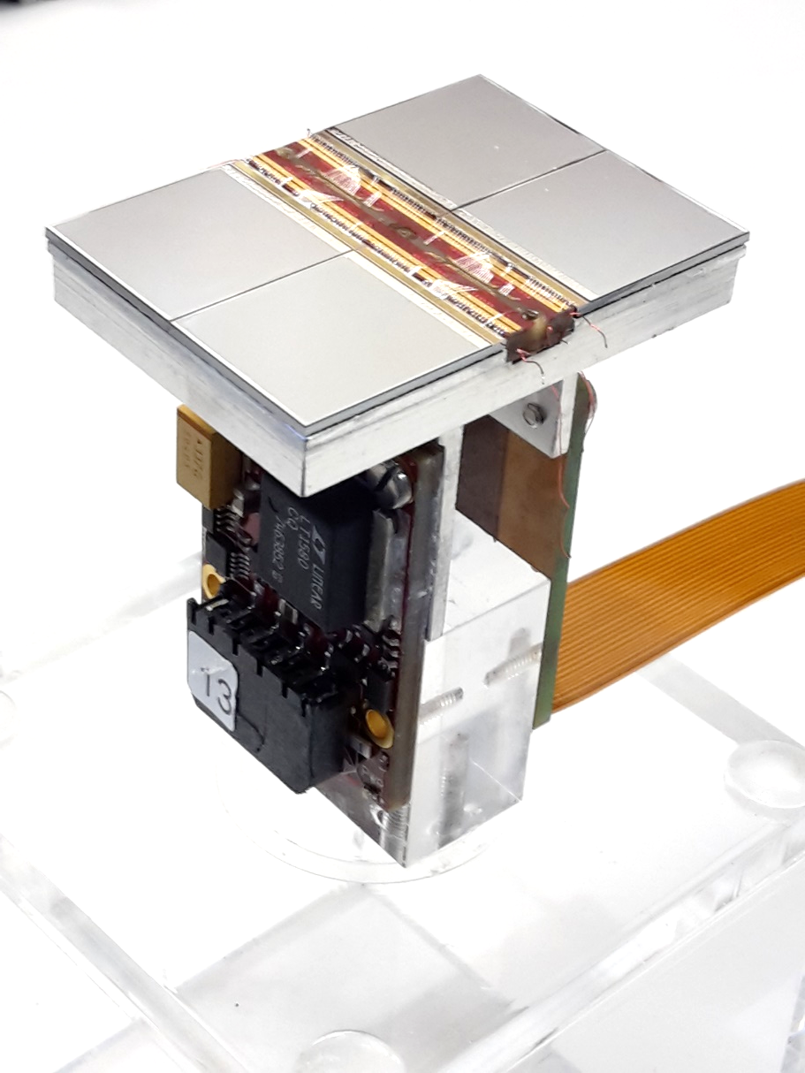






A Pixel TPC as a central tracker
Yevgen Bilevych, Klaus Desch, Sander van Doesburg, Harry van der Graaf, Fred Hartjes, Jochen Kaminski, Peter Kluit, Naomi van der Kolk, Cornelis Ligtenberg, Gerhard Raven, and
Jan Timmermans
ECFA 2024 presentation
FCC tracking workshop 2025

Slide 2
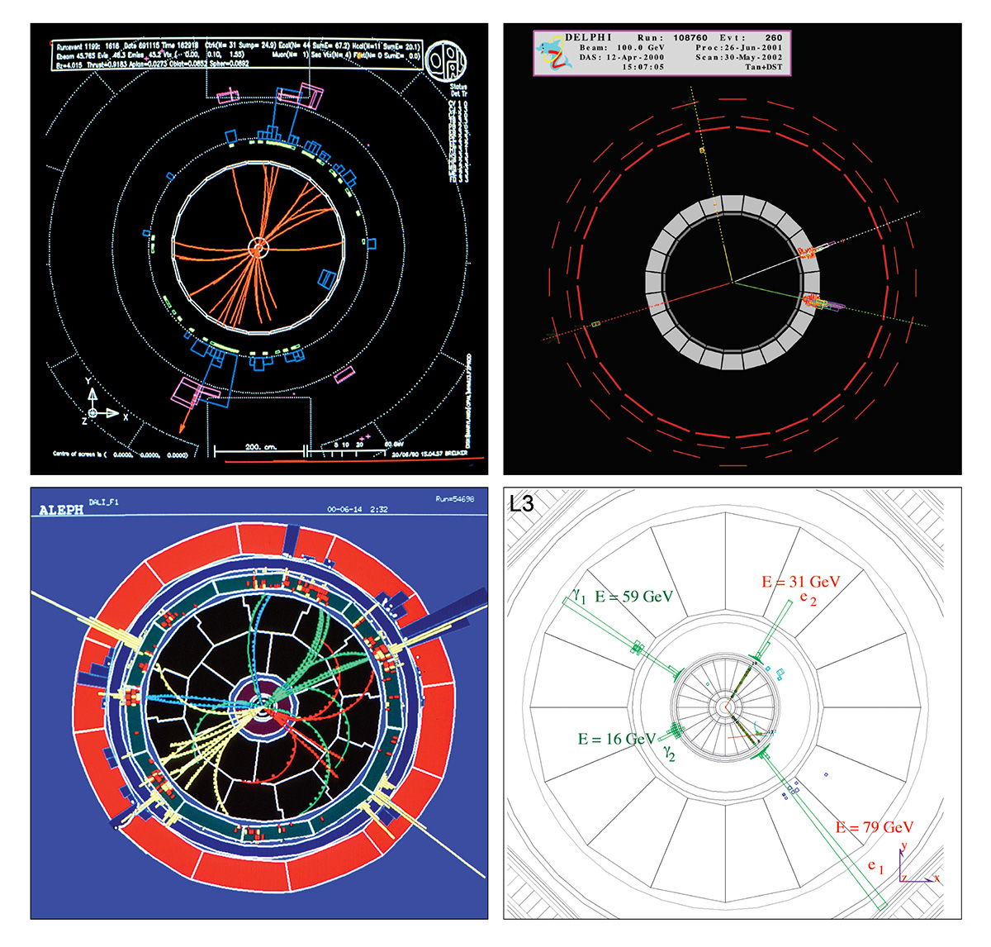
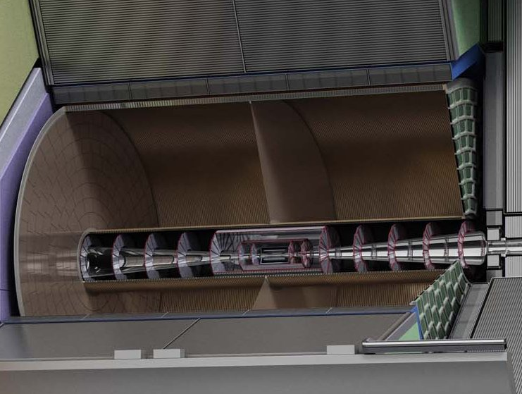
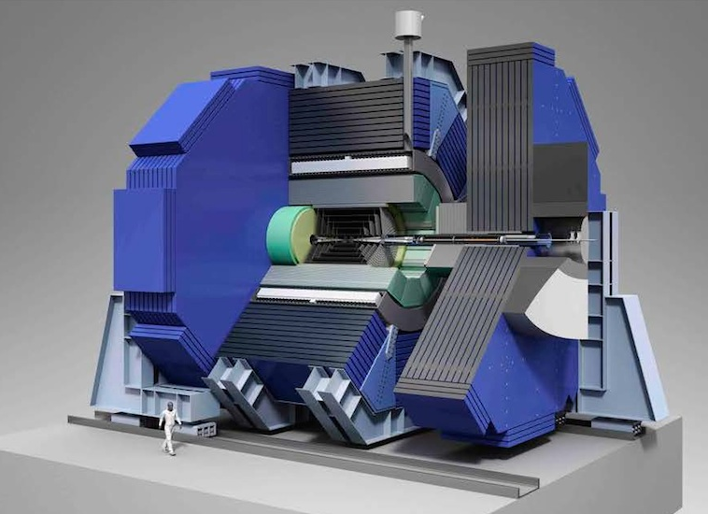
Nikhef involvement in Detector R&D for Future colliders
Linear
LEP experiments Tesla ILD/SiD CLIC detector
1989-2000 2001 2008 2018
ILD LOI 2010 IDR 2020

Slide 3
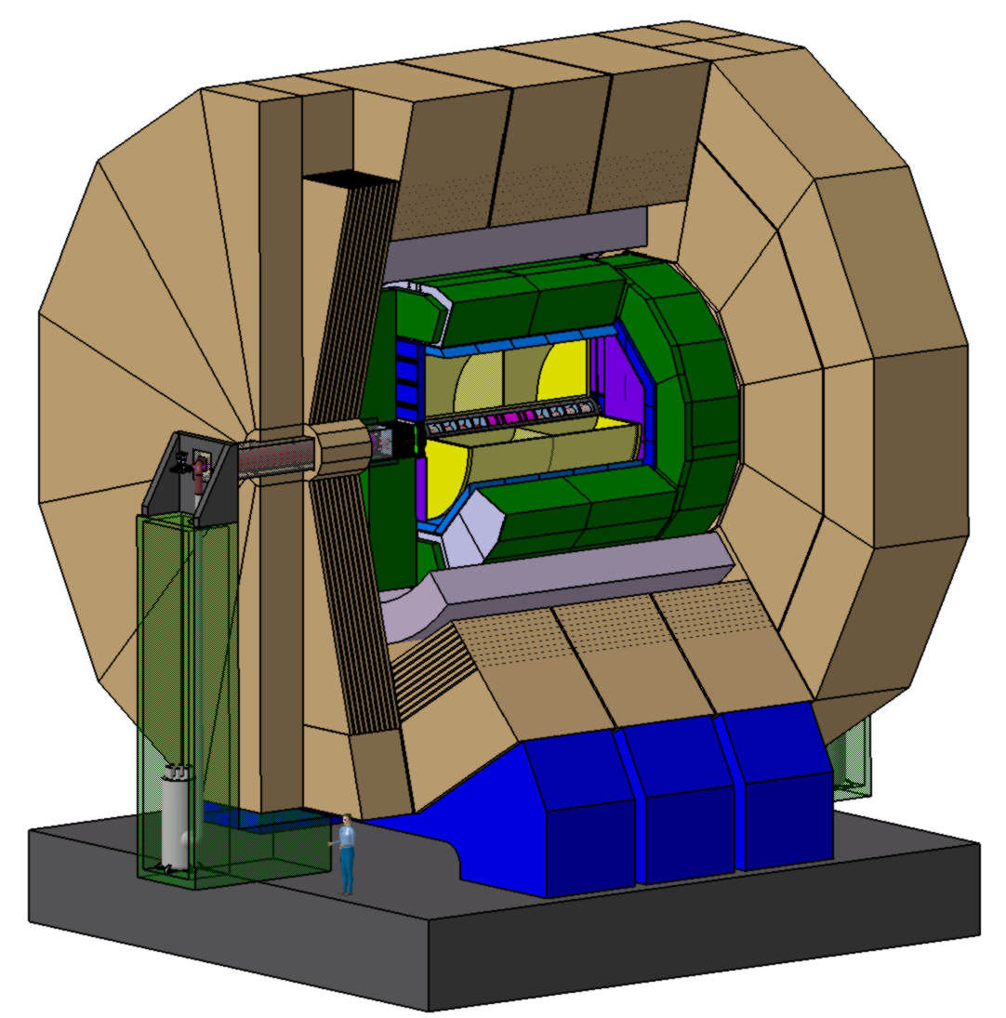
Nikhef involvement in Detector R&D for Future colliders
CLD
ILD/SiD CLIC detector CEPC detector FCCee concepts
2008 2018 2018 CDR 2025 TDR
TPC/Si Si Pixel TPC

Slide 4
The ILD Detector concept
ILD LOI 2010 IDR 2020. Nikhef member of ILD since 2008

Slide 5
The ILD Detector concept
ILD fundamental choices
similar to other FCC/ILC concepts
Marcel Demarteau
plea 2025 for a TPC
Adapted from Ties Behnke

Slide 6
Nikhef detector R&D for future e⁺e⁻ colliders
2001 Involved in the Tesla electron-positron collider project at DESY and the symposium
2002 Start of R&D on GridPix detectors since the first working prototype detector made by Harry van de Graaf, Jan Timmermans et al. GridPix = Gaseous detector with grid and silicon readout chip.
2002-2024 Gradual development of the GridPix detector for a Pixel TPC with 6 theses and an EUDET grant (2004-2008) by Alessandro Forniani (2005), Max Chefdeville (2009), Martin Fransen (2012), Spiros Tsigaridas (2017), Cornelis Ligtenberg (2021)
2007 LCTPC collaboration since 2007: R&D collaboration for a TPC at a (linear) collider
2007 Participation in the ILD experiment: Nikhef expressed interest in the TPC, silicon tracking and the forward calorimeter. ILD developed a detector concept with a (Pixel) TPC for a linear electron-positron collider (thesis Ligtenberg)
2021 ILD develops a detector concept at a circular electron-positron collider. Nikhef contributes actively to a Pixel TPC for the CEPC/FCCee.
[*]2012-2015 CLIC accelerator: the Rasnik alignment method to the beam adjustment system and thesis Glenn Vanbavinckhove (2012) on Optics for colliders (LHC,CLIC)

Slide 7
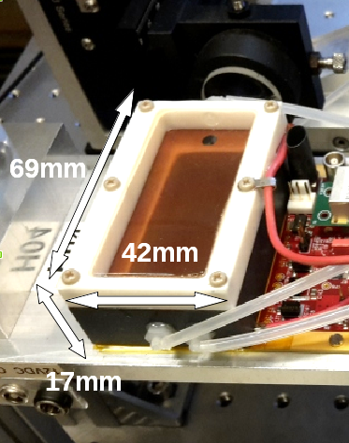
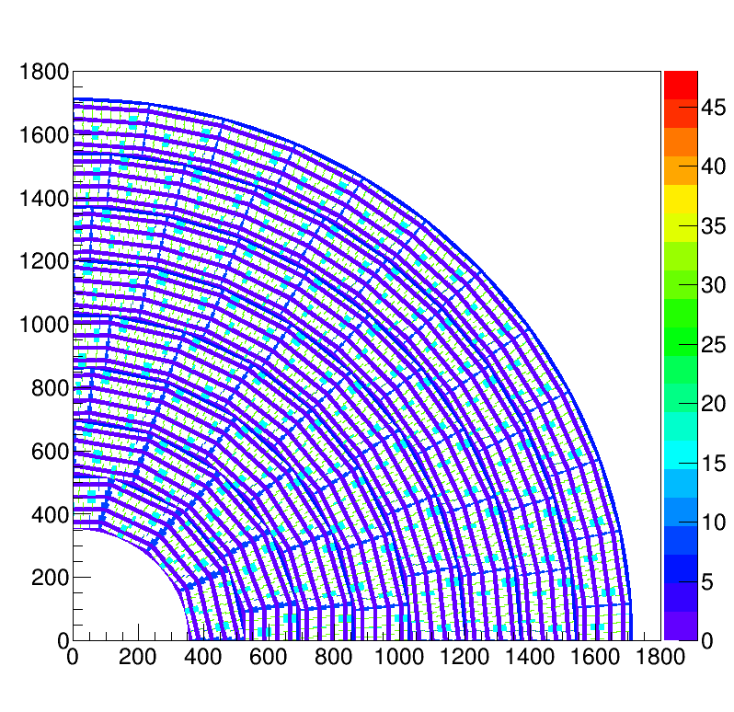
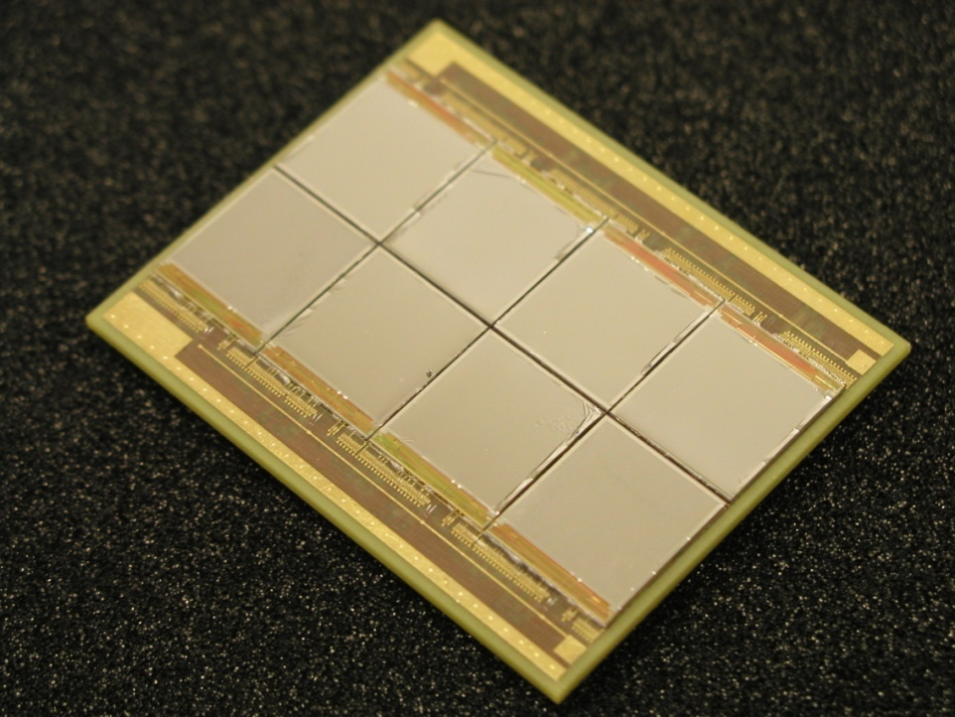
Pixel TPC
(Octopuce)
(TimePix1) TPX3 chip Quad Module TPC plane
(2007-14) 2017 2018 2019

Slide 8
TPC requirements
The R&D on a TPC for a e.g. Linear Collider is done in the LCTPC collaboration
Requirements for a TPC from the ILC TDR
ILD like detector concept with a TPC central tracker can be used for FCC
Challenging tracking precision
driven by (Z) Higgs running
For Z running the requirement on δ(1/p_{t}) can IMO be loosened by e.g. a factor 10 (LEP like)

Slide 9
TPC layout
Material budget is
0.01 X₀ TPC gas
0.01 X₀ inner cylinder
0.03 X₀ outer cylinder
< 0.25 X₀ endplates (incl readout)
Note the very low budget in the barrel region. Material budget can be respected by different technologies like GEM, MicroMegas and Pixels
TPC is sliced between silicon detectors VTX, SIT and SET
pixel readout is a serious option for the TPC readout plane @ ILC/FFC-ee/CLIC/CEPC colliders

Slide 10
Why a (pixel) TPC as a central tracker
Low material budget that allows high precision tracking
Continuous 3D tracking (x,y, t) and track following
Excellent v0 reconstruction
Ideal for particle flow and combined calorimetry
TPC is sliced between silicon detectors
provides required momentum resolution and constraints
Very powerful particle identification based on dEdx
for electrons (suppress pions)
for kaons (H->ss) and protons
TPC excellent option for FCCee WW, ZH, tt etc running
Running at the Z is challenging due to beam and synchrotron backgrounds
A pixel TPC combines a large drift volume with a silicon read out plane
tracking with high granularity and low systematic uncertainties
due to “silicon” precision (1-10 μm) in the production process
the best (see slides) PID performance dEdx and cluster counting
CEPC

Slide 11
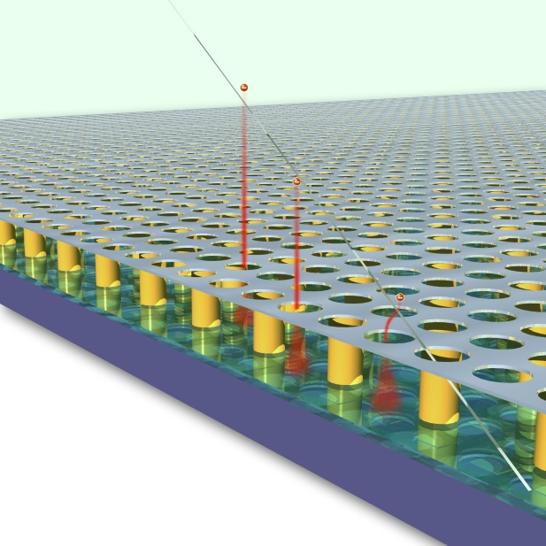
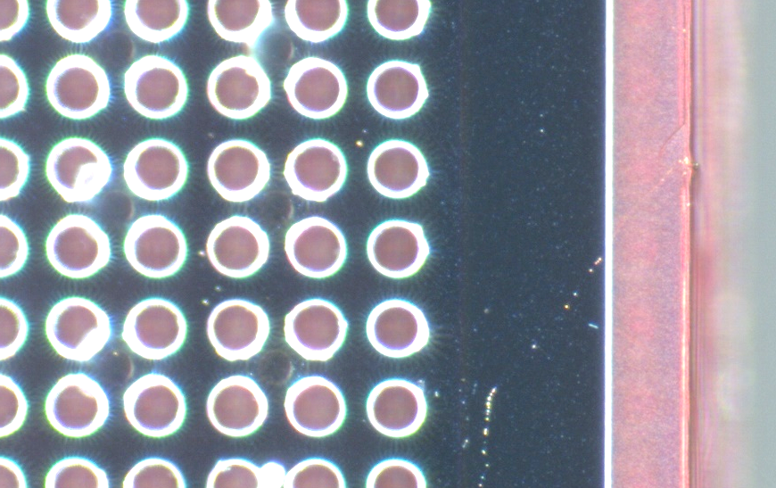
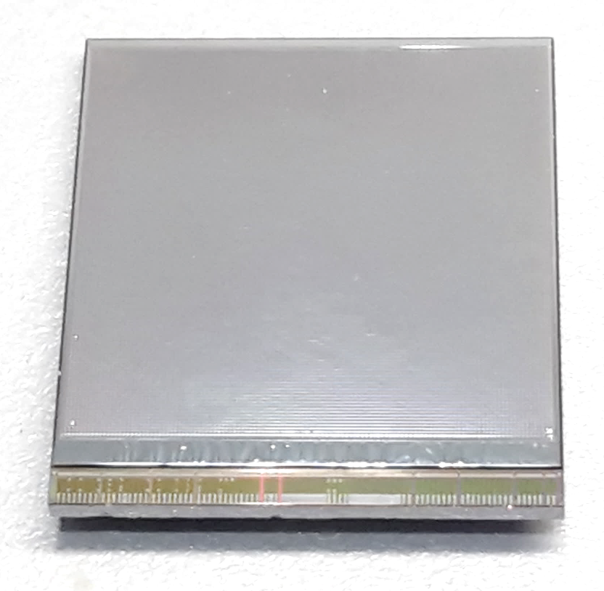
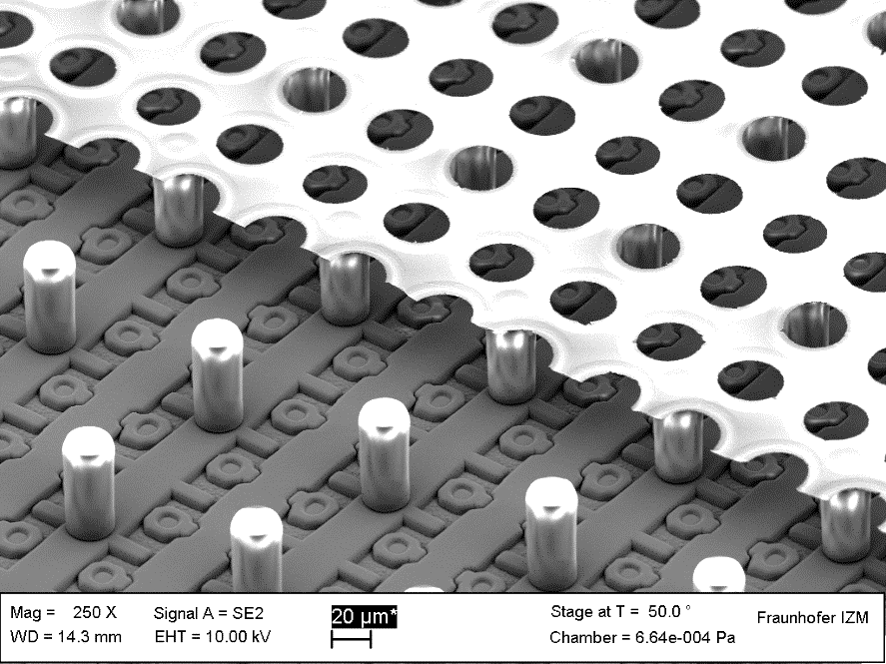
GridPix technology
Pixel chip with integrated Grid (Micromegas-like)
InGrid post-processed @ IZM (in 2025 @ Bonn)
Grid set at negative voltage (300 – 600 V) to provide gas amplification
Very small pixel size (55 µm)
detecting individual electrons
dyke
55 µm
Aluminium grid (1 µm thick)
35 µm wide holes, 55 µm pitch
Supported by SU8 pillars 50 µm high
Grid surrounded by SU8 dyke (150 µm wide solid strip) for mechanical and HV stability
50 µm

Slide 12
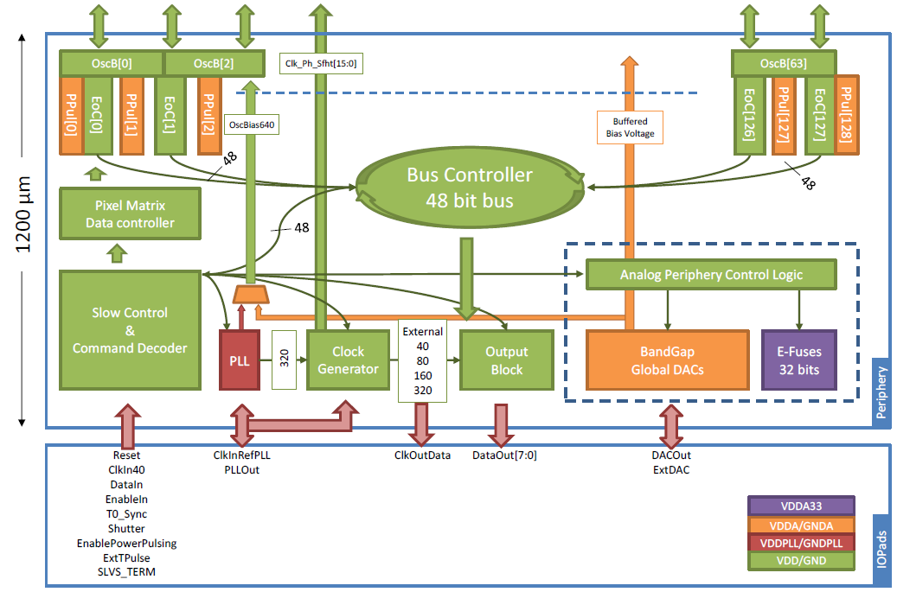
Pixel chip: TimePix3
256 x 256 pixels
55 x 55 µm pitch
14.1 x 14.1 mm sensitive area
TDC with 640 MHz clock (1.56 ns)
Used in the data driven mode
Each hit consists of the pixel address and time stamp of arrival time (ToA)
Time over threshold (ToT) is added to register the signal amplitude
compensation for time walk
Trigger (for t₀) added to the data stream as an additional time stamp
Power consumption
~1 A @ 2 V (2W) depending on hit rate
good cooling is important
Sensitive area
14.1 mm
2+3 mm

Slide 13
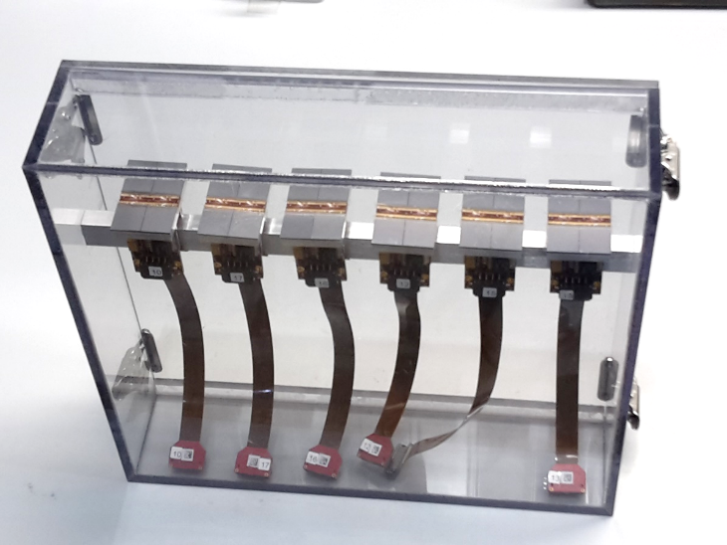
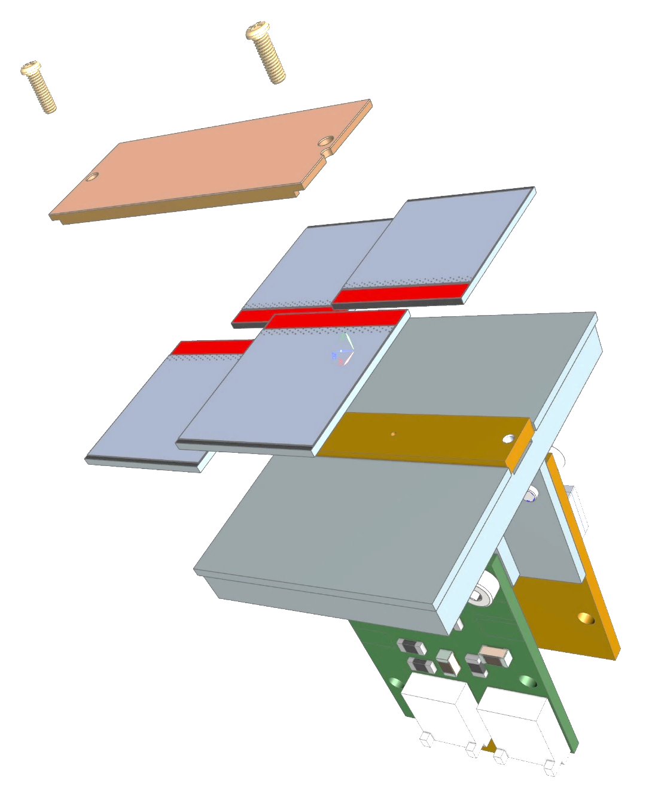
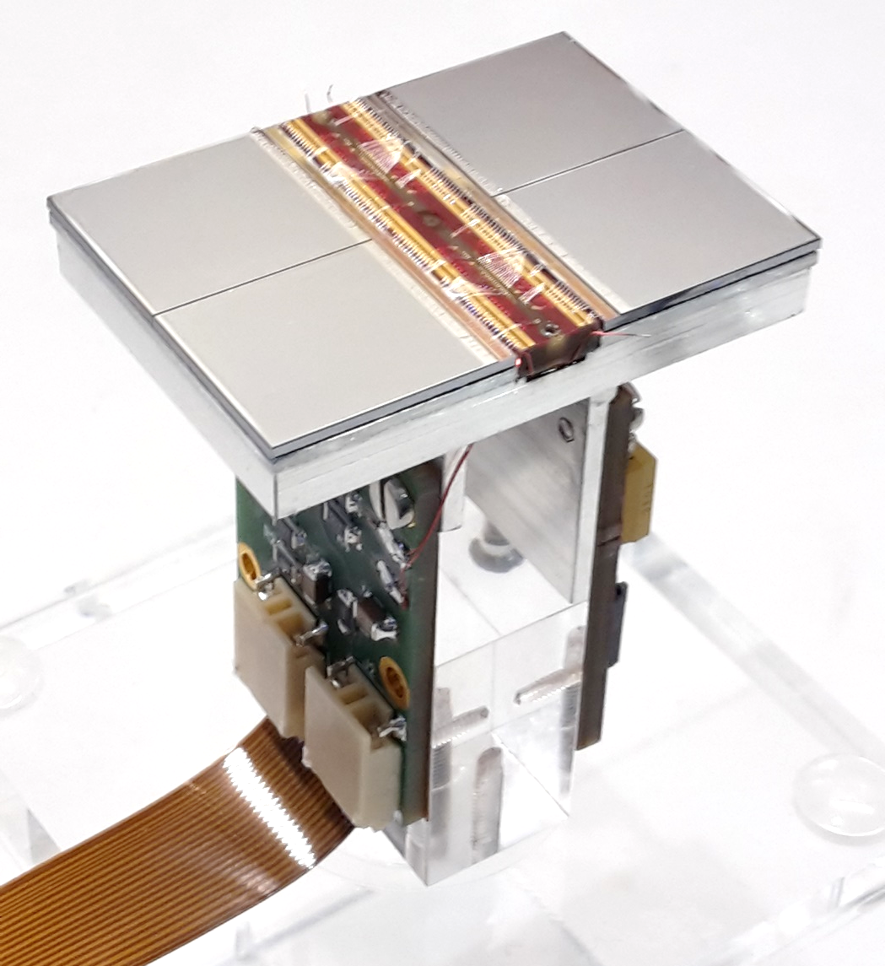
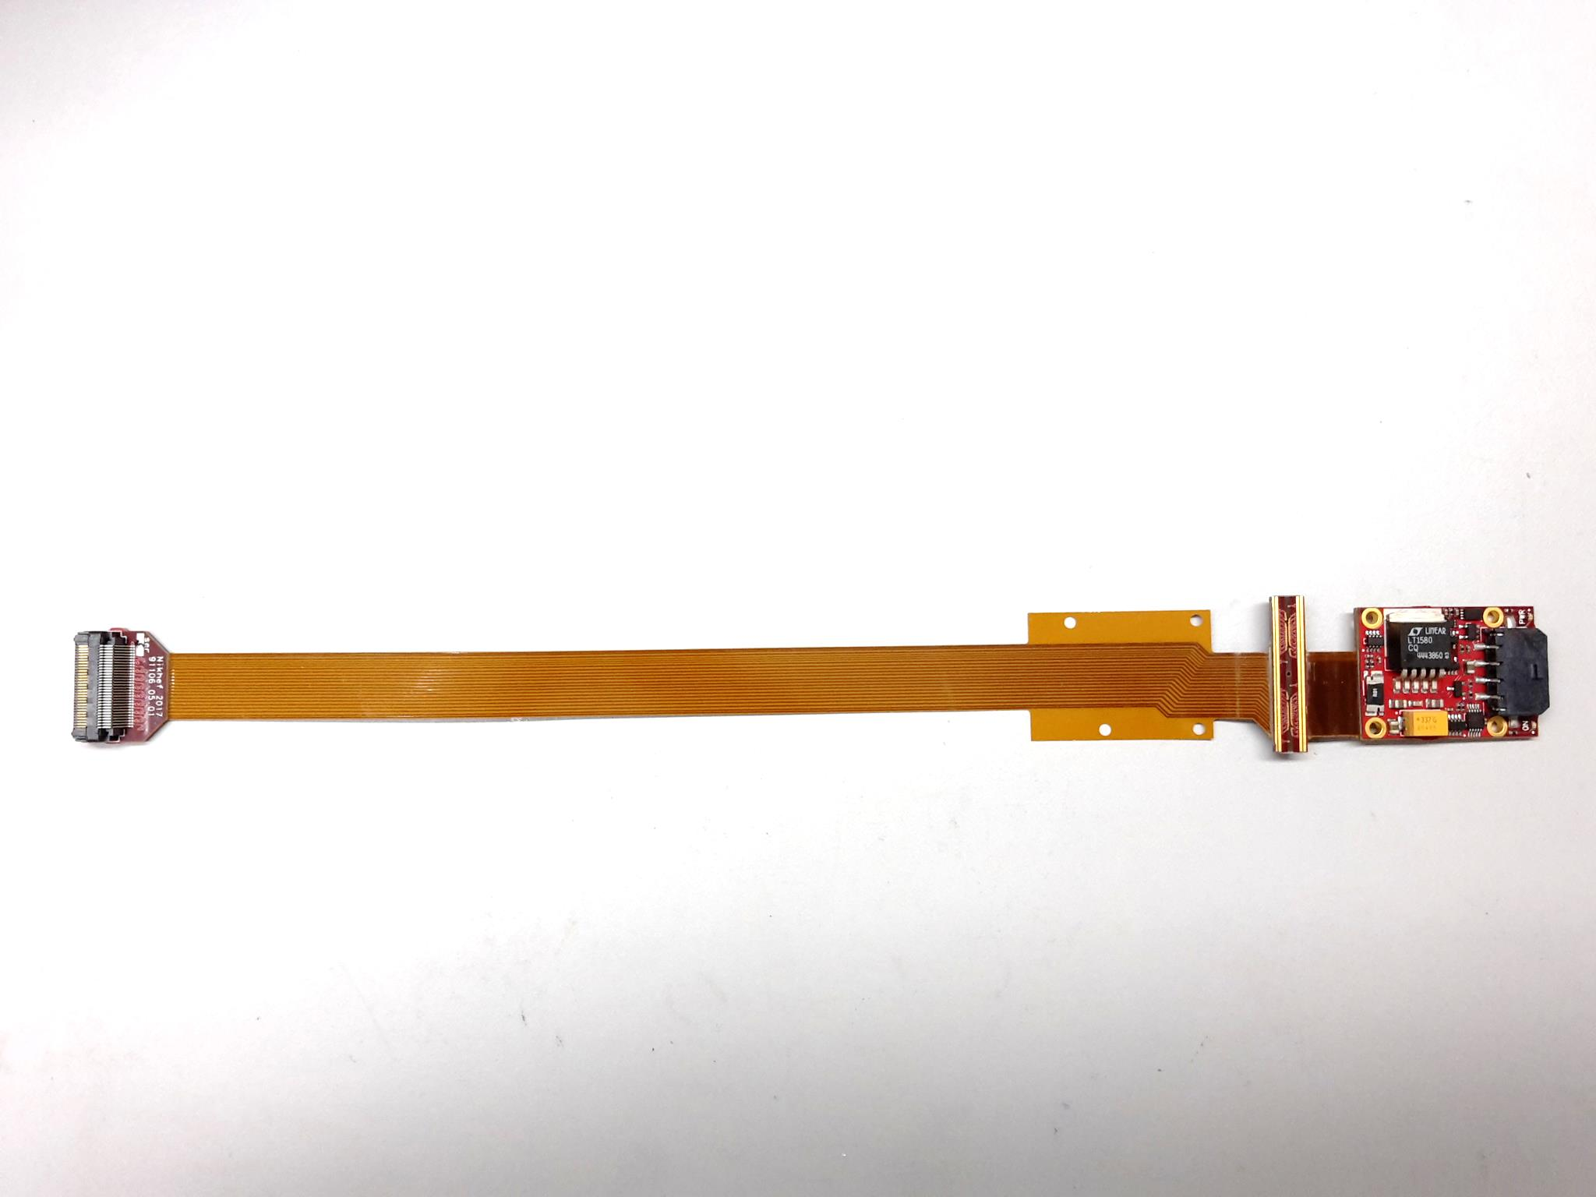
QUAD design and realization
Four-TimePix3 chips
All services (signal IO, LV power) are located under the detection surface
The area for connections was squeezed to the minimum
Very high precision 10 μm mounting of the chips and guard
QUAD has a sensitive area of 68.9%
DAQ by SPIDR board
39.6 x 28.38 mm
series of QUADs
Guard
TPX3
TPX3
TPX3
TPX3
COld
CArrier

Slide 14
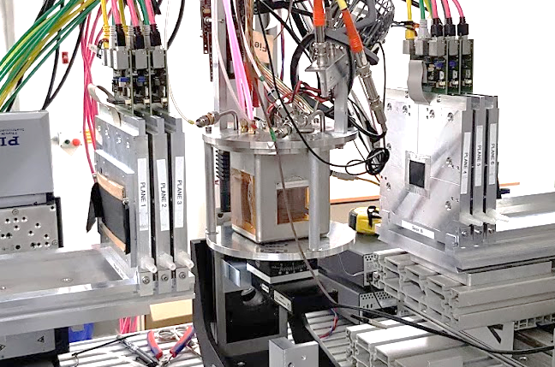
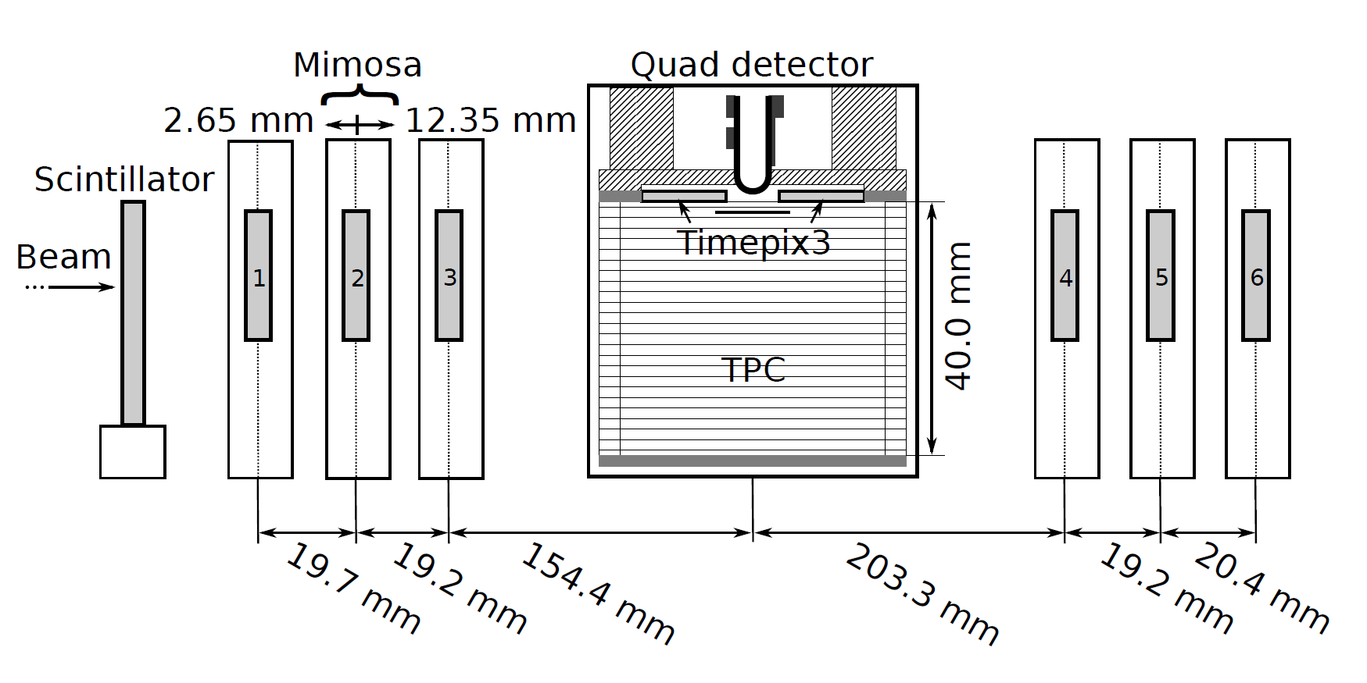

QUAD test beam in Bonn (October 2018)
ELSA: 2.5 GeV electrons
Tracks referenced by Mimosa telescope
QUAD sandwiched between Mimosa planes
Largely improved track definition
6 planes with 18.4 μm × 18.4 μm sized pixels
Gas: Ar/CF₄/iC₄H₁₀ 95/3/2 (T2K)
E_{d} = 400 V/cm, V_{grid} = -330 V
Typical beam height above the chip: ~1 cm
Published NIMA https://doi.org/10.1016/j.nima.2019.163331
@Bonn
Field cage

Slide 15
QUAD as a building block
8-QUAD module (2x4 quads) with field cage
in red guard wires

Slide 16
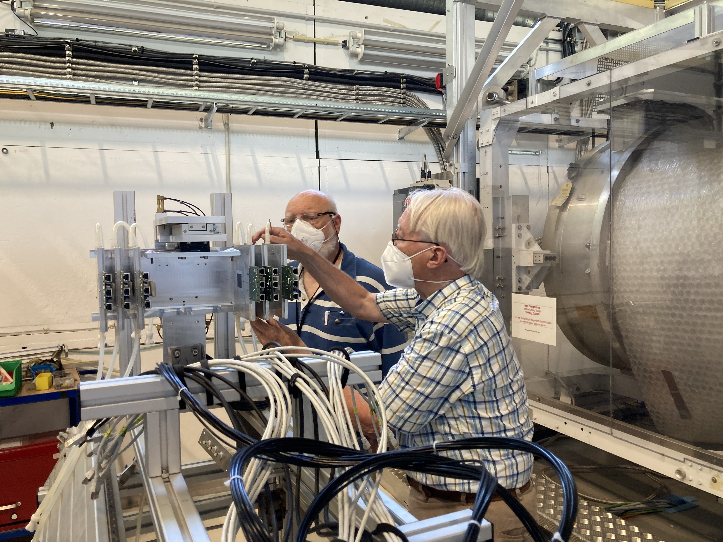
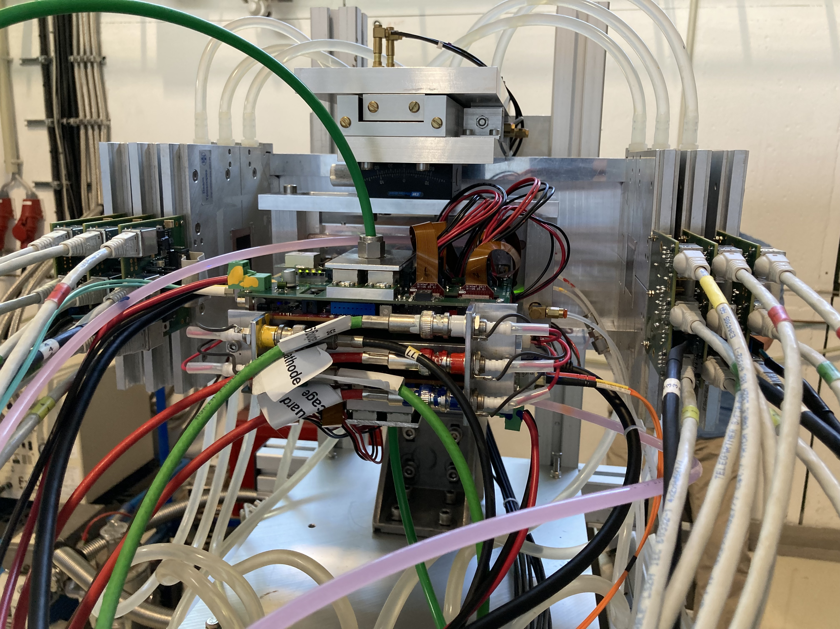
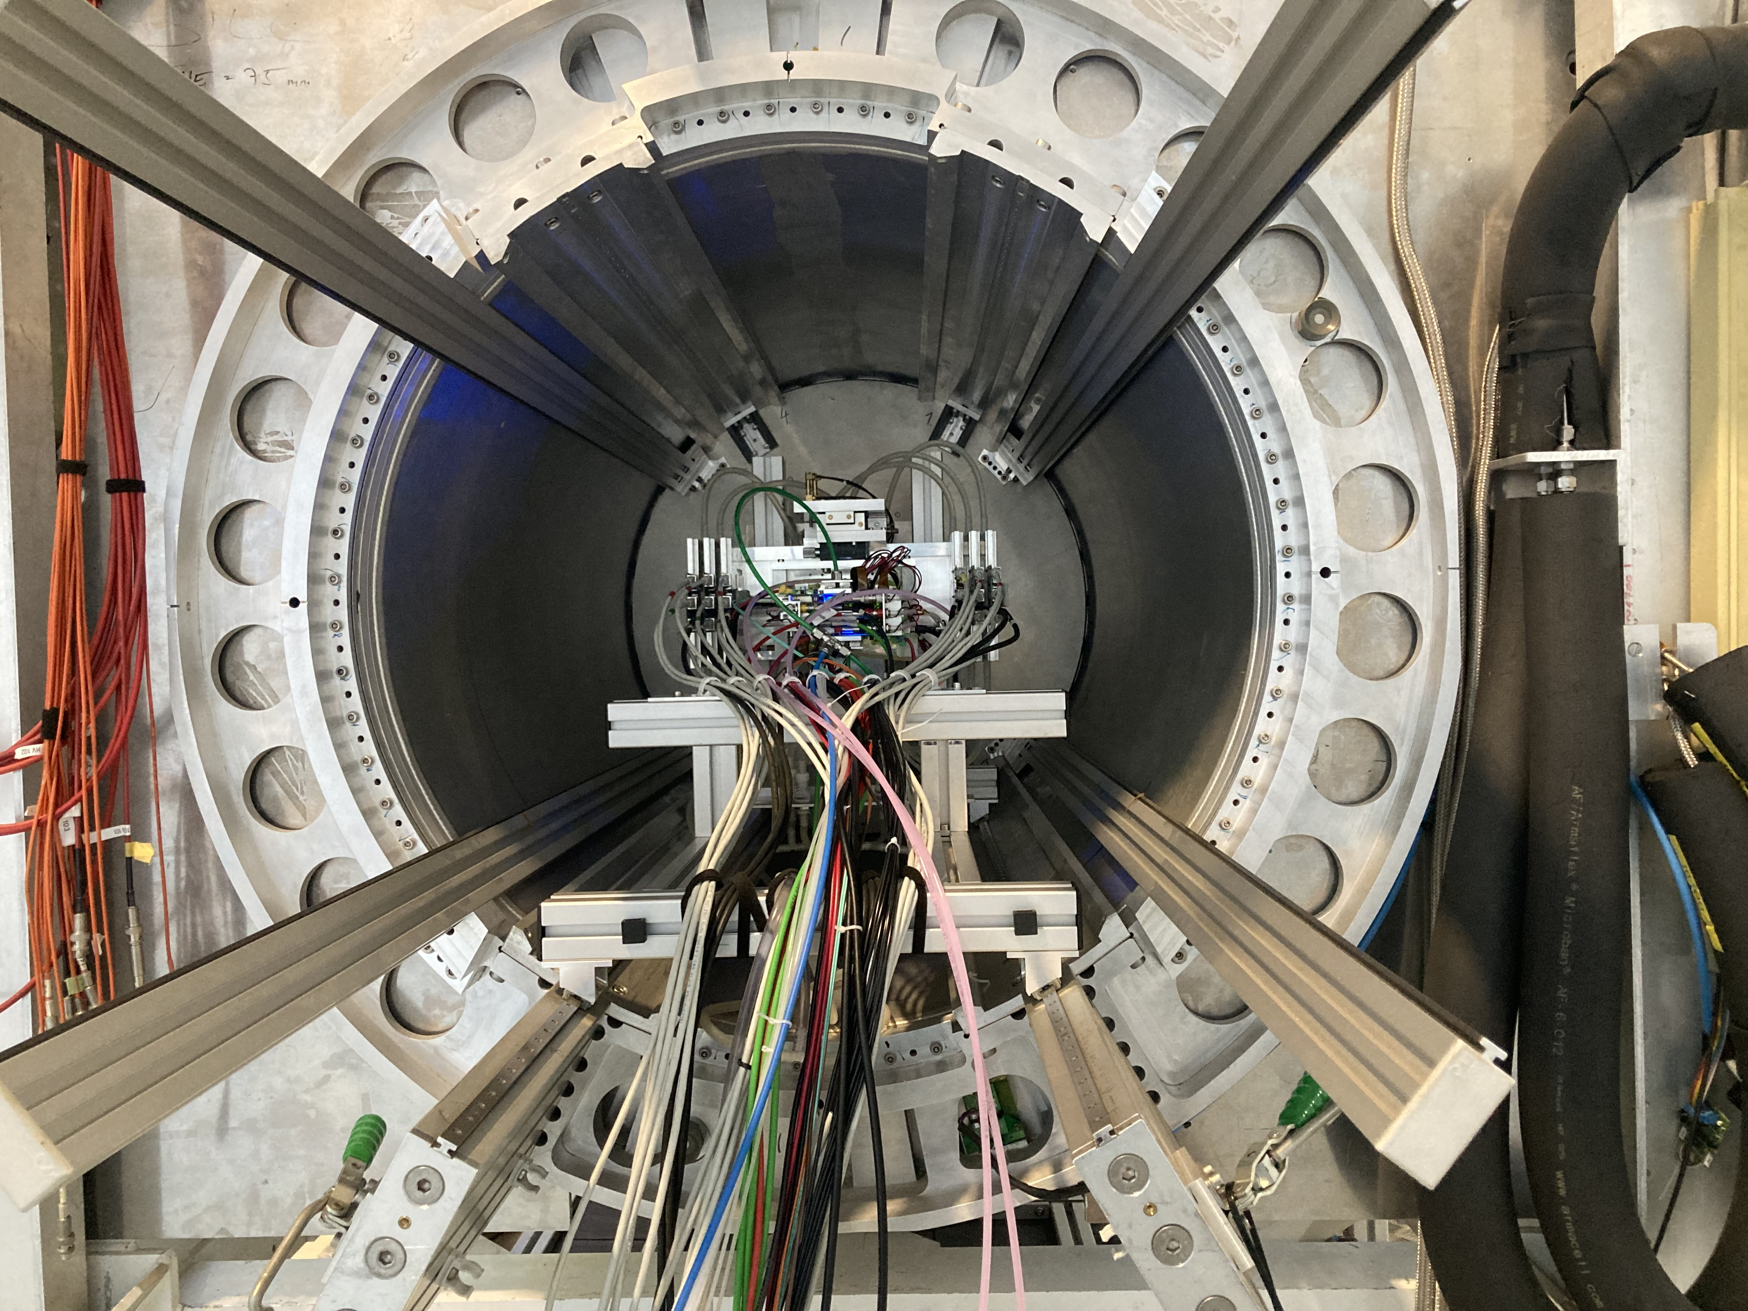
DESY testbeam June 2021
Mounting the 8 quad module between the silicon planes
sliding it into the 1 T PCMAG solenoid
Towards a Pixel TPC part I: construction and test of a 32-chip GridPix detector, Nucl. Instrum. Meth. A 1075 (2025) 345

Slide 17
DESY testbeam June 2021

Slide 18
DESY testbeam Module Analysis
Event display with module and telescope
TPX3 track 1130 hits
χ²_{xy} = 677.5/1128
χ²_{z} = 775.9/1069
Asymmetric tail outlier removal applied 1071 hits in z kept.
TPX3 track hits
Telescope track hits (off track green)
x global
x local
z global
y local
z global
y global
z local drift
y local

Slide 19
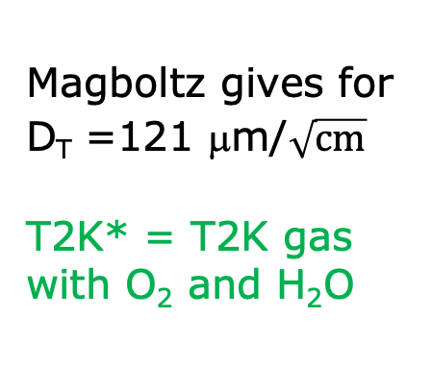


DESY testbeam Module Analysis
B=1 T p=5 and 6 GeV
Fitted resolution
$$σxy,z2=σ2xy0,z0+D2xy,z \left(z−z0\right)$$
σ² _{xy0}= σ²_{pixel} + σ²_{xy tele} σ²_{pixel}= 55²/12 μm²
σ_{xy tele}= 42 μm
$DT$ 120 μm/$\sqrt{cm}$
$DL$ 251 μm/$\sqrt{cm}$
Magboltz gives for D_{T} =121 μm/$\sqrt{cm}$
T2K* = T2K gas with O₂ and H₂O
ToT > 50 μs
B=1 T
T2K*
E_{d}=280 V/cm

Slide 20
DESY testbeam Module Analysis
B=1T p=5 GeV
Distribution of mean residuals in the module plane
Method row
B=1 T data set
xy
z
method | rms (stat) xy | bins xy | rms (stat) z | bins z
row | 13 (2) μm | 896 | 19 (5) μm | 896
column | 11 (2) μm | 880 | 20 (5) μm | 880
Method column
* We did not include the 4 corner chips and (11), 14, 8, 13 and 19.
These are affected by the field cage and the short in chip 11.

Slide 21
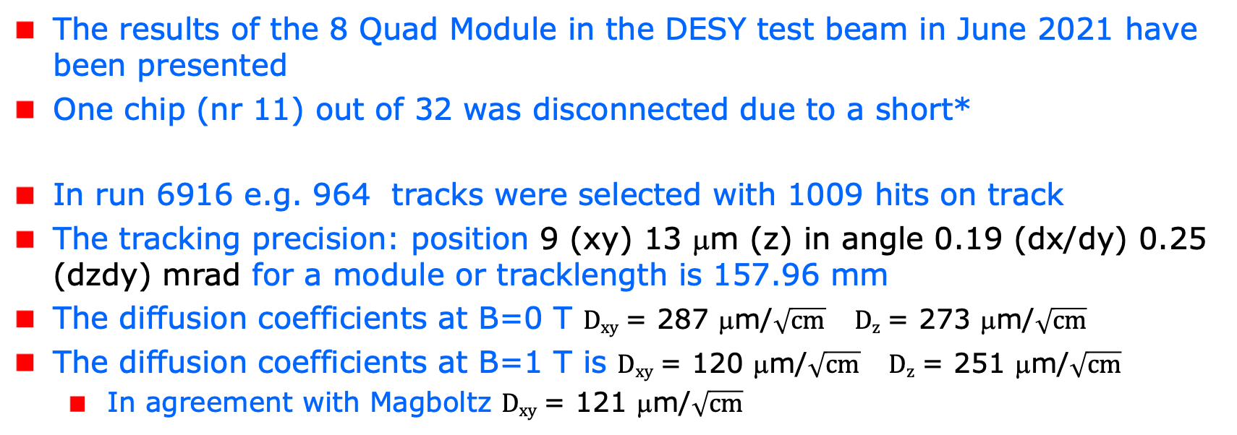
Tracking resolution and precision
The results of the 8 Quad Module in the DESY test beam in June 2021 have been presented
One chip (nr 11) out of 32 was disconnected due to a short*
In run 6916 e.g. 964 tracks were selected with 1009 hits on track
The tracking precision: position 9 (xy) 13 μm (z) in angle 0.19 (dx/dy) 0.25 (dzdy) mrad for a module or tracklength is 157.96 mm
The diffusion coefficients at B=0 T $Dxy$ = 287 μm/$\sqrt{cm}$ $Dz$ = 273 μm/$\sqrt{cm}$
The diffusion coefficients at B=1 T is $Dxy$ = 120 μm/$\sqrt{cm}$ $Dz$ = 251 μm/$\sqrt{cm}$
In agreement with Magboltz $Dxy$ = 121 μm/$\sqrt{cm}$
*the chip was successfully repaired in 2023 Bonn

Slide 22
Tracking resolution and precision
Results for the module showed that:
the HV of the guard wires was well tuned
B=0 T rms residuals in the module plane xy 13 μm and z 15 μm
The results are compatible with (very) high stats quad measurement
B= 1 T rms residuals in the plane xy 13 μm and z 20 μm;
High tracking precision is demonstrated with small systematics
deformations xy stay below 13 μm
Published in Nucl. Instrum. Meth. A 1075 (2025) 345
Towards a Pixel TPC part I: construction and test of a 32-chip GridPix detector

Slide 23
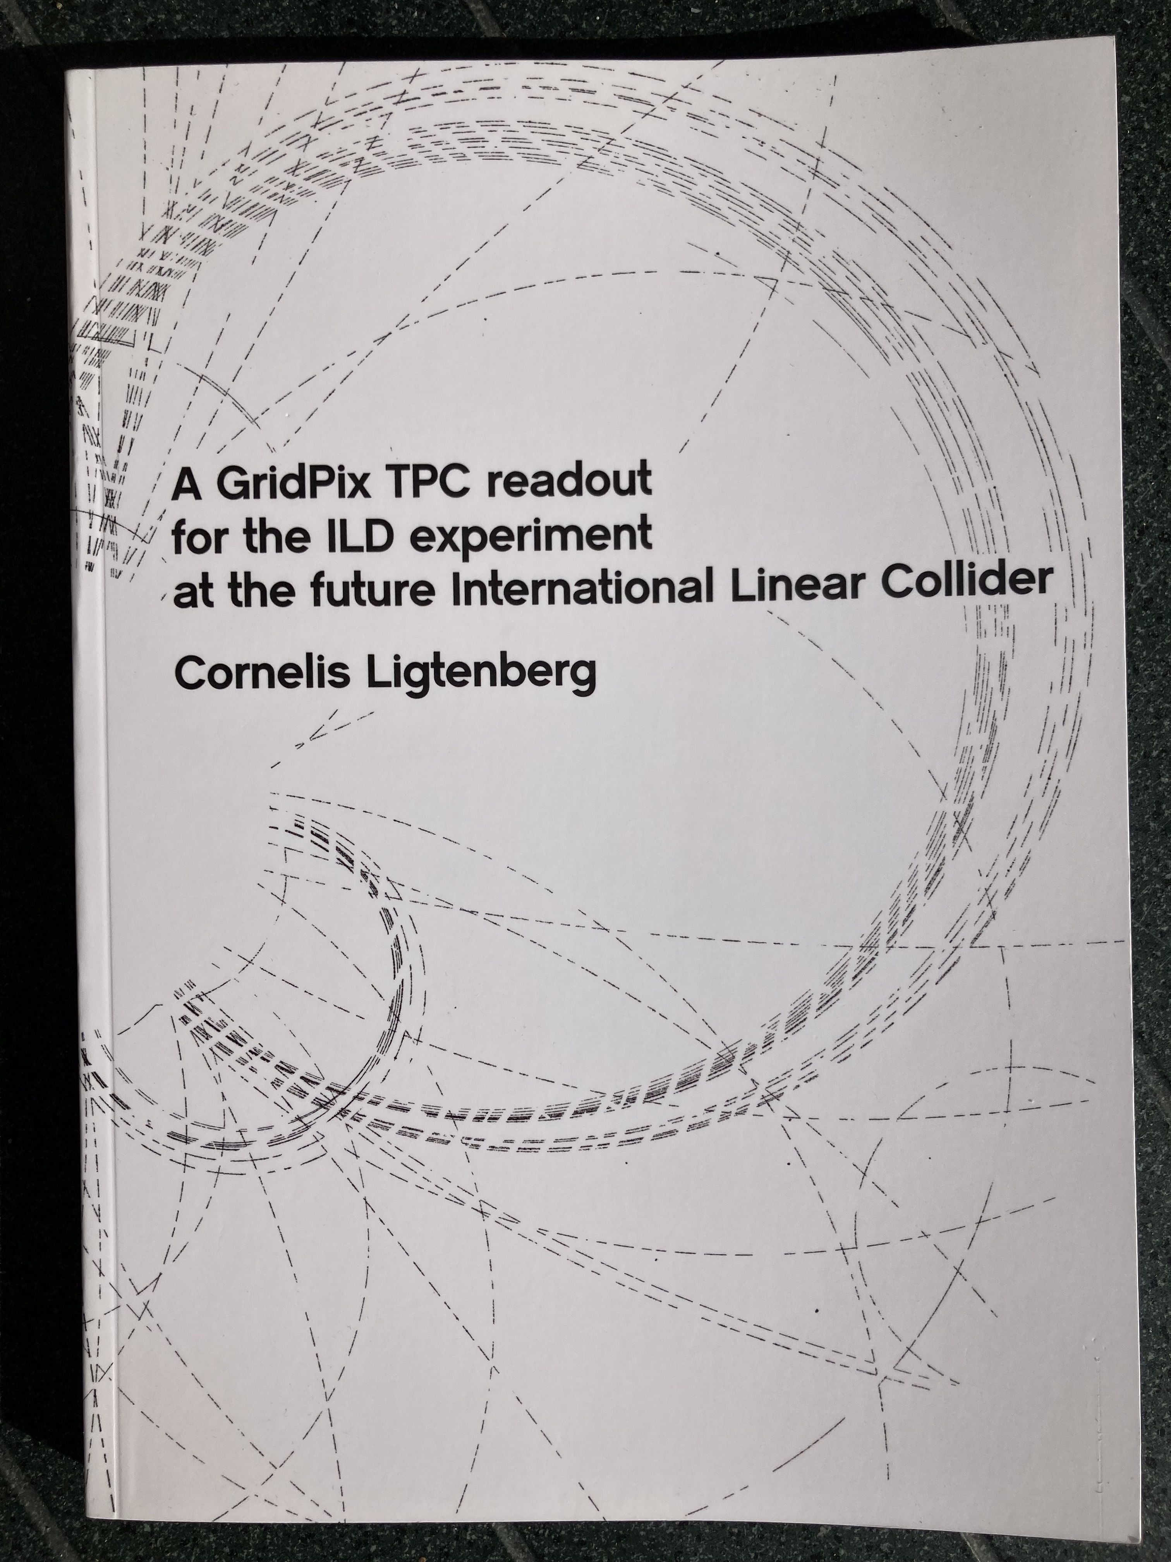
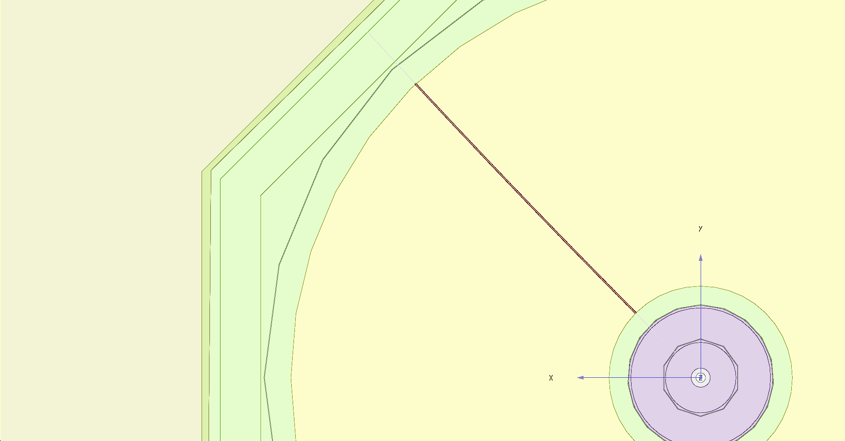
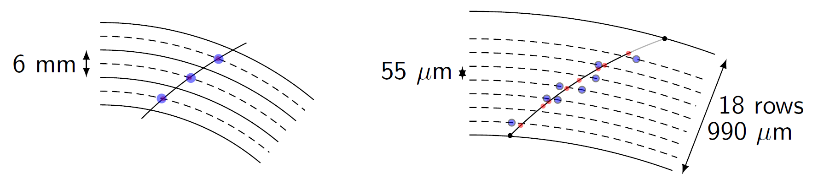
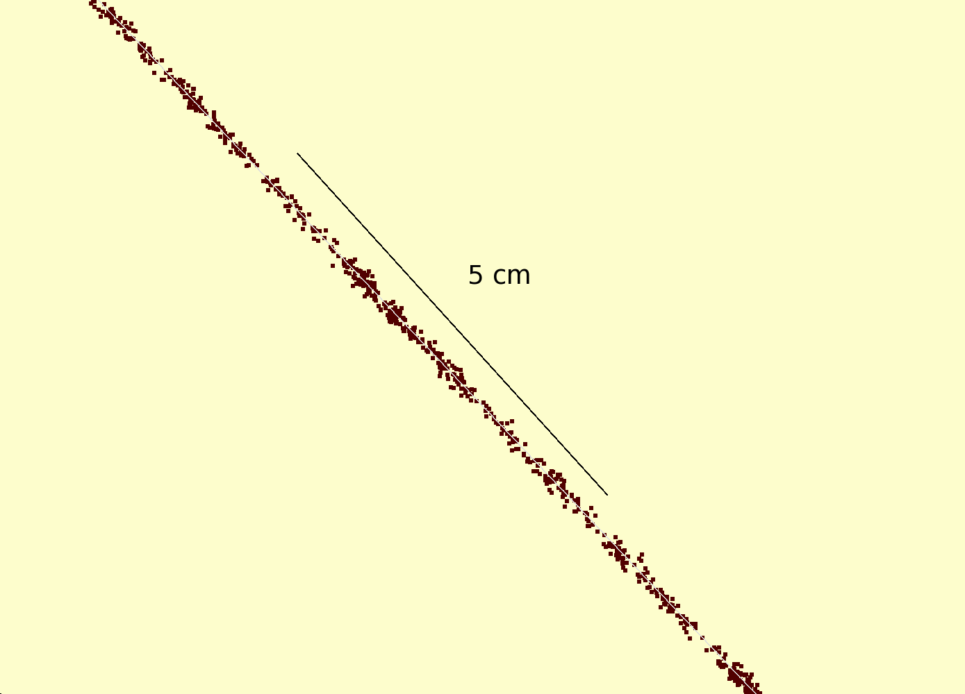
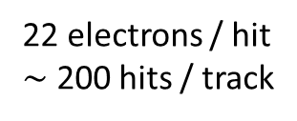
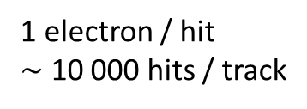
Simulation of ILD TPC with pixel readout
To study the performance of a large pixelized TPC, the pixel readout was implemented in the full ILD DD4HEP (Geant4) simulation
Changed the existing TPC pad readout to a pixel readout
Adapted Kalman filter track reconstruction to pixels
details: PhD thesis Kees Ligtenberg 2022
pixels
pads
50 GeV muon track with
pixel readout

Slide 24
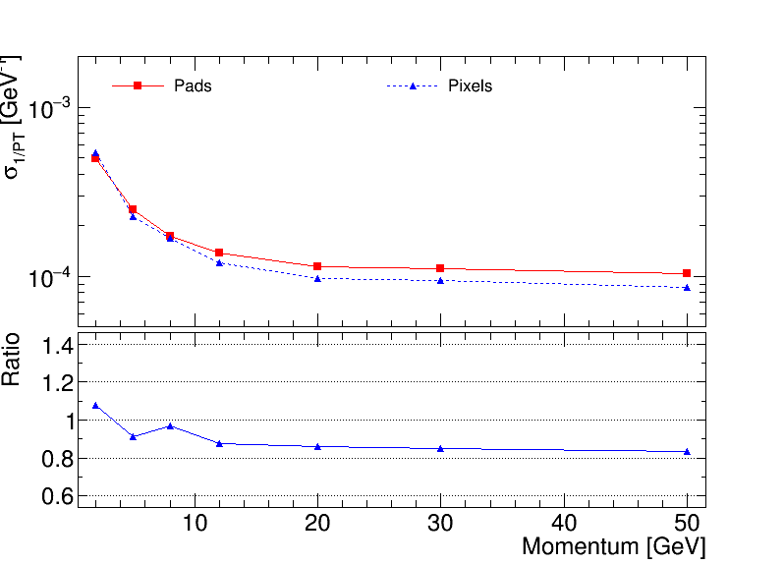
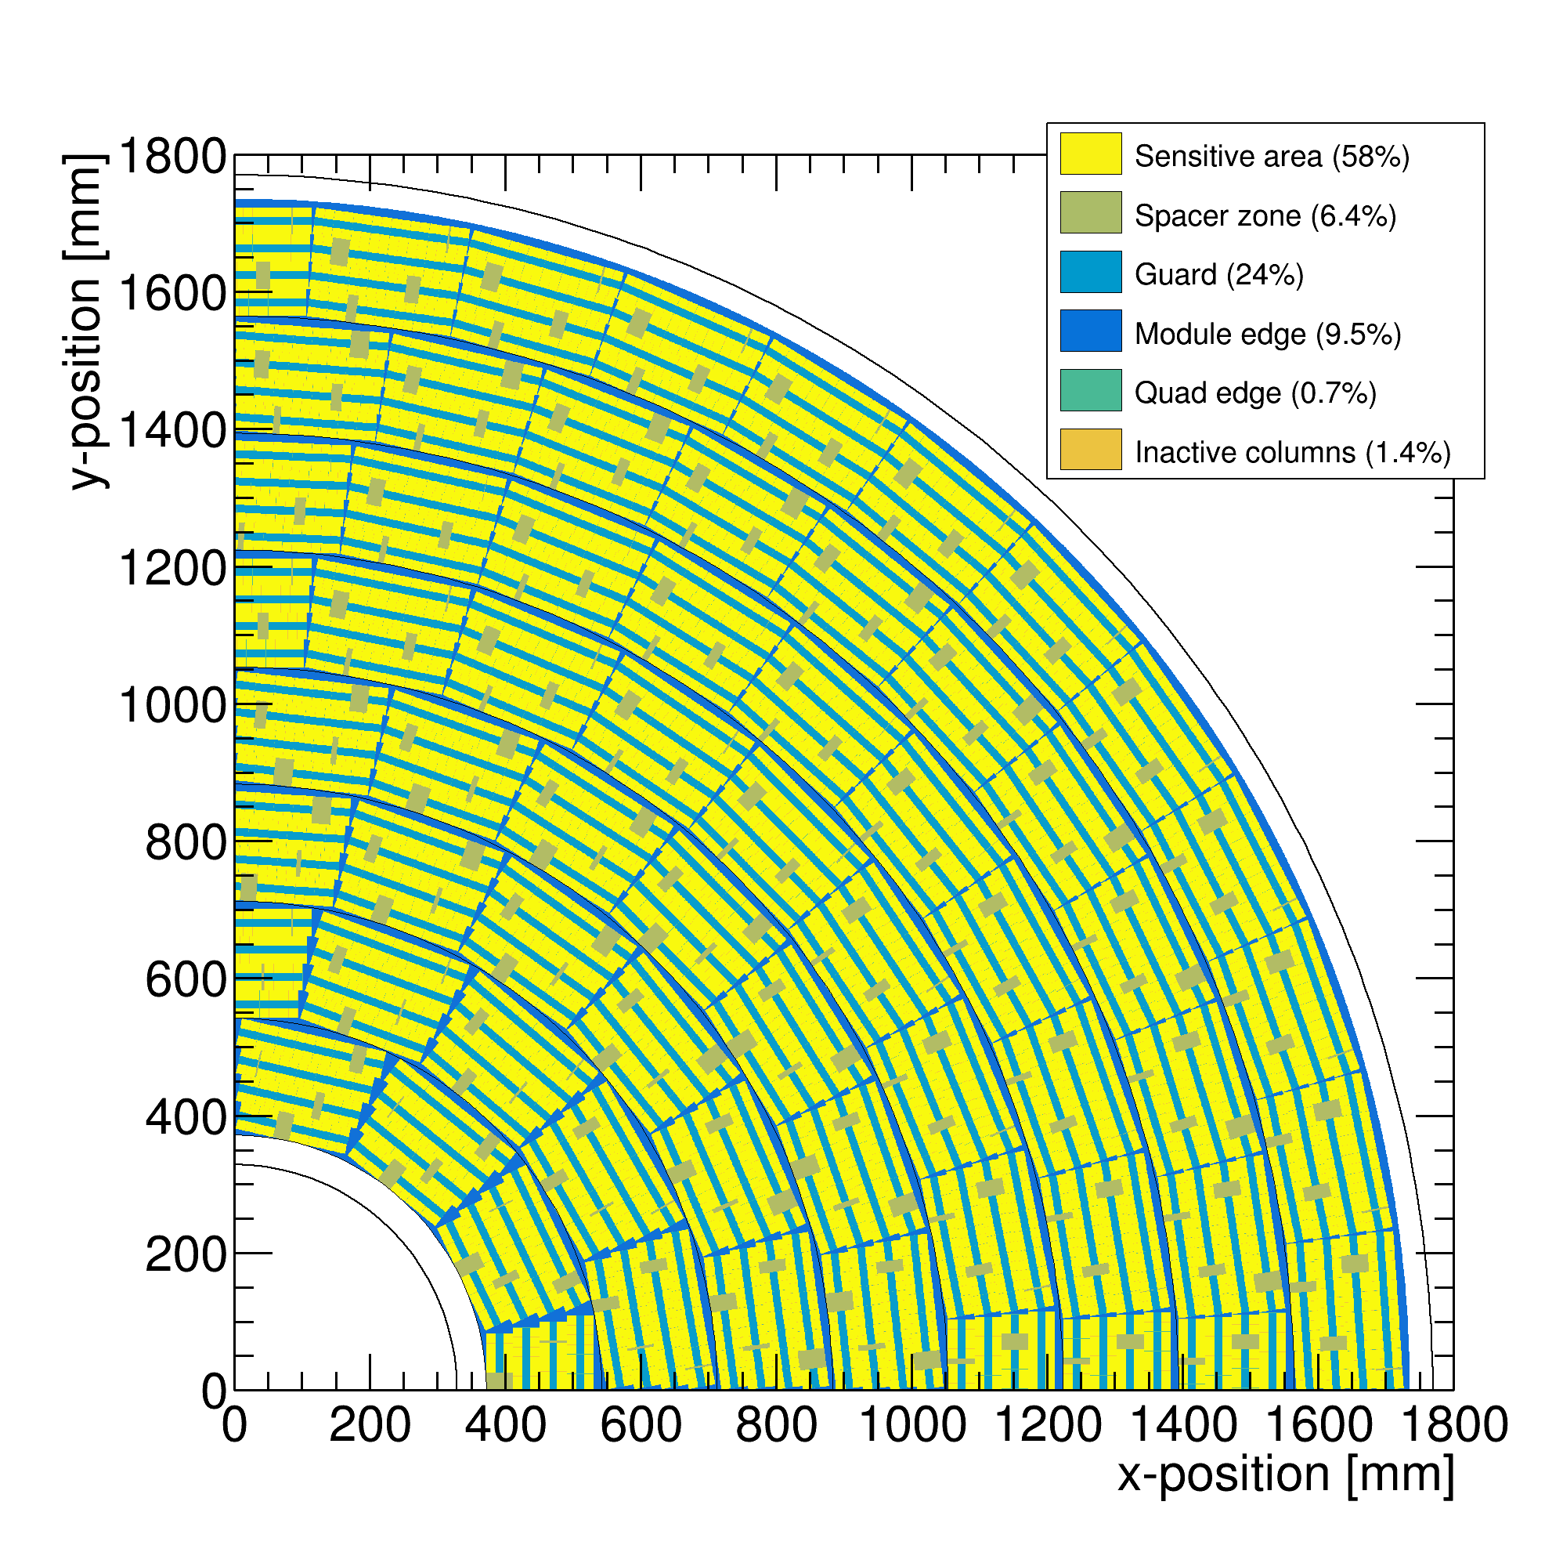
Performance of a GridPix TPC at ILC
From full simulation the momentum resolution can be determined
Momentum resolution is about 15% better for the pixels with realistic coverage (with the quads arranged in modules coverage 59%) and deltas.

Slide 25
Pixel TPC tracking studies
ILD tracking Performance for a Pixel TPC based on test beam
Running at B=3.5 T improves the resolution
10 cm track resolution
Single electron resolution 6 mm track(“pad”) resolution
T2K
Each 10 cm we have a point with a resolution of < 18 (31) μm on the track
Comparable to performance of a silicon detector (but TPC gas material).

Slide 26
DESY testbeam Module Analysis
Particle identification (PID) performance
It is possible to study in test beam data the dE/dx or dN/dx of electrons
The Pixel TPC has measurements with 55 μm pixel size
It detects single electrons with an efficiency > 85%
This allows to measure the number of clusters (hits) as a function of the distance along the track dN/dx (dE/dx) with high granularity
The advantage of hit counting in a Pixel TPC is – due to the digital read out - that one is not including the fluctuations from the multiplication process in the charge measurement
Using e.g. a pad readout, the charge is used as a measure of dEdx
This readout has a larger granularity and includes avalanche fluctuations
One has to go to very small pads (‘pixels’) to measure the clusters

Slide 27
DESY testbeam Module Analysis
Testbeam PID performance
B=0 T
B=1 T
NIM A 1075 (2025) 345
B=0 T has a large Landau tail
B=1 T smaller Landau tail and a more gaussian distribution
An electron crossing 8 chips in the module has about 1000 hits

Slide 28
DESY testbeam Module Analysis
Analysis of PID performance
Combine chips to form a 1 m long track with 60 % coverage for electrons
Method 1 ”dEdx truncation”: reject large clusters and then run dEdx @ 90% using slices of 20 pixels along track (xy) (gives nr of selected hits). A large cluster has more than 6 hits in 5 consecutive pixels.
Method 2 “Template fit”: fit the slope of the N_{scaled} minimum distance (d) in xy distribution with an exponential function (N_{scale}(d)=defines the inverse weights):
N(d)_{scaled} = N_{scale}(d) N_{observed}(d)
N(d)_{scaled} is then fitted for each track with N₀ exp(-slope d)
Calculate the PID observable for electrons and MIP (==70% of hits)
method 1 = nr of selected hits, method 2 = fitted slope
Resolution is σ = σ(PID)/PID (for σ we use the rms)
Published as “Towards a Pixel TPC part II: particle identification with a 32-chip GridPix detector”, Nucl. Instrum. Meth. A 1081 (2026) 170849

Slide 29
DESY testbeam Module Analysis
PID performance method “dEdx truncation”
Electron resolution
3.6%
1 m track 60% and coverage
Linearity MIP-e = 1.03
z drift=5-15 mm (flat)
MIP distribution is obtained by dropping 30% of the hits
T2K* gas

Slide 30
DESY testbeam Module Analysis
PID performance method “Template fit”
Calculate minimum distance between the hits.
The slope of the distribution is related to the number of primary clusters /cm
The diffused peak at d<10 (black) comes from clusters with more than 1 hit. Weights are applied at d < 10 to the follow the exponential cluster distance distribution (blue). In red the exponential function.
Per 1 m track the slope is fitted to the full distance distance distribution using a ML fit.
B=1 T data
Nucl. Instrum. Meth. A 1081 (2026) 170849

Slide 31
DESY testbeam Module Analysis
PID performance method “Template fit”
Electron resolution
2.9%
1 m track 60% and coverage
Linearity MIP-e = 1.07
Ideally this is 1. A number larger than 1 means that the resolution is +7% larger

Slide 32
DESY testbeam Module Analysis
Summary of PID performance
The PID resolution for electrons from data by combining tracks to form a 1 m long track with realistic coverage ~60% coverage.
Method | B=0 Resolution (%) | B= 1 T Resolution (%)
(1) dEdx truncation | 6.0 | 3.6
(2) Template fit | 5.4 | 2.9
The resolution for B=0 is worse than of the B=1 T data because of the larger fluctuations, that were already observed at the chip level.
Published as “Towards a Pixel TPC part II: particle identification with a 32-chip GridPix detector”, Nucl. Instrum. Meth. A 1081 (2026) 170849

Slide 33
DESY testbeam Module Analysis
dEdx Performance extrapolated to the ILD detector
ILD detector
rInner = 329 rOuter = 1770 mm
halflength (z) = 2350 mm
electron resolution = 2.5(3.0)%
at θ=π/2 for method 2 (1)
Assume Pixel TPC performance at B = 1 T at p = 5,6 GeV/c
Test beam B = 1 T
p=5,6 GeV/c
electron resolution 2.9(3.6)% for method 2 (1)
1 m track 60% and coverage

Slide 34
DESY testbeam Module Analysis
ILD dEdx performance for T2K gas
Ullrich Einhaus performed dEdx studies in ILD and extracted the ILC soft parametrisations for energy loss based on G4 and full simulation of the ILD TPC with T2K gas
Link to the software. Samples were generated in 2020 with ILC soft v02-02 and v02-02-01

Slide 35
DESY testbeam Module Analysis
Pixel TPC PID performance
ILD Performance with specified detector dimensions for particles at cos θ = 0
Pixel TPC resolution from electron p = 5 (6) GeV test beam (for B = 1 T) of 2.5% and 3% (--- = method 1) at cos θ = 0
Separation electron pion defined as:
|<Eloss e> - <Eloss π>| / σ _{π}
Separation pion kaon as:
|<Eloss π > - <Eloss Κ>| / σ _{π}

Slide 36
DESY testbeam Module Analysis
Pixel TPC PID performance
The expected pion-kaon separation for momenta in the range of 2.5-45 GeV/c at cos θ = 0 is more than 5.5(4.5)σ for the two resolution scenarios.
At a momentum of 100 GeV/c the separation is still 3.0(2.0)σ.
Protons can be separated from pions for momenta in the range of 2.5-100 GeV/c with more than 6.0(4.8)σ.
Nucl. Instrum. Meth. A 1081 (2026) 170849

Slide 37
Pixel TPC PID performance
The PID resolution for an electron with p=5,6 GeV/c of 1 m track length with 60% coverage is measured to be 2.9(3.6)% at B = 1 Tesla.
The extrapolated PID resolution for an ILD detector is 2.4% (3%)
This allows for particle identification and separation of kaons from pions up to momenta of 45 GeV with more than 5.5σ (4.5σ) for cos θ = 0. The separation increases up to cos θ = 0.85 (see back up slide).
As demonstrated, the digital read out of a pixel TPC with a small pixel size allows to perform hit and cluster counting
Currently a coverage of ~60% is realized with the TPX3 chip. Using the next generation TPX4 chip with Through Silicon Via‘s will allow to enlarge the coverage and increase the PID and tracking performance. The R&D is part of the DRD1 program

Slide 38
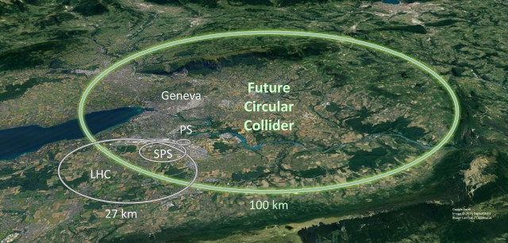
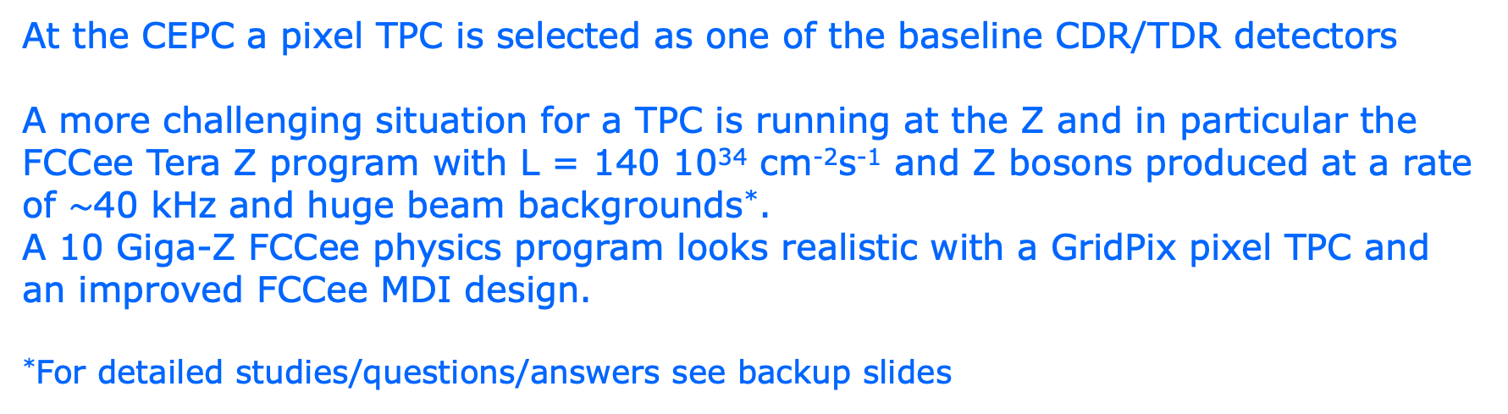
A Pixel TPC at a circular collider
At the FCCee a pixel TPC as a central tracker – sliced between silicon detectors as in the ILD concept detector - is well suited to carry out the WW, ZH and tt physics program.
At the CEPC a pixel TPC is selected as one of the baseline CDR/TDR detectors
A more challenging situation for a TPC is running at the Z and in particular the FCCee Tera Z program with L = 140 10³⁴ cm⁻²s⁻¹ and Z bosons produced at a rate of $\sim$40 kHz and huge beam backgrounds*.
A 10 Giga-Z FCCee physics program looks realistic with a GridPix pixel TPC and an improved FCCee MDI design.
*For detailed studies/questions/answers see backup slides

Slide 39
Detector MDI optimization for FCCee
This is important to reduced the machine backgrounds from beam-strahlung and synchrotron radiation.
The problem with the current FCCee Machine-Detector-Interface (MDI) - so the interaction region is that there are many machine elements near the detector, that create huge backgrounds from beamstrahlung…. 2500 – 20 times higher than in the ILC.
Recently the FCC synchrotron radiation bakcgorund turned out to be up to five orders of magnitude larger than the beam background.
It is clear that this makes it difficult to operate any type of detector…

Slide 40
Conclusions: Pixel TPC at a circular collider
The performance of a pixel TPC based on GridPixes has been studied based on prototypes and test beam measurements. It provides
high precision continuous tracking with a low material budget
very powerful particle identification
At the FCCee a pixel TPC as a central tracker – sliced between silicon detectors as in the ILD concept detector - is well suited to carry out the WW, ZH and tt physics program.
A 10 Giga-Z FCCee physics program looks realistic with the proposed pixel TPC and an improved FCCee MDI design.
After years of R&D, a pixel TPC has become a realistic viable option for experiments
R&D on a Pixel TPC with GridPix devices with reduced ion back flow based on the TPX3 or TPX4 ASICs are part of the DRD1 program
One could consider to use Ne as a TPC gas for the Tera-Z running

Slide 41
Backup plots

Slide 42
Pixel TPC tracking studies
ILD tracking Performance for a Pixel TPC based on test beam
The last 10 cm track provides very high resolution ‘point’ in the endcap (cos θ>0.8). This is due to the short drift distance and the high resolution pixel readout.
One use the endcap ‘point’ to calibrate out (part of) the TPC distortions.

Slide 43
DESY testbeam Module Analysis
Pixel TPC PID performance acceptance
Separation pion kaon
|<Eloss π > - <Eloss Κ>| / σ _{π}
Separation pion kaon for different cos(theta) values due to the track length dependence
For cos(theta)=0 till 0.95 the separation lies between the black and red curves. Only above 0.95-0.975 the separation drops till the blue curve.
Excellent performance over very large polar angle range
ILD Pixel TPC

Slide 44
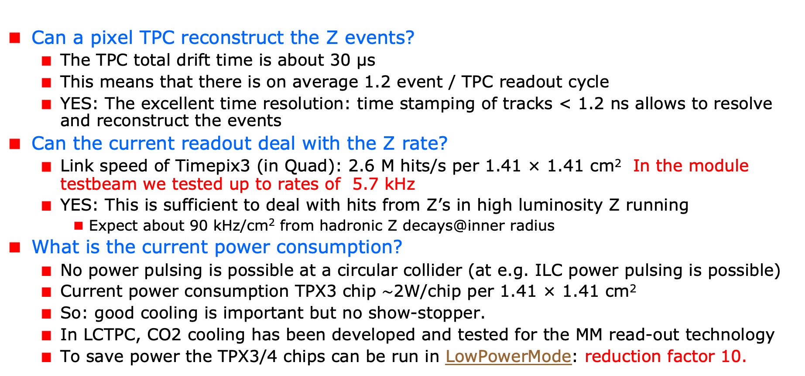
A Pixel TPC at a circular collider
Can a pixel TPC reconstruct the Z events?
The TPC total drift time is about 30 μs
This means that there is on average 1.2 event / TPC readout cycle
YES: The excellent time resolution: time stamping of tracks < 1.2 ns allows to resolve and reconstruct the events
Can the current readout deal with the Z rate?
Link speed of Timepix3 (in Quad): 2.6 M hits/s per 1.41 × 1.41 cm² In the module testbeam we tested up to rates of 5.7 kHz
YES: This is sufficient to deal with hits from Z’s in high luminosity Z running
Expect about 90 kHz/cm² from hadronic Z decays@inner radius
What is the current power consumption?
No power pulsing is possible at a circular collider (at e.g. ILC power pulsing is possible)
Current power consumption TPX3 chip $\sim$2W/chip per 1.41 × 1.41 cm²
So: good cooling is important but no show-stopper.
In LCTPC, CO2 cooling has been developed and tested for the MM read-out technology
To save power the TPX3/4 chips can be run in LowPowerMode: reduction factor 10.

Slide 45
A Pixel TPC at a circular collider
The importance of the beam background and the optimization of the FCCee machine detector interface MDI
Hit rates from beam background are significant (wrt hits of Z decays)
The beam background study presented in the October 2024 ECFA meeting by Daniel Jeans (for a 2 T B field) would correspond to a sizeable background rate of about 300 MHz/cm² (@inner radius).
Since October 2024, the FCCee MDI has improved. A study summarizes the reduced beam background results. The results have been discussed in the FCCee workshop.
Recently the synchrotron background was studied that turns out to be very large for tracking detectors. Clearly it is important to reduce this background substantially.
The Pixel TPC – due to the high granularity – has an occupancy of < 1% for 300 MHz/cm² (@inner radius). The read-out speed of the current TPX3 has to be upgraded to cope with the large background rates. R&D for a fast read-out based on TPX3/4, like the VeloPix (LHCb) is needed.

Slide 46
A Pixel TPC at a circular collider
What about track distortions?
Not an issue for running at cms energies of WW, ZH, tt
There are two important sources of track distortions of the TPC drift field:
the slowly drifting primary ions (from Zs and background)
the ions produced in the amplification process flowing back (IBF)
At the ILC gating is possible to reduce the IBF; at FCC-ee this is not realistic, for a Pixel TPC a double grid is the best solution (see below)
Is it possible to reduce the IBF for a pixel TPC?
IDEA: by making chip with a double grid structure (see back up slide)
This idea was already realized as a ‘TWINGRID’ NIMA 610 (2009) 644-648
For GEMs for the ALICE TPC this was also the way – use several GEMs to reduce IBF
The IBF* can be easily modelled and with a hole size of 25 μm an IBF of 3 10⁻⁴ can be achieved and the value for IBF*Gain (2000) would be 0.6.
YES: the IBF can be reduced. It needs R&D that can be done in the detector lab in Bonn.
* Measured IBF of single grid GrixPix is 1.3% and IBF*Gain (2000) is 26.

Slide 47
A Pixel TPC at a circular collider
What would be the size of the TPC distortions at a TeraZ factory?
Tera-Z studies by Daniel Jeans and Keisuke Fuji show that for FCC-ee this means: distortions from Z decays up to < O(100) μm.
The problem is that the beam and synchrotron backgrounds are by far the dominant source for the ions in the TPC volume. The beam distortions by beam backgrounds are less than 1 cm as the latest studies by Daniel Jeans shows. The synchrotron backgrounds are largest and the reduction of that background –by optimizing the MDI - is important for all detectors.
There is also an idea to operate the TPC with a Neon based gas that could bring the backgrounds down by a factor of 40. This needs study.
It can be argued that in an ILD like detector the distortions can be mapped out using the silicon VTX-SIT/SET detectors. See e.g. the backup slide on fitting out TPC distortions.

Slide 48
A Pixel TPC at a circular collider
A 10 G Z FCCee physics program* could be carried out, but
It needs a lot of power to process the large amounts of background hits in the tracking detectors
It needs more study to reduce the backgrounds by an improved MDI
Fitting techniques should be studied to correct for the TPC distortions
The current TPX3 read out should be optimized to cope with the high readout rate and minimise the power consumption
* The physics case for a Tera Z physics program seems IMO rather weak

Slide 49
Fitting out and reducing TPC distortions
It is possible to map out distortions using e.g. muons from Z decays
E.g. by fitting the 3D spatial distribution as a function of time as was done by ALEPH and more recently by ALICE. Using this distribution the hits positions are corrected and the TPC track refitted.
However, with silicon trackers around the TPC, more elaborate methods can be used. One can use the track predictions based of the silicon trackers SIT and SET to correct on a track-by-track level the TPC track.
One can use as a constraint that the extrapolated positions and angles agree with the measured in the SIT and SET.
Practically, one can e.g. correct the TPC track parameters
The ultimate way is a fitting technique similar to ATLAS. In the ATLAS track fit the common systematics is fitted out for sets of Muon hits. For ILD @ FCC the fit would fit free parameters in the distortion model, while using as a constraint the SIT and SET position and direction measurements.
The simplest case is a model where the strength (amplitude) and radial dependence would be scaled and a model is used for the 3D extrapolations.

Slide 50
Reducing the Ion back flow in a Pixel TPC
The Ion back flow can be reduced by adding a second grid to the device.
It is important that the holes of the grids are aligned. The Ion back flow is a function of the geometry and electric fields. Detailed simulations – validated by data - have been presented in LCTPC WP #326.
With a hole size of 25 μm an IBF of 3 10⁻⁴ can be achieved and the value for IBF*Gain (2000) would be 0.6.
Ion backflow | Hole 30 μm | Hole 25 μm | Hole 20 μm
Top grid | 2.2% | 1.2% | 0.7%
GridPix | 5.5% | 2.8% | 1.7%
Total | 12 10⁻⁴ | 3 10⁻⁴ | 1 10⁻⁴
transparancy | 100% | 99.4% | 91.7%

