Slide 1
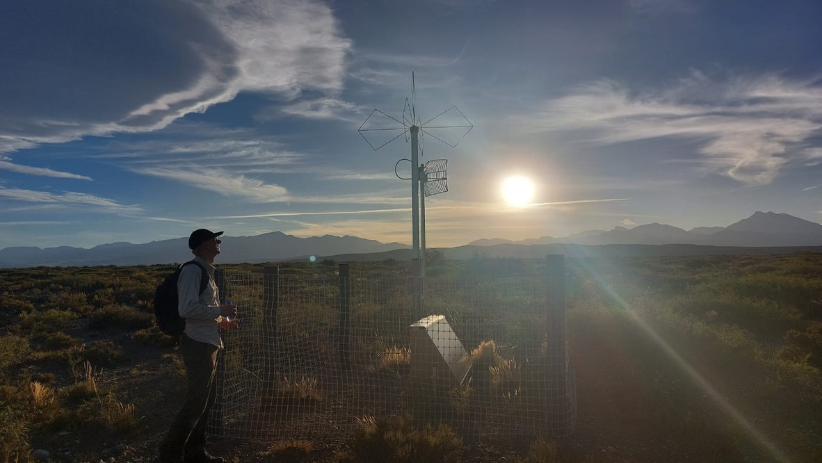
Cosmic Ray Detection
Charles Timmermans

Slide 2
Outline
Energy loss by a particle in a medium
Creation of detectable radiation
Air Showers
The Pierre Auger Observatory
Hands on experimentation

Slide 3
Basics
All detection of particles rely on interaction of particles with an active medium, thereby loosing energy and producing a measurable signal
That measurable signal can be
  Light
  Radio waves
  Sound
  Heat
  Bubble density

Slide 4
Energy loss: Bethe-Bloch
Ionisation and excitation of the surrounding medium:
  Air shower detection
  Signal from water Cherenkov detectors
  Signal from scintillator detectors
  Tracking detectors
  Calorimeters

Slide 5
Classical Energy-loss formula
Momentum of target particle changes when test particle travels through medium:
Integrating from –infinity to +infinity, only transverse force is important:

Slide 6
Classical Energy-loss formula
Only interactions with electrons are important!

Slide 7
Classical Energy-loss formula
Let the test particle move through a tube of electrons
Number of electrons:
Energy loss due to tube:
Electron density:
Integrating over b:

Slide 8
Classical Energy-loss formula
Let the test particle move through a tube of electrons
Maximum energy transfer (central collision):
Minimal b:
Minimal energy transfer: Mean excitation energy per electron I
Maximal b:

Slide 9
Classical Energy-loss formula
Let the test particle move through a tube of electrons
Average excitation potential
Electron Density

Slide 10
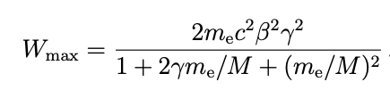
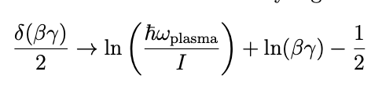
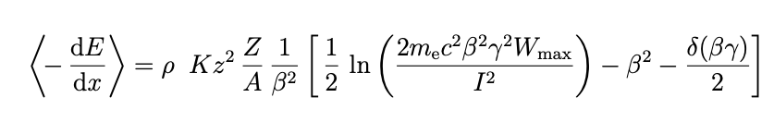
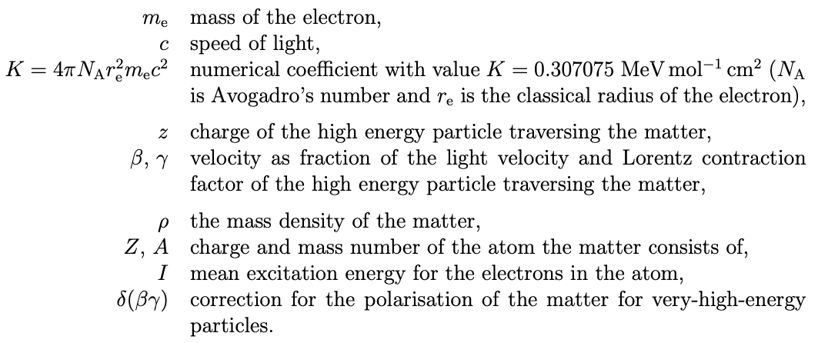
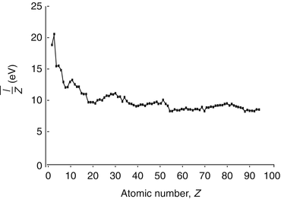
Max E transfer
EM field saturation
Bethe-Bloch:

Slide 11
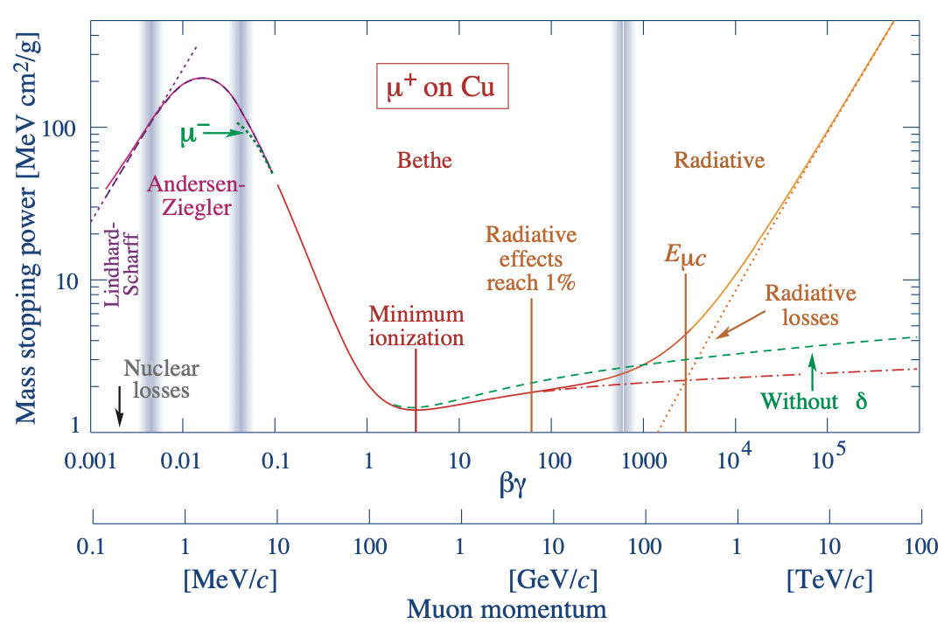

Slide 12
Fluctuations in Energy loss
Bethe-Bloch describes the average energy loss, not the most probable!
Landau gave a description of the fluctuations, assuming only the EM-interactions with the electrons in the medium:
Δx Thickness of medium
r density of medium

Slide 13
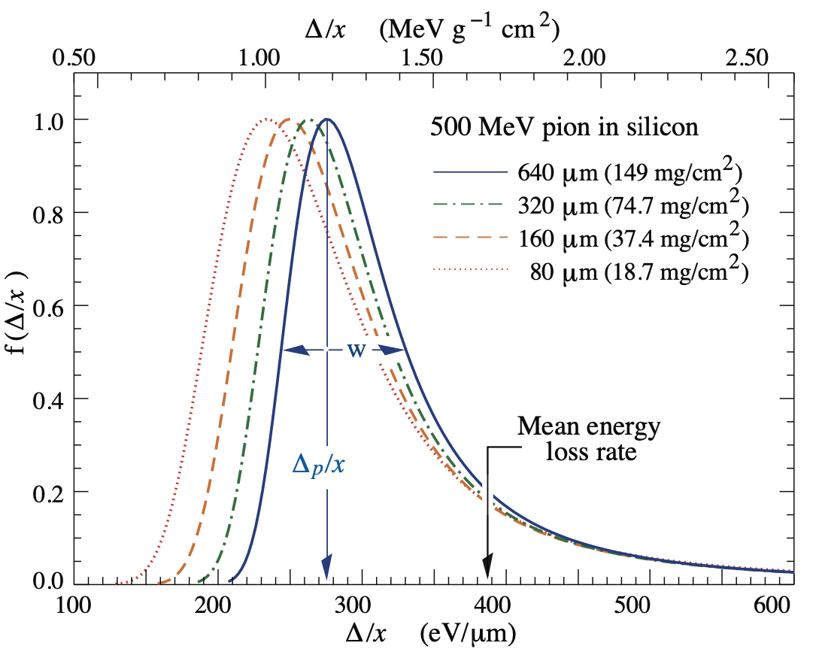
Landau Fluctuations

Slide 14
Cherenkov Radiation
Discovered in 1934 by Cherenkov and Vavilov
Described in 1937 by Frank and Tamm
Charged particles cause radiation if their velocity is greater than the local phase velocity of light
This radiation is coherent at a particular angle relative to the direction of the particle
In water energy loss is about 10⁴ less than that of ionization!

Slide 15
Organic scintillators
Low-Z materials
Fast response time
Best for electrons and muons

Slide 16
Schematic of scintillator useage

Slide 17
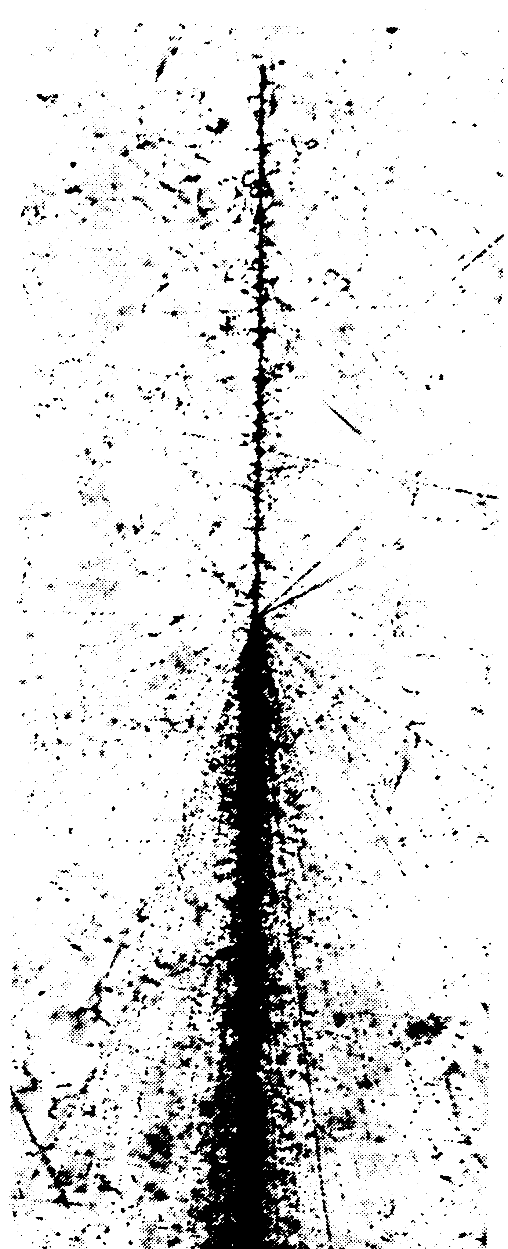
Air Showers
Cosmic Ray
Collision in the Emulsion
Particle Cascade
A cosmic ray induced shower in an emulsion
50μm

Slide 18
Energy Transfer
Notes:
The interactions mainly create pions.
1/3 are neutral piuons decaying into photons
Charged pions at high energy interact
At low energy they create muons

Slide 19
Energy Transfer
At low energy muons carry away a significant fraction of the energy

Slide 20
Air shower content

Slide 21
Particle Energies

Slide 22
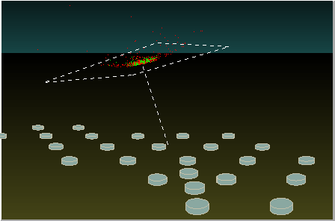
Rough description of An Air shower
An electromagnetic current of changing size moving through the atmosphere at the speed of light

Slide 23
Creation of a radio signal
Macroscopic: Compare the air shower to a wire in which a changing current is induced that is moving perpendicular to its length with the speed of light
Microscopic: Trajectories of individual electrons and positrons are influenced by magnetic fields causing synchrotron radiation

Slide 24
Macroscopic picture of the Radio Signal
Electrons and positrons are deflected in Earth magnetic field
Net current in the direction of the Lorentz Force
Positive Ions travel slower than the air shower particles, but are created at the speed of the shower
Shower front has a net-negative charge due to:
Compton Scattering
Knock out electrons
Positron annihilation
Simulation Codes:
EVA
MGMR3D
(Krijn de Vries, Olaf Scholten)

Slide 25
MIcroscopic picture of the Radio Signal
Follow individual particles
Emission due to acceleration of charged particles
Is added to a code for simulation of the creation of particle simulation of Air showers code
Simulation Codes:
COREAS
ZHAIRES
(Huege,
Zas, Halsen, Stanev)
Makes no assumption on different emission mechanisms

Slide 26
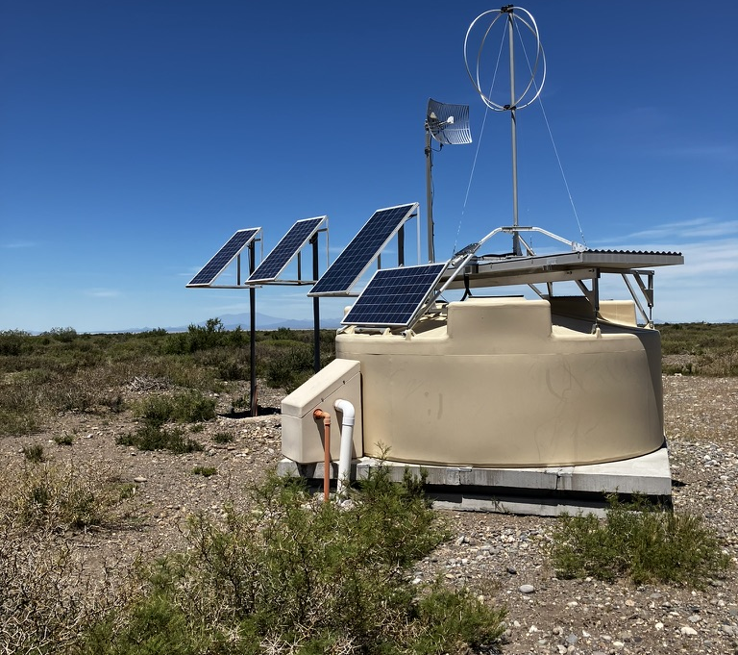
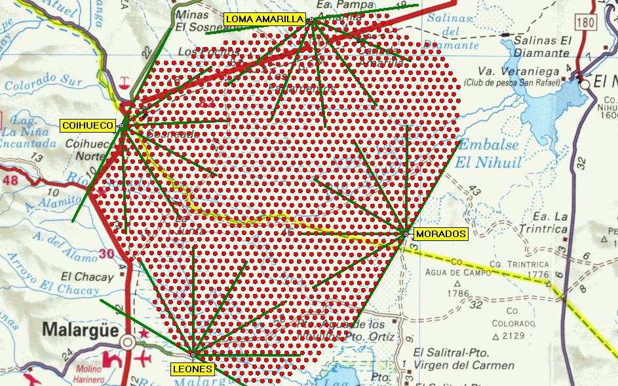
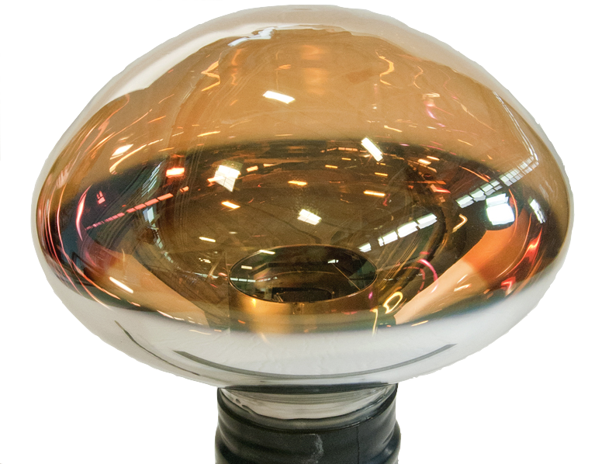
The Pierre Auger Observatory
https://www.auger.org

Slide 27
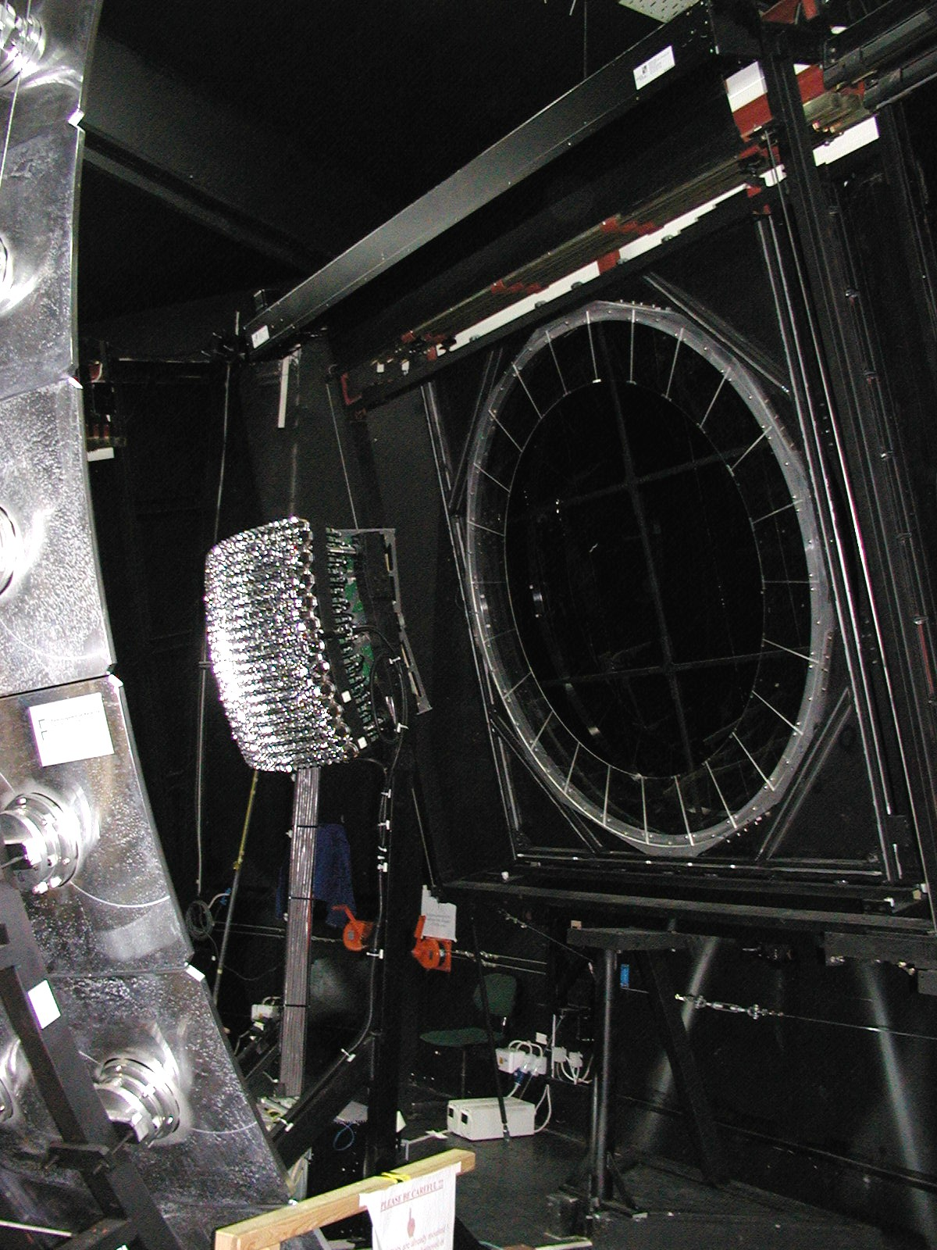
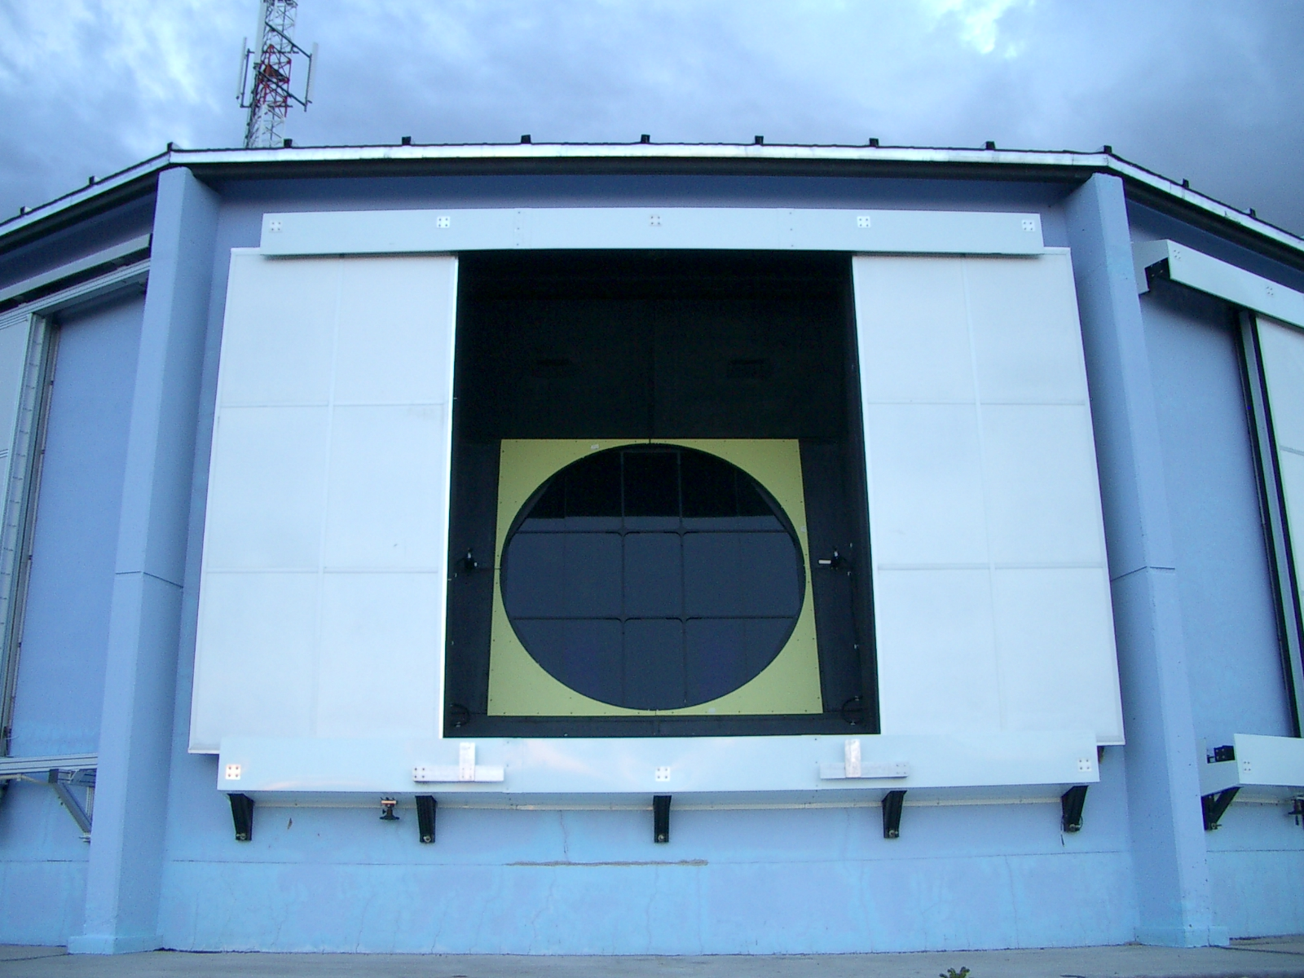
The Pierre Auger Observatory

Slide 28
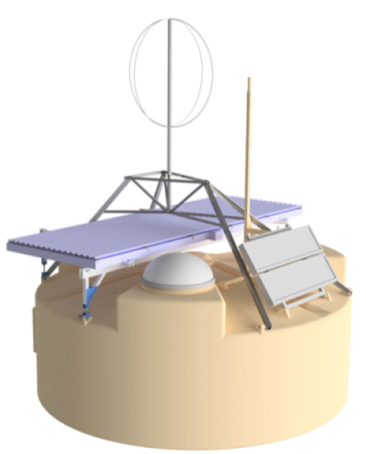
The Pierre Auger Observatory

Slide 29
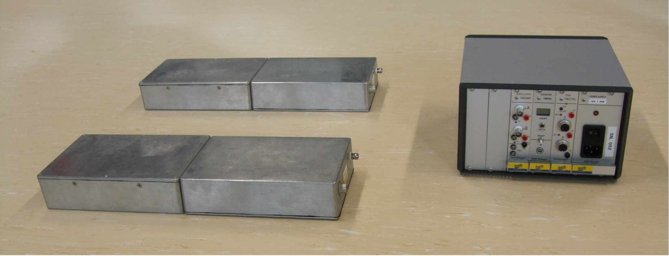
Hands-on: Determine the (vertical) muon flux
Parts:

Slide 30
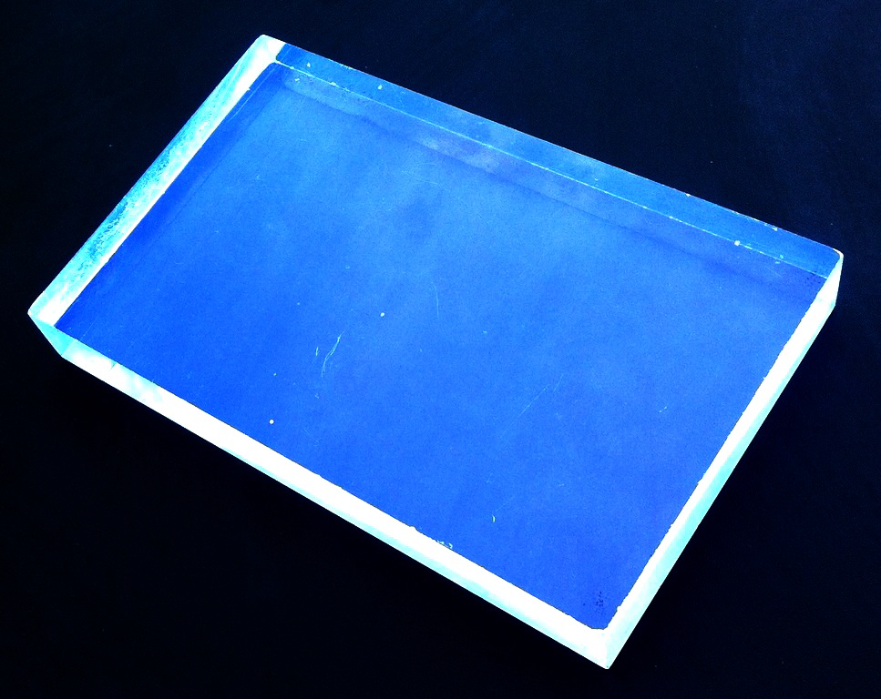
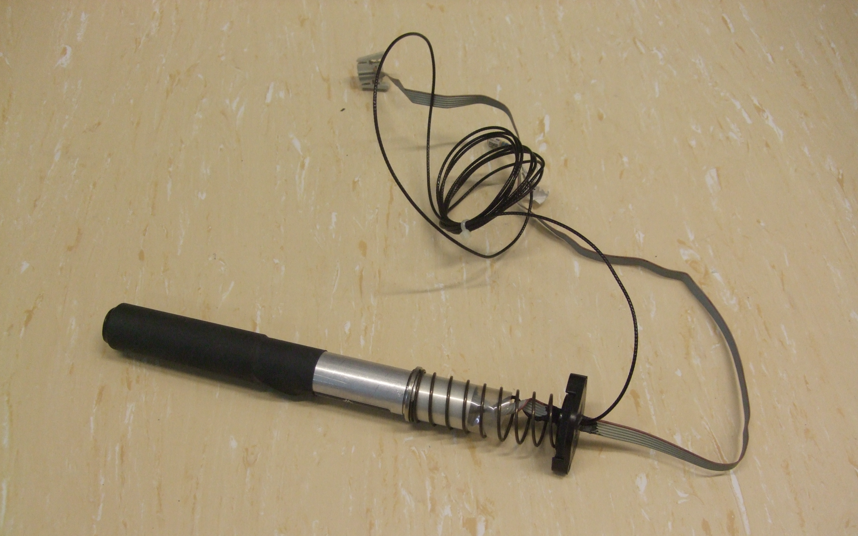
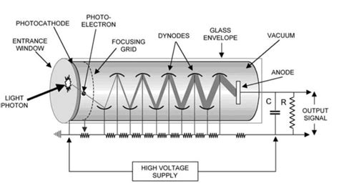
Hands-on: Determine the (vertical) muon flux

Slide 31
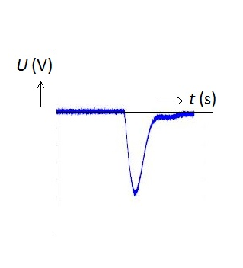
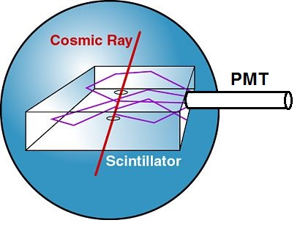
Hands-on: Determine the (vertical) muon flux
1-2% of energy loss is converted in fotons → 10⁵ fotons/muon
~1% of fotons reach PMT
Efficiency PMT ~30%
Amplification PMT ~10⁵
Pulseheight ~20 mV
Pulsewidth ~ 25 ns

Slide 32
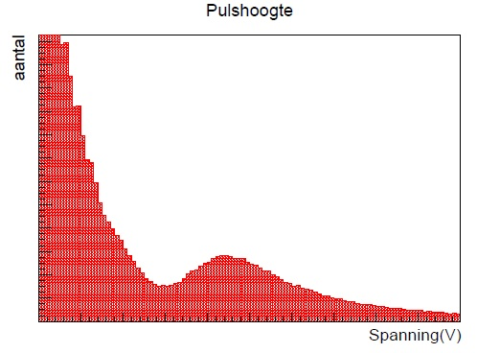
Hands-on: Determine the (vertical) muon flux
Pulse Height
Occurances
Voltage (V)

Slide 33
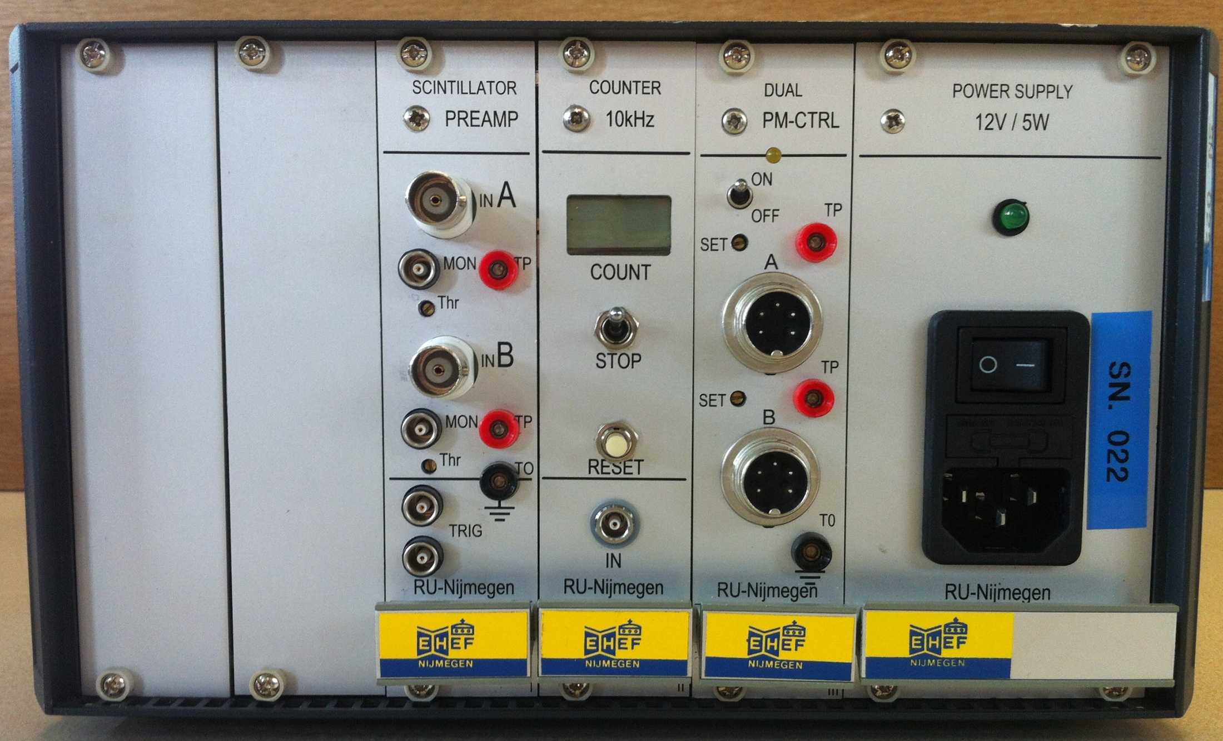
Hands-on: Determine the (vertical) muon flux
High Voltage
Counter 1
Threshold 1 (V)
High Voltage
Counter 2
Threshold 2 (V)
Counter AND

Slide 34
Hands-on: Determine the (vertical) muon flux
Determine good HV values and thresholds
Determine the efficiency of your setup
Determine the amount of noise in your setup
Determine the vertical flux, including its uncertainty

