Slide 1
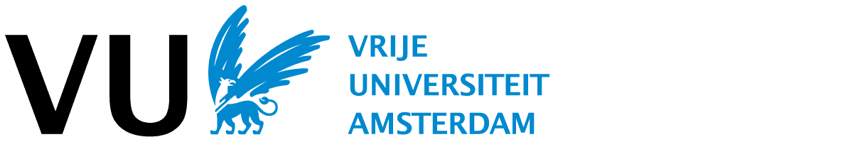



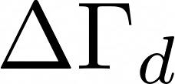
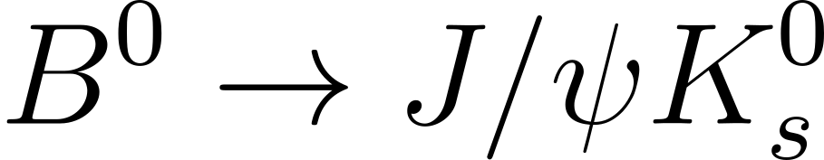
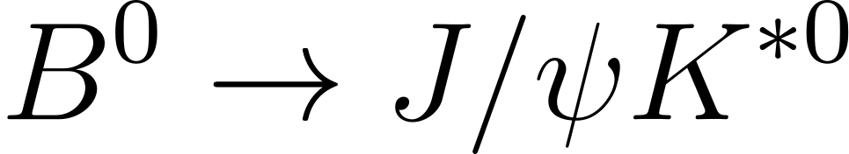
Measurement of from and decay channels
MSc Thesis Presentation
Lieke Gijsen
Supervisors: Gerhard Raven, Daniel Magdalinski
20 April 2026
Notes:
Welcome all to my master thesis presentation, which is about measuring delta gamma d from the B0 to J-psi Kshort and J-psi Kstar decays.

Slide 2

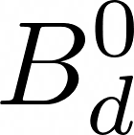

Goal of the thesis
[1] A. Lenz and U. Nierste, Numerical updates of lifetimes and mixing parameters of B mesons, in CKM unitarity triangle (2010).
[2] Particle Data Group collaboration, Particle listings, B0, page 6 (2025).
Measure : difference in decay times between mass eigenstates
Independent, stringent test on SM
SM prediction: [1]
World average measurement: [2]
Very large uncertainty!
Notes:
Delta gamma d is the difference between the decay times of the B0d mass eigenstates
Why would I do this analysis? Independent, stringent test on SM (New physics can modify ΔΓd without violating other SM tests).
The standard model prediction for DGd/Gd (mean value of these decay times) is given by this expression.
But prior measurements lack precision, the world average has an uncertainty that is a factor of 10 times larger than the actual value.
However, these prior measurements were not optimised for measuring DGd, at least in LHCb, they were only separate lifetime measurements and thus not taking advantage of the fact that DGd is a difference, which can make a lot of systematic uncertainties cancel out. If I take two lifetime values both with their own uncertainty, I am counting some of the systematic uncertainties double if I simply throw these values and errors in an equation to get DGd. My aim was to do exploit the fact that DGd is a difference and get a more accurate measurement for DGd.
Perform simultaneous fit of CP-eigenstate and flavour-specific channels. ((the CP eigenstate has a significantly larger term proportional to deltagammad than the Kstar, flavour specific state, has. -> I want both of them to get DeltaGammad because it reduces systematic errors)). Plus the J/psi modes have relatively clean signals (which means good statistics) and these two channels are topologically similar, even further reducing the systematic uncertainties.

Slide 3
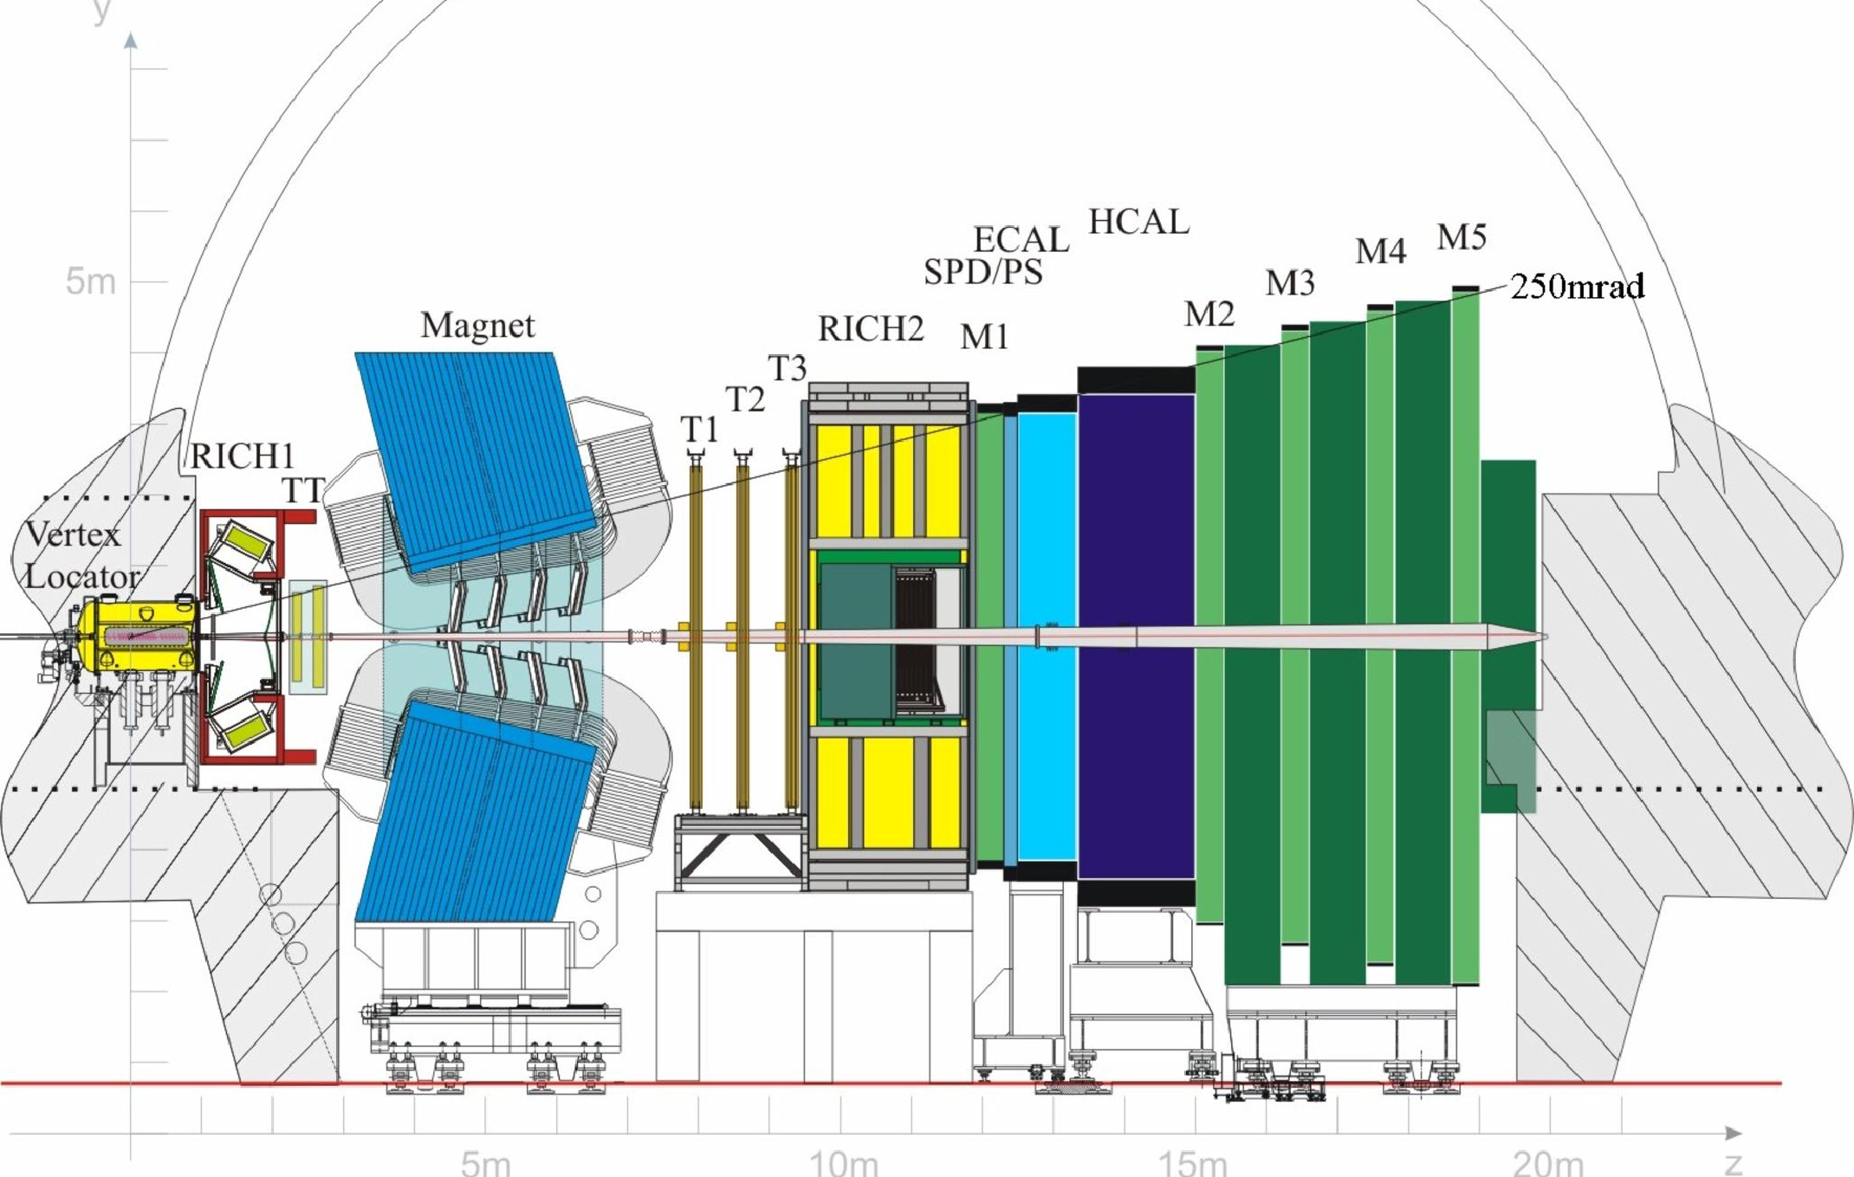
LHCb detector
b-physics triggering
time resolution and vertexing
particle identification
Notes:
LHCb is much better suited than ATLAS for measuring B-decay lifetimes (and thus ΔΓ_d) because its entire design is optimized for precisely this kind of flavour-physics analysis.
Duidelijker/simpeler uitleggen wat vertexing is. B-physics

Slide 4
Where to extract from?
Method: Compare decay time distributions of
(CP eigenstate)
(flavour-specific)
Perform simultaneous fit to cancel out systematic uncertainties with LHCb Run2 data
Notes:
Delta gamma d is the difference between the decay times of the
Why would I do this analysis? Independent, stringent test on SM (New physics can modify ΔΓd without violating other SM tests).
The standard model prediction for DGd is….
But prior measurements lack precision, the world average has an uncertainty that is a factor of 10 larger than the actual value.
However, these prior measurements were not optimised for measuring DGd, at least in LHCb, they were only separate lifetime measurements and thus not taking advantage of the fact that DGd is a difference, which can make a lot of systematic uncertainties cancel out. If I take two lifetime values both with their own uncertainty, I am counting some of the systematic uncertainties double if I simply throw these values and errors in an equation to get DGd. My aim was to do exploit the fact that DGd is a difference and get a more accurate measurement for DGd.
Perform simultaneous fit of CP-eigenstate and flavour-specific channels. ((the CP eigenstate has a significantly larger term proportional to deltagammad than the Kstar, flavour specific state, has. -> I want both of them to get DeltaGammad because it reduces systematic errors)). Plus the J/psi modes have relatively clean signals (which means good statistics) and these two channels are topologically similar, even further reducing the systematic uncertainties.

Slide 5

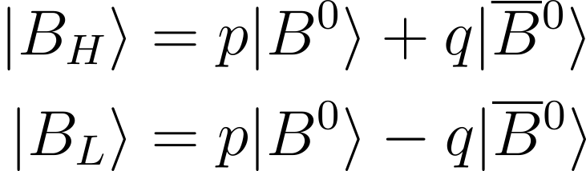
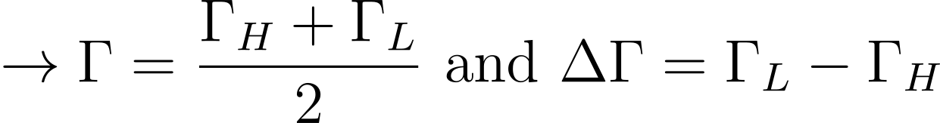
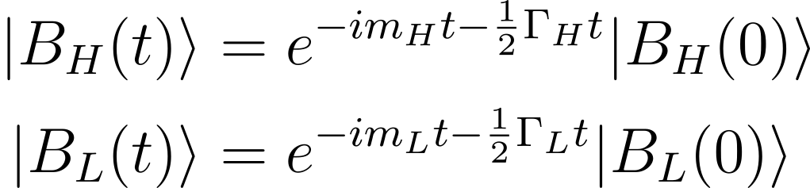
Neutral meson mixing
Effective Hamiltonian:
Define eigenstates of Hamiltonian as:
Particle interaction as flavour states, but propagation as eigenstates of effective Hamiltonian
Time evolution:
Notes:
The theory behind DGd is about neutral meson mixing. We start from the effective Hamiltonian. If we express the eigenstates as shown here, these heavy and light eigenstates will have their own mass from the M part of the Hamiltonian and their own lifetime from this Gamma part of the Hamiltonian. In the case of the B0_d, the difference in lifetime is relatively small and there is a mass difference, so this is why these are mass eigenstates and they are called heavy and light.
The masses and lifetimes assigned to the interaction states B0 and anti-B0 are a combination of the heavy and light masses and lifetimes. This means that particle interaction as flavour states B0 and anti-B0 , but propagation as mass eigenstates of effective Hamiltonian BH and BL -> from calculating the eigenvalues and eigenvectors.
(delta m gives oscillation in decay time and delta gamma gives difference in decay rate (diff slopes of decay time distributions)
Time evolution according to solution of the schrodinger equation with our effective hamiltonian. To then can get transferred back into the time evolution of the flavour eigenstates with the superposition involving p and q (for the mixing of B0).

Slide 6
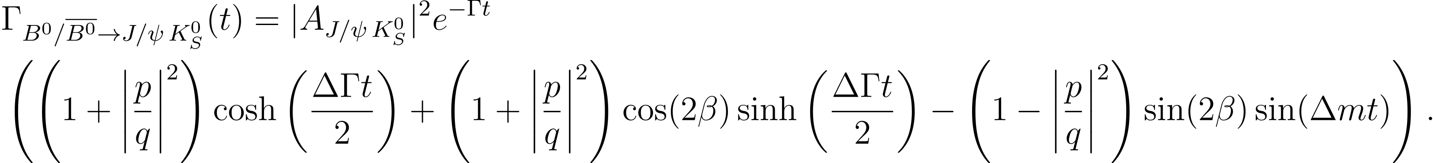
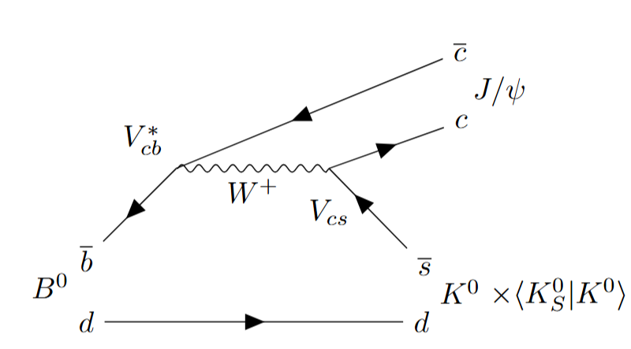
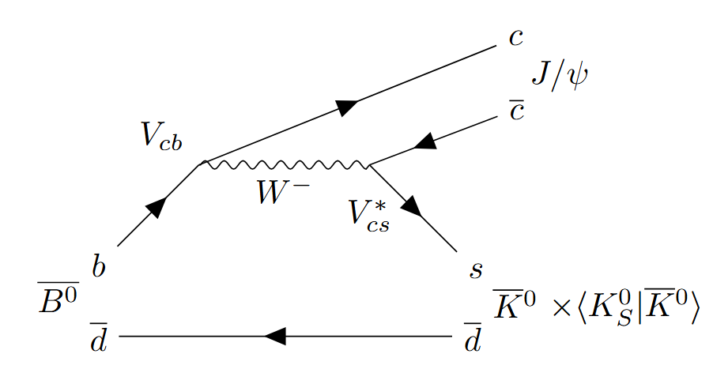
Channel specific decay rates
Notes:
For the channels that I am interested in, so again B0 to J/psi Kshort and Kstar. rom feynman diagrams and filling in lambda in the master equations
DGd controls hyperbolic terms in pdf -> mostly sensitive to DGd in CP-eigenstate channels
K0s eigenstate of kaon system (u and s quark), decays to pi pi.

Slide 7
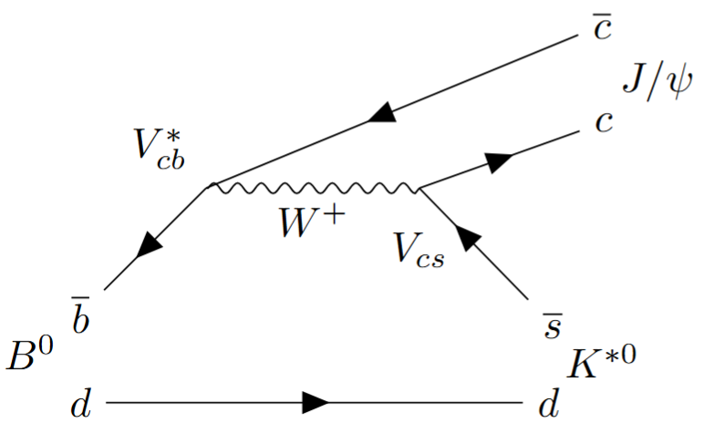
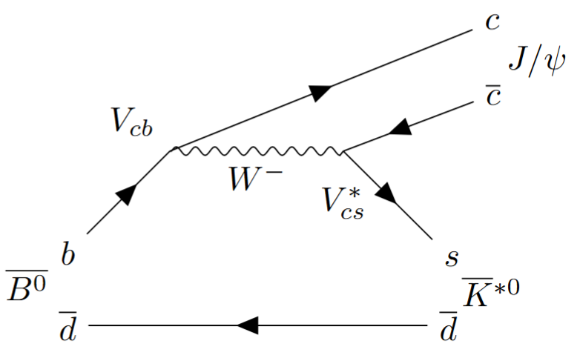
Channel specific decay rates
Notes:
For the channels that I am interested in, so again B0 to J/psi Kshort and Kstar. rom feynman diagrams and filling in lambda in the master equations
The
DGd controls hyperbolic terms in pdf -> mostly sensitive to DGd in CP-eigenstate channels
K*0 decay to K pi

Slide 8
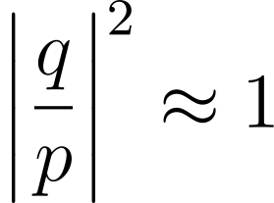
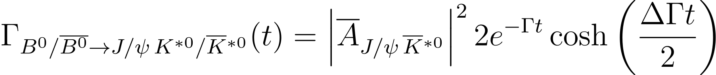
Channel specific decay rates
Notes:
The Kstar is an excited state of the normal K0. the quark spins are aligned making it have a spin of 1 instead of 0. The Kstar decays into a non-excited kaon and a pion.
The main difference is that for Kstar, a B0 can only go to a Kstar and an antiB0 can only go to an anti Kstar, while for the Kshort, both B0 and anti-B0 can go to Kshort, because Kshort is again an eigenstate of the hamiltonian, but now for the Kaon system. So the Kshort is a linear combination of K0 and antiK0.
DGd controls hyperbolic terms in pdf -> sinh in Kshort thats not in Kstar.
Note that the decay rates are averaging over the B0 and anti-B0 states, so these are untagged decay rates.

Slide 9

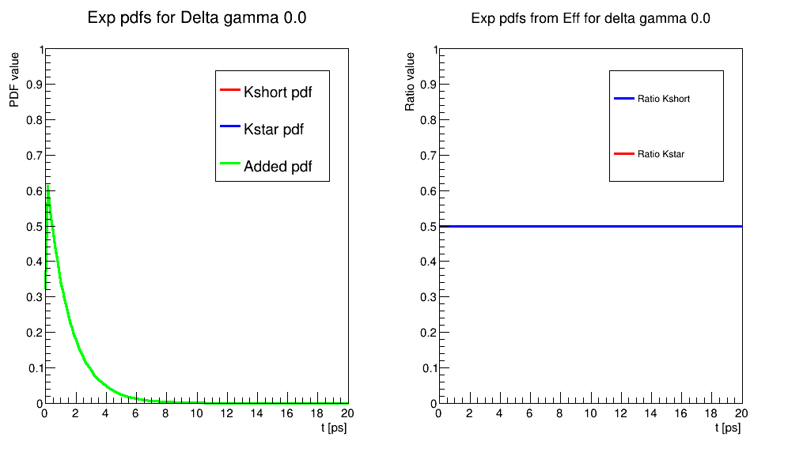

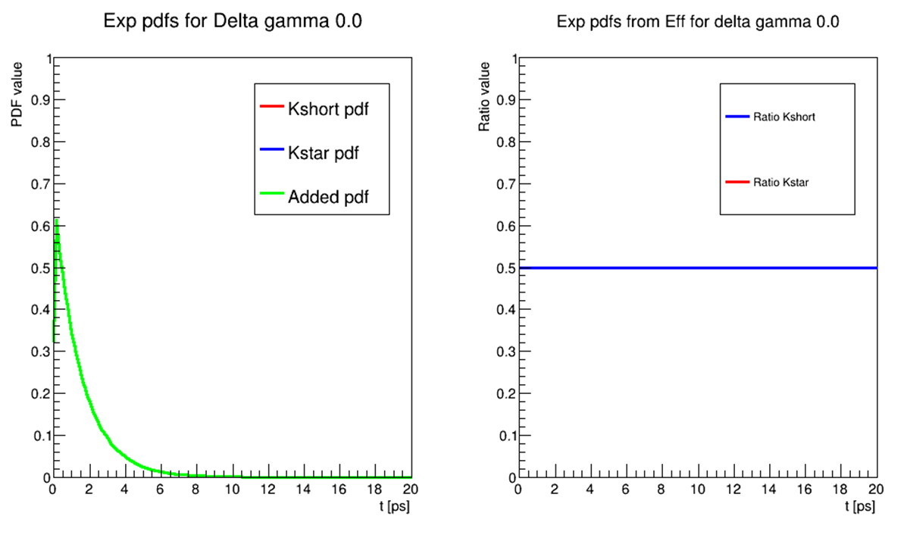
Feasibility study
Toys showing dependency of channel ratios on
Notes:
To see the dependency of deltagamma a bit more clear, you can look at this animation. In the left plot… in the right plot… -> way easier to distinguish for larger deltagamma. In addition, it is always easier to distinguish the ratios, than the normal decay time pdfs.
So this would hint that using the ratio of the samples is advantageous for the delta gamma d analysis.
Compare two ways of fitting simultaneously: new model directly using ratio of the two samples and RooSimultaneous, a built in function in RooFit.
f=0.5, Gammad is 0.65 ps^-1 here.
Most sensitive around the crossing, which is where the derivative of the ratio is the largest! Derivative as function of DGd gets larger for higher lifetimes looking at the exponential decay functions, but weighting with yield gives highest sensitivity at 1.58 ish.

Slide 10
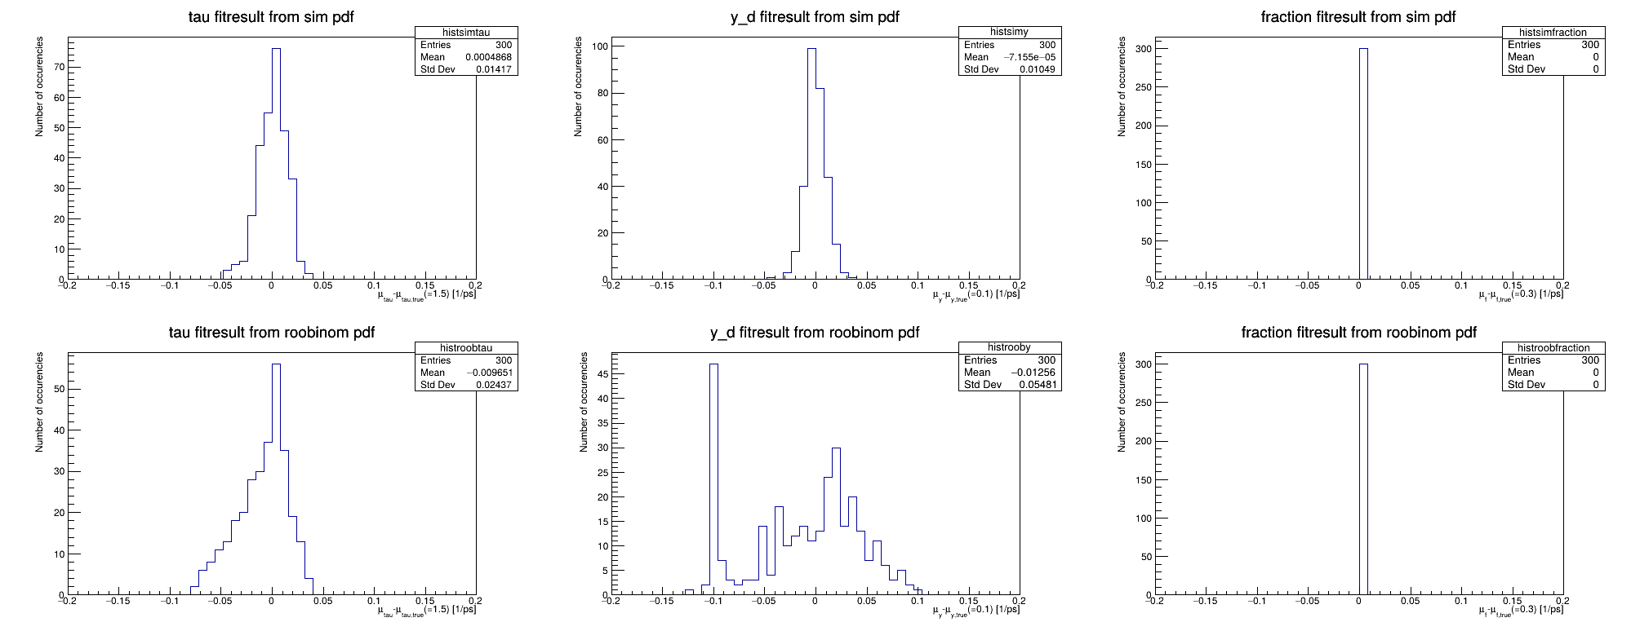
Feasibility study
Compare two ways of fitting simultaneously: new model directly using ratio of the two samples and RooSimultaneous
RooSimultaneous is best after all
Notes:
I made some toy simulations to test this and the two plots you see here give some of the results from this testing. The plots show the deviation of the fit result from the generated value of the toy simulation for deltagammad. So if the fit would be perfect, I would get a spike at 0. In this plot for the roosimultaneous, we indeed see this peak around zero. But for the model using the ratio, we don’t.
So this did not work as well as we had hoped and due to time limits
I moved on with the analysis by using the RooSimultaneous function.
However, in the end, RooSimultaneous is probably implicitly already fitting through the ratio, because it needs to account for both samples at the same time. The only way to maximize this jointly is to find the common $ΔΓ$ that best describes both samples simultaneously, which is mathematically equivalent to constraining the ratio of the two distributions. It would still be nice to check this.
However, there were some problems with the model, because for instance, the fits with this pdf did not converge for some of the toy data that I generated. We found that the variable which represented the distribution of events over the two samples, which we put in as a fraction, was causing this. And when me and my supervisor Gerhard Raven tried to fix it in the code, we discovered that there was something wrong (at least for my usage) in two ROOT functions that I was using. Because efficiencies were being normalized, while efficiencies should not be normalized. So Gerhard made some new functions in ROOT which would do this correctly, which he named RooBinomial, and still the RooSimultaneous did a better job at fitting, as you see in the plot here. These show histograms of the distributions of the fit results of the main fit variables minus the one that the toys were generated with. If the fits were perfect, we would only have peaks at zero. From the fit results for y, we see that the RooSimultaneous fit is way more stable, and more accurate.

Slide 11
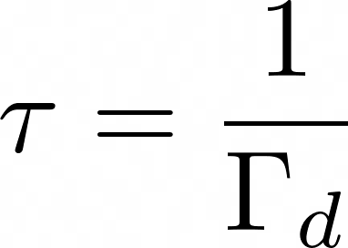
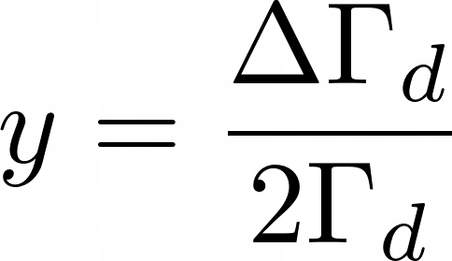
Simultaneous fit to reduce uncertainties
Simultaneous fit of and Run 2 LHCb data 5.57 fb⁻¹
Suppress common systematics (trigger, resolution, production asymmetry)
Fit parameters: and and a fraction of events in vs sample
Notes:
With this parameters we can easily compare it to previous analyses and the world average.

Slide 12
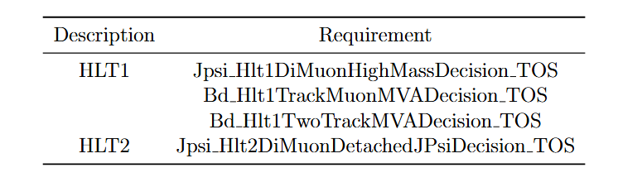
Analysis triggers
Decay time unbiased trigger
Decay time biased trigger
Account for with acceptance!
Notes:
At LHCb, proton collisions happen at 40 million times per second. You cannot save all of them — there's simply not enough storage or computing power. So you need a system that decides on the spot which collisions are interesting enough to keep. (You could for instance do a very rough reconstruction of the tracks of particles in the detector.)
But this can bias the decay time distributions if you cut too harsh or filter on lifetime, which is not ideal in case you are trying to measure something with lifetimes involved, like deltagammad. But we can account for this with something called the acceptance.
Trigger unbiased, trigger biased -> different acceptance curves should be ok. Then you account for the biasing.
Butttt later in spline ratio kplus and kshort very different for trigger B, so there can we use this spline ratio-> probably bad, and yes we also see this in the kshort fit to data for trigger B.

Slide 13
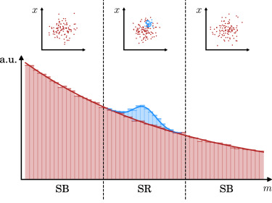
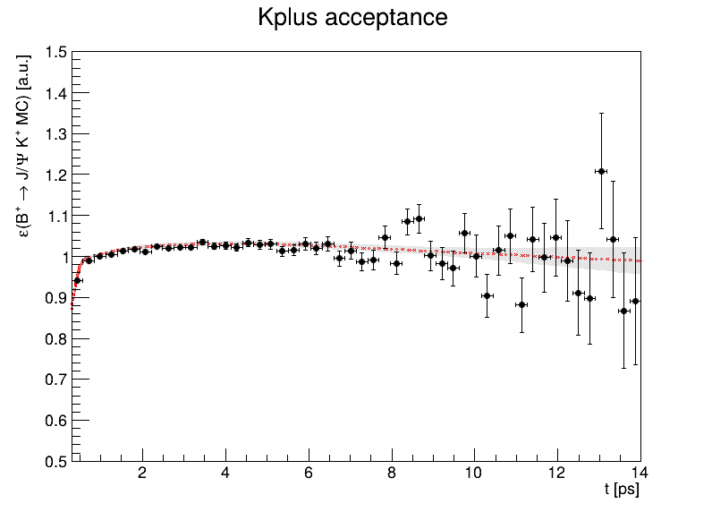


[3] V. Belis, P. Odagiu, T.K. Aarrestad, Machine learning for anomaly detection in particle physics (2024).
Analysis method: background subtraction
Trigger, stripping, BDT selection on MC and data
Create data sets with sWeights: sideband subtraction
extended RooBDecay pdfs convoluted with resolution model and cubic spline acceptance model:
Fit MC splines for , and control channel , then get and splines for data with:
[3]
Notes:
For the trigger, two combinations of trigger lines were used
Stripping selections and vetos were performed and after those a multivariate boosted decision tree was used to further subtract background in MC and data.
COWs would be a more general way of weighting the dataset, plus it should be less biasing for the lifetime distributions, this is tested with the Kendall rank correlation between invariant mass and tau.
With sWeights: estimate of covariance matrix of the fit needs to be corrected!!!!!!!!!!!!!!!!
Acceptance correlated to lifetime -> fix lifetime to extract spline from decay time fit:
Since the acceptance curve is correlated to the lifetime, I have to fix one of them for the decay time fit. But of course, we do not want to fix our delta gamma_d and gamma_d for the analysis. So our idea was to get the acceptance from B+ to J/Psi K+ by using this as an independent control sample. Because we are not interested in a measurement for the B+ to J/Psi K+ lifetime, its okay to set this fixed according to previous measurements, I am using 1.638 ps for B+ J/Psi K+, and then after fixing this lifetime, I fit to the decay time to extract a spline curve. We áre still in the process of making sure that the acceptance of K+ is similar to that of Kstar and Kshort from fitting to the reconstructed decay time distribution of signal monte carlo for all of these samples. So, to be clear, I am also fixing the Kstar and Kshort lifetimes when fitting to those monte carlo samples for the spline, and I am fixing the lifetimes to 1.519 ps, which is the lifetimes that the monte carlo samples were generated with.

Slide 14
Analysis method: resolution modelling
RooSimultaneous of two extended RooBDecay PDFs convoluted with resolution model and cubic spline acceptance model:
: triple gaussian resolution model:
[4]
: effective single gaussian resolution model:
[5]
[4] LHCb collaboration, Measurement of CP violation in B0 → ψ(→ ℓ+ℓ−)K0S (→ π+π−) decays, Phys. Rev. Lett. 132 (2024) 021801, arXiv:2309.09728
[5] LHCb collaboration, Observation of CP violation in B0 → J/ψρ(770)0 decays, arXiv:2601.15646, Submitted to Phys. Rev. Lett.
Notes:
Kinematic correction from GB reweighting (general background?)
COWs would be a more general way of weighting the dataset, plus it should be less biasing for the lifetime distributions, this is tested with the Kendall rank correlation between invariant mass and tau.
Convolution of resolution model: integral over dt’ of the part in between [], you can think about it this way: the convolution sums over all possible true t’ that could be reconstructed as the reconstructed time t that we measure, given the model that we have for the resolution.

Slide 15

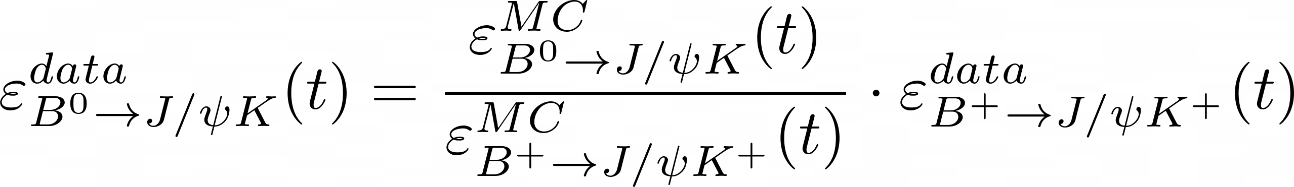
Analysis method: acceptance
RooSimultaneous of two extended RooBDecay PDFs convoluted with resolution model and cubic spline acceptance model:
Fit MC splines for , and control channel , then get and splines for data with:
Snakemake pipeline for the analysis
Notes:
Kinematic correction from GB reweighting (general background?)
COWs would be a more general way of weighting the dataset, plus it should be less biasing for the lifetime distributions, this is tested with the Kendall rank correlation between invariant mass and tau.
Acceptance correlated to lifetime -> fix lifetime to extract spline from decay time fit:
Since the acceptance curve is correlated to the lifetime, I have to fix one of them for the decay time fit. But of course, we do not want to fix our delta gamma_d and gamma_d for the analysis. So our idea was to get the acceptance from B+ to J/Psi K+ by using this as an independent control sample. Because we are not interested in a measurement for the B+ to J/Psi K+ lifetime, its okay to set this fixed according to previous measurements, I am using 1.638 ps for B+ J/Psi K+, and then after fixing this lifetime, I fit to the decay time to extract a spline curve. We áre still in the process of making sure that the acceptance of K+ is similar to that of Kstar and Kshort from fitting to the reconstructed decay time distribution of signal monte carlo for all of these samples. So, to be clear, I am also fixing the Kstar and Kshort lifetimes when fitting to those monte carlo samples for the spline, and I am fixing the lifetimes to 1.519 ps, which is the lifetimes that the monte carlo samples were generated with.

Slide 16
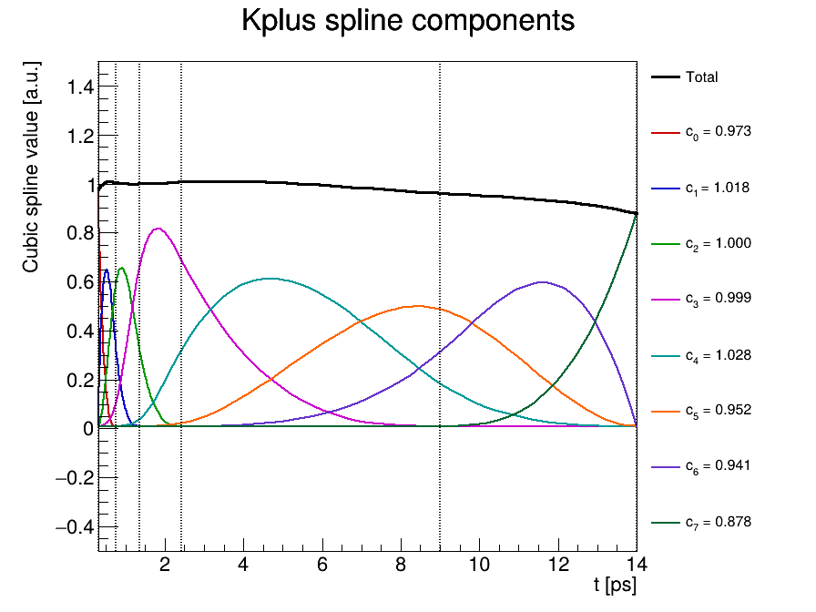
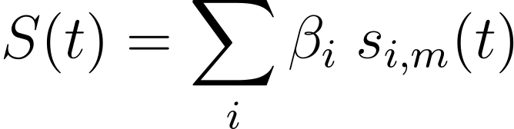
Acceptance
Acceptance described by cubic spline
Piecewise smooth function built from 3rd-order polynomials
Resistant to boundary conditions
Notes:
The acceptance is described by a cubic spline.
A spline is a smooth piecewise polynomial function. A spline can be expressed as a linear combination of basic splines, which are shown in this plot )this is just an example). In my case of a cubic spline, the basic splines consist of four different third-order polynomials stuck together in between knots, which are shown as red dots in this plot. The pieces of the basic splines are put together such that the basic spline is smooth and continuous.
In comparison to having a single n-th order polynomial as acceptance curve, the spline is preferable as an acceptance model as it is built from low-order polynomials. This makes a spline resistant to boundary oscillations and more lifetime independent, which is especially beneficial in this analysis where we want to be paranoid about any factors that can bias the lifetime distributions.
GOED UITLEGGEN WAAROM

Slide 17
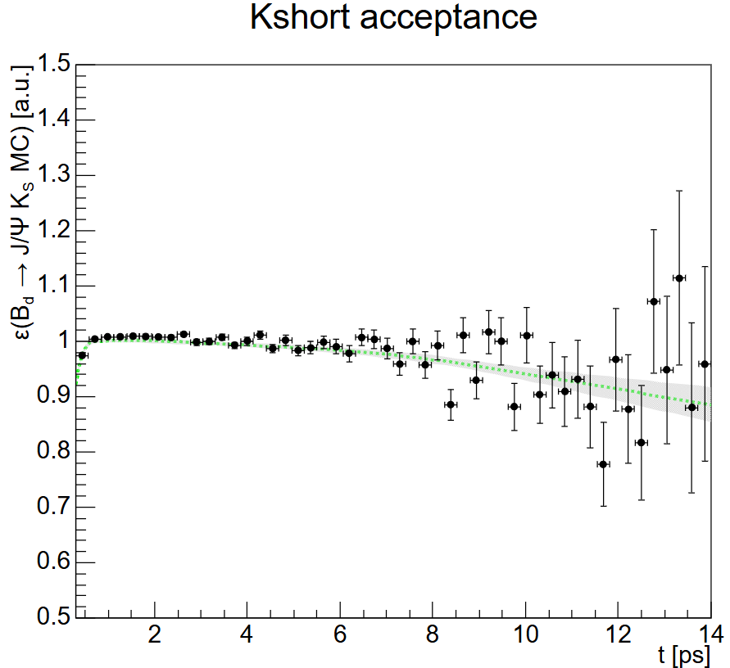
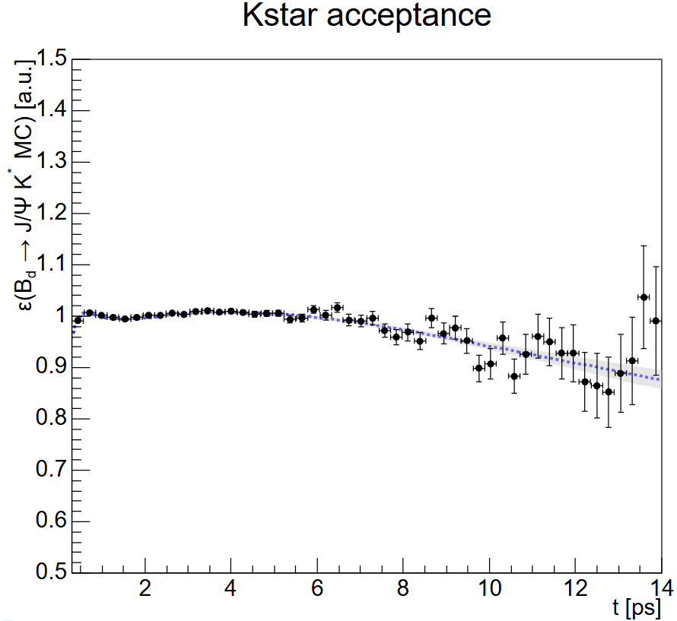
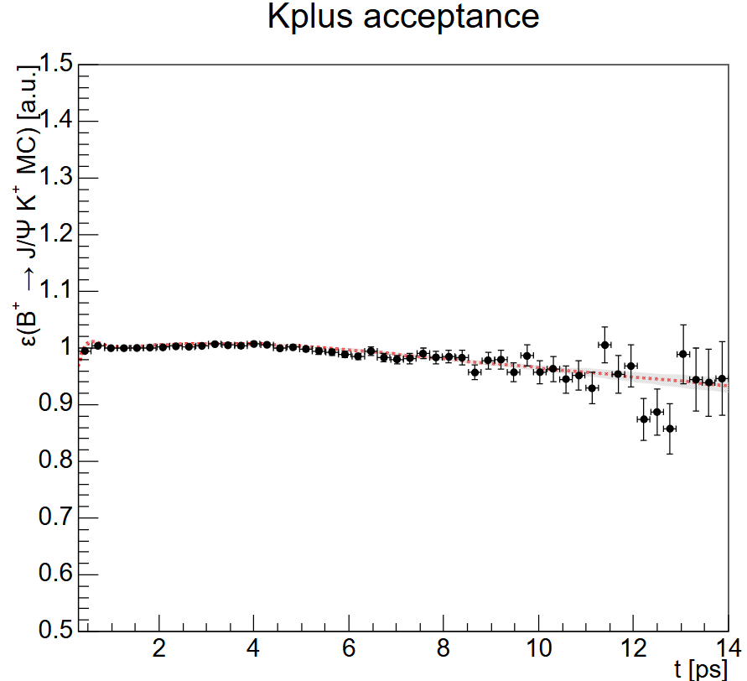
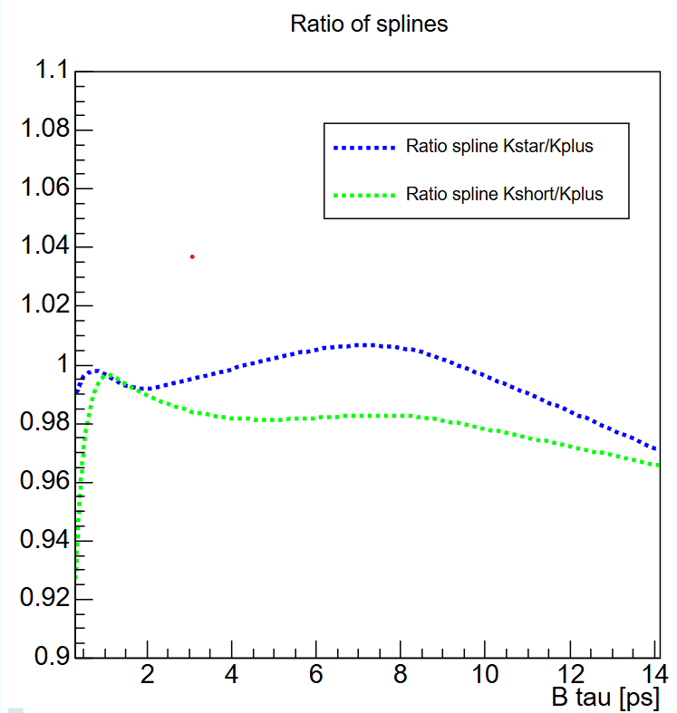
Acceptance
Described by cubic spline
Cut events for t < 0.3 ps
Equipopulated knots at [0.30, 0.75, 1.36, 2.42, 9.00] ps
After final knot: linear function
Fix basic spline at ~1-2 ps for normalisation
Plots for unbiased trigger, 2018
Notes:
The splines indeed are similar in MC, so we can use the K+ as a control sample. And, then we can get the spline acceptance curve for the data of Kstar and Kshort from the data of K+ by weighting the fits from monte carlo.
(does this not bias to fixed lifetimes for kstar and kshort used here? -> maybe a little, but this can be quantified by changing the lifetime and seeing how the final value for delta gamma will change. )

Slide 18
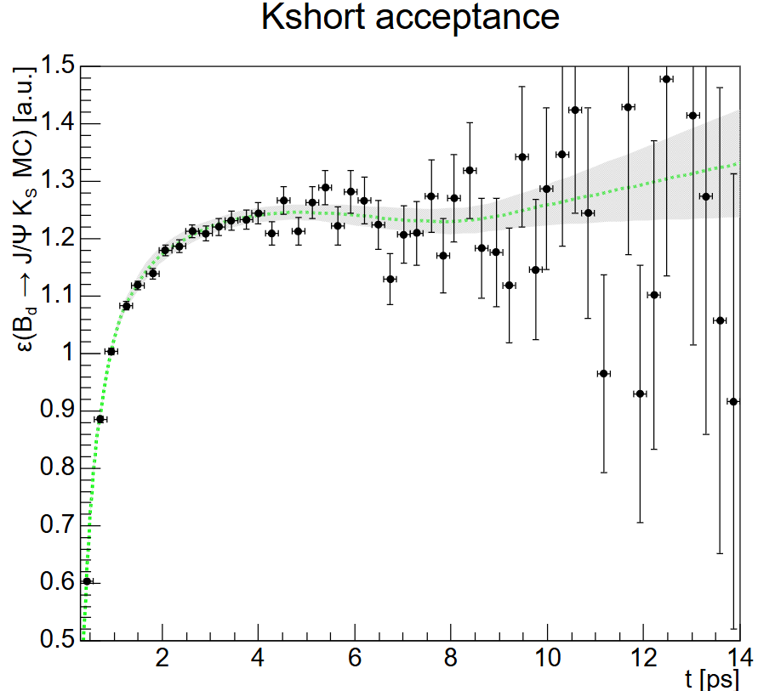
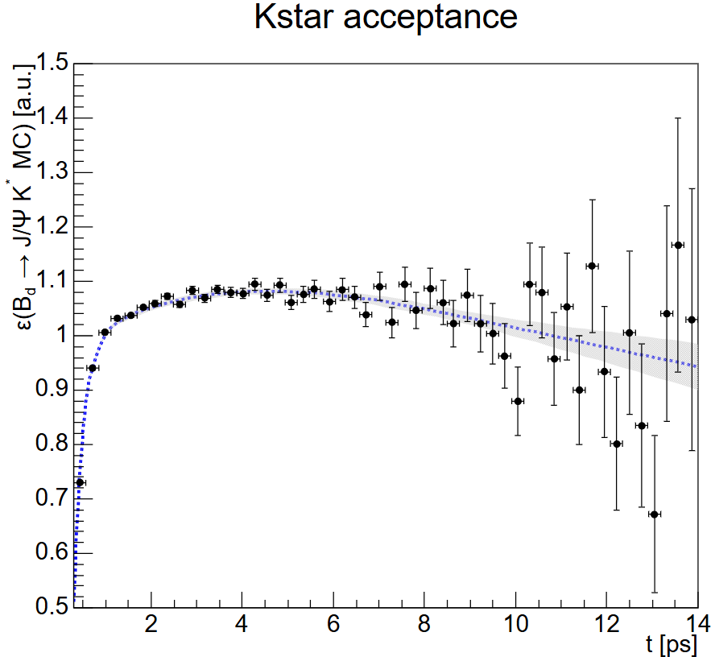
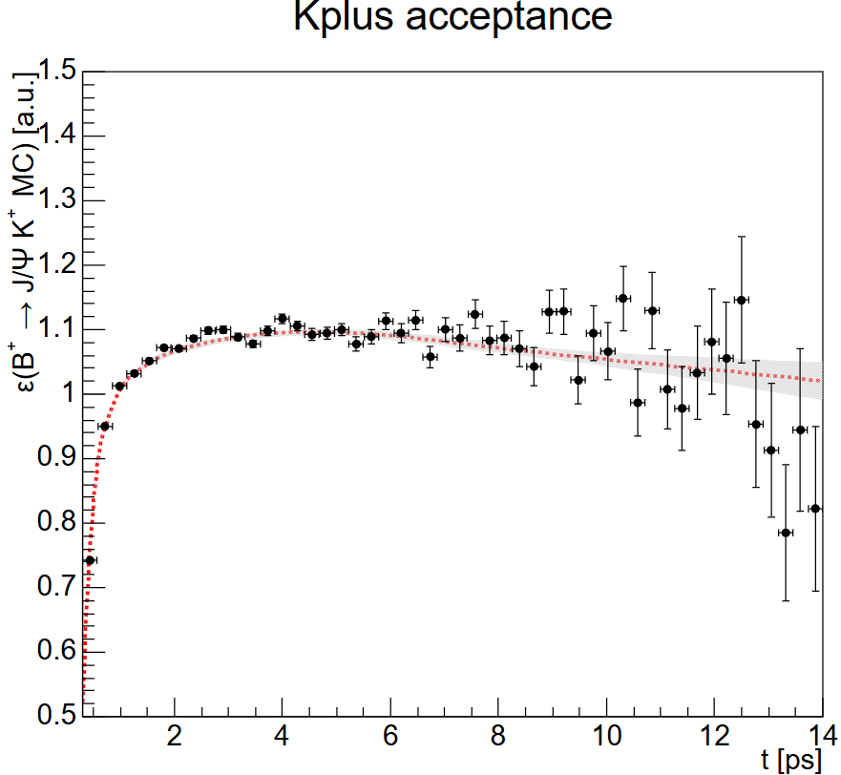
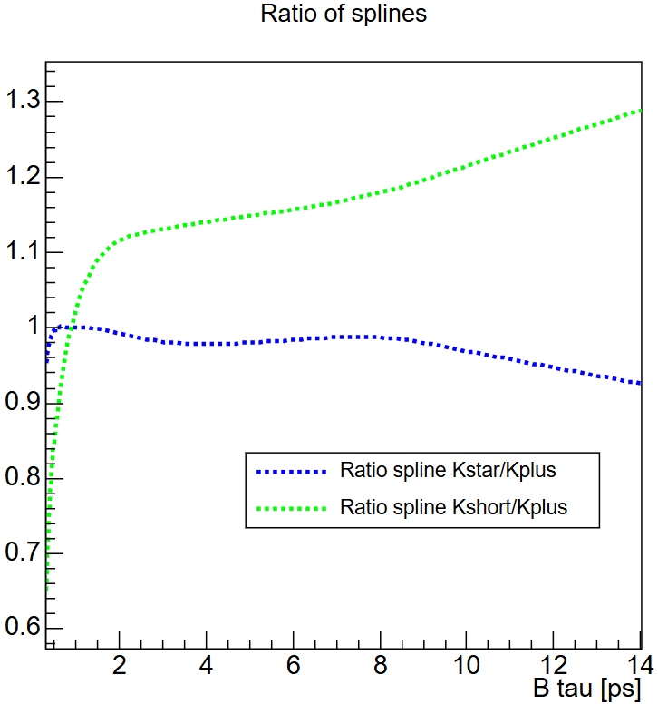
Acceptance
Described by cubic spline
Cut events for t < 0.3 ps
Equipopulated knots at [0.30, 0.75, 1.36, 2.42, 9.00] ps
After final knot: linear function
Fix basic spline at ~1-2 ps for normalisation
Plots for biased trigger, 2018
Notes:
The splines indeed are similar in MC, so we can use the K+ as a control sample. And, then we can get the spline acceptance curve for the data of Kstar and Kshort from the data of K+ by weighting the fits from monte carlo.
(does this not bias to fixed lifetimes for kstar and kshort used here? -> maybe a little, but this can be quantified by changing the lifetime and seeing how the final value for delta gamma will change. )

Slide 19
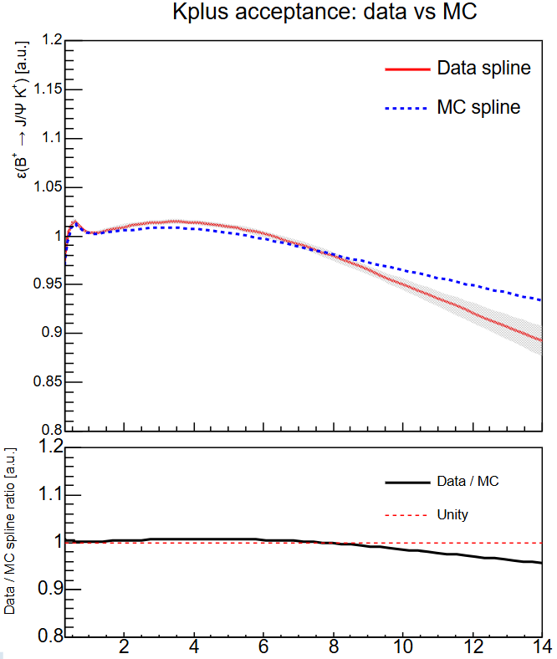
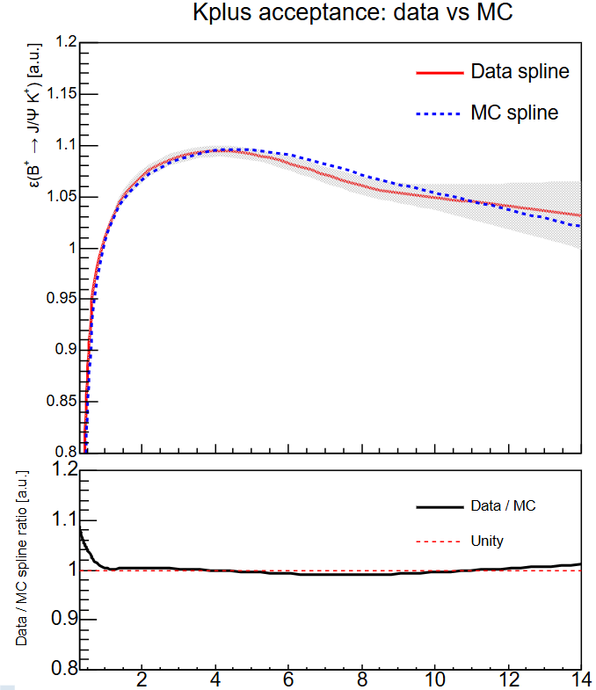
Acceptance
Unbiased trigger
Biased trigger
Notes:
The splines indeed are similar in MC, so we can use the K+ as a control sample. And, then we can get the spline acceptance curve for the data of Kstar and Kshort from the data of K+ by weighting the fits from monte carlo.
(does this not bias to fixed lifetimes for kstar and kshort used here? -> maybe a little, but this can be quantified by changing the lifetime and seeing how the final value for delta gamma will change. )

Slide 20
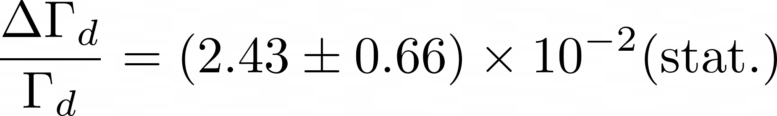
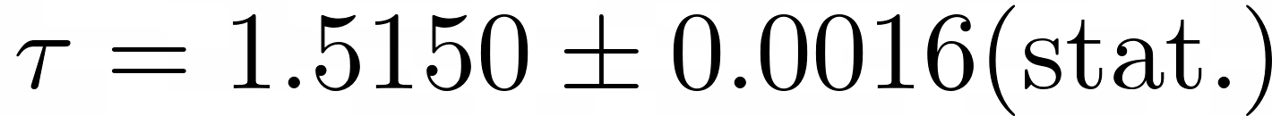

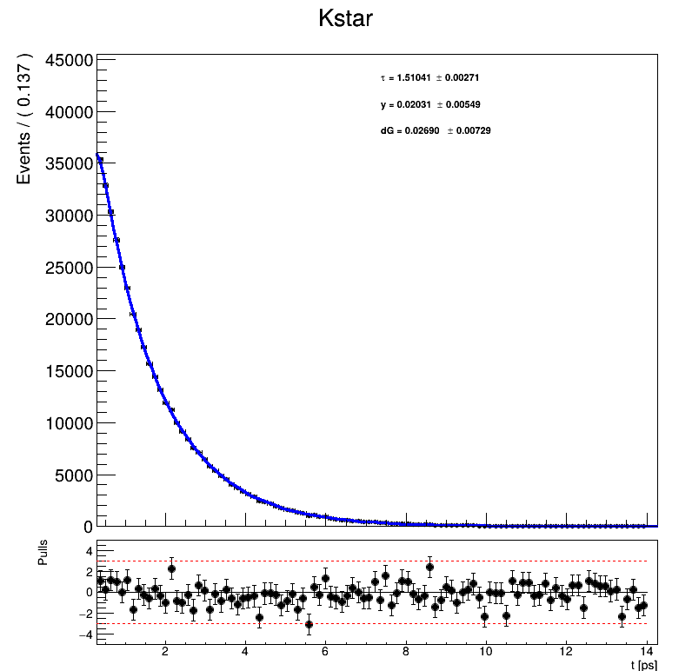
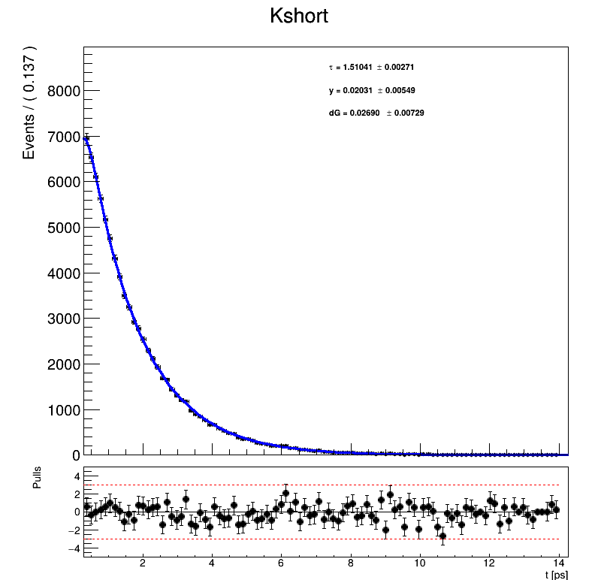
Simultaneous fit
Final result, plot shows 2018 fit result
Unbiased trigger result ;

Slide 21
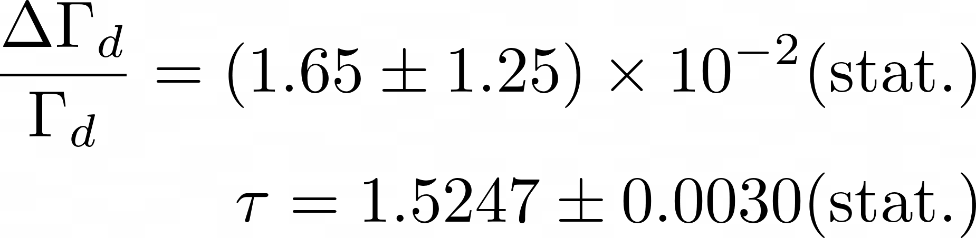
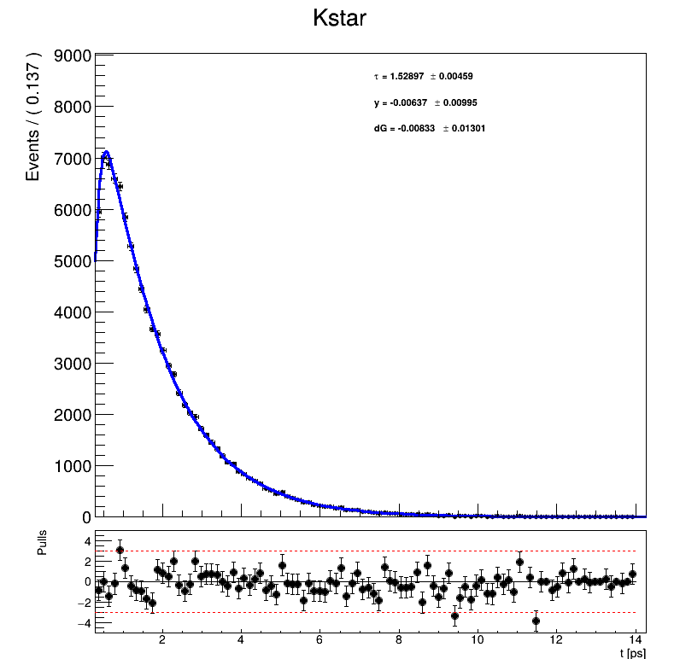
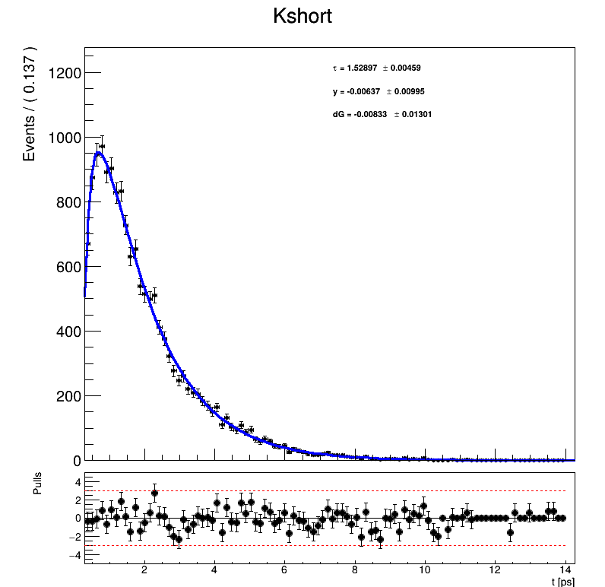
Simultaneous fit
Final result, plot shows 2018 fit result
Biased trigger result ;

Slide 22
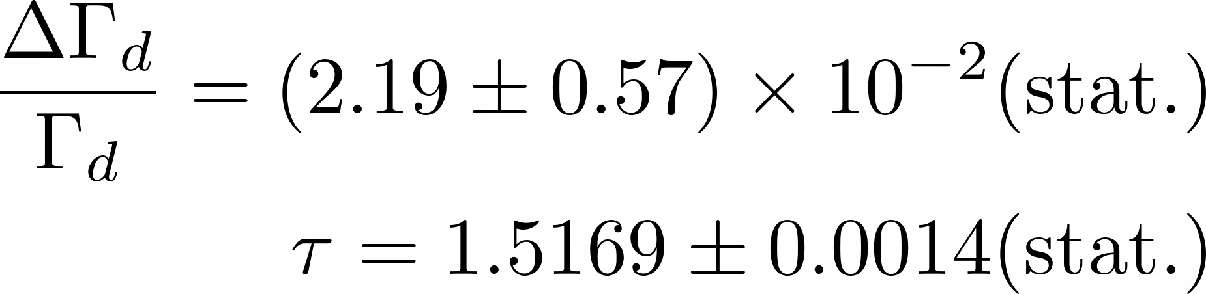
Simultaneous fit
Unbiased trigger result: ;
Biased trigger result: ;
Combined trigger result: ;

Slide 23
Systematic uncertainties
Tested:
Spline knots independent
Time range independent
Constants independent
Resolution model: in progress
Spline parameters: in progress
Notes:
This shows a list of the systematic uncertainties that I tested with the MC samples. For all of these parameters, I changed their value in the model or I made the MC samples a bit worse. I for instance smeared the samples and tested if the fit result deviated from the expected outcome.
Mass-time correlation and trigger and selection effects

Slide 24
Summary & outlook
My result:
SM prediction: [1]
World average: [2]
Better than world average!

Slide 25
Summary & outlook
RooSimultaneous better than 2 separate fits
Kplus control mode for acceptance model
Fitted Kshort and Kstar simultaneously
Tested systematics
Future work: resolution model for this analysis

Slide 26
Backup

Slide 27
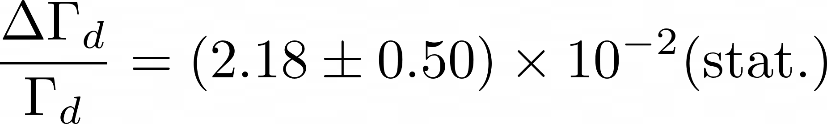


Simultaneous fit
Unbiased trigger result with fixed to PDG value of 1.517 ps -> assign systematic for this
Final result:

Slide 28
Why use CP-eigenstate and flavour-specific state?
Large difference in terms containing DGd, good statistics, reduced systematics
Could use suppressed and favoured channels:
B0 -> D(∗)±π∓
Tagged analysis
Less statistics because less clean signal
Could use CP-even CP-odd channels:
J/ψK0s / J/ψK0L
Have to disentangle CP-eigenvalues through angular analysis: less statistics
Or disentangle CP-eigenvalues with Dalitz plot analysis (which needs tagged analysis): lower statistics and systematic errors from Dalitz model
Why not only use CP-eigenstate channel? -> large systematic uncertainties
Notes:
Use simultaneous fits of CP-eigenstate and flavour-specific channels. -> I need both of them to get DeltaGammad because the CP eigenstate has a significantly larger term proportional to deltagammad than the Kstar, flavour specific state, has.

Slide 29

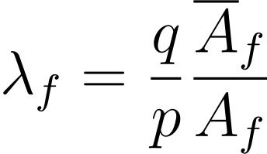
Neutral meson mixing
; ;
Gives master equations:
Notes:
Now we also add the final states of the decay to the equations. This gives us 4 possible amplitudes
The decay rate is defined as taking the absolute square of this.
… filling in gives master equations

Slide 30

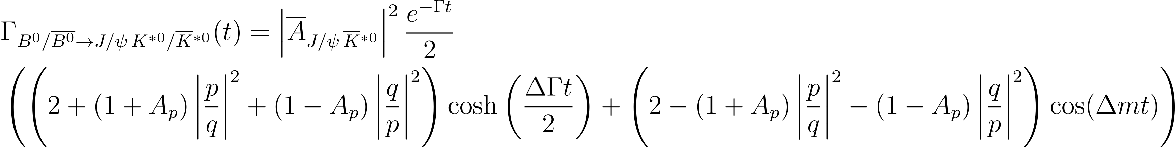
Where is ?
Notes:
From feynman diagrams and filling in lambda in the master equations
DGd controls hyperbolic terms in pdf -> mostly sensitive to DGd in CP-eigenstate channels

Slide 31
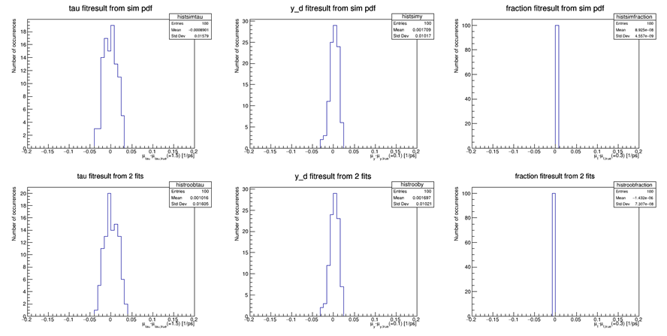
Compared RooSimultaneous to an analysis which fits two separate lifetimes
Feasibility study
Notes:
After all the tests that I did, we decided to use the RooSimultaneous for the DGd analysis.
We also compared the RooSimultaneous fitting to an analysis which fits to two seperate lifetimes and this is shown in the 6 plots here. They show the distributions of the fit results that come out of the two different fit methods from 100 toys generated by generating events for the two samples seperately (for simplicity I used long and short again). There are three free parameters in the fits; the mean lifetime or gamma_d, y which is delta gamma_d over 2 gamma_d, and the fraction of events in one of the two samples. The plots show the fit values for those parameters minus the value that the toys were generated with, so we want the distributions to be centered at zero. The top row shows the results from the Roosimultaneous and the bottom row for the two seperate lifetime fits.
-> as you can see the RooSimultaneous performs very similar to the 2 seperate lifetime fits. This is without systematic errors like in data! Some of the systematic errors should cancel by using the roosimultaneous, so for data using roosimultaneous will probably be even better than is shown in these plots.

Slide 32
Why simultaneous fit and not separate fits?
Find all systematic uncertainties -> then later a lot of systematics cancels out, so a lot of work for nothing.
Also it is not trivial in what way the systematic uncertainties cancel out -> complicated to get the systematic uncertainty from separate fits at all.

Slide 33
What was the new pdf?
Calculate ratio of the samples as a function of the pdfs for those samples and the fraction of events in them
Make efficiency pdf from this ratio
Total model: two exponentials combined, but samples split by efficiency pdf:
What was wrong: efficiency was normalised, RooProdPdf wants efficiency to be normalised (shouldn’t be)
Notes:
we found out that there was something wrong in the RooEfficiency and RooProdPdf functions that we were using, because RooEfficiency was returning a RooAbsolutePdf, which is normalised, but no normalising should be performed for an efficiency. And RooProdPdf expects that the two input functions need to be normalised, while we want one of the input functions to be an efficiency, which should thus not be normalised.
There is a function RooEffProd which is almost doing the correct thing, as in, it is using the input functions correctly, taking one as a pdf and one as an efficiency, but then instead of splitting the sample in for instance long and short, it just throws away all the events of short.
But, that was something easy enough for us to correct, so Gerhard has been working on making a new function RooBinomialProd which correctly implements the RooEffProd and also keeping all the data.

Slide 34
Notes for the interview
More about the combination of the channels -> at LHCb we have something called snakemake where we have a nice program to create a pipeline in and keep our analyses consistent. If I am going to combine channels, it would be ideal to use something like this. Do you have something similar in ATLAS?
Since the channels are quite rare, I would say that simulation based inference (SBI) would be a good way of using ML to optimize this analysis (maybe even better for the other position considering the search for the even more rare decay). Do you think this would be a good idea?
Probably should be using COWs or optimize sWeights in some way.
Photon final state is rare but very clear signal.
What do I add to the analysis/group if I get the position? I am very determined and eager to learn, I do not quit (maybe even cling on to something too long sometimes), I am organized, I can collaborate well. I bring a fresh perspective — not only because I’m young and relatively new to the field, but also because I come from a different research group (LHCb). The insights I’ve gained there allow me to approach problems here in a new and constructive way.

Slide 35
Notes for the interview
I have combined school with volleyball since primary school. I have always been able to manage both, and so far nothing has ever deviated from plan, which makes me confident that this will continue to be the case. Moreover, the combination of volleyball and academic work is very beneficial for me because it gives me energy: after a day of working behind my computer, I enjoy being able to move, and after an intensive volleyball training, I look forward to working on my project.
Why would I want the position? I think this field of physics is the most interesting since it still has a lot of open questions, the properties of the Higgs and Higgs potential being one of them. I think it is obvious that the next step for a possible new discovery in the field of particle physics is in finding out everything about the Higgs potential that we can. Other than that I think AI, but I prefer ML, will grow massively and I think this can really help us further in the future. And I feel like I myself can grow useful skills with ML in this PhD project and with the expertise that the ATLAS group at Nikhef has.

