Slide 1

Block encode a general matrix: postselection
For a generic $(α,a)$ block encoding ($α:$ subnormalisation factor, $a:$ # of ancilla qubits), if we start from${\left.|0\right\rangle }_{a}{\left.|0^{n}\right\rangle }_{W}\left.|ψ\right\rangle$, then
$$U{\left.|0\right\rangle }_{a}{\left.|0^{n}\right\rangle }_{W}{\left.|Ψ\right\rangle }_{J}=\frac{1}{N}\underset{\begin{aligned}a ancilla qubits, \\ good branch\end{aligned}}{\underbrace{{\left.|0\right\rangle }_{a}{\left.|0^{n}\right\rangle }_{W}\tilde{A}{\left.|Ψ\right\rangle }_{J}}}+\sqrt{1−{\left\|\tilde{A}{\left.|Ψ\right\rangle }_{J}\right\|}^{2}}\underset{\begin{aligned}everything else, \\ bad branch\end{aligned}}{\underbrace{\left.|σ_{Ψ}^{⊥}\right\rangle }}$$
The success probability is
$$p_{Ψ}={\left\|\tilde{A}{\left.|Ψ\right\rangle }_{J}\right\|}^{2}=\frac{{\left\|A{\left.|Ψ\right\rangle }_{J}\right\|}^{2}}{α^{2}N^{2}}\underset{A is Hermitian}{\underbrace{=}}\frac{{\left\langle Ψ\left|A^{2}\right|Ψ\right\rangle }_{J}}{α^{2}N^{2}}$$
For our $A=3I−B$ and $α=3$,
$$p_{Ψ}=\frac{{\left\langle Ψ\left|{\left(3I−B\right)}^{2}\right|Ψ\right\rangle }_{J}}{9N^{2}}$$
H

Slide 2

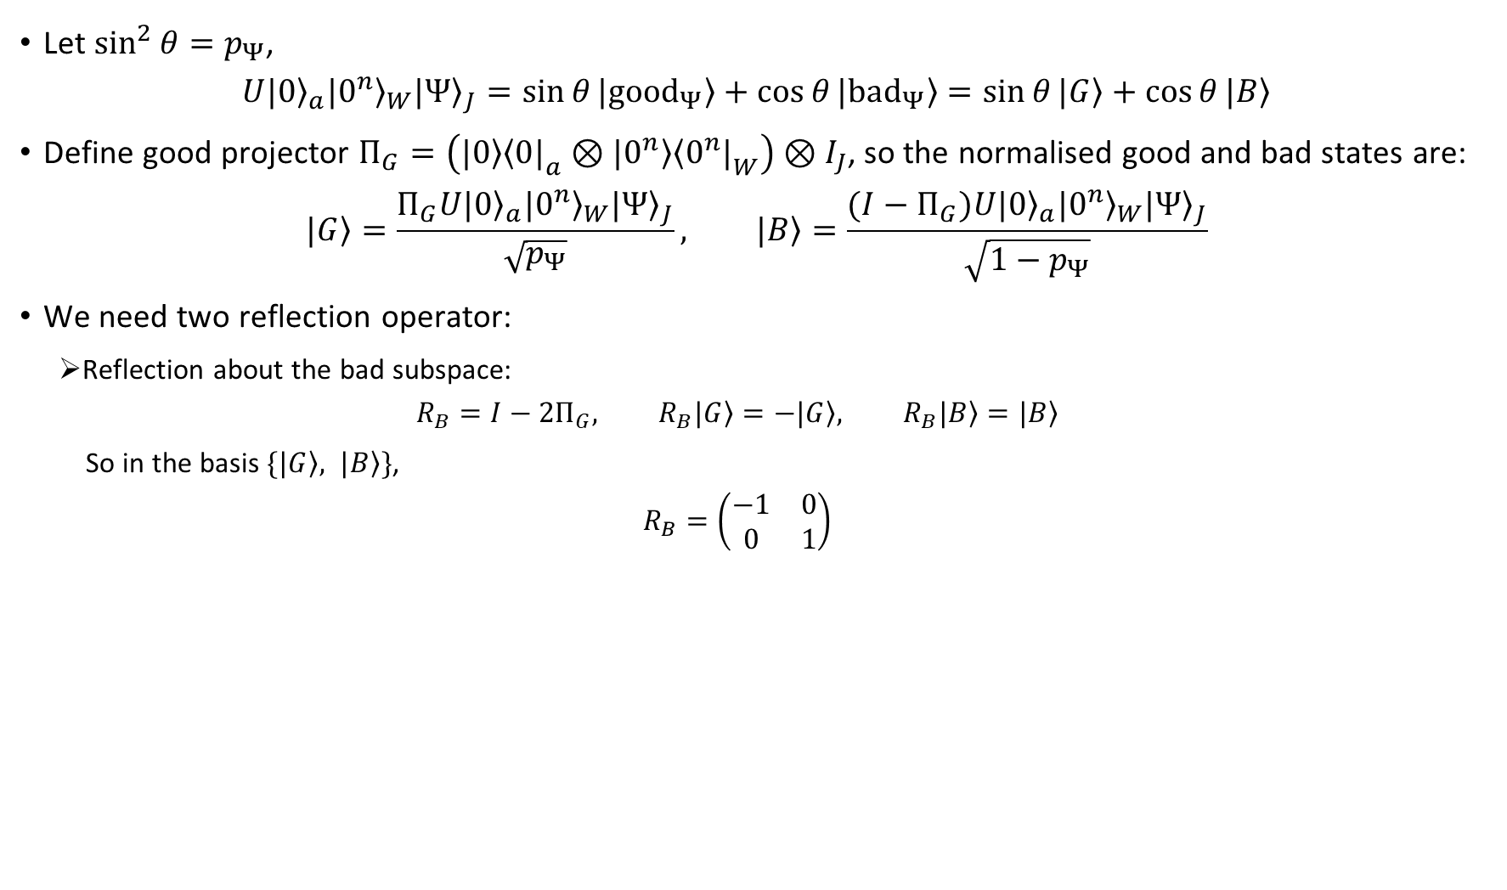
Block encode a general matrix: postselection
Let $\sin^{2}{θ}=p_{Ψ}$,
$$U{\left.|0\right\rangle }_{a}{\left.|0^{n}\right\rangle }_{W}{\left.|Ψ\right\rangle }_{J}=\sin{θ}\left.|{good}_{Ψ}\right\rangle +\cos{θ}\left.|{bad}_{Ψ}\right\rangle =\sin{θ}\left.|G\right\rangle +\cos{θ}\left.|B\right\rangle$$
Define good projector $Π_{G}=\left(\left.|0\right\rangle {\left\langle 0|\right.}_{a}⊗\left.|0^{n}\right\rangle {\left\langle 0^{n}|\right.}_{W}\right)⊗I_{J}$, so the normalised good and bad states are:
$$\left.|G\right\rangle =\frac{Π_{G}U{\left.|0\right\rangle }_{a}{\left.|0^{n}\right\rangle }_{W}{\left.|Ψ\right\rangle }_{J}}{\sqrt{p_{Ψ}}}, \left.|B\right\rangle =\frac{(I−Π_{G})U{\left.|0\right\rangle }_{a}{\left.|0^{n}\right\rangle }_{W}{\left.|Ψ\right\rangle }_{J}}{\sqrt{1−p_{Ψ}}}$$
We need two reflection operator:
Reflection about the bad subspace:
$$R_{B}=I−2Π_{G}, R_{B}\left.|G\right\rangle =−\left.|G\right\rangle , R_{B}\left.|B\right\rangle =\left.|B\right\rangle$$
So in the basis $\{\left.|G\right\rangle , \left.|B\right\rangle \}$,
$$R_{B}=\left(\begin{matrix}−1 & 0 \\ 0 & 1\end{matrix}\right)$$
https://arxiv.org/pdf/quant-ph/0005055

Slide 3
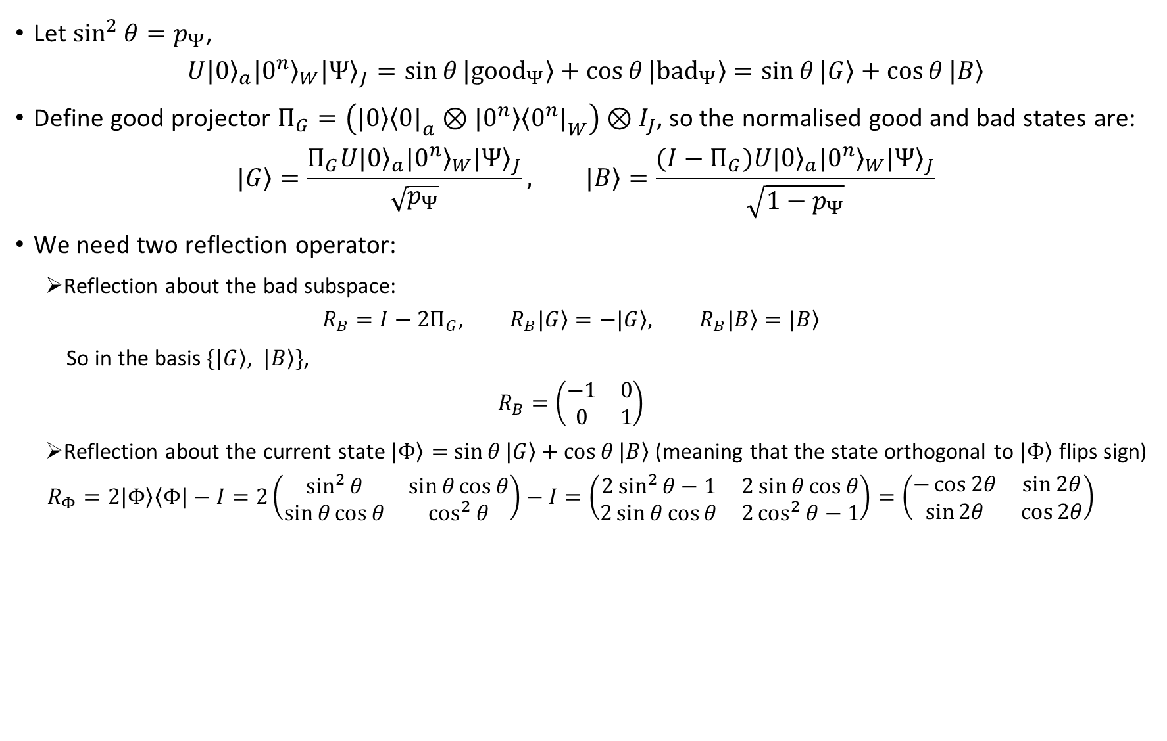
Block encode a general matrix: postselection
Let $\sin^{2}{θ}=p_{Ψ}$,
$$U{\left.|0\right\rangle }_{a}{\left.|0^{n}\right\rangle }_{W}{\left.|Ψ\right\rangle }_{J}=\sin{θ}\left.|{good}_{Ψ}\right\rangle +\cos{θ}\left.|{bad}_{Ψ}\right\rangle =\sin{θ}\left.|G\right\rangle +\cos{θ}\left.|B\right\rangle$$
Define good projector $Π_{G}=\left(\left.|0\right\rangle {\left\langle 0|\right.}_{a}⊗\left.|0^{n}\right\rangle {\left\langle 0^{n}|\right.}_{W}\right)⊗I_{J}$, so the normalised good and bad states are:
$$\left.|G\right\rangle =\frac{Π_{G}U{\left.|0\right\rangle }_{a}{\left.|0^{n}\right\rangle }_{W}{\left.|Ψ\right\rangle }_{J}}{\sqrt{p_{Ψ}}}, \left.|B\right\rangle =\frac{(I−Π_{G})U{\left.|0\right\rangle }_{a}{\left.|0^{n}\right\rangle }_{W}{\left.|Ψ\right\rangle }_{J}}{\sqrt{1−p_{Ψ}}}$$
We need two reflection operator:
Reflection about the bad subspace:
$$R_{B}=I−2Π_{G}, R_{B}\left.|G\right\rangle =−\left.|G\right\rangle , R_{B}\left.|B\right\rangle =\left.|B\right\rangle$$
So in the basis $\{\left.|G\right\rangle , \left.|B\right\rangle \}$,
$$R_{B}=\left(\begin{matrix}−1 & 0 \\ 0 & 1\end{matrix}\right)$$
Reflection about the current state $\left.|Φ\right\rangle =$ $\sin{θ}\left.|G\right\rangle +\cos{θ}\left.|B\right\rangle$ (meaning that the state orthogonal to $\left.|Φ\right\rangle$ flips sign)
$$R_{Φ}=2\left.|Φ\right\rangle \left\langle Φ|\right.−I=2\left(\begin{matrix}\sin^{2}{θ} & \sin{θ}\cos{θ} \\ \sin{θ}\cos{θ} & \cos^{2}{θ}\end{matrix}\right)−I=\left(\begin{matrix}2\sin^{2}{θ}−1 & 2\sin{θ}\cos{θ} \\ 2\sin{θ}\cos{θ} & 2\cos^{2}{θ}−1\end{matrix}\right)=\left(\begin{matrix}−\cos{2θ} & \sin{2θ} \\ \sin{2θ} & \cos{2θ}\end{matrix}\right)$$
https://arxiv.org/pdf/quant-ph/0005055

Slide 4
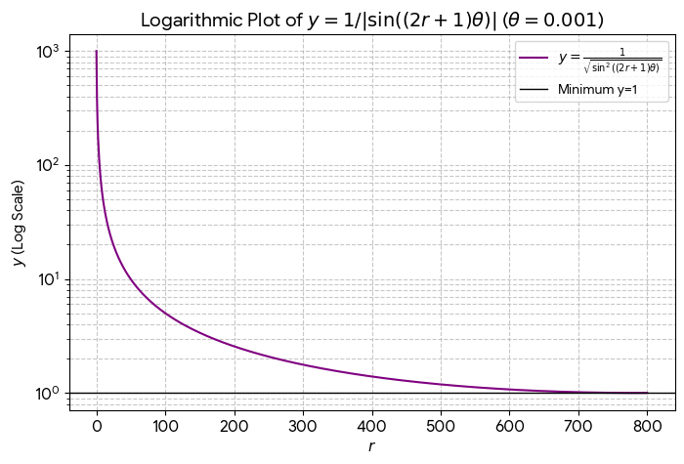
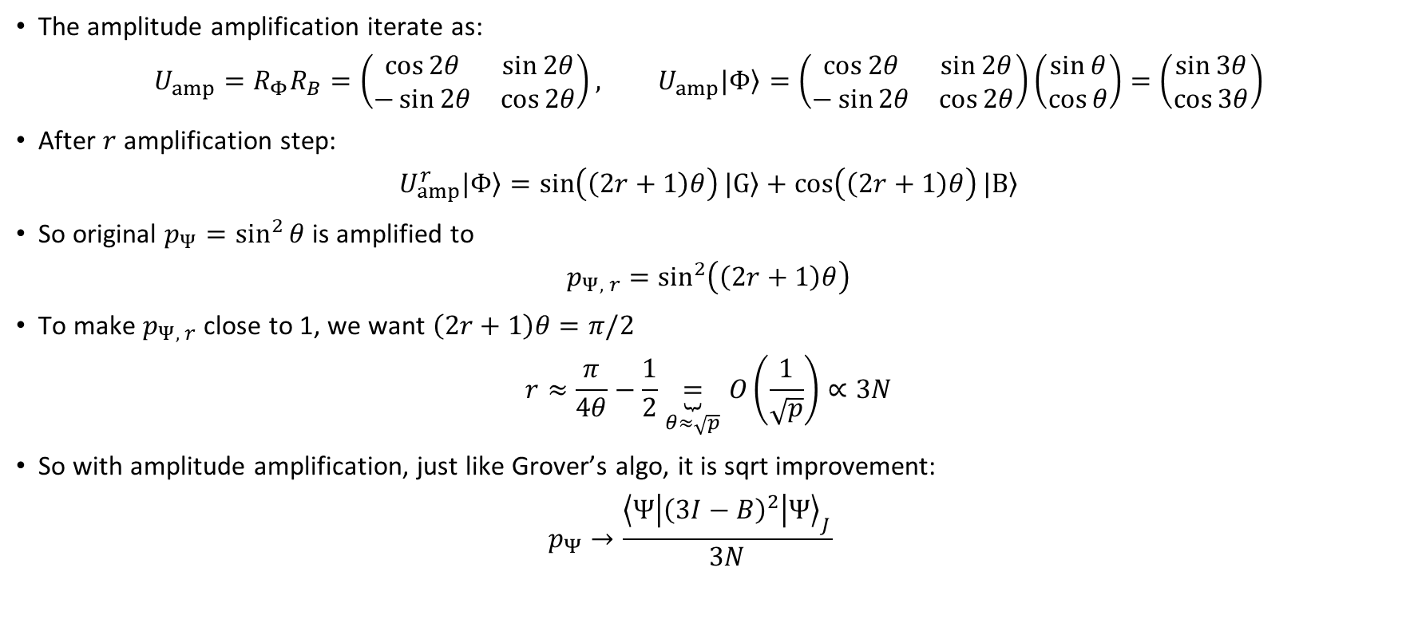
Block encode a general matrix: postselection
The amplitude amplification iterate as:
$$U_{amp}=R_{Φ}R_{B}=\left(\begin{matrix}\cos{2θ} & \sin{2θ} \\ −\sin{2θ} & \cos{2θ}\end{matrix}\right), U_{amp}\left.|Φ\right\rangle =\left(\begin{matrix}\cos{2θ} & \sin{2θ} \\ −\sin{2θ} & \cos{2θ}\end{matrix}\right)\left(\begin{matrix}\sin{θ} \\ \cos{θ}\end{matrix}\right)=\left(\begin{matrix}\sin{3θ} \\ \cos{3θ}\end{matrix}\right)$$
After $r$ amplification step:
$$U_{amp}^{r}\left.|Φ\right\rangle =\sin\left(\left(2r+1\right)θ\right)\left.|G\right\rangle +\cos\left(\left(2r+1\right)θ\right)\left.|B\right\rangle$$
So original $p_{Ψ}=\sin^{2}{θ}$ is amplified to
$$p_{Ψ, r}=\sin^{2}\left(\left(2r+1\right)θ\right)$$
To make $p_{Ψ, r}$ close to 1, we want $\left(2r+1\right)θ=π/2$
$$r≈\frac{π}{4θ}−\frac{1}{2}\underset{θ≈\sqrt{p}}{\underbrace{=}}O\left(\frac{1}{\sqrt{p}}\right)∝3N$$
So with amplitude amplification, just like Grover’s algo, it is sqrt improvement:
$$p_{Ψ}→\frac{{\left\langle Ψ\left|{\left(3I−B\right)}^{2}\right|Ψ\right\rangle }_{J}}{3N}$$

Slide 5
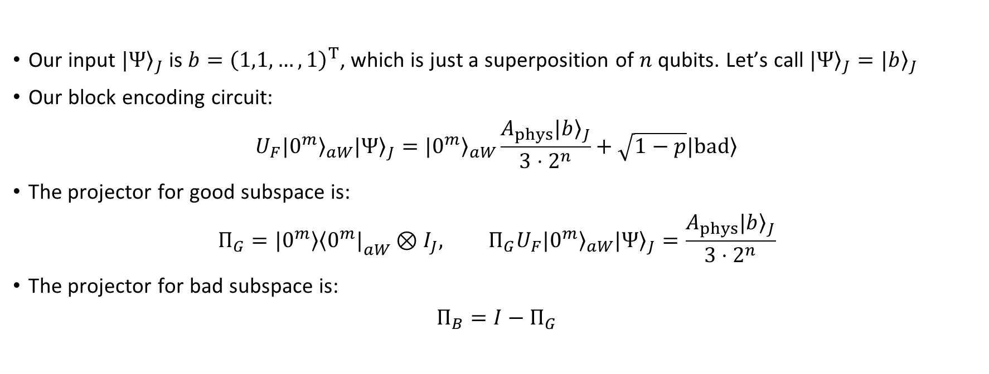
Block encode a general matrix: postselection
Our input ${\left.|Ψ\right\rangle }_{J}$ is $b={\left(1,1,…,1\right)}^{T}$, which is just a superposition of $n$ qubits. Let’s call ${\left.|Ψ\right\rangle }_{J}={\left.|b\right\rangle }_{J}$
Our block encoding circuit:
$$U_{F}{\left.|0^{m}\right\rangle }_{aW}{\left.|Ψ\right\rangle }_{J}={\left.|0^{m}\right\rangle }_{aW}\frac{A_{phys}{\left.|b\right\rangle }_{J}}{3⋅2^{n}}+\sqrt{1−p}\left.|bad\right\rangle$$
The projector for good subspace is:
$$Π_{G}=\left.|0^{m}\right\rangle {\left\langle 0^{m}|\right.}_{aW}⊗I_{J}, Π_{G}U_{F}{\left.|0^{m}\right\rangle }_{aW}{\left.|Ψ\right\rangle }_{J}=\frac{A_{phys}{\left.|b\right\rangle }_{J}}{3⋅2^{n}}$$
The projector for bad subspace is:
$$Π_{B}=I−Π_{G}$$

Slide 6
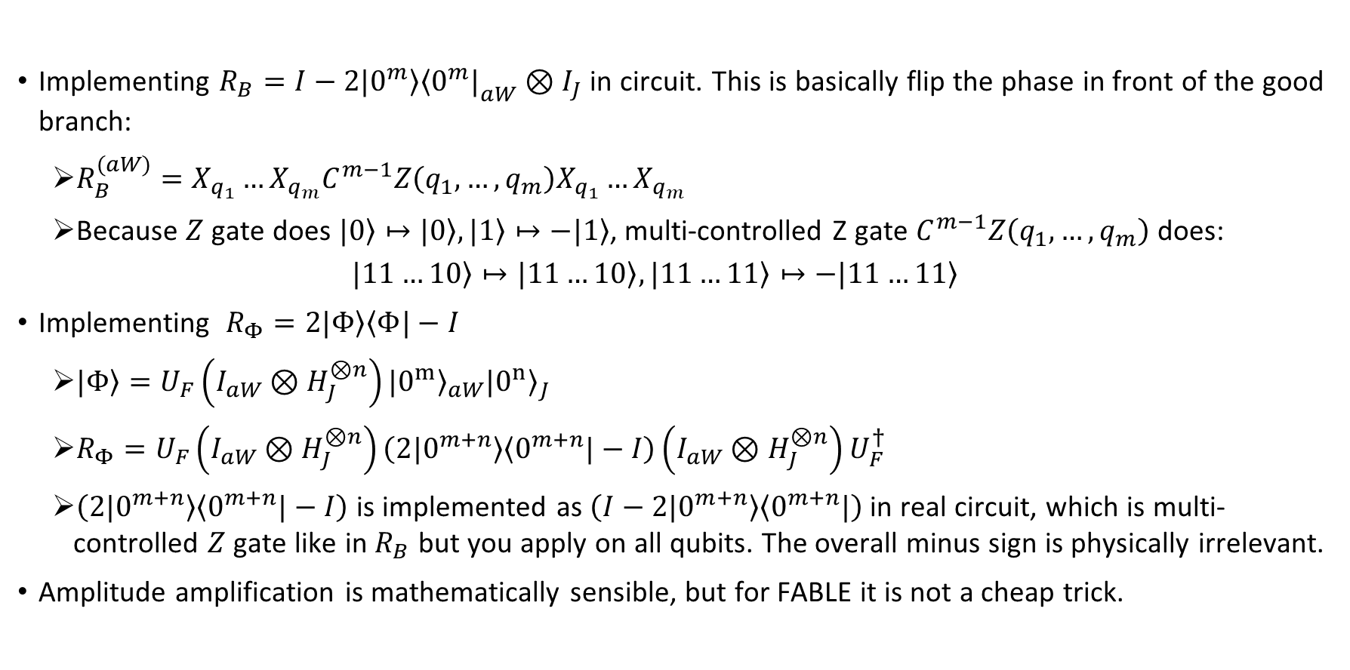
Block encode a general matrix
Implementing $R_{B}=I−2\left.|0^{m}\right\rangle {\left\langle 0^{m}|\right.}_{aW}⊗I_{J}$ in circuit. This is basically flip the phase in front of the good branch:
$R_{B}^{(aW)}=X_{q_{1}}…X_{q_{m}}C^{m−1}Z\left(q_{1},…,q_{m}\right)X_{q_{1}}…X_{q_{m}}$
Because $Z$ gate does $\left.|0\right\rangle ↦\left.|0\right\rangle ,\left.|1\right\rangle ↦−\left.|1\right\rangle$, multi-controlled Z gate $C^{m−1}Z\left(q_{1},…,q_{m}\right)$ does:
$$\left.|11…10\right\rangle ↦\left.|11…10\right\rangle ,\left.|11…11\right\rangle ↦−\left.|11…11\right\rangle$$
Implementing $R_{Φ}=2\left.|Φ\right\rangle \left\langle Φ|\right.−I$
$\left.|Φ\right\rangle =U_{F}\left(I_{aW}⊗H_{J}^{⊗n}\right){\left.|0^{m}\right\rangle }_{aW}{\left.|0^{n}\right\rangle }_{J}$
$R_{Φ}=U_{F}\left(I_{aW}⊗H_{J}^{⊗n}\right)\left(2\left.|0^{m+n}\right\rangle \left\langle 0^{m+n}|\right.−I\right)\left(I_{aW}⊗H_{J}^{⊗n}\right)U_{F}^{†}$
$\left(2\left.|0^{m+n}\right\rangle \left\langle 0^{m+n}|\right.−I\right)$ is implemented as $\left(I−2\left.|0^{m+n}\right\rangle \left\langle 0^{m+n}|\right.\right)$ in real circuit, which is multi-controlled $Z$ gate like in $R_{B}$ but you apply on all qubits. The overall minus sign is physically irrelevant.
Amplitude amplification is mathematically sensible, but for FABLE it is not a cheap trick. ​

Slide 7
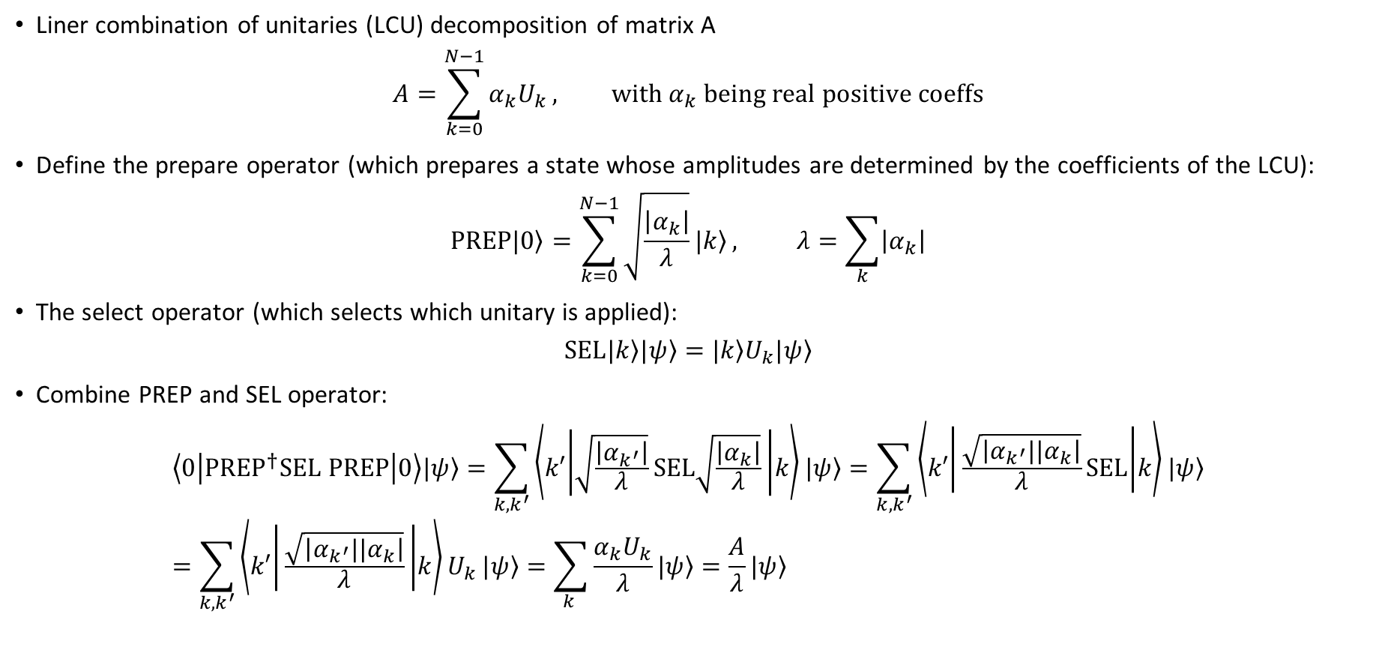
Block encoding with LCU
Liner combination of unitaries (LCU) decomposition of matrix A
$$A=\sum_{k=0}^{N−1}{α_{k}U_{k}}, with α_{k} being real positive coeffs$$
Define the prepare operator (which prepares a state whose amplitudes are determined by the coefficients of the LCU):
$$PREP\left.|0\right\rangle =\sum_{k=0}^{N−1}{\sqrt{\frac{\left|α_{k}\right|}{λ}}\left.|k\right\rangle }, λ=\sum_{k}{\left|α_{k}\right|}$$
The select operator (which selects which unitary is applied):
$$SEL\left.|k\right\rangle \left.|ψ\right\rangle =\left.|k\right\rangle U_{k}\left.|ψ\right\rangle$$
Combine PREP and SEL operator:
$$\left\langle 0 | {PREP}^{†}SEL PREP | 0\right\rangle \left.|ψ\right\rangle =\sum_{k,k^{′}}{\left\langle k′ | \sqrt{\frac{\left|α_{k^{′}}\right|}{λ}}SEL\sqrt{\frac{\left|α_{k}\right|}{λ}} | k\right\rangle }\left.|ψ\right\rangle =\sum_{k,k^{′}}{\left\langle k′ | \frac{\sqrt{\left|α_{k^{′}}||α_{k}\right|}}{λ}SEL | k\right\rangle }\left.|ψ\right\rangle =\sum_{k,k^{′}}{\left\langle k′ | \frac{\sqrt{\left|α_{k^{′}}||α_{k}\right|}}{λ} | k\right\rangle U_{k}}\left.|ψ\right\rangle =\sum_{k }{\frac{α_{k}U_{k}}{λ}}\left.|ψ\right\rangle =\frac{A}{λ}\left.|ψ\right\rangle$$
MottonenStatePreparation

Slide 8
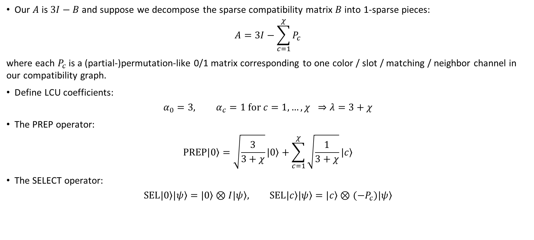
Block encoding with LCU
Our $A$ is $3I−B$ and suppose we decompose the sparse compatibility matrix $B$ into 1-sparse pieces:
$$A=3I−\sum_{c=1}^{χ}{P_{c}}$$
where each $P_{c}$ is a (partial-)permutation-like 0/1 matrix corresponding to one color / slot / matching / neighbor channel in our compatibility graph.
Define LCU coefficients:
$$α_{0}=3, α_{c}=1 for c=1,…,χ ⇒λ=3+χ$$
The PREP operator:
$$PREP\left.|0\right\rangle =\sqrt{\frac{3}{3+χ}}\left.|0\right\rangle +\sum_{c=1}^{χ}{\sqrt{\frac{1}{3+χ}}\left.|c\right\rangle }$$
The SELECT operator:
$$SEL\left.|0\right\rangle \left.|ψ\right\rangle =\left.|0\right\rangle ⊗I\left.|ψ\right\rangle , SEL\left.|c\right\rangle \left.|ψ\right\rangle =\left.|c\right\rangle ⊗{(−P}_{c})\left.|ψ\right\rangle$$

Slide 9
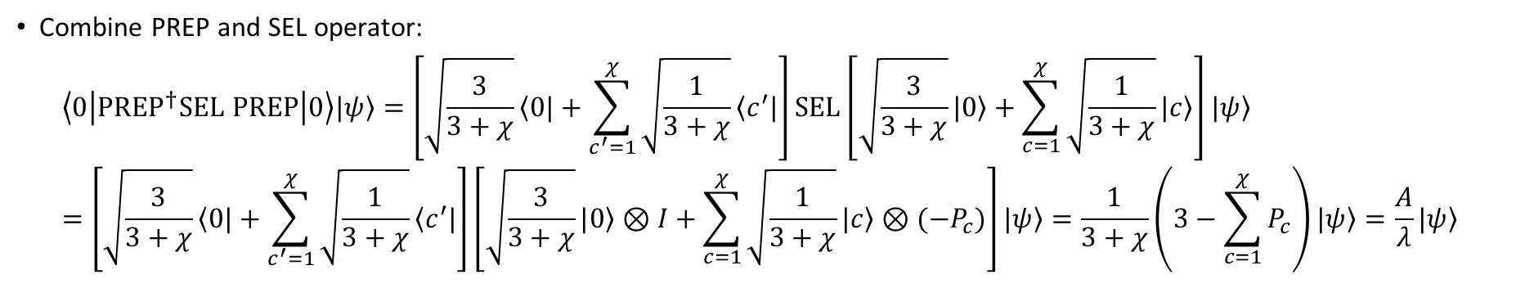
Block encoding with LCU
Combine PREP and SEL operator:
$$\left\langle 0 | {PREP}^{†}SEL PREP | 0\right\rangle \left.|ψ\right\rangle =\left[\sqrt{\frac{3}{3+χ}}\left\langle 0|\right.+\sum_{c^{′}=1}^{χ}{\sqrt{\frac{1}{3+χ}}\left\langle c^{′}|\right.}\right]SEL\left[\sqrt{\frac{3}{3+χ}}\left.|0\right\rangle +\sum_{c=1}^{χ}{\sqrt{\frac{1}{3+χ}}\left.|c\right\rangle }\right]\left.|ψ\right\rangle =\left[\sqrt{\frac{3}{3+χ}}\left\langle 0|\right.+\sum_{c^{′}=1}^{χ}{\sqrt{\frac{1}{3+χ}}\left\langle c^{′}|\right.}\right]\left[\sqrt{\frac{3}{3+χ}}\left.|0\right\rangle ⊗I+\sum_{c=1}^{χ}{\sqrt{\frac{1}{3+χ}}\left.|c\right\rangle }⊗(−P_{c})\right]\left.|ψ\right\rangle =\frac{1}{3+χ}\left(3−\sum_{c=1}^{χ}{P_{c}}\right)\left.|ψ\right\rangle =\frac{A}{λ}\left.|ψ\right\rangle$$

Slide 10
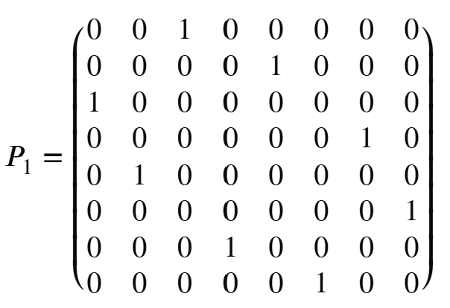
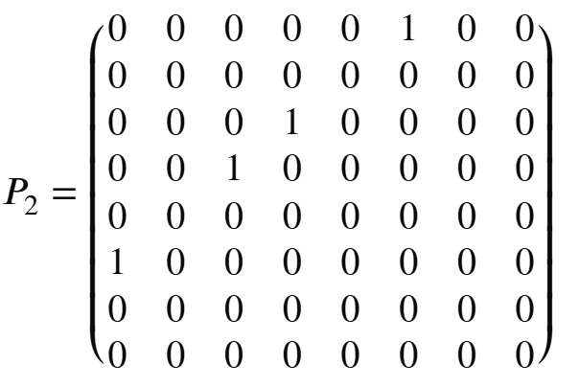
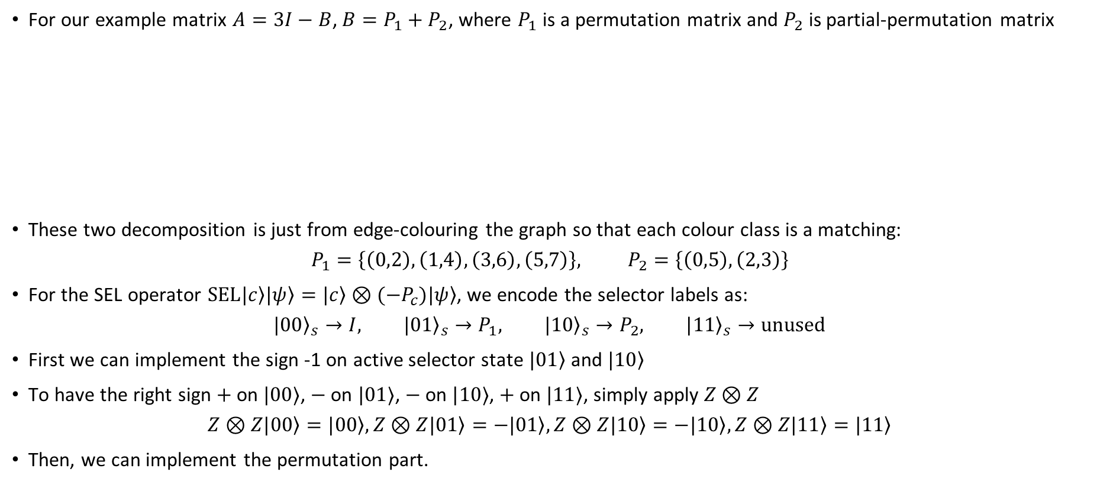
Block encoding with LCU
For our example matrix $A=3I−B$, $B=P_{1}+P_{2}$, where $P_{1}$ is a permutation matrix and $P_{2}$ is partial-permutation matrix
These two decomposition is just from edge-colouring the graph so that each colour class is a matching:
$$P_{1}=\left\{\left(0,2\right),\left(1,4\right),\left(3,6\right),\left(5,7\right)\right\}, P_{2}=\left\{\left(0,5\right),\left(2,3\right)\right\}$$
For the SEL operator $SEL\left.|c\right\rangle \left.|ψ\right\rangle =\left.|c\right\rangle ⊗(−P_{c})\left.|ψ\right\rangle$, we encode the selector labels as:
$${\left.|00\right\rangle }_{s}→I, {\left.|01\right\rangle }_{s}→P_{1}, {\left.|10\right\rangle }_{s}→P_{2}, {\left.|11\right\rangle }_{s}→unused$$
First we can implement the sign -1 on active selector state $\left.|01\right\rangle$ and $\left.|10\right\rangle$
To have the right sign $+$ on $|00⟩$, $−$ on $|01⟩$, $−$ on $|10⟩$, $+$ on $|11⟩$, simply apply $Z⊗Z$
$$Z⊗Z\left.|00\right\rangle =\left.|00\right\rangle ,Z⊗Z\left.|01\right\rangle =−\left.|01\right\rangle ,Z⊗Z\left.|10\right\rangle =−\left.|10\right\rangle ,Z⊗Z\left.|11\right\rangle =\left.|11\right\rangle$$
Then, we can implement the permutation part.

Slide 11
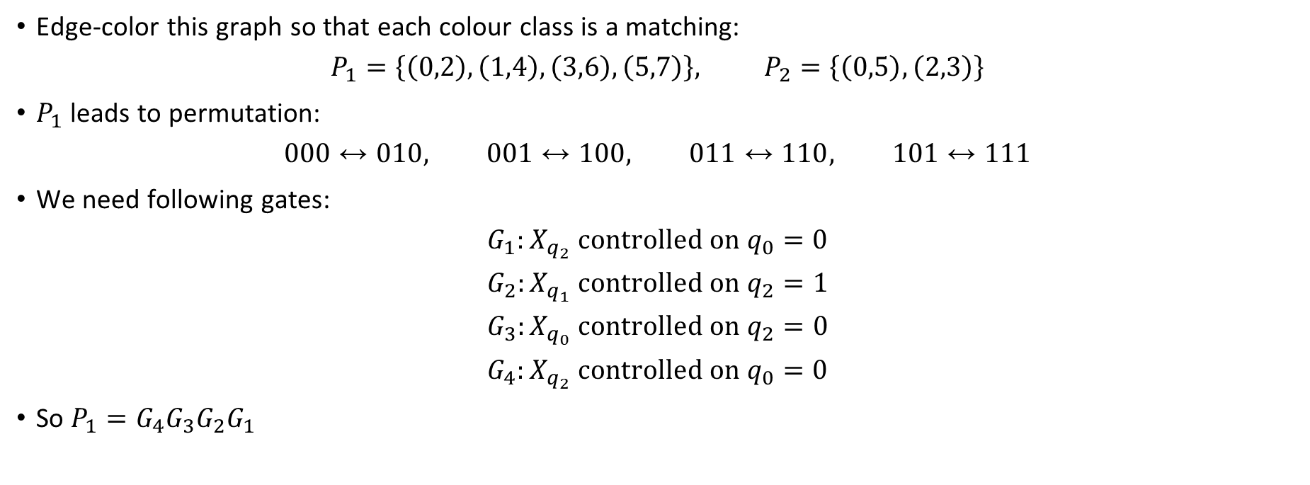
Block encoding with LCU
Edge-color this graph so that each colour class is a matching:
$$P_{1}=\left\{\left(0,2\right),\left(1,4\right),\left(3,6\right),\left(5,7\right)\right\}, P_{2}=\left\{\left(0,5\right),\left(2,3\right)\right\}$$
$P_{1}$ leads to permutation:
$$000↔010, 001↔100, 011↔110, 101↔111$$
We need following gates:
$$G_{1}:X_{q_{2}} controlled on q_{0}=0$$
$$G_{2}:X_{q_{1}} controlled on q_{2}=1$$
$$G_{3}:X_{q_{0}} controlled on q_{2}=0$$
$$G_{4}:X_{q_{2}} controlled on q_{0}=0$$
So $P_{1}=G_{4}G_{3}G_{2}G_{1}$

Slide 12
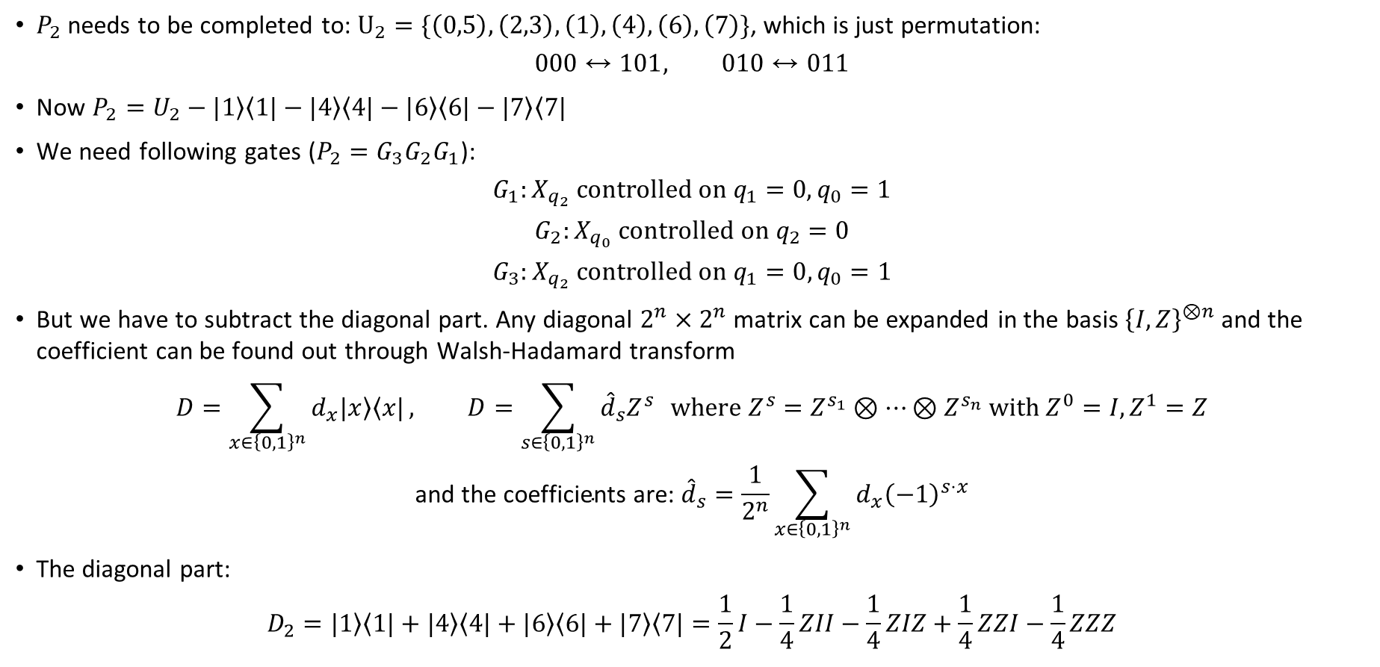
Block encoding with LCU
$P_{2}$ needs to be completed to: $U_{2}=\{\left(0,5\right),\left(2,3\right),\left(1\right),\left(4\right),\left(6\right),\left(7\right)\}$, which is just permutation:
$$000↔101, 010↔011$$
Now $P_{2}=U_{2}−\left.|1\right\rangle \left\langle 1|\right.−\left.|4\right\rangle \left\langle 4|\right.−\left.|6\right\rangle \left\langle 6|\right.−\left.|7\right\rangle \left\langle 7|\right.$
We need following gates ($P_{2}=G_{3}G_{2}G_{1}$):
$$G_{1}:X_{q_{2}} controlled on q_{1}=0, q_{0}=1$$
$$G_{2}:X_{q_{0}} controlled on q_{2}=0$$
$$G_{3}:X_{q_{2}} controlled on q_{1}=0, q_{0}=1$$
But we have to subtract the diagonal part. Any diagonal $2^{n}×2^{n}$ matrix can be expanded in the basis ${\left\{I,Z\right\}}^{⊗n}$ and the coefficient can be found out through Walsh-Hadamard transform
$$D=\sum_{x∈{\left\{0,1\right\}}^{n}}{d_{x}\left.|x\right\rangle \left\langle x|\right.}, D=\sum_{s∈{\left\{0,1\right\}}^{n}}{{\hat{d}}_{s}Z^{s}} where Z^{s}=Z^{s_{1}}⊗…⊗Z^{s_{n}} with Z^{0}=I, Z^{1}=Z$$
$$\text{and} \text{the} \text{coefficients} \text{are}\text{: }{\hat{d}}_{s}=\frac{1}{2^{n}}\sum_{x∈{\left\{0,1\right\}}^{n}}{d_{x}{\left(−1\right)}^{s⋅x}}$$
The diagonal part:
$$D_{2}=\left.|1\right\rangle \left\langle 1|\right.+\left.|4\right\rangle \left\langle 4|\right.+\left.|6\right\rangle \left\langle 6|\right.+\left.|7\right\rangle \left\langle 7|\right.=\frac{1}{2}I−\frac{1}{4}ZII−\frac{1}{4}ZIZ+\frac{1}{4}ZZI−\frac{1}{4}ZZZ$$

Slide 13


Block encoding with LCU
Note that now $A=\frac{7}{2}I−P_{1}−U_{2}−\frac{1}{4}ZII−\frac{1}{4}ZIZ+\frac{1}{4}ZZI−\frac{1}{4}ZZZ$
This means that we need 3 qubits for PREP and SEL.
$$PREP\left.|0\right\rangle =\sum_{k=0}^{N−1}{\sqrt{\frac{\left|α_{k}\right|}{λ}}\left.|k\right\rangle }, λ=\sum_{k}{\left|α_{k}\right|}=3.5+1+1+\frac{1}{4}+\frac{1}{4}+\frac{1}{4}+\frac{1}{4}=6.5≤(3+C+\# of correction terms)\max\left(α_{k}\right)$$
The success probability:
$$p_{LCU}=\frac{{\left\|A_{phys}\left.|ψ\right\rangle \right\|}^{2}}{λ^{2}}, comparing to p_{FABLE}=\frac{{\left\|A_{phys}\left.|ψ\right\rangle \right\|}^{2}}{{\left(3N\right)}^{2}}$$
Note that $N$ is not necessarily all used, depending on decomposition
lambda_LCU for 64x64 matrix = 11.625

Slide 14
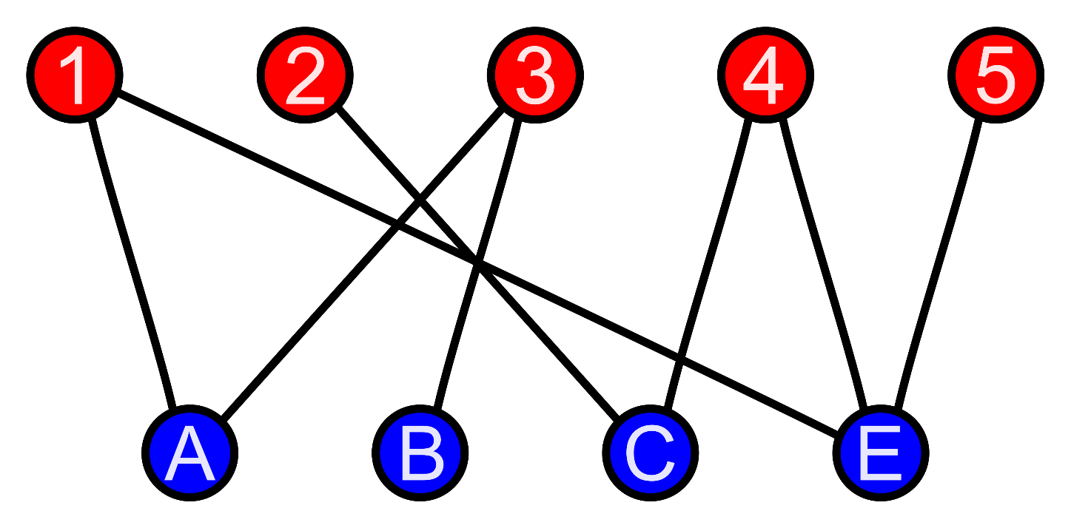

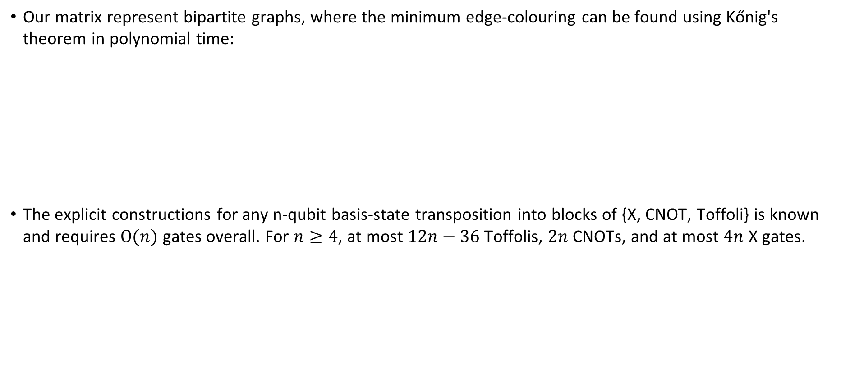
Block encoding of general sparse Hermitian matrix
Our matrix represent bipartite graphs, where the minimum edge-colouring can be found using Kőnig's theorem in polynomial time:
The explicit constructions for any n-qubit basis-state transposition into blocks of {X, CNOT, Toffoli} is known and requires $O(n)$ gates overall. For $n≥4$, at most $12n−36$Toffolis, $2n$ CNOTs, and at most $4n$ X gates.
https://arxiv.org/pdf/2309.12820

