Slide 1
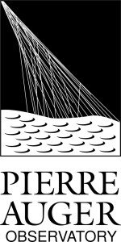
The Cosmic-Ray Group
The Pierre Auger Observatory
Kevin Almeida Cheminant

Slide 2
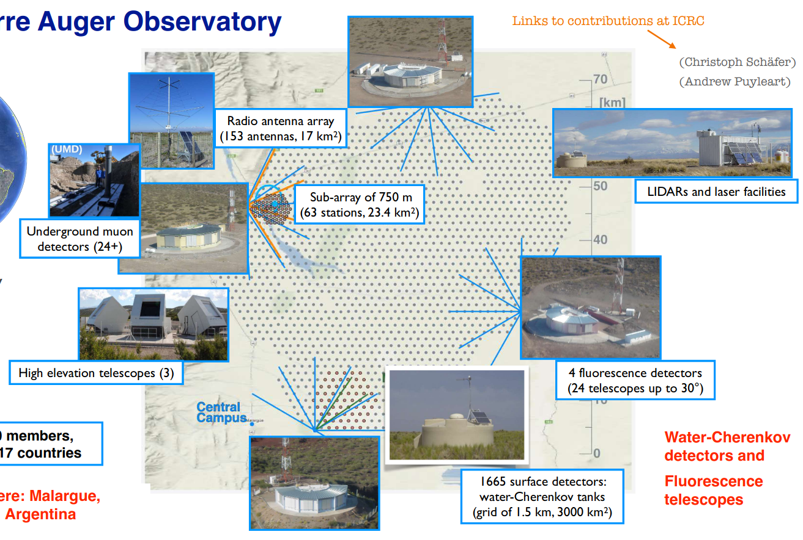
The Pierre Auger Observatory - Phase I
An hybrid UHECR experiment in the Argentinean pampa since 2004
17 countries – ~400 scientists and staff
AERA
Water-Cherenkov Surface Detectors
3 arrays – 1500 m, 750 m, 433 m.
Fluorescence Detectors (FD)
4+1 sites measuring the longitudinal
profile.
Underground Muon Detectors
direct measurement of muons
Radio antennas
measuring the electromagnetic
component.
LIDARS
monitoring the atmospheric conditions.

Slide 3
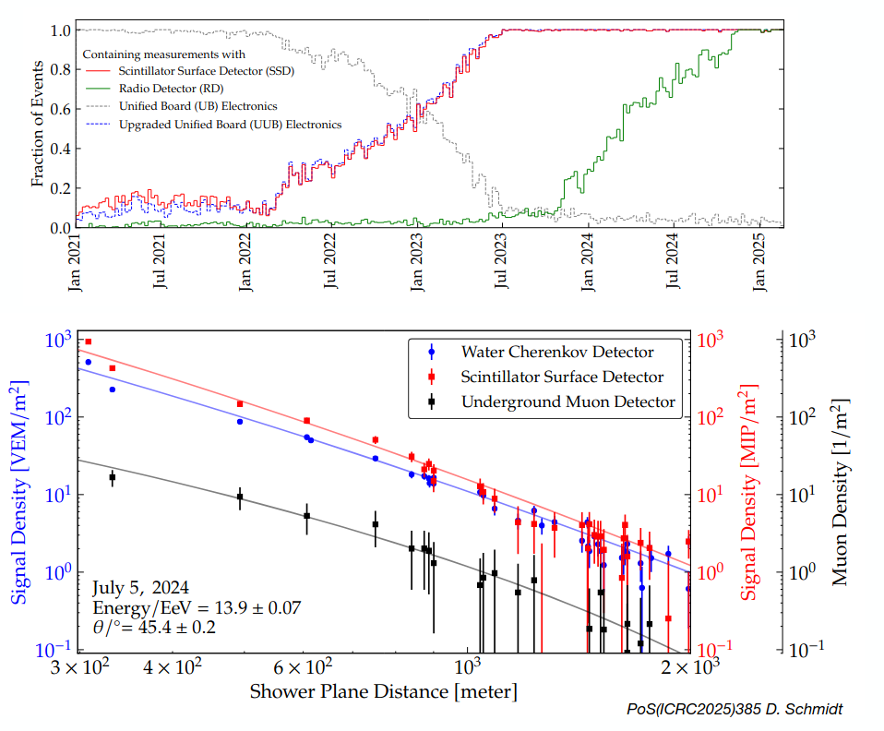
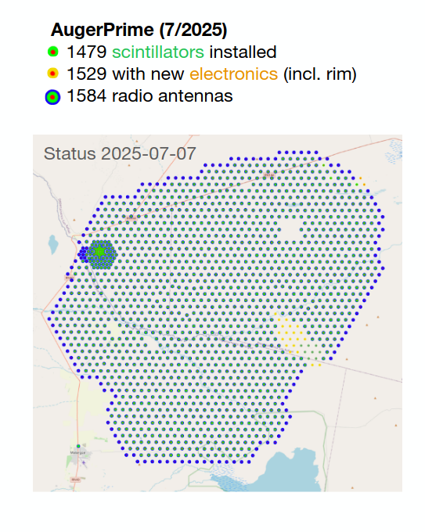
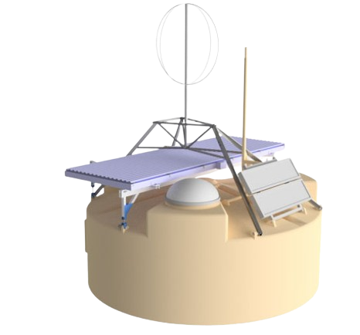
AugerPrime - Phase II

Slide 4

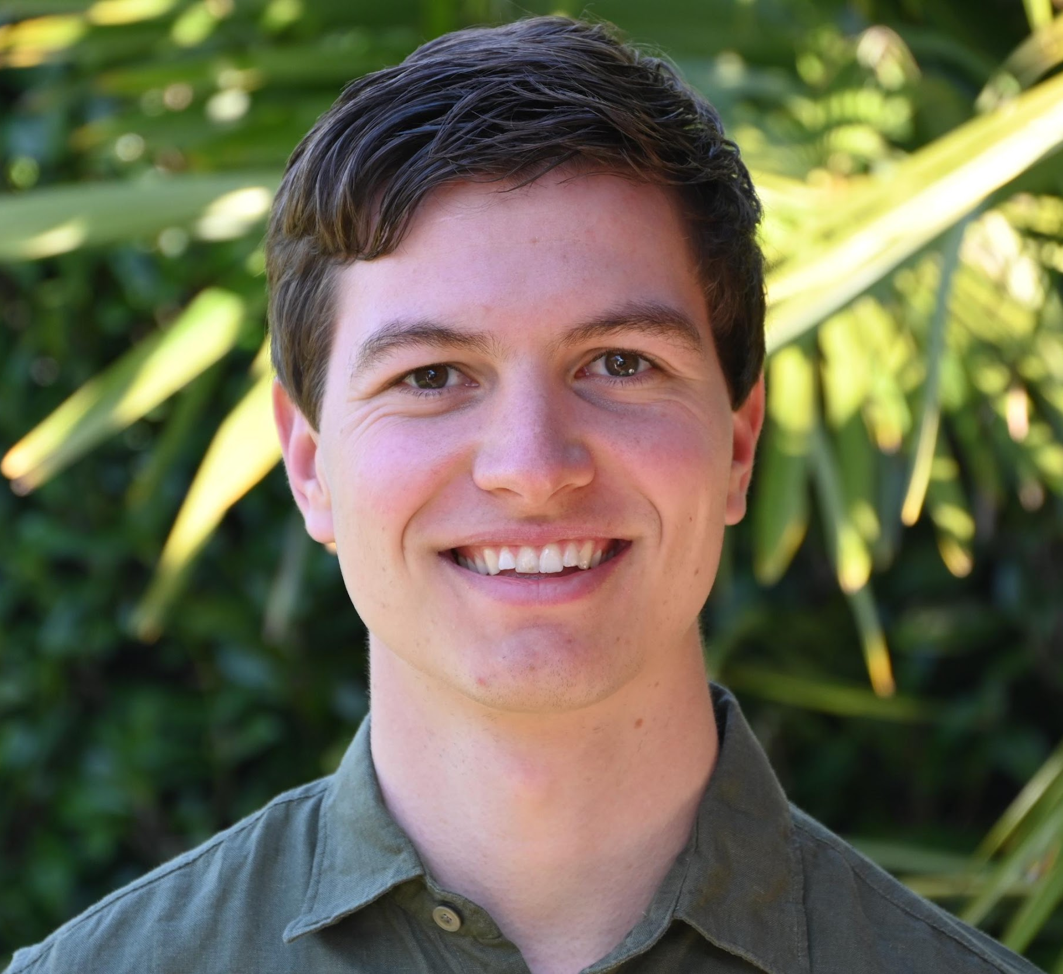

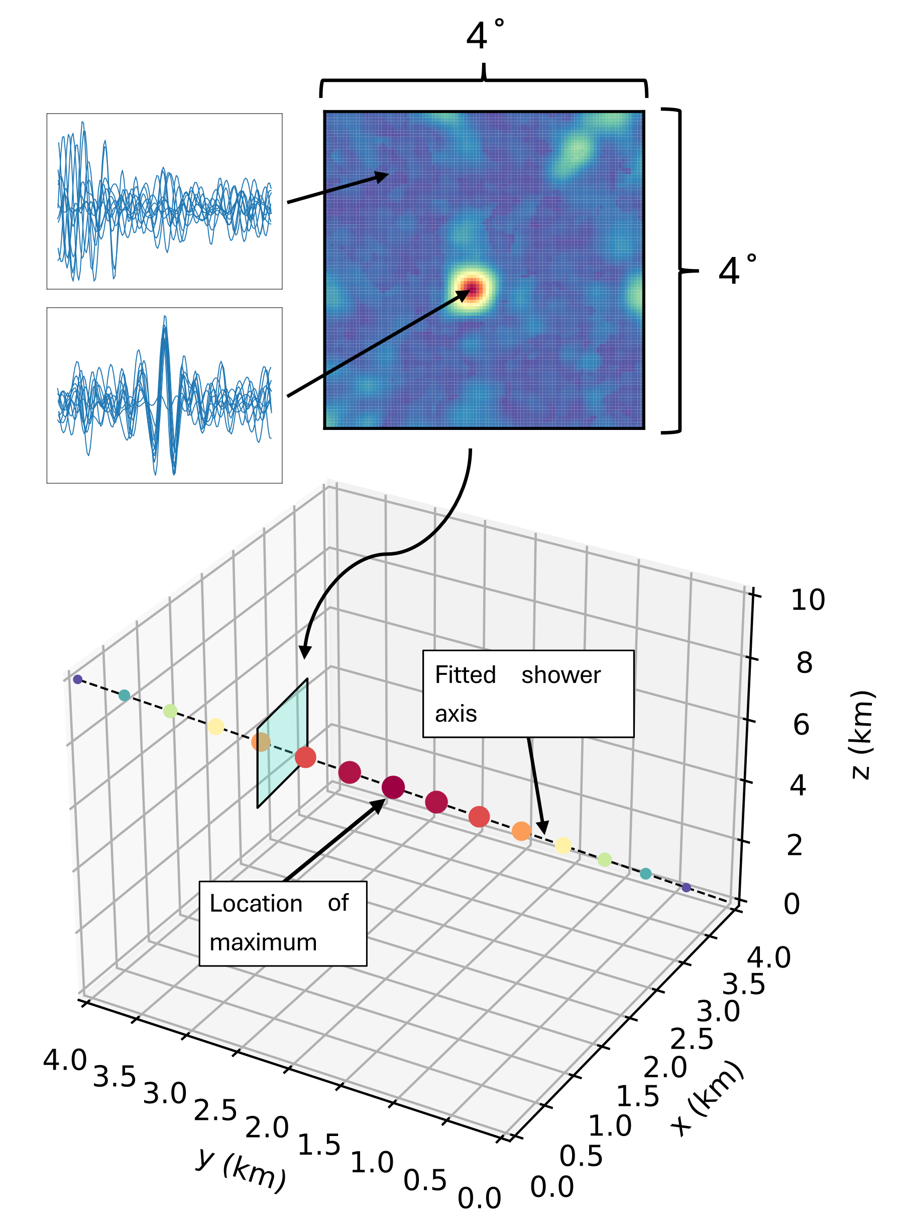
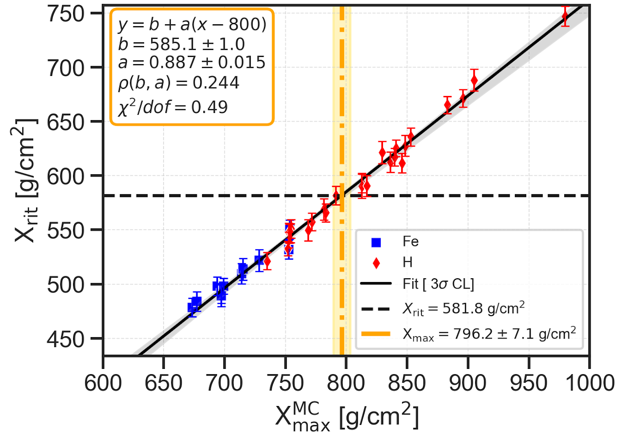
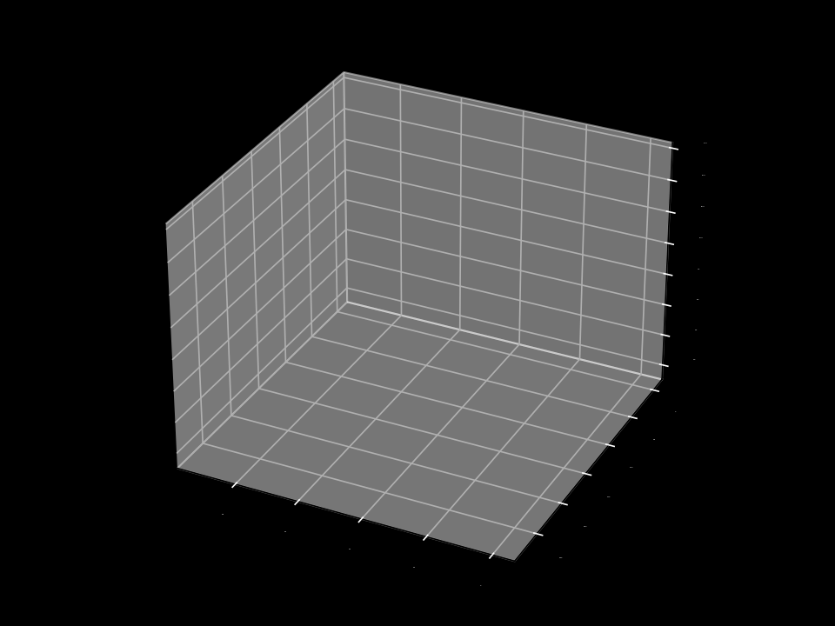
Interferometry
Harm Schoorlemmer, Pim Van Dillen, Juan Yebra-Ammerman
Combine all antennas by overlapping the waveforms of multiple antennas.
Full 3D mapping of the air shower’s emission region.
Reconstruction of the depth of maximum development X_{max} possible.
Composition studies.

Slide 5
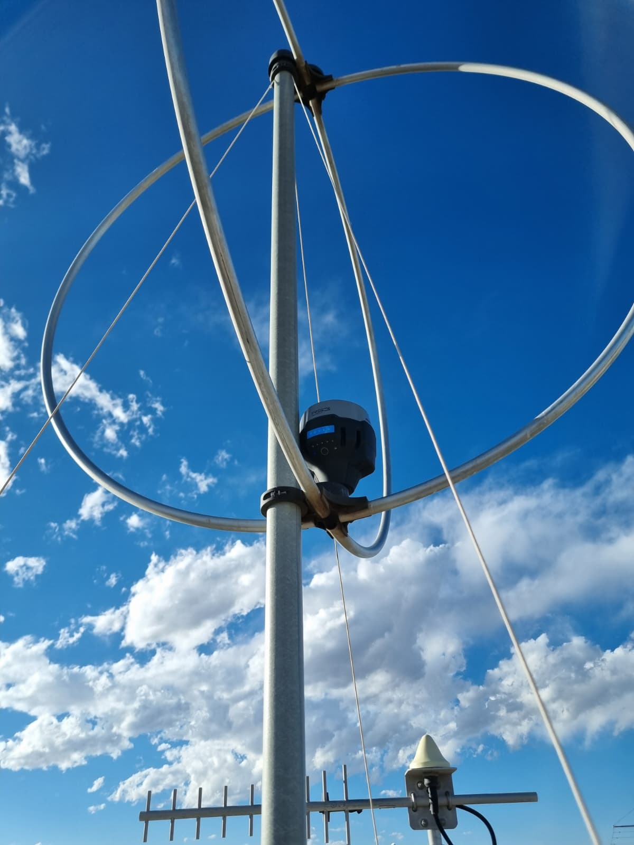
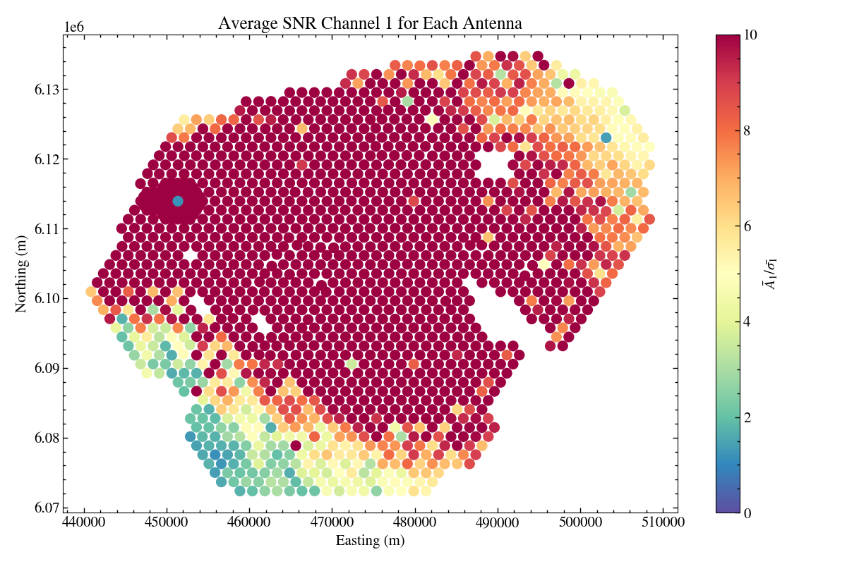
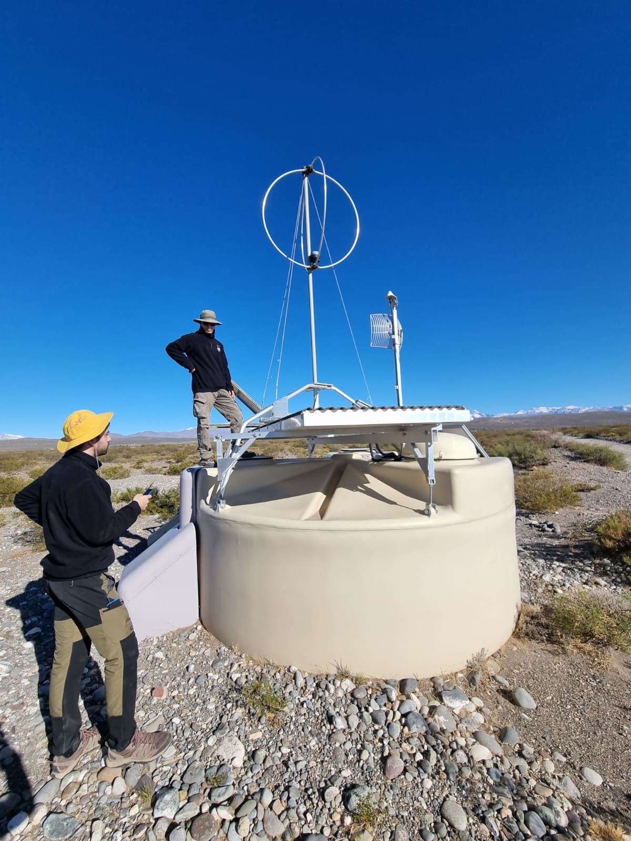
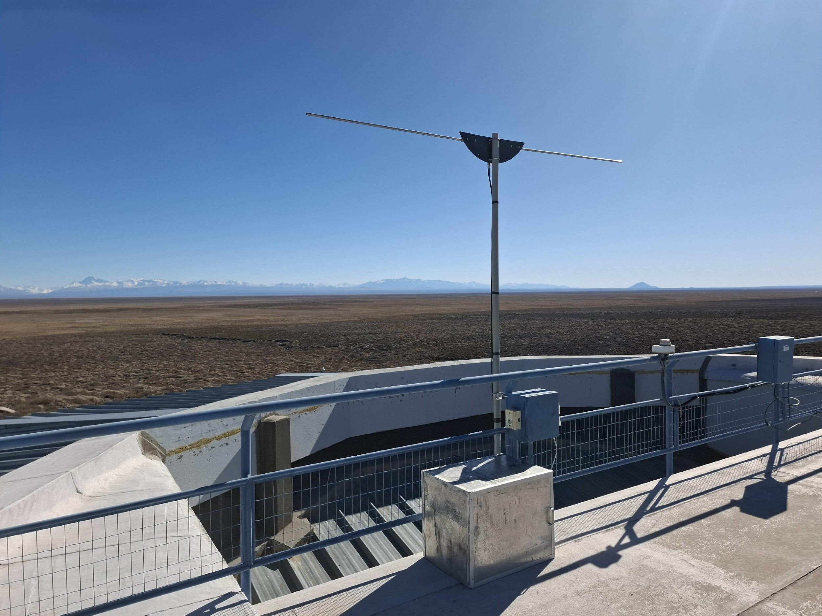
Interferometry
Harm Schoorlemmer, Pim Van Dillen, Juan Yebra-Ammerman
Very accurate timing of the signal needed over the full array (3000 km²)
Clock synchronisation < 1 ns: Beacons
Positional accuracy < 30 cm: Differential GPS survey

Slide 6
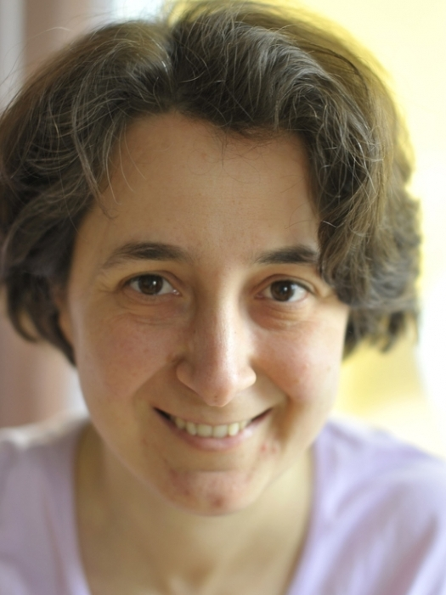

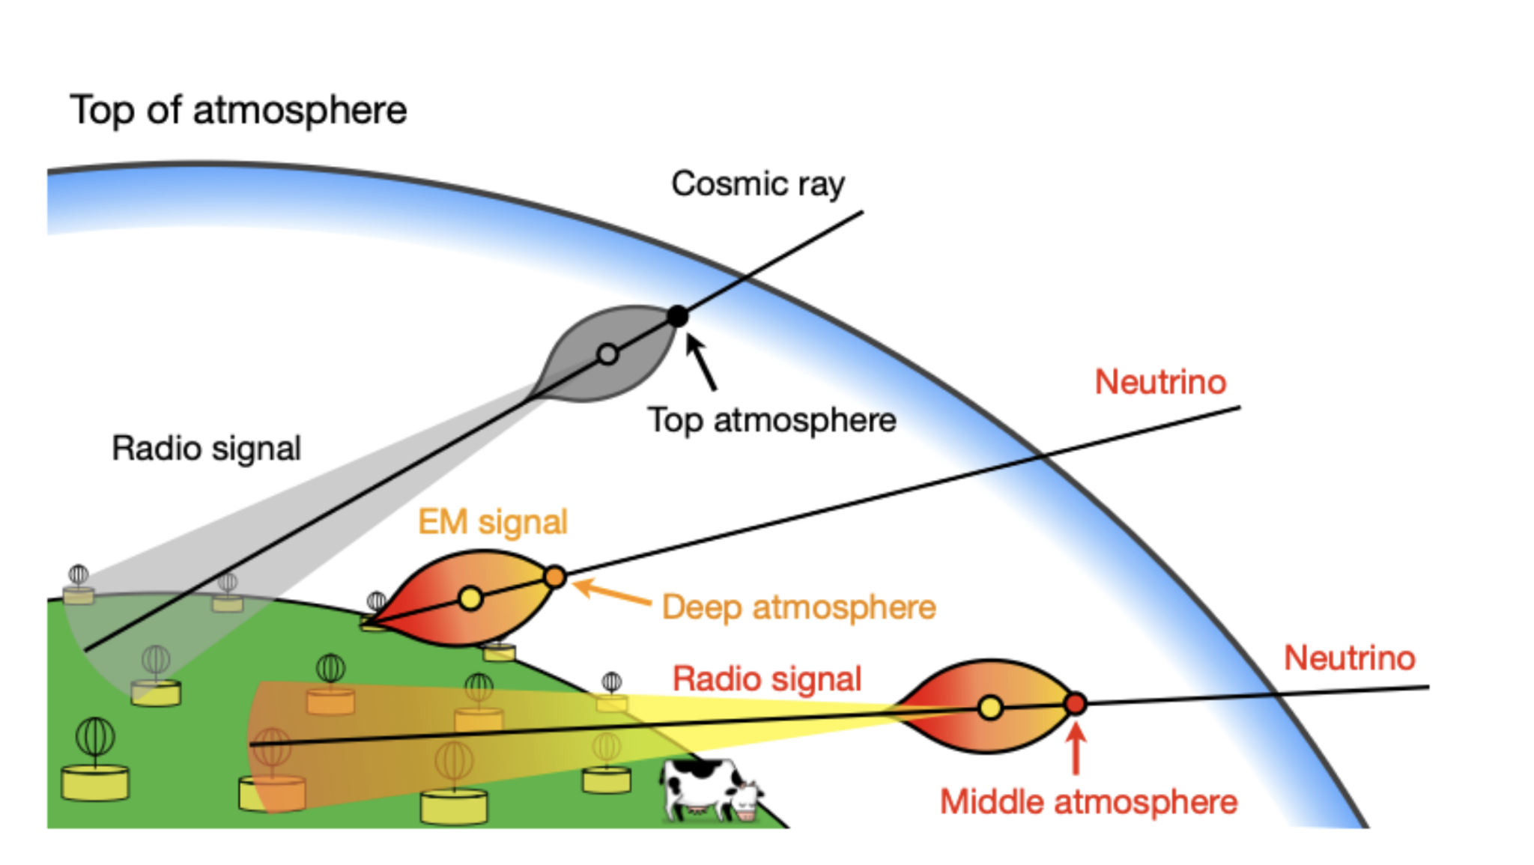
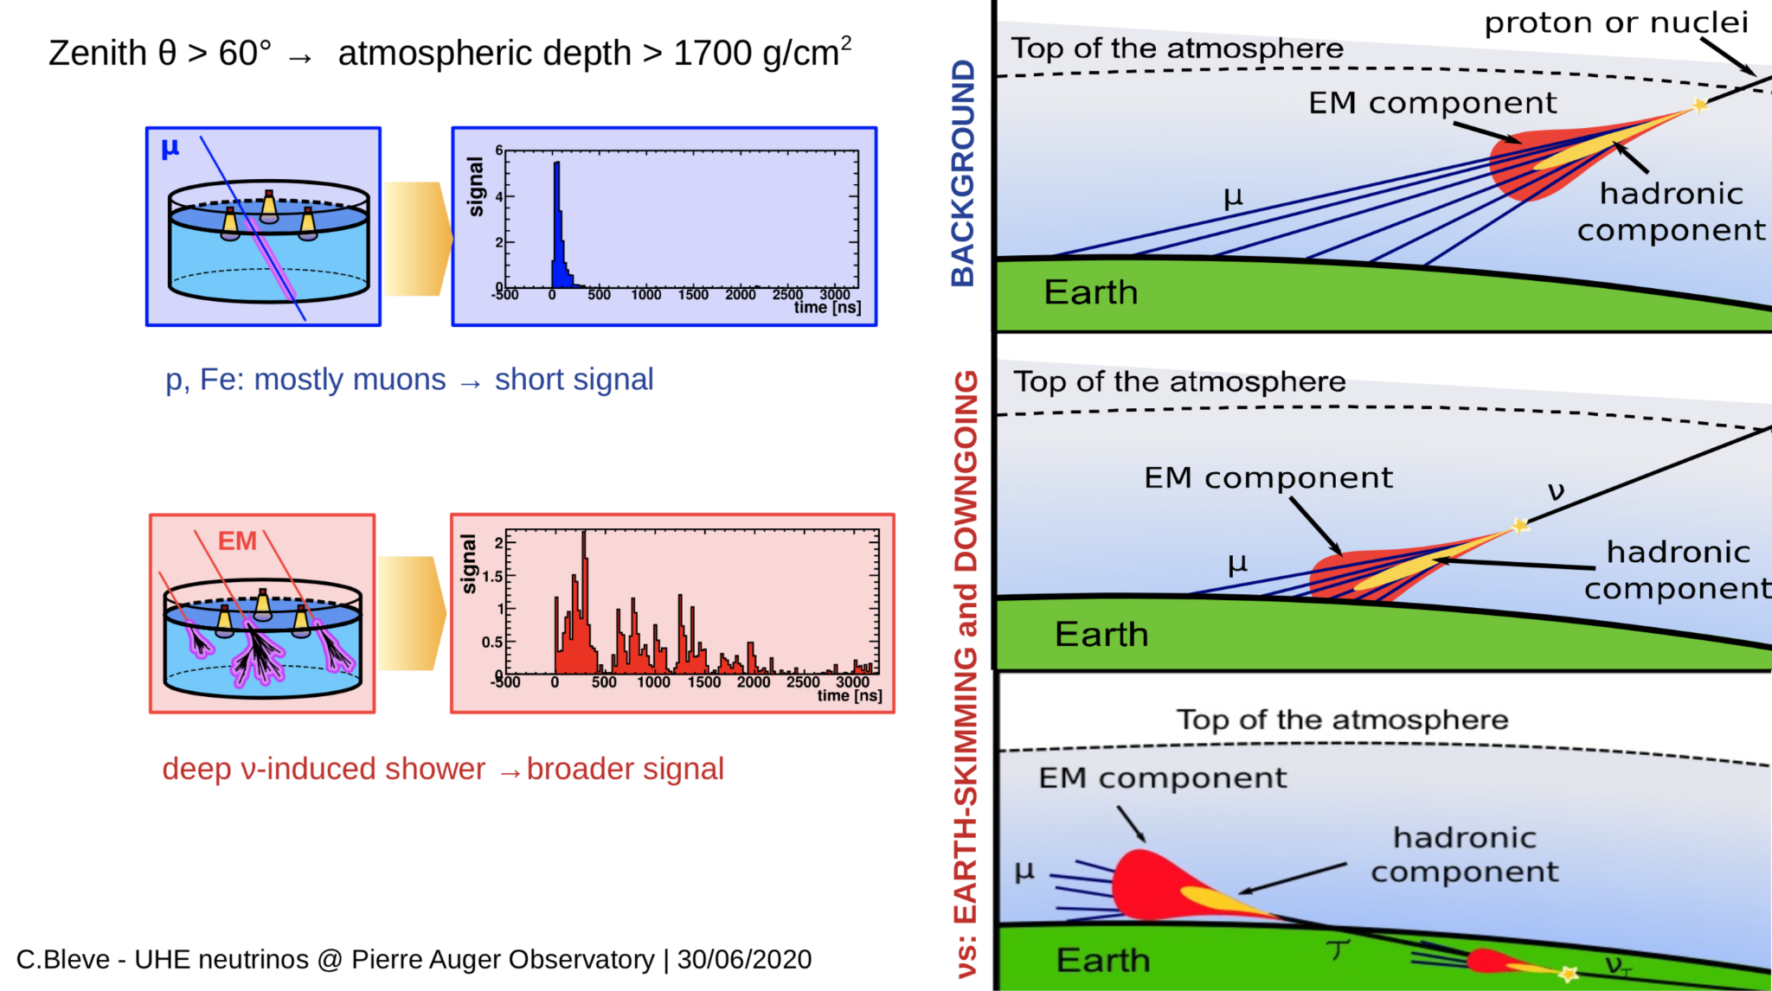
Radio-based trigger for UHE 𝜈
Cristina Galea, Harm Schoorlemmer, former PhD student Mohit Saharan
Neutrino = nearly horizontal shower with an EM component.

Slide 7
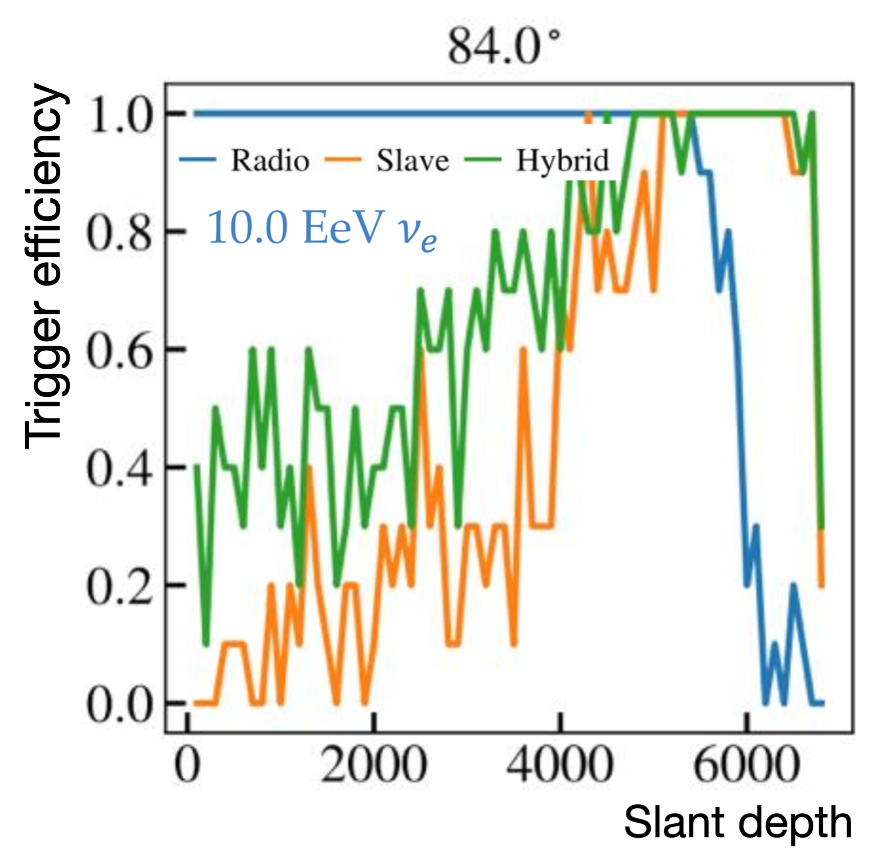
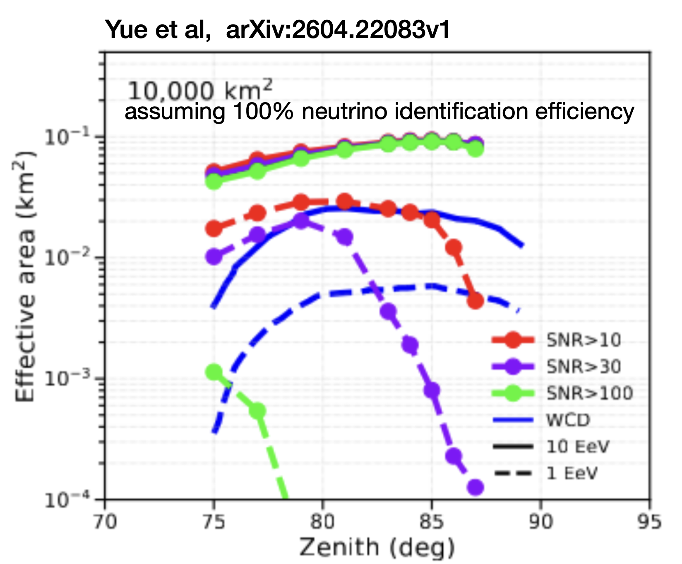
Radio-based trigger for UHE 𝜈
Cristina Galea, Harm Schoorlemmer, former PhD student Mohit Saharan
Developed and tested an RD-based trigger, complimentary to the WCD triggers, which significantly increases sensitivity to neutrinos and photons above 10¹⁸ eV.
Very challenging due to small DAQ communication bandwidth and local radio noise.
Tested on 4% of the stations, soon under test using the whole array.

Slide 8

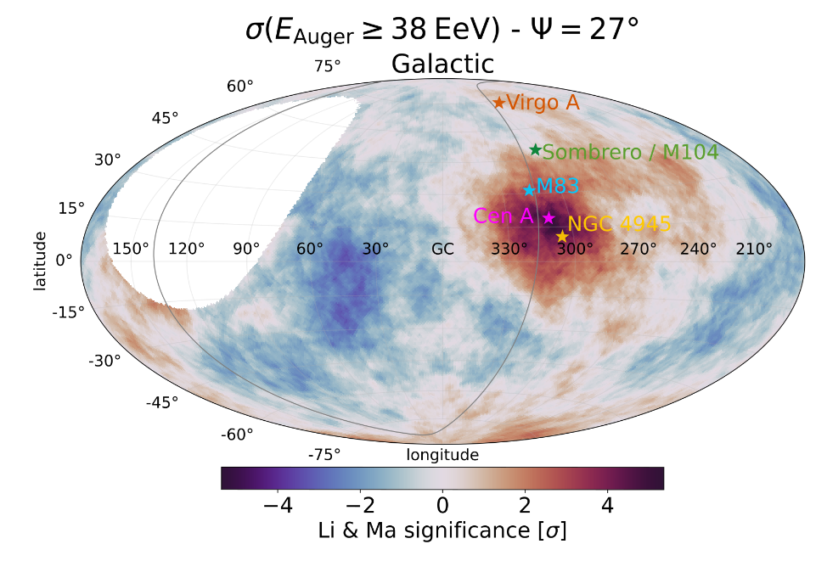
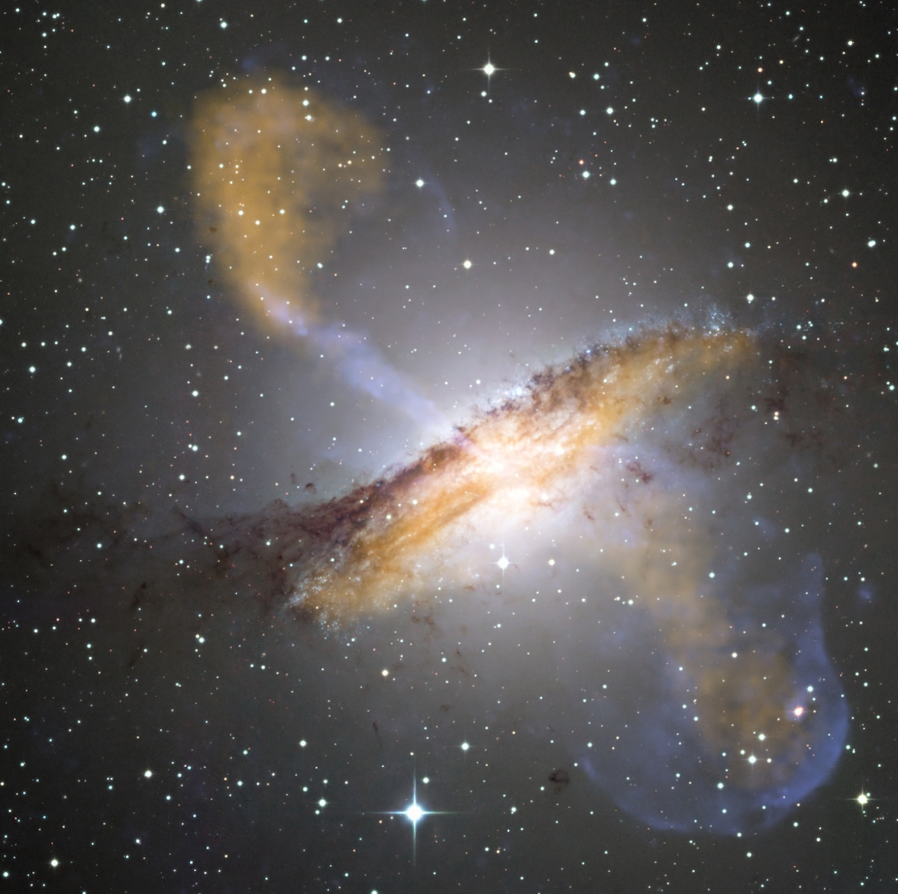
Sources of UHE cosmic rays
Teresa Bister
Which source could explain
the most prominent flux excess measured by the Pierre Auger Observatory?
T. Bister, Astroparticle Physics 175 (2026)
through simulations using new models of the Galactic magnetic field:
Centaurus A can reproduce excess properties very well for light mass composition (Z≲6) & strong local extragalactic magnetic field.
but: cannot currently differentiate between other source candidates and Cen A
→ AugerPrime necessary!

Slide 9
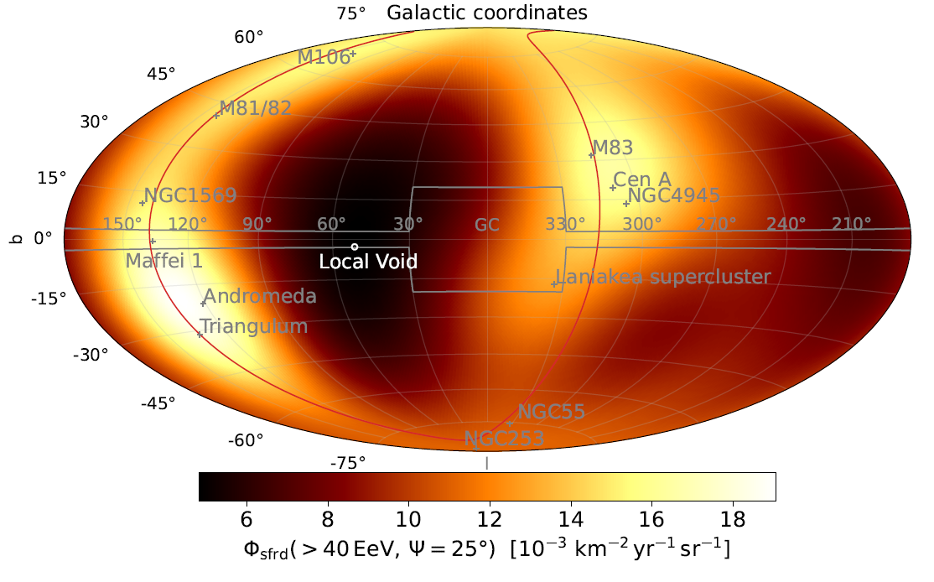
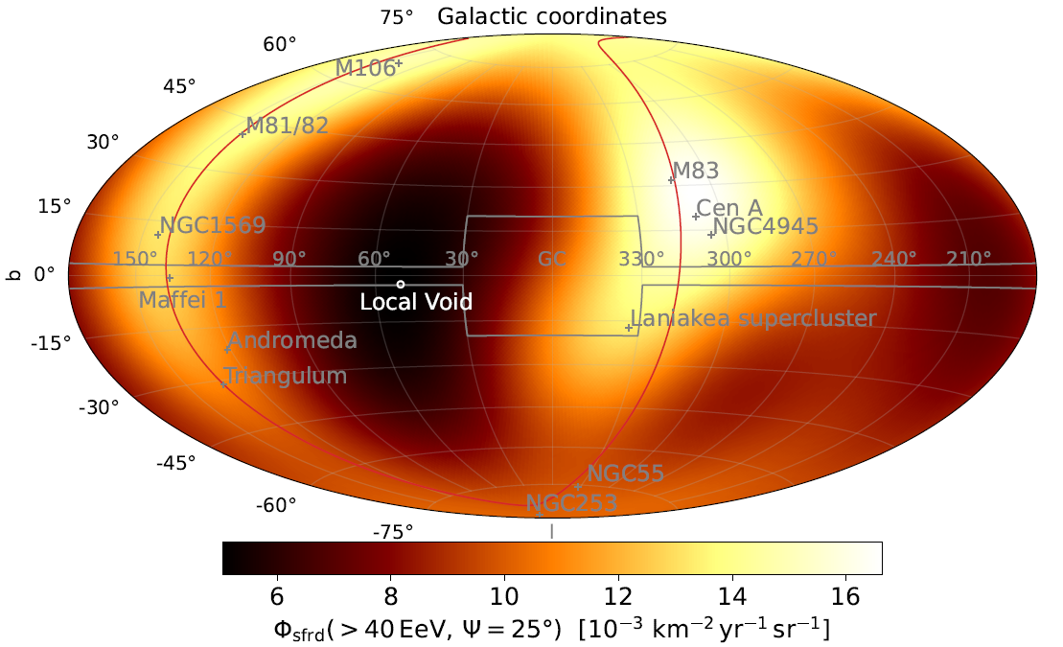
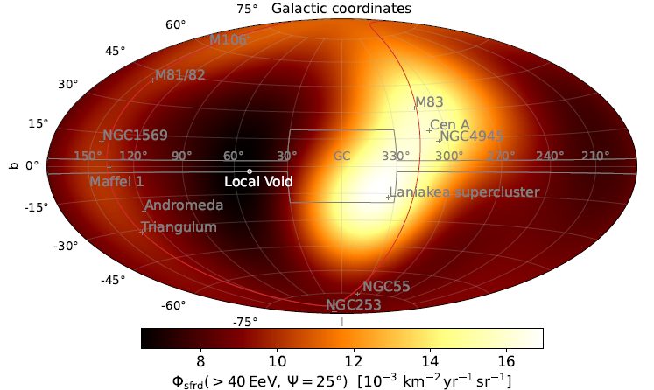
Sources of UHE cosmic rays
Teresa Bister
Coming soon with the Pierre Auger Collaboration:
Use whole data set in different energy bins to constrain the rate and type of transient sources compatible with Auger data.
large burst rate
(e.g. long gamma-ray bursts)
intermediate burst rate
(e.g. short gamma-ray bursts)
small burst rate
(e.g. jetted tidal disruption events)

Slide 10

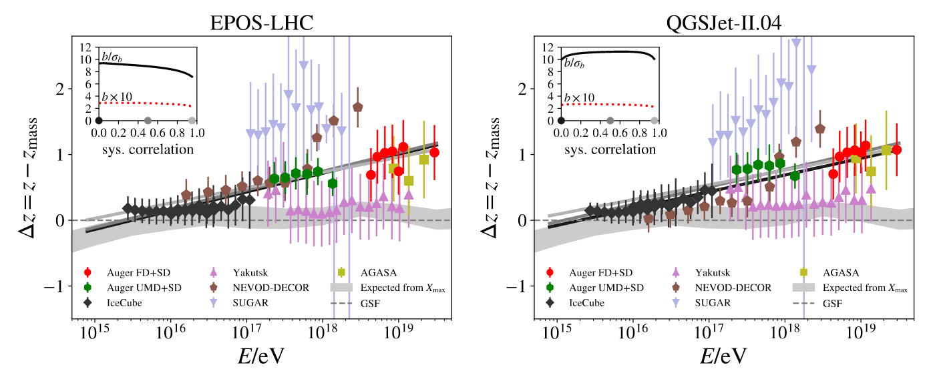
The Muon Puzzle
Kevin Almeida Cheminant
A muon excess is observed in the data of multiple experiments, compared to hadronic interaction models predictions!

Slide 11
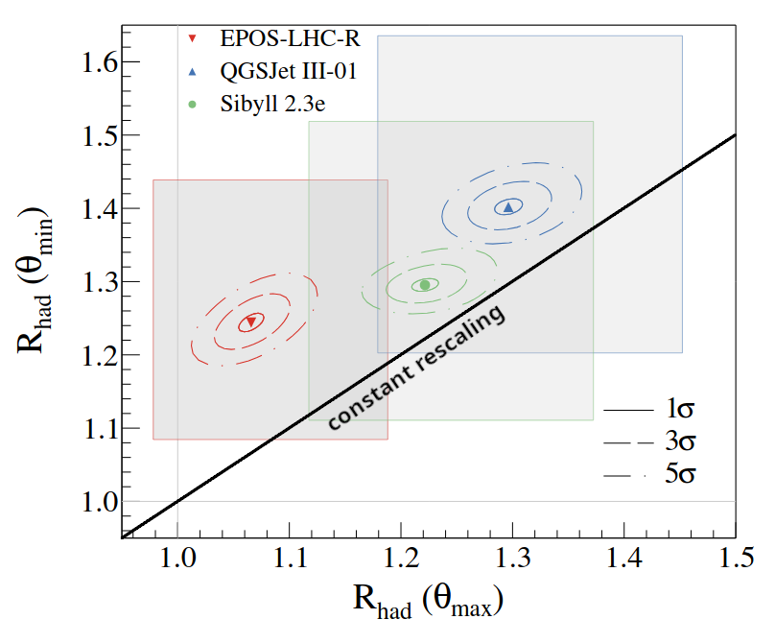
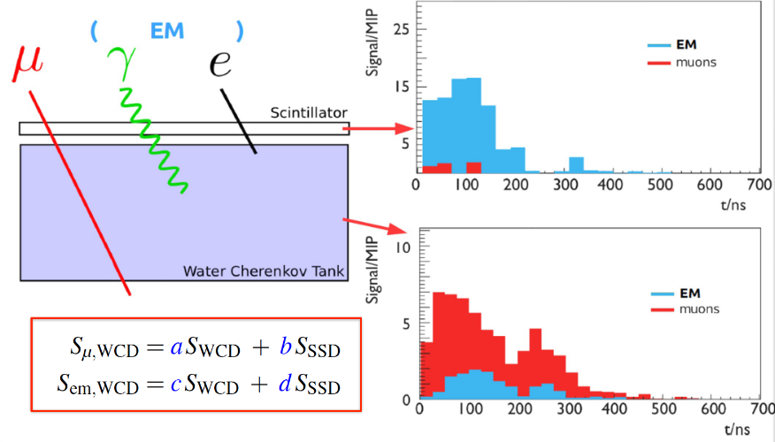
The Muon Puzzle
Kevin Almeida Cheminant
Phase I: the muon discrepancy is larger for vertical showers, even with the most recent hadronic interaction models…
The simulated muon energy spectrum is also too hard!
Phase II
PoS(ICRC2025)528

Slide 12
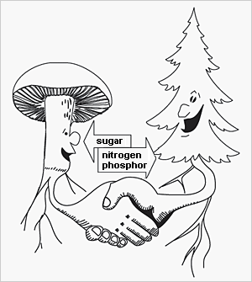
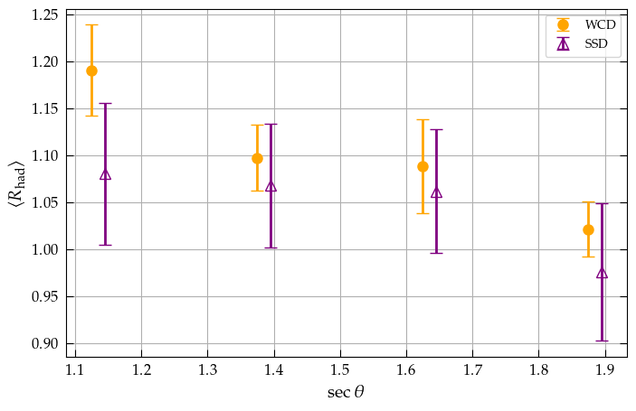
The Muon Puzzle
Kevin Almeida Cheminant
At 10 EeV, SSD data is compatible with a constant rescaling of the hadronic component → more data to come soon!
EPOS-LHCR
Auger
HIM
interpretation
data
PRELIMINARY

Slide 13
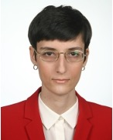

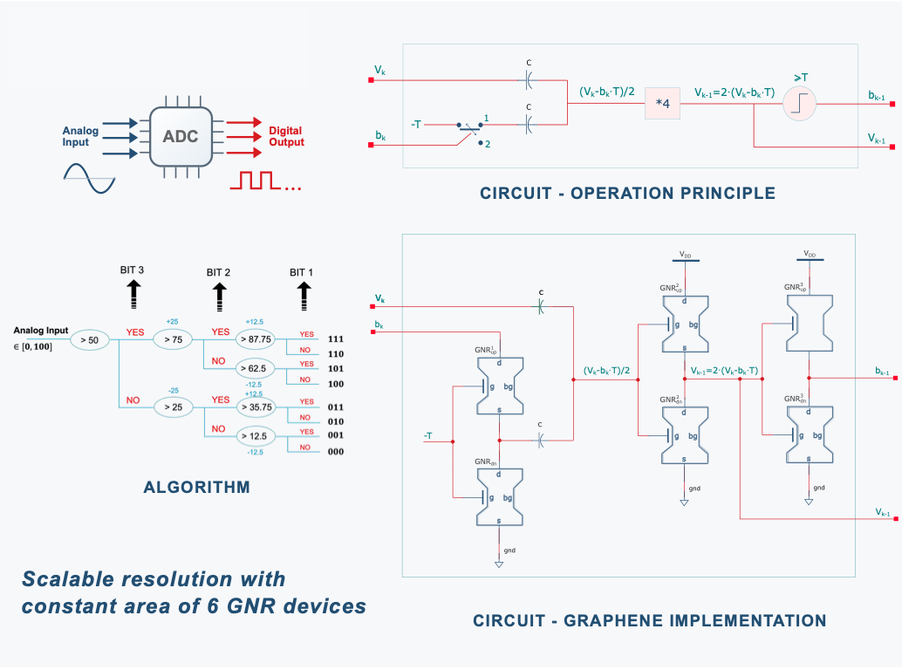
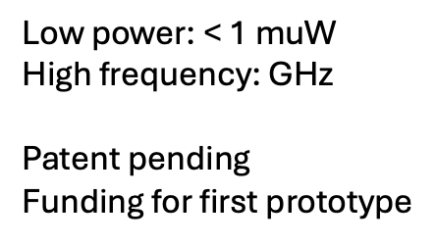
Hardware efforts - Graphene ADC
Nicoleta Cucu-Laurenciu, Charles Timmermans

Slide 14
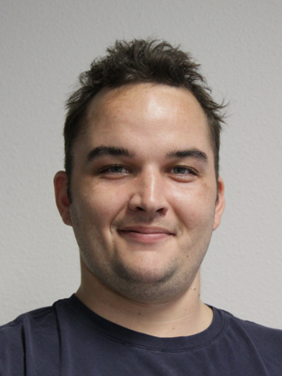



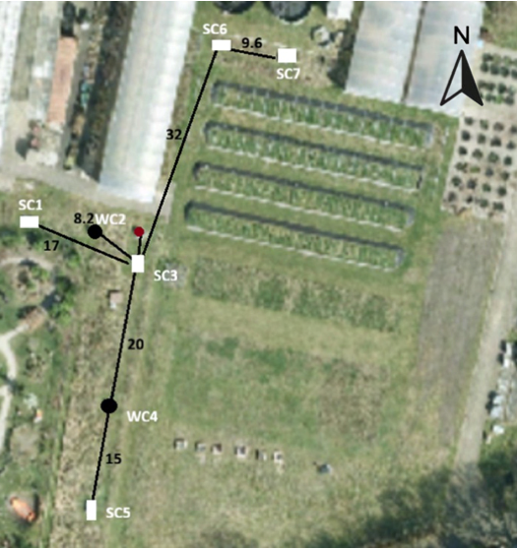
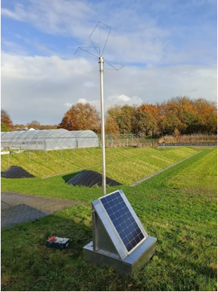
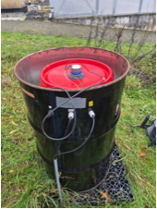
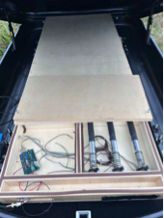
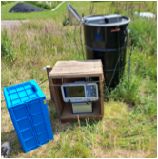
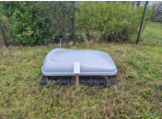
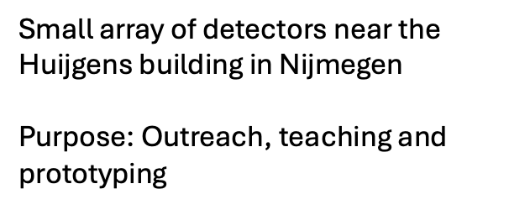
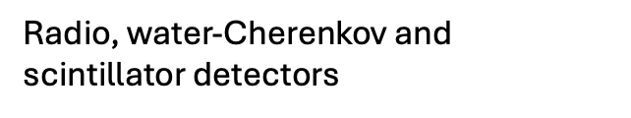
Hardware efforts - KORSTMOS
Rik van den Bosch, Marie-Nour Hartman,
Jochem van Rabenswaaij, Nicoleta Cucu Laurenciu, Charles Timmermans

Slide 15
Thank you!

