Slide 1

New sensor technologies for particle tracking
Tjip Bischoff on behalf of the Detector R&D group.

Slide 2
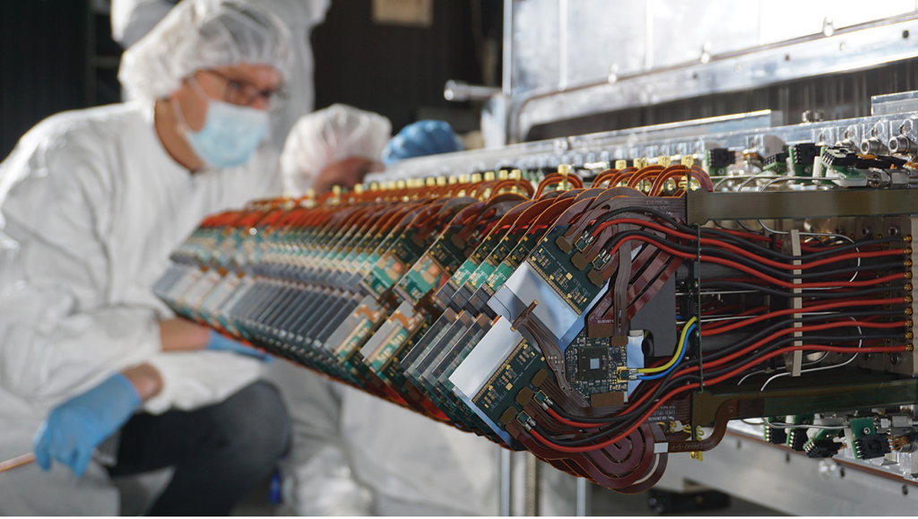
Readout
Sensor
Notes:
Explain that you detect the origin of the particle by tracing back it’s route, from multiple interactions

Slide 3
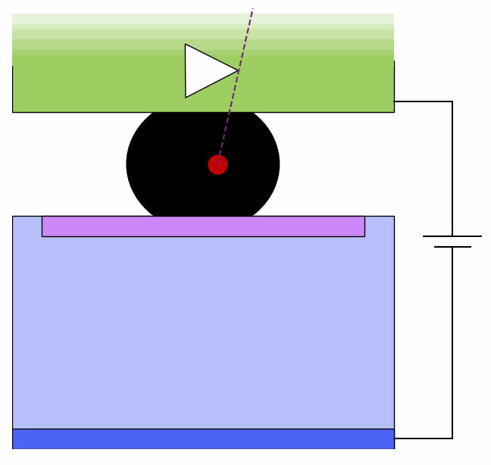


How does a silicon pixel sensor operate
Readout
A charged particle creates electron hole pairs
Electrons drift to one side, holes to the other
The movement of these charge carriers induces a signal on the readout electrode
Sensor
Electrons
Holes

Slide 4
Challenges for tracking sensors
Spatial resolution -> Where does a particle go through the sensor
Material budget -> How much scattering happens in the sensor
Timing resolution -> When did the particle go through the sensor
Radiation hardness -> How long can the sensor last
(More on this by Ginger)
The goal for the HL-LHC is 50x50x50 (50 microns thick, 50 micron pitch and 50 ps timing resolution)

Slide 5
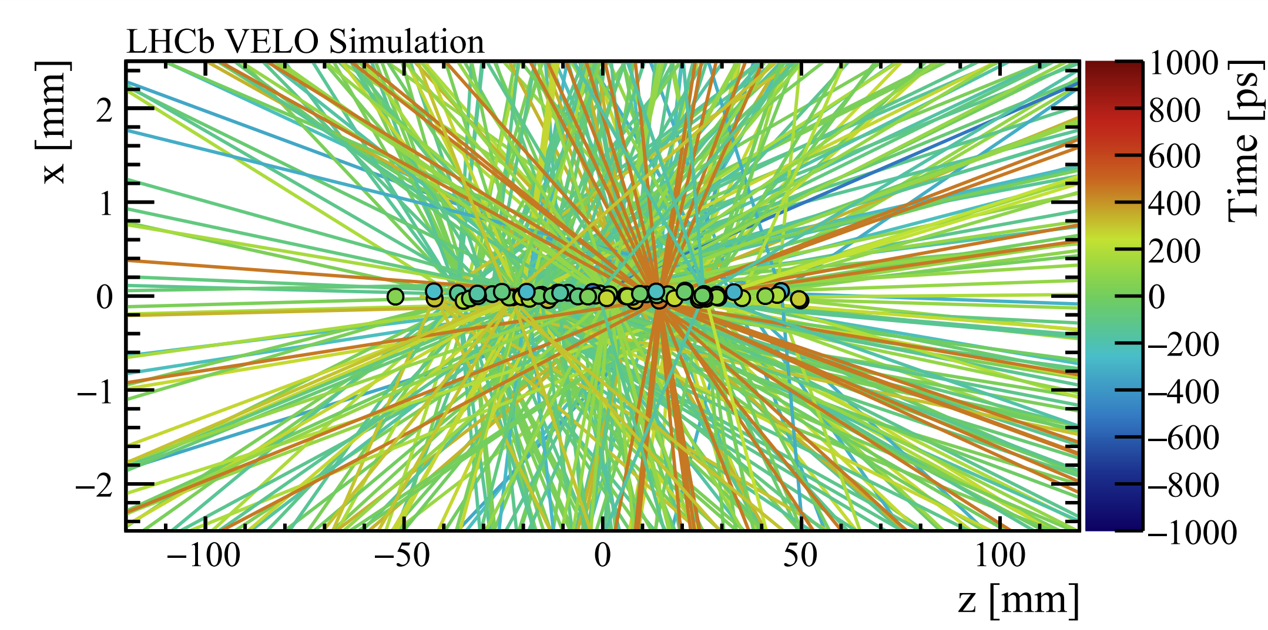
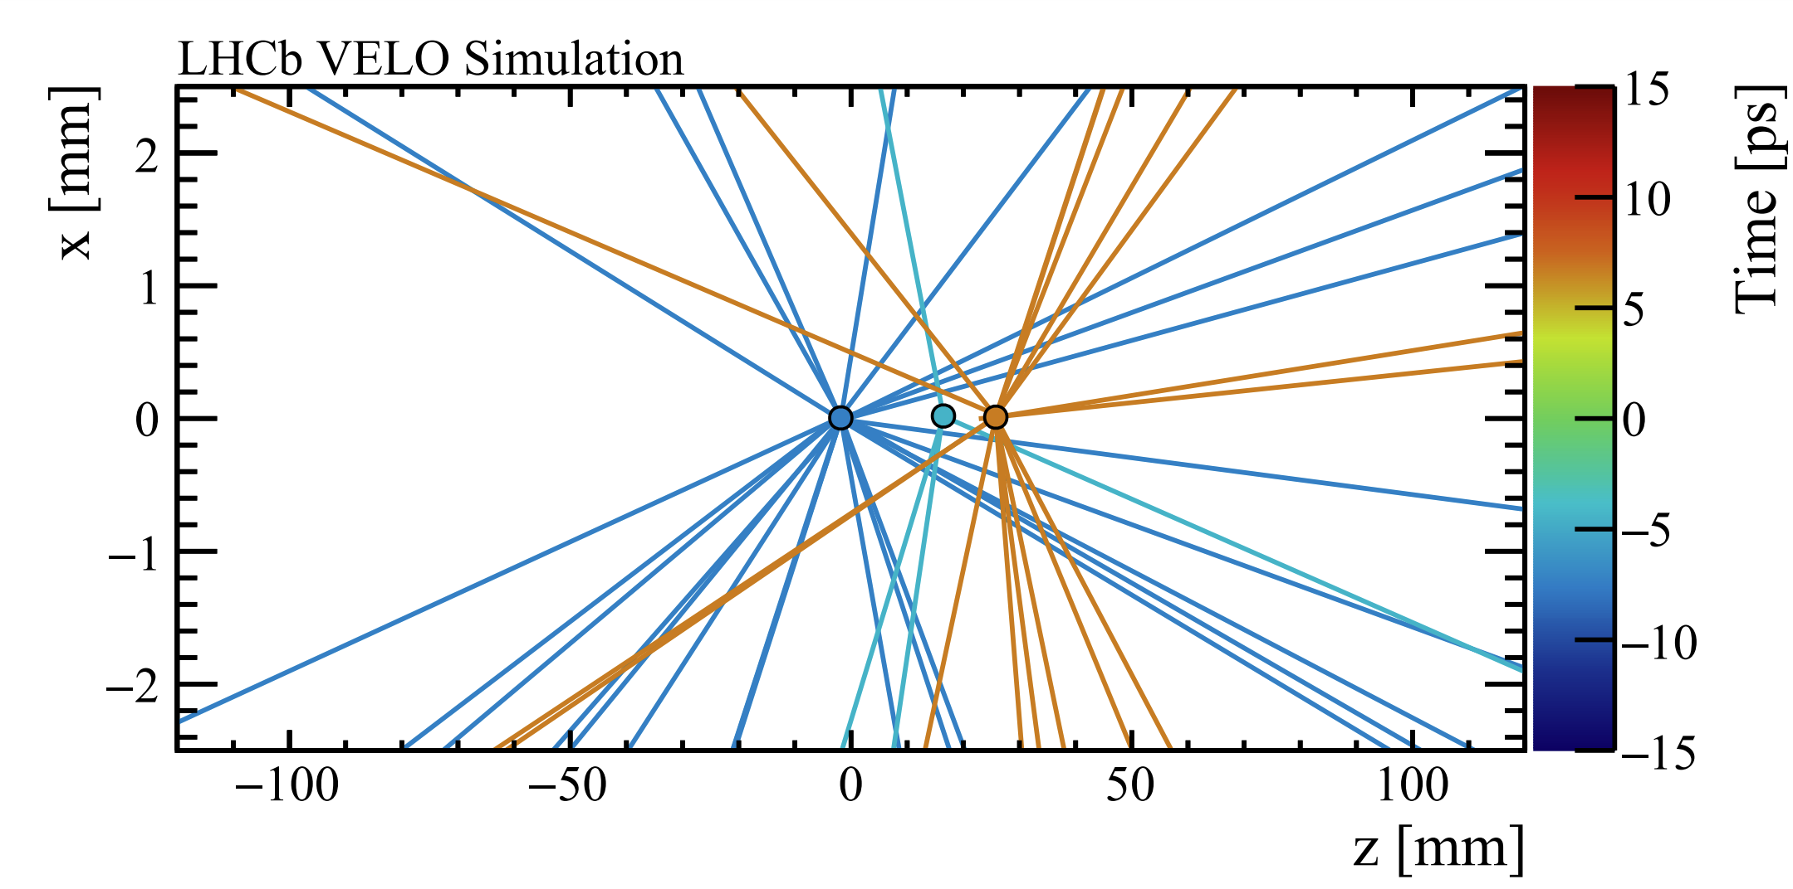
Why do we want timing information?
Enable 4D tracking
Precise spatial resolution
Precise timing information
Window: 2000 ps
Window: 30 ps

Slide 6
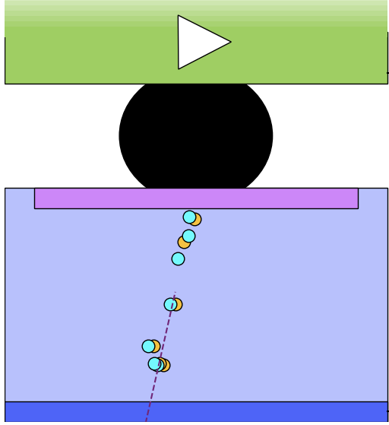
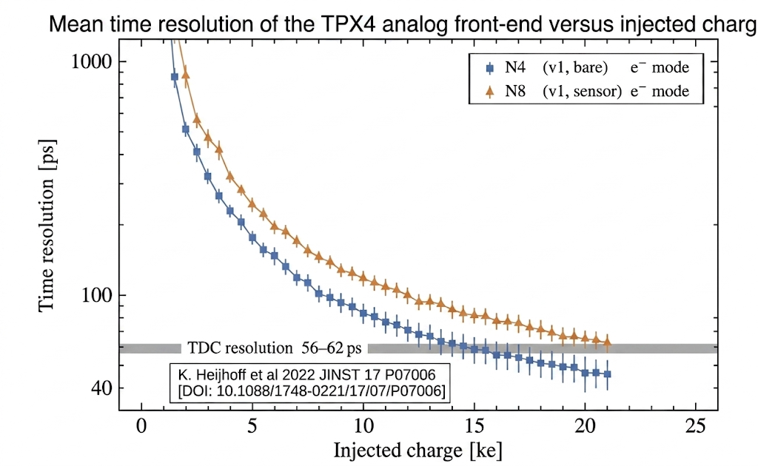
Timing performance
We want thin sensors, so we get a fast uniform signal
We want a large signal, since the front-end electronics will perfom better
Time resolution (ps)
Injected charge (ke)

Slide 7
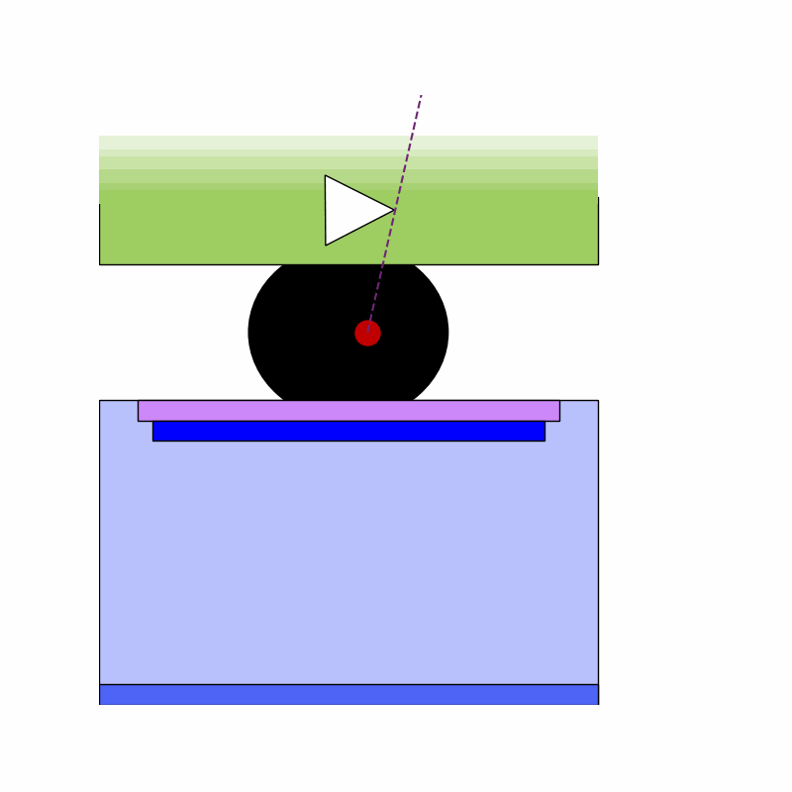
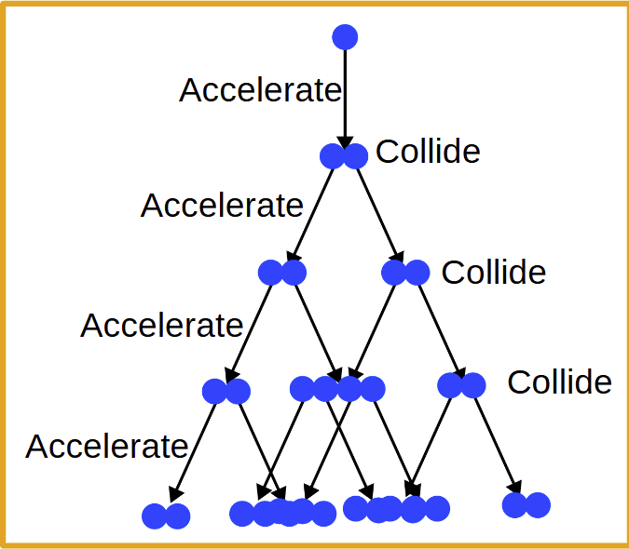
Gain mechanisms.
Allows us to combine a thin sensor with a large signal.
Need a region with a high electric field.
Electrons can kick loose other electrons when they have enough kinetic energy, which creates an avalanche effect.

Slide 8
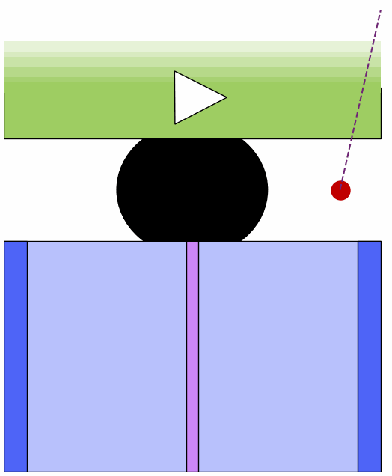
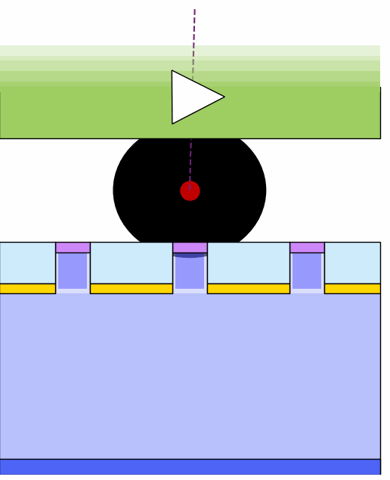
How to achieve gain
Using doping (LGADs)
Using geometry (3D)
Using Geometry + Electrodes (SiEM)

Slide 9
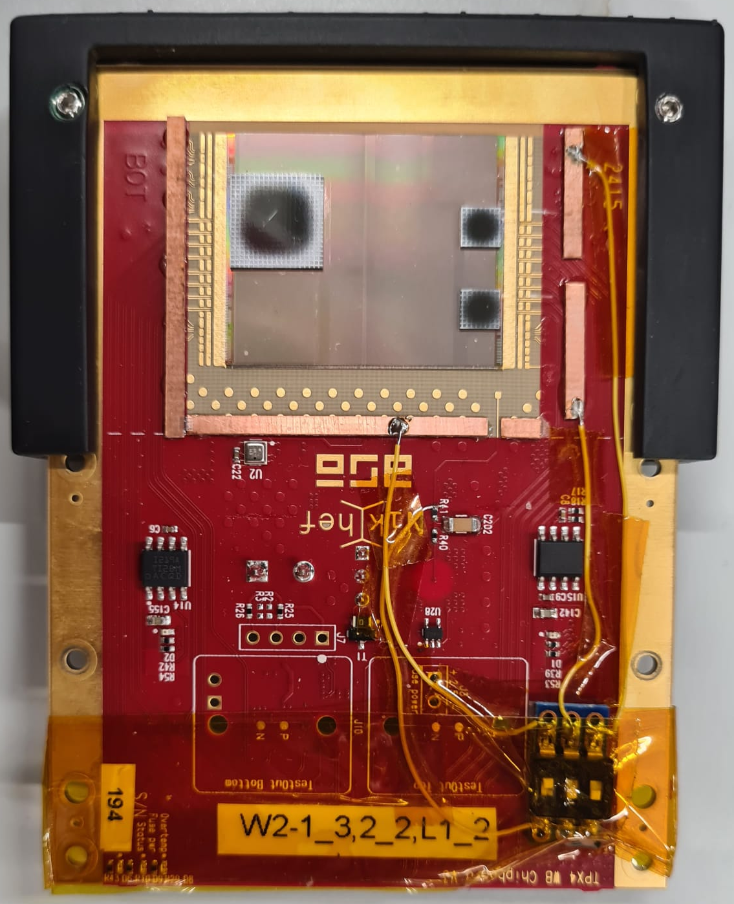
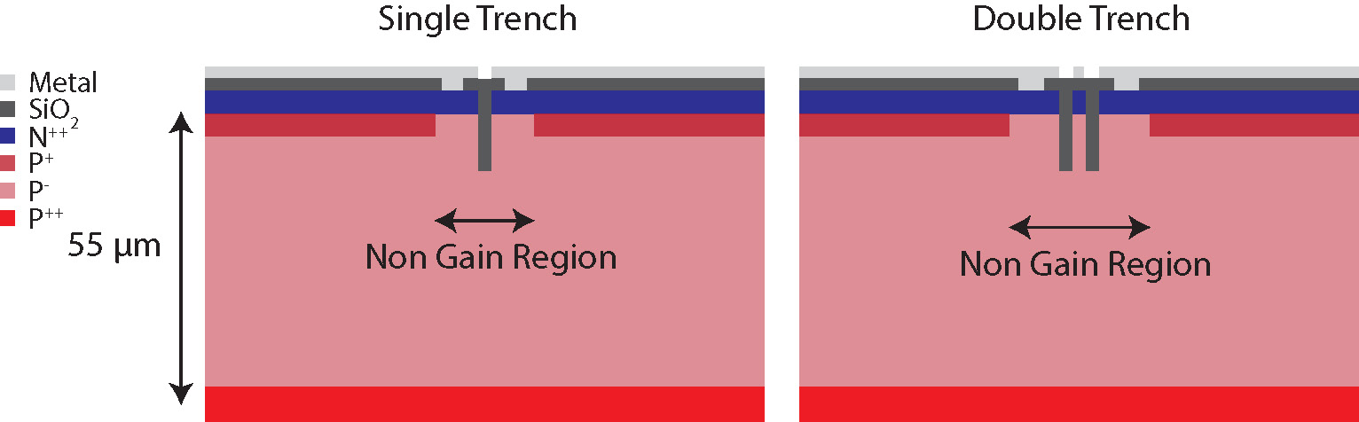
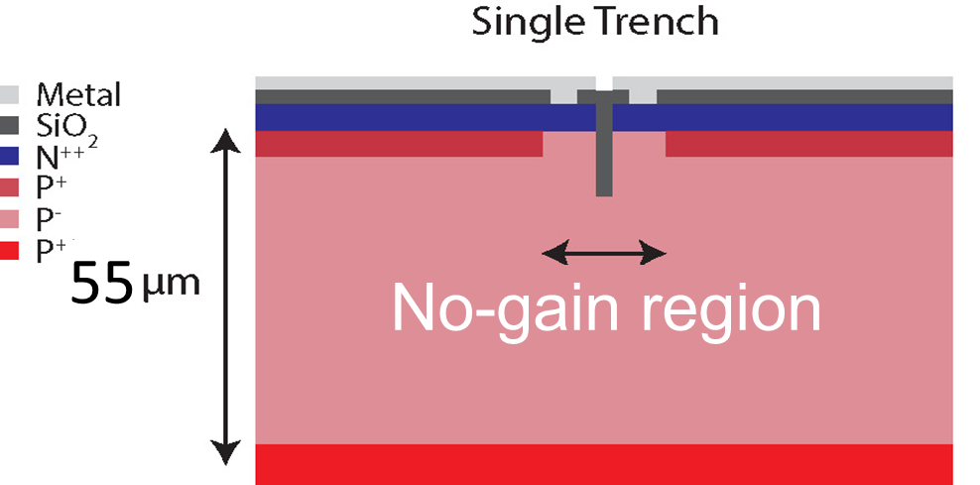
TI-LGADs (Trench Isolated Low Gain Avalange Diodes)
Disadvantage of LGADs, large pitch size -> Lower spatial resolution
New technologies like trenches allow small pitches
Not very radiation hard
55
45
No-gain region

Slide 10
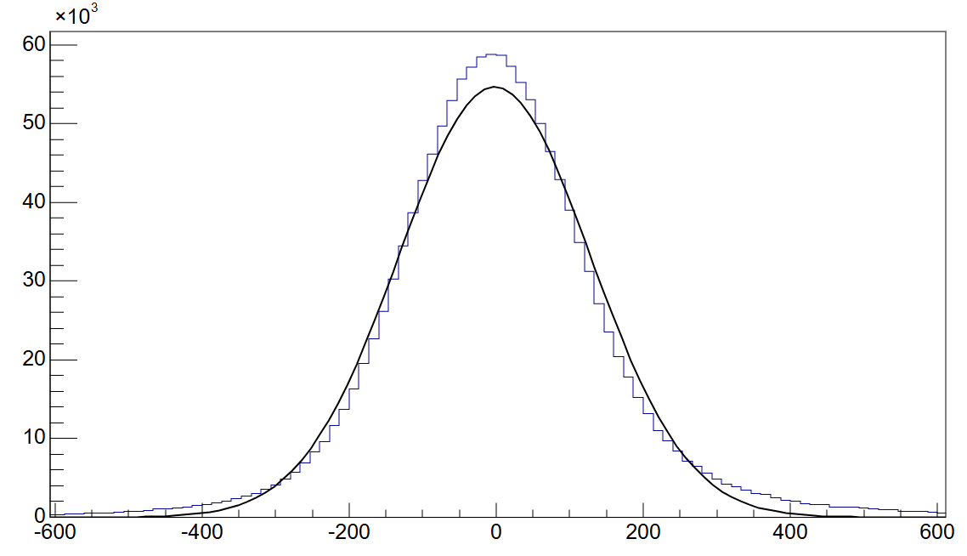


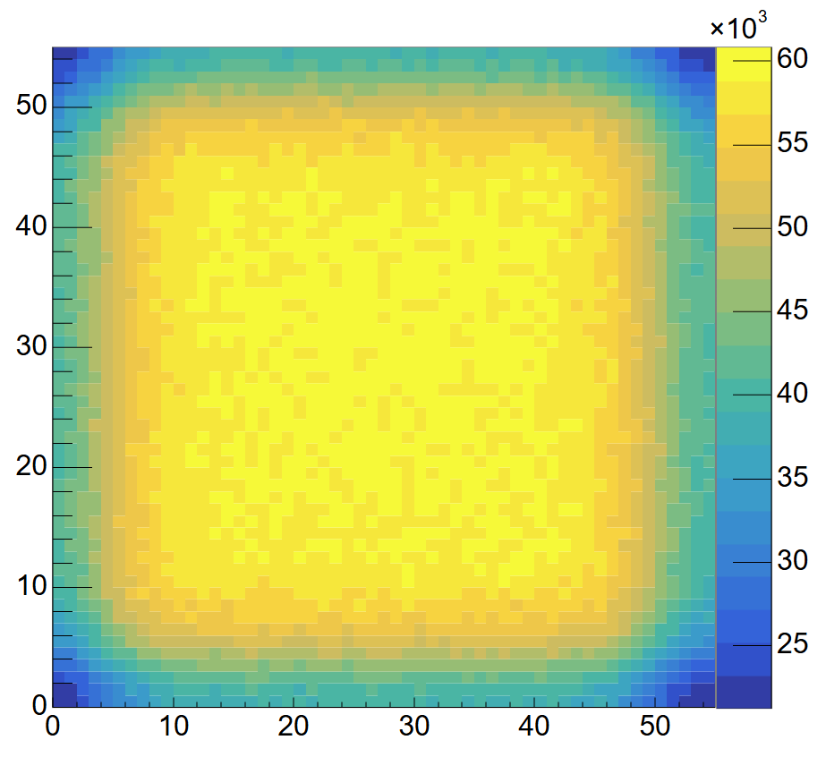


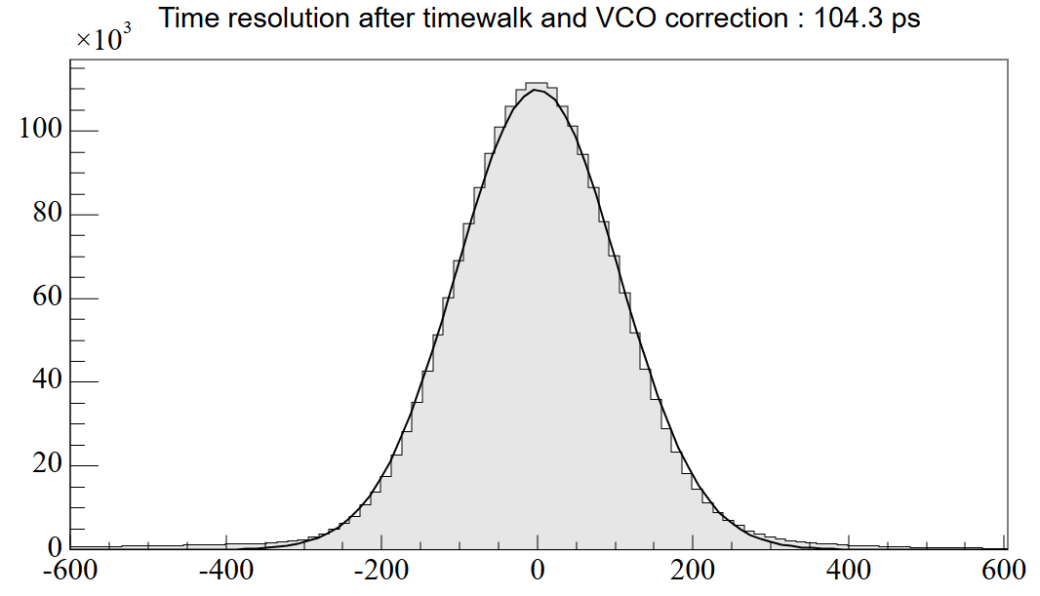



Achieved resolution
130 ps
Intrapixel charge
Inner 60%
104 ps

Slide 11
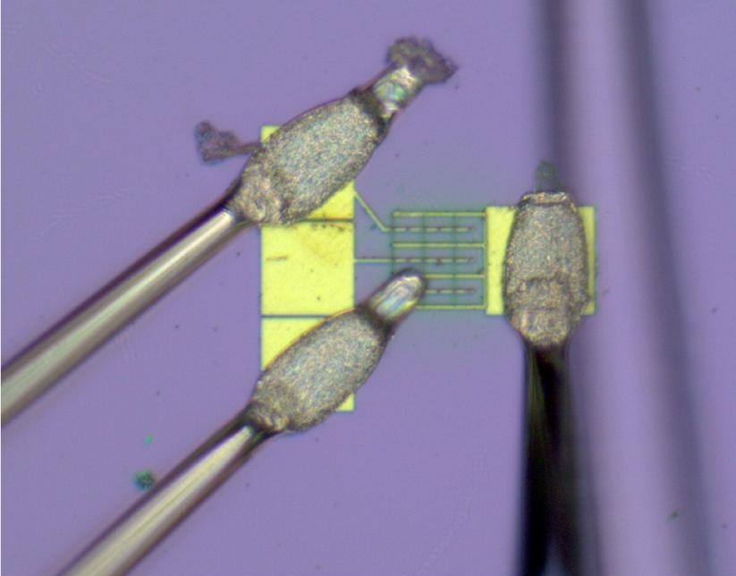
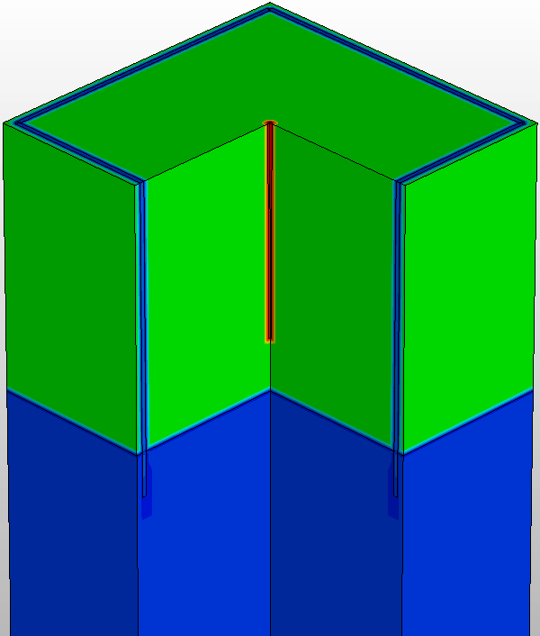
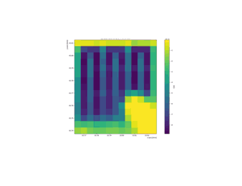
3D sensors
No extra doping layer, so radiation hard.
A. Loi, https://indico.cern.ch/event/1586892/contributions/6846213/

Slide 12
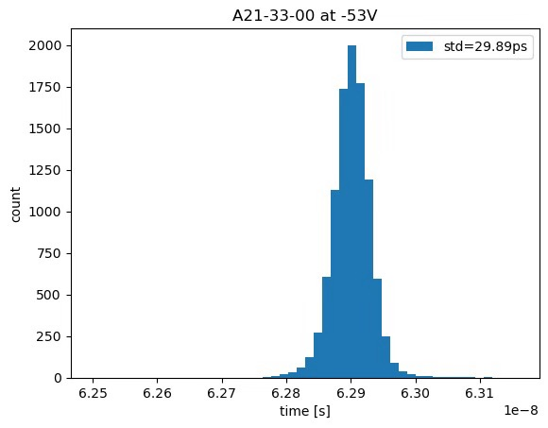
First laser results look promising (but not representative for the full system)
Testbeam measurements are waiting for analysis.
Gain at different bias voltages
Timing resolution with laser
Sensor only
charge/charge_{10V}
bias voltage [V]

Slide 13
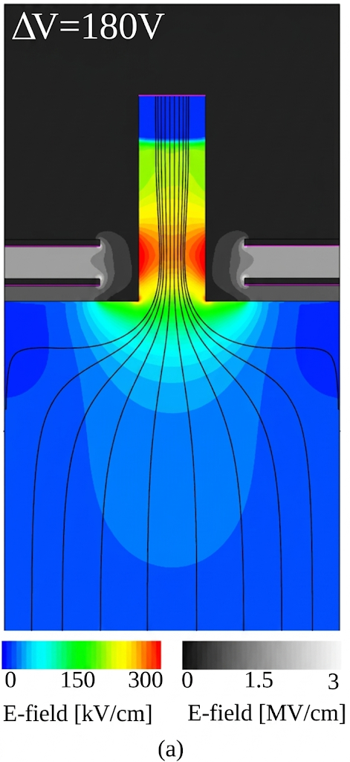
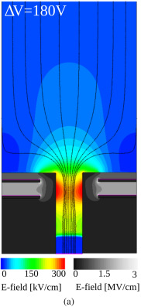
SiEM (Silicon Electron Multiplier)
M. Halvorsen, 10.1016/j.nima.2022.167325
Combination of geometry and electrodes
Voltage can be controlled
Less sensitive to radiation damage
Design is still being optimised
  One electrode or two electrodes
  Straight pillars or slanted pillars

Slide 14



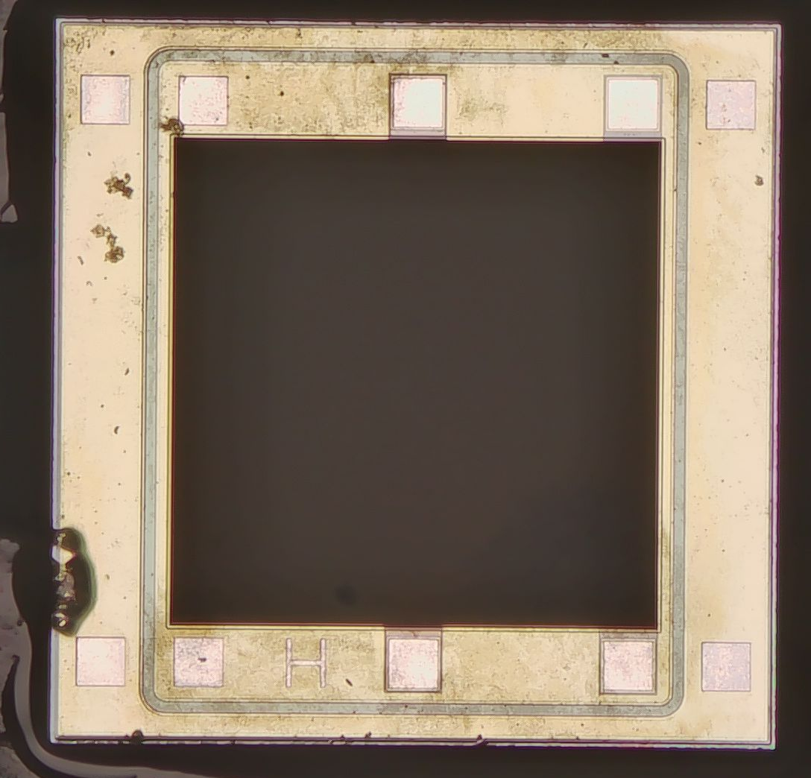
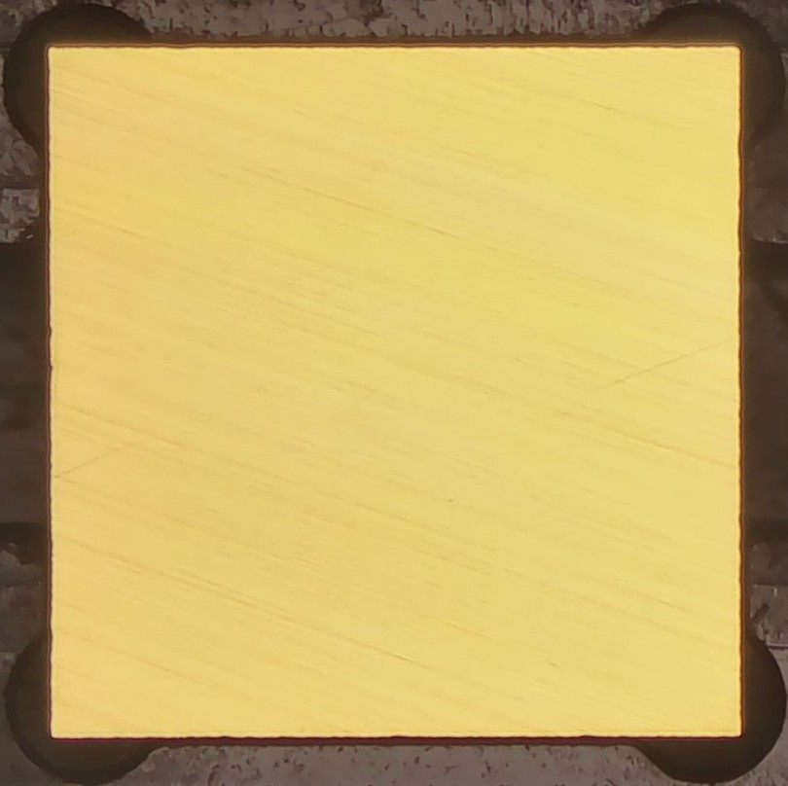
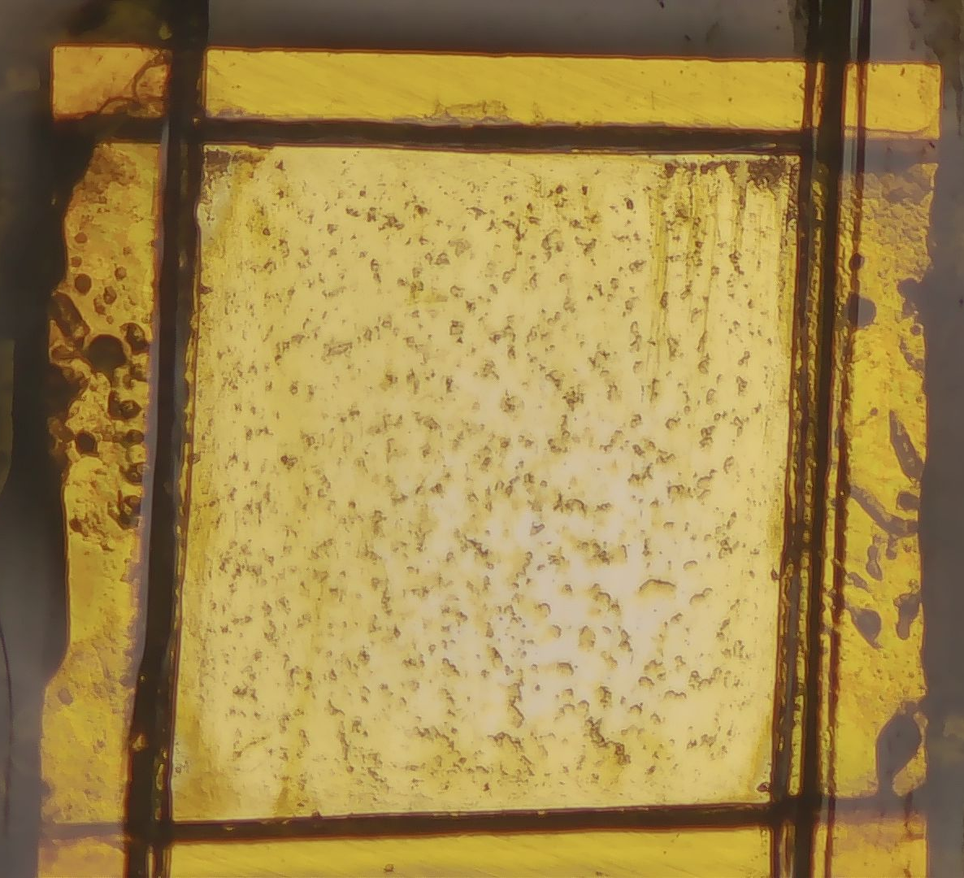
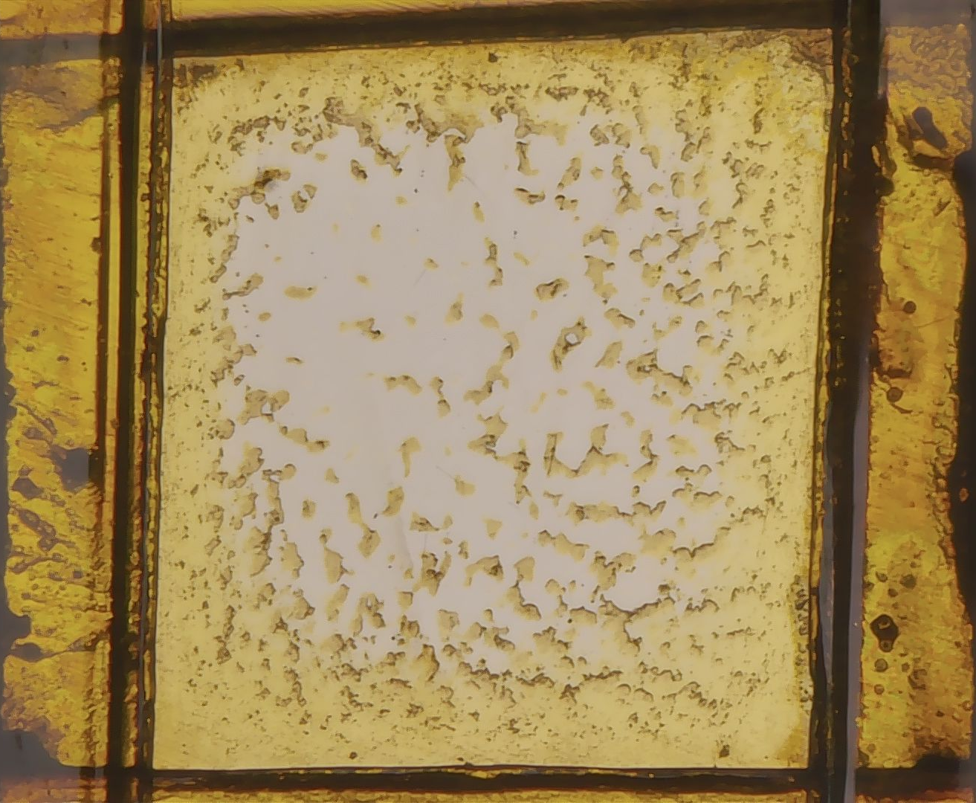
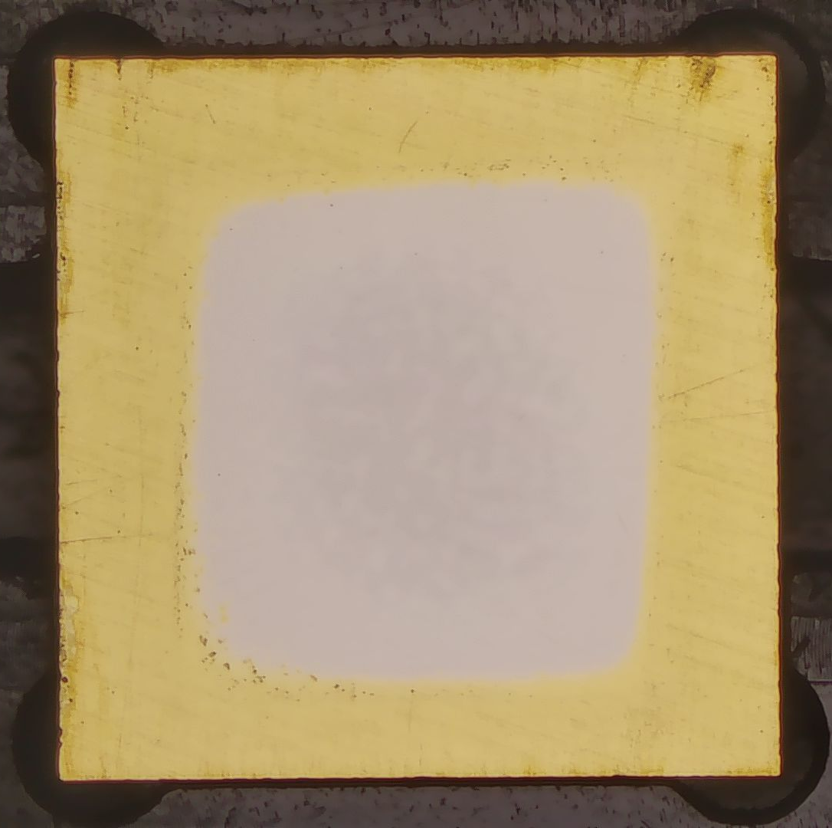
Every dot is a pillar, 10 microns between pillars
SiEM
First measurements performed in the lab
Sensors need to be polished to allow laser measurements
Structures are quite delicate
(the first one broke)
200x200 pillars
3x3 mm

Slide 15
Conclusion
Currently no perfect combination (good for us, there is a lot to test).
LGADs: most mature technology, not radiation hard enough
3Ds with gain: Look promising, still need to be tested further
SiEM: Cool idea, still in early development.
I only showed a few examples, not a complete overview.
All these devices only use Silicon, Ginger will show the
advantages of other materials

Slide 16
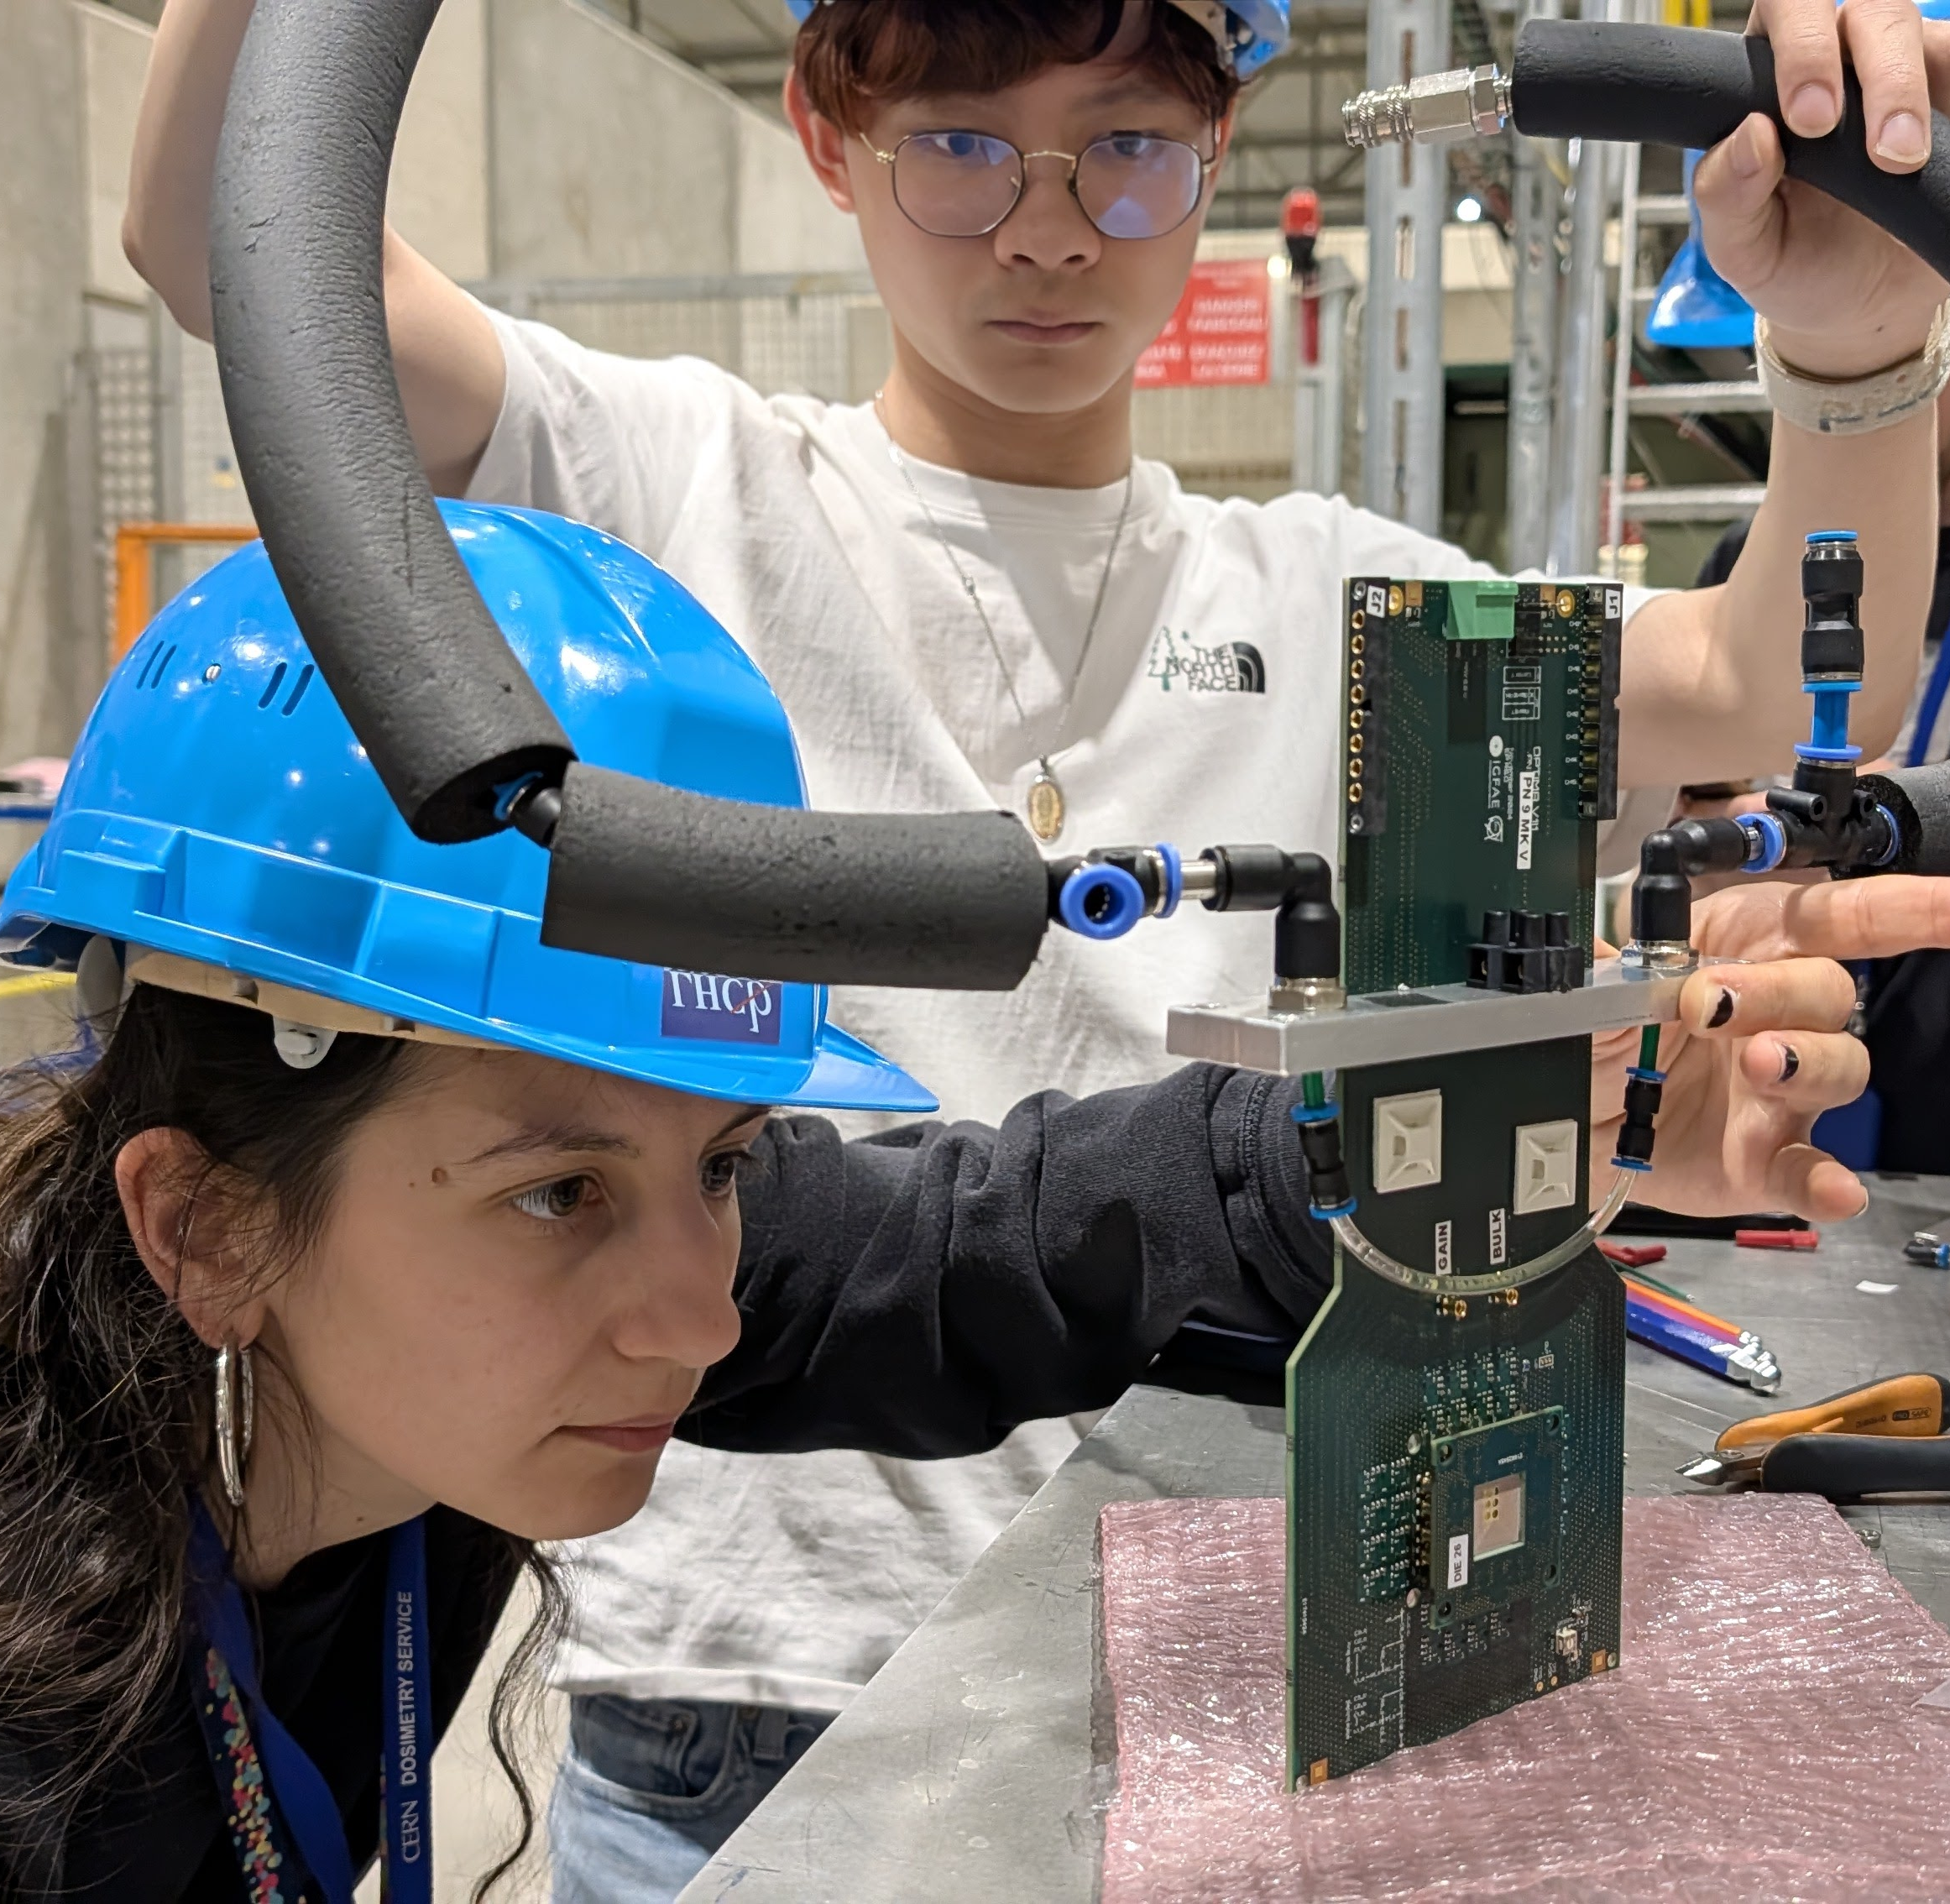
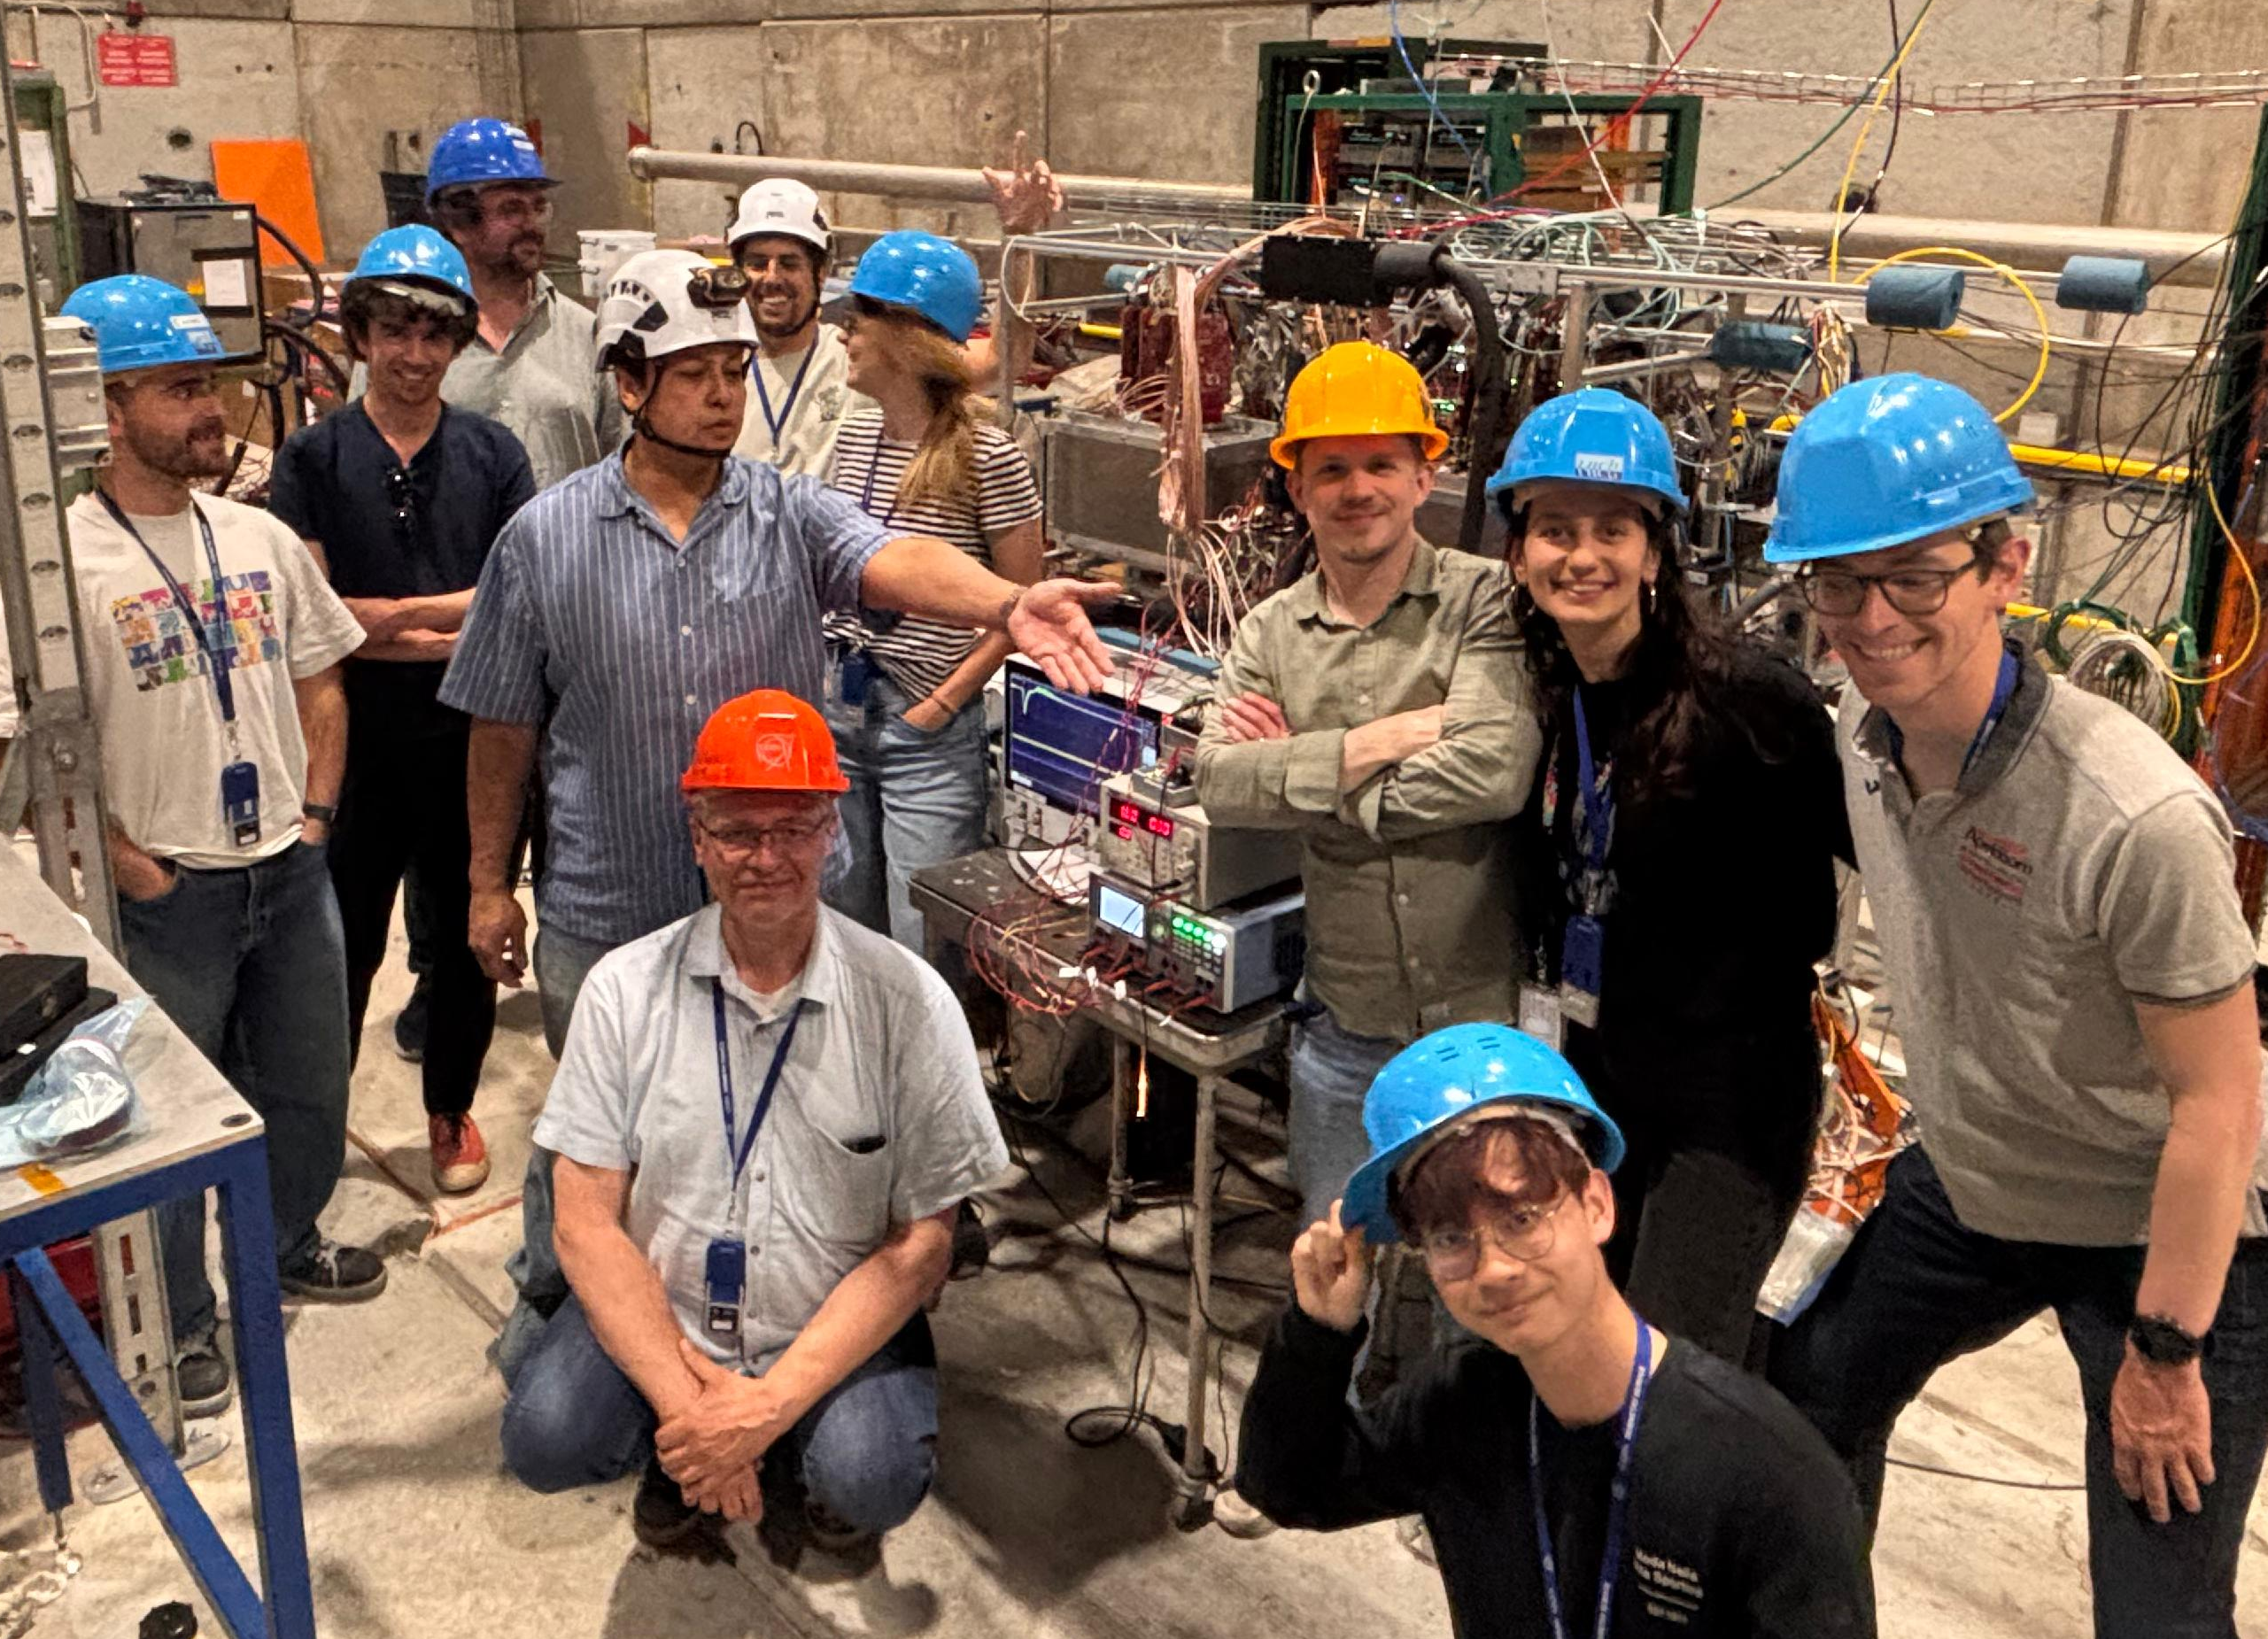
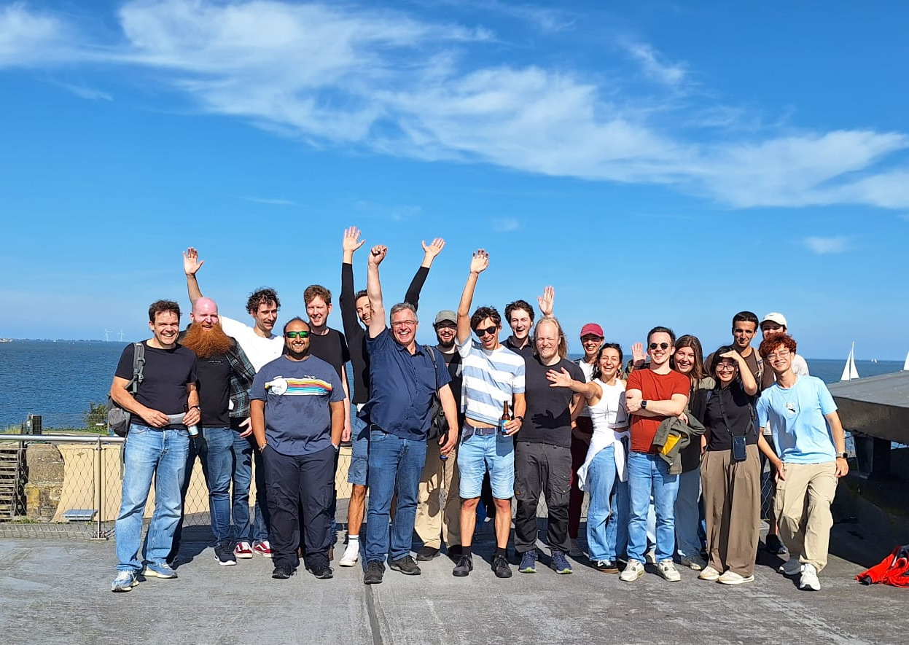
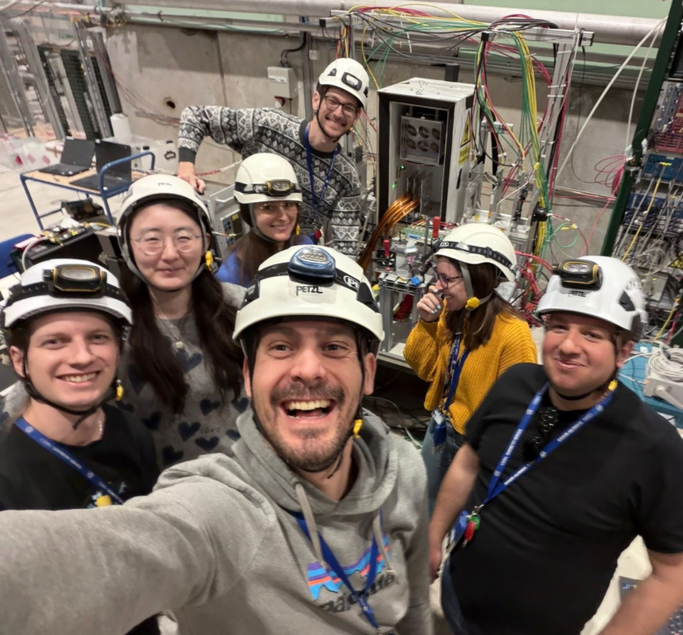
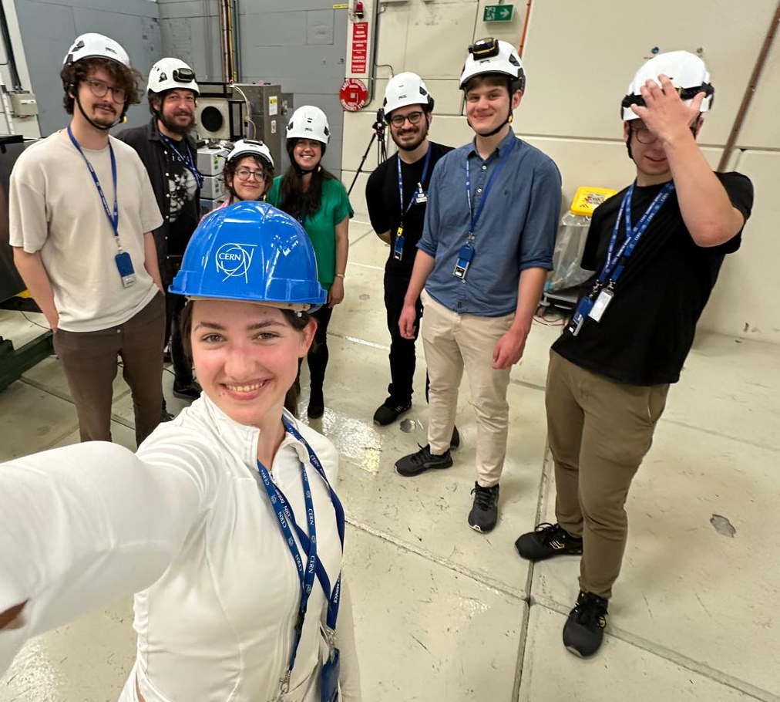
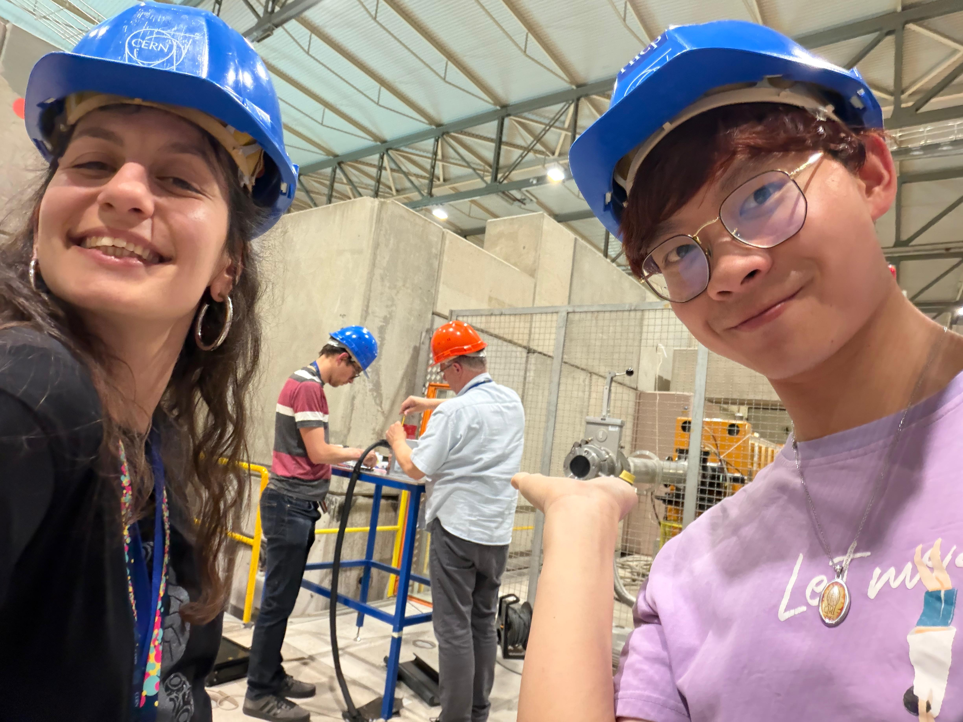
Questions?
Team 3D
Team 3D

