Slide 1

Hits2Higgs & More
ATLAS & AI Group
Presenting: Eugene Shalugin – eugene.shalugin@nikhef.nl

Slide 2
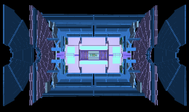
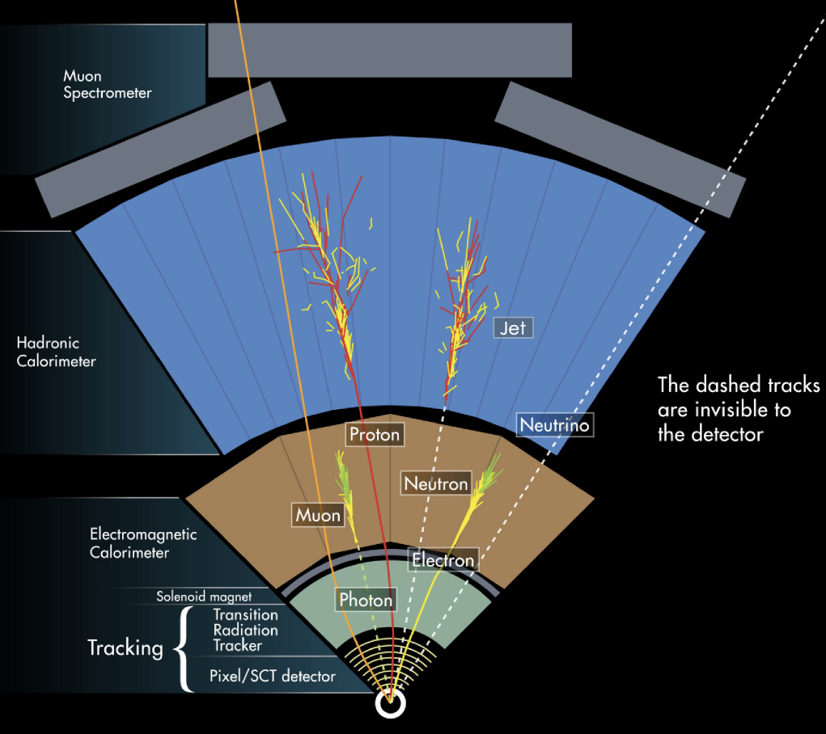
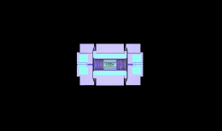

Higgs / no Higgs
Jets, b-tagged Jets, e, mu, tau, MET..
10^1
Leptons, MET
Jets, b-tagging
Tracks & Vertexes
Hits
10^4

Slide 3
Higgs / no Higgs
Jets, b-tagged Jets, e, mu, tau, MET..
10^1
Leptons, MET
Jets, b-tagging
Tracks & Vertexes
Hits
10^4
Hits
Notes:
10^4 -> 10^1 = data compression => loss of information

Slide 4
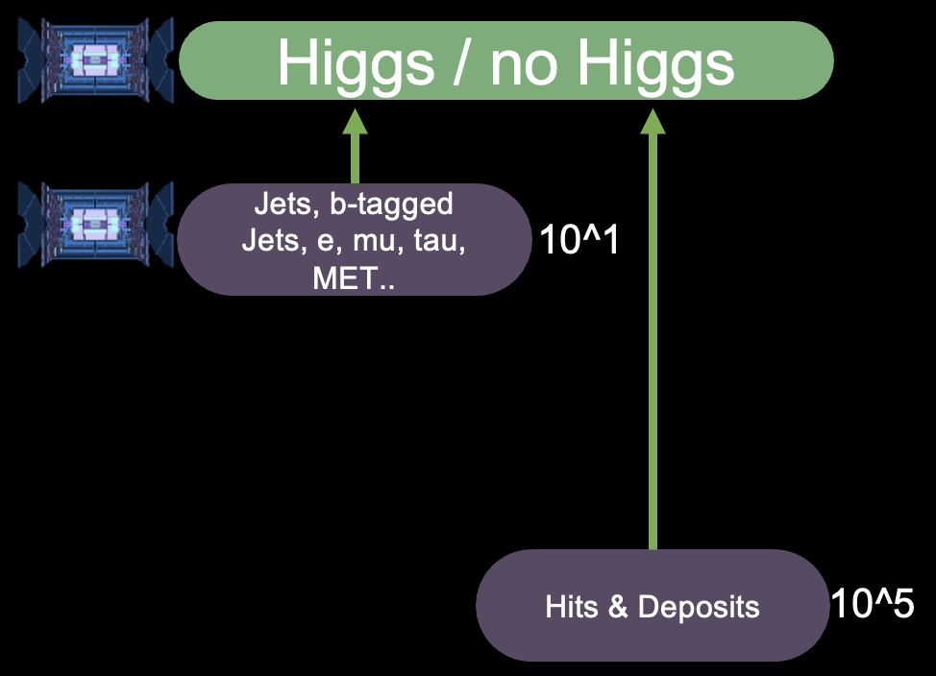
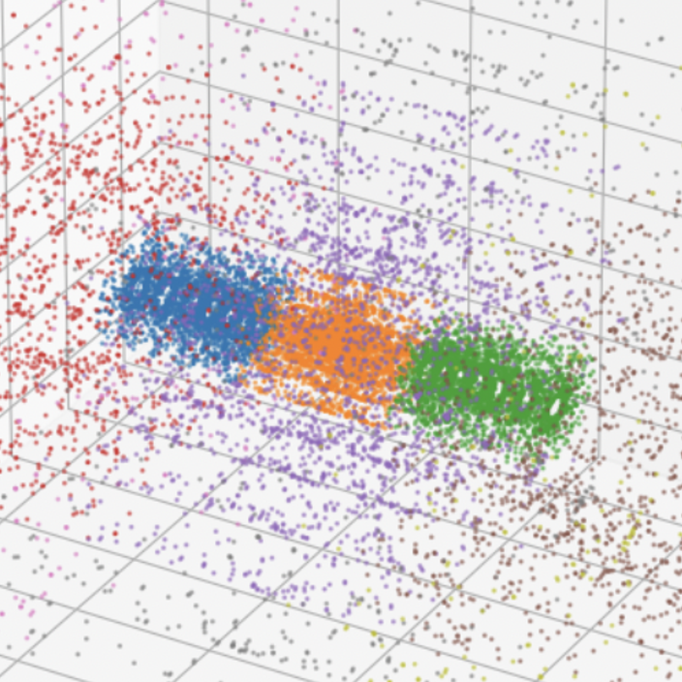
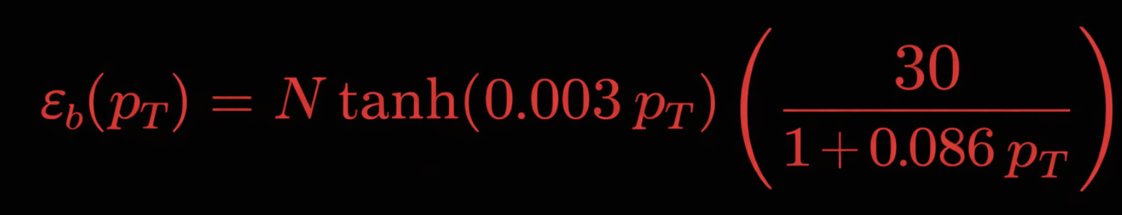
Hits
Data
ROOT files
Jets, METtrk, b-tags
ACTS+FATRAS
ACTS+FATRAS
Detector Response
Simulation
Digitisation
Open Data Detector
Output: SimHits
TrackJetFinder
TrackMissingET
TrackBTagging
Jets, b-jets, METtrk
Delphes ATLAS Card
Notes:
B-tagging - optimistic => overestimating recobj pipeline

Slide 5
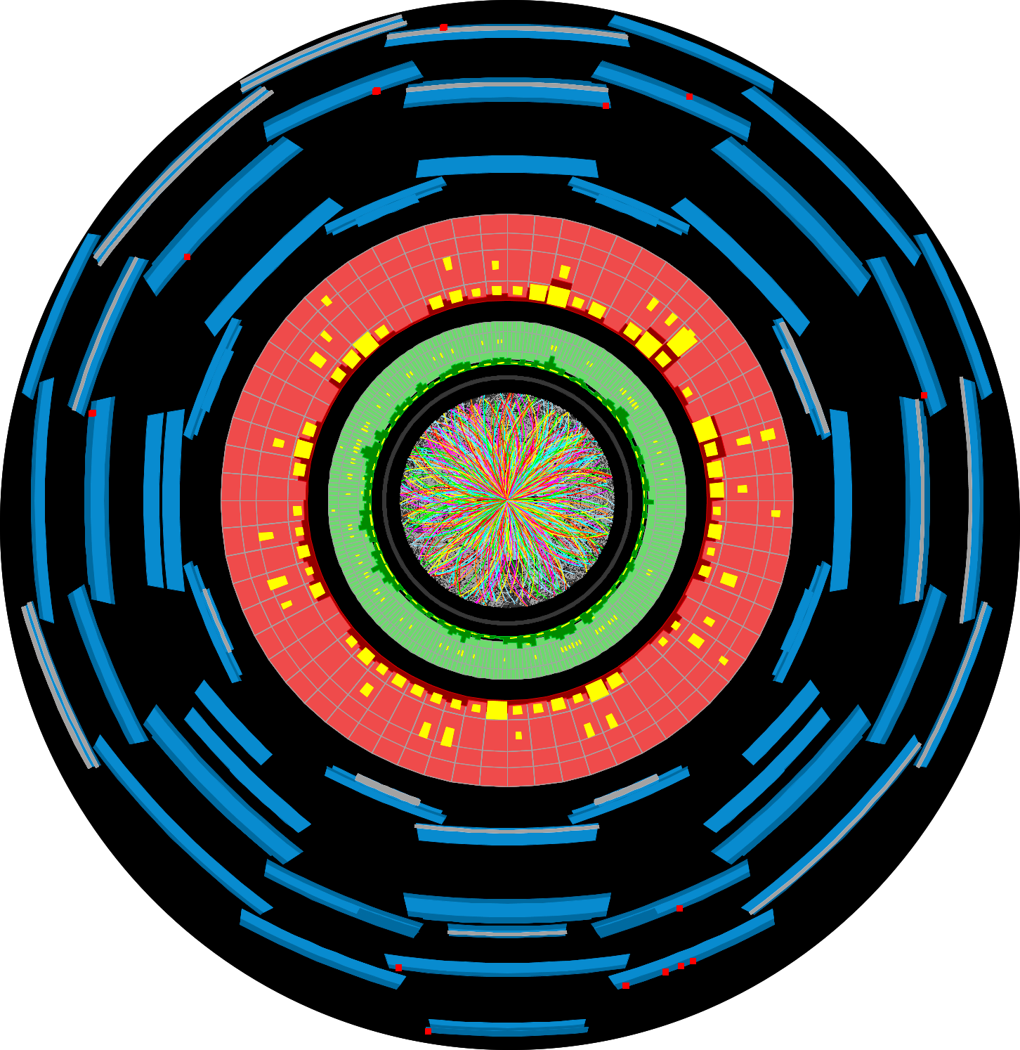
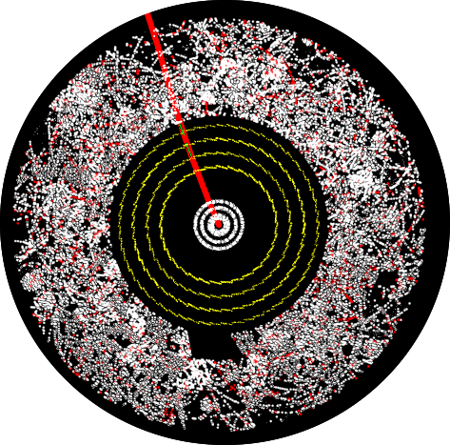
Models
ParT
2.13M params
Rec Objects
10^1
FlexAttention
Higgsformer
70k – 1M params
Trackformer Architecture
10^4
(x, y, z) = token
+ HT regression

Slide 6
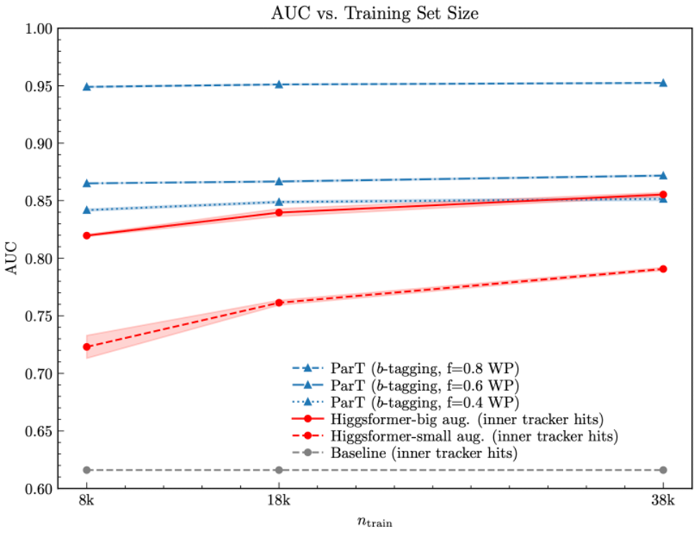
Higgsformer
from
Higgsformer
6

Slide 7
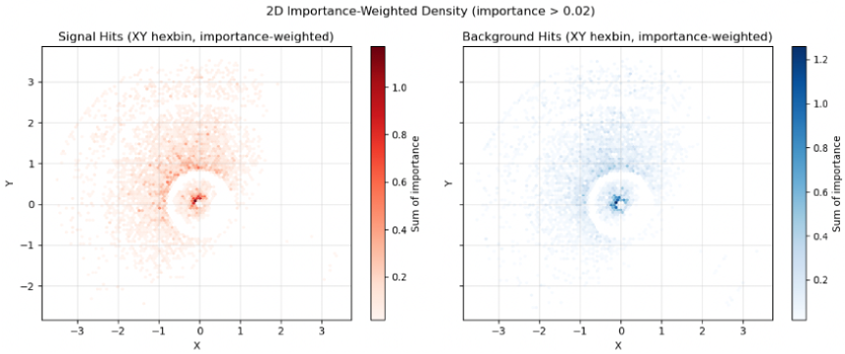
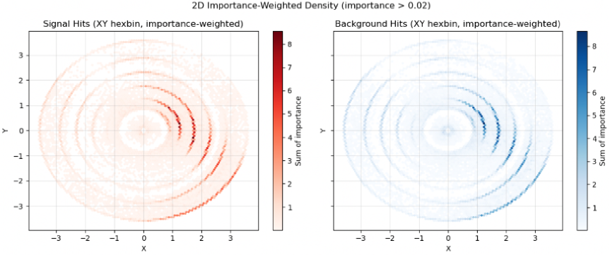
Learned Features Exploration
Most Important Hits
Higgsformer-small 10k
Higgsformer-small 40k
Notes:
Mask one hit, compare difference between original and masked
Expect phi invariance - getting it

Slide 8
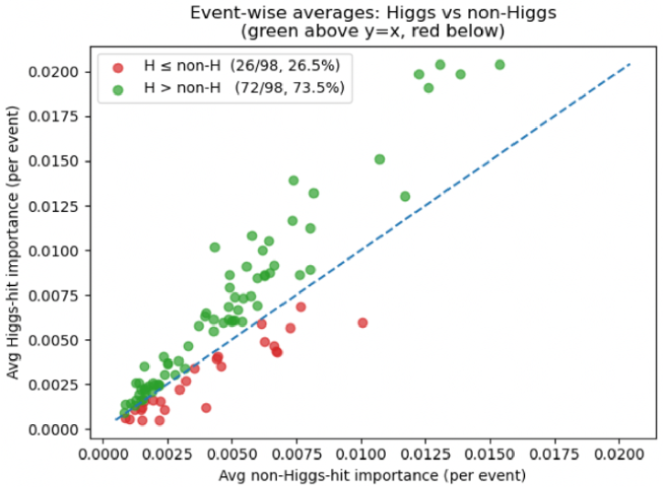
Learned Features Exploration
Higgs-related Hits Importance
Higgs-related Hits Masked
–
Notes:
No true barcodes transferred over MC tools. Matching on PID and kinematics to find Higgs descendant hits.

Slide 9
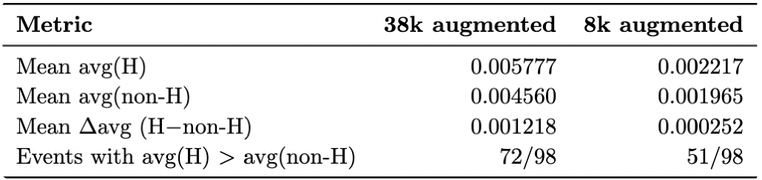
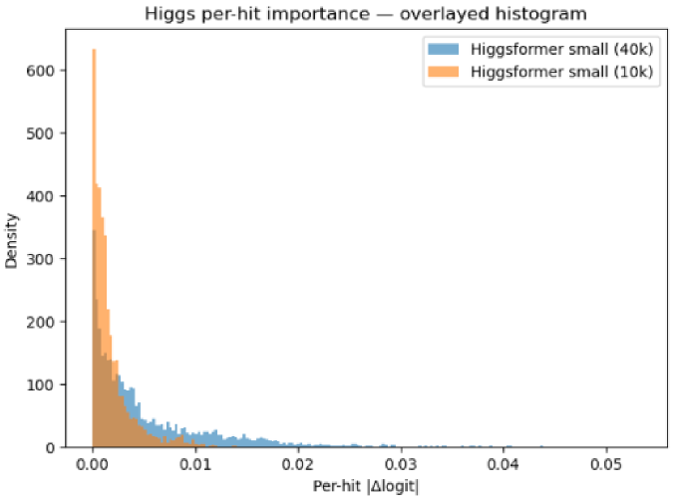
Learned Features Exploration
Higgs-related Hits Importance

Slide 10
RecFree vs RecObj ML
from
ParT
+
O (
)
from
Higgsformer
10

Slide 11
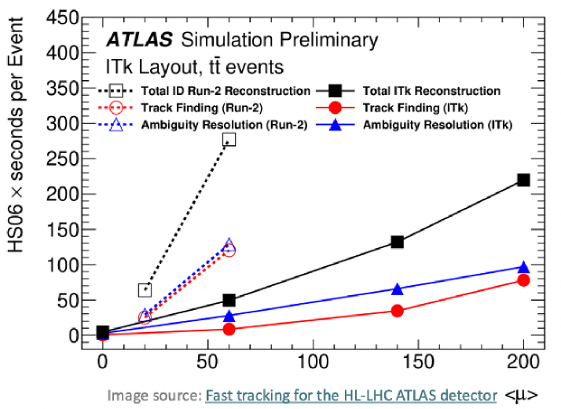
’From LaLa Land to HH Land’
©Tristan
10ms
1000ms
Higgsformer
TODO Practical applications:
use for b trigger – in discussion with trigger group
add learned emberdding to reco algos

Slide 12
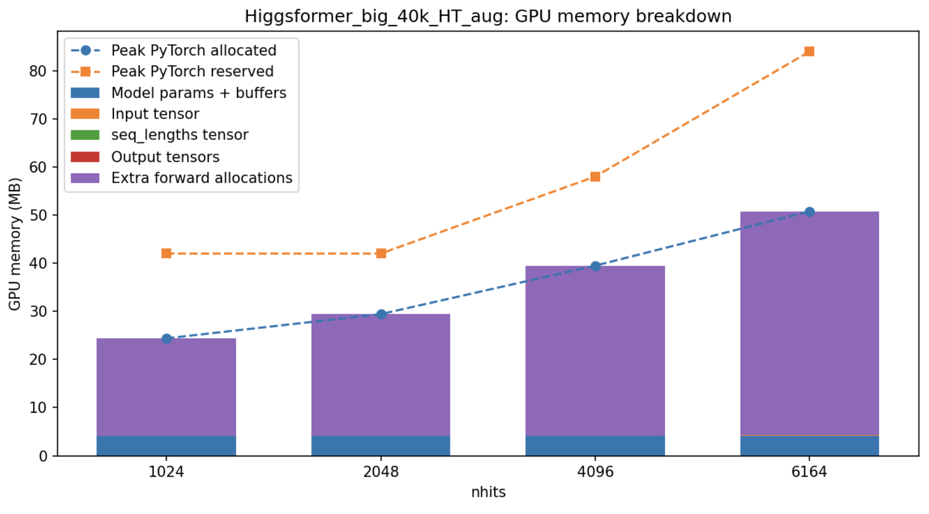
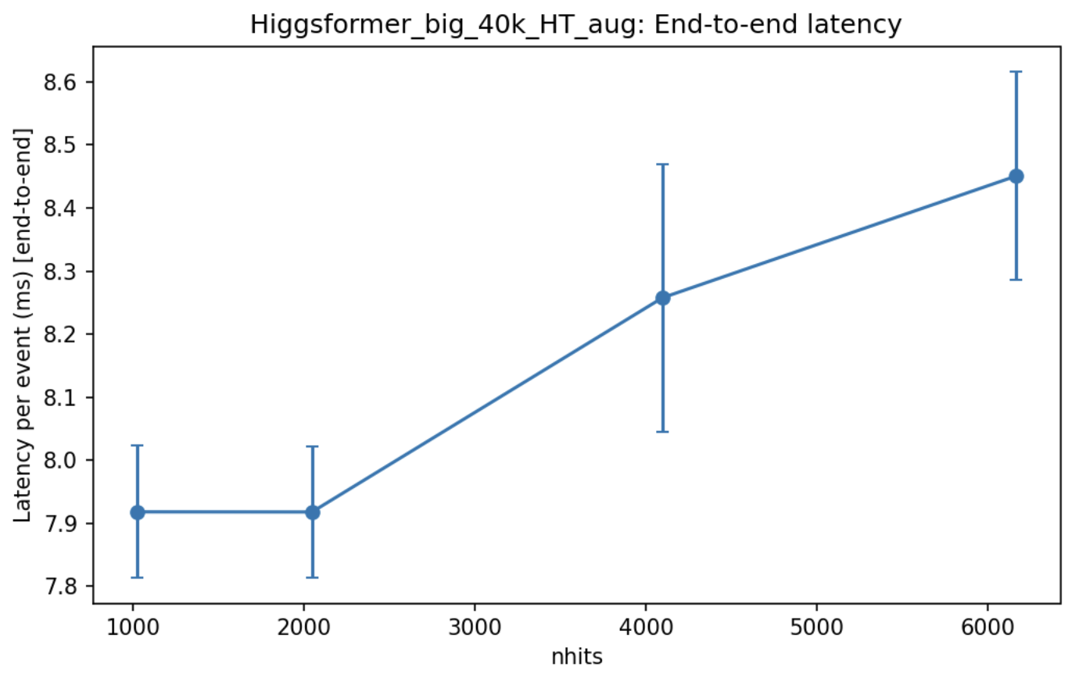
‘From LaLa Land to HH Land’
©Tristan

Slide 13
If enough time (Backup)

Slide 14
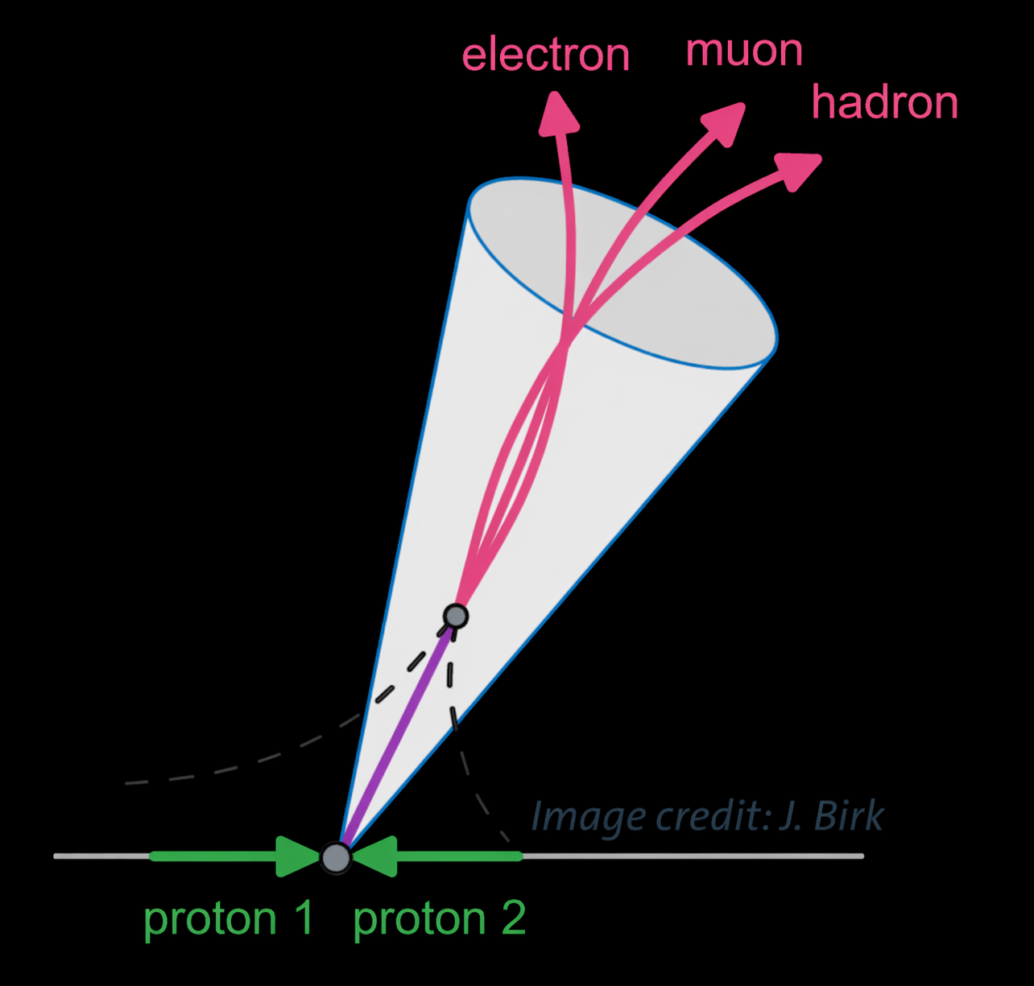
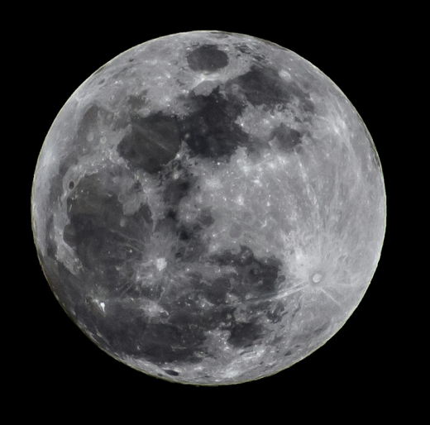
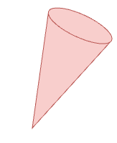
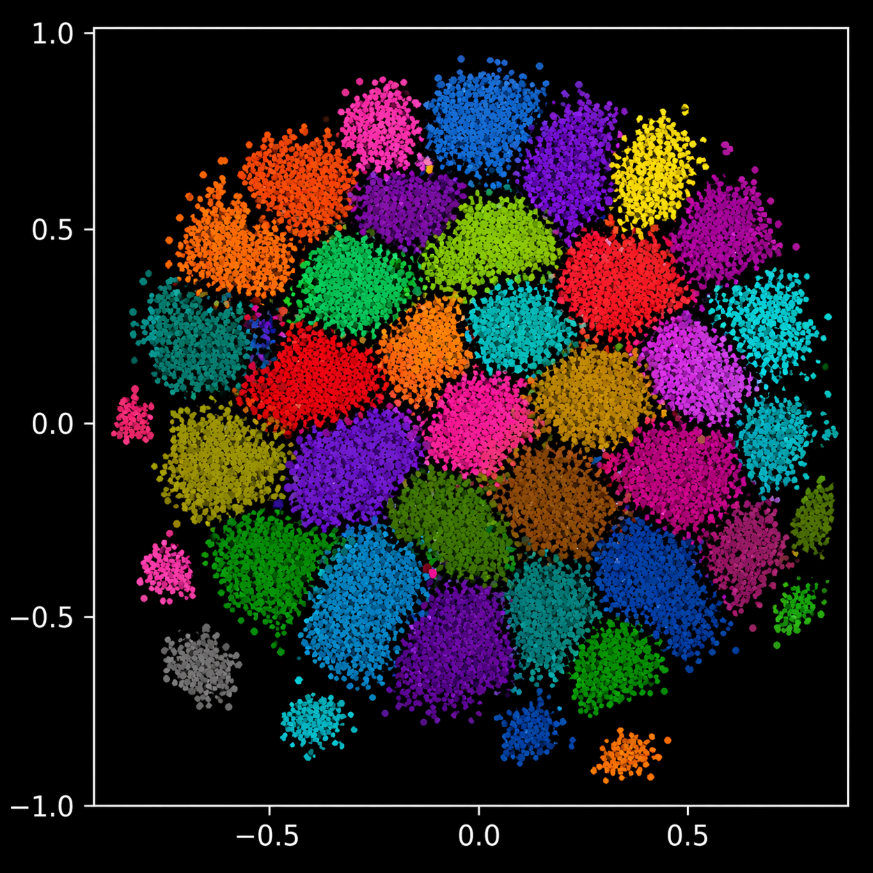
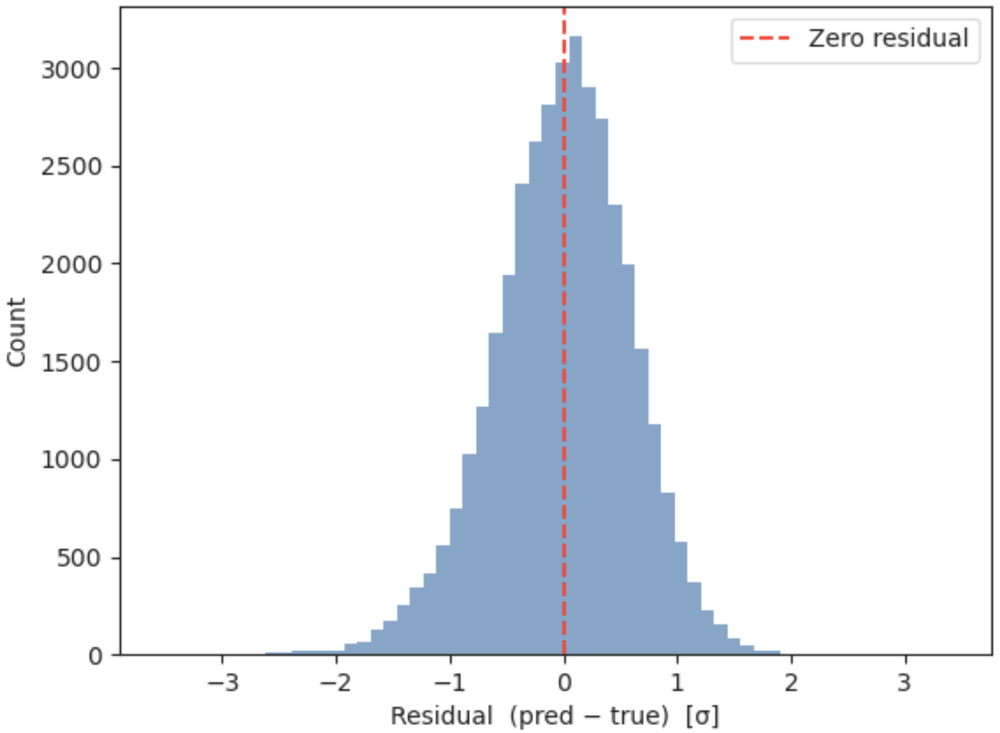
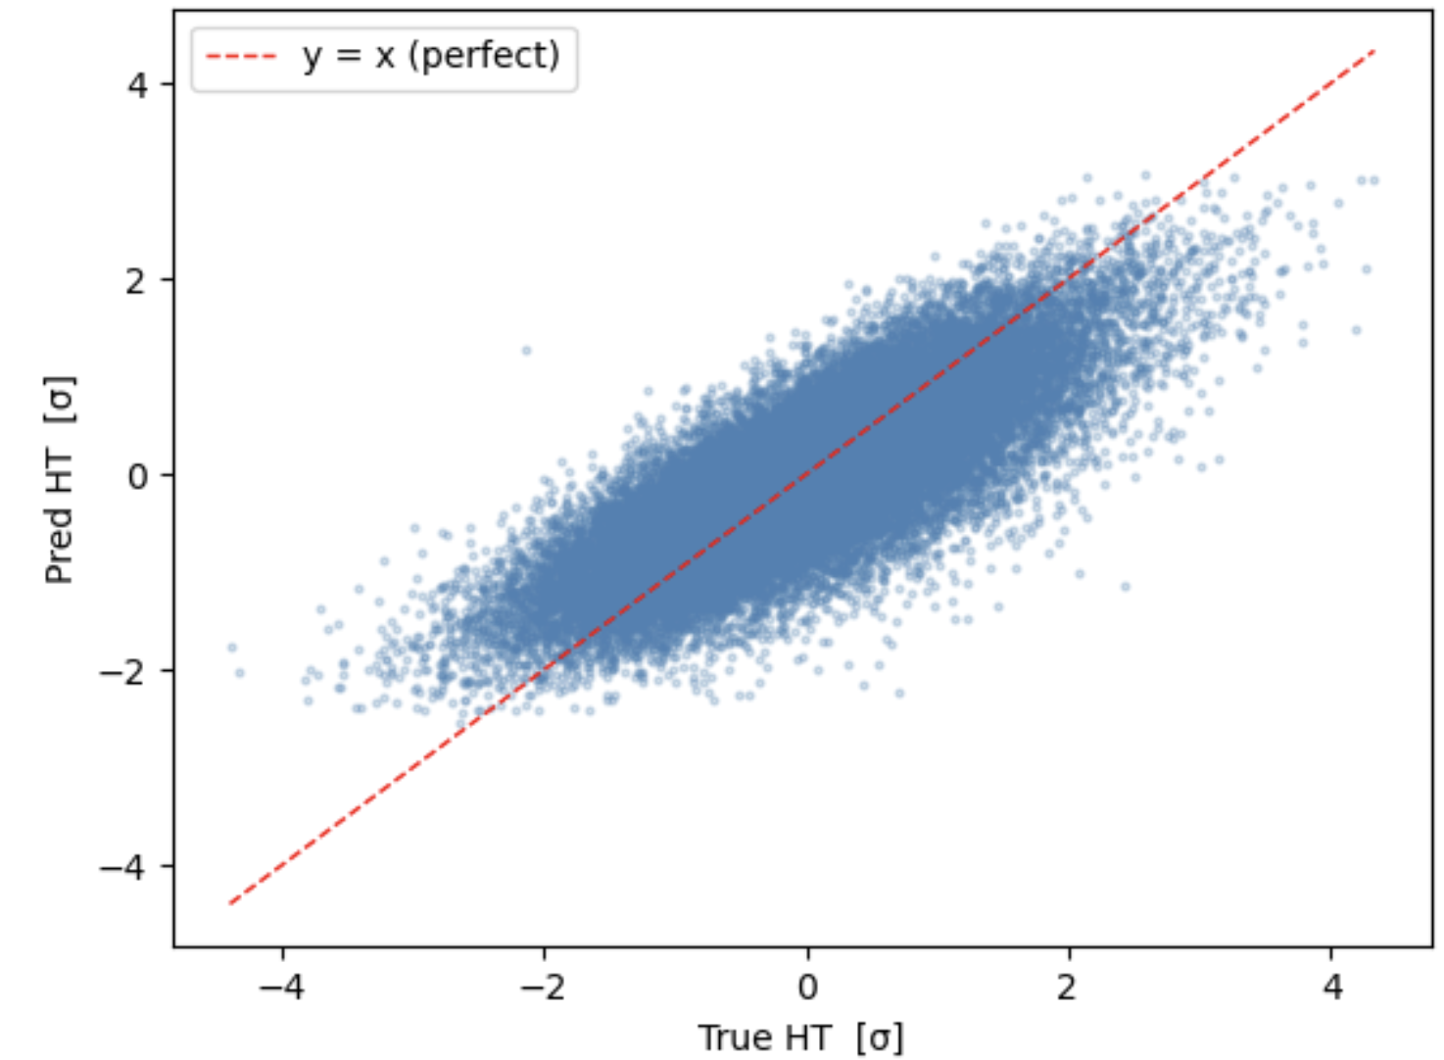
0)
Reconstruct objects
The Moonshot
R=0.4
vertex cut?
1)
Data-driven optimisation
track pT cut?
Event Classification
Jets,
Flavour Tagging
Leptons
MET, HT
Higgsformer
Latent Representation
Notes:
10^4 -> 10^1 = data compression => loss of information

Slide 15
0)
Reconstruct objects
The Moonshot
R=0.4
vertex cut?
1)
Data-driven optimisation
track pT cut?
Event Classification
Jets I
Jets II
?
Leptons
MET, HT
Higgsformer
Latent Representation
Notes:
10^4 -> 10^1 = data compression => loss of information

Slide 16
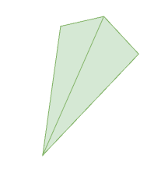

0)
Reconstruct objects
The Moonshot
R=0.4
vertex cut?
1)
Data-driven optimisation
track pT cut?
Event Classification
Data-driven object definition
Jets,
Flavour Tagging
2)
Higgsiness?
Partial jets?
Leptons
3)
Improving reco eff.
MET, HT
(adding learned embeddings)
Higgsformer
Missing Physics
Latent Representation
Notes:
10^4 -> 10^1 = data compression => loss of information

Slide 17
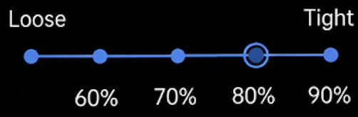
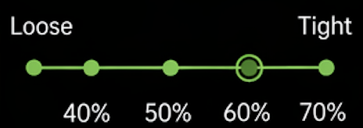
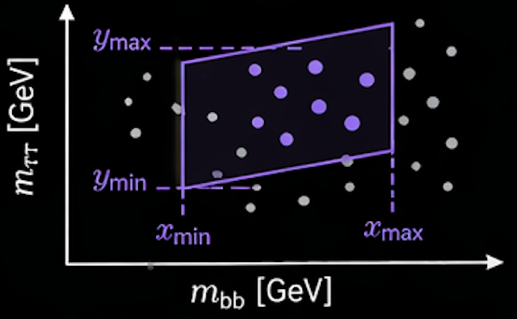
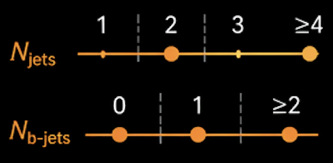

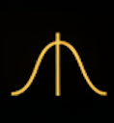
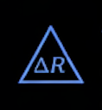


















Analysis as an Optimisation Problem
The Moonshot
(but smaller)
The selection is defined by a parameter vector θ
$θ=(θ_{1},θ_{2}$, $θ_{3}$, $θ_{4}$,…, $θ_{N})$
1. b-tag Working Point
2. τ-ID Working Point
3. SR Geometry
4. Category Splits
controls the b-jet selection
efficiency vs purity
controls the hadronic τ
identification efficiency
defines the signal region
in key discriminant variables
defines boundaries for
event categorisation
Example: split by jet multiplicity
and b-tag multiplicity
b-tag efficiency
$$τ_{had}$$
ID efficiency
$$θ_{1}$$
$$θ_{2}$$
$$θ_{3}$$
$$θ_{4}$$
Jet $p_{T}$ thresholds
MET requirement
Mass windows
Angular selections
Leading/subleading
jet $p_{T}$ cuts
Threshold on $E_{T}^{miss}$
$m_{bb}$ window size
$m_{ττ}$ window size
e.g. $△R\left(τ,jet\right)$
minimum
Others
$$θ_{5}$$
$$θ_{6}$$
$$θ_{7}θ_{8}$$
$$θ_{7}θ_{8}$$
$$θ_{9},…,θ_{N}$$

Slide 18
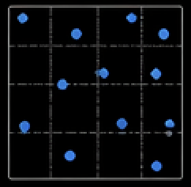
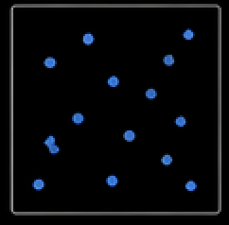

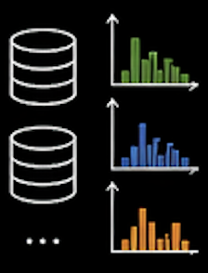
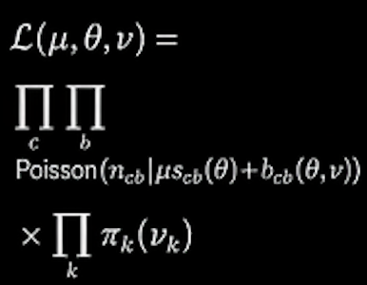
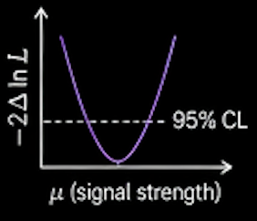

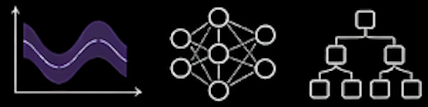
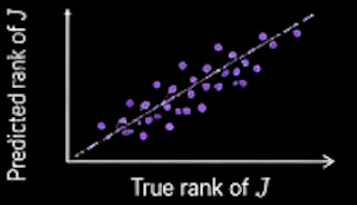
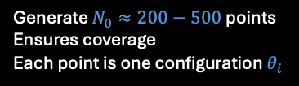







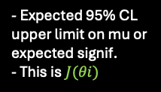
Workflow
Future Work
Step 1 – Sampling $θ$-space
Step 2 – For each $θ$ compute $J$
Step 3 – Train the surrogate
expensive step
Compute
expected
sensitivity
Input:
$θ$ vectors
Latin Hypercube
Sampling
Sobol Sequences
Apply
selections
Build
templates
Build
likelihoods
$(θ_{1},θ_{2}$, $θ_{3}$, $θ_{4}$,…, $θ_{d})$
$$θ_{1} \\ θ_{2}$$
…
$$θ_{N_{0}}$$
Target:
$J(θ)$ expected sensitivity
Models:
- Object-level cuts
- Event-level cuts
- Assign categories
- Poisson per bin
- Normalisation
nuisances
- Shape nuisances
(later)
- Expected 95% CL
upper limit on mu or
expected signif.
- This is$J(θi)$
GP
NNs
BDTs
Generate $N_{0}≈200−500$ points
Ensures coverage
Each point is one configuration $θ_{i}$
- For each process
(sig+bkg)
- Fill histograms
Validate:
- MAE on heldout $θ$
- Rank correlation

Slide 19

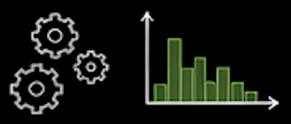
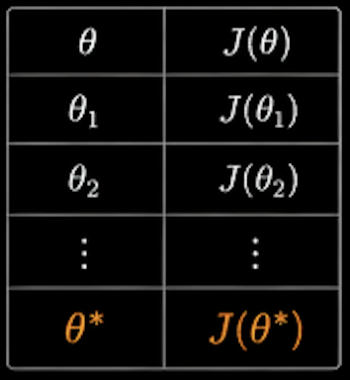
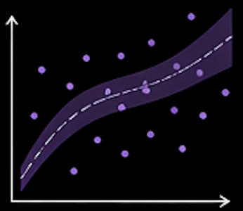
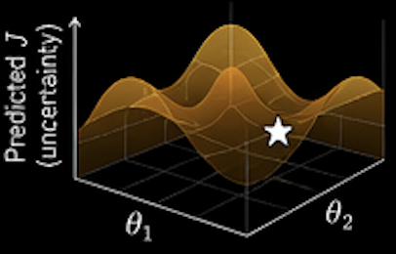
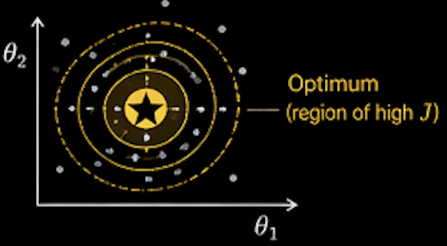
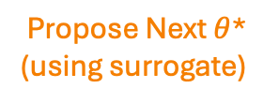
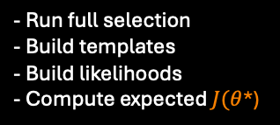

Final Sauce
Future Work
Step 4 – Bayesian optimization loop
Stop When:
Propose Next $θ$*
(using surrogate)
Evaluate $J(θ$*)
with whole pipeline
Add to dataset
Retrain surrogate
Improvement in J saturates
Uncertainty near optimum
is small
Update model
with new data
Acquisition function
(e.g. expected improvement)
- Run full selection
- Build templates
- Build likelihoods
- Compute expected $J(θ$*)
Repeat the loop
Notes:
Apologies, frequentists

Slide 20
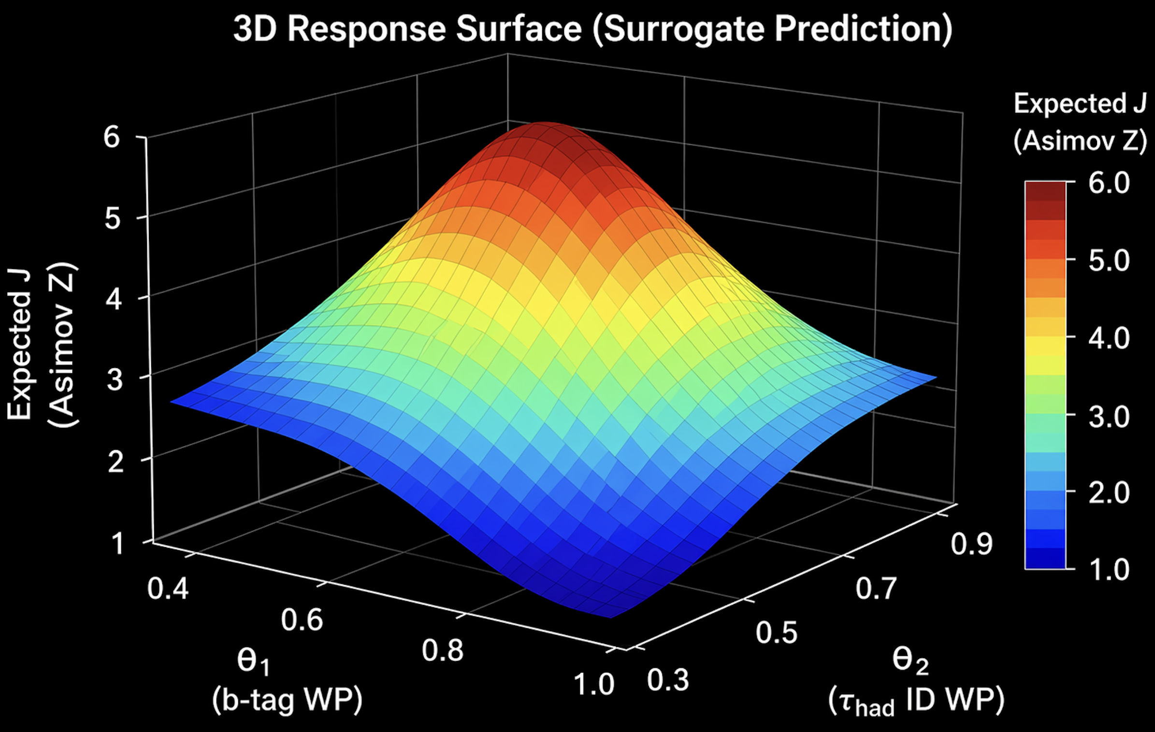
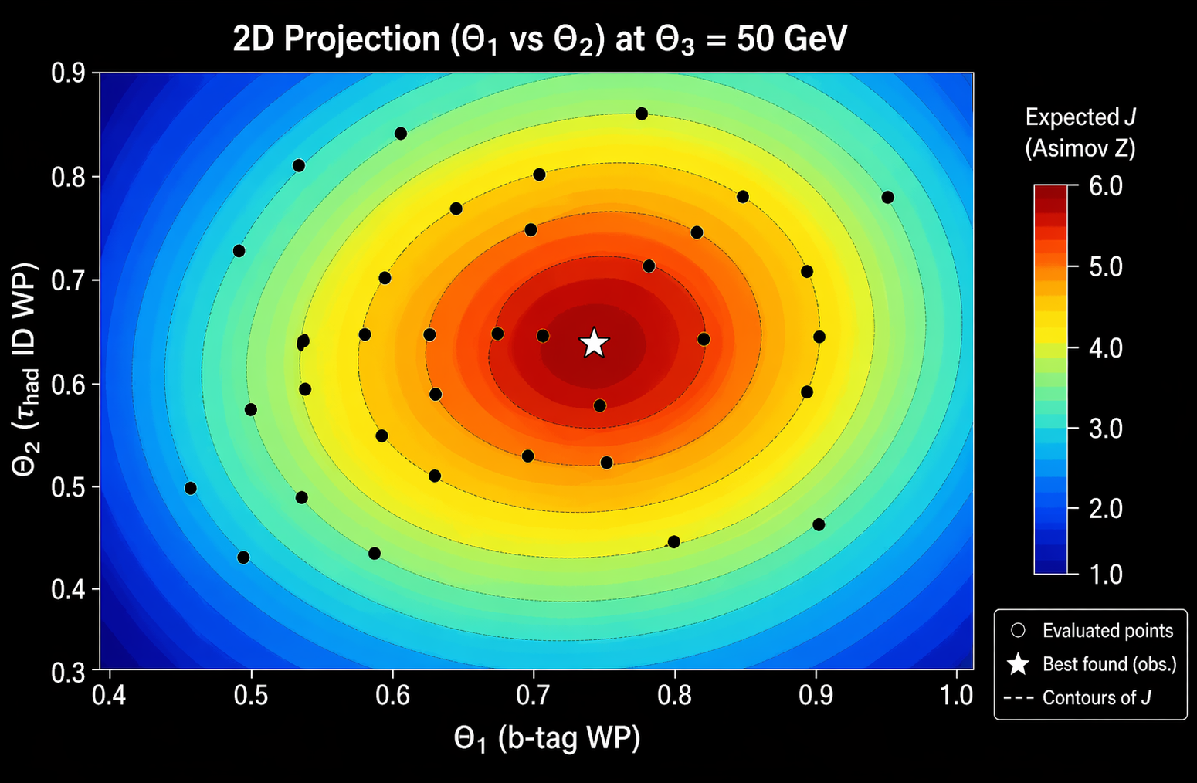
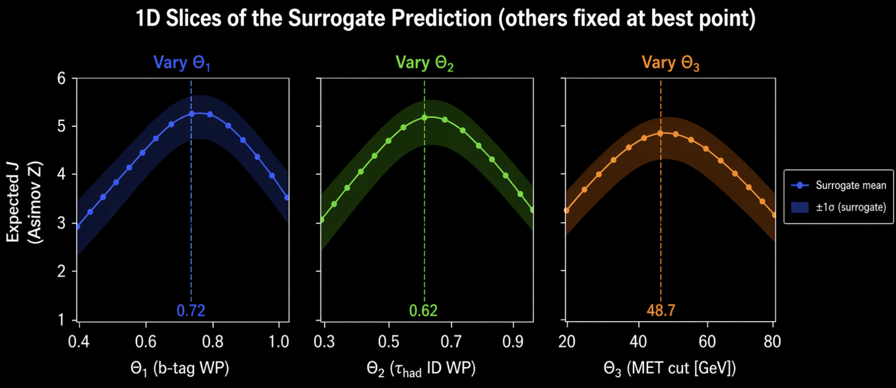

What we will get (mock plots & numbers)
Future Work
Best point (observed so far):
$θ^{∗}=\text{(0.72, 0.62, 48.7 }\text{GeV}\text{)}→J=1.2$

Slide 21

R=0.4
The Moonshot
(but smaller)
vertex cut?
Data-driven optimisation
track pT cut?
R=0.28
ntuples
<Someformer>
E(J(θ))
4b – Varsha, Andrea – produced ntuples yesterday
bbττ – Varsha, Samuel – producing ntuples

Slide 22

from
RecFree vs RecObj ML
ParT
10^4 human-years of
reconstruction algorithms development
+
from
ParT
+
O (
)
from
Higgsformer
22

