Slide 1
esfri ACTIVITIES
Giorgio ROSSI

Slide 2
ROLE OF ESFRI
The European Strategy Forum on Research Infrastructures – ESFRI – was established in 2002 with a mandate from the Council of the European Union to:
support a coherent and strategy-led approach to policy-making on Research Infrastructures in Europe
facilitate multilateral initiatives leading to the better use and development of Research Infrastructures
ESFRI brings together representatives of Ministers of the 28 Member States, 12 Associated States, and of the European Commission that are the decision makers and financers of the ESFRI Research Infrastructures
indicates strategies for the necessary major financial investment (~20 b€) and long-term commitment for operation (~2 b€/year, +15% of current effort)
upon mandate of Competitiveness Council of the European Union, ESFRI has completed the ESFRI Roadmap 2016 and starts now the update process that will lead to the ESFRI Roadmap 2018

Slide 3
ESFRI INTRUMENTS
EXECUTIVE BOARD – elected by the ESFRI FORUM – prepares strategic documents and gives recommendations to the FORUM
STRATEGIC WORKING GROUPs – in five scientific domains, plus a new one on Data, Computing and Digital RIs – perform the evaluation of the scientific excellence of the Research Infrastructure Projects and Landmarks and provide the Landscape Analysis in each domain
IMPLEMENTATION GROUP performs the assessment of the maturity of the Research Infrastructure Projects and the implementation progress of the Landmarks
AD HOC WORKING GROUPs – mandated by ESFRI FORUM or by the Competitiveness Council – provide vision and advise on specific issues of general interest for RIs

Slide 4
21 Projects
29 Landmarks

Slide 5
NEW PROPOSALS
NEW PROPOSALS
EVALUATION of THE SCIENTIFIC CASE
ASSESSMENT OF MATURITY
Broader IMPACT:
Alignment of methodology at National Roadmap Level (> 24)
“structuring effect of national budgets”

Slide 6
ROADMAP DYNAMICS
Monitoring of ESFRI Projects
Periodic review of ESFRI Landmarks
Broader IMPACT:
“structuring long term sustainability of investment in successful RIs”

Slide 7
ESFRI PROJECTS
are Research Infrastructures with a high degree of maturity
strengthen the European Research Infrastructure system with their pan-European added value
can be at different stages of their lifecycle according to the date of inclusion in the ESFRI Roadmap
engage in developing advanced data management practices in their domain
Undergo Monitoring for the evaluation of the scientific case and the assessment of the progress of the projects towards implementation
have a maximum term of residency of 10 years on ESFRI Roadmap

Slide 8
ESFRI LANDMARKS
are Research Infrastructures already implemented, that are delivering science services or effectively advancing in their construction
are reference elements of competitiveness of the European Research Area
are reference stewards of data management practices
undergo Periodic Review for the assessment of the evolution and actualisation of the scientific case and the implementation, identifying their main long-term sustainability challenges
display a global dimension with potential evolution towards Global Research Infrastructure

Slide 9
ESFRI LANDSCAPE
provides an overview of the European ecosystem
identifies the context, in each domain, of the operational national or international Research Infrastructures open to scientists and technology-developers through peer-review of competitive science proposals
identifies the commons in data science and open data good practices
identifies the gaps and the potential evolution of each field in the foreseeable future
ESFRI in no case acts as an advocate of specific potential future projects

Slide 10
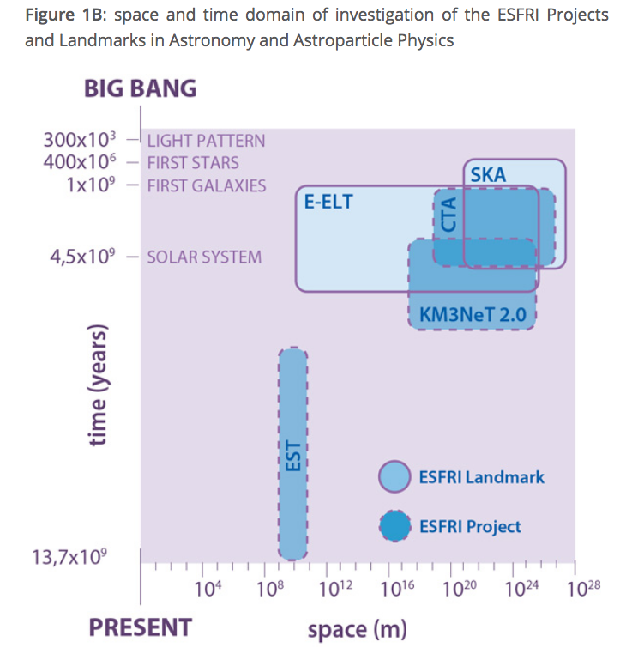
ESFRI LANDSCAPE
Astroparticle Physics
and Astronomy
ASTERICS cluster

Slide 11
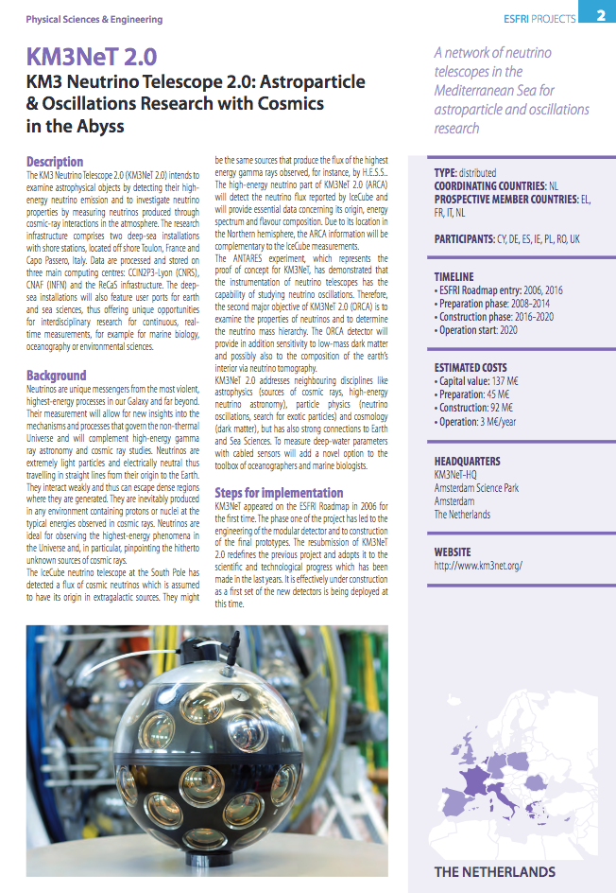
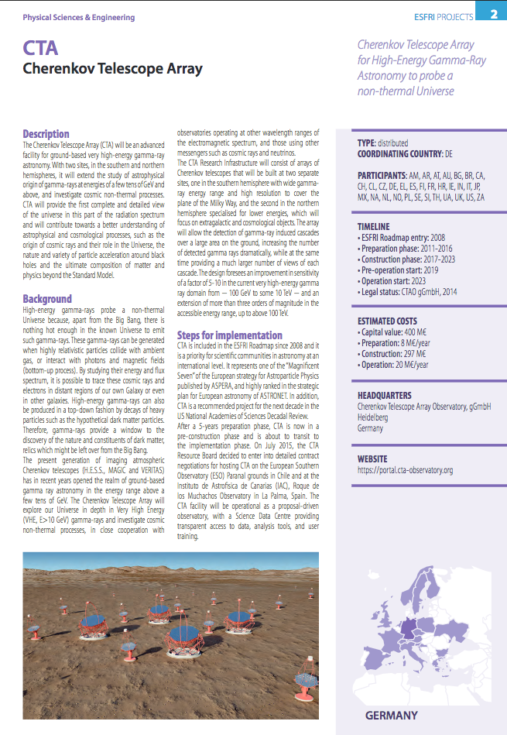
Two sites under construction, 2016
One site under construction, 2008

Slide 12
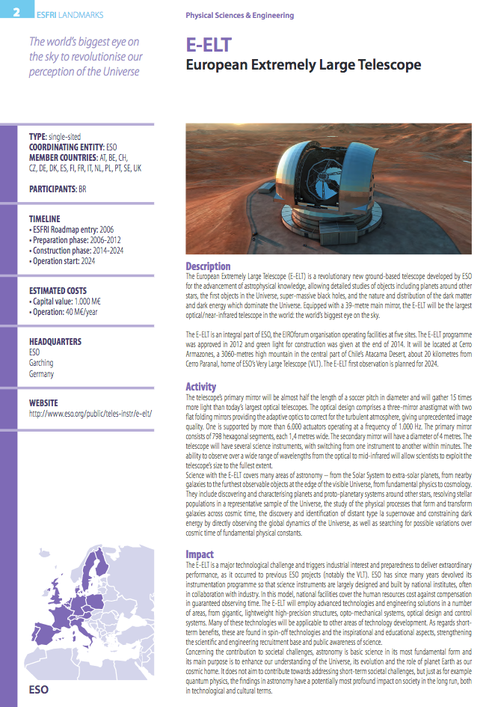
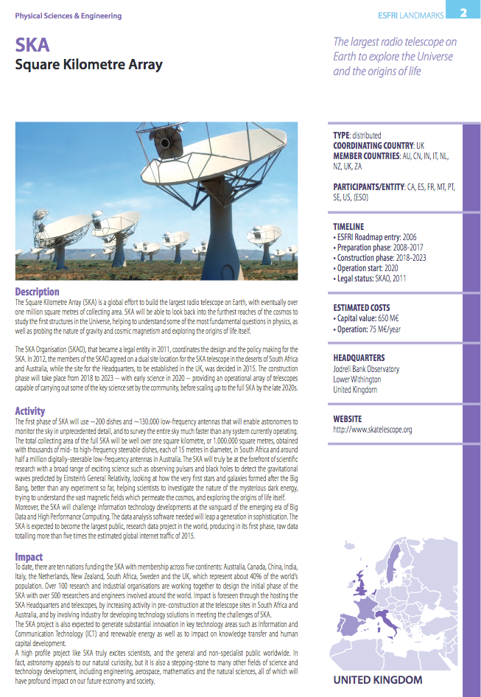
Single site under construction, 2006
Two sites under construction, 2006

Slide 13
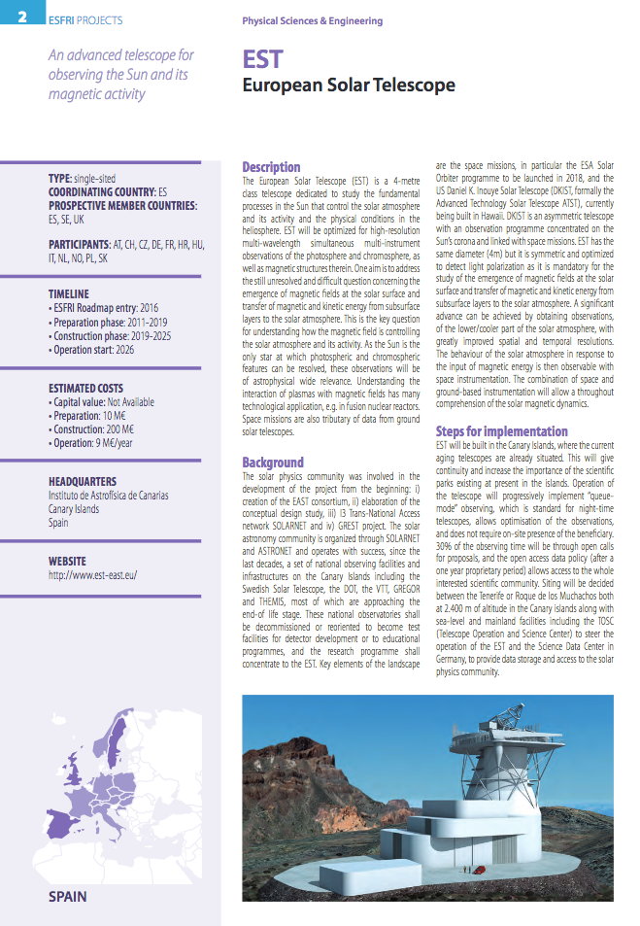
e-Infrastructure
One site under construction, 2016

Slide 14
INVESTMENT STRATEGIES IN e-INFRASTRUCTURES
Ad hoc Working Group on e-INFRA
The Working Group on Investment Strategies in e-Infrastructures – e-INFRA WG – was active in 2015/2016 in order to prepare the response to the Conclusions of the Council of the European Union of 29th May 2015 that
“INVITES ESFRI to explore mechanisms for better coordination of Member States’ investment strategies in e-Infrastructures, covering also HPC, distributed computing, scientific data and networks”.
ESFRI adopted the recommendation during its 59th Plenary Forum that took place on 9th December 2016 in Brussels.

Slide 15
INVESTMENT STRATEGIES IN e-INFRASTRUCTURES
Recommendations (2 and 3 of 9)
ESFRI advises to establish urgently a convergent policy of funding mechanisms for e-Infrastructures at the various levels (institutional, regional, national, European). Such policy could include support and financing of e-Infrastructures for scientific users, providing incentives to researchers to generate FAIR and reproducible (+R) data, as well as the development of enabling e-tools/e-technologies and the mainstreaming of support actions addressing e-needs of all levels of intervention.
ESFRI suggests to act as STRATEGY FORUM OF FUNDERS of the e-Infrastructures for European science as a key element of support of a coherent approach to policymaking on Research Infrastructure in Europe.

Slide 16
ELEMENTS FOR THE ESFRI POSITION ON EOSC
(63rd ESFRI Forum, 13/12/2017, Lund)
ESFRI is a strategy hub of funders
ESFRI (and other internationally open) RIs are unique in assuring a robust quality control on scientific data to be opened
EOSC should adopt a SUBSIDIARITY and PARTICIPATORY principle, where robust data management practices exist it should NOT DELEGITIMATE, should not CREATE FUNDING PROBLEMS to well DMP-performing RIs
EOSC should FILL THE GAPS of unstructured areas
EOSC should enable high level INTERDISCIPLINARITY
EOSC should make high level INTEROPERABILITY possible and workable
ESFRI is more than a “stakeholder” of the EOSC as it represents the effort of the Landmarks and Projects (80-90% funded by MS and AS) in developing Open Science objectives and namely Open Data policies that amount to ca 15% average of the overall financial effort in RIs. Therefore ESFRI is the Strategy Hub of Founders also for a large share of the EOSC-building actions.
INVESTMENT STRATEGIES IN e-INFRASTRUCTURES
Recommendation (2)

Slide 17
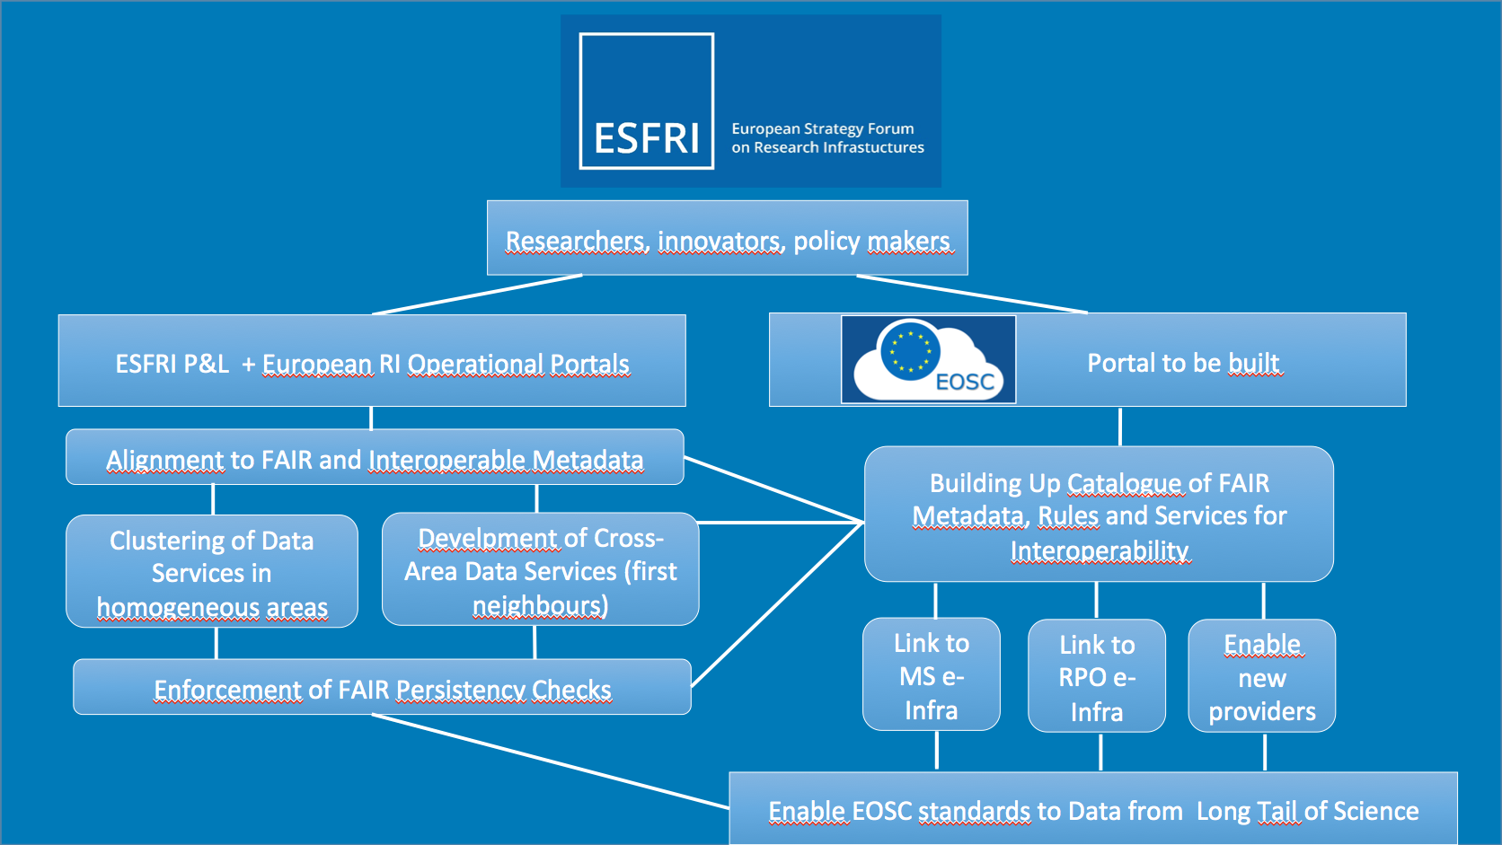

Slide 18
LONG-TERM SUSTAINABILITY OF RIs
Ad hoc Working Group on LTS
The Long-Term Sustainability Working Group – LTS WG – was created by ESFRI in 2016 to comprehensively respond to the Conclusions of the Competitiveness Council of the European Union of 27th May 2016 that
”UNDERLINES the importance of ensuring Long-Term Sustainability of Research Infrastructures and INVITES the Commission to prepare together with ESFRI and relevant stakeholders a targeted action plan”.
The concluding report of the LTS WG was published as ESFRI Scripta Vol.2 in October 2017.

Slide 19
LONG-TERM SUSTAINABILITY OF RIs
ESFRI SCRIPTA VOL.2
Downloadable at www.esfri.eu

Slide 20
LONG-TERM SUSTAINABILITY OF RIs
MAIN RECOMMENDATIONS
The seven main recommendations are declined into 35 final specific recommendations

Slide 22
NEUTRON SCATTERING FACILITIES IN EUROPE
ESFRI SCRIPTA VOL.1
Downloadable at www.esfri.eu

Slide 23
NEW PROPOSALS UNDER EVALUATION
As novel proposals with a dominant, or substantial, digital research infrastructure character have been proposed to the ESFRI Roadmap 2018, ESFRI decides to proceed in establishing a Strategy Working Group on Data, Computing and Digital Research Infrastructures – DIGIT SWG –
 | PROPOSAL | LEAD SWG | OTHER SWG
1 | DiSSCo | ENV | DIGIT
2 | EHRI | SCI
3 | EIRENE | H&F | ENV
4 | eLTER | ENV
5 | EU-IBISBA | H&F | ENE
6 | EuroNanoLab | PSE
7 | EuroStrain | PSE
8 | IFMIF-DONES | ENE | PSE
9 | METROFOOD | H&F | ENV
10 | OPERAS | SCI | DIGIT
11 | RESILIENCE | SCI
12 | SILECS | DIGIT

Slide 24
PARALLEL PROCESSES
STRATEGY WORKING GROUPS (SWG) IN FIVE SCIENTIFIC DOMAINS EVALUATE SCIENTIFIC CASE
IMPLEMENTATION GROUP (IG) ASSESSES IMPLEMENTATION
scientific excellence
pan-European relevance
socio-economic impact
e-needs
stakeholder commitment
user strategy & access policy
preparatory work
planning
governance & management
human resources policy
finances
risks

