Slide 1

Cavern Newtonian Noise Calculations with ANNA
24 March 2026 | EMR Noise Meeting | Valentin Tempel

Slide 2
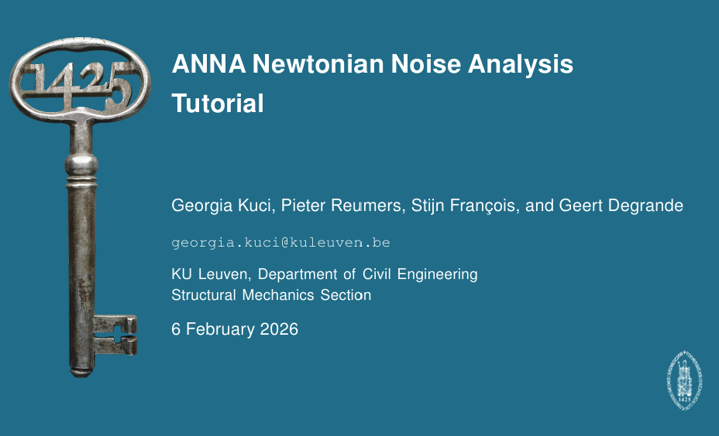
ANNA Newtonian Noise Analysis
ANNA Newtonian Noise Analysis is a toolbox that computes Newtonian Noise from a seismic wave field
NN can be evaluated for arbitrary meshes
both rock volume [bulk terms] and caverns effects [surface terms]
as well as the dipole approach can be computed in ANNA
Currently: Matlab implementation, mesh: Gmsh 4.15.1
Based on examples in ANNA tutorial:
  Plane harmonic P-wave in a full space with sphere cavity.
  Plane harmonic S-wave in a full space with sphere cavity.
Modify to different caverns…
… starting with cuboids / cylinders
crosscheck of analytical results

Slide 3
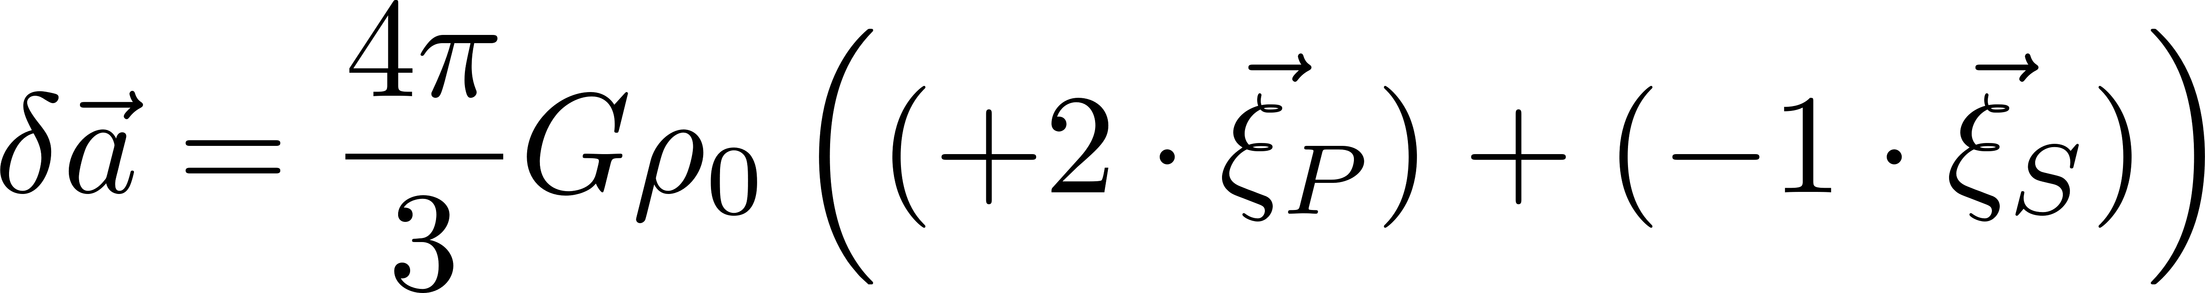
Remider: Homogenous full space with spherical cavern (mirror at center)
homogenous full space with spherical cavern
is typical standard case for analytical NN models of so-called body waves (e.g. currently used for the ET noise budget)
rather simple and exact analytical expressions
coupling matrices, are all unit matrices
very simple expression in the limit of full space and small spherical caverns:
  acceleration response in full space is flat in frequency domain:
  → double integration to convert from acceleration to mirror displacement
  → strain NN is quadratically suppressed with frequency
Some analytical terms (spherical bessel functions) are helpful to “correct” for effects of “small” integration volume…
(to isolate interesting NN effects)

Slide 4
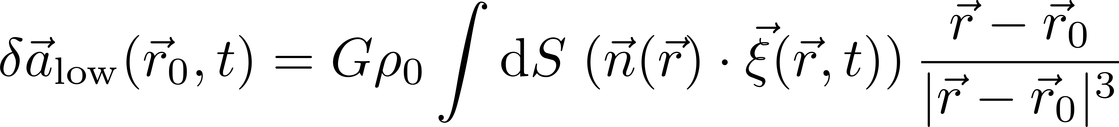
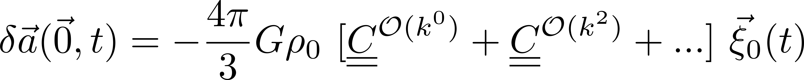
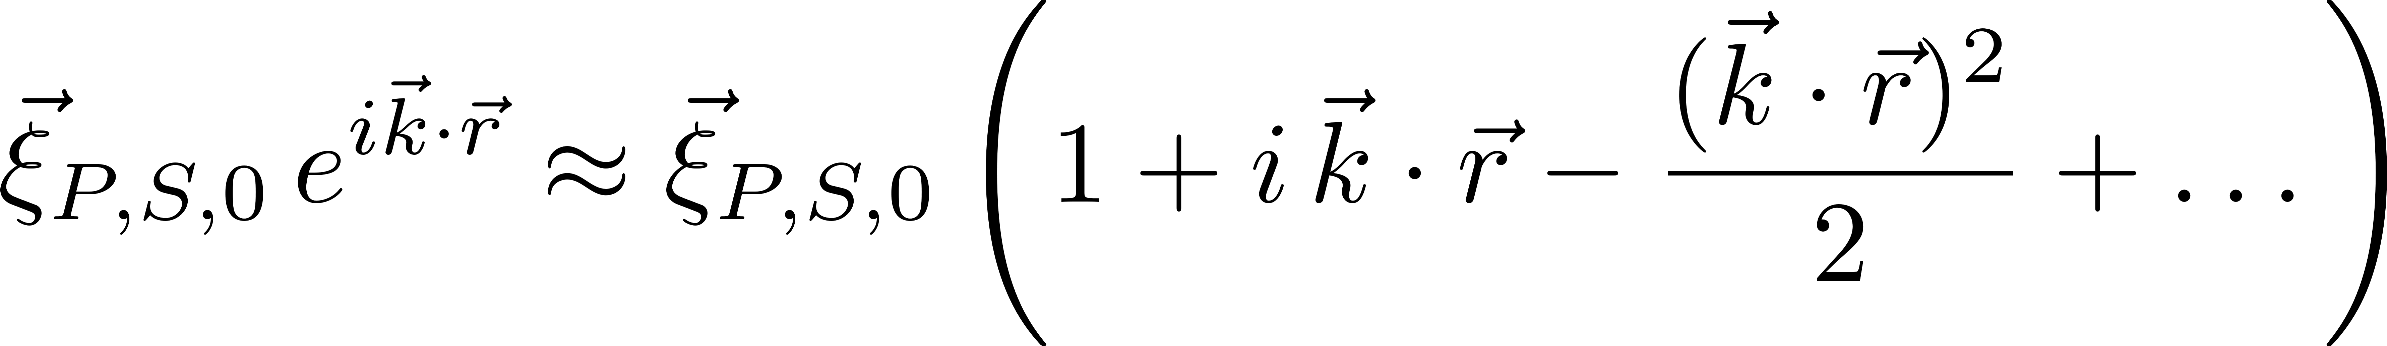
Reminder: NN coupling for arbitrary caverns
Starting with the surface formulation of NN:
Small Cavern Approximation (SCA) → constant displacement vector can be used…
This can of course be extended to the next orders → no constant displacement vector

Slide 5
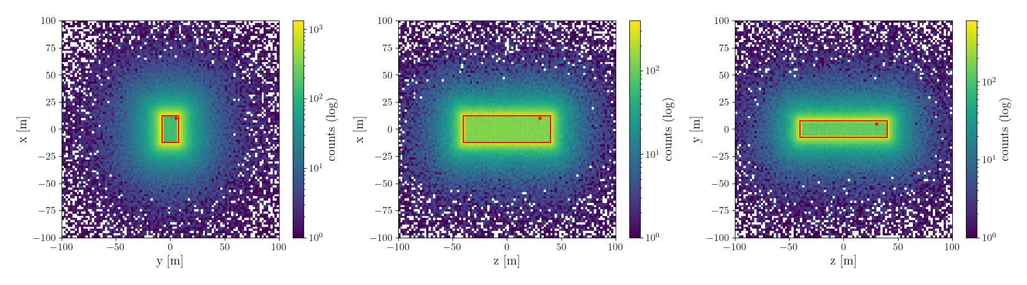
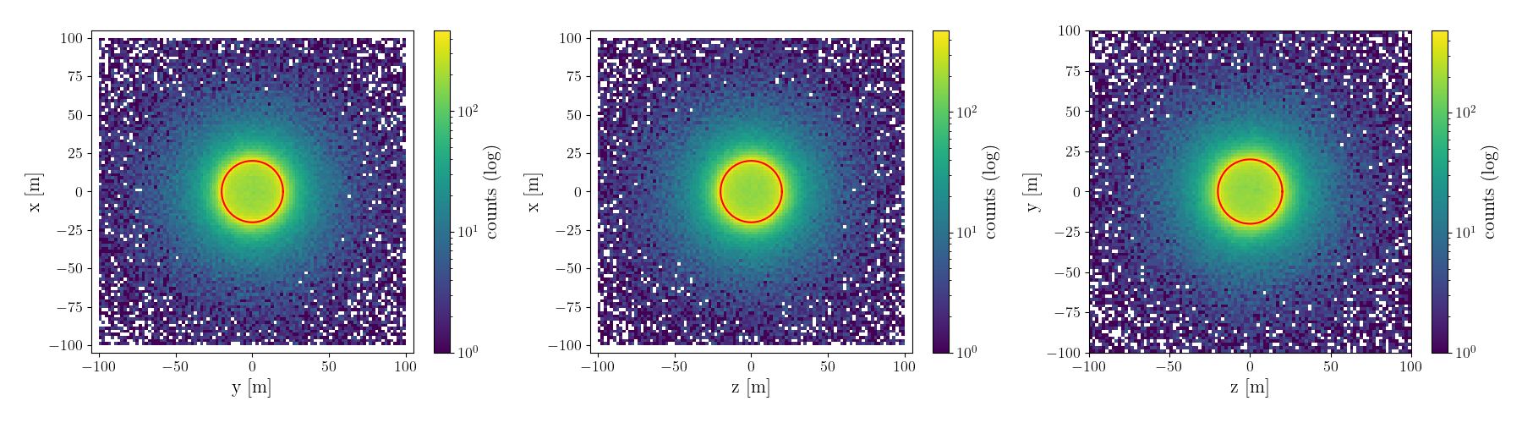

Slide 6
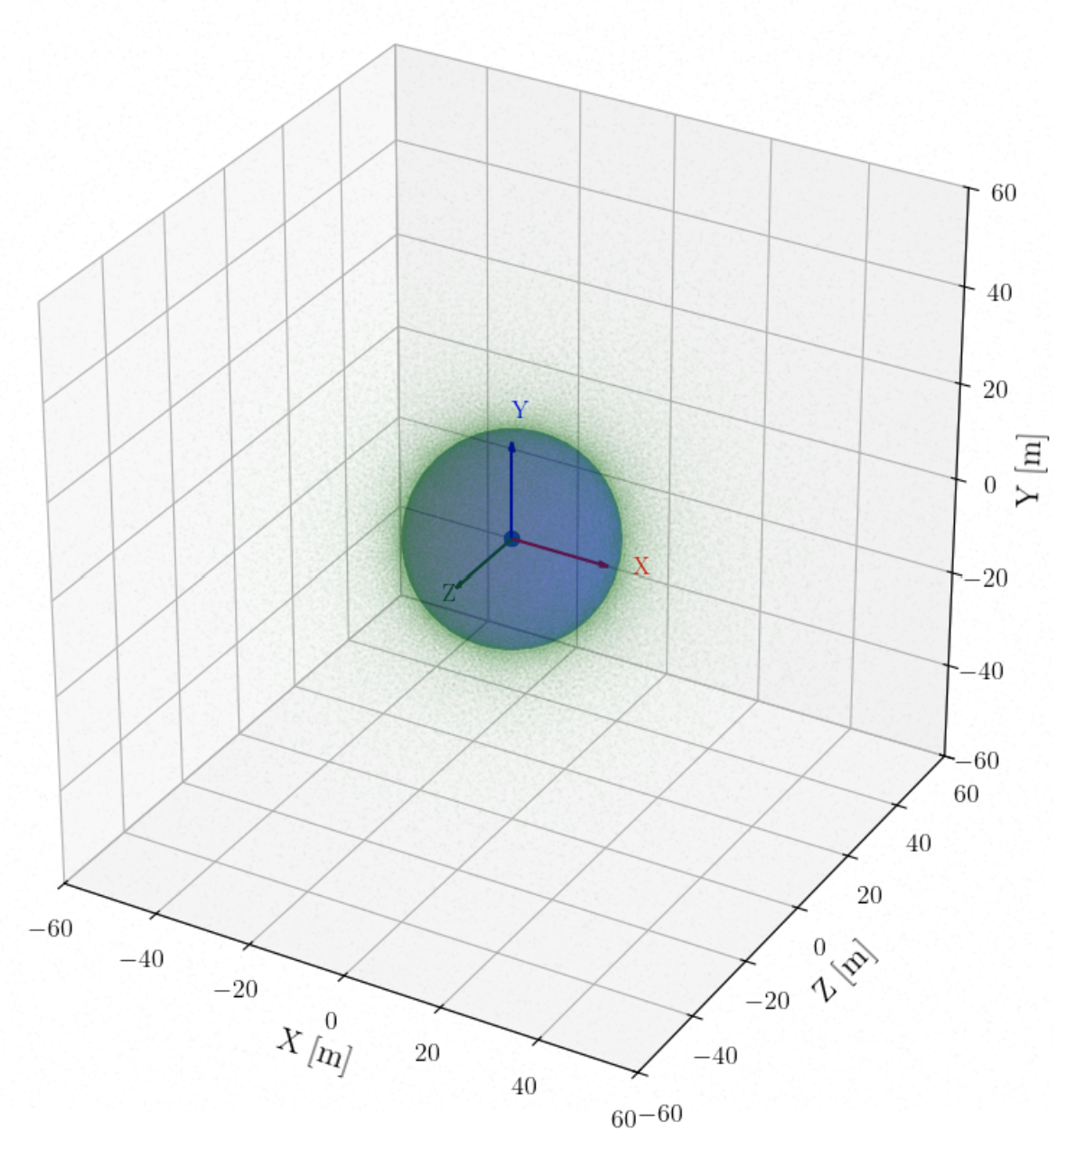
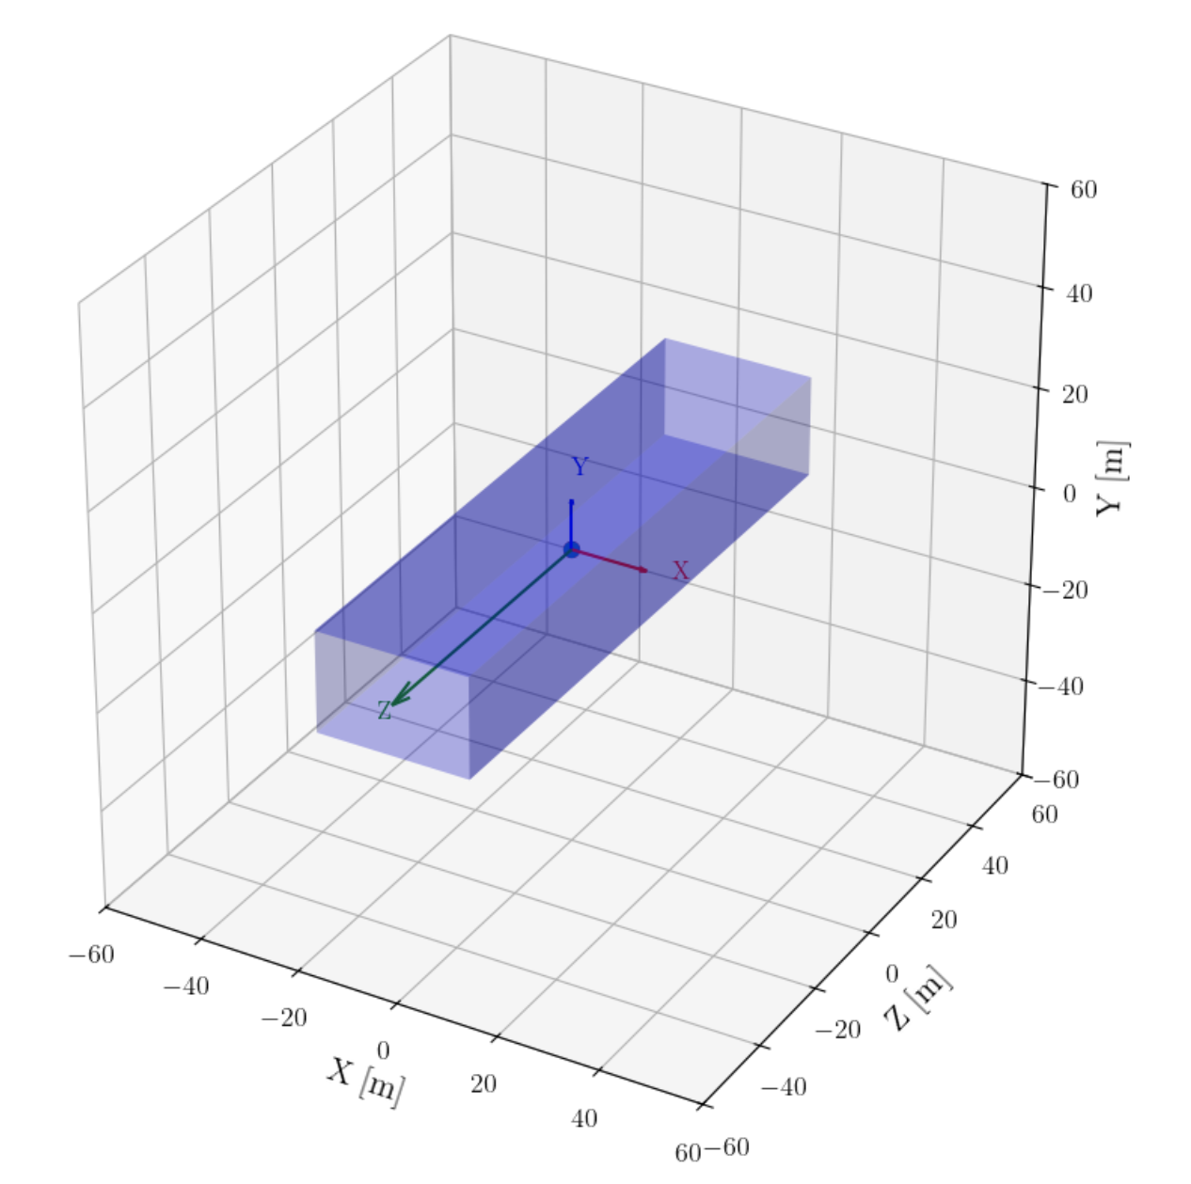
Comparison of Sphere and Cuboid Geometry used for the next two slides

Slide 7
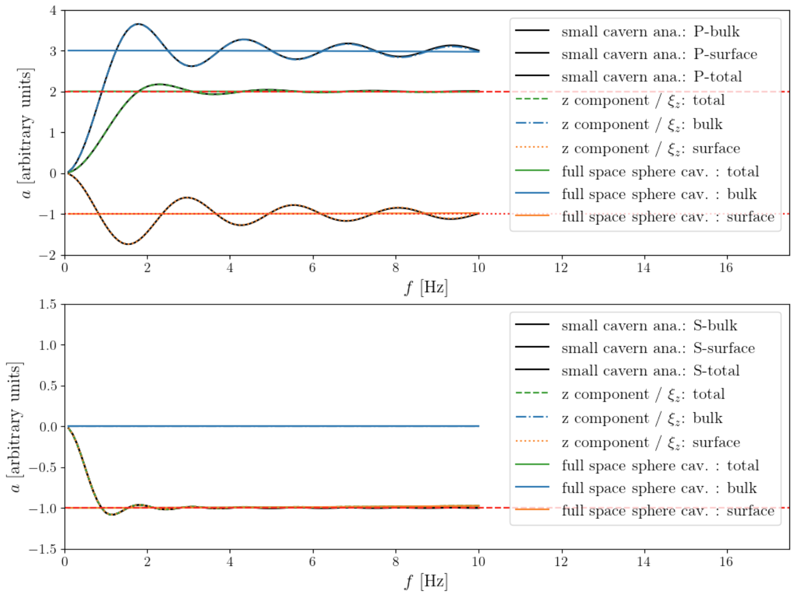
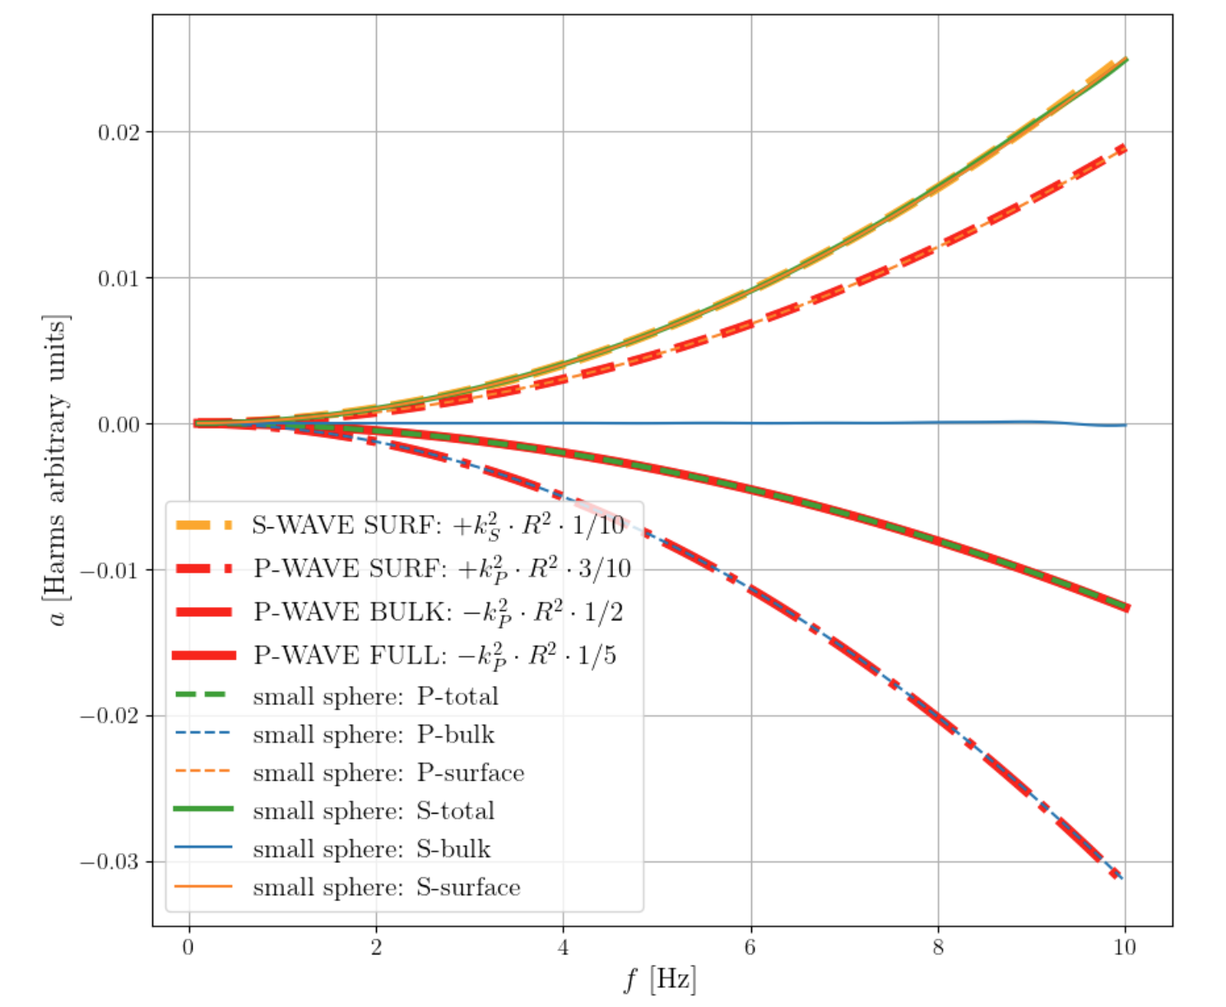
ANNA results for the spherical cavern (for P- and S- wave example) in homogenous medium
Isolating the quadratic order cavern effects
(after subtraction of known outer integration terms)

Slide 8
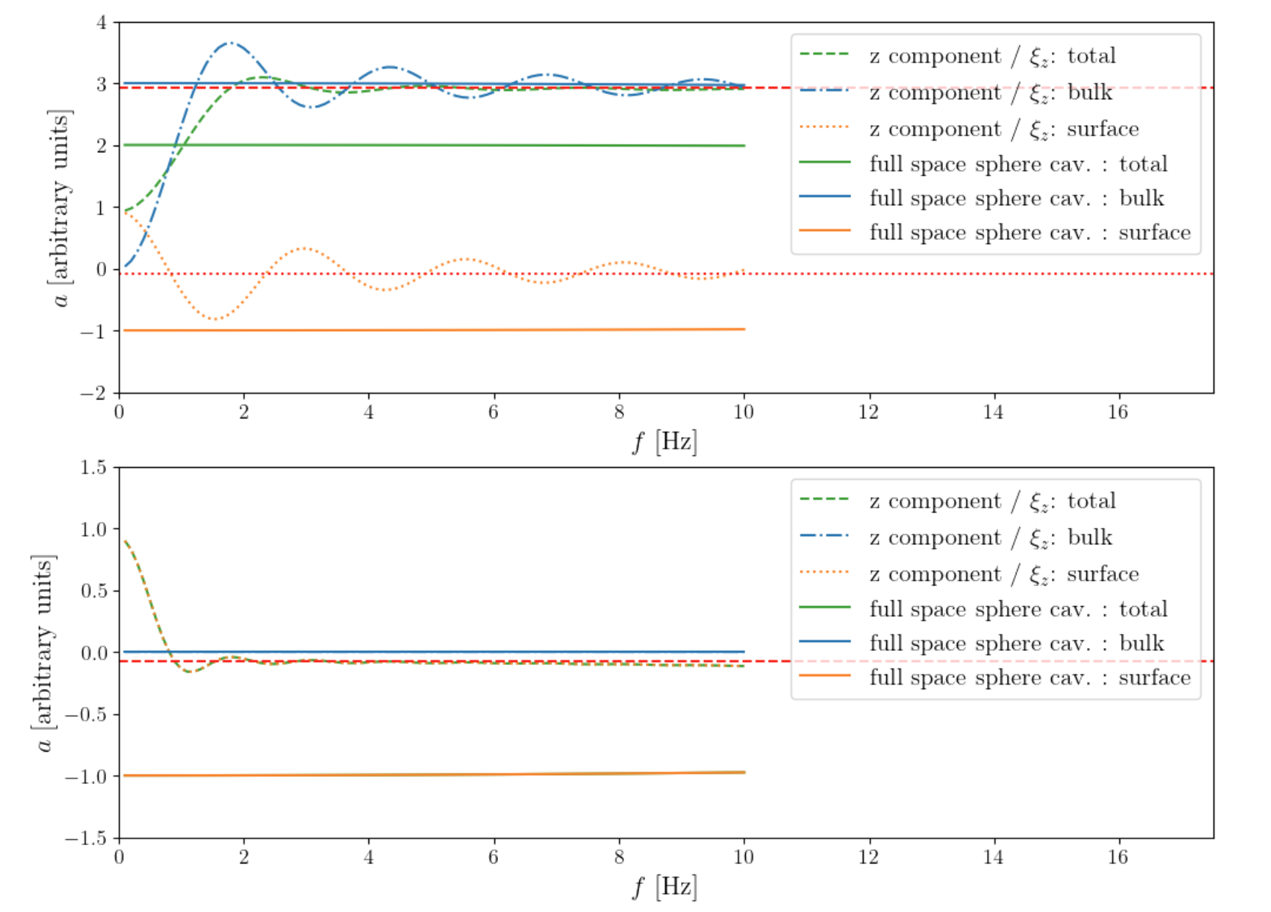
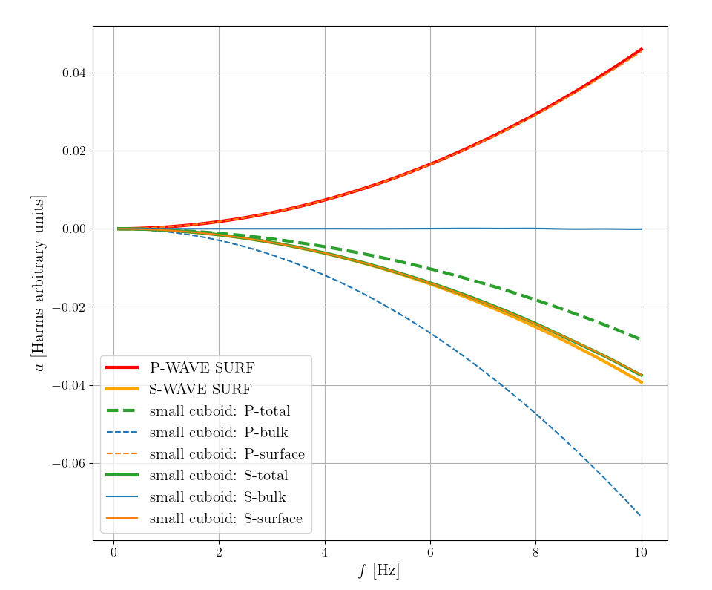
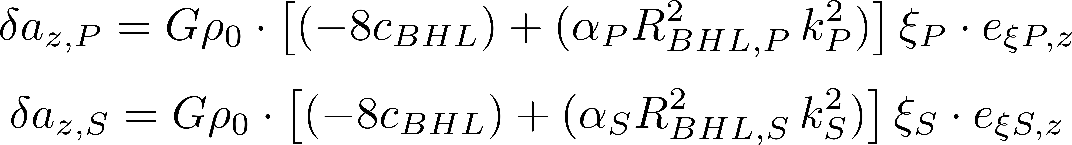
ANNA results for the cuboid cavern (for P- and S- wave example) in homogenous medium
Cavern wall NN for S-waves reduced by approx. one order of magnitude, for P-waves NN is increased by approx. 50%
Isolating the quadratic order cavern effects
(after subtraction of known outer integration terms)

Slide 9
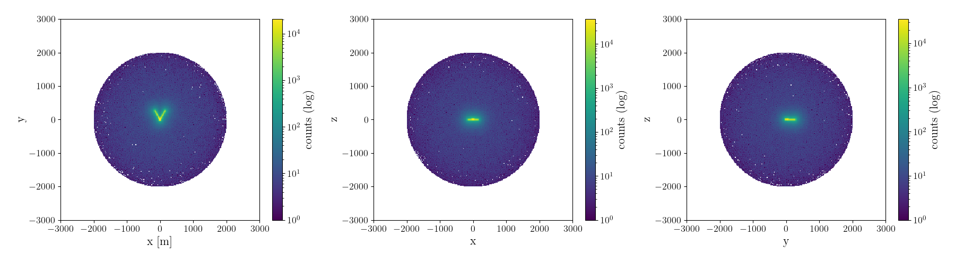
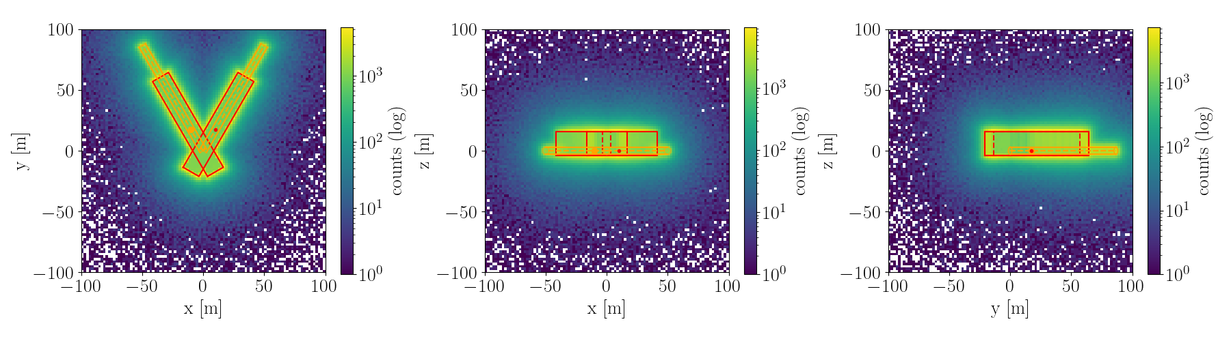

Slide 10
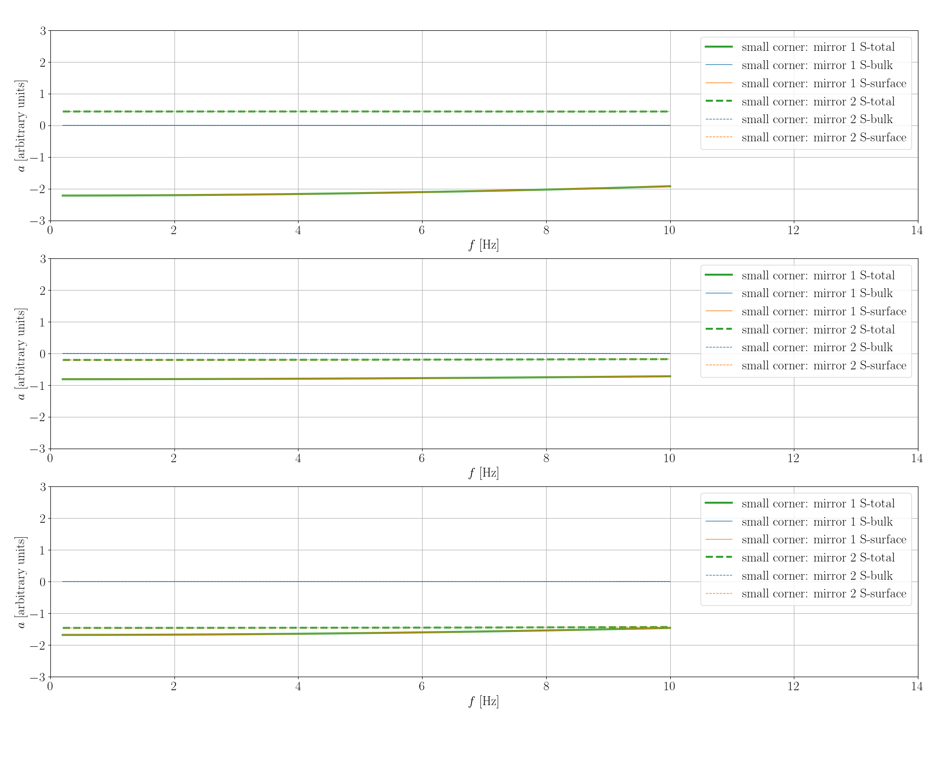
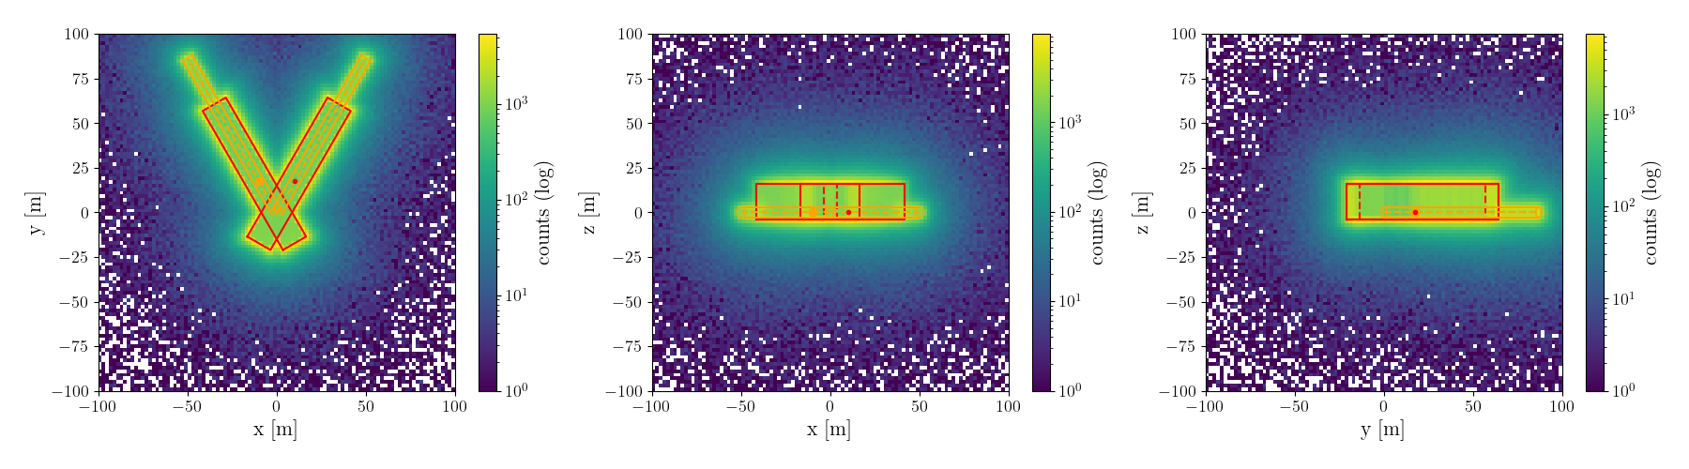
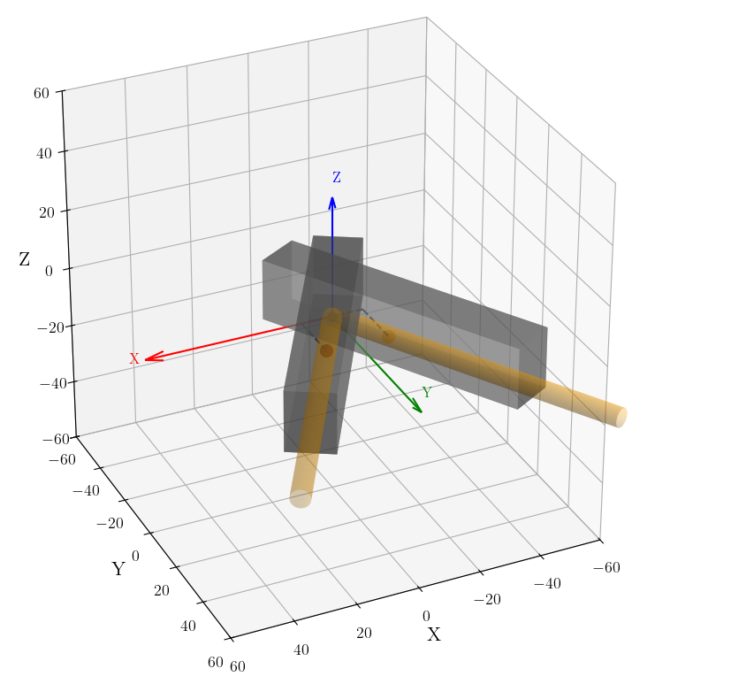

Slide 11
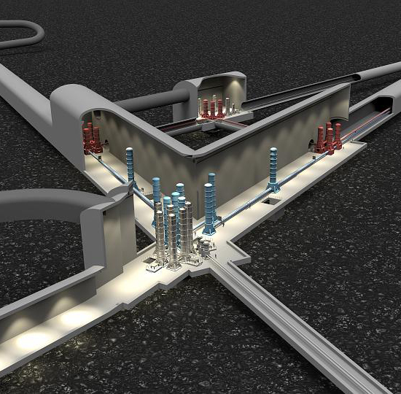
Summary and Outlook
TODAY:
What NN cavern geometry effects can we resolve with ANNA?
  very good agreement with analytical theory for NN accelerations
  constant and quadratic order for cavern effects: resolved very well
  higher orders probably not immediately needed for ET seismic NN
  (neither in NN estimation nor mitigation)
Seismic NN response for realistic caverns quite different compared to spheres
→ OUTLOOK / Ongoing… :
Model a more realistic cavern including tunnel
e.g. corner as on the right, with two mirrors
  one needs to be a bit more careful…
  no analytical checks are available
  bad mesh quality around caverns risks significant deviations
Include Scattering Effects etc. (maybe using ElastoDynamics Toolbox ?)
Hopefully
SOON:

