Slide 1

pySeisNN-1D An opensource tool in python and Fortran for modeling Newtonian noise in 1D layered subsurface
S. Koley, M. Hadrien, F. Nguyen, M. Fays

Slide 2
Workflow – The software was developed keeping in mind a modular structure for easier updates and future improvements
User provided configuration specify simulation parameters
runNN.py
Config.ini
Green’s function generation
QSEIS - Fortran
Mesh generation
NNGeometry.py
createDB.py
Simulates displacement field
gfLoader.py
simDisp.py
Computes Newtonian noise
NNCompute.py
NNPP.py
strain
plotUtils.py

Slide 3
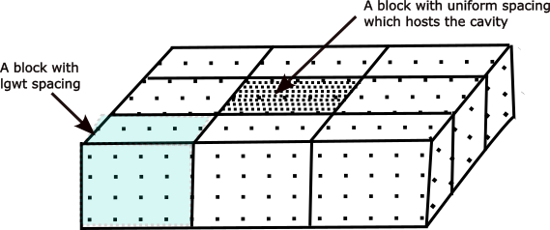
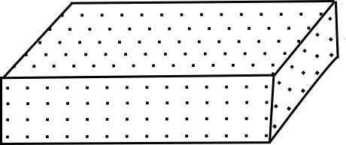
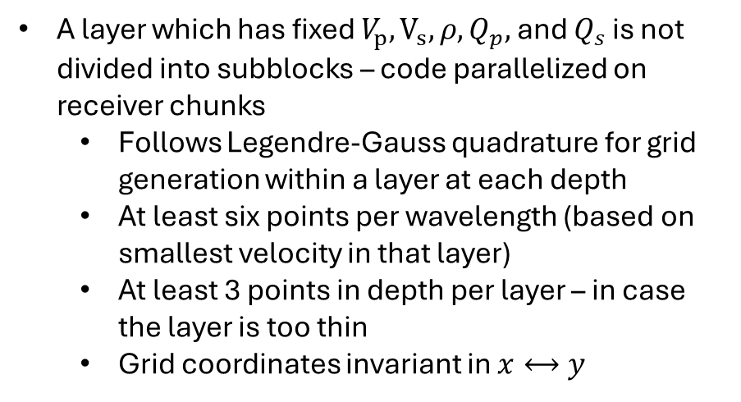
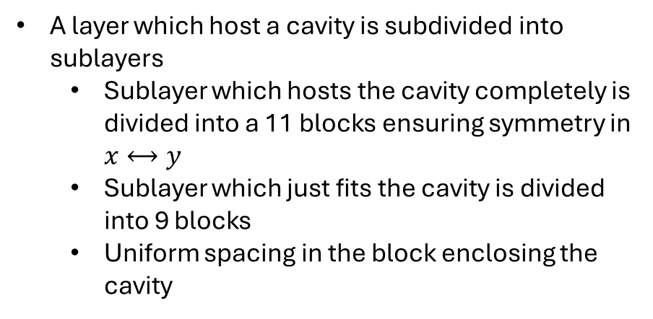
NNGeometry – Following a right-handed cartesian coordinate system this module partitions the layers into sublayers and layers into blocks for parallelized computation
A layer which has fixed $V_{p}, V_{s}, ρ, Q_{p},$ and $Q_{s}$ is not divided into subblocks – code parallelized on receiver chunks
Follows Legendre-Gauss quadrature for grid generation within a layer at each depth
At least six points per wavelength (based on smallest velocity in that layer)
At least 3 points in depth per layer – in case the layer is too thin
Grid coordinates invariant in $x⟷y$
A layer which host a cavity is subdivided into sublayers
Sublayer which hosts the cavity completely is divided into a 11 blocks ensuring symmetry in $x⟷y$
Sublayer which just fits the cavity is divided into 9 blocks
Uniform spacing in the block enclosing the cavity
z
y
z
y
x
The image is for illustration purpose only.
In principle lgwt spacing is not uniform
x

Slide 4
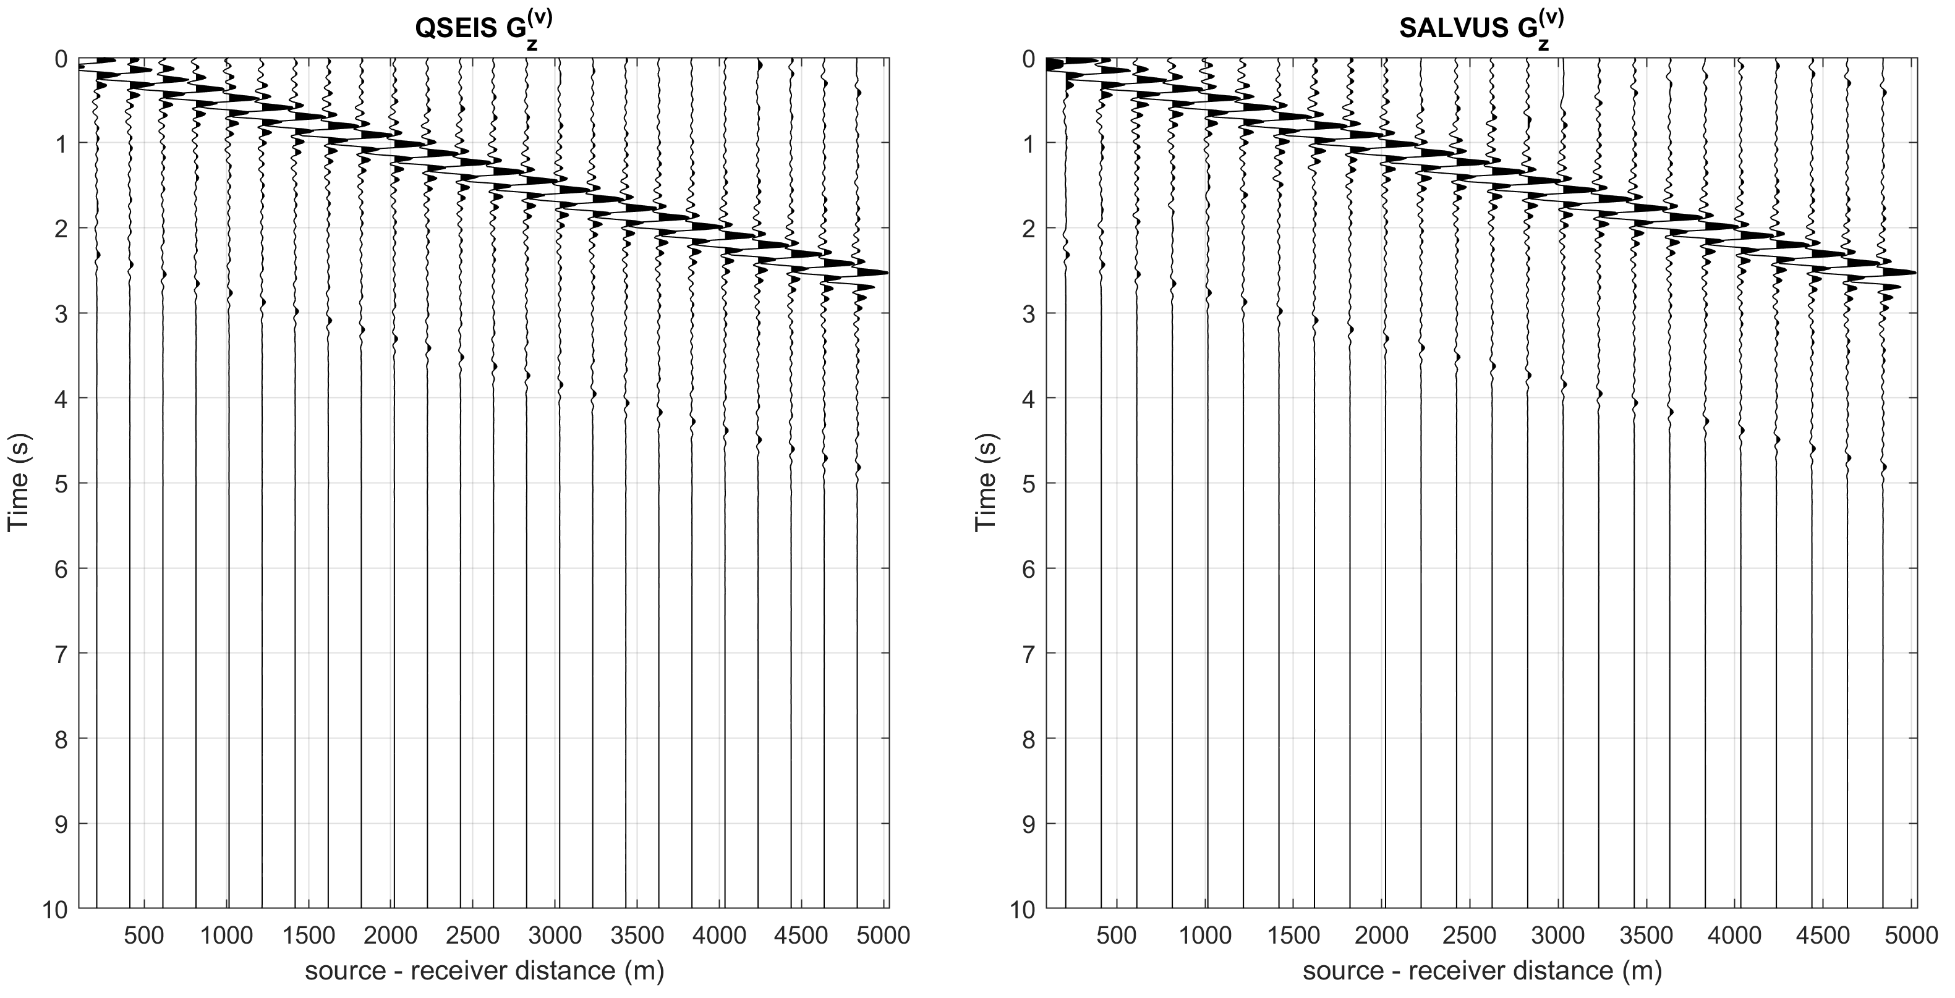
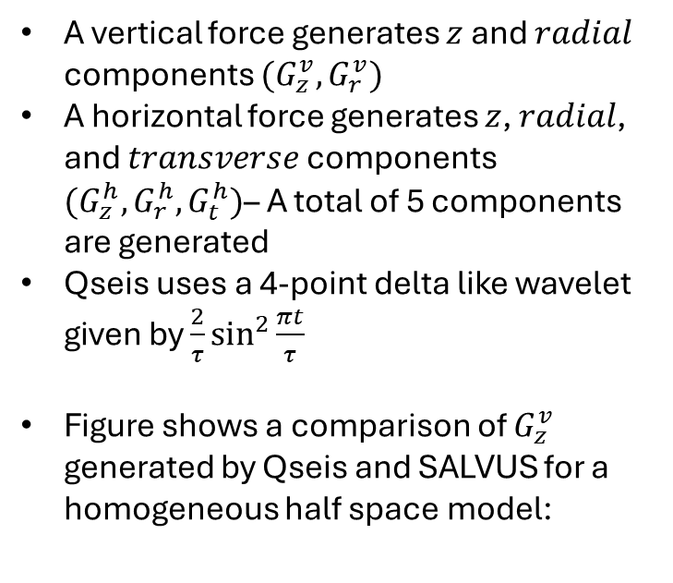
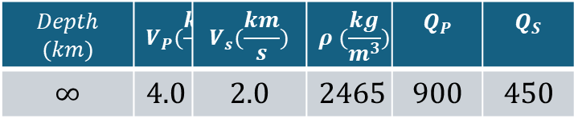
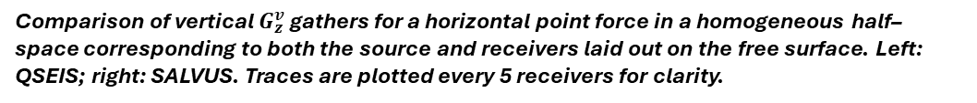
Qseis vs SALVUS – createDB.py – Green’s function corresponding to both vertical and horizontal forces are generated (a note on accuracy)
A vertical force generates $z$ and $radial$ components $(G_{z}^{v}, G_{r}^{v})$
A horizontal force generates $z$, $radial$, and $transverse$ components $(G_{z}^{h}, G_{r}^{h}, G_{t}^{h})$– A total of 5 components are generated
Qseis uses a 4-point delta like wavelet given by $\frac{2}{τ}\sin^{2}{\frac{πt}{τ}}$
Figure shows a comparison of $G_{z}^{v}$ generated by Qseis and SALVUS for a homogeneous half space model:
$$Depth$$ $$(km)$$ | $$V_{P}(\frac{km}{S})$$ | $$V_{s}(\frac{km}{s})$$ | $$ρ (\frac{kg}{m^{3}})$$ | $$Q_{P}$$ | $$Q_{S}$$
$$∞$$ | $$4.0$$ | $$2.0$$ | $$2465$$ | $$900$$ | $$450$$
Comparison of vertical $G_{z}^{v}$ gathers for a horizontal point force in a homogeneous half–space corresponding to both the source and receivers laid out on the free surface. Left: QSEIS; right: SALVUS. Traces are plotted every 5 receivers for clarity.

Slide 5
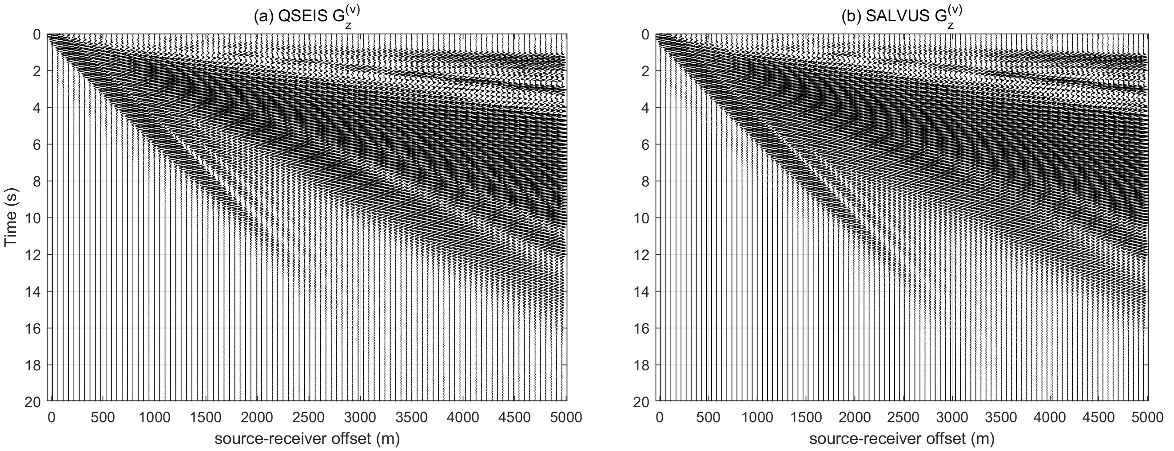
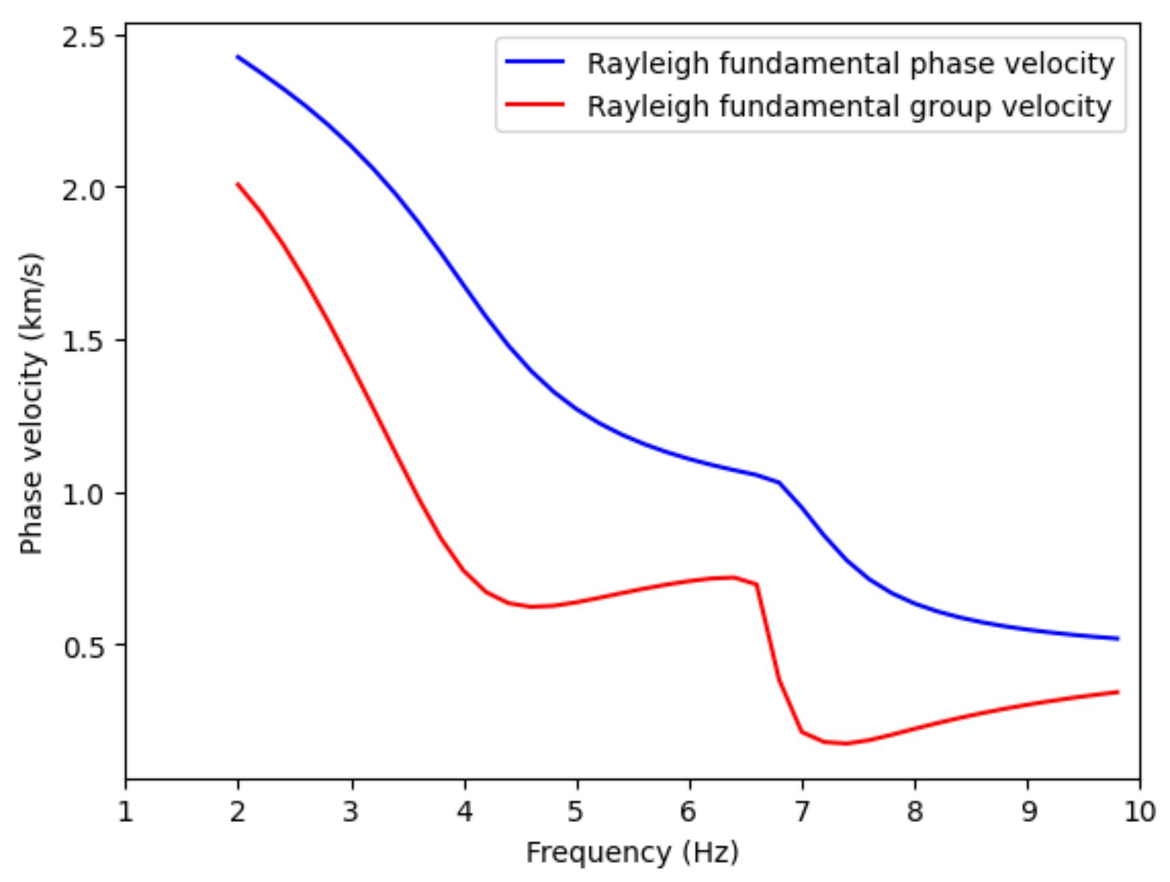
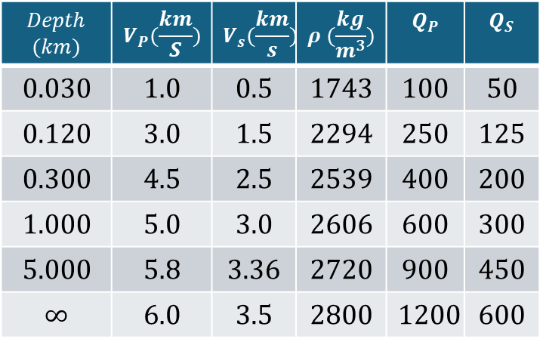
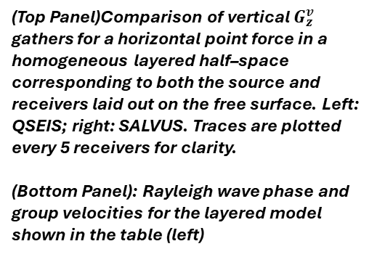
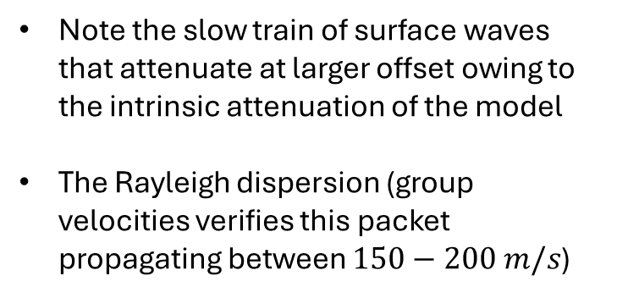
Qseis vs SALVUS – a comparison of Green’s function for a layered medium with realistic intrinsic attenuation
Note the slow train of surface waves that attenuate at larger offset owing to the intrinsic attenuation of the model
The Rayleigh dispersion (group velocities verifies this packet propagating between $150−200 m/s$)
$$Depth$$ $$(km)$$ | $$V_{P}(\frac{km}{S})$$ | $$V_{s}(\frac{km}{s})$$ | $$ρ (\frac{kg}{m^{3}})$$ | $$Q_{P}$$ | $$Q_{S}$$
$$0.030$$ | $$1.0$$ | $$0.5$$ | $$1743$$ | $$100$$ | $$50$$
$$0.120$$ | $$3.0$$ | $$1.5$$ | $$2294$$ | $$250$$ | $$125$$
$$0.300$$ | $$4.5$$ | $$2.5$$ | $$2539$$ | $$400$$ | $$200$$
$$1.000$$ | $$5.0$$ | $$3.0$$ | $$2606$$ | $$600$$ | $$300$$
$$5.000$$ | $$5.8$$ | $$3.36$$ | $$2720$$ | $$900$$ | $$450$$
$$∞$$ | $$6.0$$ | $$3.5$$ | $$2800$$ | $$1200$$ | $$600$$
(Top Panel)Comparison of vertical $G_{z}^{v}$ gathers for a horizontal point force in a homogeneous layered half–space corresponding to both the source and receivers laid out on the free surface. Left: QSEIS; right: SALVUS. Traces are plotted every 5 receivers for clarity.
(Bottom Panel): Rayleigh wave phase and group velocities for the layered model shown in the table (left)

Slide 6
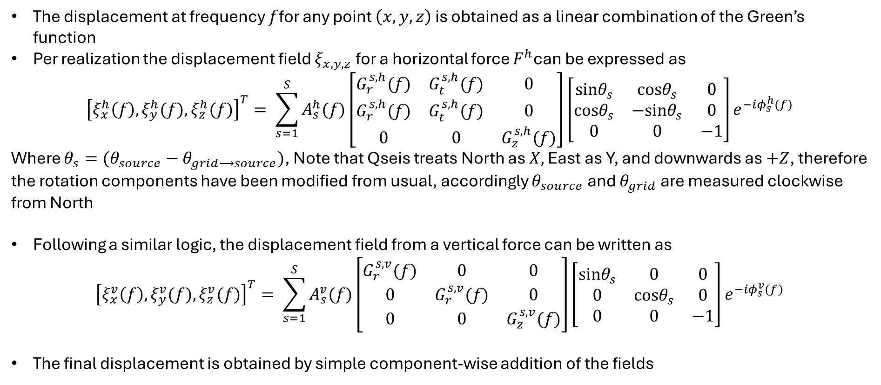
simDisp.py – module that uses the Green’s function to model the displacement at any point within the simulation domain
The displacement at frequency $f$for any point $\left(x,y,z\right)$ is obtained as a linear combination of the Green’s function
Per realization the displacement field $ξ_{x,y,z}$ for a horizontal force $F^{h}$can be expressed as
$${\left[ξ_{x}^{h}\left(f\right), ξ_{y}^{h}(f), ξ_{z}^{h}(f)\right]}^{T}= \sum_{s=1}^{S}{A_{s}^{h}(f)\left[\begin{matrix}G_{r}^{s,h}(f) & G_{t}^{s,h}(f) & 0 \\ G_{r}^{s,h}(f) & G_{t}^{s,h}(f) & 0 \\ 0 & 0 & G_{z}^{s,h}(f)\end{matrix}\right]\left[\begin{matrix}sinθ_{s} & cosθ_{s} & 0 \\ cosθ_{s} & −sinθ_{s} & 0 \\ 0 & 0 & −1\end{matrix}\right]}e^{−iφ_{s}^{h}(f)}$$
Where $θ_{s}=(θ_{source}−θ_{grid⟶source})$, Note that Qseis treats North as $X,$ East as Y, and downwards as $+Z$, therefore the rotation components have been modified from usual, accordingly $θ_{source}$ and $θ_{grid}$ are measured clockwise from North
Following a similar logic, the displacement field from a vertical force can be written as
$${\left[ξ_{x}^{v}\left(f\right), ξ_{y}^{v}(f), ξ_{z}^{v}(f)\right]}^{T}= \sum_{s=1}^{S}{A_{s}^{v}(f)\left[\begin{matrix}G_{r}^{s,v}(f) & 0 & 0 \\ 0 & G_{r}^{s,v}(f) & 0 \\ 0 & 0 & G_{z}^{s,v}(f)\end{matrix}\right]\left[\begin{matrix}sinθ_{s} & 0 & 0 \\ 0 & cosθ_{s} & 0 \\ 0 & 0 & −1\end{matrix}\right]}e^{−iφ_{s}^{v}(f)}$$
The final displacement is obtained by simple component-wise addition of the fields

Slide 7
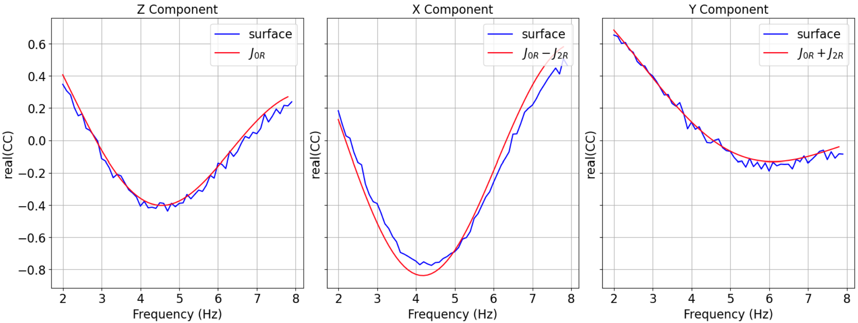
simDisp.py – Check 1: compare cross-correlation between two points to theoretical results to verify correctness
Frequency domain cross-correlation between two points on the surface separated along x-axes when the excited by a stochastic distribution of vertical forces in a homogeneous half space must be $J_{0}\left(kd\right)±J_{2}(kd)$, where $k$ is the Rayleigh wave number and $d$ the separation between the stations
Cross-correlations $C_{zz}, C_{xx},$ and $C_{yy}$ between two points on the surface separated by 250 meters along X axes. The noise field is produced from random distribution of vertical forces on the surface. The observed correlations match the theoretical one

Slide 8
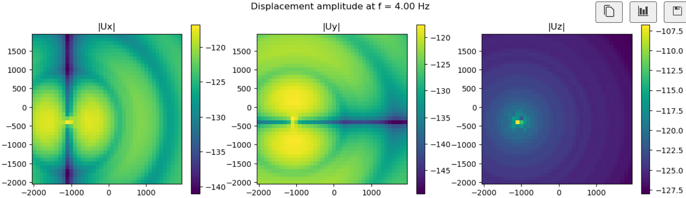
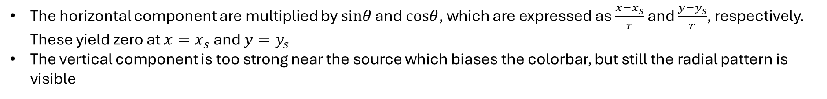
simDisp.py – Check 2: displacement field in a homogeneous half-space from a single vertical force shows the nodal structure in the horizontal components and radial for vertical component
The horizontal component are multiplied by $sinθ$ and $cosθ$, which are expressed as $\frac{x−x_{s}}{r}$ and $\frac{y−y_{s}}{r}$, respectively. These yield zero at $x=x_{s}$ and $y=y_{s}$
The vertical component is too strong near the source which biases the colorbar, but still the radial pattern is visible
Absolute value of the displacement field corresponding to $x, y, z$ components at 4 Hz due to a vertical source acting on the surface

Slide 9
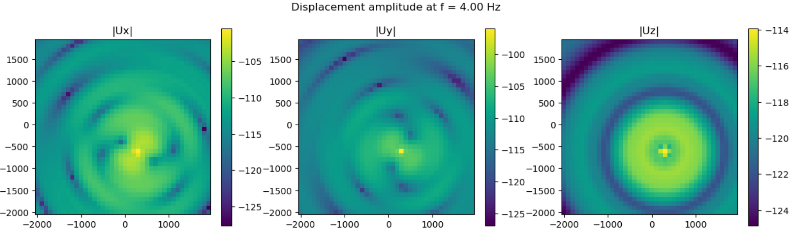
simDisp.py – Check 3: displacement field in homogeneous half-space from a single horizontal force shows the dipole radiation pattern in the horizontal components
The $U_{x}$ aligns along the direction of the force and $U_{y}$ perpendicular to it.
Unlike vertical forces, the horizontal component of the displacement field is not axisymmetric
Absolute value of the displacement field corresponding to $x, y, z$ components at 4 Hz due to a horizontal source acting on the surface

Slide 10
Validation for Rayleigh waves in homogeneous half-space

Slide 11
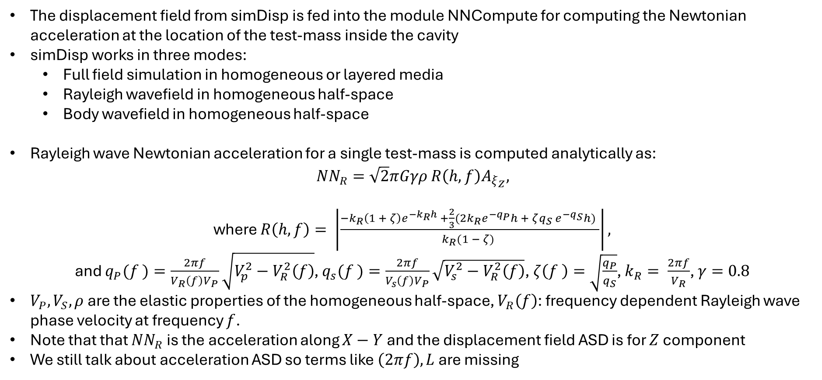
Analytical formulation: Newtonian noise from a diffuse Rayleigh wavefield in a homogeneous half-space
The displacement field from simDisp is fed into the module NNCompute for computing the Newtonian acceleration at the location of the test-mass inside the cavity
simDisp works in three modes:
Full field simulation in homogeneous or layered media
Rayleigh wavefield in homogeneous half-space
Body wavefield in homogeneous half-space
Rayleigh wave Newtonian acceleration for a single test-mass is computed analytically as:
$$NN_{R}=\sqrt{2}πGγρ R\left(h,f\right)A_{ξ_{Z}},$$
where $R\left(h,f\right)= \left|\frac{−k_{R}\left(1 + ζ\right)e^{−k_{R}h} +\frac{2}{3}(2k_{R}e^{−q_{P}}h + ζq_{S} e^{−q_{S}}h) }{k_{R}(1 − ζ) }\right|,$
and $q_{P}(f )=\frac{2πf}{V_{R}\left(f\right)V_{P}}\sqrt{V_{p}^{2}−V_{R}^{2}\left(f\right)}$, $q_{s}(f )=\frac{2πf}{V_{s}\left(f\right)V_{P}}\sqrt{V_{s}^{2}−V_{R}^{2}\left(f\right)}$, $ζ\left(f \right)=\sqrt{\frac{q_{P}}{q_{S}}}$, $k_{R}= \frac{2πf}{V_{R}}$, $γ=0.8$
$V_{P}, V_{S}, ρ$ are the elastic properties of the homogeneous half-space, $V_{R}\left(f\right)$: frequency dependent Rayleigh wave phase velocity at frequency $f$.
Note that that $NN_{R}$ is the acceleration along $X−Y$ and the displacement field ASD is for $Z$ component
We still talk about acceleration ASD so terms like $\left(2πf\right), L$are missing
Only implemented for analytical validation, code not optimized for speed

Slide 12
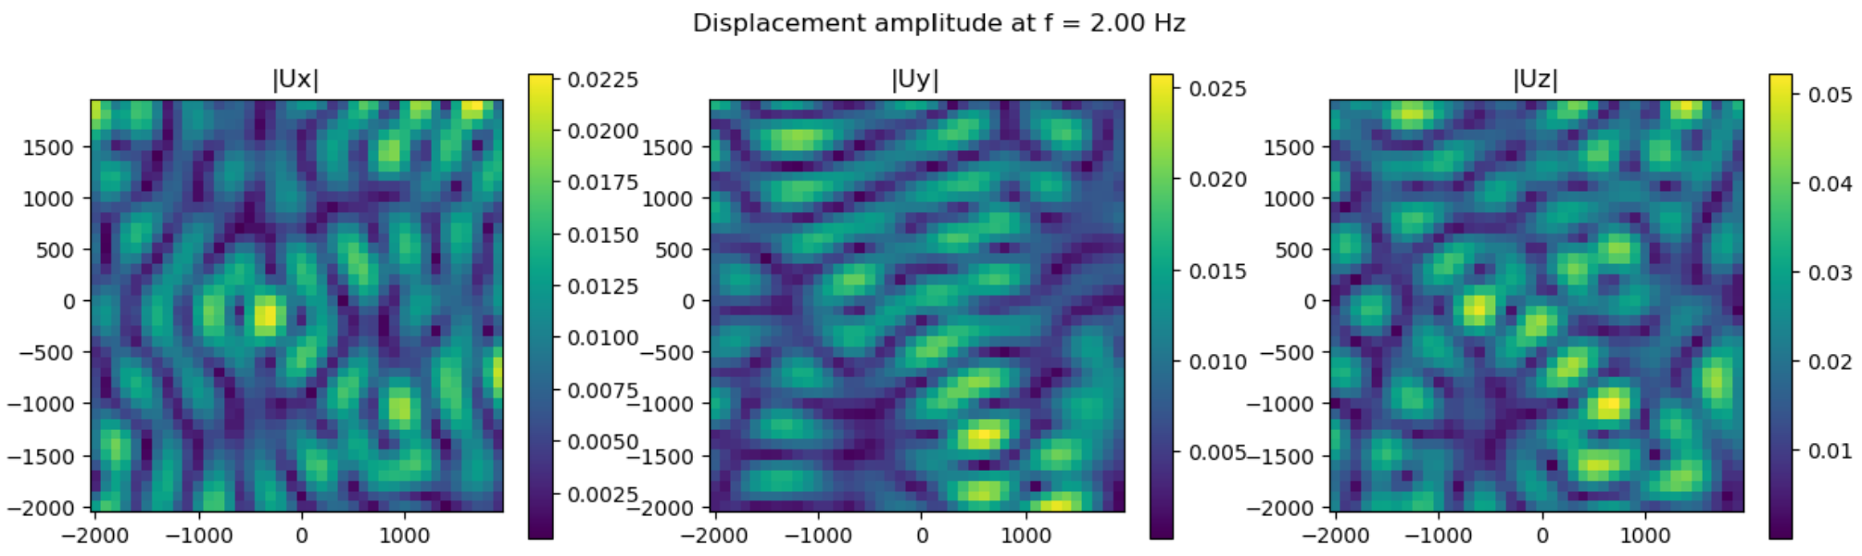
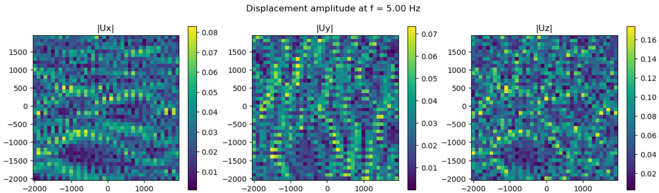
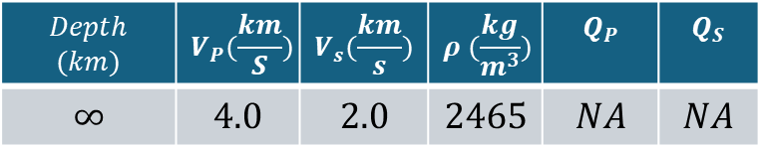
simDisp.py – Source parameters and visualization of a diffuse Rayleigh wavefield for one realization
Homogeneous half-space model
We perform a total of 50 realizations, and each realization has 100 sources
Stochastic properties of the source:
Source phase
Source amplitude
Wave direction
We already see that the size of the coherent blocks diminish with increasing frequency (figures right show 2 Hz and 5 Hz) since the wavelength decreases, although the phase velocity is constant for homogeneous half space
$$Depth$$ $$(km)$$ | $$V_{P}(\frac{km}{S})$$ | $$V_{s}(\frac{km}{s})$$ | $$ρ (\frac{kg}{m^{3}})$$ | $$Q_{P}$$ | $$Q_{S}$$
$$∞$$ | $$4.0$$ | $$2.0$$ | $$2465$$ | $$NA$$ | $$NA$$
The top (2 Hz) and bottom (5 Hz) panels show the absolute value of the displacement field obtained from a superposition of 100 waves, which implies one realization in the simulation

Slide 13
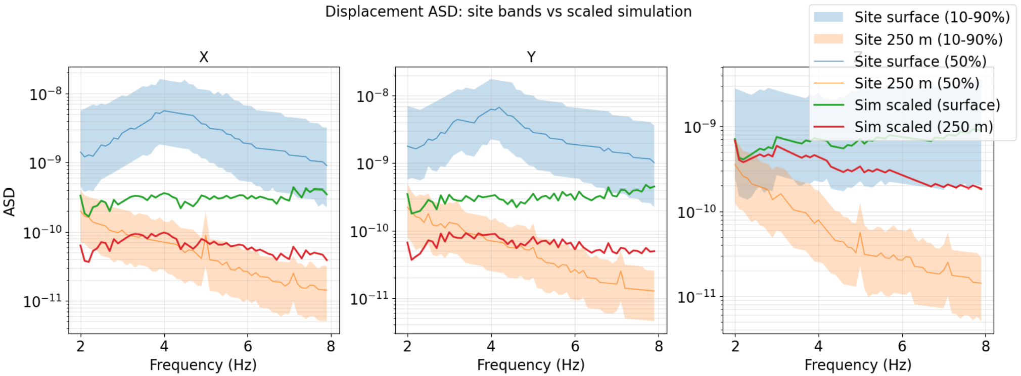
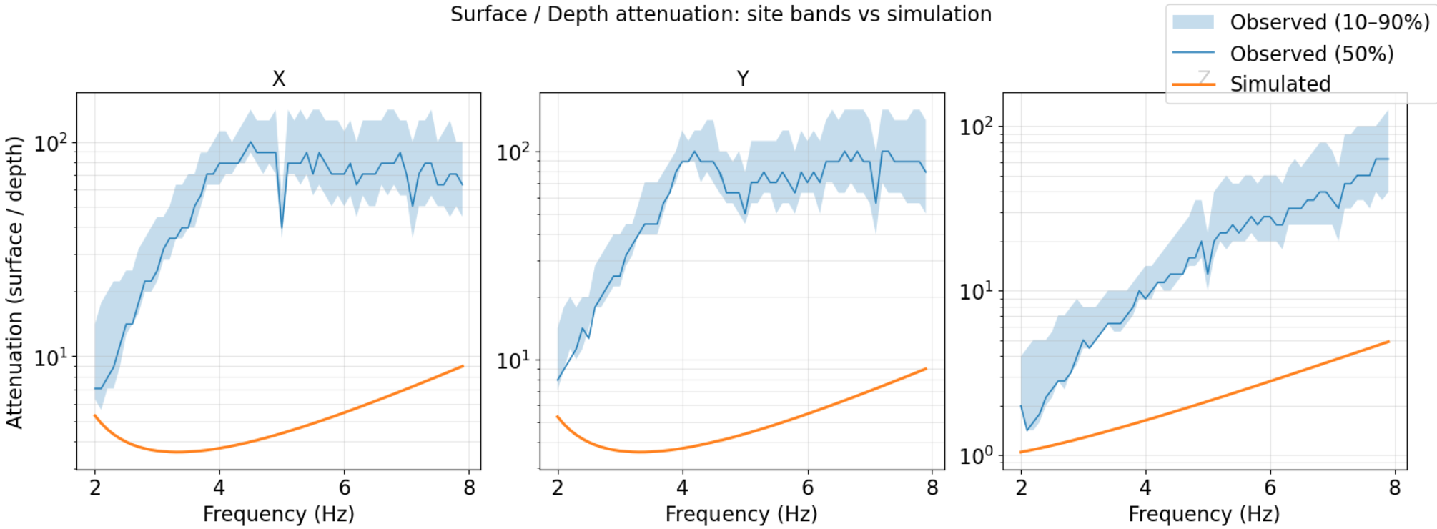
simDisp.py – Such a Rayleigh wavefield for a homogeneous half-space is not a true representation of EMR like geology
Rayleigh waves in homogeneous half space fails to explain the observed ASD’s at Terziet and hence also the attenuation
But this exercise is performed only to validate the code
Figures to the right show all components of simulated displacement scaled to match the vertical component on the surface at Terziet
The attenuation is also not matched and simply shows the Rayleigh depth dependent transfer function in homogeneous half-space

Slide 14
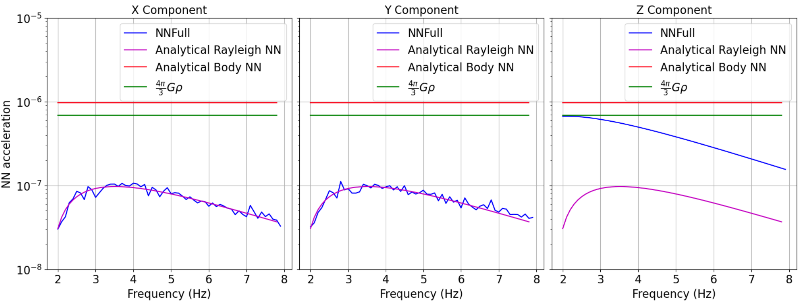
NNCompute.py – Newtonian acceleration at a single test-mass matches the analytical estimate reasonably
The displacement of all components are scaled such that vertical component of the surface displacement is 1.0
In principle one must never scale vertical and horizontal components separately. Scaling of all components must be done by one factor, and not separate ones.
If it so happens that one wants to bias a particular component, they must do that when simulating the displacements by biasing the forces in one direction.
The solid blue curve which represents the simulated NN acceleration matches the magenta curve representative of the analytical estimate.
The vertical component is not supposed to match and the analytical results only holds for the horizontal directions

Slide 15
Validation for plane body waves in homogeneous half-space

Slide 16
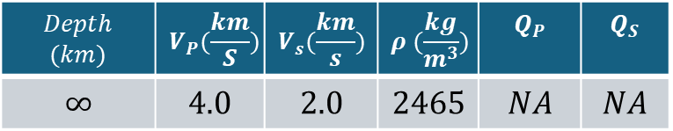
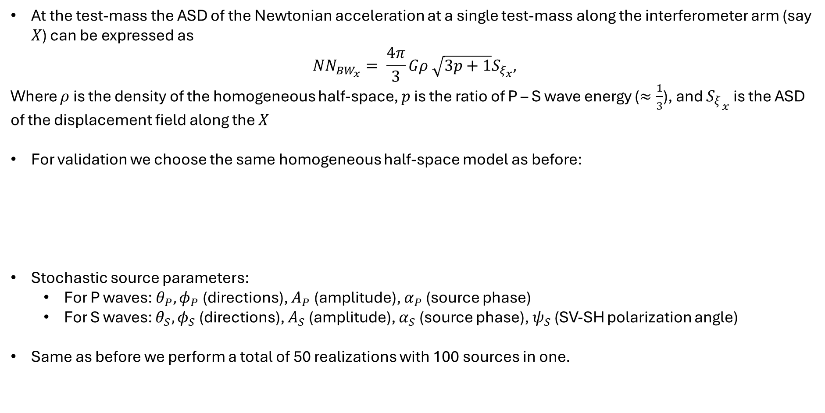
Analytical formulation: Newtonian noise from a diffuse plane body wavefield in a homogeneous half-space
At the test-mass the ASD of the Newtonian acceleration at a single test-mass along the interferometer arm (say $X$) can be expressed as
$$NN_{BW_{x}}= \frac{4π}{3}Gρ \sqrt{3p+1}S_{ξ_{x}},$$
Where $ρ$ is the density of the homogeneous half-space, $p$ is the ratio of P – S wave energy ($≈\frac{1}{3}$), and ${S_{ξ}}_{x}$ is the ASD of the displacement field along the $X$
For validation we choose the same homogeneous half-space model as before:
Stochastic source parameters:
For P waves: $θ_{P}, φ_{P}$ (directions), $A_{P}$ (amplitude), $α_{P}$ (source phase)
For S waves: $θ_{S}, φ_{S}$ (directions), $A_{S}$ (amplitude), $α_{S}$ (source phase), $ψ_{S}$ (SV-SH polarization angle)
Same as before we perform a total of 50 realizations with 100 sources in one.
$$Depth$$ $$(km)$$ | $$V_{P}(\frac{km}{S})$$ | $$V_{s}(\frac{km}{s})$$ | $$ρ (\frac{kg}{m^{3}})$$ | $$Q_{P}$$ | $$Q_{S}$$
$$∞$$ | $$4.0$$ | $$2.0$$ | $$2465$$ | $$NA$$ | $$NA$$

Slide 17
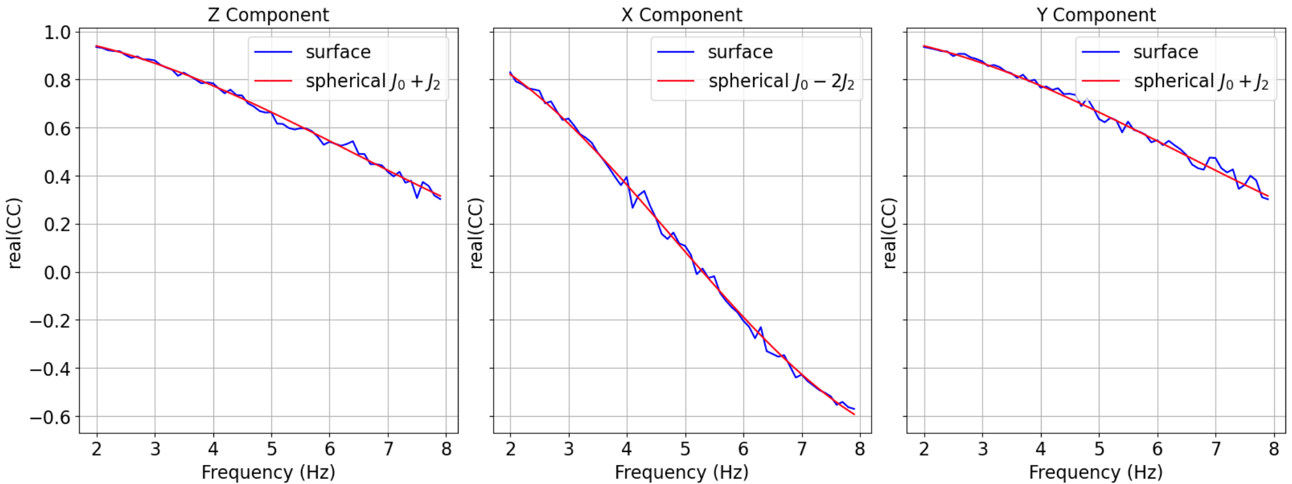
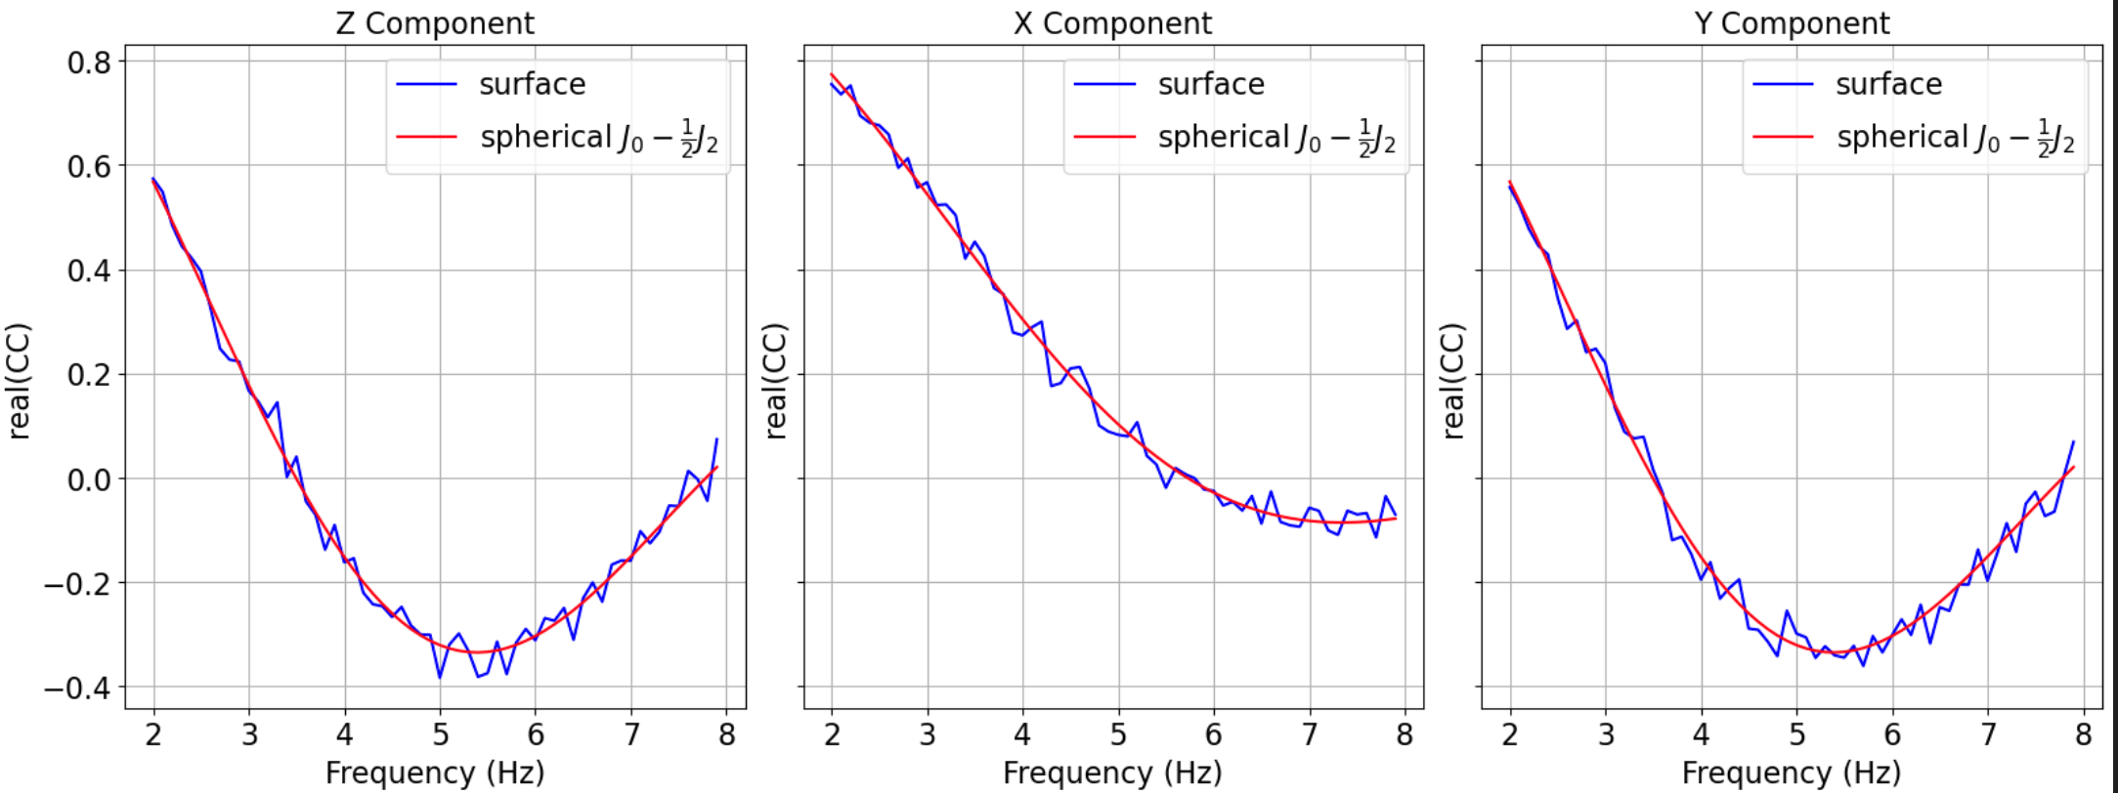
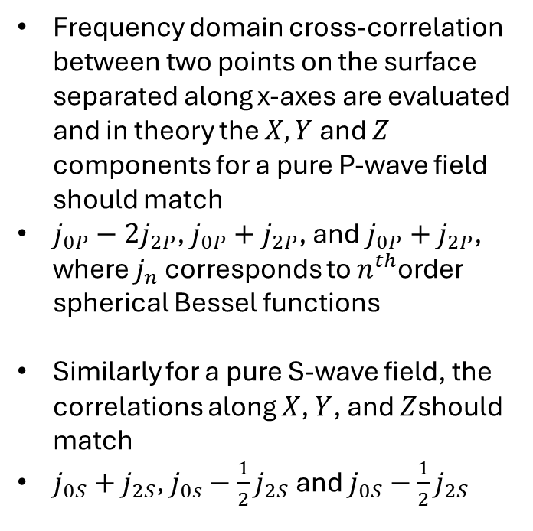
simDisp.py – Check: compare cross-correlation between two points to theoretical results to verify correctness (refer to notes)
Frequency domain cross-correlation between two points on the surface separated along x-axes are evaluated and in theory the $X,Y$ and $Z$ components for a pure P-wave field should match
$j_{0P}−2j_{2P}$, $j_{0P}+j_{2P}$, and $j_{0P}+j_{2P}$, where $j_{n}$ corresponds to $n^{th}$order spherical Bessel functions
Similarly for a pure S-wave field, the correlations along $X$, $Y$, and $Z$should match
$j_{0S}+j_{2S}$, $j_{0s}−\frac{1}{2}j_{2S}$and $j_{0S}−\frac{1}{2}j_{2S}$
Top panel: Czz, Cxx, Cyy for pure P-wavefield, bottom panel for pure S-wave field

Slide 18
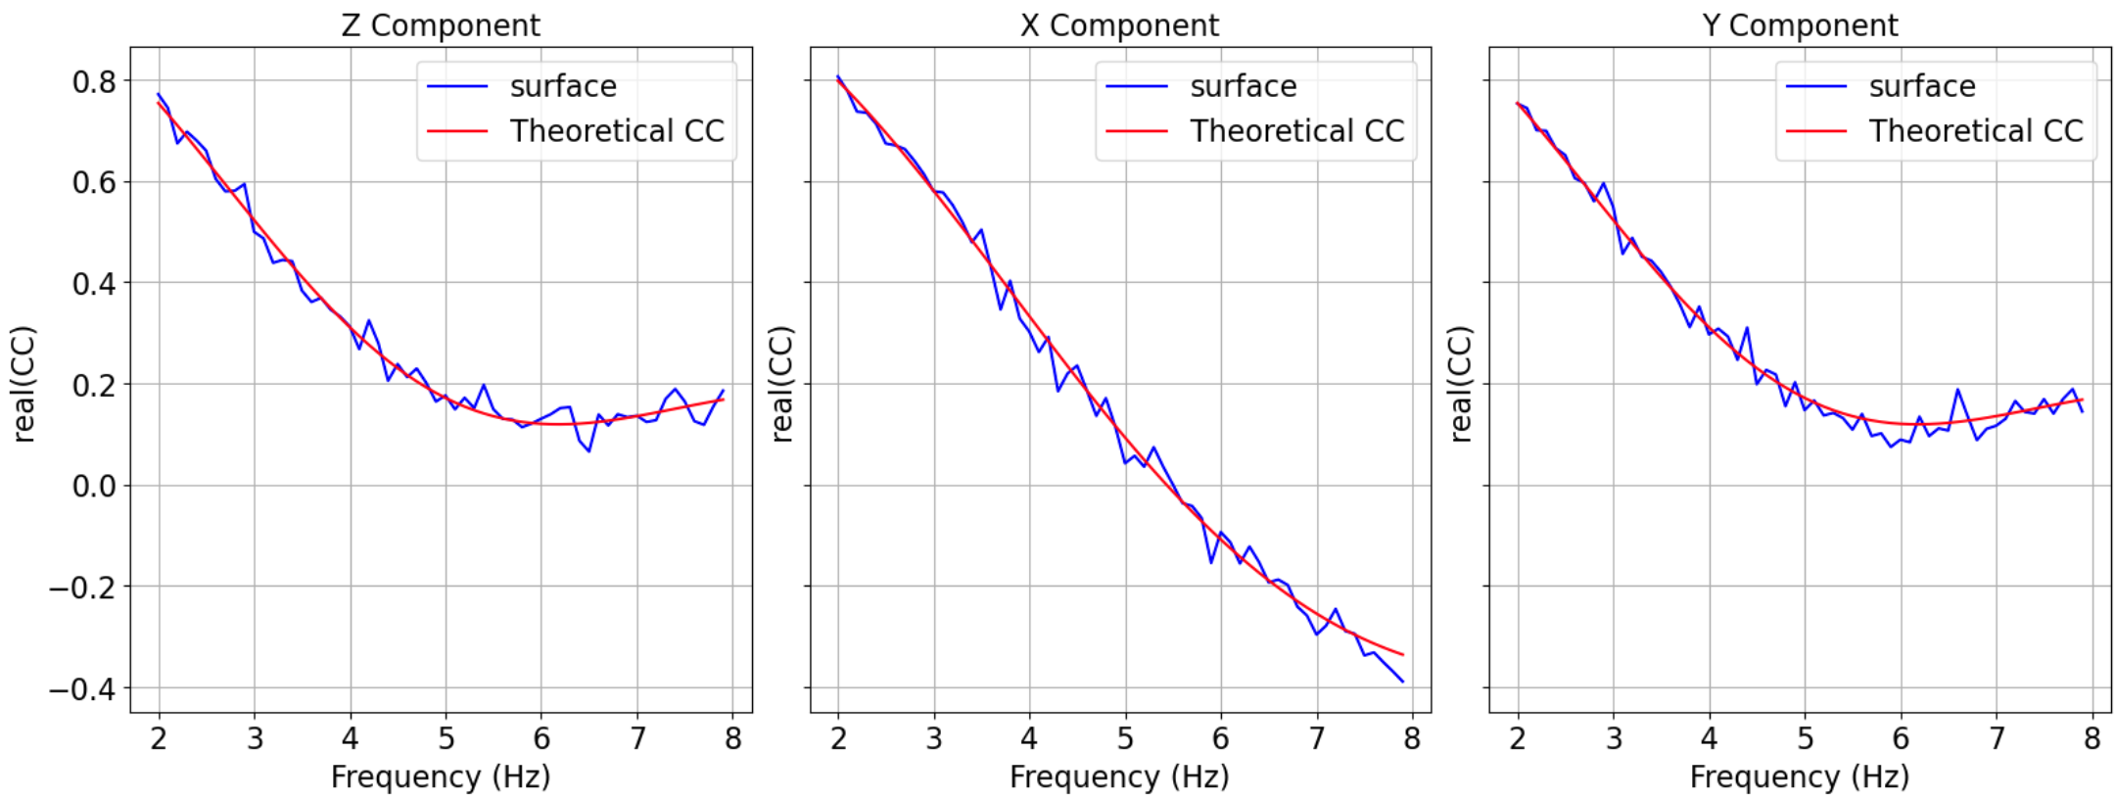
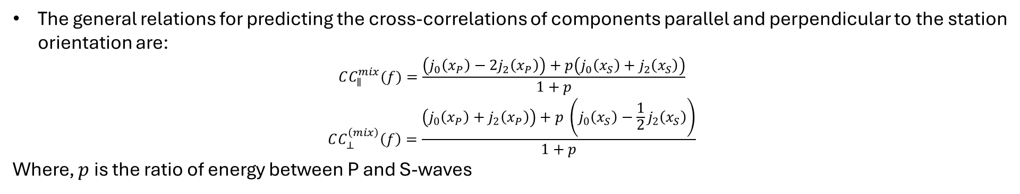
simDisp.py – Check: compare cross-correlation between two points to theoretical results for a mixture of plane P and S waves
The general relations for predicting the cross-correlations of components parallel and perpendicular to the station orientation are:
$$CC_{∥}^{mix}​(f)=\frac{\left(j_{0}​\left(x_{P}​\right)−2j_{2}​\left(x_{P}​\right)\right)+p\left(j_{0}​\left(x_{S}​\right)+j_{2}​\left(x_{S}​\right)\right)}{1+p}$$
$$CC_{⊥}^{\left(mix\right)}\left(f\right)=\frac{\left(j_{0}\left(x_{P}\right)+j_{2}\left(x_{P}\right)\right)+p \left(j_{0}\left(x_{S}\right)−\frac{1}{2}j_{2}\left(x_{S}\right)\right)}{1+p}$$
Where, $p$is the ratio of energy between P and S-waves
Czz, Cxx, Cyy for a mixture of P and S waves and p = 1

Slide 19
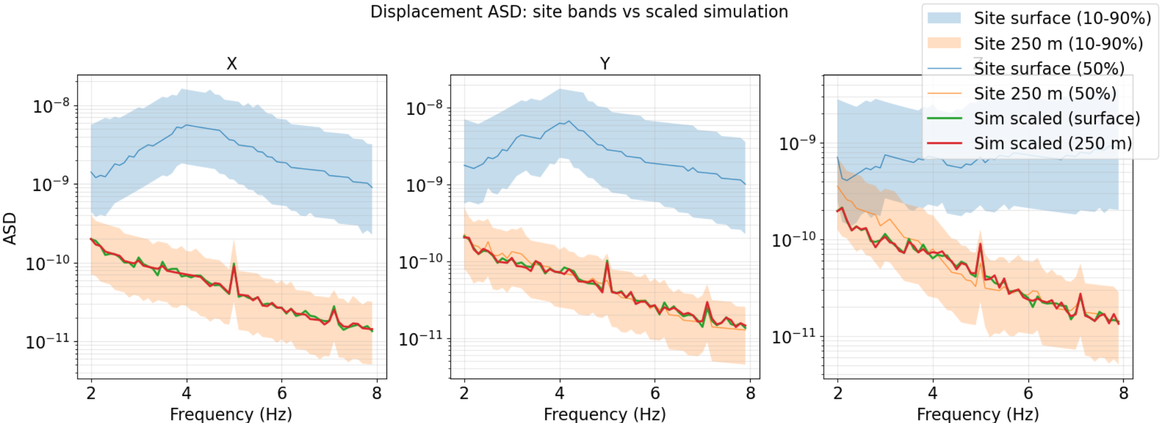
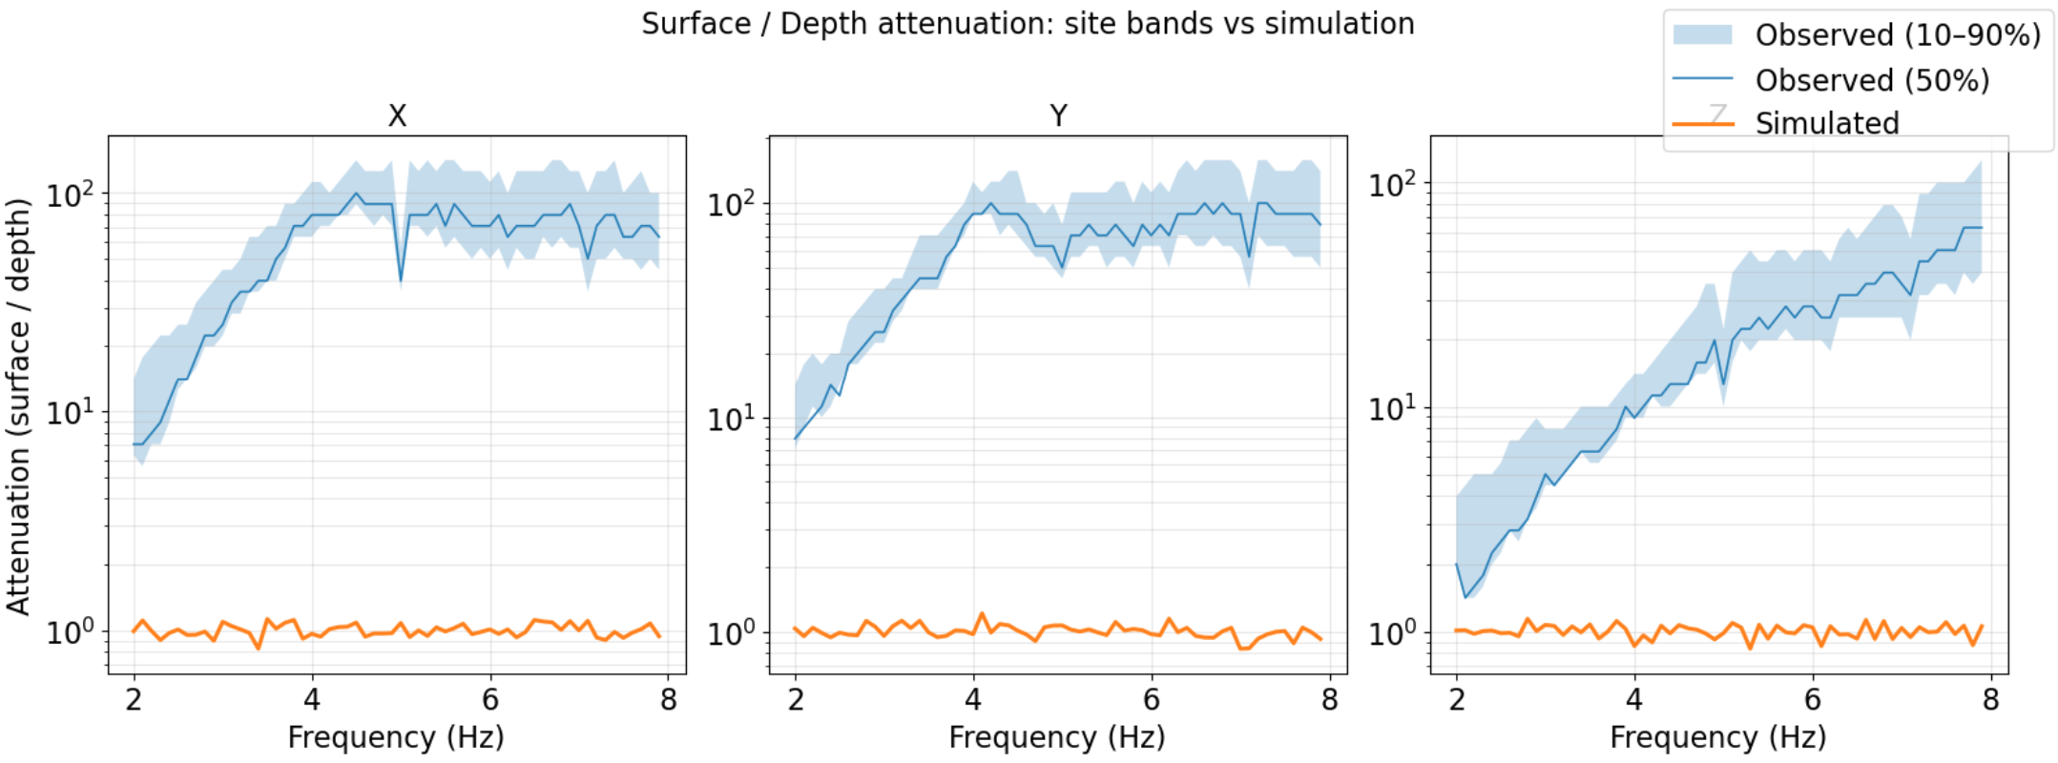
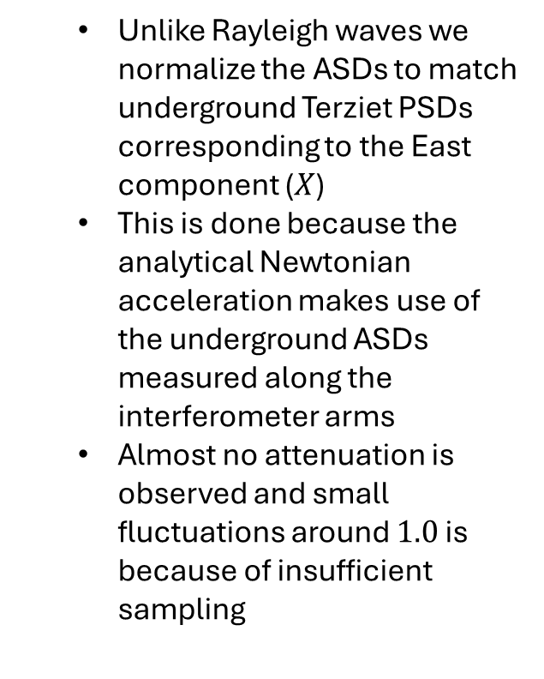
simDisp.py – A superposition of plane P and S waves fail to reproduce the surface and underground noise ASDs
Unlike Rayleigh waves we normalize the ASDs to match underground Terziet PSDs corresponding to the East component ($X$)
This is done because the analytical Newtonian acceleration makes use of the underground ASDs measured along the interferometer arms
Almost no attenuation is observed and small fluctuations around $1.0$ is because of insufficient sampling

Slide 20
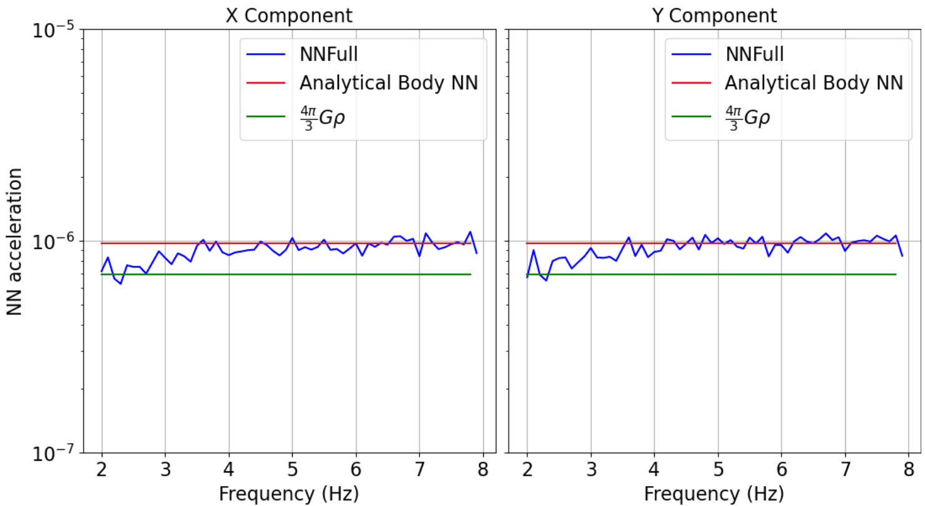
NNCompute.py – Newtonian acceleration at a single test-mass matches the analytical estimate reasonably from 4 Hz
The little underestimation below 4 Hz is due to insufficient integration radius
Small fluctuations around the analytical result occur due to insufficient sampling of plane waves
Due to time constraints we limited the number of realizations to 50 and 100 sources per realization
The solid blue curve which represents the simulated NN acceleration matches the blue curve representative of the analytical estimate for frequencies greater than 4 Hz.
The vertical component is no shown as it is not relevant in this context.

Slide 21
Full field solution from vertical and horizontal forces in homogeneous half-space

Slide 22
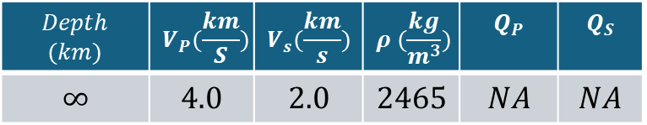
Newtonian noise from the full wavefield in a homogeneous half-space
The same homogeneous half-space model as before:
Stochastic source parameters:
Location of the source
Vertical forces:
Amplitude
Phase
Horizontal forces (default to decouple from vertical)
Amplitude
Phase
Angle of action
It is also possible to use a bias the force amplitude along vertical and horizontal
In the current implementation it is switched off
$$Depth$$ $$(km)$$ | $$V_{P}(\frac{km}{S})$$ | $$V_{s}(\frac{km}{s})$$ | $$ρ (\frac{kg}{m^{3}})$$ | $$Q_{P}$$ | $$Q_{S}$$
$$∞$$ | $$4.0$$ | $$2.0$$ | $$2465$$ | $$NA$$ | $$NA$$

Slide 23
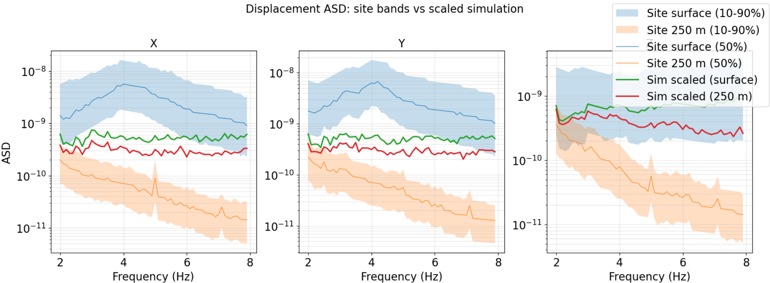
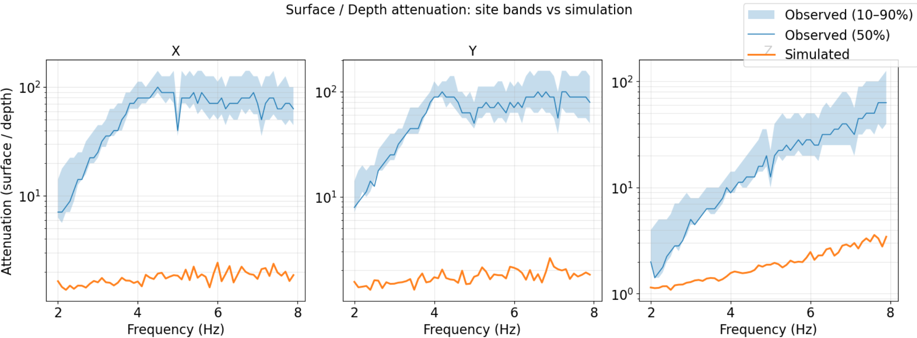
simDisp.py – A full wavefield superposition for 50 realizations with 100 vertical and horizontal forces acting on the surface per realization
We normalize to match the Z component ASD on the surface
A complete solution in a homogeneous half space cannot match the Terziet scenario
The horizontal components on the surface and at depth are not reconstructed and also the attenuation on the vertical component is too small
Vertical component shows similar Rayleigh like attenuation
The horizontal component shows little attenuation as if it were strongly dominated by body waves

Slide 24
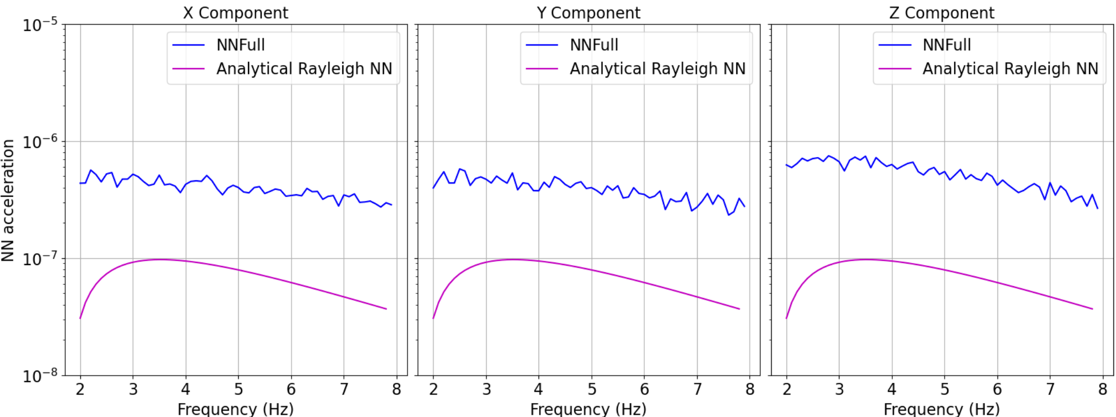
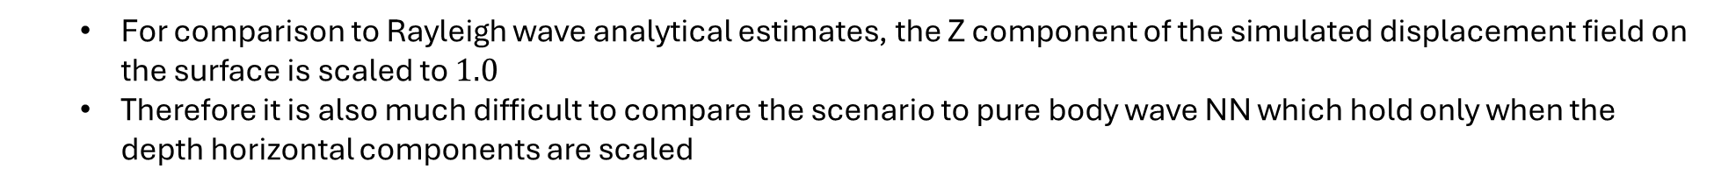
NNCompute.py – Newtonian acceleration at a single test-mass is stronger as compared to the case when Rayleigh waves existed
For comparison to Rayleigh wave analytical estimates, the Z component of the simulated displacement field on the surface is scaled to $1.0$
Therefore it is also much difficult to compare the scenario to pure body wave NN which hold only when the depth horizontal components are scaled
The solid blue curve which represents the simulated NN acceleration and is higher than the analytical NN from Rayleigh waves as expected.
The Analytical body NN is not shown as the results only hold true when normalized with the underground horizontal ASD.

Slide 25
Newtonian noise from a layered geology that closely matches surface-underground attenuation observed at Terziet

Slide 26
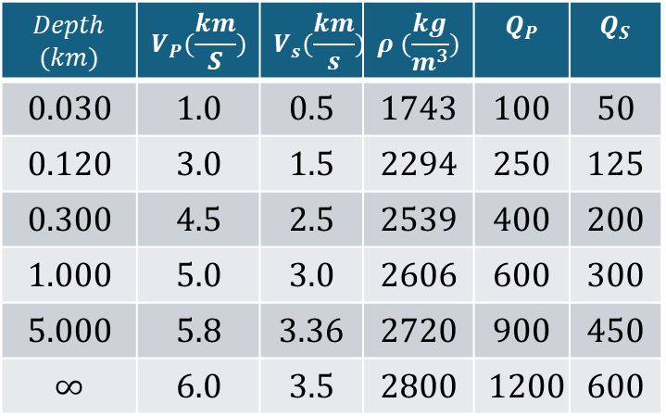

Newtonian noise from the full wavefield in a layered geology
The layered geology over half-space used for demonstration is the following:
Note that the velocity and thickness of the soft layer on top was chosen such that it matches the peak frequency of 4 Hz $(\frac{Vs}{4∗h})$ H/V spectral ratio
This model is for demonstration purposes only and does not match the Rayleigh wave phase velocity dispersion observed at Terziet
However, it does match the attenuation observed at the site
$$Depth$$ $$(km)$$ | $$V_{P}(\frac{km}{S})$$ | $$V_{s}(\frac{km}{s})$$ | $$ρ (\frac{kg}{m^{3}})$$ | $$Q_{P}$$ | $$Q_{S}$$
$$0.030$$ | $$1.0$$ | $$0.5$$ | $$1743$$ | $$100$$ | $$50$$
$$0.120$$ | $$3.0$$ | $$1.5$$ | $$2294$$ | $$250$$ | $$125$$
$$0.300$$ | $$4.5$$ | $$2.5$$ | $$2539$$ | $$400$$ | $$200$$
$$1.000$$ | $$5.0$$ | $$3.0$$ | $$2606$$ | $$600$$ | $$300$$
$$5.000$$ | $$5.8$$ | $$3.36$$ | $$2720$$ | $$900$$ | $$450$$
$$∞$$ | $$6.0$$ | $$3.5$$ | $$2800$$ | $$1200$$ | $$600$$

Slide 27
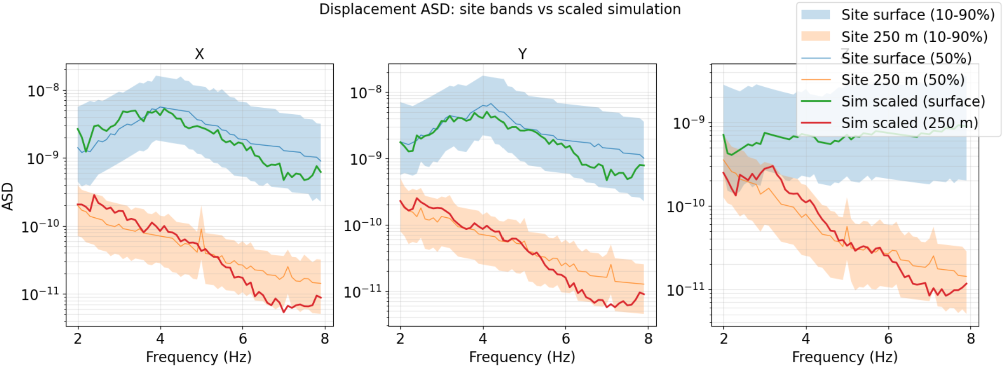
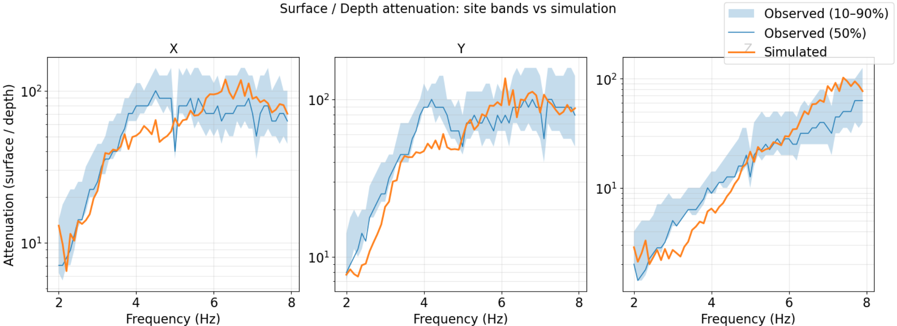
simDisp.py – A full wavefield superposition from 100 vertical and horizontal forces acting on the surface per realization, and 50 total realizations
We normalize to match the Z component ASD on the surface
The horizontal components on the surface and at depth match naturally
Ideally a correct model should depict should behavior and one should not rescale every component separately
If one chooses to have a different scaling, that should be done before the simulation with scaleVH factor turned on

Slide 28
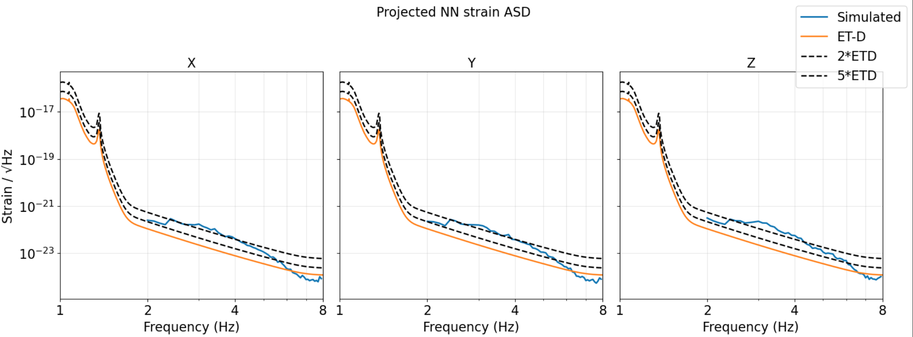
NNPP.py – Newtonian noise projection on ETD considering uncorrelated contribution from the four test-masses show a factor 2 – 5 subtraction necessary
The NN estimate is a factor 5 above ETD in the 2.5 to 4 Hz band, which coincides with slight underestimation of the observed surface-underground attenuation of the horizontal component
NN estimate from a layered geology overlayed on the ETD curve. For better assessment 2*ETD and 5*ETD have also been plotted

Slide 29
Outlook and future work
The last few slides point to the uncertainty that one faces while choosing a model to start with
The layered model chosen did not fit the phase velocity dispersion but did match the attenuation properties
If a Terziet like geology is used for simulation, it will only provide overattenuation and one has to then revert to adding plane body waves to match the deficiency in the underground noise levels (like Georgia’s work or Henk Jan’s)
We aim to proceed further with this uncertainty quantification related to the geology and source distribution so that we can reach a middle ground where both phase velocity and attenuation can be matched

