Slide 1
ETpathfinder Workshop
ET-xxxxxxx
2026-03-23
Installation Update
M. Baars, R. Elsinga, K. Lam
for the ETpathfinder team

Slide 2
Contents
Installation progress since last workshop
BST and INT installation differences
Installation plans moving forward
SIT
Infrastructure

Slide 3
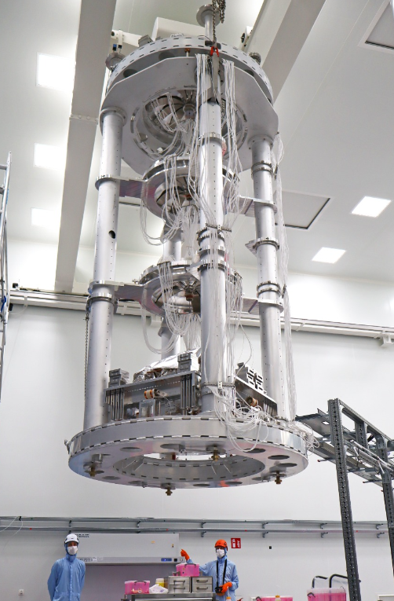
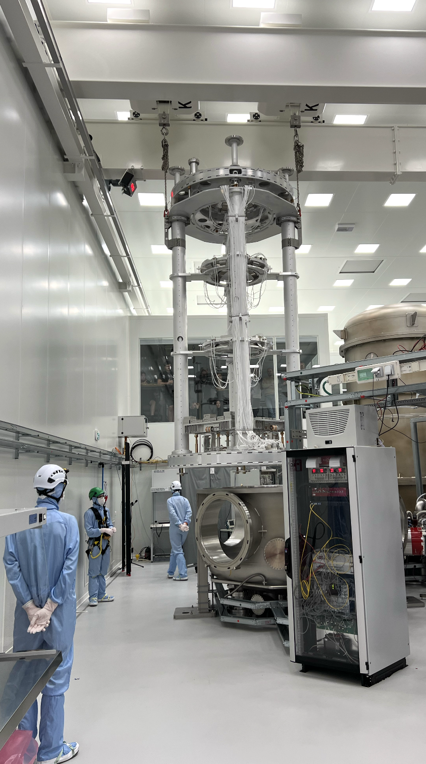
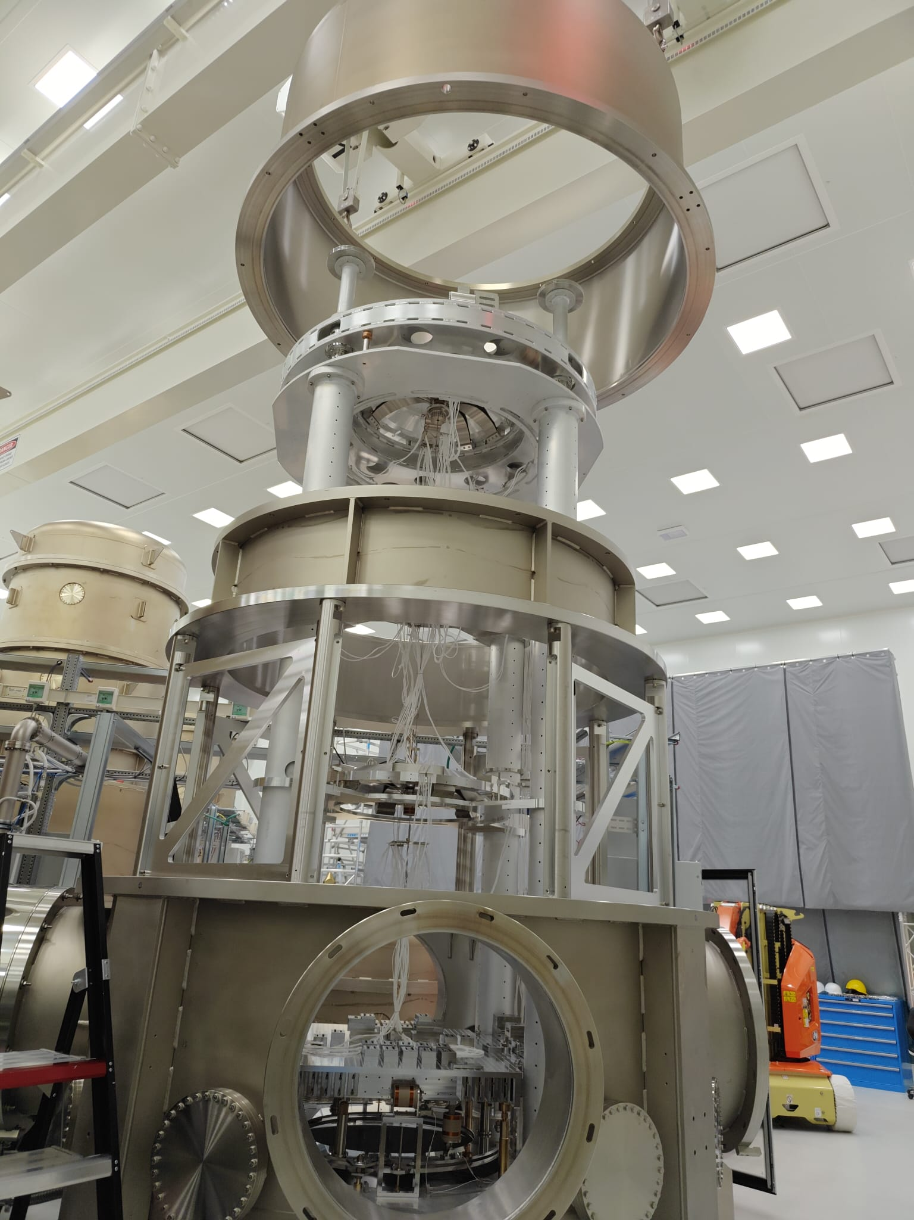
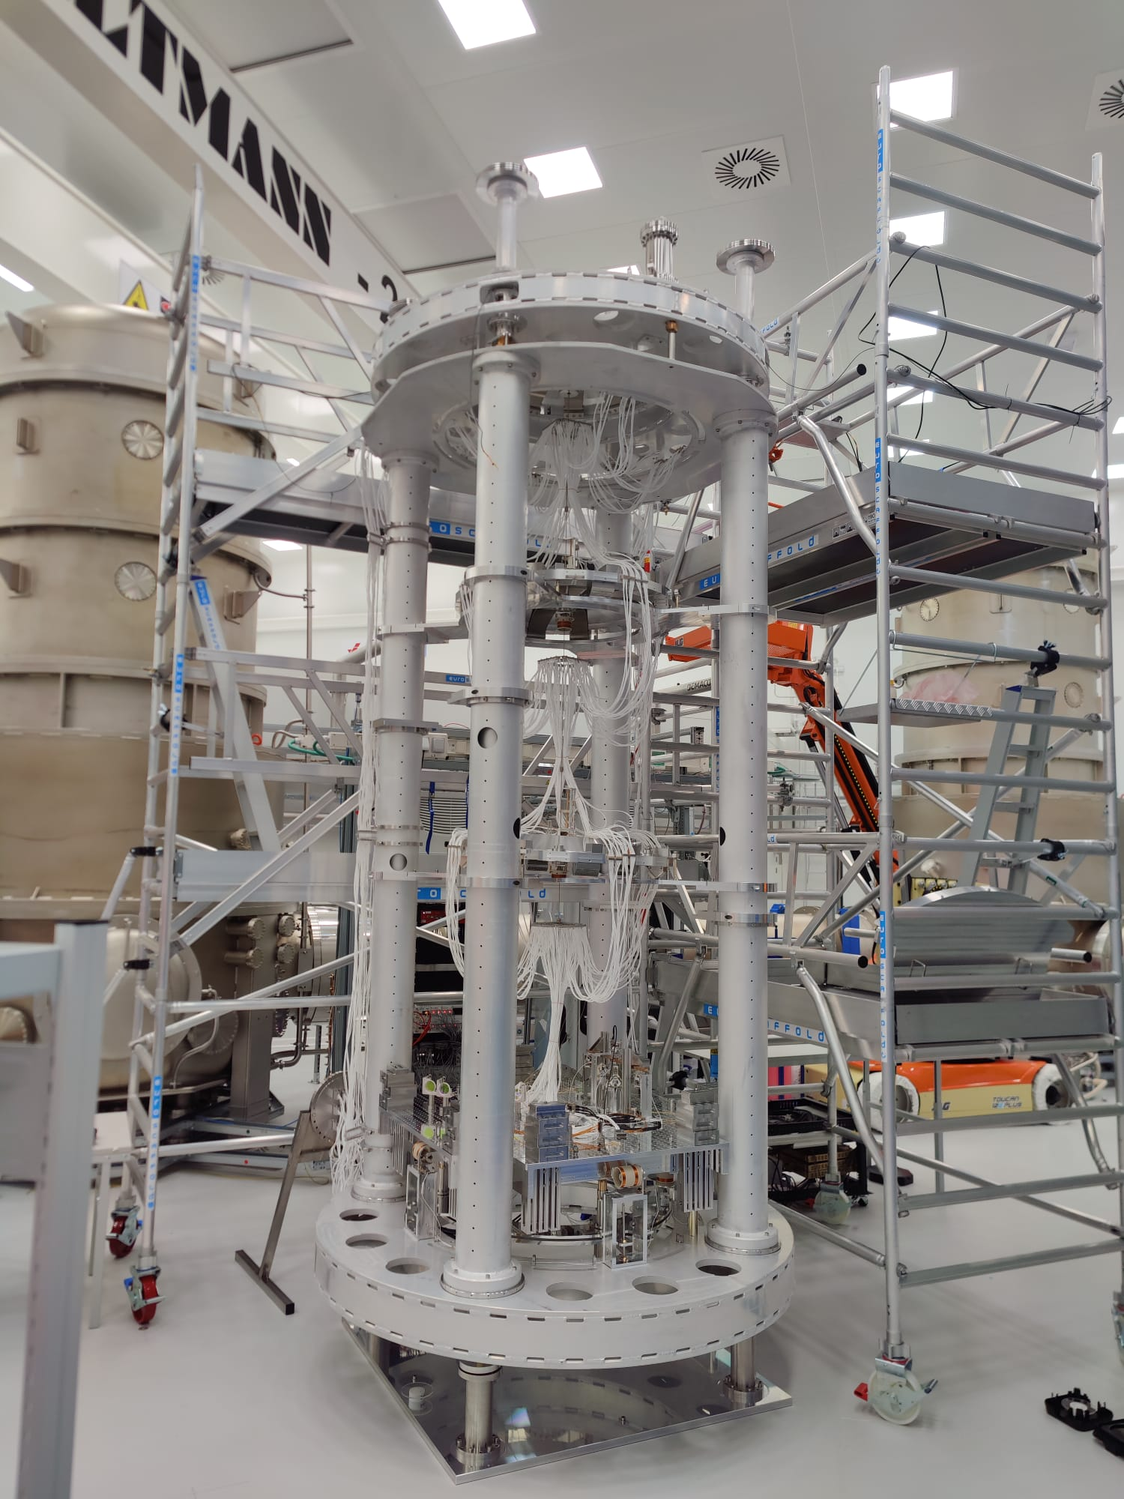
Installation progress since last workshop (June 2025)
BST Tower closing
BST IM installed
New lifting tool arrival ->
BST Hoisting
INT Tower closing
INT
commissioning
INT Hoisting
BST Commissioning
INT pre-
commissioning
INT Preparation
INT Installation
SIT Preparation
Jun Jul Aug Sep Oct Nov Dec Jan Feb Mar Apr
2025
2026

Slide 4
Insights in how INT differs from BST
Personnel - some improvements
Not one big installation group, but several specialized sub-groups
Installation groups were filled more intelligently
Matching amount of work to amount of people, generally giving smaller groups
Better spread of specialists
Less “tourism” / invest time with coming towers in mind
Communication - more or less the same
Slack / Mattermost still work very well for quick communications
The Gitlab ticket system continued to be used for smaller preparatory tasks
The parts storage overview again proved to be very useful
Planning and preparation - improved
More parallel working and starting building things as soon as possible
Dedicated UM visits just for gathering parts, in advance of planned work

Slide 5
Insights in how INT differs from BST (continued)
Installation - improved
The installation process that was split into multiple chunks of work led by different people, gave rise to intermediate milestones such as “Large IPs installed”, “Optical bench installed”, etc., which improved team morale.
GAS1 was filled with manufacturing errors that needed in-situ fixing and repairs, causing 2 weeks of delay.
Having learned that a lot of the tuning and balancing steps would be undone from hoisting, less time was spent getting it perfect on the build-up site.
Having learned from BST commissioning, a lot of tuning and balancing steps were done in a more informed way, saving time and re-doing things later.
This time much more involved in commissioning, gaining new insights that will also benefit coming towers.
Shifting as much work as possible from “after hoisting” to “before hoisting” worked very well. The amount of double work was minimal, while the uncomfortable working environment of the bottom vessel was kept to a minimum.

Slide 6
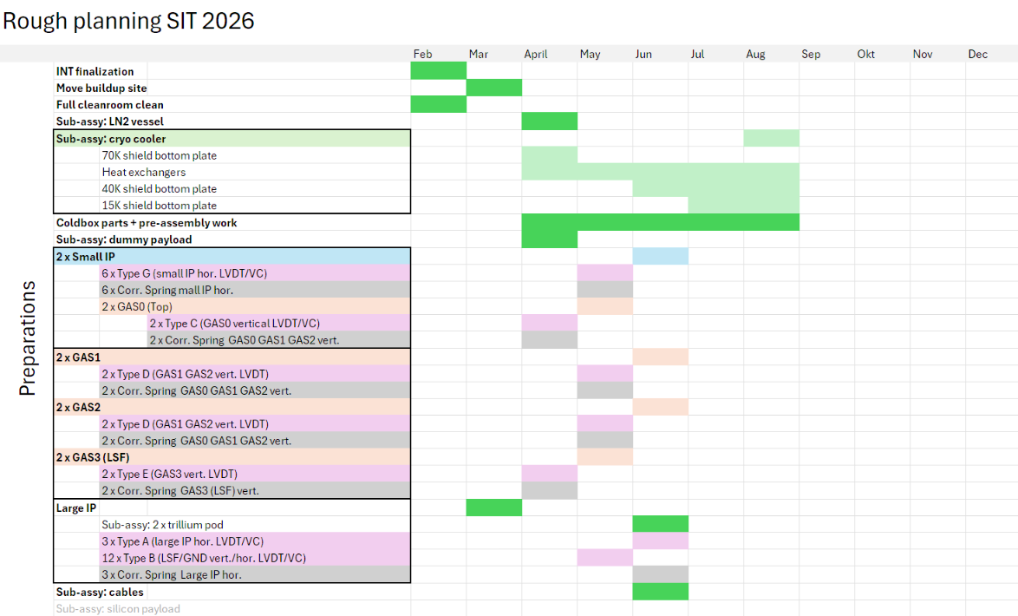
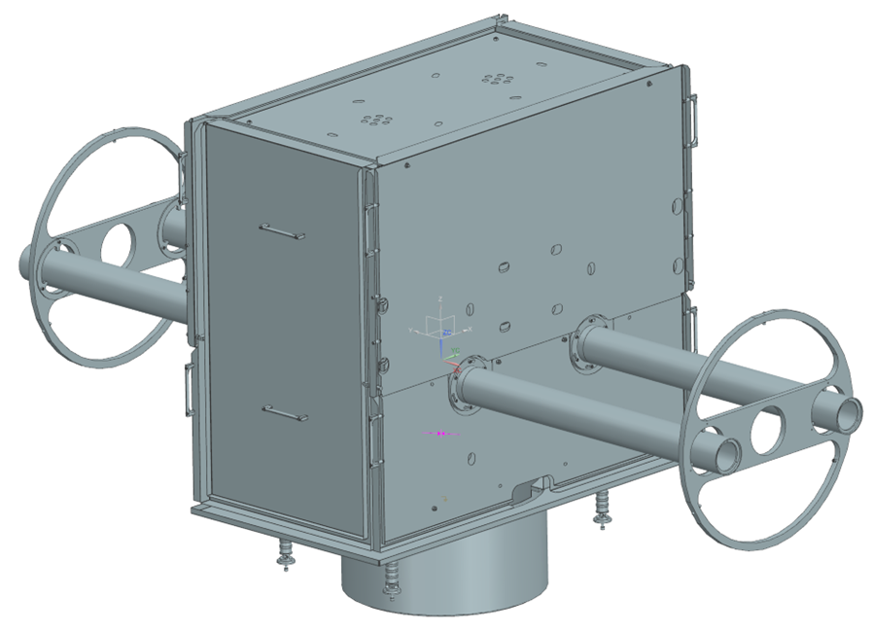
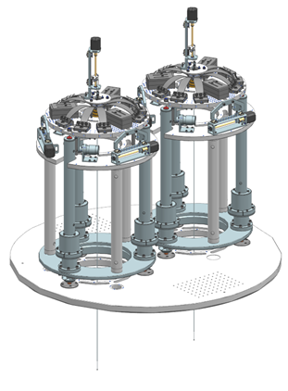
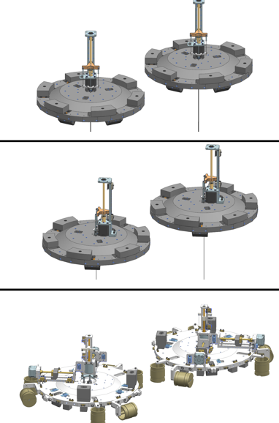
Installation plans moving forward - SIT
Subassemblies prepared
by various partners

Slide 7
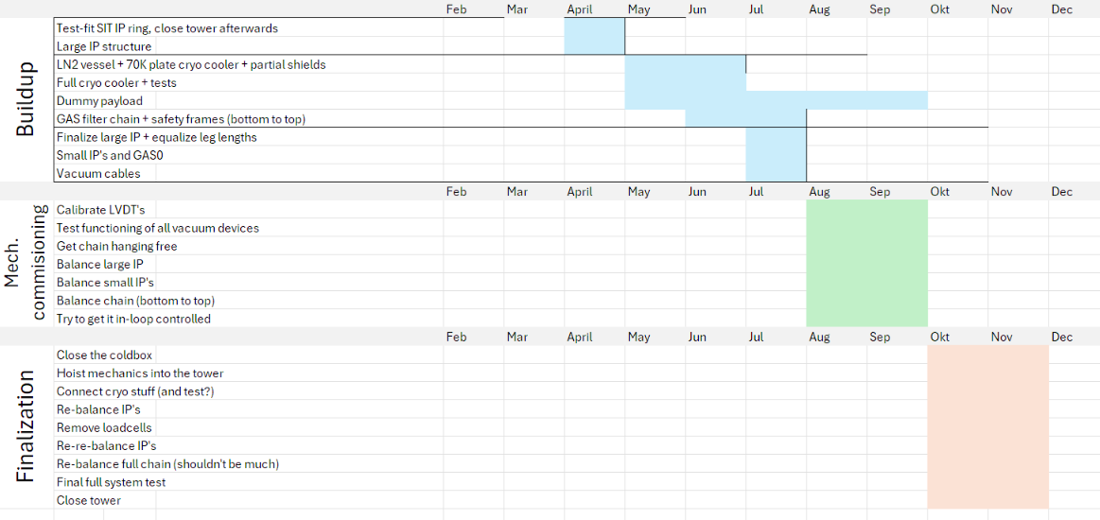
Installation plans moving forward - SIT (continued)
First steps of SIT installation
Cryogenic Payload
will not be ready! See tomorrow’s Payload Discussion Session.

Slide 8
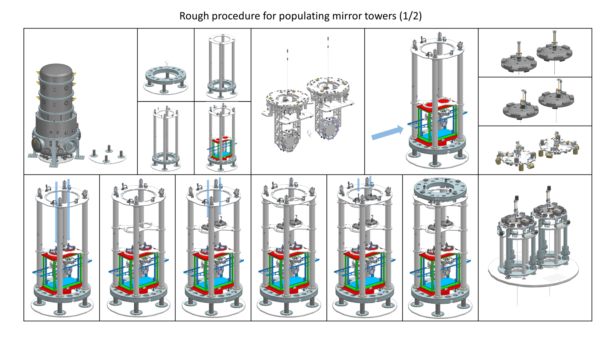

Slide 9
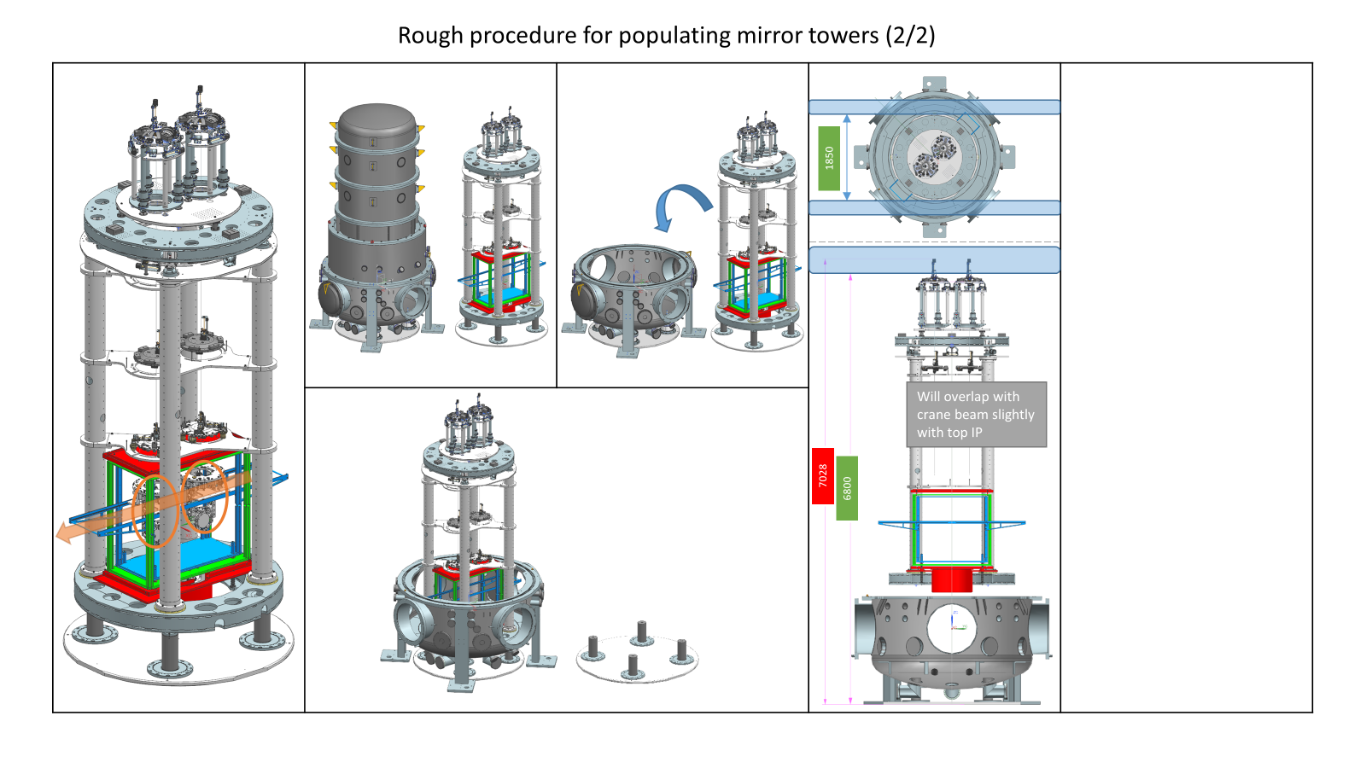

Slide 10
Installation plans moving forward - Infrastructure in 2026
In addition to the activities towards SIT Installation, there are other infrastructure related installation activities planned as well:
Cabling of vacuum devices
Vacuum test of a populated central section (BST + INT)
Finalize water cooling system for E-racks
Additional vacuum line for Cryo Consortium
Mantle Lifting System for BST
Grounding of metal structures in the cleanroom

Slide 11
Discussion

