Slide 1
CP violation in the quark sector
N. Tuning
P. Koppenburg

Slide 2
CP violation in the quark sector
Quarks: SM, CKM, UT Niels, 30’
Mesons: Mixing and CPV types Niels, 30’
B-mesons: Decays and Experiment Patrick, 60’

Slide 3
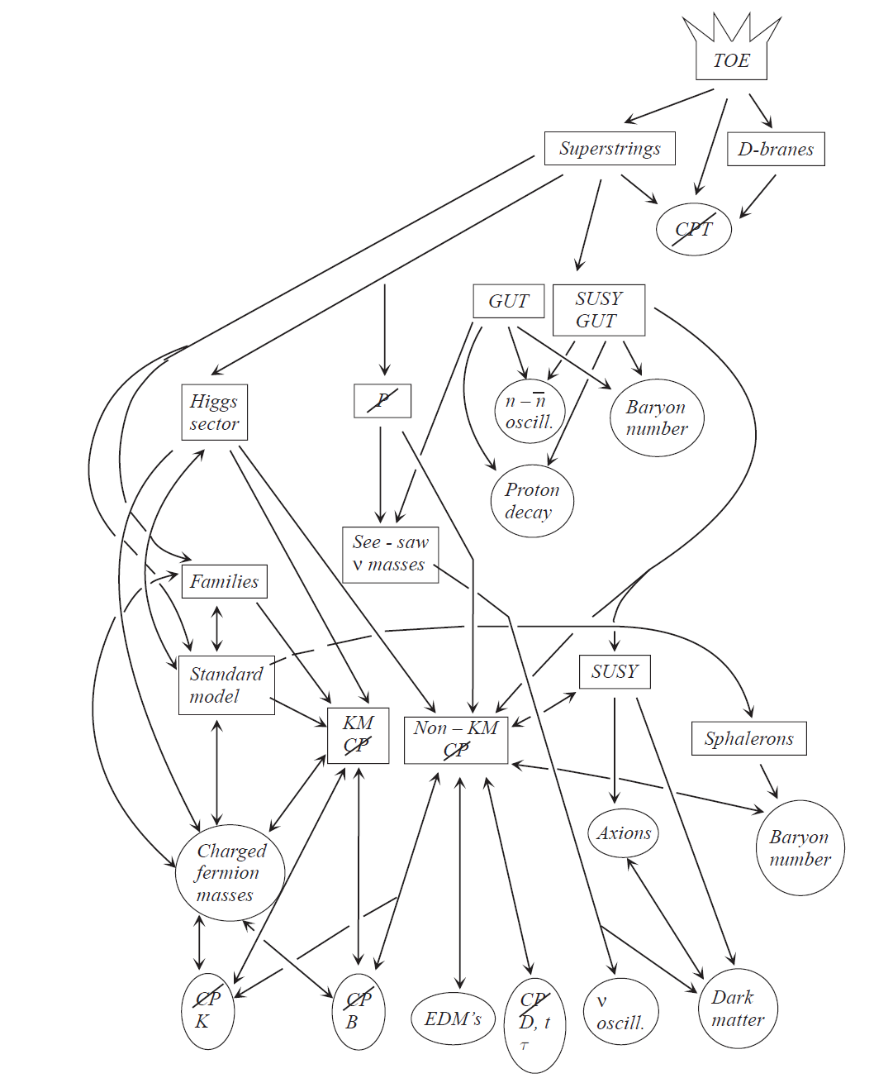
Grand picture….
These lectures
Main motivation
Universe

Slide 4
Jargon
Flavour physics
EDM
quarks
quarks
CP
violation
Rare
decays
Precision physics
neutrinos
τ, μ
Leptons
g-2

Slide 5
Today
Flavour physics
quarks
quarks
CP
violation
Rare
decays
neutrinos
τ, μ
Leptons

Slide 6
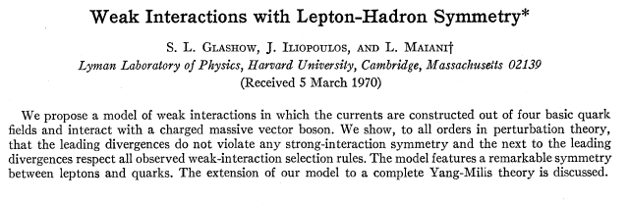
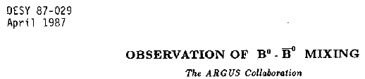


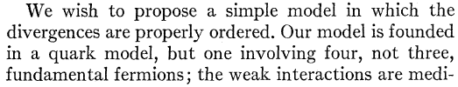
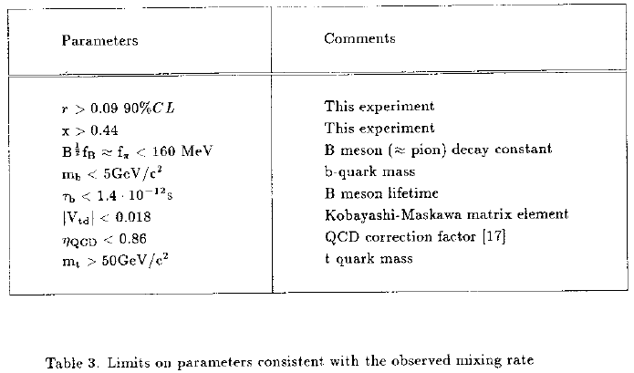
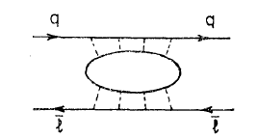
Flavour physics has a track record…
GIM mechanism in K⁰→μμ
CP violation, K_{L}⁰→ππ
B⁰←→B⁰ mixing
Glashow, Iliopoulos, Maiani,
Phys.Rev. D2 (1970) 1285
Christenson, Cronin, Fitch, Turlay,
Phys.Rev.Lett. 13 (1964) 138-140
ARGUS Coll.
Phys.Lett.B192:245,1987

Slide 7
Flavour physics has a track record…
Rare decay implies 2nd up-quark
“discovery” of charm?
CP violation implies 3rd family
“discovery” of bottom?
Mixing implies heavy quark
“discovery” of top?

Slide 8
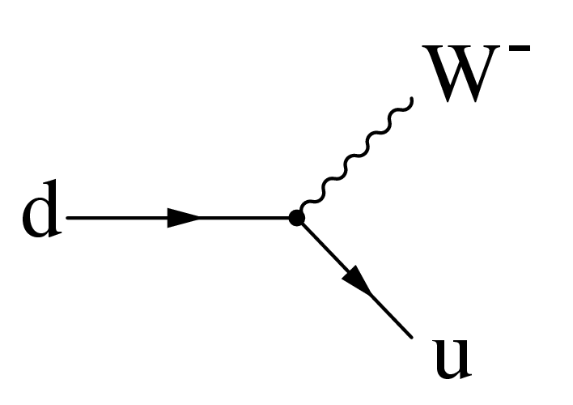
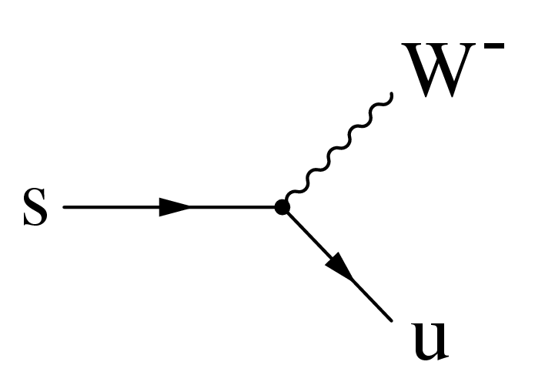
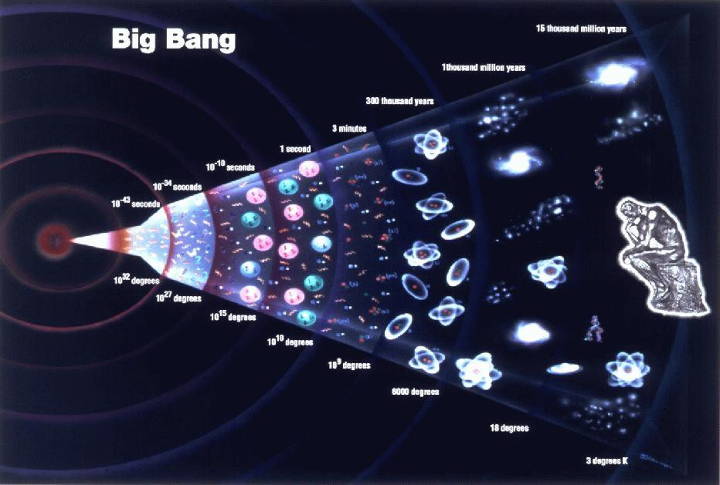
Motivation
CP-violation (or flavour physics) is about charged current interactions
Interesting because:
Standard Model: in the heart of quark interactions
Cosmology: related to matter – anti-matter asymetry
Beyond Standard Model: measurements are sensitive to new particles
Matter Dominates !
b
s
s
b

Slide 9
Grand picture….
These lectures
Main motivation
Universe

Slide 10
Personal impression:
People think (?) it is a complicated part of the SM. Why?
Non-intuitive concepts?
Imaginary phase in transition amplitude, T ~ e^{iφ}
Different bases to express quark states, d’=0.97 d + 0.22 s + 0.003 b
Oscillations (mixing) of mesons: |K⁰> ↔ |‾K⁰>
Complicated calculations?
Many decay modes? “Beetopaipaigamma…”
PDG reports 400+ decay modes of the B⁰-meson:
Γ₁ l⁺ ν_{l} anything ( 10.33 ± 0.28 ) × 10⁻²
Γ₃₄₇ ν ν γ <4.7 × 10⁻⁵ CL=90%
And for one decay there are often more than one decay amplitudes…

Slide 11
CP violation in the SM Lagrangian
Focus on charged current interaction (W±): let’s trace it
u_{L}^{I}
W^{+μ}
g
d_{L}^{I}

Slide 12
The Standard Model Lagrangian
L_{Kinetic} : • Introduce the massless fermion fields
• Require local gauge invariance ➔ gives rise to existence of gauge bosons
L_{Higgs} : • Introduce Higgs potential with <φ> ≠ 0
• Spontaneous symmetry breaking
The W⁺, W⁻,Z⁰ bosons acquire a mass
L_{Yukawa} : • Ad hoc interactions between Higgs field & fermions
Niels Tuning (12)
Notes:
12

Slide 13
Fields: Notation
Y = Q - T₃
Fermions:
with ψ = Q_{L}, u_{R}, d_{R}, L_{L}, l_{R}, ν_{R}
Quarks:
Interaction rep.
Under SU2:
Left handed doublets
Right hander singlets
SU(3)_{C}
SU(2)_{L}
Hypercharge Y
(=avg el.charge in multiplet)
Left-
handed
generation
index
Leptons:
Scalar field:
Note:
Interaction representation: standard model interaction is independent of generation number
Niels Tuning (13)
Notes:
13

Slide 14
Fields: Notation
Q = T₃ + Y
Y = Q - T₃
Explicitly:
The left handed quark doublet :
Similarly for the quark singlets:
The left handed leptons:
And similarly the (charged) singlets:
Niels Tuning (14)
Notes:
14

Slide 15
:The Kinetic Part
: Fermions + gauge bosons + interactions
Procedure:
Introduce the Fermion fields and demand that the theory is local gauge invariant under SU(3)_{C}xSU(2)_{L}xU(1)_{Y} transformations.
Start with the Dirac Lagrangian:
Replace:
Fields:
G_{a}^{μ} : 8 gluons
W_{b}^{μ} : weak bosons: W₁, W₂, W₃
B^{μ} : hypercharge boson
Generators:
L_{a} : Gell-Mann matrices: ½ λ_{a} (3x3) SU(3)_{C}
T_{b} : Pauli Matrices: ½ τ_{b} (2x2) SU(2)_{L}
Y : Hypercharge: U(1)_{Y}
For the remainder we only consider Electroweak: SU(2)_{L} x U(1)_{Y}
Niels Tuning (15)
Notes:
15
Replace the derivative with the covariant derivative introducing the force carriers: gluons, weak vector bosons and photon.
The constants g_s, g and g’ are the corresponding coupling constants of the gauge particles.

Slide 16
: The Kinetic Part
For example, the term with Q_{Li}^{I} becomes:
Writing out only the weak part for the quarks:
u_{L}^{I}
W^{+μ}
L=J_{μ}W^{μ}
W⁺ = (1/√2) (W₁+ i W₂)
W⁻ = (1/√ 2) (W₁ – i W₂)
g
d_{L}^{I}
Niels Tuning (16)
Notes:
16
Writing out the weak part leads to terms that can be illustrated by Feynman diagrams. The interactions are usually written as a current J times a gauge field.
Exercise:
To show this use the defitions of the parity and charge operators. Start by setting q_l = ½ (1+g_5) q, etc. Use also (1-g_5)g_0 = g_0(1+g_5). Show for a few terms that Parity leads to q_l -> q_R. For C it goes similarly using transformation properties under C.
In fact, one can see immediately that, since the lagrangian contains vector terms and axial vector terms, which transform with opposite sign, that it cannot be Parity or charge conserving. Under CP, both the vector and axial currents are odd.

Slide 17
: The Higgs Potential
Broken
Symmetry
V(φ)
Symmetry
V(φ)
φ
φ
~ 246 GeV
Spontaneous Symmetry Breaking: The Higgs field adopts a non-zero vacuum expectation value
Procedure:
Substitute:
And rewrite the Lagrangian (tedious):
.
The W⁺,W⁻,Z⁰ bosons acquire mass
The Higgs boson H appears
(The other 3 Higgs fields are “eaten” by the W, Z bosons)
Niels Tuning (17)
Notes:
17
The Higgs potential has an asymmetric minimum in one of the 4 degrees of freedom: Re(phi_0). Only this component remains in the final Lagrangian: the Higgs field. The other three components are absorbed in the mass terms of the W+, W-, Z bosons. The photon remains massless.

Slide 18
: The Yukawa Part
Since we have a Higgs field we can (should?) add (ad-hoc) interactions between φ and the fermions in a gauge invariant way.
The result is:
doublets
singlet
~
i, j : indices for the 3 generations!
With:
(The CP conjugate of φ
To be manifestly invariant under SU(2) )
are arbitrary complex matrices which operate in family space (3x3)
➔ Flavour physics!
Niels Tuning (18)
Notes:
18
Remember that the Lagrangian is a scalar object (it must respect Lorentz invariance). How can we make scalars with left handed doublets, higgs doublets and right handed singlets?
Y_ij are Yukawa coupling constants, the lefthanded fermion doublet and the higgs doublet together make a scalar to be multiplied by the righthanded fermion scalar.

Slide 19
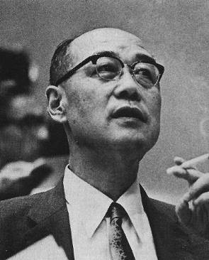
: The Yukawa Part
Writing the first term explicitly:
Niels Tuning (19)
Notes:
19
Answer: The lagrangian involves scalar and pseudoscalar interactions (since d_r = ½ (1-g_5) d etc.) in a similar way as the nuclean-meson potential.

Slide 20
: The Yukawa Part
There are 3 Yukawa matrices (in the case of massless neutrino’s):
Each matrix is 3x3 complex:
27 real parameters
27 imaginary parameters (“phases”)
many of the parameters are equivalent, since the physics described by one set of couplings is the same as another
It can be shown (see ref. [Nir]) that the independent parameters are:
12 real parameters
1 imaginary phase
This single phase is the source of all CP violation in the Standard Model
……Revisit later
Niels Tuning (20)
Notes:
20

Slide 21
: The Fermion Masses
S.S.B
Start with the Yukawa Lagrangian
After which the following mass term emerges:
with
L_{Mass} is CP violating in a similar way as L_{Yuk}
Niels Tuning (21)
Notes:
21
In the vacuum, the only non-zero component of the Higgs field is phi^0.
The L_mass is CP conserving if the Mass matrices are real.

Slide 22
: The Fermion Masses
S.S.B
Writing in an explicit form:
The matrices M can always be diagonalised by unitary matrices V_{L}^{f} and V_{R}^{f} such that:
Then the real fermion mass eigenstates are given by:
d_{L}^{I} , u_{L}^{I} , l_{L}^{I} are the weak interaction eigenstates
d_{L} , u_{L} , l_{L} are the mass eigenstates (“physical particles”)
Niels Tuning (22)

Slide 23
: The Fermion Masses
S.S.B
In terms of the mass eigenstates:
In flavour space one can choose:
Weak basis: The gauge currents are diagonal in flavour space, but the flavour mass matrices are
non-diagonal
Mass basis: The fermion masses are diagonal, but some gauge currents (charged weak interactions)
are not diagonal in flavour space
In the weak basis: L_{Yukawa} = CP violating
In the mass basis: L_{Yukawa} → L_{Mass} = CP conserving
➔ What happened to the charged current interactions (in L_{Kinetic}) ?
Niels Tuning (23)
Notes:
23
Use the fact that: d ½ (1+g_5) m_d ½ (1+g_5) d = m d ½ (1+g5) d.
And similarly: d ½ (1-g_5) m_d ½ (1-g_5) d = m d ½ (1-g5) d.
Sum them up to get: m d d

Slide 24
: The Charged Current
The charged current interaction for quarks in the interaction basis is:
The charged current interaction for quarks in the mass basis is:
The unitary matrix:
With:
is the Cabibbo Kobayashi Maskawa mixing matrix:
Lepton sector: similarly
However, for massless neutrino’s: V_{L}^{ν} = arbitrary. Choose it such that V_{MNS} = 1 ➔ There is no mixing in the lepton sector
Niels Tuning (24)
Notes:
24

Slide 25
Charged Currents
The charged current term reads:
Under the CP operator this gives:
(Together with (x,t) -> (-x,t))
A comparison shows that CP is conserved only if V_{ij} = V_{ij}*
In general the charged current term is CP violating
Niels Tuning (25)
Notes:
25

Slide 26
The Standard Model Lagrangian (recap)
L_{Kinetic} : •Introduce the massless fermion fields
•Require local gauge invariance → gives rise to existence of gauge bosons
➔ CP Conserving
L_{Higgs} : •Introduce Higgs potential with <φ> ≠ 0
•Spontaneous symmetry breaking
The W⁺, W⁻,Z⁰ bosons acquire a mass
➔ CP Conserving
L_{Yukawa} : •Ad hoc interactions between Higgs field & fermions
➔ CP violating with a single phase
L_{Yukawa} → L_{mass} : • fermion weak eigenstates:
- mass matrix is (3x3) non-diagonal
• fermion mass eigenstates:
- mass matrix is (3x3) diagonal
➔ CP-violating
➔ CP-conserving!
L_{Kinetic} in mass eigenstates: CKM – matrix
➔ CP violating with a single phase
Niels Tuning (26)
Notes:
26

Slide 27
Recap
Diagonalize Yukawa matrix Y_{ij}
Mass terms
Quarks rotate
Off diagonal terms in charged current couplings
Niels Tuning (27)
Notes:
27
Replace the derivative with the covariant derivative introducing the force carriers: gluons, weak vector bosons and photon.
The constants g_s, g and g’ are the corresponding coupling constants of the gauge particles.

Slide 28

Ok…. We’ve got the CKM matrix, now what?
It’s unitary
“probabilities add up to 1”:
d’=0.97 d + 0.22 s + 0.003 b (0.97²+0.22²+0.003²=1)
How many free parameters?
How many real/complex?
How do we normally visualize these parameters?
Niels Tuning (28)
Notes:
28

Slide 29
What do we know about the CKM matrix?
Magnitudes of elements have been measured over time
Result of a large number of measurements and calculations
Magnitude of elements shown only, no information of phase

Slide 30
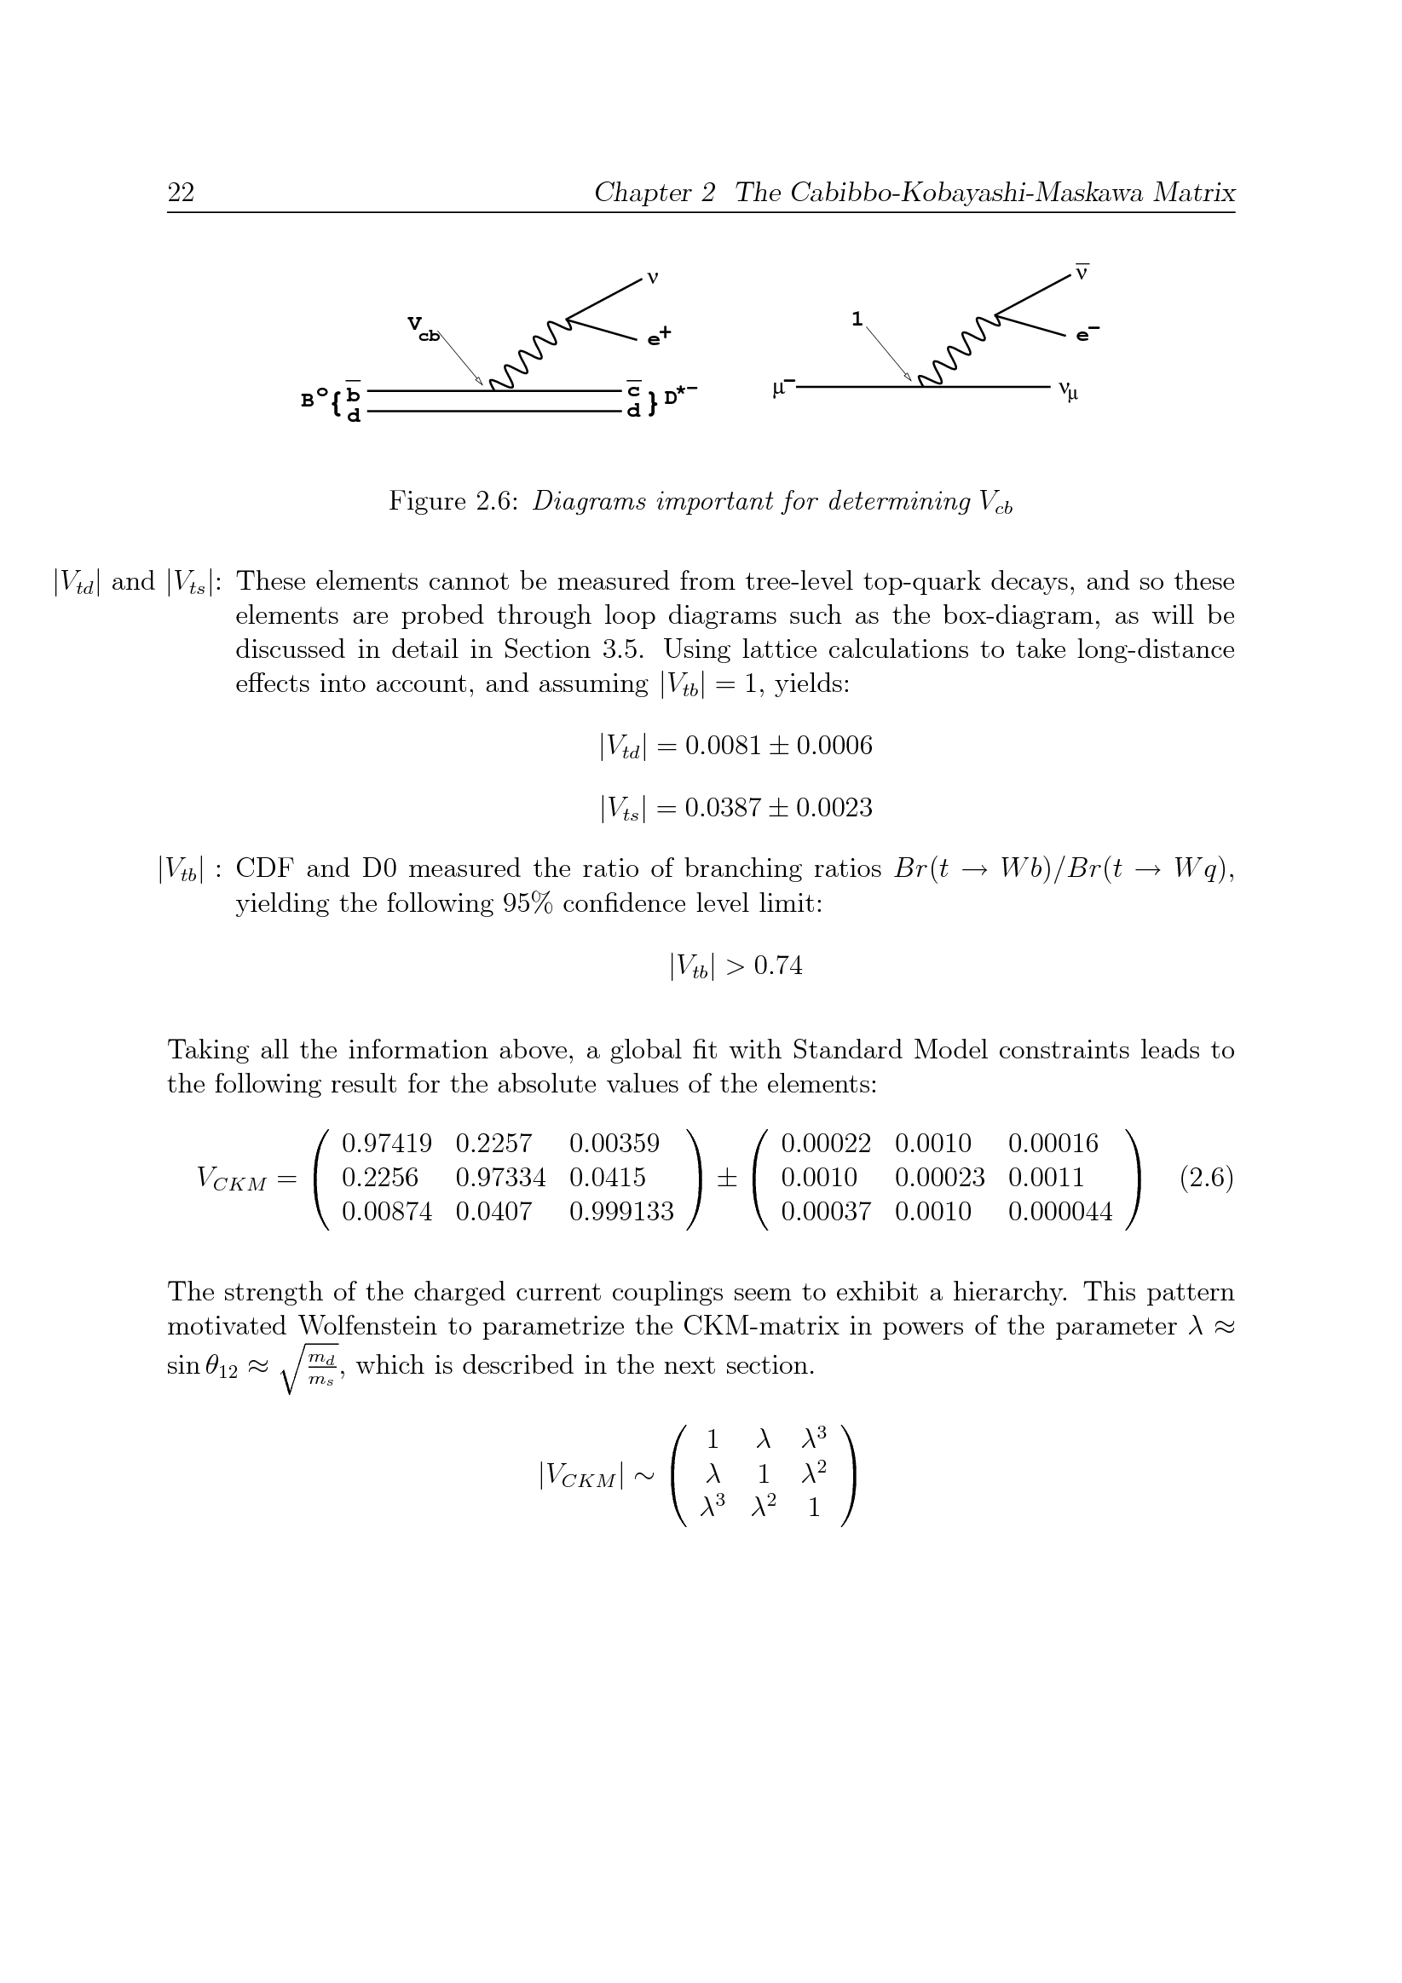
What do we know about the CKM matrix?
Magnitude of elements shown only, no information of phase
Niels Tuning (30)
Magnitudes of elements have been measured over time
Result of a large number of measurements and calculations
Notes:
30

Slide 31
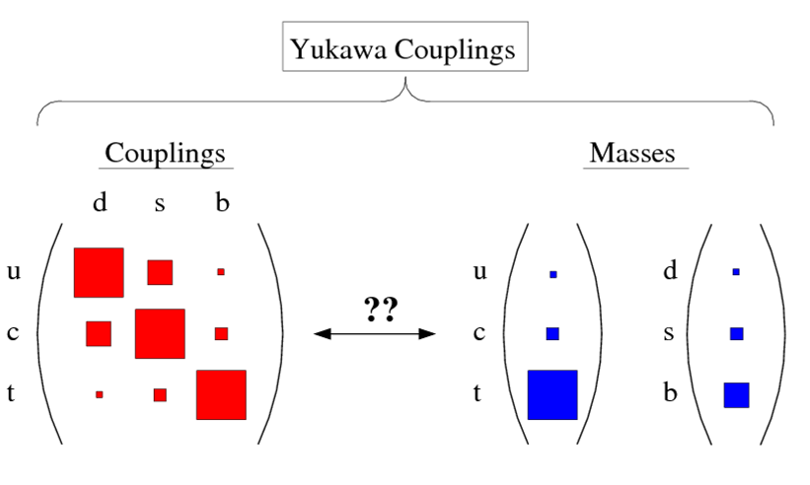
What’s going on??
??? Edward Witten, 17 Feb 2009…
See “From F-Theory GUT’s to the LHC” by Heckman and Vafa (arXiv:0809.3452)

Slide 32
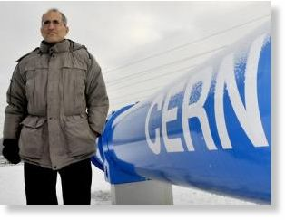
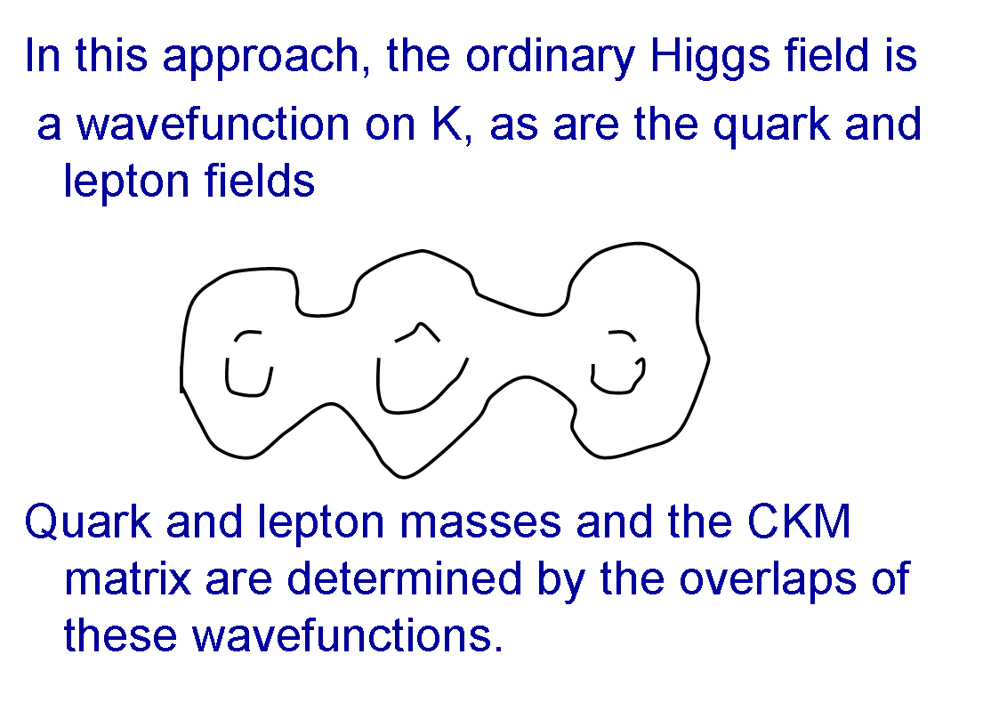
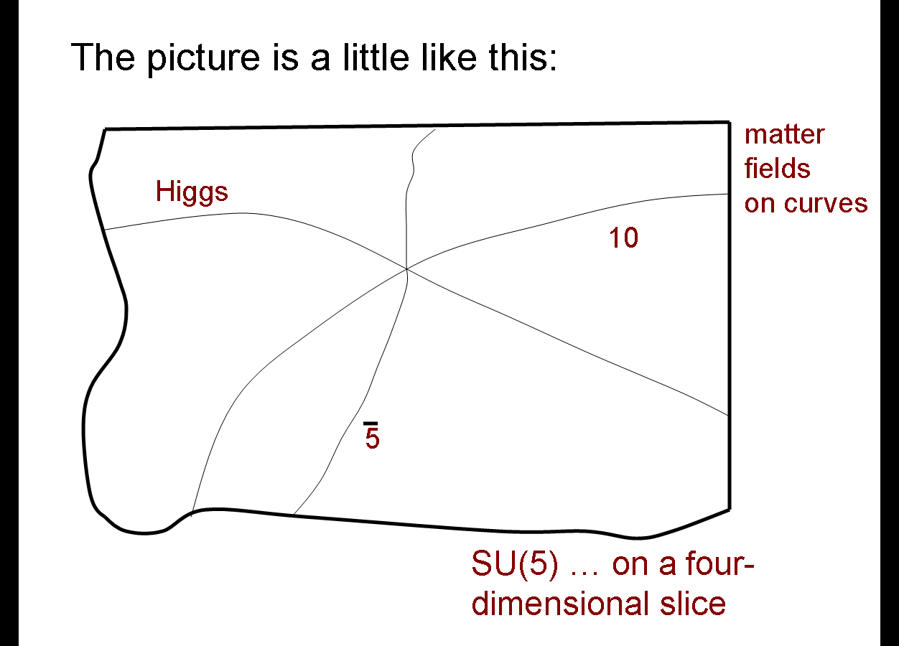
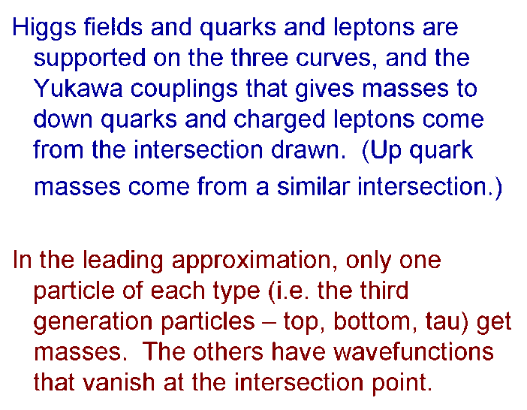
What’s going on??
In 2004, Time magazine stated that Witten was widely thought to be the world's greatest living theoretical physicist.
??? Edward Witten, 17 Feb 2009…
See “From F-Theory GUT’s to the LHC” by Heckman and Vafa (arXiv:0809.3452)

Slide 33
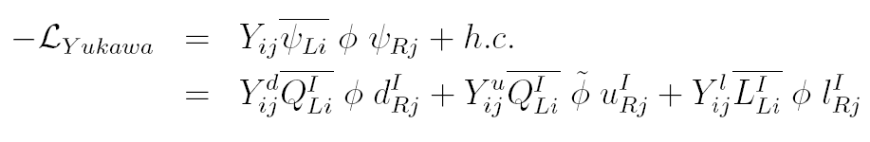


Intermezzo: How about the leptons?
We now know that neutrinos also have flavour oscillations
Neutrinos have mass
Diagonalizing Y^{l}_{ij} doesn’t come for free any longer
thus there is the equivalent of a CKM matrix for them:
Pontecorvo-Maki-Nakagawa-Sakata matrix
vs

Slide 34
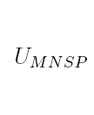
Intermezzo: How about the leptons?
the equivalent of the CKM matrix
Pontecorvo-Maki-Nakagawa-Sakata matrix
a completely different hierarchy!
vs

Slide 35
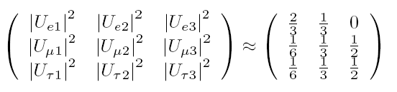
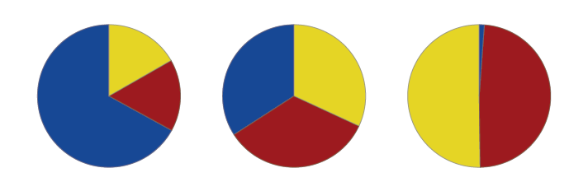
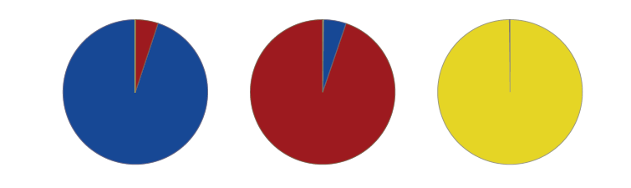
Intermezzo: How about the leptons?
the equivalent of the CKM matrix
Pontecorvo-Maki-Nakagawa-Sakata matrix
a completely different hierarchy!
vs
ν₁
ν₂
ν₃
d
s
b
See eg. PhD thesis R. de Adelhart Toorop

Slide 36
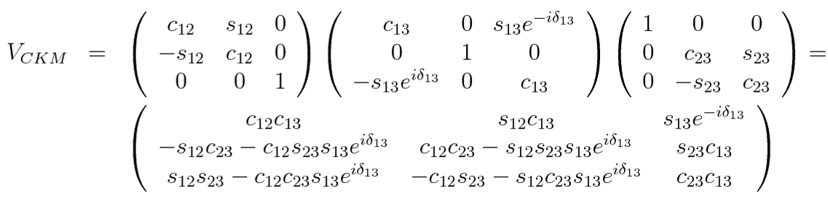
From 2 to 3 generations
2 generations: d’=0.97 d + 0.22 s (θ_{c}=13º)
3 generations: d’=0.97 d + 0.22 s + 0.003 b
Parameterization used by Particle Data Group (3 Euler angles, 1 phase):

Slide 37
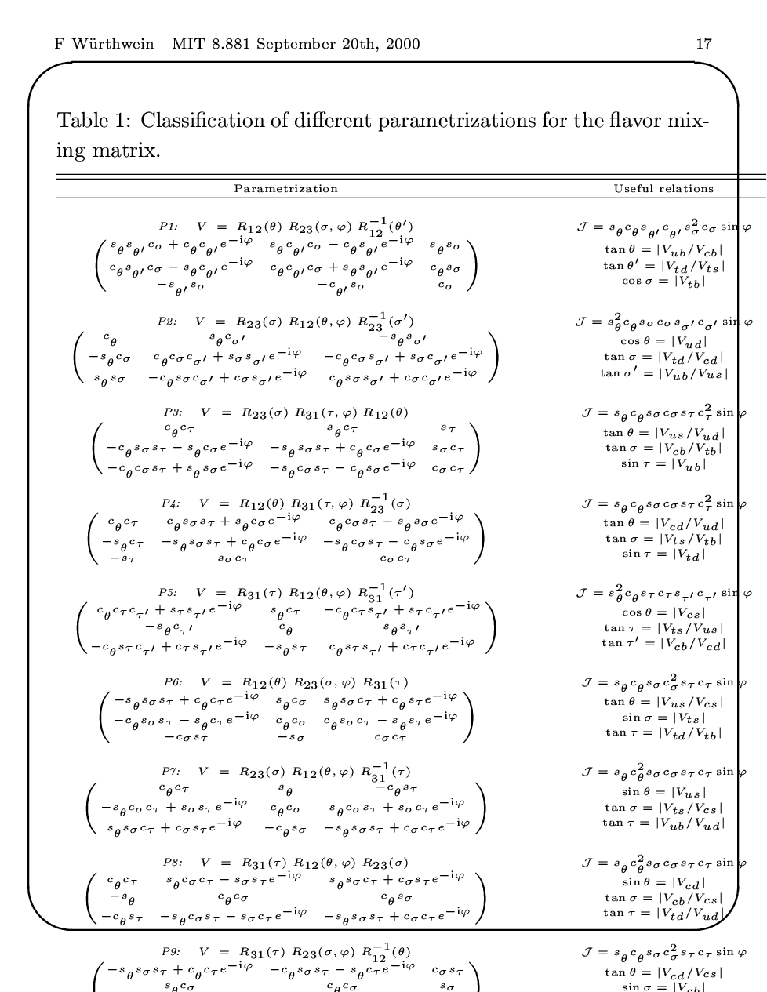
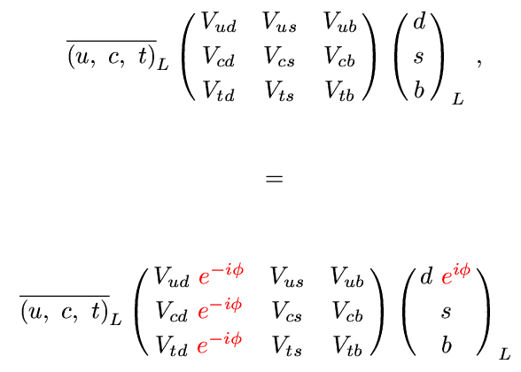
Possible forms of 3 generation mixing matrix
→ Different parametrizations! It’s about phase differences!
Re-phasing V:
KM
PDG
3 parameters: θ, τ, σ
1 phase: φ
Niels Tuning (37)
Notes:
37

Slide 38
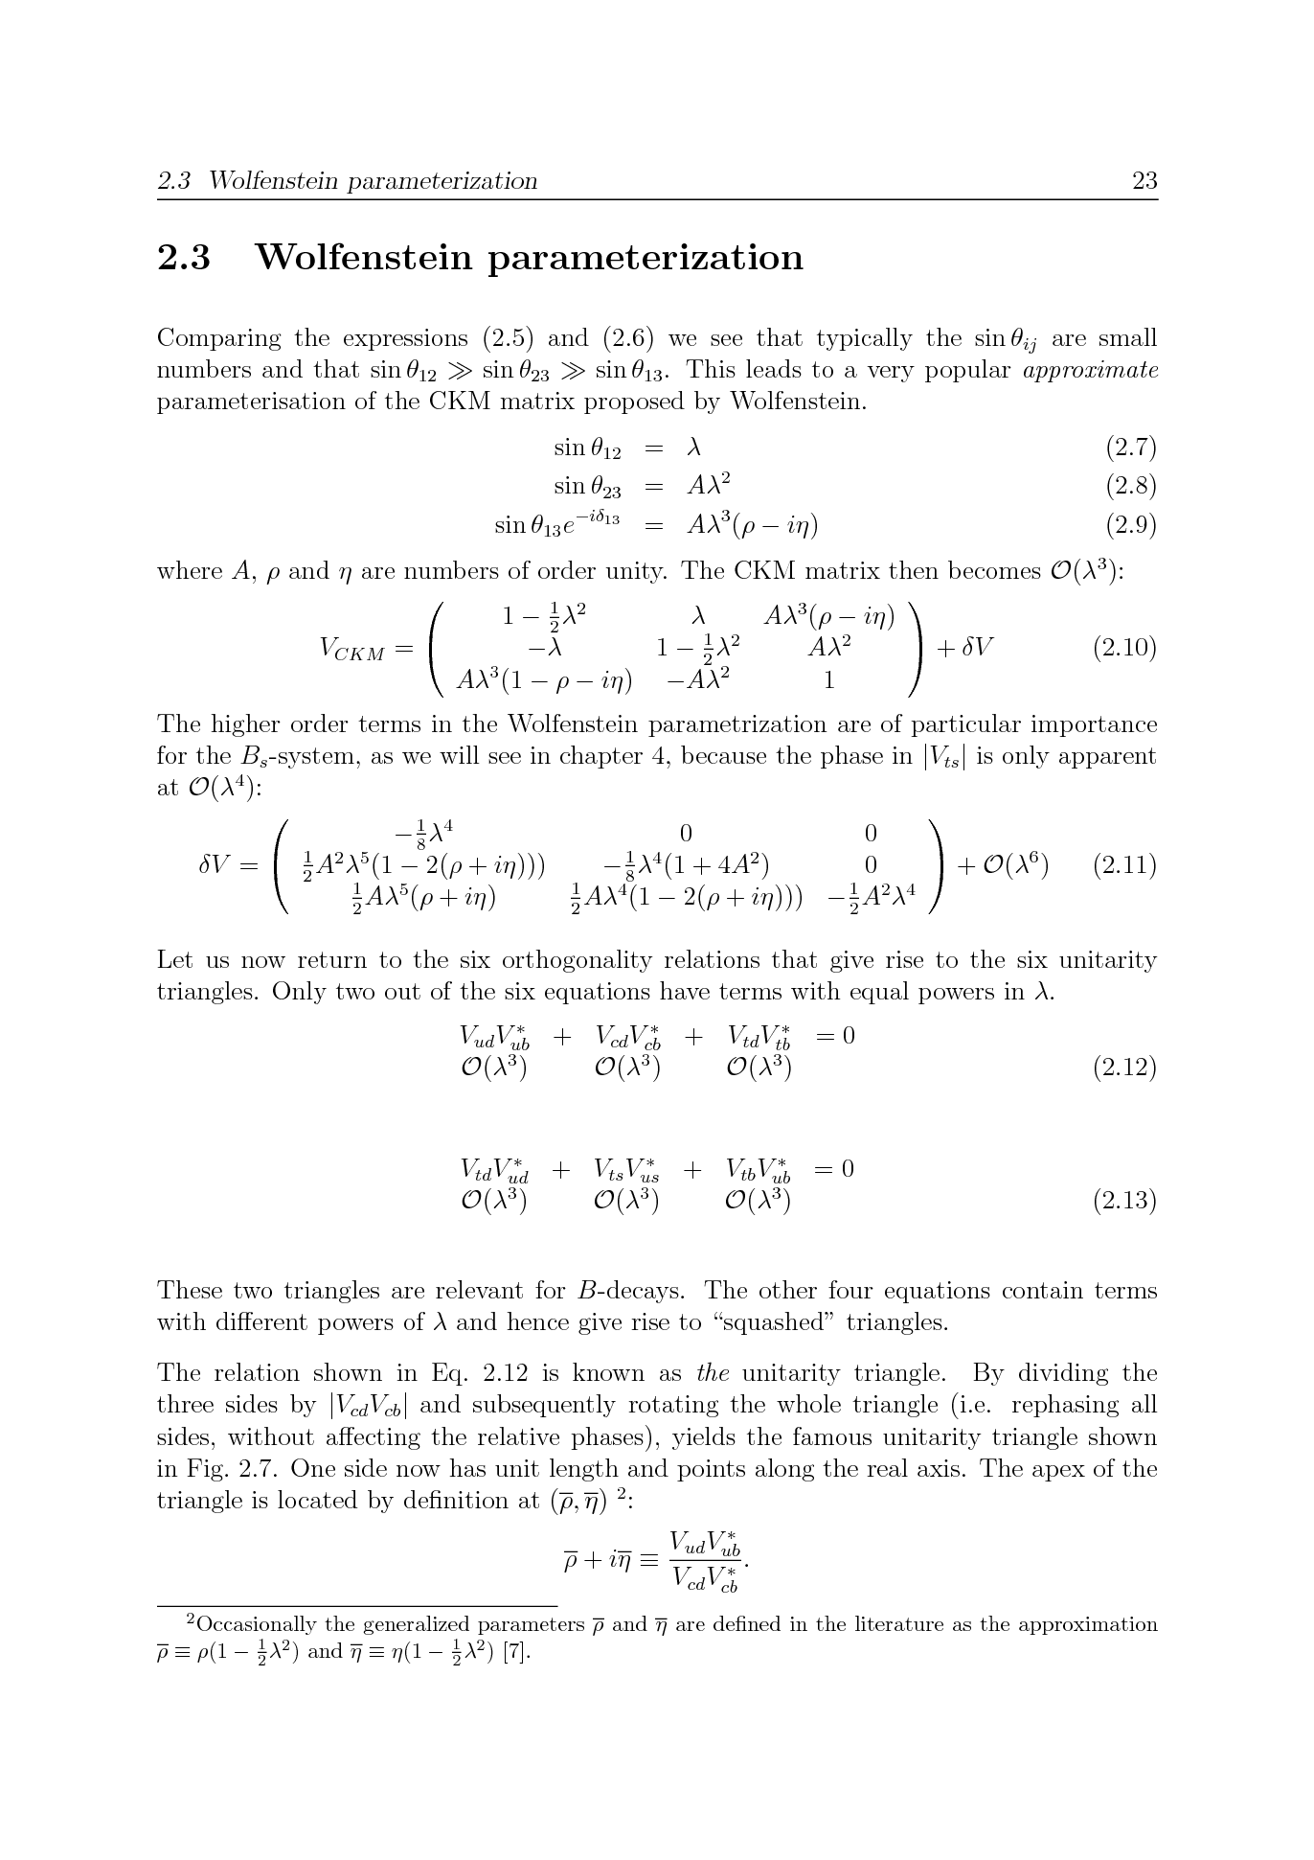
Wolfenstein parameterization
3 real parameters: A, λ, ρ
1 imaginary parameter: η

Slide 39
Wolfenstein parameterization
3 real parameters: A, λ, ρ
1 imaginary parameter: η

Slide 40
Deriving the triangle interpretation
Starting point: the 9 unitarity constraints on the CKM matrix
Pick (arbitrarily) orthogonality condition with (i,j)=(3,1)

Slide 41
Visualizing the unitarity constraint
Sum of three complex vectors is zero → Form triangle when put head to tail
(Wolfenstein params to order λ⁴)

Slide 42
Visualizing the unitarity constraint
Divide all sides by length of base
Constructed a triangle with apex (ρ,η)
(ρ,η)
(0,0)
(1,0)

Slide 43
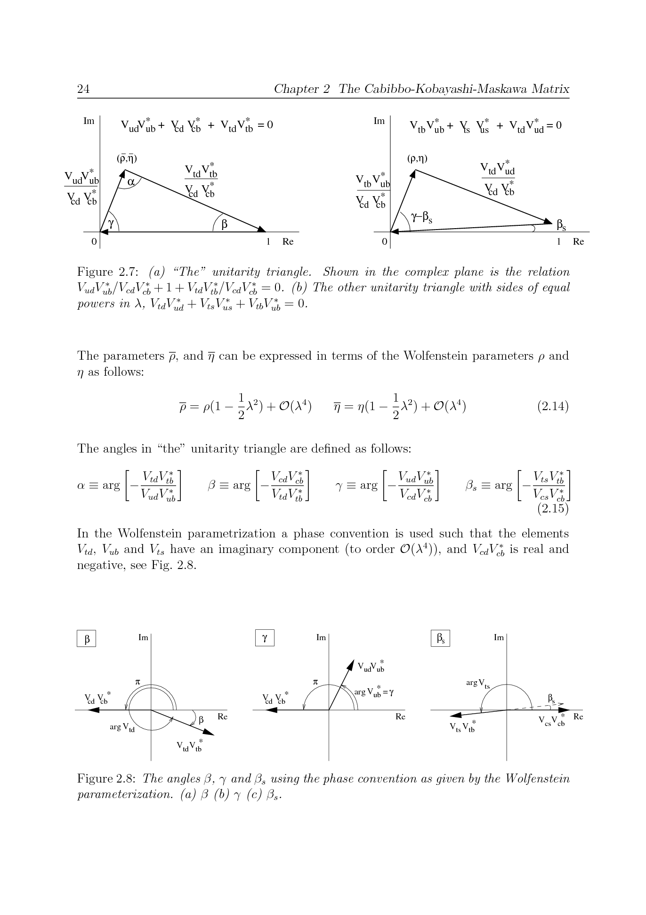
“The” Unitarity triangle
We can visualize the CKM-constraints in (ρ,η) plane

Slide 44
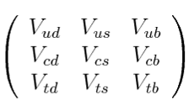
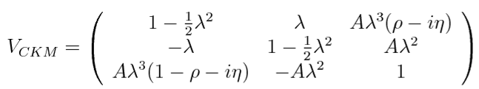
β
We can correlate the angles β and γ to CKM elements:

Slide 45
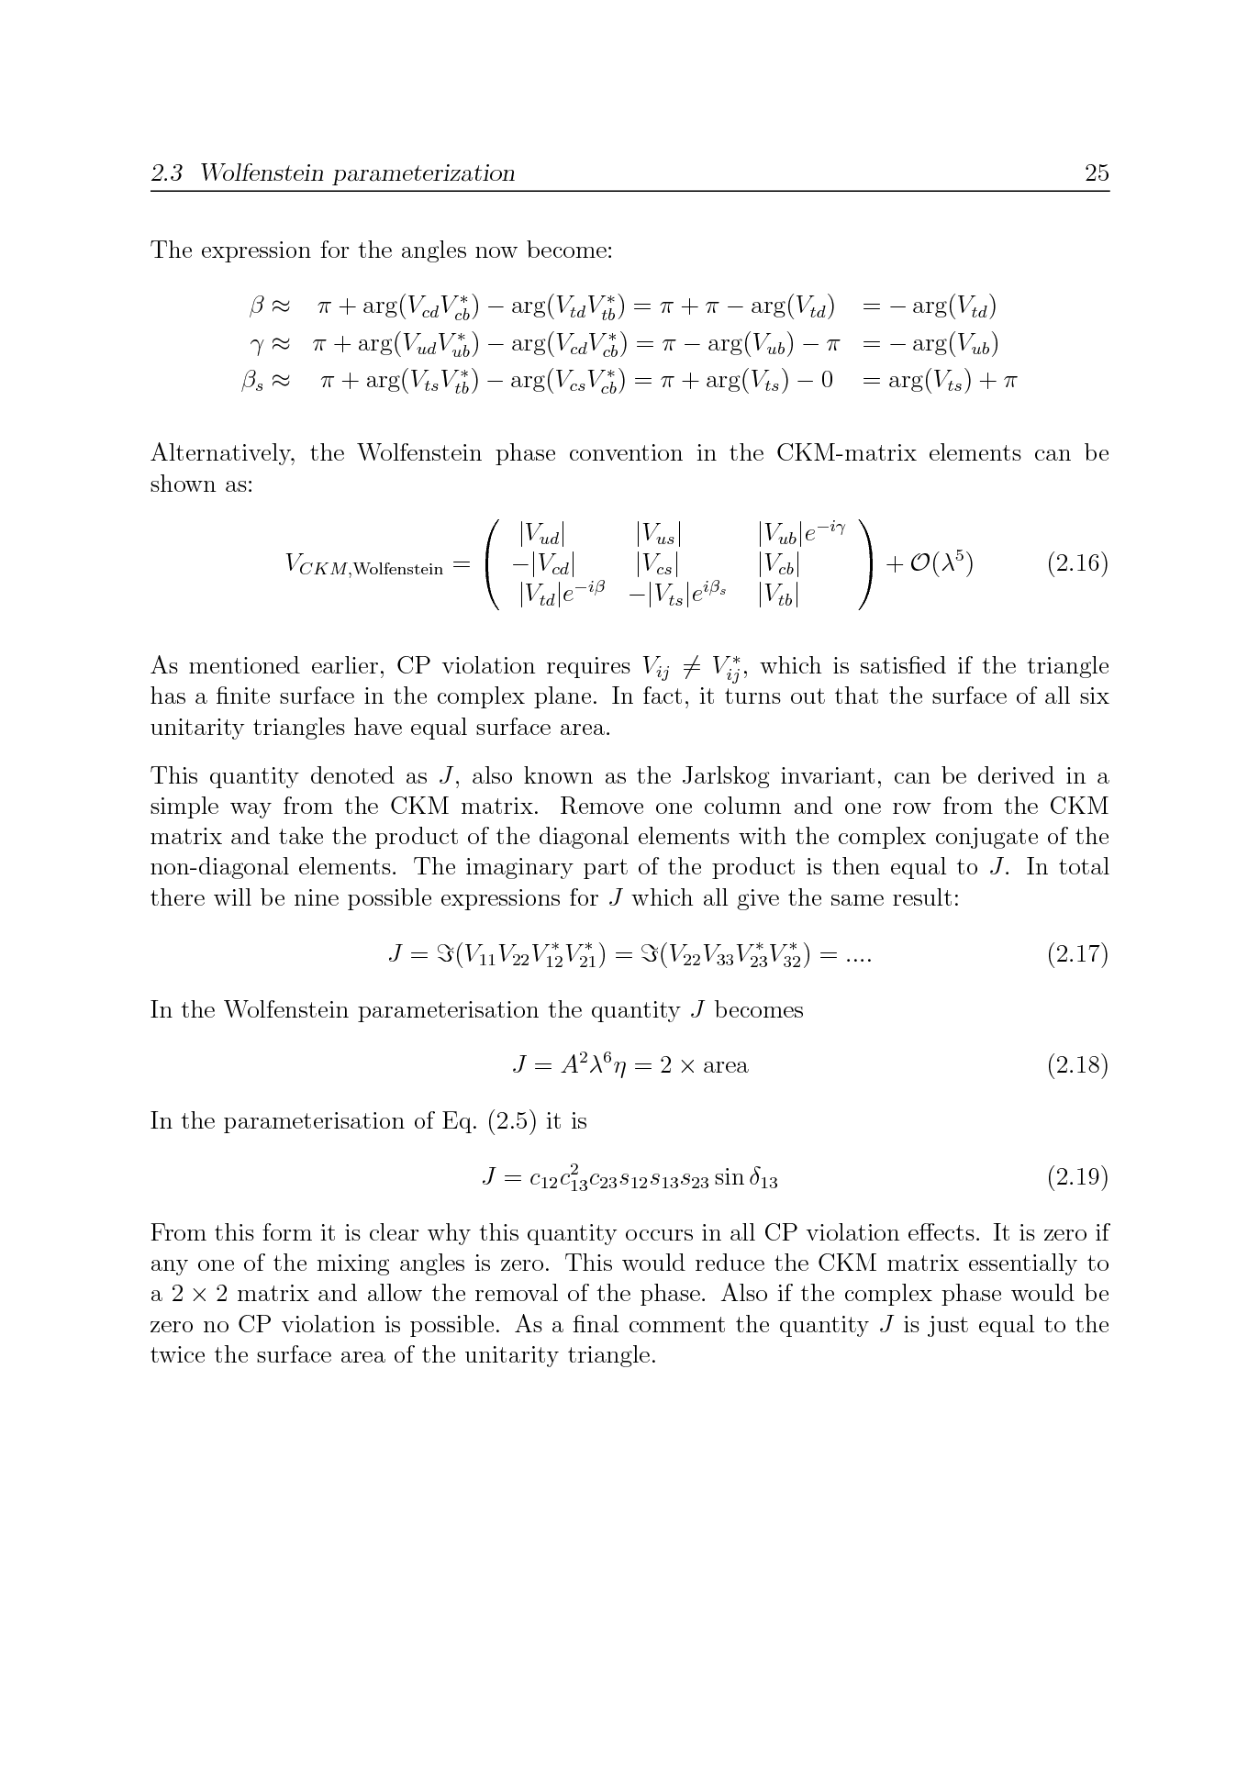
The phases in the Wolfenstein parameterization

Slide 46
“The” Unitarity triangle

Slide 47
Quarks → Mesons
Quarks:
Mesons
“Oscillations” important ingredient!
u
W
d,s,b
s
b
s
b

Slide 48
CP violation in the quark sector
Quarks: SM, CKM, UT Niels, 30’
Mesons: Mixing and CPV types Niels, 30’
B-mesons: Decays and Experiment Patrick, 60’

Slide 49
Recap
u^{I}
W
d^{I}
Diagonalize Yukawa matrix Y_{ij}
Mass terms
Quarks rotate
Off diagonal terms in charged current couplings
u
W
d,s,b
Niels Tuning (49)
Notes:
49
Replace the derivative with the covariant derivative introducing the force carriers: gluons, weak vector bosons and photon.
The constants g_s, g and g’ are the corresponding coupling constants of the gauge particles.

Slide 50
CKM-matrix: where are the phases?
Possibility 1: simply 3 ‘rotations’, and put phase on smallest:
Possibility 2: parameterize according to magnitude, in O(λ):
u
W
d,s,b

Slide 51
“The” Unitarity triangle
We can visualize the CKM-constraints in (ρ,η) plane
arg(V_{ub}) = -γ
arg(V_{td}) = -β

Slide 52
Quarks → Mesons
Quarks:
Mesons
“Oscillations” important ingredient!
u
W
d,s,b
s
b
s
b

Slide 53
Dynamics of Neutral B (or K) mesons…
Time evolution of B⁰ and B⁰ can be described by an effective Hamiltonian:
No mixing, no decay…
No mixing, but with decays…
(i.e.: H is not Hermitian!)
With decays included, probability of observing
either B⁰ or B⁰ must go down as time goes by:

Slide 54
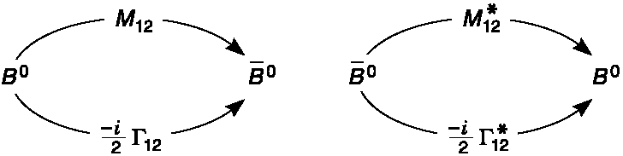
Describing Mixing…
Time evolution of B⁰ and B⁰ can be described by an effective Hamiltonian:
Where to put the mixing term?
Now with mixing – but what is the
difference between M₁₂ and Γ₁₂?
M₁₂ describes B⁰ ↔ B⁰ via off-shell states, e.g. the weak box diagram
Γ₁₂ describes B⁰↔f↔B⁰ via on-shell states, eg. f=π⁺π⁻

Slide 55
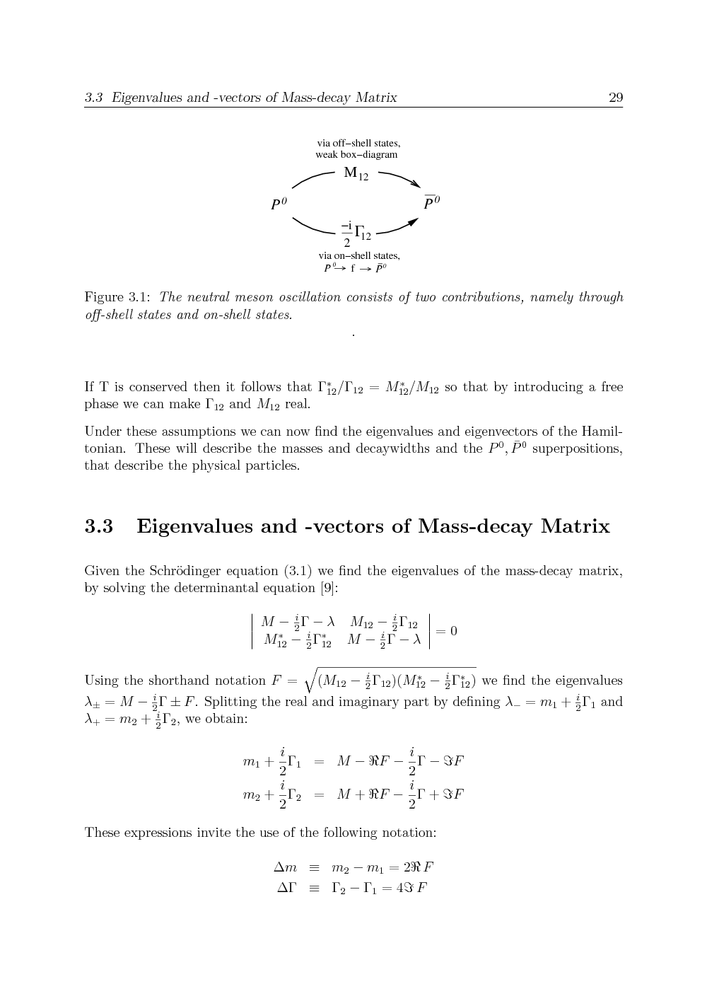
Solving the Schrödinger Equation
Eigenvalues:
Mass and lifetime of physical states: mass eigenstates
Notes:
The physical particles are the eigenstates of the Hamiltonian. Solve the eigenvalues lambda by putting det (H11-lambda*I) = 0
This you can not see here. You just have to sit down and *do* it.

Slide 56
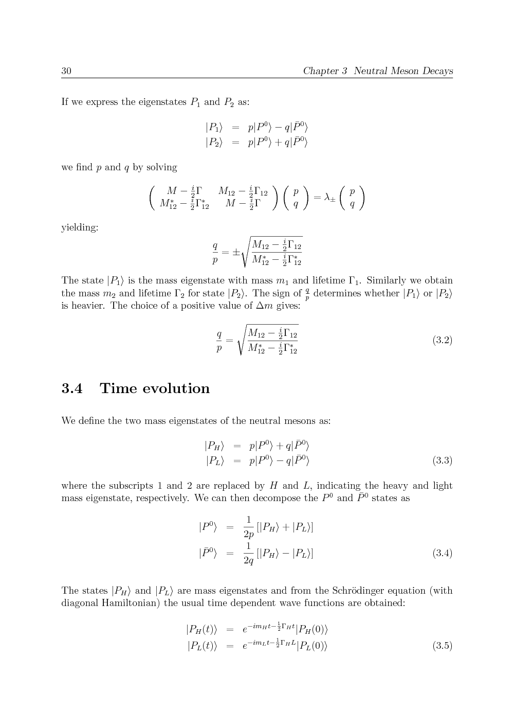
Solving the Schrödinger Equation
Eigenvectors:
mass eigenstates
Notes:
The physical particles are the eigenstates of the Hamiltonian. Solve the eigenvalues lambda by putting det (H11-lambda*I) = 0
This you can not see here. You just have to sit down and *do* it.

Slide 57
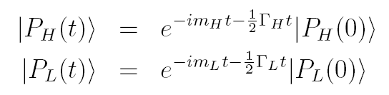
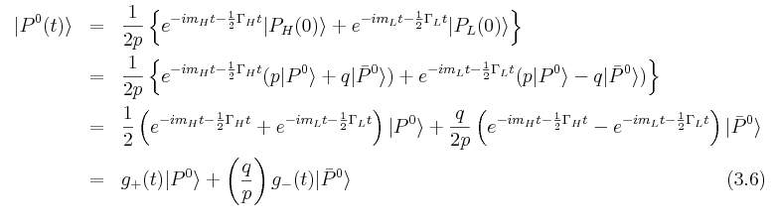
Time evolution
With diagonal Hamiltonian, usual time evolution is obtained:

Slide 58
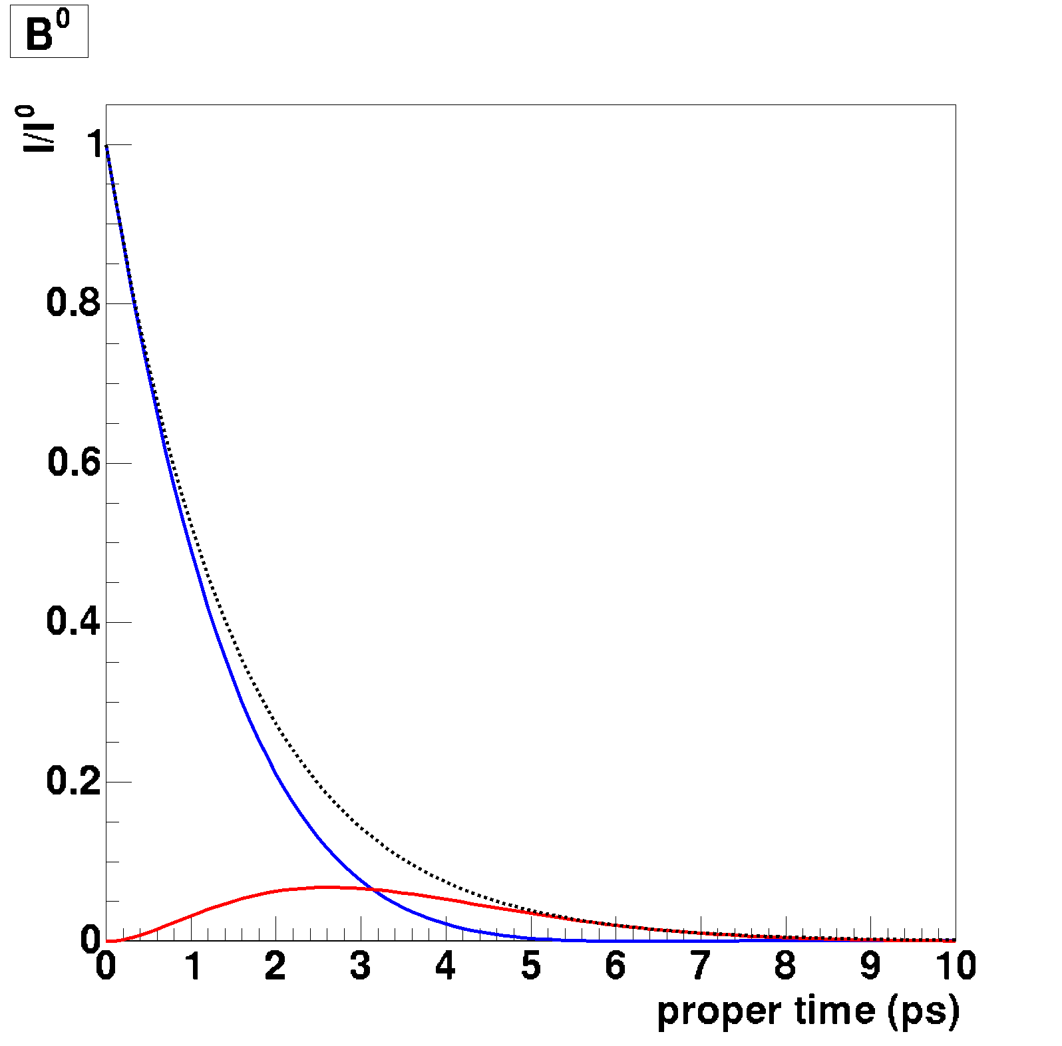
Measuring B Oscillations
For B⁰, expect:
ΔΓ ~ 0,
|q/p|=1
~
B⁰→B⁰
B⁰→B⁰
Decay probability
Proper Time →
Notes:
Use cos^2 (dmt/2) = 0.5 * (1 + cos(dmt))

Slide 59
Compare the mesons:
P⁰→P⁰
Same concept, different phenomenology:
P⁰→P⁰
K⁰
D⁰
B⁰
B_{s}⁰
x=Δm/Γ: avg nr of
oscillations before decay
By the way,
ħ=6.58 10⁻²² MeVs

Slide 60
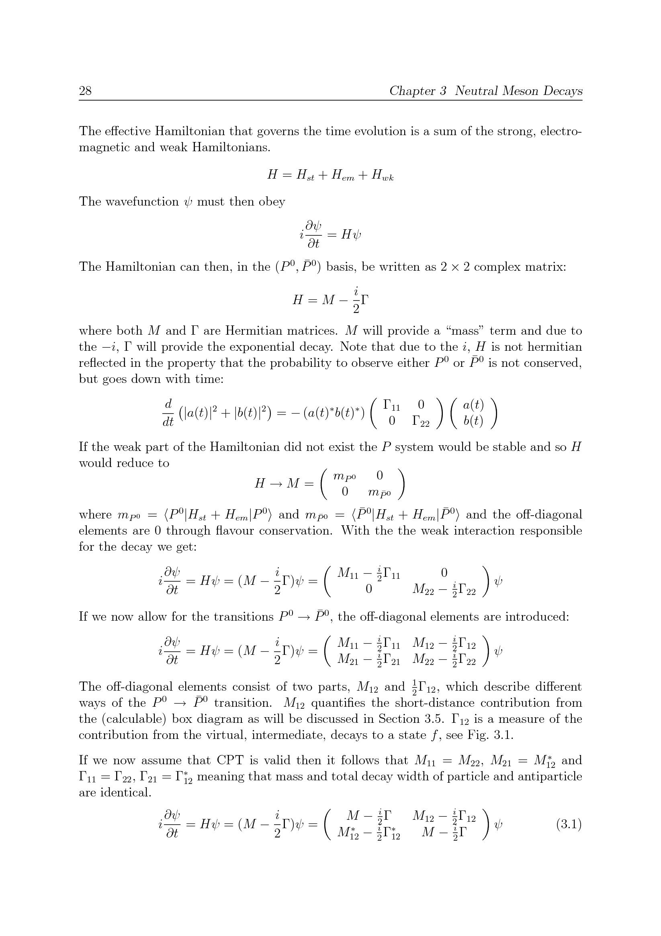
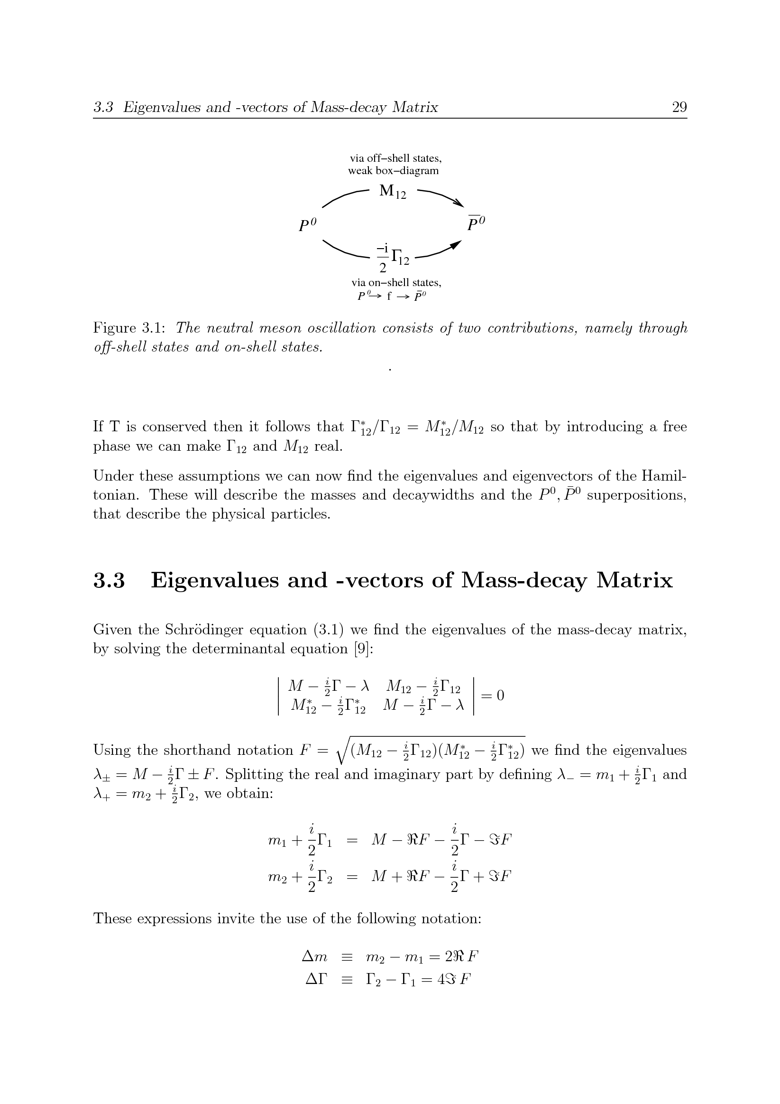
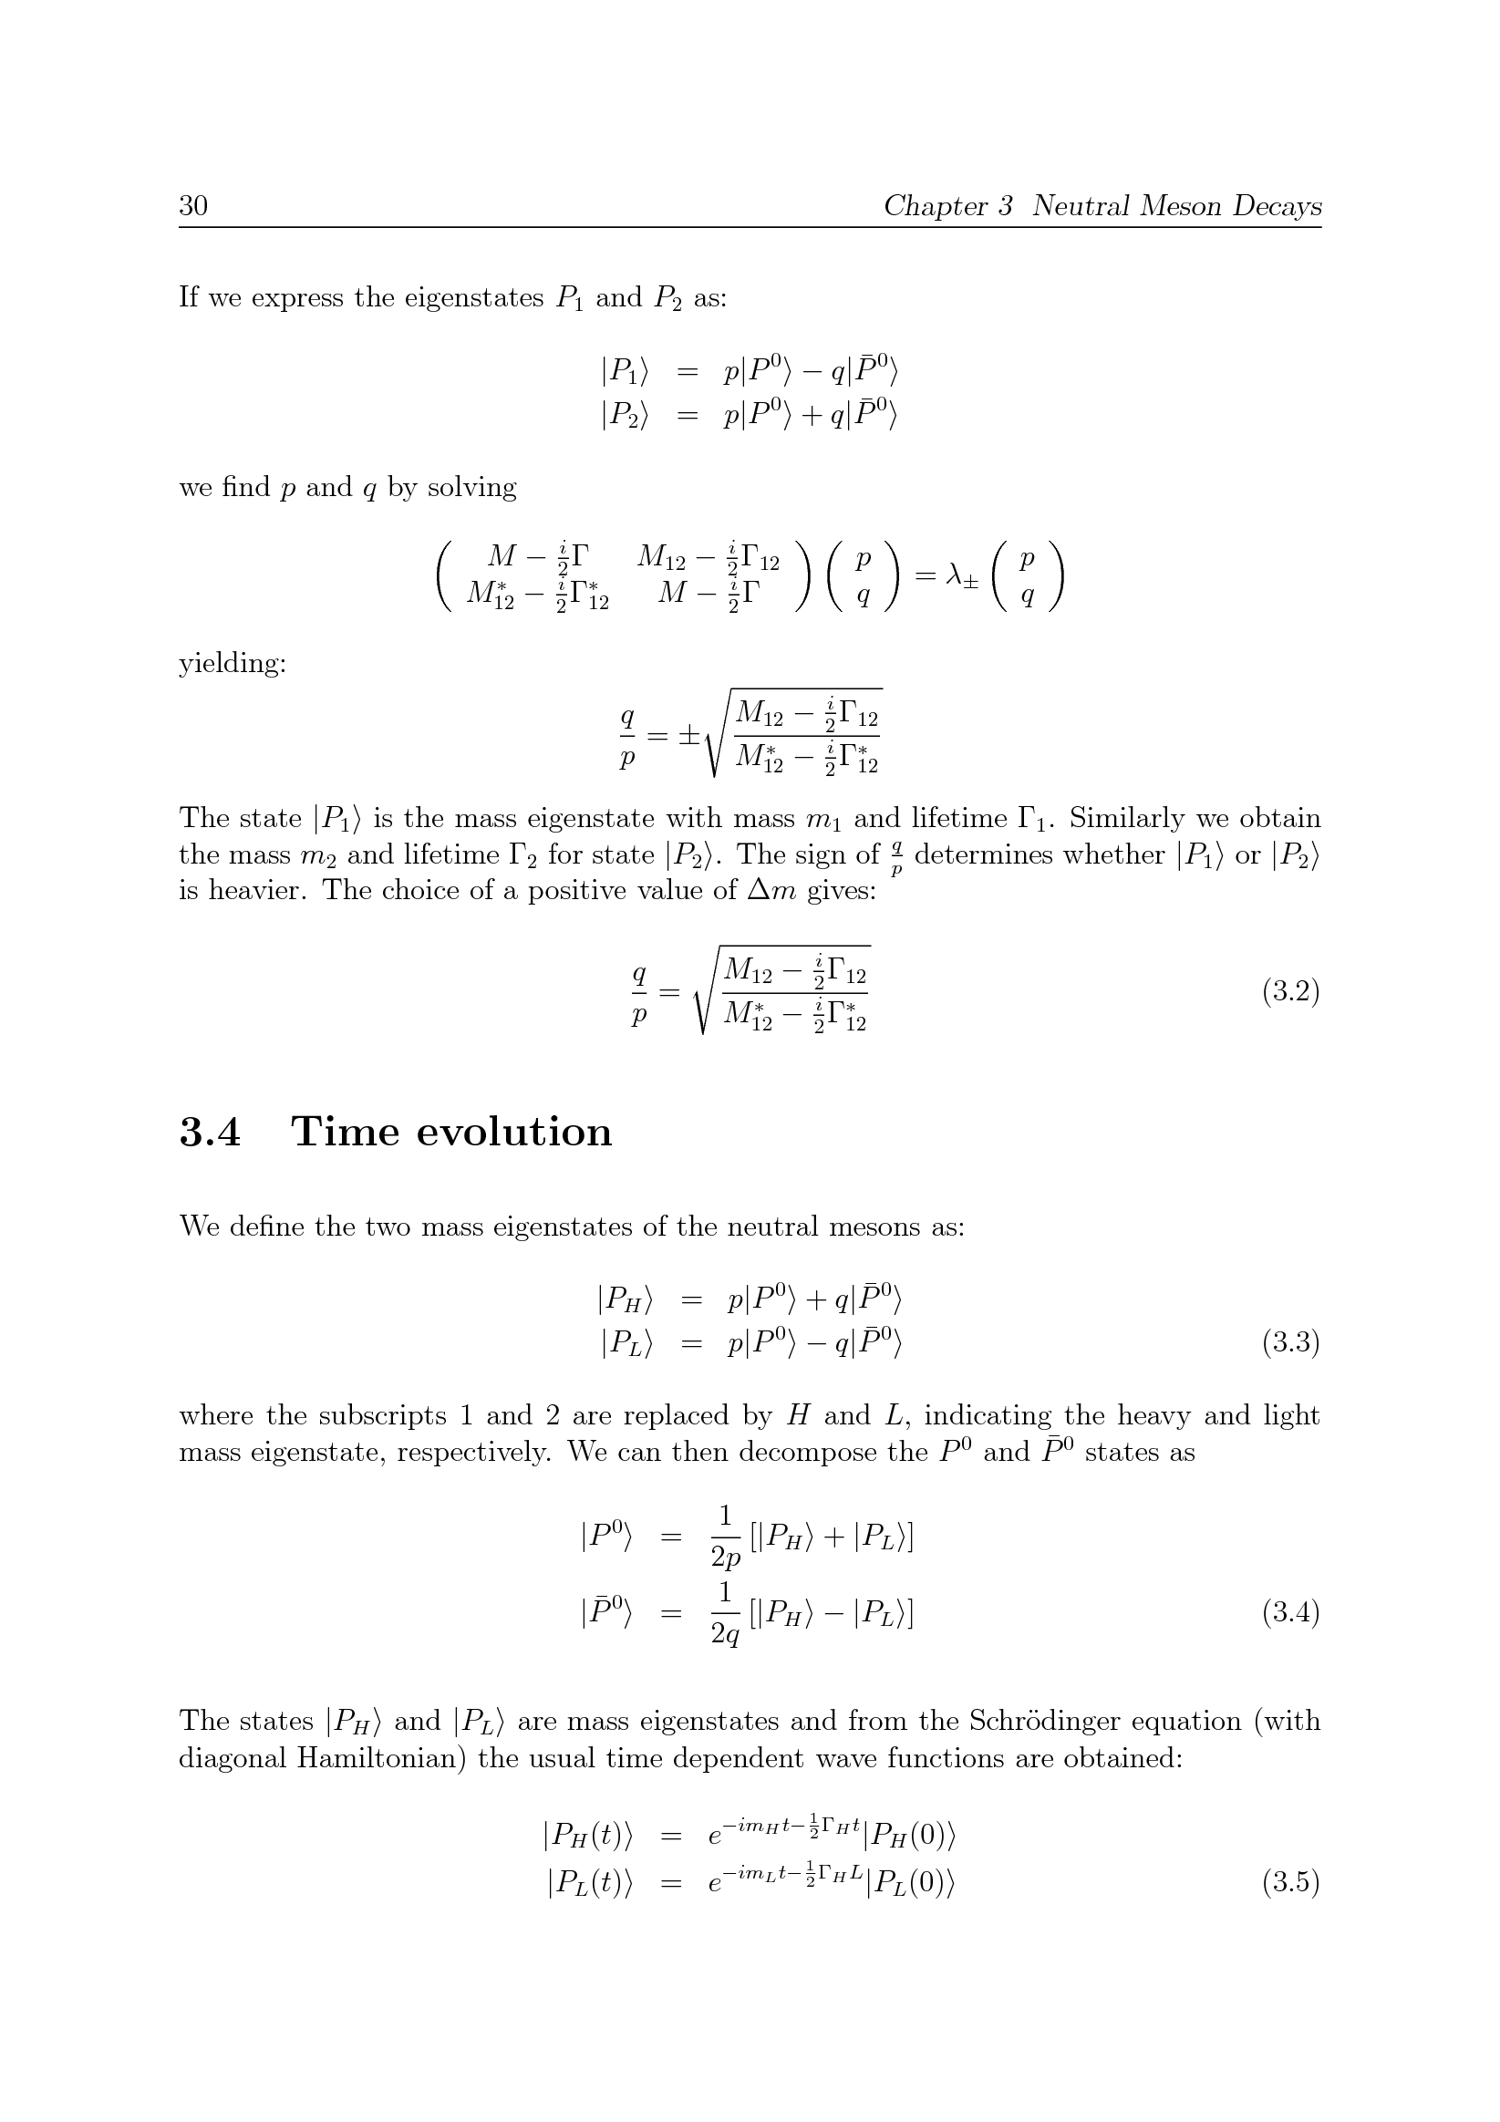
Oscillations (1)
Start with Schrodinger equation:
Find eigenvalue:
Solve eigenstates:
Eigenstates have diagonal Hamiltonian: mass eigenstates!
(2-component state in
P⁰ and P⁰ subspace)

Slide 61
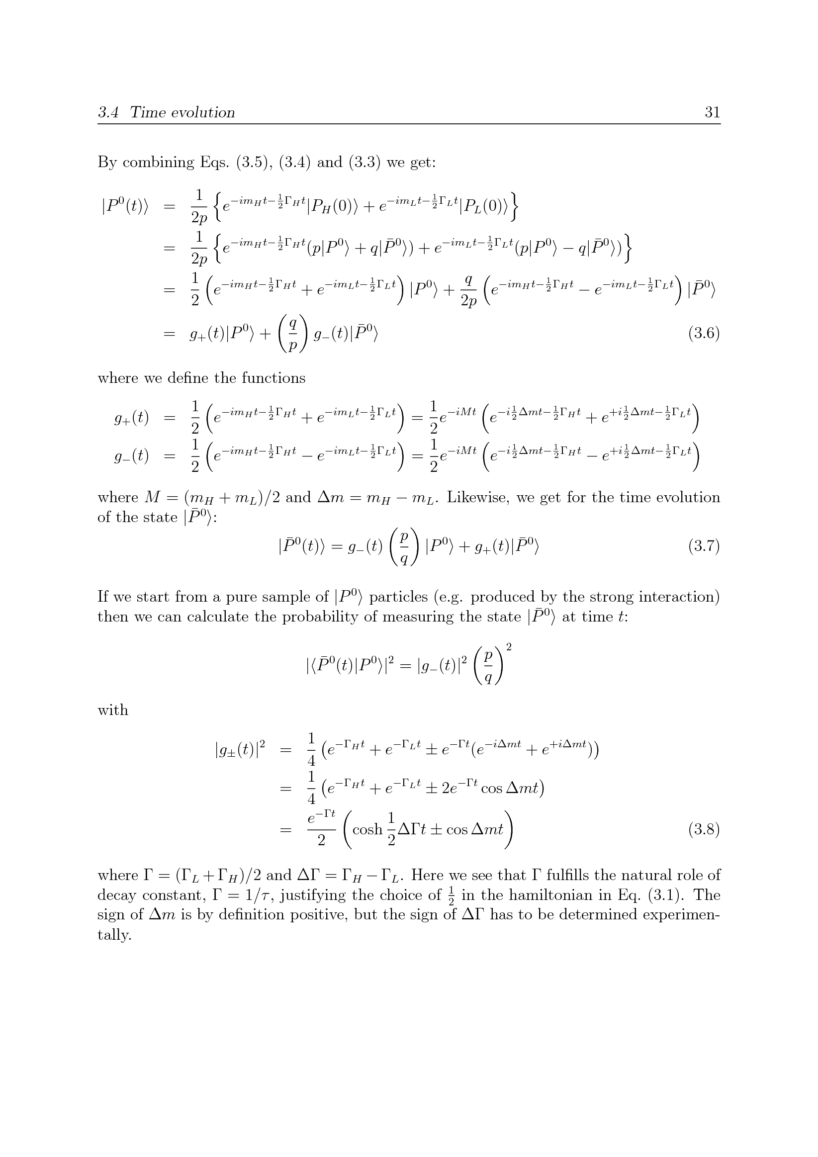
Oscillations (2)
Two mass eigenstates
Time evolution:
Probability for |P⁰> → |P⁰> !
Express in M=m_{H}+m_{L} and Δm=m_{H}-m_{L} → Δm dependence

Slide 62
Oscillations: summary
p, q:
Δm, ΔΓ:
x,y: mixing often quoted in scaled parameters:
q,p,M_{ij},Γ_{ij} related through:
Time dependence (if ΔΓ~0, like for B⁰):
with

Slide 63
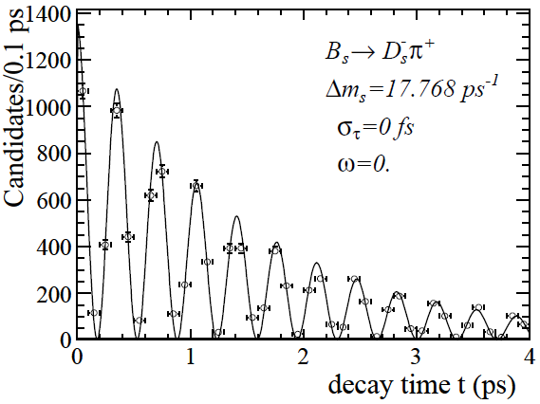
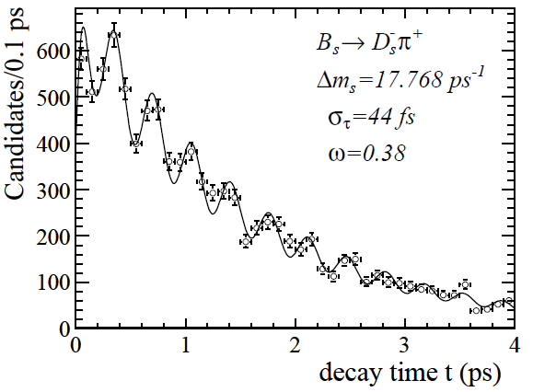
B_{s}⁰ mixing (Δm_{s})
Ideal
Tagging,
resolution
Acceptance
LHCb, Nature Phys. 18 (2022) 1
2104.04421 [hep-ex]
Niels Tuning (63)

Slide 64
Mixing → CP violation?
NB: Just mixing is not necessarily CP violation!
However, by studying certain decays with and without mixing, CP violation is observed
Next: Measuring CP violation…

Slide 65
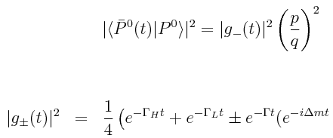

Meson Decays
Formalism of meson oscillations:
Subsequent: decay

Slide 66
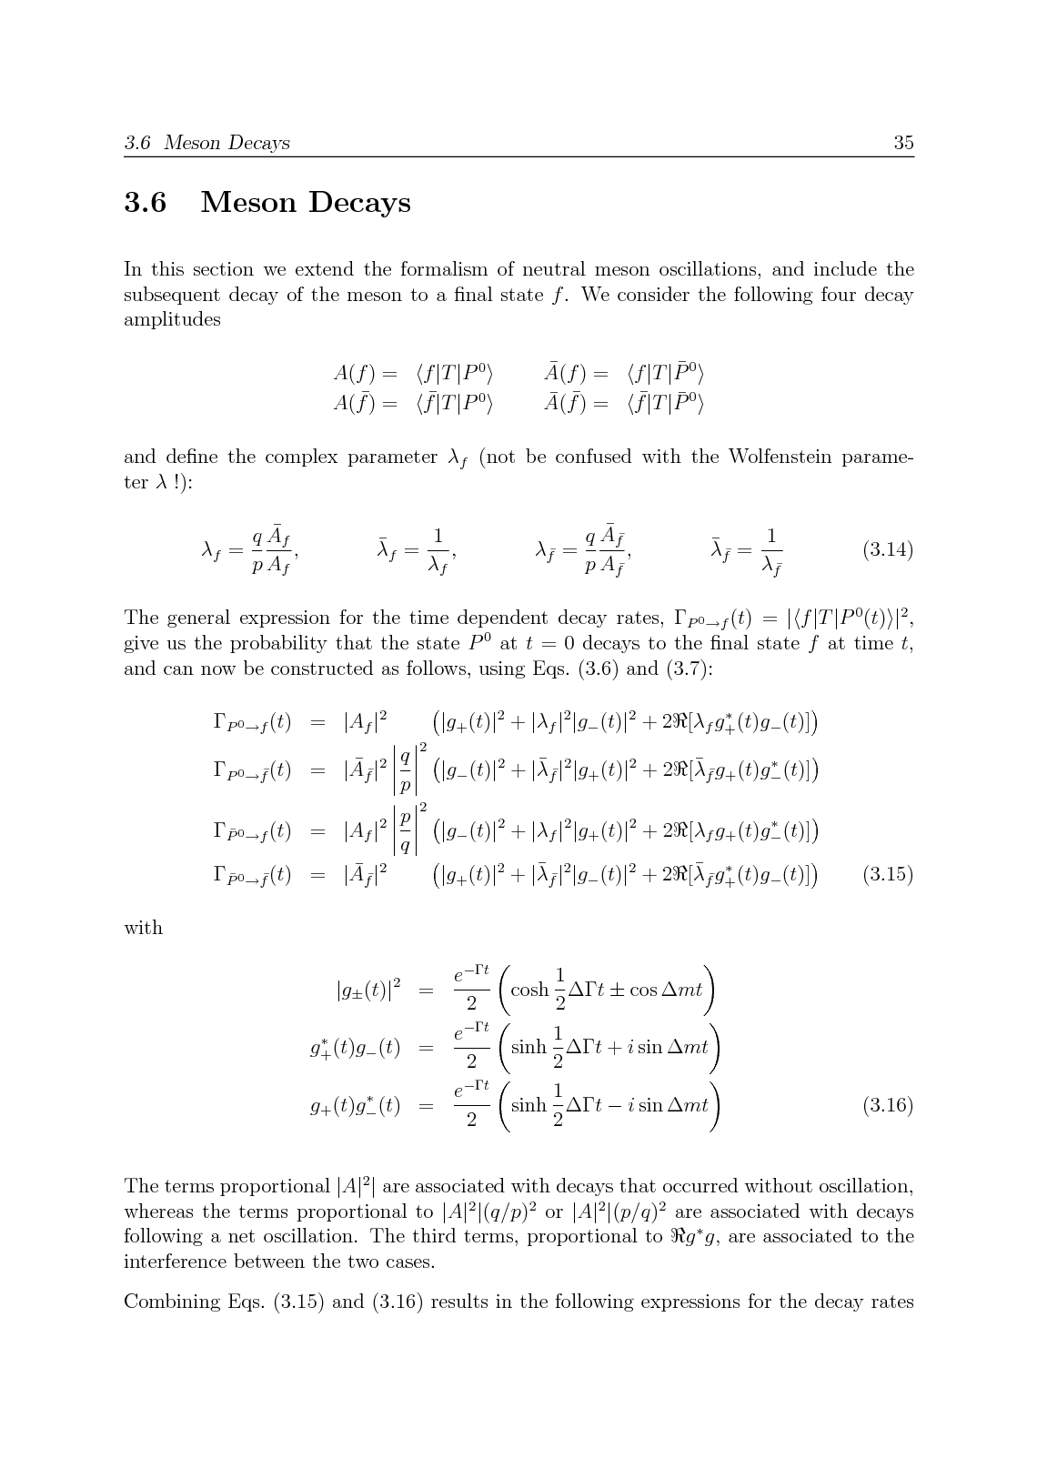
Notation: Define A_{f} and λ_{f}

Slide 67
Some algebra for the decay P⁰ → f
Interference
P⁰ →f
P⁰→P⁰ →f

Slide 68
Some algebra for the decay P⁰ → f

Slide 69
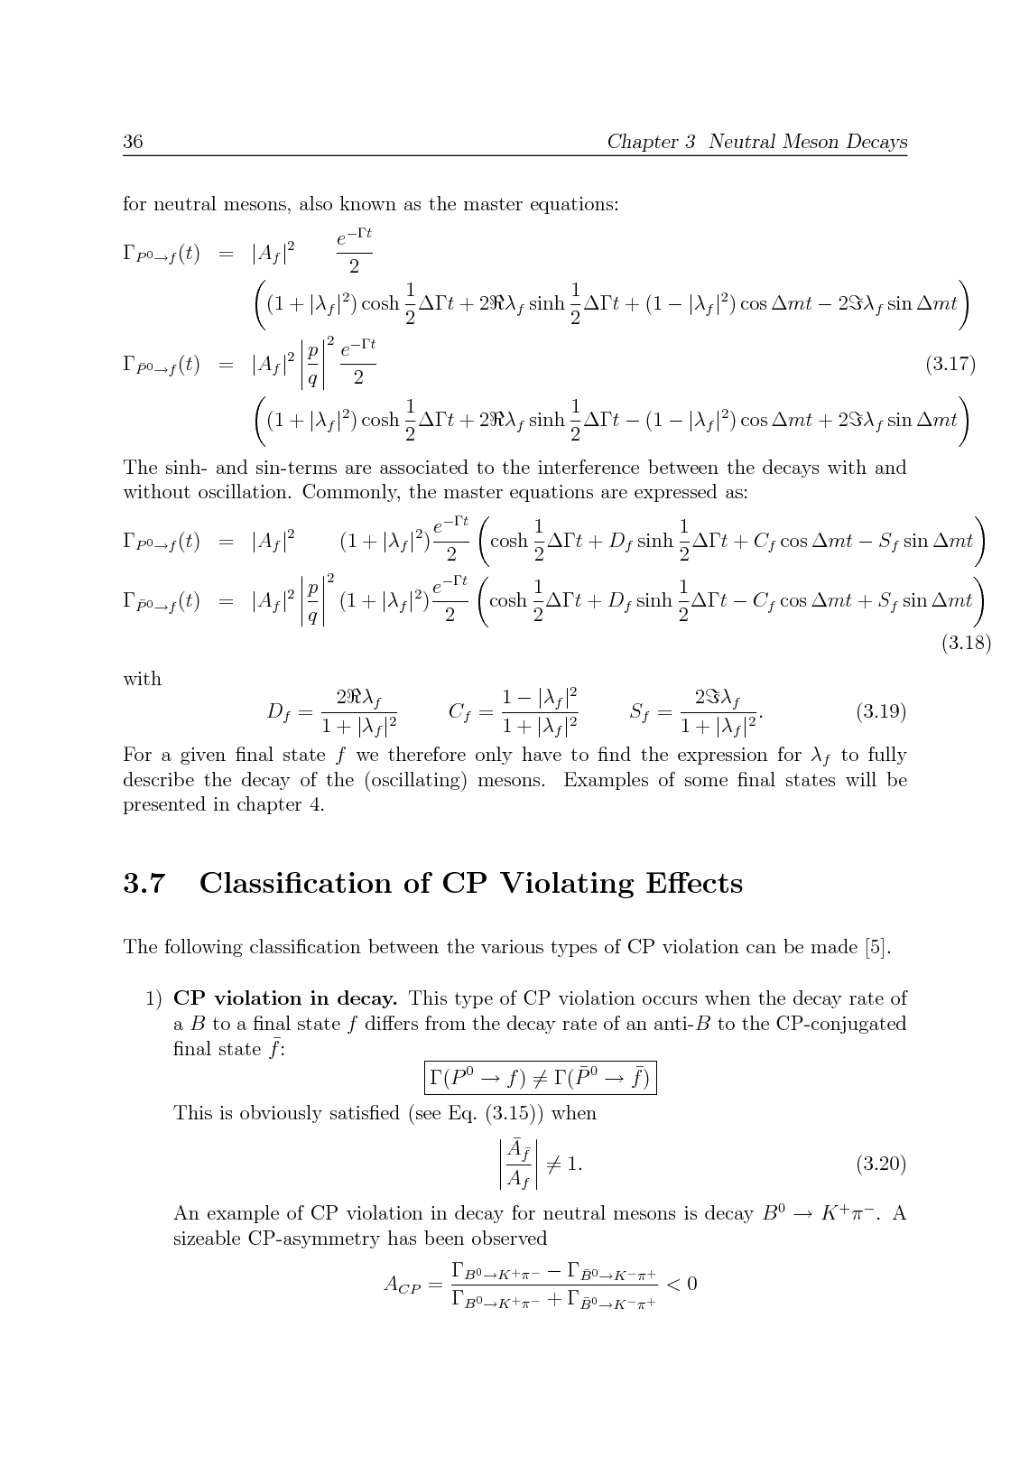
The ‘master equations’
(‘direct’) Decay
Interference

Slide 70
The ‘master equations’
(‘direct’) Decay
Interference

Slide 71
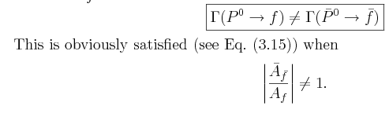
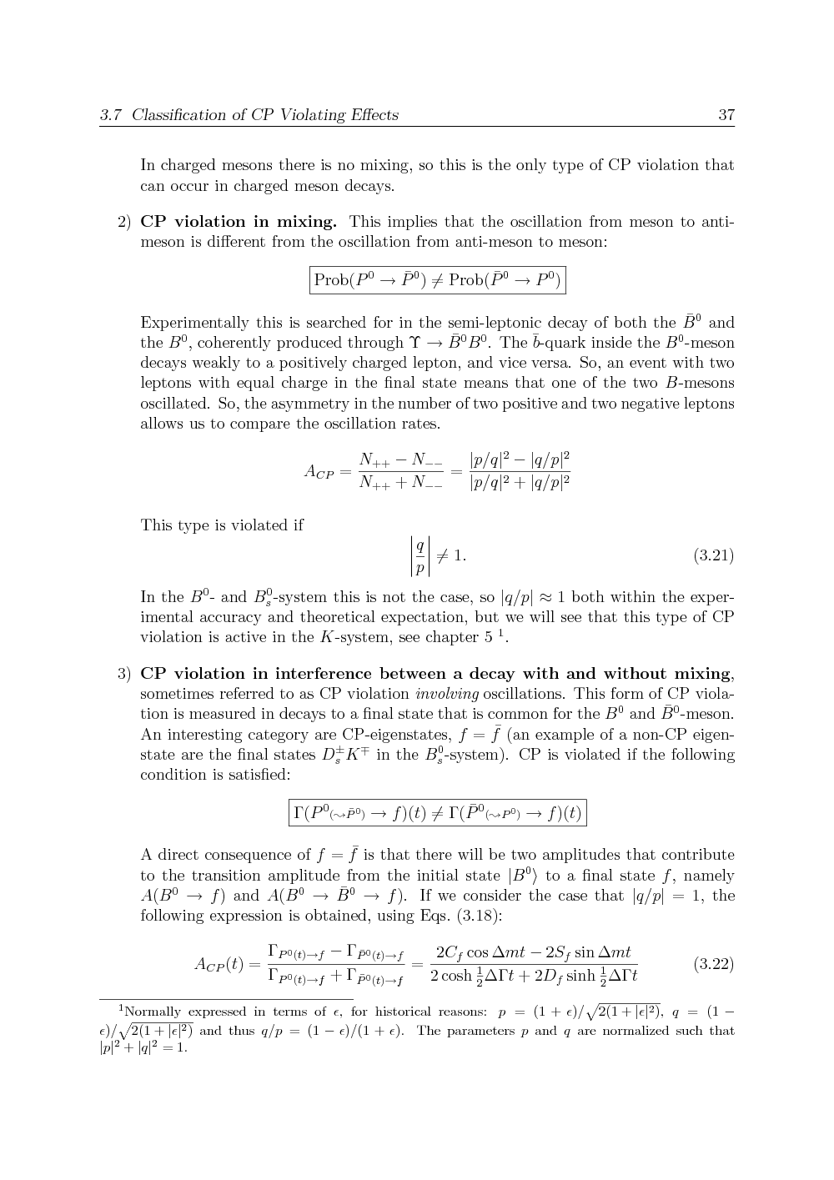
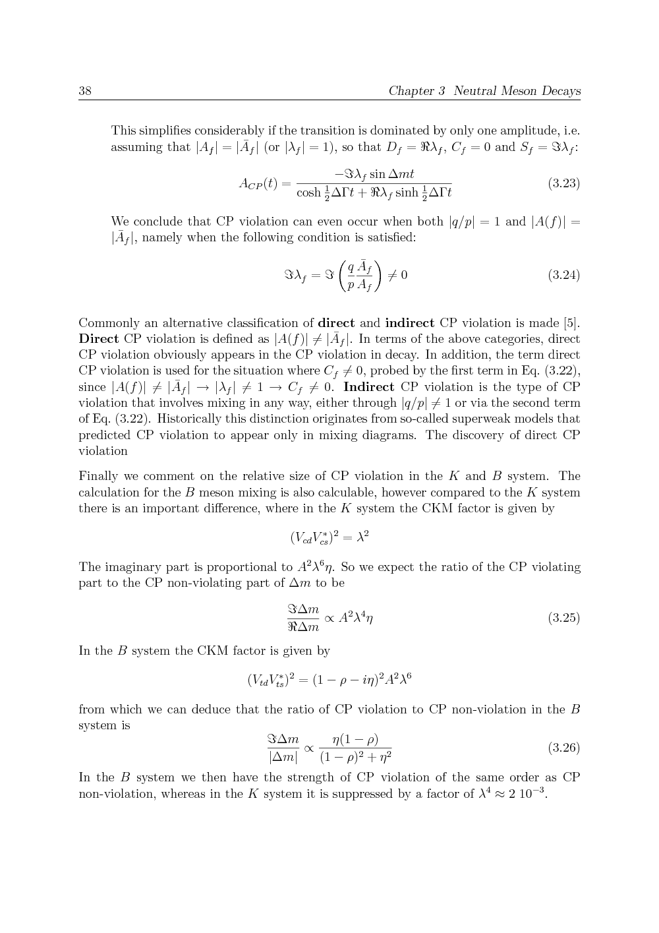
Classification of CP Violating effects
CP violation in decay
CP violation in mixing
CP violation in interference

Slide 72



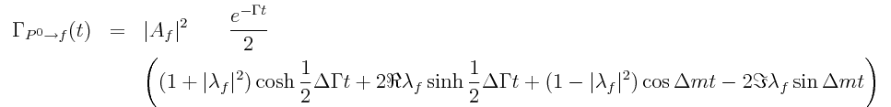
Meson Decays
Formalism of meson oscillations:
Subsequent: decay
P⁰ →f
P⁰→P⁰ →f
Interference
(‘direct’) Decay
Interference

Slide 73


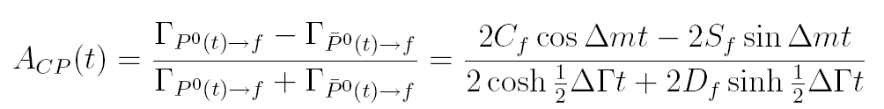
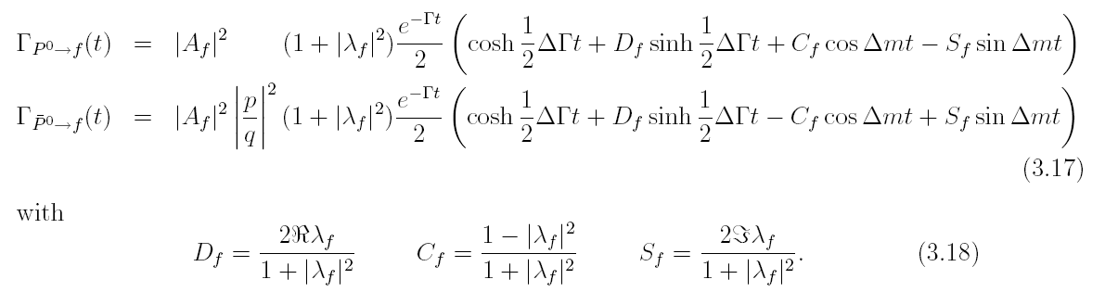
CP violation: type 3

Slide 74
Classification of CP Violating effects - Nr. 3:
Consider f=f :
If one amplitude dominates the decay, then A_{f} = A_{f}
CP violation in interference

Slide 75

Relax: B⁰→J/ΨK_{s} simplifies…
|λ_{f}|=1
ΔΓ=0

Slide 76


λ_{f} for B⁰ → J/ψK⁰_{S}
d
b
b
d
d
s
s
d
Notes:
|Vcs Vcd|^2 mc^2 = (1*lambda)^2 mc^2 vs. |Vts Vtd|^2 mt^2 = (lambda^2*lambda^3)^2 mt^2 → suppressed by lambda^8, enhanced by (mt/mc)^2 << 1

Slide 77

λ_{f} for B⁰ → J/ψK⁰_{S}
Time-dependent CP asymmetry
Theoretically clean way to measure β
Clean experimental signature
Branching fraction: O(10⁻⁴)
“Large” compared to other CP modes!
Notes:
|Vcs Vcd|^2 mc^2 = (1*lambda)^2 mc^2 vs. |Vts Vtd|^2 mt^2 = (lambda^2*lambda^3)^2 mt^2 → suppressed by lambda^8, enhanced by (mt/mc)^2 << 1

Slide 78
CP eigenvalue of final state J/ψK⁰_{S}
CP |J/ψ> = +1 |J/ψ>
CP |K⁰_{S}> = +1 |K⁰_{S}>
CP |J/ψK⁰_{S}> = (-1)^{l} |J/ψK⁰_{S}>
( S(B)=0 → L(J/ψK⁰_{S})=1 !)
Relative minus-sign between
state and CP-conjugated state:
Notes:
|Vcs Vcd|^2 mc^2 = (1*lambda)^2 mc^2 vs. |Vts Vtd|^2 mt^2 = (lambda^2*lambda^3)^2 mt^2 → suppressed by lambda^8, enhanced by (mt/mc)^2 << 1

Slide 79





Sum of 2 amplitudes: sensitivity to phase
Now also look at CP-conjugate process
Investigate situation at time t, such that |A₁| = |A₂| :
Directly observable result (essentially just from counting) measure CKM phase β directly!
N(B⁰ → f) ∝ |A|² ∝ (1-cosφ)²+sin²φ
= 1 -2cosφ+cos²φ+sin²φ
= 2-2cos(π/2-2β)
∝ 1-sin(2β)
+
=
Γ(B→f)=
sin(φ)
π/2+2β
CP
1-cos(φ)
+
=
Γ(B→f)=
sin(φ)
π/2-2β
N(B⁰ → f) ∝ (1+cosφ)²+sin²φ
= 2+2cos(π/2-2β)
∝ 1+sin(2β)
1+cos(φ)

Slide 80
Remember!
Necessary ingredients for CP violation:
Two (interfering) amplitudes
Phase difference between amplitudes
one CP conserving phase (‘strong’ phase)
one CP violating phase (‘weak’ phase)
2 amplitudes
2 phases

Slide 81

Remember!
2 amplitudes
2 phases

Slide 82




Courtesy Daan van Eijk
Time dependent CP violation
B⁰ tag
B⁰ tag
mixed
mixed
unmixed
unmixed
Total amplitude
Total amplitude
CP asymmetry
Decay Rate
φ = 10 deg
Γ/Δm = 1.3

Slide 83
“The” Unitarity triangle: consistency?!

Slide 84
“The” Unitarity triangle

Slide 85
Remember
Necessary ingredients for CP violation:
Two (interfering) amplitudes
Phase difference between amplitudes
one CP conserving phase (‘strong’ phase)
one CP violating phase (‘weak’ phase)
2 amplitudes
2 phases

Slide 86
Is there time?

Slide 87
Classification of CP Violating effects: where is discovery of CP violation with kaons from 1964?
CP violation in decay
CP violation in mixing
CP violation in interference

Slide 88
CP eigenvalue
Remember:
P² = 1 (x → -x → x)
C² = 1 (ψ → ψ → ψ )
➔ CP² =1
CP | f > = ± | f >
Knowing this we can evaluate the effect of CP on the K⁰
CP|‾K⁰> = -1| K⁰>
CP| K⁰> = -1|‾K⁰ >
Mass/Lifetime eigenstates: almost CP eigenstates!
|K₁> = p| K⁰> +q|K⁰>
|K₂> = p| K⁰> - q|K⁰>
|K₁> (CP=+1) → π π (CP= (-1)(-1)(-1)^{l=0} =+1)
|K₂> (CP=-1) → π π π (CP = (-1)(-1)(-1)(-1)^{l=0} = -1)
( S(K)=0 → L(ππ)=0 )

Slide 89
CP eigenvalue
Remember:
P² = 1 (x → -x → x)
C² = 1 (ψ → ψ → ψ )
➔ CP² =1
CP | f > = ± | f >
Knowing this we can evaluate the effect of CP on the K⁰
CP|‾K⁰> = -1| K⁰>
CP| K⁰> = -1|‾K⁰ >
Mass/Lifetime eigenstates: almost CP eigenstates!
|K_{S}> = p| K⁰> +q|K⁰>
|K_{L}> = p| K⁰> - q|K⁰>
|K_{s}> (CP=+1) → π π (CP= (-1)(-1)(-1)^{l=0} =+1)
|K_{L}> (CP=-1) → π π π (CP = (-1)(-1)(-1)(-1)^{l=0} = -1)
( S(K)=0 → L(ππ)=0 )

Slide 90



The Cronin & Fitch experiment
Essential idea: Look for K₂ → ππ decays 20 meters away from K⁰ production point
Decay pions
K₂ → ππ decays (CP Violation!)
Incoming K₂ beam
Result: an excess of events at Θ=0 degrees!
K₂ → πππ decays
CP violation, because K₂ (CP=-1) changed into K₁ (CP=+1)
Note scale: 99.99% of K →πππ decays are left of plot boundary
Niels Tuning (90)
Notes:
90

Slide 91


Kaons…
Different notation: confusing!
K₁, K₂, K_{L}, K_{S}, K₊, K₋, K⁰
Smaller CP violating effects
But historically important!
Concepts same as in B-system, so you have a chance to understand…

Slide 92
Kaons…
Different notation: confusing!
K₁, K₂, K_{L}, K_{S}, K₊, K₋, K⁰
Smaller CP violating effects
But historically important!
Concepts same as in B-system, so you have a chance to understand…
=
CP eigenstates

Slide 93
Kaons…
Different notation: confusing!
K₁, K₂, K_{L}, K_{S}, K₊, K₋, K⁰
Smaller CP violating effects
But historically important!
Concepts same as in B-system, so you have a chance to understand…
Mass/lifetime eigenstates

Slide 94
Kaons…
Different notation: confusing!
K₁, K₂, K_{L}, K_{S}, K₊, K₋, K⁰
Smaller CP violating effects
But historically important!
Concepts same as in B-system, so you have a chance to understand…
Flavour eigenstates

Slide 95
CP violation in the quark sector
Quarks: SM, CKM, UT Niels, 30’
Mesons: Mixing and CPV types Niels, 30’
B-mesons: Decays and Experiment Patrick, 60’

