Slide 1
FASTTRACK: PDP
Roel Aaij, David Groep
Nikhef

Slide 2
FASTTRACK WP 5.1 Accelerator Validation Facility
Intended hardware: 8 servers with accelerators and fast network
Deliverables: selection and procurement of hardware for the facility
Intended phase-1 (Q4 2026)
Intended phase-2 (Q4 2030)
Personpower:
CT system engineering technician: People and knowledge available in house
CT software support for the experiments Neither people nor knowledge available in-house
0.75 FTE/y in total
FASTTRACK: PDP
1

Slide 3
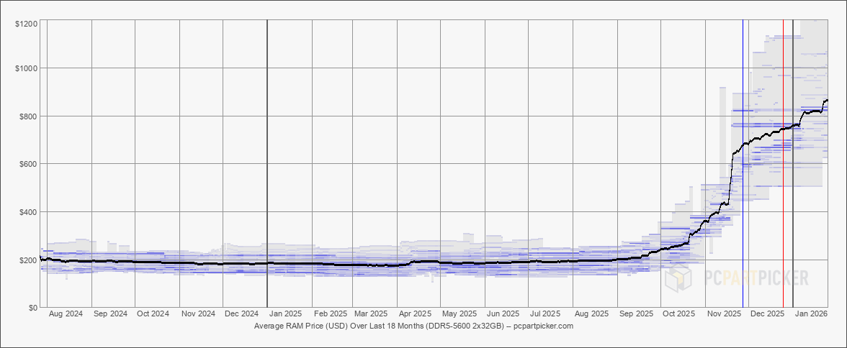
RAM and SSD Prices
Memory (RAM) and disk (SSD) prices started to rise at the end of 2025
AI hyperscalers are buying a large fraction of available capacity
Affects both server and accelerator cost
Likely to last well into 2027
We intend to delay the first phase by 6 months
https://pcpartpicker.com/trends/price/memory/
FASTTRACK: PDP
2

Slide 4
FASTTRACK WP 5.2 Algorithms
Personpower:
Effort embedded in the experiments on software/algorithm engineering
needs another 1.2 - 1.5 FTE/y - but not entirely flat (weighted to >= 2029/2030)
Will depend on the CT and experiments together, but neither people nor knowledge available in-house as yet (and this is complementary to and not the same as other ML efforts)

