Slide 1
Quantum Tracking Meeting 12-3-2026
Scope of LHCb Q-Tracking Project

Slide 2
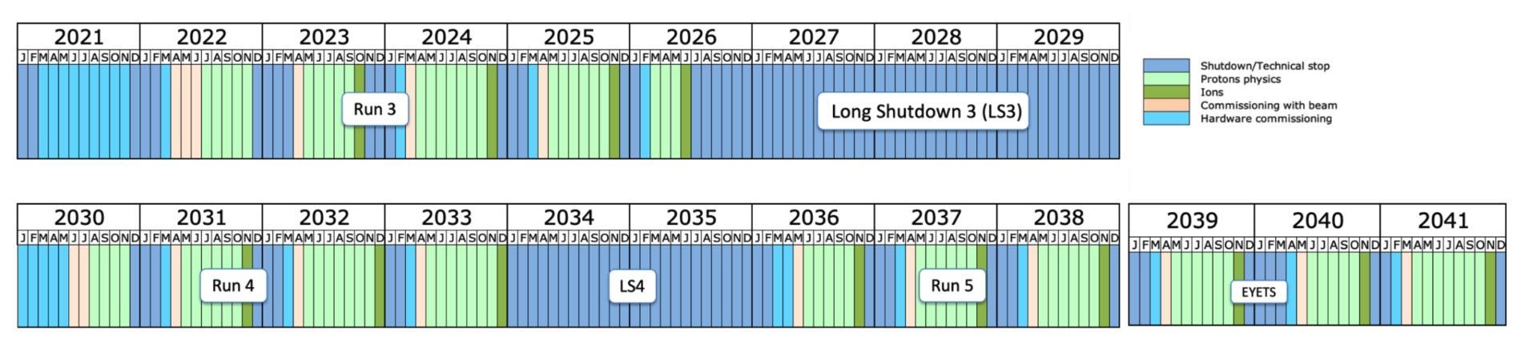
LHC planning
Today
LHCb Upgrade-II
(QC target)
… 2045 – 2048: Start FCC
Timeline of the LHCb experiment:
LHCb original detector: Run-1 + Run-2
LHCb Upgrade 1: Run-3 + Run-4
LHCb Upgrade 2: Run-5… (target of current QC studies)

Slide 3
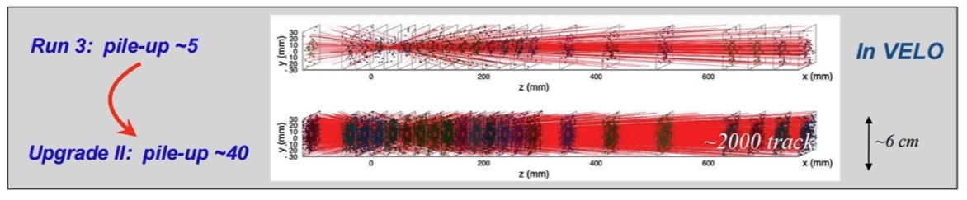
Open Issues for further Investigation
~400 GPUs
Preprocessing: how to get detector data loaded in a hybrid data processing flow
Unsolved.
Efficient matrix encoding part of the problem
Quantum processing
Currently investing a procedure to solve Hamiltonian with 1-bit HHL for many events in parallel
➔ Does the current Hamiltonian work in realistic events with high density?
Other approaches can be investigated: QSVT, other,…
Postprocessing
Currently reading out active segments seems unrealistic – requires too many shots
Other approaches to be investigated: quantum post-processing towards vertex reconstuction?

Slide 4
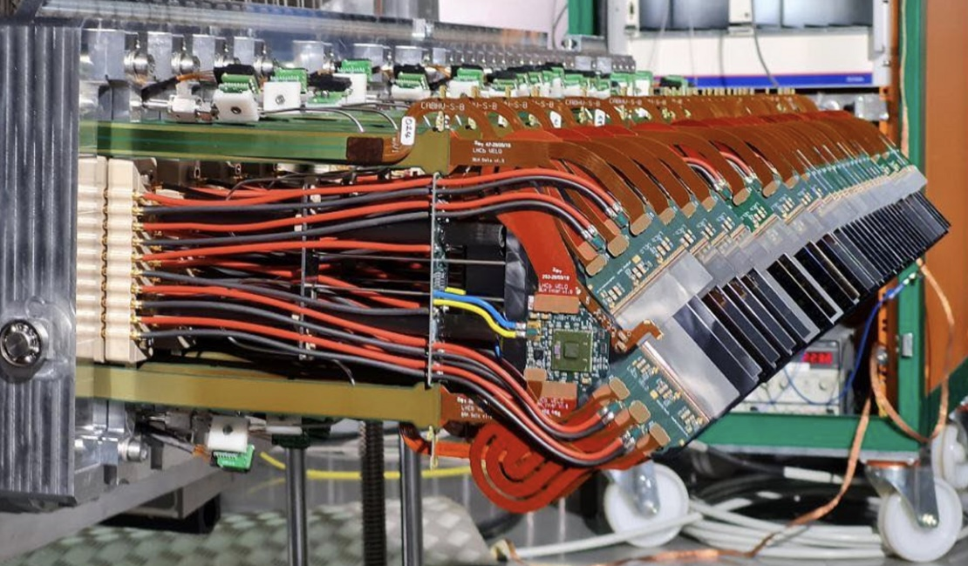
Velo Detector

Slide 5
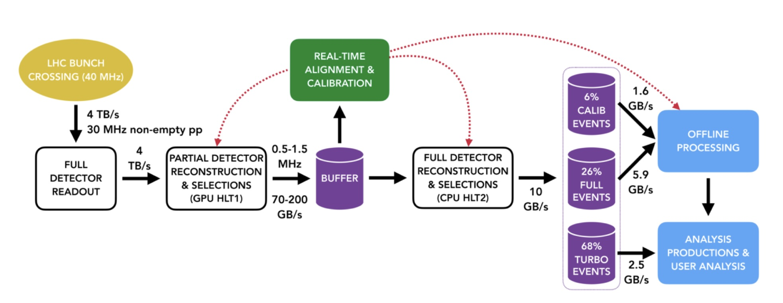
Real Time Data Processing

