Slide 1

Quantum Variational Rewinding for Anomaly Detection in Simulated Gravitational Wave Data
Shi Qiu
Department of Advanced Computing Sciences

Slide 2
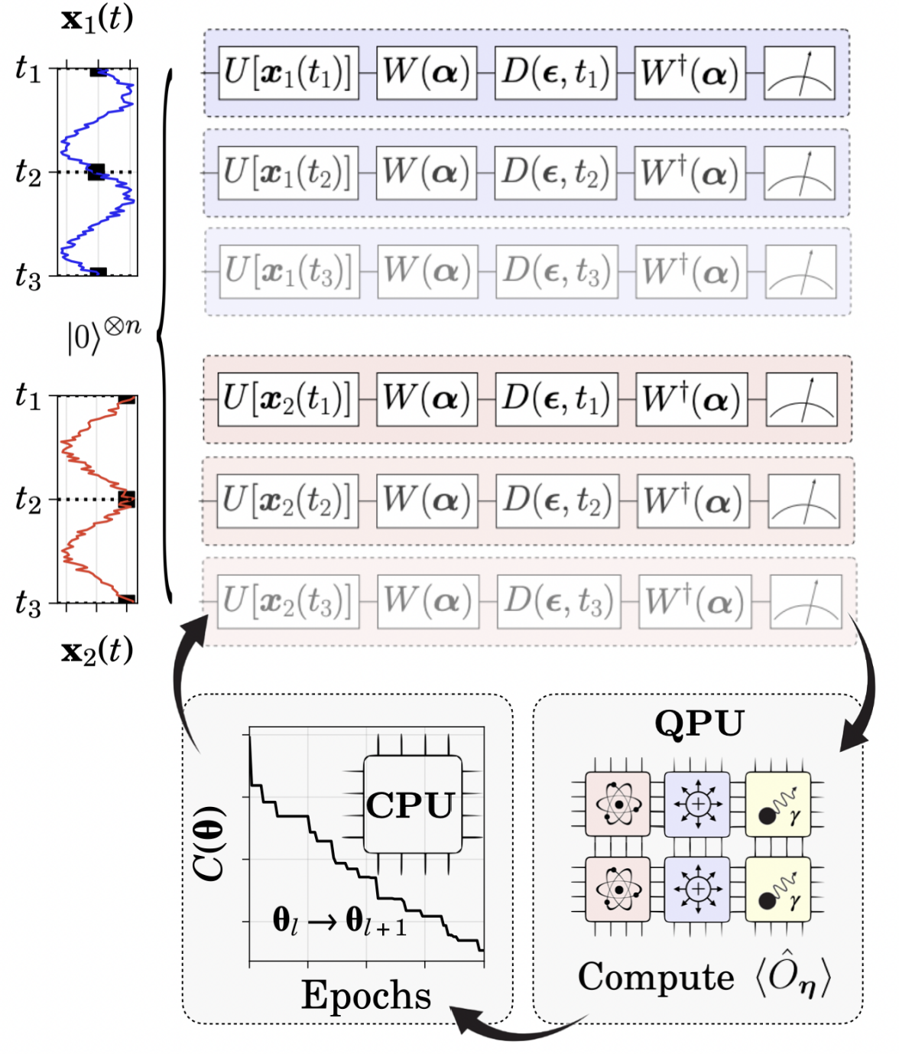
Quantum Variational Rewinding Algorithm
A quantum machine learning algorithm designed for one-class classification problem: non-anomalous and anomalous behavior in time series.
Designed in a way that is suitable for present-generation and near-future QPUs

Slide 3
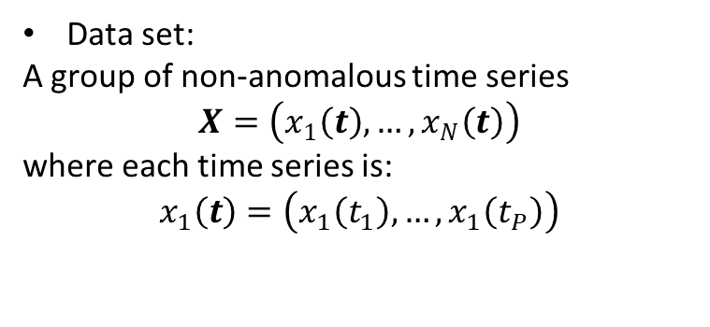
Quantum Variational Rewinding Algorithm
Data set:
A group of non-anomalous time series
$$X=\left(x_{1}\left(t\right), …,x_{N}\left(t\right)\right)$$
where each time series is:
$$x_{1}\left(t\right)=\left(x_{1}\left(t_{1}\right), …,x_{1}\left(t_{P}\right)\right)$$

Slide 4
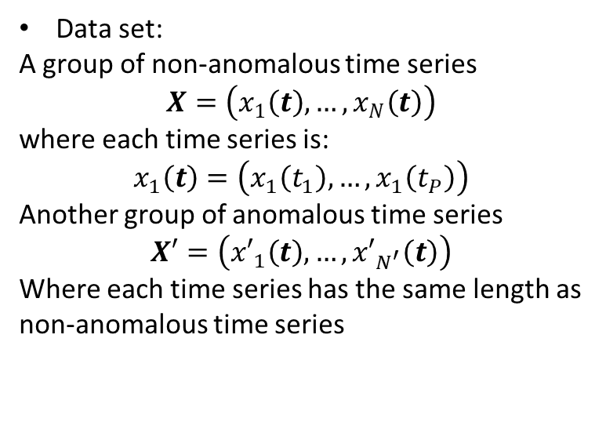
Quantum Variational Rewinding Algorithm
Data set:
A group of non-anomalous time series
$$X=\left(x_{1}\left(t\right), …,x_{N}\left(t\right)\right)$$
where each time series is:
$$x_{1}\left(t\right)=\left(x_{1}\left(t_{1}\right), …,x_{1}\left(t_{P}\right)\right)$$
Another group of anomalous time series
$$X′=\left({x′}_{1}\left(t\right), …,{x′}_{N^{′}}\left(t\right)\right)$$
Where each time series has the same length as non-anomalous time series

Slide 5
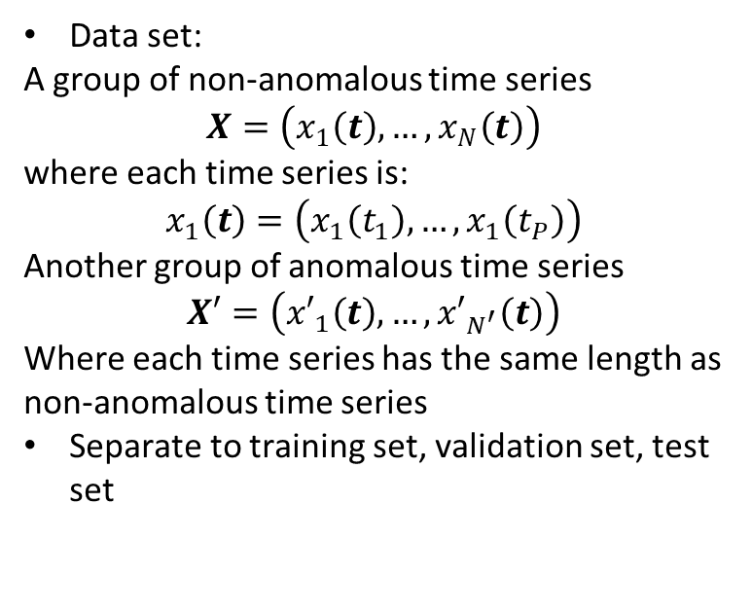
Quantum Variational Rewinding Algorithm
Data set:
A group of non-anomalous time series
$$X=\left(x_{1}\left(t\right), …,x_{N}\left(t\right)\right)$$
where each time series is:
$$x_{1}\left(t\right)=\left(x_{1}\left(t_{1}\right), …,x_{1}\left(t_{P}\right)\right)$$
Another group of anomalous time series
$$X′=\left({x′}_{1}\left(t\right), …,{x′}_{N^{′}}\left(t\right)\right)$$
Where each time series has the same length as non-anomalous time series
Separate to training set, validation set, test set

Slide 6
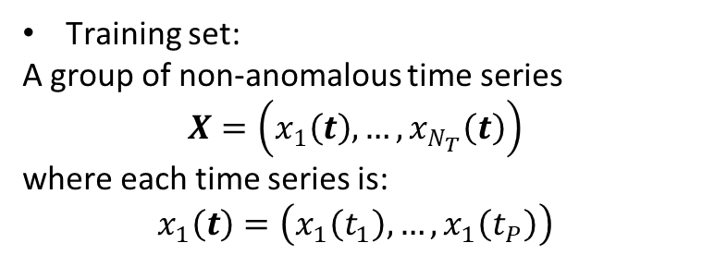
Quantum Variational Rewinding Algorithm
Training set:
A group of non-anomalous time series
$$X=\left(x_{1}\left(t\right), …,x_{N_{T}}\left(t\right)\right)$$
where each time series is:
$$x_{1}\left(t\right)=\left(x_{1}\left(t_{1}\right), …,x_{1}\left(t_{P}\right)\right)$$

Slide 7
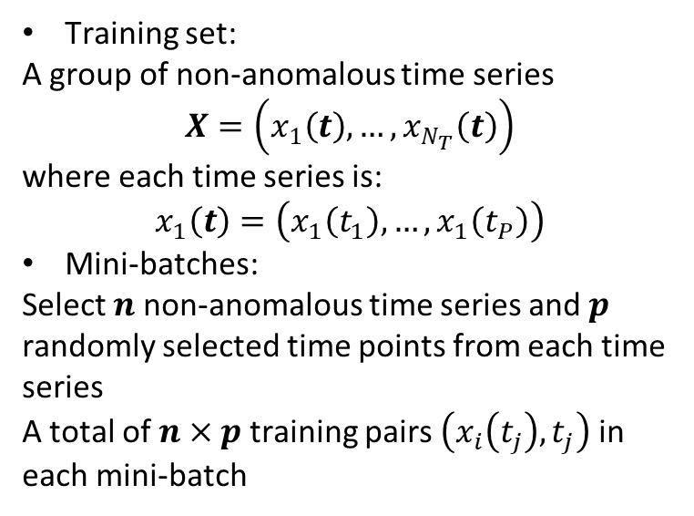
Quantum Variational Rewinding Algorithm
Training set:
A group of non-anomalous time series
$$X=\left(x_{1}\left(t\right), …,x_{N_{T}}\left(t\right)\right)$$
where each time series is:
$$x_{1}\left(t\right)=\left(x_{1}\left(t_{1}\right), …,x_{1}\left(t_{P}\right)\right)$$
Mini-batches:
Select $n$ non-anomalous time series and $p$ randomly selected time points from each time series
A total of $n×p$ training pairs $\left(x_{i}\left(t_{j}\right), t_{j}\right)$in each mini-batch

Slide 8
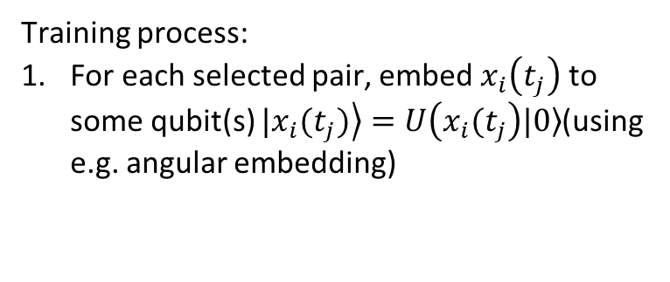
Quantum Variational Rewinding Algorithm
Training process:
For each selected pair, embed $x_{i}\left(t_{j}\right)$ to some qubit(s) $\left.|x_{i}(t_{j})\right\rangle =U\left(x_{i}(t_{j}\right)\left.|0\right\rangle$(using e.g. angular embedding)

Slide 9
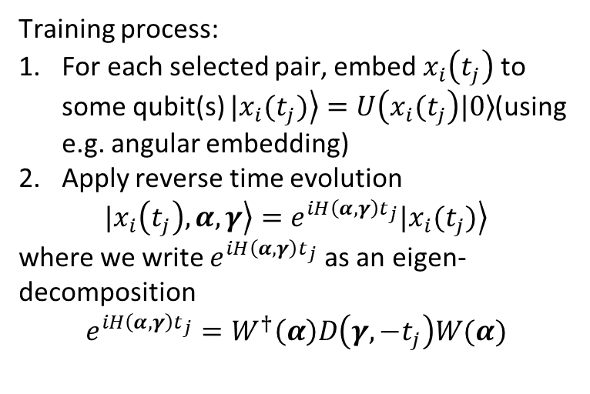
Quantum Variational Rewinding Algorithm
Training process:
For each selected pair, embed $x_{i}\left(t_{j}\right)$ to some qubit(s) $\left.|x_{i}(t_{j})\right\rangle =U\left(x_{i}(t_{j}\right)\left.|0\right\rangle$(using e.g. angular embedding)
Apply reverse time evolution
$$\left.|x_{i}\left(t_{j}\right),α,γ\right\rangle =e^{iH\left(α,γ\right)t_{j}}\left.|x_{i}(t_{j})\right\rangle$$
where we write $e^{iH\left(α,γ\right)t_{j}}$as an eigen-decomposition
$$e^{iH\left(α,γ\right)t_{j}}=W^{†}\left(α\right)D\left(γ,−t_{j}\right)W(α)$$

Slide 10
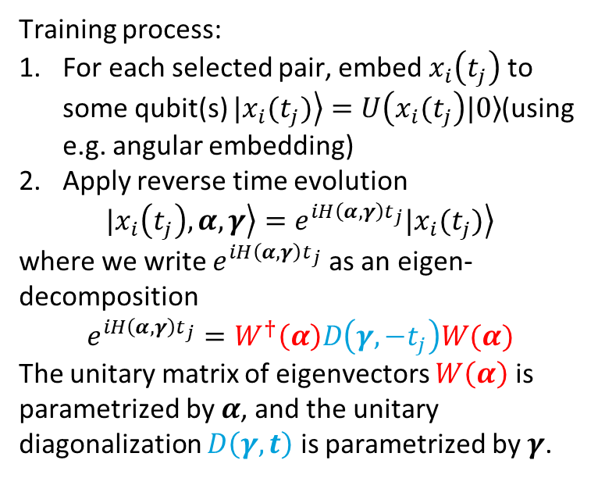
Quantum Variational Rewinding Algorithm
Training process:
For each selected pair, embed $x_{i}\left(t_{j}\right)$ to some qubit(s) $\left.|x_{i}(t_{j})\right\rangle =U\left(x_{i}(t_{j}\right)\left.|0\right\rangle$(using e.g. angular embedding)
Apply reverse time evolution
$$\left.|x_{i}\left(t_{j}\right),α,γ\right\rangle =e^{iH\left(α,γ\right)t_{j}}\left.|x_{i}(t_{j})\right\rangle$$
where we write $e^{iH\left(α,γ\right)t_{j}}$as an eigen-decomposition
$$e^{iH\left(α,γ\right)t_{j}}=W^{†}\left(α\right)D\left(γ,−t_{j}\right)W(α)$$
The unitary matrix of eigenvectors $W\left(α\right)$ is parametrized by $α$, and the unitary diagonalization $D\left(γ,t\right)$ is parametrized by $γ$.

Slide 11

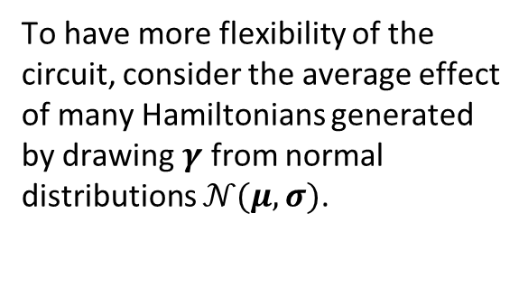


Quantum Variational Rewinding Algorithm
Circuit diagram
$$W(α)$$
$$D\left(γ,−t_{j}\right)$$
$$W^{†}\left(α\right)$$
To have more flexibility of the circuit, consider the average effect of many Hamiltonians generated by drawing $γ$ from normal distributions $𝒩(μ, σ)$.

Slide 12
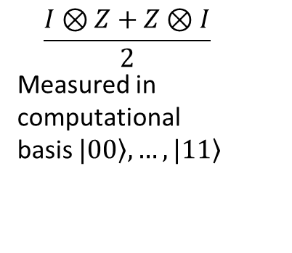
Quantum Variational Rewinding Algorithm
Circuit diagram
$$W(α)$$
$$D\left(γ,−t_{j}\right)$$
$$W^{†}\left(α\right)$$
To have more flexibility of the circuit, consider the average effect of many Hamiltonians generated by drawing $γ$ from normal distributions $𝒩(μ, σ)$.
$$\frac{I⊗Z+Z⊗I}{2}$$
Measured in computational basis $\left.|00\right\rangle , …,\left.|11\right\rangle$

Slide 13
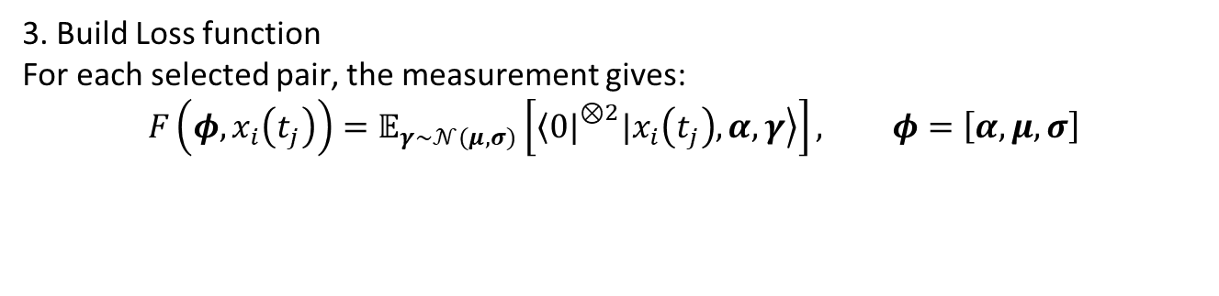
Quantum Variational Rewinding Algorithm
3. Build Loss function
For each selected pair, the measurement gives:
$$F\left(φ, x_{i}\left(t_{j}\right)\right)=𝔼_{γ\sim 𝒩(μ,σ)}\left[{\left\langle 0|\right.}^{⊗2}\left.|x_{i}\left(t_{j}\right),α,γ\right\rangle \right], φ=\left[α,μ,σ\right]$$

Slide 14
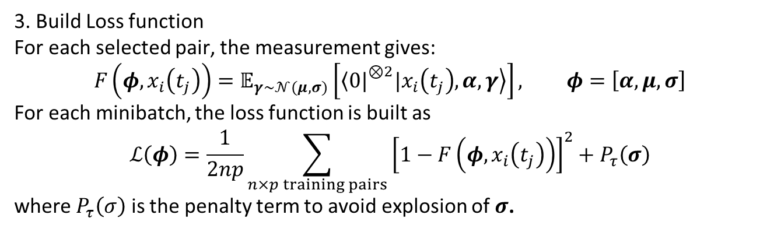
Quantum Variational Rewinding Algorithm
3. Build Loss function
For each selected pair, the measurement gives:
$$F\left(φ, x_{i}\left(t_{j}\right)\right)=𝔼_{γ\sim 𝒩(μ,σ)}\left[{\left\langle 0|\right.}^{⊗2}\left.|x_{i}\left(t_{j}\right),α,γ\right\rangle \right], φ=\left[α,μ,σ\right]$$
For each minibatch, the loss function is built as
$$ℒ\left(φ\right)=\frac{1}{2np}\sum_{n×p training pairs}{{\left[1−F\left(φ, x_{i}\left(t_{j}\right)\right)\right]}^{2}+P_{τ}\left(σ\right)}$$
where $P_{τ}\left(σ\right)$ is the penalty term to avoid explosion of $σ$.

Slide 15
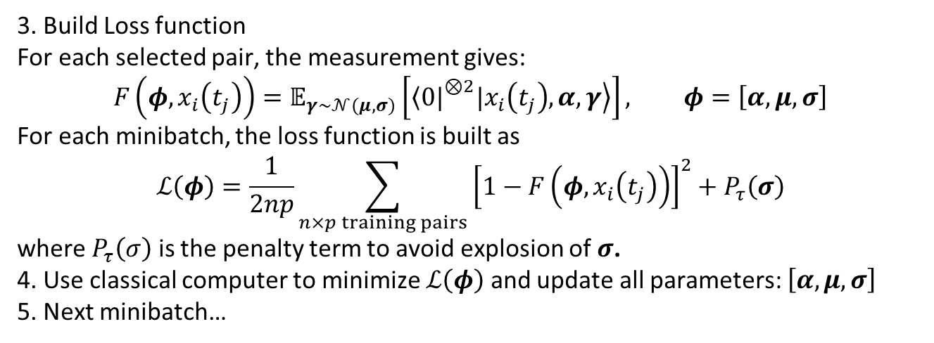
Quantum Variational Rewinding Algorithm
3. Build Loss function
For each selected pair, the measurement gives:
$$F\left(φ, x_{i}\left(t_{j}\right)\right)=𝔼_{γ\sim 𝒩(μ,σ)}\left[{\left\langle 0|\right.}^{⊗2}\left.|x_{i}\left(t_{j}\right),α,γ\right\rangle \right], φ=\left[α,μ,σ\right]$$
For each minibatch, the loss function is built as
$$ℒ\left(φ\right)=\frac{1}{2np}\sum_{n×p training pairs}{{\left[1−F\left(φ, x_{i}\left(t_{j}\right)\right)\right]}^{2}+P_{τ}\left(σ\right)}$$
where $P_{τ}\left(σ\right)$ is the penalty term to avoid explosion of $σ$.
4. Use classical computer to minimize $ℒ\left(φ\right)$ and update all parameters: $\left[α,μ,σ\right]$
5. Next minibatch…

Slide 16
Quantum Variational Rewinding Algorithm
After training, the parameters $φ=\left[α,μ,σ\right]$ are frozen.

Slide 17
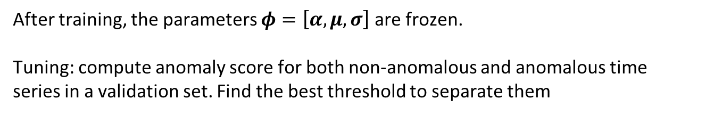
Quantum Variational Rewinding Algorithm
After training, the parameters $φ=\left[α,μ,σ\right]$ are frozen.
Tuning: compute anomaly score for both non-anomalous and anomalous time series in a validation set. Find the best threshold to separate them

Slide 18
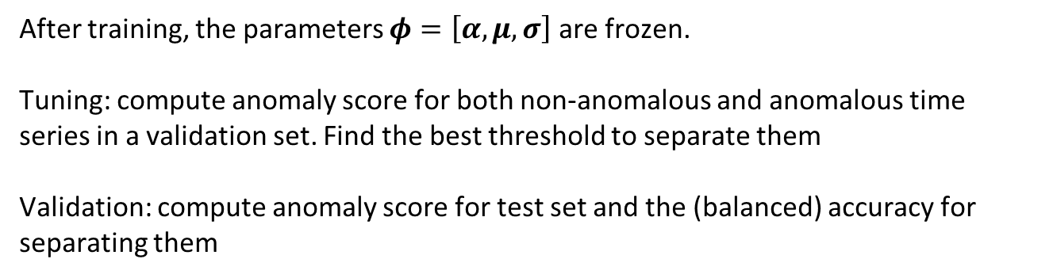
Quantum Variational Rewinding Algorithm
After training, the parameters $φ=\left[α,μ,σ\right]$ are frozen.
Tuning: compute anomaly score for both non-anomalous and anomalous time series in a validation set. Find the best threshold to separate them
Validation: compute anomaly score for test set and the (balanced) accuracy for separating them

Slide 19
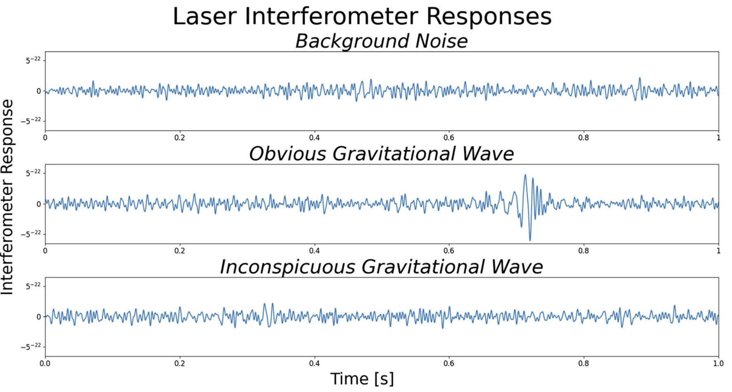
LIGO simulated data
Dataset contains:
4967 non-anomalous (background noise) time series
78 time series with GW signal embedded
https://link.springer.com/article/10.1007/s42484-025-00244-w

Slide 20
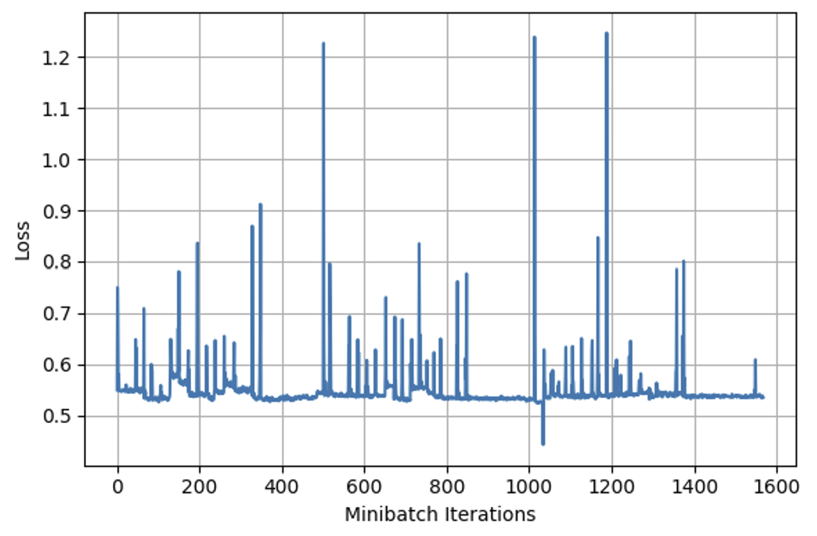
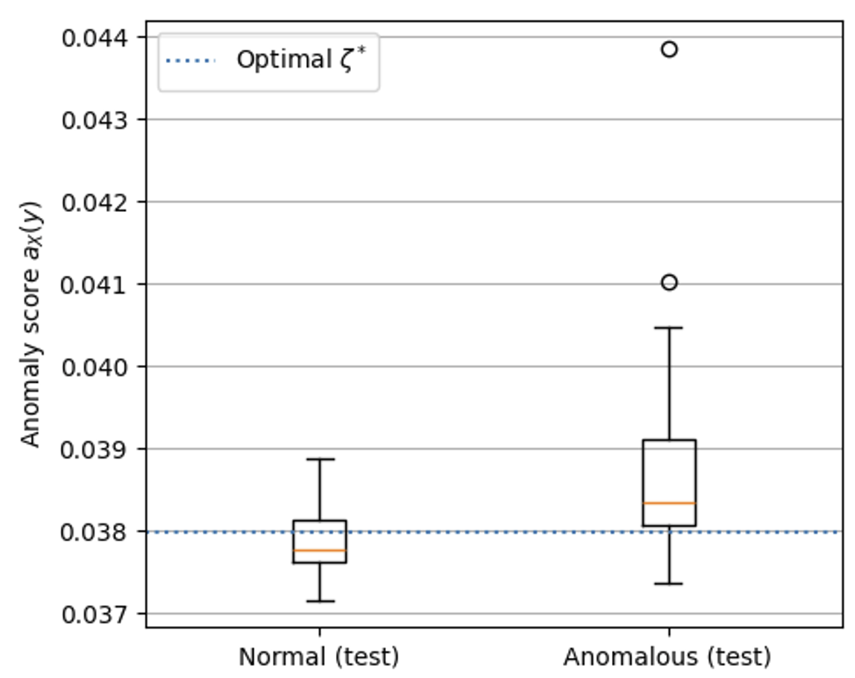
LIGO results
No physical hardware noise is added in the current simulation on Pennylane
Balanced accuracy of 71.8%

Slide 21
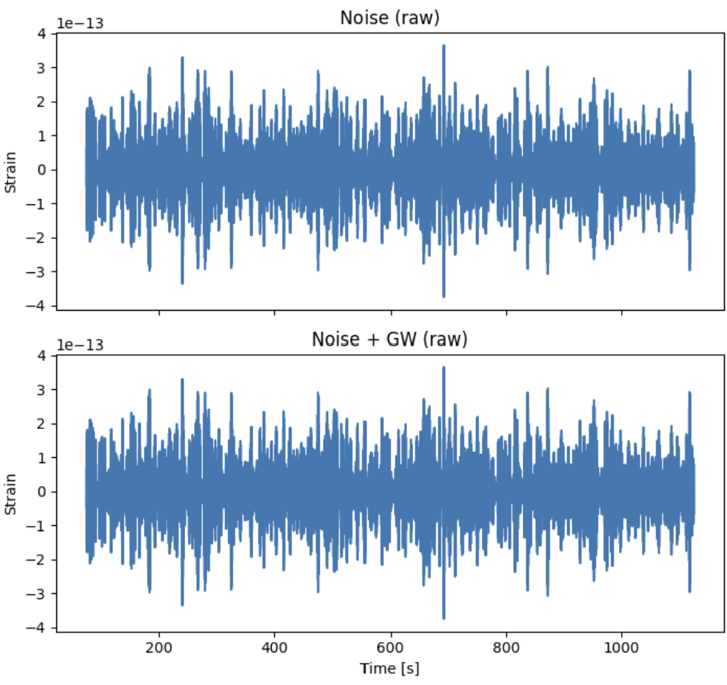
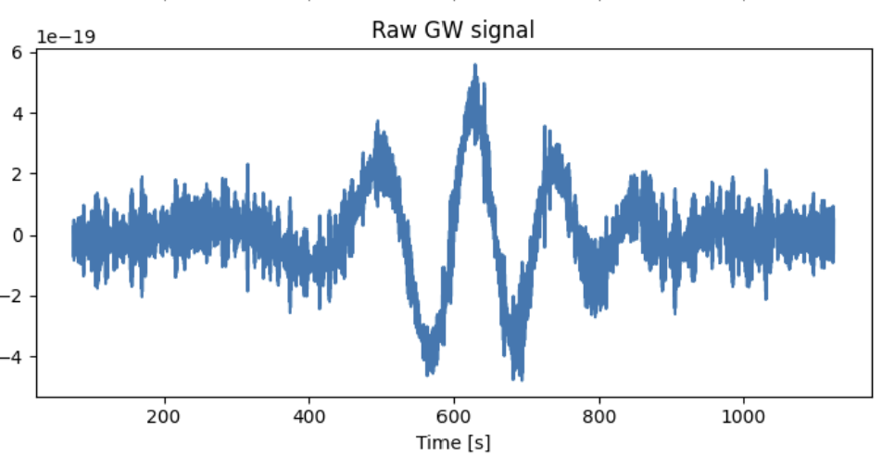
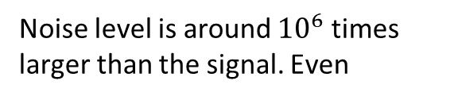
LISA simulated data
Dataset contains:
500 non-anomalous and anomalous time series
Noise level is around ${10}^{6}$ times larger than the signal. Even

Slide 22
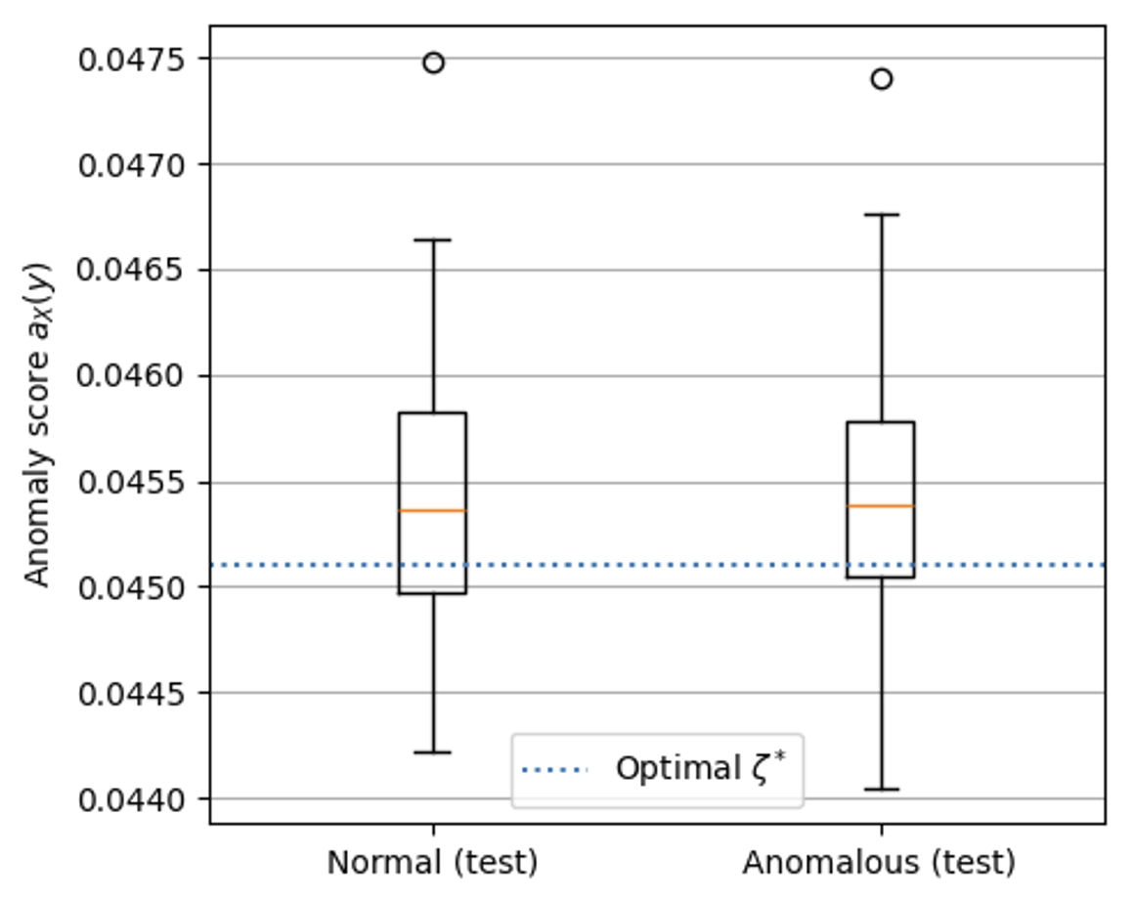
LISA results
Balanced accuracy of 50%
This is reasonable as the signal is way too small for LISA.

Slide 23
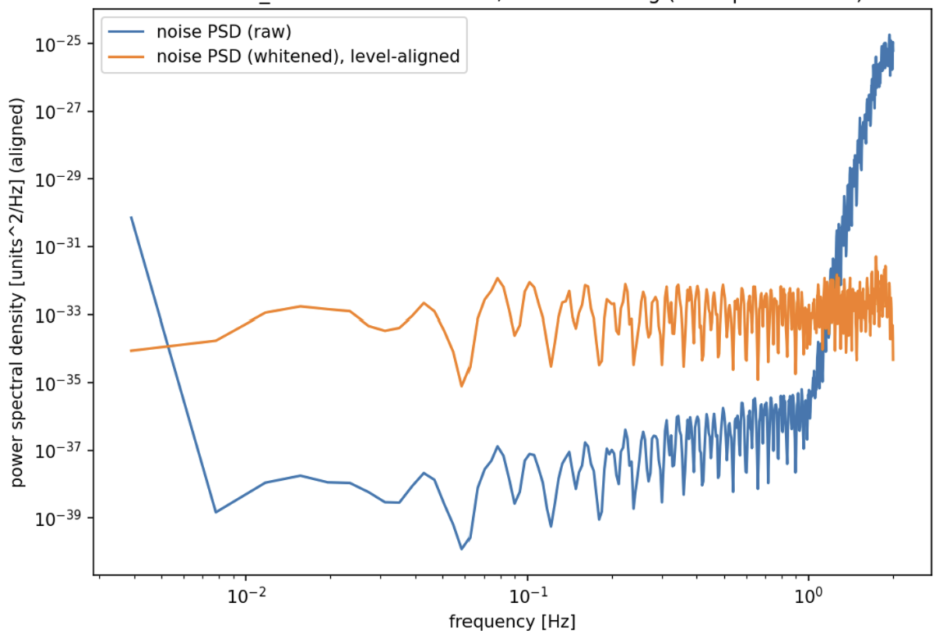
Whitening of the data
Power Spectral Density (PSD) describes how the power or variance of a time-series signal is distributed across different frequencies.
Whitening makes the power spectral density flat

Slide 24
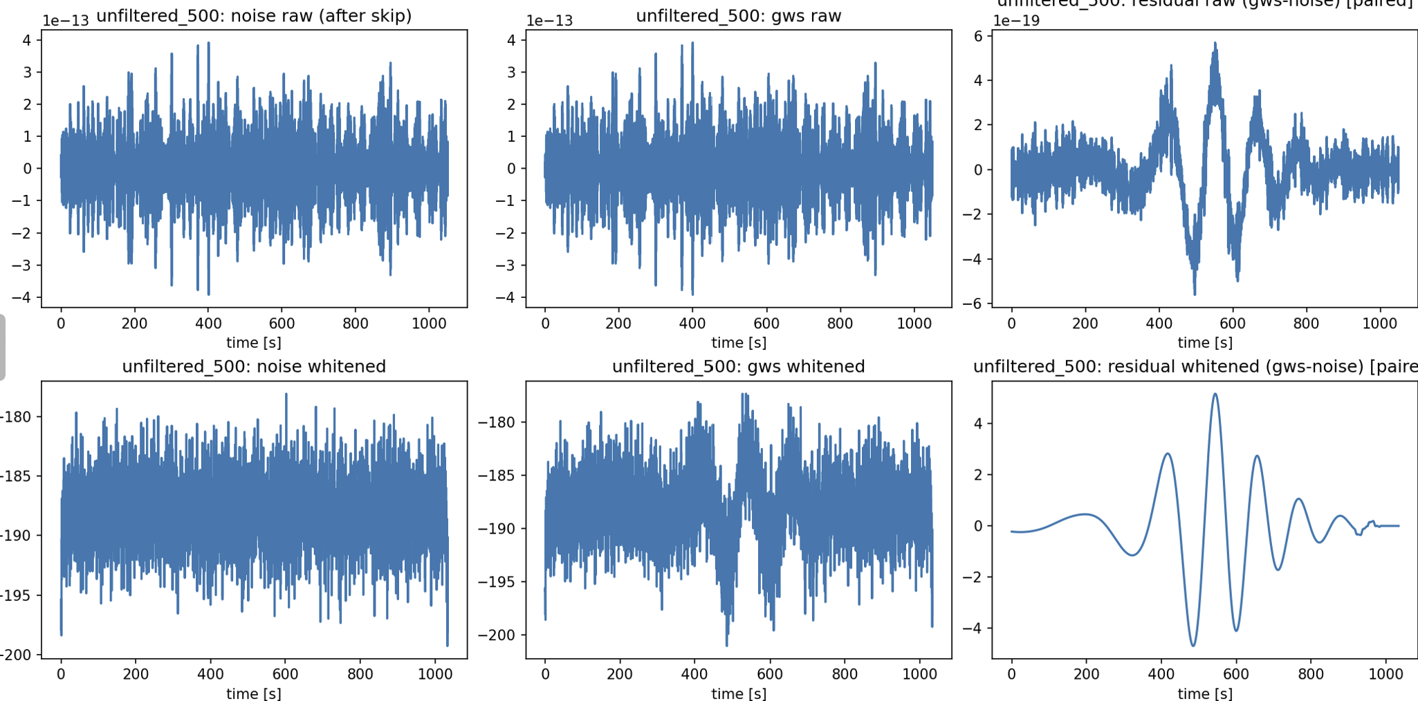
Whitening of the data
Still needs more checking here to confirm if we do it fairly.
Such a whitening will surely lead to a very high accuracy

Slide 25
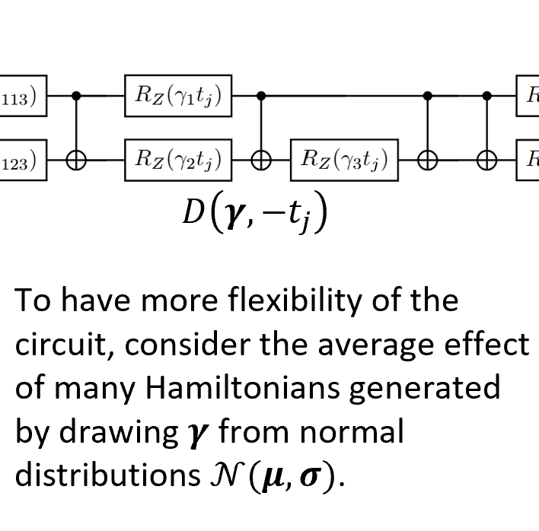
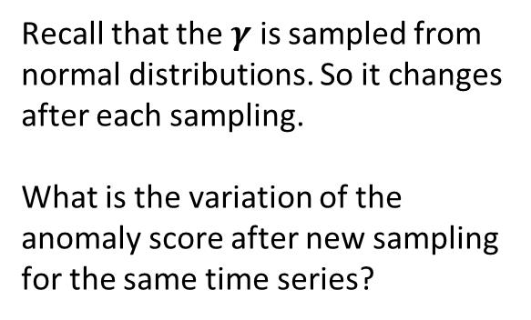
Detectability of anomalies using QVR
Recall that the $γ$ is sampled from normal distributions. So it changes after each sampling.
What is the variation of the anomaly score after new sampling for the same time series?

Slide 26
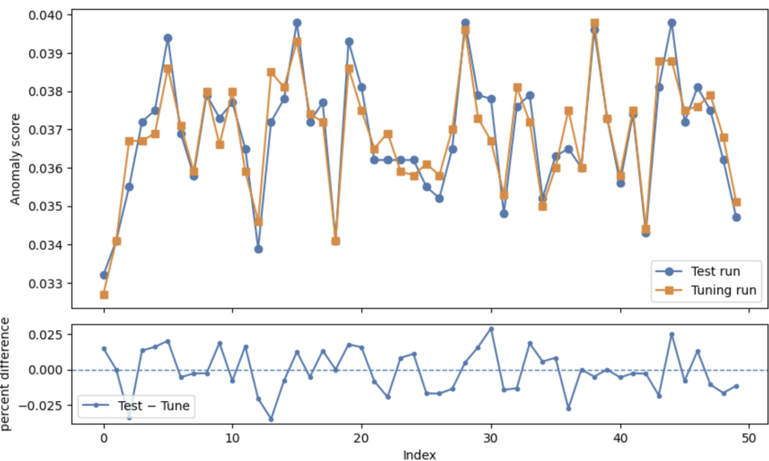
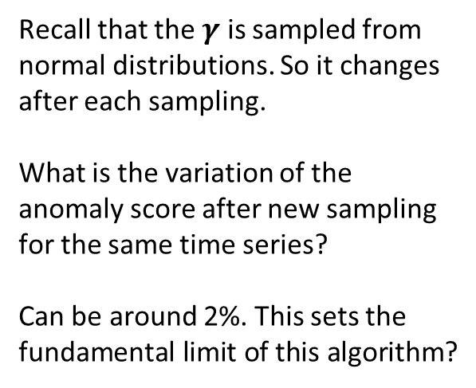
Detectability of anomalies using QVR
Recall that the $γ$ is sampled from normal distributions. So it changes after each sampling.
What is the variation of the anomaly score after new sampling for the same time series?
Can be around 2%. This sets the fundamental limit of this algorithm?

Slide 27
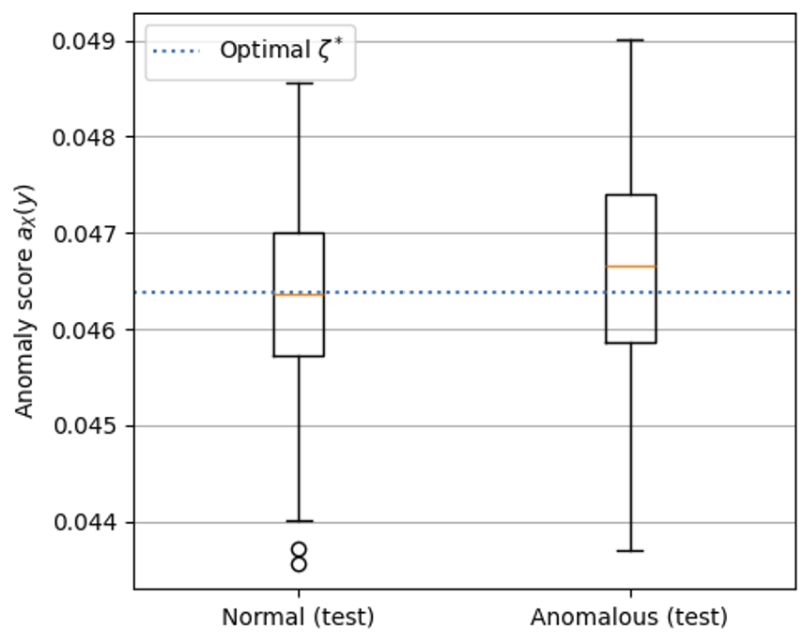
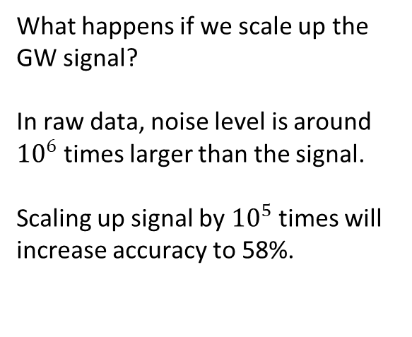
Detectability of anomalies using QVR
What happens if we scale up the GW signal?
In raw data, noise level is around ${10}^{6}$ times larger than the signal.
Scaling up signal by ${10}^{5}$ times will increase accuracy to 58%.

Slide 28
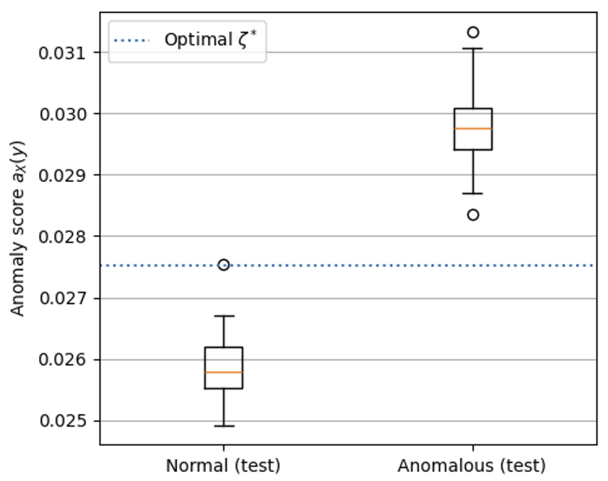
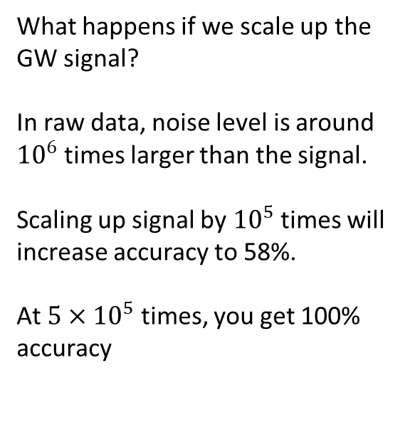
Detectability of anomalies using QVR
What happens if we scale up the GW signal?
In raw data, noise level is around ${10}^{6}$ times larger than the signal.
Scaling up signal by ${10}^{5}$ times will increase accuracy to 58%.
At $5×{10}^{5}$ times, you get 100% accuracy

Slide 29
Open questions
Does adding more wires improves the detectability?
Does the quantumness in QVR really help?
How to compare with classical analogies?
Would modifying the gates help demonstrate this more convincingly (e.g. changing the CNOT pattern or restricting/removing non-Clifford gates)?
$$W(α)$$
$$D\left(γ,−t_{j}\right)$$
$$W^{†}\left(α\right)$$

