Slide 1
Determination of the Neutrino Mass Ordering: the Global Landscape
Daan van Eijk
18 November 2025
Neutrino Group Outing

Slide 2
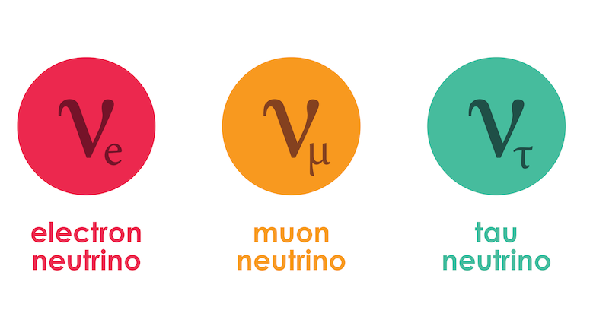
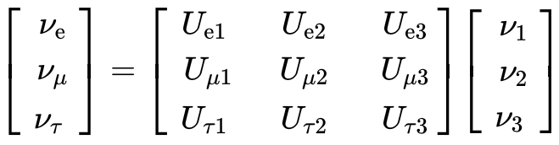


Neutrino Oscillations : PMNS Matrix
PMNS
Flavour eigenstates
Mass eigenstates
1
2
3
PMNS
Physics parameter
Notes:
Mention we measure atmospheric neutrinos (lower left) traversing the earth, oscillating as they go. Our detector is sensitive to nu_mu disappearance, in particular to nu_tau. That probability is expressed by the equation, which can be turned into the oscillogram on the right. Our observables are L (proxy cos(theta) and E. The pattern contains the information on the PMNS matrix mixing elements (depth of oscillation min/maximum) and the frequency of the oscillations, which are our physics parameters (green)

Slide 3
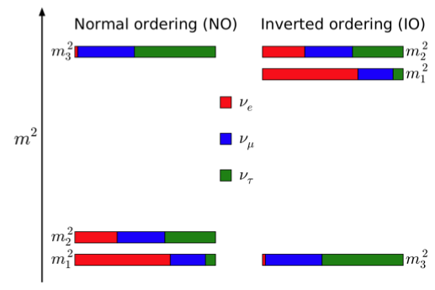
Neutrino Oscillations: Neutrino Mass Ordering
Flavour eigenstates
Mass eigenstates
1
2
3
Mass state propagation
∆m²₃₂ > 0: normal ordering (NO)
∆m²₃₂ < 0: inverted ordering (IO)
Physics parameter
Notes:
Mention we measure atmospheric neutrinos (lower left) traversing the earth, oscillating as they go. Our detector is sensitive to nu_mu disappearance, in particular to nu_tau. That probability is expressed by the equation, which can be turned into the oscillogram on the right. Our observables are L (proxy cos(theta) and E. The pattern contains the information on the PMNS matrix mixing elements (depth of oscillation min/maximum) and the frequency of the oscillations, which are our physics parameters (green)

Slide 4
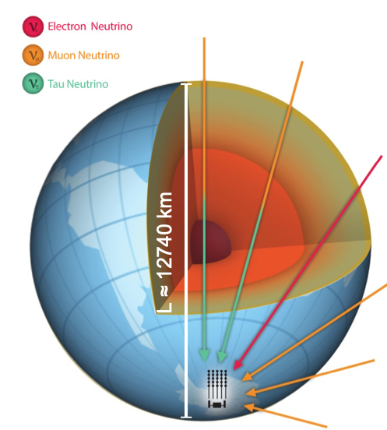

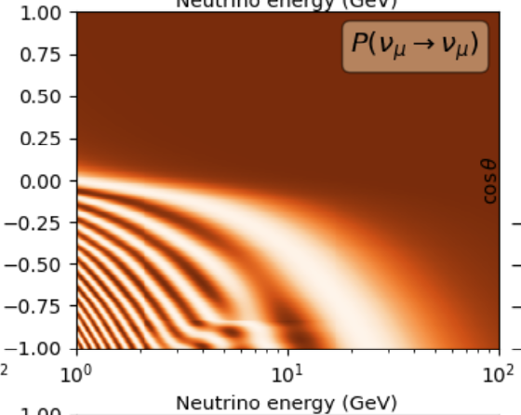
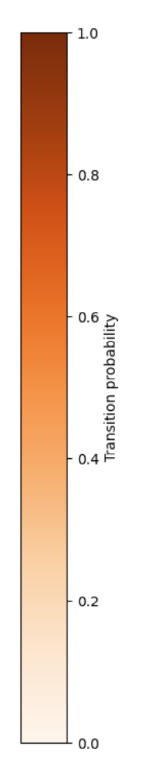
Atmospheric Neutrinos
KM3NeT/ORCA energies
Propagation
PMNS
Notes:
Mention we measure atmospheric neutrinos (lower left) traversing the earth, oscillating as they go. Our detector is sensitive to nu_mu disappearance, in particular to nu_tau. That probability is expressed by the equation, which can be turned into the oscillogram on the right. Our observables are L (proxy cos(theta) and E. The pattern contains the information on the PMNS matrix mixing elements (depth of oscillation min/maximum) and the frequency of the oscillations, which are our physics parameters (green)

Slide 5
Atmospheric Neutrinos
oscillation maximum ~ sin²(2θ₂₃)
Propagation
PMNS
oscillation frequency ~ Δm²₃₂
Notes:
Mention we measure atmospheric neutrinos (lower left) traversing the earth, oscillating as they go. Our detector is sensitive to nu_mu disappearance, in particular to nu_tau. That probability is expressed by the equation, which can be turned into the oscillogram on the right. Our observables are L (proxy cos(theta) and E. The pattern contains the information on the PMNS matrix mixing elements (depth of oscillation min/maximum) and the frequency of the oscillations, which are our physics parameters (green)

Slide 6
Atmospheric Neutrinos: Matter Effect in Neutrino Oscillations
Distortions in regular neutrino oscillation patterns due to ‘MSW’ matter effect in dense materials
Notes:
Mention we measure atmospheric neutrinos (lower left) traversing the earth, oscillating as they go. Our detector is sensitive to nu_mu disappearance, in particular to nu_tau. That probability is expressed by the equation, which can be turned into the oscillogram on the right. Our observables are L (proxy cos(theta) and E. The pattern contains the information on the PMNS matrix mixing elements (depth of oscillation min/maximum) and the frequency of the oscillations, which are our physics parameters (green)

Slide 7
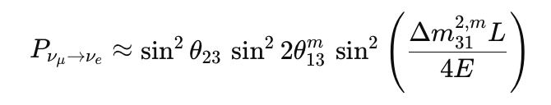
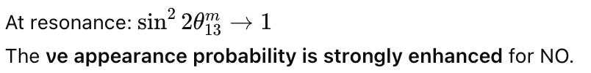
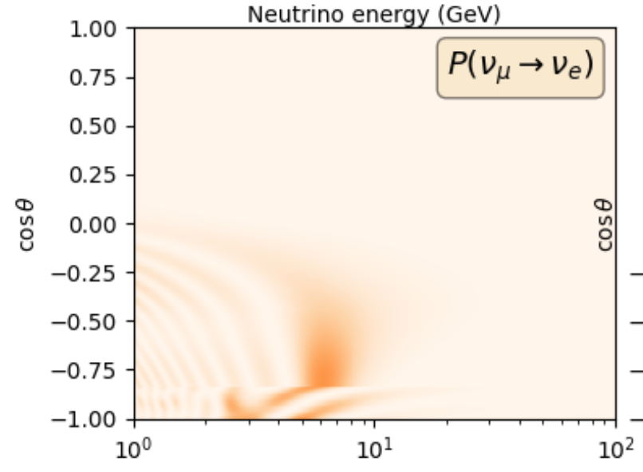
NMO Sensitivity: Event Topologies
Notes:
Mention we measure atmospheric neutrinos (lower left) traversing the earth, oscillating as they go. Our detector is sensitive to nu_mu disappearance, in particular to nu_tau. That probability is expressed by the equation, which can be turned into the oscillogram on the right. Our observables are L (proxy cos(theta) and E. The pattern contains the information on the PMNS matrix mixing elements (depth of oscillation min/maximum) and the frequency of the oscillations, which are our physics parameters (green)

Slide 8
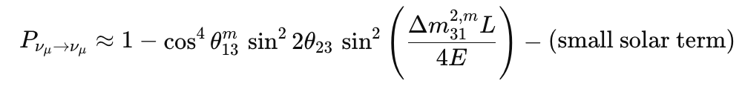
NMO Sensitivity: Event Topologies
Notes:
Mention we measure atmospheric neutrinos (lower left) traversing the earth, oscillating as they go. Our detector is sensitive to nu_mu disappearance, in particular to nu_tau. That probability is expressed by the equation, which can be turned into the oscillogram on the right. Our observables are L (proxy cos(theta) and E. The pattern contains the information on the PMNS matrix mixing elements (depth of oscillation min/maximum) and the frequency of the oscillations, which are our physics parameters (green)

Slide 9
NMO Sensitivity: Event Topologies
Therefore: NMO sensitivity mostly in showers
Notes:
Mention we measure atmospheric neutrinos (lower left) traversing the earth, oscillating as they go. Our detector is sensitive to nu_mu disappearance, in particular to nu_tau. That probability is expressed by the equation, which can be turned into the oscillogram on the right. Our observables are L (proxy cos(theta) and E. The pattern contains the information on the PMNS matrix mixing elements (depth of oscillation min/maximum) and the frequency of the oscillations, which are our physics parameters (green)

Slide 10
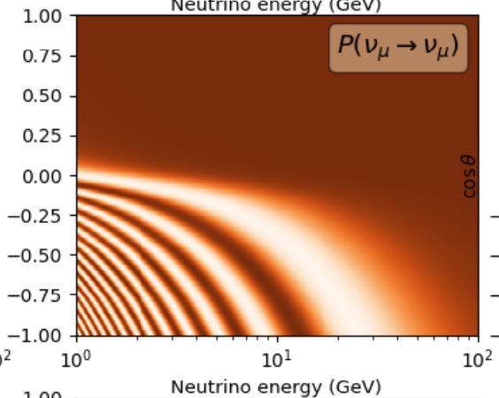
∆m²₃₂ > 0: normal ordering (NO)
∆m²₃₂ < 0: inverted ordering (IO)
NMO Sensitivity: Neutrino Energies and Directions
NO
IO
Notes:
Let’s zoom in on that frequency, delta m32^2. It’s the diference between the masses squared. There’s three such differences for three neutrinos. We know one of them, including its sign: we know m2 > m1 and the size is 100 times smaller than the second and third mass splitting m32^2, which therefore roughly equals m31^2. The goal for KM3NeT/ORCA now is to determine the sign of delta m32^2. If it’s positive that’s normal ordering, if it’s negative it’s inverted ordering. But how do we actually do that? Did you notice anything odd about the oscillogram I showed you on the previous slide?

Slide 11
∆m²₃₂ > 0: normal ordering (NO)
∆m²₃₂ < 0: inverted ordering (IO)
NMO Sensitivity: Neutrino Energies and Directions
NO
IO
NMO sensitivity in energy range 3-10 GeV and -1< cos(theta)< -0.8
Notes:
Let’s zoom in on that frequency, delta m32^2. It’s the diference between the masses squared. There’s three such differences for three neutrinos. We know one of them, including its sign: we know m2 > m1 and the size is 100 times smaller than the second and third mass splitting m32^2, which therefore roughly equals m31^2. The goal for KM3NeT/ORCA now is to determine the sign of delta m32^2. If it’s positive that’s normal ordering, if it’s negative it’s inverted ordering. But how do we actually do that? Did you notice anything odd about the oscillogram I showed you on the previous slide?

Slide 12
NMO Sensitivity: Neutrinos vs Anti-Neutrinos
NO
IO
-
-
-
-
NO
IO
+
If this would all, there would be no sensitivity to NMO!

Slide 13
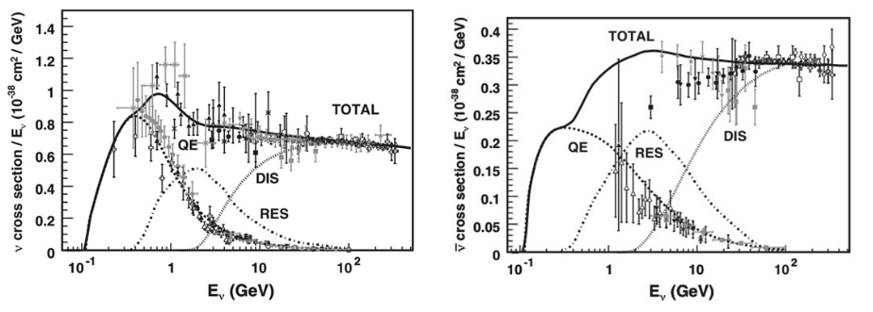
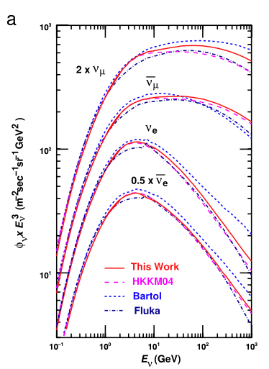
NMO Sensitivity: Fluxes and Cross Sections
Neutrino
Anti-Neutrino
Cross section higher for neutrinos
Flux higher for atmospheric neutrinos

Slide 14
NMO Sensitivity: Neutrinos vs Anti-Neutrinos
NO
IO
-
-
-
-
NO
IO
+
Asymmetric fluxes and cross sections for atmospheric neutrinos and antineutrinos saves the NMO sensitivity

Slide 15
Summary NMO Sensitivity (for atmospheric neutrinos)
NMO sensitivity in energy range 3-10 GeV
NMO sensitivity for -1< cos(theta)< -0.8
NMO sensitivity due to MSW effect (asymmetric between NO and IO)
NMO sensitivity mostly from shower channel
NMO sensititivity due to unequal neutrino/antineutrino cross sections
NMO sensititivity due to unequal neutrino/antineutrino fluxes

Slide 16
NMO Experiments
Running
Atmospheric:
          KM3NeT/ORCA
          IceCube
          SuperK
Accelerator:
NOvA
T2K
Reactor:
JUNO
Future
Atmospheric:
          INO
Accelerator:
DUNE
HyperK

Slide 17
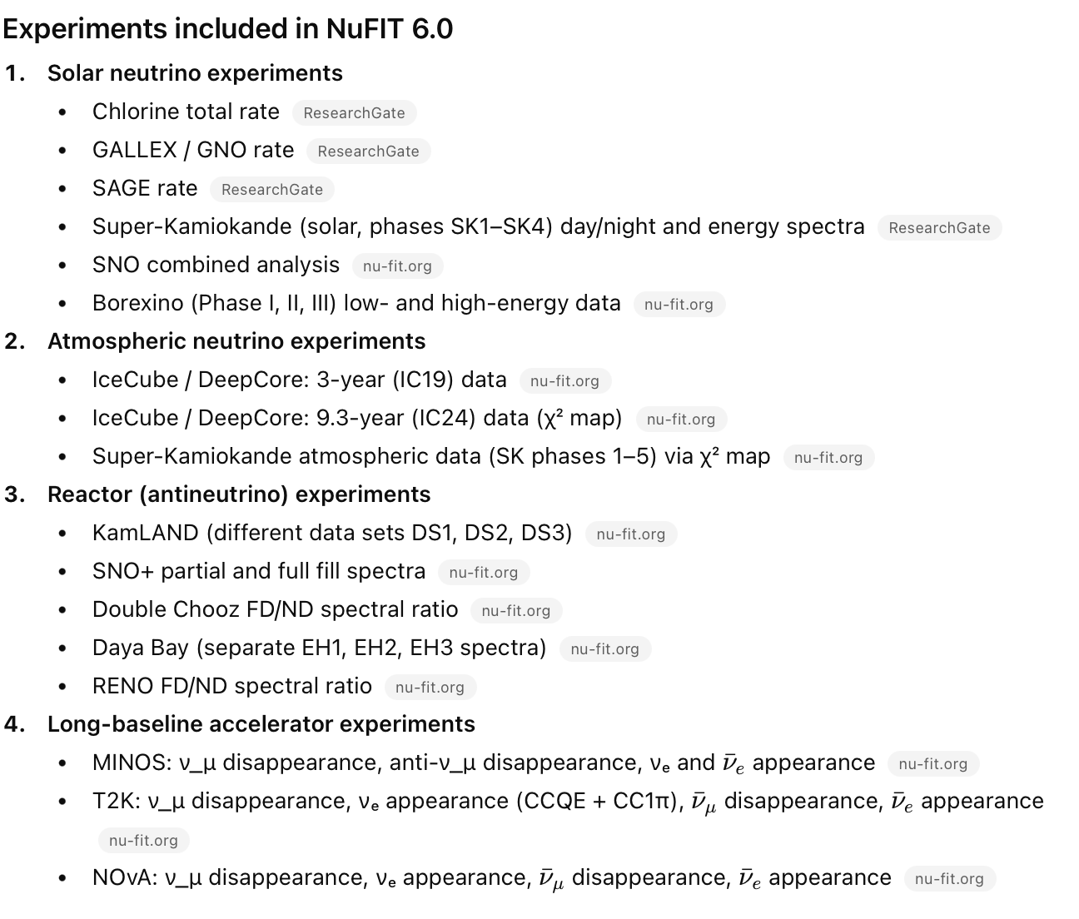
Current Global Fit: NuFit 6.0
Running
Atmospheric:
          KM3NeT/ORCA
          IceCube
          SuperK
Accelerator:
NOvA
T2K
Reactor:
JUNO

Slide 18
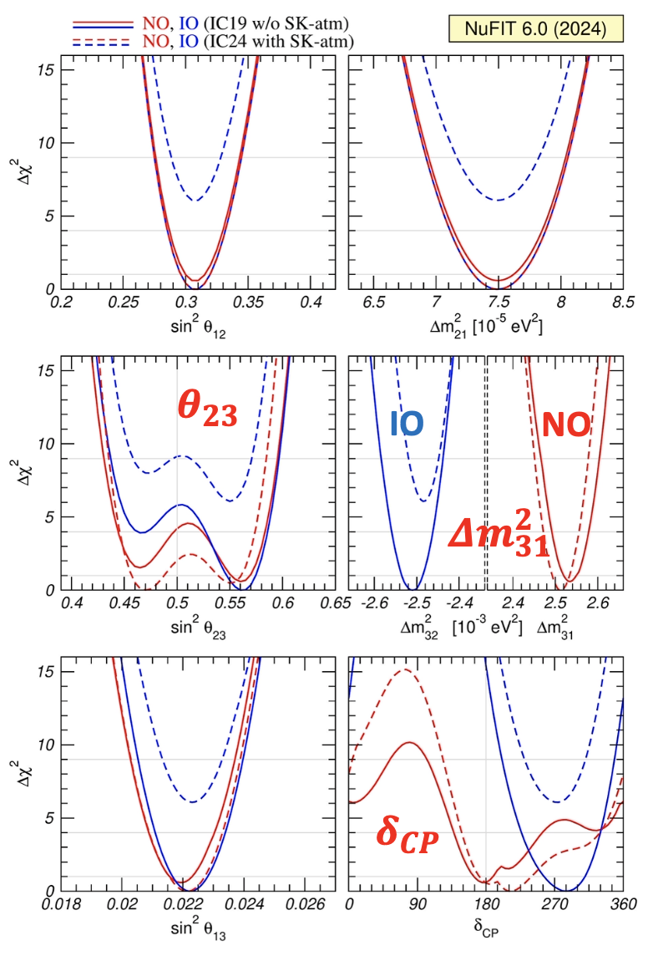
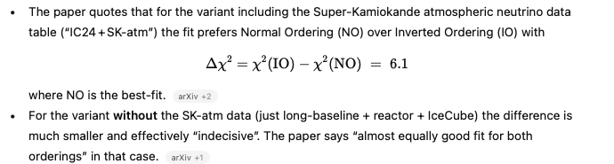
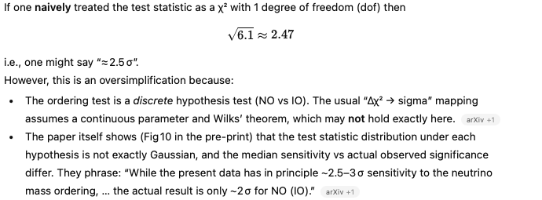
Current Global Fit
Notes:
ORCA has good changes of determining the NMO, if it grows sufficiently large, sufficiently fast.

Slide 19
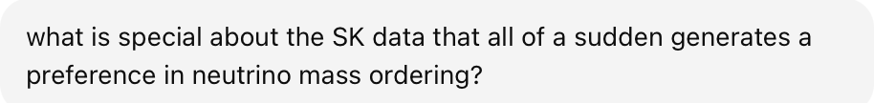
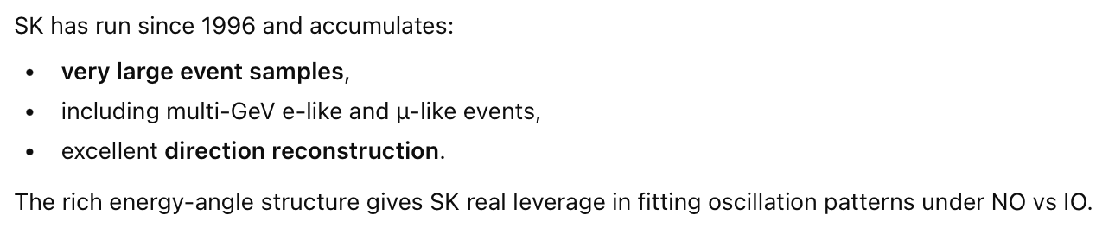
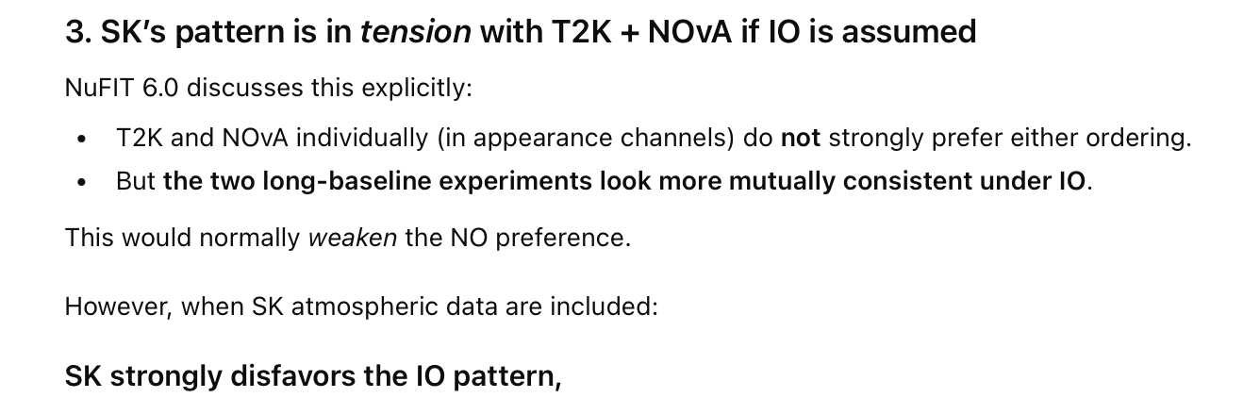
Current Global Fit
More on this later
Notes:
ORCA has good changes of determining the NMO, if it grows sufficiently large, sufficiently fast.

Slide 20
NMO Experiments
Running
Atmospheric:
          KM3NeT/ORCA
          IceCube
          SuperK
Accelerator:
NOvA
T2K
Reactor:
JUNO
Future
Atmospheric:
          INO
Accelerator:
DUNE
HyperK
Reactor:

Slide 21
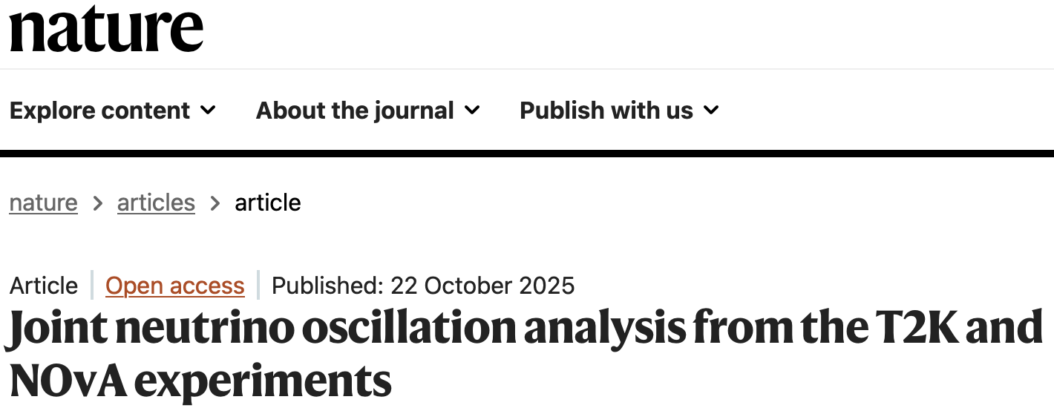
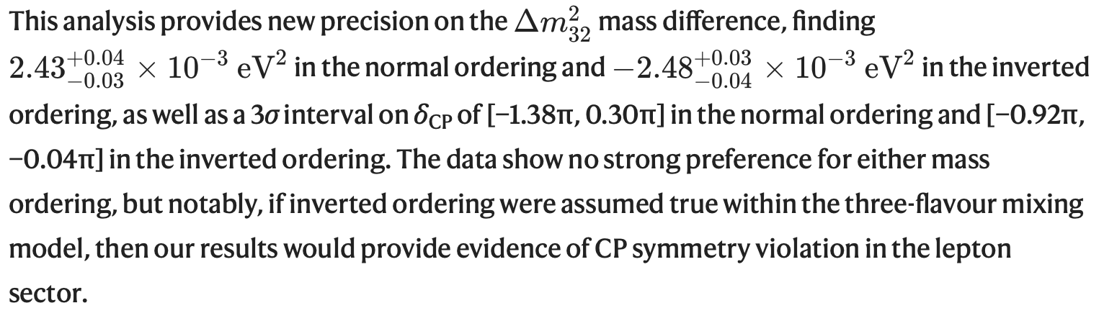

Slide 22
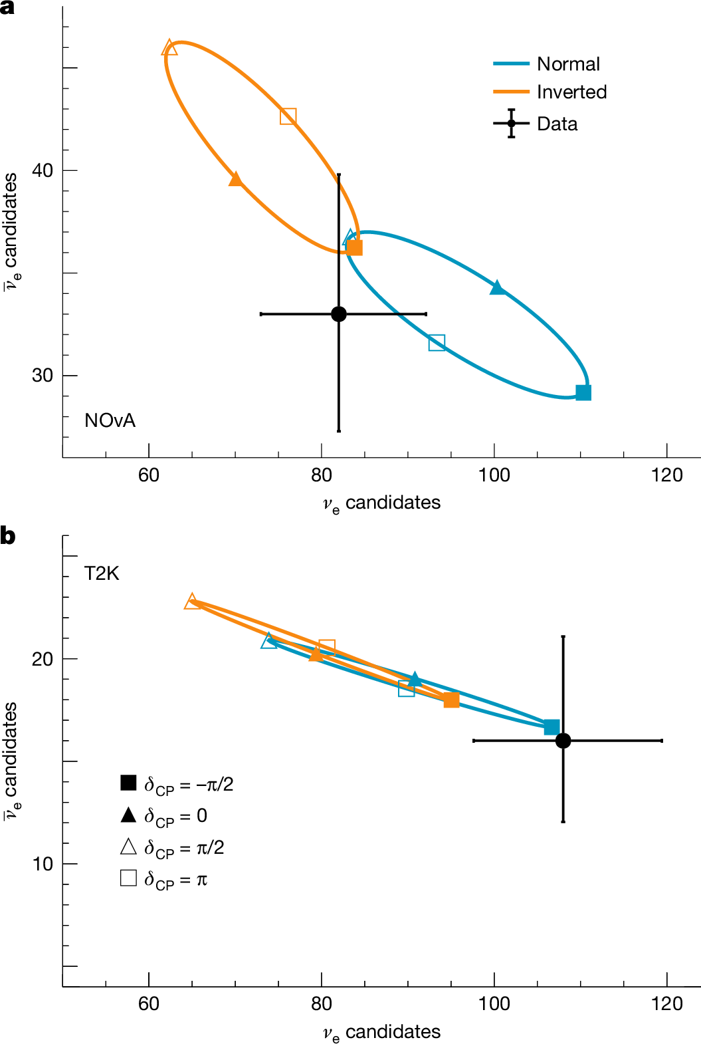
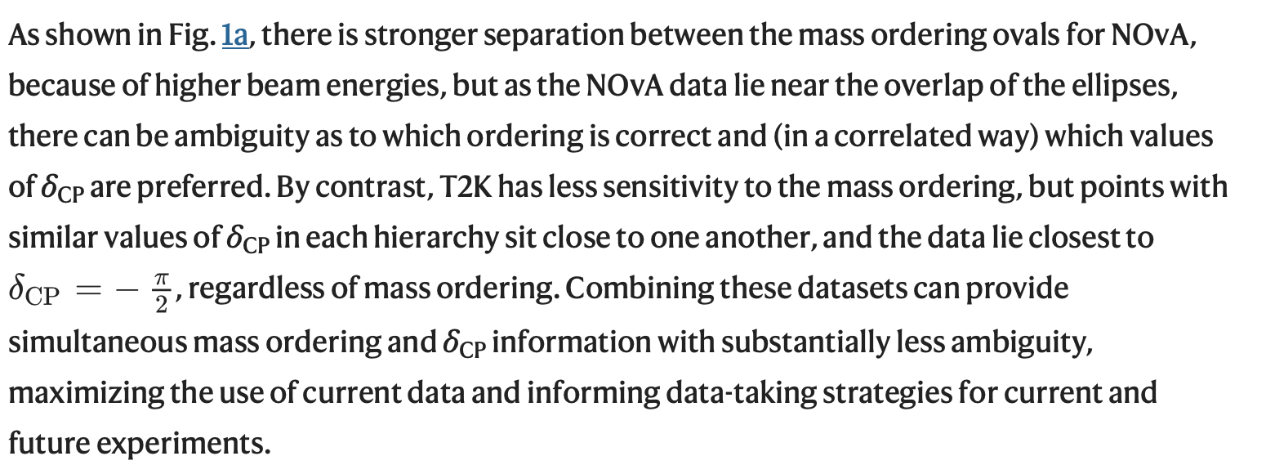
?

Slide 23
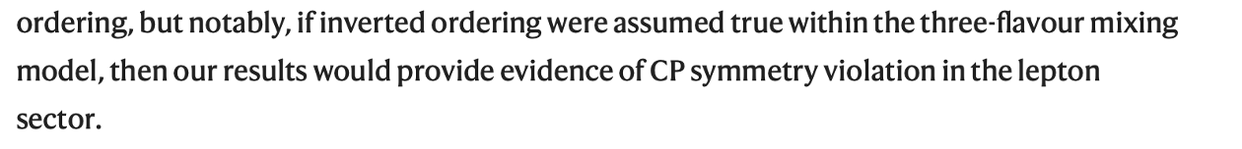

Slide 24
NMO Experiments
Running
Atmospheric:
          KM3NeT/ORCA
          IceCube
          SuperK
Accelerator:
NOvA
T2K
Reactor:
JUNO
Future
Atmospheric:
          INO
Accelerator:
DUNE
HyperK
Reactor:

Slide 25
KM3NeT/ORCA’s NMO Projections
ORCA-115

Slide 26
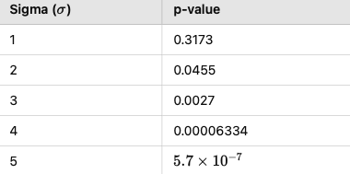
NMO Sensitivity
ORCA-115

Slide 27
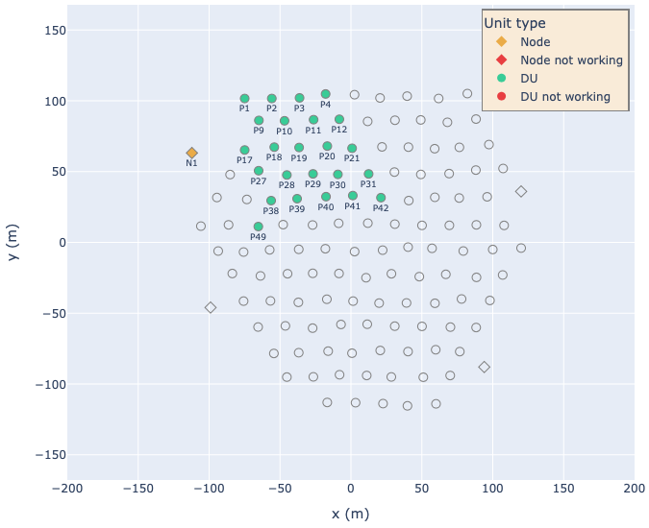
KM3NeT/ORCA Detector
Current ORCA detector

Slide 28
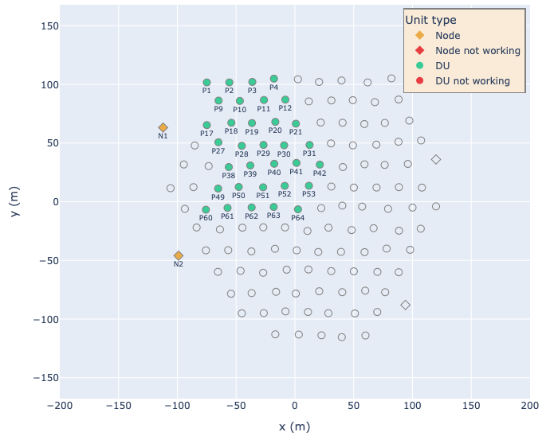
KM3NeT/ORCA Datasets
0.7 Mt-y
1.7 Mt-y

Slide 29
0.7 Mt-y
1.7 Mt-y
KM3NeT/ORCA NMO Results
ORCA-115
Notes:
NO=0.13 -> somewhere between 1 and 2 sigma
IO=0.79 -> sigma smaller than one

Slide 30
NMO Experiments
Running
Atmospheric:
          KM3NeT/ORCA
          IceCube
          SuperK
Accelerator:
NOvA
T2K
Reactor:
JUNO
Future
Atmospheric:
          INO (unclear timeline)
Accelerator:
DUNE (2031)
HyperK (2028)
Reactor:

Slide 31
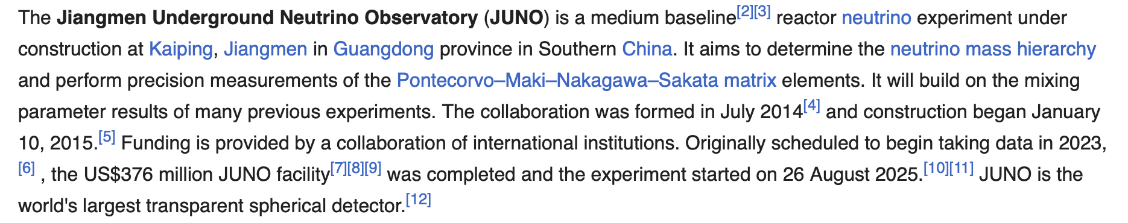
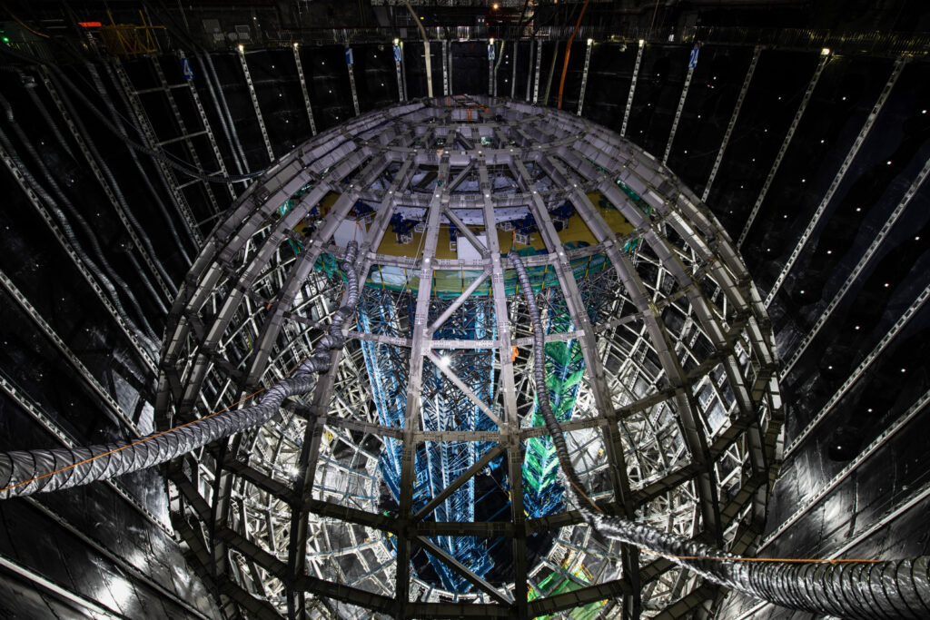
JUNO

Slide 32
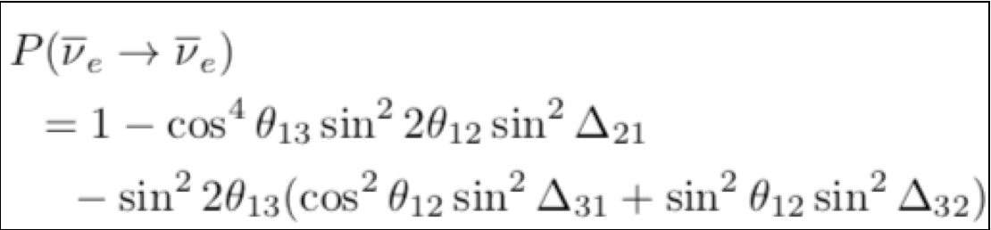
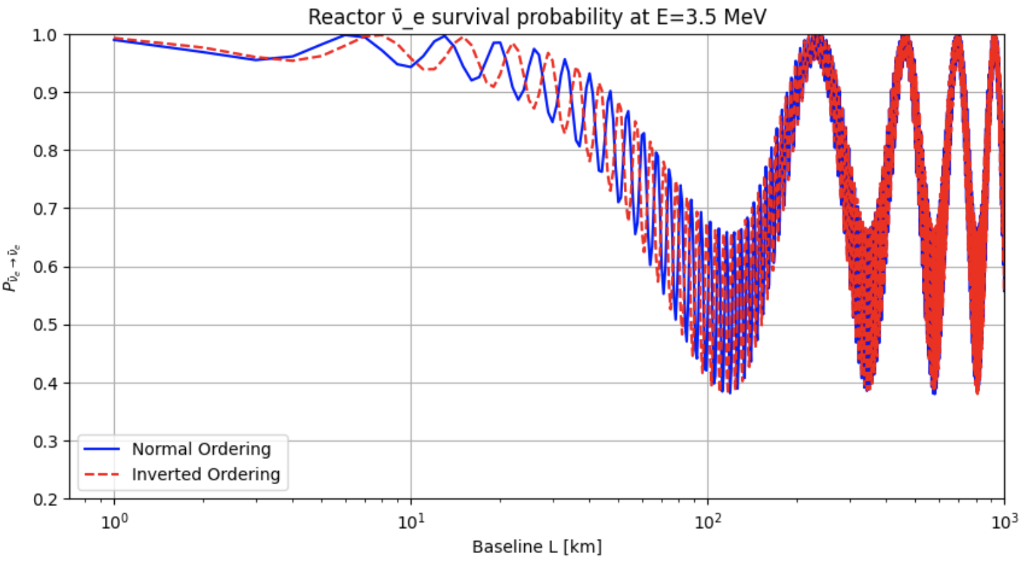
NMO Sensitivity Reactor Experiments

Slide 33
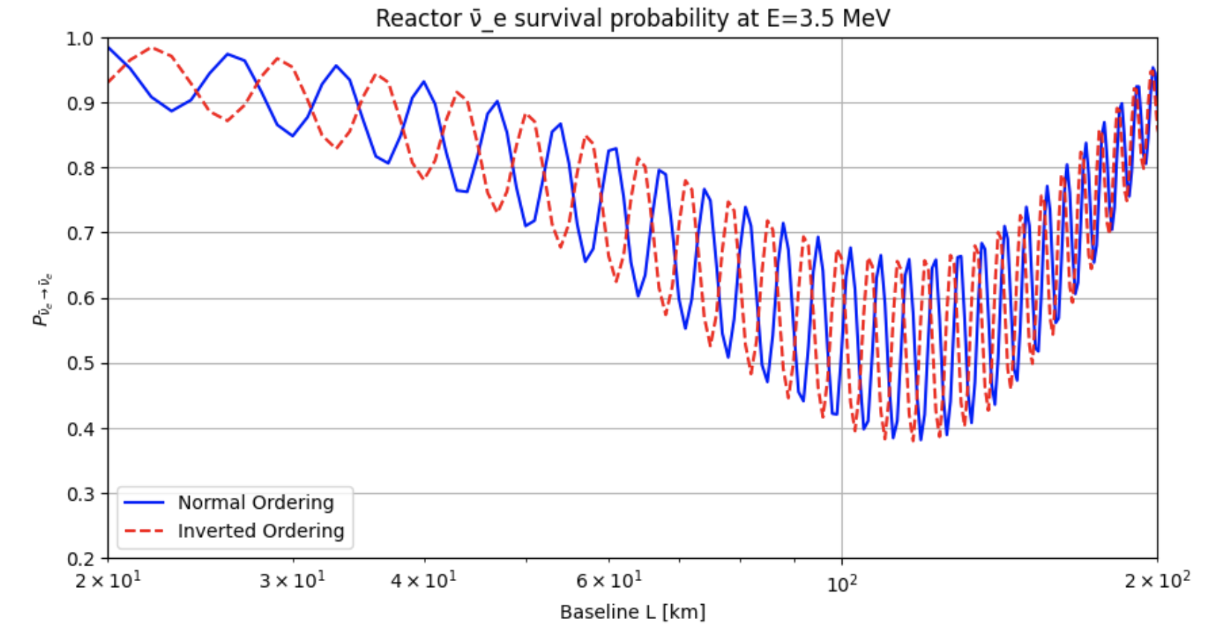
NMO Sensitivity Reactor Experiments: Zoom on Second Dip

Slide 34
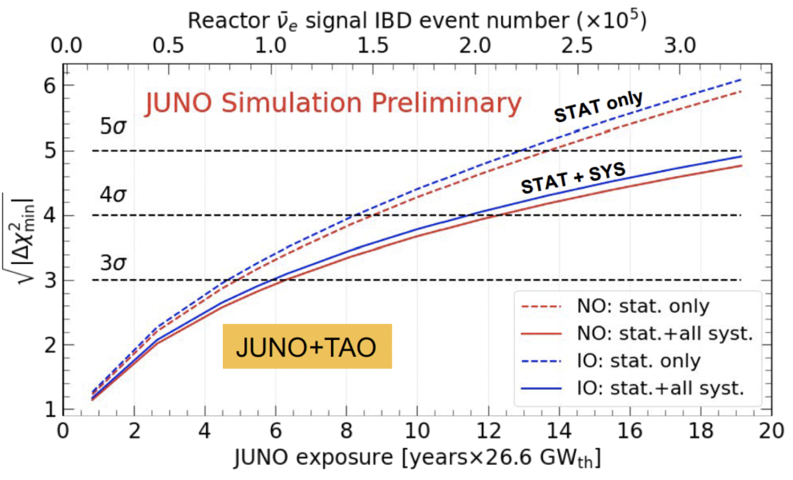
JUNO NMO Sensitivity Projections

Slide 35
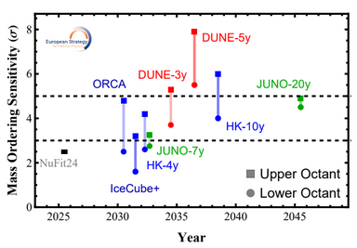
JUNO NMO Sensitivity Projections

Slide 36
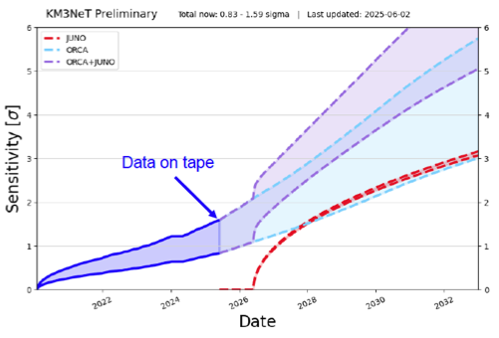
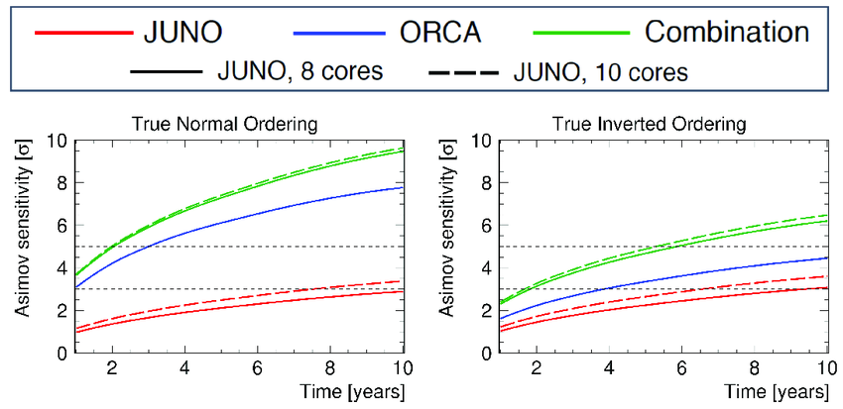
Combinations

Slide 37
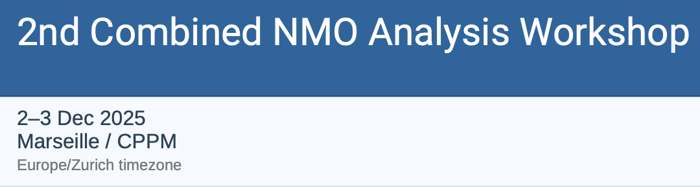
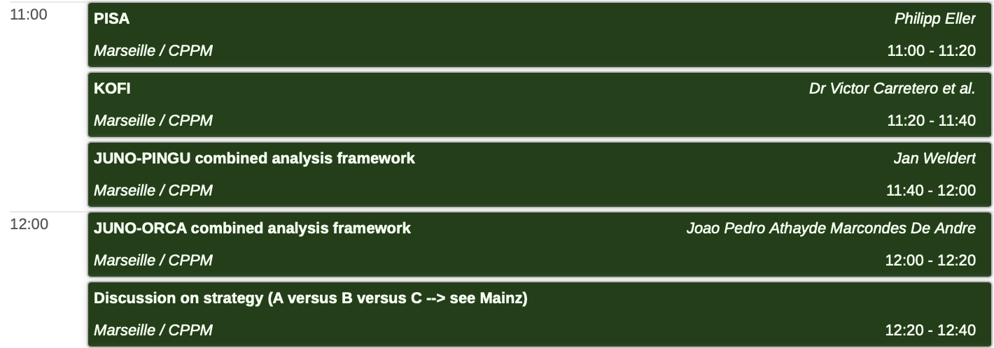
Combinations

Slide 38
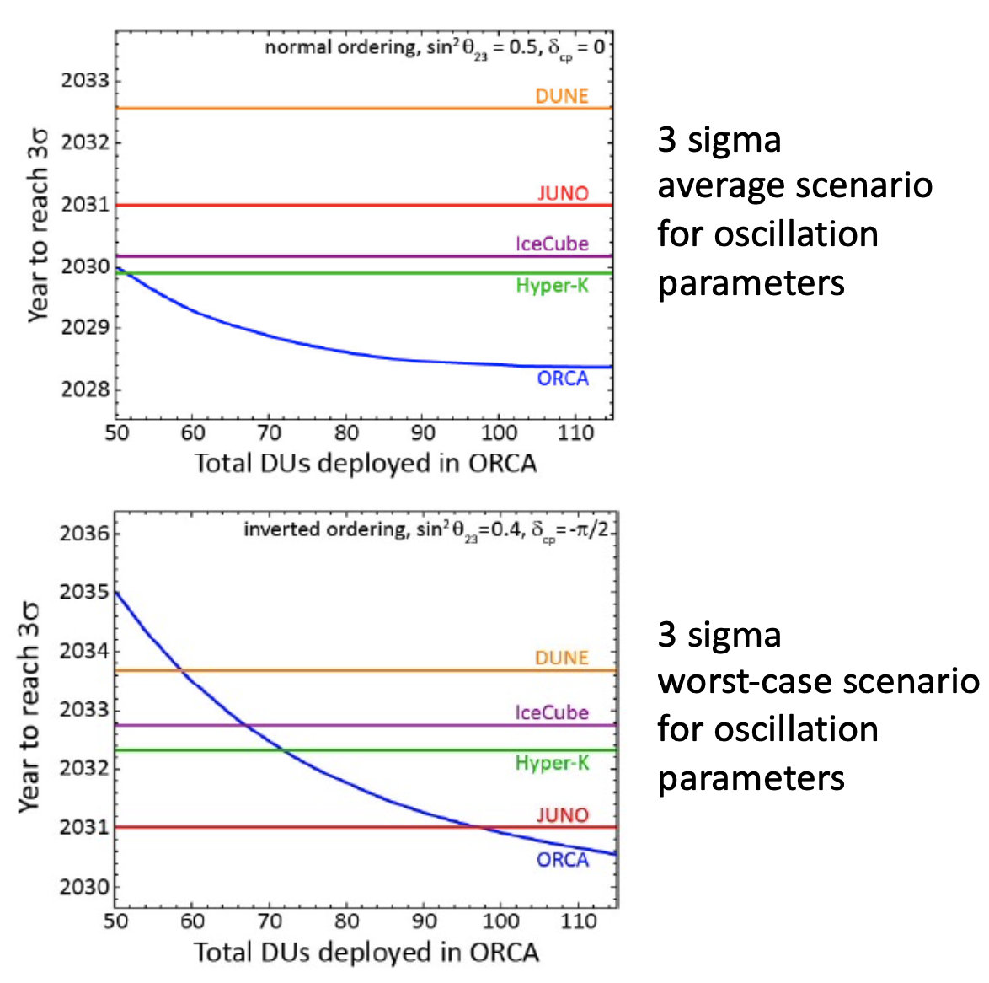
All Experiments
Notes:
ORCA has good changes of determining the NMO, if it grows sufficiently large, sufficiently fast.

Slide 39
Questions/Discussion
What is INO, what makes it special, will it happen? What are their NMO projections?
What about other combinations? HyperK/Juno? HyperK/IceCube/KM3NeT?
Does the latest NOvA/T2K result hint at KM3NeT/ORCA’s worst scenario?
Notes:
ORCA has good changes of determining the NMO, if it grows sufficiently large, sufficiently fast.

