Slide 1
PMT simulation
M. de Jong

Slide 2
Introduction (1/2)
PMT response
each photon¶ is converted to a photo-electron according measured transit time distribution
all photo-electrons are subsequently time sorted
PMT signal
photo-electrons within rise time of amplifier are merged
amplitude of analogue signal is determined according known gain and gain spread
¶ The QE of the PMT actually is included in km3, KM3Sim, JSirene, etc.

Slide 3
Introduction (2/2)
PMT hit
hit time & time over threshold requires designated model
PMT hits
overlapping PMT hits are merged
leading edge is set to earliest leading edge of all hits
time over threshold is set to difference between latest trailing edge and earliest leading edge of all hits

Slide 4
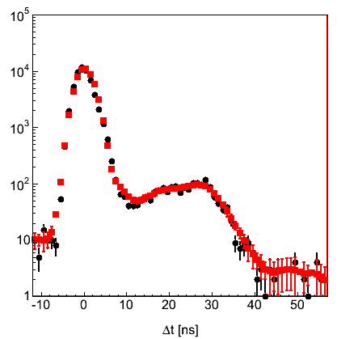
Transit time (1/1)
see <Jpp>/examples/JDetector/JTTS.sh
data
smoothed

Slide 5


Time over threshold (1/2)
gain
spread
time over threshold = 0
$\frac{∂V}{∂t}=0 ⟹ \frac{∂t}{∂V}=∞$
charge [V]
$$x_{1}$$
threshold
time over threshold
time

Slide 6





Time over threshold (2/2)
$$f\left(x\right)≡g\left(x\right)×h(x)$$
specification
$$f\left(1\right)$$
$$g\left(x\right)=a+bx$$
time over threshold
$$h(x)=\sqrt{\frac{x−x_{1}}{x}}$$
$$x_{1}$$
1
charge

Slide 7

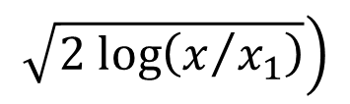
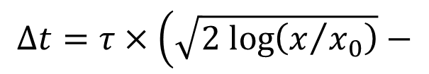



Time slewing (1/1)
Gaussian
$$Δt=τ×\left(\sqrt{2 log\left(x/{x_{0}}\right)}−\right.$$
$$\left.\sqrt{2 log\left(x/{x_{1}}\right)}\right)$$
charge [V]
$$τ$$
$$x_{1}$$
threshold
$$x_{0}$$
$$Δt$$
time

Slide 8




Time slewing (2/2)
$${}_{ }^{40}{K → {}_{ }^{40}{Ca} + e}$$
see e.g. presentation
Karel M.
$$t_{2}−t_{1}$$
$$t_{2}$$
$$t_{1}$$
time over threshold

Slide 9

PMT parameters (1/2)
Model constraints:
threshold $⟹x_{1}$
time over threshold peak $⟹a+b≅27$
time over threshold width $⟹b≅\frac{5 ns}{gain spread}$

Slide 10

PMT parameters (2/2)
threshold 0.3 npe
gain spread 0.3 unit
rise time 10 ns
$a$ 18 ns
$b$ 15 ns

Slide 11
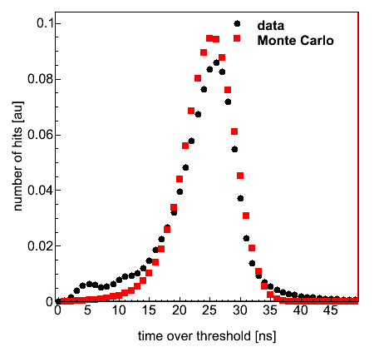
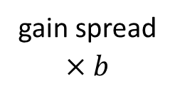
data – Monte Carlo (1/2)
gain spread
threshold
gain spread
$$×b$$

Slide 12
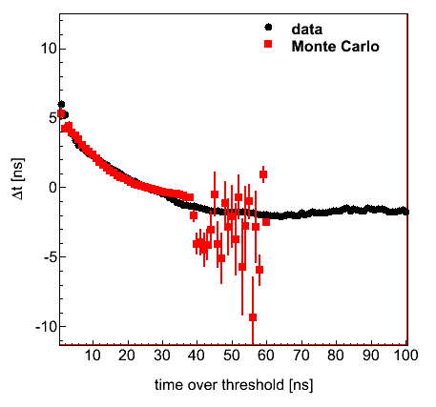
data – Monte Carlo (2/2)
time
slewing

Slide 13
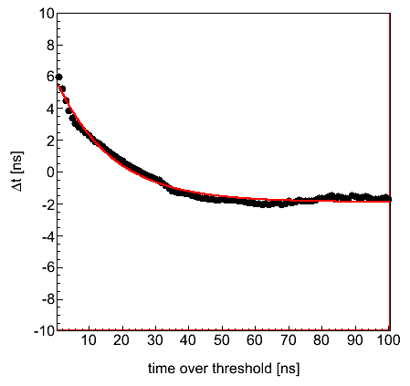
Time slewing correction (1/2)
data
fit

Slide 14
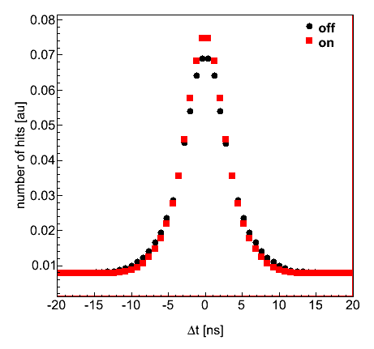
Time slewing correction (2/2)
σ_{off} = 3.3 ns
σ_{on} = 3.0 ns

Slide 15
Status & Outlook
Simple two-parameter model for simulation of PMT hit
describes reasonably well time over threshold
describes reasonable well time slewing
Time slewing
correction based on in situ K40 data
improves time resolution by 10%

