Slide 1
RCauth 10th year birthday party
a multi-domain anycasted high availability solution for stateful services in RCauth.eu
David Groep
Nikhef and Maastricht University
October 2025

Slide 2
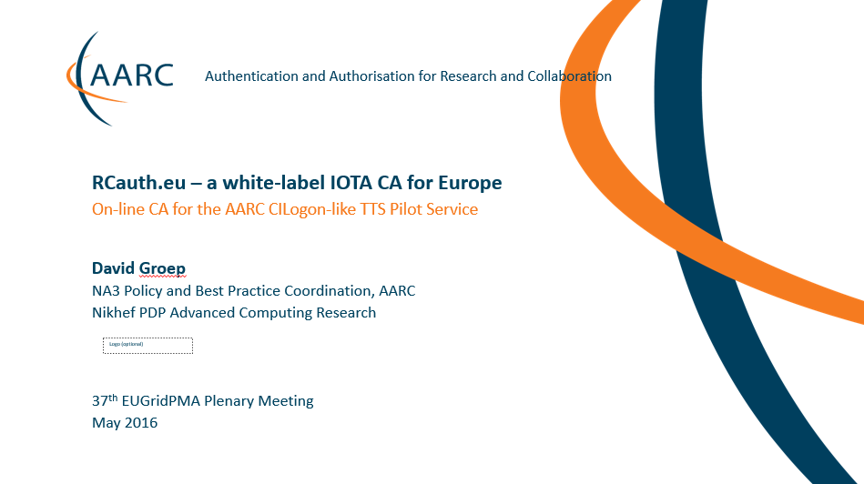
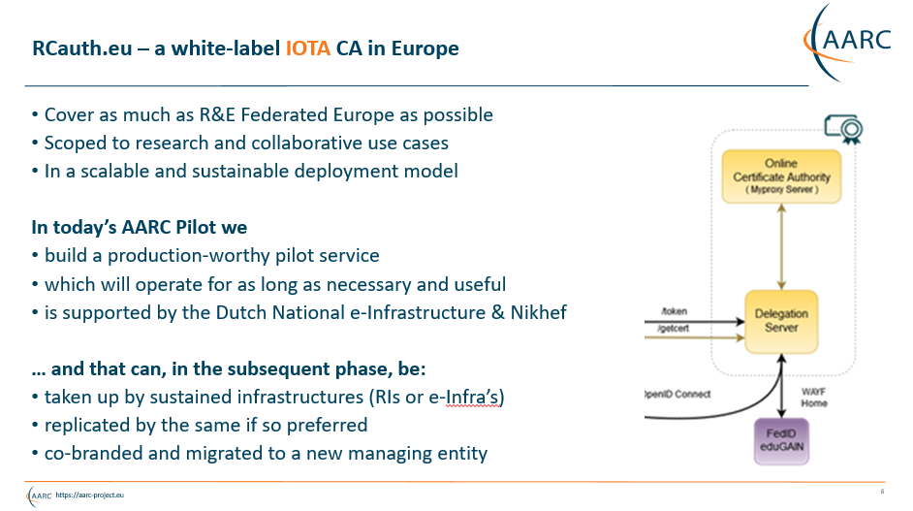
Remember the days … ?

Slide 3
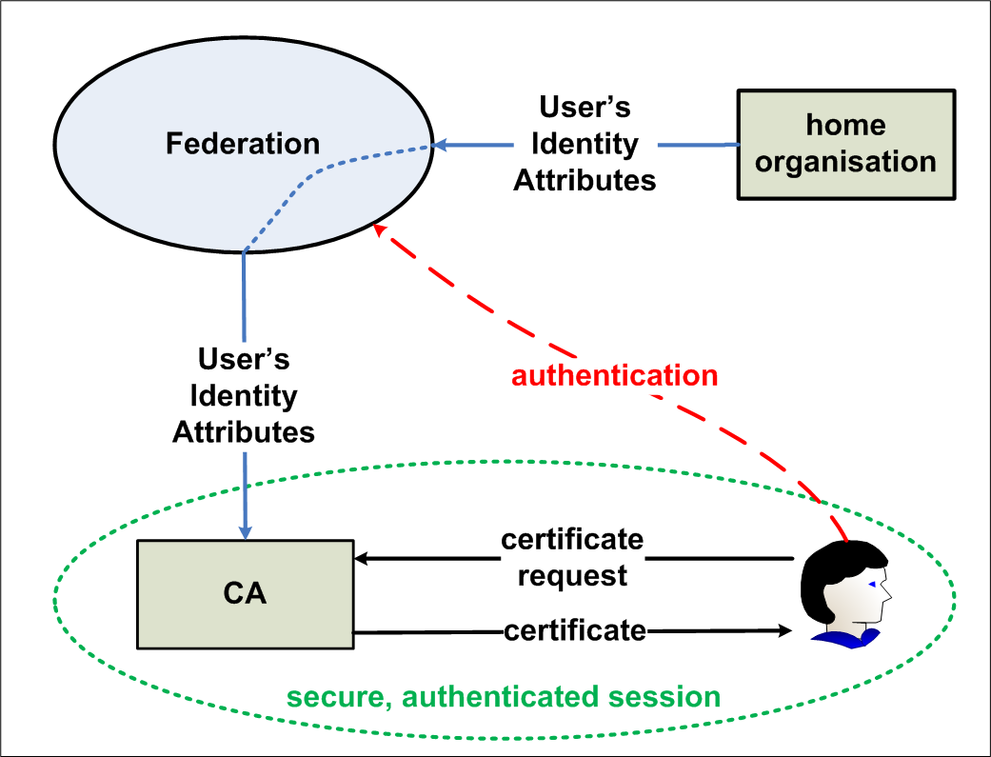
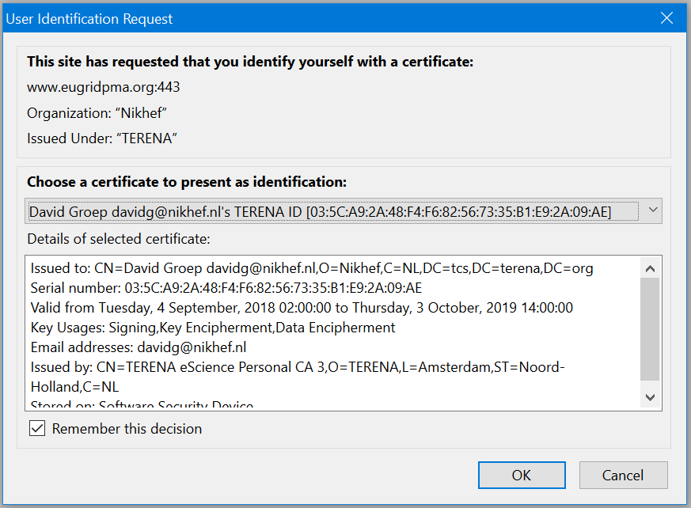


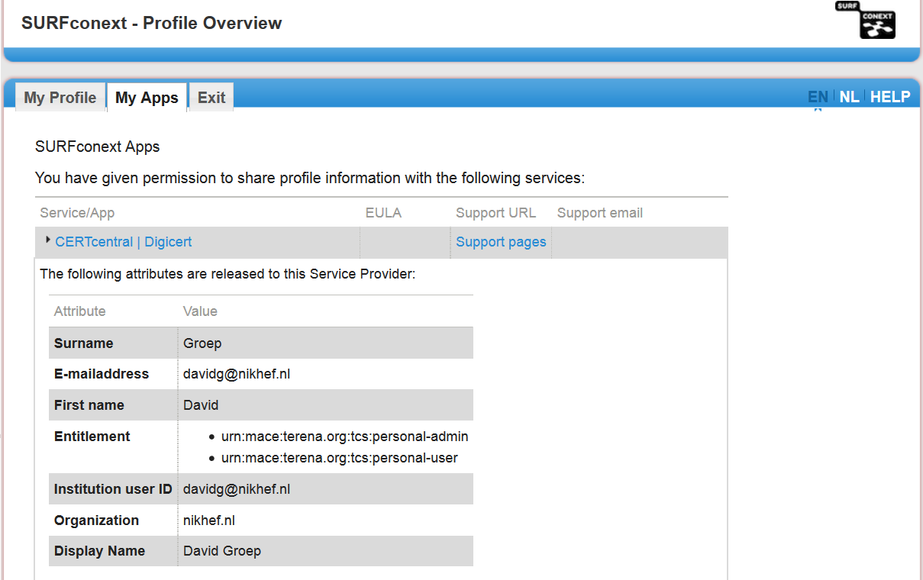
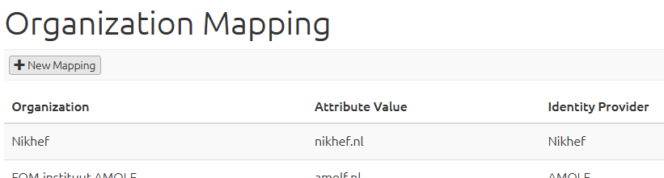


The first ‘Token Translation Service’?
GEANT Trusted Certificate Service
And the reverse: IGTF eduGAIN Bridge by GRNET
GEANT TCS acts as SAML Service provider
to eduGAIN: eligible authenticated users can obtain
client certificate for access and delegation to services
https://ca.dutchgrid.nl/tcs/
https://cert-manager.com/customer/surfnet/idp/clientgeant
https://www.geant.org/Services/Trust_identity_and_security/Pages/TCS.aspx

Slide 4
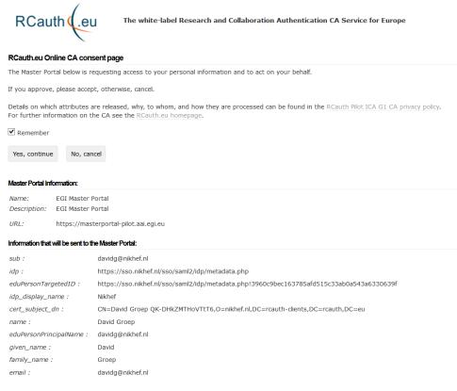
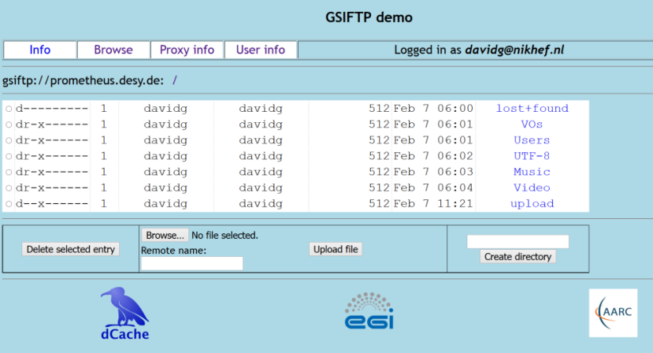
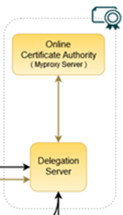
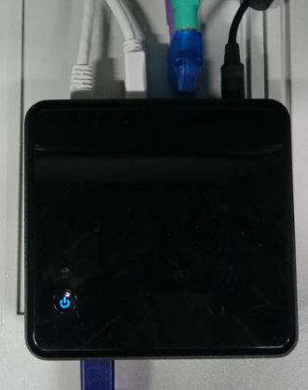

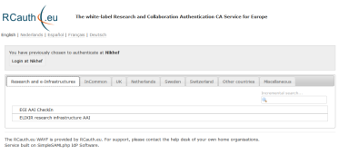


Flow for RCauth-like scenarios
Community Science Portal
Accredited
PKIX Authority
Infrastructure Master
Portal Credential Store
REFEDS R&S
Sirtfi Trust
User Home Org
or Infrastructure IdP
Policy Filtering WAYF / eduGAIN
Built on CILogon and MyProxy
www.cilogon.org
4
see also https://rcdemo.nikhef.nl/
Notes:
VO portal can be anything even a simple shell
Certs stored only for 11 days
Master portal can add attributes via VOMS (or others in the future)

Slide 5

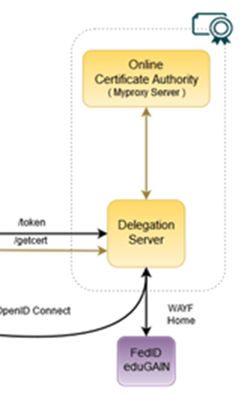

RCauth.eu – a white-label IOTA CA in Europe
Cover as much as R&E Federated (Europe++) as possible
Scoped to research and collaborative use cases
In a scalable and sustainable deployment model
Service inspired by and using components (such as the DS) from
Jim Basney’s CILogon, see https://www.cilogon.org/docs/20141030-basney-cilogon.pdf

Slide 6
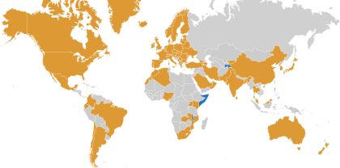
Our Registration Authorities: the Federated IdPs [1.3.2]
RAs are the eligible IdPs connected through a
Federated Identity Management System (FIMS)
primarily: ensemble of IdPs in eduGAIN that
meet the policy requirements of this CA
Eligible applicants are all affiliated to an RA
Three eligibility models
Direct relationship CA-IdP, with agreement declaration
Rest of eduGAIN: – “Sirtfi” security incident response and OpSec capabilities plus
– REFEDS “R&S section 6” non-reassigned identifiers and applicant name
are required, and tested via statement in ‘meta-data’ any by releasing the proper attributes
within the Netherlands, SURFconext Annex IX* already ensures compliance for all IdPs
“IdPs within eduGAIN [#3] are deemed to have entered materially into an agreement with the CA”

Slide 7
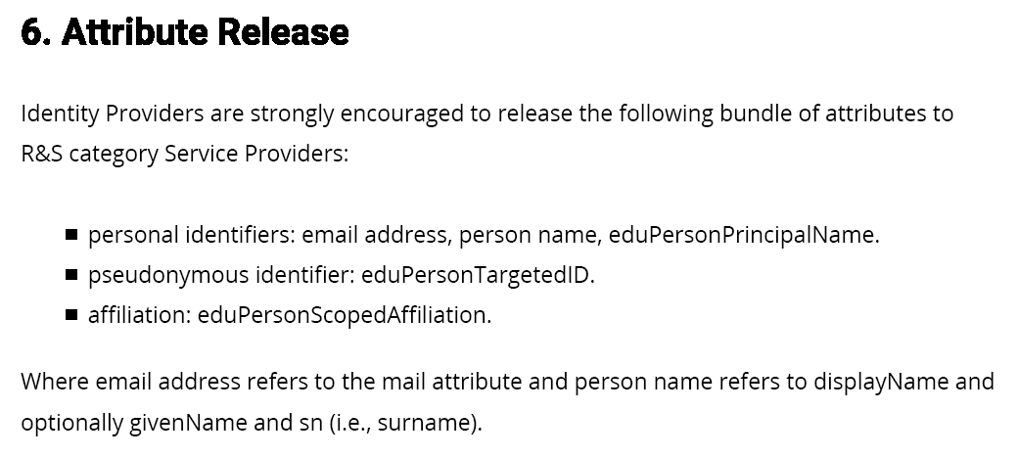
REFEDS R&S section 6
https://refeds.org/category/research-and-scholarship

Slide 8
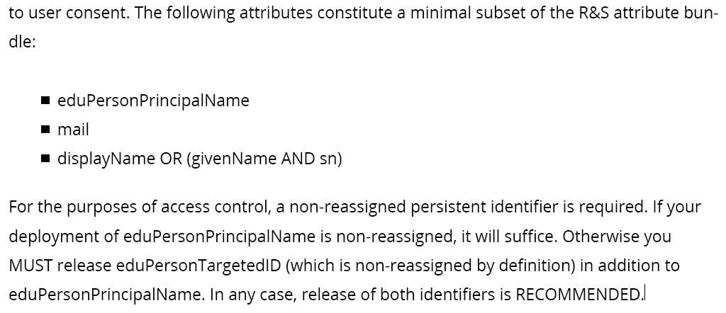
REFEDS R&S section 6 – the non-reassigned identifier

Slide 9

Sirtfi – Security Incident Response Trust framework for Federated Identity
A means by which to enable a coordinated response to a security incident in a federated context that does not depend on a centralised authority or governance structure to assign roles and responsibilities for doing so, but entity organisations self-asserts. The Sirtfi trust framework posits that organisations asserting conformance with these will coordinate their response to security incidents.
Derived from the first four elements of the SCI Framework
Operational Security: patch and vulnerability management; IDS and threat mitigation; service ownership management; user suspension and termination; CSIRT capability
Incident Response: CSIRT contact in meta-data; timely response; collaborate in IR; defined processes; privacy respect; TLP information sharing
Traceability: timestamped accurate logs are available; log retention process in place
Participant Responsibilities: users agree to an AUP; awareness and acceptance of the AUP
https://refeds.org/SIRTFI

Slide 10
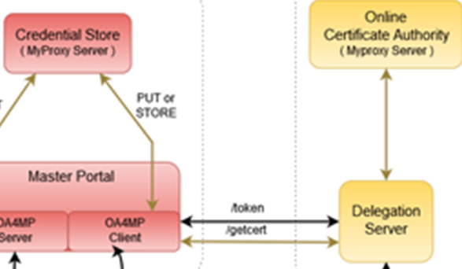
Other Participants
RCauth will seldom see individual users
authentication requests come via the Master Portals
we will (ourselves & directly!) authenticate the users, but …
… then release the certificate to the intermediary
In the RCauth case:
Explicit relationships required
Encoded via a (shared) OIDC Client ID and Client Secret
Contrary to e.g. Google, we will not accept ‘any’ OIDC client, but explicitly configure trust
Assessment based on PKP Guidelines and Trusted Credential Repository guidelines
Along with other criteria (for scalability): constituency, community size, relevance, &c

Slide 11
The basics for any Certification Authority: Policy and Practice Statement in RFC 3647 format
https://www.rcauth.eu/
CP/CPS document
CA certs, link to superior (“DCA Root”) CA
CRL – issued daily for a period of 30 days (and after each revocation)
Supplementary policy documents (links to SURFnet contract Annex IX, eduGAIN, R&S, Sirtfi)
Sign-up form (unilateral) for explicit IdPs
– but the fact that you can sign up does not mean you’ll be accepted…

Slide 12
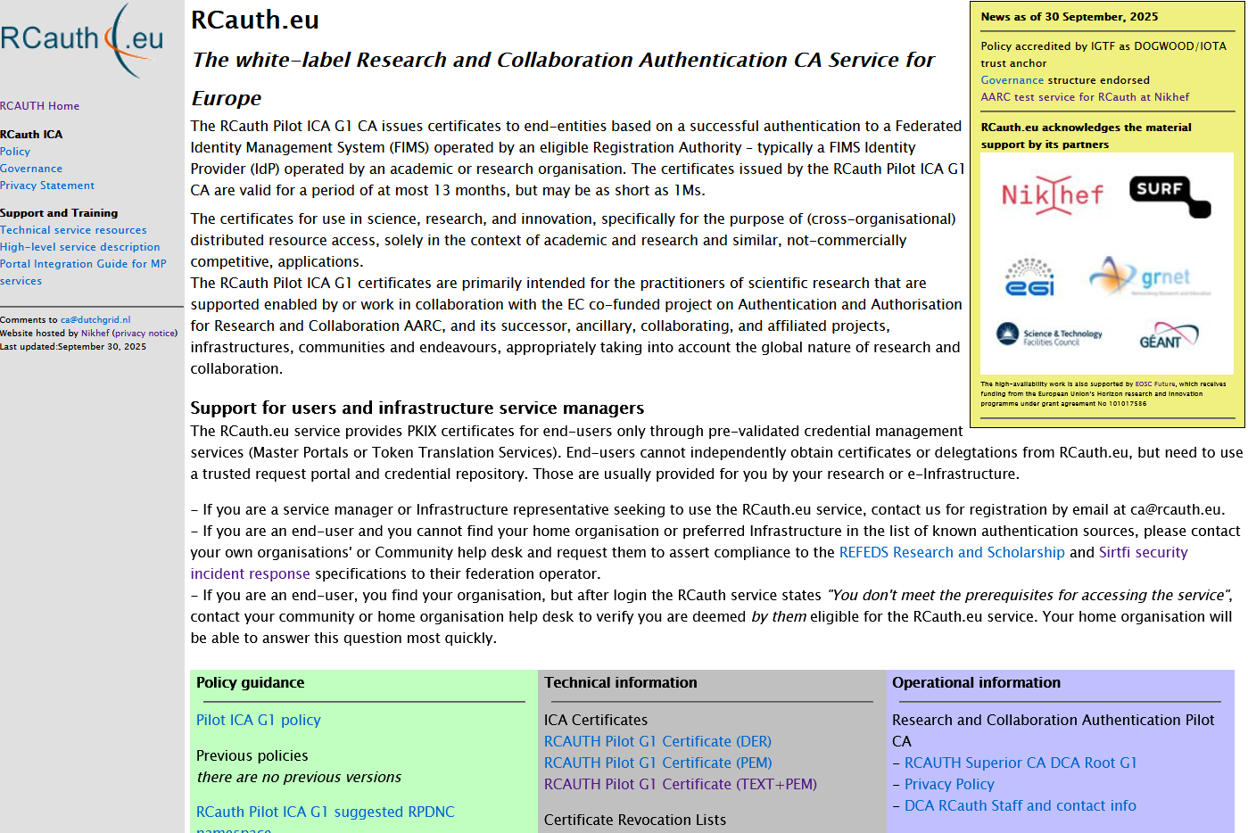

Slide 13
The AARC Pilot started on Feb 1st, 2016 …
Certificate:
Data:
Version: 3 (0x2)
Serial Number:
09:f5:d7:56:8e:89:e8:87:d8:16:53:fe:ab:c7:84:e2
Signature Algorithm: sha256WithRSAEncryption
Issuer: DC=nl, DC=dutchgrid, O=Certification Authorities,
CN=DCA Root G1 CA
Validity
Not Before: Feb 1 00:00:00 2016 GMT
Not After : Jan 31 23:59:59 2026 GMT
Subject: DC=eu, DC=rcauth, O=Certification Authorities,
CN=Research and Collaboration Authentication Pilot G1 CA
Subject Public Key Info:
Public Key Algorithm: rsaEncryption
Public-Key: (2048 bit)

Slide 14
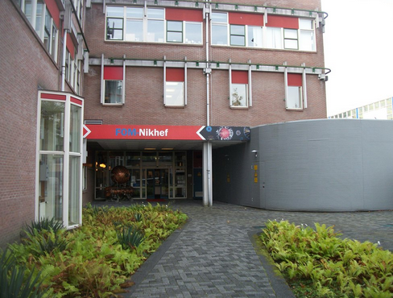
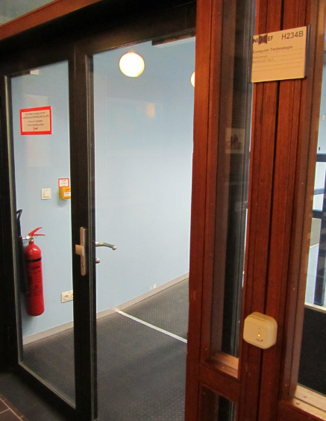

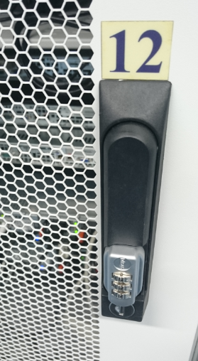
Physical controls
Located at Nikhef, Amsterdam, NL
Nikhef-specific part of the DC Housing Facilities
Room capacity 400kW, total ~ 2MW, 2N+ no-break
ID based access control, 24hr guard on-site, 2nd floor (above see-level)
CA and security systems in locked dedicated cabinet.
On-line CA signing system in locked drawer
CA signing system
Delegation Server

Slide 15
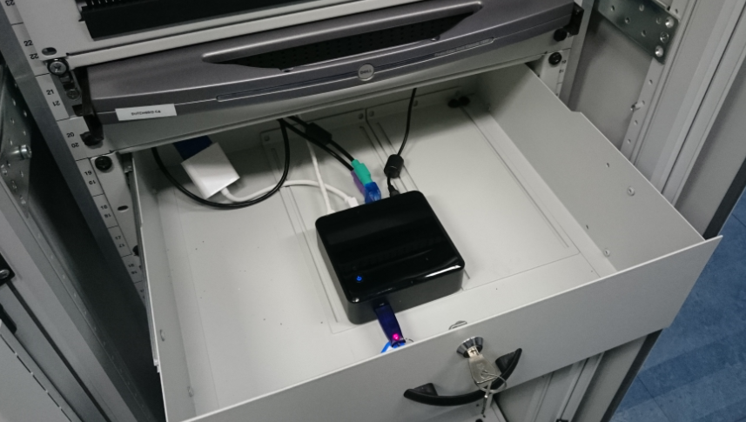


More pretty pictures

Slide 16


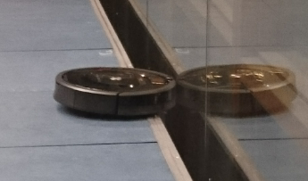
Slightly more ugly pictures …

Slide 17
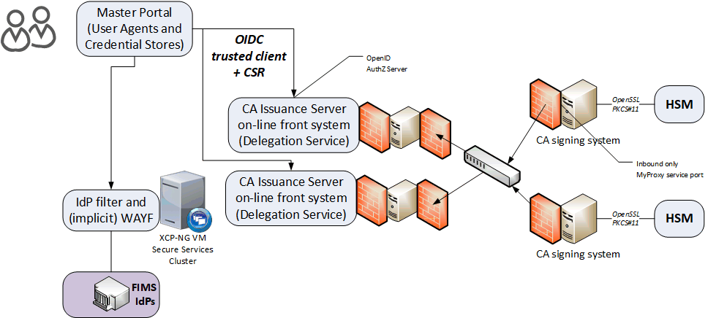
A local highly-available setup at Nikhef Amsterdam
Most ‘fault-prone’ components are
  Intel NUC (single power supply)
  HSM (can lock itself down, and the USB connection is prone to oxidation)
  DS front-end servers (they are physical hardware, albeit with redundant disks and powersupplies)
Eliminated first
using ‘local HA’
private
semi-redundant
switch

Slide 18
Meeting the world: from naming to addressing …

Slide 19
Name uniqueness [3.1]
Federations, with their distributed responsibility model, always face a consistency challenge
  Release of any identifier associated with a individual person (‘privacy concerns’)
  Guaranteeing non-reassignment of an identifier - has not played a major role inside any single org till now
  Agreeing on how to name the name (attribute) of the authenticated user is different
We have to rely on the RAs (institutions) to provide an identifier that we can use - even if the institution itself does not consider RCauth.eu on its own worthy of specific attention
We can leverage grander schemes and agreements
eduPerson schema – almost all federations use this, and most require specs compliance
REFEDS Research and Scholarship (“R&S”) specification – aligns attribute release (and federation registrars check for minimal compliance
Sirtfi – new standard to harmonize incident response and opsec capabilities and processes

Slide 20
eduPerson and REFEDS R&S
Sources of naming and uniqueness, that work today
eduPersonPrincipalName – a scoped point-in-time unique identifier, which could be (but usually is not) privacy preserving: “davidg@nikhef.nl”, “P70081609@maastrichtuniversity.nl”
eduPersonTargetedID – a scoped transient non-reassigned identifier, different for each targeted service in the world – so every SP gets a different one of these: urn:geant:nikhef.nl:nikidm:idp:sso!27c8d63ed42c84af2875e2984
or are good candidates
subject-id - a scoped persistent non-reassigned identifier, which should be privacy-preserving: 44f7751265a6e8b228f9@nikhef.nl
Others of interest to construct a unique name
schacHomeOrganization – subdomain-name styled identifier of the home org (from SCHAC)
eduPersonUniqueID – like subject-id, but never gained much traction

Slide 21
Constructing a non-reassigned subjectName
/DC=eu/DC=rcauth/DC=rcauth-clients/O=orgdisplayname/CN=commonName
All the uniqueness will be in the commonName – that will “contain sufficient information such that an enquiry via the issuer allows unique identification of the vetted entity”
The orgdisplayname is used to “identify the identity management system via which the identity of this person was vetted” [IOTA 3.2]
So if – over time – the orgdisplayname may conflict, be re-used, or is ambiguous, we don’t need it: we will use the commonName to trace and ensure non-reassignment!

Slide 22
CommonName – the big challenge
Requirements
Contain a representation of the real name of the applicant as asserted by the IdP
the opaque option is not very friendly to downstream services
Must be unique and non-reassigned
Allow – via the issuer – unique identification of the entity in the stated IdP
So we construct it out of 2 or 3 elements
Readable name of the applicant (max. 40 characters)
Unique Shortened Representation of the identifier provided by the IdP (16 characters)
Optional: ensured-uniqueness sequence number (max. 3 digits)

Slide 23
commonName – readable name element
REFEDS R&S gives a subset of attributes that should be released: displayName, givenName + surname, commonName. We construct the readable name from
the displayName attribute from the IdP
the givenName attribute, followed by a space, followed by the sn attribute from the IdP
the commonName (cn) attribute from the IdP
and then make it printable using java.text.Normalizer.Form.NFD and map the remainder to “X”
If IdP sends us this UTF-8 | Representation in CN RDN
Jőzsi Bácsi | Jozsi Bacsi
Guðrún Ósvífursdóttir | GuXrun Osvifursdottir
Χρηστος Κανελλοπουλος | XXXXXXX XXXXXXXXXXXXX
簡禎儀 | XXX

Slide 24
but Νικόλας Λιαμπότης may not quitelike that … and I understand …
java.text.Normalizer.Form.NFD and ‘X-ing’ the rest particularly bad for
Greeks, Bulgarians, Chinese, Georgians, Thai, Armenians, Serbians, …
ICU - International Components for Unicode (icu-project.org) appears to be better, but:
there are many options for transliteration
some code points shared between different languages, that prefer different transliterations
some code points are absent even in UTF-8 causing ambiguity
So we moved to the ICO, but even then the mapping is not trivial:
UTF-8 → Latin-1 → ASCII → IA5String (we need PrintableString + “@” and minus [:/=])
ICU
ICU
regex

Slide 25
It’s all Greek to me!
ICU can do many things to Λιαμπότης
http://userguide.icu-project.org/transforms/general#TOC-Greek
Greek-Latin → Liampótēs → Liampotes
Greek-Latin/BGN → Liambótis → Liambotis
Greek-Latin/UNGEGN → Liampóti̱s → Liampotis
and the official (passport) Greek ELOT-743 transliteration is “Liampotis”

Slide 26
But straightforward translation is not always good
Just Any-Latin fails for Slavonic unique “sh” sounds. E.g. for ‘Миша’
with Any-Latin becomes ‘Miša’ which then translates into ‘Misa’ after the Latin-Ascii
but quite some people called ‘Миша’ want to see ‘Mischa’, but not all, so you need
first Russian-Latin/BGN, making it ‘Misha’, which is slightly better, then do Any-Latin (1-to-1)
but “Russian-Latin/BGN+Serbian-Latin/BGN” is different from the reverse …
First Any-Latin/BGN, then Any-Latin, to fix mapping to → š and the → s
Բարեւ աշխարհ → Barev ashkharh (with the /BGN, to ensure the “sh”)
ישראל → ysr'l (taken care of without the /BGN, otherwise theש never makes it)
And Unicode does not distinguish the diaeresis and the umlaut
Mühlstraße → Muhlstrasse should have been ‘Muehlstrasse’
reünie → reunie is good, you definitely don’t want ‘reuenie’
As the so for stability, we keep Any-Latin here and treat all as a diaeresis

Slide 27
But straightforward translation is not always good
So the (for now) best combination seems to be the ordered transformation:
Transliterator.getInstance( "Russian-Latin/BGN;"+
"Serbian-Latin/BGN;"+
"Greek-Latin/UNGEGN;"+
"[:Nonspacing Mark:] remove;"+
"Any-Latin/BGN;“ +
"Any-Latin;“ +
"Latin-Ascii“
);
result.replaceAll("[^\\p{Lower}\\p{Upper}\\p{Digit} '()+,-.?@]", "X");
ordering to retain “ш” → “sh”
Fixes greek Λ adding a useless space
Retain proper “sh” when coming from
Armenian or Hebrew by /BGN first

Slide 28
What will we get?
$ java -cp icu4j-59_1.jar:. transliterate2 [...]
"Jőzsi Bácsi" "Guðrún Ósvífursdóttir" \
"Χρηστος Κανελλοπουλος" "簡禎儀“
Input: Jőzsi Bácsi
Output: Jozsi Bacsi
Input: Guðrún Ósvífursdóttir
Output: Gudrun Osvifursdottir
Input: Χρηστος Κανελλοπουλος
Output: Christos Kanellopoulos
Input: 簡禎儀
Output: jian zhen yi

Slide 29
The RCauth pan-European distributed service

Slide 30
RCauth.eu Governance
Governance Board
RCauth PMA
Ops Coordination Team
Representatives (and one alternate) from
each Materially Contributing Stakeholder
EGI.eu, EUDAT (ETFC), GÉANT, Nikhef (SURF)
Individuals drawn from the wide community […]
experts in the field of identity management
for research and collaboration,
PKI technology and identity bridging
STFC
GRNET
Nikhef
Operations people from each of the hosting partners with a (copy of) the RCauth.eu signing key,
and those partners otherwise involved in OPS

Slide 31
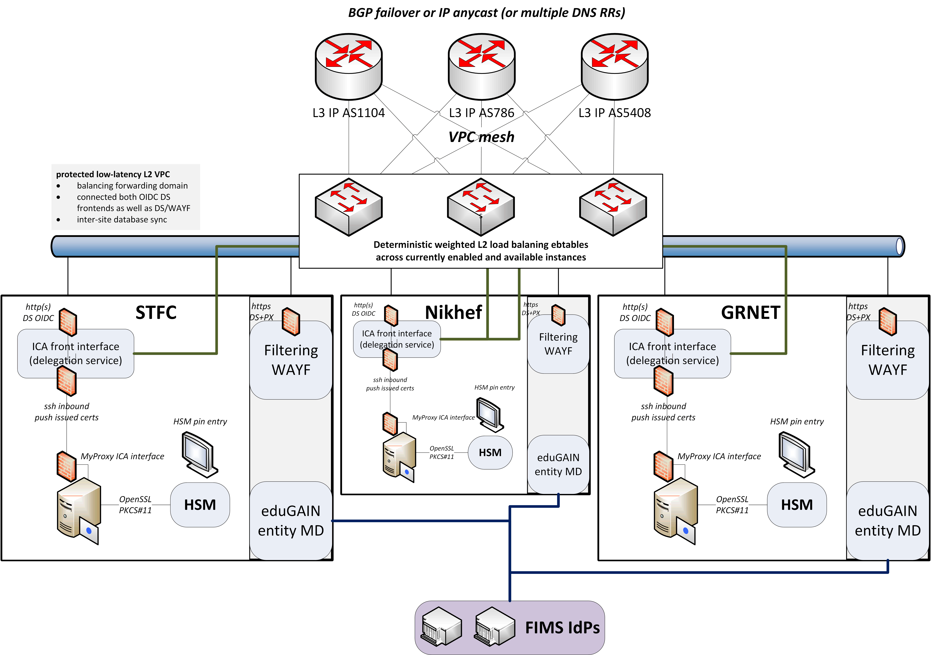
Since we do not like SPOFs …
Implement a High Availability setup
across the 3 sites
using IP anycast
L3 VPN or L2 VPC
with minimal effort
work supported by EOSC Hub and EOSC Future

Slide 32
Distributed RCauth service
HA proxy
DS
DB
VPN
client
VPN server
STFC
GRNET
Nikhef
HA proxy
DS
DB
VPN client
VPN server
HA proxy
DS
DB
VPN client
VPN server
selected imagery: Mischa Sallé, Jens Jensen, Nicolas Liampotis

Slide 33
A transparent multi-site setup
HA proxy
HA proxy
Need a way to send users to “closest” working service
Each HA proxy forward mainly to its own DS
If a HA loses its backend DS, it can still route to the other DS’es
HA proxy
selected imagery: Mischa Sallé, Jens Jensen, Nicolas Liampotis

Slide 34
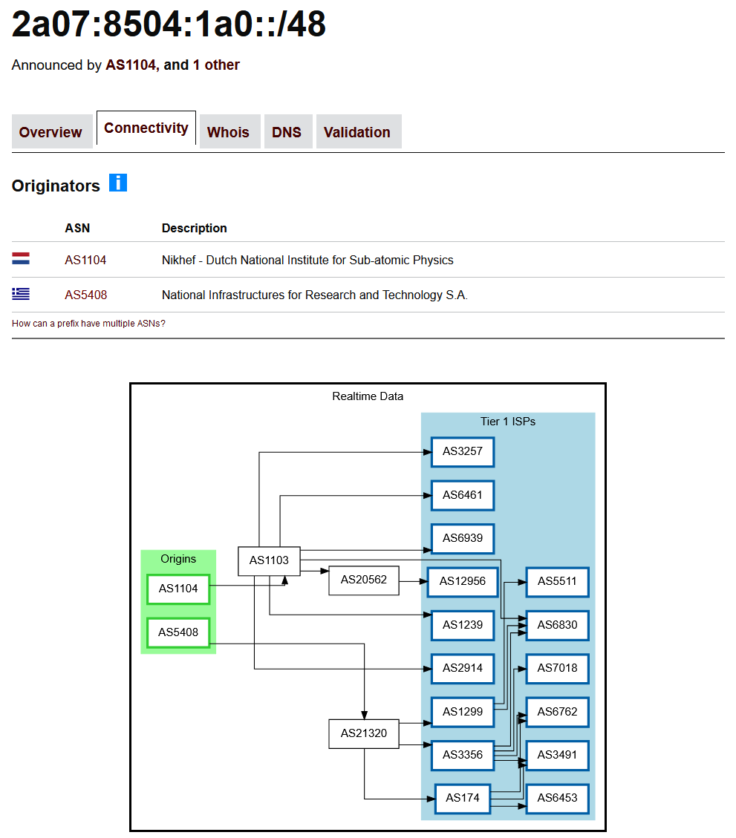
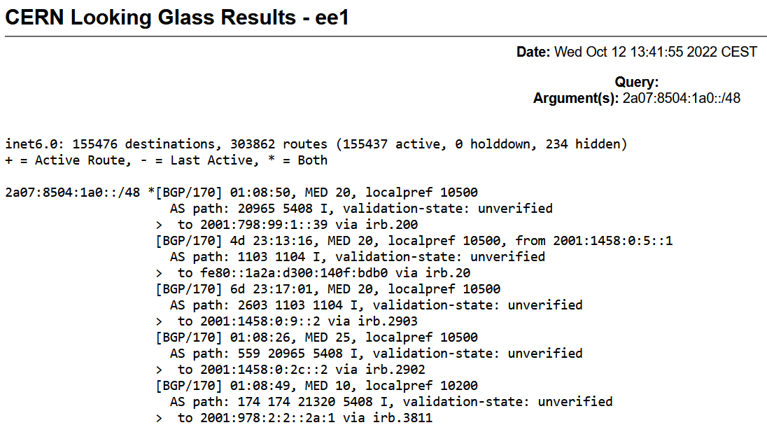

Slide 35
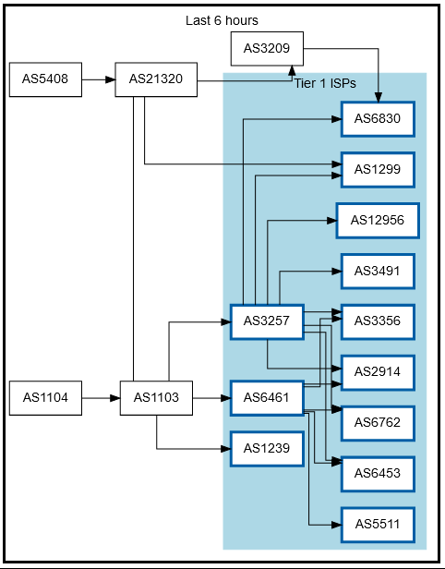
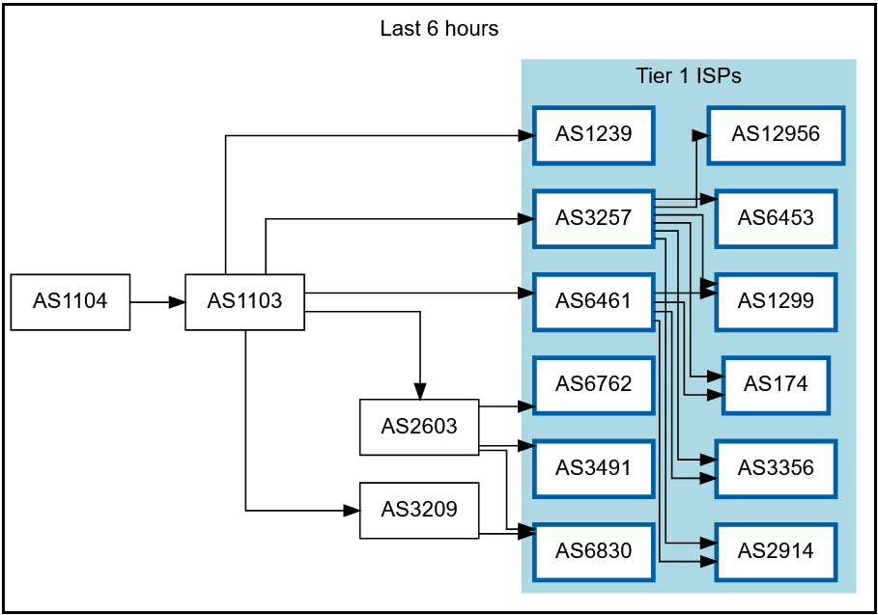
Getting 145.116.216.0/24 out there
route maps: bgp.tools for 145.116.216.0/24 – IPv6 would be similar

Slide 36
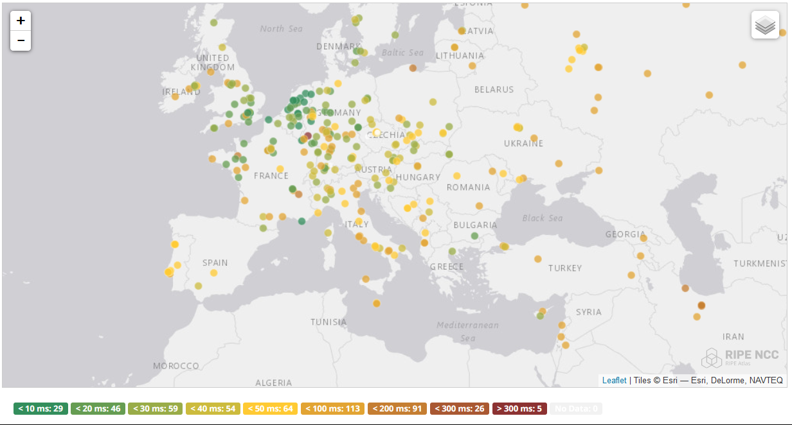
And you get reasonable load balancing
map: RIPE NCC RIPE Atlas- 500 probes, zoomed in on Europe

Slide 37
Current status
All sites can sign production certificates
DS databases cross-site replication using Galera over OpenVPN
HA CRL cross site synchronisation and issuance
WAYF servers (GRNET and Nikhef)

Slide 38
Reusing the RCauth experience!
HA distributed web service with HA database backend
HA database
  3x node peer-peer redundant VPN: automatic failover
  In principle extensible to >3 but what topology?
  Galera cluster well known, MySQL/MariaDB has both advantages and drawbacks
Web service
  3x HAproxy: stability and flexibility
HAHAP | BGP Anycast: ‘bog-standard’ if service admins, cloud admins, and network people can collaborate and investigate incidents together
Credential issuance and moving shared secrets is still cumbersome in practice
The difference between theory and practice is that, in theory, there is no difference

Slide 39

The journey is not over jus ye
While RCauth use today is limited, technology and experience lives on
  anycasted stateful services,
  token translation and assurance alignment
and still used, also for teaching, so it makes sense to keep it around

Slide 40
Re-issuance based on same key, new serial
Data:
Serial Number:
05:77:6b:ba:ff:bf:1e:86:a4:6a:ca:a5:d9:60:8b:98
Signature Algorithm: sha256WithRSAEncryption
Issuer: DC=nl, DC=dutchgrid, O=Certification Authorities,
CN=DCA Root G1 CA
Validity
Not Before: Feb 1 00:00:00 2016 GMT
Not After : Jan 31 23:59:59 2036 GMT
Subject: DC=eu, DC=rcauth, O=Certification Authorities,
CN=Research and Collaboration Authentication Pilot G1 CA
Subject Public Key Info:
Public Key Algorithm: rsaEncryption
Public-Key: (2048 bit)
Modulus:
00:b7:a3:91:cb:e3:2a:19:c5:f7:8f:0f:a0:e2:44:

Slide 41
Plan
Update the certificate in the validator and master portals
distribute in 1.138 release (November 2025)
Keep the service and technology running, and
… re-use expertise for new services!

Slide 42

Still here? Thanks!
This work has also been co-supported by projects that have
received funding from the European Union’s Horizon research and
innovation programmes under Grant Agreement No. 856726 (GN4-3),
101017536 (EOSC Future), 777536 (EOSC-hub), 730941 (AARC2).
RCauth.eu distributed setup
in collaboration with Mischa Sallé and
Tristan Suerink (Nikhef), Nicolas Liampotis and Kyriakos Gkinis (GRNET), and Jens Jensen (STFC RAL)

