Slide 1


IGTF Fabric Updates
David Groep
davidg@nikhef.nl
status of our authorities and trust fabric news
October 2025
part of the work programme of GEANT 5-1 EnCo, and AARC TREE
the work has received co-funding from the European Union
co-supported by Nikhef and the Dutch National e-Infrastructure coordinated by SURF

Slide 2
Meanwhile in Europe …
EUGridPMA and IGTF distribution matters
constituency and developments

Slide 3
EMEA area membership evolution
Europe⁺: GEANT TCS, and CZ, DE, DK(+FI+IS+NO+SE), GR, HR, NL, PL, RO, SI, SK; AM, MD, ME, MK, RS, RU, TR, UA, UK
Middle East: IR, PK
Africa: DZ, KE, MA
CERN, RCauth.eu

Slide 4
Membership and other changes
PKIX Authorities
migration to GEANT TCS continues https://wiki.geant.org/display/TCSNT/TCS+Participants+Sectigo
Transition complete: TR-Grid
Re-issue extended validity ICA for RCauth.eu Pilot ICA G1 proposed for 1.138 release
Self-audit review
Cosmin Nistor tracks the status on the PMA Wiki
real-time interaction between authority and reviewers helps, but …

Slide 5
Distribution signing key update
Propose to discontinue the ‘3rd generation’ 1024-bit signing key in the 1.138 release – around the end of October 2025
Changes from 1.134 to 1.135
---------------------------
(05 May 2025)
NOTE: the _default_ package signing key has changed to the 4th generation
for increased security and compatibility. The new key is a 2048 bit
RSA with fingerprint 565F4528EAD3F53727B5A2E9B055005676341F1A.
The GPG public key file can be retrieved from
https://dl.igtf.net/distribution/current/GPG-KEY-EUGridPMA-RPM-4
and imported on rpm-based distributions with 'rpmkeys --import <file>'
or on Debian (apt) based systems set in Signed-By in sources.list or
added as a file in /etc/apt/trusted.gpg.d/

Slide 6

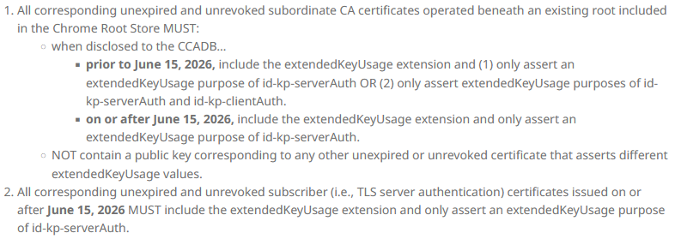
Other things to keep in mind, beyond CABF …
The pubic end to abusing server certs for client auth? Yeah!
https://googlechrome.github.io/chromerootprogram/ section 3.2
and it is to be strictly true from early 2027 onwards:
will this solve part of LE issue?
almost seems triggered by the DCVOTA profile ☺

Slide 7
The challenge of self-signed roots and FF & RedHat’ s idea of what self-signed means …

Slide 8
Rocky9+, AlmaLinux9+, RHEL9+ and
With RHEL9 also deprecating SHA-1, but at the same time
still having self-signed SHA-1 based root certs in the ca-certificates
package, depends on a RedHat/OSSL proprietary set of ‘bonus bits’ appended to the end of the ASN.1 certificate blob.
For the others, there is – for now – a policy override:
update-crypto-policies --set DEFAULT:SHA1
update-crypto-policies --set LEGACY
even if that is a rather course-grained and blunt tool

Slide 9
Reissuance of legacy roots – state and progress
ASGCCA-2007 ArmeSFo
CESNET-CA-Root
DZeScience DigiCertAssuredIDRootCA-Root
DigiCertGridRootCA-Root IHEP-2013
KEK
RomanianGRID
SRCE SiGNET-CA
TRGrid seegrid-ca-2013
Fixed recently: TRGrid, KEK

Slide 10

Building OUR global trust fabric
Questions?
David Groep davidg@nikhef.nl
https://www.nikhef.nl/~davidg/presentations/
https://orcid.org/0000-0003-1026-6606

