Slide 1

65th EUGridPMA, AARC, IGTF, and GN5 EnCo Karlsruhe meeting
October 2025
David Groep

Slide 2
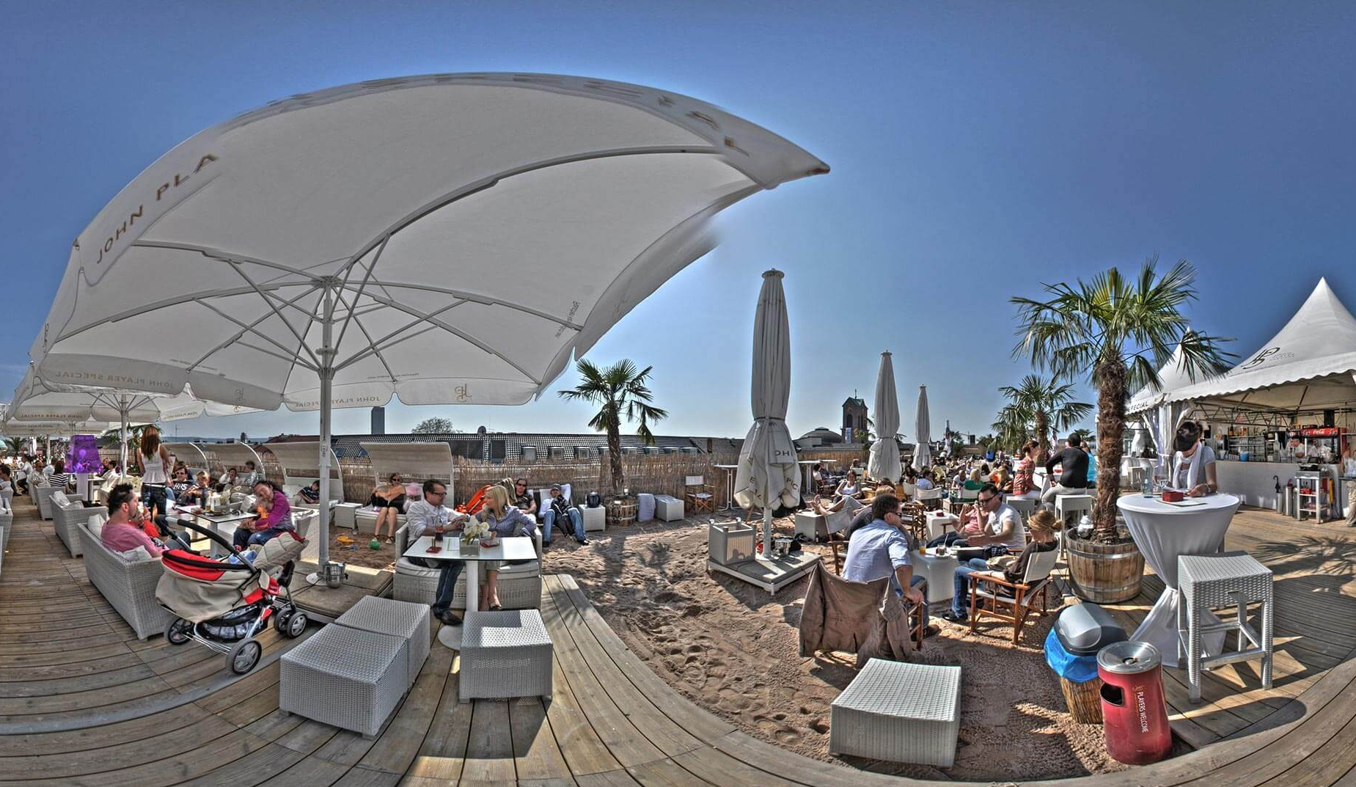
Great to be here …. in-person – or remote!
Thanks to Marcus Hardt and KIT

Slide 3
Part of a series
Today (Wednesday) morning: membership, self-assessments, PKIX fabric issues
Agenda building
State of the IGTF Trust Fabric
GEANT TCS updates
ELM, DCVOTA and updates from our global peers
Thursday: A Global View, Trust, trust mechanisms, wallets
Security Baseline (AARC G084)
Wallets, Verifiable credentials, and eID assurance (AARC I085)
Friday (until ~ 15.00)
OIDFed and R&E
GEANT Trust and Identity – enabling communities
and although some of you are remote … let it not be a series of presentations, but raise your (virtual) hand, engage, comment, engage in violent agreement, add or shorten, &c!

Slide 4
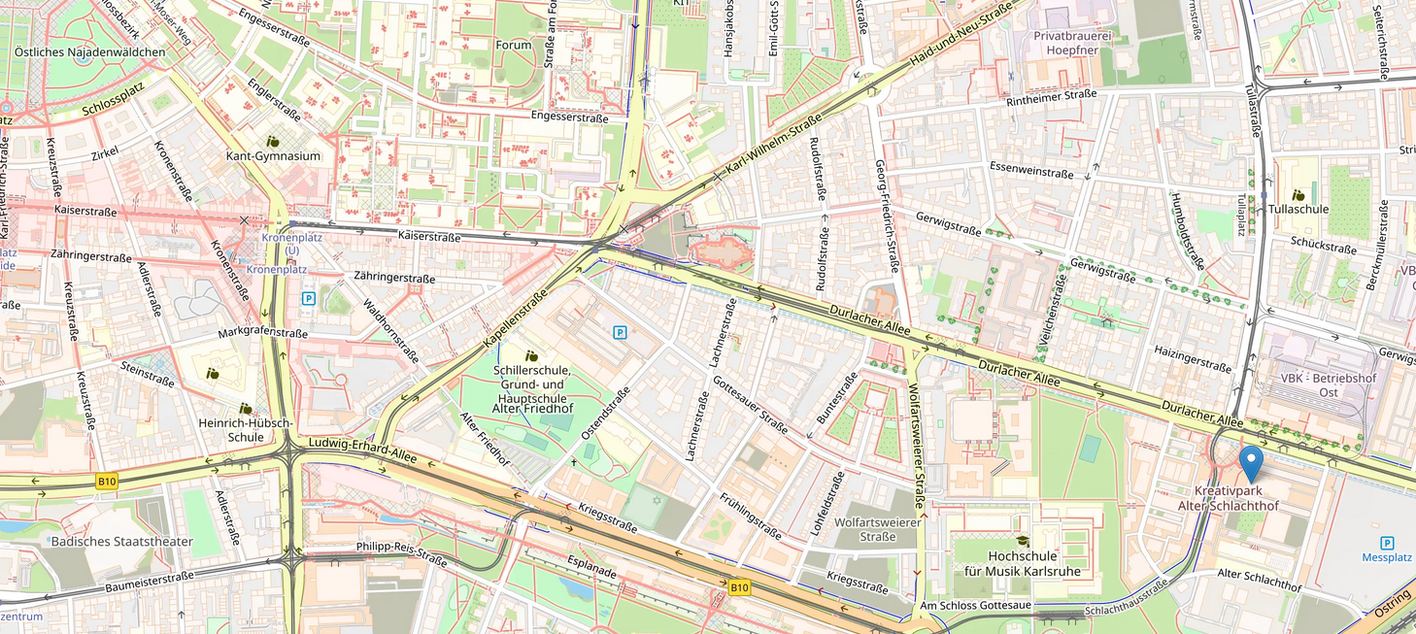
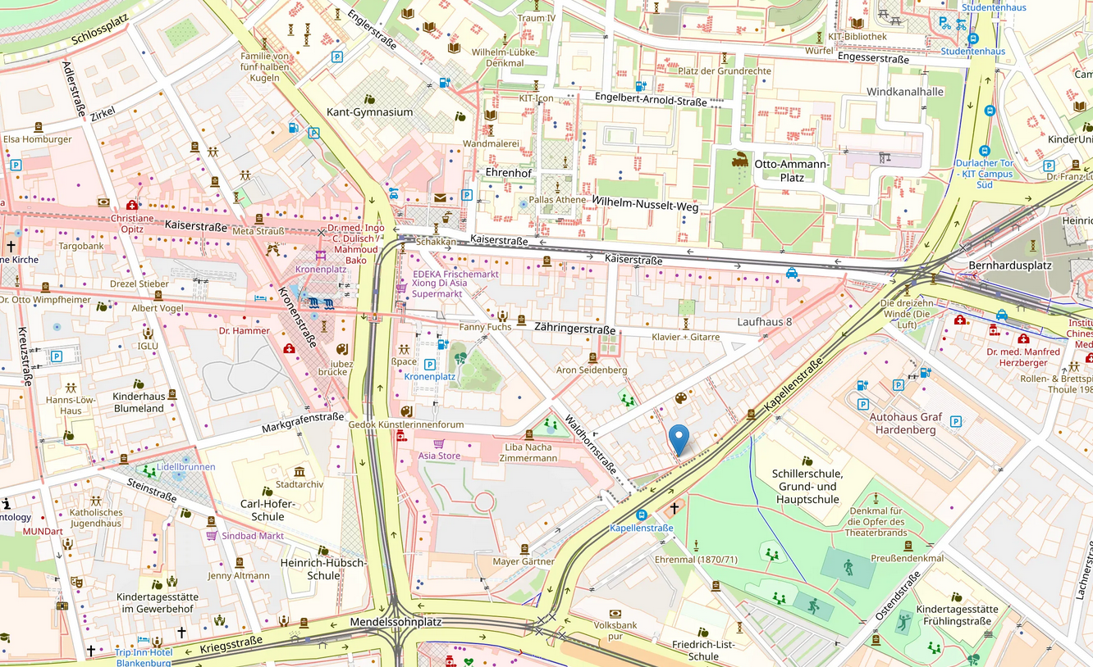
Essential Logistics – https://eugridpma.org/l/65
Wednesday Oct 1st 19:30
Carls Wirsthaus in the east, former slaughterhouse area https://osm.org/go/0DPvrLn0t?m=
Thursday Oct 2nd 19:00
Der Vogelbräu center East, successful local micro brew https://osm.org/go/0DPvj4rdc?m=

Slide 5
Logistics
Upload presentations to the agenda page https://eugridpma.org/agenda/65
you should have a login, or invite email
For the benefit of those on-line-only, also connect to zoom (without audio please!), and share your screen when presenting/editing https://eugridpma.org/z/65

Slide 6
Building a global trust fabric
Questions?

