Slide 1
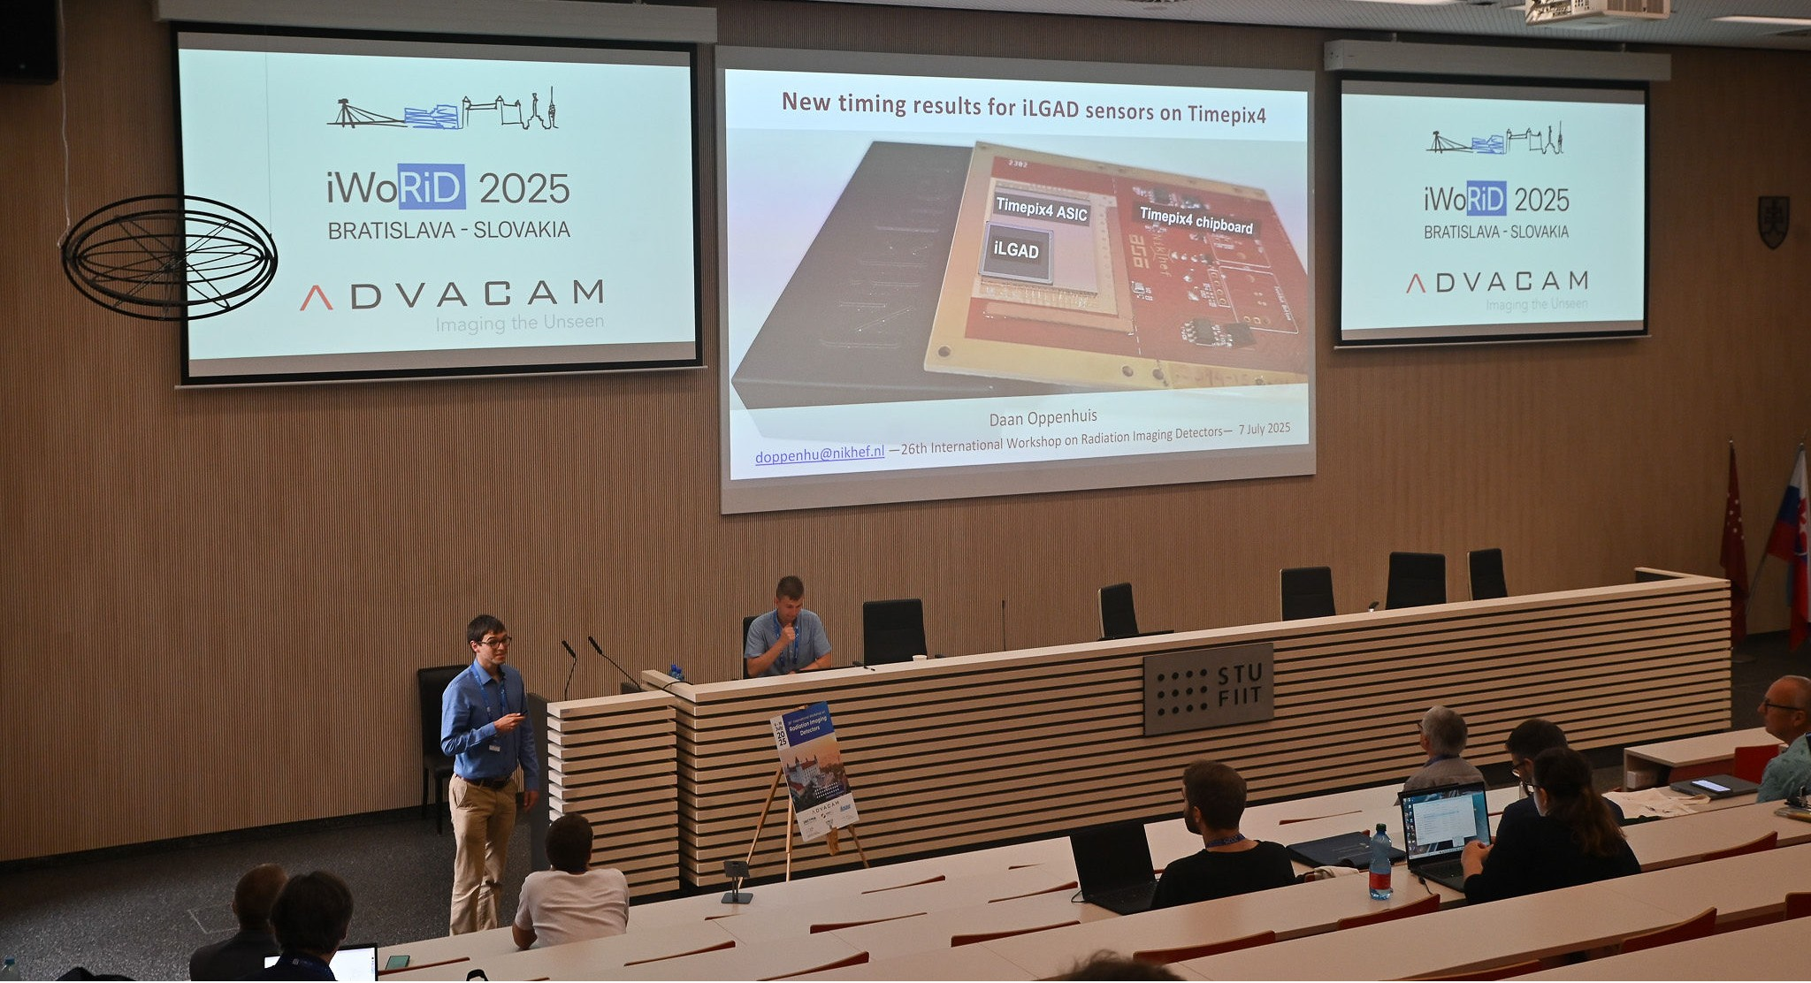
Overview of current research activities
Daan Oppenhuis
doppenhu@nikhef.nl —FASTER meeting Nijmegen— 24 October 2025

Slide 2
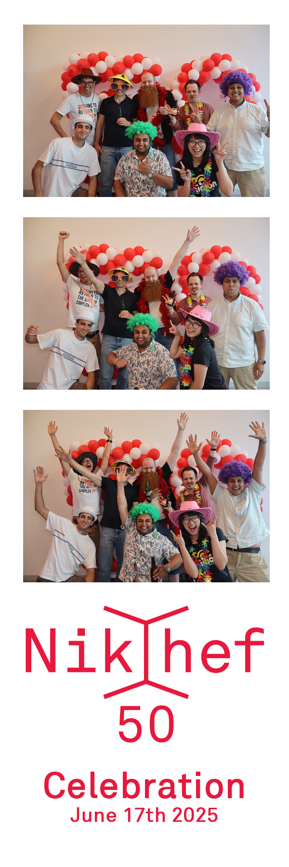
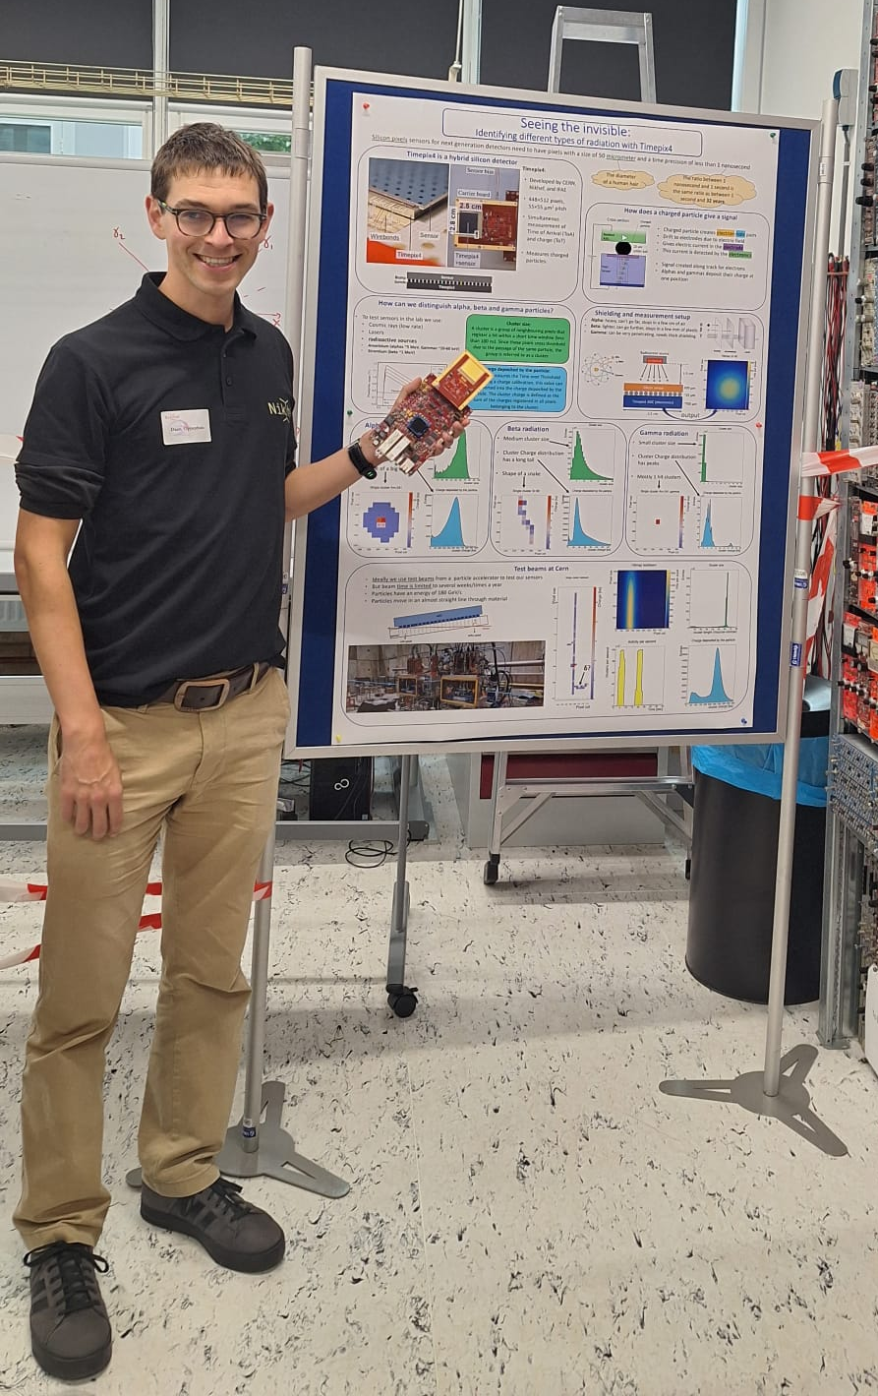
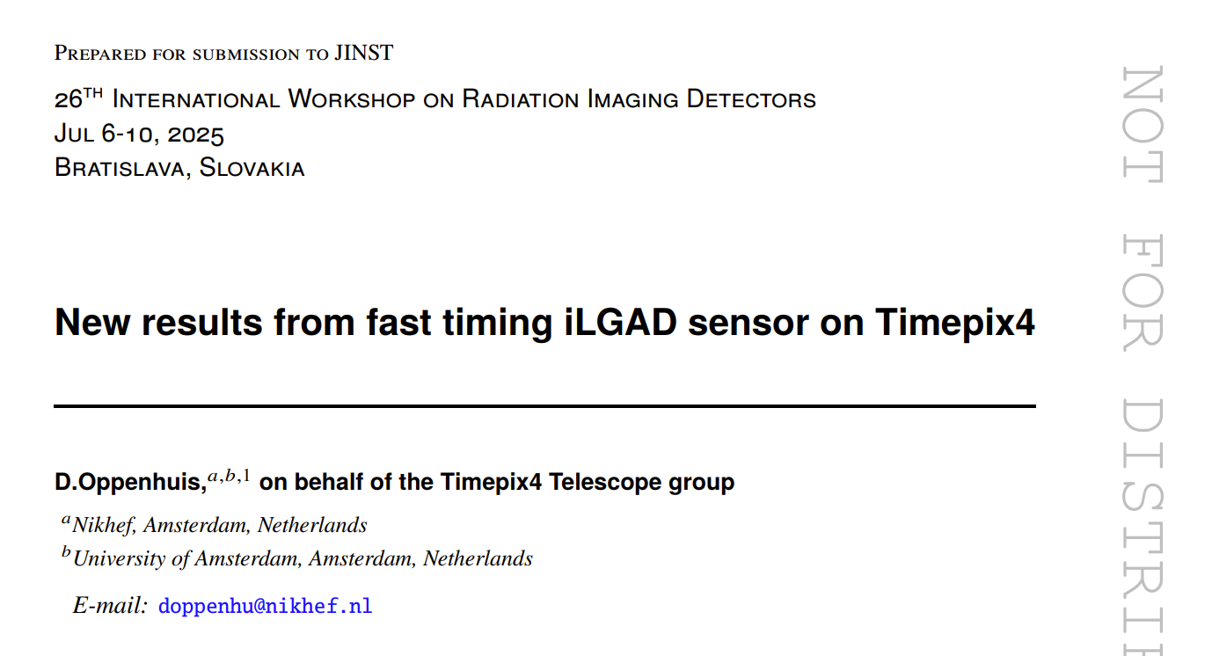
My work in the last months
Present at the Nikhef 50 year celebration
Presentation at IWORID
Wrote a proceeding (still under review)
Poster and demonstration at the Nikhef open day
https://doi.org/10.48550/arXiv.2509.09308

Slide 3
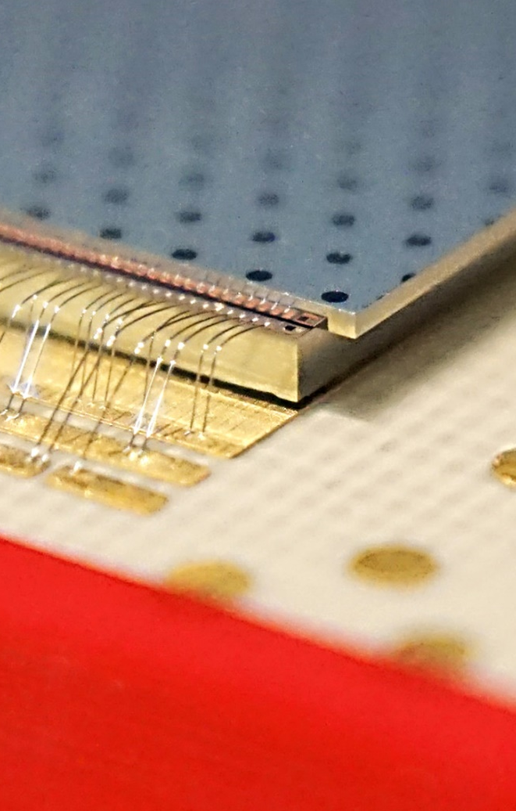
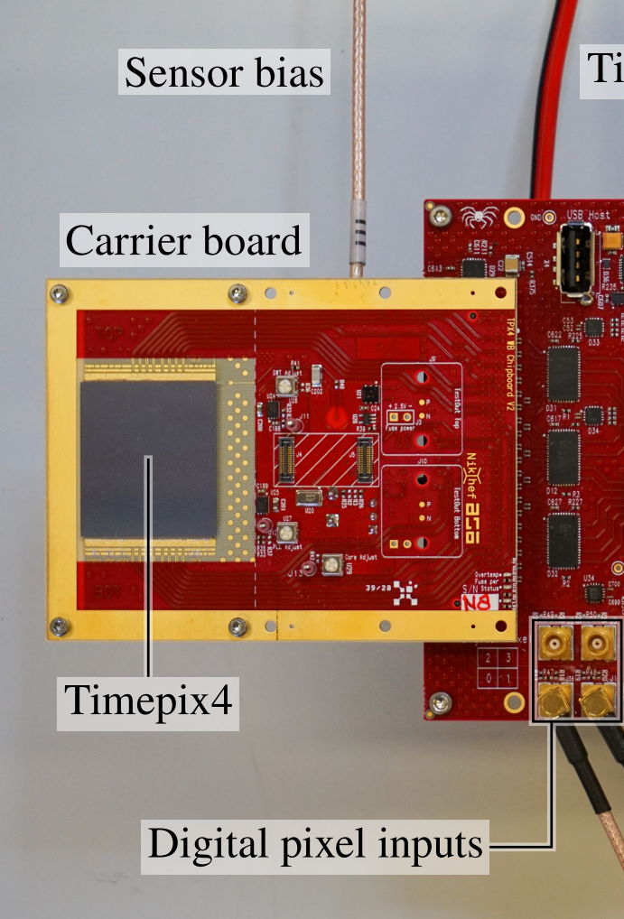
Timepix4: Hybrid pixel detector readout ASIC
Timepix4:
Developed by CERN, Nikhef, and IFAE
448×512 pixels, 55×55 µm² pitch
Simultaneous measurement of Time of Arrival (ToA) and charge
Time-bin size of 25 ns/128 = 195 ps
2.5 cm
2.8 cm
Sensor
Wirebonds
Timepix4
Timepix4+sensor
Sensor
Bump
bonds
Timepix4

Slide 4
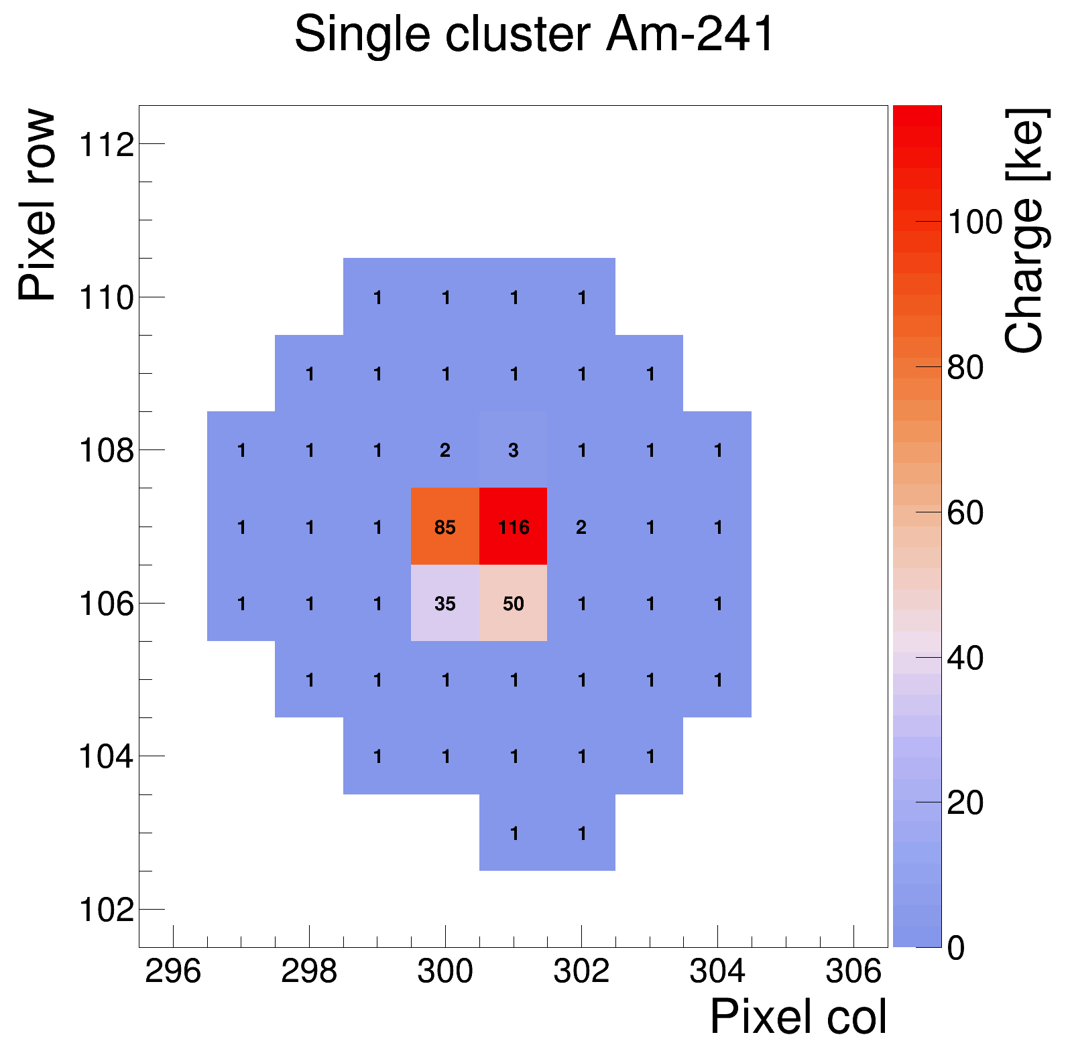
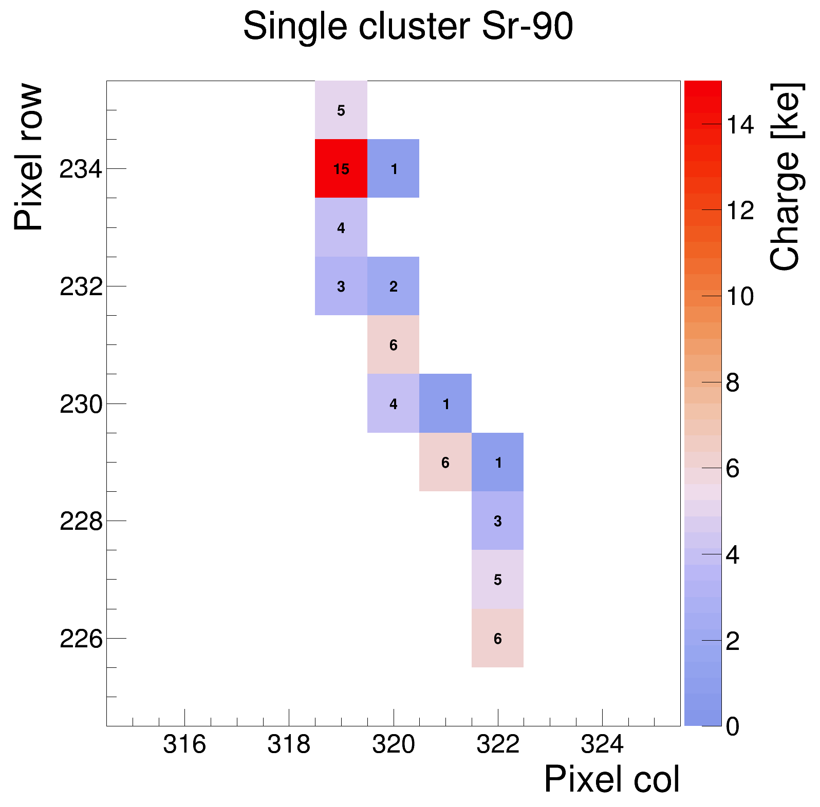
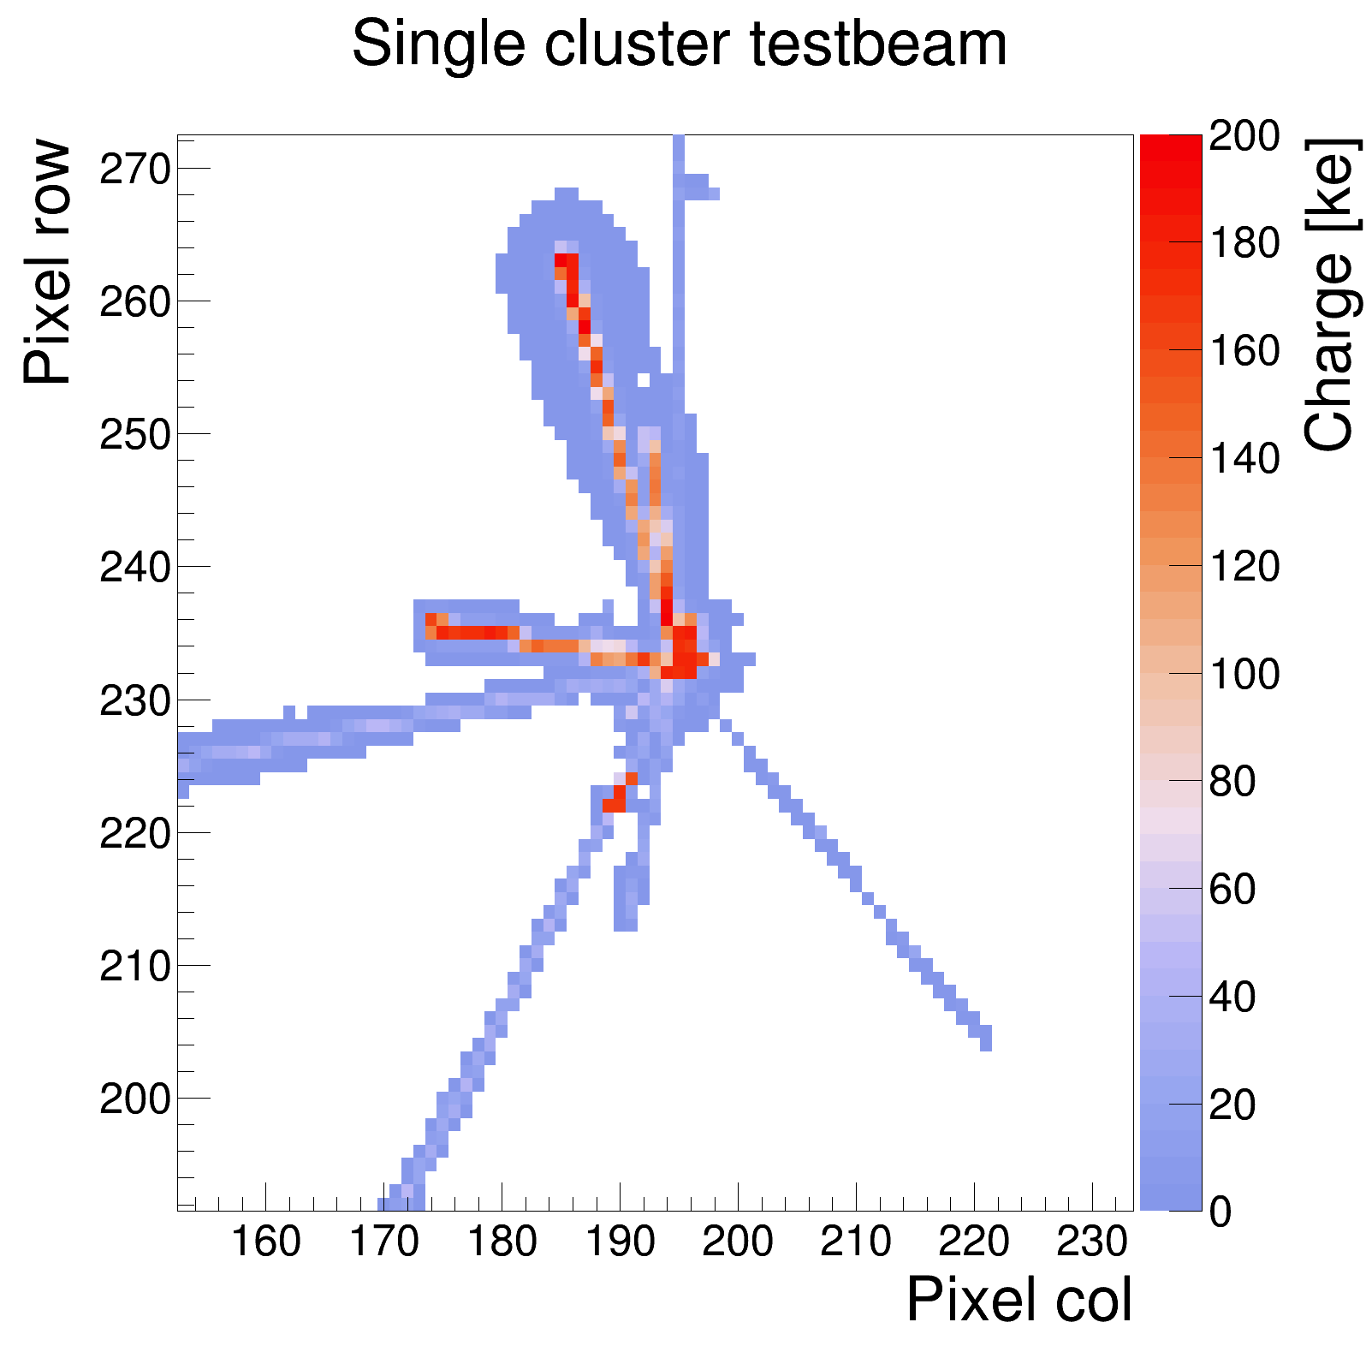
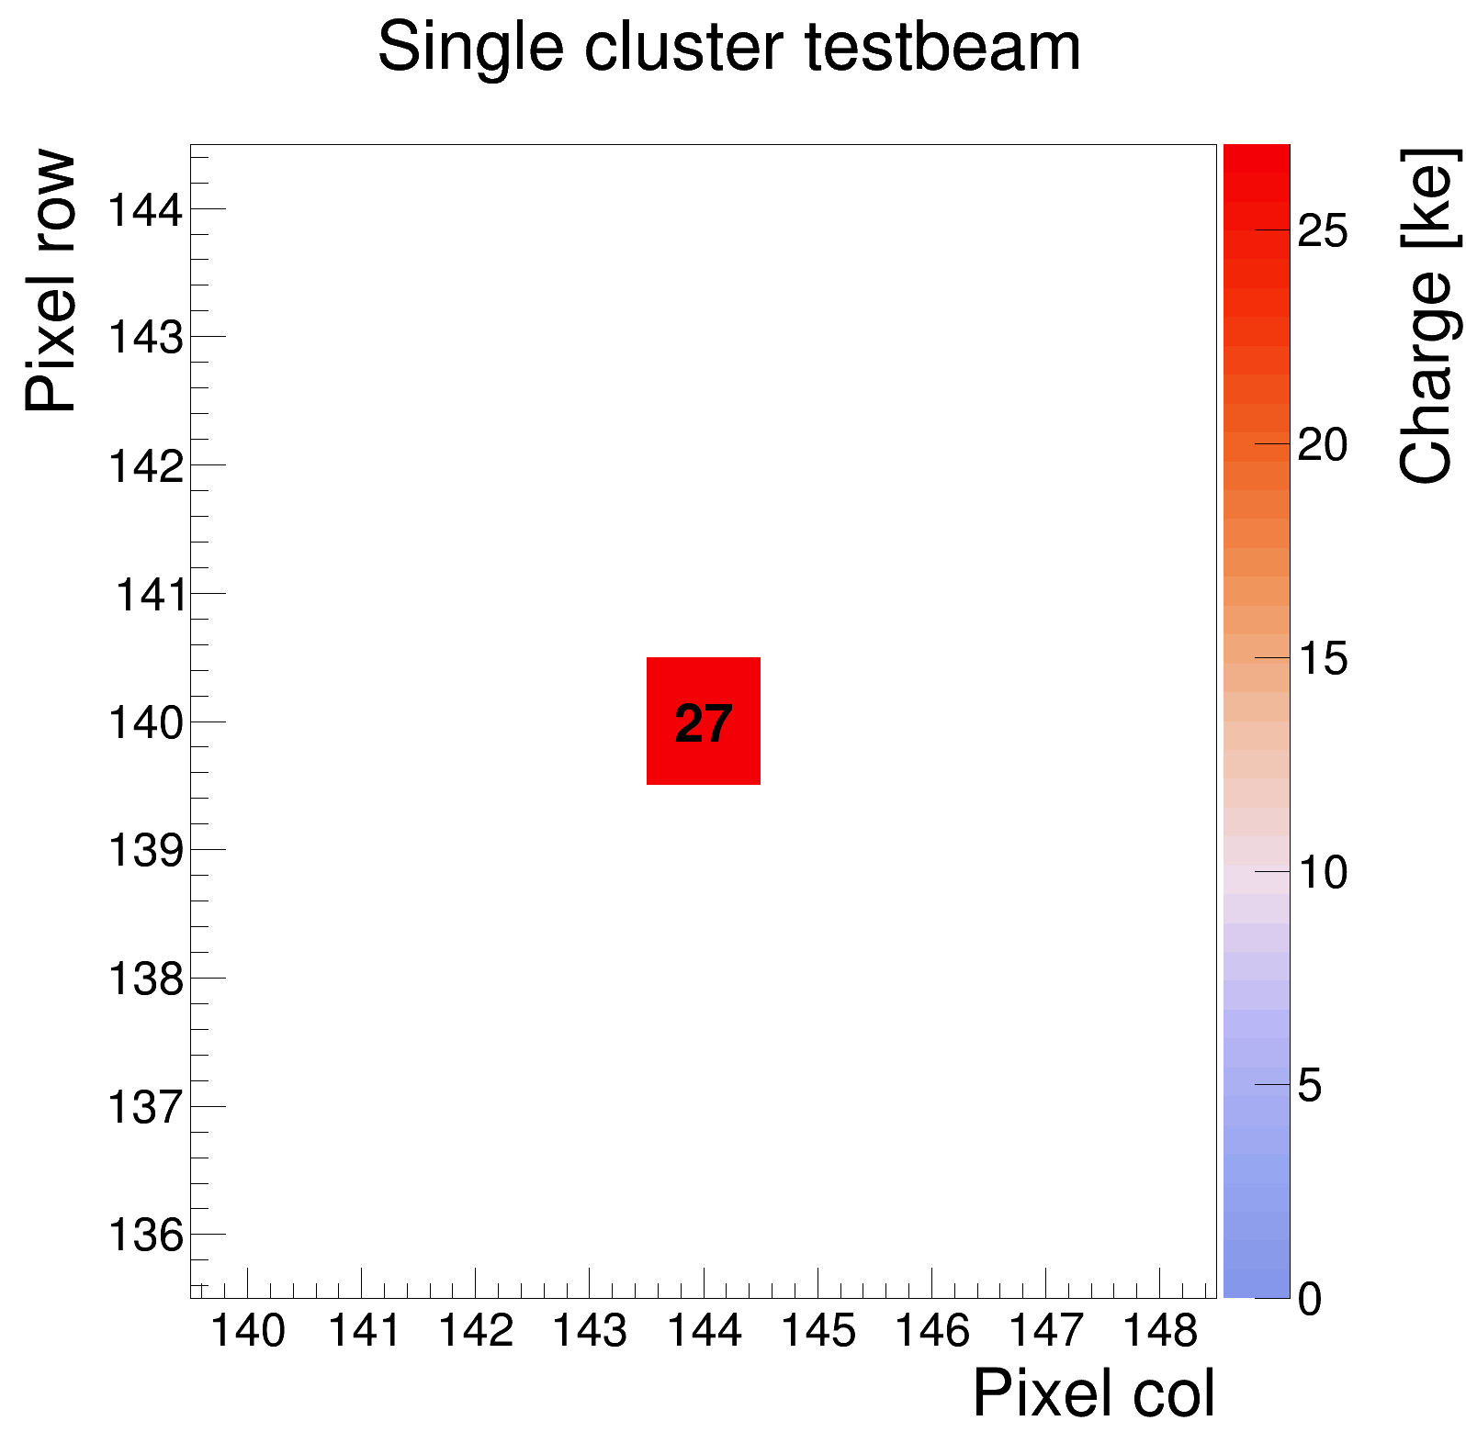
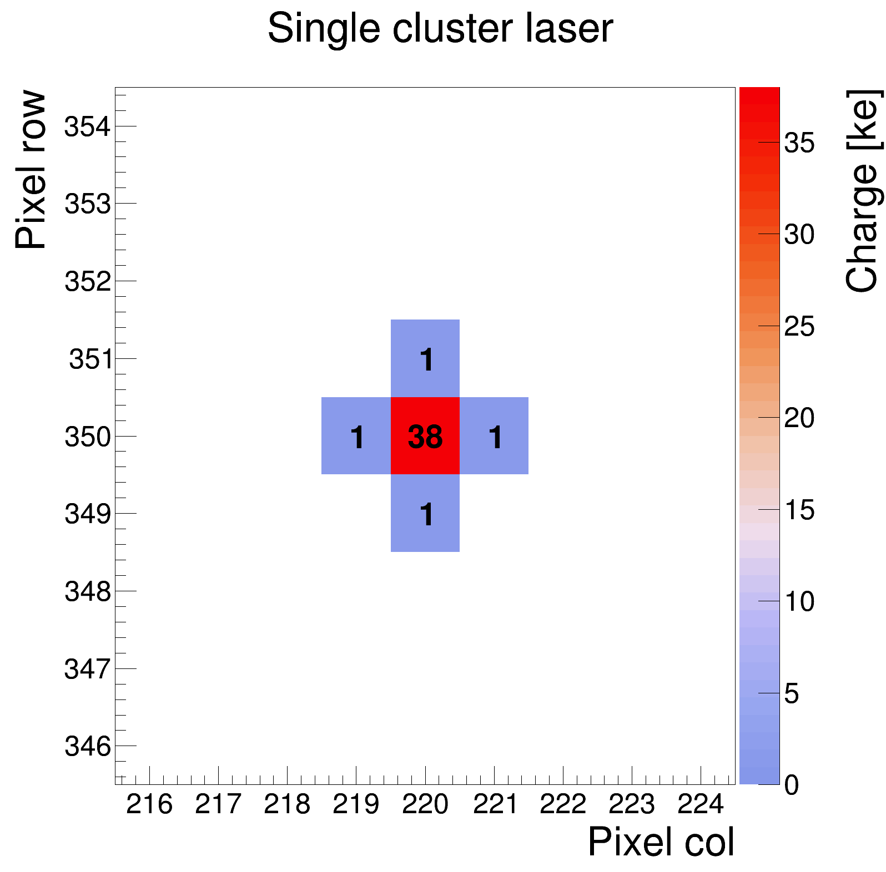
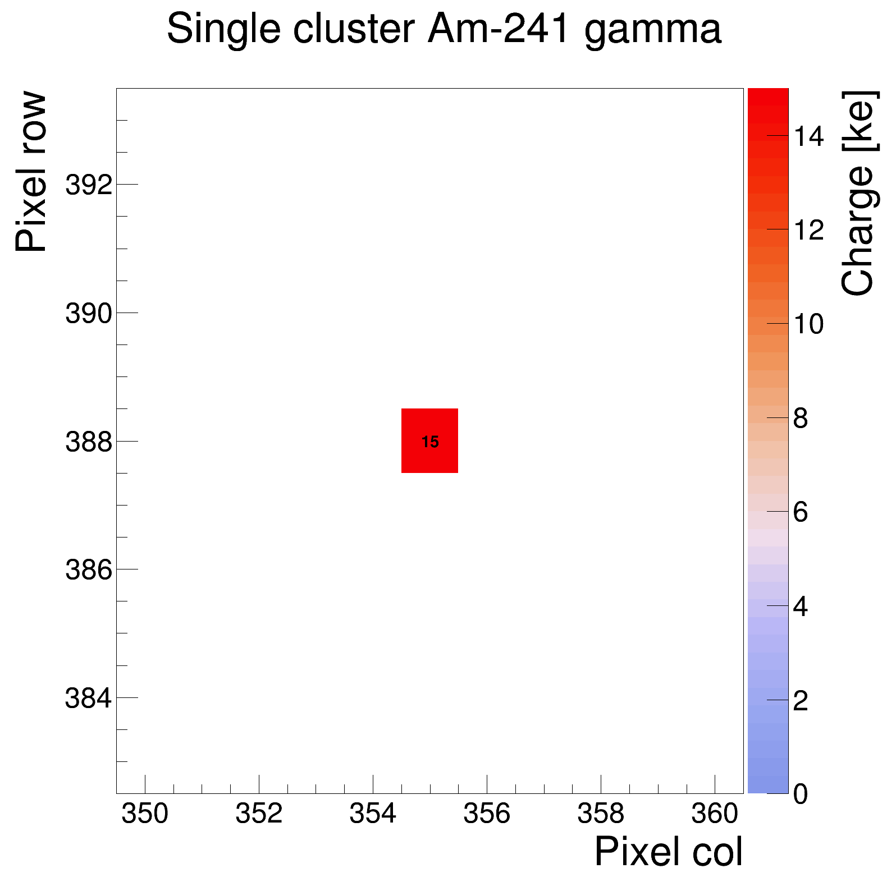
How can we test Timepix4 with sensors?
With radioactive sources (alpha, beta and gamma)
With Lasers (Wavelengths from 700 nm to 1550 nm)
With test beams at CERN
Test beam 180 Gev/c pions (mostly)
Nuclear interaction
Radioactive source
Laser

Slide 5
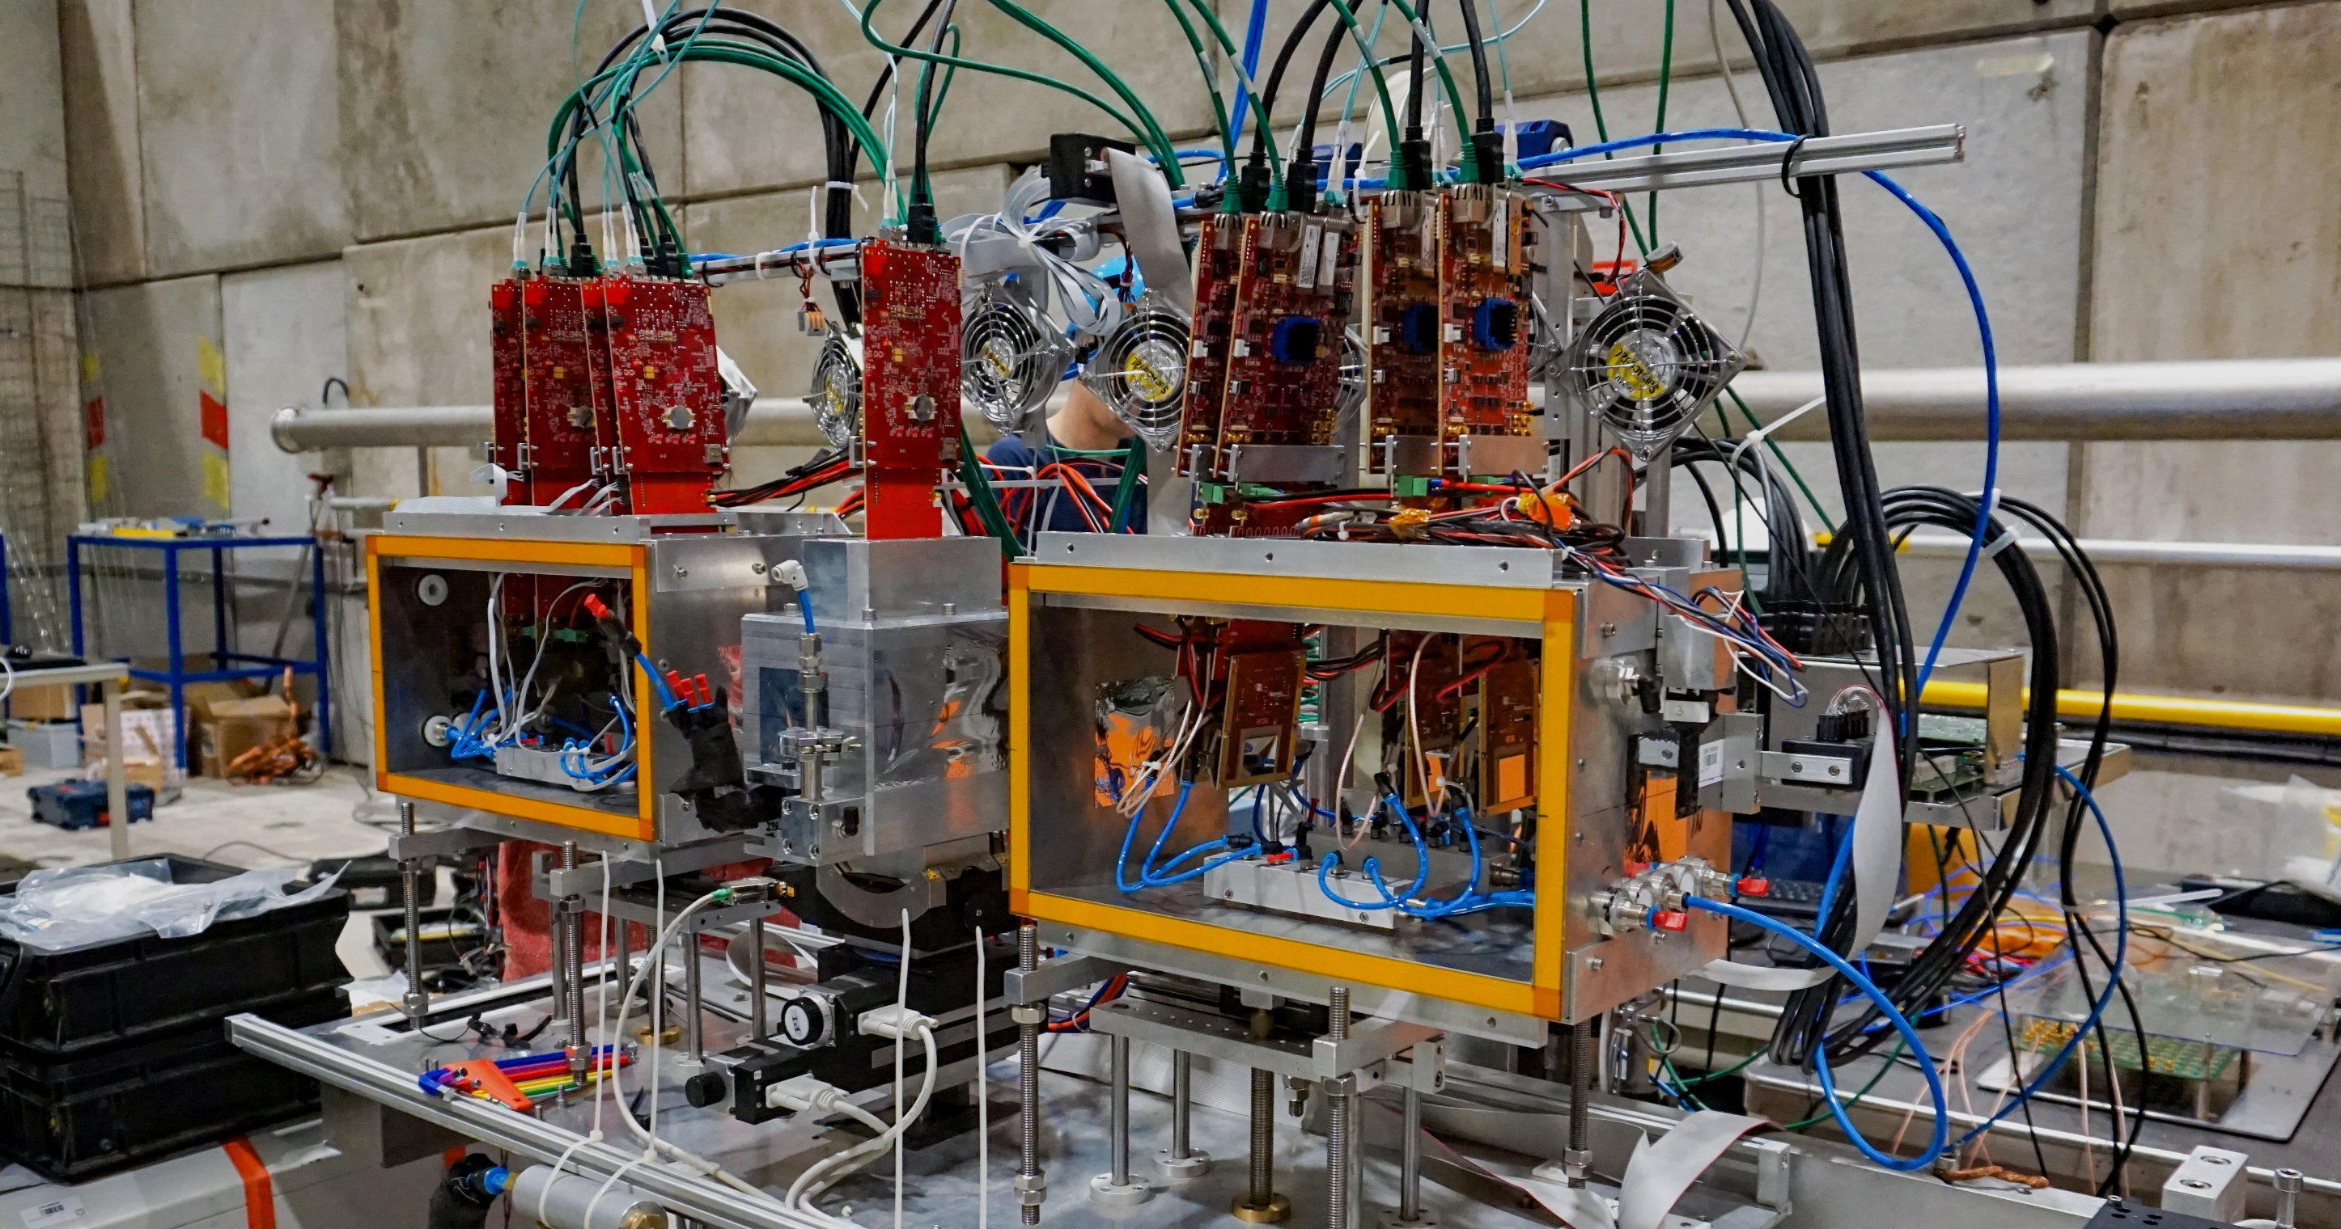
Timepix4 Telescope
Device under test (DUT)
Two MCPs downstream (in 2024) provide precise time references to study timing performance of telescope
Combined MCP resolution: 12 ps
4 Tracking planes
4 Tracking planes
Hadron beam 180 GeV/c
https://doi.org/10.48550/arXiv.2503.15207
The Timepix4 Beam Telescope

Slide 6
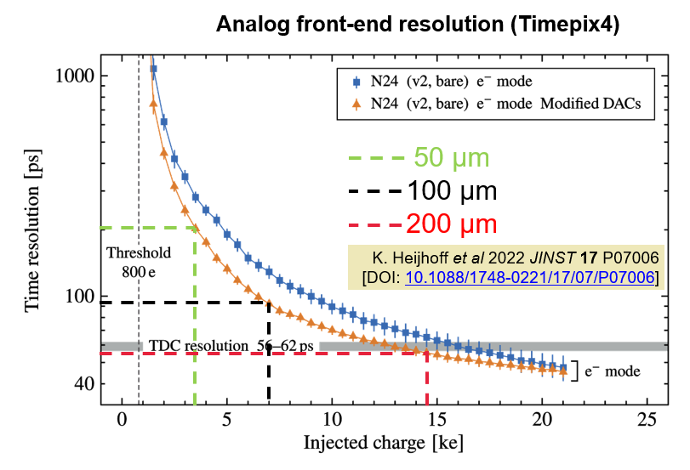
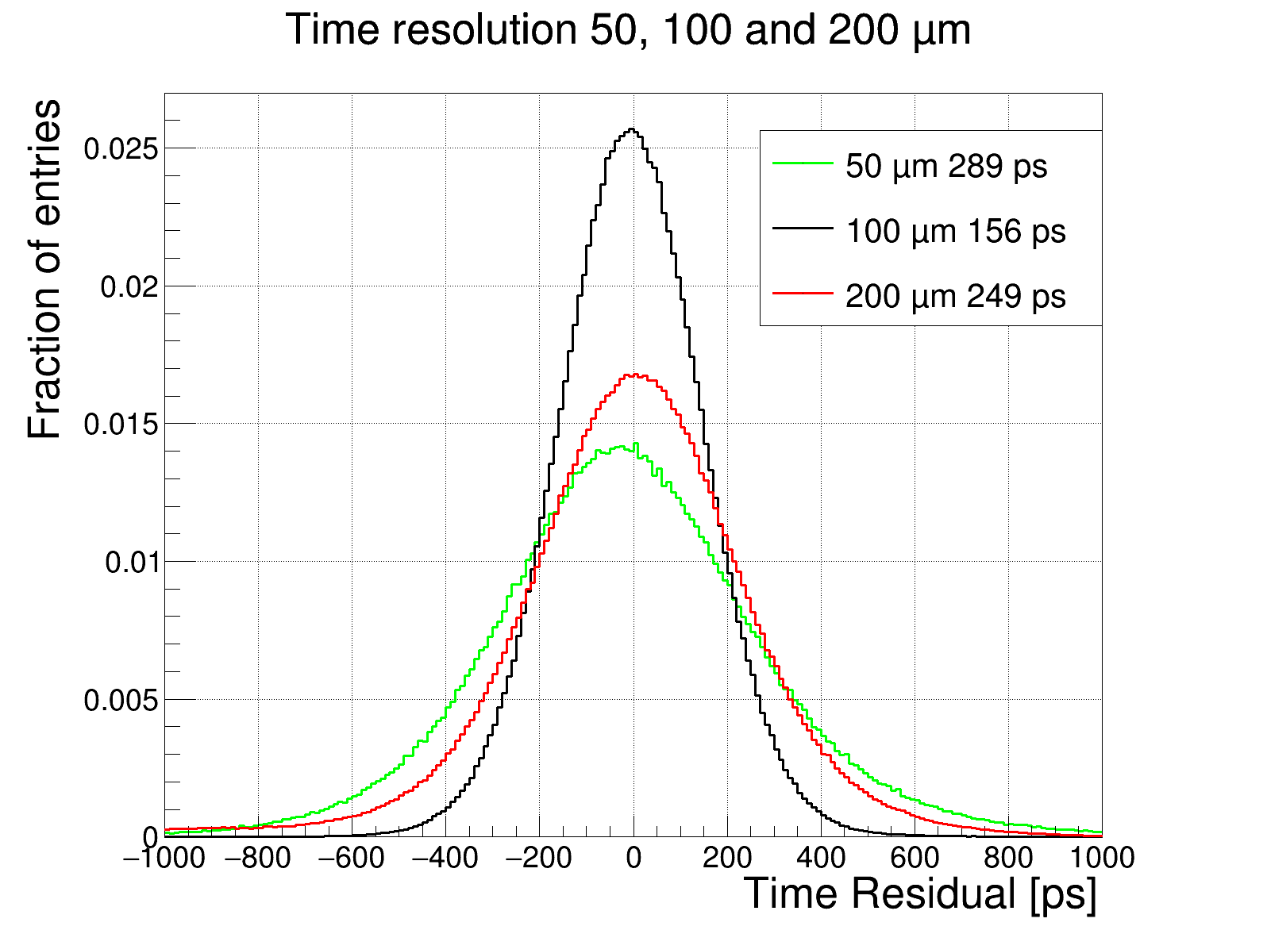
Planar sensors in testbeam
Thin sensors improve time errors due to Landau fluctuations
Reduced signal size worsens analog front end resolution
Optimum for planar sensors around 100 µm
So a thin sensor with gain would be optimal→LGADs

Slide 7
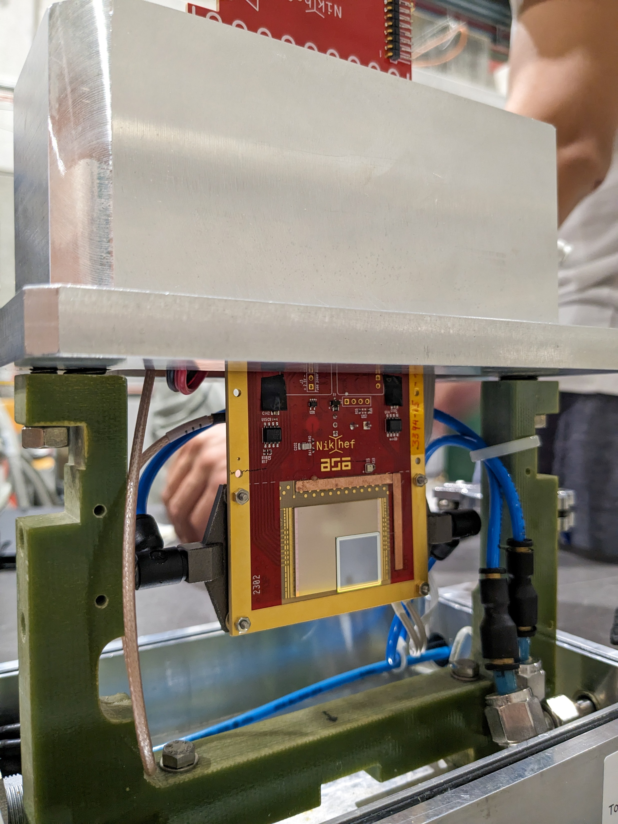
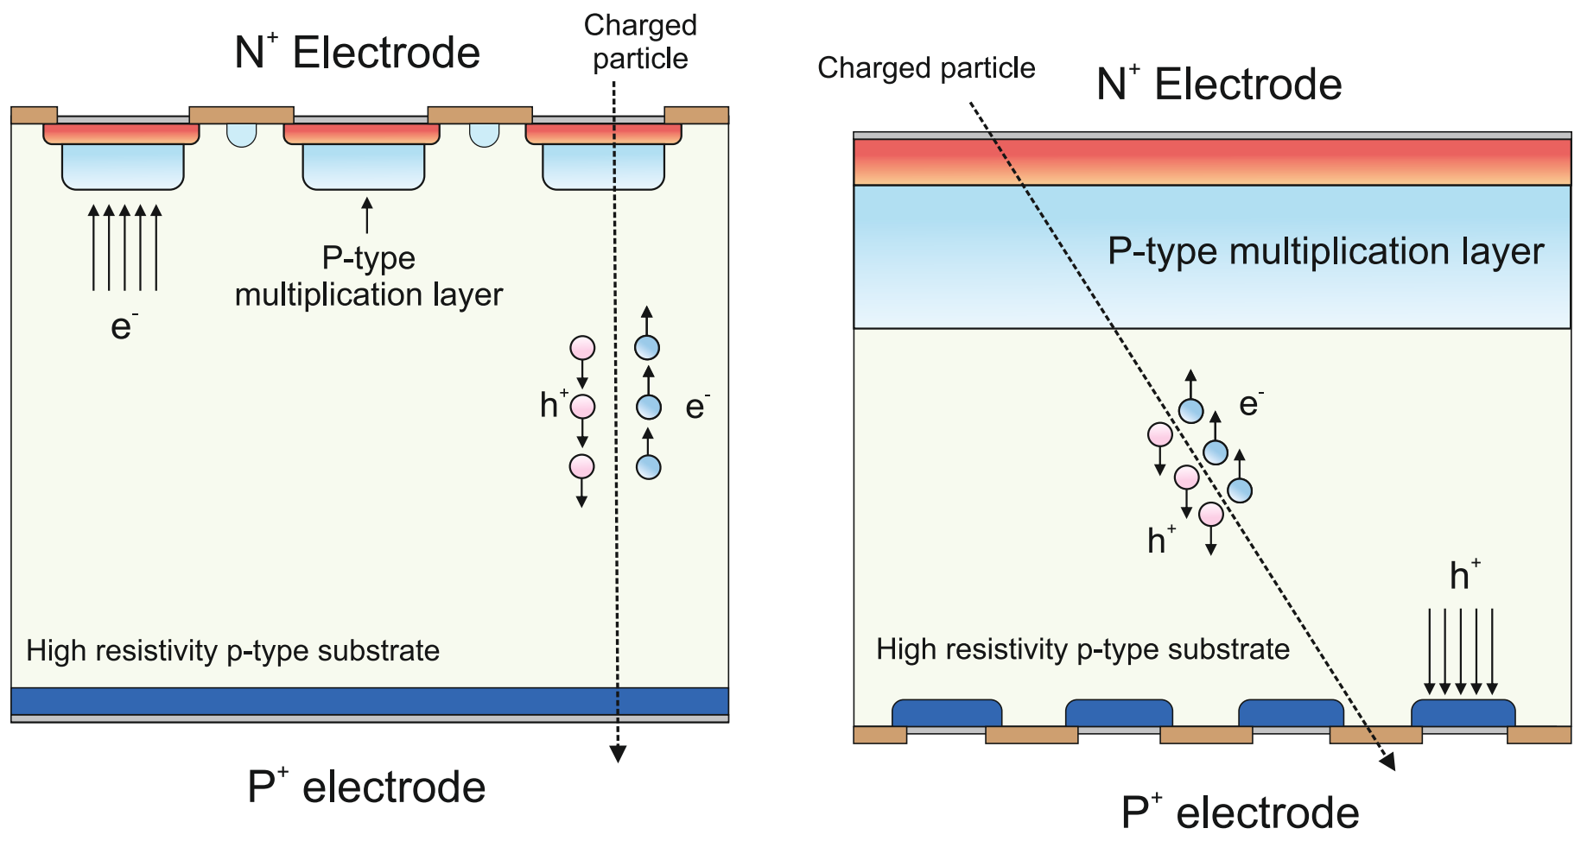
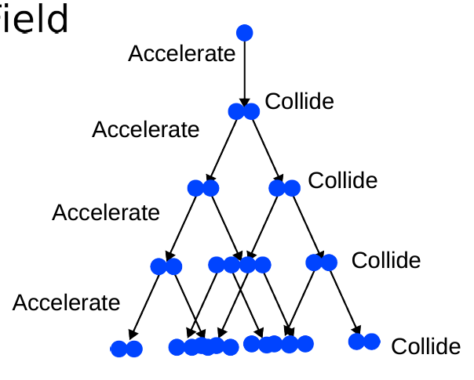
Inverted LGAD on Timepix4
Low-gain avalanche diodes (LGADs) use charge multiplication to deliver larger input signals
Small pixel size cannot be achieved in standard LGAD technology (without losing efficiency)
Inverted LGADs (iLGADs) solve this by placing the gain layer on the backside
Sensors produced by Micron and provided by Glasgow University
Standard LGAD
100 µm
Inverted LGAD
n⁺
1.3 mm
55 µm
250 µm
h⁺
Space between pixels needs to be large which degrades the fill factor
p bulk
e⁻
Amplification region
Not to scale
p bulk
p-type multiplication layer
p⁺
n⁺
E-Field
A. Doblas et al Sensors 2023, 23, 3450 [DOI: 10.3390/s23073450]

Slide 8
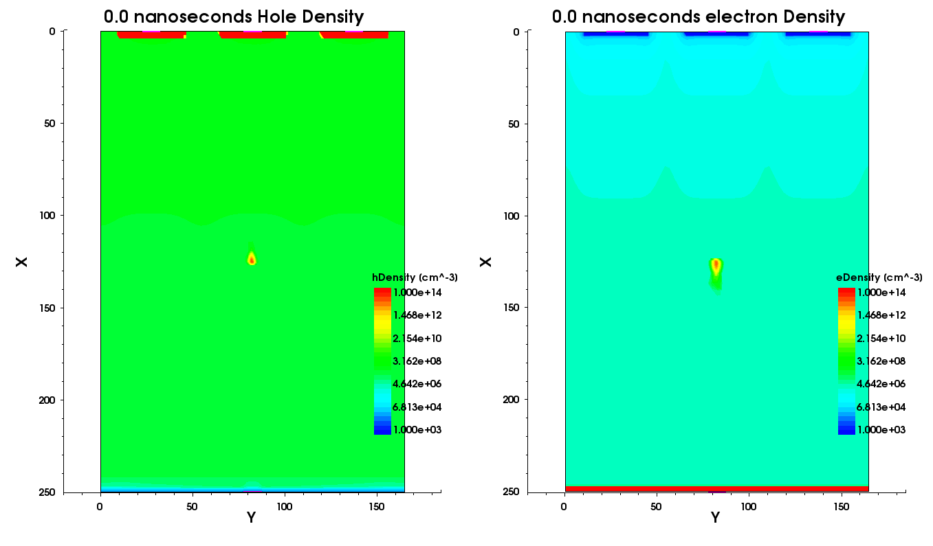
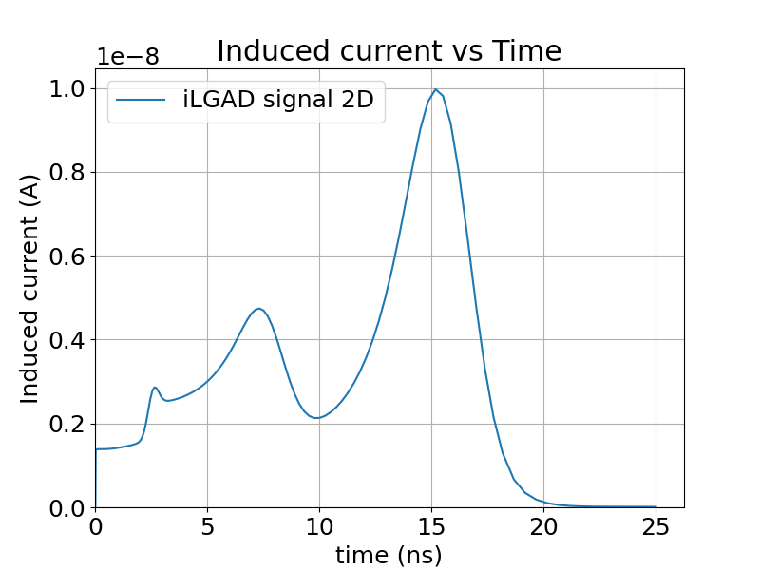
Simulation of signals from an iLGAD
Induced current has two peaks
From initial holes and secondary holes

Slide 9
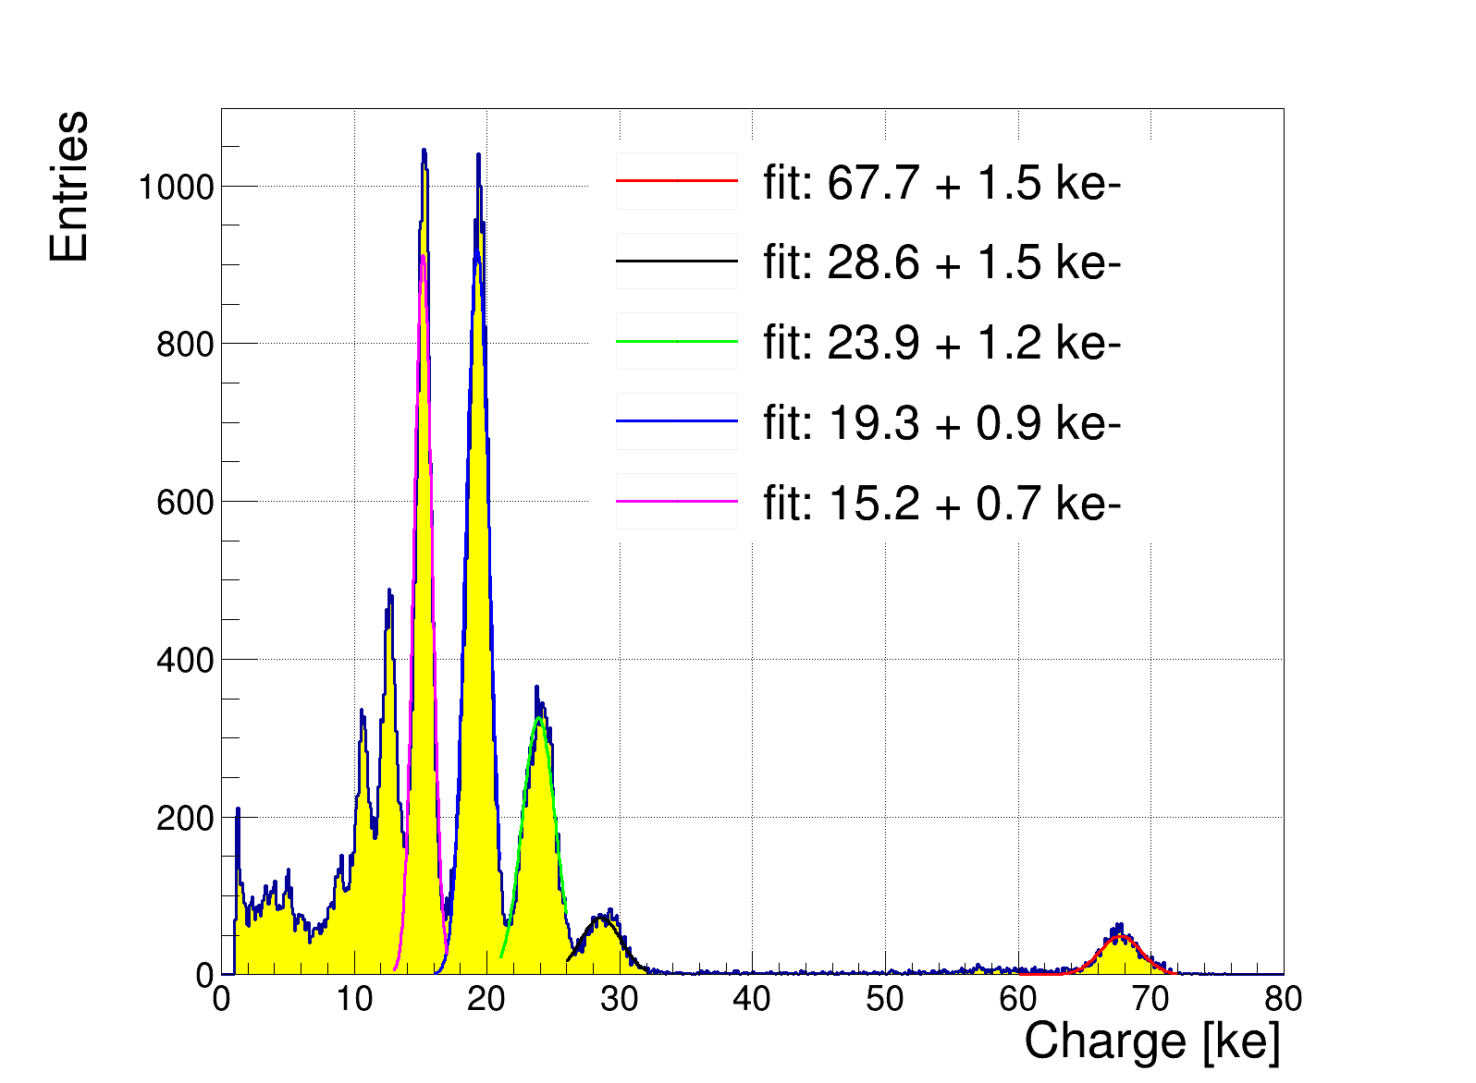
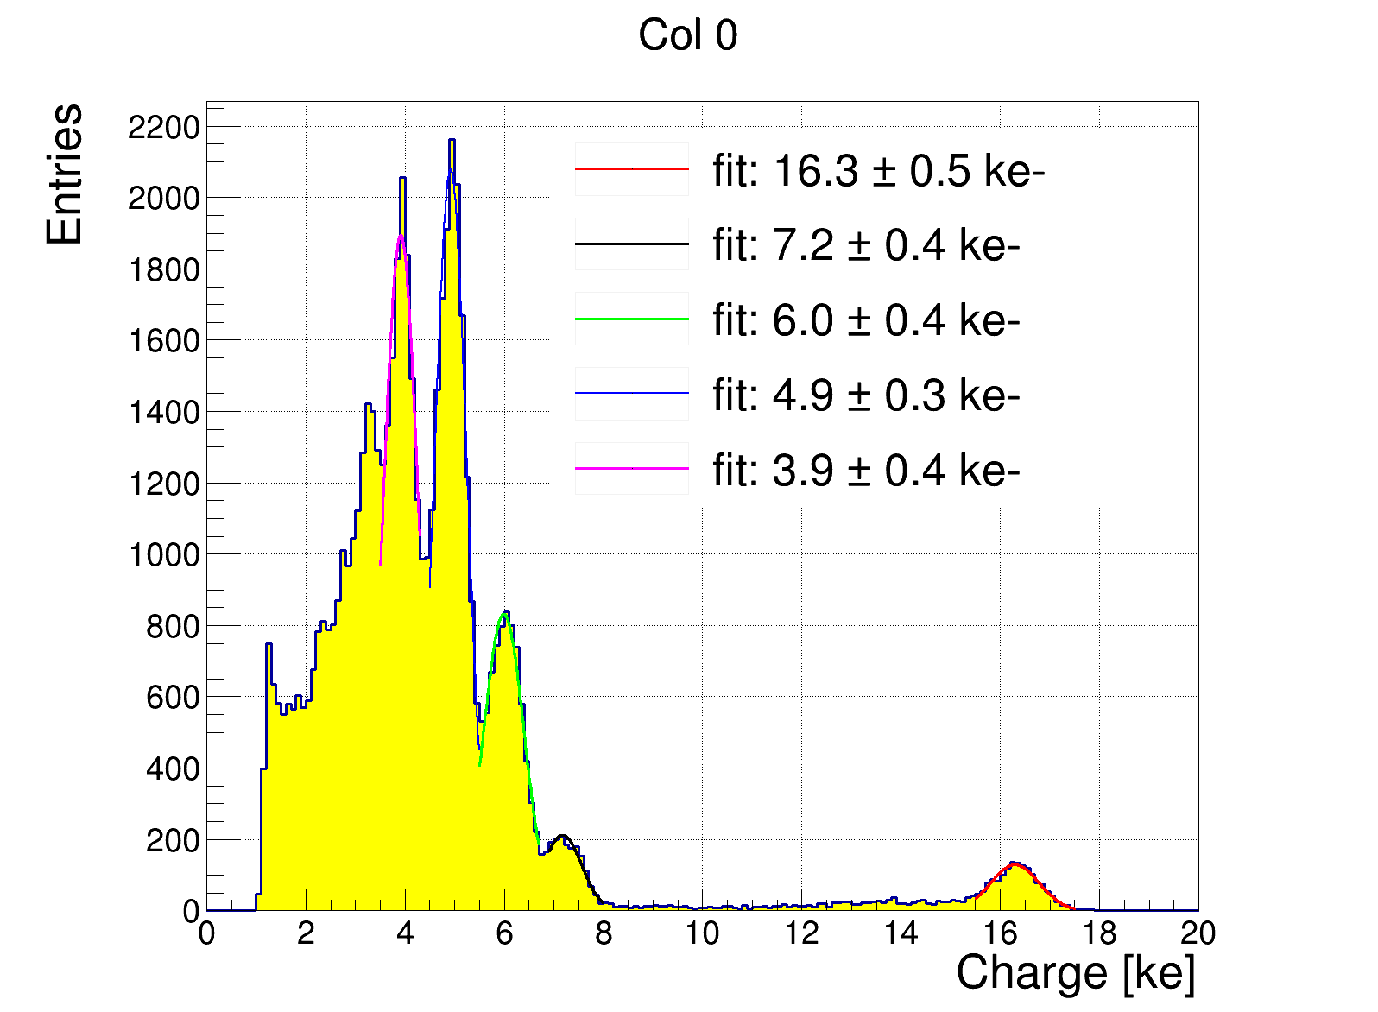
Sensor layout
Gain determination in the lab
Radioactive source measurement in lab
Known energy deposit of the 6 x-ray peaks
No gain border comparison with gain region
Gain is 4.1 ± 0.1
Gain lower than optimal
Gain region
4 px
248 px
No gain border
No gain region
Gain region

Slide 10
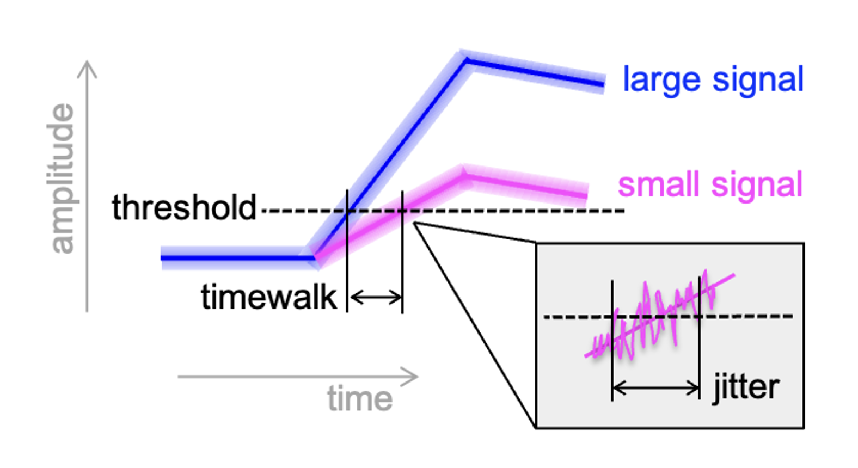
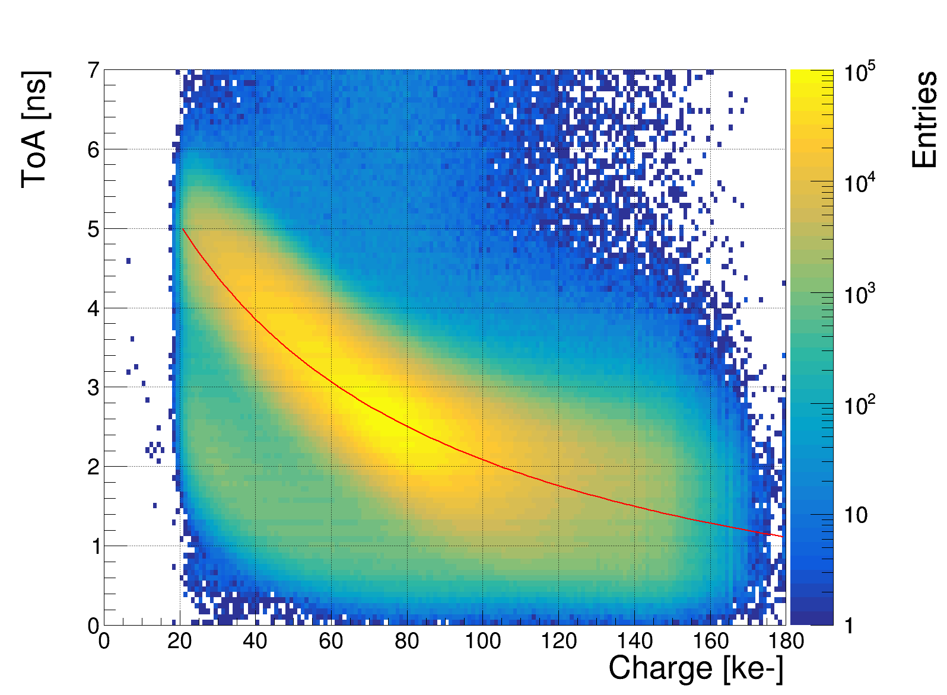
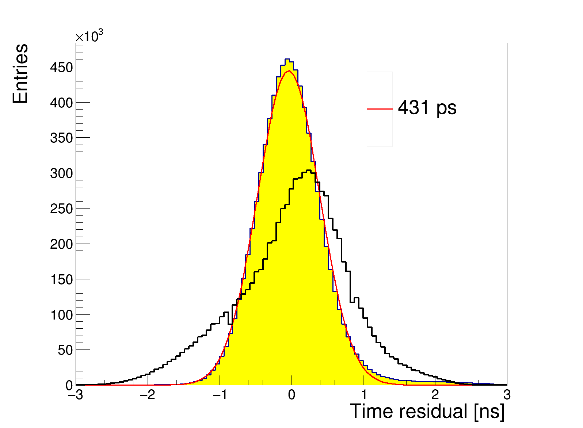
ToA
Time resolution after global correction
Large signals cross threshold earlier than smaller ones
Global timewalk correction improves resolution from: 759 ps to 431 ps
Timewalk curve is broad at 250V
under the assumption that the charge calibration and the ToT measurement are linear

Slide 11
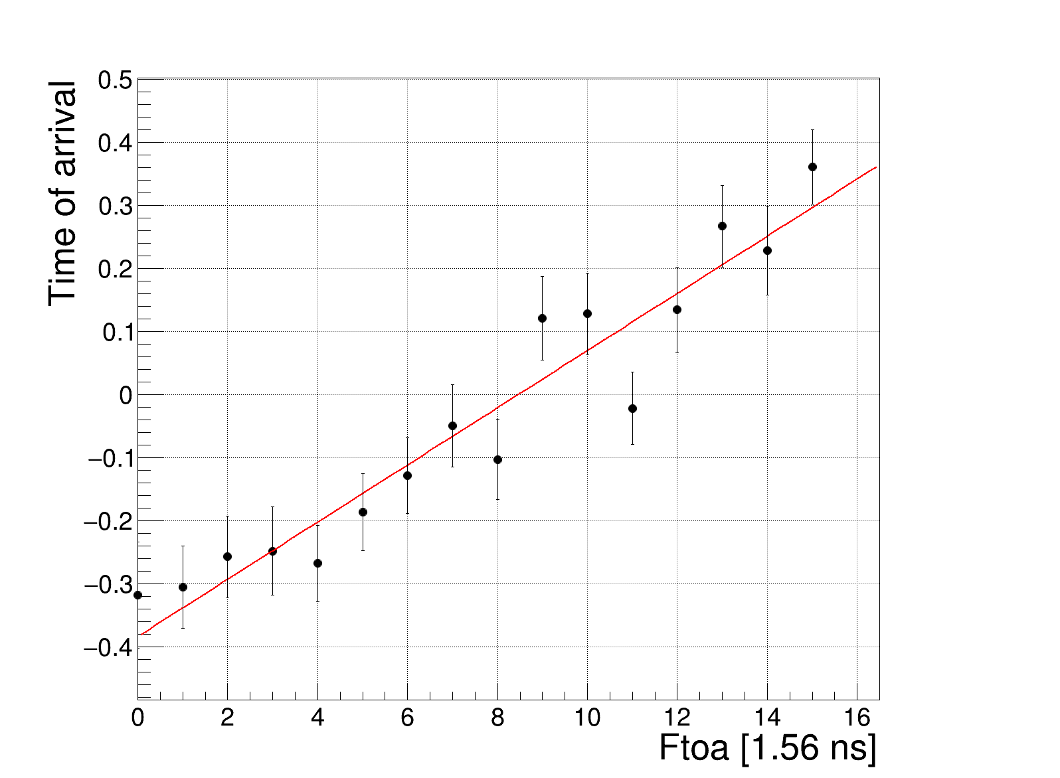
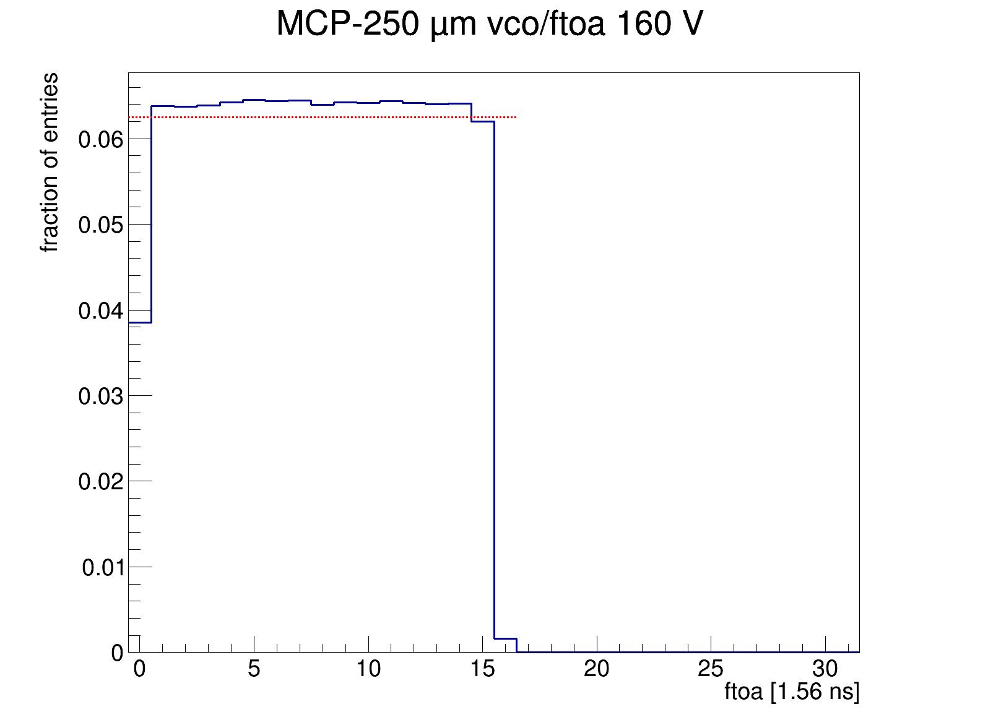
Clock corrections
Every 8 pixels have a VCO running at 640 MHz
16 fine-toa bins per 40 MHz cycle
Some VCOs run too fast, some too slow. correction is needed

Slide 12
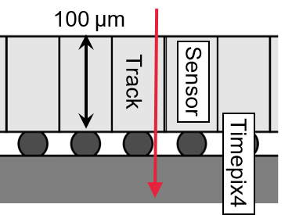
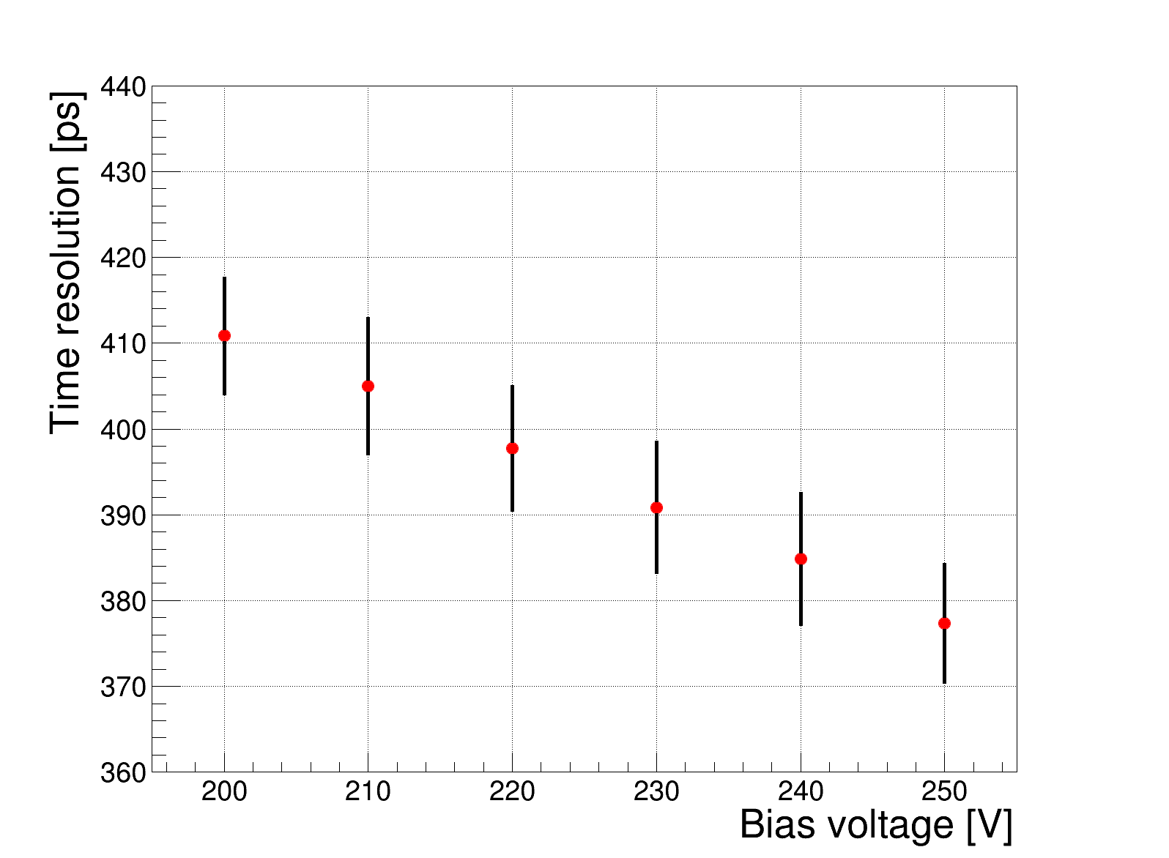
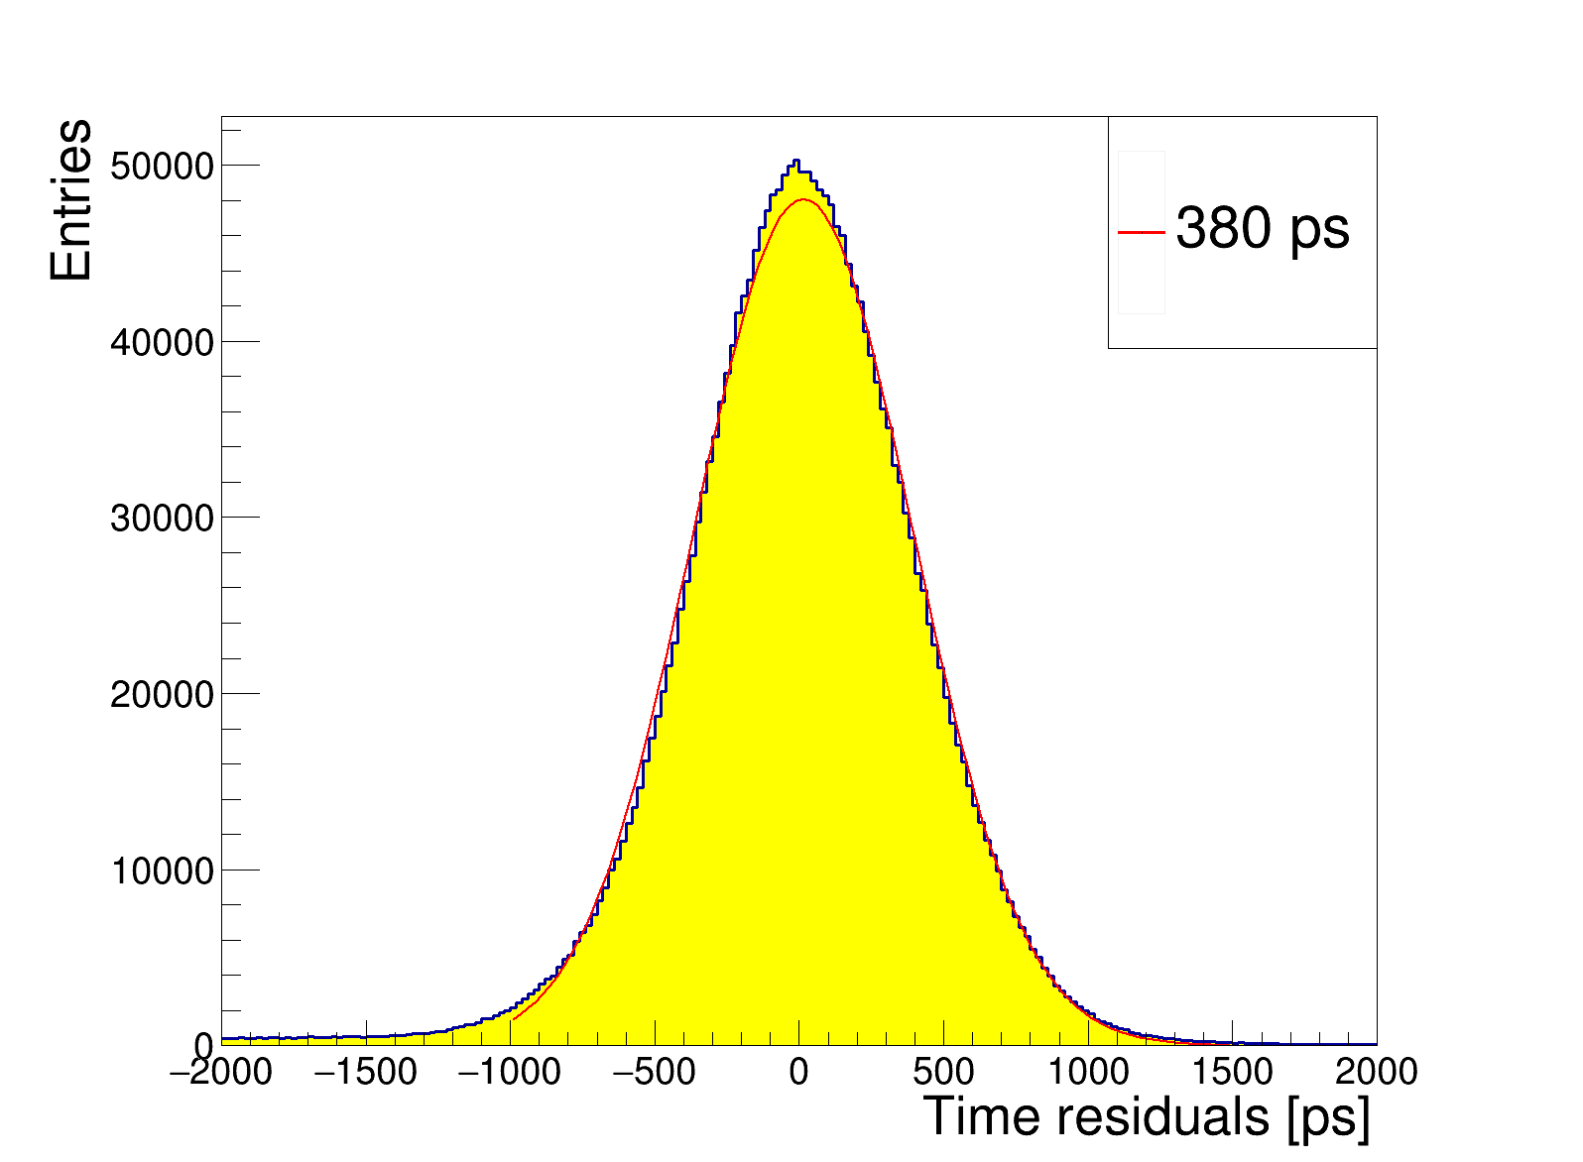
Time resolution vs bias voltage for perpendicular tracks
Time-resolution improves with a higher bias voltage
Per pixel corrections needed for optimal time resolution
After per pixel corrections: ~377 ps (250 V)
Time bin size + analog front end ~100 ps (sensor is the dominating factor)
377 ps

Slide 13
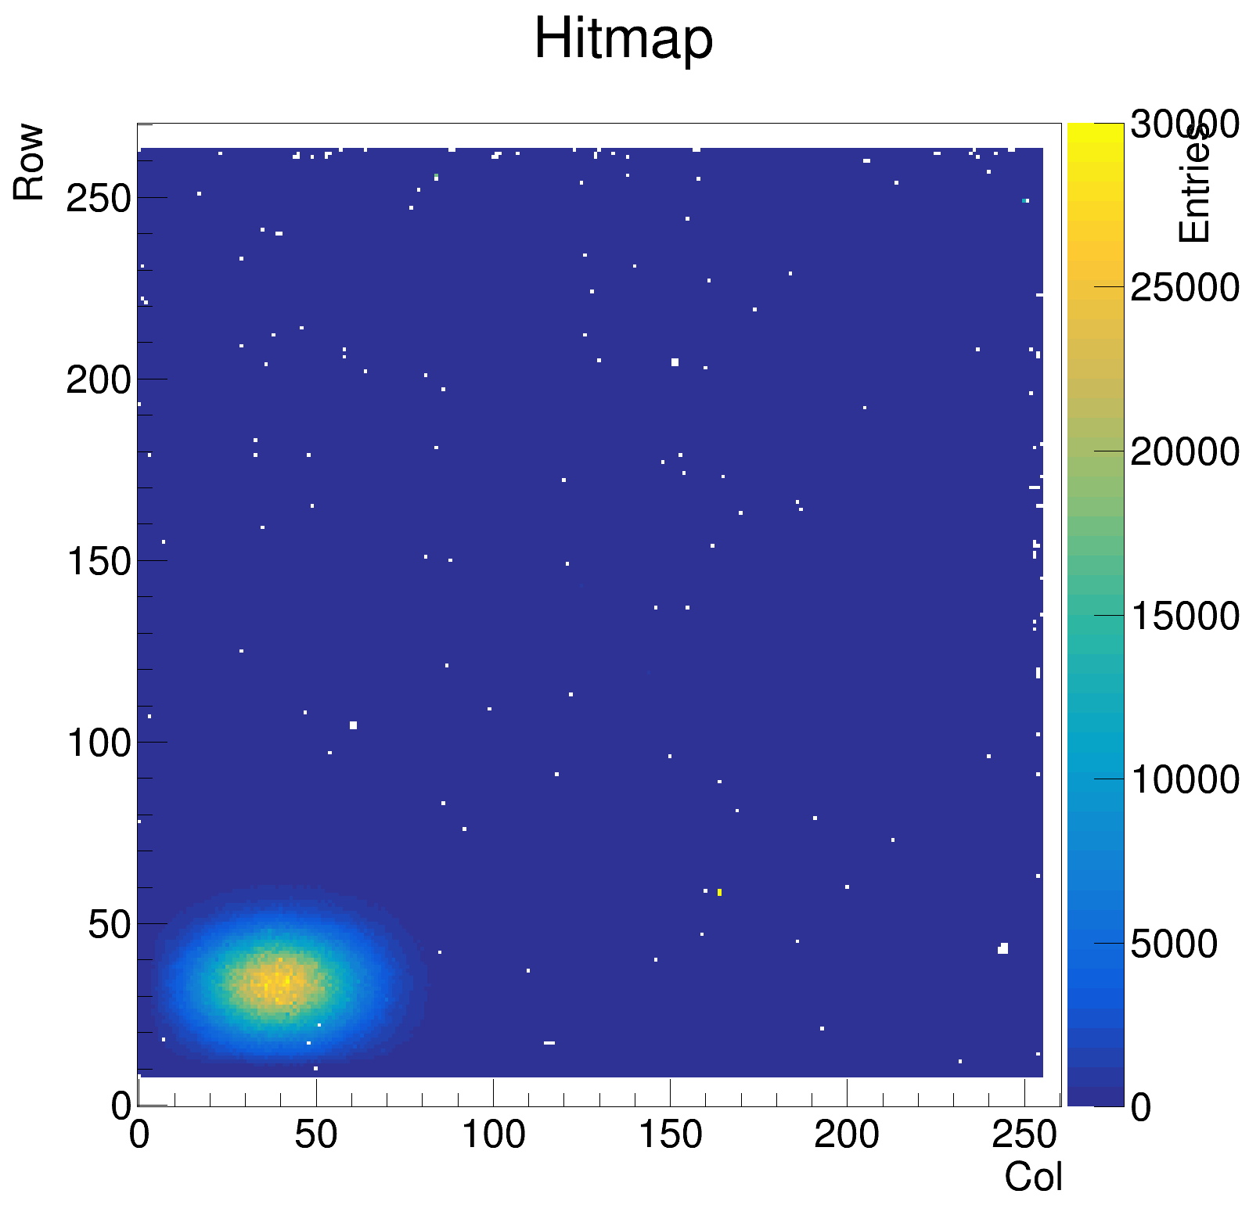
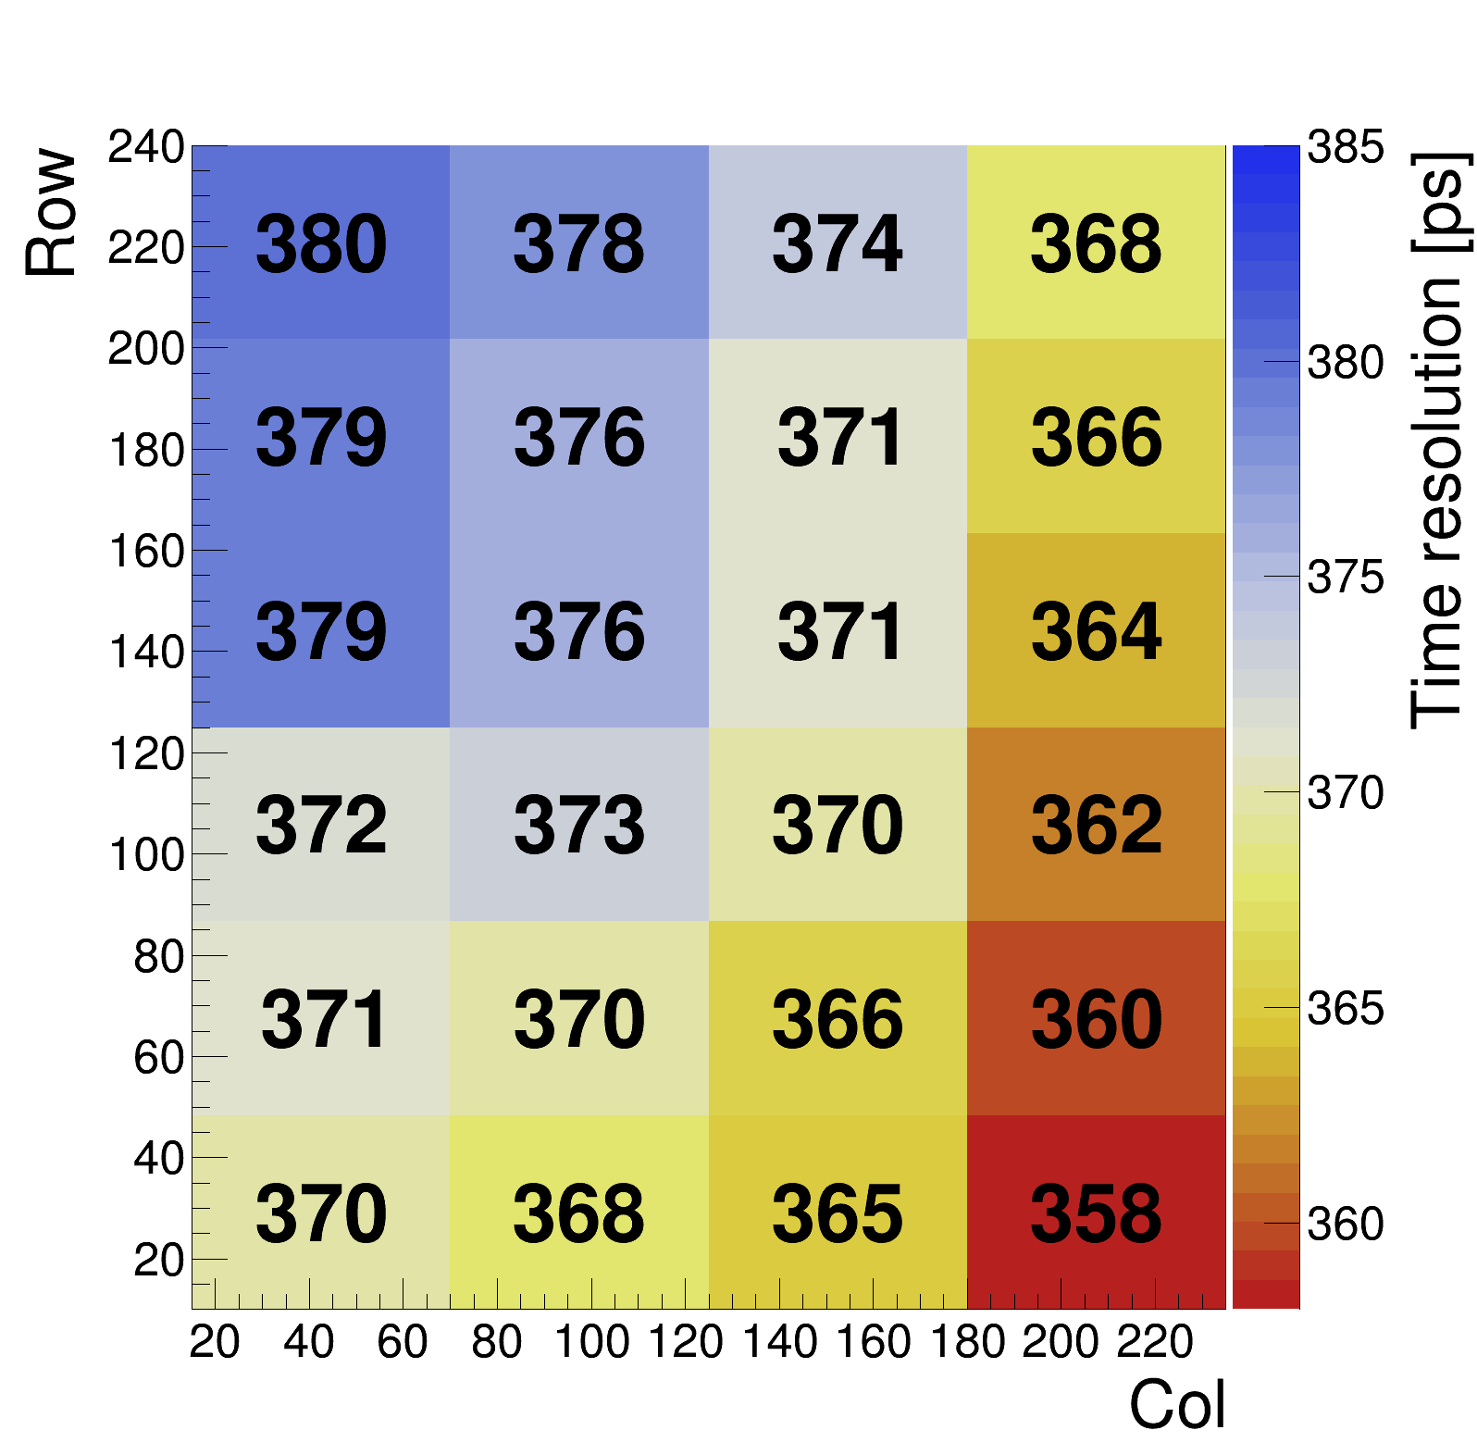
Scan over pixelmatrix
Moved the sensor in x and y direction to see differences in time resolution over the matrix
Best time resolution of 358 ps in bottom right corner

Slide 14
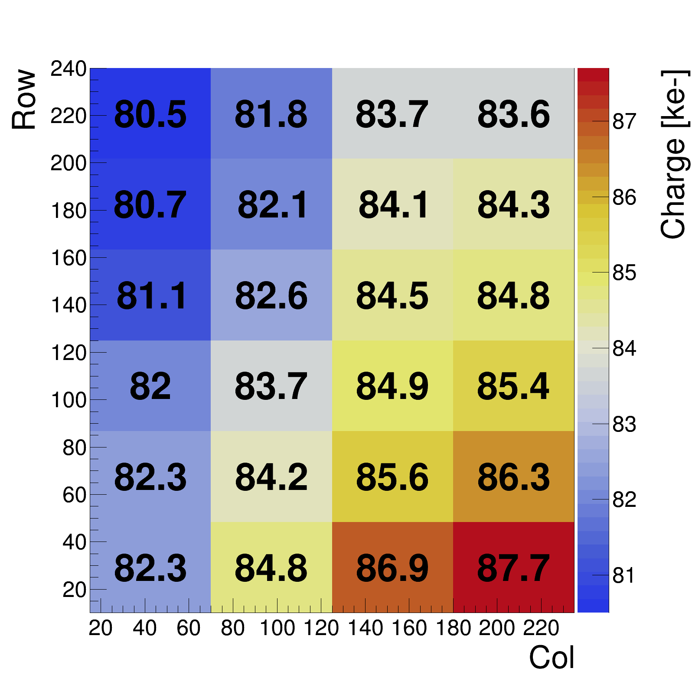
Scan over pixelmatrix
This seems to be correlated with the charge deposited per pixel
So a higher gain would improve the time-resolution

Slide 15
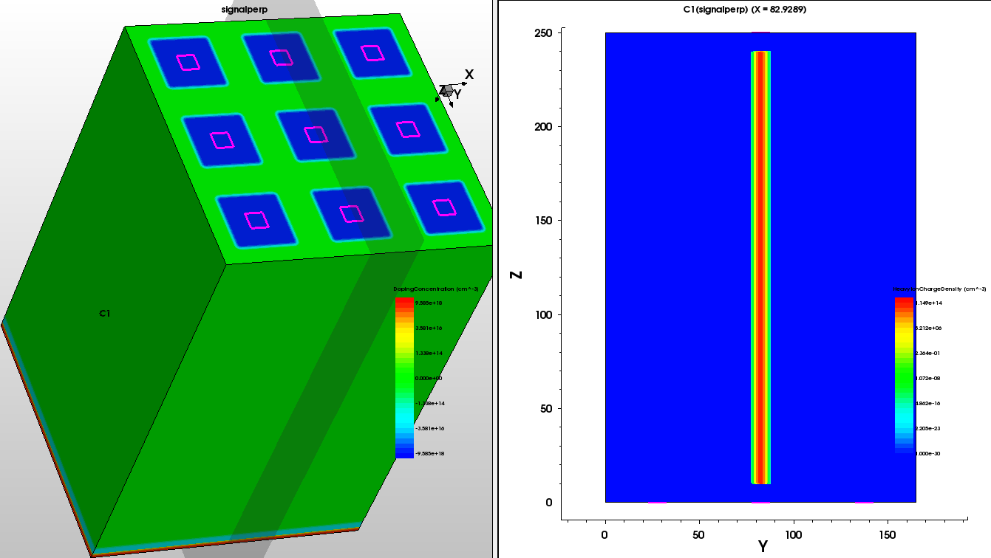
TCAD Simulations
9 pixels, p-doped layer at the back for gain
Perpendicular signal 200V bias applied

Slide 16
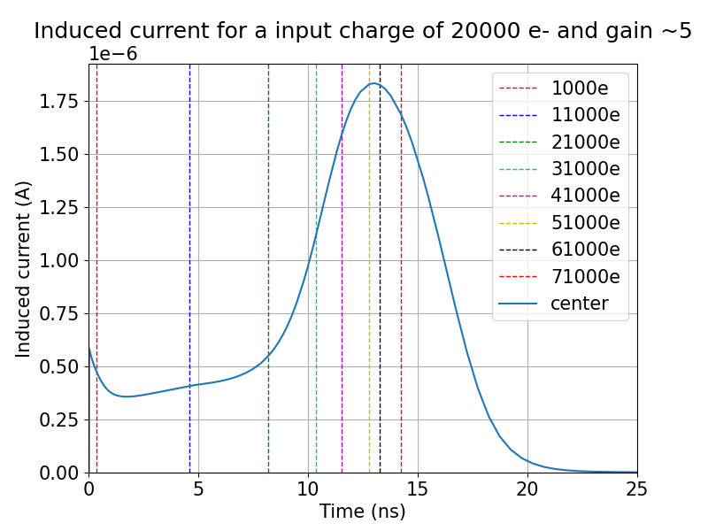
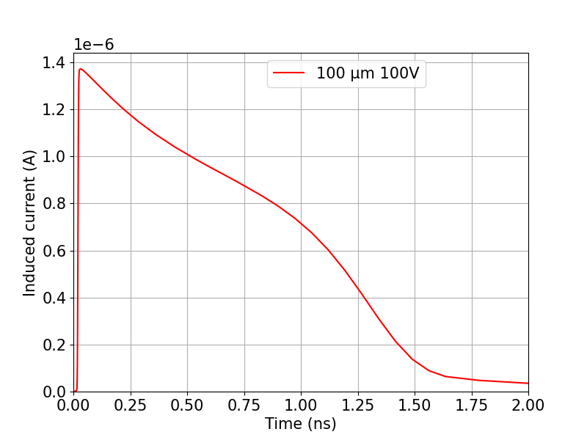
Induced current from a perpendicular signal (simulated)
It takes a long time to get the signal out of the sensor ~20 ns
For comparison a planair 100 um at 100V needs only 2 ns to collect all charge
Need a very high threshold to go over threshold at the induced current

Slide 17
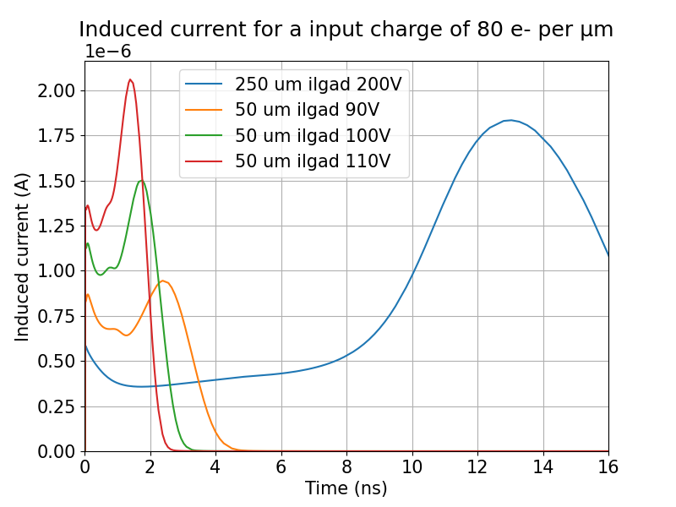
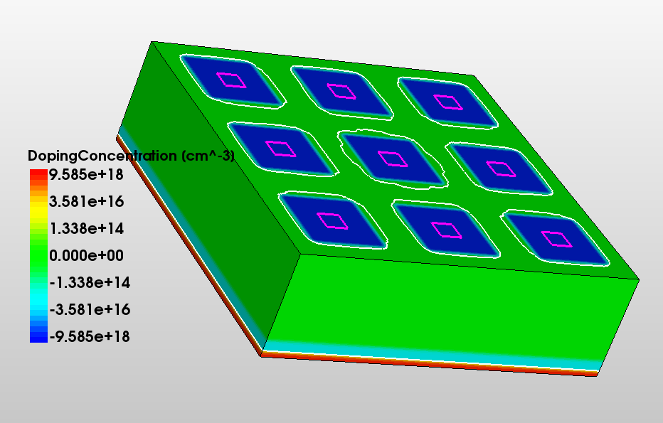
Induced current for thin iLGADS
For thin 50 um iLGADS charge collection is much faster
Depleted at 75V a little bit more overdepletion gives a much higher signal
50 µm

Slide 18
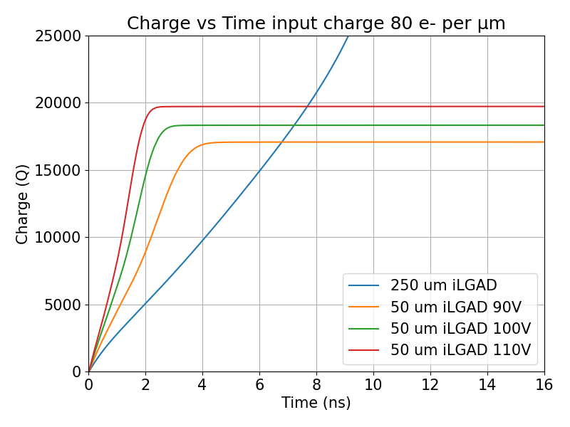
Integrated charge for thin iLGADS
For thin 50 um iLGADS charge collection is much faster
Depleted at 75V a little bit more overdepletion gives a much higher signal
Conclusion: for good timing we need thinner iLGADs

Slide 19
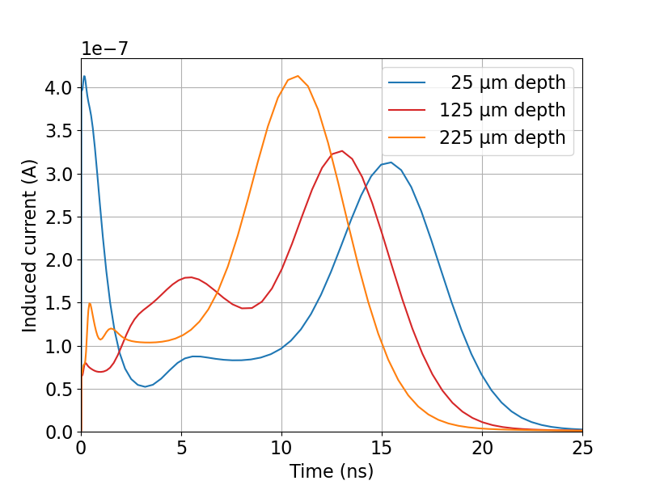
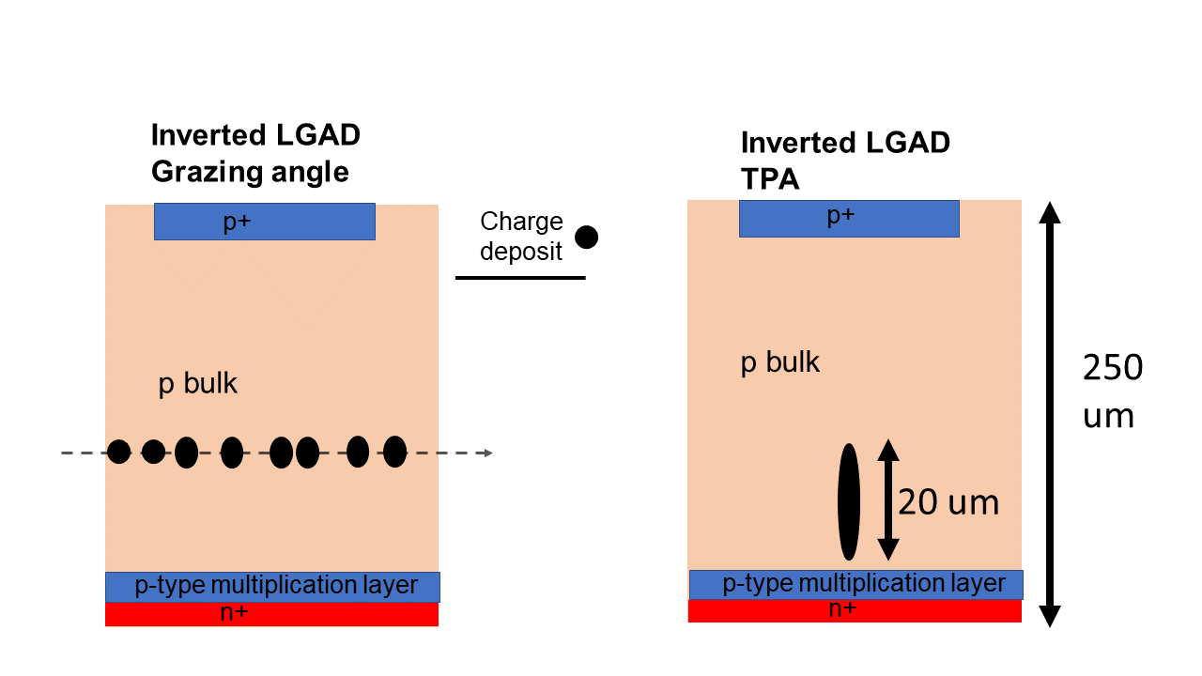
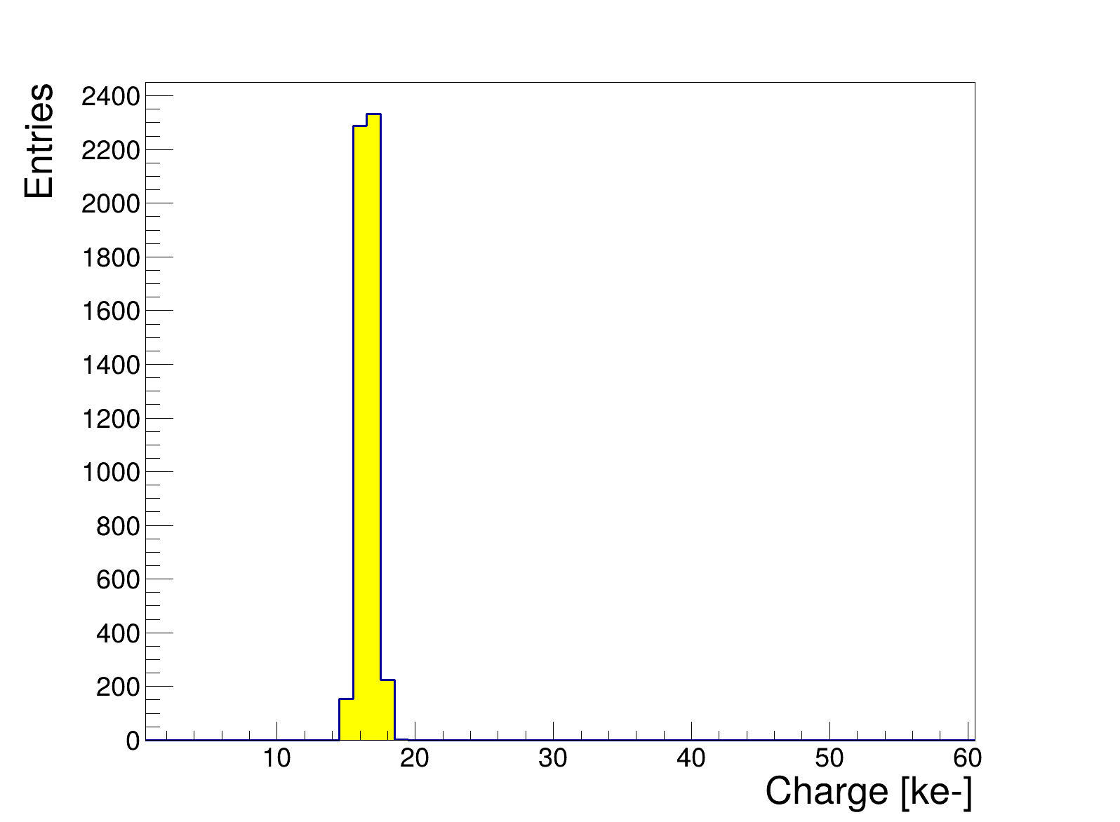
Two-Photon Absorption (TPA) Laser
TPA laser has a wavelength of 1550 nm
Possibility to inject small voxels at a certain depth
As a time reference the digital input pixel of Timepix4 is used
Simulation for charge at different depths

Slide 20
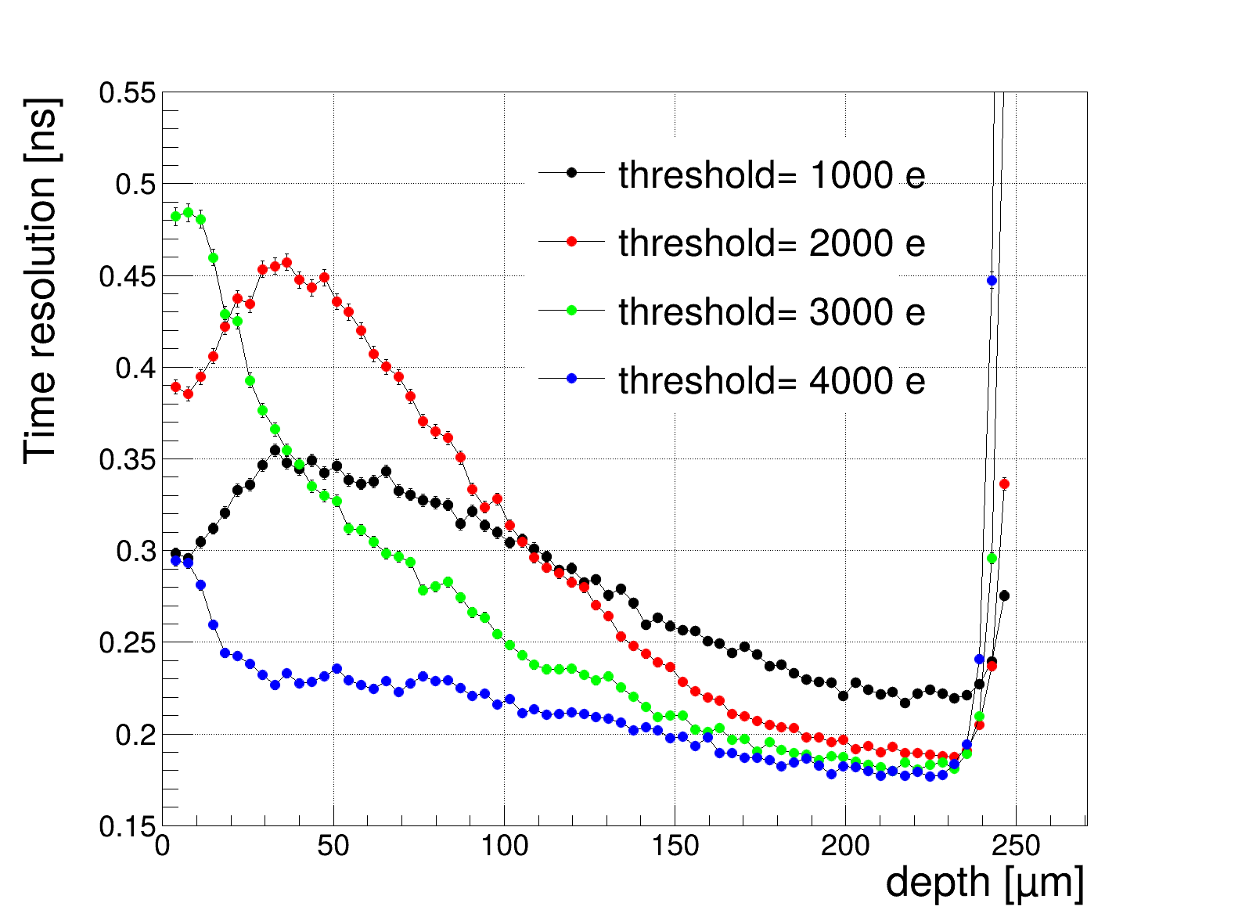
Time resolution per depth
Time resolution best at the gain layer
A higher threshold makes the time resolution quite constant, because you go always over threshold on the gain signal
0 µm
250 µm

Slide 21
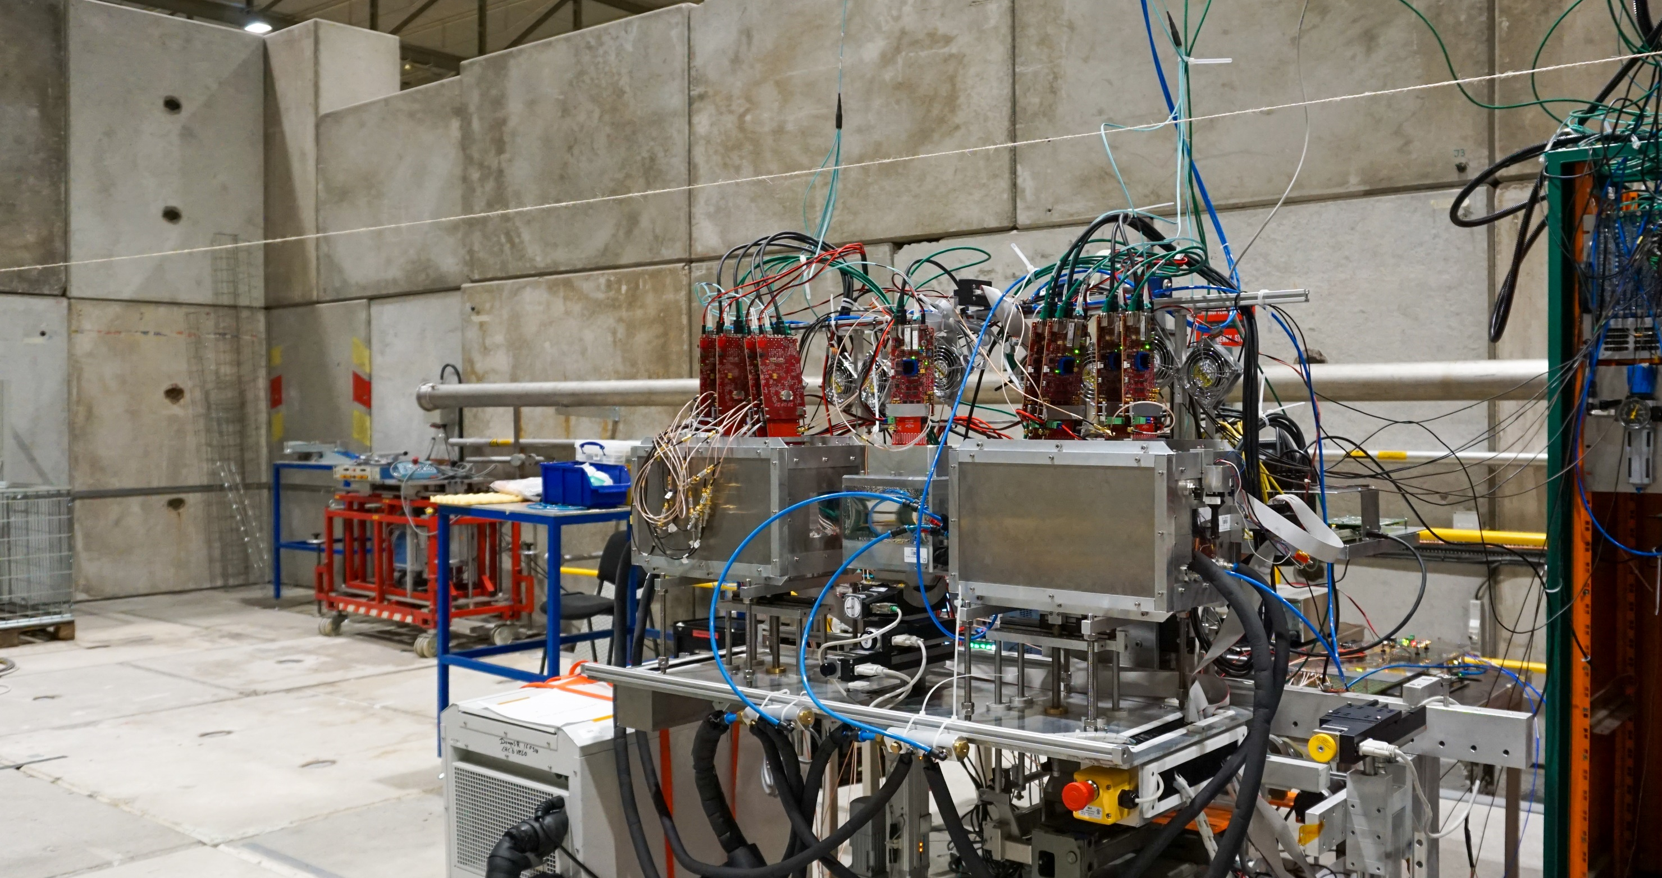
iLGAD, Conclusions
Time resolution is not great 358 ps
Explanation:
The sensor is too thick
The gain of order 4 is too low (10-20 is what is aimed for)
The charge collection duration is too long
A very high threshold is needed to use the peak of the induced current
Future:
New production of thin 50 µm iLGAD from AIDAinnova is ongoing, but will take a while
Simulations show that thin iLGADs will improve the time resolution

Slide 22
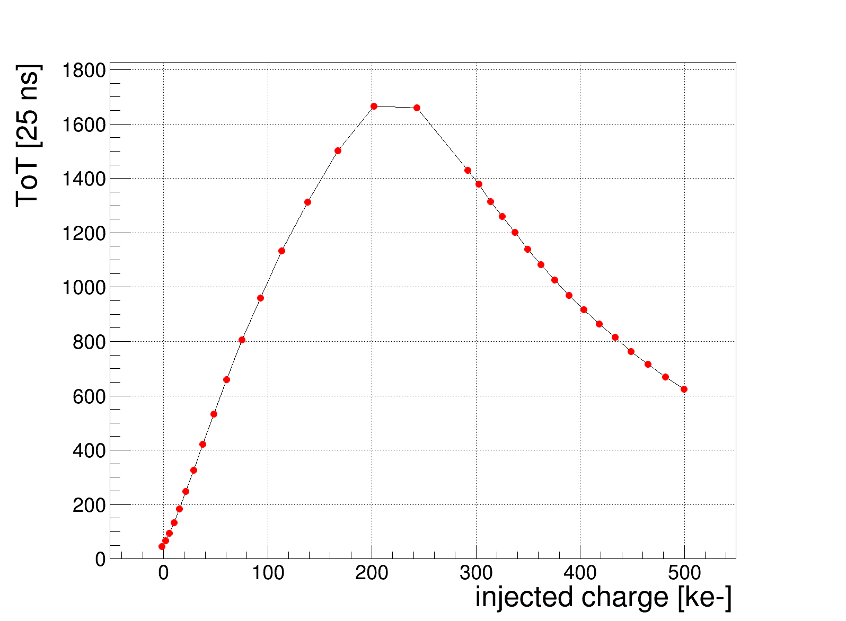
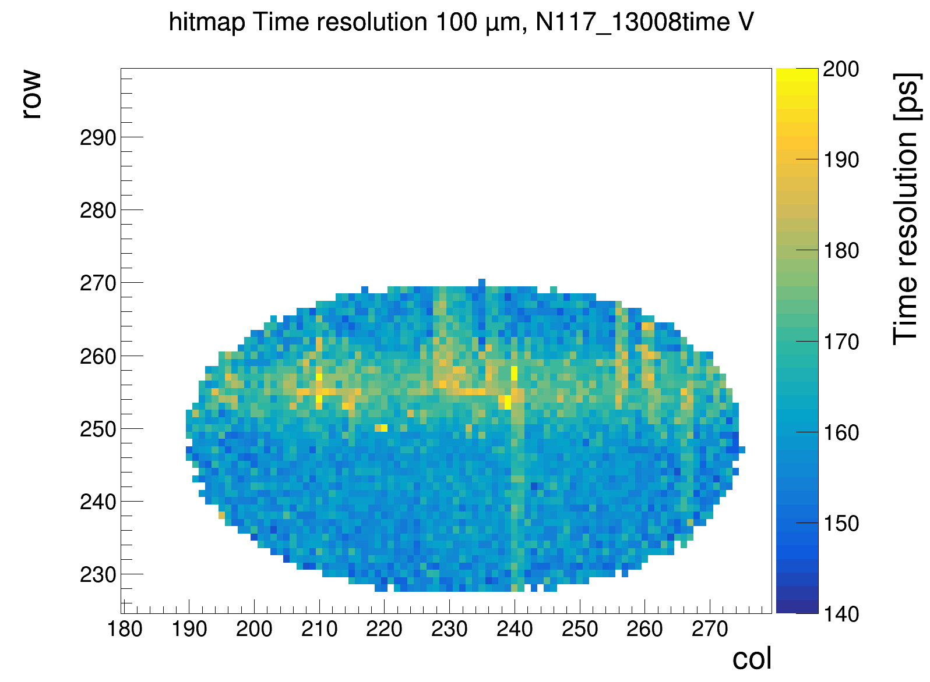
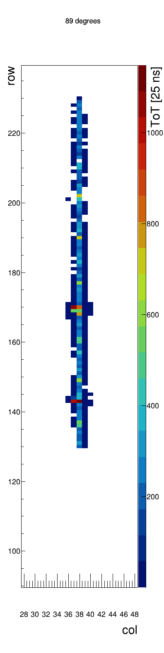
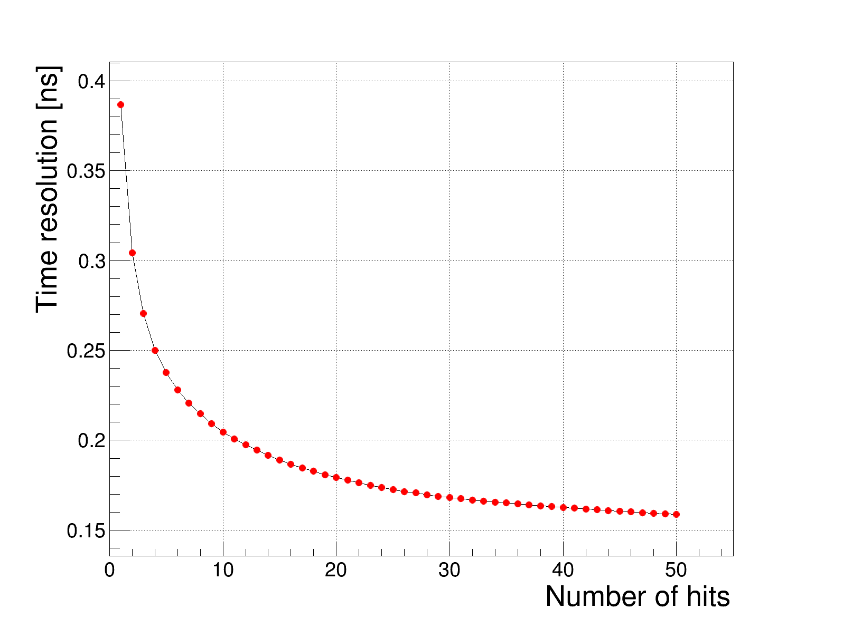
The future
Almost finished with iLGAD research
Focus will shift towards Timepix4 ASIC
Vulcano effect
Vulcano effect
Worse timing in central periphery?
Correlation between hits in the ASIC

Slide 23
Back-up slides

Slide 24
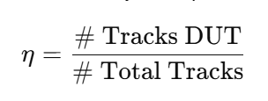
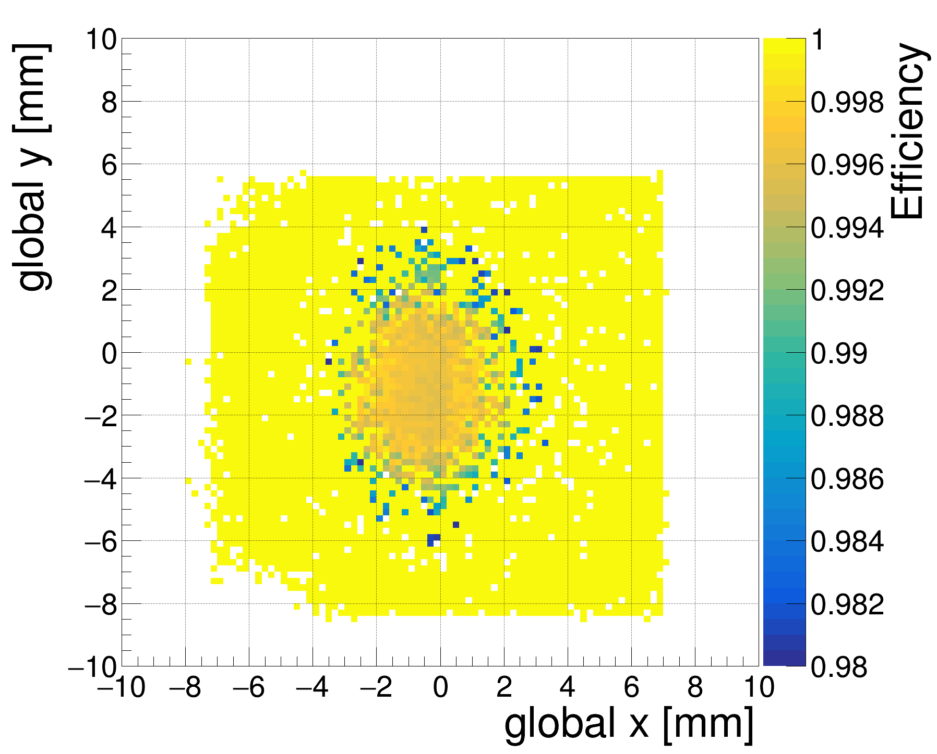


Sensor efficiency with testbeam
Efficiency determined w.r.t. tracks from Timepix4 telescope
Only tracks selected that pass the DUT inside the sensor area.
Efficiency is excellent 99.6 ± 0.1
Global Efficiency
Intra pixel Efficiency
Pixel pitch
Pixel pitch

Slide 25






Time measurement in Timepix4
Coarse and fine time measurement – 40 MHz and 640 MHz
Constant current discharge
Current signal
Leakage current compensation
220 µm
Ultrafine time measurement – 195 ps
640 MHz
Nominal TDC resolution: 195 ps/$\sqrt{\text{12}}$ = 56 ps
Time over threshold (ToT) measures signal charge

Slide 26




Time resolution
ToA measurement with 640 MHz voltage-controlled oscillator
Per superpixel VCO corrections
After Timewalk+VCO corrections: ~168-185 ps
Track time: 4 × 100 μm orthogonal planes : 90 ps
Comparison
of two
superpixels
Frequency per SPixel
σ =168 ps
After VCO
corrections
Time residuals [ns]

Slide 27

Time resolution vs threshold for perpendicular tracks
Amplified signal is late, so maybe better time resolution for a higher threshold
Time-resolution stays constant for different thresholds for an iLGAD
iLGAD not better than an even thicker 300 µm sensor
Why is our time resolution better than for the 300 µm planar sensor? Amplified signal comes too late
Interesting to disentangle the time resolution for different depths in the sensor

Slide 28



Not a uniform charge deposition in a 250 um sensor
NA=0.7 ↑ NA → ↑ focusing → ↑ refraction → ↑ spherical aberration
Less signal towards the implant ☹
250 um (back)
0 um (implant)
Characterisation of Silicon Detectors Using the Two Photon Absorption – Transient Current Technique Sebastian Pape aus Dortmund
https://cds.cern.ch/record/2889325/files/CERN-THESIS-2023-336.pdf

Slide 29




E. Dall'Occo et al 2021 JINST 16 P07035
[DOI: 10.1088/1748-0221/16/07/P07035]
Grazing angle measurements
Grazing angle measurement used to study time resolution as function of depth in the sensor
Selection of clusters without δ-rays
Operated at different bias voltages and thresholds
δ
Hitmap grazing angle
iLGAD (TPX3 sized)

Slide 30






Angle scan
Measurement of the thickness is in agreement with specifications (250 µm)
84° 86 ° 88 ° 89 °

Slide 31


Time resolution as function of depth
Time resolution seems best at 70 µm depth
The initial signal is 55 *70 eh/µm =~4000e-
Shape of the time resolution curve depends on threshold
Best time resolution at low threshold
Threshold scan
0 µm
250 µm

Slide 32



Timewalk+drift correction per depth
Timewalk curve is a mix of drift in sensor and timewalk
Close to the ASIC timewalk dominated by initial signal
Near the gain layer the charges come at once and therefore the slope of the curve is flatter
0 µm
250 µm
preliminary
preliminary
preliminary

Slide 33




Starting up simulations to understand results
Electric Field and weighting field are high at opposite side of the sensor
At the implants we are not close to velocity saturation, so higher Voltages in the future
Doping concentration
Drift Velocity (200V)
Weighting potential
preliminary
250 µm
preliminary
165 µm
165 µm
165 µm

Slide 34


Drift Velocity (200V)
Weighting potential
Thin vs thick sensor in TCAD simulations
50 µm
50 µm
165 µm
165 µm
Drift Velocity (200V)
Weighting potential
Doping concentration
preliminary
250 µm
preliminary
165 µm
165 µm
165 µm

Slide 35

Optimal Time measurements in pixel detectors
Ballpark number estimation for a 100 µm sensor
Time-bin size of 25 ns/128 = 195 ps (= resolution of ~60 ps)
Analog Front end depends on the charge of the signal (resolution ~90-100 ps for 100 µm planar measured)
Sensor depends biasvoltage, threshold etc.
Analytical limit is 0.075T with T the time for collect all the charge (100 µm planar parallel plate, ~80 ps)
Riegler, W. (2025). Time resolution limits in silicon sensors from Landau fluctuations and electronics noise. arXiv preprint arXiv:2504.02570.
Analog front end
~140 ps = ~80 ps + ~95 ps + 60 ps
calculated =analytically calculated + assumed/measured + assumed

Slide 36

Cross section LGAD
Giacomini, G. (2023). LGAD-Based Silicon Sensors for 4D Detectors. Sensors, 23(4), 2132. https://doi.org/10.3390/s23042132

Slide 37




Gain determination in the lab
Radio-active source measurement in lab
Known energy deposit of the 60 keV x-ray peak
No gain border comparison with gain region
Gain is 4.1 ± 0.1
Gain lower than optimal
P. Svihra 2024 arXiv:2409.20194
calibrated
uncalibrated
No gain area
16.5 ke-

Slide 38

IV-curve

Slide 39


Time resolution planar sensors (50,100,200,300 um)

Slide 40


Time resolution planar sensors (50,100,200,300 um)

Slide 41



Time resolution after per pixel correction
Select central 300 pixels with most hits
After per pixel correction 377 ps
For planar 100 um sensor time resolution is 151 ps
300 pixels
*under the assumption that the charge calibration and the ToT measurement are linear

Slide 42


Overview testbeam measurement
Charge deposited is a landau convoluted with a gaussian
On average 70-80 electrons per µm
Timewalk correction needed due to Landau fluctuations
1.4 cm

Slide 43




Overview testbeam measurement
Large cluster size at perpendicular beam incidence
We suspect due to bipolar signals in neighboring pixels
Examples of clusters

Slide 44

Telescope configuration (2024)
12 ps time res.
Perpendicular and grazing angle
E. Dall'Occo et al 2021 JINST 16 P07035
[DOI: 10.1088/1748-0221/16/07/P07035]

Slide 45


Hitmap 8 planes
Upstream arm
Downstream arm
H8 beamline at SPS / CERN
180 GeV/c mixed beam
To optimize time and spatial resolution:
charge calibration
timewalk correction
clock correction
Upstream arm
Downstream arm

Slide 46



Microchannel plate (MCP) time reference (2024 setup)
Two MCPs provide precise time references to study timing performance of telescope
Placed at the end/far downstream to not hinder other groups in same beam area (large material contribution)
Combined MCP resolution: 12 ps
Photek PMT240
Photonis PP2365Y
Ortec 9327
Telescope
2 x MCP
due to nuclear interactions

Slide 47




DUT
Spatial resolution
Downstream arm
Four innermost planes rotated 9° around x and y to enhance charge sharing between pixels
Charge-weighted mean gives cluster position
Single plane resolution: 4.3 µm
Pointing resolution at DUT: 2.4 µm (Mixed hadron beam 180 GeV/c)
Working on η corrections to improve spatial resolution
Pointing resolution
Sensor
Tpx4
DUT
cluster - track [µm]
300 µm

Slide 48

Correlations in ASIC
Cluster time resolution is calculated the mean ToA of nhits
Should look into the weighted mean
There is a high correlation between hits
Without correlations 390 ps/$\sqrt{50}=55$ ps
A grazing angle track moves along one column
In the future it would be nice to have tracks crossing multiple columns

