Slide 1
Quantum Particle Tracking with TrackHHL
Xenofon Chiotopoulos
Nikhef and Maastricht University
Faster Day
October 2025

Slide 2
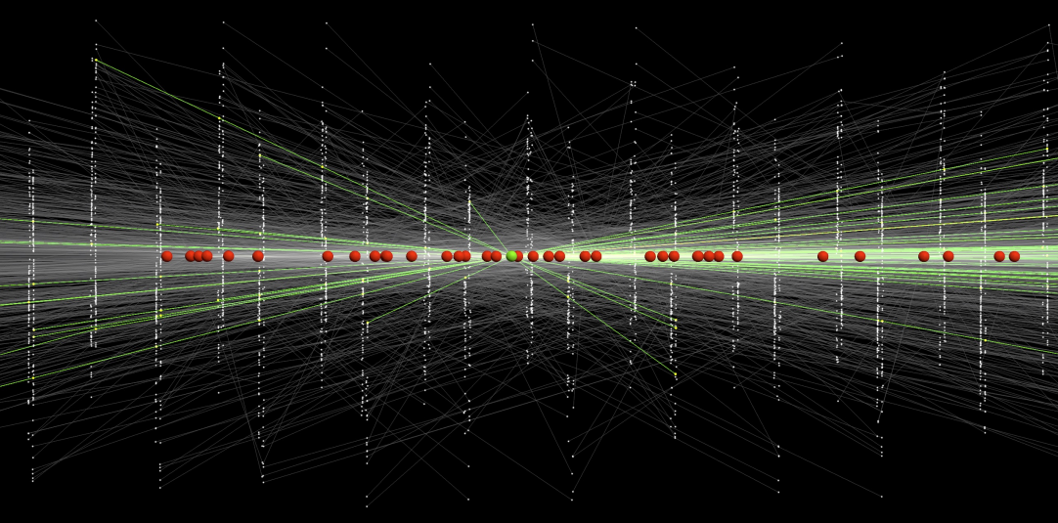
Current approach: massive parallel GPU-based combinatorics
R&D: Can a quantum algorithm help?

Slide 3
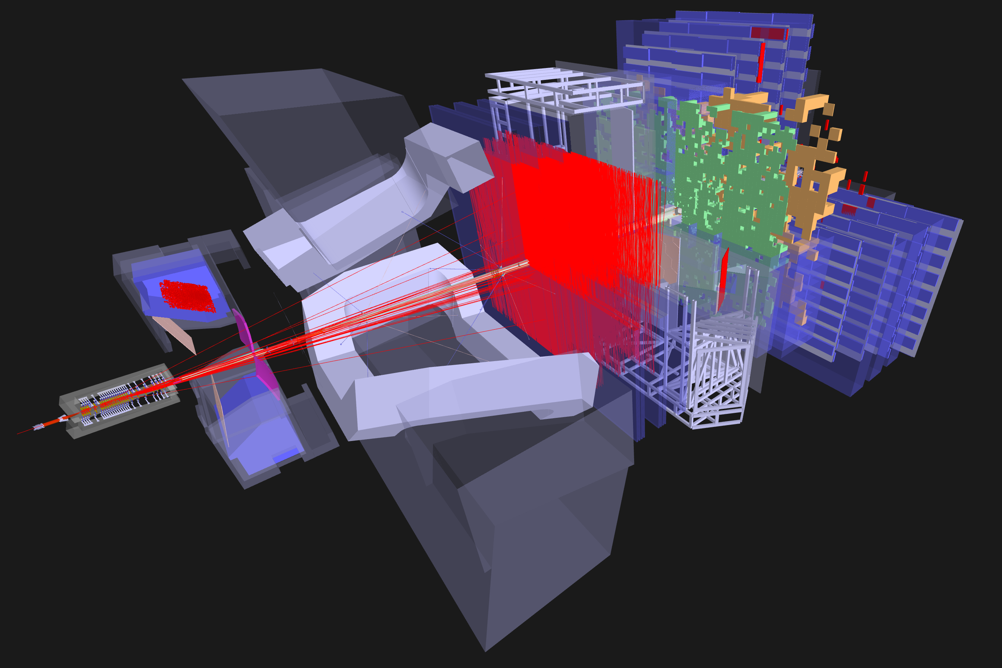
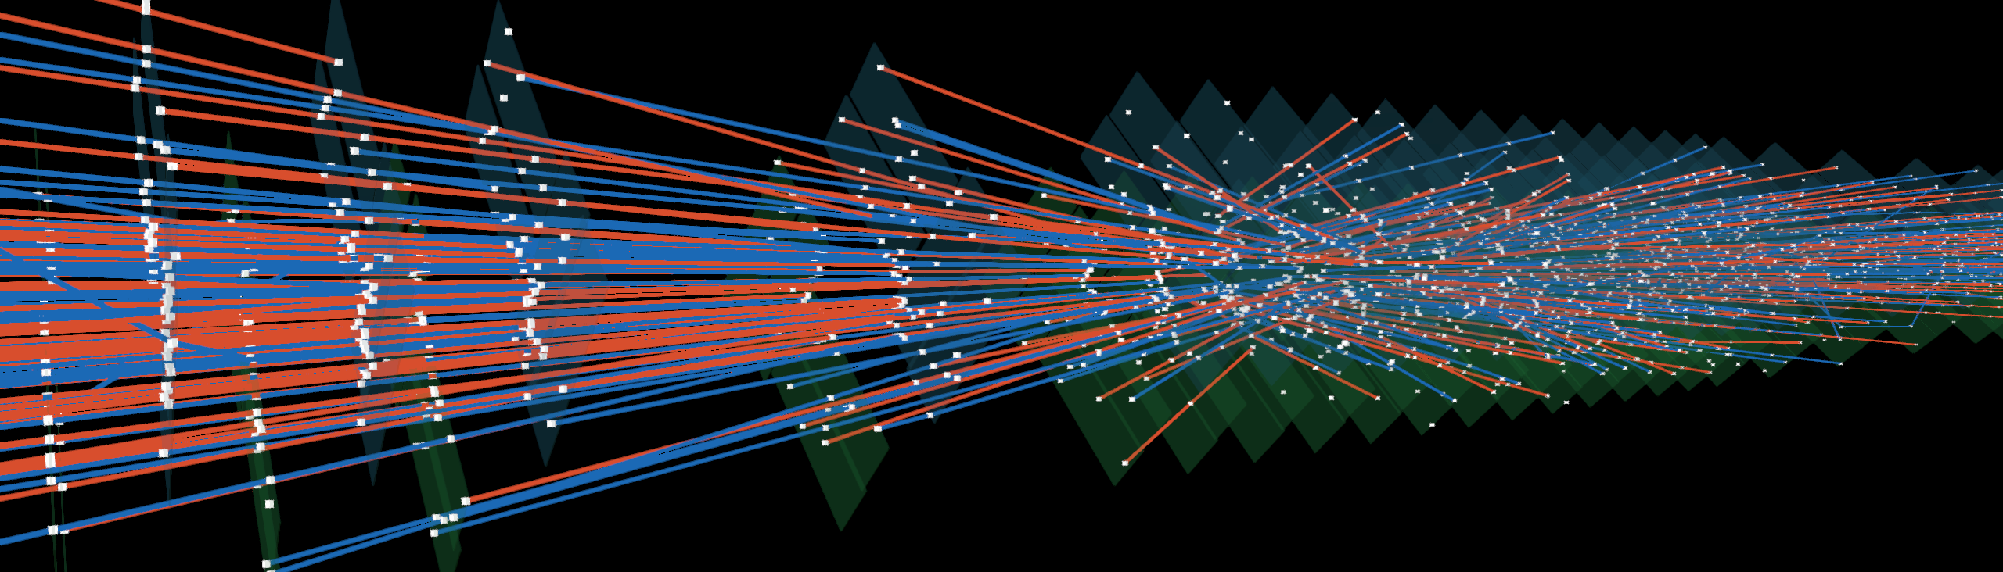
R&D: LHCb Velo detector
R&D: Quantum algorithm for pattern recognition in LHCb Vertex Detector:
Algorithmic use case for a small scale quantum computer
Applications long term depending also on hardware developments
R&D towards longer term with potential spin-offs
Investigated various approaches: HHL, QAOA, VQE, VQLS, annealing

Slide 4
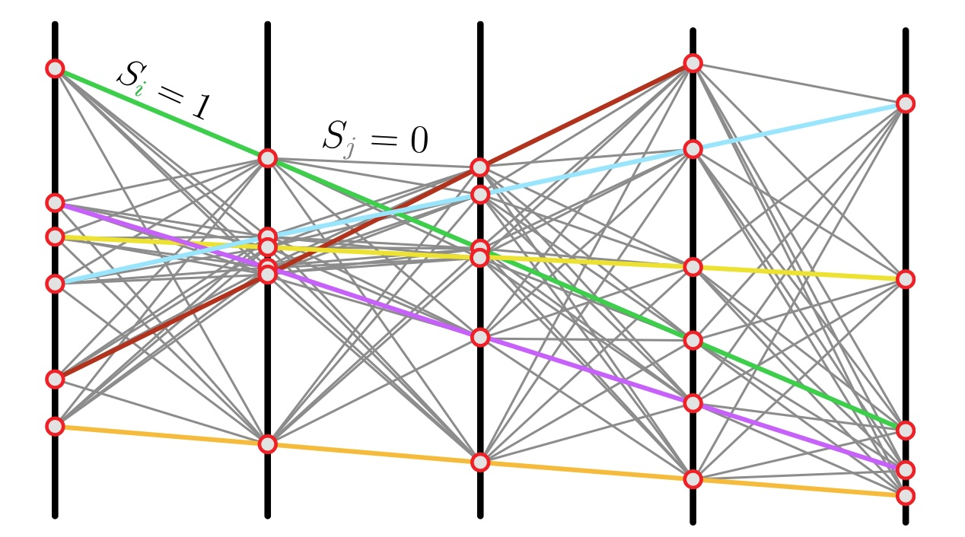
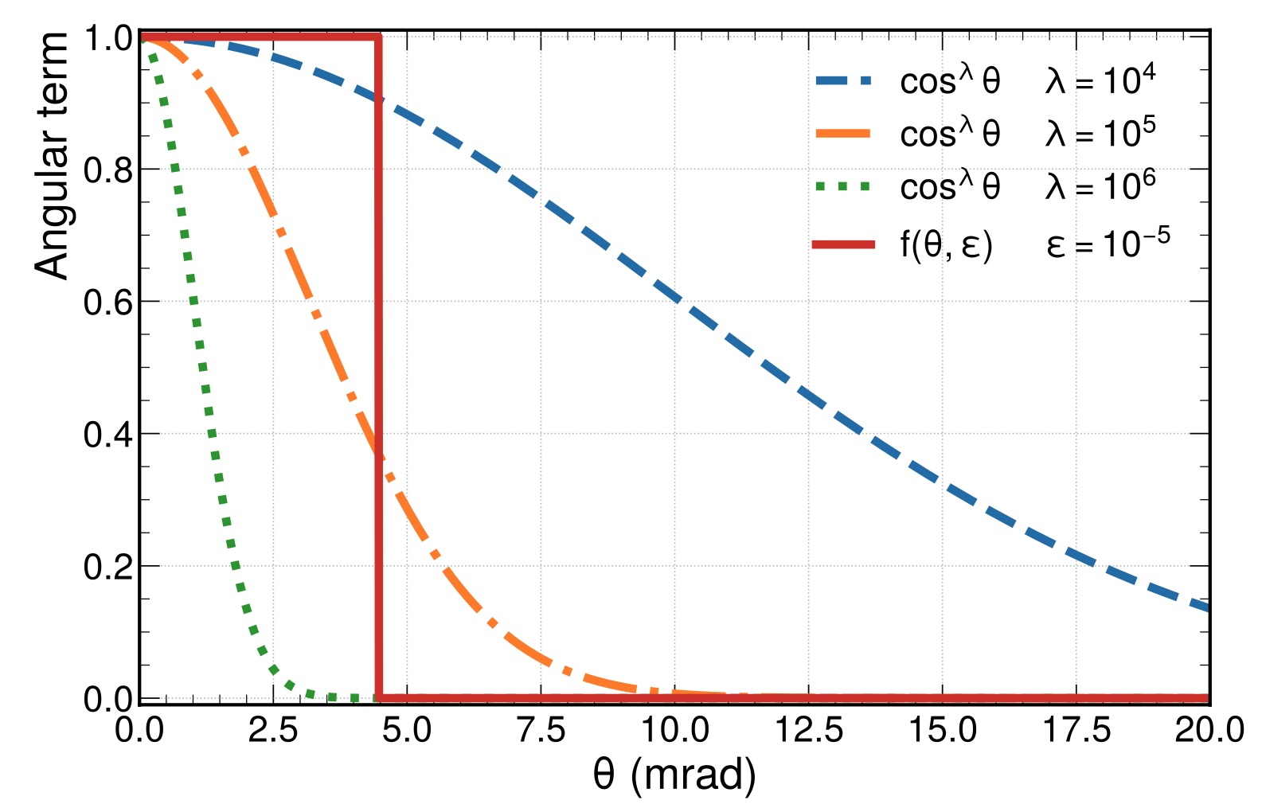
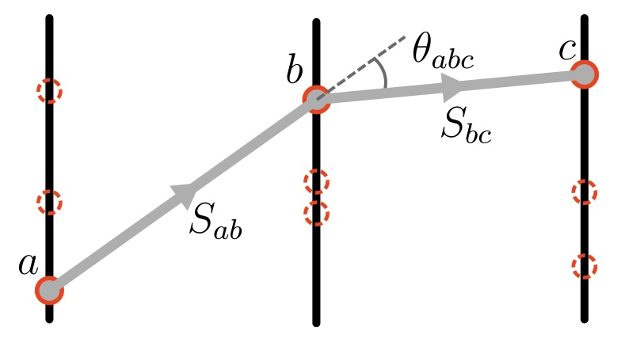
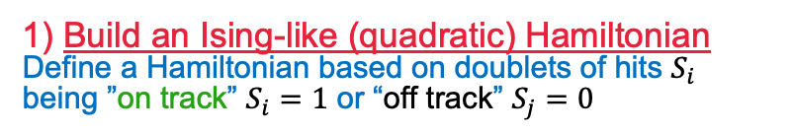
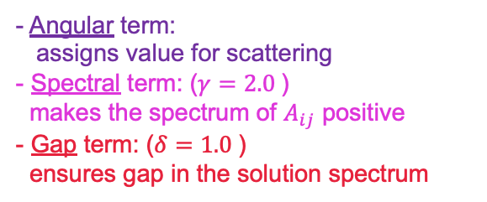
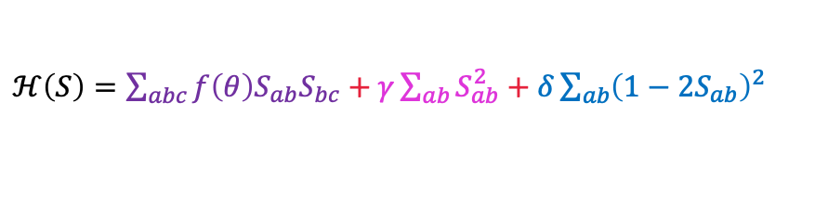
Method: “Global” algorithm for trackfinding
1) Build an Ising-like (quadratic) Hamiltonian
Define a Hamiltonian based on doublets of hits $S_{i}$ being ”on track” $S_{i}=1$ or “off track” $S_{j}=0$
$ℋ\left(S\right)=\sum_{abc}{f\left(θ\right)S_{ab}S_{bc}+γ\sum_{ab}{S_{ab}^{2}}+δ\sum_{ab}{{\left(1−2S_{ab}\right)}^{2}}}$
- Angular term:
assigns value for scattering
- Spectral term: ($γ=2.0$)
makes the spectrum of $A_{ij}$ positive
- Gap term: ($δ=1.0$)
ensures gap in the solution spectrum

Slide 5
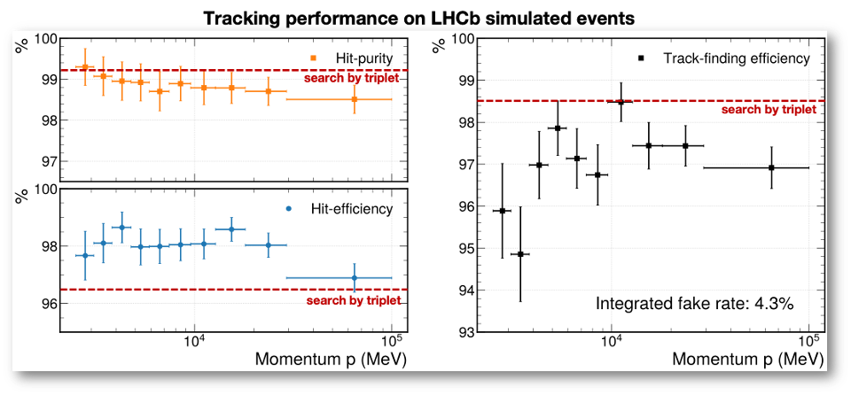
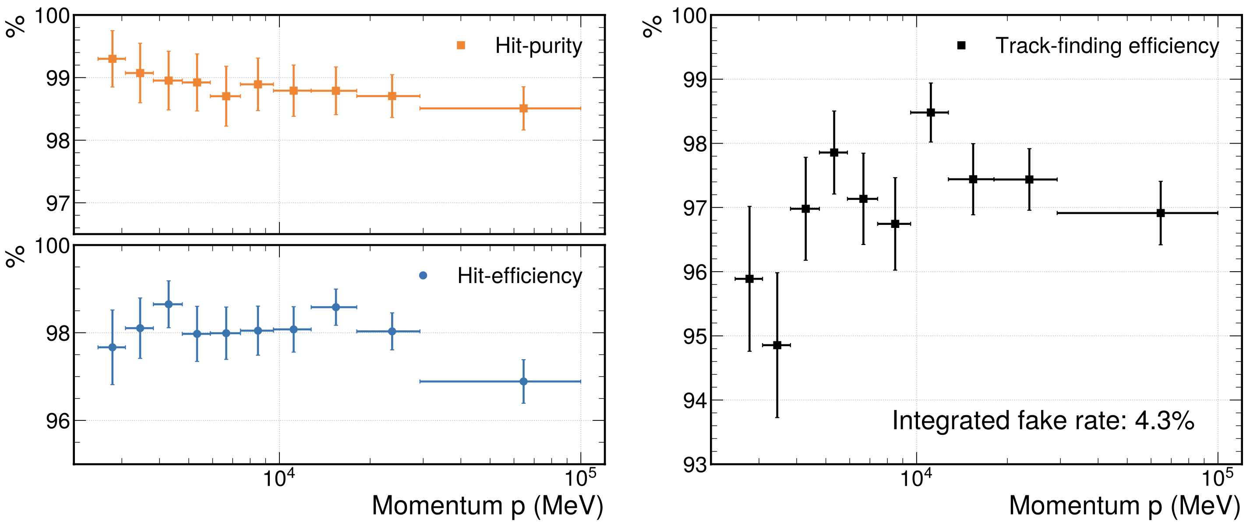

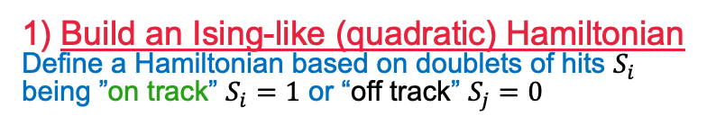

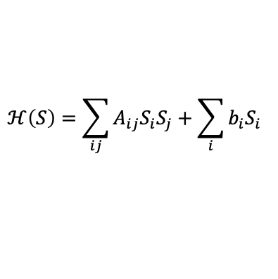

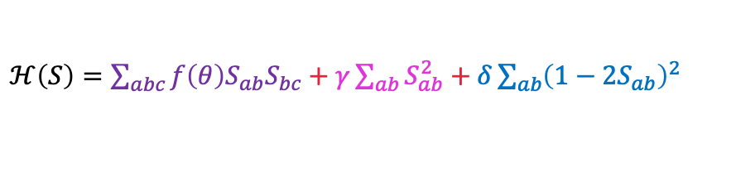
Method: “Global” algorithm for trackfinding
1) Build an Ising-like (quadratic) Hamiltonian
Define a Hamiltonian based on doublets of hits $S_{i}$ being ”on track” $S_{i}=1$ or “off track” $S_{j}=0$
$ℋ\left(S\right)=\sum_{abc}{f\left(θ\right)S_{ab}S_{bc}+γ\sum_{ab}{S_{ab}^{2}}+δ\sum_{ab}{{\left(1−2S_{ab}\right)}^{2}}}$
2) Find ground state of:
$$ℋ\left(S\right)=\sum_{ij}{A_{ij}S_{i}S_{j}+\sum_{i}{b_{i}S_{i}}}$$
Try by solving classically
good performance! $↓$
$$S_{i}∈\left\{0,1\right\}$$
Link
3) Apply a trick:
Relaxation: $S_{i}∈\left\{0,1\right\} ⇒ S_{i}∈ℝ$
Minimization: $∇_{S}ℋ=0 ⇒ AS=b$
Solve the large matrix inversion to find $S$
Discretization: $S_{i}∈ℝ ⇒ S_{i}∈\left\{0,1\right\}$

Slide 6
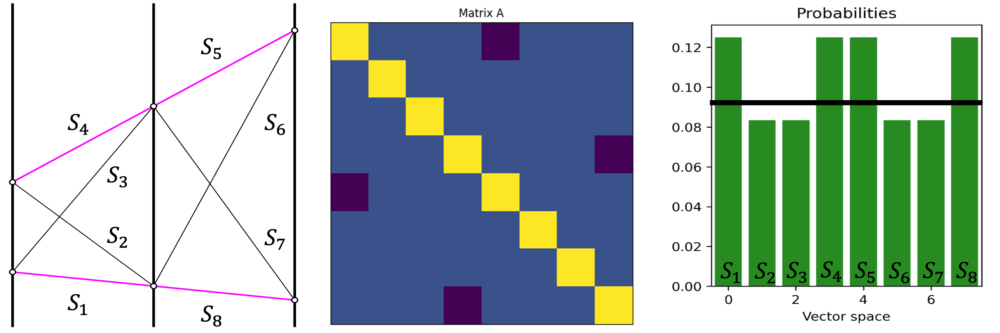

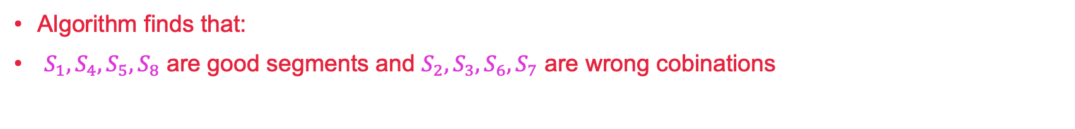


Simplest (trivial) case how it works classically
Two tracks in three layers
$∇_{S}ℋ=0 ⇒ S=A^{−1}b$
$S_{i}$ On
threshold
$S_{i}$ Off
Algorithm finds that:
$S_{1}, S_{4}, S_{5}, S_{8}$ are good segments and $S_{2}, S_{3}, S_{6}, S_{7}$ are wrong cobinations

Slide 7
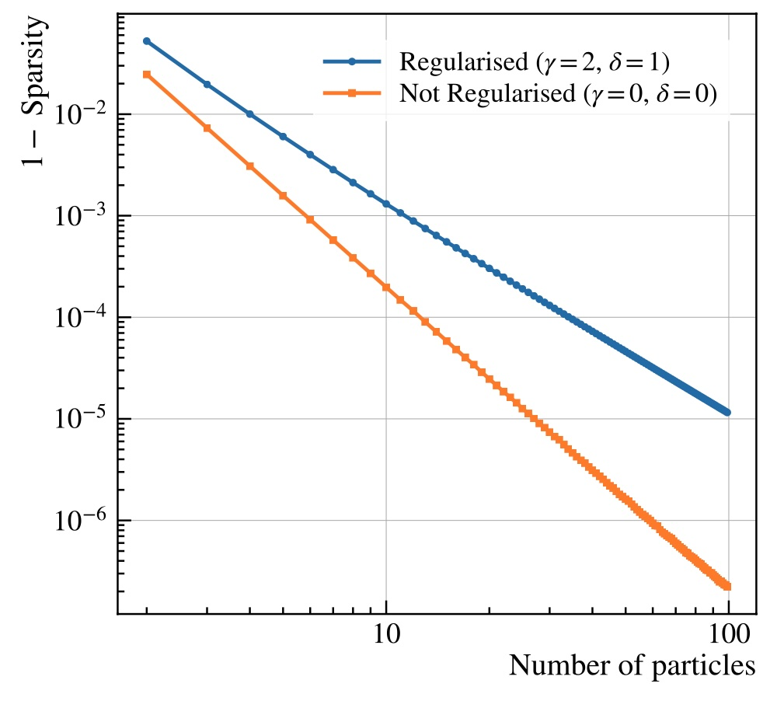
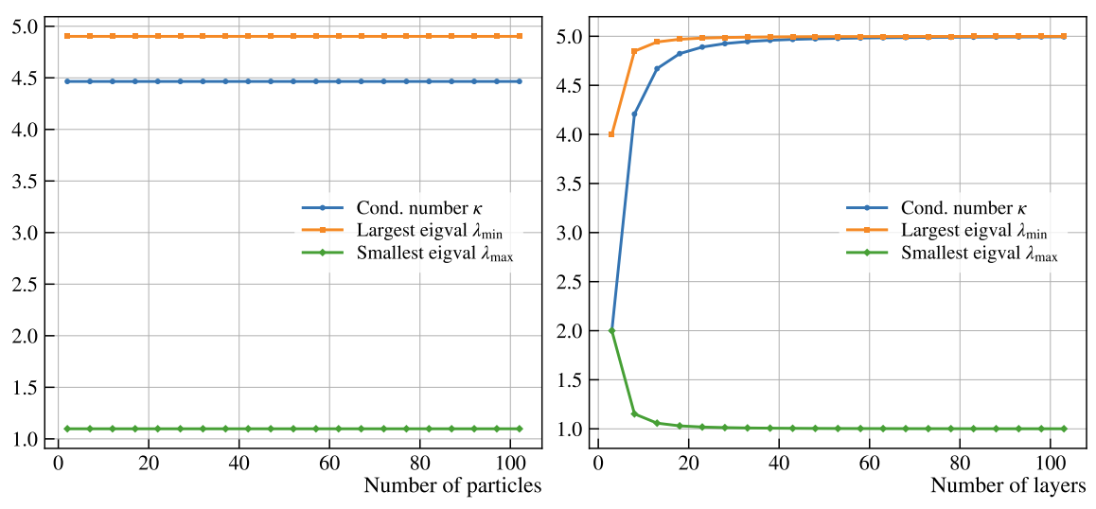
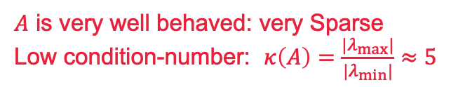
Matrix Properties
$A$ is very well behaved: very Sparse
Low condition-number: $κ\left(A\right)=\frac{|λ_{max}|}{|λ_{min}|}≈5$
HHL Promises $O\left(log\left(N\right)κ^{2}\right)$ runtime vs $O\left(N√κ\right)$

Slide 8
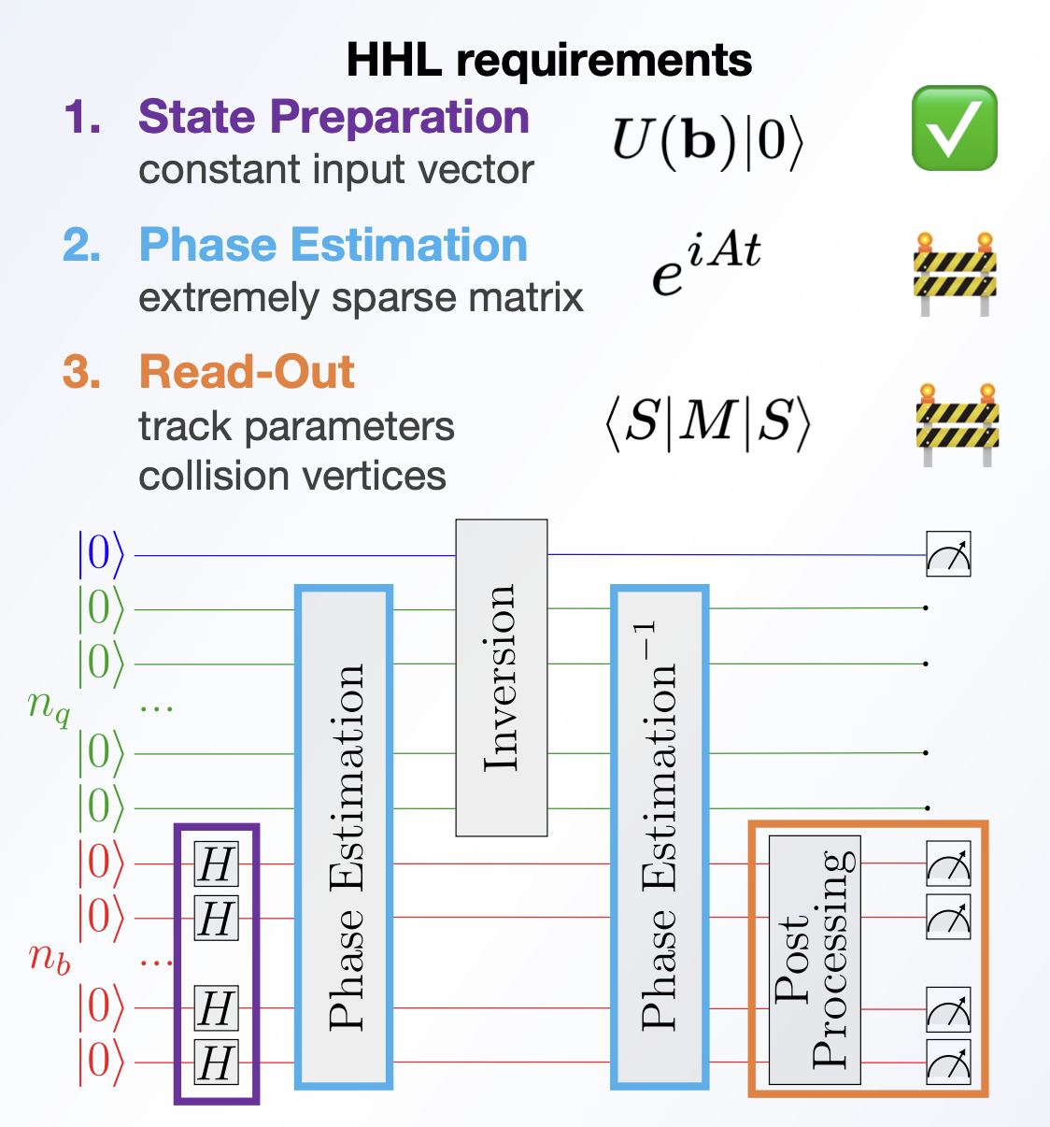
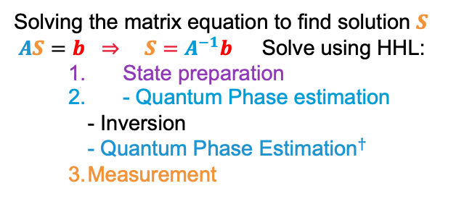
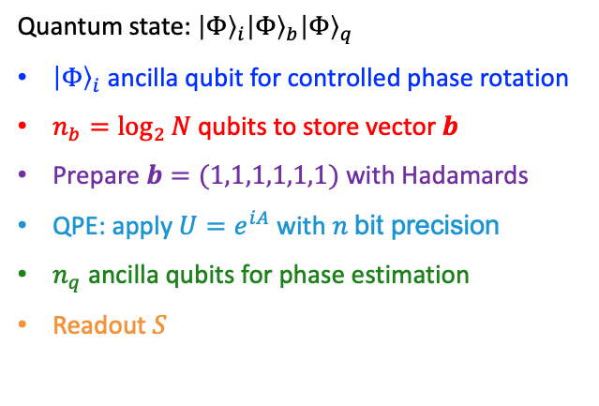
The Quantum Algorithm: Harrow-Hassadim-Lloyd
Solving the matrix equation to find solution $S$
$AS=b$ $⇒ S=A^{−1}b$ Solve using HHL:
State preparation
- Quantum Phase estimation
- Inversion
- Q${\text{uantum} \text{Phase} \text{Estimation}}^{†}$
3. Measurement
Quantum state: ${\left|Φ\right\rangle }_{i}{\left|Φ\right\rangle }_{b}{\left|Φ\right\rangle }_{q}$
${\left|Φ\right\rangle }_{i}$ ancilla qubit for controlled phase rotation
$n_{b}=\log_{2}{N}$ qubits to store vector $b$
Prepare $b=(1,1,1,1,1,1)$ with Hadamards
QPE: apply $U=e^{iA}$ with $n$bit precision
$n_{q}$ ancilla qubits for phase estimation
Readout $S$

Slide 9
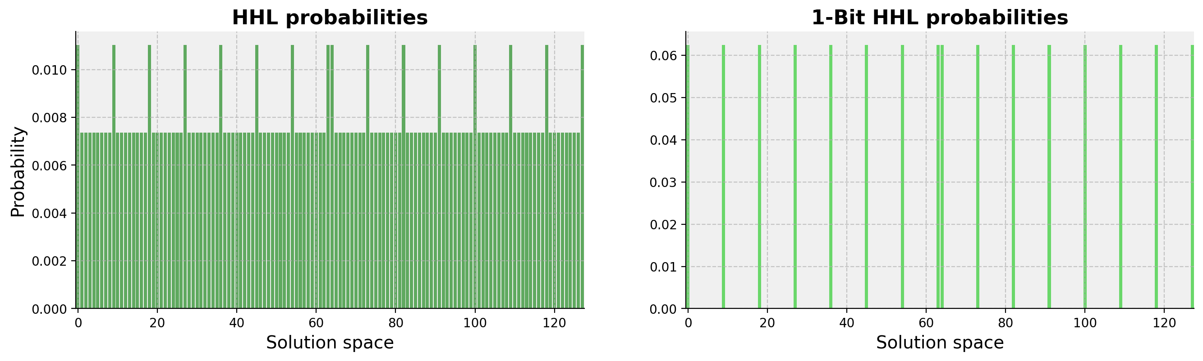
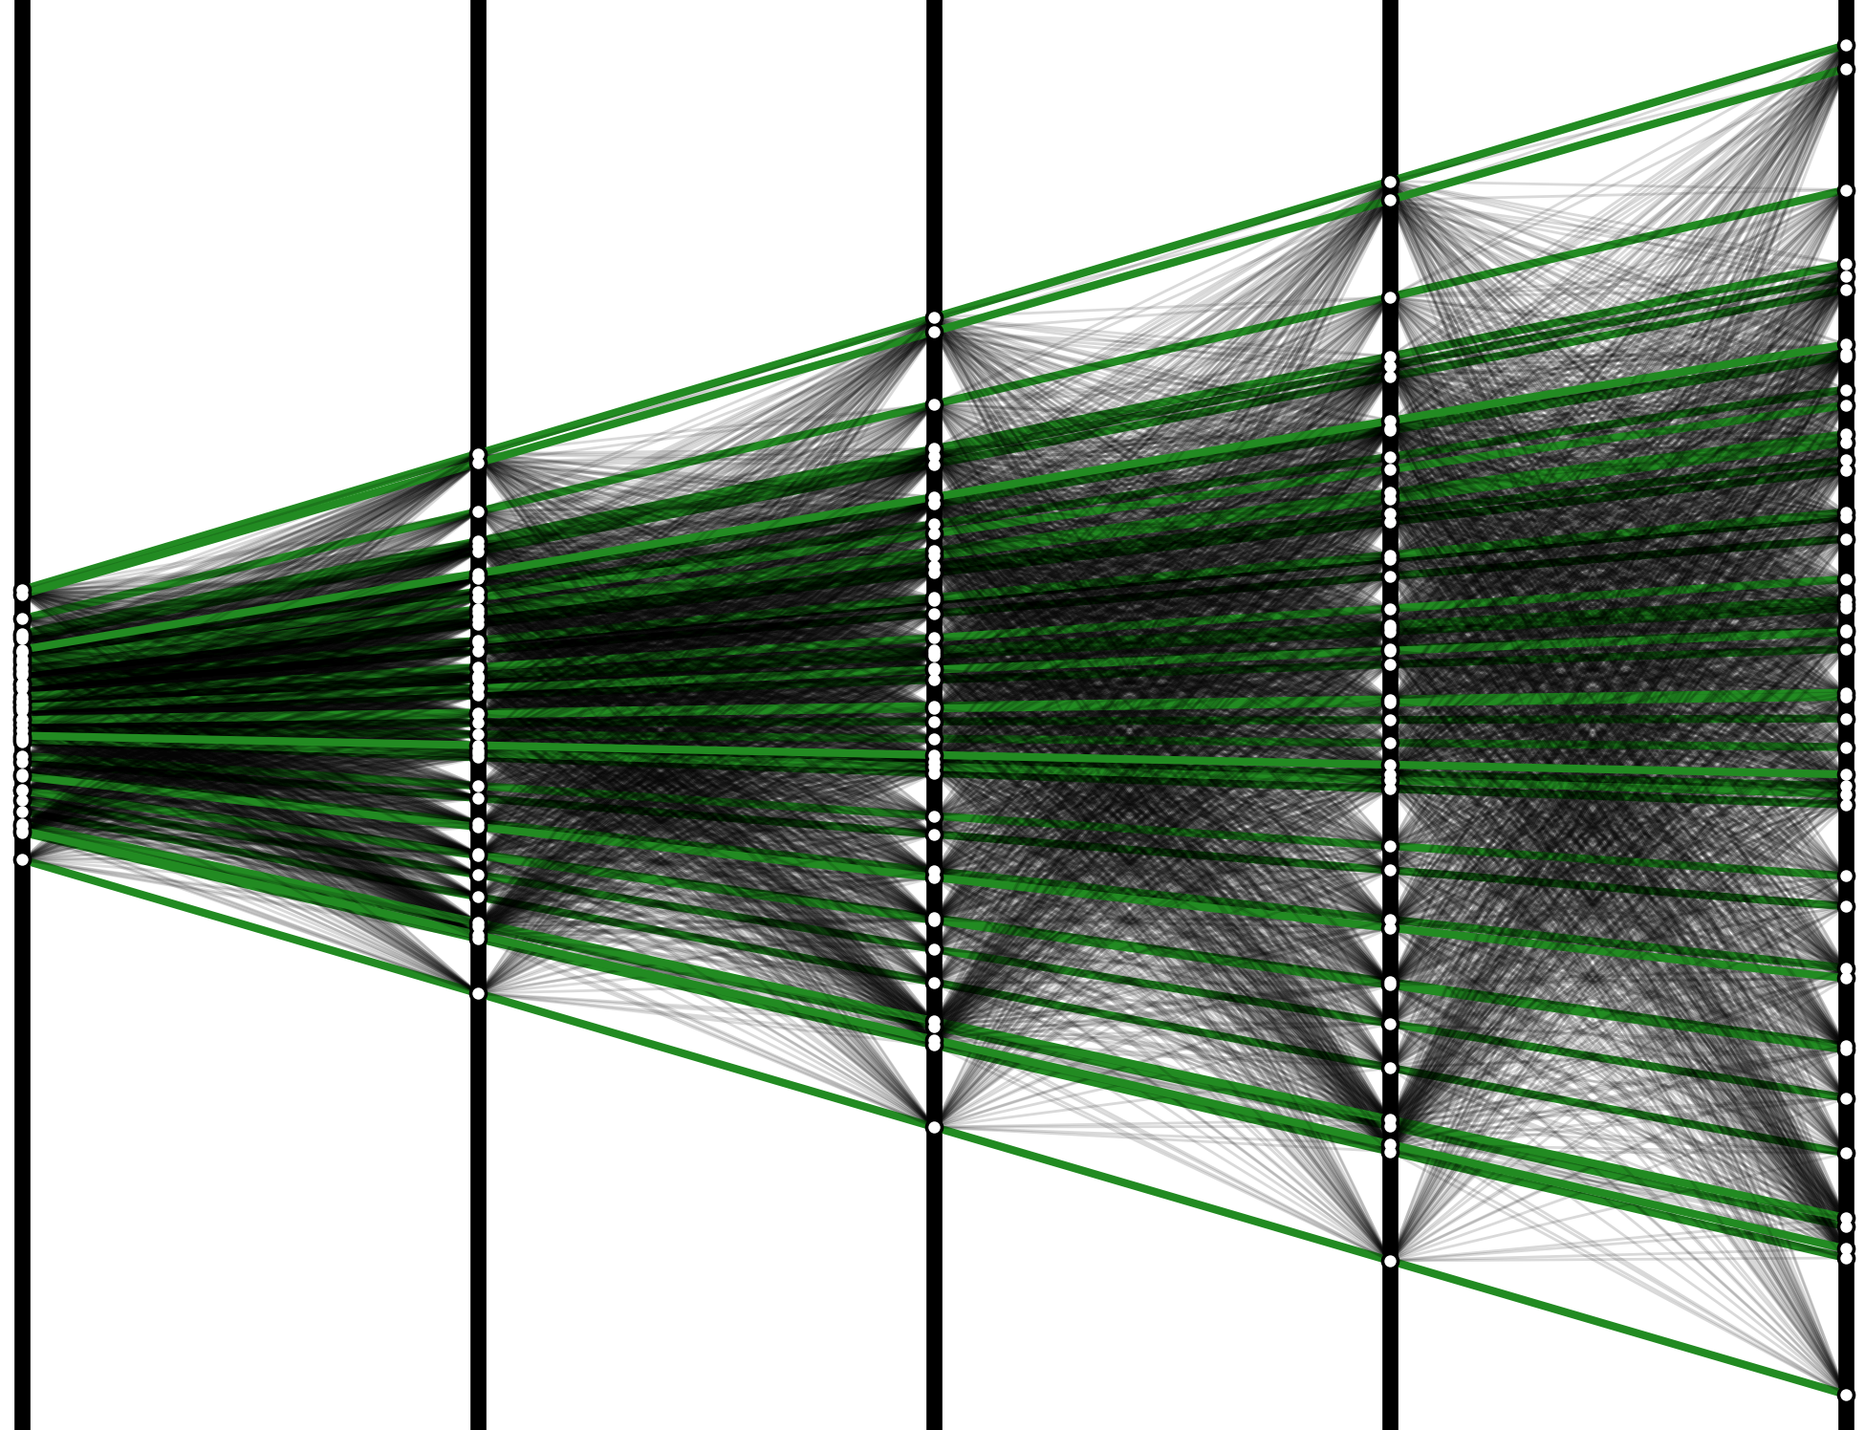


Consider the case:
Solutions “off”
$$S_{i}=0$$
Solutions “on”
$$S_{i}=1$$

Slide 10
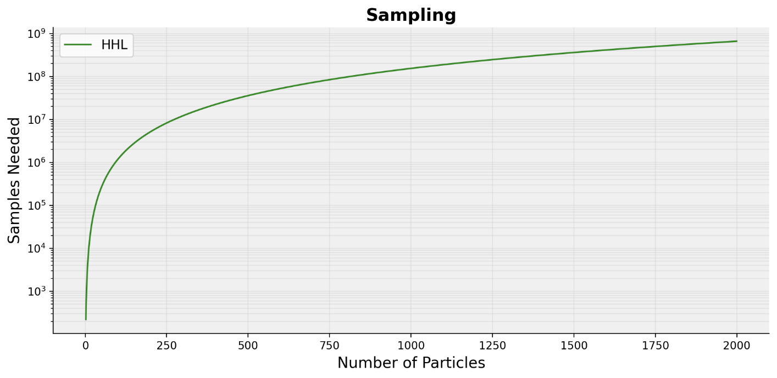
Sampling Problem

Slide 11
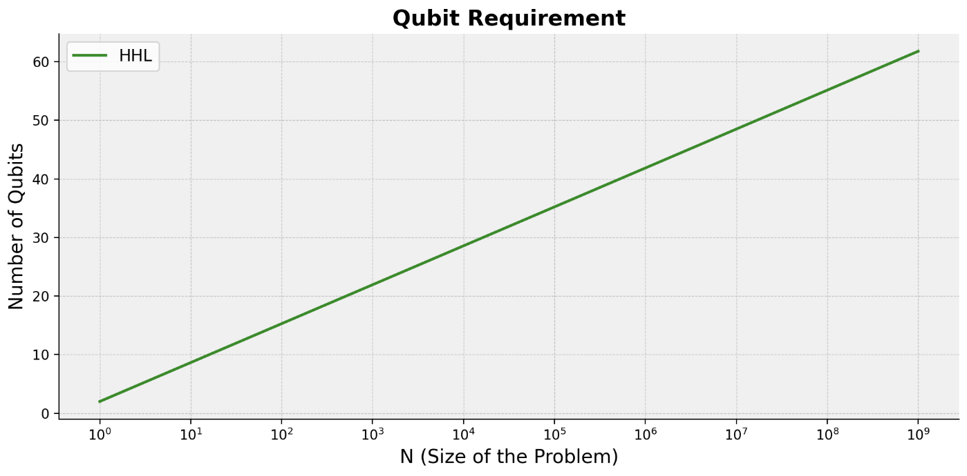
Qubit Requirement

Slide 12

1-Bit HHL
Conditional Inversion

Slide 13

Consider the case:
Solutions “off”
$$S_{i}=0$$
Solutions “on”
$$S_{i}=1$$

Slide 14
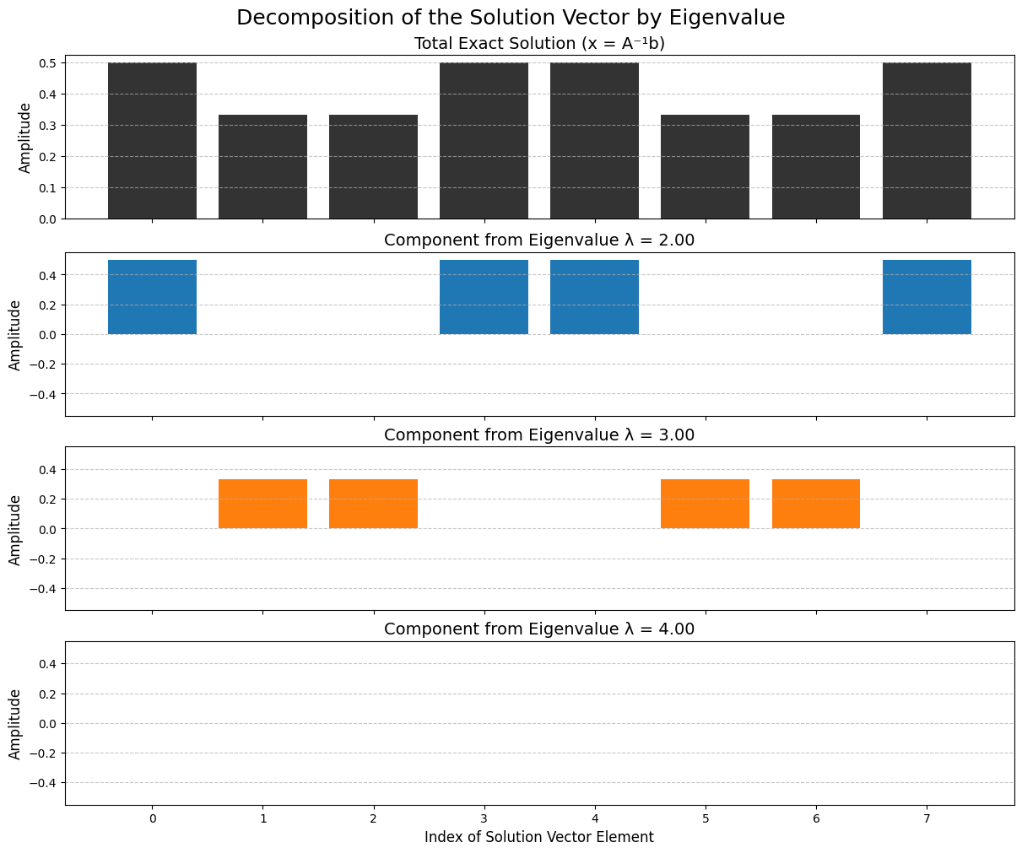
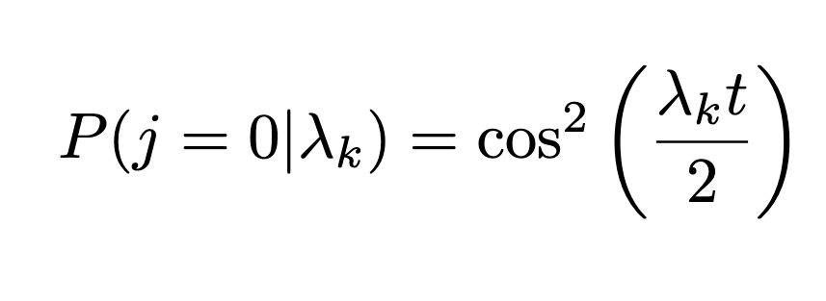
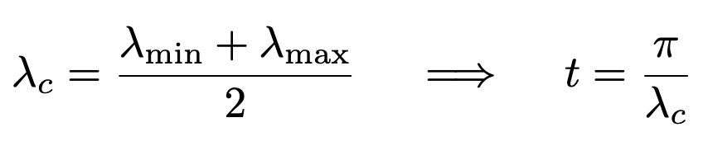
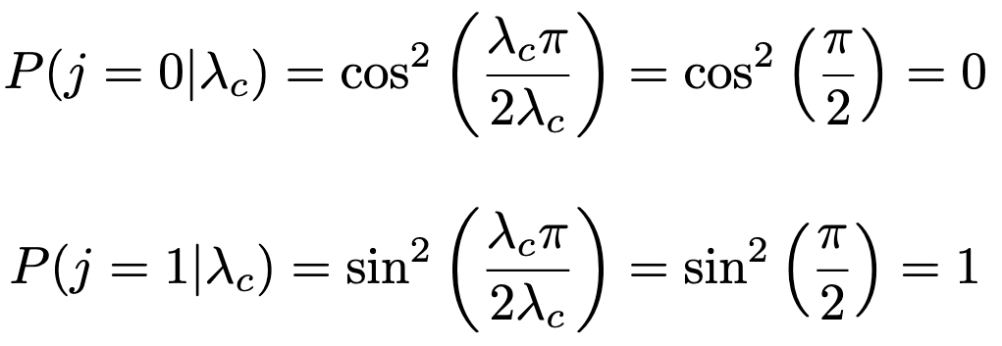
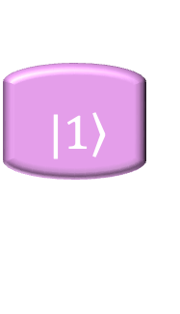

How does this work?
QPE BIN
$$|\left.0\right\rangle$$
$$|\left.1\right\rangle$$
Results from this week

Slide 15





A Quantum Clock
QPE BIN
$$λ=2$$
$$λ=3$$
$$λ=4$$
$$|\left.0\right\rangle$$
$$|\left.1\right\rangle$$
$$|\left.0\right\rangle$$
$$|\left.1\right\rangle$$

Slide 16
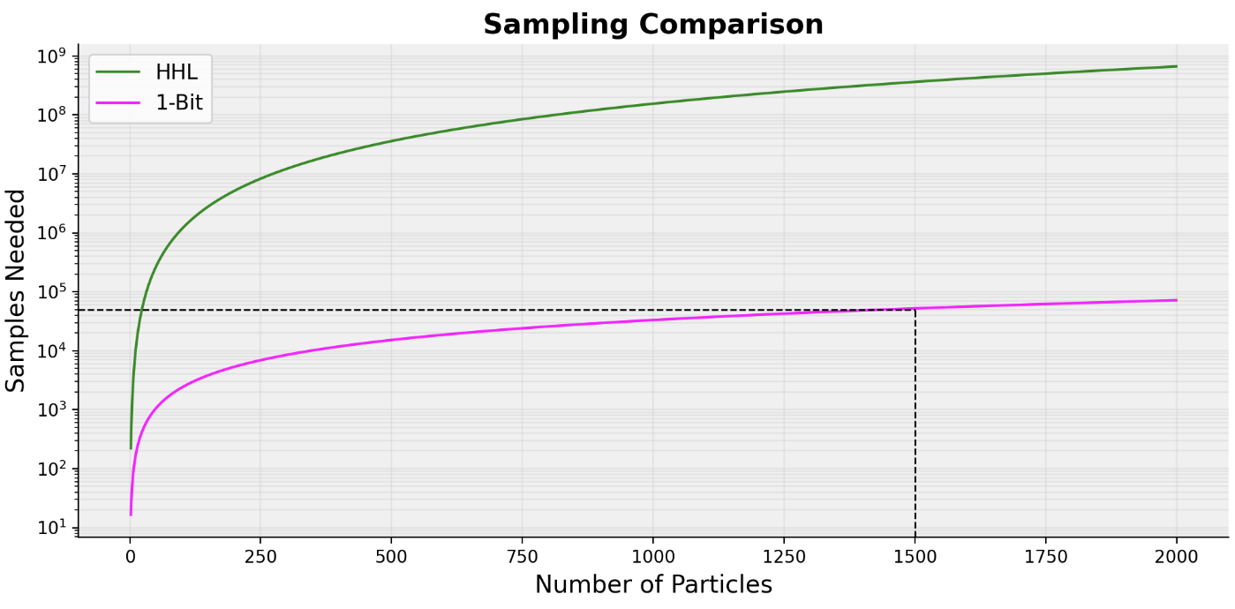
Sampling Problem

Slide 17
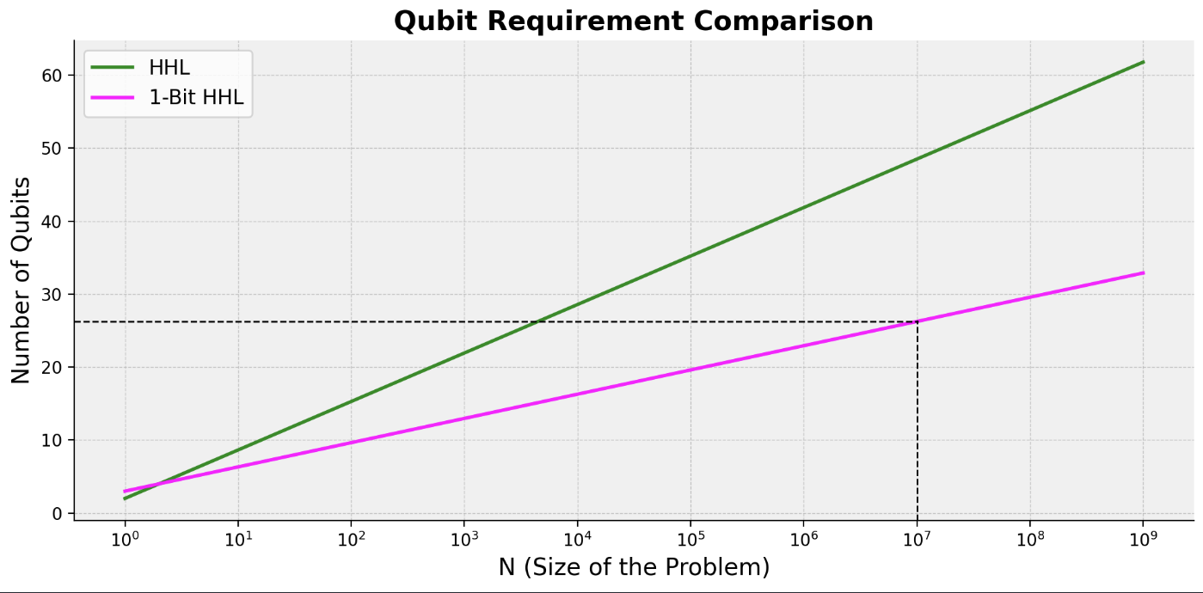
Qubit Requirement

Slide 18
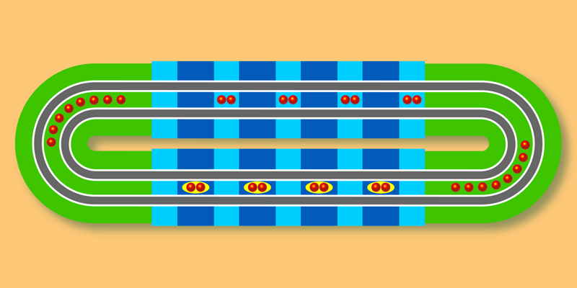
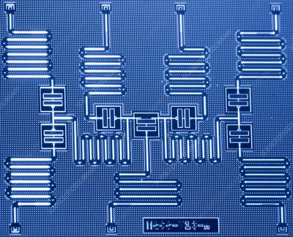
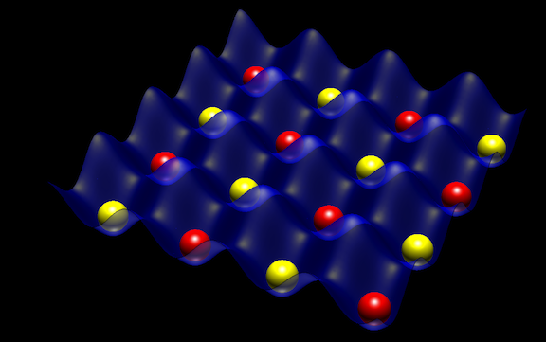
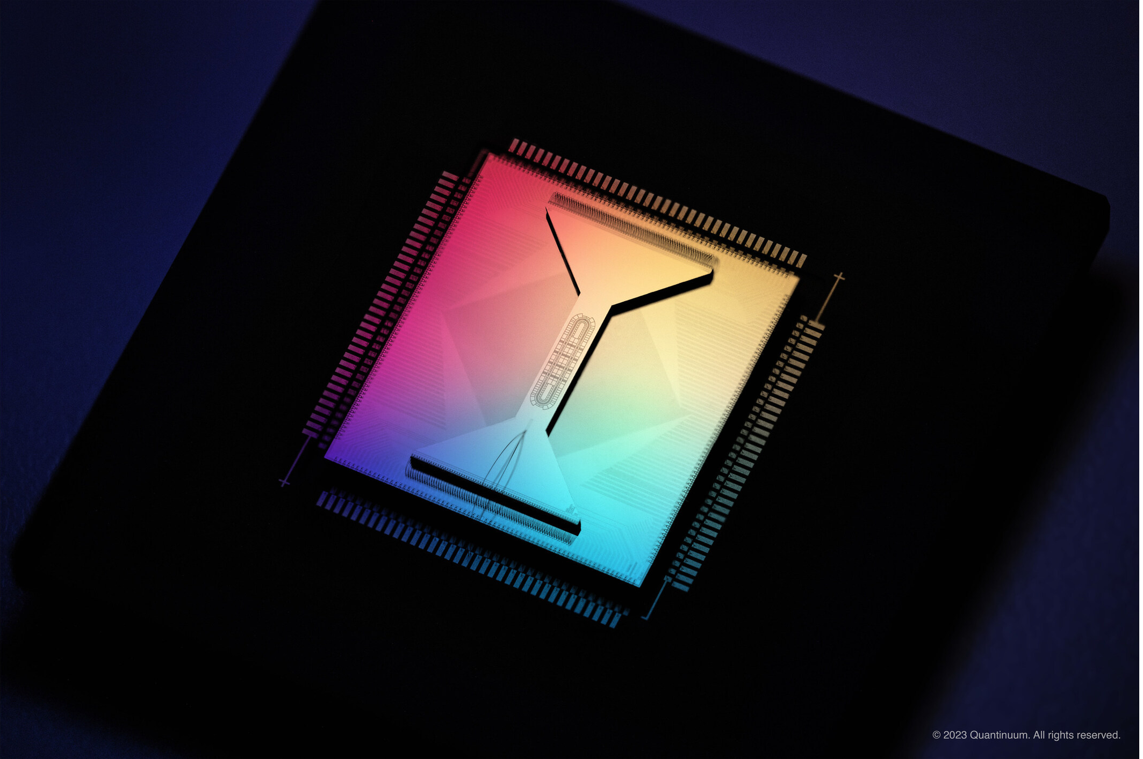
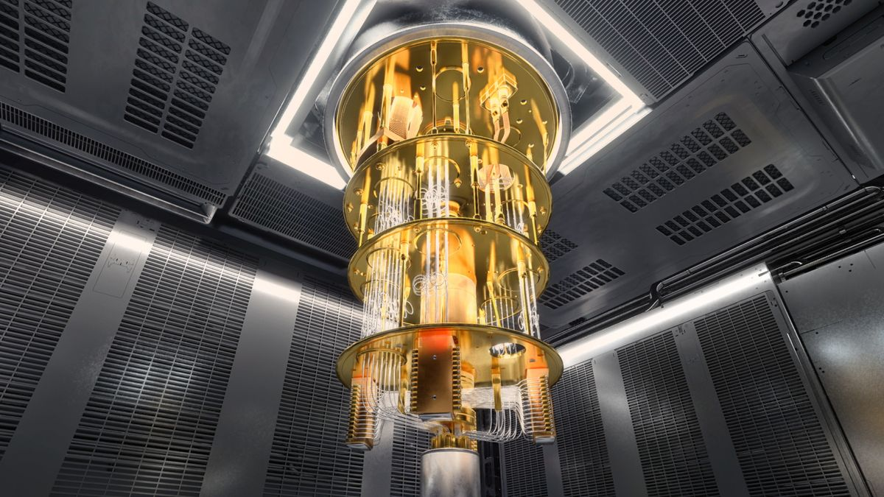
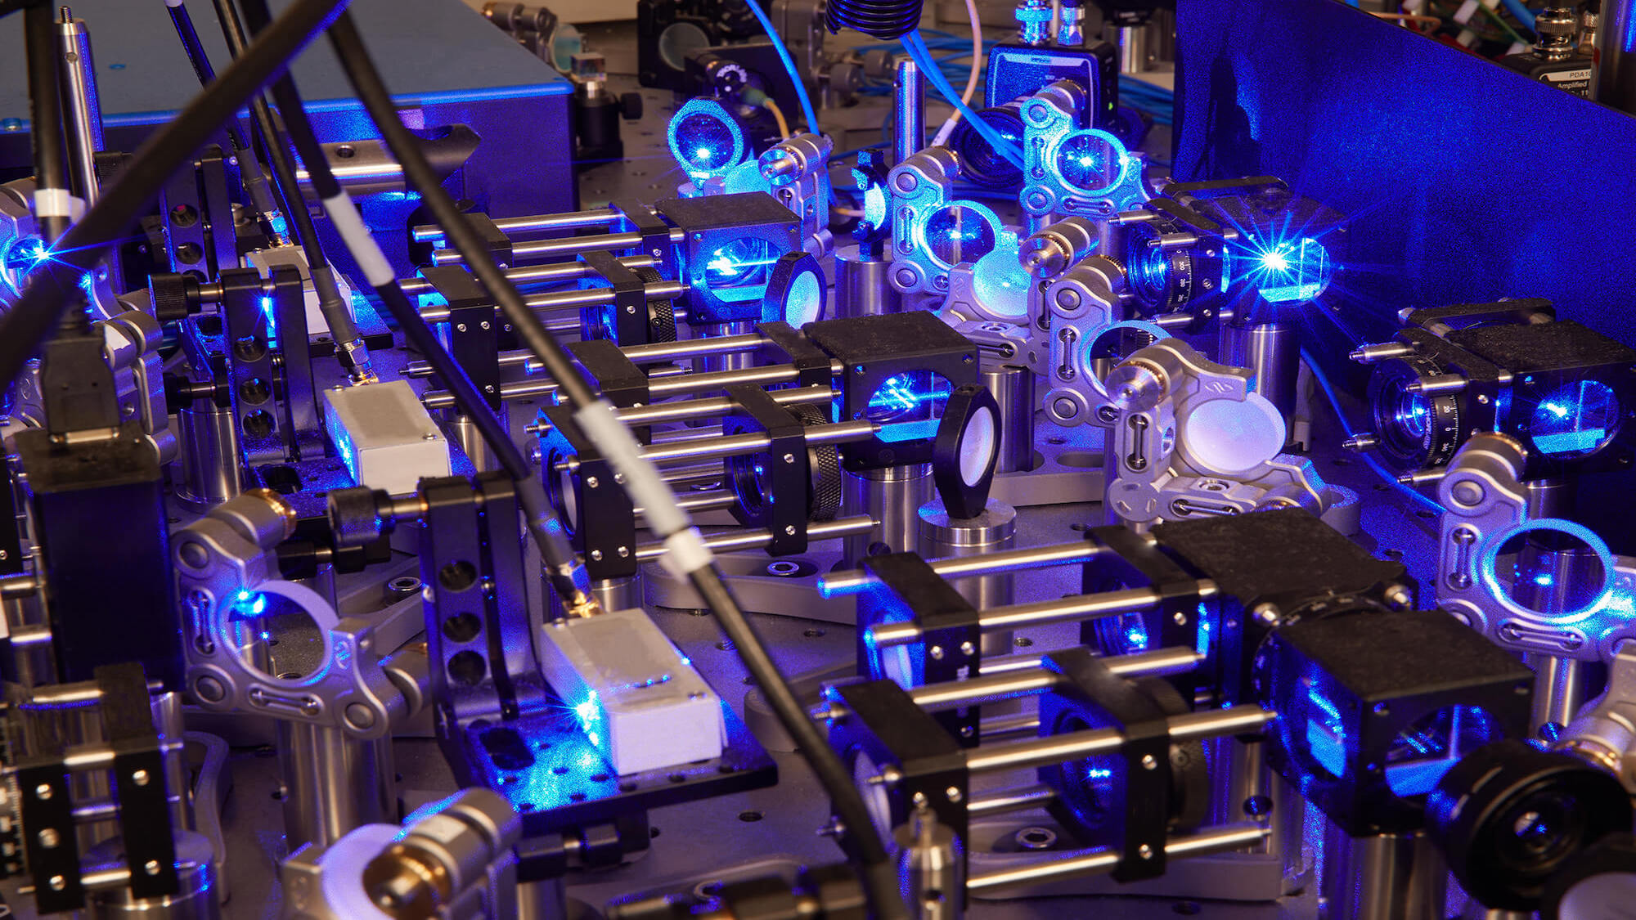
Hardware Choices
Trapped Ions (Quantinuum)
Superconducting (IBM)
Neutral Atoms (TU Eindhoven)

Slide 19
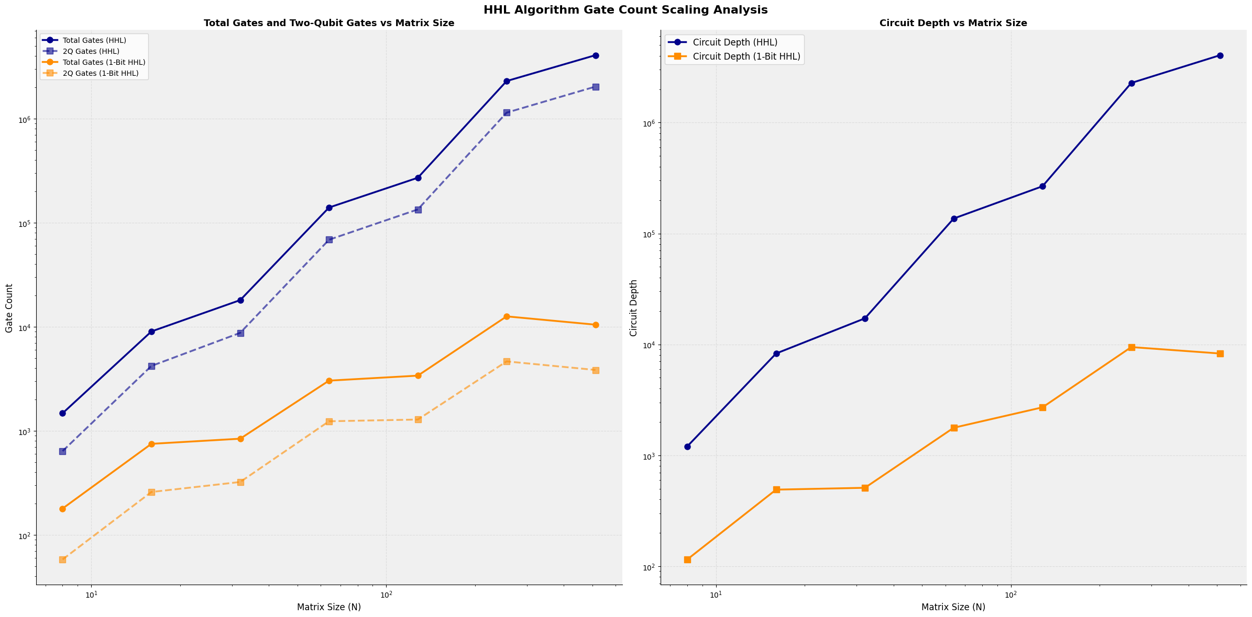
Circuit Depth (Hardware Agnostic)

Slide 20
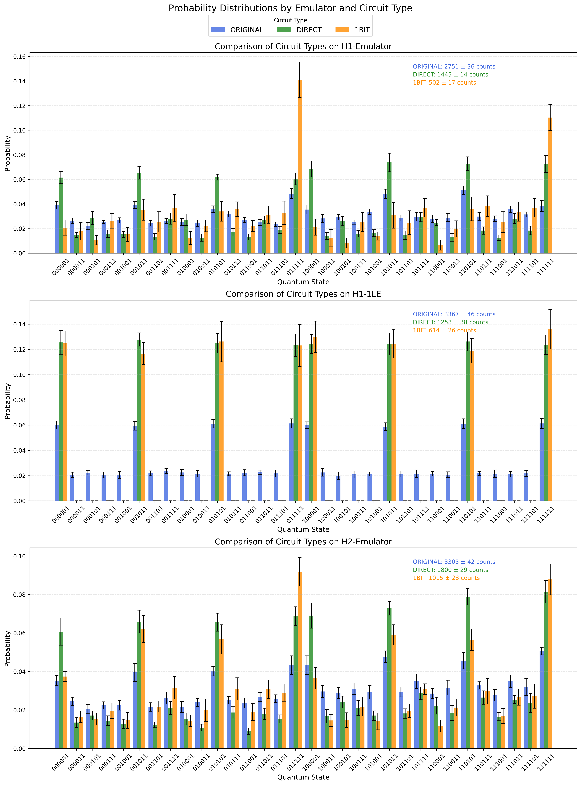
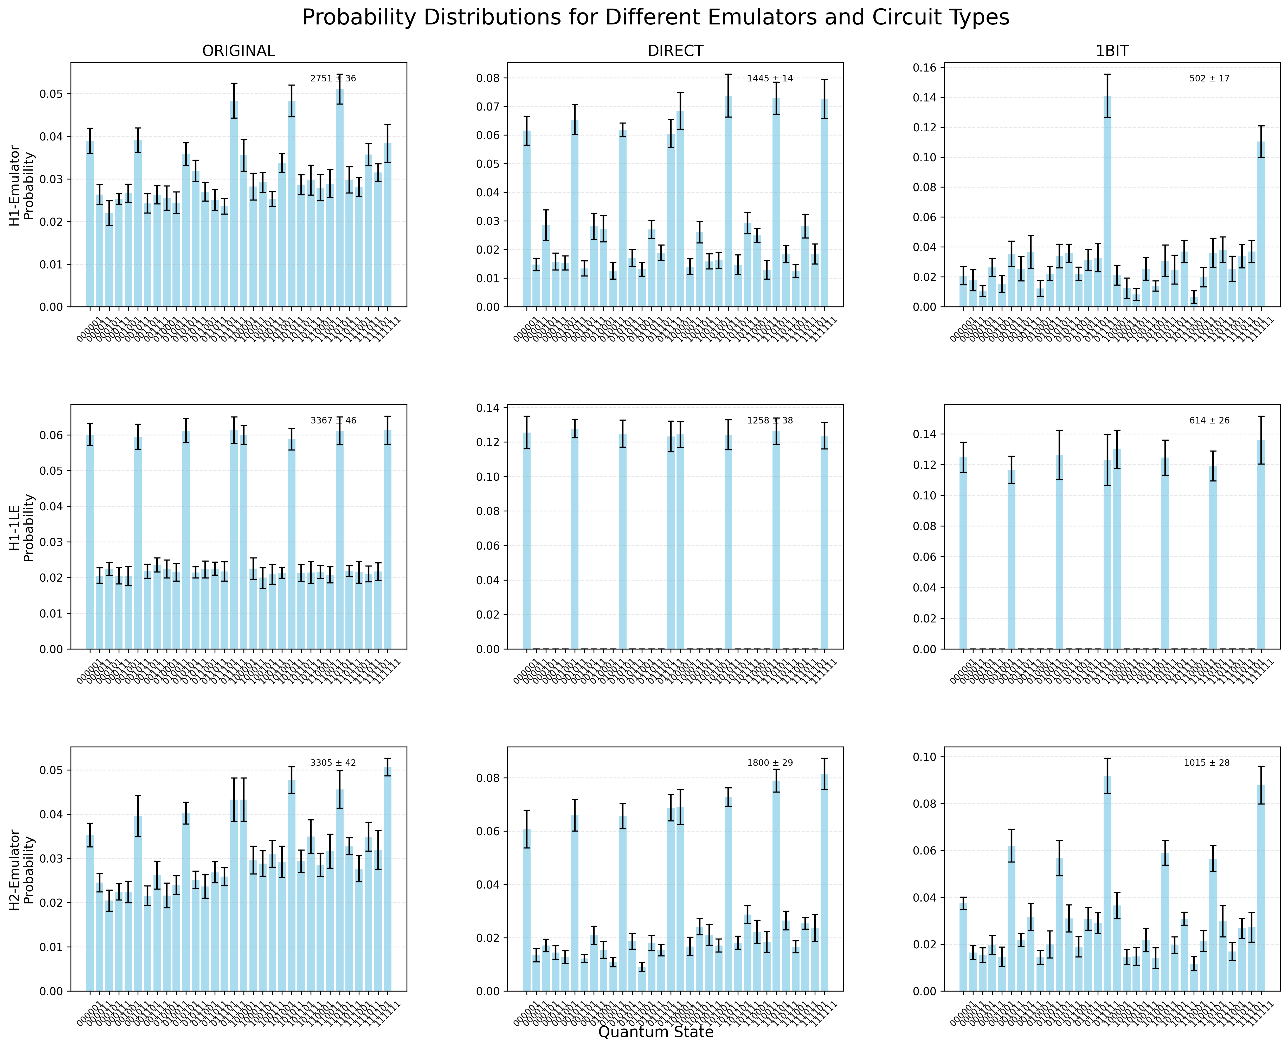
Testing Quantinuum Hardware Emulators

Slide 21
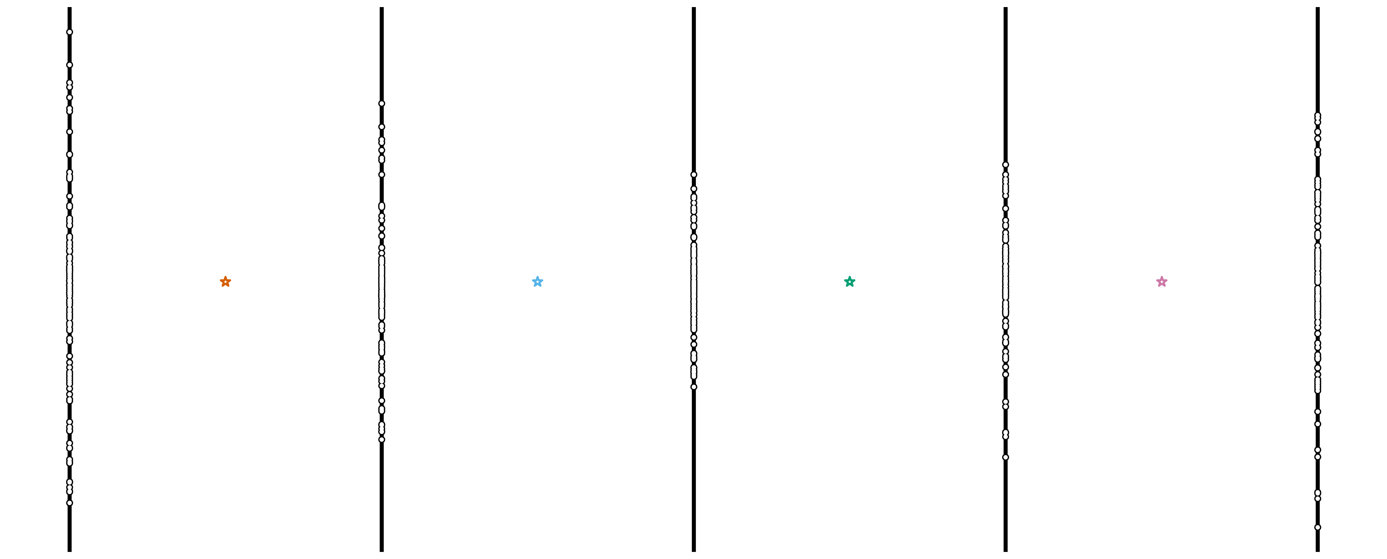

Slide 22
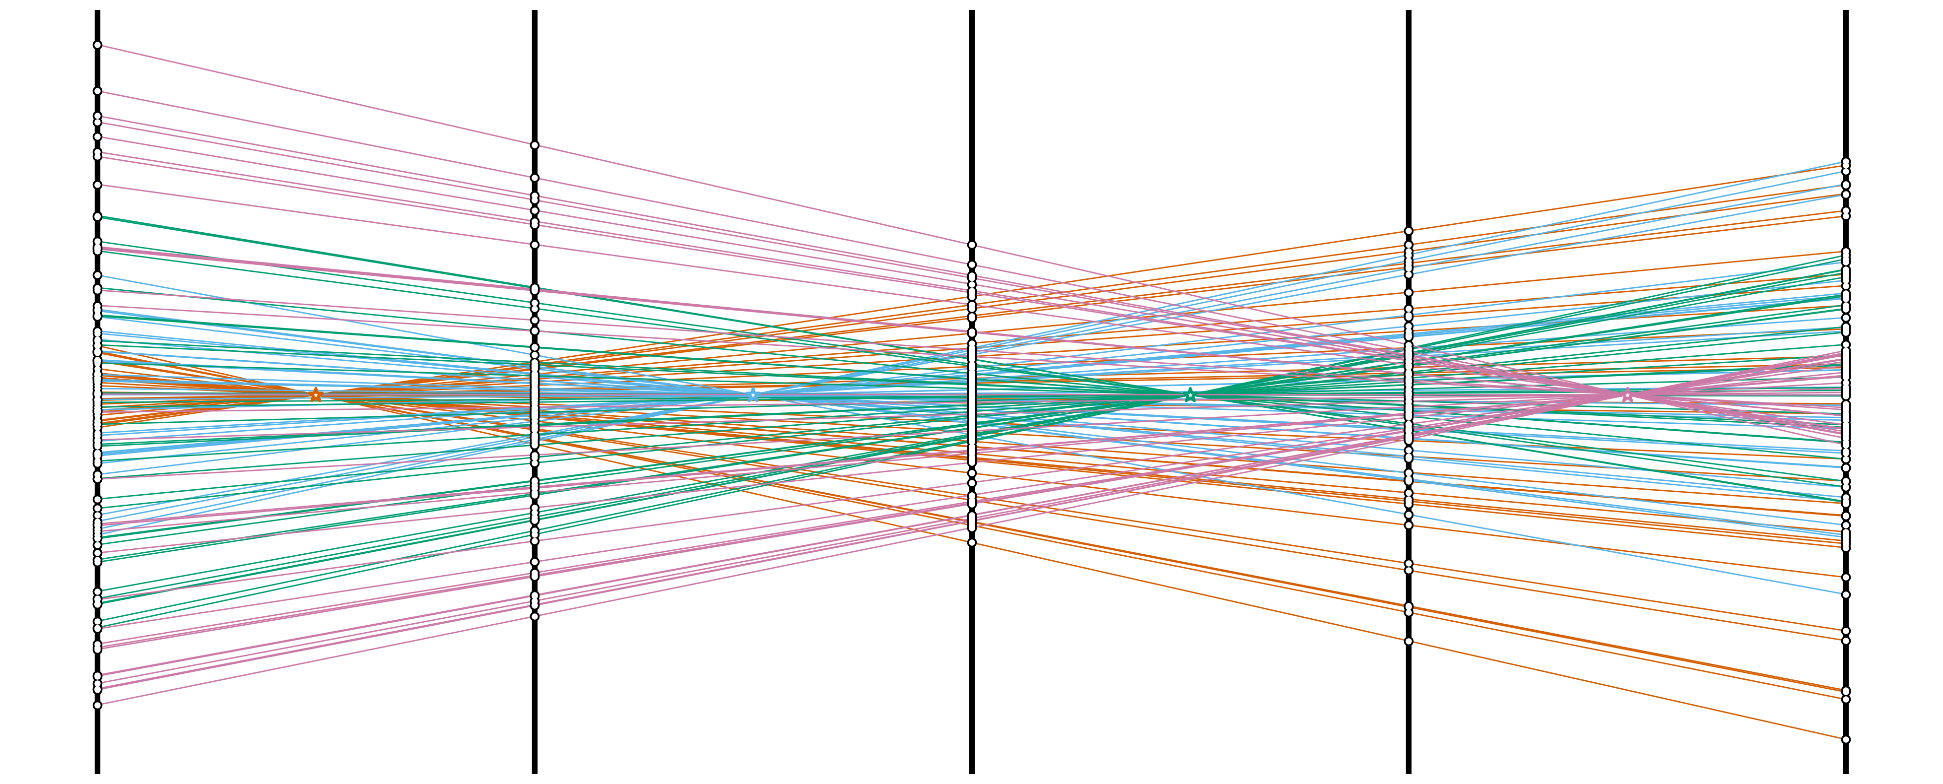

Slide 23
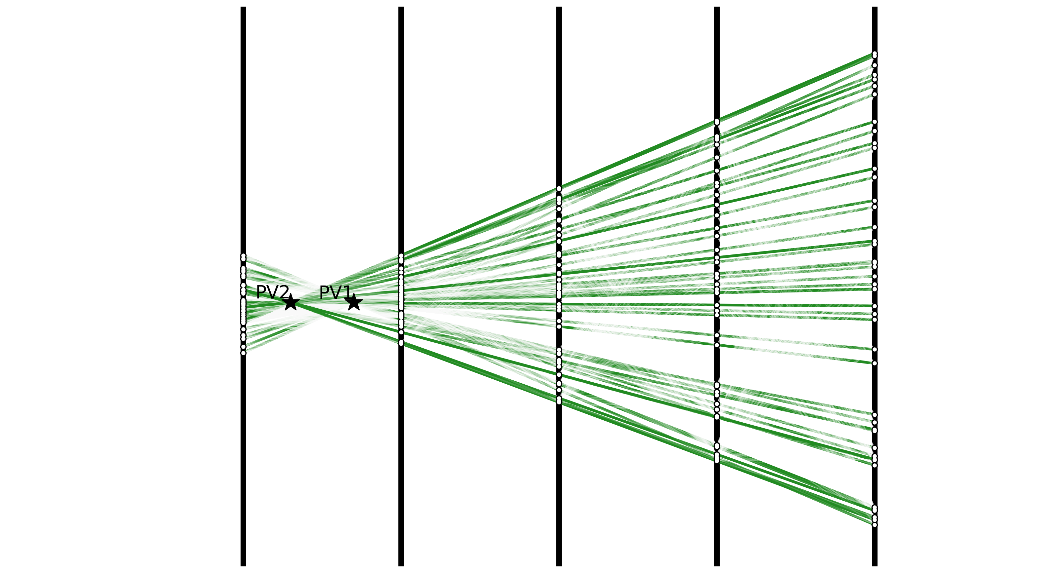
Post-processing: Vertex Reconstruction
Vertex 1
Vertex 2
Extrapolate all segments to the beam line for direct Vertex finding via Hough Transform

Slide 24
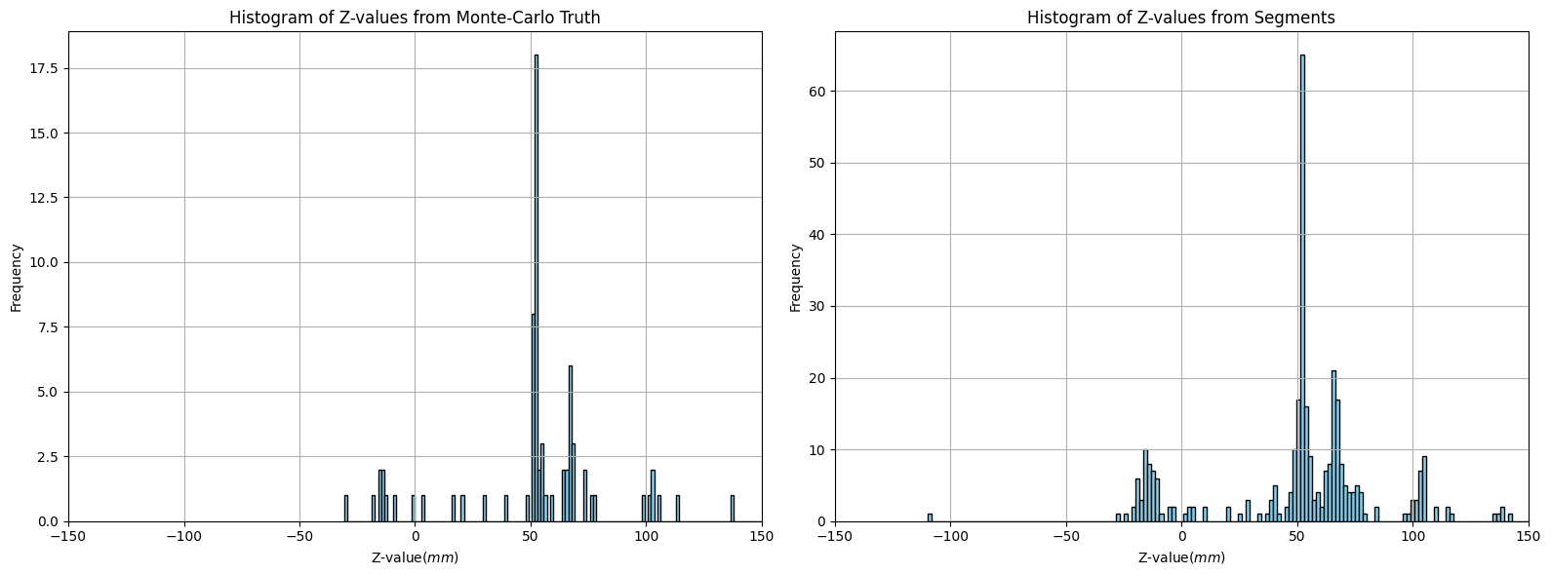
Vertex finding precision
Exact Tracks
Found Segments
Vertex-1
Vertex-2
Vertex-1
Vertex-2

Slide 25
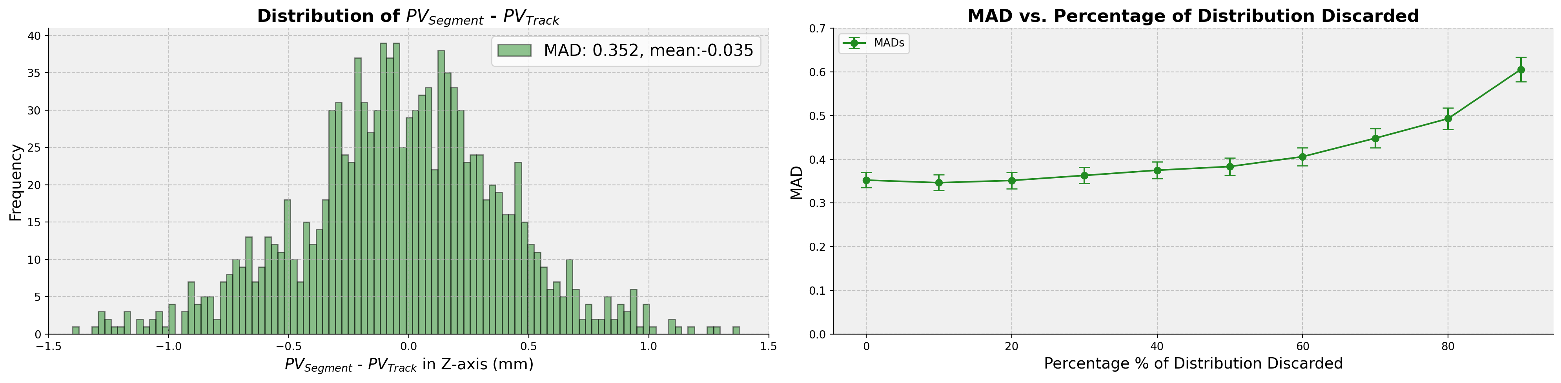
Vertex precision with fraction of segments
Distribution of precision of the
extrapolated vertex point
Mean Average Distance (MAD) of recontructed vertex
versus the fraction of segments obtained in readout
Link
Requiring only fraction (~50%) of all states → strong reduction of number of readouts

Slide 26
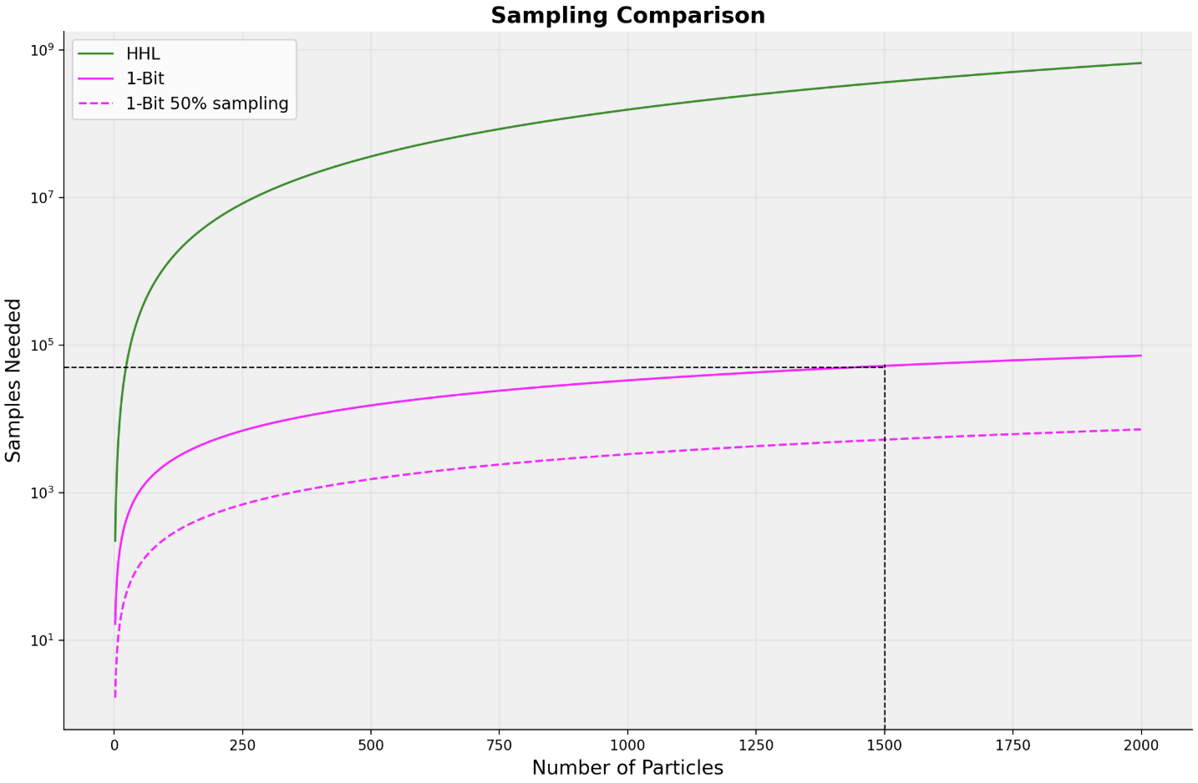
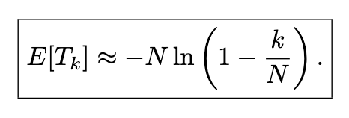
Readout issue: 1-bit QPE

Slide 27


Remaining Tasks
$$\frac{1}{n(l−1)}$$
Test Toy with Realistic detector inefficiency
Writing
$$n=Tracks, l=detecor layers$$
More efficient inversion algorithms QSVT
Quantum Method for PVs

Slide 28
Backup Slides
Xenofon Chiotopoulos
Nikhef and Maastricht University
Faster Day
October 2025

Slide 29

Circuit Transpiled for different hardware

Slide 30

Circuit Depth 1-Bit

Slide 31



Flavour Reconstruction

Slide 32




Flavour Reconstruction
Data
ROC AUC: 0.640
Optimal threshold: 0.489
B meson fraction: 0.507
Anti-B meson fraction: 0.493
B mistag rate (ω_B): 0.390
Anti-B mistag rate (ω_B̄): 0.418
Average mistag rate (ω): 0.404
Dilution factor (D = 1-2ω): 0.193
Tagging power (εD²): 0.0371 (3.71%)
MC
ROC AUC: 0.677
Optimal threshold: 0.477
B meson fraction: 0.494
Anti-B meson fraction: 0.506
B mistag rate (ω_B): 0.382
Anti-B mistag rate (ω_B̄): 0.374
Average mistag rate (ω): 0.378
Dilution factor (D = 1-2ω): 0.244
Tagging power (εD²): 0.0597 (5.97%)

