Slide 1
By Laura van der Schaaf
20.06.2017
Cavity locking, thermal effects and the phase cameras

Slide 2
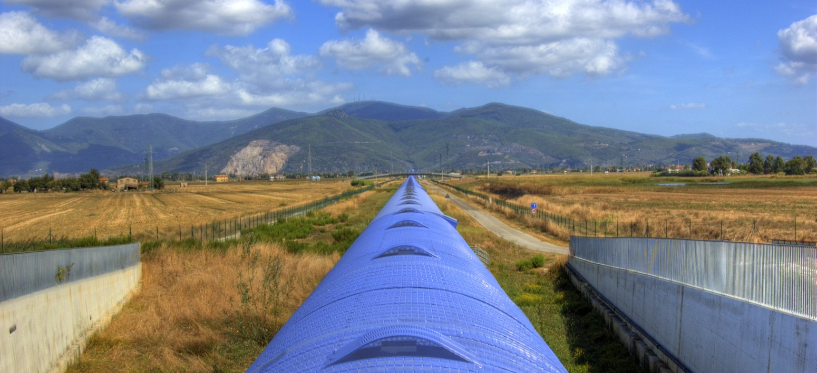
Overview
Cavity control
Effect of thermal effects on the cavity control
Thermal compensation system and the phase cameras

Slide 3
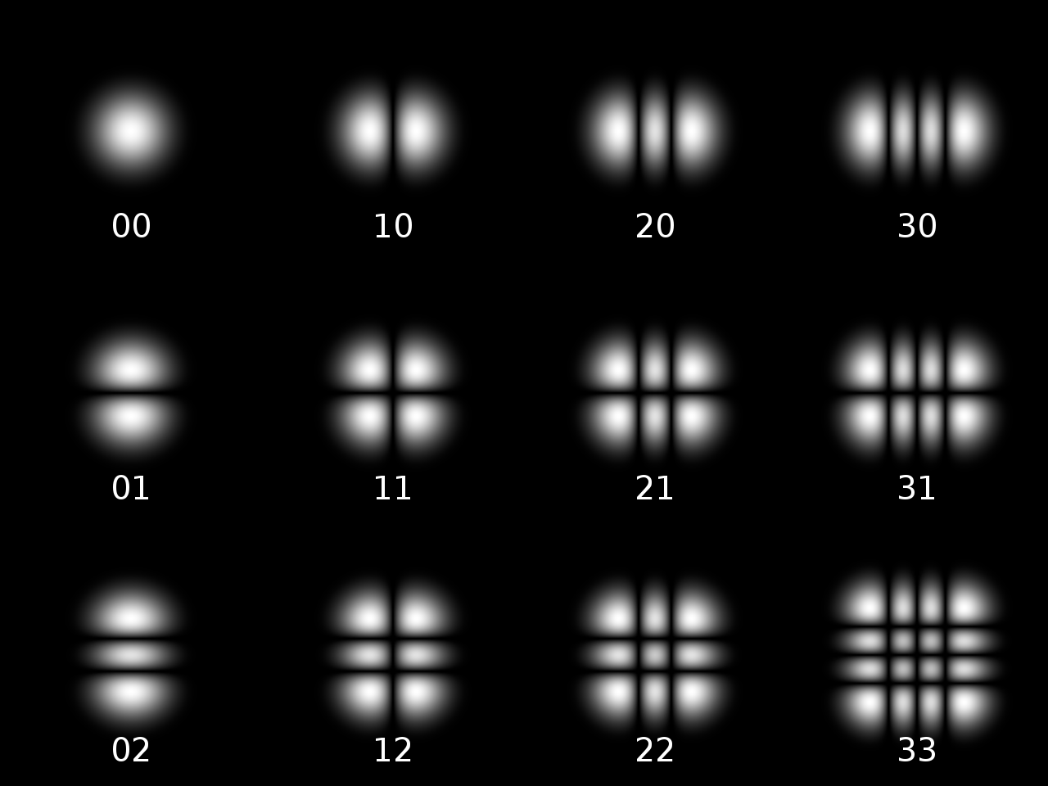
Laser light – not an infinitesimal line
In case of plane wave:
$$\vec{E}=\sum_{sb}{\sum_{mn}{c_{nm}}}A_{mn}\left(x,y,z\right)e^{−ikz}e^{i\left(w_{c}±w_{s}\right)t}\hat{E}$$
131 MHz
6 MHz
Complex amplitude
Time dependence
Part of the laser light is made to oscillate at different frequencies: sidebands
m
$$Φ\left(m,n;z\right)=\left(m+n+1\right)arctan\left(λz/πw_{0}^{2}\right)$$
Phase increases with propagation distance
Phase decreases with beam width
n
We will see that the sensitivity of AdV is affected
by this phase shift

Slide 4
Simulating cavities - Finesse
It would be far too tedious (if not impossible) to compute something as complicated as a gravitational wave detector by hand. Therefore, several simulation tools are available, amongst which Finesse. All further computations in this presentation are done in Finesse.
Finesse can be downloaded (for free!) here: http://www.gwoptics.org/finesse/
The python wrapper can be found here (yes – again for free!): http://www.gwoptics.org/pykat/
Examples can be found here: http://www.gwoptics.org/finesse/examples/
To learn about some of the parameters the following slides follow roughly the Virgo arm example
(thus the parameters deviate slightly from AdV)

Slide 5
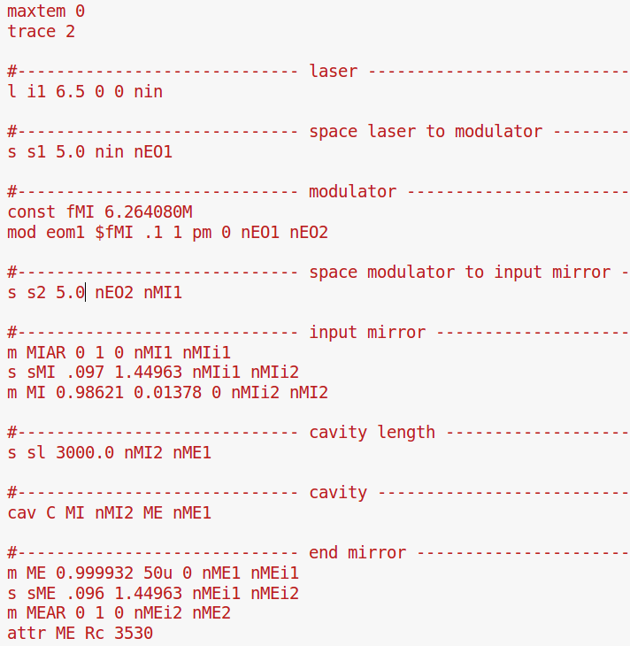
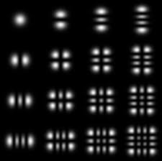
Overview of exercise cavity that we want to control
MI: reflective coating
R = 0.98621
T = 0.01378
ME: reflective coating
R = 0.999932
T = 50e-6
Rc = 3530 m
I1: 6.5 W
1064 nm
nin
nEO1
nEO2
nMI1
nMI2
nME1
nME2
eom1
s1: 5 m
s2: 5 m
s: 3000 m
sMI: 9.7 cm
sME: 9.6 cm
maxtem 0 sets the basis for the intensity distribution of the laser light:
For now only this mode
mod eom1 adds sidebands at the frequency fMI, with modulation index 0.1 and order 1:
1
0.1
f [Hz]
6.264080 MHz

Slide 6
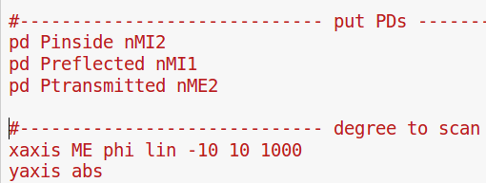
Overview of exercise cavity that we want to control
MI: reflective coating
R = 0.98621
T = 0.01378
ME: reflective coating
R = 0.999932
T = 50e-6
Rc = 3530 m
I1: 6.5 W
1064 nm
nin
nEO1
nEO2
nMI1
nMI2
nME1
nME2
eom1
s1: 5 m
s2: 5 m
s: 3000 m
sMI: 9.7 cm
sME: 9.6 cm
Place some (virtual) photo detectors to see
the cavity response to changing arm length

Slide 7
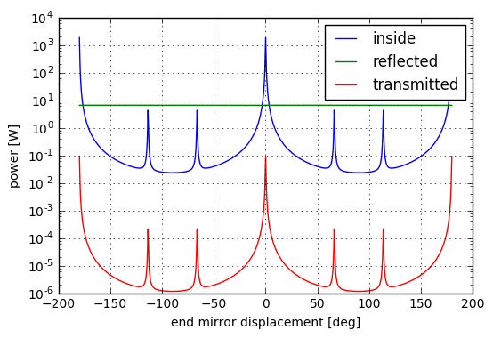
Overview of exercise cavity that we want to control
MI: reflective coating
R = 0.98621
T = 0.01378
ME: reflective coating
R = 0.999932
T = 50e-6
Rc = 3530 m
I1: 6.5 W
1064 nm
nin
nEO1
nEO2
nMI1
nMI2
nME1
nME2
eom1
s1: 5 m
s2: 5 m
s: 3000 m
sMI: 9.7 cm
sME: 9.6 cm
transmitted
reflected
inside
$$2kLmod2π=0$$
By scanning the length of the cavity resonances occur.
Resonance condition:
$$2kLmod2π=0$$
Wavenumber k different for the three frequency components.

Slide 8
Locking the cavity – is the current information sufficient?
Power inside the cavity (and in the transmitted beam) drops when:
Cavity gets longer
Cavity gets shorter
Laser power fluctuates
Cavity cannot be locked to the working point by just monitoring the power at different ports.

Slide 9
Demodulation
Construct an error signal which is zero at the locking point and has opposite signs for too long respectively too short cavities.
Method:
- measure the power of the beam with a fast diode:
Transfer function for location of interferometer where you are looking at the signal (example transmission)
Power in carrier
after EOM
Power in sideband
after EOM
DC contribution
RF contribution
Part we want to extract next – the error signal

Slide 10
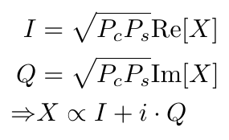
Demodulation
Demodulate to get the quantity X:
1. Multiply with local oscillator:
2. Low-pass filter to get the I and Q values (resp. X):

Slide 11
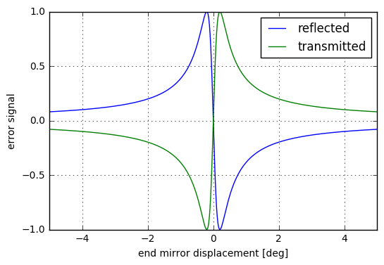
(part of) X as error signal
By demodulating and low pass filtering at the sideband frequency X can be measured. In Finesse a detector for demodulation already exists, with the following code the I value (real part of X) is measured and can be used as an error signal.
With this signal we can lock the cavity such that the power in the cavity is maximized. The sign of the error signal differs for too long/too short cavity and is not affected by laser power fluctuations.

Slide 12
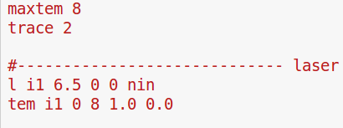
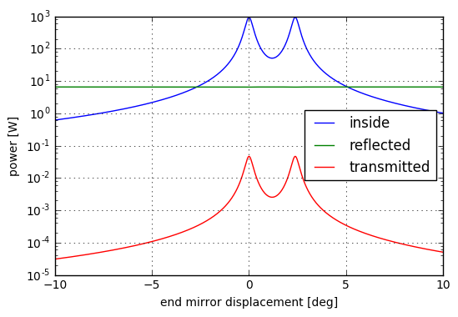
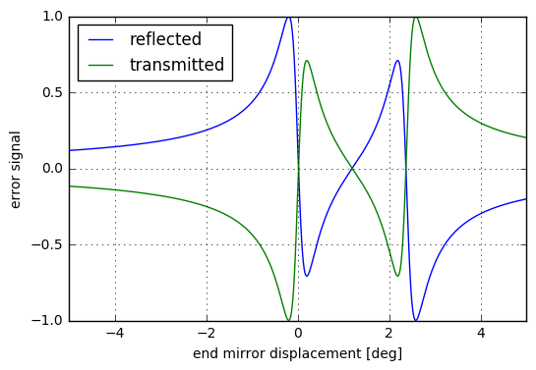
Is there any thing that can affect the error signal in an unwanted manner?
Before only this mode
For a different mode the error signal looks different – might lock onto the 8 0 mode by mistake
→ problems with for example angular controls

Slide 13
Remember the statement from the beginning?
Laser light – not an infinitesimal line
In case of plane wave:
$$\vec{E}=\sum_{sb}{\sum_{mn}{c_{nm}}}A_{mn}\left(x,y,z\right)e^{−ikz}e^{i\left(w_{c}±w_{s}\right)t}\hat{E}$$
131 MHz
6 MHz
Complex amplitude
Time dependence
Part of the laser light is made to oscillate at different frequencies: sidebands
m
$$Φ\left(m,n;z\right)=\left(m+n+1\right)arctan\left(λz/πw_{0}^{2}\right)$$
Phase increases with propagation distance
Phase decreases with beam width
n
We will see that the sensitivity of AdV is affected by this phase shift

Slide 14
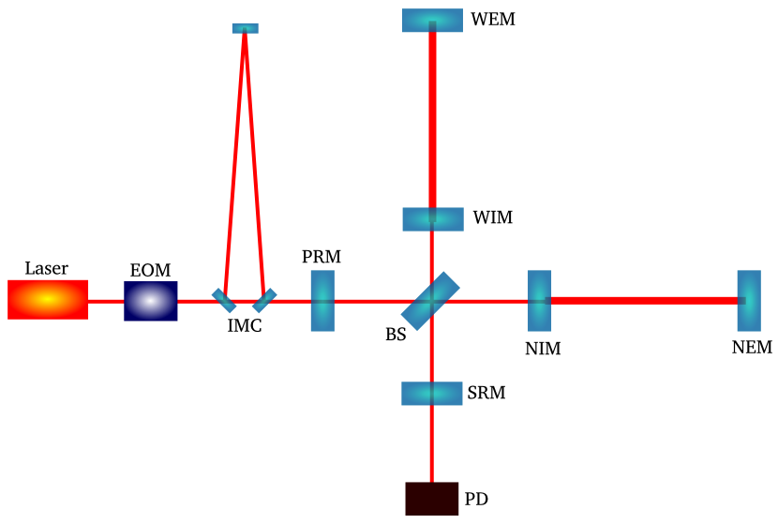
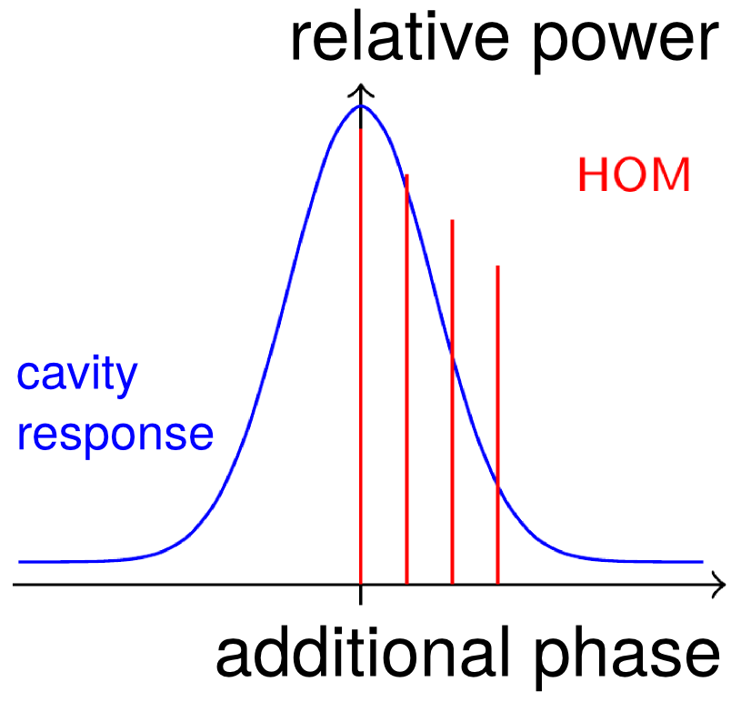
The marginally stable power recycling cavity
Higher order modes:
Higher order modes (HOM) can cause unstable control signals and a reduction of the sensitivity of the interferometer
Power recycling cavity shorter than the arms with larger beam waist
→ more likely to harbor higher order modes

Slide 15
The marginally stable power recycling cavity
Higher order modes:
Higher order modes (HOM) can cause unstable control signals and a reduction of the sensitivity of the interferometer
IMC (input mode cleaner):
Filters out higher order modes from the input.
The IMC cleanes the input light → there should be no significant contributions from higher order modes at the input

Slide 16
Where do higher order modes come from?
Substrate inhomogeneities
Thermal lensing
Coating errors
$$L_{opt}=n\left(T\right)⋅L_{geom}$$

Slide 17
Plan of action against higher order modes
Compensation plates
Phase cameras
(sensor)
CO2-lasers
(only one shown)
information

Slide 18
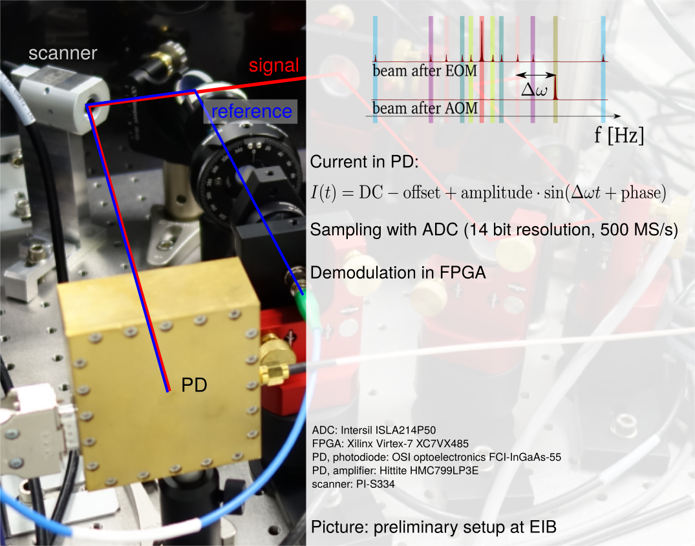
Scan the laser front with Archimedean spiral to get phase and amplitude maps.
Typical beam size 833 μm
PD aperture 55 μm
5

Slide 19
Demodulation for PC
Add computation

Slide 20
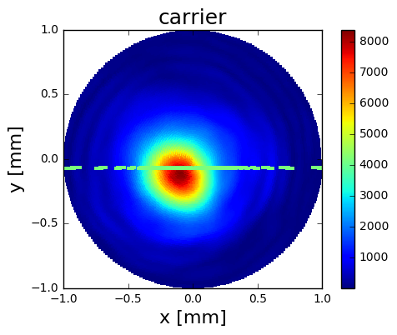
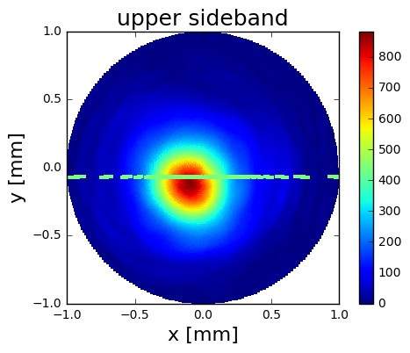
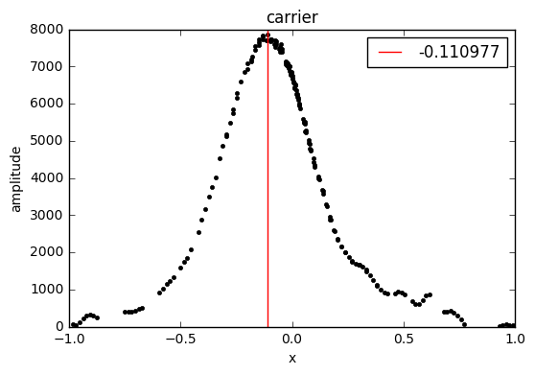
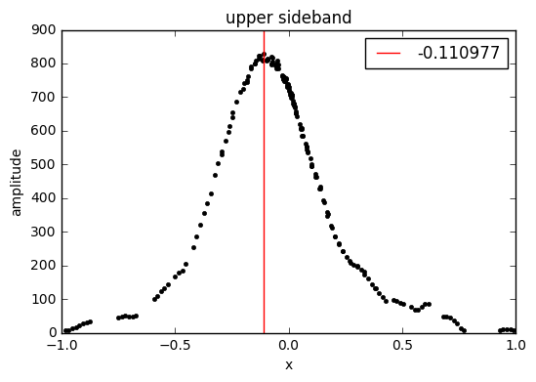
Amplitude maps
Example of amplitude maps for carrier and sideband from the Nikhef Prototype.

Slide 21
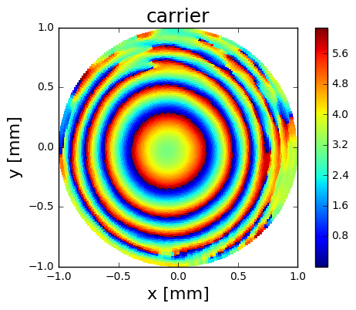
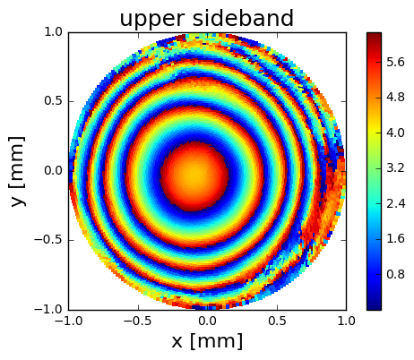
Phase maps
Buried inside the phase maps is distance information – and thus information on the thermal effects that altered the effective path length.

Slide 22
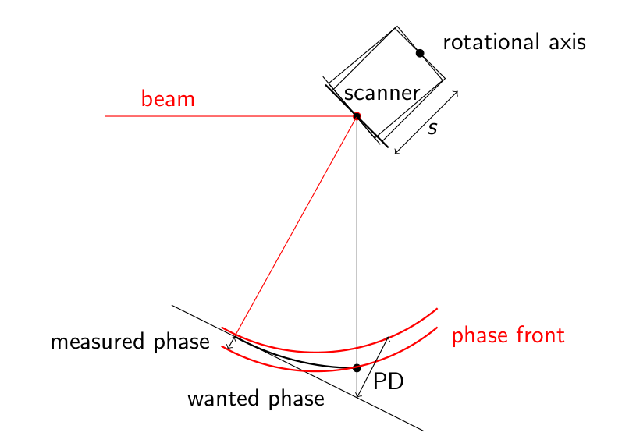
Phase images dominated by the scanner
Phase images are dominated by the scanner – either calibrate for scanner effect or work with relative phase images (phase of sideband – phase of carrier).

Slide 23
Make a movie of the amplitude images over time for the two ports
Show phase movies if they look sensible

Slide 24
Following slides wont be used

Slide 25
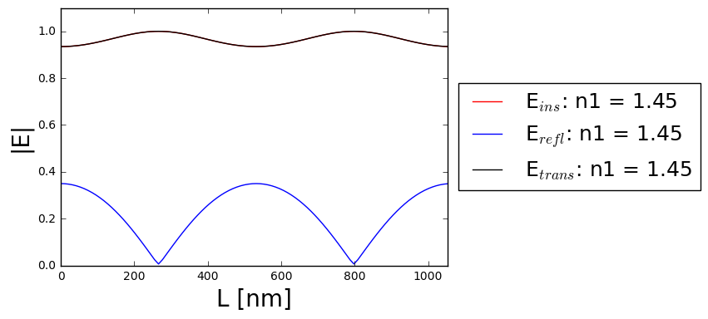
Reminder of the working principle of a cavity
In interferometric gravitational wave detectors several cavities are employed. This slide is an overview of the basic physics involved in cavities. For simplicity plane waves are used.
Einc
M1
Eins
M2
Etrans
$$E_{ins}=t_{as}^{1}t_{sa}^{1}E_{inc}−r_{as}^{1}r_{as}^{2}e^{2ikL}E_{ins}$$
L
$$→E_{ins}=\frac{t_{as}^{1}t_{sa}^{2}}{1+r_{as}^{1}r_{as}^{2}e^{2ikL}}E_{inc}$$
Erefl
$$→E_{trans}=E_{ins}t_{as}^{2}t_{sa}^{2}e^{ikL}$$
$$→E_{refl}={ir}_{as}^{1}E_{inc}+{ir}_{as}^{2}t_{as}^{1}t_{sa}^{1}e^{2ikL}E_{ins}$$
Plugging values into the equations:
The electric field amplitude and thus
the power depend on the length of the cavity.
In principle cavities should be usable
to measure the distance between two mirrors.

Slide 26
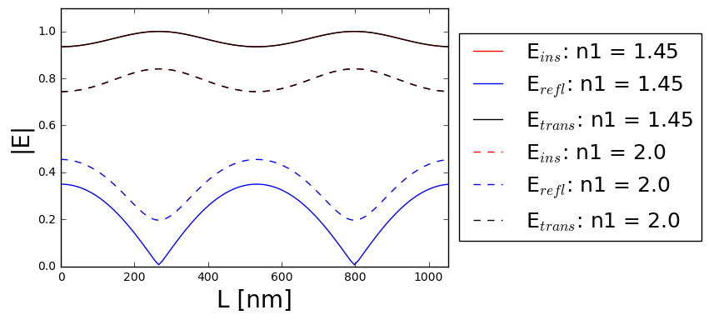
Effect of temperature on the simple model
In interferometric gravitational wave detectors several cavities are employed. This slide is an overview of the basic physics involved in cavities. For simplicity plane waves are used.
Reflectivity and transmissivity given by the Fresnel equations, depend on:
Material
Polarization
Propagation direction
temperature
Temperature changes affect:
shape of mirror
(heating mirrors makes them bulge outwards)
refractive index:
- due to temperature
- due to bulging outwards
Small note of warning:
In optics you have reflectivity and reflectance
Reflectivity: how much amplitude is reflected
Reflectance: how much power is reflected
And similarly for transmissivity and transmittance
Plugging values into the equations:
Einc
M1
Eins
M2
Etrans
L
n2 = 1.45
Erefl
Already with this super simple model
we see that temperature effects can
alter the laser power at the different
locations in/outside the cavity.

