Slide 1


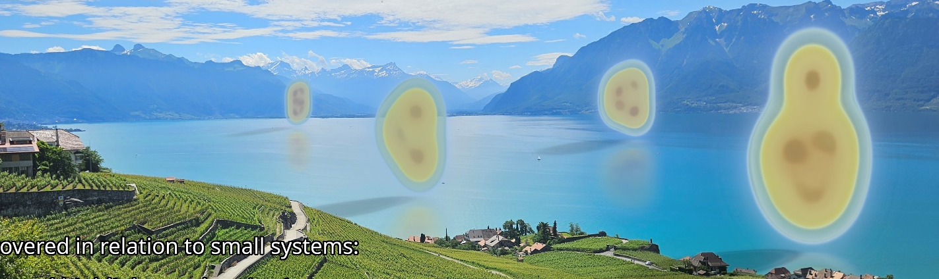
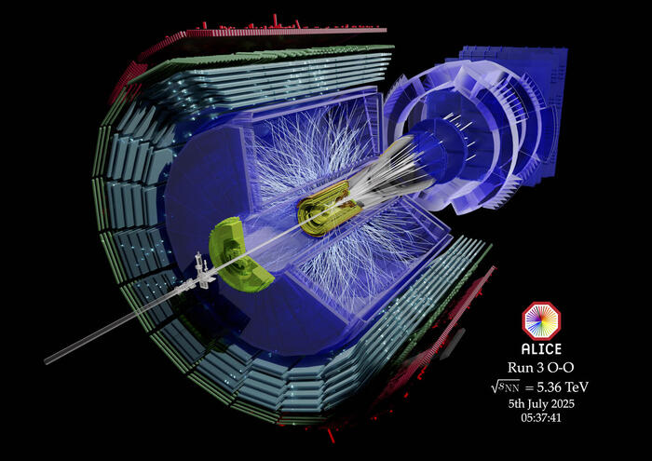
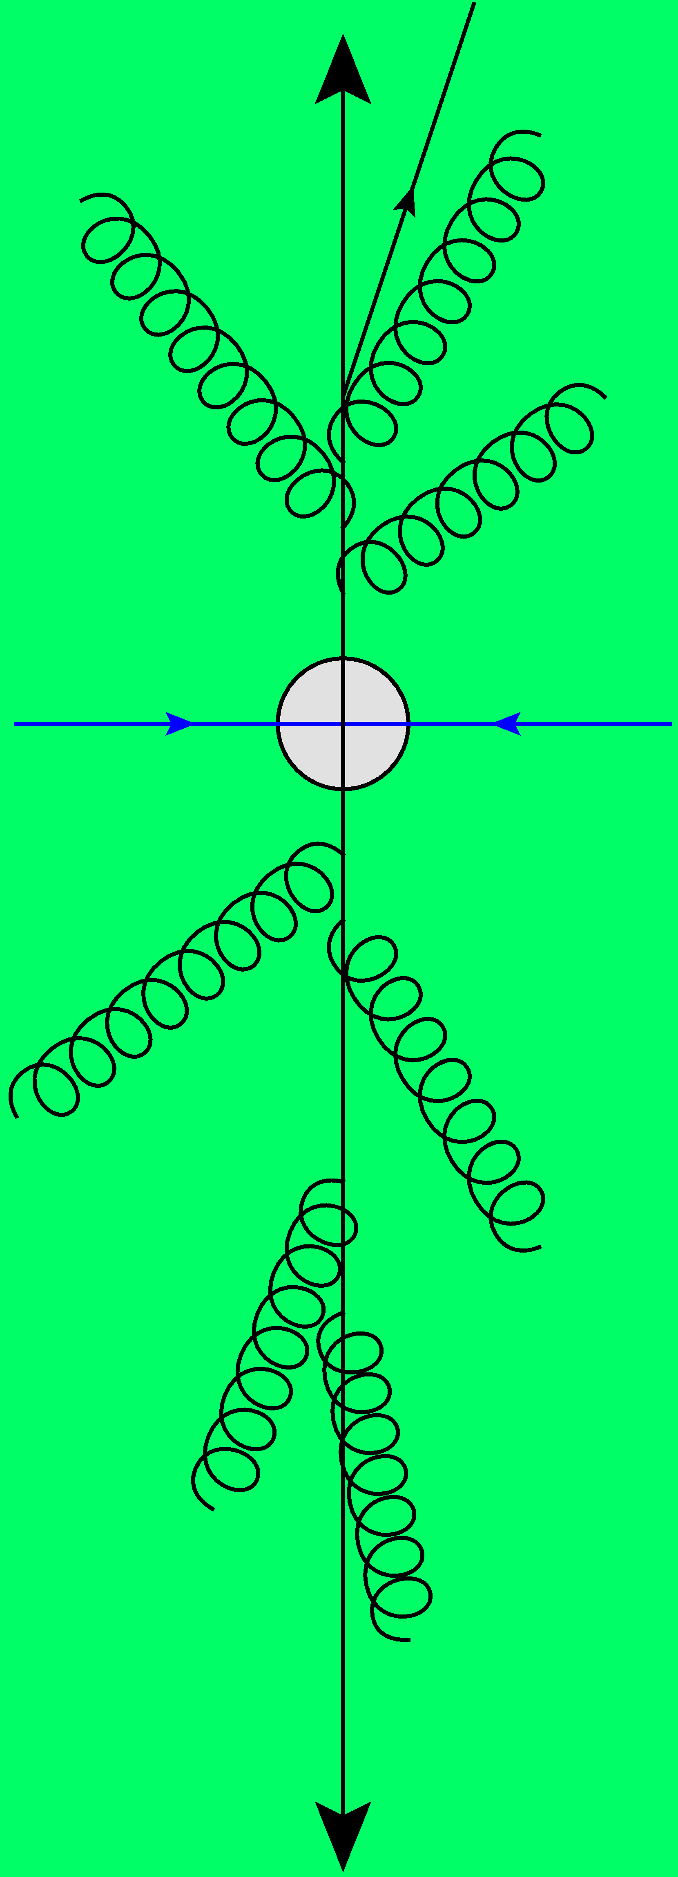
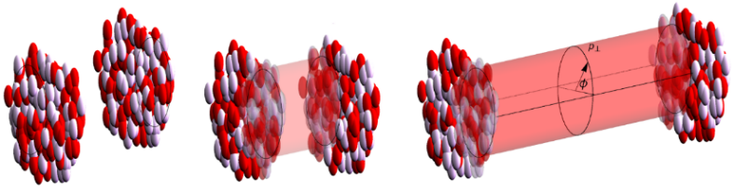
Trajectum framework applied to light ion collisions
Work mostly with Govert Nijs and Giuliano Giacalone
Wilke van der Schee
ALICE Week
03 November 2025

Slide 2
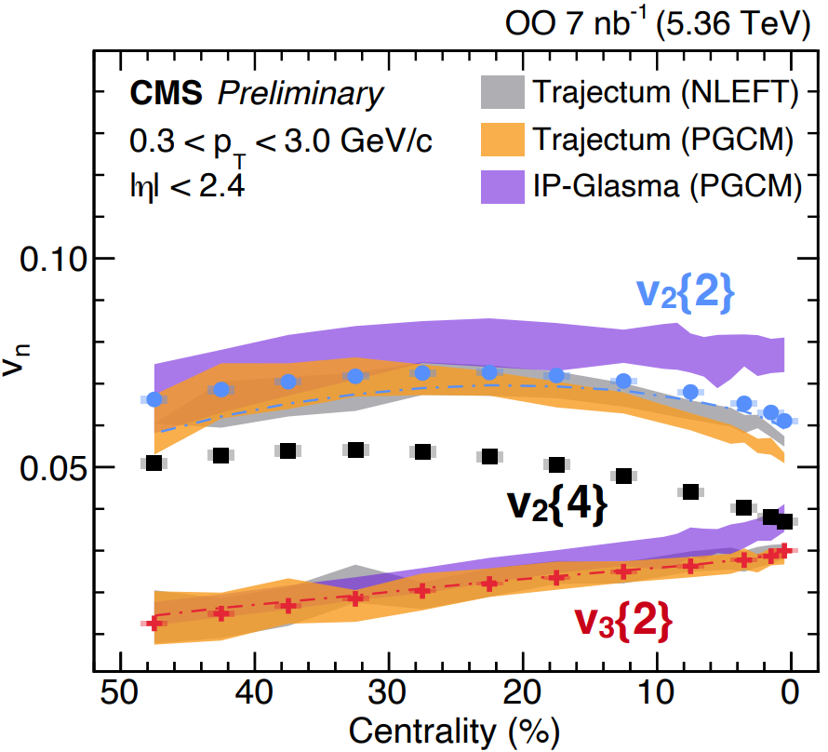
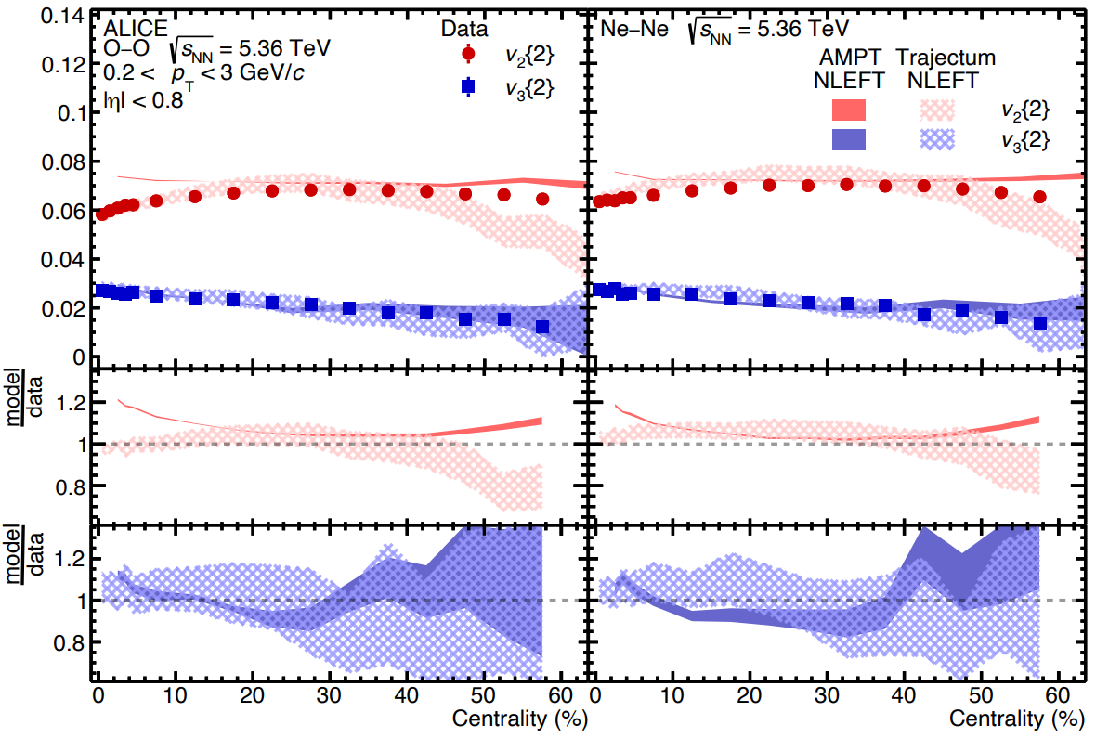
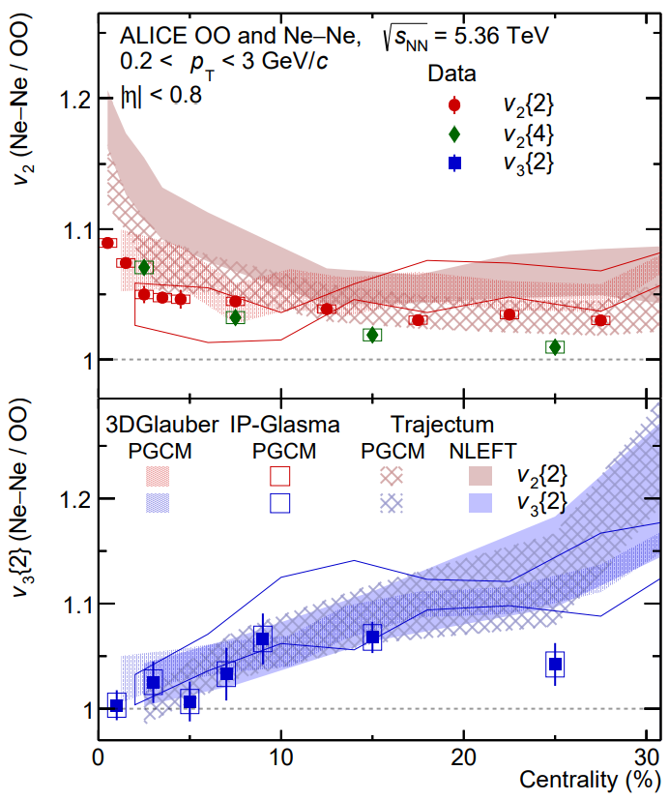
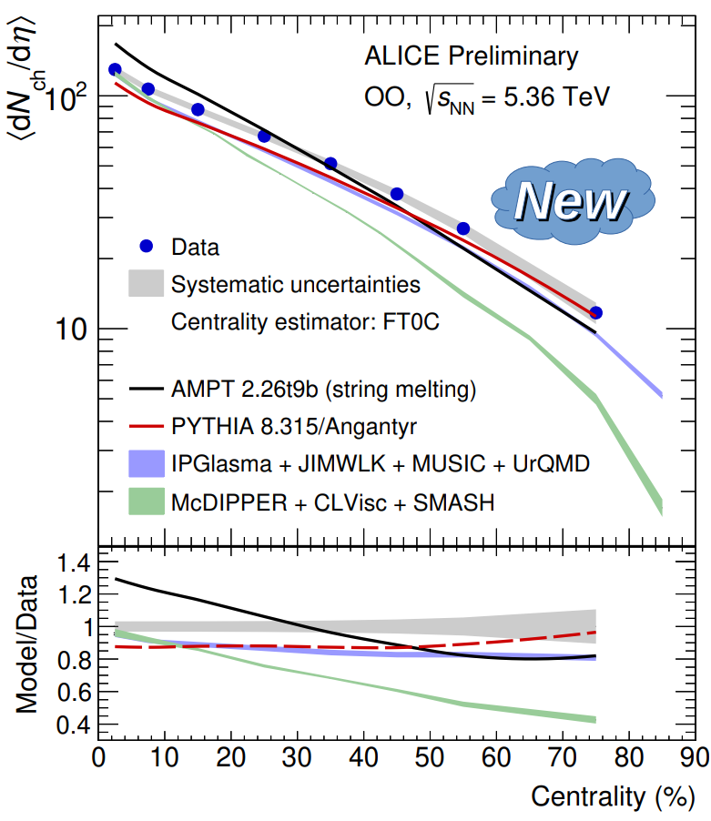
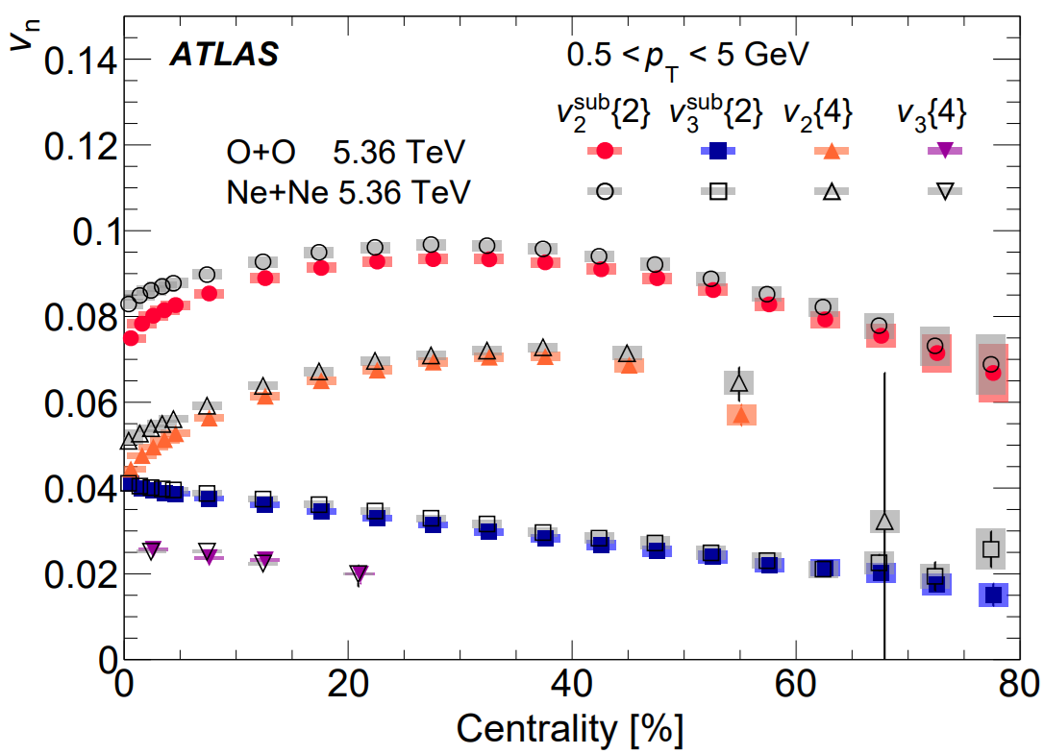
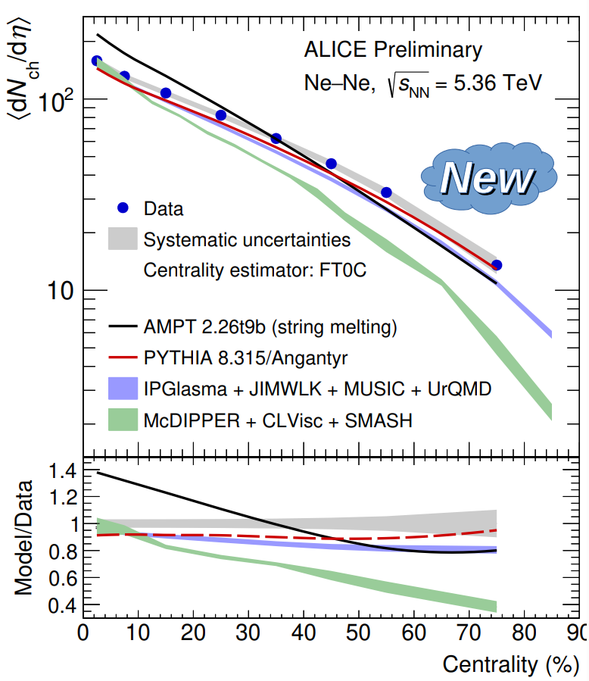
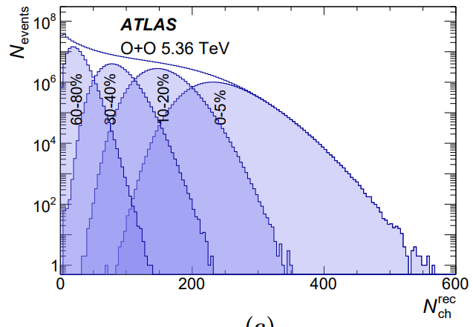
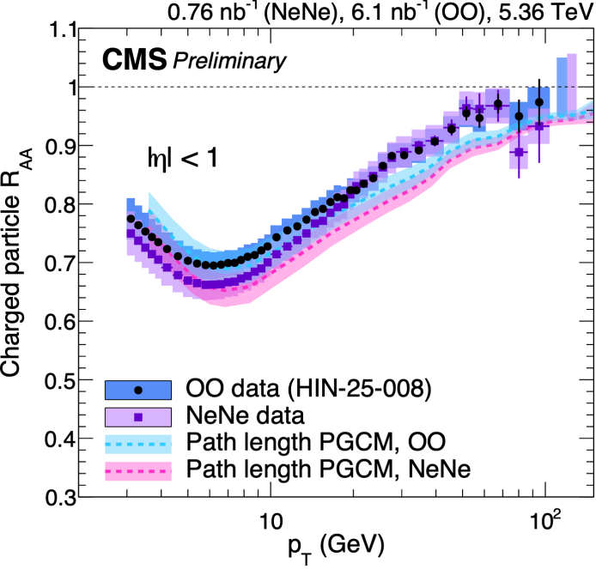
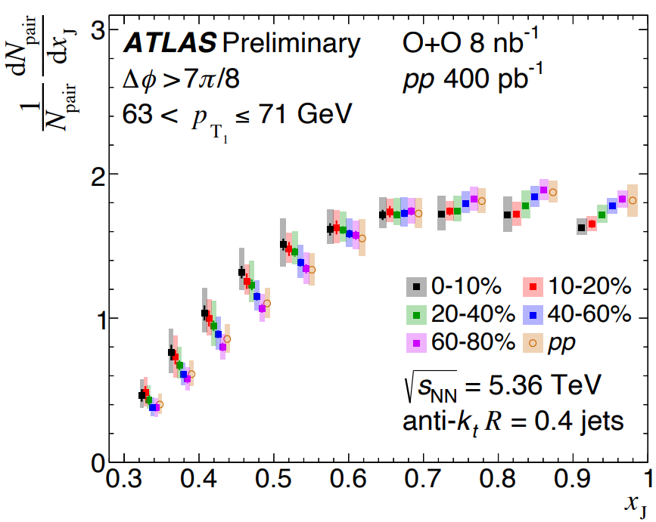
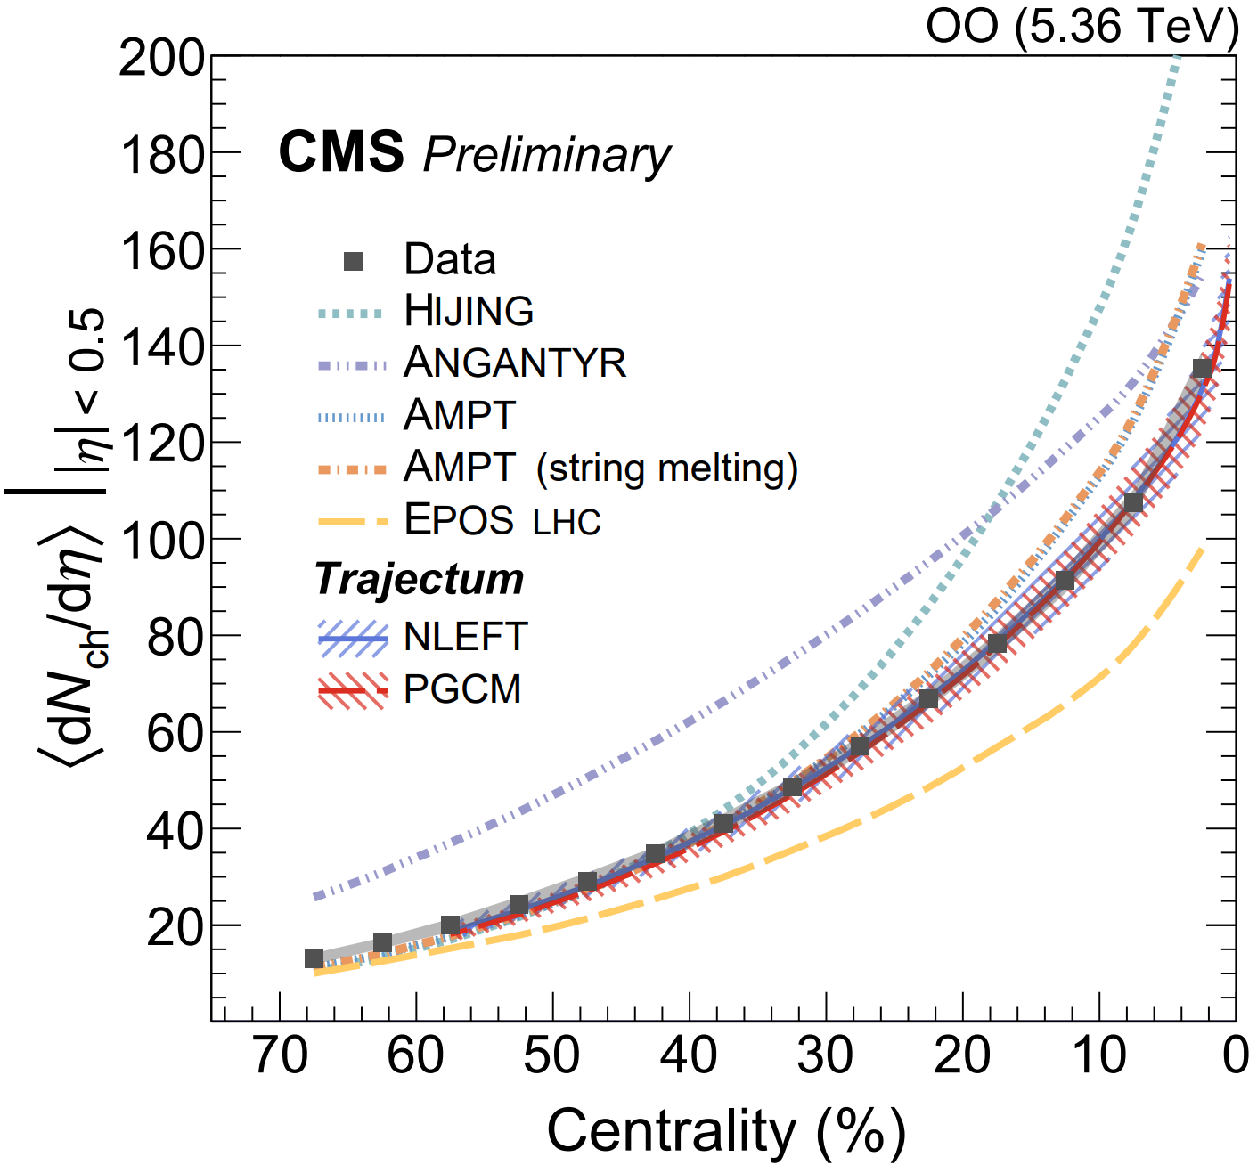

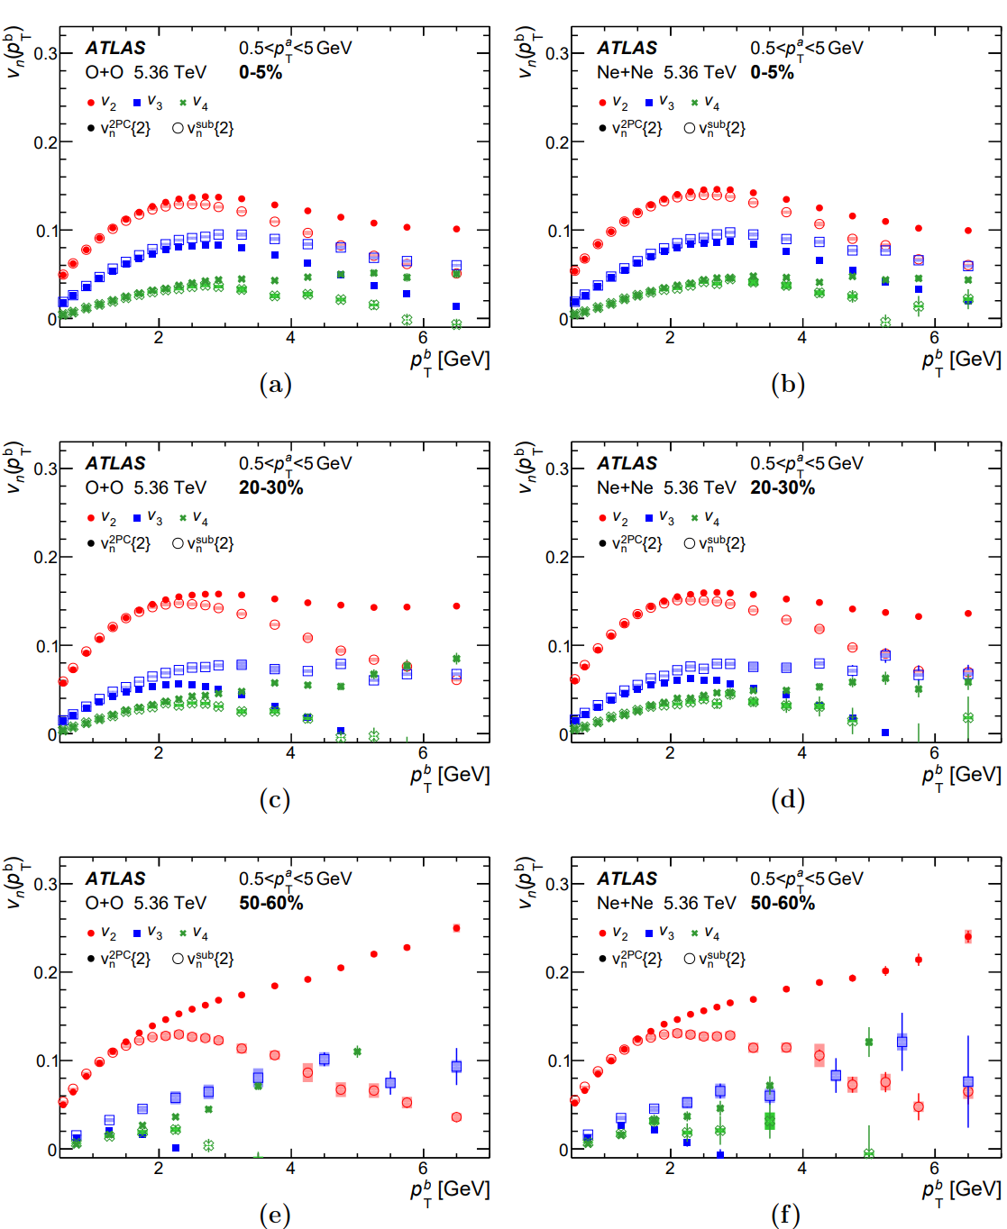
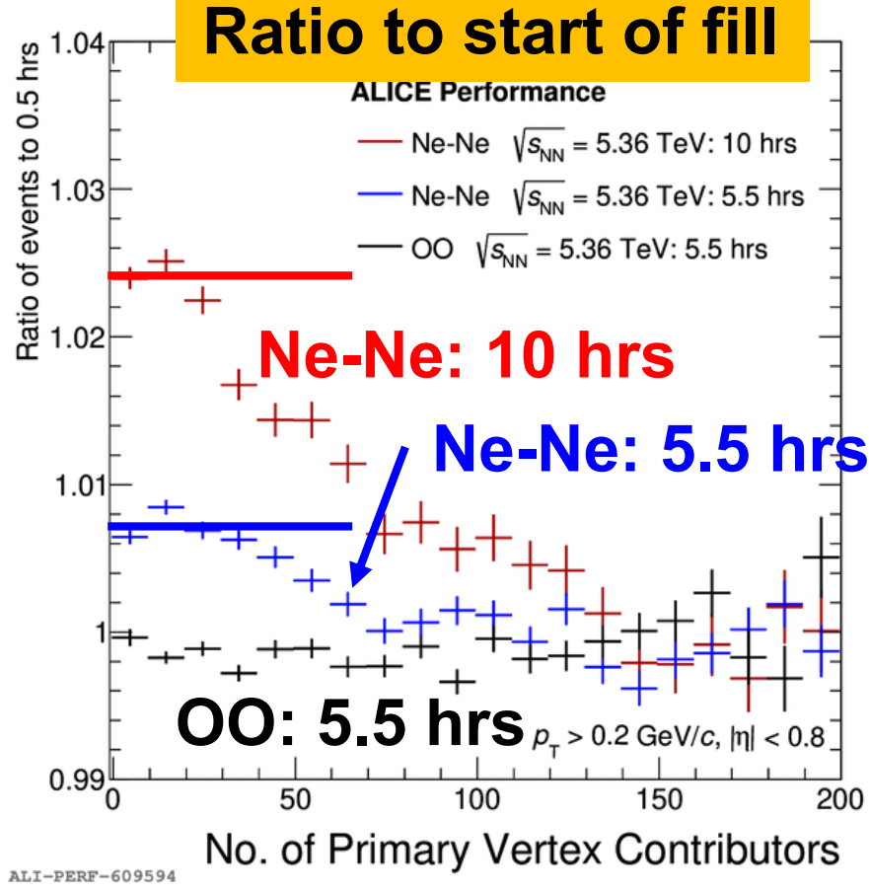
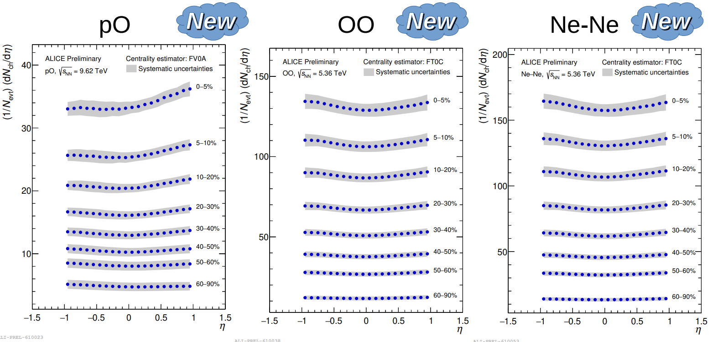
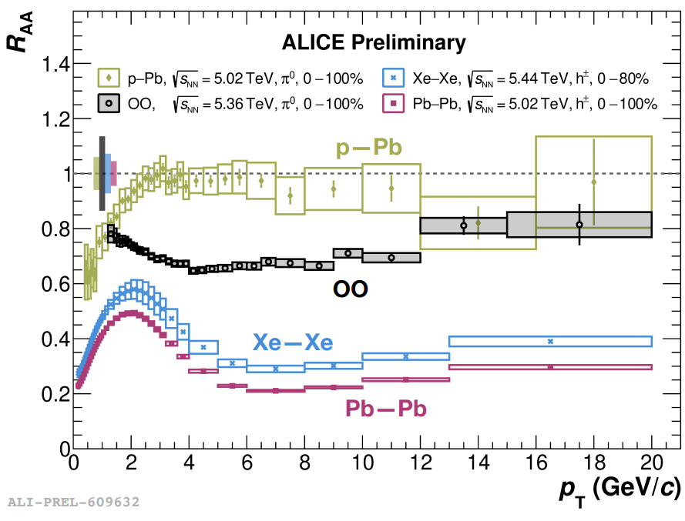
Exciting times: light ion collisions allow(ed?) for genuine predictions

Slide 3
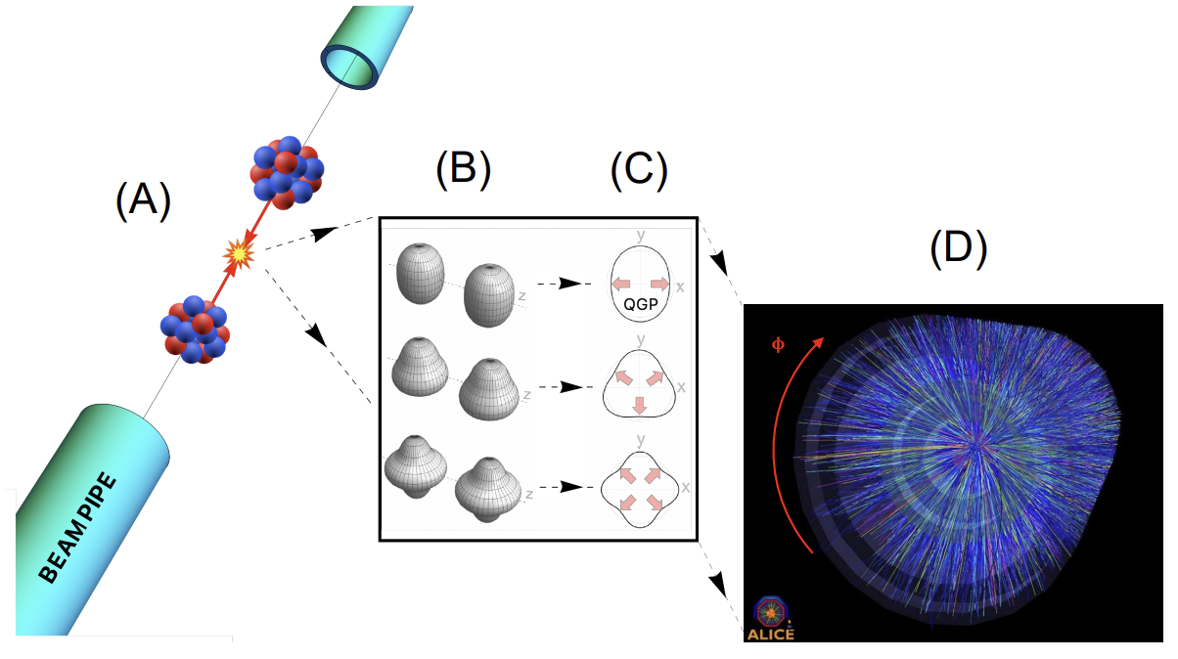
The shape of nuclei
Hydrodynamics converts
position space anisotropy into momentum space anisotropy
Benjamin Bally, James Daniel Brandenburg, Giuliano Giacalone, Ulrich Heinz, Shengli Huang, Jiangoyng Jia, Dean Lee, Yen-Jie Lee, Wei Li, Constantin Loizides, Matthew Luzum, Govert Nijs, Jacquelyn Noronha-Hostler, Mateusz Ploskon, WS, Bjoern Schenke, Chun Shen, Vittorio Somà, Anthony Timmins, Zhangbu Xu and You Zhou
Imaging the initial condition of heavy-ion collisions and nuclear structure across the nuclide chart (2022)

Slide 4
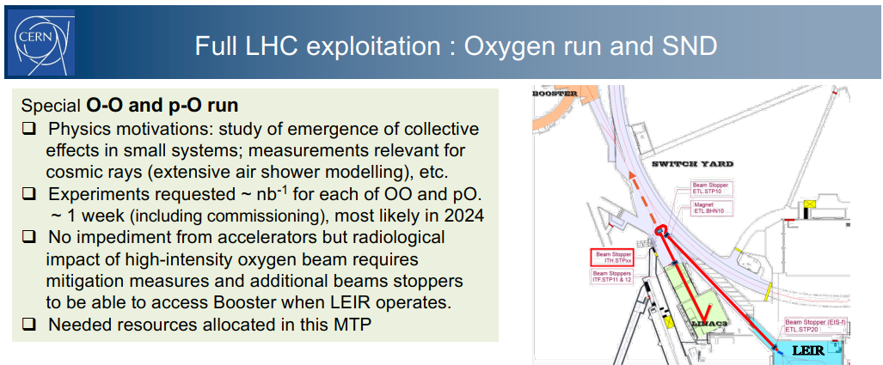
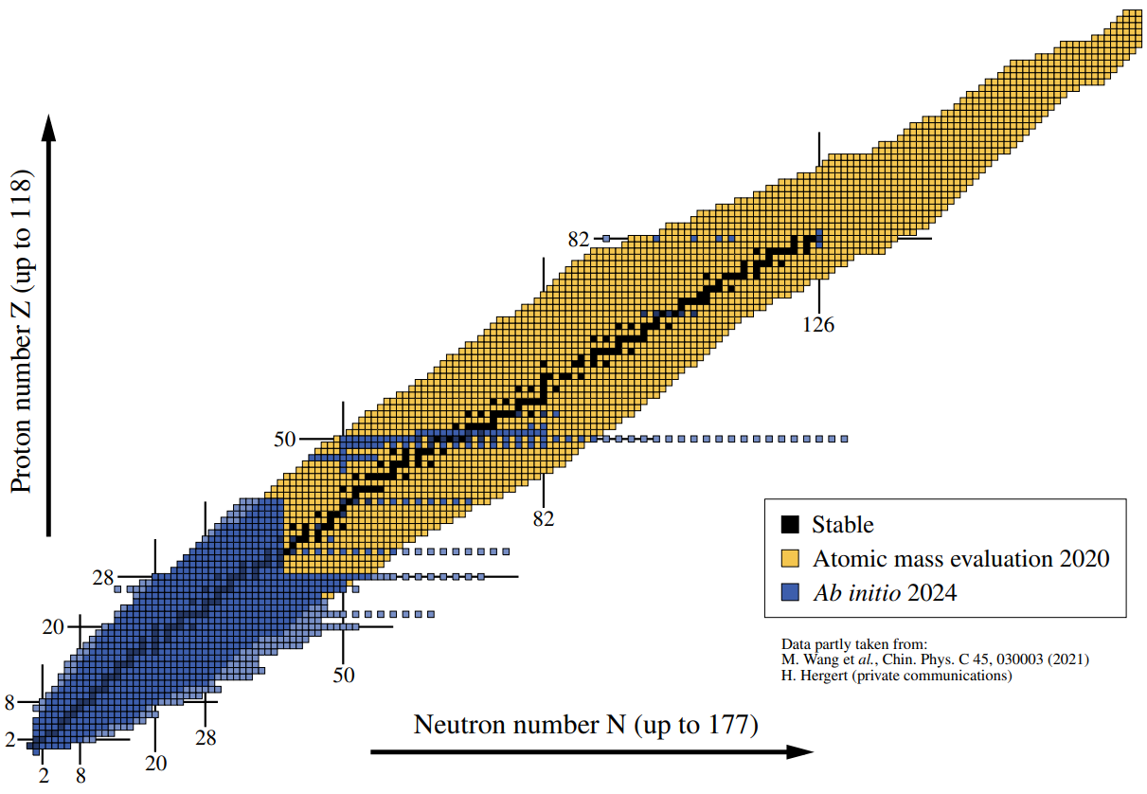
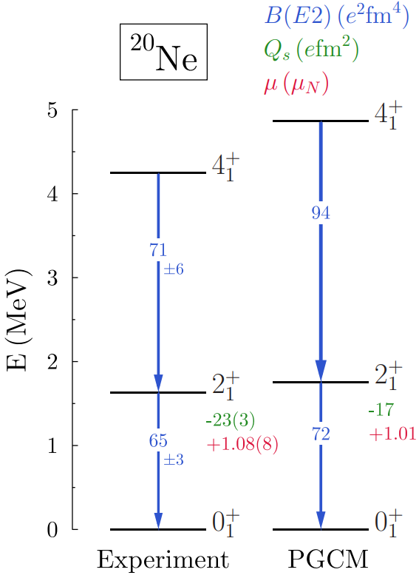
Synergy between HIC and nuclear structure
LHC seems like an expensive machine to determine the shapes of nuclei
  Ion collisions are unique: yoctosecond imaging of the ground state
  Much like a collapse of the wave function (nucleon positions)
  Thickness function: two-dimensional projection / random orientation
  Very complementary to `standard’ nuclear structure:
    Charge profile, excitation energies, isospin density (PREX)
Two-way transfer:
heavy ion community needs to know the structure accurately
  Fluctuations are enormous
  Unlikely to learn much without full control of the shape
Giuliano Giacalone et al, Nuclear Physics Confronts Relativistic Collisions Of Isobars (2025)

Slide 5
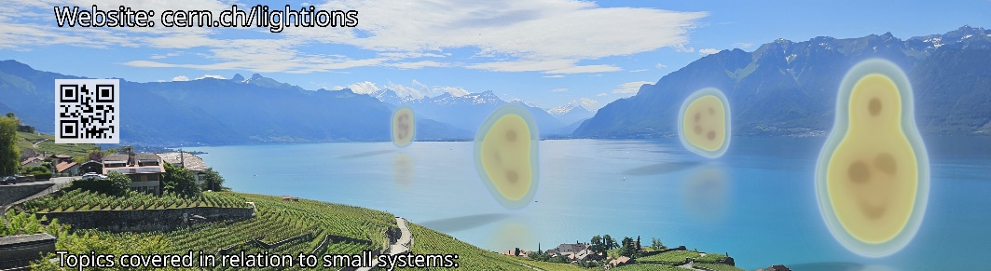

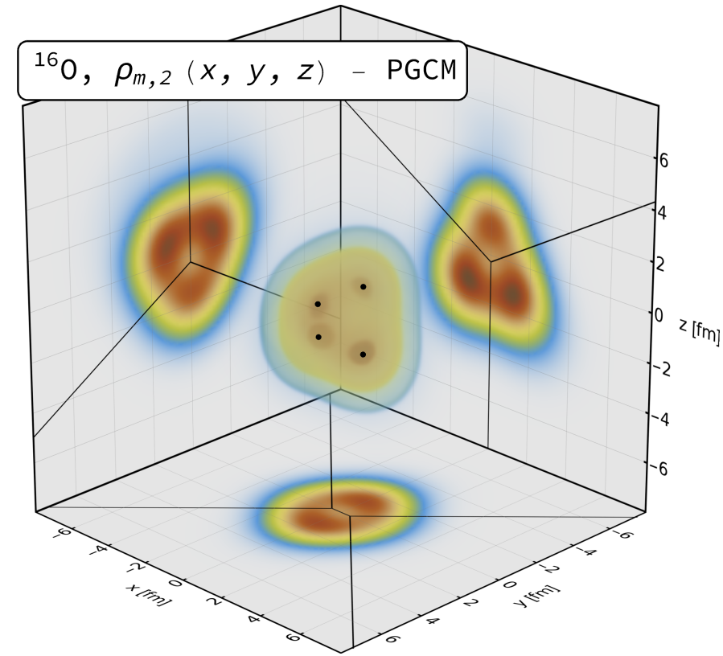


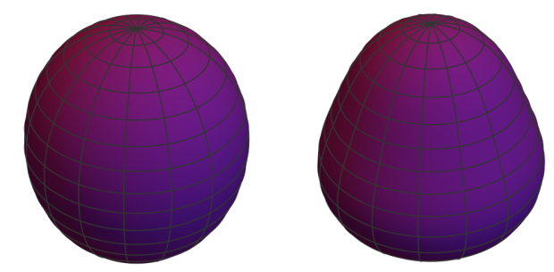
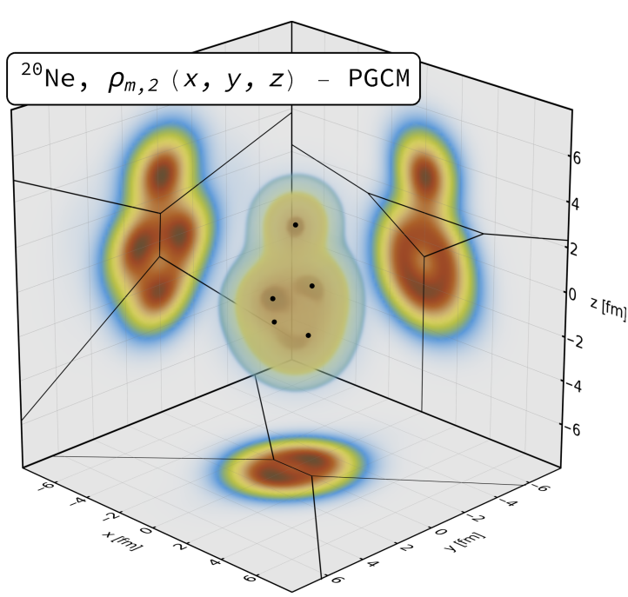
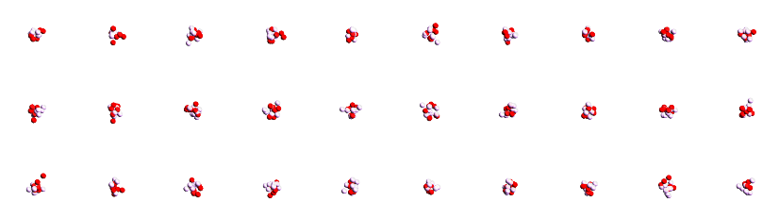
¹⁶Oxygen and ²⁰Neon nuclear structure
Studied using two complementary nuclear structure methods:
State-of-the-art Projected Generator Coordinate Method (PGCM)
  N³LO chiral EFT with Hartree-Fock-Bogoliubov constrained states
  We sample 4 nucleons in Voronoi regions determined by 4 or 5 local maxima
`Pinhole’ configurations from
Nuclear Lattice Effective Field Theory (NLEFT)
  Minimal pionless EFT Hamiltonian, lattice of eight sites (spacing = 1.315fm)
  Output is directly nucleon positions (!) (but note negative weights for 1/3 configs ☹)
  We still cluster the nucleons to optimise the breaking of periodic lattice
Giuliano Giacalone, Benjamin Bally, Govert Nijs, Shihang Shen et al,The unexpected uses of a bowling pin: exploiting 20Ne isotopes for precision characterizations of collectivity in small systems (2024)

Slide 6
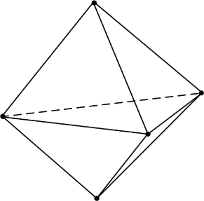
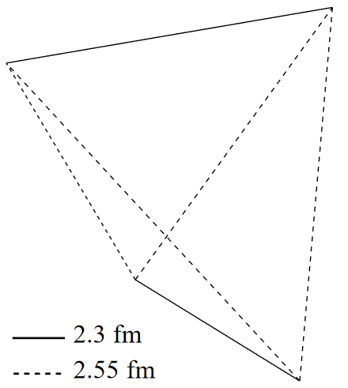
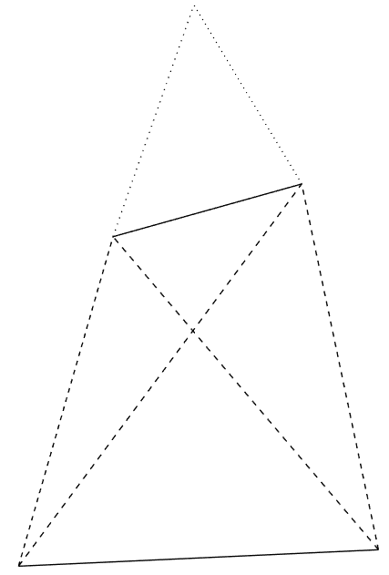
Alphas from nuclear structure
Two big surprises (at least to me ☺)
¹⁶O alphas do not form a regular tetrahedron (!)
→ more like two coupled rods
Similar results in NLEFT
²⁰Ne alphas do not form a bipyramid (!)
→ seemingly randomly placed on top…
(was a challenge to find due to breaking of
symmetry, credit to Benjamin Bally)
Of course the intuition of alphas as point particles
with interaction energy is really quite naïve…
Giuliano Giacalone, Benjamin Bally, Govert Nijs, Shihang Shen et al,The unexpected uses of a bowling pin: exploiting 20Ne isotopes for precision characterizations of collectivity in small systems (2024)

Slide 7
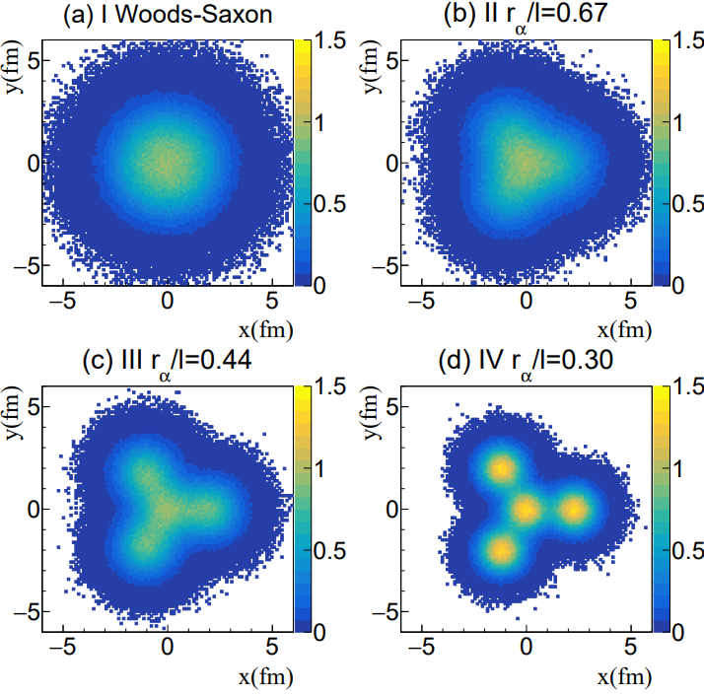
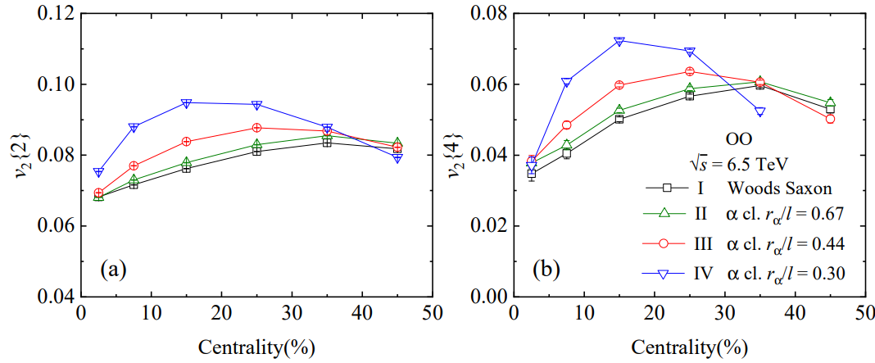
How do we see α-clustering?
The first obvious try: compare Woods-Saxon with alpha clustered shape
Significantly different flow
PGCM ab initio close to case II (green, not very different from WS)
But how to correct for systematic uncertainty due to viscosity etc etc?
Nicholas Summerfield, Bing-Nan Lu, Christopher Plumberg, Dean Lee, Jacquelyn Noronha-Hostler and Anthony Timmins, 16O16O at RHIC and the LHC comparing α clustering vs substructure (2021)
Yuanyuan Wang, Shujun Zhao, Boxing Cao, Ho-jie Xu and Huichao Song, Exploring the compactness of α cluster in 16O nuclei with relativistic 16O+16O Collisions (2024)

Slide 8
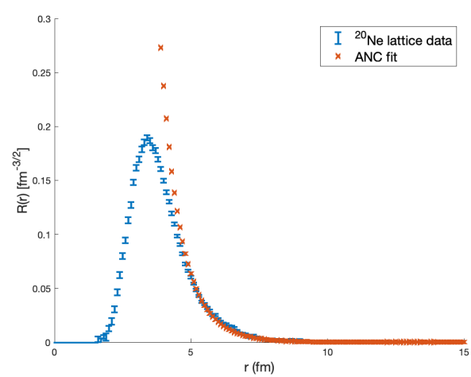
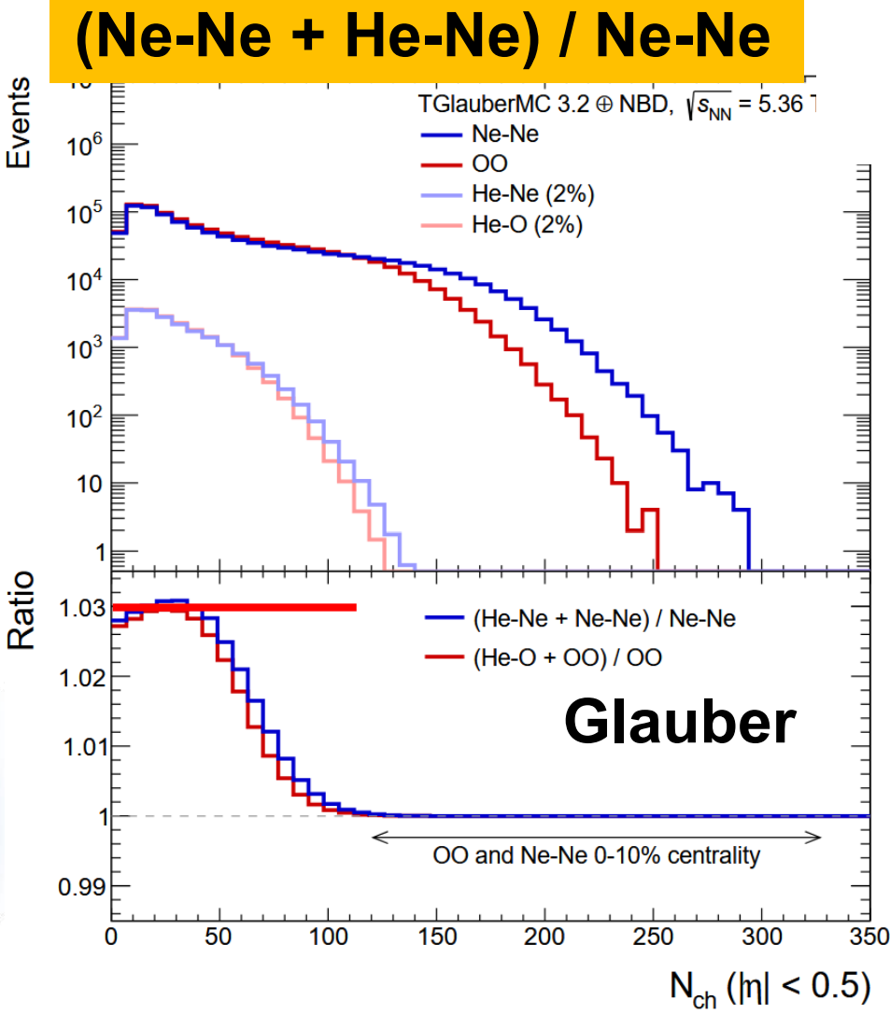
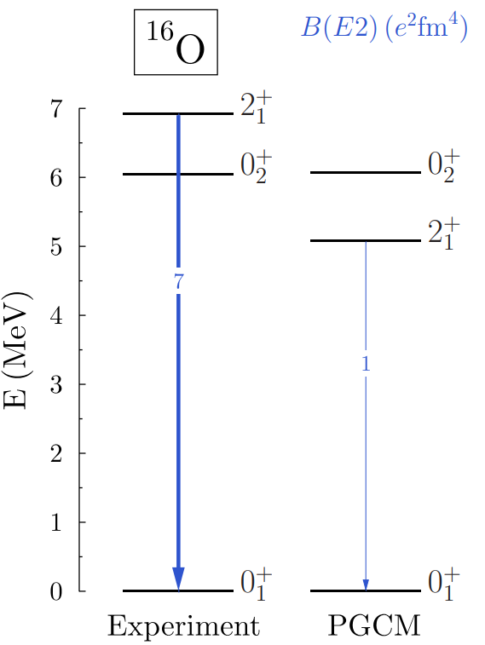
Did we see α – clustering? (I think yes)
After 10 hours convincingly 2% ²⁰Ne – ⁴He collisions in ALICE
  Not seen in Oxygen collisions (!)
  Not yet seen in other experiments (pile-up, different bunches?)
The (only?) convincing argument why this happens:
  Neon top α breaks off
  Related: First excited state Neon much lower energy
  Much more convincing than flow measurements
Unexpected benefit: first time asymmetric
nuclear collisions at top LHC energy (!)
  Especially mean p_{T} will be interesting to verify
  size and hydrodynamic paradigm
  Possible to distinguish E-by-E? V0A versus V0C, ZDC asymmetry, mean p_{T}?
E. Harris et al, Quantifying α clustering in the ground states of ¹⁶O and ²⁰Ne (2025)
Govert Nijs and WS, Transmutation of 16O and 20Ne at the Large Hadron Collider (2025)
https://indico.cern.ch/event/1436085/contributions/6107509/attachments/2966206/5218662/talk_bally_cern_13112024.pdf
https://indico.cern.ch/event/1479384/contributions/6631982/attachments/3130687/5553818/JFGO8p.pdf

Slide 9
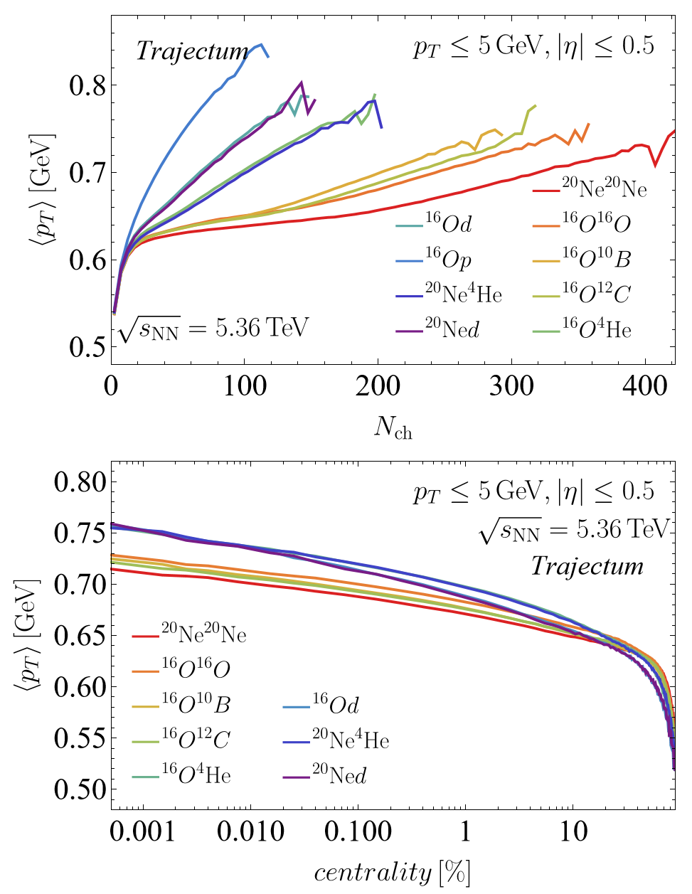
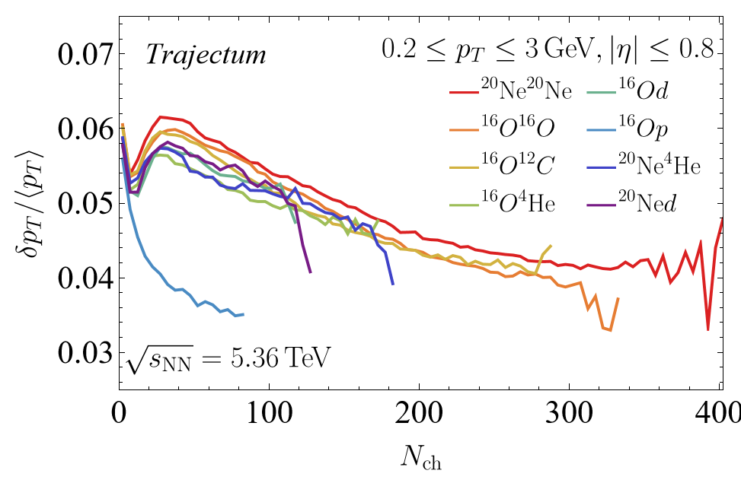
Transmutation: a prediction
The mean transverse momentum of Ne-He will be measured and large
  Close analogy with `speed of sound’, or ultracentral PbPb
  But in much smaller system (!)
  pO also interesting mean pt fluctuations
WS and Govert Nijs, Transmutation of ¹⁶O and ²⁰Ne at the Large Hadron Collide (2025)

Slide 10
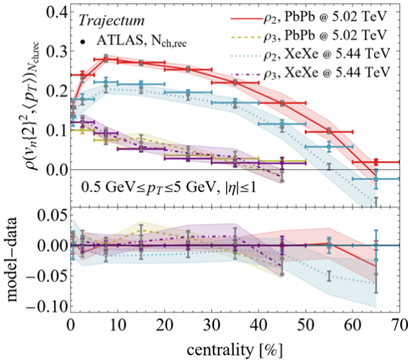
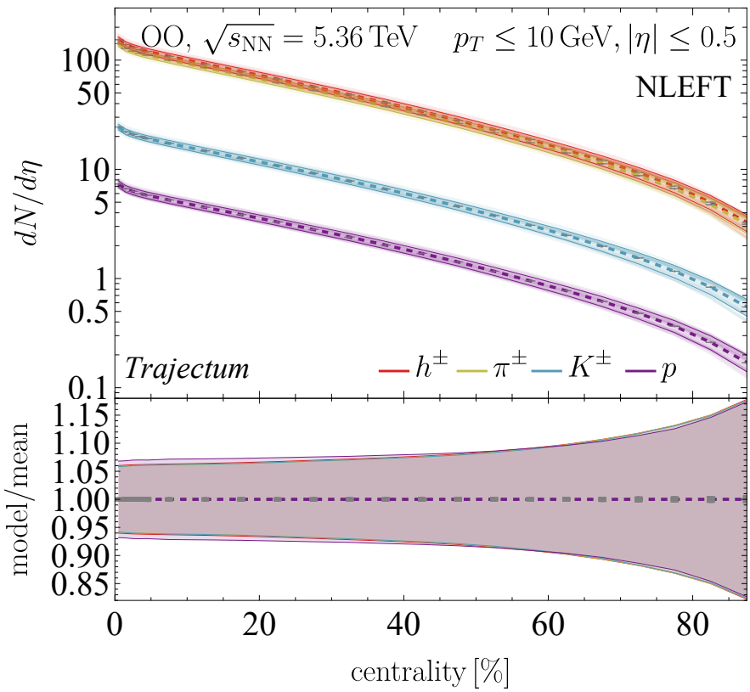
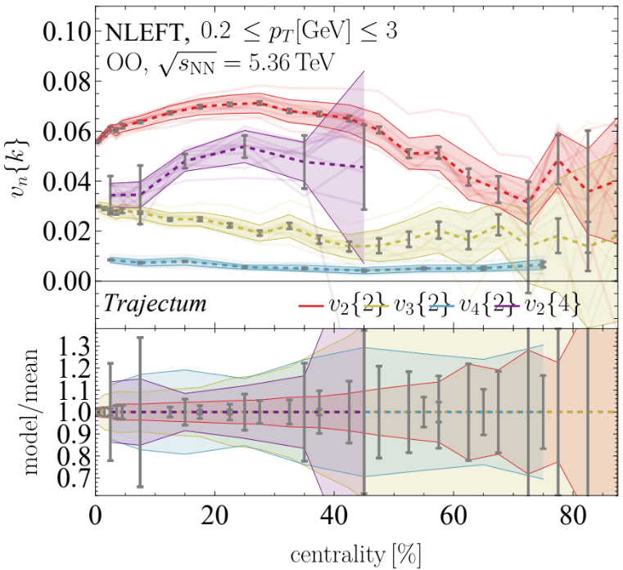
Exciting times: heavy ions is now a precision science
Systematic uncertainties, also in theoretical estimates
  Uncertainty comes from Bayesian posterior
  Full correlations among datapoints is included
Uncertainties can be small
  ~6% for multiplicity in OO
  ~2-5% for anisotropic flow (except v₂{4}: statistics dominate)
Corollaries:
  We need to understand the shapes of colliding nuclei precisely
  We need to have the full model of heavy ion collisions under control
  This is necessary to understand `the details’ such as:
    Hydrodynamisation
    Extreme hydrodynamics: when gradients are large
    First and second order viscous gradient corrections, during hydro and freeze-out
Giuliano Giacalone et al, The unexpected uses of a bowling pin: exploiting 20Ne isotopes for precision characterizations of collectivity in small systems (2024)
CMS, First measurement of pseudorapidity distributions of charged hadrons in oxygen-oxygen collisions at √s_{NN}= 5.36 TeV (2025)

Slide 11
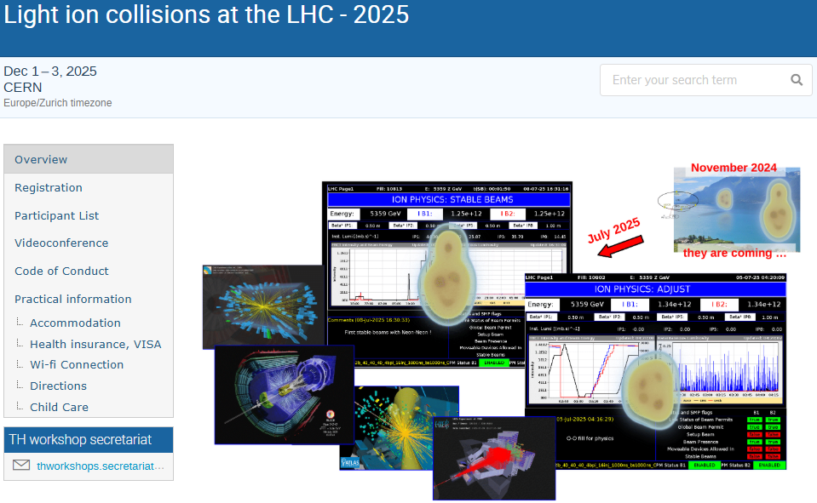
Light ions at the LHC – the sequel
Cern.ch/lightions2025

Slide 12
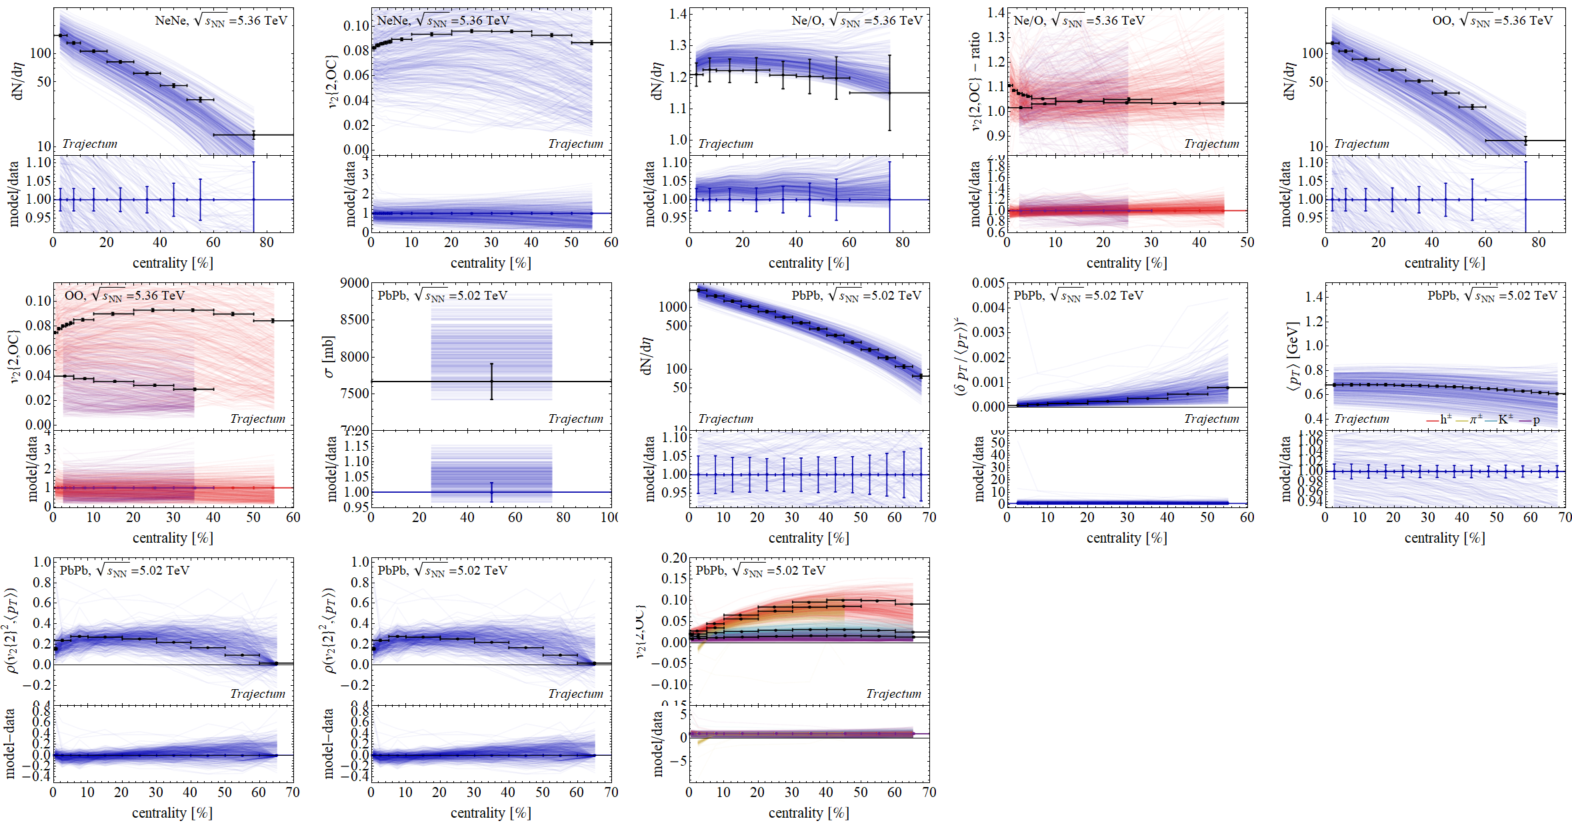
Refit parameters based on current data
Work in progress

Slide 13
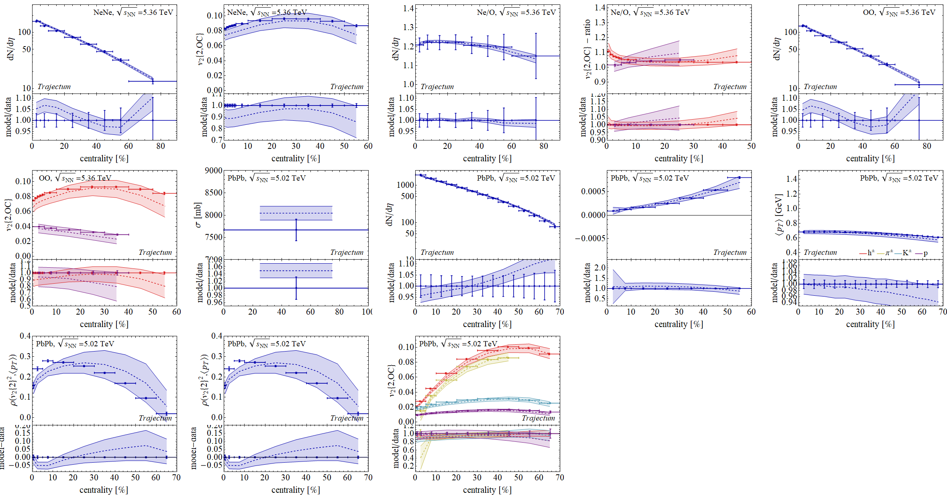
Refit parameters based on current data
Work in progress

Slide 14
Multiplicity

Slide 15
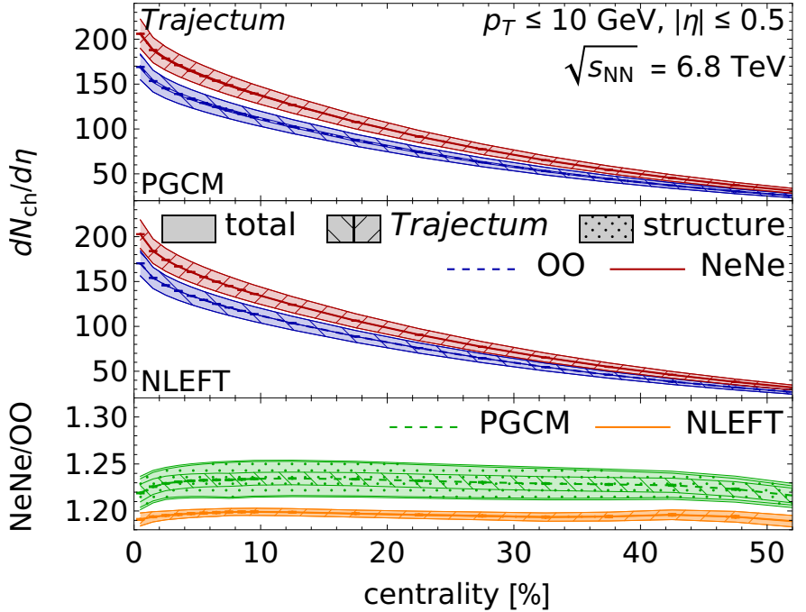
Exciting times: light ion collisions allow(ed?) for genuine predictions
Hydrodynamic predictions for light ion collisions
All the way to dN/dη ~ 10; hydro at its limits?
Model is (only!) fitted to PbPb data
Difference PGCM/NLEFT is understood due to size differences
Giuliano Giacalone et al, The unexpected uses of a bowling pin: exploiting 20Ne isotopes for precision characterizations of collectivity in small systems (2024)
CMS, First measurement of pseudorapidity distributions of charged hadrons in oxygen-oxygen collisions at √s_{NN}= 5.36 TeV (2025)

Slide 16
Exciting times: comparison with CMS and ALICE
Agreement almost too good to be true?
Also: non-hydro models tend to be off
(but notice lack of syst uncertainty)
Giuliano Giacalone et al, The unexpected uses of a bowling pin: exploiting 20Ne isotopes for precision characterizations of collectivity in small systems (2024)
CMS, First measurement of pseudorapidity distributions of charged hadrons in oxygen-oxygen collisions at √s_{NN}= 5.36 TeV (2025)
https://indico.cern.ch/event/1479384/contributions/6663047/attachments/3131557/5555439/IS_mult_v3.pdf

Slide 17
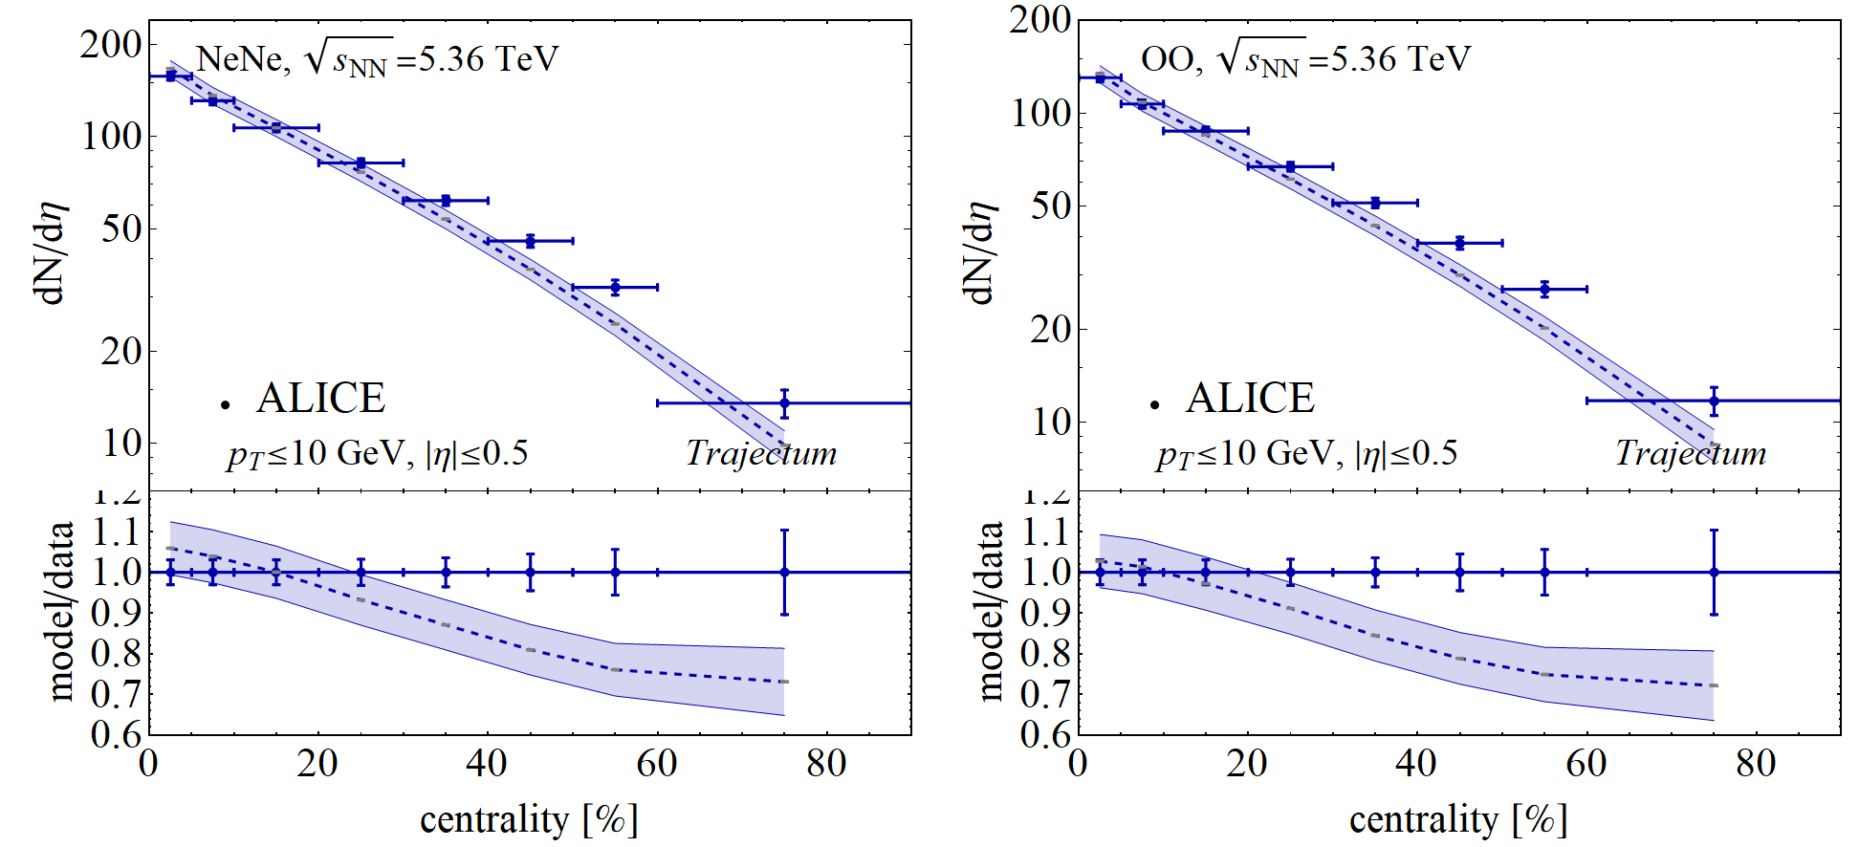
Exciting times: comparison with CMS and ALICE
Agreement almost too good to be true?
Maybe true: fits CMS much better than ALICE..
0-5% class: CMS has 135.3, ALICE has 130.3 (4.0 uncertainty)
50-60% class: CMS has 22.5, ALICE has 27.0 (1.5 uncertainty)
[different cuts means CMS should be approximately 1% lower]
Giuliano Giacalone et al, The unexpected uses of a bowling pin: exploiting 20Ne isotopes for precision characterizations of collectivity in small systems (2024)
CMS, First measurement of pseudorapidity distributions of charged hadrons in oxygen-oxygen collisions at √s_{NN}= 5.36 TeV (2025)
https://indico.cern.ch/event/1479384/contributions/6663047/attachments/3131557/5555439/IS_mult_v3.pdf

Slide 18
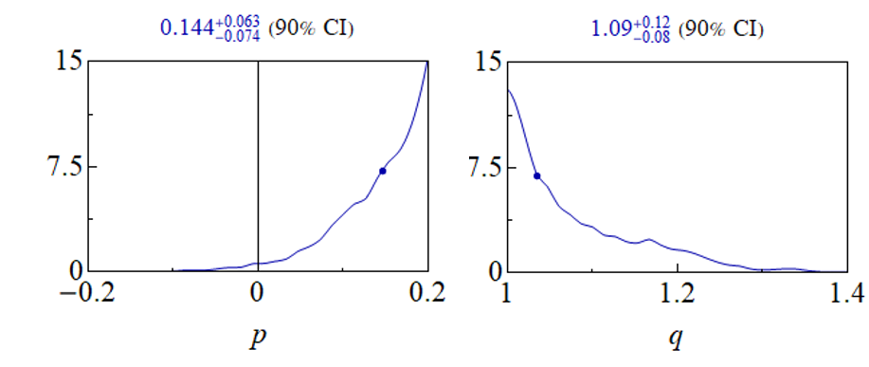
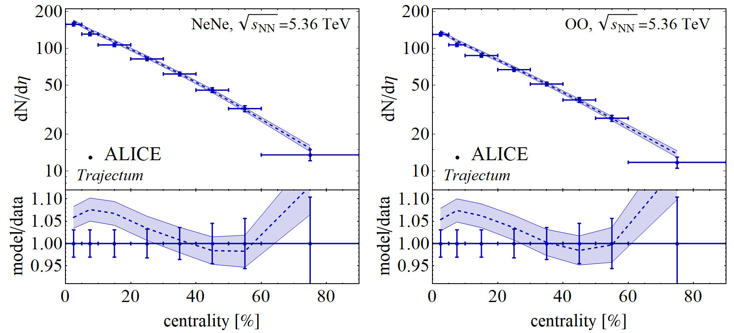
Exciting times:
Fitting new ALICE data
Work in progress
(no smash or lattice spacing correction)
Fit seems to work OK; but slightly strange Trento parameters
Giuliano Giacalone et al, The unexpected uses of a bowling pin: exploiting 20Ne isotopes for precision characterizations of collectivity in small systems (2024)
CMS, First measurement of pseudorapidity distributions of charged hadrons in oxygen-oxygen collisions at √s_{NN}= 5.36 TeV (2025)
https://indico.cern.ch/event/1479384/contributions/6663047/attachments/3131557/5555439/IS_mult_v3.pdf

Slide 19
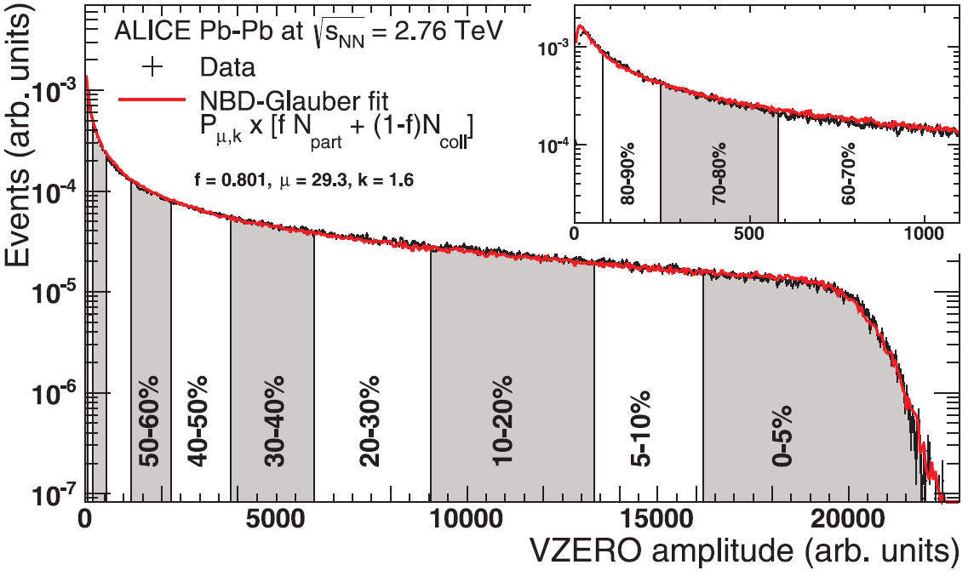
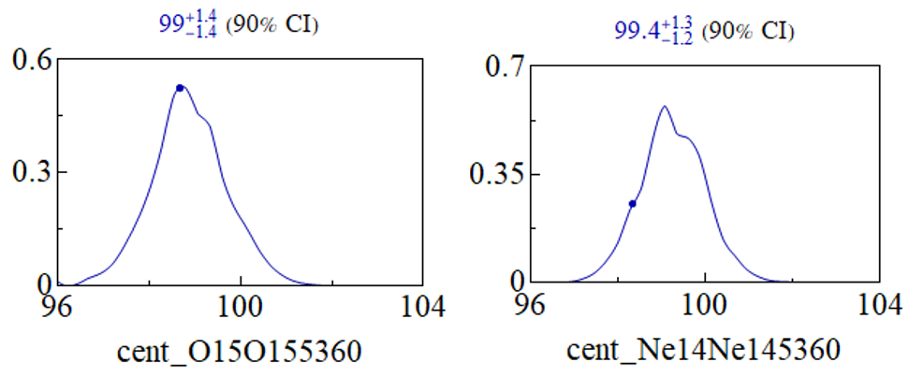
Exciting times:
Fitting new ALICE data
Work in progress
(no smash or lattice spacing correction)
How is the centrality determination done? Usually NBD-Glauber; perhaps a bit outdated?
Nevertheless, preliminary Trajectum results (varying the 100% anchor point) suggest results consistent with 100% (slight preference for 99%).
This is done with ALICE dN/deta, but ATLAS vnk [we don’t vary centrality normalisation per experiment]
Giuliano Giacalone et al, The unexpected uses of a bowling pin: exploiting 20Ne isotopes for precision characterizations of collectivity in small systems (2024)
CMS, First measurement of pseudorapidity distributions of charged hadrons in oxygen-oxygen collisions at √s_{NN}= 5.36 TeV (2025)
https://indico.cern.ch/event/1479384/contributions/6663047/attachments/3131557/5555439/IS_mult_v3.pdf

Slide 20
Flow

Slide 21
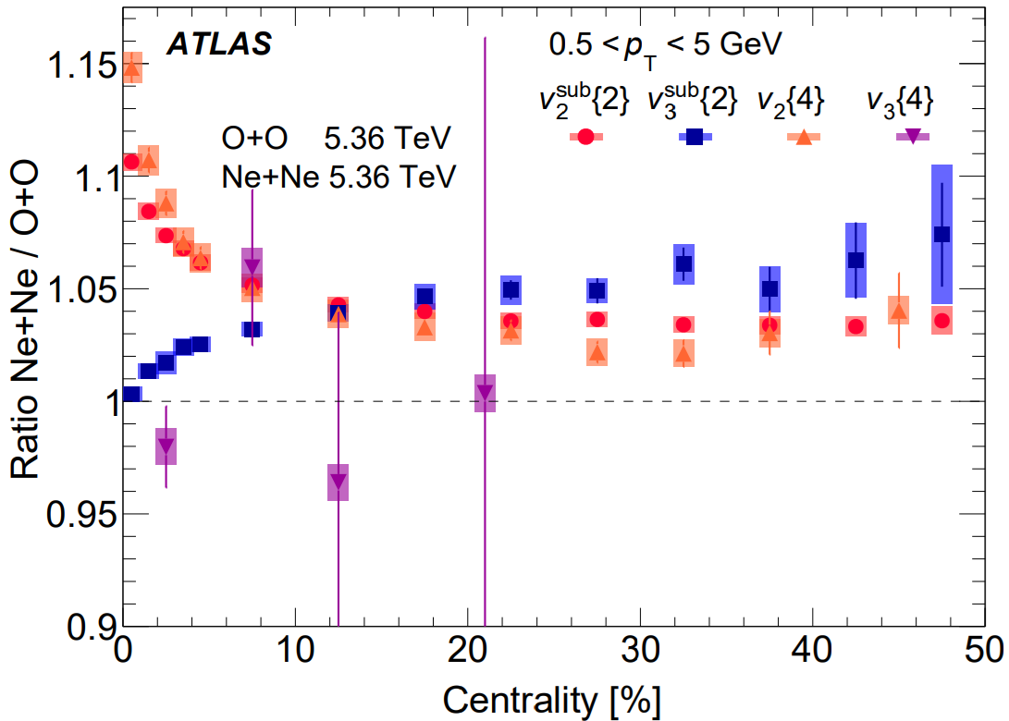

Anisotropic flow --- ratio
0-1% elliptic flow ratio significantly overestimated
  But: uncertainty is only one standard deviation (treat uncertainty seriously)
  Also: PGCM significantly closer
  Not clear if ATLAS and ALICE are consistent
https://cds.cern.ch/record/2942004/files/HIN-25-009-pas.pdf (CMS)
https://arxiv.org/pdf/2809.05171 (ATLAS)
https://arxiv.org/abs/2809.06428 (ALICE)

Slide 22



Anisotropic flow --- ratio: subnucleonic structure
Actually: not all uncertainties cancel in the ratio
  Subnucleonic structure affects oxygen significantly more than neon
  Reducing 0-1% ratio by up to 10%
  Potentially even making NLEFT viable as a structure
  Consistent with IP-Glasma?
  → Seeing first hints about how we can learn about hydro, small systems, initial stage, nuclear structure etc etc

Slide 23

Exciting times:
Fitting new ALICE data
Work in progress
(no smash or lattice spacing correction)
Fit seems to work OK; but slightly strange Trento parameters
Giuliano Giacalone et al, The unexpected uses of a bowling pin: exploiting 20Ne isotopes for precision characterizations of collectivity in small systems (2024)
CMS, First measurement of pseudorapidity distributions of charged hadrons in oxygen-oxygen collisions at √s_{NN}= 5.36 TeV (2025)
https://indico.cern.ch/event/1479384/contributions/6663047/attachments/3131557/5555439/IS_mult_v3.pdf

Slide 24


What’s next?
New systems such as OO and NeNe have shown clear advantages;
should be considered already before run 5?
⁴⁰Ca or ⁴⁸Ca
Nice spherical nuclei; interesting for the neutron skin, synergy with neutron stars
⁷⁶Ge and/or ⁷⁶Se
Relevant for neutrinoless double beta decay; in between Neon and Xenon sizewise
⁸⁴Kr
Synergy with injector/HEARTS++
Might yield the physics goals of PbPb + much more?
Need at least high nucleon-nucleon lumi, and sizeable QGP?

Slide 25

What’s next?

Slide 26


What’s next?

Slide 27

















Exciting times!
Many more measurements will follow
  Mean p_{T}, higher order correlations like ρ₂,
  ultracentral fluctuations, spectra, jets
  Much better understanding of the shape
  Hydrodynamics at its limits!
  Energy loss in small systems
  Ne-He collisions

Slide 28
Light ions at the LHC – the sequel
Cern.ch/lightions2025

Slide 29
Back-up

Slide 30

Transmutation: results
Lots of elements, but with 0.034% momentum cut not much `survives’
(compare total hadronic cross section: 1.42b)
  Dominant are deuteron and Helium-4
  Quite crucially depends on momentum distribution; large systematic uncertainty since nucleons are not really `free’

Slide 31

Posterior with light ions work in progress

Slide 32

Prior with light ions work in progress

Slide 33




The mean transverse momentum – an interplay with hard probes
A path-length approach to energy loss: assume energy loss ~ T³ and extrapolate from (central) PbPb
  Also significant difference between PGCM and NLEFT
  CMS data somewhere in the middle? (no uncertainties available though…)
WS, Isobel Kolbe, Govert Nijs, Kumail Ruhani, Ishtiaq Ahmed and Shahin Iqbal, Three models for charged hadron nuclear modification from light to heavy ions (2025)

Slide 34


Anisotropic flow --- SMOG2
Fixed target mode LHCb
  Lower energy, asymmetric 3+1D hydro
  Very accurate predictions from NLEFT + Chun Shen QM25,
  including v₃
https://indico.cern.ch/event/1479384/contributions/6663093/attachments/3132588/5557527/IS25.pdf (SMOG2)
https://indico.cern.ch/event/1334113/contributions/6289808/ (Bjoern Schenke, Chun Shen,Heikki Mäntysaari and Wenbin Zhao)

