Slide 1
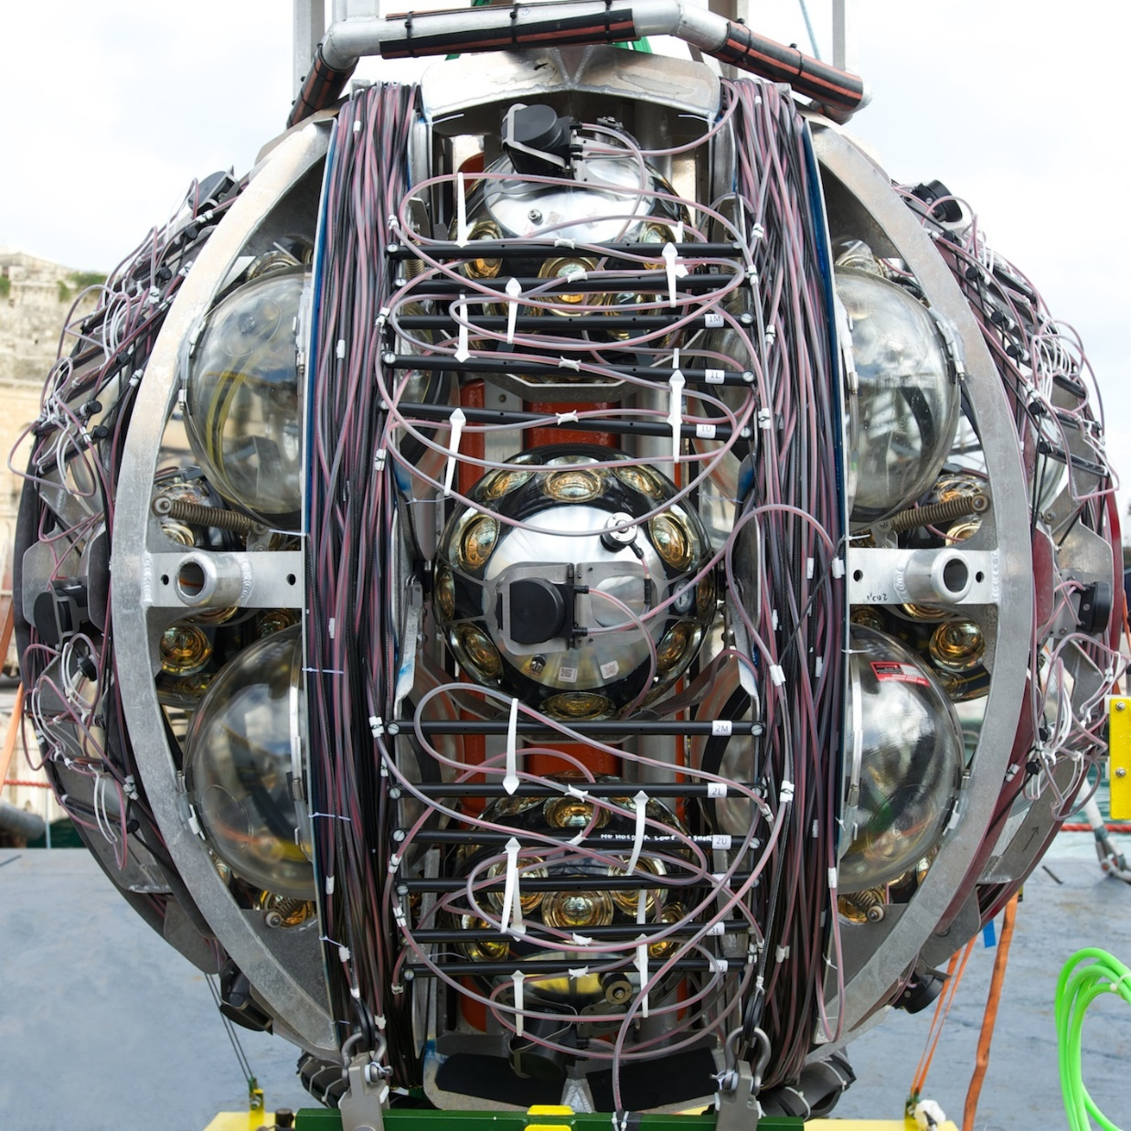
AI/ML in the KM3NeT* group
Aart Heijboer
* Asked also Dune, but nikhef-group is hardware-focussed, for now

Slide 2
Current situation – production use of AI/ML
Production use of AI/ML:
Currently no (advanced) AI/ML in production (!)
Reconstruction = classical Maximum Likelihood, classification: BDT*
Outside production (mostly outside Nikhef)
GNN, CNN for reconstruction and classification;
performance promising, but worries about changing/moving detector
In-house experts :
Not many (Ronald Bruijn probably most ‘expert’)
Several Msc projects
MSc (Leiden, 2024) Jesse Bosman (background/track/shower discrimination)
MSc (Leiden, 2021) Gijs Vermarien (tau identification / track-shower via GNN)
MSc (Delft, 2023), Liselotte Dijkema (accoustic neutrino detection).
* BDT and other feature-based MVA’s are used frequently, but don’t count as AI/ML

Slide 3
Mid-term
Expected improvements on 3 yr timescale
Improve reconstruction and classification of neutrinos near the detection threshold
(lower threshold for astronomy, and improve mass hierarchy measurement)
In particular: Address wide variety of (hadronic) final states in ORCA
Use ML/AI to measure the composition of Cosmic Rays
‘mixed’ AI/Maximum likelihood reconstruction ( let AI model the PDF )
Nikhef involvement:
currently not leading institute in AI/ML (in fact, we lead in the more classical approaches).
“Leading” institute: Ecap, Erlangen.
Ambition/needed resources/etc @Nikhef group in next years to be clarified.
  Sentiment is we should get into the business, though. First step seems (self)education.
Expectorations/plans for coding assistance:
No formal plan, but some of use this and we expect it will be important in future.

Slide 4
Long-term future (5-10 years) – future directions
Acoustic neutrino detection:
  Nikhef group doing R&D in future acoustic neutrino detector
  AI may be enabling technology to find acoustic signals in huge background.
Is there any other information regarding the use and potential of ML/AI in your research area that is relevant to be discussed in the task force?
Basic knowledge and expertise is missing; propose education of Nikhef staff.

