Slide 1
Timepix 4
Substrate ideas
30 APR 2025
Yutaro Takahashi

Slide 2
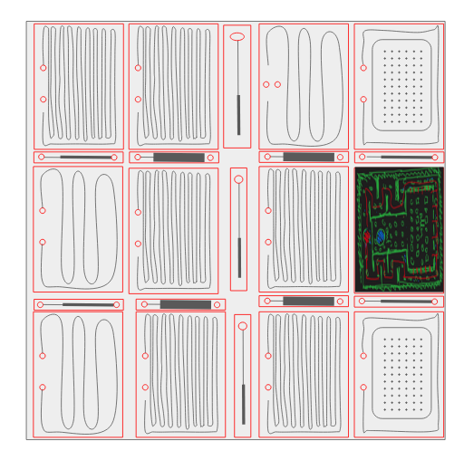
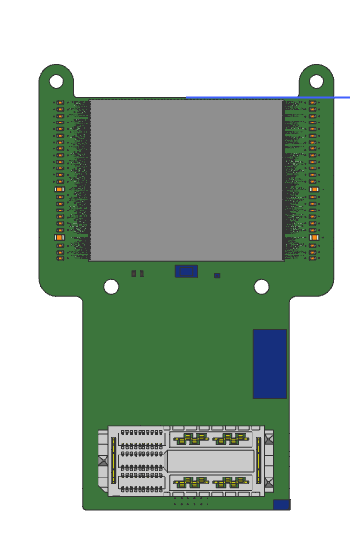
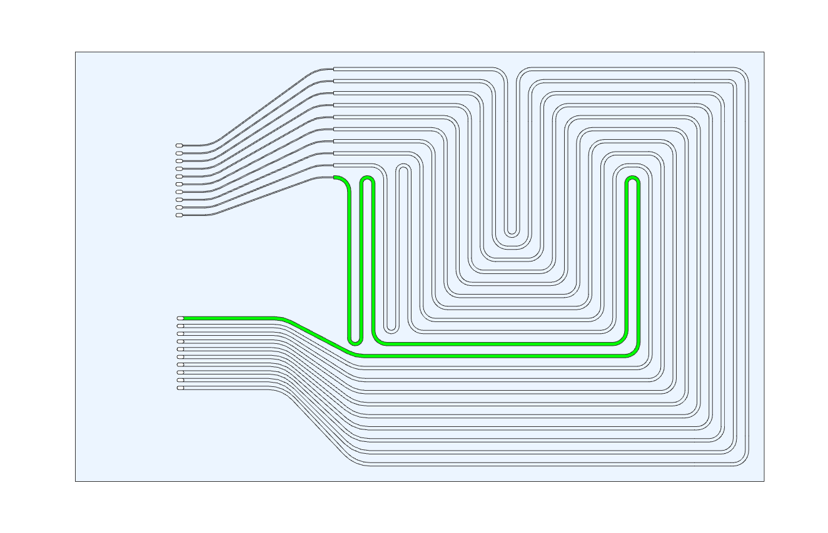
Micronit
Wafer 150 x 150 x 0,27 mm
  One wafer with etched structure
  One closing wafer (optionally etched)
  Microchannel design with variants
    Equivalent to LTCC based (CERN variant)
    Same with higher density of channels
  Pillar design
    S-shaped channel
    S-shaped channel with higher density of pillars
    Straight channel
45
40
36
30
25
25
25

Slide 3
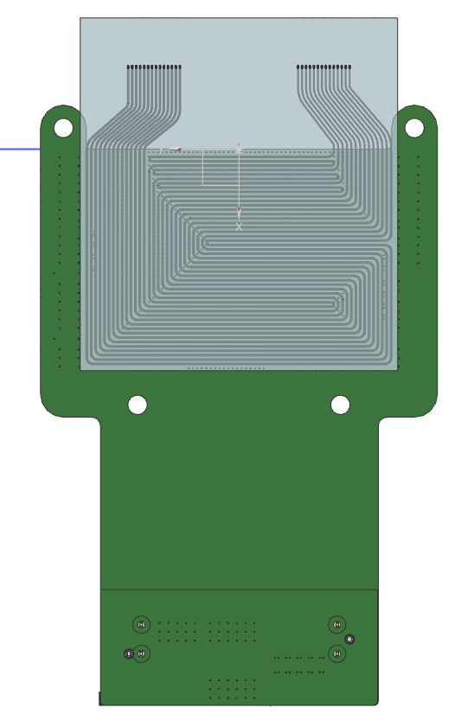
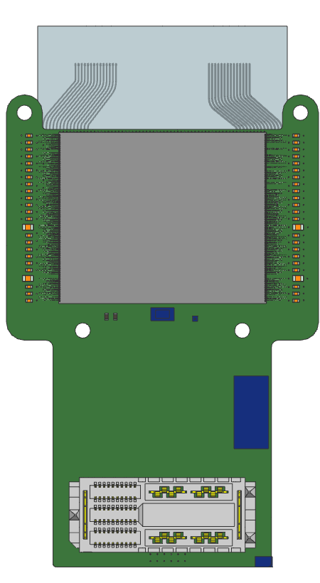
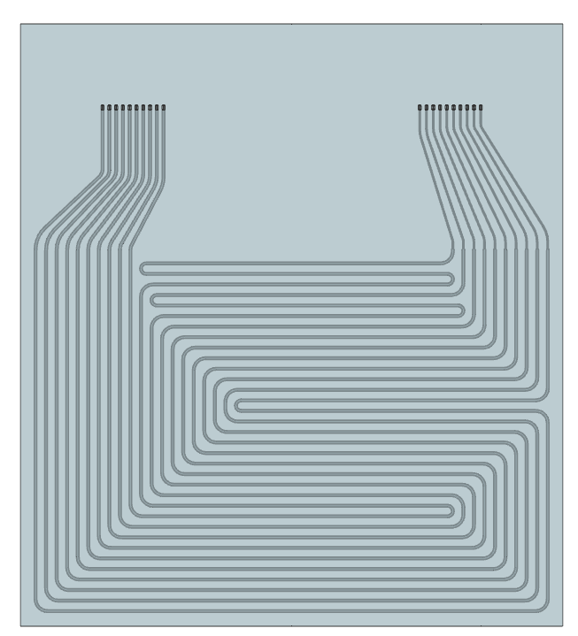
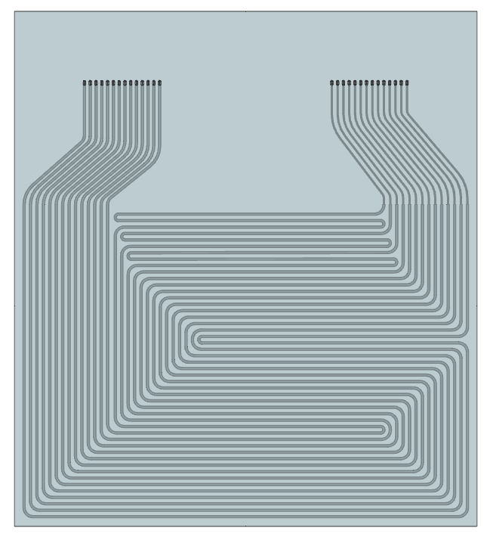
Microchannel variants
MC (Microchannel) Product 3
MC Product 3 dense
40
36

Slide 4
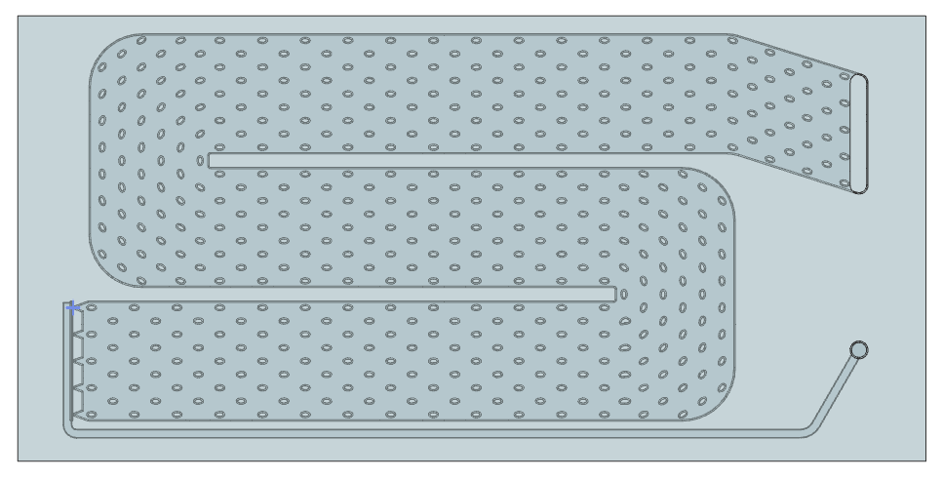
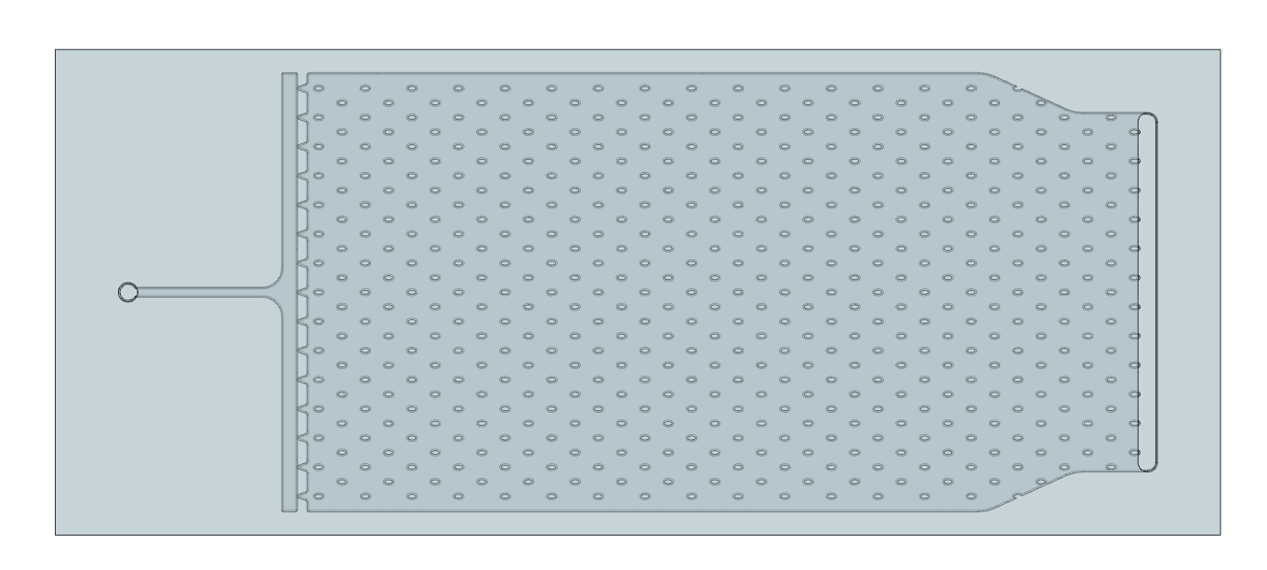
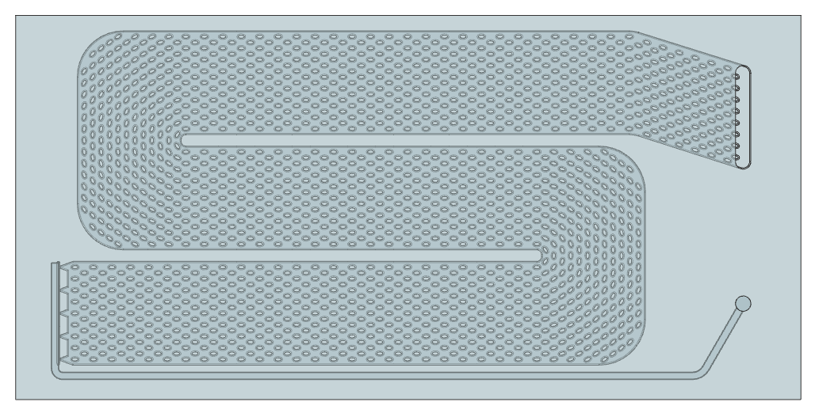
Pillar variants
Pillar Type S
Pillar Type I – Different connector
Pillar Type S dense
60
25

Slide 5
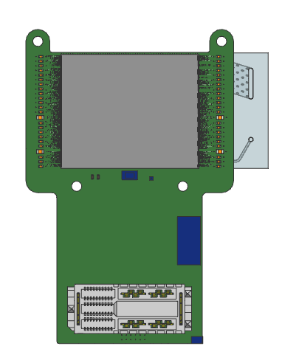
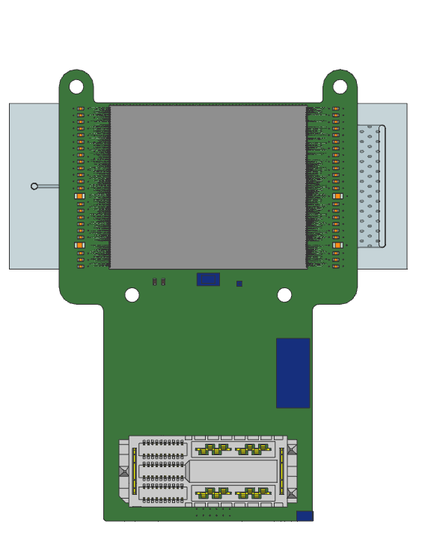
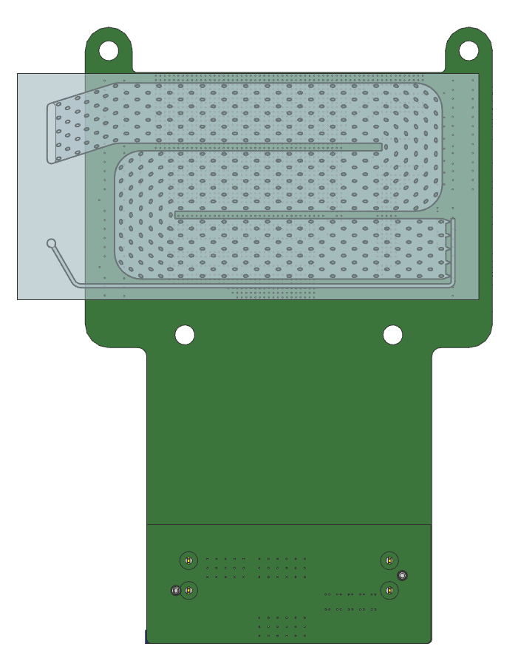
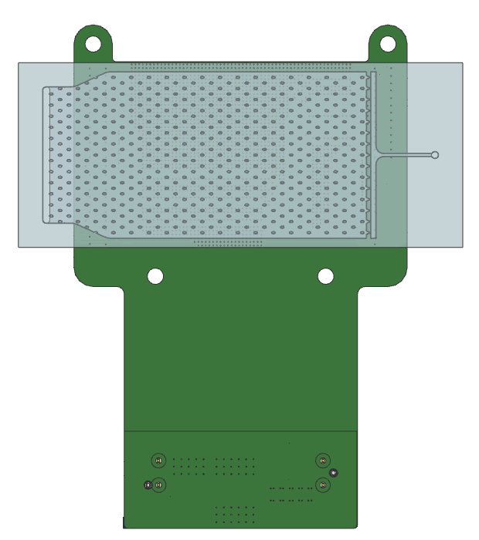
51
60

Slide 6
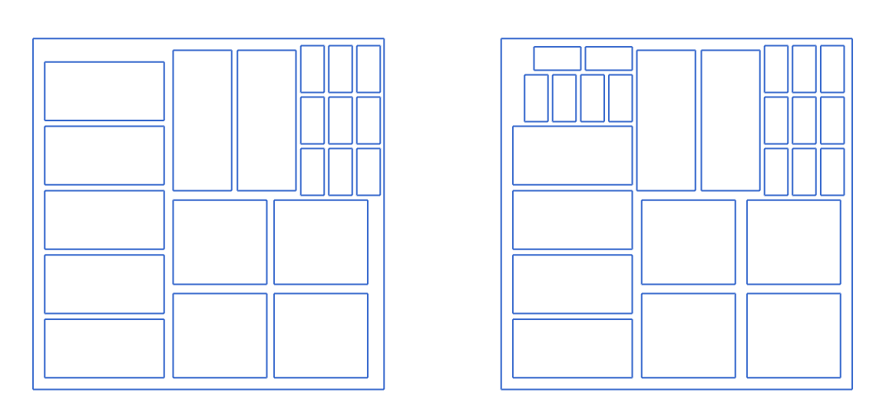
Wafer design
11 substrates (2 of each variant + 1)
9 pressure test samples
10 substrates (2 of each variant)
15 pressure test samples

Slide 7
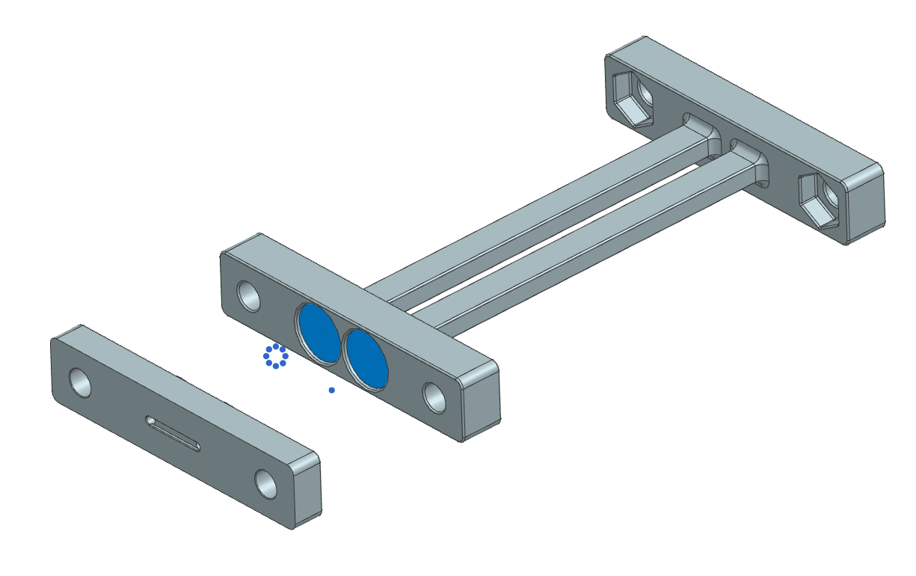
3d printed structure
Material
  Aluminum
  Al2O3, AlN
Open structure with internal pillars

Slide 8
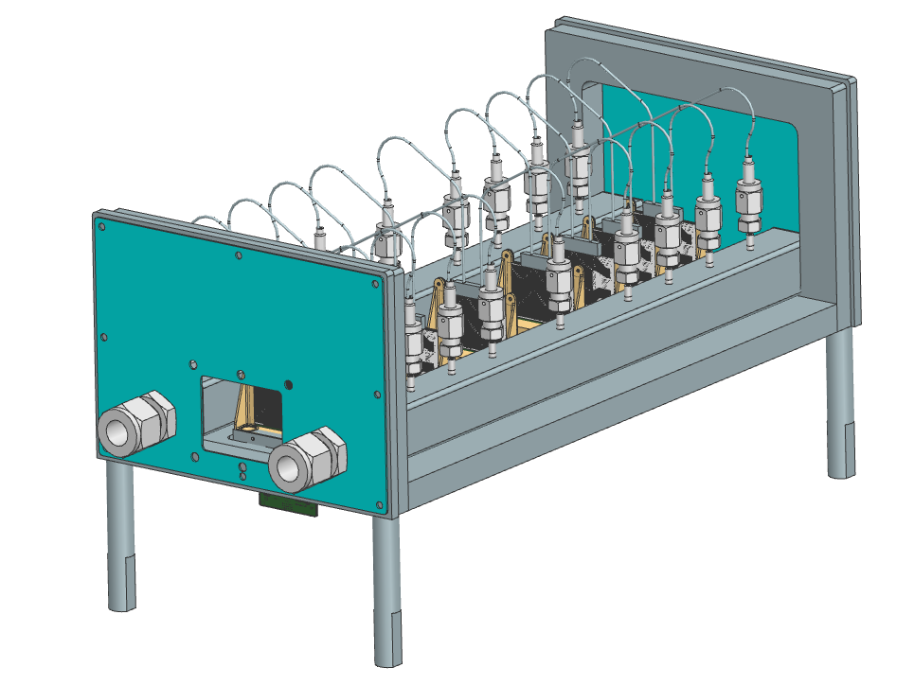
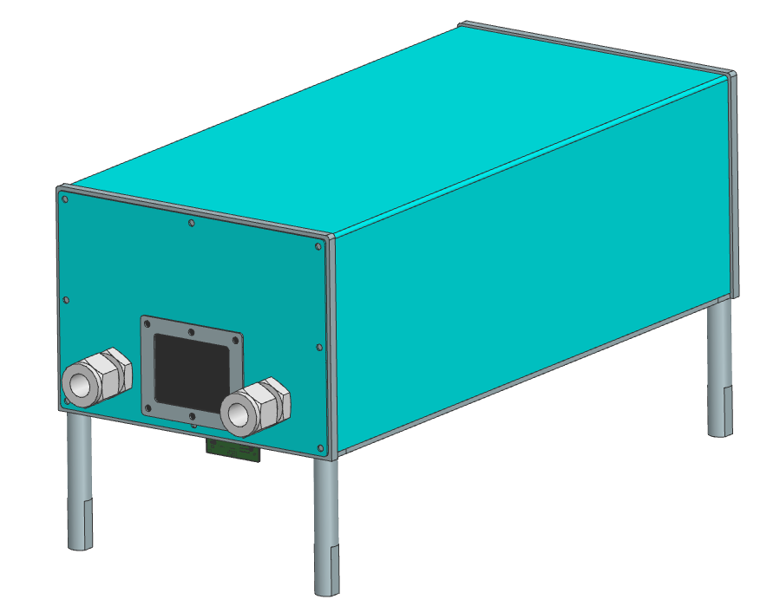
Lumitracker
Based on earlier design, but with focus on manufacturability, position accuracy and stability.
VCR connectors for reliable liquid connection
Large tube for even flow distribution over cooling substrates
Removable top cover for light tightness & sufficient service acces
Mylar sheet in sensor line for low material sealing
Feedthrough fluidic connectors; coolant inlet and outlet

Slide 9
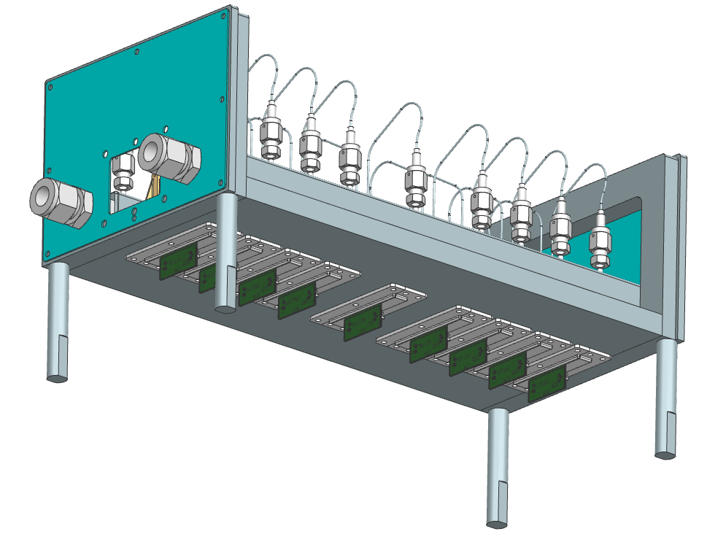
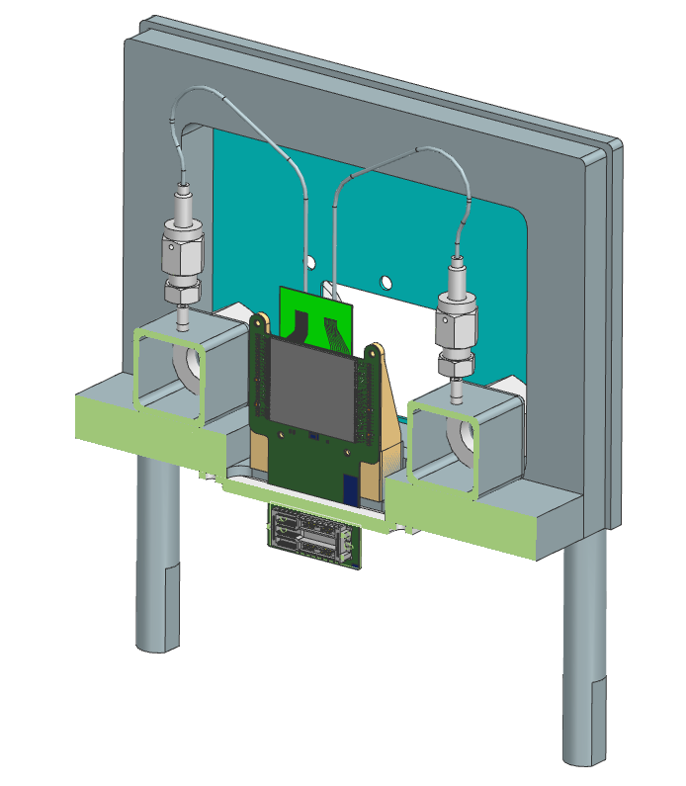
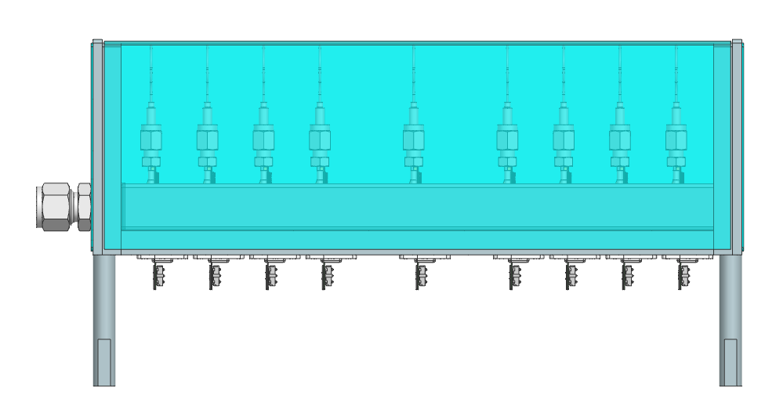
Cooling substrate (TBD) glued to back of Timepix4
3d printed or machined closing plates
Removable feet for cable protection
Cooling substrate (TBD) mounted on holder and positioned in base plate
Baseplate for accurate positional reference
Radiation hard chipboard with connectors outside LumiTracker box
Equal sensor spacing to previous design

Slide 11
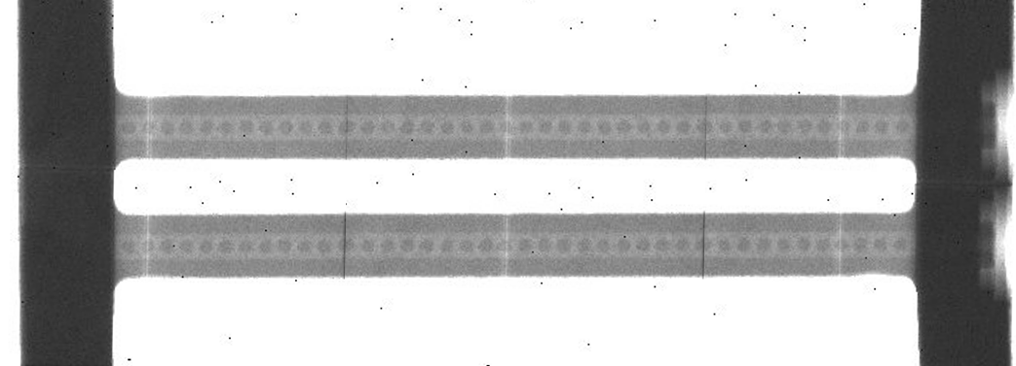
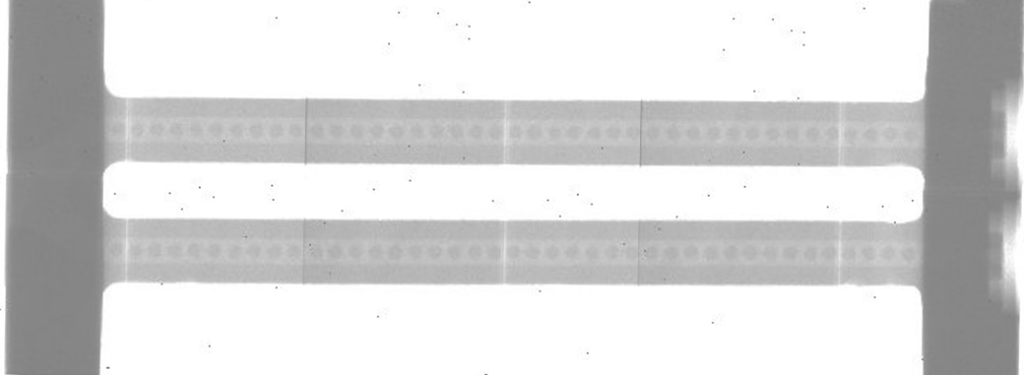
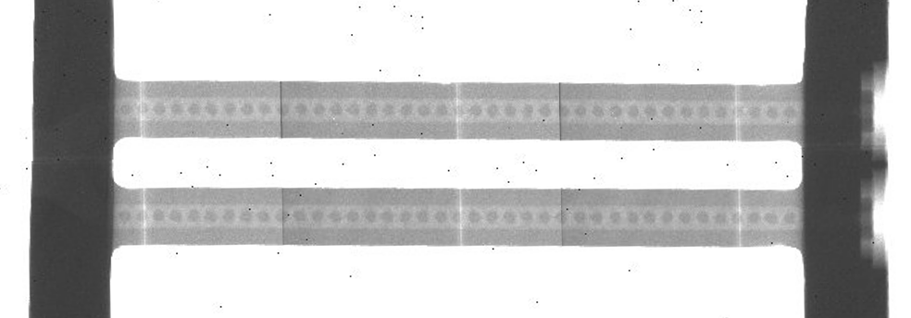
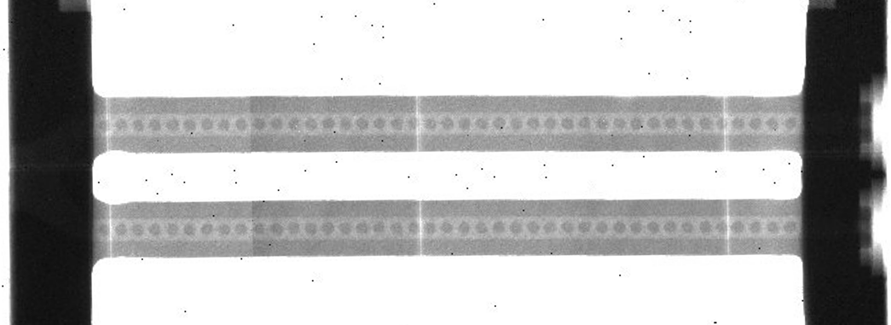
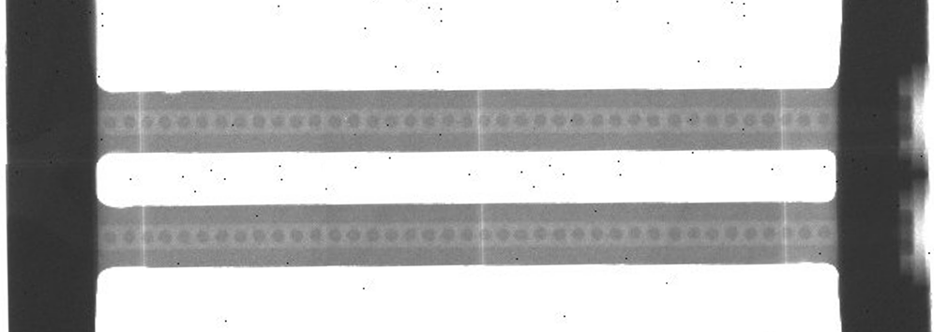
3d printed aluminum
Stitched X-ray images
Good:
  All channels seem to clear
  (All X-ray image acquisition & processing by myself)
Not good:
  3d printed surface can NOT be used for sealing with an o-ring
  Created Dummy sensor with 4 Thermocouples and installed substrate, but no meaningful results due to leakage.
Status
  Requested Espen to rework sealing surfaces.
  Restart tests later this week?

Slide 12
Extra slides

Slide 13
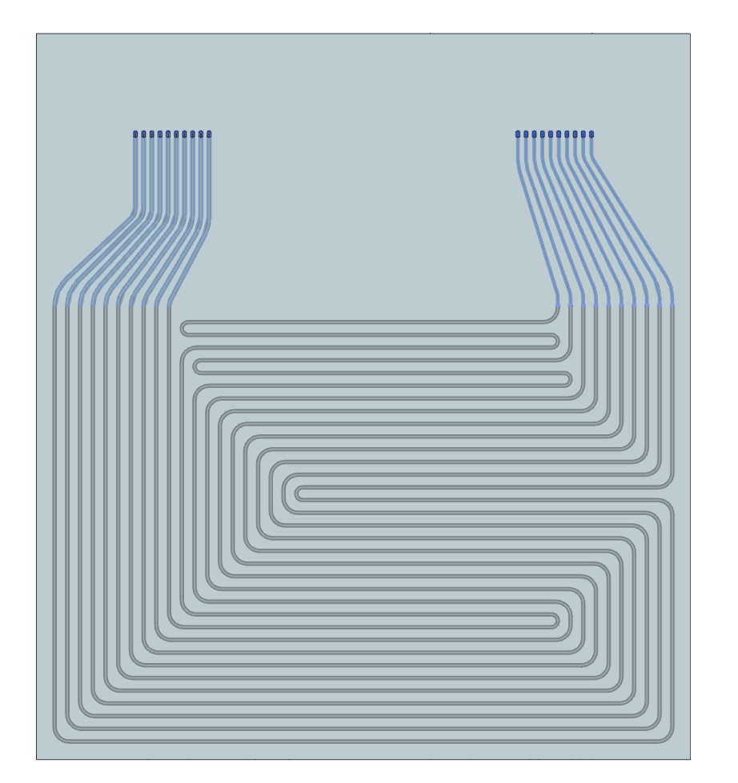
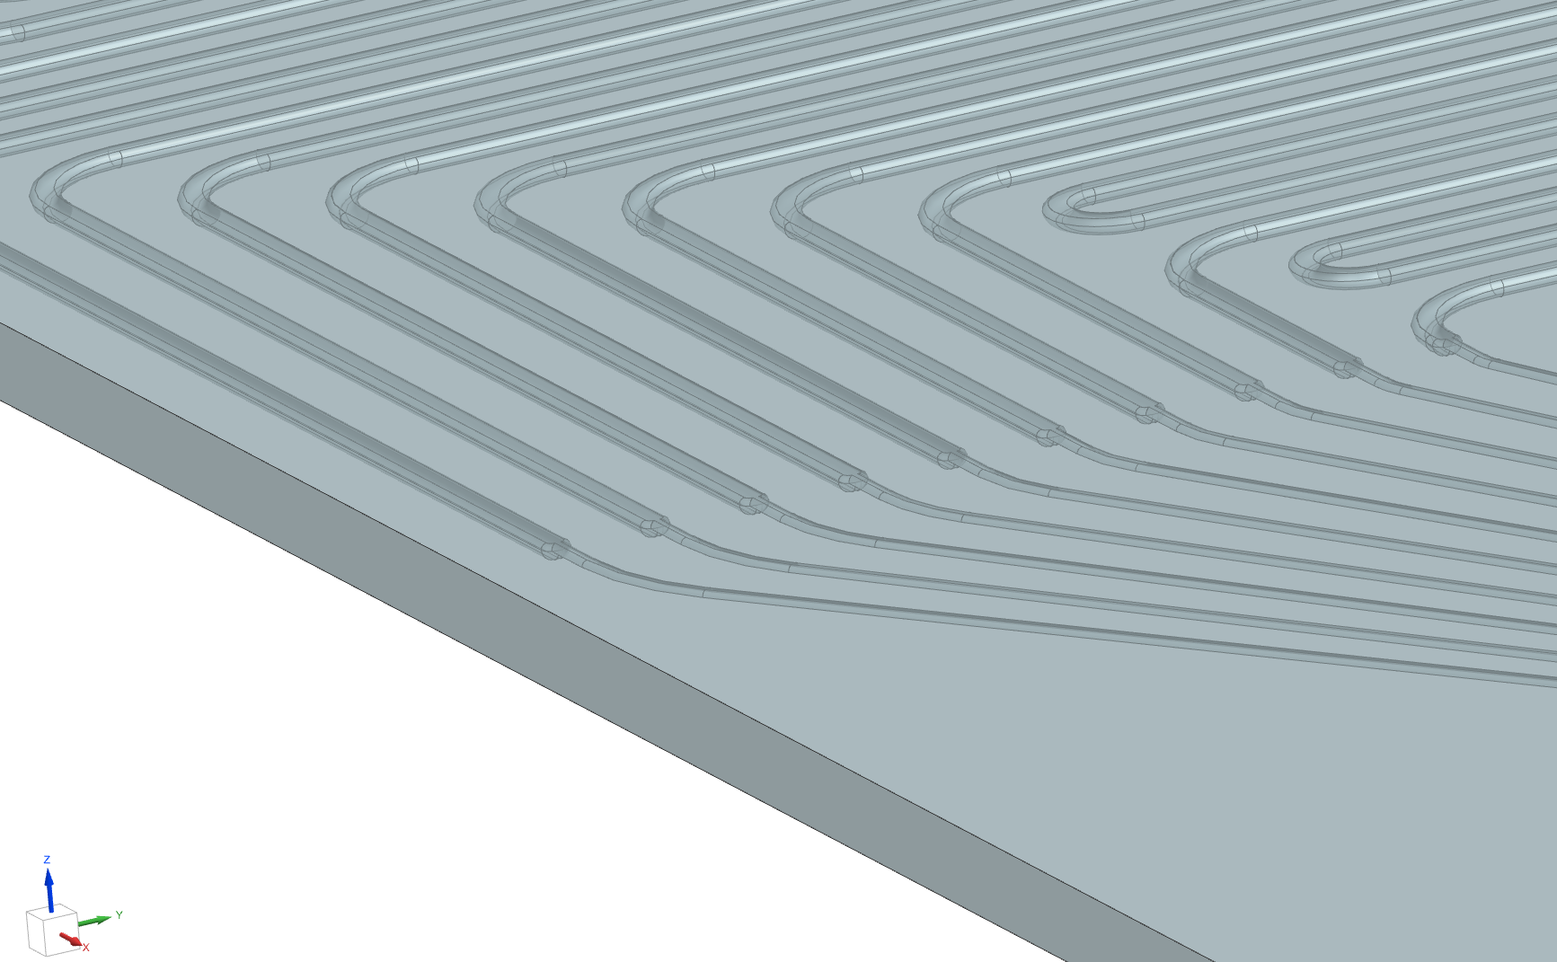
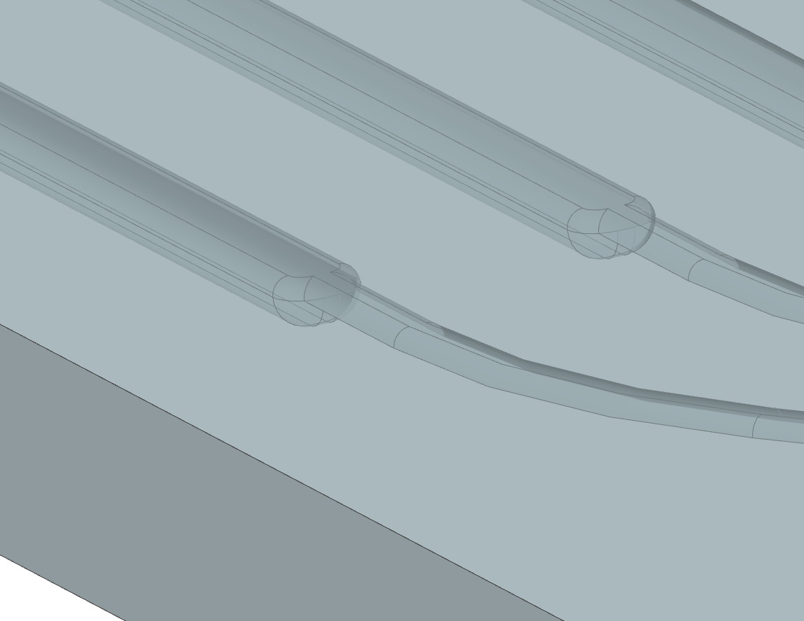
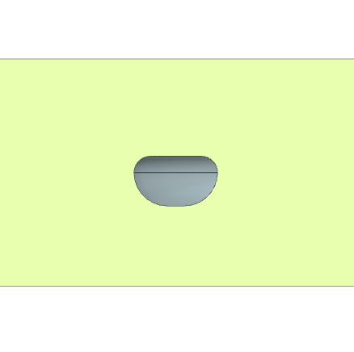
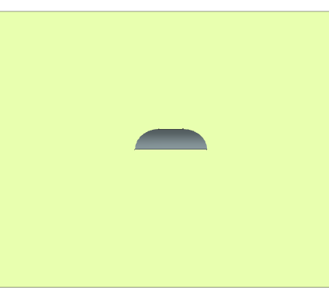
Micro channel design for wet etching
Same layout as LTCC design, but producible by wet etching
  Equivalent hydraulic diameter
    Channel: 200 x 120 um => 200 x 120 um
    Restriction: 60 x 60 um => 40 x 120 um
  Top layer etch depth 40 um
  Bottom layer etch depth: 80 um
  Including etching diameter
40
25
36
R40
R80

Slide 14
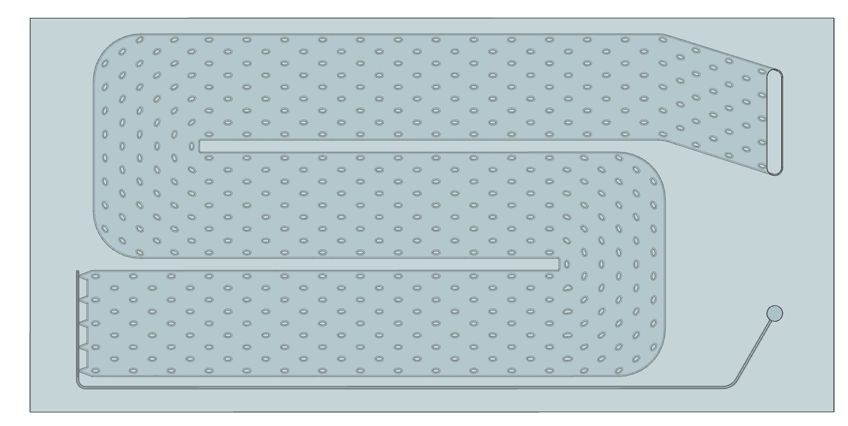
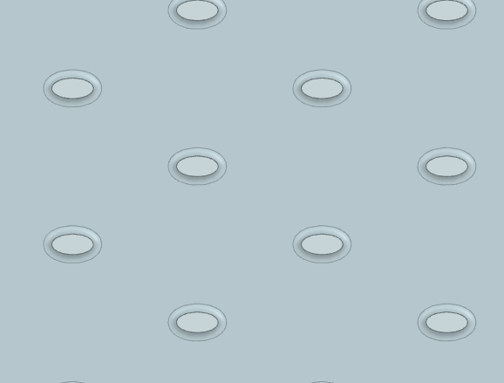
Design: Pillar Type S
51
25
Material: Glass (Borosilicate)
Concept idea:
  Limited thermal conductivity of glass => large conducting surface desired
  High velocity is good for heat transfer => limit hydraulic diameter
  Target: Wide channel with low height: 6.75 mm x 80 um (Dh = 3,54 mm)
Strength:
  Idea: to keep the stress below 186 MPa (safety factor 1.5 on theoretical yield stress), a pillar required every ~1.4 mm.
  For a staggered pillar layout, the pitch between the pillars is chosen of [x, y] = [1.2 mm, 1.5 mm]
3
3
30
3
4,5
7,5
Interfacing surface
Cooling surface
Connecting surface
Bonding surface
Bonding surface
45
36
4,5
1,5
1,4
30
25
1,2

Slide 15
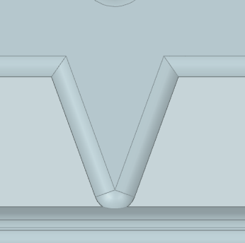
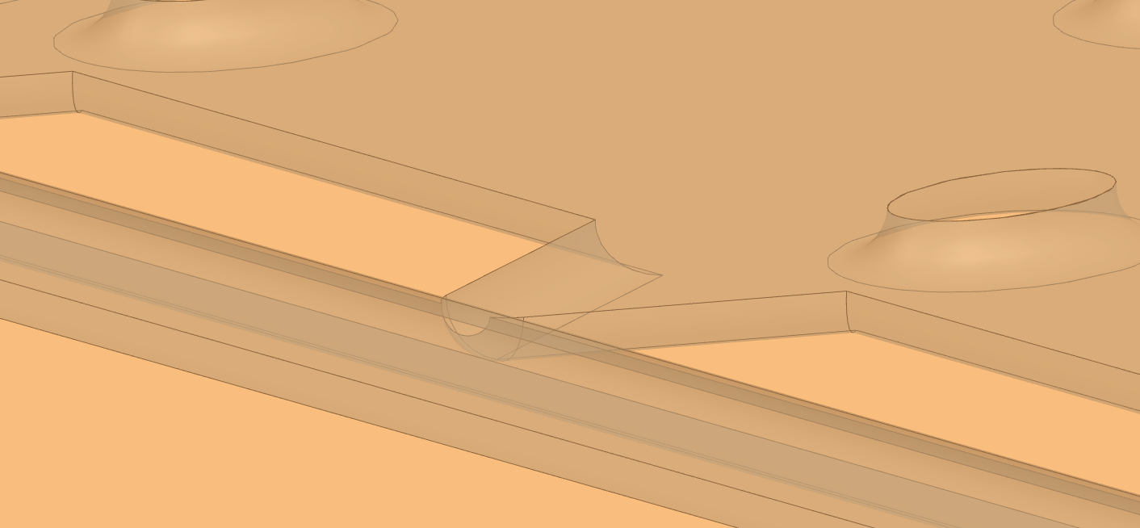
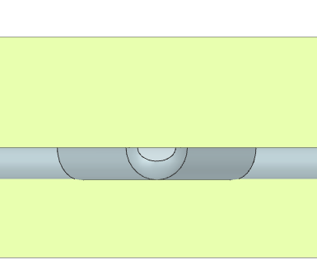
Design: Pillar Type S
Etched sublimation channel
Orifice
Etched input channel
Orifice Design
  5 orifices for even flow distribution through channel
  Size: Semi-circle with width ~93 um (large tolerance),
About orifices
  Due to the phase change, heat input, unknown quality, etc, it is extreme difficult to make a good estimation on the mass flow through the orifice.
    If too small: Large Dp over orifice. Insufficient mass flow (Mass flow restricted by max. pressure => orifice strength)
    If too large: Sufficient mass flow. Low Dp. Blockage before orifice?
  Hypothesis on orifice size: Better too small than too large.
Orifice
Etched channel
93 um

Slide 16
Micronit
Meeting 20 MRT, Wilfred Buesink, Jerone Haneveld
  Borosilicate.
    Standard thickness for etched layer: 400 um, 300 um, 270 um
    Cap layer: 210 um , 175 um
  Fused Silica
    250 um available, but only in 4 inch wafers
  Alignment: ±10 um is relatively standard. ±5 um is possible, but more challenging.
  Mask accuracy: ±1 um precision.
    (Min. Gap width 5um, or else etch might not enter material through opening)
  Metallization is possible, often as last step
Cost indications
  Design and consult €2000 to €3000
  Mask: €1000 per mask
  Total (including sacrificial wafer): Borosilicate: €10k to €15k => Gives 16 to 20 chips with ~70% yield (but no guarantees)
    Fused silica, €2000 per mask: Total project: €15k to €20k

Slide 17
Glass – Heat analysis
Closed structure
2W/cm²
Comparison Closed and Open structure - Glass
DT | Silicon - Closed [°C] | Glass - Closed – optimistic [°C] | Glass - Closed – conservative [°C] | Glass – Open 3 channels [°C]
Overhang | - | - | - | 1,5
Sensor | 0,1 | 0,1 | 0,1 | 0,3
Glue | 1,4 | 1,4 | 1,4 | 5,7
Substrate | 0,04 | 4,2 | 20,8 | 23,8
Coolant | ?
Total | 1,6 | 5,7 | 22,3 | 31,3
Conclusion
  Glass has a poor thermal conductivity, which will influence the DT significantly. To mitigate, thin walls should be used, which might lead to strength issues.

Slide 18
Glass - Strength
From: schott-BOROFLOAT-mechanicalproperties-datasheet-EN_2021_06.pdf
The strength of glass is not a material constant, but is subject to a statistical distribution according to the type and distribution of surface defects and depends, among other things, on the following criteria:
• Conditions during glass processing (including edge processing, drilled holes, etc.)
• Used condition of the glass surface
• Force, type and duration of the effective load
• Environmental conditions (e.g.: corrosive chemicals)
• The geometry of the glass pane and accompanying installation factors
When specifying data for the mechanical strength of glass, the special properties of this brittle material must be taken into account. When glass comes into contact with materials that are just as hard or harder, surface defects in the form of indentations and cracks occur. When glass is subjected to a mechanical load,
the build-up of critical stress at the points of these indentations and cracks cannot be relieved by plastic flow, as is possible with ductile materials such as metals. Glass breaks without warning, whereby the material failure can occur over a relatively wide load area.
When using glass as a construction material (e.g. in mechanical and plant engineering), the respective country- and industry specific requirements and standards must be observed for any material suitability test as well as the basis or any construction calculations.
Strength of glass is not a material constant, but a statistical distribution dependent on:
  Surface defects, condition during glass processing, load, environmental conditions, etc.
Standards must be observed for any material suitability test as well as the basis of any construction calculations.
Borosilicate glass | Theoretical | Permissible (EN 1595)
Tensile | 280 MPa | 7 MPa
Compression | 2000 MPa | 100 MPa

Slide 19
Glass – Design
Radiation length
  For same material budget as 500 um Si, the Silica can be 650 um thick.
Strength
  When using the permissible strength of 7 MPa: Glass becomes a feasible option when the channels are smaller than ~0.2 mm wide. In that range, the min. wall thickness is below ~0.3 mm.
Conclusion / Discussion
  Glass is an option when total thickness <650 um thick, and channels of <0,24 mm wide.
  Pillar like structures might be challenging given the small allowable channel width.
  How much safety?
  The max. allowable stress of 7 MPa is an interpretation of EN 1595 from a single source. Further research on EN 1595 could change the stress value.
  The calculated thickness is based on a rough FEM analysis and might be inaccurate.
Channel width | Min thickness – Permissible strength | Min thickness – Theoretical strength
1,5 mm | 1,9 mm | 0,3 mm
0,75 mm | 0,95 mm | 0,15 mm
0,37 mm | 0,47 mm | 0,074 mm
0,2 mm | 0,25 mm | 0,040 mm
0,1 mm | 0,13 mm | 0,020 mm

Slide 20
Glass – Thermal performance
 | Thermal conductivity
Silicon (Si) | 124 W/(m*K)
Fused Silica | 1,7 W/(m*K)
Borosilicate | 1,1 W/(m*K)
DT over material thickness
  Wall thickness: 250 um
Results
  Silicon: 0,04 K (negligible)
  Borosilicate glass: 4,2 K
Conclusion
  The DT within the substrate can be considered negligible in the silicon substrate.
  For the Borosilicate glass the DT is significant (and even higher in more realistic models with channels instead of full surface cooling).
  This might not be a bad thing for Krypton or CO2 sublimation cooling
q_{heat.load}
t_{wall.glass}
Cooling

Slide 21
Pillar design
Some guidelines from literature
  Pillars often lead to enhancement of heat transfer. This is due to an increased conductive surface, but often at the cost of increased pressure drop.
  Staggered pillars lead to higher heat transfer than inline pillars; as the flow is more disturbed.
  Elliptical pillars lead to higher heat transfer than circular.
  Increasing the number of pillars (and thus reducing the void fraction = ratio area without pillars / total area) generally lead to increased heat transfer, but lead to an increased pressure drop. However, there is a optimum.
Sources:
Heat transfer and pressure drop in microchannels with isotropically etched pillars at sub-ambient temperatures, [H.S. Cao, S. Vanapalli, et al. 2019] https://ris.utwente.nl/ws/files/85920301/heat_transfer.pdf
Thermal performance of elliptical pin fin heat sink under combined natural and forced convection [P.A Deshmukh, R.M. Warkhedkar 2013]

Slide 22
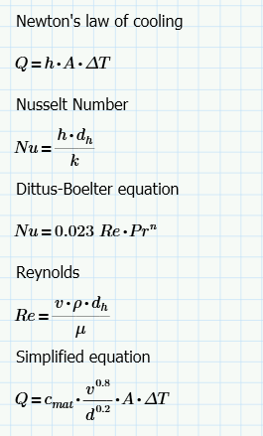
Pillars can increase heat transfer h by:
  Increase conductive surface (theoretical effect (Dittus-Boelter): N)
  (locally) increase velocity (N^{0.8})
  Reduce hydraulic diameter (N^{0,2})
  Adding “turbulence” for better intermixing and more fin surface area coming in contact with the coolant (?)
Conclusion?
  Largest positive effect on heat transfer by adding pillars:
    Additional conductive (wetted) surface
    Local increase velocity
c_{mat} – material characteristic based on temperature, pressure and phase
v – flow velocity [m/s]
d – hydraulic diameter
A – conductive surface
DT – Temperature differenc

Slide 23
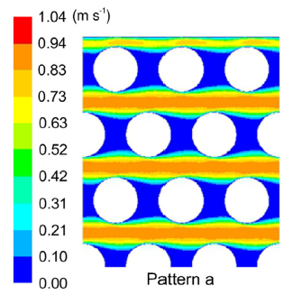
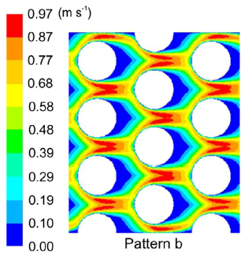
Pillar design
Pillar
A_{rem}
A_{wet}
Conductive area
  Pillars add conductive surface (A_{wet}: blue), but remove ground surface (A_{rem}: red).
  To increase conductive surface, while minizing the removed ground surface:
    Minimize d_{pillar} (in case of cylindrical pillar, at least: d_{pillar} < 2 h_{pillar})
    Change pillar shape such that A_{cond} : A_{rem} increases. E.g. eliptical fin, heart-shape, etc
  Limitation: if d_{pillar} becomes too small, the heat can not be effectively removed through the pin. Avoid: A_{rem} << A_{cond}
  Pillars are relatively more effective when h_{pillar} is large
(local) Velocity
  Pillars locally accelerate fluids.
    High velocity
    Maximize surface area with high velocity
    Minimize surface area with low velocity
  Staggered configuration
    Although in-line has a slightly higher top velocity, the staggered has a much larger surface in contact with the high velocity (roughly whole frontal surface).
  Shape
    The cylindrical pillar has a relatively large low velocity area trailing the pillar (in blue). A different shape could decrease the low velocity area.

Slide 24
 |  | Density | Radiation length | CTE | Thermal conductivity | Strength
Silicon (Si) |  | 2329 kg/m3 | 94 mm | 2,49 | 124 W/(m*K) | 120 MPa
Aluminum Nitride (AlN) |  |  | 84 mm | 3,9 | 180 W/(m*K) | 260 Mpa
Aluminum Oxide (Al2O3) | Lithalox 350 (3d printed) | 3985 kg/m3 | ~69 mm | 7-8 | 29 W/(m*K) | 400 Mpa
 | Corundum | 3960 kg/m3 | 69 mm | 5,5 | 46 W/(m*K) | 300 MPa
Aluminium | AlSi10Mg (3d printed) | 2680 kg/m3 | 89 mm | 20,9 | 113 W/(m*K) | 220 MPa
 | Al | 2699 kg/m3 | 89 mm | 24 | 210 W/(m*K)
Titanium | Grade 23 | 4500 kg/m3 | 36 mm | 8,6 | 6,7 W/(m*K) | 830 MPa
Fused Silica |  | 2200 kg/m3 | 123 mm | 0,4 | 1,7 W/(m*K)
Borosilicate |  | 2230 kg/m3 | 126 mm | 3,25 | 1,1 W/(m*K) | 280 Mpa (tensile), 34 Mpa (flexural) 7 MPa (ISO 1595)
Borofloat | 33 | 2230 kg/m3 |  | 3,25 | 1,2 W/(m*K) | 150 MPa (bending), 25 MPa (used condition)
Stycast | 2850FT |  |  |  | 1,12 W/(m*K)
Saffier (Al2O3) |  | 3980 kg/m3 |  | 3,3-5,6 | 23,1 W/(m*K) | 276 MPa

