Slide 1
The IGTF to eduGAIN Bridge
Bringing X.509 and SAML together
Ioannis Kakavas
Nicolas Liampotis
AARC SA1 - Pilots
AARC SA1 - Pilots
Identity & Security Engineer, GRNET S.A.
AAI Research Engineer, GRNET S.A.
39th EUGridPMA meeting, Firenze
2017-01-30

Slide 2
AARC
support the collaboration model across institutional and sector borders
advance mechanisms that will improve the experience for users
guarantee their privacy and security
build on the very many existing and evolving components ESFRI clusters, eduGAIN, national AAI federations, NGIs, IGTF, SCI, SirTFi
design, test and pilot any missing components
integrate them with existing working flows

Slide 3
AARC
support the collaboration model across institutional and sector borders
advance mechanisms that will improve the experience for users
guarantee their privacy and security
build on the very many existing and evolving components ESFRI clusters, eduGAIN, national AAI federations, NGIs, IGTF, SCI, SirTFi
design, test and pilot any missing components
integrate them with existing working flows

Slide 4
Bridging IGTF to eduGAIN The facts
eScience Services
Traditionally support X.509 authentication
Paradigm shift towards federated SSO
Support for authentication at Home Organizations
eScience Services Users
Large number of them already have X.509 certificates
Some of them might not have an account at the Identity Provider of their Home Organization
Some of them might not have a Home Organization
Some of them might not want to / cannot use their Home Organization account
eScience Services Authentication
X.509 certificates from IGTF Accredited CAs provide higher assurance than Home Organization IdP credentials

Slide 5
Bridging IGTF to eduGAIN The problem statement
How can we allow eScience Services Users to access the Services
Using the X.509 certificates that they already have
Not forcing them to register/use Home Organization accounts
Carrying a high LoA (Level of Assurance)
And at the same time
How can we allow eScience Services
To follow the paradigm shift to federated SSO
To not lose/alienate their user base
To maintain LoA requirements

Slide 6
Bridging IGTF to eduGAIN The solution
authX509toSAML
https://github.com/jkakavas/authX509toSAML

Slide 7
Bridging IGTF to eduGAIN authX509toSAML
Functionality
Authenticates users based on their X.509 certifcates
Translates X.509 certificates to SAML assertions
Stateless by design -> Distributed nature
*https://www.cs.virginia.edu/~evans/cs551/saltzer/

Slide 8
Bridging IGTF to eduGAIN authX509toSAML
Design Principles*
Principle of Economy of Mechanism
Minimal implementation ( minimal bugs )
Each component should do what it is designed to do
Principle of Fail-safe Defaults
Provide sane defaults where applicable
Principle of Open Design
Use / extend well known software components
Principle of Psychological Acceptability
Easy to use workflow / UX that users are familiar with
*https://www.cs.virginia.edu/~evans/cs551/saltzer/

Slide 9
Bridging IGTF to eduGAIN authX509toSAML Components
Apache2 httpd server
Handles X509 client authentication
Accepts only certificates signed by IGTF accredited Cas
SimpleSAMLphp module ( authX509toSAML)
Performs token translation
Authenticated certificate → SAML Assertion

Slide 10
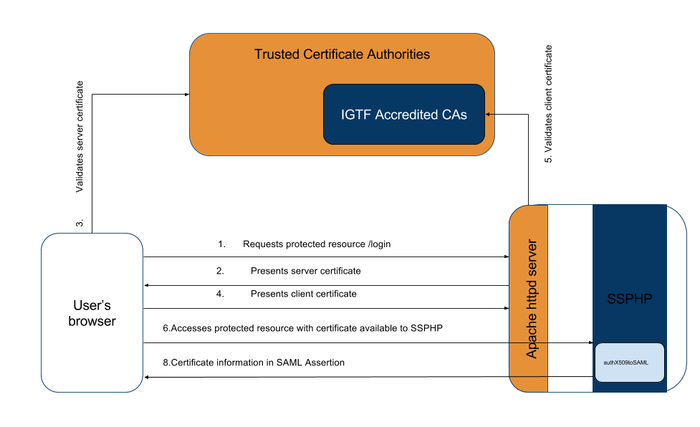
Bridging IGTF to eduGAIN authX509toSAML

Slide 11
Bridging IGTF to eduGAIN authX509toSAML
Apache2 httpd Configuration
SSLVerifyClient require
SSLVerifyDepth 1
SSLCACertificatePath "/usr/share/igtf-policy/classic_mics“
Debian packages: igtf-policy-{classic,mics}

Slide 12
Bridging IGTF to eduGAIN authX509toSAML
SimpleSAMLphp module (authX509toSAML)
'x509' => array(
'authX509toSAML:X509userCert',
'authX509toSAML:cert_name_attribute': 'CN',
'authX509toSAML:assertion_name_attribute': 'displayName',
'authX509toSAML:assertion_dn_attribute': 'distinguishedName',
'authX509toSAML:assetion_assurance_attribute': 'eduPersonAssurance',
'authX509toSAML:parse_san_emails': TRUE
'authX509toSAML:parse_policy': TRUE,
'authX509toSAML:export_eppn': FALSE,
),

Slide 13
Bridging IGTF to eduGAIN authX509toSAML
SimpleSAMLphp module (authX509toSAML)
'cert_name_attribute': The attribute in the certificate carrying the name of the subject
'assertion_name_attribute':The attribute in the SAML Assertion to map the above
'assertion_dn_attribute': The attribute in the SAML Assertion to map the DN
'assetion_assurance_attribute': The attribute ubin the SAML Assertion to use for certificate policy attributes
‘parse_san_emails': Attempt to parse SANs with type emailAddress
'parse_policy': Attempt to parse Certificate Policy extention,
'export_eppn': Attempt to parse eduPersonPrincipalName from the CN ( i.e. Grid Robot certificates

Slide 14
Bridging IGTF to eduGAIN Demo
“Researcher needs to have access to SAML Service Provider published in eduGAIN, but they do not have an account at the IdP of their Home Organization. They do, however, have a certificate issued to them by the IGTF accredited HellasGrid Certification Authority.”
https://snf-666522.vm.okeanos.grnet.gr/ssp/module.php/core/frontpage_auth.php

Slide 15
ikakavas@noc.grnet.gr

