Slide 1
AARC TREE – Policy and good practice harmonisation
WP2
David Groep†, Dave Kelsey‡
AARC TREE WP2 Leads
†Nikhef and Maastricht University ‡Rutherford Laboratory (STFC-UKRI)
AARC TREE project meeting
Reading, UK, April 2, 2025

Slide 2
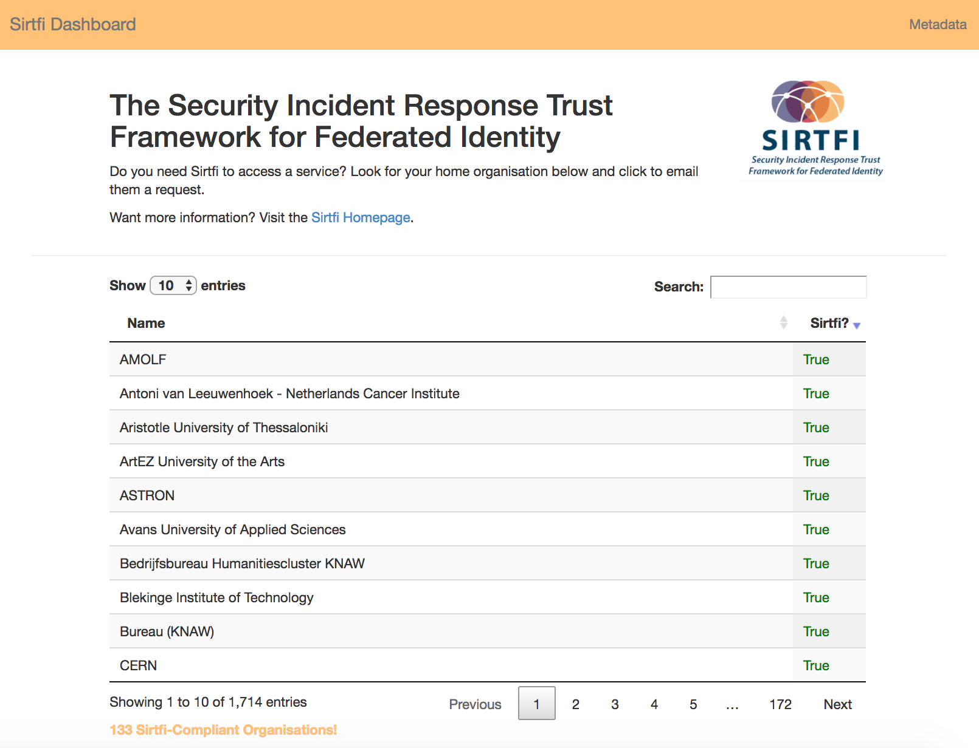
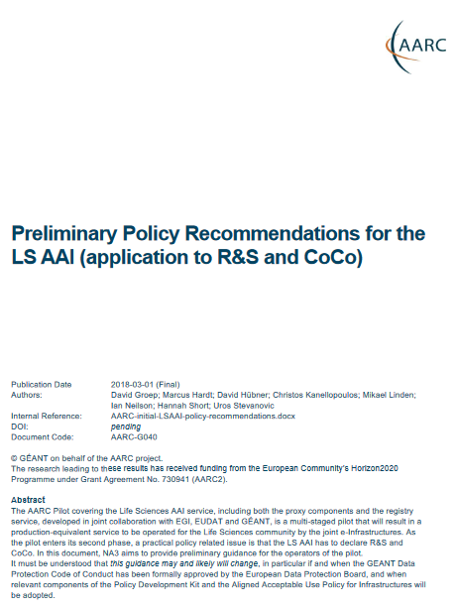
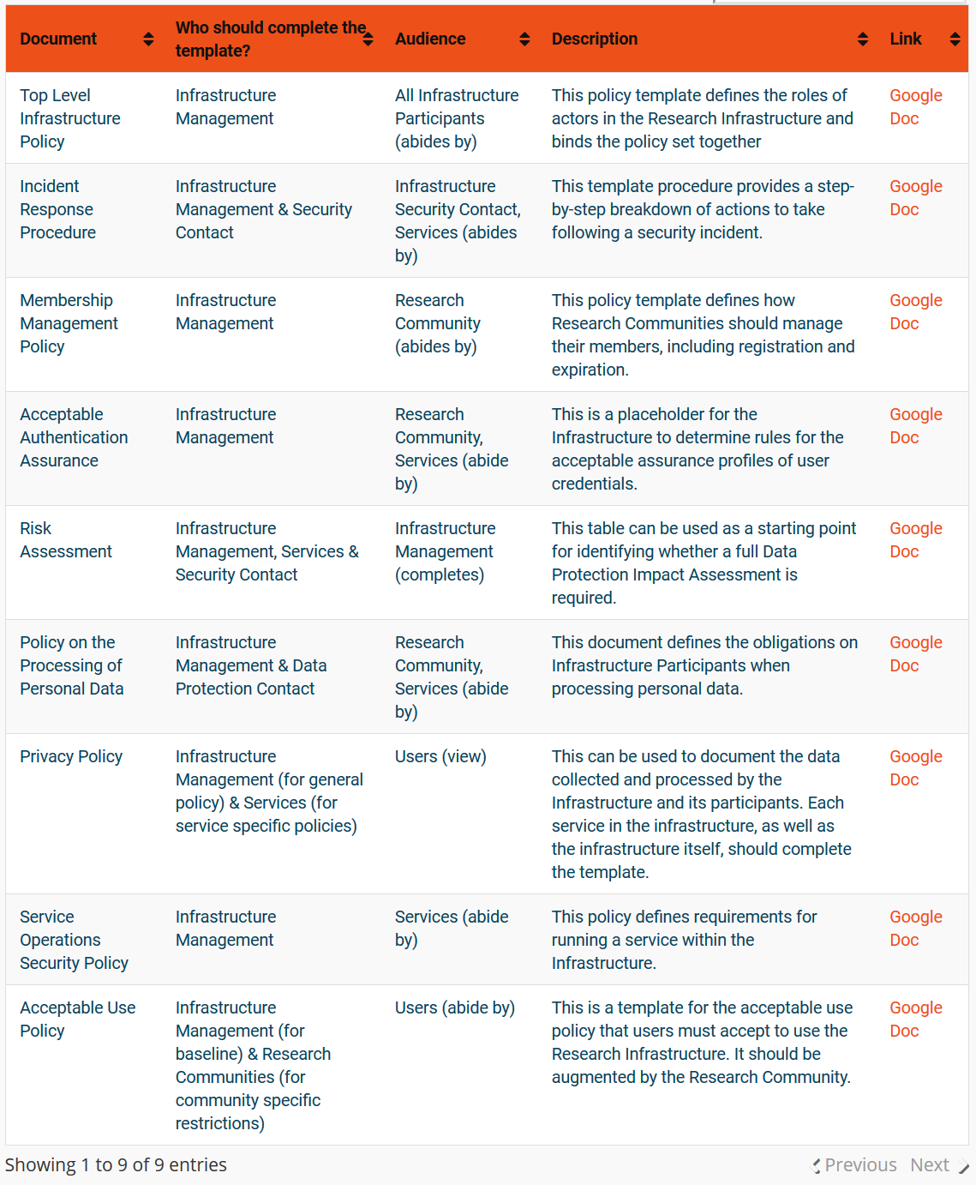
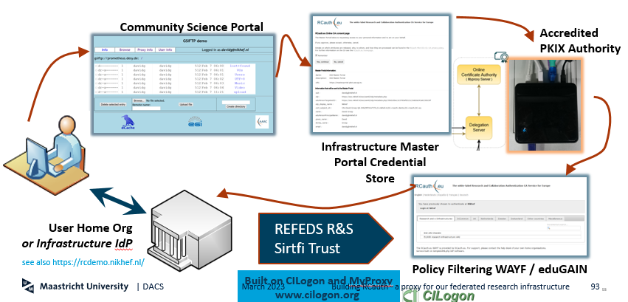
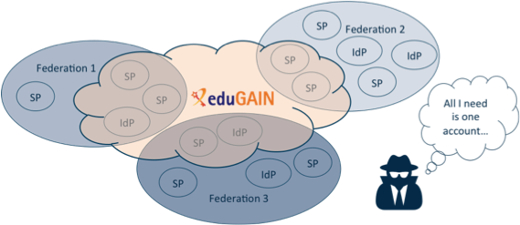
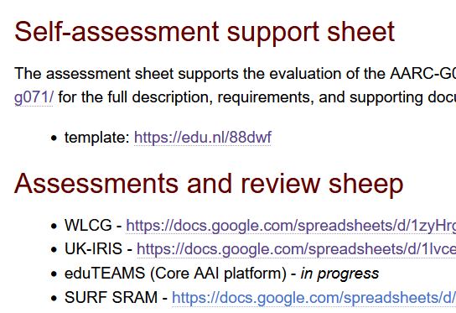
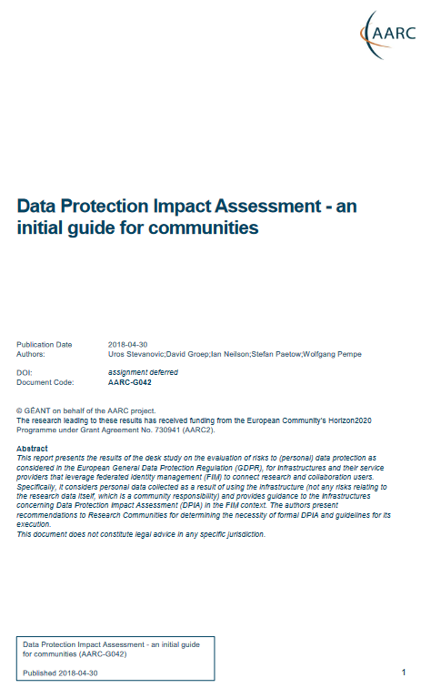
AARC beyond incumbent practices and policies?
Current Policy Development Kit is targeted at large and structured communities – and quite complex
https://aarc-community.org/policy

Slide 3
Two-pronged approach for policy and good practice for AARC BPA 2025
Infrastructure alignment and policy harmonisation: ‘helping out the proxy’
Operational Trust for Community and Infrastructure BPA Proxies
Increase acceptance of research proxies by identity providers through common baselines
Review infrastructure models for coordinated AUP, T&C, and privacy notices, improving cross-infrastructure user experience (users need to click only once)
User-centric trust alignment and policy harmonization: ‘helping out the community’
Lightweight community management policy template
Guideline on cross-sectoral trust in novel federated access models
Assurance in research services through (eIDAS) public identity assertion
Anchored in the researcher user communities by co-creation with FIM4R

Slide 4
WP2 Policy Deliverables
 | Deliverable name | Short description | #WP | Lead | Type | Due
M2.1 | Guidance for notice management by proxies | Guideline submitted to AEGIS |  |  |  | M10
D2.1 | Trust framework for proxies and Snctfi research services | Trust framework, guidelines and best practice for BPA proxies and interaction with research services | WP2 | RAL | R | M15
M2.2 | eID assurance model suitability assessed | Report submitted to AEGIS |  |  |  | M18
D2.2 | AARC Policy Development Kit Revision | Evolved suite of guidelines and templates for research and infrastructure communities | WP2 | Nikhef | R | M24
✓

Slide 5
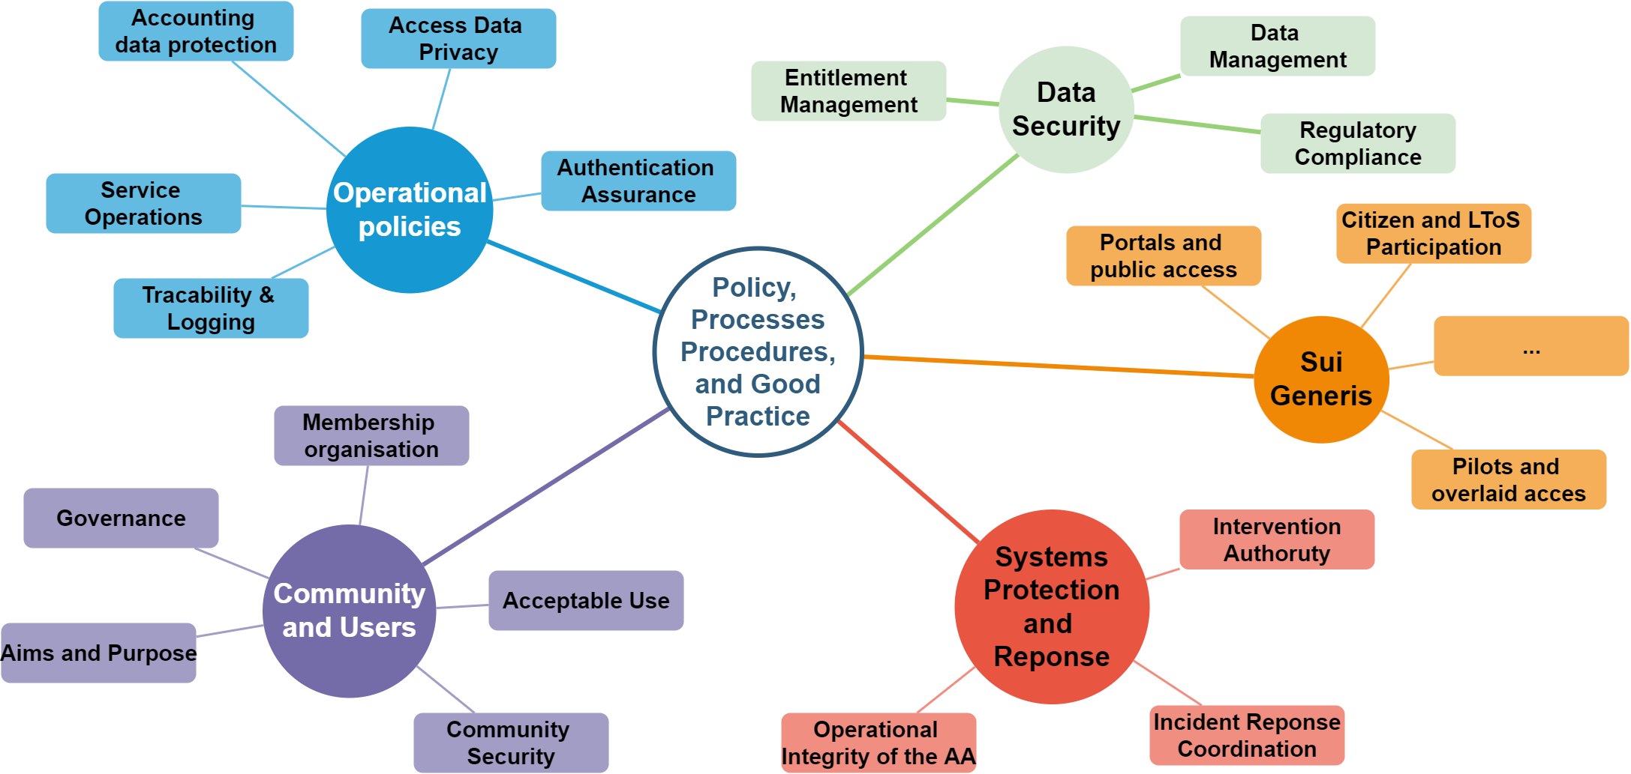
Many policy aspects and trusted security practices to consider!

Slide 6
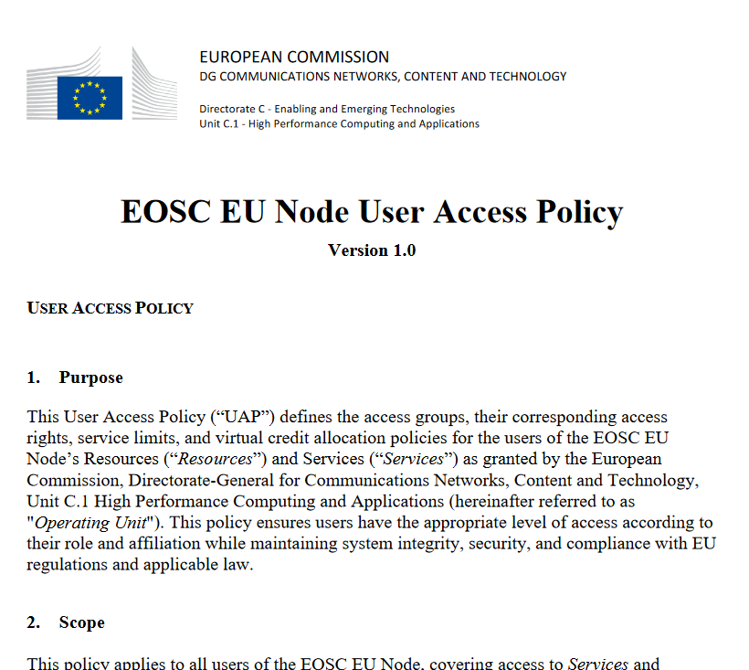
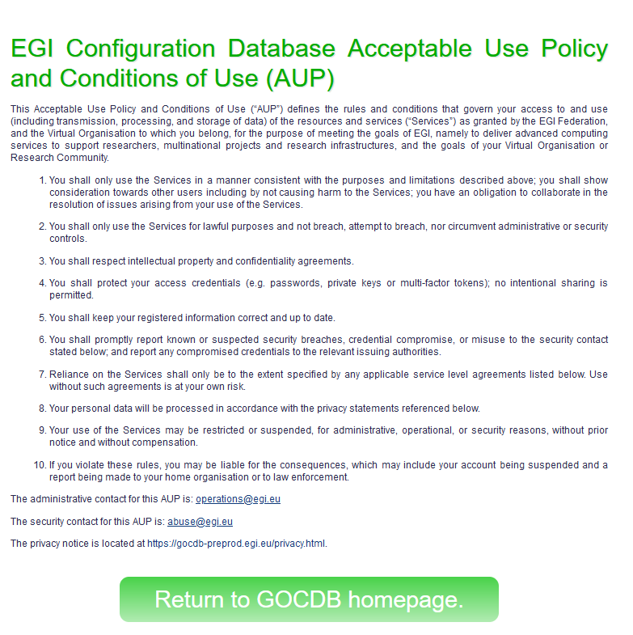
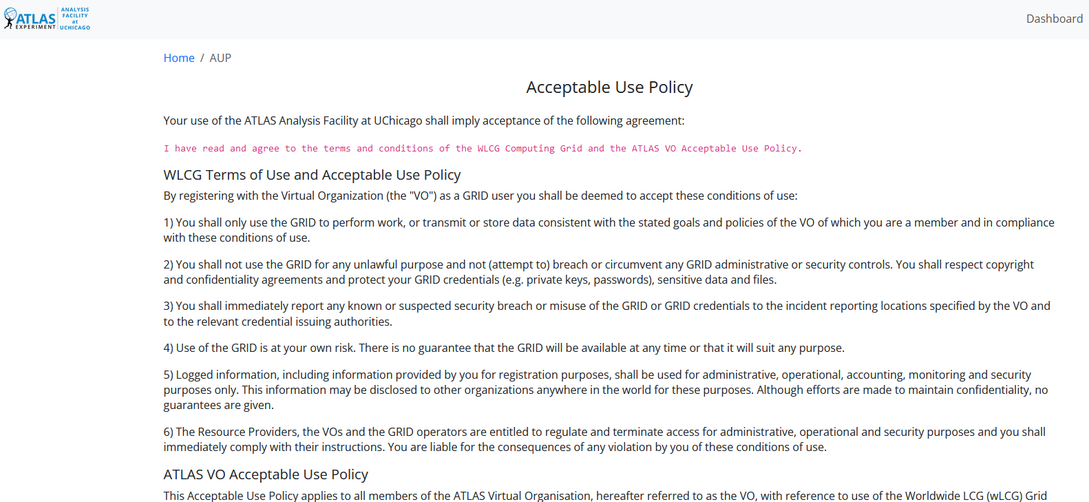
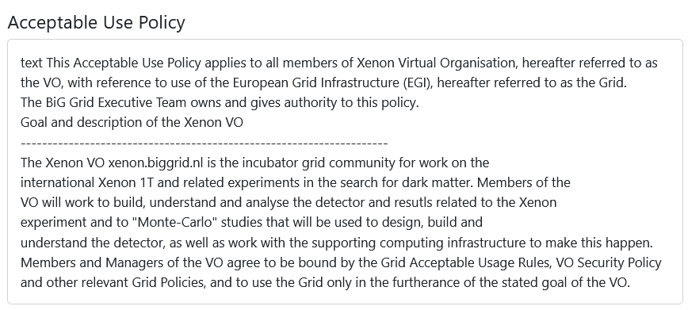
With fewer clicks to more resources – while keeping the user informed
reference models for acceptable use policy and privacy notice collection to improve cross-infrastructure user experience

Slide 7
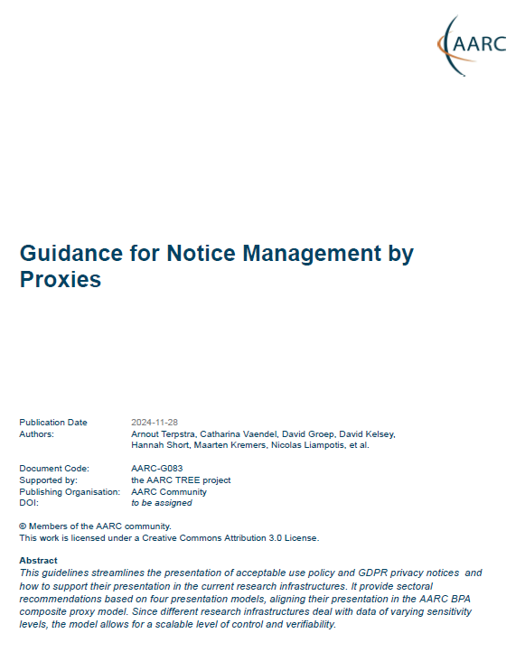
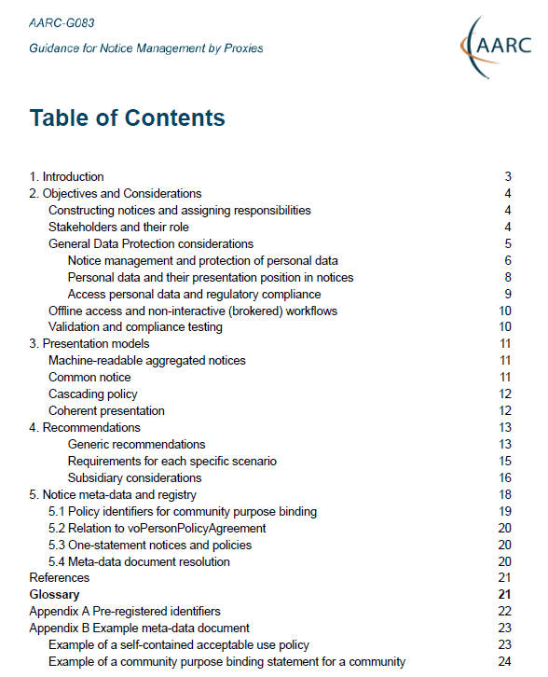
New AARC guidance on Notice Management by Proxies (AARC-G083)
Four presentation models In order of preference
machine-readable aggregated notice
common notice (single common authority domain)
cascading notices (assume responsibility for underlings)
coherent presentation: you show what you need (but not more)
Recommend WISE Baseline AUP plus model to construct notices and communicate acceptance based on the AARC ID-community-infra hierarchy of proxies
sufficient to build you a comprehensive WISE Baseline AUP
and a set of privacy notices (for those GDPR encumbered)
plus a namespace inspired by RFC6711’s LoA registry

Slide 8
Recommendations – generic and per presentation model
use of the WISE Baseline AUP is RECOMMENDED
the notice presentation component MUST record, collect and retain time-stamped information related to notice presentation
a notice presentation component that records logs about notice presentations SHOULD collect and retain necessary user contact information
a service provider or proxy that is intentionally connected up-stream to an AARC BPA proxy MUST inform all accepted and acknowledged upstream proxy operators

Slide 9
Can we construct all of the WISE Baseline AUP at the proxy?
Four elements are needed:
the purpose binding for everything the user is going to experience
the 10 commandments (or materially equivalent)
aggregate of the terms and conditions for the proxy and the services behind it to which the user will (or may!) have access including limits on personal data processing for data held within the service or data provider
list of privacy notices for connected services (‘two clicks away’)
plus the source(s) of authority for this combined notice

Slide 10
Mechanisms
‘meta-data’ for notice information at a well known endpoint
voPersonPolicyAgreement signalling downstream on a per-user bases
aggregation rules for included and augmenting notices
notice types in line with the WISE Baseline AUP (purpose, acceptable-use, conditions, sla, privacy) where privacy notices are those for ‘access personal data’ as meant in REFEDS CoCo v2
and:
include state information on validity, acceptance period, refresh period, and version
multi jurisdiction (EEA and others) and multi-language are needed

Slide 11
Automatically constructing notices? Will that work? We can at least try!
{ "id": "urn:doi:10.60953/68611c23-ccc7-4199-96fe-74a7e6021815", "aut": "https://www.nikhef.nl/", "aut_name": "Nikhef", "valid_from": 1649023200, "ttl": 604800, "contacts": [ "helldesk@nikhef.nl", "information-security@nikhef.nl" ], "security_contacts": [ "abuse@nikhef.nl" ], "privacy_contacts": [ "privacy@nikhef.nl" ], "policy_class": "acceptable-use", "notice_refresh_period": 34214400, "includes_policy_uris": [ "https://documents.egi.eu/document/2623" ], "policy_uri": "https://www.nikhef.nl/aup/", "description#nl_NL": "Deze Gebruiksvoorwaarden betreffen het gebruik van netwerk en computers bij Nikhef. Iedere gebruiker van deze middelen of diensten wordt geacht op hoogte te zijn van deze voorwaarden en deze na te leven.", "description": "This Acceptable Use Policy governs the use of the Nikhef networking and computer services; all users of these services are expected to understand and comply to these rules." }
{ "id": "https://operations-portal.egi.eu/vo/view/voname/xenon.biggrid.nl", "aut": "https://xenonexperiment.org/", "aut_name": "Xenon-nT collaboration", "valid_from": 1311890400, "ttl": 31557600, "contacts": [ "grid.support@nikhef.nl", ], "security_contacts": [ "vo-xenon-admins@biggrid.nl" ], "policy_class": "purpose", "augments_policy_uris": [ "https://wise-community.org/wise-baseline-aup/v1/" ], "policy_uri": "https://operations-portal.egi.eu/vo/view/voname/xenon.biggrid.nl", "description": "detector construction and experiment analysis for the search of dark matter using Xenon detectors" }

Slide 12
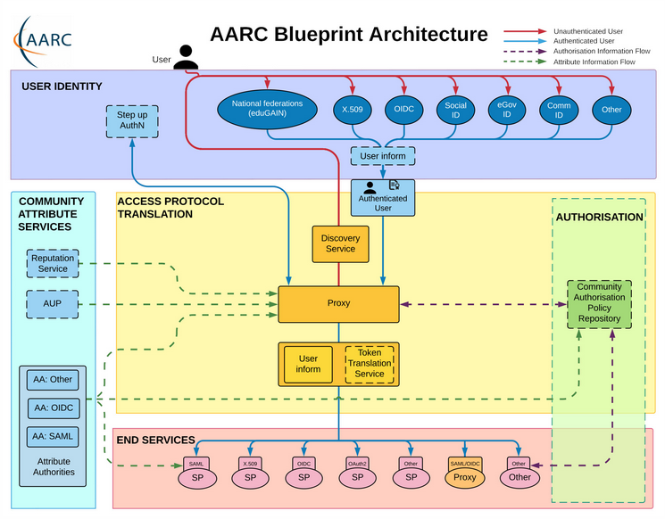
Practices we already have, practices we need to harmonise
Authentication/identity sources
NIST SP800-63
FIPS140
ISO 27001
IGTF AP Profiles
REFEDS MFA
REFEDS Assurance Framework
AARC-G071 for the Community Attribute Authority (AA) and operation of the Proxy
Service provider operations
ISO27k
NIS2
ITSRM2
while for identity sources and for services there is extensive normalisation, our AARC BPA ‘proxy’ did not …

Slide 13
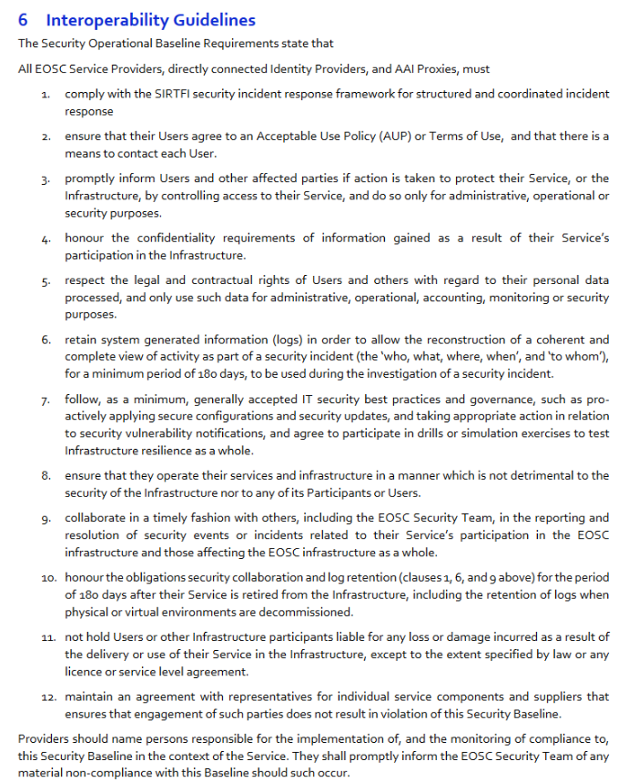
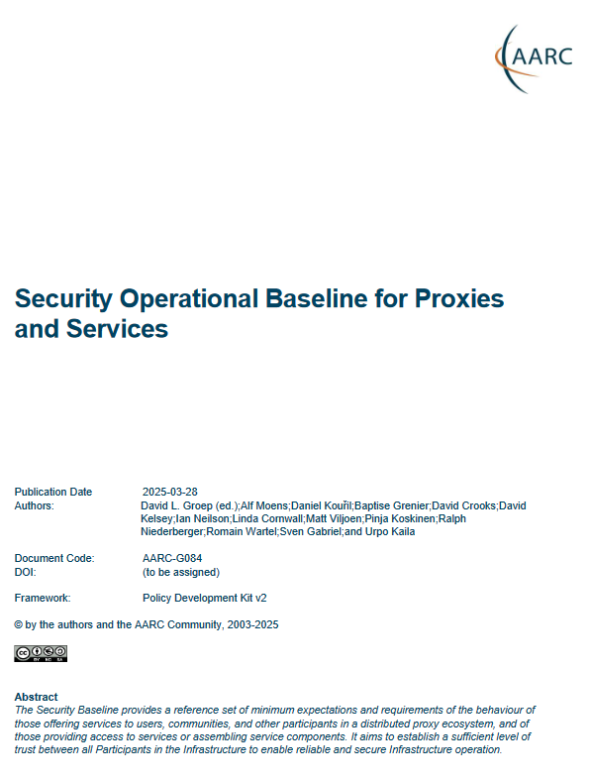
Proxy Operations: Information Security and Security Operational Baseline
‘address information security for disciplines and infrastructures - some of which process sensitive data’
Baseline Service Security policy the AARC PDK v1 was very successful, but diverged in several directions:
national implementations and specialisations
was included in the EOSC Interoperability Framework as the ‘Security Operational Baseline’
but has not been brought home to the broader research community – yet …
AARC TREE now re-aligning these in the new PDK - with guidance and FAQs
Just ported it back as AARC-G084!
https://doi.org/10.5281/zenodo.7396724
Pending DOI 10.5281/zenodo.15119296

Slide 14
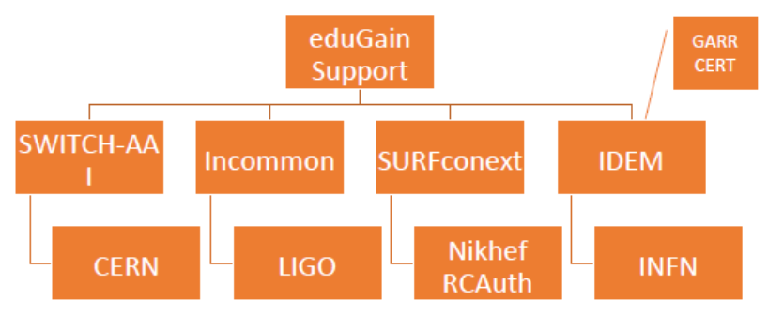
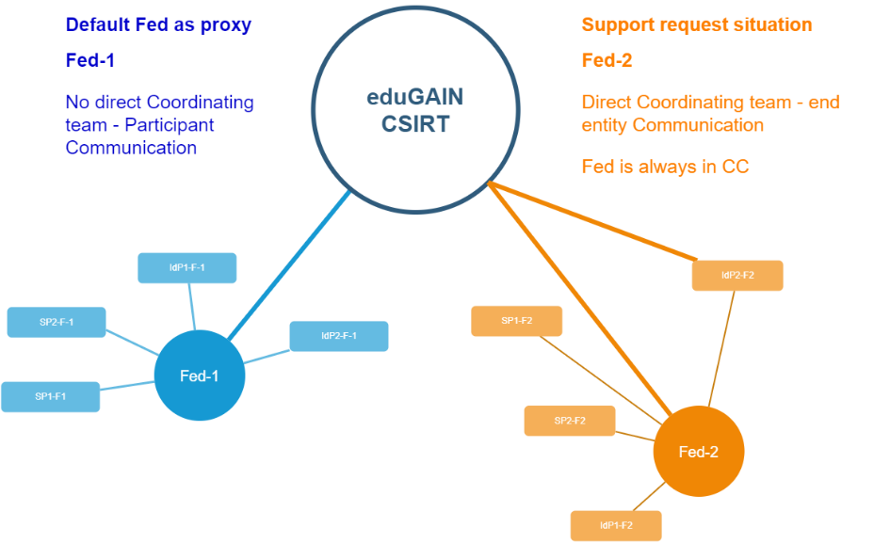
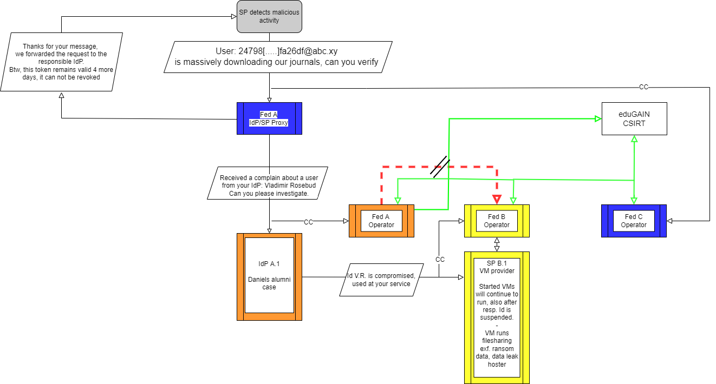
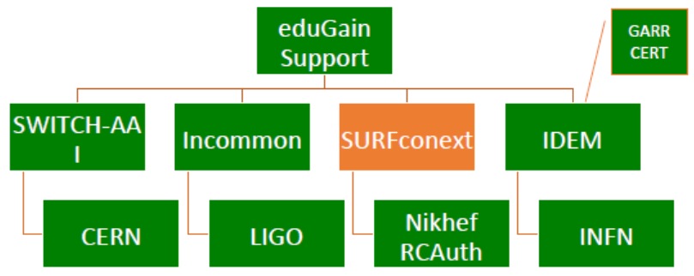
Response and traceability across IdP-SP Proxies: beyond the limits of Sirtfi
Srtfi v1
Guidelines for a joint operational trust baseline for membership management and proxy components, supplemented by policy guidance for sectoral federations with more specific policies where needed
‘How can we convey the trust in what is in and behind the proxy?’
‘How to provide timely traceability between services and identities through the proxy?’
Based on requirements from FIM4R, WISE, and the proxy operators in AEGIS.
|
|CSIRT
joint work with GN5 ‘Enabling Communities’ and eduGAIN CSIRT
images: AARC Sirtfi v1 exercise (Hannah Short), eduGAIN security TTX (Sven Gabriel, eduGAIN CSIRT)

Slide 15
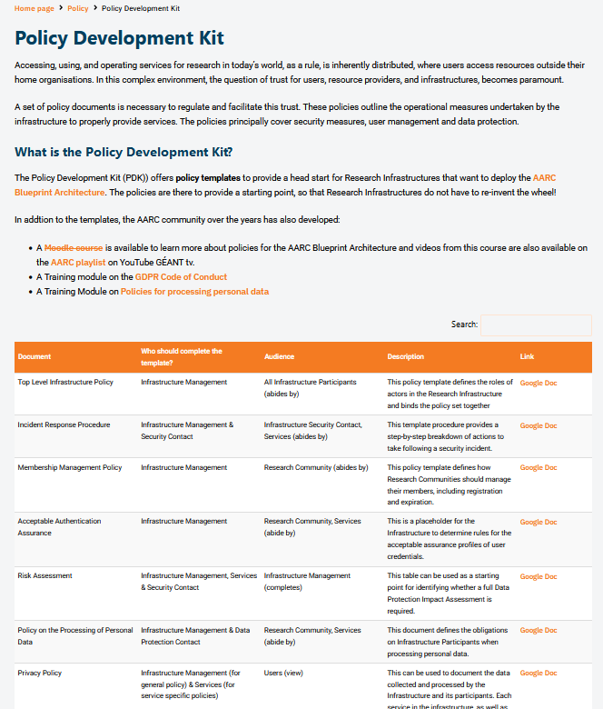
Developing the Trust framework, guidelines and best practice for BPA proxies and interaction with research services
minimise the number of divergent policies empower identity providers, service providers, user communities to rely on interoperable policies
From the old PDK to a new Policy, Process, and Procedure Development Kit (‘P3DK’)
Simplify!
comprehensive review of the existing policy suite
input from national research infrastructures and nodes
not only in Europe but e.g. also Australia
leverage the works we co-created with REFEDS and EOSC
https://aarc-community.org/policies/policy-development-kit/

Slide 16
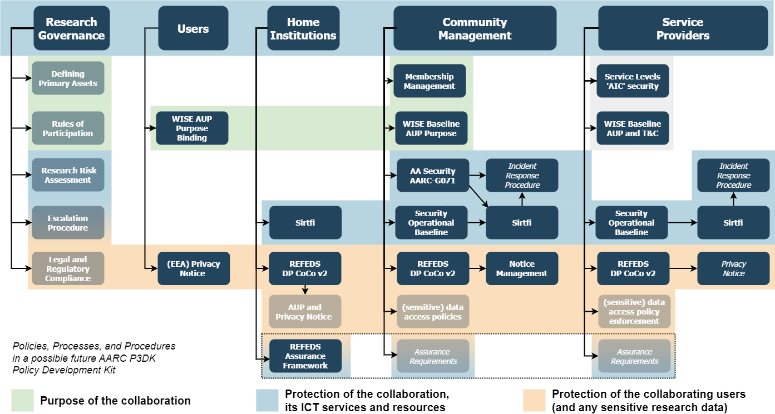
Building the trust framework: development of the new P3DK structure
work in progress
for D2.1 (May ‘25)

Slide 17
AAI infrastructure providers for communities: a new ‘Snctfi’ trust mark
review and enhance effectiveness of Snctfi ‘evolved’
the set of guidelines that describe a (self-) assessable baseline for the proxy operator a set of service providers behind an AARC BPA Proxy

Slide 18
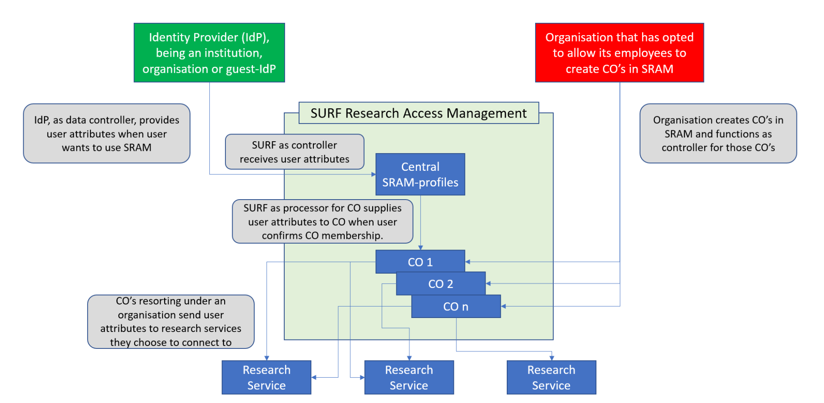
Helping out the community – a simpler policy toolkit for communities
provide a revised policy development kit for mid-sized communities using the research infrastructures
Requirement from the AAI operators in FIM4R and BPA operators:
“small to mid-sized communities do not have the resources to maintain a bespoke community management policy”
But both communities and operators of membership management services are today unclear about trust assurance level of members: current templates in toolkit too complex and prescriptive
develop ‘minimum viable community management’ for most small and mid-sized use cases
give template and implementation guidance (FAQ) on community lifecycle management
leverage complement of PDK practices that communities can ‘source’ from trusted providers
where is the community here?!
work in progress for user trust alignment

Slide 19
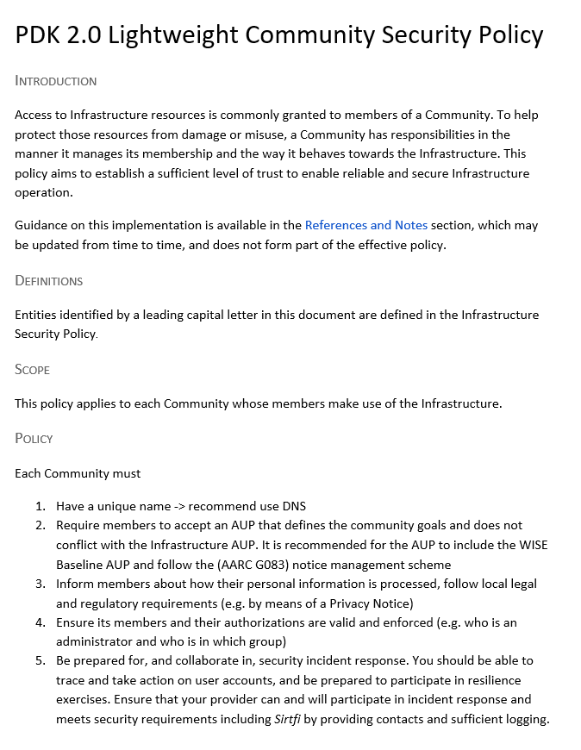
Simplified Community Management policy – down to five items!
Each Community must
Have a unique name (we recommend use DNS domain names)
Require members to accept an AUP that defines the community goals and does not conflict with the Infrastructure AUP. It is recommended for the AUP to include the WISE Baseline AUP and follow the (AARC G083) notice management scheme
Inform members about how their personal information is processed, follow local legal and regulatory requirements (e.g. by means of a Privacy Notice)
Ensure its members and their authorizations are valid and enforced (e.g. who is an administrator and who is in which group)
Be prepared for, and collaborate in, security incident response. You should be able to trace and take action on user accounts, and be prepared to participate in resilience exercises. Ensure that your provider can and will participate in incident response and meets security requirements including Sirtfi by providing contacts and sufficient logging.
work in progress for user trust alignment

Slide 20
Can we build on a trusted baseline and expectations to increase acceptance of research infrastructure proxies with R&E identity providers
guidelines on cross-sectoral trust in novel federated access models
Even though unique identifier, name, email, and affiliation are most relevant ‘home’ attributes, we
still need assurance statements and know attribute freshness
we have proxies met with scepticism by IdPs: lack of personalised and R&S attributes
do trust qualities ‘traverse’ proxies?
can operators rely on their ‘downstream’ providers?
Does more trust in proxies and services help our users?
Joined up with the Wallet work both for models and assurance
work in progress for user trust alignment

Slide 21
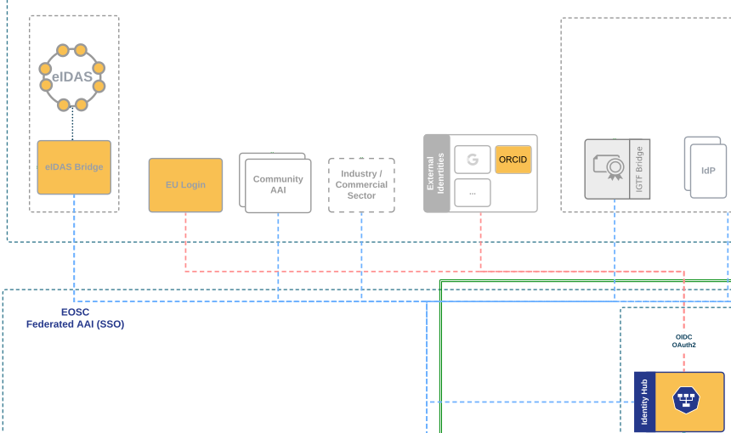
More diverse sources of identity & assurance
investigate researcher assurance through eID wallets and public (eIDAS) identity assurances.
Most reliable (and most ‘available’) source of assurance may be the government identity ecosystem
Step-up can now readily be done ‘at home’ by users through their national eID schemes
Better attainable than relying on home institutions?
eIDAS 2 and EU ID Wallets, in combination with OpenID Federation pilots look promising!
… but:
what to do with non-European users? And how to link identities?
work recently started in collaboration with related Identity Wallet groups

Slide 22
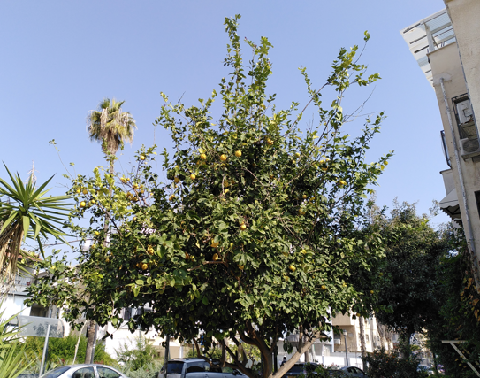
One AARC (Policy) Tree …
Everyone will sit under their AARC TREE, and no one will make them afraid
… but there should be talk under the tree!

Slide 23
davidg@nikhef.nl

Slide 24
But when, oh when?
WP3 Use Case Analysis
WP5 Compendium

Slide 25
A (very) distributed activity – let’s go and ensure a joint coherent output!
 | STFC | Nikhef | NDN | EGI | CERN | GRNET | KIT | SURF | MU | GEANT & KIFU | SUM
Work item | PM | PM | PM | PM | PM | PM | PM | PM | PM | PM | PM
Research Infra Alignment (Nikhef) |  |  |  |  |  |  |  |  |  |  | 21
Operational Trust for Proxies |  |  | ★ |  |  |  |  |  |  |  | 
‘Snctfi’ R&E Baselining & Integration | ★ | ★ |  |  | ★ |  |  | ★ |  |  | ★
Models for Cross-Infra AUP & Privacy Notices | ★ | ★ |  | ★ |  | ★ | ★ |  |  | ★ | 
User-centric Trust Alignment (RAL) |  |  |  |  |  |  |  |  |  |  | 26
Lightweight Community Management Policy |  |  |  | ★ | ★ |  | ★ | ★ |  | ★ | 
Guideline for Novel Federation Models | ★ |  |  | ★ |  |  |  |  |  | ★ | 
Assurance in Research through eID |  |  | ★ | ★ |  |  |  |  |  |  | 
FIM4R Policy Evolution |  | ★ | ★ |  |  |  |  |  |  |  | ★
 |  |  |  |  |  |  |  |  |  |  | 47

