Slide 1

Federated Identity for Australian Research (FIM4AR)
Progress, wins, and unmet needs
John Scullen
Head of Trust & Identity Strategy and Futures
February 2026
Notes:
Hi everyone, I’m Russell from the Australian Access Federation.
Today I’ll talk through what’s actually happening in Australia’s research identity space, what researchers genuinely need, what still hurts, and what we’ve learned from our incubators and collaborations.

Slide 2

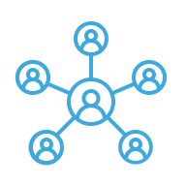


Globally connected, Australian controlled, Trust and Identity infrastructure
26
NCRIS Facilities
90,000
Researchers
490
International service connections (2025)
13M
Authentications (2025)
Notes:
The AAF operates Australia’s national trust and identity infrastructure.
We are one of 25 NCRIS Capabilities (for Trust and Identity) providing seamless, safe and secure access and authorisation services for 90,000 researchers in Australia and beyond
Our expertise in Trust and Identity enables cross-sector collaboration at scale
We enable over 12M authentications annually
This includes extending trusted access to all researchers, not just universities.
High assurance identity for cyber security and sensitive data.
Nationally aligned architectures aligned with AARC.
Tools for data, compute, instruments and software.
A system-wide approach to FAIR, CARE and sensitive data.
So the good news is the the plumbing works.

Slide 3

Notes:
The bad news is that many researchers don’t understand or care about the plumbing until it breaks.

Slide 4


Transforming Australian research infrastructure through trust and identity
Goal
System-wide adoption of Trust and Identity
Enabling a more researcher centric national research infrastructure for Australia.
Guiding principles
Seamless connection
Privacy preserving
Cyber secure
Enhanced collaboration
Increased productivity
Underpinning an innovation and translation network
Sovereign capability
Strengthening Australia’s research and development ecosystem for a ‘Future Made in Australia’.

Slide 5


Core themes: Australian collaborations are still forming Often unsure where they want to go... Identity is usually an afterthought, policy is inconvenient, and trust is assumed
Notes:
Core Theme: Researchers Don’t Know What They Want. About they only thing they know for sure is that they don't want to manage identity in any way. At some level it becomes unavoidable, even if it's just defining the rules to automate authorisation.
A consistent theme across all our incubators:
Most researchers don’t know what they want.
They don't understand federated identity management (I find this is a theme that goes beyond research) - it's a unusual concept to grasp.
When they think they do, they prioritise edge cases over fundamentals. They are reluctant to move forward with anything until they have an solution to all the edge cases, no matter how infrequently they occur.
Identity is usually an afterthought, policy is inconvenient, and trust is assumed.
Our job is helping the ecosystem define a repeatable, scalable model that works for everyone
Researchers love to solve their own problem when the guy in the cubical next door could be helped

Slide 6



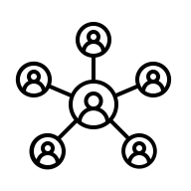
Why does this happen?
Lack of governance (collaborations)
Don’t understand identity assurance
Who’s the community?
Collaboration
complexity
Notes:
Australia has world class research but variable maturity in collaboration design. Focused around shared data and resources – may rely on org – but not on collaborations. May rely on parent org legal/requirements - also maybe not – when they need it, mismatched understanding. Funding follows the research – small percent of researchers have high leverage – clash of cultures??
Many collaborations don’t have governance. These collaborations can sit inside or outside universities and other institutions, and often have bespoke requirements.
Researchers and collaborators don’t understand identity assurance, authentication and identity assurance.
They haven’t defined who their community is. Unlike Europe, many of the Australian research communities are only just emerging. Since they are still forming they don't know where the boundaries are and seem reluctant try to define those boundaries, even if they need to change later on
Complexity can be high with collaborations, in terms of people, process and technology
This is why the Policy Development Kit exists.

Slide 7
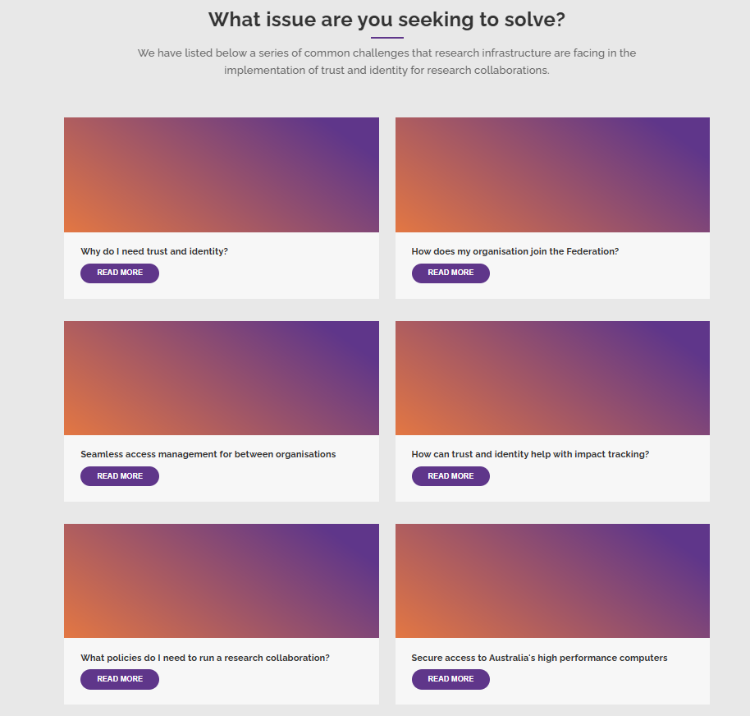
PDK: Policy Development Kit
Common T&I policies, architecture blueprint and resources, enabling trusted and secure collaboration across multiple services and organisations
https://trust.aaf.edu.au/australian-access-federation-policy-development-toolkit/
.
Notes:
Originates from AARC
Australian version though.
The PDK is meant to help collaborations formalise governance, data protection, authorisation and membership.
Reality:
Many groups aren’t mature enough to adopt it yet.
Governance feels like a future problem.
Australian collaborations often form after the tech is chosen, not before.

Slide 8

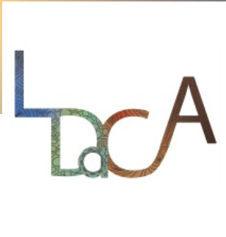




Some of our incubators
CADRE
Advanced REMS, good data classification with fine-grained access controls, IdP of last resort
LDaCA
Variable data sensitivity across data collections, multiple Identity Providers, including IdP of last resort
ARDC SEAF Component
Mapping between T&I Dataspaces Framework
ARDC Nectar Component
Architectural Reference for a federated AAI to support research collaborations
National Imaging Facility
XNAT/REDCap Integration with AAI
Microscopy Australia
Tracking instrument level research impact
Notes:
@Patrick/@John help me a bit here – need to say exactl what each thing is doing – main use case
Summary of incubators:
CADRE – Automating secure data access for humanities and social science data sets; REMS (resource management system) - DAC looks at access request, allows etc, press yes, person has access to system.
LDaCA – Similar as CADRE – more for open, automatically grant access – bypass custodian - (different research area: Language data) - CILogon
SEAF – Partnership between industry / research, env impact assessment for mining company/commerical, western australia – shared environment analytics facility
NECTAR – allow researchers to build AAIs – on research cloud – ref architecture doc
NIF
CADRE: advanced REMS use case, good data classification with fine-grained access controls, IdP of last resort
REMS greatly improves transparency for everyone in the process, reduces approval time through a more structured set of questions, and provides data access committees with history and precedents to help make access request decisions
LDaCA: variable data sensitivity across data collections, multiple identity providers, including IdP of last resort.
Microscopy Australia: tracking instrument level research impact.
National Imaging Facility: secure multi site sensitive health data collaboration – seeking to integrate XNAT & REDCap with AAI.
ARDC-Nectar: Developing an Architectural Reference for a federated AAI to support research collaborations
ARDC-SEAF: investigating how to strengthen identity, access, and data-governance capabilities across the Australian research and government ecosystems
to facilitate secure, interoperable data sharing
GUARDIANS: data custodian-driven workflows and identity challenges for access to sensitive genomic data
This portfolio displays a spectrum of needs.
NIF – XNAT/REDCAP and kubernetes -
XNAT uplift – extend to desktop/claims k8s stuff – OIDC claims – can't do authorisations
AARC Tree – finishing – most work gone to policy – tech architecture good – AAF contributed back

Slide 9


Example 1
GUARDIANS: (human Genomics Uplift for Australia through Research Data Infrastructure At National Scale)
The GUARDIANS mission is to empower Australian researchers to easily and securely discover, access, and analyse human genomics data across national infrastructure, using the latest tools and resources.
Notes:
GUARDIANS has brilliant scientists but low identity maturity.
What guardians does is basically does: seeks to give researchers streamlined access to large coordinated genomic datasets via: a centralised data commons and genome repository; secure access and shared identity management; and tools, training and workflows for data discovery, sharing and analysis.
- the partners are still focused on data and analytics platforms – nice UIs & good UXs
- love federated AuthN, want access for non-edu, ambivalent about delegating access to an AAI
They think service by service instead of community-wide.
Trust is personal rather than systematic.
Data classification is unclear, but slowly maturing
Identity assurance needs aren’t documented.
Little investment in basic IAM knowledge; focus goes to platform features.
We’re effectively running identity 101 between genome pipelines.

Slide 10
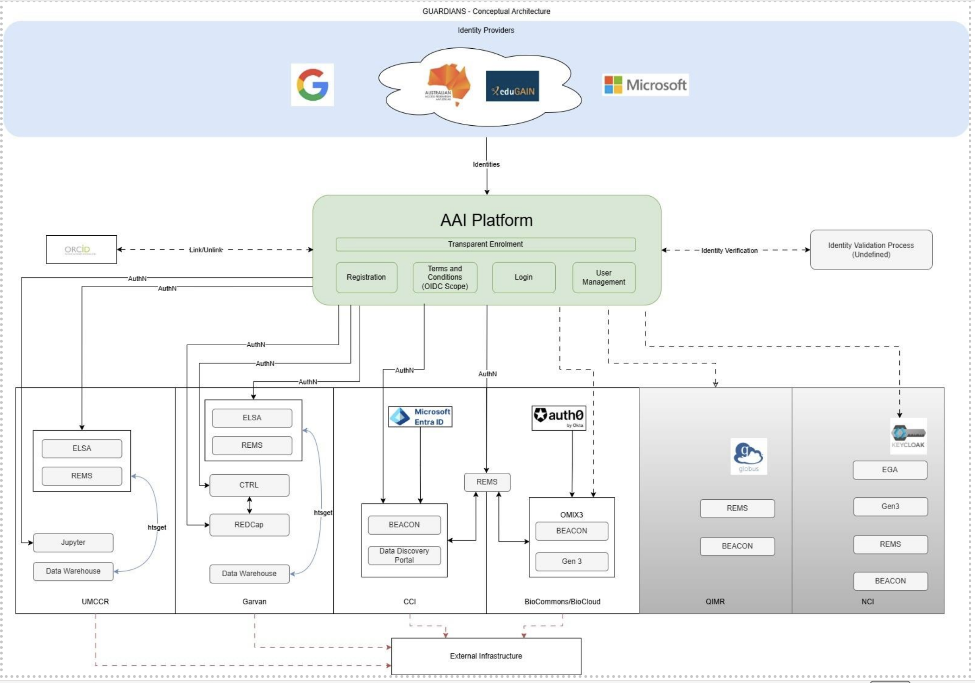
Notes:
What’s going on here? Why did we do it? Better collaboration between institutions for data classification? @Patrick
This is authentication focused – but will move into authz
This is the proposed GUARDIANS architecture – end of year one in a four year project – to achieve better data sharing between and beyond the partners
What are the partner roles, what are trying to do? Sometimes sharing across, some provide, some consume, etc – not everyone has same type of dataset
CILogon
Build a single trusted AAI for researchers
Accept identities from trusted upstream providers (e.g., institutional SSO, national/academic federation, global providers)
Verify & link identities to a persistent research persona (incl. optional linking to ORCID) ORCID
Central permissions & audit via consistent, reviewable access rules (seen in services like REMS) REMS
One login, many trusted doors across research institutions & clouds
Reduce account sprawl, improve collaboration, and strengthen security with auditable consent
The trust glue for federated research access in Australia

Slide 11


Example 2
SEAF and Nectar Architecture
A Shared Environmental Analytics Facility (SEAF): Translating science knowledge and data analytics into timely information for streamlined decisions
Notes:
What are What’s the main thing SEAF are trying to do?
SEAF – Partnership between industry / research, env impact assessment for mining company/commerical, western australia – shared environment analytics facility
SEAF brings together industry, government and research.
It solves onboarding non-edu users without requiring cloud accounts.
Provides a consistent identity layer across Azure and Nectar.
Uses AAF and CILogon as the bridge into research clouds.
Addresses a major unmet need for non-edu collaborators.

Slide 12
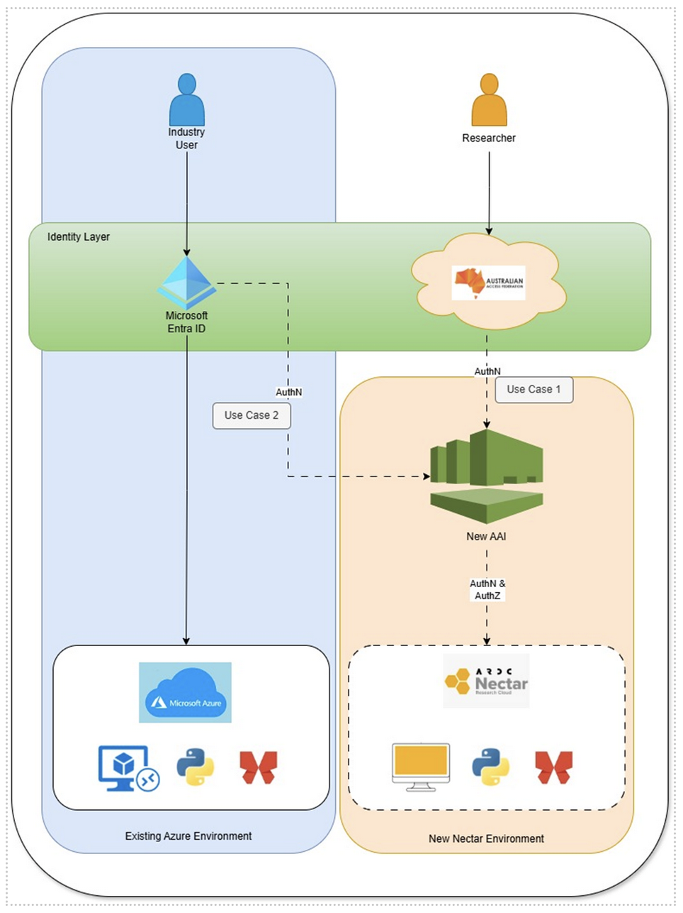
Notes:
Get Anurag/Patrick to explain
Main goal is to make new AAI so they don't have to go through Entra ID MS365 – wanting to open it to AAF federation – Putting researchers to NECTAR
Can't give new account for new users – Use NECTAR as that's Australia's (free?) research infra – expanding user base + edu, could plug in govt (Have to give them new account etc, regulator etc, through vangaurd etc)
Options paper – including CILogon, Keycloak, WIP – work with them with PDK
SEAF: main use case/solve is: new AAI will – orange is new layer for collaborations – could plug in govt, nectar to allow collaborations (CILogon – open bridge to research collabs no cost)

Slide 13
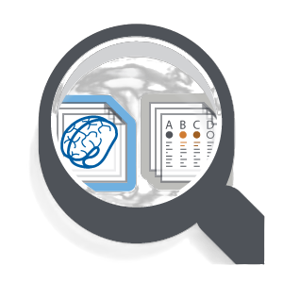
Example 3
Better federation support for common research tools
Native OIDC authentication and authorisation support for REDCap and XNAT

Slide 14

What tools are working well
REMS
https://github.com/CSCfi/rems
Notes:
The most important tool right now is CILogon.
REMS workflows for approvals. Look at requests etc, approval – next step over email and manual approval, CILogon for AAI different use case. (REMS no local users)
CILogon integration for groups and claims.
Support for Google, Microsoft, GitHub, ORCID onboarding (where appropriate).
AARC-aligned architecture.
Identity assurance early steps.
It manages users, groups, roles and entitlements.
Generates custom OAuth and OIDC claims.
Integrates with external sources.
Supports provisioning to downstream services.
Researchers want:
A user friendly project dashboard on top of CILogon.
Better researcher onboarding tools.
Simpler MFA enforcement.

Slide 15
Ongoing challenges
Non-edu users from industry, government and community groups
Portable identity models and verifiable credentials
identity that belongs to the individual, not the institution; and
attribute authorities – e.g. who do you work for?
Identity assurance gaps
MFA signalling issues
Low governance and process maturity (and limited interest)
Platforms still using local accounts
Notes:
Non-edu users from industry, government and community groups.
Identity assurance gaps.
MFA signalling issues across eduGAIN. Demand for high assurance is growing.
Health, genomics, clinical trials and HPC all require stronger controls.
MFA signalling is inconsistent across federations.
Longer term need for document verification, REFEDS assurance, digital identity integration and verifiable credentials.
Portable identity models and verifiable credentials.
Low maturity in governance.
Communities not understanding policy enough to implement technical controls.
Platforms still requiring local accounts.

Slide 16
What would help
An easy way to include non-edu collaborators
Persistent identity owned by the individual
A willingness to adopt the PDK or at least read it – collaborations should do policy first. Reality: collaborations use tech to understand the policy 😕
Common trust models, not just technology standards
Better engagement with other sectors
Notes:
Non-edu users from industry, government and community groups.
Identity assurance gaps.
MFA signalling issues across eduGAIN. Demand for high assurance is growing.
Health, genomics, clinical trials and HPC all require stronger controls.
MFA signalling is inconsistent across federations.
Longer term need for document verification, REFEDS assurance, digital identity integration and verifiable credentials.
Portable identity models and verifiable credentials.
Low maturity in governance.
Communities not understanding policy enough to implement technical controls.
Platforms still requiring local accounts.

Slide 17
Questions
Visit: trust.aaf.edu.au Email: john.scullen@aaf.edu.au
Notes:
Need researches to define what they want – what they're trying to accomplish – needs to be very clear -
Australia must adopt AARC, REFEDS, global federation models and FAIR and CARE.
FIM4R recommendations shape our national approach.
We need help articulating requirements for communities that cannot articulate them.
Help define unmet needs.
Help solve the non-edu user problem.
Help shape portable identity and assurance models.
The more we work together on common approaches and tools, the less bespoke engineering is required.
And the less bespoke engineering required, the less likely a research developer will write their own authentication system in Python at 2am.

