Slide 1



















FIM4R version 2 paper
David Kelsey (STFC UK Research and Innovation) at FIM4R22 Amsterdam 9 Feb 2026 (reused old slides from July 2018)
With thanks to the FIM4R Authors and Contributors for their collaboration on the whitepaper and the following slides.
** Not all contributors’ logos represented

Slide 2
Motivation
Research Communities provide complex use cases where federated identity can be leveraged to great effect
Distributed users
Distributed services
The specific way of working brings specific challenges that go beyond the functionality typically offered by federations and interfederation
FIM4R provides a forum for Research Community representatives to exchange experiences of implementing AAI and by combining our voices we hope to influence the future direction of FIM in a way that meets the needs of our Users

Slide 3
“Every researcher is entitled to focus on their work and not be impeded by needless obstacles nor required to understand anything about the FIM infrastructure enabling their access to research services.” FIM4R version 2

Slide 4
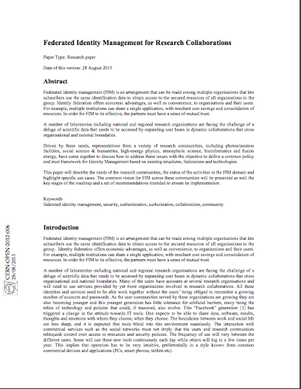
2012: FIM4R version 1
Published a whitepaper in 2012 that guided the direction of identity federation for research https://fim4r.org/documents/
Specified a common vision together with common requirements and recommendations
Revised (just to specify priorities) in 2013

Slide 5
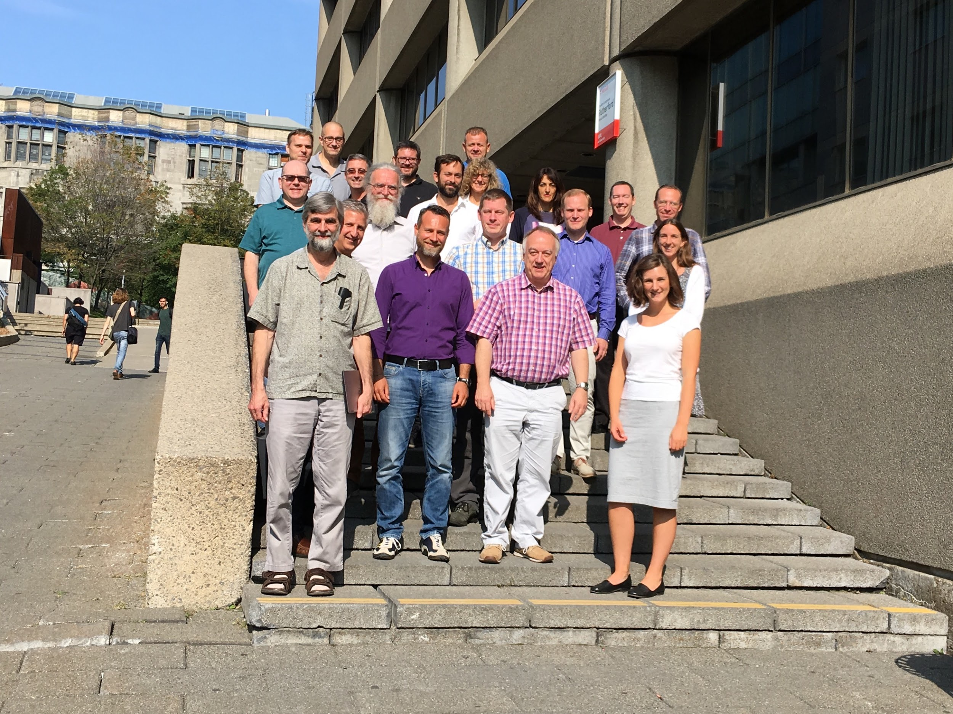
2018: FIM4R version 2
https://doi.org/10.5281/zenodo.1296031
Representatives of more than 20 research communities have provided input
Five face to face meetings in Europe and North America
Vienna (TIIME) x 2
Montreal (RDA)
Barcelona (RDA)
San Francisco (Internet2 TechEx)
A new distillation of specific requirements and a set of recommendations is the result of this process
Dept. of Physics, McGill University, Montreal (Sep 2017)

Slide 6
Who is represented?
Research Fields (14)
Others
Arts and Humanities
Climate Science
Earth Observation
European Neutron and Photon Facilities
Gamma-Ray Astronomy
Gravitational Wave Astronomy
High Energy Physics
Ionospheric and Atmospheric Science
Infectious Disease Research
Life Sciences
Linguistics
Nuclear Physics
Radio Astronomy
Virtual Atomic and Molecular Data Centre
Research Driven Services
HNSciCloud
ORCID
Identity Federation Projects/Communities
AARC(2)
GÉANT-GN4
InCommon/Internet2
REFEDS

Slide 7
Progress since 2012 (as seen in 2018)

Slide 8
Evolution of FIM
Aim: “Authenticate locally, authorize globally”
deliver good user experience
extend the reach of campus credentials
reduce the number of credentials needed by users
leverage campus credential management practices
focus more energy on their own services
make federation a global infrastructure
academic collaboration, itself global, benefits
In a very substantial sense, this has been achieved (for Authentication)
FIM now spans the national R&E federations from many countries into an aggregated whole known as eduGAIN

Slide 9
The more difficult part (as seen in 2018)
“Authorise Globally” is more difficult (as identified in FIM4R v1)
Access control/Authorisation to Research SPs
perform checks of the attributes assigned to the user
user needs to get those attributes from somewhere
Initially just a singular infrastructure
that operated by the national R&E federations
But the campus IDP is not authoritative for research attributes
Concept of FIM gradually began to evolve
Social ID gateways admitted users without waiting on their campus
Credential providers for unaffiliated users started to pop up
Research e­-Infrastructures experimented with Proxies

Slide 10
What are the successes since 2012? (As seen in 2018)
Much has changed since 2012. The FIM4R paper was taken seriously and AAI is now more mature with many successes
European Commission funding (H2020) for the AARC/AARC2 projects
Federations and interfederation have found their role as an Authentication infrastructure; Authorisation managed by Communities
eduGAIN’s operational support capability is now in place and maturing
e-Infrastructures are deploying shared AAI services (EGI, EUDAT, GÉANT, EOSC-hub, …)
Specific successes include the Sirtfi and Snctfi trust frameworks
Standardisation and best practices for the emerging trend of “proxy” architecture (The AARC Blue Print Architecture)

Slide 11
Outstanding Challenges (1) (documented in 2018)
Usability & User Experience
Considerable time spent in bilateral debugging
Discovery services unintuitive
Data Privacy and EU GDPR
Better data access and privacy expectations need to be balanced, E.g. ELIXIR Human Data resources are potentially liable for breaches
Attribute release by risk averse IdPs is already problematic, this may be aggravated
Assurance profiles
Frameworks defined but not well adopted or propagated

Slide 12
Outstanding Challenges (2)
Interfederation and many federations do not offer an adequate level of operational support and security for Research use cases
eduGAIN has become recognised as a brand and those wishing to “join” experience a steep learning curve and inconsistent federation practices
Although several generic AAI infrastructures are evolving, their respective advantages and availability are unclear

Slide 13
Common Requirements (documented in 2018)

Slide 14
Requirements Collection (for V2 paper 2018)
Began during 11th FIM4R Workshop in September 2017 in Montreal
28 individuals, presentations by research communities and cyber infrastructures
Pooled thoughts on the outstanding requirements
Integrated into matrix
Established initial categories
Produced initial mapping of requirements to constituencies needed to address them
Identified requirements for which something entirely new needed

Slide 15
11 Requirements Categories
Identity Lifecycle & Linking (2)
Discoverability & Usability (3)
Authorisation and (De-)/Provisioning (7)
Attribute Release (3)
Security Incident Response (4)
Research Community Proxies (4)
Assurance & Multi Factor Authentication (2)
Interoperability (3)
Non Web (4)
On-Boarding & Support (5)
Sustaining Critical Infrastructure (3)
Total: 40

Slide 16
Recommendations (2018 – FIM4R version 2 paper)

Slide 17
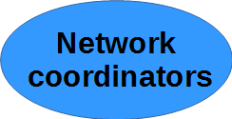

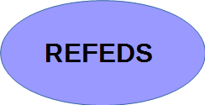

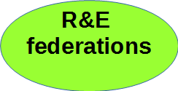




Nine Stakeholder Groups to address
General Stakeholders
Network coordinators and operators: GÉANT (Europe), Internet2 (US)
Research funding bodies
REFEDS (Research and Education FEDerations group)
Identity federation operators
Researcher’s Home organisations
National R&E federations
eduGAIN operators providing the Interfederation
Research
Research e-infrastructures in general
Research community proxies in particular
Research communities

Slide 18
Overview on recommendations
Governance & Sustainability
Research representation, funding for sustainable operation, ongoing coordination
Baseline of User Experience
Attribute release, remove interoperability barriers, non-legal status, user mobility
Security Incident Response Readiness
For federations, interfederation and organisations
Harmonisation of Proxy Operations & Practices
Reuse generic services, follow best practices for interoperability
Sensitive Research User Experience
Support multifactor authentication and publish Assurance Profiles

Slide 19
Acknowledgements
© 2018 by the FIM4R v2 Authors
This work is licensed under a Creative Commons Attribution 4.0 International License.
The authors acknowledge the contributions to this work made by all former members of the FIM4R collaboration. In particular, we thank Bob Jones from CERN, for his vision and leadership during the FIM4R v1 era, and for his contributions to Version 2. We also wish to thank colleagues, too many to name individually, in REFEDS, in GN4, among the national federations, the providers of identity management software, and the operators of many diverse Trust and Identity services for their endeavours to meet our FIM4R requirements.

Slide 20
Acknowledgements
The authors also acknowledge the support and collaboration of many other colleagues in their respective institutes, research communities and IT Infrastructures, together with the funding received by these from many different sources. These include but are not limited to the following: (i) The Worldwide LHC Computing Grid (WLCG) project is a global collaboration of more than 170 computing centres in 43 countries, linking up national and international grid infrastructures. Funding is acknowledged from many national funding bodies and we acknowledge the support of several operational infrastructures including EGI, OSG and NDGF/NeIC. (ii) EGI acknowledges the funding and support received from the European Commission and the many National Grid Initiatives and other members. EOSC-hub receives funding from the European Union’s Horizon 2020 research and innovation programme under grant agreement No 777536. (iii) The work leading to these results has received funding from the European Union’s Horizon 2020 research and innovation programme under Grant Agreement No. 730941 (AARC2). (iv) Work on the development of ESGF’s identity management system has been supported by UK The Natural Environment Research Council and funding from the European Union's Seventh Framework Programme for research, technological development and demonstration through projects IS-ENES (grant agreement no 228203) and IS-ENES2 (grant agreement no 312979). (v) Ludek Matyska and Michal Prochazka acknowledge funding from the RI ELIXIR CZ project funded by MEYS Czech Republic No. LM2015047. (vi) Scott Koranda acknowledges support provided by the United States National Science Foundation under Grant No. PHY-1700765. (vii) GÉANT Association on behalf of the GN4 Phase 2 project (GN4-2). The research leading to these results has received funding from the European Union’s Horizon 2020 research and innovation programme under Grant Agreement No. 731122(GN4-2). (viii) ELIXIR acknowledges support from Research Infrastructure programme of Horizon 2020 grant No 676559 EXCELERATE. (ix) CORBEL life science cluster acknowledges support from Horizon 2020 research and innovation programme under grant agreement No 654248. (ix) Mirjam van Daalen acknowledges that the research leading to this result has been supported by the project CALIPSOplus under the Grant Agreement 730872 from the EU Framework Programme for Research and Innovation HORIZON 2020. (x) EISCAT is an international association supported by research organisations in China (CRIRP), Finland (SA), Japan (NIPR), Norway (NFR), Sweden (VR), and the United Kingdom (NERC).

Slide 21
Questions?

Slide 22
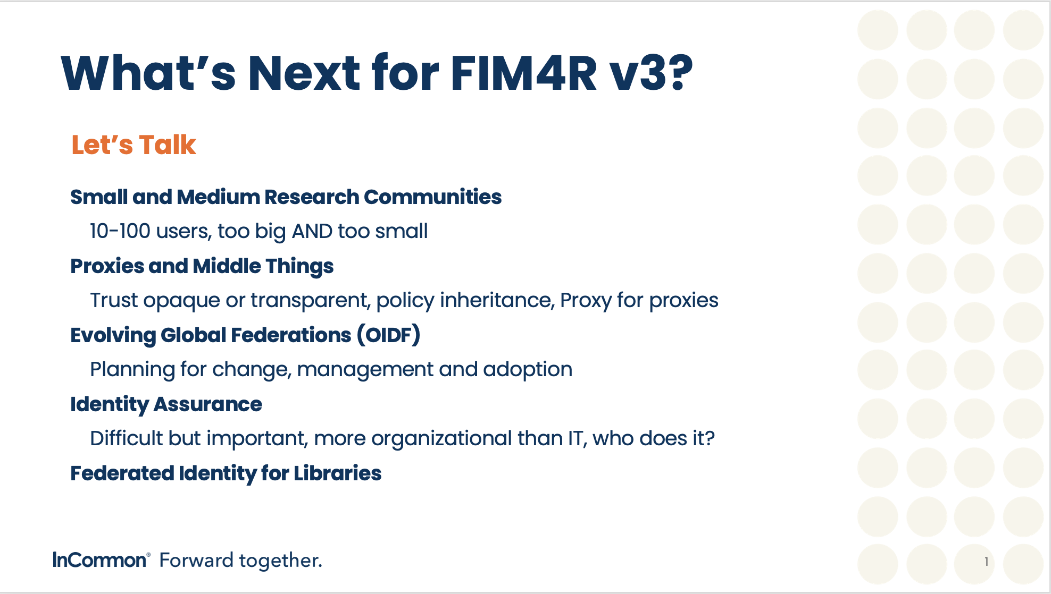

Slide 23
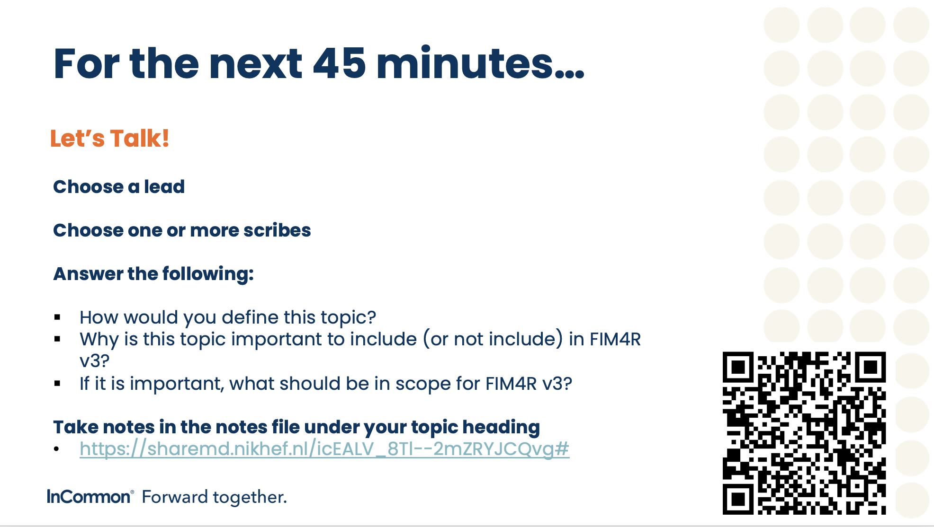

Slide 24
Backup slides (more details)

Slide 25
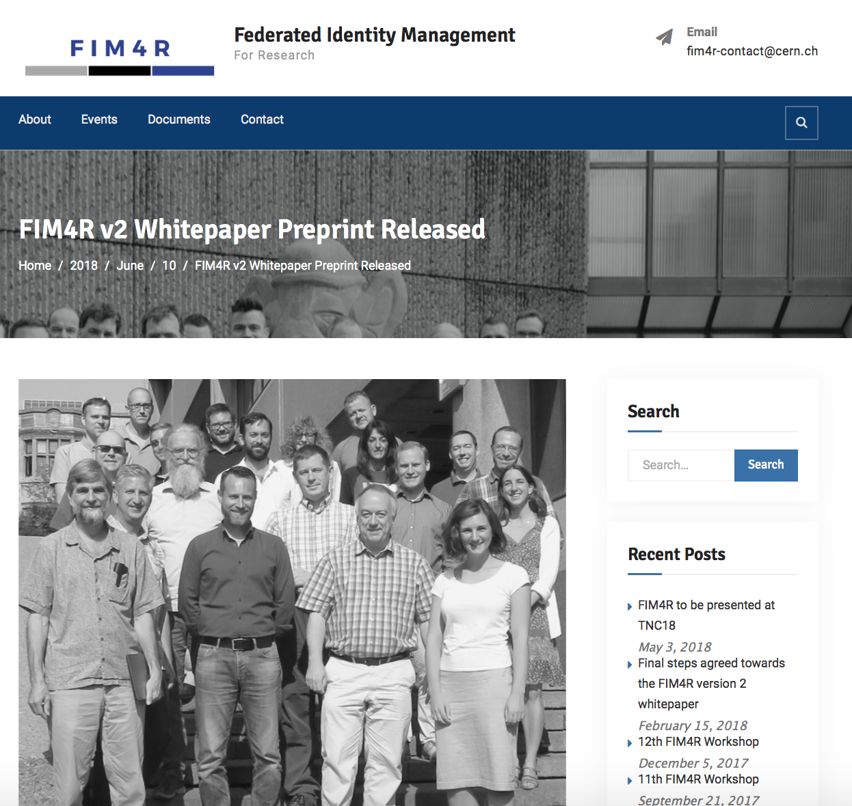
Visit fim4r.org

Slide 26
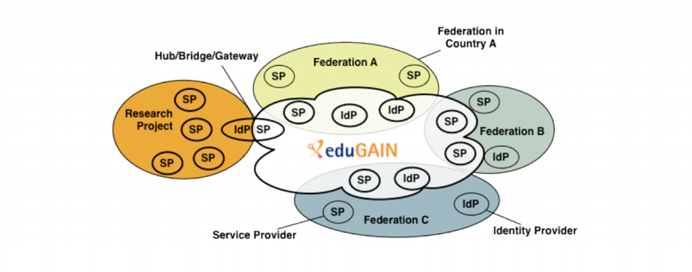
The Research Community SP/IdP Proxy

Slide 27
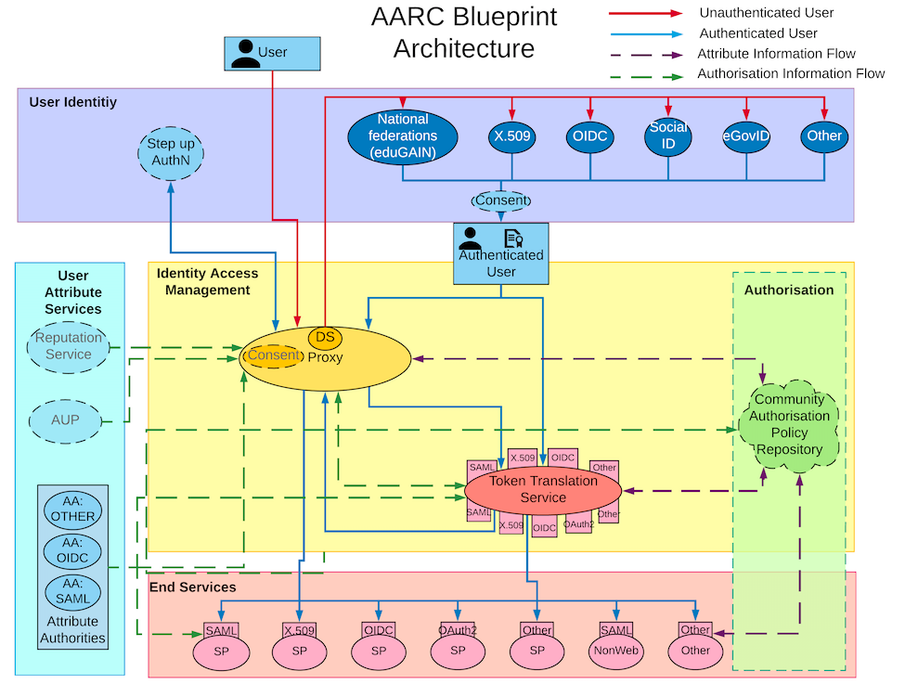
The Proxy Architecture allows Research Communities to satisfy many FIM4Rv1 requirements themselves, but comes with a large overhead
https://aarc-project.eu/architecture/

Slide 28
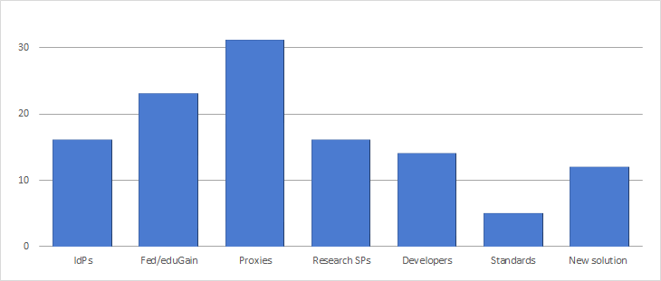
FIM Ecosystem Constituents
Identified specific constituencies within the FIM ecosystem who, it is believed, can best address each of the requirements that were gathered
Number of requirements to be addressed

Slide 29
Governance and Coordination
Increase research representation in FIM governance
Sustain operation of critical FIM services
Provide avenues for ongoing coordination

Slide 30

Baseline of Research User Experience
Release Research & Scholarship attributes
Provide usability essentials
Remove interoperability barriers in eduGAIN metadata processes
Admit research organisations to federation
Enable researcher mobility

Slide 31
Security Incident Response Readiness
Organisations participating in R&E federations should apply best practices in operational security to their federated entities

Slide 32

Harmonisation of Proxy Operations
Follow the proxy model and related AARC guidelines
Re-use shared AAI and related services
All large-scale e-infrastructures are encouraged to make AAI services generally available to research communities

Slide 33

Sensitive Research User Experience
Identity provider organisations are encouraged to provide strong authentication credentials to their researchers
implement the REFEDS MFA Profile to enable research service providers

