Slide 1


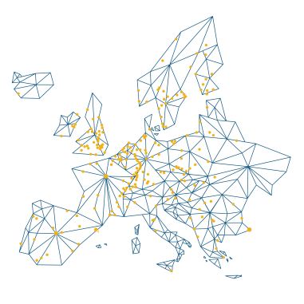
FIM4L update
Jos Westerbeke
TIIME, Amsterdam, 9 Febr. 2026

Slide 2
A LIBER working group
FIM4L is a library-led working group
that aims to further the usage of Fede-
rated Identity Management technolo-
gies by providing guidelines for libra-
ries on how to deploy such technologies
while at the same time preserving the
privacy of the users. It promotes the use
of eduGAIN, the world-wide infrastruc-
ture for FIM in the higher Ed community.
Led by
libraries
Recognized by
publishers
LIBER consortium
400+ libraries in EU
Several publishers, like Elsevier, EBSCO, are aware of FIM4L activities.
Notes:
FIM4L is a known name. We are not only a LIBER group, We maintain are own website and are independent. A global initiative. (endorsed)

Slide 3
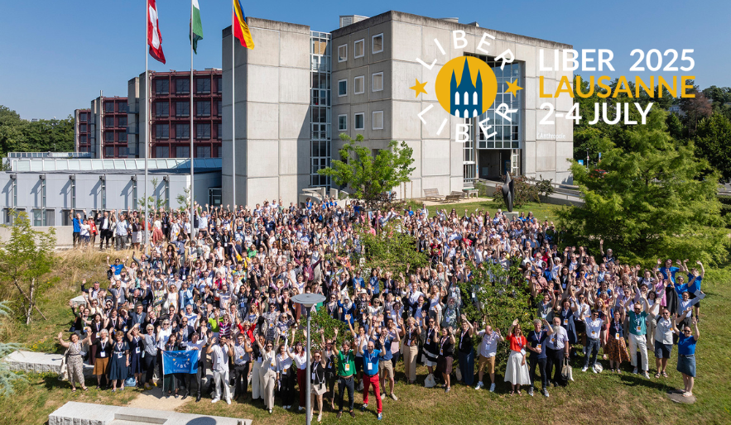
Notes:
LIBER Annual Conference

Slide 4
“
FIM4L principles:
Protecting privacy = enabling freedom of information.
Proving identity = quality of scholarly information.
FIM4L mission:
Creating and maintaining a safe online (library) environment for academics.

Slide 5
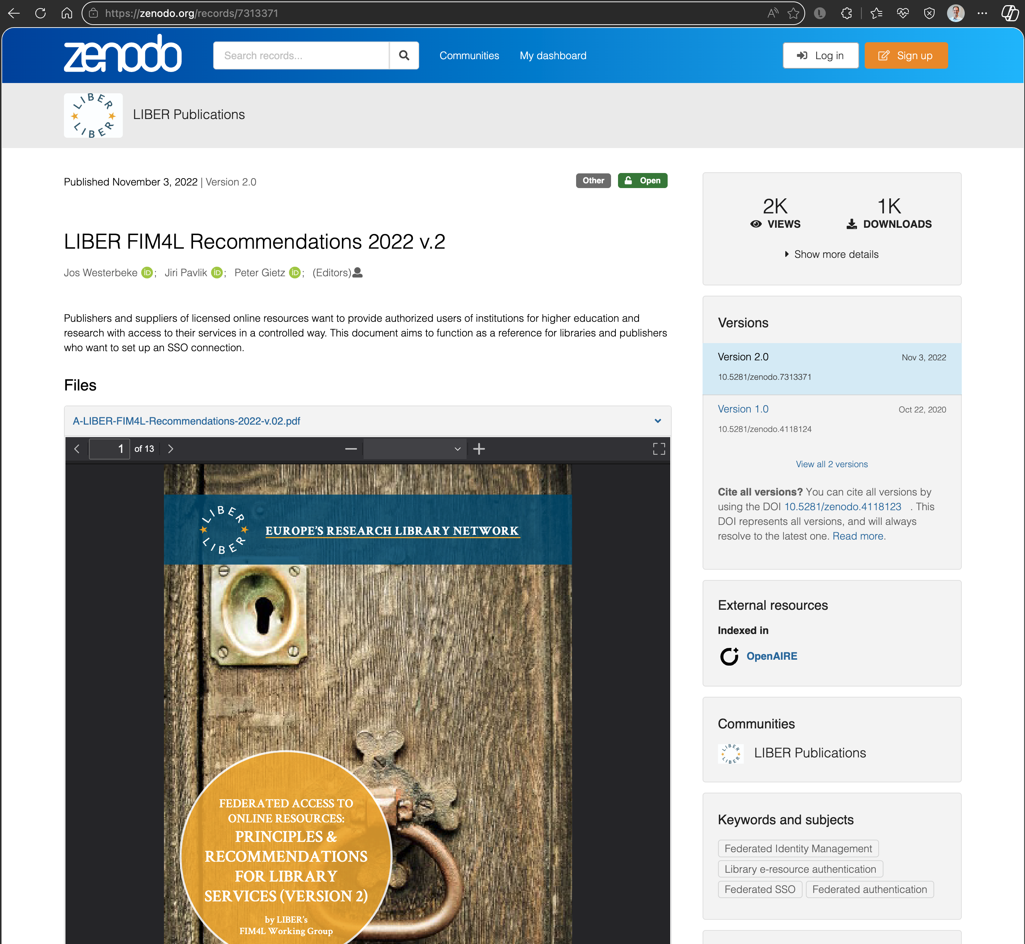

https://zenodo.org/record/7313371
Notes:
This is our main achievement. Among top downloads for LIBER Zenodo publications. Used as a reference for establishing federated SSO at negotiations between library and publisher. REFEDS Pseudonymous access/ persistent identifier.

Slide 6
What we’ve done in 2023-2025
Upholding the SSO Recommendations and watching publishers’ activities on authentication. Providing information for patrons/students about using SSO for library resources, usable to create an infographic.
Managed Access use cases for Open Science listed in a blogpost on the LIBER website.
1
3
Representing FIM4L at conferences like last year with a poster session at LIBER conference.
4
Open Access talks about whether FIM4L could help with FIM in the Open Science ecosystem with “managed access” for Open Access resources.
2
Monitoring digital wallets development and following Verifiable Credentials developments.
5

Slide 7
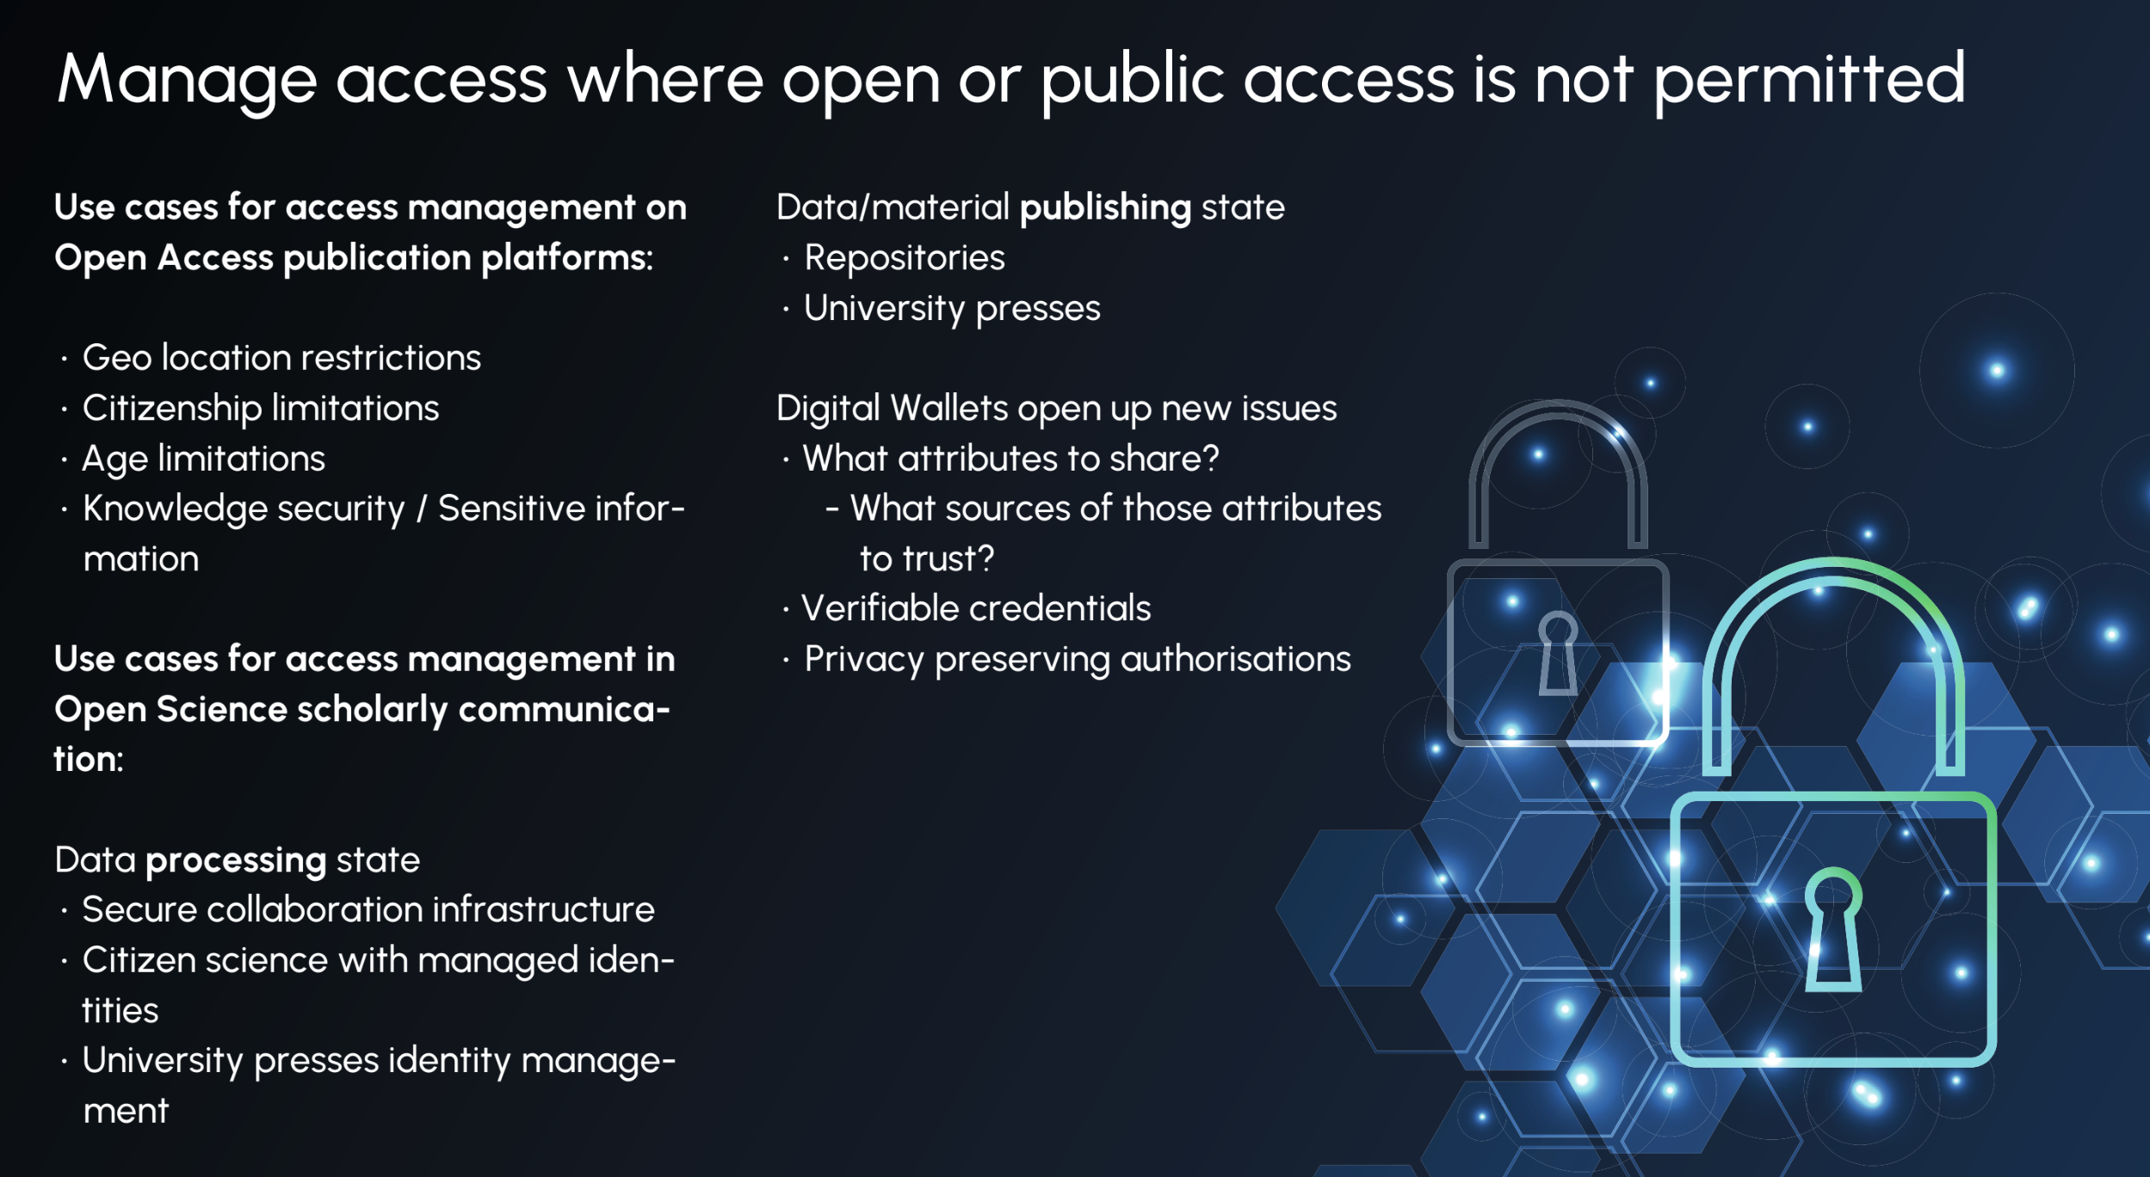
Notes:
Poster at LIBER conference 2025

Slide 8
What is going on?
Diamond Open Access
Libraries like moving to “university presses” to cut the costs of Open Access publishing.
EU initiatives
E.g. EOSC and OpenAlex are gaining traction. Libraries dare to cancel Scopus or WoS. Support for more digital sovereignty.
Repositories: more autonomy
Libraries are looking for more independent storage and discovery for own academic output.
Open Science ecosystem
Using PID’s like ORCID. Collaboration infrastructure, peer-to-peer review, OpenAIRE etc.
Notes:
This all is asking for good FIM. But what about FIM? What place should the library take? A trusted institution which could possible proof/verify certain things like PID’s? (FIM4L principles) We cannot proof/uphold peer-to-peer review quality, but uphold ”trusted identity”.

Slide 9
Where is FIM4L now? And where should we be?
LIBER WGs have an end
We still have work items (Open Science infrastructure, Wallets, etc.)
We are contemplating about new umbrella for the activity
Also we are thinking of other domains
Any input from FIM4R most welcome
Notes:
FIM4L: guiding privacy and making trust relationships.

Slide 10

Thank you
Questions?
[contact details]

